Slide 1
Intro
“Big Idea” Question
Review Concepts
Check-In Questions
Teacher Engagement
Vocabulary
Student-Friendly Definition
Examples & Non-Examples
Frayer Model
Simulation/Activity
Notes:
OK everyone, get ready for our next lesson. Just as a reminder, these are the different components that our lesson may include, and you’ll see these icons in the top left corner of each slide so that you can follow along more easily!

Slide 2
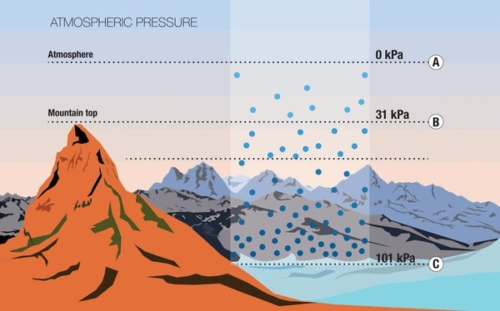
Atmospheric Pressure
Intro
Notes:
Today we will be learning about Atmospheric Pressure.

Slide 3
Big Question: How do changes in air pressure affect the weather around us, and how does this impact our daily lives?
Notes:
Our “big question” is: How do changes in air pressure affect the weather around us, and how does this impact our daily lives?
[Pause and illicit predictions from students.]
Be sure to keep this question and your predictions in mind as we move through this video and questions.

Slide 4
Demonstration
TEACHER DIRECTIONS:
Before viewing: Gather the materials and briefly introduce the concept of atmospheric pressure and the objective of observing its changes due to temperature.
During: Encourage students to closely observe the balloon as the jar cools down. Ask them to note any changes they see happening to the balloon.
After: Tell students that today they will be learning more about the term atmospheric pressure
Notes:
A feasible and effective classroom demonstration to teach about atmospheric pressure to 4th-grade students could involve using simple materials to create a hands-on activity. Here's a demonstration you could try:
Materials needed:
A balloon
A glass jar or plastic bottle with a narrow neck
A rubber band
A bowl of cold water
A bowl of hot water
Steps:
Start by stretching the balloon over the mouth of the jar or bottle. Make sure it's sealed tightly.
Place the jar or bottle in the bowl of hot water for a few minutes, allowing the air inside to warm up.
While the jar is still warm, transfer it to the bowl of cold water. Make sure the balloon is still stretched over the mouth of the jar.
Observe what happens to the balloon as the jar cools down in the cold water. The balloon should start to deflate or contract.
Explanation:
Heating the air inside the jar causes it to expand, creating higher pressure inside the jar.
When the jar is moved to the cold water, the air inside begins to cool down and contract, creating lower pressure inside the jar compared to the surrounding air pressure.
The higher pressure outside the jar pushes the balloon inward, causing it to deflate or contract.
This demonstration helps students understand the concept of atmospheric pressure and how changes in temperature can affect air pressure. You can further discuss with students how these principles apply to weather patterns and phenomena like wind and storms.

Slide 5
Notes:
Before we move on to our new topic, let’s review some other words & concepts that you already learned and make sure you are firm in your understanding.

Slide 6
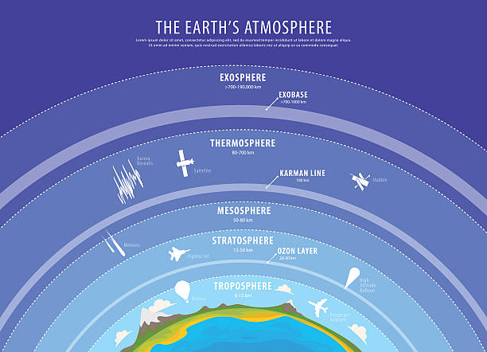
Atmosphere: The layer of gases surrounding the Earth
Notes:
Atmosphere is the layer of gases surrounding the Earth.

Slide 7
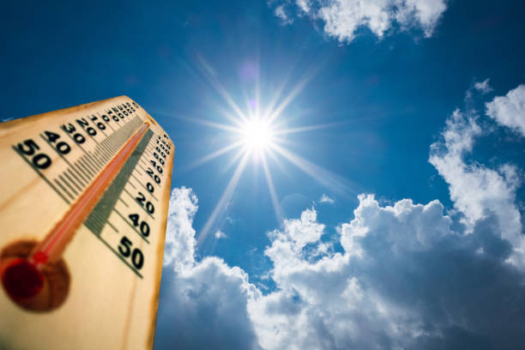
Weather: The condition of the atmosphere at a certain place and time
Notes:
Weather is the condition of the atmosphere at a certain place and time.

Slide 8
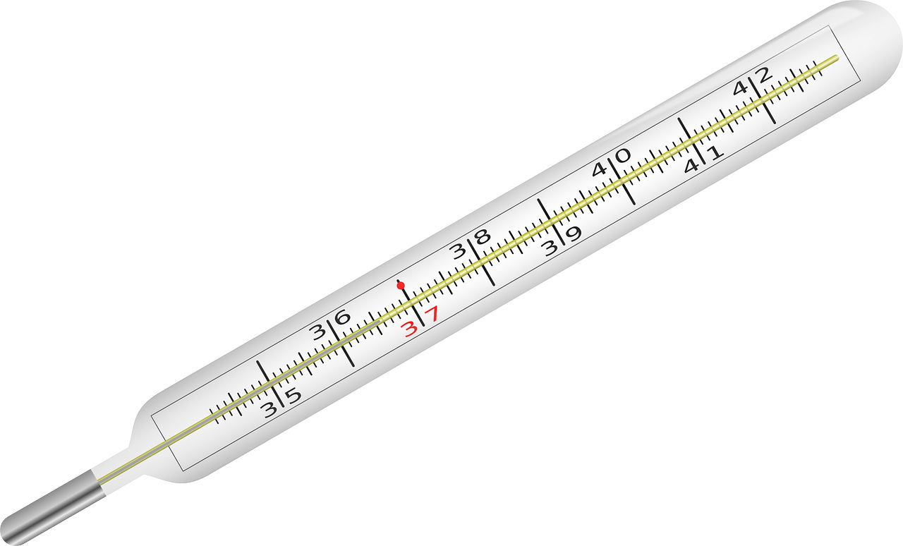
Temperature: how hot or cold something is
Notes:
Temperature is how hot or cold something is.

Slide 9
Altitude: The height above sea level or the Earth's surface
Notes:
Altitude is the height above sea level or the Earth’s surface.

Slide 10
Notes:
Now let’s pause for a moment to review the information we have covered already.

Slide 11
True or False: Atmosphere is the layer of gases surrounding the Earth
A. True
B. False
Notes:
True or false: Atmosphere is the layer of gases surrounding the Earth
[True]

Slide 12
True or False: Atmosphere is the layer of gases surrounding the Earth
A. True
B. False
Notes:
True or false: Atmosphere is the layer of gases surrounding the Earth
[True]

Slide 13
A. Time
B. Height
C. Temperature
Altitude is the ______ above sea level or the Earth's surface
Notes:
Altitude is the ______ above sea level or the Earth's surface
[Height]

Slide 14
A. Time
B. Height
C. Temperature
Altitude is the ______ above sea level or the Earth's surface
Notes:
Altitude is the ______ above sea level or the Earth's surface
[Height]

Slide 15
What is the the condition of the atmosphere at a certain place and time?
Rain
Height
Altitude
Weather
Notes:
What is the the condition of the atmosphere at a certain place and time?
[Weather]

Slide 16
What is the the condition of the atmosphere at a certain place and time?
Rain
Height
Altitude
Weather
Notes:
What is the the condition of the atmosphere at a certain place and time?
[Weather]

Slide 17
True or False: Temperature is how hot or cold something is
A. True
B. False
Notes:
True or False: Temperature is how hot or cold something is
[True]

Slide 18
True or False: Temperature is how hot or cold something is
A. True
B. False
Notes:
True or False: Temperature is how hot or cold something is
[True]

Slide 19
Atmospheric Pressure
Notes:
Now that we’ve reviewed, let’s define our new term, Atmospheric Pressure.

Slide 20
Atmospheric Pressure: The weight of all the air in the atmosphere pushing down on Earth's surface.
Notes:
Atmospheric Pressure: The weight of all the air in the atmosphere pushing down on Earth's surface.

Slide 21
Notes:
Let’s check-in for understanding.

Slide 22
What is atmospheric pressure?
Notes:
What is atmospheric pressure?
[Atmospheric Pressure: The weight of all the air in the atmosphere pushing down on Earth's surface.]

Slide 23
Notes:
That is the basic definition, but there is a bit more you need to know.

Slide 24
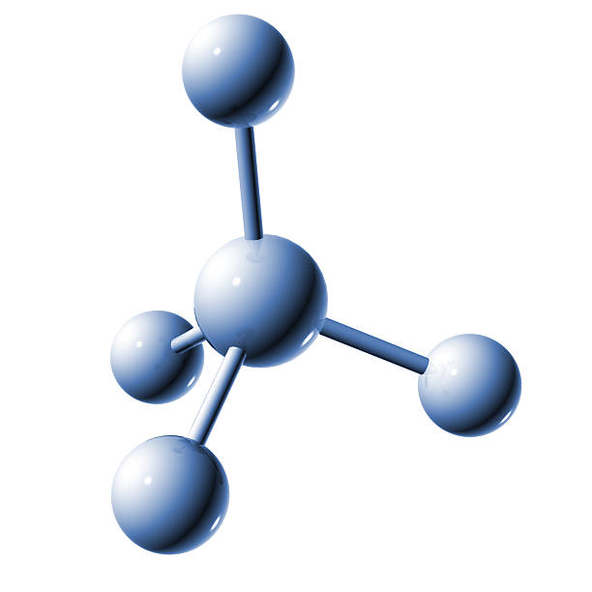
Air Molecules
There is a force because of all the tiny, invisible pieces called molecules that make up the air. They're super light on their own, but when you have a lot of them together, they can actually weigh quite a bit! So, all those air molecules above us create a push, and that push is what we call atmospheric pressure.
Notes:
Air Molecules; There is a force because of all the tiny, invisible pieces called molecules that make up the air. They're super light on their own, but when you have a lot of them together, they can actually weigh quite a bit! So, all those air molecules above us create a push, and that push is what we call atmospheric pressure.

Slide 25
Altitudes
When you go up high, like if you climb a tall tree or a mountain, there are fewer air molecules above you, so the pressure is lighter. But when you're down low, like at the bottom of a valley, there are lots of air molecules above you, so the pressure is stronger.
Notes:
Altitudes: When you go up high, like if you climb a tall tree or a mountain, there are fewer air molecules above you, so the pressure is lighter. But when you're down low, like at the bottom of a valley, there are lots of air molecules above you, so the pressure is stronger.

Slide 26
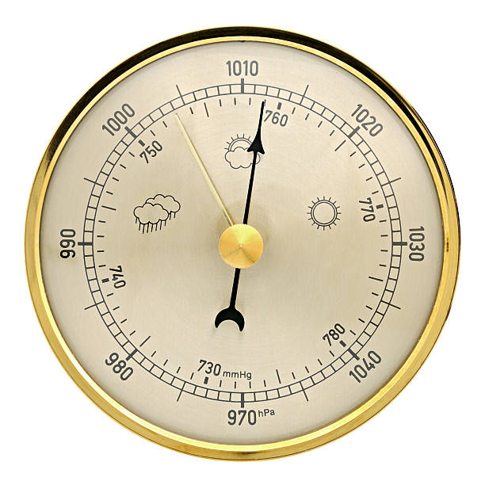
Barometer
We can measure atmospheric pressure with a special tool called a barometer. It helps us understand if the air pressure is high, which usually means sunny weather, or low, which might mean rain or storms.
Notes:
Barometer: We can measure atmospheric pressure with a special tool called a barometer. It helps us understand if the air pressure is high, which usually means sunny weather, or low, which might mean rain or storms.

Slide 27
Notes:
Now let’s pause for a moment to review the information we have covered already.

Slide 28
True or False: A barometer measures atmospheric pressure
Notes:
True or False: A barometer measures atmospheric temperature
[True]

Slide 29
True or False: A barometer measures atmospheric pressure
Notes:
True or False: A barometer measures atmospheric temperature
[True]

Slide 30
The atmosphere is made up of tiny particles called___________.
Notes:
The atmosphere is made up of tiny particles called___________.
[Molecules]

Slide 31
The atmosphere is made up of tiny particles called Molecules.
Notes:
The atmosphere is made up of tiny particles called___________.
[Molecules]

Slide 32
When you go up high, the atmospheric pressure gets _____.
Notes:
When you go up high, the atmospheric pressure gets ___________.
[lower]

Slide 33
When you go up high, the atmospheric pressure gets lower.
Notes:
When you go up high, the atmospheric pressure gets ___________.
[lower]

Slide 34
Notes:
Now, let’s talk about some examples of atmospheric pressure..

Slide 35
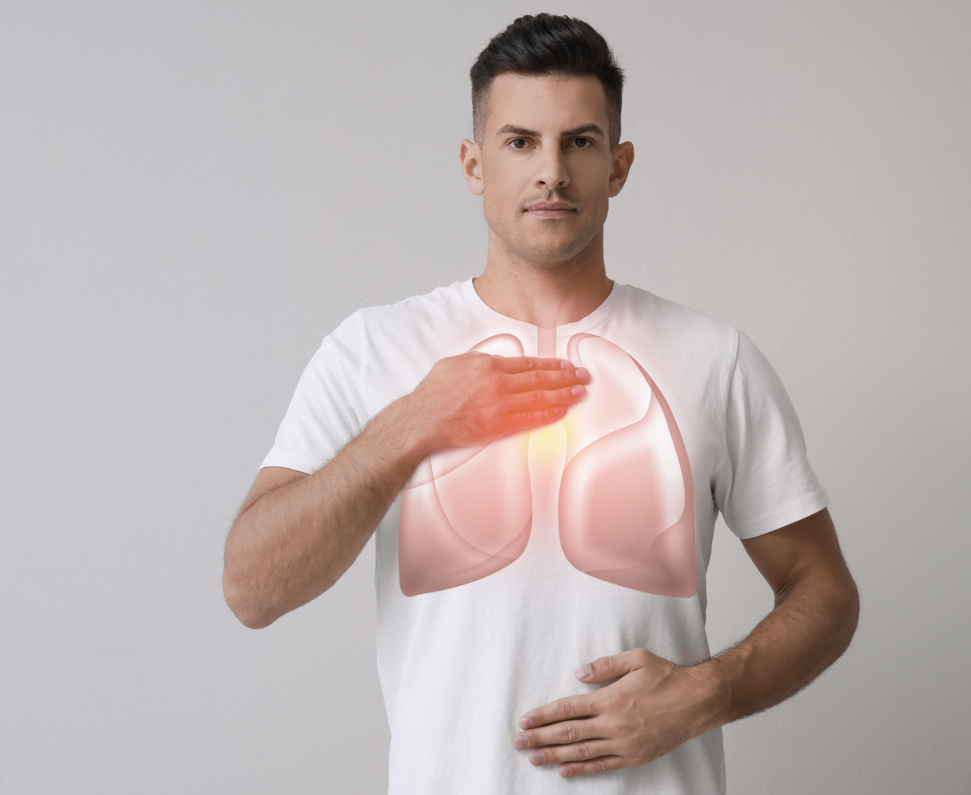
Breathing is an example of something that happens due to atmospheric pressure. When you inhale, your lungs expand because the atmospheric pressure is greater on the outside. When you exhale, your lungs shrink due to the decrease in atmospheric pressure.
Notes:
Breathing is an example of something that happens due to atmospheric pressure. When you inhale, your lungs expand because the atmospheric pressure is greater on the outside. When you exhale, your lungs shrink due to the decrease in atmospheric pressure.

Slide 36
Another example of something that happens due to atmospheric pressure is tightly closed doors and windows. Doors and windows are often designed to seal tightly. Atmospheric pressure helps keep them closed. If you open a window during a storm, you might feel a force pushing it closed.
Notes:
Another example of something that happens due to atmospheric pressure is tightly closed doors and windows. Doors and windows are often designed to seal tightly. Atmospheric pressure helps keep them closed. If you open a window during a storm, you might feel a force pushing it closed.

Slide 37
Notes:
Now, let’s talk about some non-examples of atmospheric pressure.

Slide 38
Wind is NOT an example of atmospheric pressure. Wind happens because the air moves from one place to another, like when you blow on a pinwheel and it spins. But atmospheric pressure is more about the steady, constant push of air that's always around us, not just when it's moving fast.
Notes:
Wind is NOT an example of atmospheric pressure. Wind happens because the air moves from one place to another, like when you blow on a pinwheel and it spins. But atmospheric pressure is more about the steady, constant push of air that's always around us, not just when it's moving fast.

Slide 39
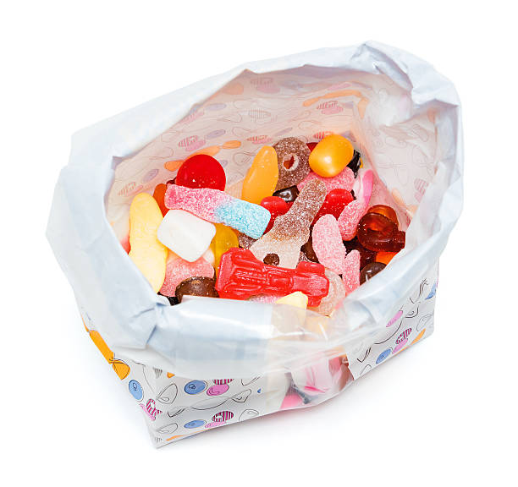
Weight is NOT atmospheric pressure. Imagine you're holding a big bag of candy. The bag feels heavy because of all the candy inside pushing down on your hand. That push is what we call weight. So, weight is just how much something pushes down because of gravity. It is not atmospheric pressure.
Notes:
Weight is NOT atmospheric pressure. Imagine you're holding a big bag of candy. The bag feels heavy because of all the candy inside pushing down on your hand. That push is what we call weight. So, weight is just how much something pushes down because of gravity. It is not atmospheric pressure.

Slide 40
Notes:
Now let’s pause for a moment to check your understanding.

Slide 41
How is wind different from atmospheric pressure?
Notes:
How is wind different from atmospheric pressure?
[Wind is the movement of air from one place to another, while atmospheric pressure itself is the steady force exerted by the weight of the air.]

Slide 42
How is wind different from atmospheric pressure?
Wind is the movement of air from one place to another, while atmospheric pressure itself is the steady force exerted by the weight of the air.
Notes:
How is wind different from atmospheric pressure?
[Wind is the movement of air from one place to another, while atmospheric pressure itself is the steady force exerted by the weight of the air.]

Slide 43
Remember!!!
Notes:
So remember!

Slide 44
Atmospheric Pressure: The weight of all the air in the atmosphere pushing down on Earth's surface.
Notes:
Atmospheric Pressure: The weight of all the air in the atmosphere pushing down on Earth's surface.

Slide 45
Notes:
We will now complete this concept map, called a Frayer model, to summarize and further clarify what you have learned about the term Atmospheric Pressure.

Slide 46
Definition
Picture
Atmospheric Pressure
Example
How does atmospheric pressure impact my life?
Notes:
To complete the Frayer model, we will choose from four choices the correct picture, definition, example, and response to the question, “How does atmospheric pressure impact my life?” Select the best response for each question using the information you just learned. As we select responses, we will see how this model looks filled in for the term atmospheric pressure.

Slide 47
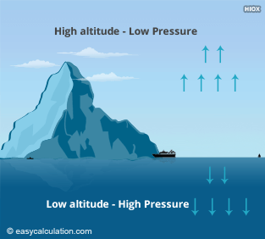
Directions: Choose the correct picture of atmospheric pressure from the choices below.
A
B
C
D
Notes:
Choose the one correct picture of atmospheric pressure from these four choices and drag and place it in the picture box below.

Slide 48
Directions: Choose the correct picture of atmospheric pressure from the choices below.
A
B
C
D
Notes:
You chose the picture that shows atmospheric pressure.

Slide 49
Definition
Picture
Atmospheric Pressure
Example
How does atmospheric pressure impact my life?
Notes:
Here is the Frayer Model filled in with a picture of atmospheric pressure.

Slide 50
Directions: Choose the correct definition of atmospheric pressure from the choices below.
A
The force of gravity pulling objects toward the ground.
B
The distance between layers of the atmosphere.
C
The weight of all the air in the atmosphere pushing down on Earth's surface.
D
The amount of water vapor present in the air.
Notes:
Choose the one correct definition of atmospheric pressure from these four choices and drag and place it in the definition box below.

Slide 51
Directions: Choose the correct definition of atmospheric pressure from the choices below.
A
The force of gravity pulling objects toward the ground.
B
The distance between layers of the atmosphere.
C
The weight of all the air in the atmosphere pushing down on Earth's surface.
D
The amount of water vapor present in the air.
Notes:
You chose “The weight of all the air in the atmosphere pushing down on Earth’s surface” This is correct! This is the definition of atmospheric pressure.

Slide 52
Definition
Picture
The weight of all the air in the atmosphere pushing down on Earth's surface.
Atmospheric Pressure
Example
How does atmospheric pressure impact my life?
Notes:
Here is the Frayer Model with a picture and the definition filled in for atmospheric pressure: The weight of all the air in the atmosphere pushing down on Earth's surface.

Slide 53
Directions: Choose the correct example of something that happens because of atmospheric pressure from the choices below.
A
The sound of wind blowing through trees.
B
The heat felt from the sun on a warm summer day.
C
The feeling of lightness when flying in an airplane.
D
Breathing
Notes:
Choose the one correct example of atmospheric pressure from these four choices and drag and place it in the example box below.

Slide 54
Directions: Choose the correct example of something that happens because of atmospheric pressure from the choices below.
A
The sound of wind blowing through trees.
B
The heat felt from the sun on a warm summer day.
C
The feeling of lightness when flying in an airplane.
D
Breathing
Notes:
You chose “Breathing.” This is an example of atmospheric pressure!

Slide 55
Definition
Picture
The weight of all the air in the atmosphere pushing down on Earth's surface.
Atmospheric Pressure
Breathing
Example
How does atmospheric pressure impact my life?
Notes:
Here is the Frayer Model with a picture, definition, and an example of atmospheric pressure: The water pressure felt when diving deep underwater.

Slide 56
Directions: Choose the correct response for “how atmospheric pressure impact my life?” from the choices below.
A
It regulates weather patterns.
B
It affects the taste of our food.
C
It influences the speed of sound.
D
It determines the color of the sky.
Notes:
Choose the one correct response for “how does atmospheric pressure impact my life?” from these four choices and drag and place it in the box below.

Slide 57
Directions: Choose the correct response for “how atmospheric pressure impact my life?” from the choices below.
A
It regulates weather patterns.
B
It affects the taste of our food.
C
It influences the speed of sound.
D
It determines the color of the sky.
Notes:
You chose “It regulates weather patterns” That is correct! This is an example of how atmospheric pressure impacts your life.

Slide 58
Definition
Picture
The weight of all the air in the atmosphere pushing down on Earth's surface.
Atmospheric Pressure
Breathing
It regulates weather patterns.
Example
How does atmospheric pressure impact my life?
Notes:
Here is the Frayer Model with a picture, definition, example, and a correct response to “how does atmospheric pressure impact my life?”: It regulates weather patterns.

Slide 59
Remember!!!
Notes:
So remember!

Slide 60
Atmospheric Pressure: The weight of all the air in the atmosphere pushing down on Earth's surface.
Notes:
Atmospheric Pressure: The weight of all the air in the atmosphere pushing down on Earth's surface.

Slide 61
Big Question: How do changes in air pressure affect the weather around us, and how does this impact our daily lives?
Notes:
Let’s reflect once more on our big question. Our “big question” is: How do changes in air pressure affect the weather around us, and how does this impact our daily lives?
Does anyone have any additional examples to share that haven’t been discussed yet?

Slide 62
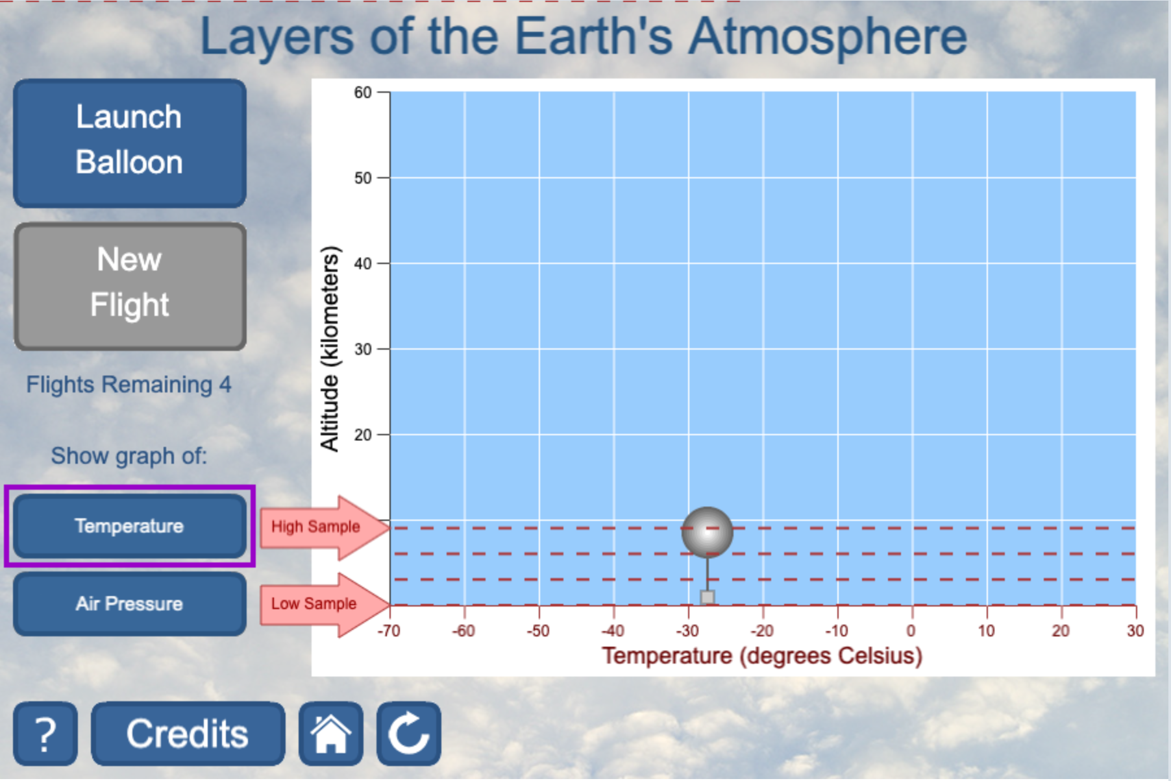
Simulation Activity
Atmospheric Pressure
(UCAR)
Click the link above for a simulation to explore atmospheric pressure.
Notes:
Click the link above for a simulation to deepen your understanding of atmospheric pressure.
Feedback: Providing a simulation activity is a great way to make science thinking visible. In this simulation…
Users can simulate launching weather balloons to explore the Earth's atmosphere.
Users can observe temperature changes with altitude in the troposphere.
Users analyze temperature and air pressure changes as the balloon ascends.
Prompts users to consider questions related to temperature, cloud formations, and atmospheric layering.
Aims to enhance understanding of atmospheric phenomena and scientific principles through interactive exploration.

Slide 63
Notes:
Thanks for watching, and please continue watching CAPs available from this website.

Slide 64
This Was Created With Resources From:
Questions or Comments
Michael Kennedy, Ph.D. MKennedy@Virginia.edu
Rachel L Kunemund, Ph.D. rk8vm@virginia.edu

