Slide 1
Intro
“Big Idea” Question
Review Concepts
Check-In Questions
Teacher Engagement
Vocabulary
Student-Friendly Definition
Examples & Non-Examples
Frayer Model
Simulation/Activity
Notes:
OK everyone, get ready for our next lesson. Just as a reminder, these are the different components that our lesson may include, and you’ll see these icons in the top left corner of each slide so that you can follow along more easily!

Slide 2
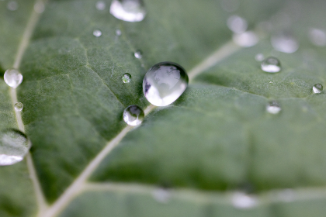
Dew Point
Intro
Notes:
Today we will be learning about Dew Point.

Slide 3
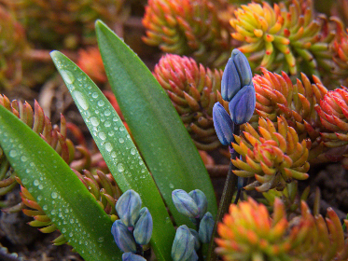
Big Question: How does understanding dew point help us predict weather patterns and make decisions in our daily lives?
Notes:
Our “big question” is: How does understanding dew point help us predict weather patterns and make decisions in our daily lives?
[Pause and illicit predictions from students.]
Be sure to keep this question and your predictions in mind as we move through this video and questions.

Slide 4
Demonstration
TEACHER DIRECTIONS:
Before viewing: Prepare the materials and briefly introduce the concept of dew point, discussing its relevance to weather and everyday life.
During: Guide students through the observation process, encouraging them to notice any changes occurring around the glass of ice water and the plastic cup of room temperature water.
After: Tell students that today they will be learning more about the term dew point.
Notes:
A simple demonstration to illustrate dew point in class can be done using a glass of ice water and a clear plastic cup. Here are the instructions:
Materials needed:
A clear plastic cup
A glass of ice water
Room temperature water
Instructions:
Begin by filling the plastic cup about halfway with room temperature water.
Place the glass of ice water next to the plastic cup on a table or desk where all students can see.
Hold the plastic cup near the glass of ice water, but do not let them touch.
Ask the students to observe what happens to the outside of the glass of ice water.
Explain to the students that the water vapor in the air around us can condense into liquid water droplets when it comes into contact with a surface that is colder than the dew point temperature.
As the cold glass of ice water chills the air around it, the water vapor in that air condenses onto the surface of the glass, forming tiny water droplets that we see as condensation.
Emphasize that the temperature at which condensation occurs is known as the dew point temperature.
Discuss with the students how this concept is important for weather forecasting and understanding humidity levels.
Allow students to ask questions and discuss their observations.

Slide 5
Notes:
Before we move on to our new topic, let’s review some other words & concepts that you already learned and make sure you are firm in your understanding.

Slide 6
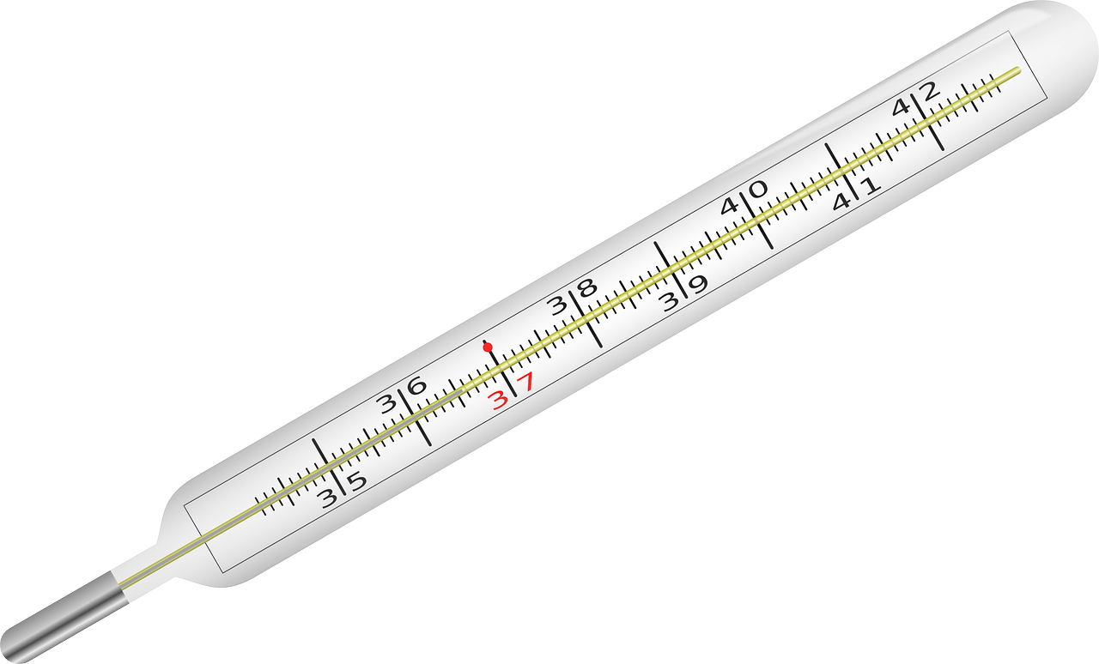
Temperature: how hot or cold something is
Notes:
Temperature is how hot or cold something is.

Slide 7
Water Vapor: the invisible gas form of water present in the air
Notes:
Water vapor is the invisible gas form of water present in the air.

Slide 8
Humidity: the amount of water vapor present in the air
Notes:
Humidity is the amount of water vapor present in the air.

Slide 9
Condensation: the process by which water vapor turns into liquid water when it cools down
Notes:
Condensation is the process by which water vapor turns into liquid water when it cools down.

Slide 10
Evaporation: the process by which liquid water turns into water vapor, rising into the air
Notes:
Evaporation is the process by which liquid water turns into water vapor, rising into the air.

Slide 11
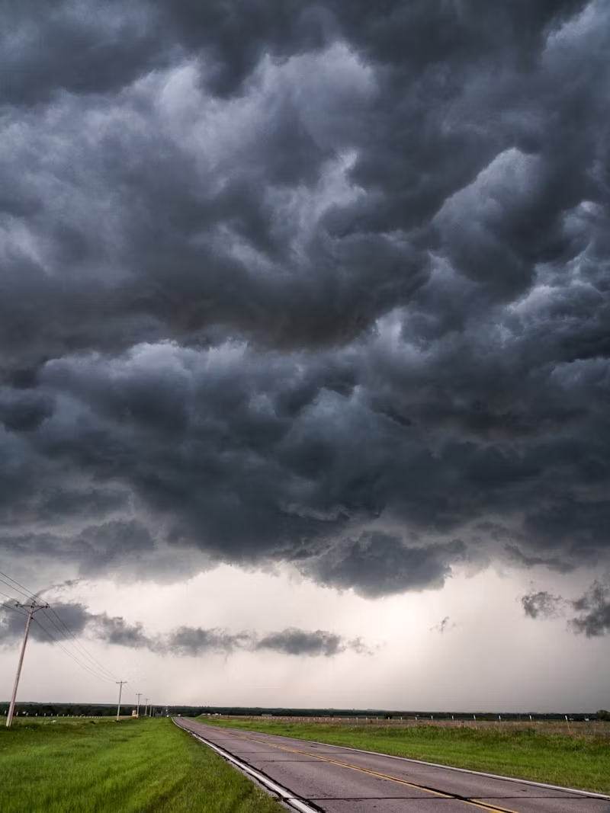
Saturation: occurs when the air is holding as much water vapor as it can at a given temperature and pressure
Notes:
Saturation occurs when the air is holding as much water vapor as it can at a given temperature and pressure.

Slide 12
Notes:
Now let’s pause for a moment to review the information we have covered already.

Slide 13
True or False: Evaporation is the process by which water vapor turns into liquid water
A. True
B. False
Notes:
True or false: Evaporation is the process by which water vapor turns into liquid water.
[False]

Slide 14
True or False: Evaporation is the process by which water vapor turns into liquid water
A. True
B. False
Notes:
True or false: Evaporation is the process by which water vapor turns into liquid water.
[False]

Slide 15
A. Liquid
B. Gas
C. Water
Water vapor is the ________ form of water present in the air
Notes:
Water vapor is the ________ form of water present in the air
[Gas]

Slide 16
A. Liquid
B. Gas
C. Water
Water vapor is the ________ form of water present in the air
Notes:
Water vapor is the ________ form of water present in the air
[Gas]

Slide 17
What is the process by which liquid water turns into water vapor?
Condensation
Evaporation
Saturation
Humidity
Notes:
What is the process by which liquid water turns into water vapor?
[Evaporation]

Slide 18
What is the process by which liquid water turns into water vapor?
Condensation
Evaporation
Saturation
Humidity
Notes:
What is the process by which liquid water turns into water vapor?
[Evaporation]

Slide 19
Humidity: the amount of water ____ present in the air
Notes:
Humidity: the amount of water ____ present in the air
[Vapor]

Slide 20
Humidity: the amount of water vapor present in the air
Notes:
Humidity: the amount of water ____ present in the air
[Vapor]

Slide 21
True or False: Saturation occurs when the air is holding as much water vapor as it can at a given temperature and pressure.
A. True
B. False
Notes:
True or False: Saturation occurs when the air is holding as much water vapor as it can at a given temperature and pressure.
[True]

Slide 22
True or False: Saturation occurs when the air is holding as much water vapor as it can at a given temperature and pressure.
A. True
B. False
Notes:
True or False: Saturation occurs when the air is holding as much water vapor as it can at a given temperature and pressure.
[True]

Slide 23
Dew Point
Notes:
Now that we’ve reviewed, let’s define our new term, Dew Point.

Slide 24
Dew Point: the temperature when the air is full of tiny water droplets, and dew forms on things like grass or leaves
Notes:
Dew Point is the temperature when the air is full of tiny droplets, and dew forms on things like grass or leaves

Slide 25
Notes:
Let’s check-in for understanding.

Slide 26
What is dew point?
Notes:
What is dew point?
[The temperature when the air is full of tiny water droplets, and dew forms on things like grass or leaves]

Slide 27
Notes:
That is the basic definition, but there is a bit more you need to know.

Slide 28
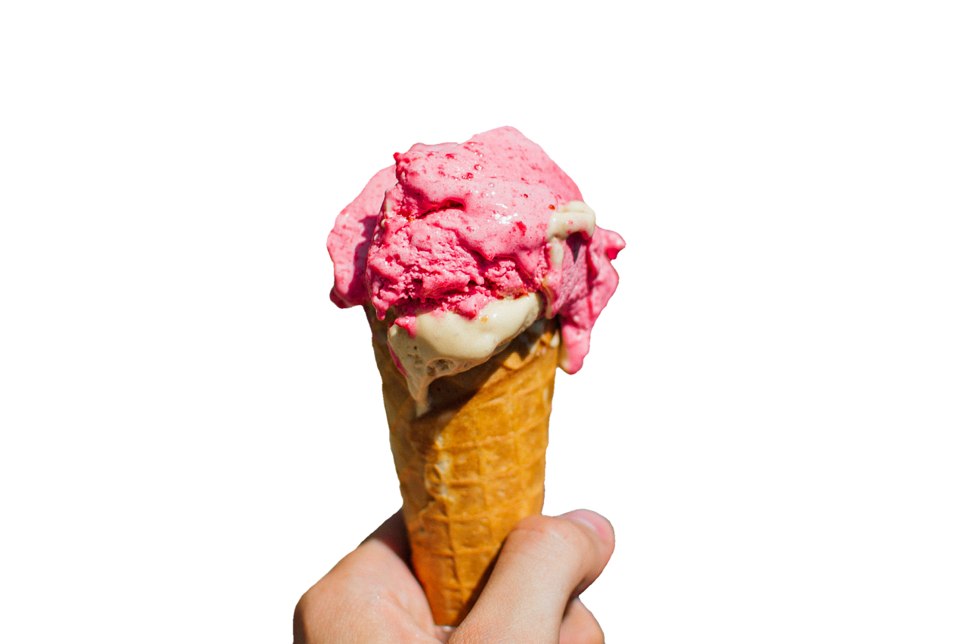
Temperature Changes
Just like how ice cream melts when it gets warm, water in the air can change too. When the temperature cools down to the dew point, the air can't hold as much water anymore, so it starts to let go of some of it. That's when dew forms.
Notes:
Temperature Changes: Just like how ice cream melts when it gets warm, water in the air can change too. When the temperature cools down to the dew point, the air can't hold as much water anymore, so it starts to let go of some of it. That's when dew forms.

Slide 29
Clear Nights
Ever notice how we see more dew on clear nights? That's because when the sky is clear, the Earth loses heat more quickly. When things cool down, they reach the dew point faster, so we see more dew in the morning.
Notes:
Clear Nights: Ever notice how we see more dew on clear nights? That's because when the sky is clear, the Earth loses heat more quickly. When things cool down, they reach the dew point faster, so we see more dew in the morning.

Slide 30
Notes:
Now let’s pause for a moment to review the information we have covered already.

Slide 31
True or False: The definition of temperature change states that when the temperature decreases to the dew point, the air can hold more water vapor.
Notes:
True or False: The definition of temperature change states that when the temperature decreases to the dew point, the air can hold more water vapor.
[False]

Slide 32
True or False: The definition of temperature change states that when the temperature decreases to the dew point, the air can hold more water vapor.
Notes:
True or False: The definition of temperature change states that when the temperature decreases to the dew point, the air can hold more water vapor.
[False]

Slide 33
On clear nights, the Earth loses heat more ___________, causing objects to cool down and reach the dew point faster.
Notes:
On clear nights, the Earth loses heat more ___________, causing objects to cool down and reach the dew point faster.
[Quickly]

Slide 34
On clear nights, the Earth loses heat more quickly, causing objects to cool down and reach the dew point faster.
Notes:
On clear nights, the Earth loses heat more ___________, causing objects to cool down and reach the dew point faster.
[Quickly]

Slide 35
Notes:
Now, let’s talk about some examples of dew point.

Slide 36
An example of dew point is a foggy mirror. When you take a hot shower and the bathroom mirror gets foggy, that's because the air in the bathroom has reached its dew point, causing the water vapor in the air to condense on the mirror.
Notes:
An example of dew point is a foggy mirror. When you take a hot shower and the bathroom mirror gets foggy, that's because the air in the bathroom has reached its dew point, causing the water vapor in the air to condense on the mirror.

Slide 37
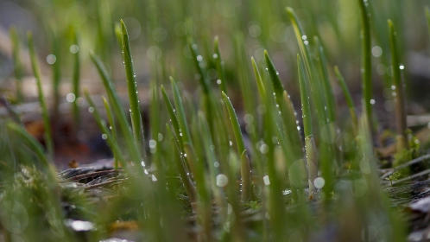
Another example of dew point is wet grass. Have you ever noticed how your grass is wet in the morning, even though it didn't rain? That's because during the night, when the temperature drops, the air cools down and reaches its dew point, causing dew to form on the grass
Notes:
Another example of dew point is wet grass. Have you ever noticed how your grass is wet in the morning, even though it didn't rain? That's because during the night, when the temperature drops, the air cools down and reaches its dew point, causing dew to form on the grass

Slide 38
Notes:
Now, let’s talk about some non-examples of dew point.

Slide 39
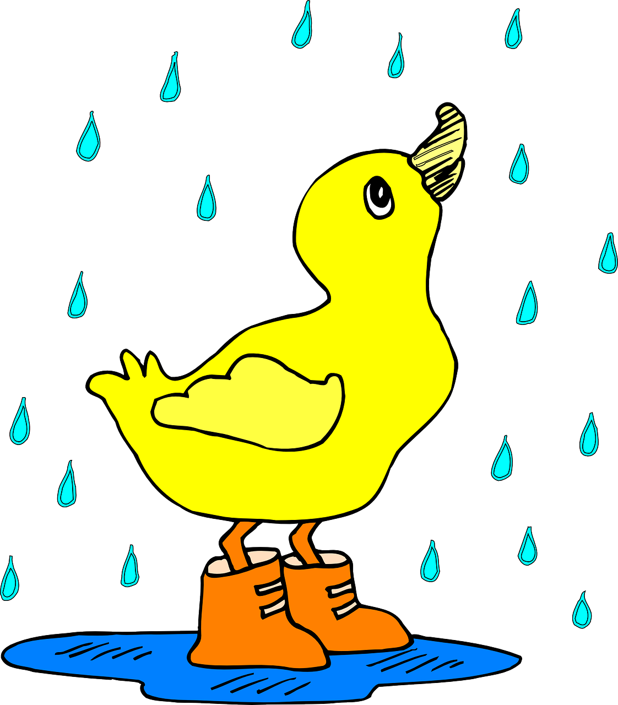
Rain is NOT an example of dew point. While rain does involve moisture in the air condensing and falling to the ground, it's not directly related to the dew point. Rain occurs when water droplets in clouds combine and become heavy enough to fall due to gravity.
Notes:
Rain is NOT an example of dew point. While rain does involve moisture in the air condensing and falling to the ground, it's not directly related to the dew point. Rain occurs when water droplets in clouds combine and become heavy enough to fall due to gravity.

Slide 40
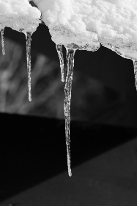
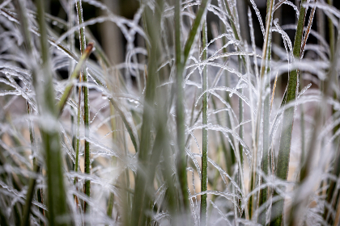
Frost is NOT dew point. Frost forms when the temperature drops below freezing and water vapor in the air directly transitions into ice crystals on surfaces. While it's related to temperature and humidity, it's not specifically tied to the dew point, as it occurs at temperatures below freezing.
Notes:
Frost is NOT dew point. Frost forms when the temperature drops below freezing and water vapor in the air directly transitions into ice crystals on surfaces. While it's related to temperature and humidity, it's not specifically tied to the dew point, as it occurs at temperatures below freezing.

Slide 41
Notes:
Now let’s pause for a moment to check your understanding.

Slide 42
How is rain different from dew point?
Notes:
How is rain different from dew point?
[Rain occurs when water droplets in clouds combine and become heavy enough to fall. Dew point is the temperature when the air is full of tiny water droplets]

Slide 43
How is rain different from dew point?
Rain occurs when water droplets in clouds combine and become heavy enough to fall. Dew point is the temperature when the air is full of tiny water droplets.
Notes:
How is rain different from dew point?
[Rain occurs when water droplets in clouds combine and become heavy enough to fall. Dew point is the temperature when the air is full of tiny water droplets]

Slide 44
Remember!!!
Notes:
So remember!

Slide 45
Dew Point: the temperature when the air is full of tiny water droplets, and dew forms on things like grass or leaves
Notes:
Dew Point is the temperature when the air is full of tiny droplets, and dew forms on things like grass or leaves

Slide 46
Notes:
We will now complete this concept map, called a Frayer model, to summarize and further clarify what you have learned about the term dew point.

Slide 47
Definition
Picture
Dew Point
Example
How does dew point impact my life?
Notes:
To complete the Frayer model, we will choose from four choices the correct picture, definition, example, and response to the question, “How does dew point impact my life?” Select the best response for each question using the information you just learned. As we select responses, we will see how this model looks filled in for the term dew point.

Slide 48
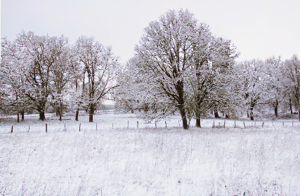
Directions: Choose the correct picture of dew point from the choices below.
A
B
C
D
Notes:
Choose the one correct picture of dew point from these four choices and drag and place it in the picture box below.

Slide 49
Directions: Choose the correct picture of dew point from the choices below.
A
B
C
D
Notes:
You chose the picture that shows dew point.

Slide 50
Definition
Picture
Dew Point
Example
How does dew point impact my life?
Notes:
Here is the Frayer Model filled in with a picture of dew point.

Slide 51
Directions: Choose the correct definition of dew point from the choices below.
A
The point where clouds turn into cotton candy
B
The temperature when the air is full of tiny water droplets
C
The same thing as rain
D
The frost on the trees in the morning
Notes:
Choose the one correct definition of dew point from these four choices and drag and place it in the definition box below.

Slide 52
Directions: Choose the correct definition of dew point from the choices below.
A
The point where clouds turn into cotton candy
B
The temperature when the air is full of tiny water droplets
C
The same thing as rain
D
The frost on the trees in the morning
Notes:
You chose “the temperature when the air is full of tiny water droplets” This is correct! This is the definition of dew point.

Slide 53
Definition
Picture
the temperature when the air is full of tiny water droplets
Dew point
Example
How does dew point impact my life?
Notes:
Here is the Frayer Model with a picture and the definition filled in for dew point: the temperature when the air is full of tiny water droplets.

Slide 54
Directions: Choose the correct example of dew point from the choices below.
A
The temperature at which water freezes into ice.
B
The temperature at which water boils into steam.
C
The temperature at which dew forms on grass in the morning.
D
The temperature at which rain falls from clouds.
Notes:
Choose the one correct example of dew point from these four choices and drag and place it in the example box below.

Slide 55
Directions: Choose the correct example of dew point from the choices below.
A
The temperature at which water freezes into ice.
B
The temperature at which water boils into steam.
C
The temperature at which dew forms on grass in the morning.
D
The temperature at which rain falls from clouds.
Notes:
You chose “The temperature at which dew forms on grass in the morning.” This is an example of dew point!

Slide 56
Definition
Picture
the temperature when the air is full of tiny water droplets
Dew point
The temperature at which dew forms on grass in the morning.
Example
How does dew point impact my life?
Notes:
Here is the Frayer Model with a picture, definition, and an example of dew point: The temperature at which dew forms on grass in the morning.

Slide 57
Directions: Choose the correct response for “how does dew point impact my life?” from the choices below.
A
It determines the time of day when it's best to water plants.
B
It helps predict if it will be sunny or cloudy tomorrow.
C
It influences how comfortable or sticky the air feels during hot weather.
D
It indicates the best time for outdoor activities like picnics or sports.
Notes:
Choose the one correct response for “how does dew point impact my life?” from these four choices and drag and place it in the box below.

Slide 58
Directions: Choose the correct response for “how does dew point impact my life?” from the choices below.
A
It determines the time of day when it's best to water plants.
B
It helps predict if it will be sunny or cloudy tomorrow.
C
It influences how comfortable or sticky the air feels during hot weather.
D
It indicates the best time for outdoor activities like picnics or sports.
Notes:
You chose “It influences how comfortable or sticky the air feels during hot weather” That is correct! This is an example of how dew point impacts your life.

Slide 59
Definition
Picture
the temperature when the air is full of tiny water droplets
Dew point
The temperature at which dew forms on grass in the morning.
It influences how comfortable or sticky the air feels during hot weather
Example
How does dew point impact my life?
Notes:
Here is the Frayer Model with a picture, definition, example, and a correct response to “how does dew point impact my life?”: It influences how comfortable or sticky the air feels during hot weather.

Slide 60
Remember!!!
Notes:
So remember!

Slide 61
Dew Point: the temperature when the air is full of tiny water droplets, and dew forms on things like grass or leaves
Notes:
Dew Point is the temperature when the air is full of tiny droplets, and dew forms on things like grass or leaves

Slide 62
Big Question: How does understanding dew point help us predict weather patterns and make decisions in our daily lives?
Notes:
Let’s reflect once more on our big question. Our “big question” is: How does understanding dew point help us predict weather patterns and make decisions in our daily lives?
Does anyone have any additional examples to share that haven’t been discussed yet?

Slide 63
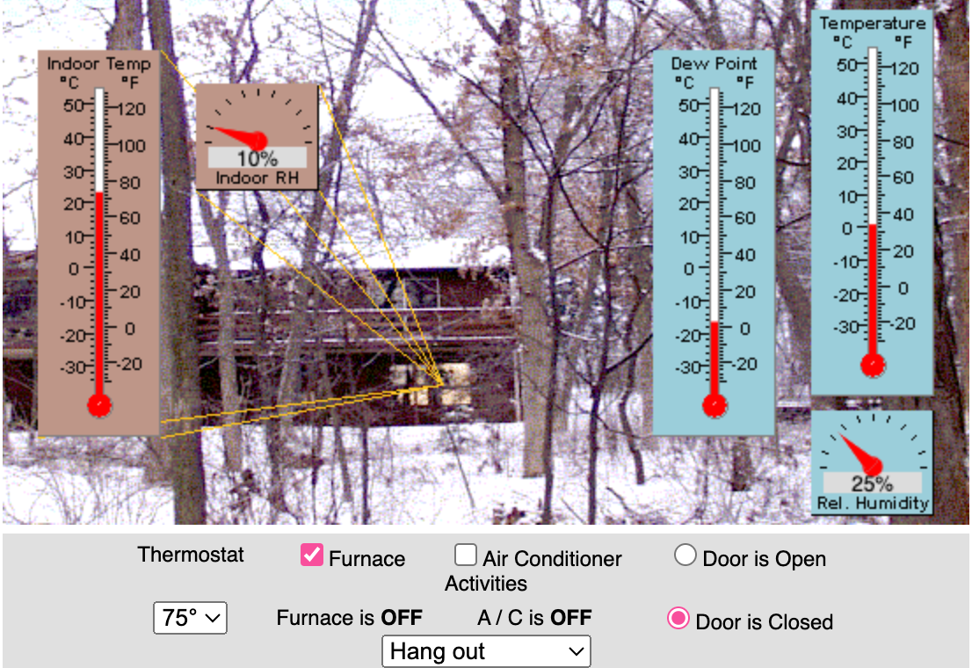
Simulation Activity
Dew Point
(CIMSS)
Click the link above for a simulation to explore dew point.
Notes:
Click the link above for a simulation to deepen your understanding of dew point.
Feedback: Providing a simulation activity is a great way to make science thinking visible. In this simulation…
Explore how changes in outdoor conditions influence comfort levels and energy usage within the house.
Experiment with various combinations of settings to understand their effects on indoor comfort and humidity levels.
Learn about the relationship between temperature, humidity, and comfort in a simulated household environment.
Observe the Relative Humidity (RH) value for the outside displayed on the meter.
Analyze data and make observations about how different activities and environmental factors interact to affect indoor living conditions.
Gain insights into practical strategies for optimizing indoor comfort and energy efficiency based on simulated scenarios.
Use the applet to simulate and understand real-world scenarios related to indoor climate control and environmental comfort.

Slide 64
Notes:
Thanks for watching, and please continue watching CAPs available from this website.

Slide 65
This Was Created With Resources From:
Questions or Comments
Michael Kennedy, Ph.D. MKennedy@Virginia.edu
Rachel L Kunemund, Ph.D. rk8vm@virginia.edu

