Slide 1
Intro
“Big Idea” Question
Review Concepts
Check-In Questions
Teacher Engagement
Vocabulary
Student-Friendly Definition
Examples & Non-Examples
Frayer Model
Simulation/Activity
Notes:
OK everyone, get ready for our next lesson. Just as a reminder, these are the different components that our lesson may include, and you’ll see these icons in the top left corner of each slide so that you can follow along more easily!

Slide 2
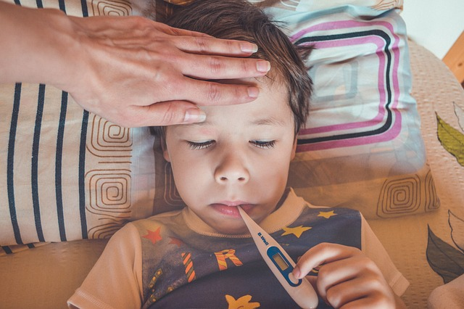
Temperature
Intro
Notes:
Today we will be learning about Temperature.

Slide 3
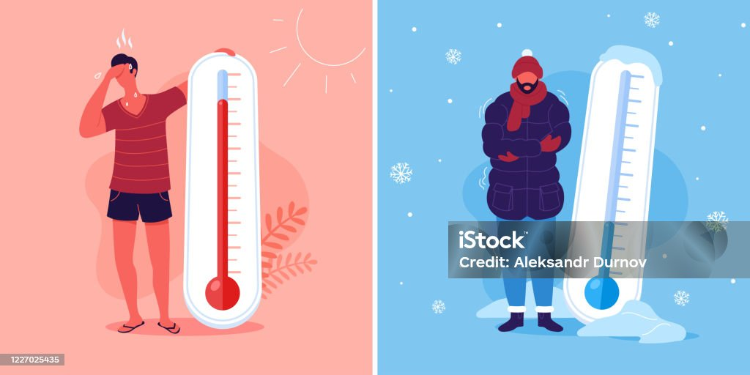
Big Question: How does temperature affect the world around us and our daily lives?
Notes:
Our “big question” is: How does temperature affect the world around us and our daily lives?
[Pause and illicit predictions from students.]
Be sure to keep this question and your predictions in mind as we move through this video and questions.

Slide 4
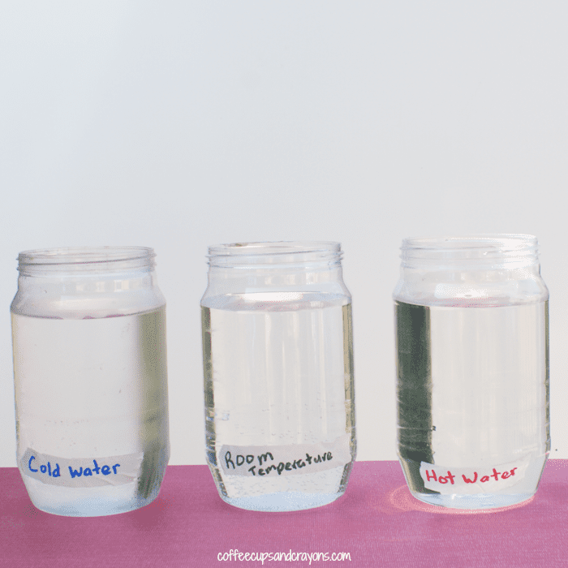
Demonstration
TEACHER DIRECTIONS:
Before viewing: Ask students to recall what they already know about temperature.
During: Engage the students in a discussion about what they observed.
Discuss the concepts of heat, thermometers, and the usage of celsius and fahrenheit.
After: Tell students that today they will be learning more about the term temperature.
Notes:
To teach about heat in the context of temperature, you can conduct a simple and engaging classroom demonstration using water and food coloring. This demonstration will help students understand the effects of heat. This simple heat experiment shows how heat causes molecules to move faster. {Plus kids think it looks cool.} Here's a step-by-step guide for the demonstration:
Super Simple Heat Experiment - Coffee Cups and Crayons
Materials needed:
3 clear jars
water
food coloring
masking tape
markers
thermometer (optional)
Procedure:
Prepare the Jars:
Label the jars with the temperatures you are going to use in the experiment. We used room temperature water {about 72°F}, hot water {about 100°F}, and cold water {about 40°F}.
Turn on your sink faucet and measure the temperature. Adjust the faucet so the temperature is about 72°F. Fill the jar labeled Room Temperature. Alternatively, you can fill a jar will cool tap water and let it sit out for day. The water will eventually become the same temperature as the room.
Fill the jar labeled Cold Water 3/4 of the way with cold tap water. Add ice to the jar to cool the water even farther. {Or you could place this jar in the refrigerator while you wait for your Room Temperature jar to be ready.} Remove the ice from the jar before finishing your experiment.
An adult should help with the Hot Water jar. Turn on your faucet as hot as it will go. Fill the jar labeled Hot Water with hot water. An adult could also heat up some water on the stove. Just be careful not to make it too hot. {100°F is hot but it won’t burn skin.}
Add in Food Coloring:
Add a drop of food coloring to each of the jars and observe what happens over time.
Class Discussion:
Lead a class discussion about heat, emphasizing key concepts such as:
What happens to the drop of food coloring?
Does the food coloring behave the same in each of the jars? Why or why not?
What is different about the jars?
What can you say about the relationship between heat and the movement of molecules? {for older kids}

Slide 5
Notes:
Before we move on to our new topic, let’s review some other words & concepts that you already learned and make sure you are firm in your understanding.

Slide 6
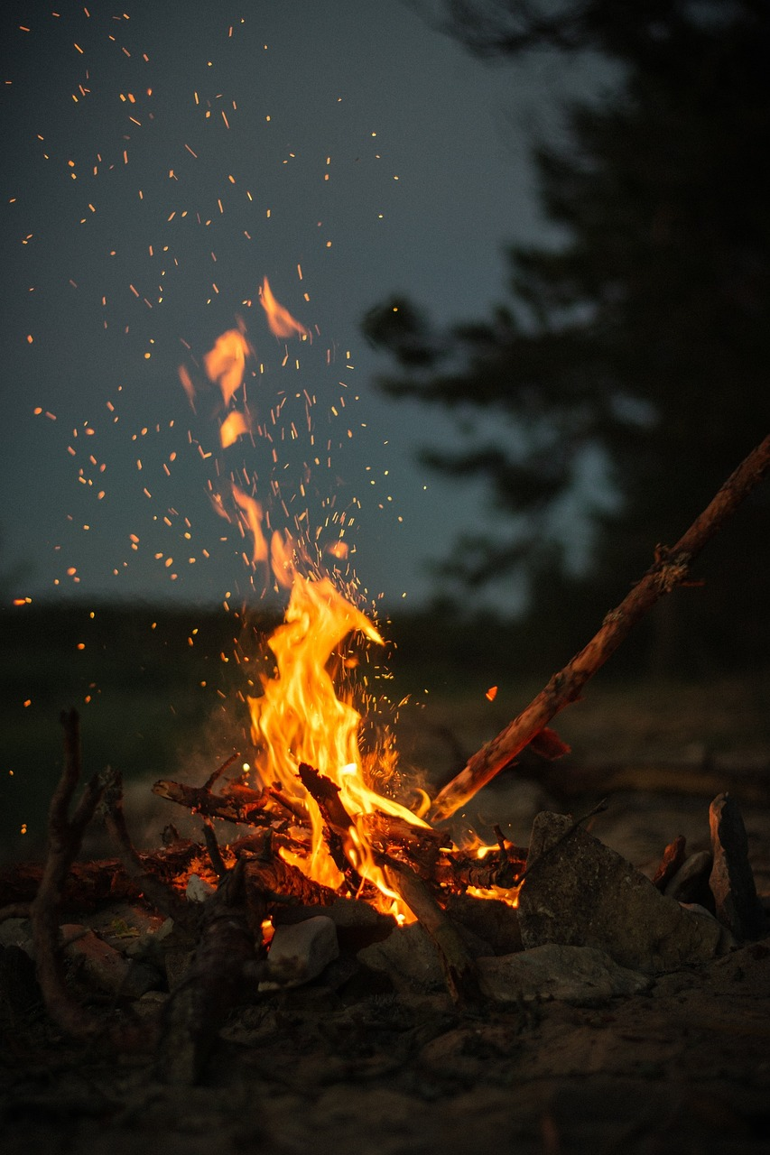
Heat: a form of energy that makes things warm or hot
Notes:
Heat is a form of energy that makes things warm or hot.

Slide 7
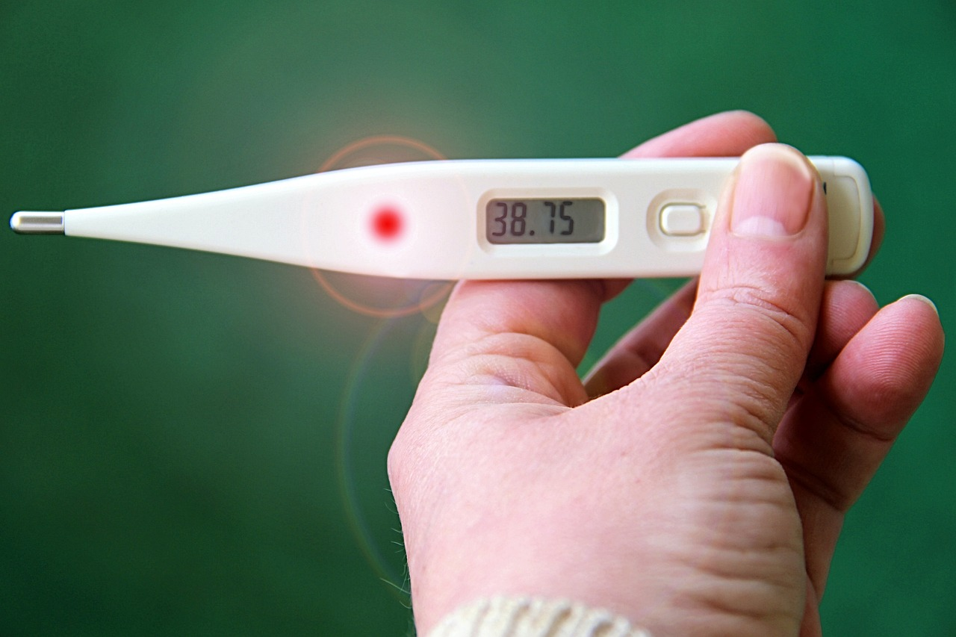
Thermometer: an instrument for measuring temperature
Notes:
A Thermometer is an instrument for measuring temperature.

Slide 8
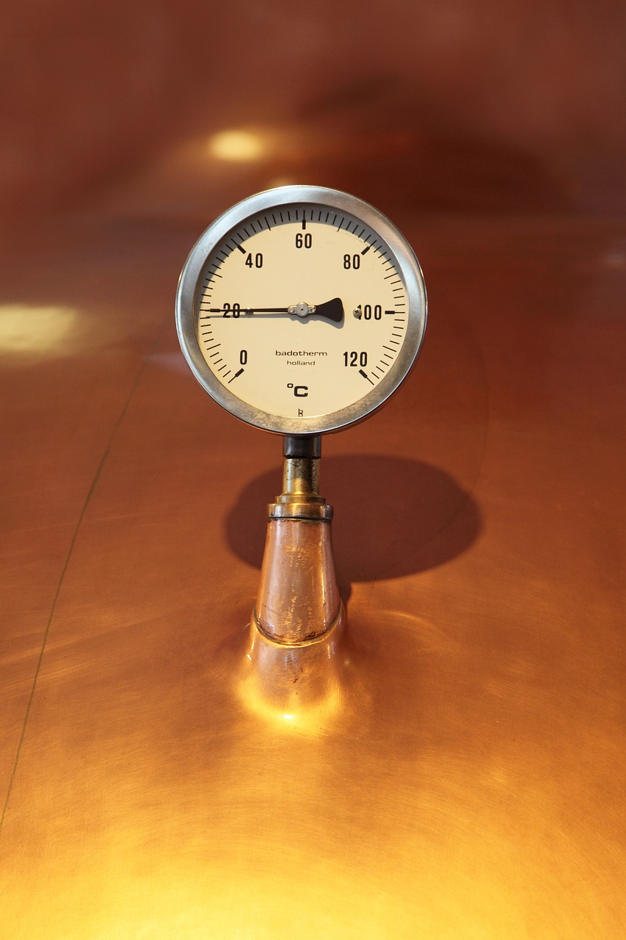
Celcius: a scale of temperature on which water freezes at 0° and boils at 100°
Notes:
Celsius is a scale of temperature on which water freezes at 0° and boils at 100°.

Slide 9
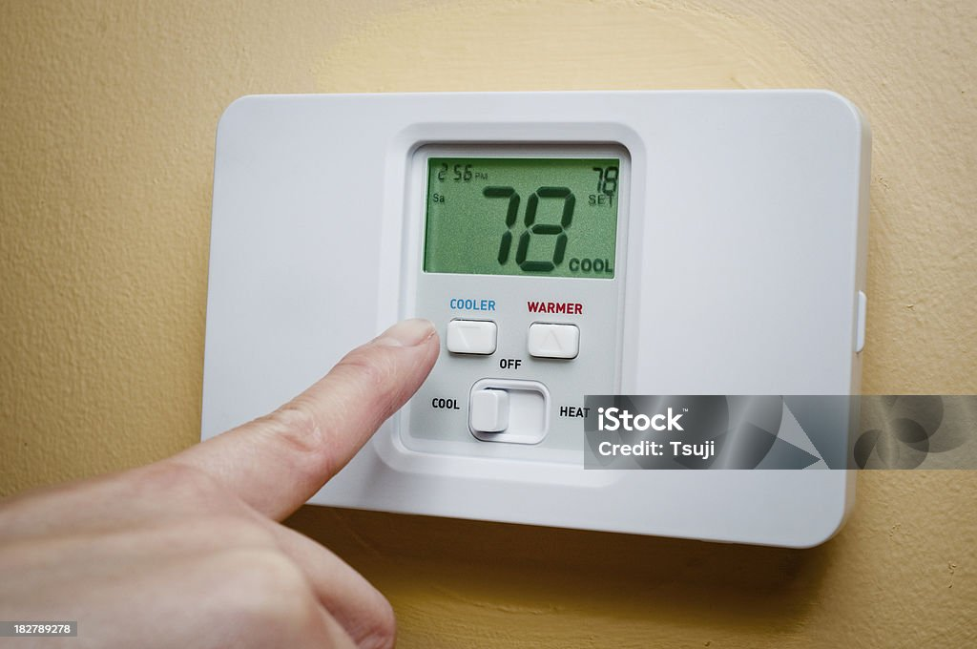
Fahrenheit: a scale of temperature on which water freezes at 32° and boils at 212°
Notes:
Fahrenheit is a scale of temperature on which water freezes at 32° and boils at 212°.

Slide 10
Matter: anything that has mass and takes up space.
Notes:
Matter is anything that has mass and takes up space.

Slide 11
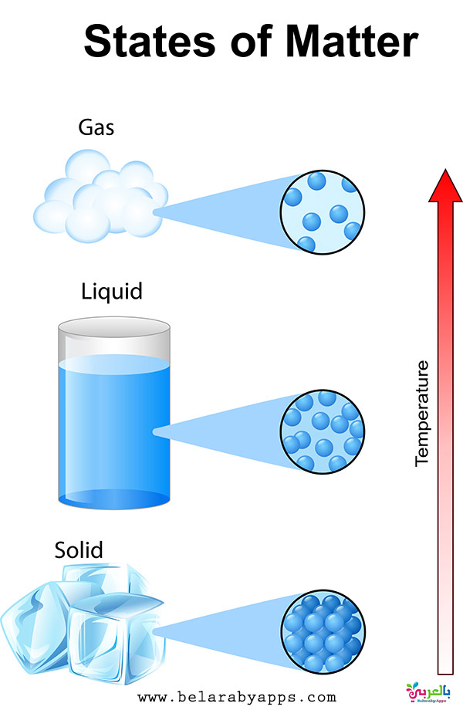
States of Matter: solids, liquids, and gases
Notes:
States of Matter are solids, liquids, and gases.

Slide 12
Notes:
Now let’s pause for a moment to review the information we have covered already.

Slide 13
True or False: Heat is the quality of being hot
A. True
B. False
Notes:
True or false: Heat is the quality of being hot.
[True]

Slide 14
True or False: Heat is the quality of being hot
A. True
B. False
Notes:
True or false: Heat is the quality of being hot.
[True]

Slide 15
A. Heat
B. Celcius
C. Thermometer
______ is an instrument for measuring temperature.
Notes:
_________ is an instrument for measuring temperature.
[Thermometer]

Slide 16
A. Heat
B. Celcius
C. Thermometer
______ is an instrument for measuring temperature.
Notes:
_________ is an instrument for measuring temperature.
[Thermometer]

Slide 17
True or False: Celsius is a scale of temperature on which water freezes at 32° and boils at 212°
Notes:
True or False: Celsius is a scale of temperature on which water freezes at 32° and boils at 212°.
[False]

Slide 18
True or False: Celsius is actually a scale of temperature on which water freezes at 0° and boils at 100°
Notes:
False:Celsius is actually a scale of temperature on which water freezes at 0° and boils at 100°.

Slide 19
True or False: States of matter include solids, water, and gases.
Notes:
True or False: States of matter include solids, water, and gases.
[False]

Slide 20
True or False: States of matter actually include solids, liquids, and gases.
Notes:
False: States of matter actually include solids, liquids, and gases.
[False]

Slide 21
Temperature
Notes:
Now let’s define our new term, Temperature.

Slide 22
Temperature: a measure of how hot or cold something is
Notes:
Temperature is a measure of how hot or cold something is

Slide 23
Notes:
Let’s check-in for understanding.

Slide 24
What is temperature?
Notes:
What is temperature?
[a measure of how hot or cold something is]

Slide 25
Notes:
That is the basic definition, but there is a bit more you need to know.

Slide 26
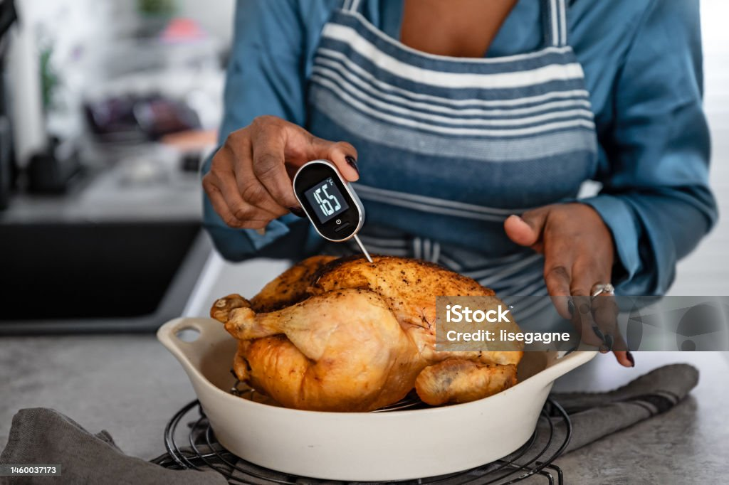
We measure temperature using a tool called a thermometer. It tells us how hot or cold something is, and the measurement is given in degrees.
Notes:
We measure temperature using a tool called a thermometer. It tells us how hot or cold something is, and the measurement is given in degrees.

Slide 27
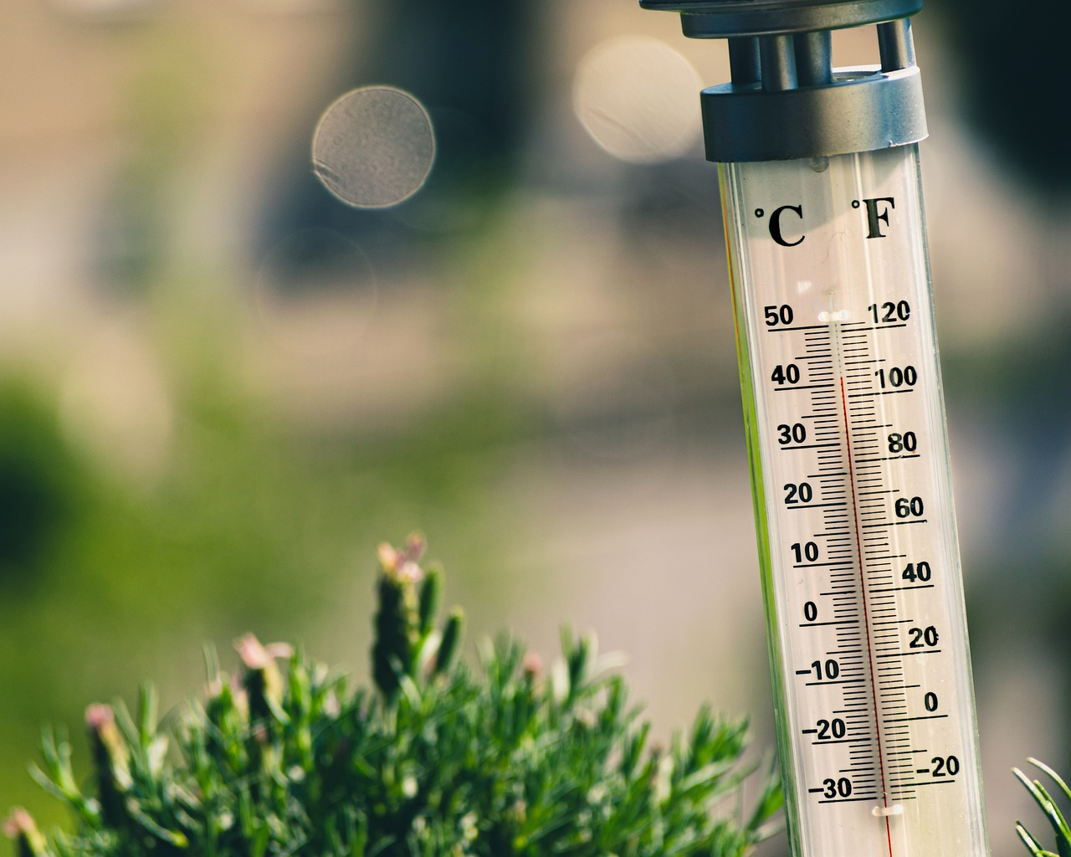
Degrees Scale: Imagine a scale with numbers. When it's hot, we use higher numbers on the scale, and when it's cold, we use lower numbers. This scale helps us quantify and compare temperatures.
Notes:
Degrees Scale: Imagine a scale with numbers. When it's hot, we use higher numbers on the scale, and when it's cold, we use lower numbers. This scale helps us quantify and compare temperatures.

Slide 28
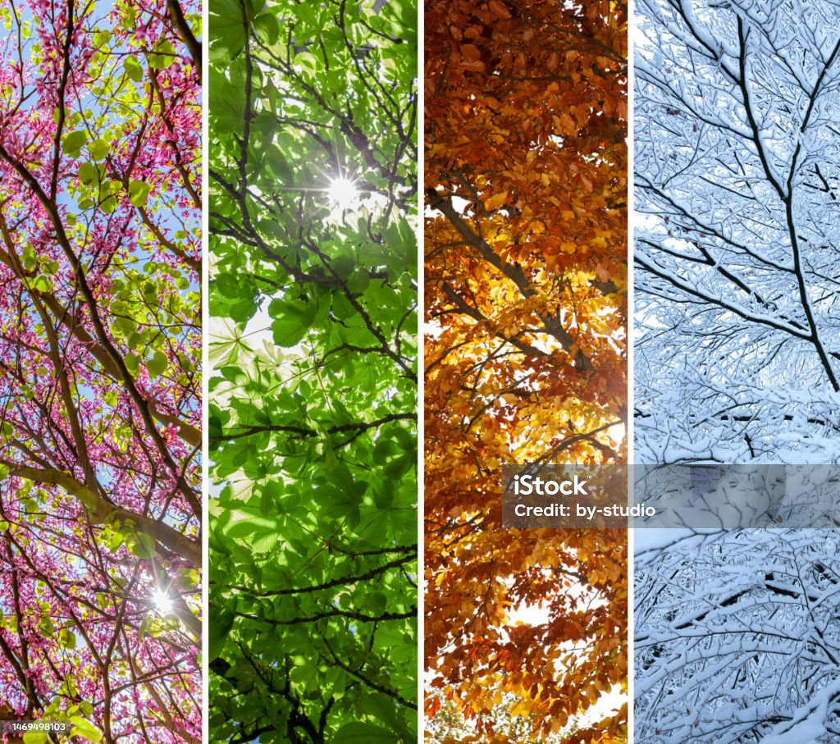
Seasonal Changes: Temperatures vary with the seasons. Summer tends to be warmer, and winter is colder. Spring and fall are intermediate seasons with temperatures not too hot or too cold.
Notes:
Seasonal Changes: Temperatures vary with the seasons. Summer tends to be warmer, and winter is colder. Spring and fall are intermediate seasons with temperatures not too hot or too cold.

Slide 29
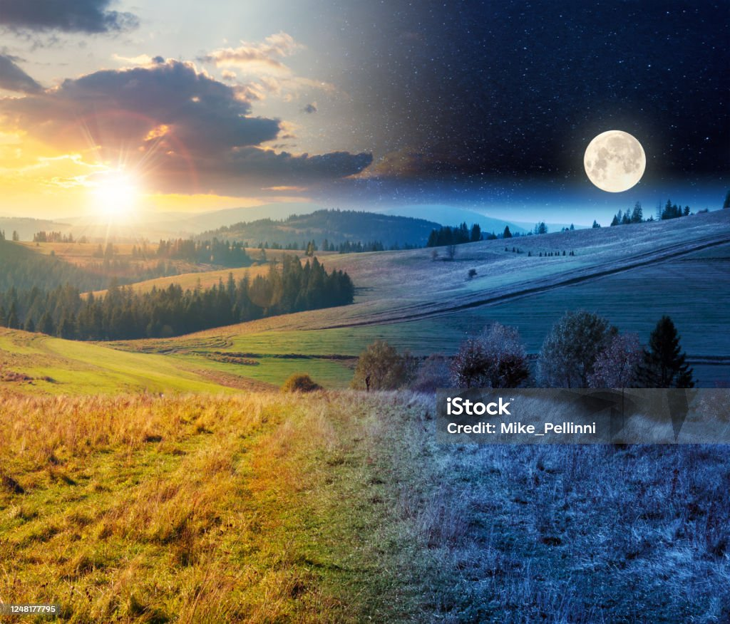
Day and Night Variation: Temperatures can also change during the day and night. Daytime is generally warmer because of the Sun, and nighttime cools down when the Sun is not shining.
Notes:
Day and Night Variation: Temperatures can also change during the day and night. Daytime is generally warmer because of the Sun, and nighttime cools down when the Sun is not shining.

Slide 30
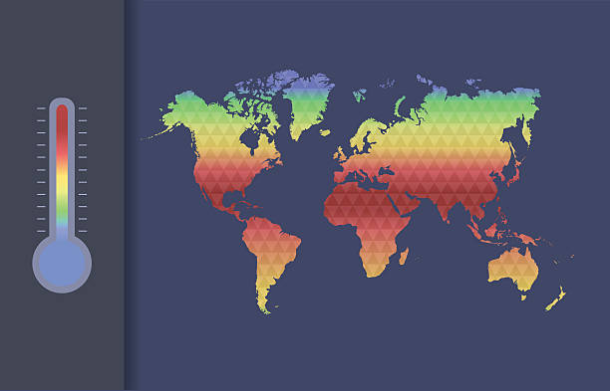
Geography and Temperature: Different places on Earth experience different temperatures. Locations near the equator tend to be warmer, while those closer to the poles can be colder.
Notes:
Geography and Temperature: Different places on Earth experience different temperatures. Locations near the equator tend to be warmer, while those closer to the poles can be colder.

Slide 31
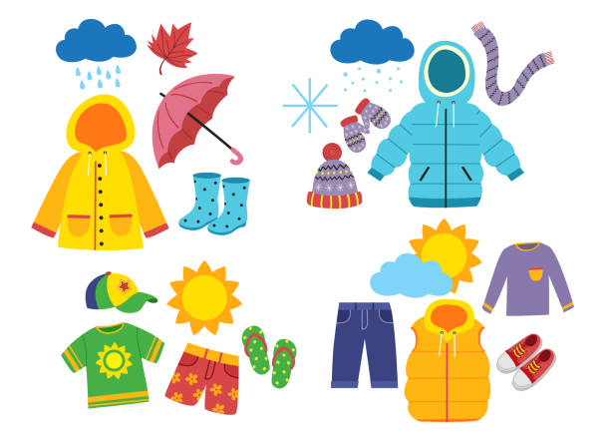
Understanding temperature helps us make practical decisions about what to wear and plan our activities. It's a practical tool for navigating our environment.
Notes:
Understanding temperature helps us make practical decisions about what to wear and plan our activities. It's a practical tool for navigating our environment.

Slide 32
Notes:
Now let’s pause for a moment to review the information we have covered already.

Slide 33
Degrees Scale: Why do you think we use a scale with numbers to measure temperature? Can you think of examples where knowing the specific temperature is useful in our daily lives?
Notes:
Degrees Scale: Why do you think we use a scale with numbers to measure temperature? Can you think of examples where knowing the specific temperature is useful in our daily lives?

Slide 34
Answer: A degrees scale makes it easier to communicate and compare temperatures across different situations. Using a degrees scale helps us dress appropriately for the weather and prepare food safely.
Notes:
Answer: A degrees scale makes it easier to communicate and compare temperatures across different situations. Using a degrees scale helps us dress appropriately for the weather and prepare food safely.

Slide 35
Seasonal Changes: Why do you think temperatures vary with the seasons, with summer being warmer, winter colder, and spring and fall having intermediate temperatures?
Notes:
Seasonal Changes: Why do you think temperatures vary with the seasons, with summer being warmer, winter colder, and spring and fall having intermediate temperatures?

Slide 36
Answer: Temperatures vary with the seasons because of the tilt of the Earth's axis and its orbit around the Sun. The Earth's axis is tilted relative to its orbit, which means different parts of the Earth receive varying amounts of sunlight at different times of the year.
Notes:
Answer: Temperatures vary with the seasons because of the tilt of the Earth's axis and its orbit around the Sun. The Earth's axis is tilted relative to its orbit, which means different parts of the Earth receive varying amounts of sunlight at different times of the year.

Slide 37
Geography and Temperature: Why do you think places near the equator are generally warmer, while locations closer to the poles can be colder?
Notes:
Geography and Temperature: Why do you think places near the equator are generally warmer, while locations closer to the poles can be colder?

Slide 38
Answer: Places near the equator are generally warmer because the sunlight hits them more directly. The Earth is round, and the equator is the part that's closest to the Sun. Thus, places farther from the equator and closer to the poles have colder temperatures.
Notes:
Answer: Places near the equator are generally warmer because the sunlight hits them more directly. The Earth is round, and the equator is the part that's closest to the Sun. Thus, places farther from the equator and closer to the poles have colder temperatures.

Slide 39
Day and Night Variation: Why do you think temperatures change during the day and night?
Notes:
Day and Night Variation: Why do you think temperatures change during the day and night?

Slide 40
Answer: Temperatures change during the day and night because of the Earth's rotation. The daytime is warmer because its energy heats up the Earth's surface, and nighttime is cooler as the absence of sunlight allows the Earth to release the stored heat.
Notes:
Answer: Temperatures change during the day and night because of the Earth's rotation. The daytime is warmer because its energy heats up the Earth's surface, and nighttime is cooler as the absence of sunlight allows the Earth to release the stored heat.

Slide 41
Notes:
Now, let’s talk about some examples of temperature.

Slide 42
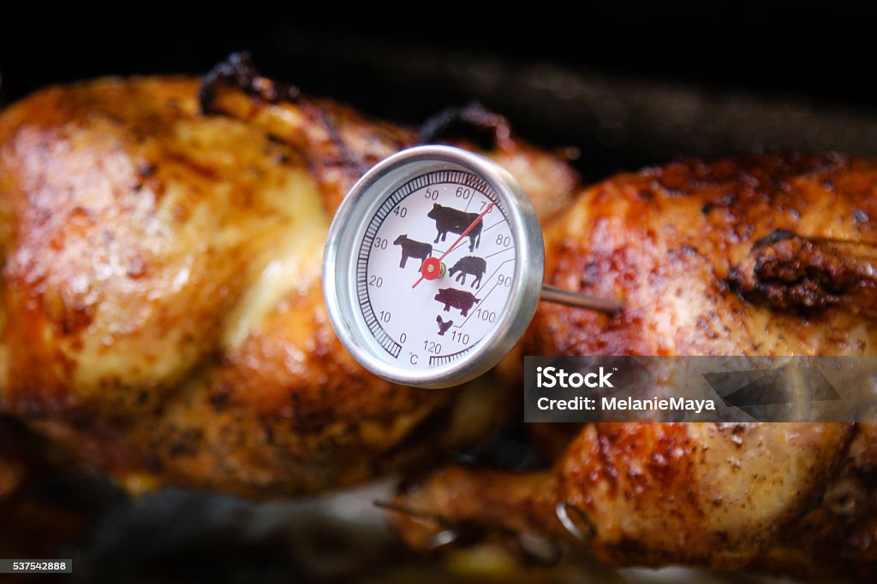
An example of temperature is a how hot a turkey in the oven is. When you put food in the oven, it heats up and the temperature of that food rises. The temperature can be measured with a food thermometer in either Celsius or Fahrenheit.
Notes:
An example of temperature is a how hot a turkey in the oven is. When you put food in the oven, it heats up and the temperature of that food rises. The temperature can be measured with a food thermometer in either Celsius or Fahrenheit.

Slide 43
Another example of temperature is your air conditioning (AC). When you look at your AC system, it tells you how hot or cold the room is, and you can change the temperature of the room.
Notes:
Another example of temperature is your air conditioning (AC). When you look at your AC system, it tells you hot hot or cold the room is and you can change the temperature of the room.

Slide 44
Notes:
Now, let’s talk about some non-examples of temperature.

Slide 45
Volume is NOT an example of temperature. While volume measures the amount of space an object or a state of matter takes up, it does not tell us how hot or cold that object is.
Notes:
Volume is NOT an example of temperature. While volume measures the amount of space an object or a state of matter takes up, it does not tell us how hot or cold that object is.

Slide 46
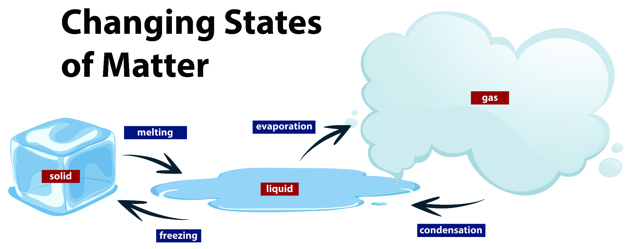
States of matter, such as solids, liquids, and gases, are NOT temperature. They do not tell us how hot or cold the matter is. However, the change between states of matter can tell us if there was an addition or absence of heat.
Notes:
States of matter, such as solids, liquids, and gases, are NOT temperature. They do not tell us how hot or cold the matter is. However, the change between states of matter can tell us if there was an addition or absence of heat.

Slide 47
Notes:
Now let’s pause for a moment to check your understanding.

Slide 48
How are states of matter different from temperature?
Notes:
How are states of matter different from temperature?
[States of matter, such as solids, liquids, and gases, are NOT temperature. They do not tell us how hot or cold the matter is. However, the change between states of matter can tell us if there was an addition or absence of heat.]

Slide 49
Remember!!!
Notes:
So remember!

Slide 50
Temperature: a measure of how hot or cold something is.
Notes:
Temperature is a measure of how hot or cold something is.

Slide 51
Notes:
We will now complete this concept map, called a Frayer model, to summarize and further clarify what you have learned about the term temperature.

Slide 52
Definition
Picture
Temperature
Example
How does temperature impact my life?
Notes:
To complete the Frayer model, we will choose from four choices the correct picture, definition, example, and response to the question, “How does temperature impact my life?” Select the best response for each question using the information you just learned. As we select responses, we will see how this model looks filled in for the term temperature.

Slide 53
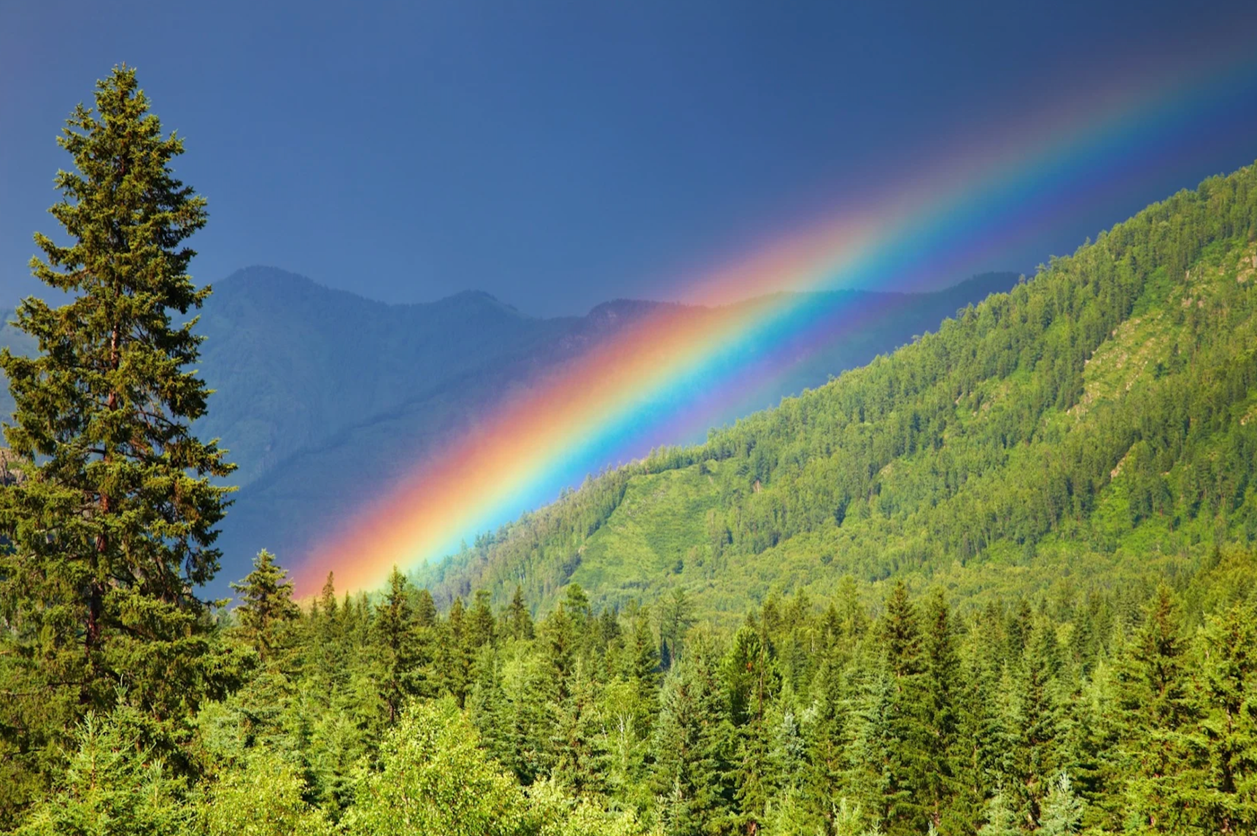
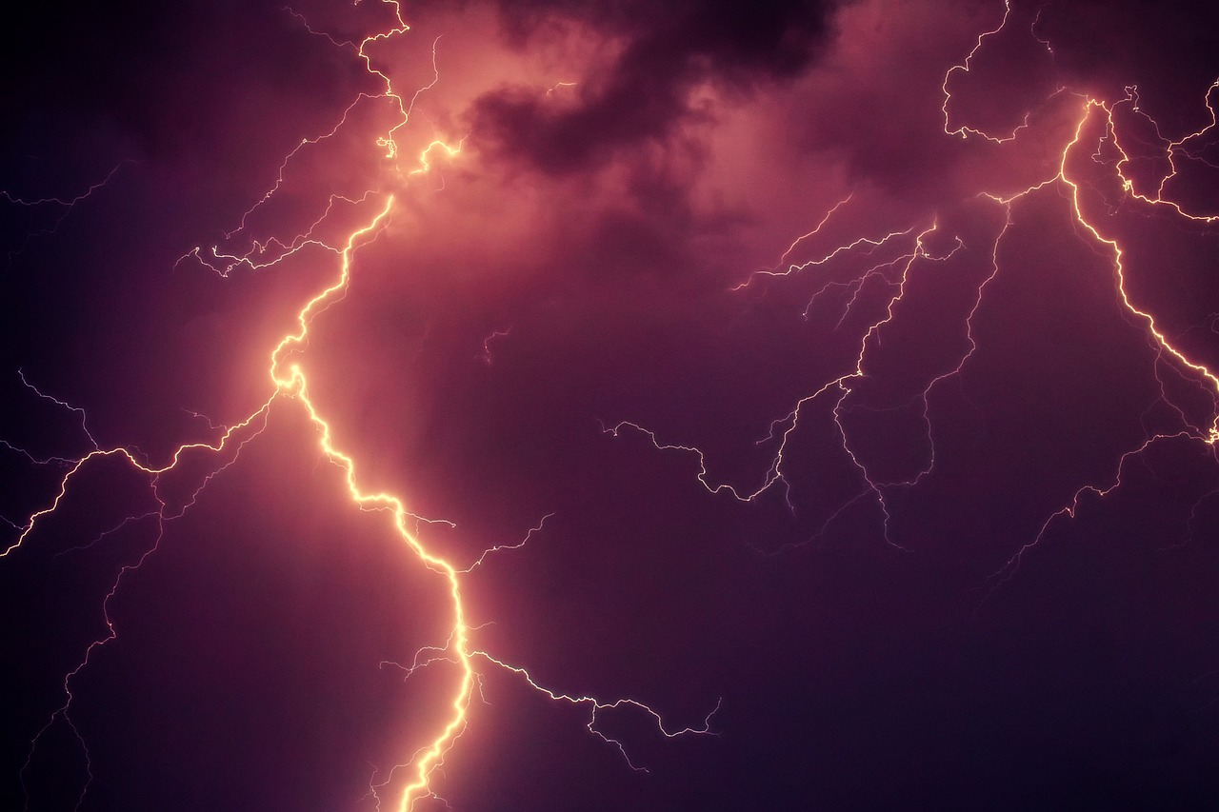
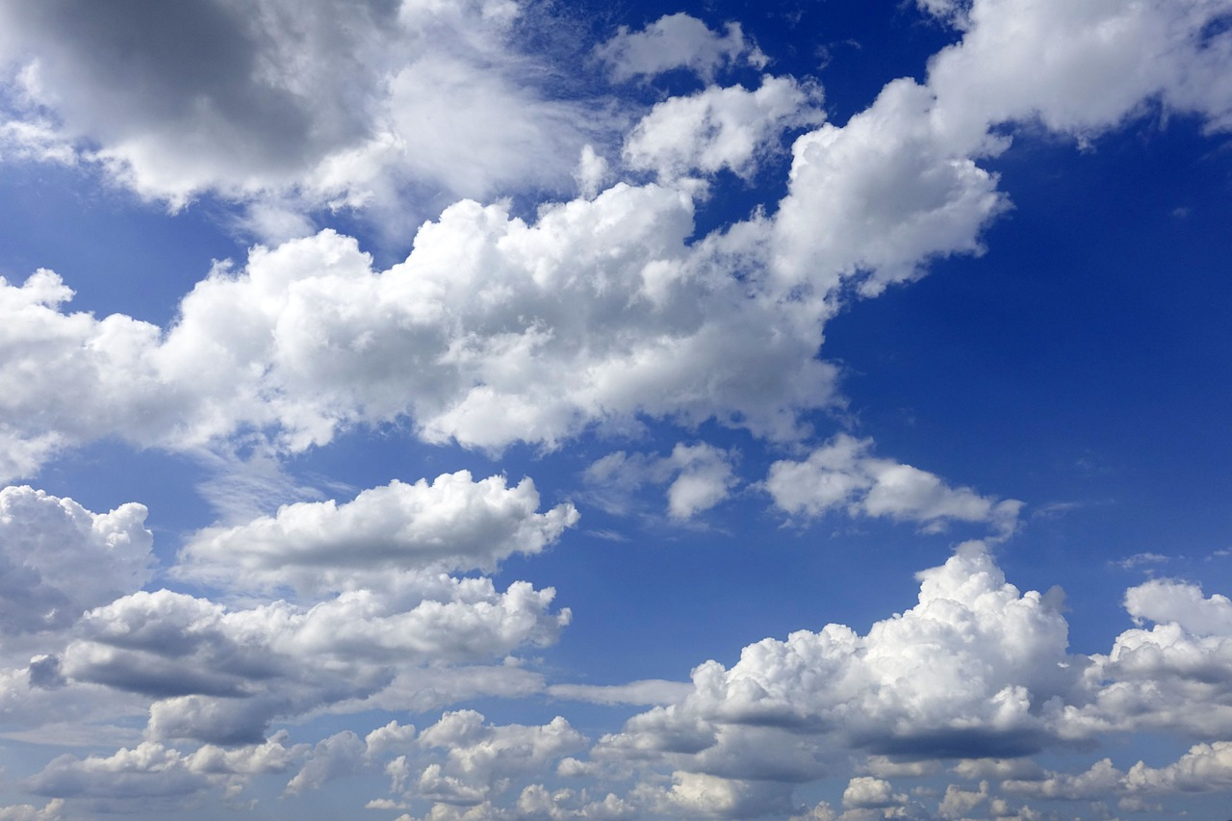
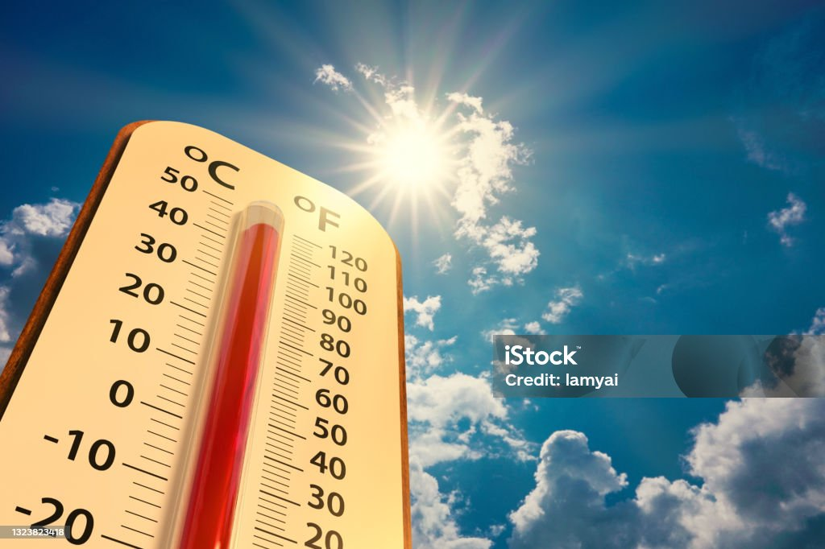
Directions: Choose the correct picture of Temperature from the choices below.
A
B
C
D
Notes:
Choose the one correct picture of Temperature from these four choices and drag and place it in the picture box below.

Slide 54
Directions: Choose the correct picture of Temperature from the choices below.
A
B
C
D
Notes:
You chose the picture that shows Temperature.

Slide 55
Definition
Picture
Temperature
Example
How does temperature impact my life?
Notes:
Here is the Frayer Model filled in with a picture of Temperature.

Slide 56
Directions: Choose the correct definition of Temperature from the choices below.
A
An animal that hunts and eats other animals
B
The ability to cause change
C
A measure of how hot or cold something is
D
The powerhouse of the cell
Notes:
Choose the one correct definition of Temperature from these four choices and drag and place it in the definition box below.

Slide 57
Directions: Choose the correct definition of Temperature from the choices below.
A
An animal that hunts and eats other animals
B
The ability to cause change
C
A measure of how hot or cold something is
D
The powerhouse of the cell
Notes:
You chose “A measure of how hot or cold something is.” This is correct! This is the definition of Temperature.

Slide 58
Definition
Picture
A measure of how hot or cold something is
Temperature
Example
How does temperature impact my life?
Notes:
Here is the Frayer Model with a picture and the definition filled in for Temperature: a measure of how hot or cold something is.

Slide 59
Directions: Choose the correct example of Temperature from the choices below.
A
The heat of the sand on the beach
B
B
The sound of a bell ringing
C
C
The feeling of softness
D
D
The smell of flowers
Notes:
Choose the one correct example of Temperature from these four choices and drag and place it in the example box below.

Slide 60
Directions: Choose the correct example of Temperature from the choices below.
A
The heat of the sand on the beach
B
The sound of a bell ringing
C
The feeling of softness
D
The smell of flowers
Notes:
You chose “The hot sand on the beach.” This is an example of Temperature!

Slide 61
Definition
Picture
A measure of how hot or cold something is
Temperature
The heat of the sand on the beach
Example
How does temperature impact my life?
Notes:
Here is the Frayer Model with a picture, definition, and an example of Temperature: The hot sand on the beach.

Slide 62
Directions: Choose the correct response for “how does temperature impact my life?” from the choices below.
A
Temperature impacts my life by producing energy for our bodies
B
Temperature affects my life by making sure I dress right for the weather, enjoy hot or cold foods, and understand when things like water or snow will change.
C
Temperature impacts my life by creating things like the air we breathe which is necessary for survival.
D
Temperature impacts my life by growing fruits and vegetables that we can eat to be healthy and strong.
Notes:
Choose the one correct response for “how does temperature impact my life?” from these four choices and drag and place it in the box below.

Slide 63
Directions: Choose the correct response for “how does temperature impact my life?” from the choices below.
A
Temperature impacts my life by producing energy for our bodies
B
Temperature affects my life by making sure I dress right for the weather, enjoy hot or cold foods, and understand when things like water or snow will change.
C
Temperature impacts my life by creating things like the air we breathe which is necessary for survival.
D
Temperature impacts my life by growing fruits and vegetables that we can eat to be healthy and strong.
Notes:
You chose “Temperature affects my life by making sure I dress right for the weather, enjoy hot or cold foods, and understand when things like water or snow will change.” That is correct! This is an example of how temperature impacts your life.

Slide 64
Definition
Picture
A measure of how hot or cold something is
Temperature
Temperature affects my life by making sure I dress right for the weather, enjoy hot or cold foods, and understand when things like water or snow will change.
The heat of the sand on the beach
Example
How does temperature impact my life?
Notes:
Here is the Frayer Model with a picture, definition, example, and a correct response to “how does temperature impact my life?”: Temperature impacts my life by powering our buildings and devices, helping us move from place to place, and overall helps us live.

Slide 65
Remember!!!
Notes:
So remember!

Slide 66
Temperature: a measure of how hot or cold something is
Notes:
Temperature is a measure of how hot or cold something is.

Slide 67
Big Question: How does temperature affect the world around us and our daily lives?
Notes:
Let’s reflect once more on our big question. Our “big question” is: How does temperature affect the world around us and our daily lives?
Does anyone have any additional examples to share that haven’t been discussed yet?

Slide 68
Simulation Activity
Temperature
(Math is Fun)
Click the link above for a simulation to explore temperature.
Notes:
In this activity you will:
Predict how an increase or decrease in heat will affect states of matter.
Interact with Celsius and Fahrenheit.
Describe how temperature change affects the world around us and is important to everyday life.
Explain how temperature affects the weather and states of matter.
Feedback: Providing a rationale during this activity helps students make connections and promotes understanding of the content.

Slide 69
Notes:
Thanks for watching, and please continue watching CAPs available from this website.

Slide 70
This Was Created With Resources From:
Questions or Comments
Michael Kennedy, Ph.D. MKennedy@Virginia.edu
Rachel L Kunemund, Ph.D. rk8vm@virginia.edu

