Slide 1
Intro
“Big Idea” Question
Review Concepts
Check-In Questions
Teacher Engagement
Vocabulary
Student-Friendly Definition
Examples & Non-Examples
Frayer Model
Simulation/Activity
Notes:
OK everyone, get ready for our next lesson. Just as a reminder, these are the different components that our lesson may include, and you’ll see these icons in the top left corner of each slide so that you can follow along more easily!

Slide 2
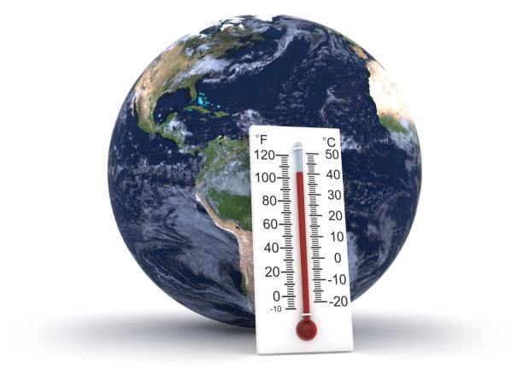
Thermometer
Intro
Notes:
Today we will be learning about thermometer.

Slide 3
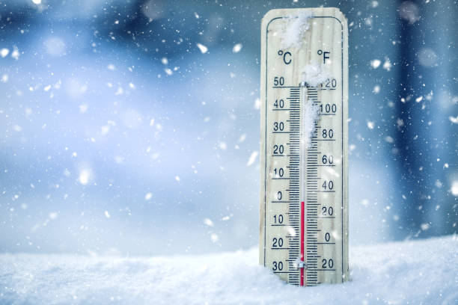
Big Question: Why do we use thermometers to measure the temperature, and how does it help us understand the weather?
Notes:
Our “big question” is: Why do we use thermometers to measure the temperature, and how does it help us understand the weather
[Pause and illicit predictions from students.]
Be sure to keep this question and your predictions in mind as we move through this video and questions.

Slide 4
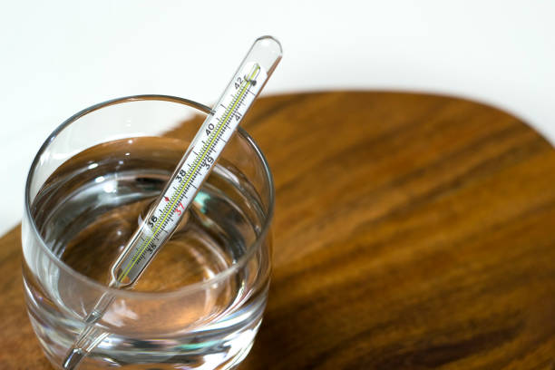
Demonstration
TEACHER DIRECTIONS:
Before viewing: Start by discussing the concept of temperature and how it describes how hot or cold something is. Use relatable examples like hot soup or a cold ice cream.
During: Discuss the readings on the thermometer and ask students to compare the temperatures of the hot and cold water.
After: Reinforce the idea that thermometers help us understand the weather by telling us how hot or cold it is outside.
Notes:
A feasible and effective classroom demonstration to teach about atmospheric pressure to 4th-grade students could involve using simple materials to create a hands-on activity.
Here's a demonstration you could try:
Materials:
Two containers (such as clear plastic cups or bowls)
Hot water
Cold water
Thermometer
Notebook or chart paper (for extension activity)
Steps:
Introduction: Begin by discussing the concept of temperature and its relation to hotness and coldness. Use relatable examples to help students understand, such as hot soup or cold ice cream.
Explanation of a Thermometer: Show students a picture or real-life example of a thermometer. Explain that it's a tool used to measure temperature and typically displays it in degrees Fahrenheit or Celsius.
Demonstration with a Thermometer:
Fill one container with hot water and the other with cold water.
Using the thermometer, measure the temperature of each container. Make sure students can observe the thermometer closely during this step.
Discuss the readings on the thermometer, emphasizing the difference between the temperatures of the hot and cold water.
Discussion: Lead a discussion about the demonstration, asking questions like:
"What did you notice about the temperature of the hot water?"
"What about the temperature of the cold water?"
"How did the thermometer help us measure the temperature?"
"Can you think of other things we could measure with a thermometer?"
Extension Activity: To reinforce learning, have students draw and label their own thermometers in their notebooks or on chart paper. They should draw lines to represent different temperature levels and label them accordingly.
Conclusion: Summarize the key points about thermometers and their role in measuring temperature. Reinforce the idea that thermometers help us understand the weather by telling us how hot or cold it is outside.
By incorporating hands-on materials and engaging discussions, students can better understand the concept of thermometers and their significance in weather measurement.

Slide 5
Notes:
Before we move on to our new topic, let’s review some other words & concepts that you already learned and make sure you are firm in your understanding.

Slide 6
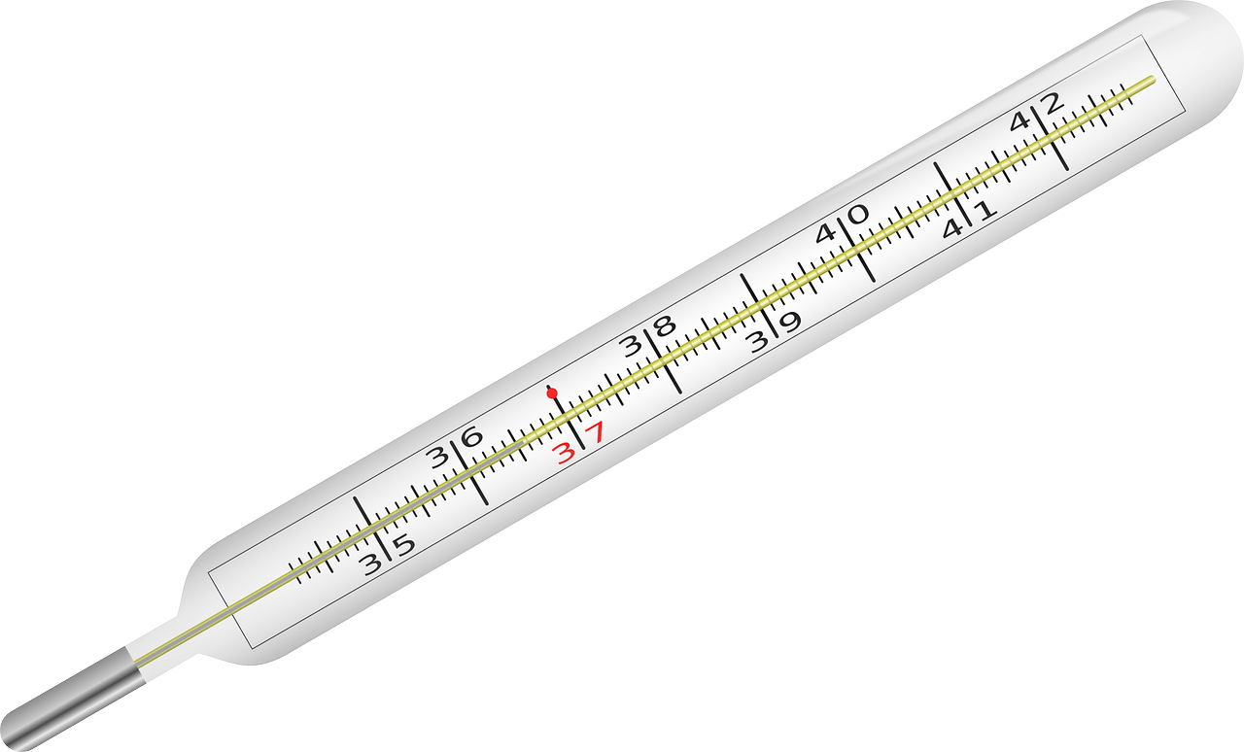
Temperature: how hot or cold something is
Notes:
Temperature is how hot or cold something is.

Slide 7
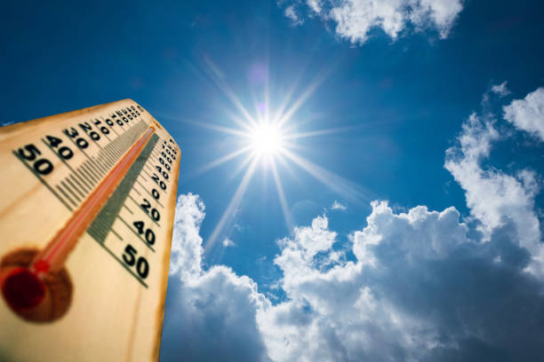
Weather: The condition of the atmosphere at a certain place and time
Notes:
Weather is the condition of the atmosphere at a certain place and time.

Slide 8
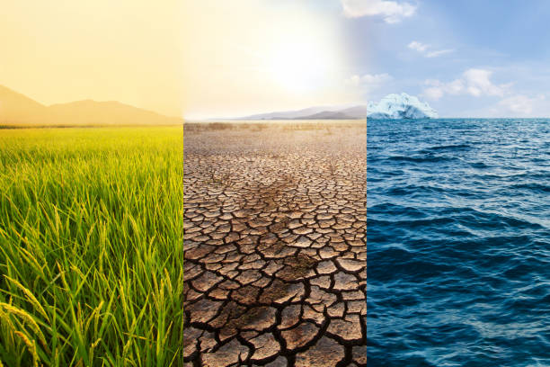
Climate: The usual weather patterns in a place over a long time
Notes:
Climate is the usual weather patterns in a place over a long time

Slide 9
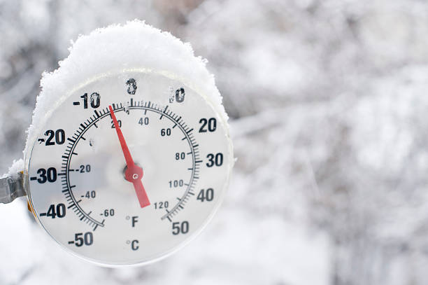
Degrees: the numbers we use to measure temperature
Notes:
Degrees are the numbers we use to measure temperature

Slide 10
Notes:
Now let’s pause for a moment to review the information we have covered already.

Slide 11
True or False: Climate is the condition of the atmosphere at a certain place and time
A. True
B. False
Notes:
True or false: Climate is the condition of the atmosphere at a certain place and time.
[False]

Slide 12
True or False: Climate is the condition of the atmosphere at a certain place and time
A. True
B. False
Notes:
True or false: Climate is the condition of the atmosphere at a certain place and time.
[False]

Slide 13
A. Climate
B. Numbers
C. Weather
Degrees are the ________ we use to measure temperature
Notes:
Degrees are the ________ we use to measure temperature
[Numbers]

Slide 14
A. Climate
B. Numbers
C. Weather
Degrees are the ________ we use to measure temperature
Notes:
Degrees are the ________ we use to measure temperature
[Numbers]

Slide 15
What tells us or hot or cold something is?
Letters
Compass
Barometer
Temperature
Notes:
What tells us or hot or cold something is?
[Temperature]

Slide 16
What tells us or hot or cold something is?
Letters
Compass
Barometer
Temperature
Notes:
What tells us or hot or cold something is?
[Temperature]

Slide 17
Weather: The condition of the _________ at a certain place and time
Notes:
Weather: The condition of the __________ at a certain place and time
[atmosphere]

Slide 18
Weather: The condition of the atmosphere at a certain place and time
Notes:
Weather: The condition of the __________ at a certain place and time
[atmosphere]

Slide 19
Thermometer
Notes:
Now that we’ve reviewed, let’s define our new term, Thermometer.

Slide 20
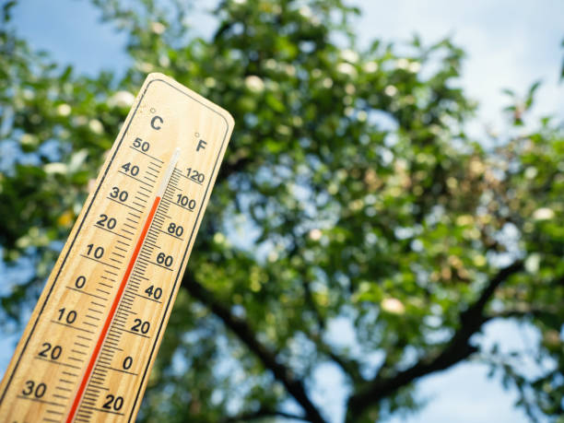
Thermometer: a tool used to measure temperature
Notes:
Thermometer: a tool used to measure temperature

Slide 21
Notes:
Let’s check-in for understanding.

Slide 22
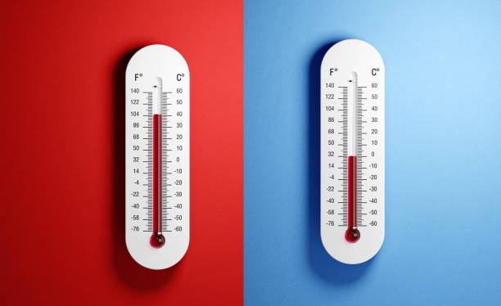
What is a thermometer?
Notes:
What is a thermometer?
[ a tool used to measure temperature]

Slide 23
Notes:
That is the basic definition, but there is a bit more you need to know.

Slide 24
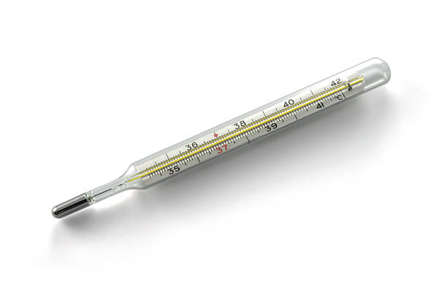
About the Tool
A thermometer is a special tool that helps us measure how hot or cold something is. It has a long, narrow tube filled with a liquid, usually colored alcohol or mercury.
Notes:
About the Tool: A thermometer is a special tool that helps us measure how hot or cold something is. It has a long, narrow tube filled with a liquid, usually colored alcohol or mercury.

Slide 25
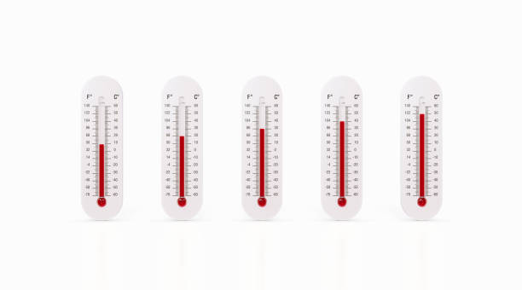
Liquid Inside Thermometer
When it gets warmer, the liquid inside the thermometer expands and goes up the tube. When it gets colder, the liquid contracts and goes down the tube.
Notes:
Liquid Inside Thermometer: When it gets warmer, the liquid inside the thermometer expands and goes up the tube. When it gets colder, the liquid contracts and goes down the tube.

Slide 26
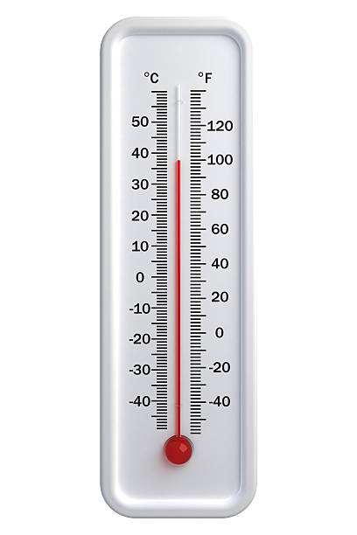
Fahrenheit & Celsius
There's a scale with numbers on the side of the thermometer to tell us the temperature in degrees Fahrenheit or Celsius.
Notes:
Fahrenheit & Celsius: There's a scale with numbers on the side of the thermometer to tell us the temperature in degrees Fahrenheit or Celsius.

Slide 27
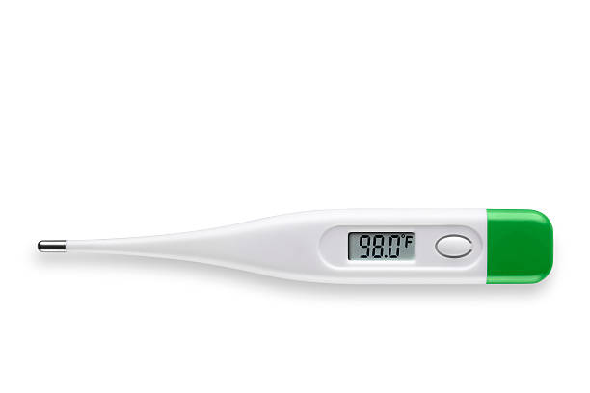
Temperature
Thermometers can come in different shapes and sizes, but they all work in a similar way to help us understand the temperature around us. We use thermometers to check the temperature outside, in our homes, or even in our bodies when we're sick.
Notes:
Temperature: Thermometers can come in different shapes and sizes, but they all work in a similar way to help us understand the temperature around us. We use thermometers to check the temperature outside, in our homes, or even in our bodies when we're sick.

Slide 28
Notes:
Now let’s pause for a moment to review the information we have covered already.

Slide 29
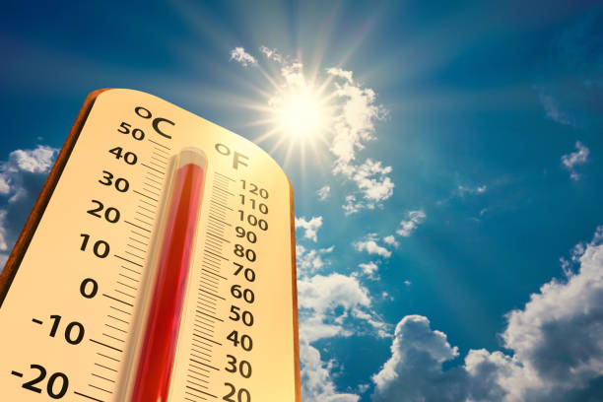
True or False: A thermometer has a long, narrow tube filled with a liquid, usually colored alcohol or mercury.
Notes:
True or False: A thermometer has a long, narrow tube filled with a liquid, usually colored alcohol or mercury.
[True]

Slide 30
True or False: A thermometer has a long, narrow tube filled with a liquid, usually colored alcohol or mercury.
Notes:
True or False: A thermometer has a long, narrow tube filled with a liquid, usually colored alcohol or mercury.
[True]

Slide 31
When it gets ________ , the liquid inside the thermometer expands and goes up the tube.
Notes:
When it gets ________ , the liquid inside the thermometer expands and goes up the tube.
[Warmer]

Slide 32
Notes:
Now, let’s talk about some examples of Thermometer.

Slide 33
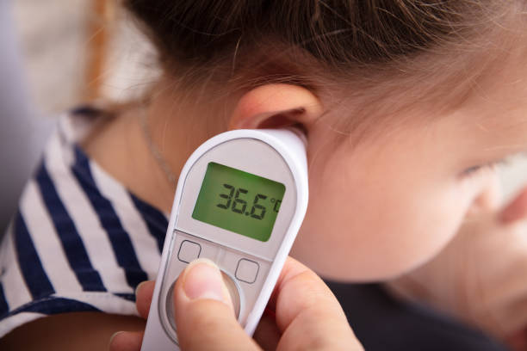
An example of a thermometer is an ear thermometer which is a thermometer that is gently inserted into the ear canal to measure body temperature.
Notes:
An example of a thermometer is an ear thermometer which is a thermometer that is gently inserted into the ear canal to measure body temperature.

Slide 34
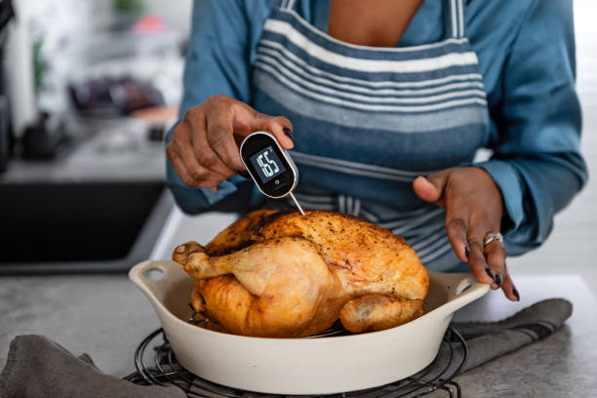
Another example of a thermometer is a meat thermometer which is a thermometer used in the kitchen to measure the temperature of food while cooking
Notes:
Another example of a thermometer is a meat thermometer which is a thermometer used in the kitchen to measure the temperature of food while cooking

Slide 35
Notes:
Now, let’s talk about some non-examples of a thermometer.

Slide 36
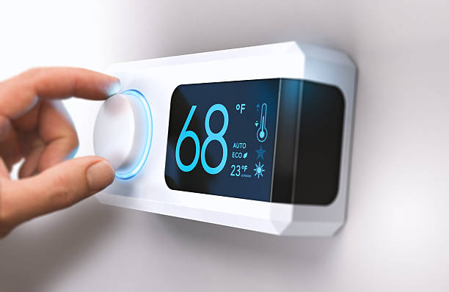
Thermostat is NOT an example of a thermometer. A thermostat is a device that controls the temperature of a heating or cooling system in a building. It doesn't measure temperature like a thermometer does.
Notes:
Thermostat is NOT an example of a thermometer. A thermostat is a device that controls the temperature of a heating or cooling system in a building. It doesn't measure temperature like a thermometer does.

Slide 37
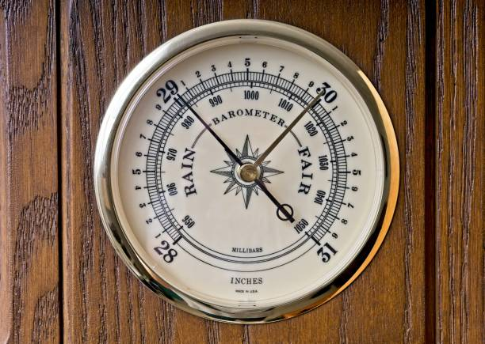
Barometer is NOT a thermometer. A barometer measures atmospheric pressure, which is related to weather conditions like changes in air pressure, but it does not measure temperature.
Notes:
Frost is NOT thermometer. Frost forms when the temperature drops below freezing and water vapor in the air directly transitions into ice crystals on surfaces. While it's related to temperature and humidity, it's not specifically tied to the thermometer, as it occurs at temperatures below freezing.

Slide 38
Notes:
Now let’s pause for a moment to check your understanding.

Slide 39
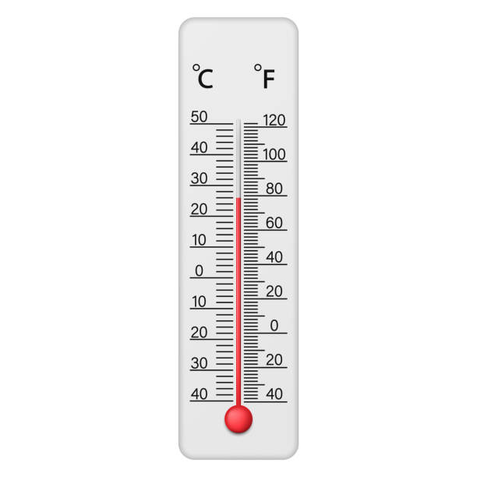
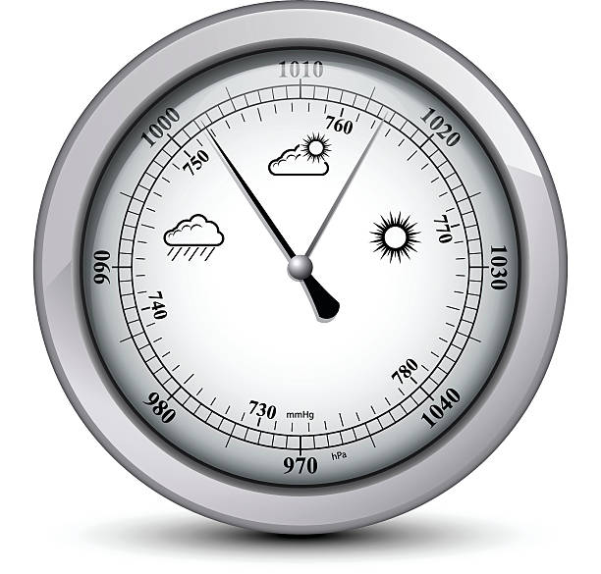
How is a barometer different from a thermometer?
Notes:
How is a barometer different from a thermometer?
[A barometer measures atmospheric pressure, which is related to weather conditions like changes in air pressure, but it does not measure temperature.

Slide 40
How is a barometer different from a thermometer?
A barometer measures atmospheric pressure, which is related to weather conditions like changes in air pressure, but it does not measure temperature.
Notes:
How is a barometer different from a thermometer?
[A barometer measures atmospheric pressure, which is related to weather conditions like changes in air pressure, but it does not measure temperature.

Slide 41
Remember!!!
Notes:
So remember!

Slide 42
Thermometer: a tool used to measure temperature
Notes:
Thermometer is a tool used to measure temperature

Slide 43
Notes:
We will now complete this concept map, called a Frayer model, to summarize and further clarify what you have learned about the term thermometer.

Slide 44
Definition
Picture
Thermometer
Example
How does a thermometer impact my life?
Notes:
To complete the Frayer model, we will choose from four choices the correct picture, definition, example, and response to the question, “How does a thermometer impact my life?” Select the best response for each question using the information you just learned. As we select responses, we will see how this model looks filled in for the term a thermometer.

Slide 45
Directions: Choose the correct picture of thermometer from the choices below.
A
B
C
D
Notes:
Choose the one correct picture of a thermometer from these four choices and drag and place it in the picture box below.

Slide 46
Directions: Choose the correct picture of thermometer from the choices below.
A
B
C
D
Notes:
You chose the picture that shows thermometer.

Slide 47
Definition
Picture
Thermometer
Example
How does a thermometer impact my life?
Notes:
Here is the Frayer Model filled in with a picture of a thermometer.

Slide 48
Directions: Choose the correct definition of a thermometer from the choices below.
A
A tool used to measure air pressure
B
A tool used to measure height
C
A tool used to measure distance
D
A tool used to measure temperature
Notes:
Choose the one correct definition of thermometer from these four choices and drag and place it in the definition box below.

Slide 49
Directions: Choose the correct definition of a thermometer from the choices below.
A
A tool used to measure air pressure
B
A tool used to measure height
C
A tool used to measure distance
D
A tool used to measure temperature
Notes:
You chose “a tool used to measure temperature” This is correct! This is the definition of a thermometer.

Slide 50
Definition
Picture
a tool used to measure temperature
Thermometer
Example
How does a thermometer impact my life?
Notes:
Here is the Frayer Model with a picture and the definition filled in for thermometer: a tool used to measure temperature

Slide 51
Directions: Choose the correct example of a thermometer from the choices below.
A
Oven
B
Meat Thermometer
C
Barometer
D
Thermostat
Notes:
Choose the one correct example of thermometer from these four choices and drag and place it in the example box below.

Slide 52
Directions: Choose the correct example of a thermometer from the choices below.
A
Oven
B
Meat Thermometer
C
Barometer
D
Thermostat
Notes:
You chose “Meat Thermometer.” This is an example of a thermometer!

Slide 53
Definition
Picture
a tool used to measure temperature
Thermometer
Meat Thermometer
Example
How does a thermometer impact my life?
Notes:
Here is the Frayer Model with a picture, definition, and an example of thermometer: meat thermometer

Slide 54
Directions: Choose the correct response for “how does a thermometer impact my life?” from the choices below.
A
By helping me decide what clothes to wear based on the weather.
B
By measuring the temperature of my turkey.
C
By measuring my body temperature when I'm sick
D
All of the above
Notes:
Choose the one correct response for “how does a thermometer impact my life?” from these four choices and drag and place it in the box below.

Slide 55
Directions: Choose the correct response for “how does a thermometer impact my life?” from the choices below.
A
By helping me decide what clothes to wear based on the weather.
B
By measuring the temperature of my turkey.
C
By measuring my body temperature when I'm sick
D
All of the above
Notes:
You chose “By helping me decide what clothes to wear based on the weather” That is correct! This is an example of how a thermometer impacts your life.

Slide 56
Definition
Picture
a tool used to measure temperature
Thermometer
Meat Thermometer
By helping me decide what clothes to wear based on the weather.
Example
How does a thermometer impact my life?
Notes:
Here is the Frayer Model with a picture, definition, example, and a correct response to “how does a thermometer impact my life?”: By helping me decide what clothes to wear based on the weather.

Slide 57
Remember!!!
Notes:
So remember!

Slide 58
Thermometer: a tool used to measure temperature
Notes:
Thermometer is a tool used to measure temperature

Slide 59
Big Question: Why do we use thermometers to measure the temperature, and how does it help us understand the weather?
Notes:
Let’s reflect once more on our big question. Our “big question” is: Why do we use thermometers to measure the temperature, and how does it help us understand the weather?
Does anyone have any additional examples to share that haven’t been discussed yet?

Slide 60
Simulation Activity
Interactive Thermometer
(Math is Fun)
Click the link above for a simulation to explore a thermometer.
Notes:
Click the link above for a simulation to deepen your understanding of thermometer.
Feedback: Providing a simulation activity is a great way to make science thinking visible. In this simulation…
The interactive allows students to change the temperature setting and observe how it affects the display on the thermometer.
It provides a real-time display of the temperature as students adjust the settings, giving them immediate feedback on their actions.
Uses graphics or animations to represent the temperature changes, making it easier for students to understand and visualize temperature variations.
Students can choose between Fahrenheit and Celsius scales, helping them become familiar with both measurement systems.
As students adjust the temperature, the interactive displays corresponding objects or things that are commonly found at that temperature.
Overall, the interactive thermometer provides an engaging and interactive way for students to explore temperature concepts, visualize temperature changes, and deepen their understanding of the world around them.

Slide 61
Notes:
Thanks for watching, and please continue watching CAPs available from this website.

Slide 62
This Was Created With Resources From:
Questions or Comments
Michael Kennedy, Ph.D. MKennedy@Virginia.edu
Rachel L Kunemund, Ph.D. rk8vm@virginia.edu

