Slide 1
Intro
“Big Idea” Question
Review Concepts
Check-In Questions
Teacher Engagement
Vocabulary
Student-Friendly Definition
Examples & Non-Examples
Morphological Word Parts
Frayer Model
Simulation/Activity
Notes:
OK everyone, get ready for our next lesson. Just as a reminder, these are the different components that our lesson may include, and you’ll see these icons in the top left corner of each slide so that you can follow along more easily!

Slide 2
Amplitude
Intro
Notes:
Today we will learn about amplitude.

Slide 3
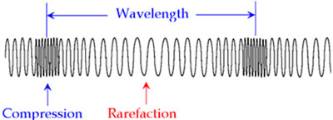
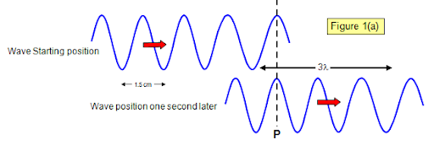
Big Question: What are the properties of waves and how are they related?
Notes:
Our “big question” is: What are the properties of waves and how are they related?
[Pause and illicit predictions from students.]
I love all these thoughtful scientific hypotheses! Be sure to keep this question and your predictions in mind as we move through these next few lessons, and we’ll continue to revisit it.

Slide 4
Demonstration
Wavelength and Amplitude
TEACHER DIRECTIONS:
Before: Click on the video above and show a video about wavelength and amplitude. Make sure to pause the video to check for understanding. Before beginning the video, ask students what they know about waves and what they predict some properties of waves might be.
During: During the video, make sure to pause and ask students what they think the amplitude of a wave is. Ask students what they observe in the video.
After: Tell students that in today’s lesson they will learn more about amplitude. They will also learn about wavelength, but that will be a little bit later.
Notes:
Let’s do a quick demonstration that will help get our brains ready to think about amplitude, and how it relates to our big question.
Feedback: Remember to plan out the demonstration so that you are able to follow a logical order. This will help students make sense of the activity and not become lost.

Slide 5
Notes:
Now let’s pause for a moment to check your understanding.

Slide 6
The ball didn’t move with the wave. Why did it just bob up and down?
Notes:
The ball didn’t move with the wave? Why did it just bob up and down?
[Matter can’t move through waves, only energy does.]
Feedback: Remember, we want students to gather information and then be able to not only evaluate but also effectively communicate what they have learned from this activity.

Slide 7
What is amplitude?
Notes:
What is amplitude?
[Amplitude is how tall a wave is]

Slide 8
How do you measure amplitude?
Notes:
How do you measure amplitude?
[Measure from the wave’s peak to its resting point (or resting point to peak)]

Slide 9
Notes:
Before we move on to our new vocabulary term, let’s review some other words & concepts that you already learned and make sure you are firm in your understanding.
Feedback: Referring to prior topics that are relevant and on topic helps students make connections to the new content they will be learning and tie it to prior knowledge.

Slide 10
Wavelength: the distance between two like points on a wave
Notes:
Wavelength is the distance between two like points on a wave.

Slide 11
Sound Waves: longitudinal waves that travel through mediums
Notes:
Sound waves are longitudinal waves that travel through mediums.

Slide 12
Compression: where particles are closely packed
Notes:
A sound wave is made of 2 main parts. Compressions where particles are closely packed...

Slide 13
Rarefaction: where particles are loosely packed
Notes:
...and rarefaction where particles are loosely packed.

Slide 14
Vibration: Movement of particles that occurs in solids, liquids, or gases.
Notes:
Vibration is the movement of particles that occurs in solids, liquids, or gases.

Slide 15
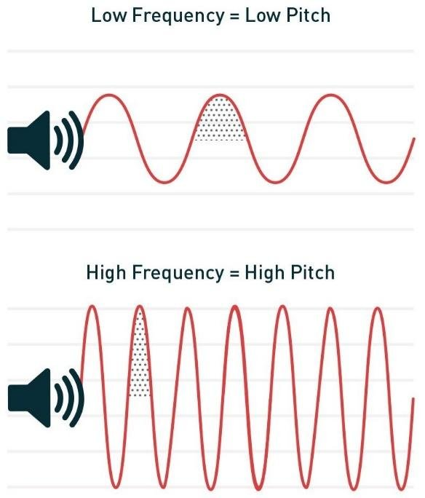
Pitch: how high or low a sound is
Notes:
Pitch is how high or low a sound is.

Slide 16
Notes:
Now let’s pause for a moment to check your understanding.
Feedback: Remember to make adjustments to your lesson and content if you see some students not demonstrating understanding, this can help them make connections and prevent frustration.

Slide 17
Vibration is the _________ that occurs in solids, liquids, or gases.
Notes:
Vibration is the ______________ that occurs in solids, liquids, or gases.

Slide 18
Vibration is the movement of particles that occurs in solids, liquids, or gases.
Notes:
Vibration is the movement of particles that occurs in solids, liquids, or gases.

Slide 19
What are sound waves?
Notes:
What are sound waves?
[Sound waves are longitudinal waves that travel through mediums.]

Slide 20
What is the difference between compression and rarefaction?
Notes:
What is the difference between compression and rarefaction?
[A sound wave is made of 2 main parts. Compressions are where particles are closely packed and rarefactions are where particles are loosely packed.]

Slide 21
Amplitude
Notes:
Now that we’ve reviewed, let’s define our new term, amplitude.

Slide 22
Amplitude: is the maximum distance a particle travels from rest
Notes:
Amplitude is the maximum distance that a particle travels from rest.
Feedback: When providing more student-friendly definitions, it is helpful to provide students with cues so that they can be prepared and know what to expect and be ready to copy down the information.

Slide 23
Notes:
Now let’s pause for a moment to check your understanding.

Slide 24
What is amplitude?
Notes:
What is amplitude?
[Amplitude is the maximum distance that a particle travels from rest.]

Slide 25
Notes:
That is the basic definition, but there is a bit more you need to know.

Slide 26
Here, the top particle has a higher amplitude than the bottom particle.
Notes:
Here, the top particle has a higher amplitude than the bottom particle.

Slide 27
The larger the amplitude a particle has, the higher its energy.
Notes:
The larger the amplitude a particle has, the higher its energy.

Slide 28
Here, the top particles also has more energy than the bottom particle since its amplitude is larger.
Notes:
Here, the top particles also has more energy than the bottom particle since its amplitude is larger.

Slide 29
Notes:
Now let’s pause for a moment to check your understanding.

Slide 30
What is amplitude?
Notes:
What is amplitude?
[Amplitude is the maximum distance that a particle travels from rest.]
Feedback: Provide clear and straightforward directions when asking students to explain the definitions. This helps to avoid confusion!

Slide 31
Which particle has a larger amplitude?
Notes:
Which particle has a larger amplitude?
[The top particle]

Slide 32
The larger the amplitude a particle has, the higher the _________.
Notes:
The larger the amplitude a particle has, the higher the __________.
[energy]

Slide 33
The larger the amplitude a particle has, the higher the energy.
Notes:
The larger the amplitude a particle has, the higher the energy.

Slide 34
Why does the top particle have more energy than the bottom particle?
Notes:
Why does the top particle have more energy than the bottom particle?
[It’s amplitude is larger, so it has more energy.]

Slide 35
Notes:
Now, let’s talk about some examples of amplitude.

Slide 36
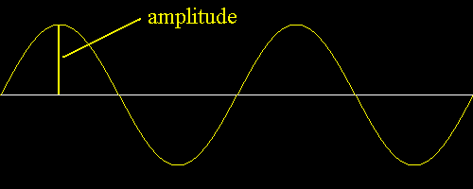
All waves will have amplitude since amplitude is the property of waves.
Notes:
Here we can see amplitude in this wave. Remember, all waves will have amplitude since amplitude is the property of waves.
Feedback: It's great practice to introduce an example of the term WITH images to go along with it, this is a great way to help students make connections.

Slide 37
This wave also has amplitude. Again, we see it is the measure from the point of rest to the particle in the wave.
Notes:
This wave also has amplitude. Again we see it is the measure from the point of rest to the particle in the wave.

Slide 38
Notes:
Next, let’s talk about some non-examples of amplitude.
Feedback: One important component of using non-examples is by clearly distinguishing similarities and explaining why it is a non-example.

Slide 39
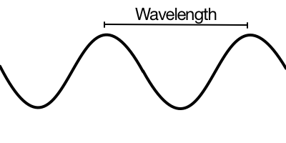
The distance between two like points on on a wave is called wavelength. This is NOT the same thing as amplitude.
Notes:
The distance between two like points on on a wave is called wavelength. This is not the same thing as amplitude. We will learn more about wavelength later.

Slide 40
Notes:
Now let’s pause for a moment to check your understanding.

Slide 41
Is the distance between the two points on the wave below an example of amplitude?
Notes:
Is the distance between the two points on the wave below an example of amplitude?
[No, it would be wavelength]

Slide 42
Is the measure of the wave (shown by the arrows) an example of amplitude?
Notes:
Is the measure of the wave (shown by arrows) an example of amplitude?
[Yes it is an example of amplitude because it shows the maximum distance a particle travels from rest.]

Slide 43
Why is the measurement shown below an example of amplitude?
Notes:
Why is the measurement shown below an example of amplitude?
[It shows the maximum distance a particle travels from rest.]
Feedback: It is important to take time throughout the close of the lesson to check for understanding one last time, this will help you know who may need more instruction or where further explanation is needed.

Slide 44
What is amplitude?
Notes:
What is amplitude?
[Amplitude is the maximum distance that a particle travels from rest.]

Slide 45
Why does the top particle have more ENERGY than the bottom particle?
Notes:
Why does the top particle have more ENERGY than the bottom particle?
[It’s amplitude is larger, so it has more energy.]

Slide 46
Remember!!!
Notes:
So remember!

Slide 47
Amplitude: is the maximum distance a particle travels from rest.
Notes:
Amplitude is the maximum distance that a particle travels from rest.

Slide 48
Remember!!!
Notes:
So remember!

Slide 49
Amplitude: is the maximum distance a particle travels from rest.
Notes:
Amplitude is the maximum distance that a particle travels from rest.

Slide 50
Notes:
We will now complete this concept map, called a Frayer model, to summarize and further clarify what you have learned about the term amplitude.

Slide 51
Definition
Picture
Amplitude
Example
How does amplitude impact my life?
Notes:
To complete the Frayer model, we will choose from four choices the correct picture, definition, example, and response to the question, “How does amplitude impact my life?” Select the best response for each question using the information you just learned. As we select responses, we will see how this model looks filled in for the term amplitude.

Slide 52
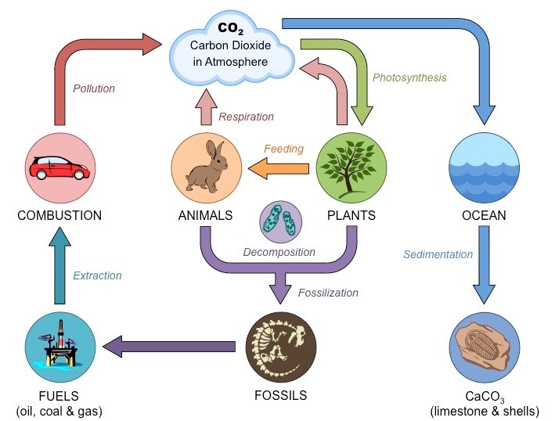
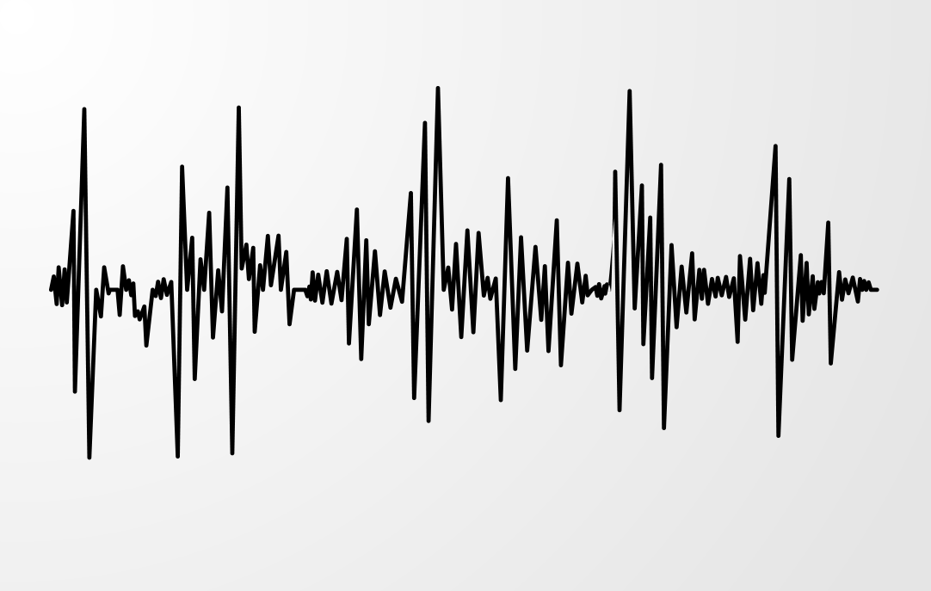
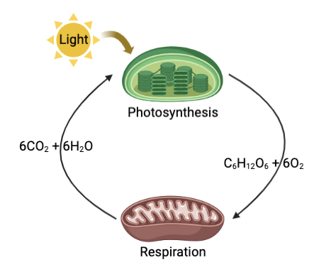
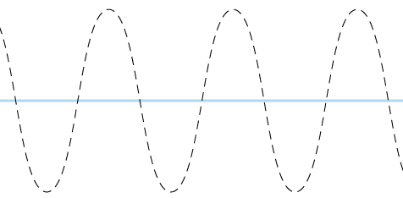
Directions: Choose the correct picture of amplitude from the choices below.
A
B
C
D
Notes:
Choose the one correct picture of amplitude from these four choices.

Slide 53
Directions: Choose the correct picture of amplitude from the choices below.
A
B
C
D
Notes:
This is the picture that shows amplitude.

Slide 54
Definition
Picture
Amplitude
Example
How does amplitude impact my life?
Notes:
Here is the Frayer model filled in with a picture of amplitude.

Slide 55
Directions: Choose the correct definition of Amplitude from the choices below.
A
A place where animals and plants live together
B
The maximum distance a particle travels from rest
C
Solid, liquid, and gas
D
The process by which oxygen is converted into carbon dioxide
Notes:
Choose the one correct definition of amplitude from these four choices.

Slide 56
Directions: Choose the correct definition of Amplitude from the choices below.
A
A place where animals and plants live together
B
The maximum distance a particle travels from rest
C
Solid, liquid, and gas
D
The process by which oxygen is converted into carbon dioxide
Notes:
“The maximum distance a particle travels from rest” is correct! This is the definition of amplitude.

Slide 57
Definition
Picture
The maximum distance a particle travels from rest
Amplitude
Example
How does amplitude impact my life?
Notes:
Here is the Frayer Model with a picture and the definition filled in for amplitude: The maximum distance a particle travels from rest

Slide 58
Directions: Choose the correct example of Amplitude from the choices below.
A
A loud sound has a high wave
B
Asteroids and comets moving in our solar system
C
A plant absorbing sunlight and water to create food
D
Brownie batter heating up and turning into brownies as it bakes in the oven
Notes:
Choose the one correct example of amplitude from these four choices.

Slide 59
Directions: Choose the correct example of Amplitude from the choices below.
A
A loud sound has a high wave
B
Asteroids and comets moving in our solar system
C
A plant absorbing sunlight and water to create food
D
Brownie batter heating up and turning into brownies as it bakes in the oven
Notes:
“A loud sound has a high wave” is correct! This is an example of amplitude.

Slide 60
Definition
Picture
The maximum distance a particle travels from rest
Amplitude
A loud sound has a high wave
Example
How does amplitude impact my life?
Notes:
Here is the Frayer Model with a picture, definition, and an example of amplitude: A loud sound has a high wave.

Slide 61
Directions: Choose the correct response for “how does amplitude impact my life?” from the choices below.
A
Amplitude explains how water changes into ice.
B
Amplitude makes sounds louder or softer.
C
Amplitude keeps the Earth not too hot or cold.
D
Amplitude helps us breathe oxygen.
Notes:
Choose the one correct response for “how does amplitude impact my life?” from these four choices.

Slide 62
Directions: Choose the correct response for “how does amplitude impact my life?” from the choices below.
A
Amplitude explains how water changes into ice.
B
Amplitude makes sounds louder or softer.
C
Amplitude keeps the Earth not too hot or cold.
D
Amplitude helps us breathe oxygen.
Notes:
“Amplitude makes sounds louder or softer.” That is correct! This is an example of how amplitude impacts your life.

Slide 63
Definition
Picture
The maximum distance a particle travels from rest
Amplitude
A loud sound has a high wave
Amplitude makes sounds louder or softer.
Example
How does amplitude impact my life?
Notes:
Here is the Frayer Model with a picture, definition, example, and a correct response to “how does amplitude impact my life?”: Amplitude makes sounds louder or softer.

Slide 64
Remember!!!
Notes:
So remember!

Slide 65
Amplitude: is the maximum distance a particle travels from rest.
Notes:
Amplitude is the maximum distance that a particle travels from rest.

Slide 66
Big Question: What are the properties of waves and how are they related?
Notes:
Let’s reflect once more on our big question. Our “big question” is: What are the properties of waves and how are they related?
Does anyone have any additional examples to share that haven’t been discussed yet?

Slide 67
Simulation Activity
Waves Gizmo
(Explore Learning)
Click on the simulation above to interact with waves.
While interacting with the waves, only change the amplitude. Predict what you think will happen when you increase or decrease the amplitude of a wave. Once you have made your predictions, change the amplitude of the wave and then click on play, so see if your prediction was correct.
Notes:
Feedback: Giving students a chance to analyze and interpret data is a great way to help them to continue to independently problem solve.

Slide 68
Notes:
Thanks for watching, and please continue watching CAPs available from this website.

Slide 69
This Was Created With Resources From:
Questions or Comments
Michael Kennedy, Ph.D. MKennedy@Virginia.edu
Rachel L Kunemund, Ph.D. rk8vm@virginia.edu

