Slide 1
Intro
“Big Idea” Question
Review Concepts
Check-In Questions
Teacher Engagement
Vocabulary
Student-Friendly Definition
Examples & Non-Examples
Morphological Word Parts
Frayer Model
Simulation/Activity
Notes:
OK everyone, get ready for our next lesson. Just as a reminder, these are the different components that our lesson may include, and you’ll see these icons in the top left corner of each slide so that you can follow along more easily!

Slide 2
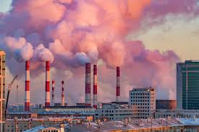
Intro
Air Pollution
Notes:
Today, we’ll be learning about the word: air pollution.

Slide 3
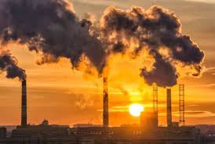
Big Question: How do you think air pollution impacts you? Do you think we should try to limit it? Why or why not?
Notes:
Our “big question” is: How do you think air pollution impacts you? Do you think we should try to limit it? Why or why not?
[Pause and illicit predictions from students.]
I love all these thoughtful scientific hypotheses! Be sure to keep this question and your predictions in mind as we move through these next few lessons, and we’ll continue to revisit it.

Slide 4
Demonstration
Particulate Matter:
For Your Eyes Only
Perform the demonstrations shown in the link about in class or watch the video and pause for discussion throughout. Set up demonstration three ahead of time to have the results ready for students.
Notes:
Now, let’s do a quick demonstration.
Feedback: In this demonstration are three activities. If running low on time, the third activity is meant to be done by students. Enabling students to engage in scientific practices is important, and this demonstration offers opportunities for students to more closely engage in carrying out investigations.

Slide 5
Notes:
Before we move on to our new vocabulary term, let’s review some other words & concepts that you already learned and make sure you are firm in your understanding.

Slide 6
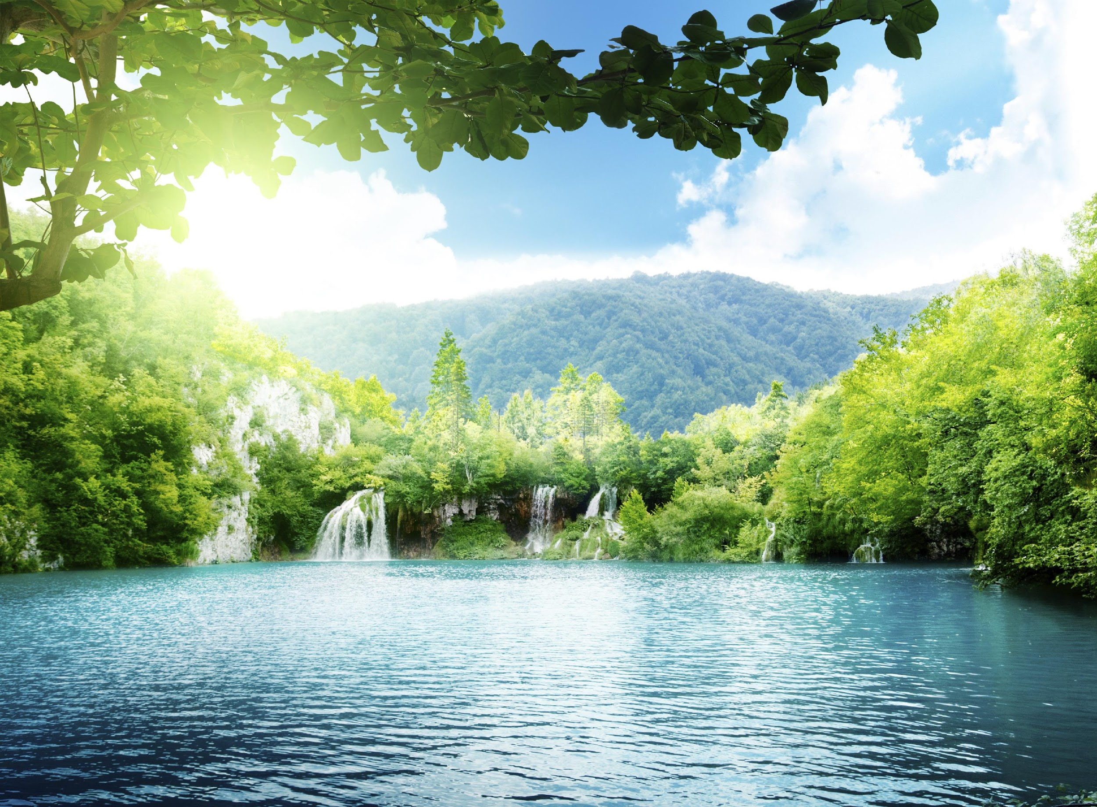
Natural Resource: found in nature
Notes:
A natural resource is anything found in nature.

Slide 7
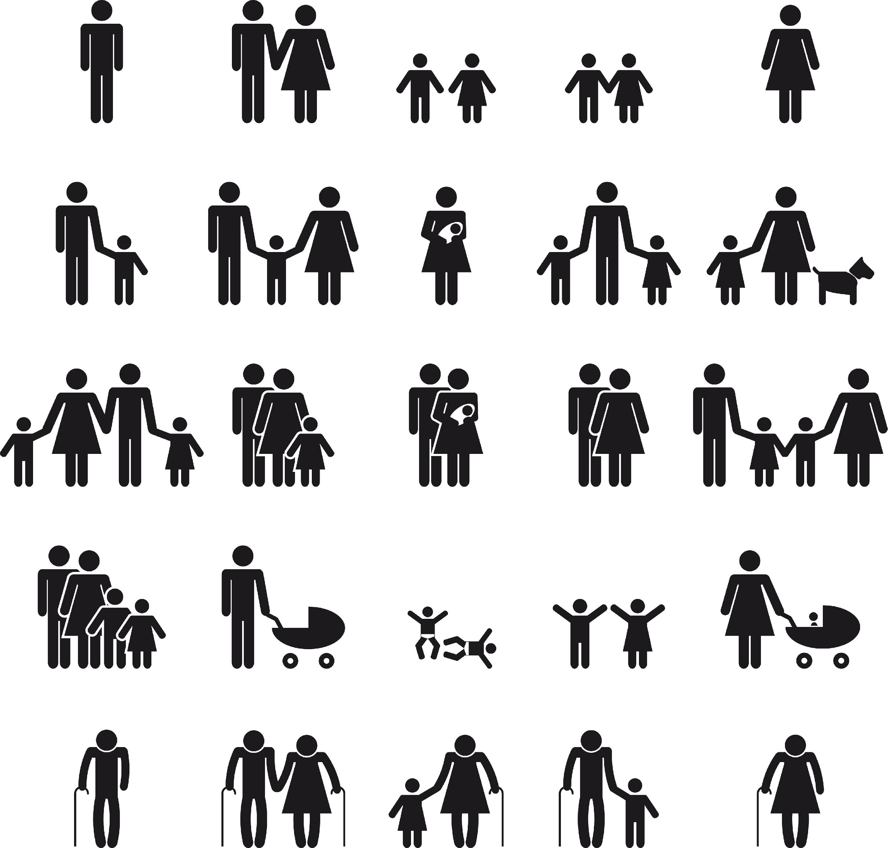
Natural resources -> used by humans
Notes:
…and used by humans.

Slide 8
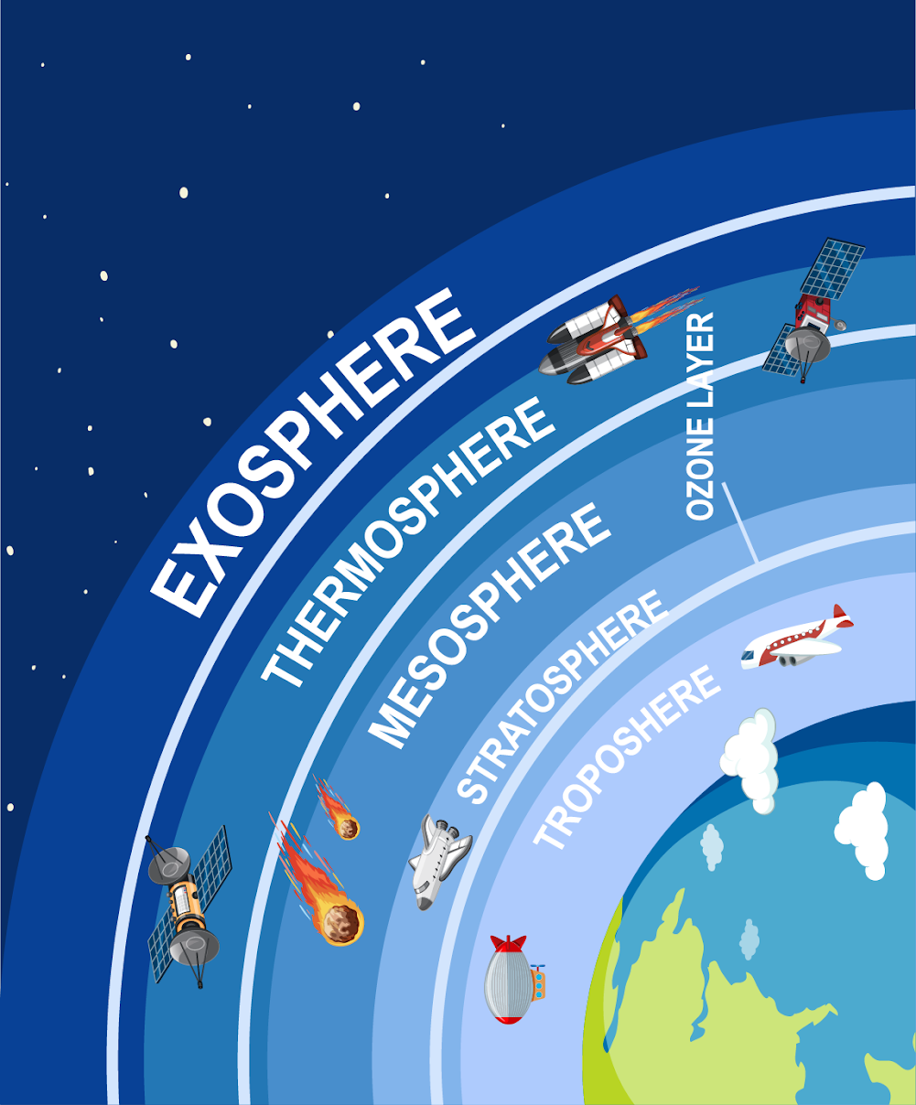
Atmosphere: the layers of gas surrounding the surface of a planet
Notes:
The atmosphere is the layers of gas surrounding the surface of a planet. Sometimes the atmosphere is called a “blanket” of gases.

Slide 9
Stratosphere: layer above the troposphere mostly made up of ozone gas.
Notes:
The stratosphere is the layer just above the troposphere, made mostly of ozone gas. This is also called the ozone layer.

Slide 10
Notes:
Now let’s pause for a moment to check your understanding.

Slide 11
What are natural resources?
Notes:
What are natural resources?
[Natural resources are anything found in nature.]

Slide 12
Give an example of how we use natural resources.
Notes:
Give an example of how we use natural resources.

Slide 13
What is the atmosphere made up of?
Notes:
What is the atmosphere made up of?
[Gas]

Slide 14
Which atmospheric layer is made up of ozone gases?
Notes:
Which atmospheric layer is made up of ozone gases?
[The stratosphere is the layer just above the troposphere, made mostly of ozone gas. This is also called the ozone layer.]

Slide 15
Air Pollution
Notes:
Now that we’ve reviewed, let’s define our new term, air pollution.

Slide 16
Air Pollution: substances, such as gases and particles, in the air that can be harmful to your health and the environment
Notes:
Air pollution is substances, such as gases and particles, in the air that can be harmful to your health and the environment.

Slide 17
Notes:
Now let’s pause for a moment to check your understanding.

Slide 18
What is air pollution?
Notes:
What is air pollution?
[Air pollution is substances, such as gases and particles, in the air that can be harmful to your health and the environment.]

Slide 19
Notes:
That’s the basic definition, but there’s more you need to know.

Slide 20
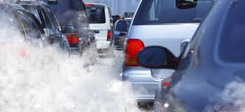
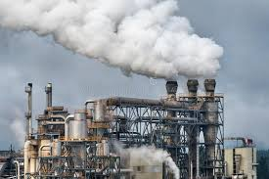
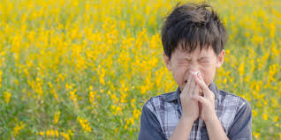
Air pollution comes from a variety of sources such car emissions, pollen, factory chemical emissions, and ozone gases.
Notes:
Air pollution comes from a variety of sources such car emissions, pollen, factory chemical emissions, and ozone gases.

Slide 21
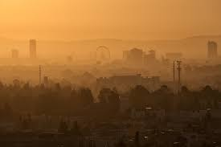
Smog that you can see here covering this city comes from ozone pollution – all of the pollution from factories, cars and other sources can come together and react with sunlight forming the smog.
Notes:
Smog that you can see here covering this city comes from ozone pollution – all of the pollution from factories, cars and other sources can come together and react with sunlight forming the smog.

Slide 22
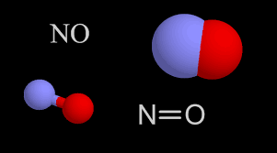
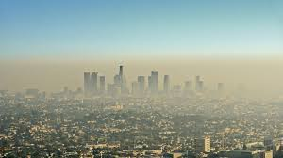
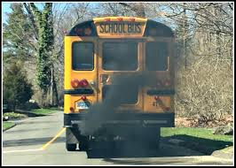
Smog is mainly created by chemical reactions between oxides of nitrogen (NOx) and volatile organic compounds (VOC) - from sources such as cars and factory pollution.
Notes:
Smog is mainly created by chemical reactions between oxides of nitrogen (NOx) and volatile organic compounds (VOC) - from sources such as the car and factory pollution.

Slide 23
In 2019, about 70 million tons of pollution were emitted into the atmosphere in the United States.
Notes:
In 2019, about 70 million tons of pollution were emitted into the atmosphere in the United States.

Slide 24
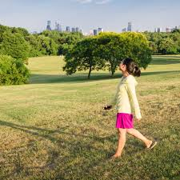
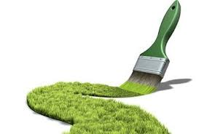
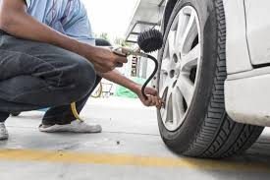
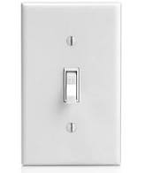
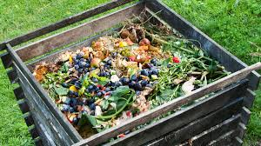
There are many small steps you can take to help manage air pollution. Reduce car trips, carpool, walk instead of driving, fill your tires with air, use environmentally friendly paint and chemicals, compost, conserve energy at home. These steps can be a lot of work but added together can make a big difference.
Notes:
There are many small steps you can take to help manage air pollution. Reduce car trips, carpool, walk instead of driving, fill your tires with air, use environmentally friendly paint and chemicals, compost, conserve energy at home. These steps can be a lot of work but added together can make a big difference.
Feedback: This is a good opportunity to ask students open-ended questions about how they take steps to help manage air pollution or how they might in the future. Helping students make connections to their own lives is an important way to support students to build conceptual understanding. Be sure to give feedback that is positive but also helps students focus in on plausible solutions.

Slide 25
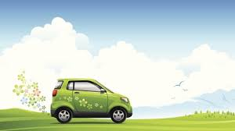
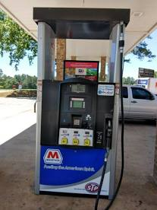
There are many big steps being taken by the government and others to reduce pollution and improve air quality. One attempt is the clean air act.
Clean Air Act
Notes:
There are many big steps being taken by the government and others to reduce pollution and improve air quality. One attempt is the clean air act.
Power plants have cut emissions that cause acid rain and are harmful to the environment using new technology.

Slide 26
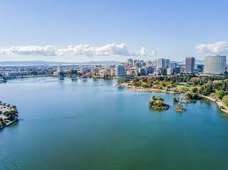
Some cities are trying to reduce pollution through improved city planning. Oakland is using air quality data to make decisions such as building schools and hospitals further away from the city and away from high pollution areas such as highways.
Notes:
Some cities are trying to reduce pollution through improved city planning. Oakland is using air quality data to make decisions such as building schools and hospitals further away from the city and away from high pollution areas such as highways.

Slide 27
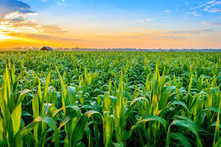
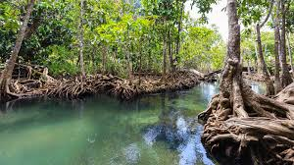
There are many benefits to decreasing air pollution such as longer life, lower rates of health issues, less damage to ecosystems and the environment such as lowering toxins, improving crops.
Notes:
There are many benefits to decreasing air pollution such as longer life, lower rates of health issues, less damage to ecosystems and the environment such as lowering toxins, improving crops.

Slide 28
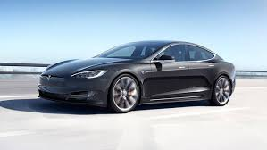
The main costs for managing pollution is money. Sometimes the costs is extra work on our part-extra effort to walk instead of drive, spend more money on more environmentally friendly products such as Tesla cars. They cost a bit more money and can be more work since you need to charge them instead of lust filling up with gas.
Notes:
The main costs for managing pollution is money. Sometimes the costs is extra work on our part-extra effort to walk instead of drive, spend more money on more environmentally friendly products such as Tesla cars. They cost a bit more money and can be more work since you need to charge them instead of lust filling up with gas.

Slide 29
Notes:
Now let’s pause for a moment to check your understanding.

Slide 30
What is air pollution?
Notes:
What is air pollution?
[Air pollution substances, such as gases and particles, in the air that can be harmful to your health and the environment.]

Slide 31
What is smog and how is it created?
Notes:
What is smog and how is created?
[Smog that you can see here covering these cities comes from ozone pollution-all of the pollution from factories, cars and other sources can come together and react with sunlight forming the smog you see here in these pictures - but is created by chemical reactions between oxides of nitrogen (NOx) and volatile organic compounds (VOC). This happens when pollutants emitted by cars, power plants, industrial boilers, refineries, chemical plants, and other sources chemically react in the presence of sunlight.]

Slide 32
What are some steps being taken to reduce air pollution?
Notes:
What are some steps being taken to reduce air pollution?

Slide 33
What are the benefits of reducing air pollution?
Notes:
What are the benefits of reducing air pollution?
[There are many benefits to decreasing air pollution such as longer life, lower rates of health issues, less damage to ecosystems and the environment such as lowering toxins, improving crops.]

Slide 34
What are some concerns with cost when thinking about reducing air pollution?
Notes:
What are some concerns with cost when thinking about reducing air pollution?
[The main costs for managing pollution is money. Sometimes the costs is extra work on our part-extra effort to walk instead of drive, spend more money on more environmentally friendly products such as Tesla cars. They cost a bit more money and can be more work since you need to charge them instead of lust filling up with gas.]

Slide 35
Notes:
Now, let’s talk about some examples of air pollution.

Slide 36
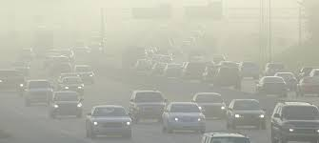
Smog and other pollution caused by cars during rush hour are examples of Air Pollution.
Notes:
Smog and other pollution caused by cars during rush hour are examples of Air Pollution.

Slide 37
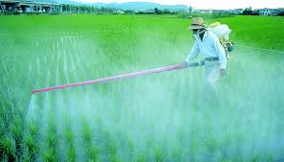
Air pollution can come from chemicals used for a variety of purposes.
Notes:
Air pollution can come from chemicals used for a variety of purposes.

Slide 38
Notes:
Now, let’s talk about some non-examples of air pollution.
Feedback: It can sometimes be difficult for students to understand why something is a non-example of a term they just learned, so it is important for teachers to try and be as clear as possible in their explanation.

Slide 39
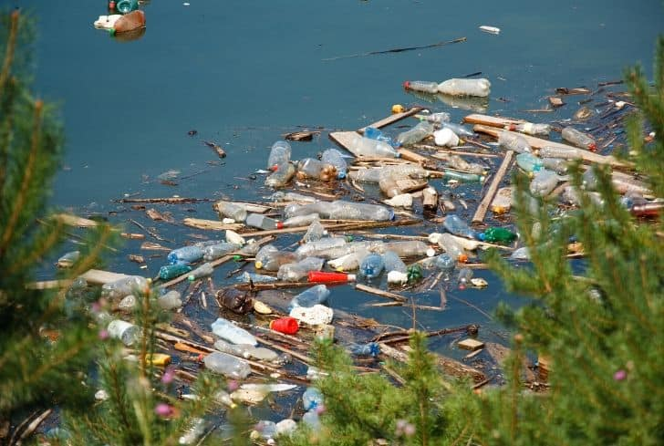
Plastics and waste thrown into water is NOT an example of air pollution. It is an example of water pollution.
Notes:
Plastics and waste thrown into water is an example of water pollution not air pollution.

Slide 40
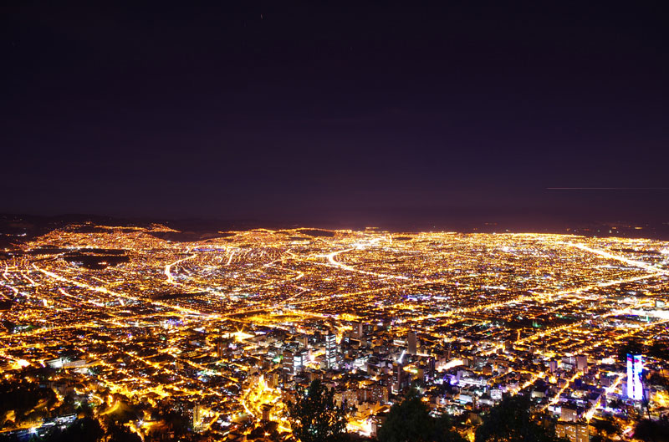
Artificial light at night is NOT an example of air pollution. It is an example of light pollution.
Notes:
Artificial light at night is an example of light pollution not air pollution.

Slide 41
Notes:
Now let’s pause for a moment to check your understanding.

Slide 42
How might chemicals like this contribute to air pollution?
Notes:
How might chemicals like this contribute to air pollution?

Slide 43
How is this NOT an example of air pollution?
Notes:
How is this not an example of air pollution?

Slide 44
Remember!!!
Notes:
So remember!

Slide 45
Air Pollution: substances, such as gases and particles, in the air that can be harmful to your health and the environment
Notes:
Air pollution substances, such as gases and particles, in the air that can be harmful to your health and the environment.

Slide 46
Notes:
We will now complete this concept map, called a Frayer model, to summarize and further clarify what you have learned about the term air pollution.

Slide 47
Definition
Picture
Air Pollution
Example
How does air pollution impact your life?
Notes:
To complete the Frayer model, we will choose from four choices the correct picture, definition, example, and response to the question, “How does air pollution impact your life?” Select the best response for each question using the information you just learned. As we select responses, we will see how this model looks filled in for the term air pollution.

Slide 48
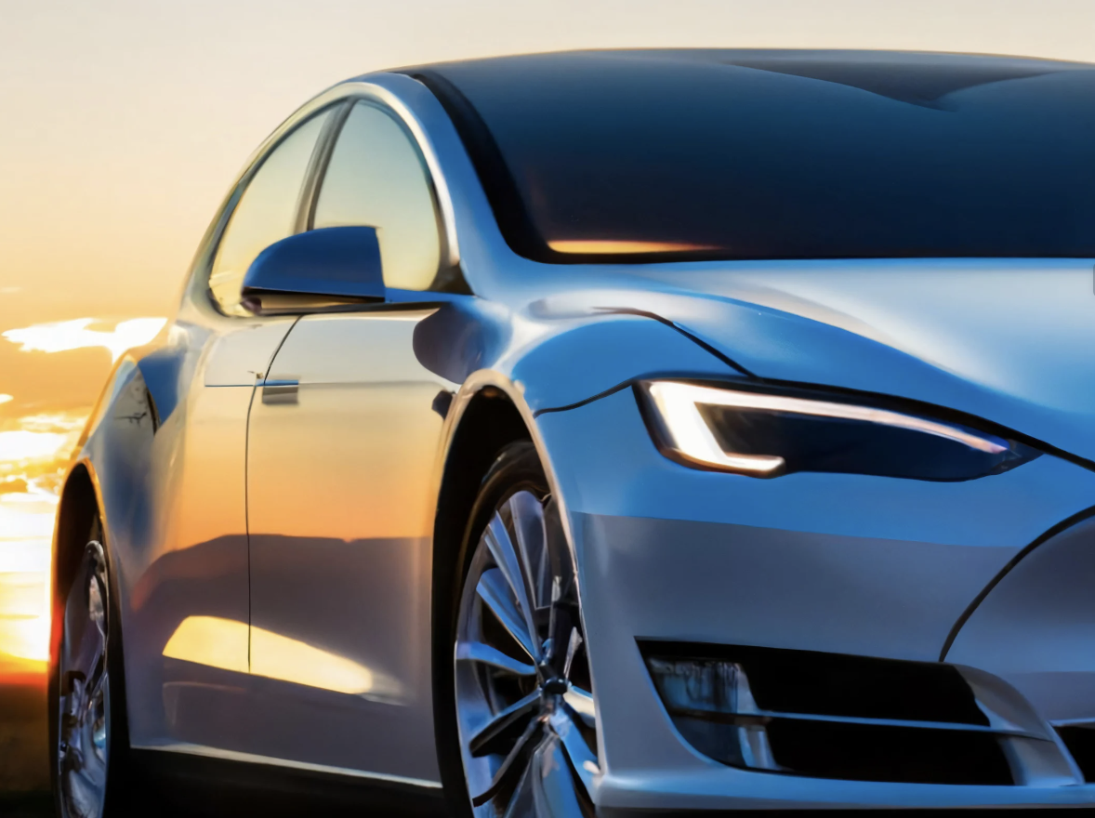
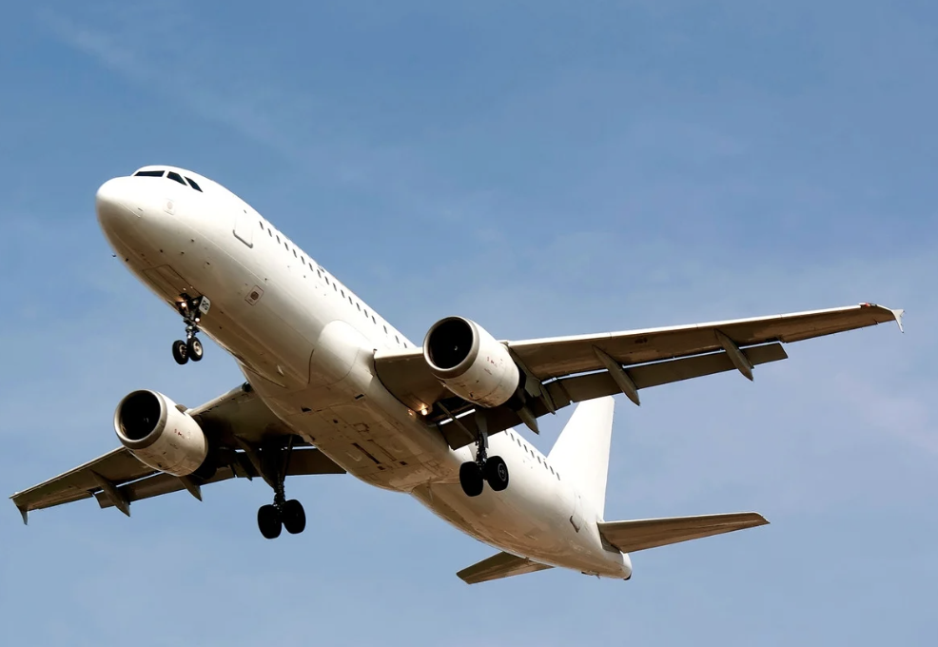
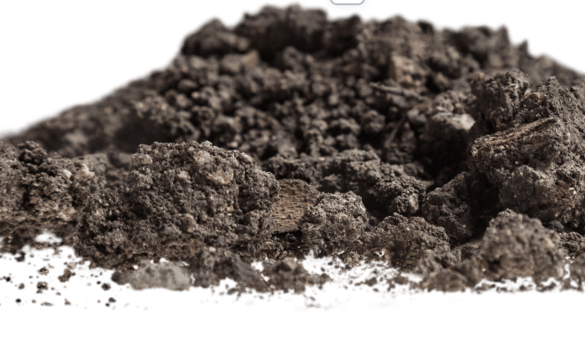
Directions: Choose the correct picture of air pollution from the choices below.
A
B
C
D
Notes:
Choose the one correct picture of air pollution from these four choices.

Slide 49
Directions: Choose the correct picture of air pollution from the choices below.
A
B
C
D
Notes:
This is the picture that shows air pollution.

Slide 50
Definition
Picture
Air Pollution
Example
How does air pollution impact your life?
Notes:
Here is the Frayer model filled in with a picture of air pollution.

Slide 51
Directions: Choose the correct definition of air pollution from the choices below.
A
The sound made by airplanes in the sky
B
The color of the sky
C
Substances, such as gases and particles, in the air that can be harmful to your health and the environment
D
The number of clouds in the atmosphere
Notes:
Choose the one correct definition of air pollution from these four choices.

Slide 52
Directions: Choose the correct definition of air pollution from the choices below.
A
The sound made by airplanes in the sky
B
The color of the sky
C
Substances, such as gases and particles, in the air that can be harmful to your health and the environment
D
The number of clouds in the atmosphere
Notes:
“Substances, such as gases and particles, in the air that can be harmful to your health and the environment” is correct! This is the definition of air pollution.

Slide 53
Definition
Picture
Substances, such as gases and particles, in the air that can be harmful to your health and the environment
Air Pollution
Example
How does air pollution impact your life?
Notes:
Here is the Frayer Model with a picture and the definition filled in for air pollution: Substances, such as gases and particles, in the air that can be harmful to your health and the environment.

Slide 54
Directions: Choose the correct example of air pollution from the choices below.
A
Water vapor
B
A house
C
A baby
D
Smog
Notes:
Choose the one correct example of air pollution from these four choices.

Slide 55
Directions: Choose the correct example of air pollution from the choices below.
A
Water vapor
B
A house
C
A baby
D
Smog
Notes:
“Smog” is correct! This is an example of air pollution.

Slide 56
Definition
Picture
Substances, such as gases and particles, in the air that can be harmful to your health and the environment
Air Pollution
Smog
Example
How does air pollution impact your life?
Notes:
Here is the Frayer Model with a picture, definition, and an example of air pollution: Smog.

Slide 57
Directions: Choose the correct response for “How do you think air pollution impacts you?” from the choices below.
A
It makes the weather warmer.
B
It can harm my health and the environment.
C
It makes the air smell better.
D
It helps plants grow faster.
Notes:
Choose the one correct response for “How do you think air pollution impacts you?” from these four choices.

Slide 58
Directions: Choose the correct response for “How do you think air pollution impacts you?” from the choices below.
A
It makes the weather warmer.
B
It can harm my health and the environment.
C
It makes the air smell better.
D
It helps plants grow faster.
Notes:
“It can harm my health and the environment.” That is correct! This is an example of how air pollution impacts you.

Slide 59
Definition
Picture
Substances, such as gases and particles, in the air that can be harmful to your health and the environment
Air Pollution
Smog
It can harm my health and the environment.
Example
How does air pollution impact your life?
Notes:
Here is the Frayer Model with a picture, definition, example, and a correct response to “How does air pollution impact your life?”: It can harm my health and the environment.

Slide 60
Simulation Activity
Smog City
Using an interactive air pollution simulator to control the air quality in Smog City 2, you can see how individual choices, environmental factors, and different types of land use affect air pollution. In Smog City 2 you are in charge - so whether your visit is a healthy or unhealthy experience depends on the decisions that you make.
Notes:
Feedback: Providing a simulation activity is a great way to make science thinking visible. In this simulation, students have the opportunity to make predictions and apply an idea to a new situation by changing the variables in the simulation (i.e., individual choices, different types of land in the first simulation and percentage of greenhouse gases and speed in the second simulation). This is an important way for students to engage in scientific practices and make connections between their real life experiences and the scientific concepts. You may decide to move one of the simulation activities to elsewhere in the lesson or choose to have students complete either based on their own interests. Enabling student choice is important for maintaining engagement.

Slide 61
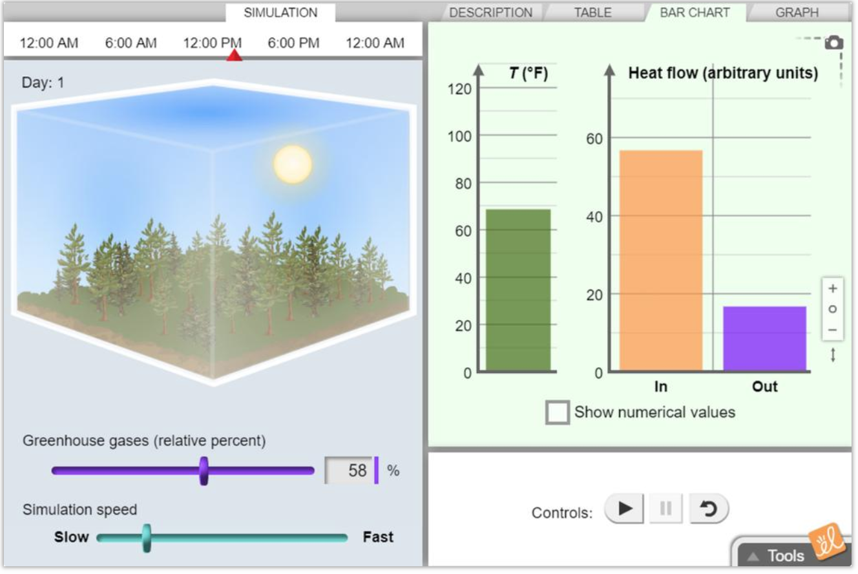
Simulation Activity
Greenhouse Effect
Click the link above to explore the effect of greenhouse gases on the temperature of the atmosphere.
Notes:
Click the link above to explore the effect of greenhouse gases on the temperature of the atmosphere.

Slide 62
Remember!!!
Notes:
So remember!

Slide 63
Air Pollution: substances, such as gases and particles, in the air that can be harmful to your health and the environment
Notes:
Air pollution substances, such as gases and particles, in the air that can be harmful to your health and the environment.

Slide 64
Big Question: How do you think air pollution impacts you? Do you think we should try to limit it? Why or why not?
Notes:
Our “big question” is: Big Question: How do you think air pollution impacts you? Do you think we should try to limit it? Why or why not?
[Pause and illicit predictions from students.]
I love all these thoughtful scientific hypotheses! Be sure to keep this question and your predictions in mind as we move through these next few lessons, and we’ll continue to revisit it.

Slide 65
Notes:
Thanks for watching, and please continue watching CAPs available from this website.

Slide 66
This Video Was Created With Resources From:
Questions or Comments
Michael Kennedy, Ph.D. MKennedy@Virginia.edu
Rachel L Kunemund, Ph.D. rk8vm@virginia.edu

