Slide 1
Intro
“Big Idea” Question
Review Concepts
Check-In Questions
Teacher Engagement
Vocabulary
Student-Friendly Definition
Examples & Non-Examples
Frayer Model
Simulation/Activity
Notes:
OK everyone, get ready for our next lesson. Just as a reminder, these are the different components that our lesson may include, and you’ll see these icons in the top left corner of each slide so that you can follow along more easily!

Slide 2
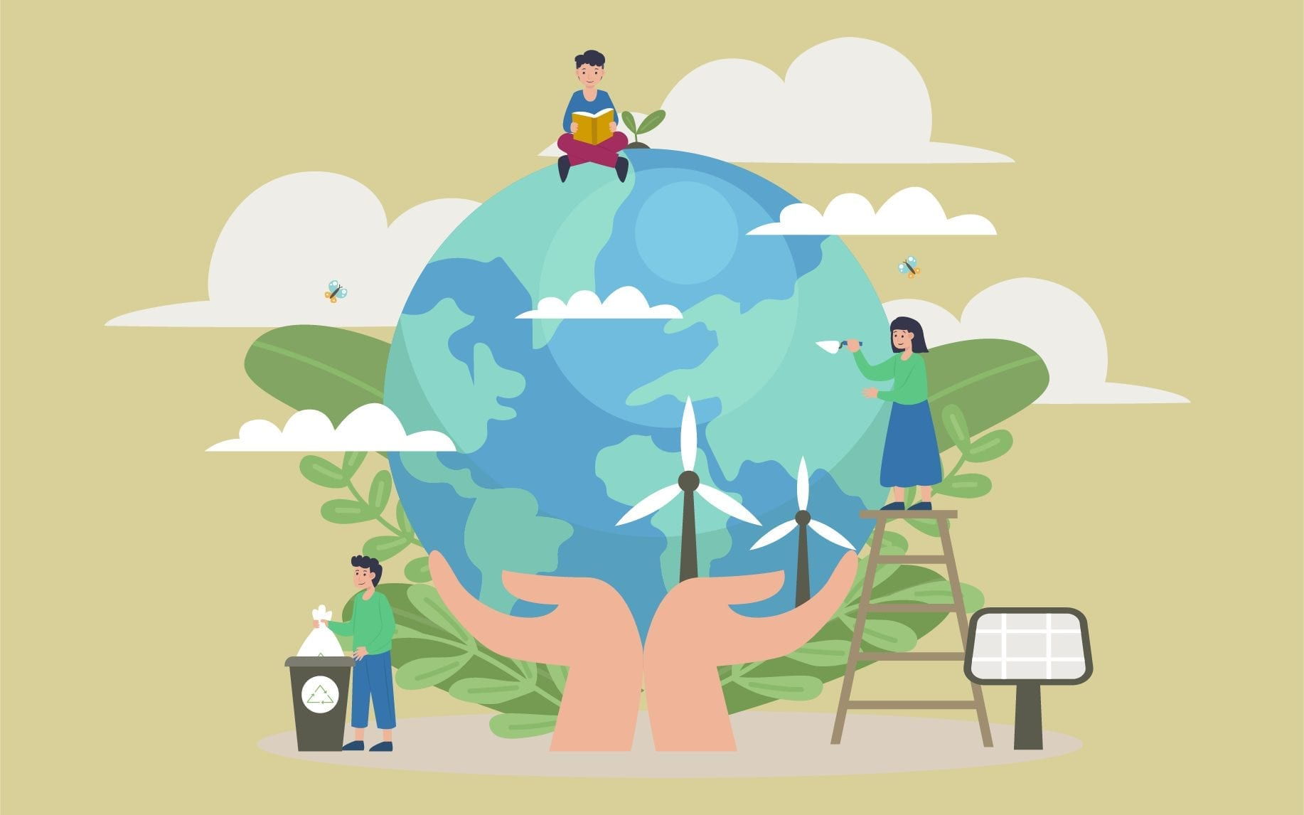
Conservation
Intro
Notes:
Today we will be learning about Conservation.

Slide 3
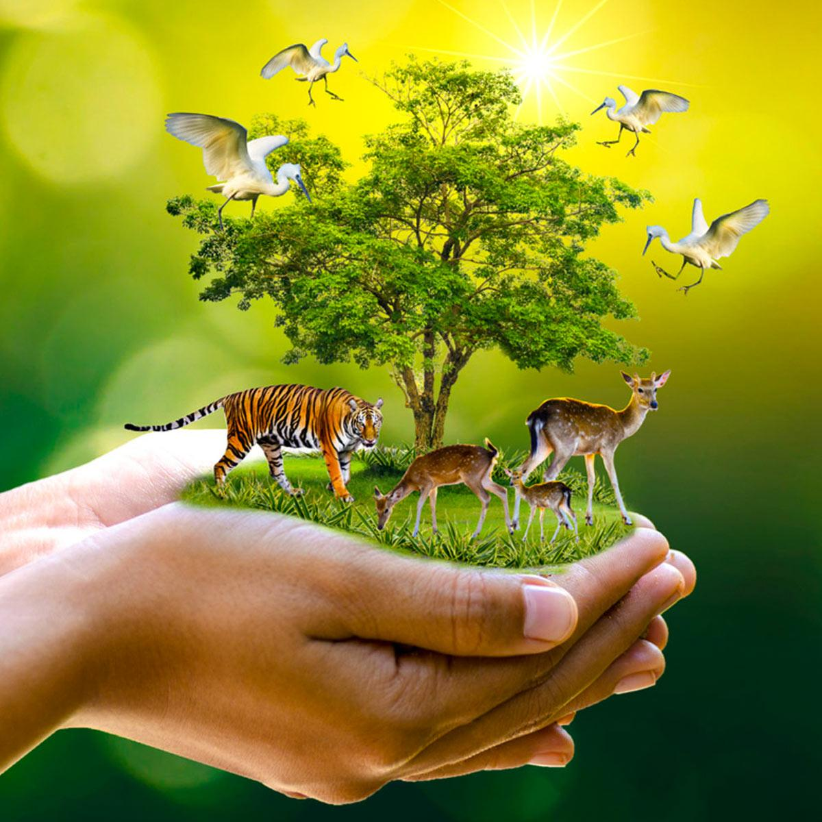
Big Question: How does the amount we use of different types of resources help us take care of our environment?
Notes:
Our “big question” is: How does the amount we use of different types of resources help us take care of our environment?
[Pause and illicit predictions from students.]
Be sure to keep this question and your predictions in mind as we move through this video and questions.

Slide 4
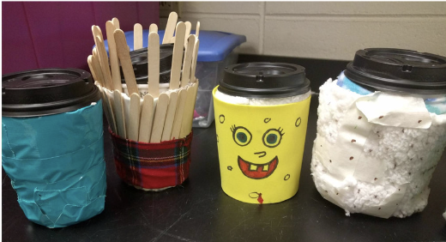
Demonstration
TEACHER DIRECTIONS:
Before viewing: Ask students to recall what they already know about energy.
During: Engage the class in a discussion about the observations. Ask questions such as: Why did one cup cool down faster than the other? How does insulation help in conserving the heat in the water? How can we apply the concept of insulation to conserve energy in our daily lives?
After: Tell students that today they will be learning more about the term energy.
Notes:
A feasible and effective classroom demonstration to teach about conservation of energy involves a simple experiment focusing on energy efficiency. This demonstration emphasizes the importance of using energy wisely and reducing waste. Here's an activity called "The Insulated Cup Challenge":
Activity: The Insulated Cup Challenge
Materials Needed:
Two identical cups (plastic or paper)
Insulating material (e.g., Styrofoam cups, bubble wrap, or newspaper)
Hot water
Thermometer
Stopwatch or timer
Optional: Ice cubes
Procedure:
Introduction:
Begin by discussing the concept of energy conservation with the students. Explain that conserving energy means using it wisely and efficiently to reduce waste.
Setup:
Fill one cup with hot water (but not too hot for safety) and the other with room temperature water. Optional: Place an ice cube in the room temperature water cup to create a noticeable temperature difference.
Insulation:
Wrap one of the cups with insulating material (Styrofoam, bubble wrap, or newspaper). Leave the other cup exposed.
Temperature Measurement:
Measure and record the initial temperature of the water in both cups using a thermometer.
Time the Cooling:
Start the timer or stopwatch and observe how long it takes for the water in each cup to cool down to a certain temperature (e.g., the initial room temperature).
Observations:
Note the differences in the cooling rates between the insulated cup and the non-insulated cup. Discuss why one cup cools down faster than the other.
Class Discussion:
Engage the class in a discussion about the observations. Ask questions such as:
Why did one cup cool down faster than the other?
How does insulation help in conserving the heat in the water?
How can we apply the concept of insulation to conserve energy in our daily lives?
Relate to Conservation:
Relate the activity to energy conservation by explaining that insulating the cup reduces heat loss, just like how being energy-efficient in our homes and schools can reduce overall energy consumption.
Extension Activity:
Challenge students to come up with other examples of insulation in everyday life, such as using blankets or wearing warm clothes in cold weather.
This activity provides a hands-on experience that helps students understand the practical aspects of energy conservation. It also encourages them to think about how simple measures, such as proper insulation, can contribute to saving energy and reducing environmental impact.

Slide 5
Notes:
Before we move on to our new vocabulary term, let’s review some other words & concepts that you already learned and make sure you are firm in your understanding.
Feedback: Reviewing key background knowledge helps lay the context and sets the students up to make sense of the new content you are introducing, it also reinforces previously learned material.

Slide 6
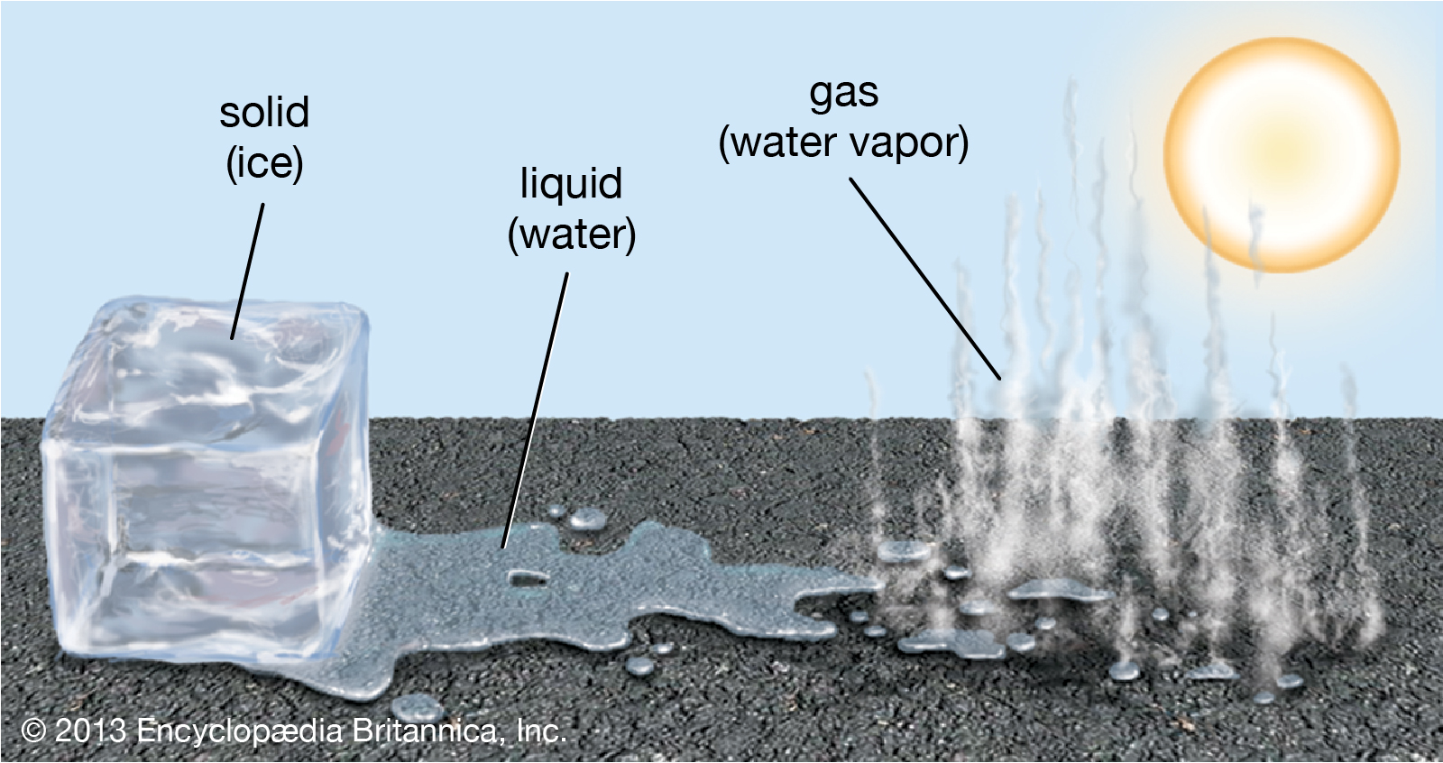
Water is the only compound that exists in all three states of matter: solid, liquid, and gas
Notes:
Water is the only compound that exists in all three states of matter: solid, liquid, and gas.

Slide 7
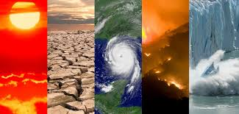
Climate: the average measurements of weather in a place over the course of years
Notes:
Climate is the average measurements of weather in a place over the course of years.

Slide 8
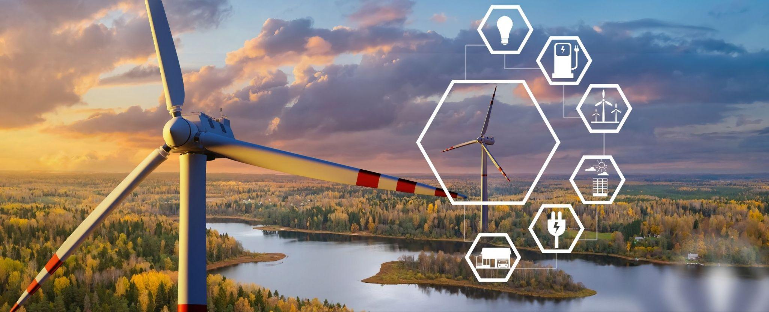
Energy: the ability to cause change
Notes:
Energy is the ability to cause change.

Slide 9
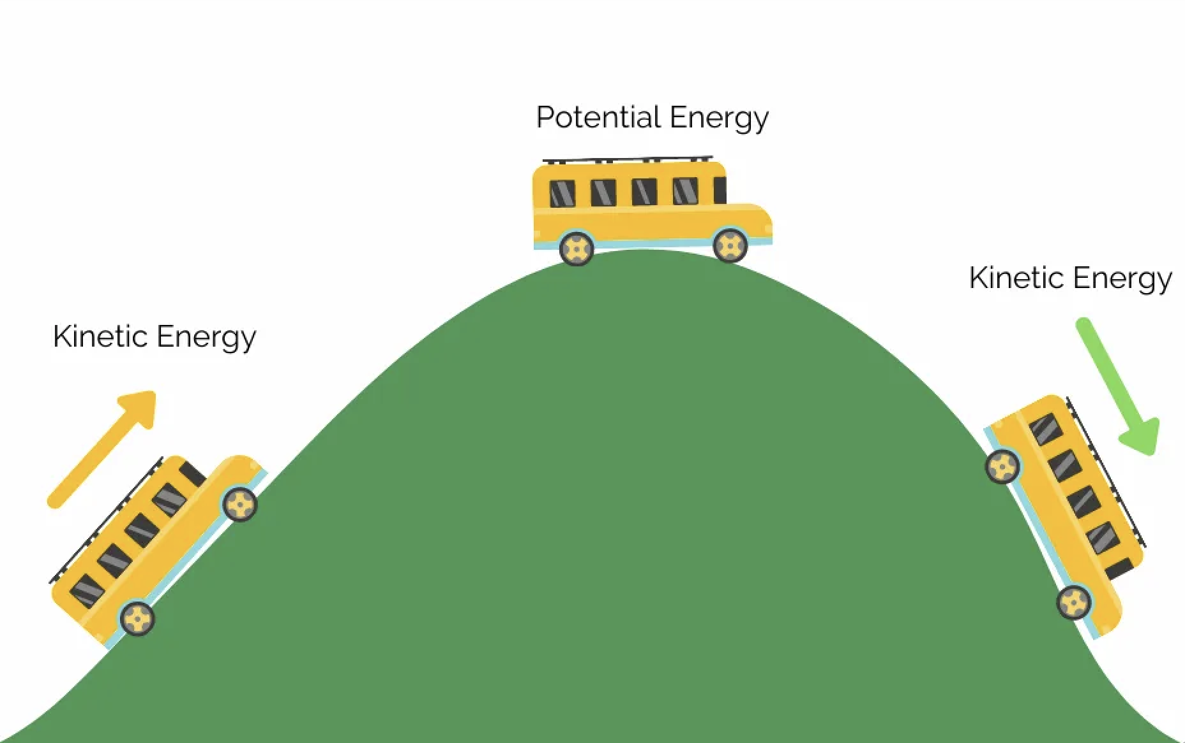
Kinetic Energy: energy of mass in motion
Notes:
Kinetic Energy is energy of mass in motion,.

Slide 10
Potential energy: stored energy
Notes:
Potential energy is stored energy.

Slide 11
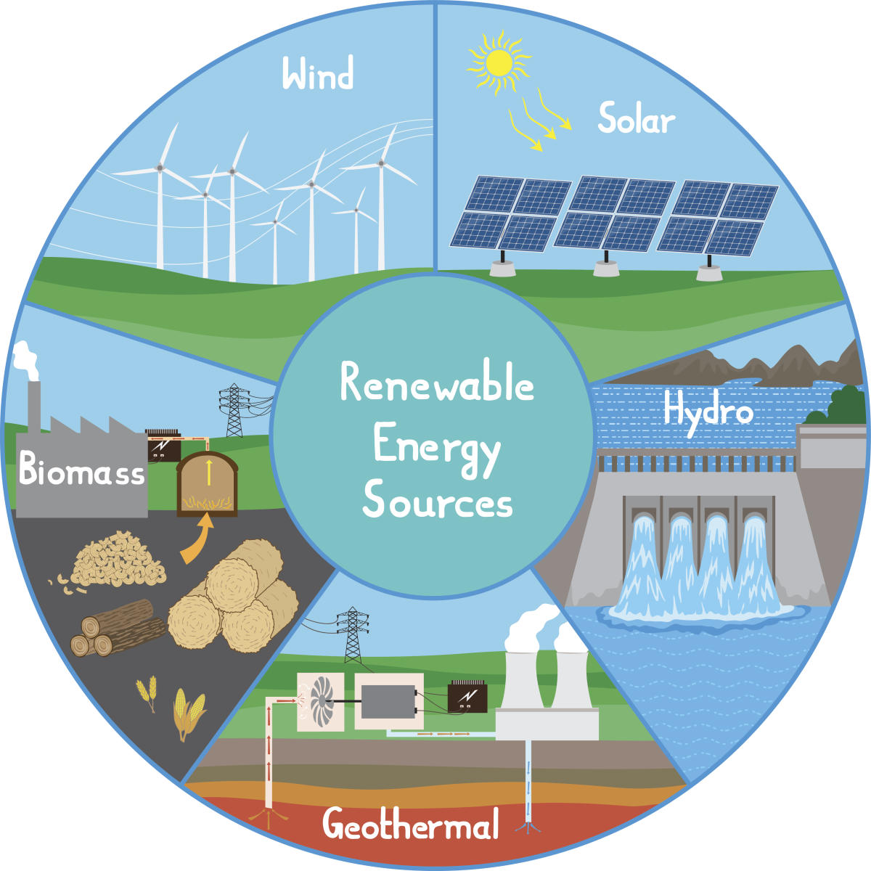
Renewable Energy: energy that comes from natural sources and will not run out
Notes:
Renewable Energy is energy that comes from natural sources and will not run out.

Slide 12
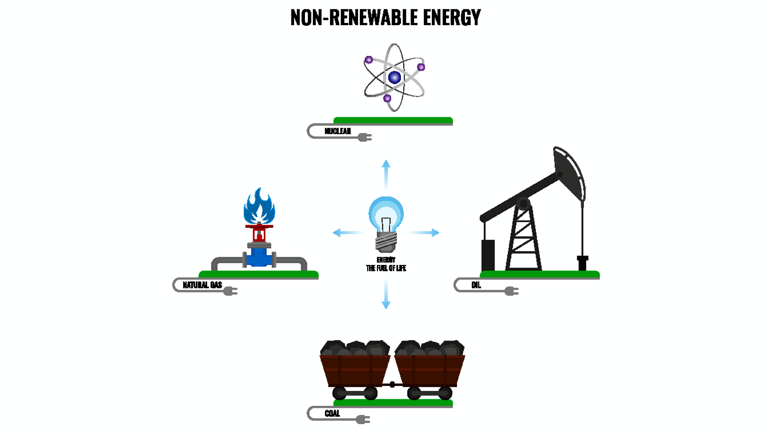
Non-Renewable Energy: energy that comes from sources that will eventually run out
Notes:
Non-Renewable Energy is energy that comes from sources that will eventually run out.

Slide 13
Notes:
Let’s check-in for understanding.

Slide 14
______ is the only compound that exists in all three states of matter: solid, liquid, and gas.
Notes:
______ is the only compound that exists in all three states of matter: solid, liquid, and gas.

Slide 15
Water is the only compound that exists in all three states of matter: solid, liquid, and gas.
Notes:
Water is the only compound that exists in all three states of matter: solid, liquid, and gas.

Slide 16
What is climate?
Notes:
What is climate?
[The average measurements of weather in a place over the course of years.]

Slide 17
True or False: Energy is the ability to cause change
Notes:
True or False: Energy is the ability to cause change.
[True]

Slide 18
True or False: Energy is the ability to cause change
Notes:
True: Energy is the ability to cause change.

Slide 19
Kinetic Energy: energy of in motion
Notes:
Kinetic Energy is energy of in motion.
[mass]

Slide 20
Kinetic Energy: energy of mass in motion
Notes:
Kinetic Energy is energy of in motion.
[mass]

Slide 21
True or False: Potential energy is stored energy
Notes:
True or False: Potential energy is stored energy.
[True]

Slide 22
True or False: Potential energy is stored energy
Notes:
True: Potential energy is stored energy.

Slide 23
Renewable Energy: energy that comes from natural sources and will run out
Notes:
Renewable Energy is energy that comes from natural sources and will run out.

Slide 24
Renewable Energy: energy that comes from natural sources and will not run out
Notes:
Renewable Energy is energy that comes from natural sources and will not run out.

Slide 25
Non-Renewable Energy: energy that comes from sources that eventually run out
Notes:
Non-Renewable Energy is energy that comes from sources that eventually run out.

Slide 26
Non-Renewable Energy: energy that comes from sources that will eventually run out
Notes:
Non-Renewable Energy is energy that comes from sources that will eventually run out.

Slide 27
Conservation
Notes:
Now let’s define our new term, Conservation.

Slide 28
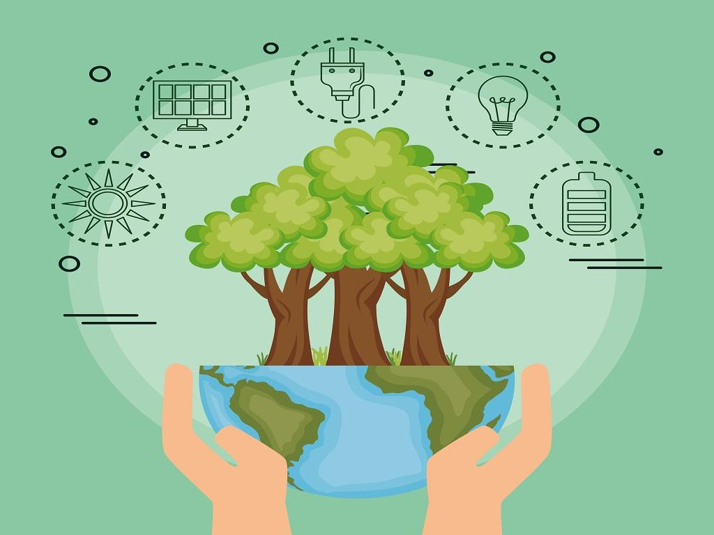
Conservation: using less of a resource to make its supply last longer
Notes:
Conservation is using less of a resource to make its supply last longer.

Slide 29
Notes:
Let’s check-in for understanding.

Slide 30
What is conservation?
Notes:
What is conservation?
[using less of a resource to make its supply last longer]

Slide 31
Notes:
That is the basic definition, but there is a bit more you need to know.

Slide 32
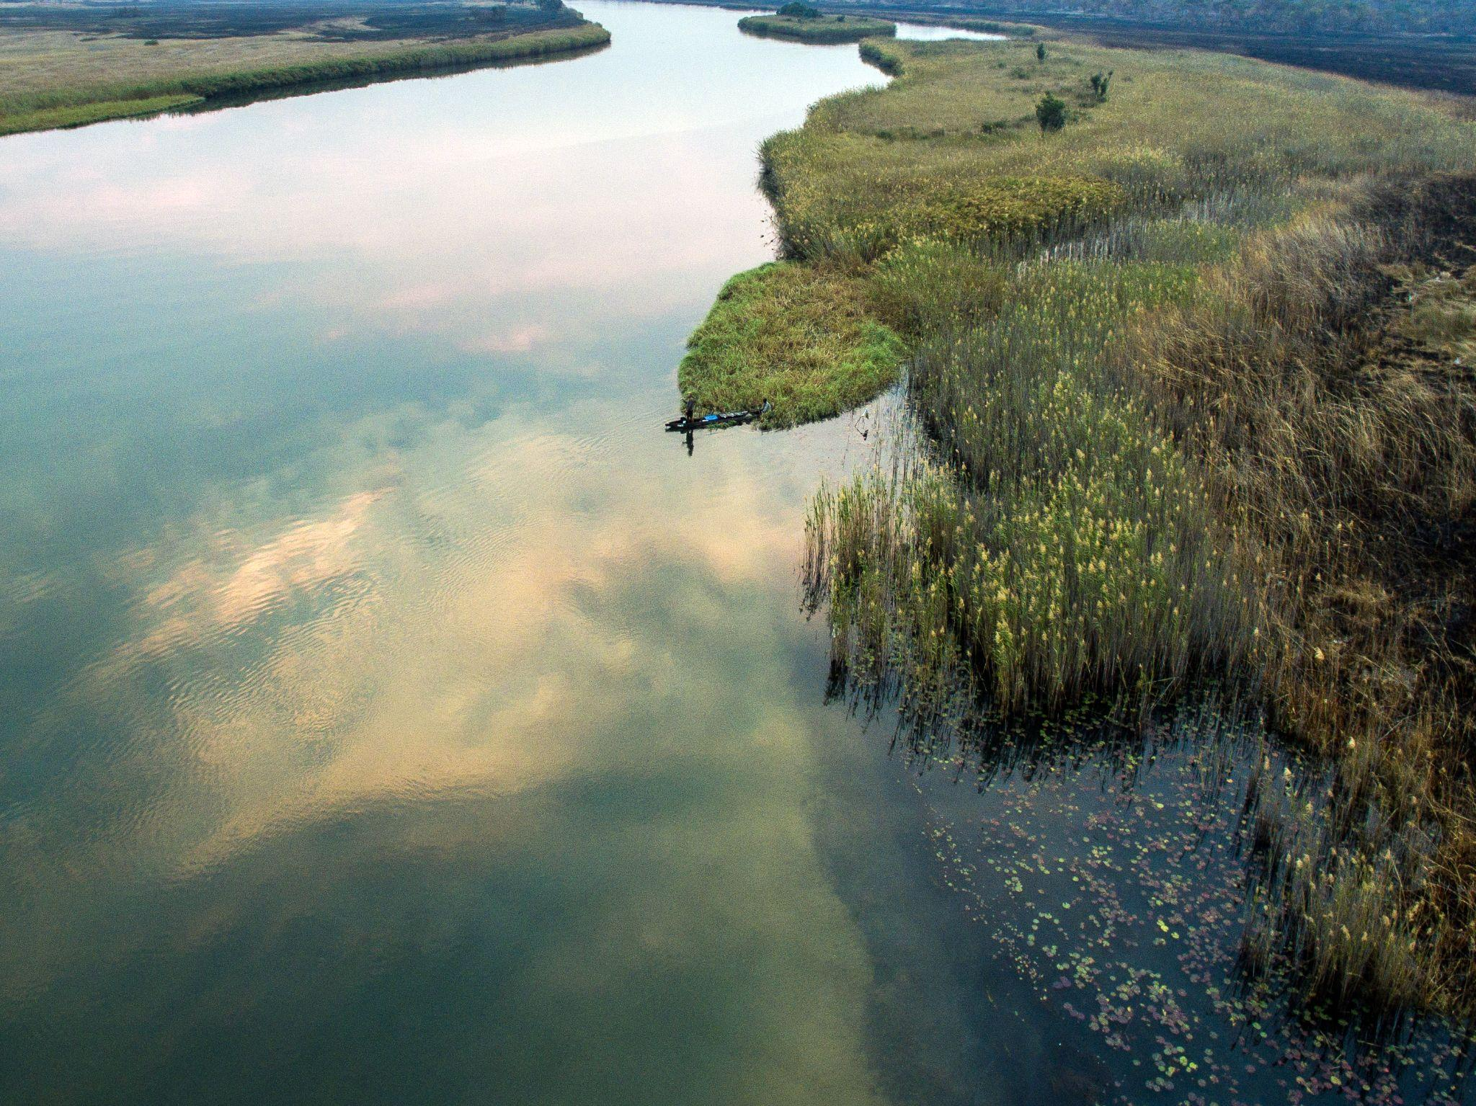
Conservation means being mindful of how much of a resource we use so that we can make it last longer.
Notes:
Conservation means being mindful of how much of a resource we use so that we can make it last longer.

Slide 33
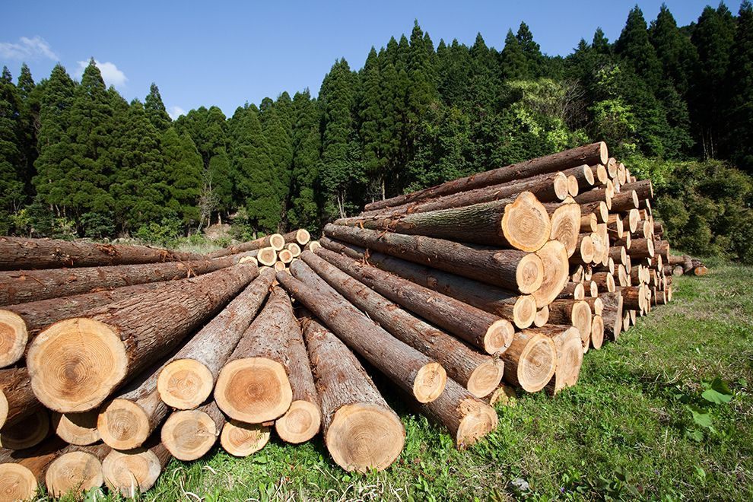
When we conserve, we try to use less of a resource, like water, energy, or trees, because we know that these resources are limited.
Notes:
When we conserve, we try to use less of a resource, like water, energy, or trees, because we know that these resources are limited.

Slide 34
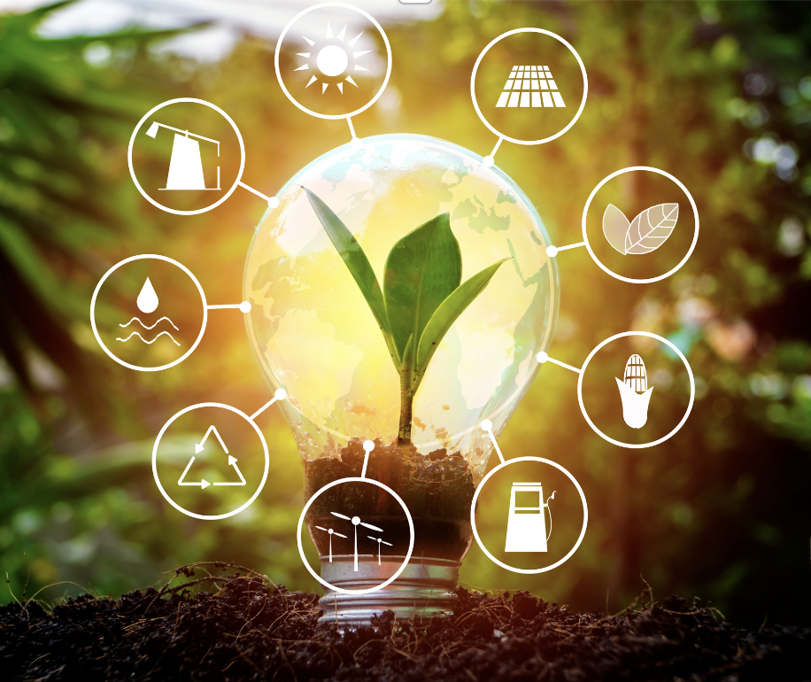
By using less, we can help protect the environment and ensure that there is enough for everyone, now and in the future. It's a way of being responsible and making sure that we don't run out of important things that we need to live, play, and thrive.
Notes:
By using less, we can help protect the environment and ensure that there is enough for everyone, now and in the future. It's a way of being responsible and making sure that we don't run out of important things that we need to live, play, and thrive.

Slide 35
Notes:
Let’s check-in for understanding.

Slide 36
Why is it important to conserve energy?
Notes:
Why is it important to conserve energy?

Slide 37
Notes:
Now, let’s talk about some examples of renewable energy.

Slide 38
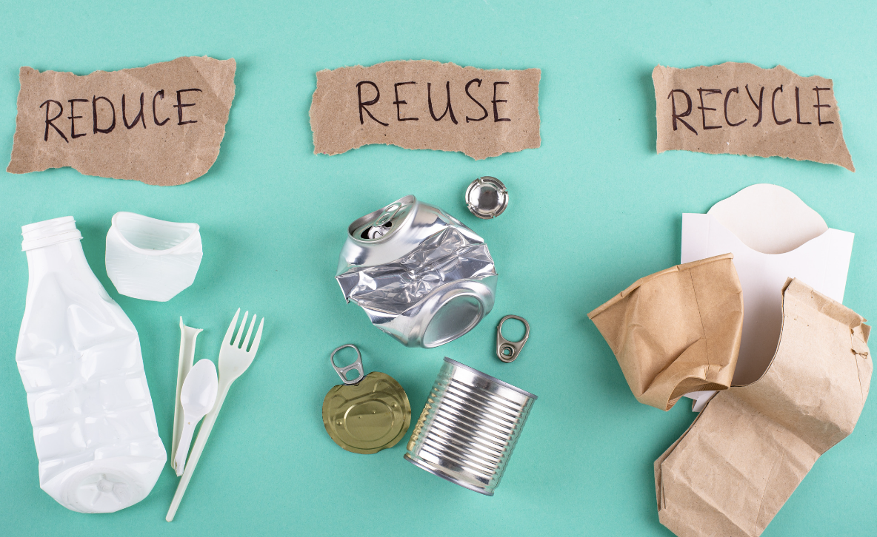
This is an example of Conservation - recycling, reducing, and reusing resources.
Notes:
This is an example of Conservation - recycling, reducing, and reusing resources. By recycling, we take resources we no longer need, such as plastic bottles, and turn them into something new. By reducing, we use less of resources to preserve them, such as taking shorter showers to use less water. Reusing means we take resources and use them for another purpose, such as using plastic milk jugs as planters to grow plants.

Slide 39
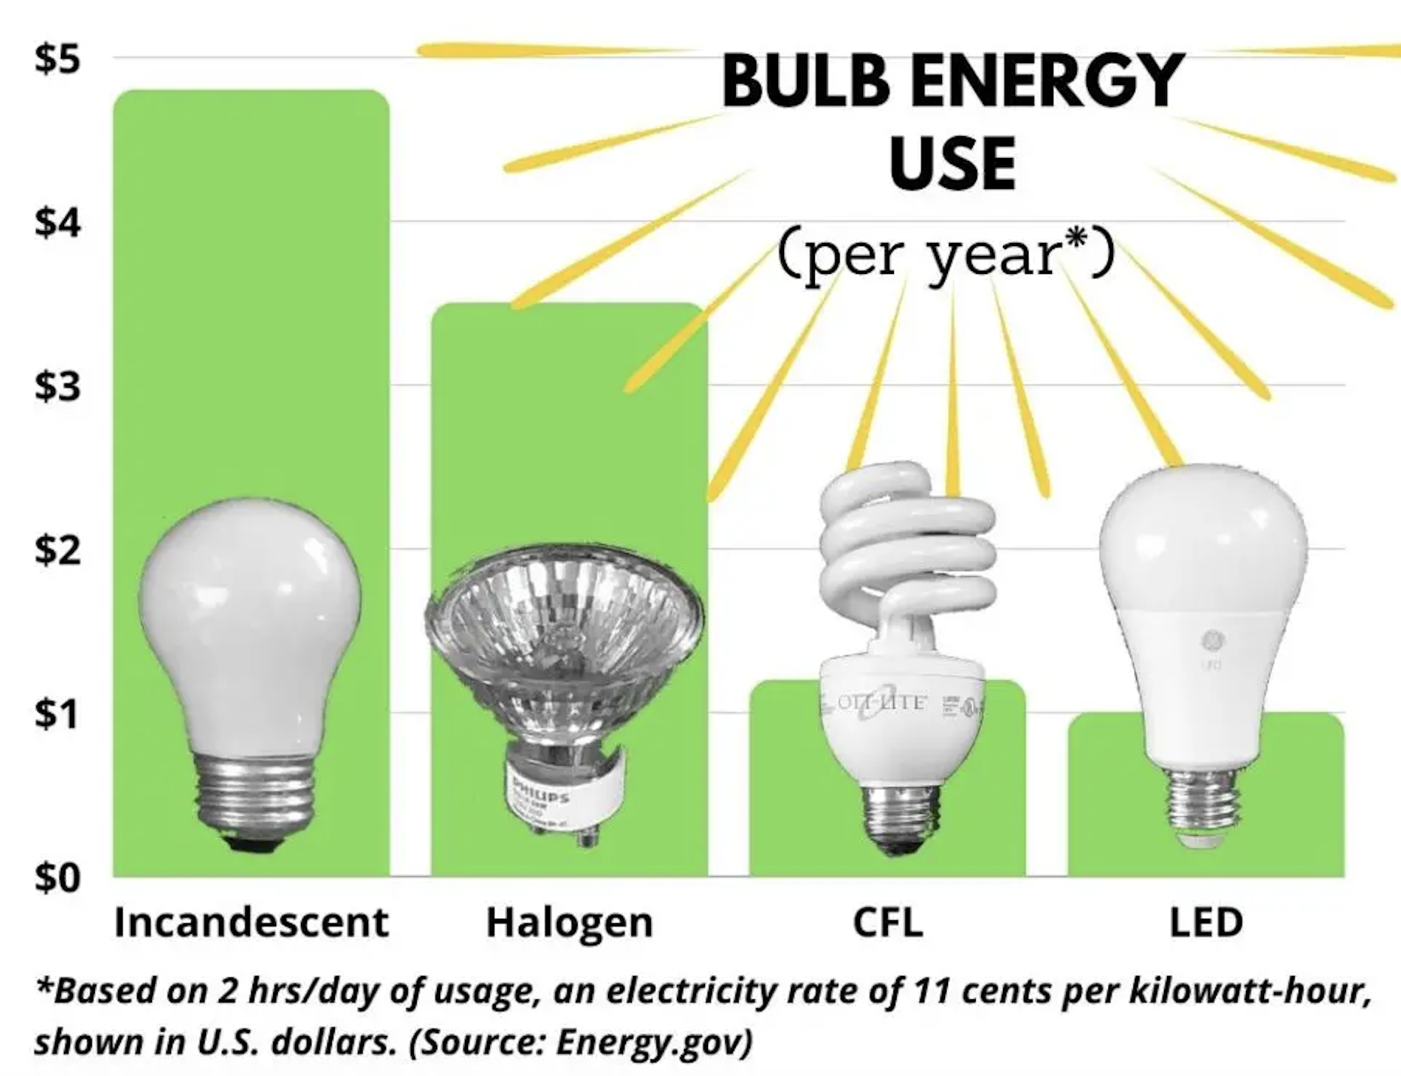
Here is another example of Conservation. Different types of light bulbs use different amounts of energy. By using light bulbs that use less energy, like LED or CFL light bulbs, this can help reduce the amount of electric energy we use and therefore conserves electricity.
Notes:
Here is another example of Conservation. Different types of light bulbs use different amounts of energy. By using light bulbs that use less energy, like LED or CFL light bulbs, this can help reduce the amount of electric energy we use and therefore conserves electricity.

Slide 40
Notes:
Now, let’s talk about some non-examples of renewable energy.

Slide 41
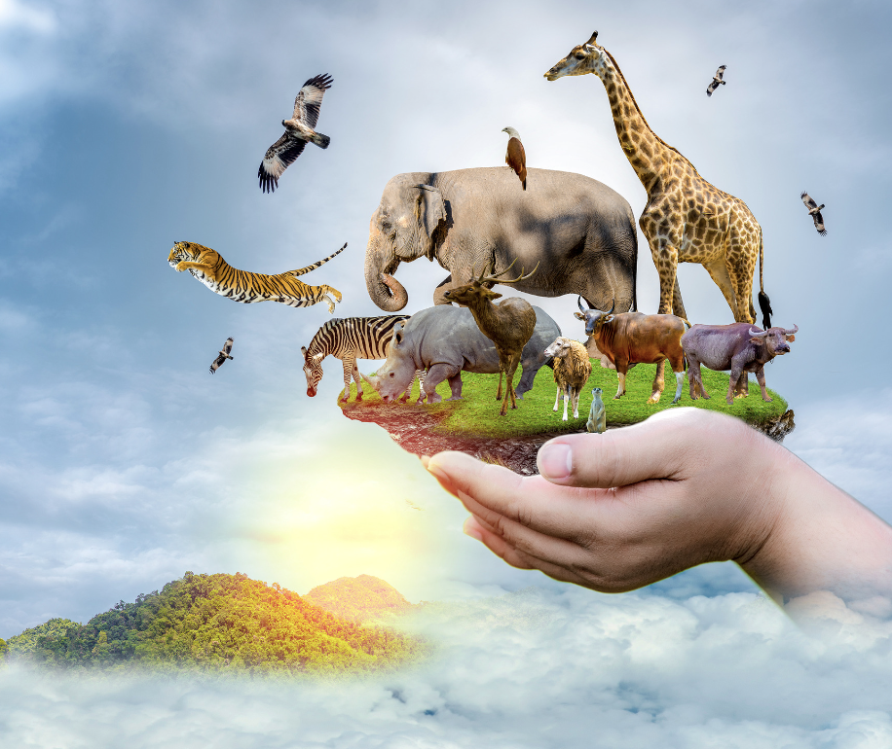
Working to save endangered animals is a vital type of conservation effort, but it is specific to helping individual animals rather than the conservation of energy or resources. This is NOT an example of conservation of energy or resources.
Notes:
Working to save endangered animals is a vital type of conservation effort, but it is specific to helping individual animals rather than the conservation of energy or resources. This is NOT an example of conservation of energy or resources.

Slide 42
Notes:
Now let’s pause for a moment to check your understanding.

Slide 43
Which one is an example of conservation of energy and resources?
Notes:
Which one is an example of conservation of energy and resources?

Slide 44
Which one is an example of conservation of energy and resources?
Notes:
Which one is an example of conservation of energy and resources?

Slide 45
Remember!!!
Notes:
So remember!

Slide 46
Conservation: using less of a resource to make its supply last longer
Notes:
Conservation is using less of a resource to make its supply last longer.

Slide 47
Notes:
We will now complete this concept map, called a Frayer model, to summarize and further clarify what you have learned about the term conservation.

Slide 48
Definition
Picture
Conservation
Example
How does conservation impact my life?
Notes:
To complete the Frayer model, we will choose from four choices the correct picture, definition, example, and response to the question, “How does conservation impact my life?” Select the best response for each question using the information you just learned. As we select responses, we will see how this model looks filled in for the term conservation.

Slide 49
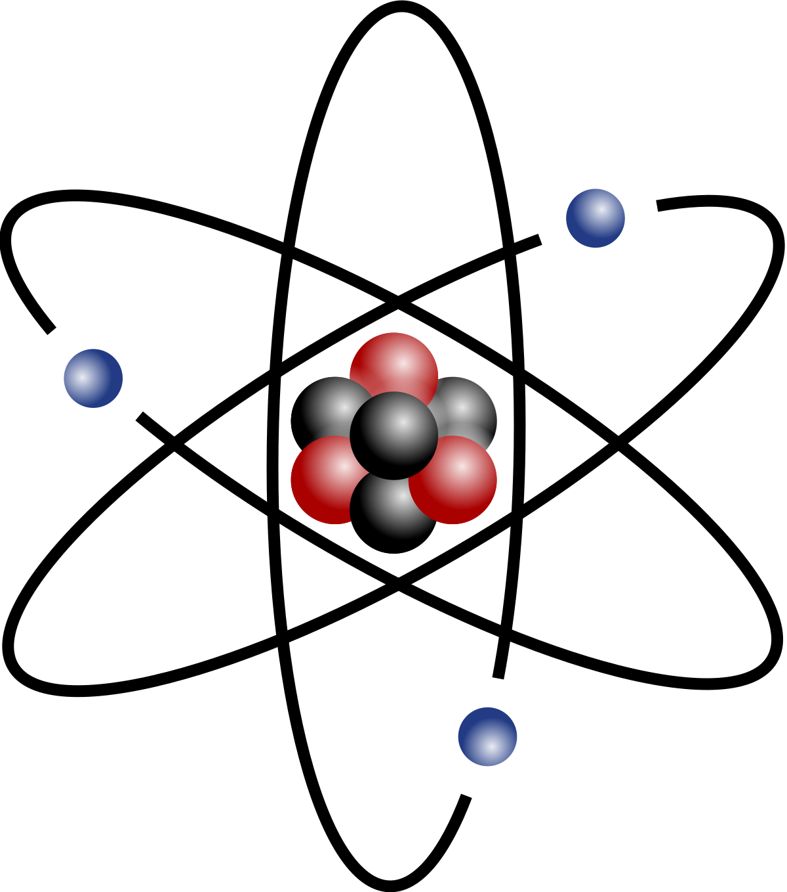
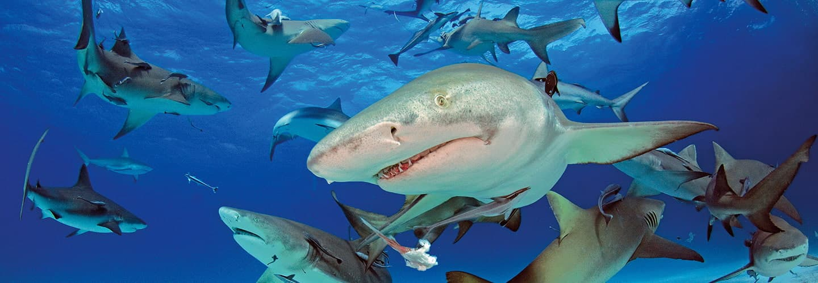
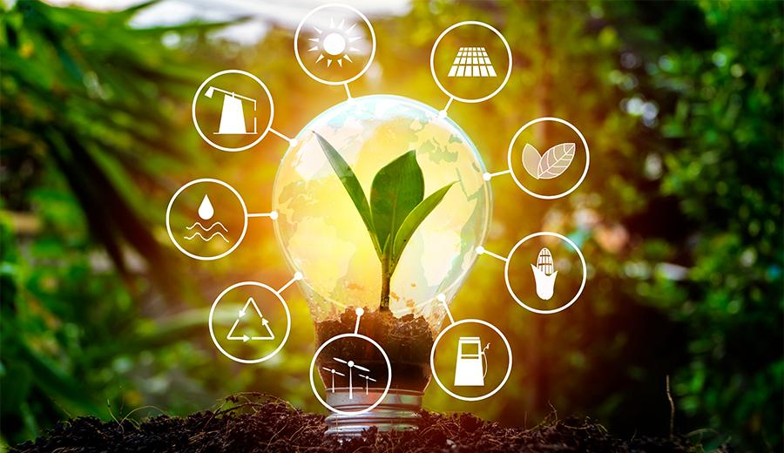
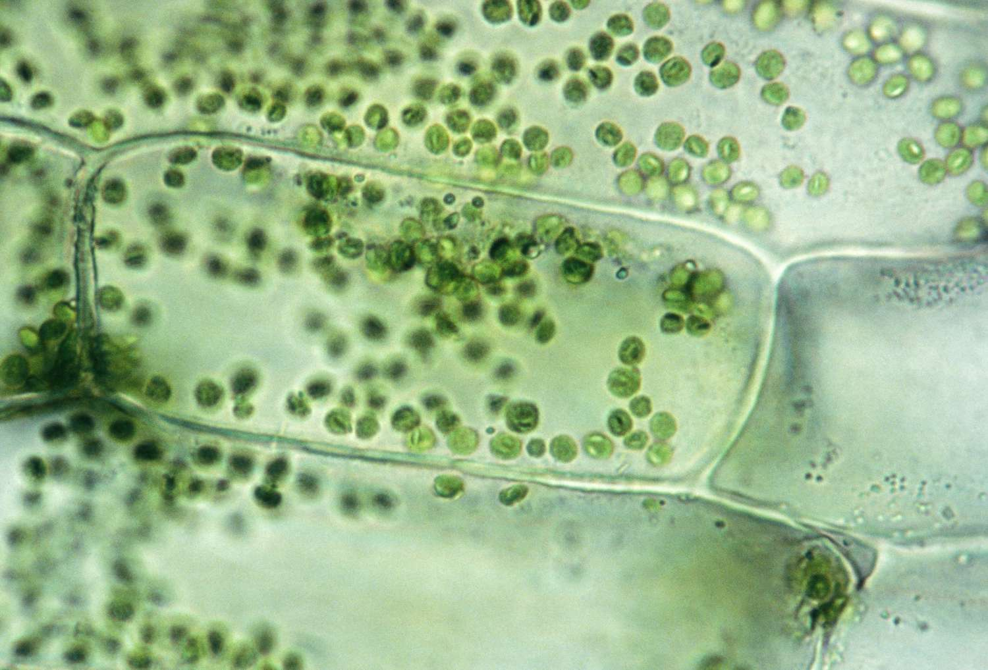
Directions: Choose the correct picture of Conservation from the choices below.
A
B
C
D
Notes:
Choose the one correct picture of Conservation from these four choices and drag and place it in the picture box below.

Slide 50
Directions: Choose the correct picture of Conservation from the choices below.
A
B
C
D
Notes:
You chose the picture that shows conservation by showing resources we use less of to make them last longer.

Slide 51
Definition
Picture
Conservation
Example
How does conservation impact my life?
Notes:
Here is the Frayer Model filled in with a picture of conservation.

Slide 52
Directions: Choose the correct definition of Conservation from the choices below.
A
Energy from heat
B
Using less of a resource to make its supply last longer
C
Smallest whole unit of matter
D
Ability to do work from the Sun
Notes:
Choose the one correct definition of Conservation from these four choices and drag and place it in the definition box below.

Slide 53
Directions: Choose the correct definition of Conservation from the choices below.
A
Energy from heat
B
Using less of a resource to make its supply last longer
C
Smallest whole unit of matter
D
Ability to do work from the Sun
Notes:
You chose “Using less of a resource to make its supply last longer.” This is correct! This is the definition of Conservation.

Slide 54
Definition
Picture
Using less of a resource to make its supply last longer
Conservation
Example
How does conservation impact my life?
Notes:
Here is the Frayer Model with a picture and the definition filled in for conservation: Using less of a resource to make its supply last longer.

Slide 55
Directions: Choose the correct example of Conservation from the choices below.
A
Animals and plants living together in one place
B
Eating a balanced diet including fruits and vegetables
C
Taking a shower instead of a bath to use less water
D
Playing video games
Notes:
Choose the one correct example of conservation from these four choices and drag and place it in the example box below.

Slide 56
Directions: Choose the correct example of Conservation from the choices below.
A
Animals and plants living together in one place
B
Eating a balanced diet including fruits and vegetables
C
Taking a shower instead of a bath to use less water
D
Playing video games
Notes:
You chose “Taking a shower instead of a bath to use less water.” This is an example of conservation!

Slide 57
Definition
Picture
Using less of a resource to make its supply last longer
Conservation
Taking a shower instead of a bath to use less water
Example
How does conservation impact my life?
Notes:
Here is the Frayer Model with a picture, definition, and an example of conservation: Taking a shower instead of bath to use less water.

Slide 58
Directions: Choose the correct response for “how does conservation impact my life?” from the choices below.
A
Conservation impacts my life by using less resources to save their supplies and help protect the environment.
B
Conservation impacts my life by making sure everyone uses as many resources as possible
C
Conservation impacts my life by making sure I have healthy food to eat.
D
Conservation impacts my life by helping me grow plants to eat and use for medicine.
Notes:
Choose the one correct response for “how does conservation impact my life?” from these four choices and drag and place it in the box below.

Slide 59
Directions: Choose the correct response for “how does conservation impact my life?” from the choices below.
A
Conservation impacts my life by using less resources to save their supplies and help protect the environment.
B
Conservation impacts my life by making sure everyone uses as many resources as possible
C
Conservation impacts my life by making sure I have healthy food to eat.
D
Conservation impacts my life by helping me grow plants to eat and use for medicine.
Notes:
You chose “Conservation impacts my life by using less resources to save their supplies and help protect the environment.” That is correct! This is an example of how conservation impacts your life.

Slide 60
Definition
Picture
Using less of a resource to make its supply last longer
Conservation
Taking a shower instead of a bath to use less water
Conservation impacts my life by using less resources to save their supplies and help protect the environment.
Example
How does conservation impact my life?
Notes:
Here is the Frayer Model with a picture, definition, example, and a correct response to “how does TERM impact my life?”: Conservation impacts my life by using less resources to save their supplies and help protect the environment.

Slide 61
Remember!!!
Notes:
So remember!

Slide 62
Conservation: using less of a resource to make its supply last longer
Notes:
Conservation is using less of a resource to make its supply last longer.

Slide 63
Big Question: How does the amount we use of different types of resources help us take care of our environment?
Notes:
Let’s reflect once more on our big question. Our “big question” is: How does the amount we use of different types of resources help us take care of our environment?
Does anyone have any additional examples to share that haven’t been discussed yet?

Slide 64
Notes:
Thanks for watching, and please continue watching CAPs available from this website.

Slide 65
This Was Created With Resources From:
Questions or Comments
Michael Kennedy, Ph.D. MKennedy@Virginia.edu
Rachel L Kunemund, Ph.D. rk8vm@virginia.edu

