Slide 1
Intro
“Big Idea” Question
Review Concepts
Check-In Questions
Teacher Engagement
Vocabulary
Student-Friendly Definition
Examples & Non-Examples
Morphological Word Parts
Frayer Model
Simulation/Activity
Notes:
OK everyone, get ready for our next lesson. Just as a reminder, these are the different components that our lesson may include, and you’ll see these icons in the top left corner of each slide so that you can follow along more easily!

Slide 2
Direction
Intro
Notes:
Today, we’ll be learning about the word: Direction.

Slide 3
Big Question: How do direction and speed impact the motion of objects in the world around us?
Notes:
Our “big question” is: How do direction and speed impact the motion of objects in the world around us?
[Pause and illicit predictions from students.]
I love all these thoughtful scientific hypotheses! Be sure to keep this question and your predictions in mind as we move through these next few lessons, and we’ll continue to revisit it.

Slide 4
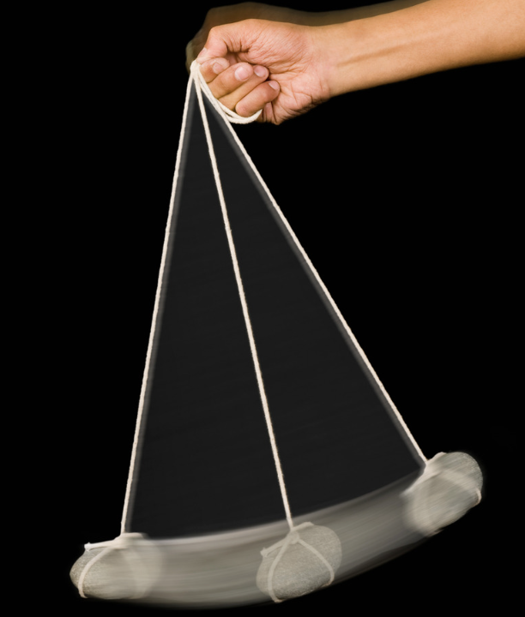
Demonstration
TEACHER DIRECTIONS:
Before viewing: Ask students to recall what they already know about direction.
During: Ask students to observe the direction the pendulum swings. Discuss how the pendulum moves from one side to the other, creating a back-and-forth motion. Emphasize that the pendulum swings in a specific direction and then swings back in the opposite direction.
After: Tell students that today they will be learning more about the term direction.
Notes:
To teach about direction in the context of energy, you can conduct a simple and engaging classroom demonstration using a pendulum. A pendulum is an excellent tool to visually demonstrate the concept of kinetic energy and the directional changes it undergoes. Here's a step-by-step guide for the demonstration:
Materials needed:
String
Weight (can be a small toy, a washer, or any small object with some mass)
Tape
Stopwatch or timer
Markers or chalk to mark the starting points on the floor
Procedure:
Set Up the Pendulum:
Tie one end of the string to the weight.
Tape the other end of the string to the ceiling or any elevated point, ensuring that the string is long enough to allow the weight to swing freely.
Mark the Starting Position:
Use markers or chalk to mark the starting position on the floor directly beneath the hanging weight.
Release and Observe:
Hold the weight at the starting position and release it.
Observe the motion of the pendulum as it swings back and forth.
Discuss with the Class:
Ask the students to observe the direction in which the pendulum swings.
Discuss how the pendulum moves from one side to the other, creating a back-and-forth motion.
Emphasize that the pendulum swings in a specific direction and then swings back in the opposite direction.
Introduce Terminology:
Introduce the terms "forward" and "backward" or "left" and "right" to describe the direction of the pendulum's motion.
Explain that when the weight is released, it swings back and forth along a path, and this path has a specific direction.
Measure and Compare:
Use a stopwatch or timer to measure the time it takes for the pendulum to complete one full swing (from one side to the other and back).
Compare the swinging times when the pendulum is released from different starting positions (closer to the vertical or farther away).
This demonstration not only illustrates the concept of direction but also introduces the idea of energy transfer as the pendulum swings back and forth, converting potential energy to kinetic energy and vice versa. It provides a tangible and visual representation for students to grasp the concept of directional movement in the context of energy.

Slide 5
Notes:
Before we move on to our new topic, let’s review some other words & concepts that you already learned and make sure you are firm in your understanding.

Slide 6
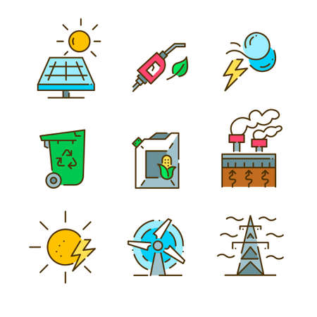
Energy: the ability to cause change
Notes:
Energy is the ability to cause change.

Slide 7
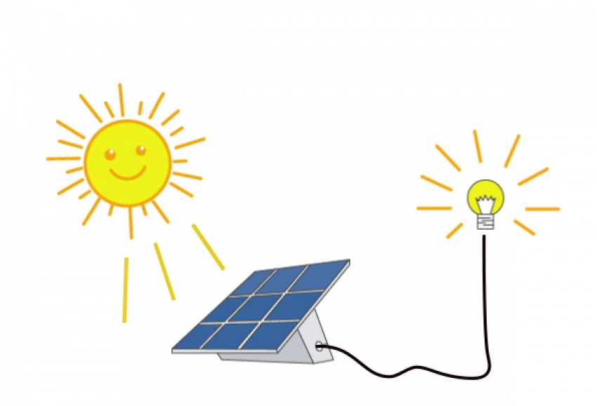
Energy transformation: changing energy from one form to another
Notes:
Energy transformation is when energy changes from one form to another.

Slide 8
Notes:
Now let’s pause for a moment to review the information we have covered already.

Slide 9
________ is the ability to cause change.
Energy
Work
Notes:
__________ is the ability to cause change.
[Energy]

Slide 10
________ is the ability to cause change.
Energy
Work
Notes:
__________ is the ability to cause change.
[Energy]

Slide 11
Energy transformation is changing energy from one form to another.
True
False
Notes:
Energy transformation is changing energy from one form to another.
[True]

Slide 12
Energy transformation is changing energy from one form to another.
True
False
Notes:
Energy transformation is changing energy from one form to another.
[True]

Slide 13
Direction
Notes:
Now that we’ve reviewed, let’s define the phrase direction.

Slide 14
Direction: where something moves or points
Notes:
Direction is where something moves or points.

Slide 15
Notes:
Let’s check-in for understanding.

Slide 16
What is direction?
Notes:
What is direction?
[Direction is where something moves or points.]

Slide 17
Notes:
That is the basic definition, but there is a bit more you need to know.

Slide 18
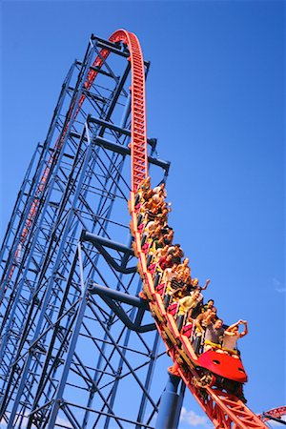
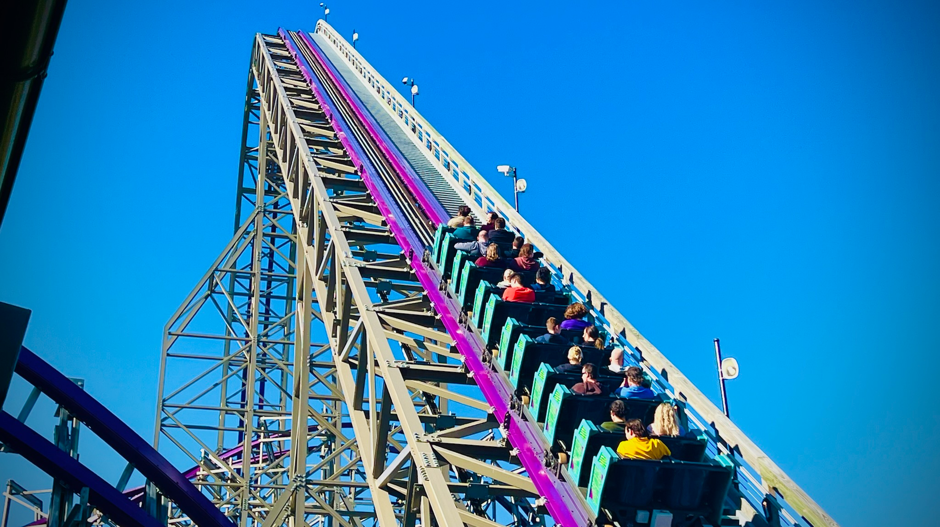
Up and down are two ways to describe an object’s direction. For example, the position of the roller coaster car on the right is an example of the down direction - the roller coaster car is moving down. The roller coaster car on the left is an example of the up direction - the roller coaster car is moving up.
Notes:
Up and down are two ways to describe an object’s direction. For example, the position of the roller coaster car on the left is an example of the down direction - the roller coaster car is moving down. The roller coaster car on the right is an example of the up direction - the roller coaster car is moving up.

Slide 19
Left and right are two other ways to describe direction. For example, the sign on the left is pointing in the left direction. The sign on the right is pointing in the right direction.
Notes:
Left and right are two other ways to describe direction. For example, the sign on the left is pointing in the left direction. The sign on the right is pointing in the right direction.

Slide 20
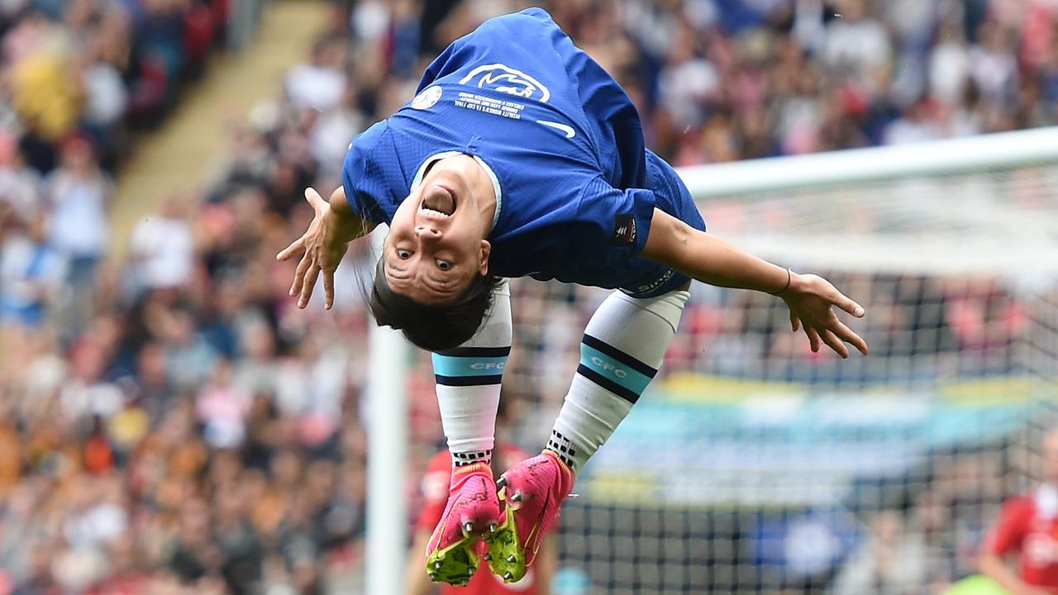
Forwards and backwards are two other ways to describe direction. The runner is moving in the forward direction. The soccer player is flipping in the backward direction.
Notes:
Forwards and backwards are two other ways to describe direction. The runner is moving in the forward direction. The soccer player is flipping in the backward direction.

Slide 21
Notes:
Let’s check-in for understanding.

Slide 22
_____ and _____ are two ways to describe the direction of the roller coaster cars.
Notes:
_____ and _____ are two ways to describe the direction of the roller coaster cars.
[Up, down]

Slide 23
Up and down are two ways to describe the direction of the roller coaster cars.
Notes:
_____ and _____ are two ways to describe the direction of the roller coaster cars.
[Up, down]

Slide 24
True or False: Up and down describe the direction of the two arrows.
True
False
Notes:
True or False: Up and down describe the direction of the two arrows.
True
False

Slide 25
True or False: Up and down describe the direction of the two arrows.
True
False
Notes:
False: The direction of the two arrows is not up and down. The direction of the two arrows is left and right.

Slide 26
The ______ direction describes the runner and the ______ direction describes the soccer player.
Notes:
The _______ direction describes the runner and the _______ direction describes the soccer player.
[forward, backward]

Slide 27
The forward direction describes the runner and the backward direction describes the soccer player.
Notes:
The _______ direction describes the runner and the _______ direction describes the soccer player.
[forward, backwards]

Slide 28
Notes:
Now, let’s talk about some examples of direction.

Slide 29
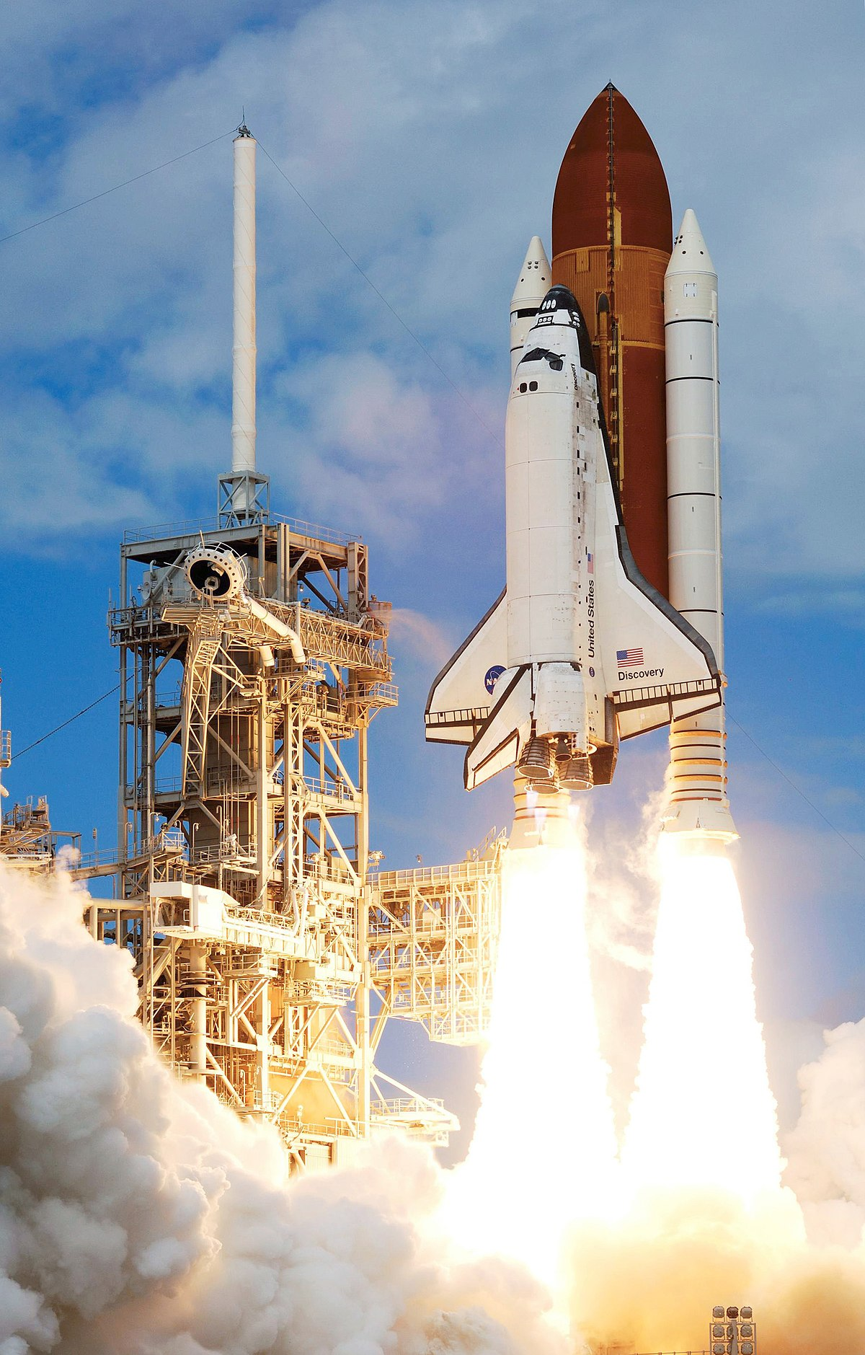
The space shuttle is pointed and moving up. This tells us the direction of the space shuttle is up.
Notes:
The space shuttle is pointed and moving up. This tells us the direction of the space shuttle is up.

Slide 30
The bowling ball is pointed and moving forward. This tells us the direction of the bowling ball is forward.
Notes:
The bowling ball is pointed and moving forward. This tells us the direction of the bowling ball is forward.

Slide 31
Notes:
Let’s check-in for understanding.

Slide 32
What is direction?
Notes:
What is direction?
[Direction is where something moves or points.]

Slide 33
Notes:
Now, let’s talk about some non-examples of direction.

Slide 34
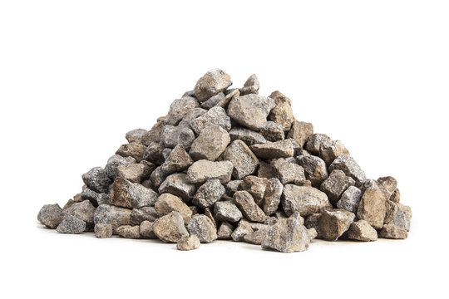
The pile of rocks are NOT moving or pointing anywhere, so they do not have a direction.
Notes:
The pile of rocks are not moving or pointing anywhere, so they do not have a direction.

Slide 35
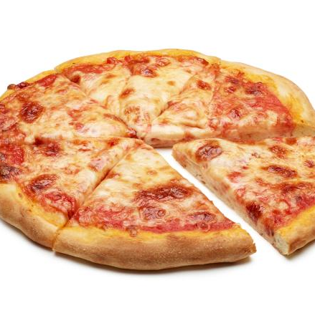
The cheese pizza is NOT an example of direction. Remember, direction is where something moves or points. The cheese pizza is not moving and it is not pointing anywhere.
Notes:
The cheese pizza is not an example of direction. Remember, direction is where something moves or points. The cheese pizza is not moving and it is not pointing anywhere.

Slide 36
Notes:
Now let’s pause for a moment to check your understanding.

Slide 37
Why does the bowling ball have a direction, but the rocks do not?
Notes:
Why does the bowling ball have a direction, but the rocks do not?
[Because the bowling ball is pointing and moving forward. The rocks are not moving and they are not pointing anywhere]

Slide 38
Notes:
We can also break down the term direction into different word parts to help us remember the meaning. Let’s take a look!

Slide 39
Direction
(root)
(suffix)
Notes:
We can break up the term direction into two parts: root and suffix.

Slide 40
Direction
Direct = guiding or indicating a path or course
Notes:
First, we have the root “direct” which means guiding or indicating a path or course. In this word, it indicates that direction involves guiding or indicating.

Slide 41
Direction
-ion = an action, process, or result
Notes:
-ion is the suffix. The “-ion” suffix means an action, process, or result. Now let’s put it all together.

Slide 42
Direct ion
Direction
An action of guiding or indicating a path or course
Notes:
So when we put it all together, direction means an action of guiding or indicating a path or course .

Slide 43
Notes:
Let’s check-in for understanding.

Slide 44
How can we use the word parts of direction to help us remember the definition of the term?
Direction
(root)
(suffix)
Notes:
How can we use the word parts of direction to help us remember the definition of the term?
[The root direct means guiding or indicating a path or course.
-ion is the suffix meaning an action, process, or result.
So when we put it all together, direction is an action of guiding or indicating a path or course.]

Slide 45
Remember!!!
Notes:
So remember!

Slide 46
Direction: where something moves or points
Notes:
Direction is where something moves or points.

Slide 47
Notes:
We will now complete this concept map, called a Frayer model, to summarize and further clarify what you have learned about the term direction.

Slide 48
Definition
Picture
Direction
Example
How does direction impact my life?
Notes:
To complete the Frayer model, we will choose from four choices the correct picture, definition, example, and response to the question, “How does direction impact my life?” Select the best response for each question using the information you just learned. As we select responses, we will see how this model looks filled in for the term direction.

Slide 49
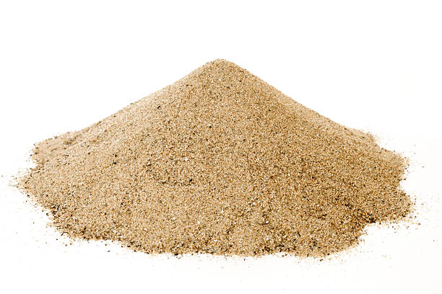
Directions: Choose the correct picture of direction from the choices below.
A
B
C
D
Notes:
Choose the one correct picture of direction from these four choices.

Slide 50
Directions: Choose the correct picture of direction from the choices below.
A
B
C
D
Notes:
This is the picture that shows direction.

Slide 51
Definition
Picture
Direction
Example
How does direction impact my life?
Notes:
Here is the Frayer model filled in with a picture of direction.

Slide 52
Directions: Choose the correct definition of Direction from the choices below.
A
Where something moves or points
B
The weight of an object
C
When an object stands still
D
The ability to cause change
Notes:
Choose the one correct definition of direction from these four choices.

Slide 53
Directions: Choose the correct definition of Direction from the choices below.
A
Where something moves or points
B
The weight of an object
C
When an object stands still
D
The ability to cause change
Notes:
“Where something moves or points” is correct! This is the definition of direction.

Slide 54
Definition
Picture
Where something moves or points
Direction
Example
How does direction impact my life?
Notes:
Here is the Frayer Model with a picture and the definition filled in for direction: Where something moves or points.

Slide 55
Directions: Choose the correct example of Direction from the choices below.
A
A puppy sleeping
B
A boat floating on water
C
A child sliding down a slide
D
A musician playing a piano
Notes:
Choose the one correct example of direction from these four choices.

Slide 56
Directions: Choose the correct example of Direction from the choices below.
A
A puppy sleeping
B
A boat floating on water
C
A child sliding down a slide
D
A musician playing a piano
Notes:
“A child sliding down a slide” is correct! This is an example of direction.

Slide 57
Definition
Picture
Where something moves or points
Direction
A child sliding down a slide
Example
How does direction impact my life?
Notes:
Here is the Frayer Model with a picture, definition, and an example of direction: A child sliding down a slide.

Slide 58
Directions: Choose the correct response for “how does direction impact my life?” from the choices below.
A
Direction helps us to understand what we read in a book
B
Direction gives us a way to describe where an object points or how an object moves
C
Direction creates a new way to see how trees grow
Direction shows us how water freezes to become ice
D
Notes:
Choose the one correct response for “how does direction impact my life?” from these four choices.

Slide 59
Directions: Choose the correct response for “how does direction impact my life?” from the choices below.
A
Direction helps us to understand what we read in a book
B
Direction gives us a way to describe where an object points or how an object moves
C
Direction creates a new way to see how trees grow
Direction shows us how water freezes to become ice
D
Notes:
“Direction gives us a way to describe where an object points or how an object moves.” That is correct! This is an example of how direction impacts your life.

Slide 60
Definition
Picture
Where something moves or points
Direction
A child sliding down a slide
Direction gives us a way to describe where an object points or how an object moves
Example
How does direction impact my life?
Notes:
Here is the Frayer Model with a picture, definition, example, and a correct response to “how does direction impact my life?”: Direction gives us a way to describe where an object points or how an object moves.

Slide 61
Remember!!!
Notes:
So remember!

Slide 62
Direction: where something moves or points
Notes:
Direction is where something moves or points.

Slide 63
Big Question: How do direction and speed impact the motion of objects in the world around us?
Notes:
Let’s reflect again on our big question. Our “big question” is: How do direction and speed impact the motion of objects in the world around us?
Does anyone have any additional examples to share that haven’t been discussed yet?
In our “big question,” there are two more vocabulary words we need to explore before we move onto our simulation activity

Slide 64
Simulation Activity
Direction
(Direction Game)
Click the link above for a simulation to explore direction.
In this activity, you will be asked to use directions to describe where certain buildings are.
Notes:
*This is the simulation for direction - please use the activity labeled 1: Directions Game.

Slide 65
Notes:
Thanks for watching, and please continue watching CAPs available from this website.

Slide 66
This Was Created With Resources From:
Questions or Comments
Michael Kennedy, Ph.D. MKennedy@Virginia.edu
Rachel L Kunemund, Ph.D. rk8vm@virginia.edu

