Slide 1
Intro
“Big Idea” Question
Review Concepts
Check-In Questions
Teacher Engagement
Vocabulary
Student-Friendly Definition
Examples & Non-Examples
Morphological Word Parts
Frayer Model
Simulation/Activity
Notes:
OK everyone, get ready for our next lesson. Just as a reminder, these are the different components that our lesson may include, and you’ll see these icons in the top left corner of each slide so that you can follow along more easily!

Slide 2
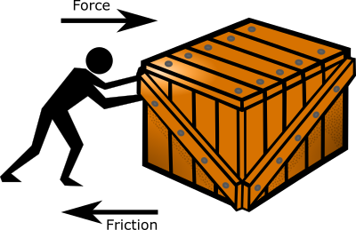
Intro
Friction
Notes:
Today, we’ll be learning about the word: Friction.

Slide 3
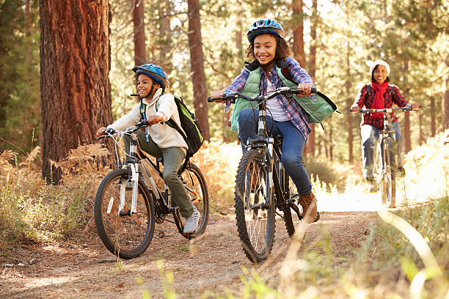
Big Question: How do friction and resistance impact the way objects move through the world?
Notes:
Our “big question” is: How do friction and resistance impact the way objects move through the world?
[Pause and illicit predictions from students.]
I love all these thoughtful scientific hypotheses! Be sure to keep this question and your predictions in mind as we move through these next few lessons, and we’ll continue to revisit it.

Slide 4
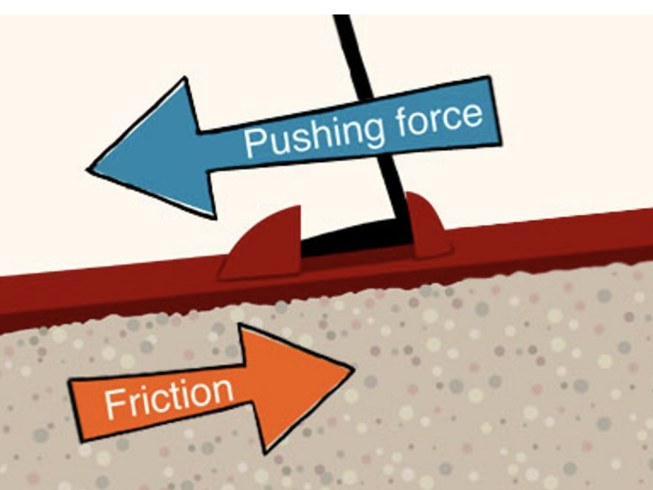
Demonstration
TEACHER DIRECTIONS:
Before viewing: Ask students to recall what they already know about friction.
During: Engage in a class discussion about the observations. Ask questions such as: Which surface created more friction, and why? How did the roughness of the surface affect the motion of the object? Can friction be helpful in some situations?
After: Tell students that today they will be learning more about the term friction.
Notes:
To teach about friction in the context of sources of energy, you can conduct a simple and engaging classroom demonstration using everyday materials. This demonstration will help students understand the concept of friction, which is the force that opposes the relative motion or tendency of such motion of two surfaces in contact. Here's a step-by-step guide for the demonstration:
Materials needed:
Two different types of surfaces (e.g., a book and a piece of sandpaper)
Small objects with wheels (e.g., toy cars or a small cart)
Stopwatch or timer
Smooth and rough surfaces (optional)
Masking tape or ruler
Markers or chalk for labeling
Procedure:
Set Up the Experiment:
Place one of the surfaces (e.g., the book) on a flat, smooth surface (e.g., a desk or table).
Place the other surface (e.g., sandpaper) on a different flat, smooth surface.
Introduce Friction:
Begin by discussing the concept of friction with the students. Explain that friction is the force that opposes motion when two surfaces are in contact.
Predictions:
Ask students to predict which surface will create more friction when an object with wheels is moved across it.
Experiment - Part 1:
Place the small object with wheels on one surface (e.g., the book) and push it gently to observe its motion. Measure the distance it travels.
Experiment - Part 2:
Repeat the process with the other surface (e.g., sandpaper) and measure the distance the object travels. Discuss any differences in its motion compared to the first trial.
Experiment - Part 3:
Introduce additional surfaces with varying degrees of roughness (e.g., smooth paper and rough fabric) to explore how friction varies.
Class Discussion:
Engage in a class discussion about the observations. Ask questions such as:
Which surface created more friction, and why?
How did the roughness of the surface affect the motion of the object?
Can friction be helpful in some situations?
Connect to Energy:
Relate the concept of friction to energy by discussing how friction can both help and hinder the movement of objects. For example, friction is necessary for walking but can also slow down a moving car.
Extension Activity:
Challenge students to design their own experiments with different surfaces and objects to further explore the effects of friction.
This hands-on demonstration allows students to observe and experience the concept of friction directly. It provides a foundation for understanding how friction influences energy-related activities and the impact it has on the motion of objects.

Slide 5
Notes:
Before we move on to our new topic, let’s review some other words & concepts that you already learned and make sure you are firm in your understanding.

Slide 6
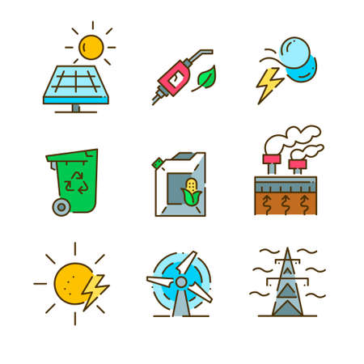
Energy: the ability to cause change
Notes:
Energy is the ability to cause change.

Slide 7
Direction: where something moves or points
Notes:
Direction is where something moves or points.

Slide 8
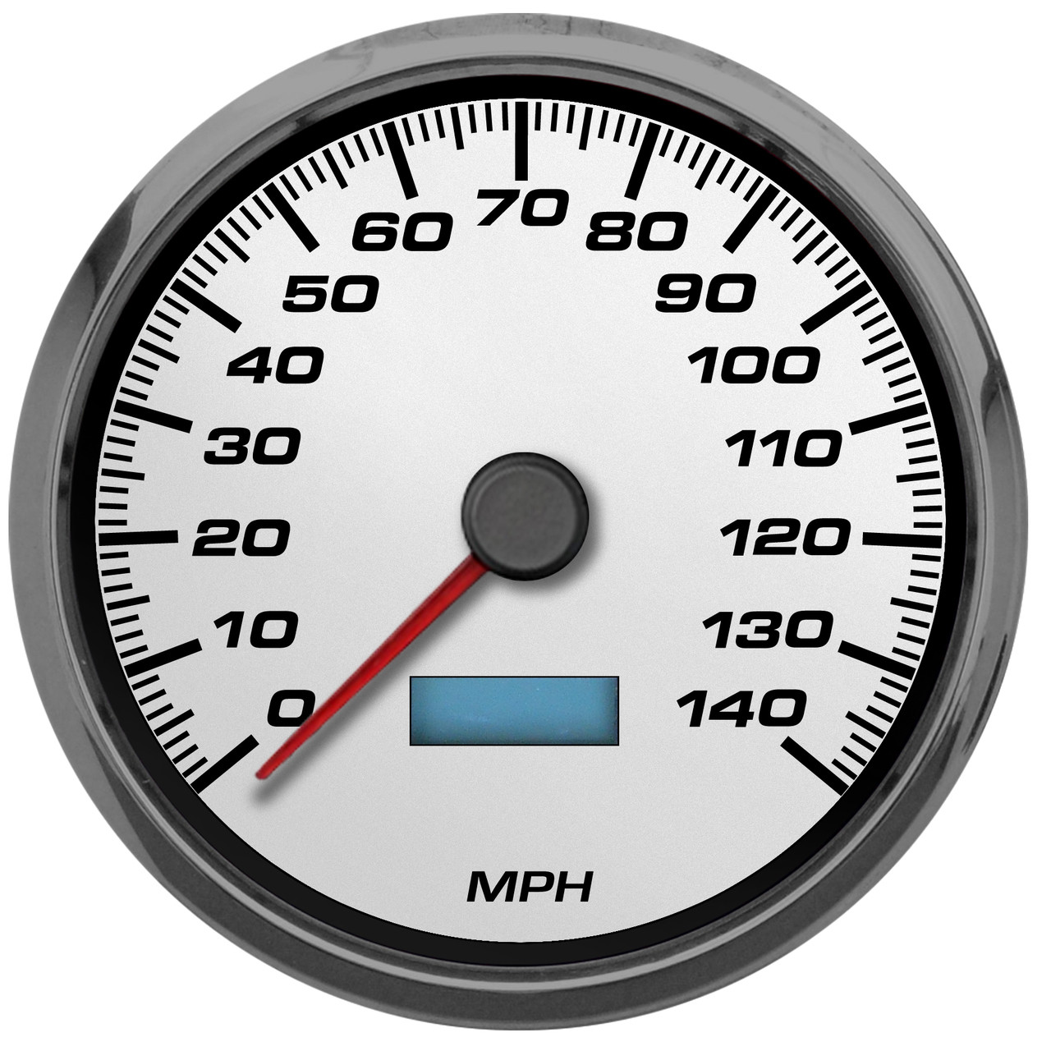
Speed: how fast an object moves
Notes:
Speed is how fast an object moves.

Slide 9
Motion: an object’s direction and speed
Notes:
Motion is an object’s direction and speed.

Slide 10
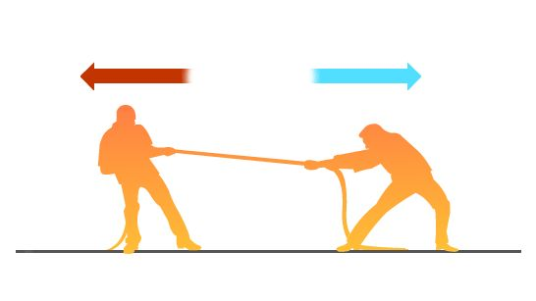
Force: any push or pull that causes an object to move, stop, or change direction.
Notes:
A force is any push or pull that causes an object to move, stop, or change direction.

Slide 11
Notes:
Now let’s pause for a moment to review the information we have covered already.

Slide 12
Energy is the ability to cause ____________.
Work
Change
Distance
Notes:
Energy is the ability to cause ____________.
[B. Change]

Slide 13
Energy is the ability to cause ____________.
Work
Change
Distance
Notes:
Energy is the ability to cause change.

Slide 14
___________ is where something moves or points.
Speed
Force
Direction
Notes:
_____ is where something moves or points.
[C. Direction]

Slide 15
___________ is where something moves or points.
Speed
Force
Direction
Notes:
Direction is where something moves or points.

Slide 16
What is speed?
Notes:
What is speed?
[Speed is how fast something moves.]

Slide 17
Motion is ___________ and __________.
Notes:
Motion is _________ and __________.
[Direction / Speed]

Slide 18
Motion is direction and speed.
Notes:
Motion is direction and speed.

Slide 19
A force is adding or taking away energy that causes objects to melt or freeze.
True
False
Notes:
True or False: A force is adding or taking away energy that causes objects to melt or freeze.
[False]

Slide 20
A force is adding or taking away energy that causes objects to melt or freeze.
True
False
Notes:
False: A force is a push or pull that causes an object to move, stop, or change direction.

Slide 21
Friction
Notes:
Now that we’ve reviewed, let’s define the word friction.

Slide 22
Friction: a force that opposes the motion of an object.
Notes:
Friction is a force that opposes the motion of an object.

Slide 23
Notes:
Let’s check-in for understanding.

Slide 24
What is friction?
Notes:
What is friction?
[A force that opposes the motion of an object]

Slide 25
Notes:
That is the basic definition, but there is a bit more you need to know.

Slide 26
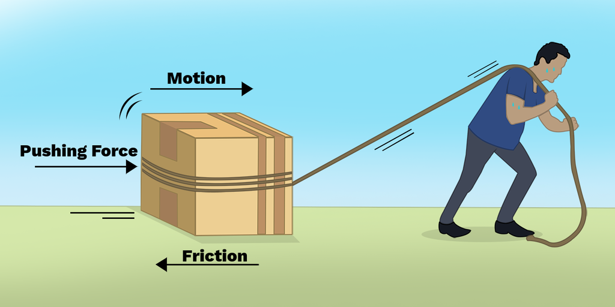
Friction is a force that happens when two objects rub against each other. When an object is moving in a certain direction, friction pushes against the object in the opposite direction. This causes the object to slow down and eventually stop.
Notes:
Friction is a force that happens when two objects rub against each other. When an object is moving in a certain direction, friction pushes against the object in the opposite direction. This causes the object to slow down and eventually stop.

Slide 27
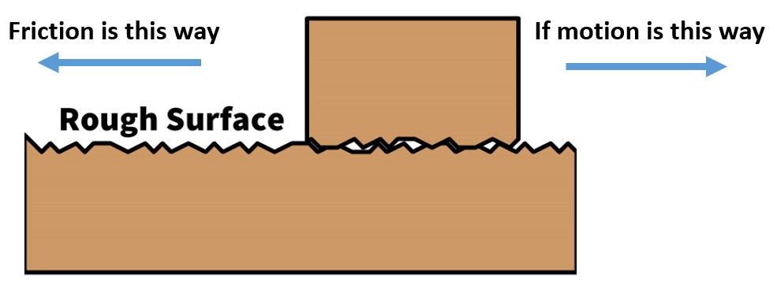
Friction is created when two rough surfaces come into contact. Even surfaces that seem very smooth have small bumps that can create friction! The rougher the objects are, the more friction is created between them.
Notes:
Friction is created when two rough surfaces come into contact. Even surfaces that seem very smooth have small bumps that can create friction! The rougher the objects are, the more friction is created between them.

Slide 28
As the two surfaces push and pull against each other, they release a little energy in the form of heat. For example, when you rub two sticks together, the friction produces enough heat that it can start a fire.
Notes:
As the two surfaces push and pull against each other, they release a little energy in the form of heat. For example, when you rub two sticks together, the friction produces enough heat that it can start a fire.

Slide 29
Notes:
Let’s check-in for understanding.

Slide 30
Friction pushes in the ________ direction of an object’s motion.
Same
Opposite
Notes:
Friction pushes in the _____ direction of an object’s motion.
[B. Opposite]

Slide 31
Friction pushes in the ________ direction of an object’s motion.
Same
Opposite
Notes:
Friction pushes in the opposite direction of an object’s motion.

Slide 32
What causes friction?
Notes:
What causes friction?
[Two rough surfaces coming into contact]

Slide 33
What causes friction?
Notes:
What causes friction? Two rough surfaces coming into contact.

Slide 34
Friction between two objects can produce _______________.
Notes:
Friction between two objects can produce _____________.
[Heat]

Slide 35
Friction between two objects can produce heat.
Notes:
Friction between two objects can produce heat.

Slide 36
Notes:
Now, let’s talk about some examples of friction.

Slide 37
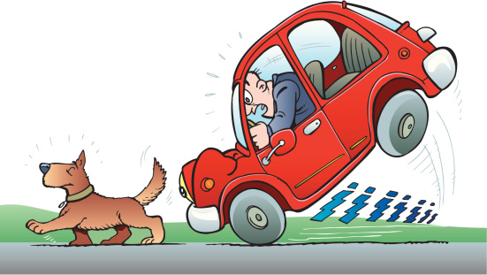
A car’s brakes is an example of friction. When the driver steps on the pedal, the brakes create friction with the car wheels. This causes the car to slow down and eventually stop.
Notes:
A car’s brakes is an example of friction. When the driver steps on the pedal, the brakes create friction with the car wheels. This causes the car to slow down and eventually stop.

Slide 38
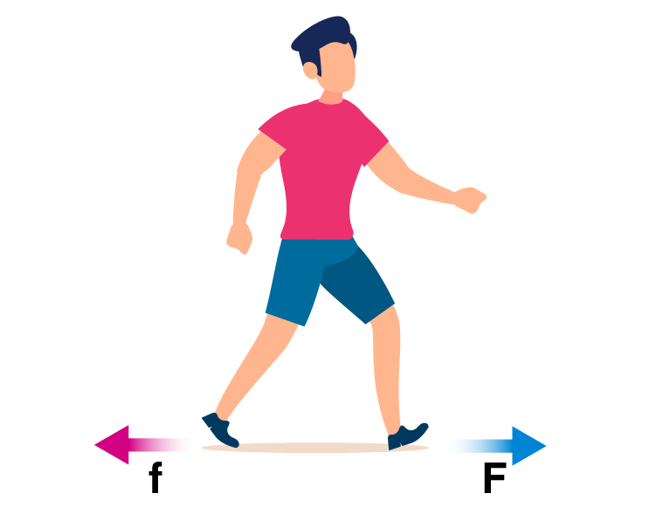
Walking is another example of friction. When we walk, our shoes create friction with the road. This helps our feet from slipping when we take our next step.
Notes:
Walking is another example of friction. When we walk, our shoes create friction with the road. This helps our feet from slipping when we take our next step.

Slide 39
Notes:
Now, let’s talk about some non-examples of friction.

Slide 40
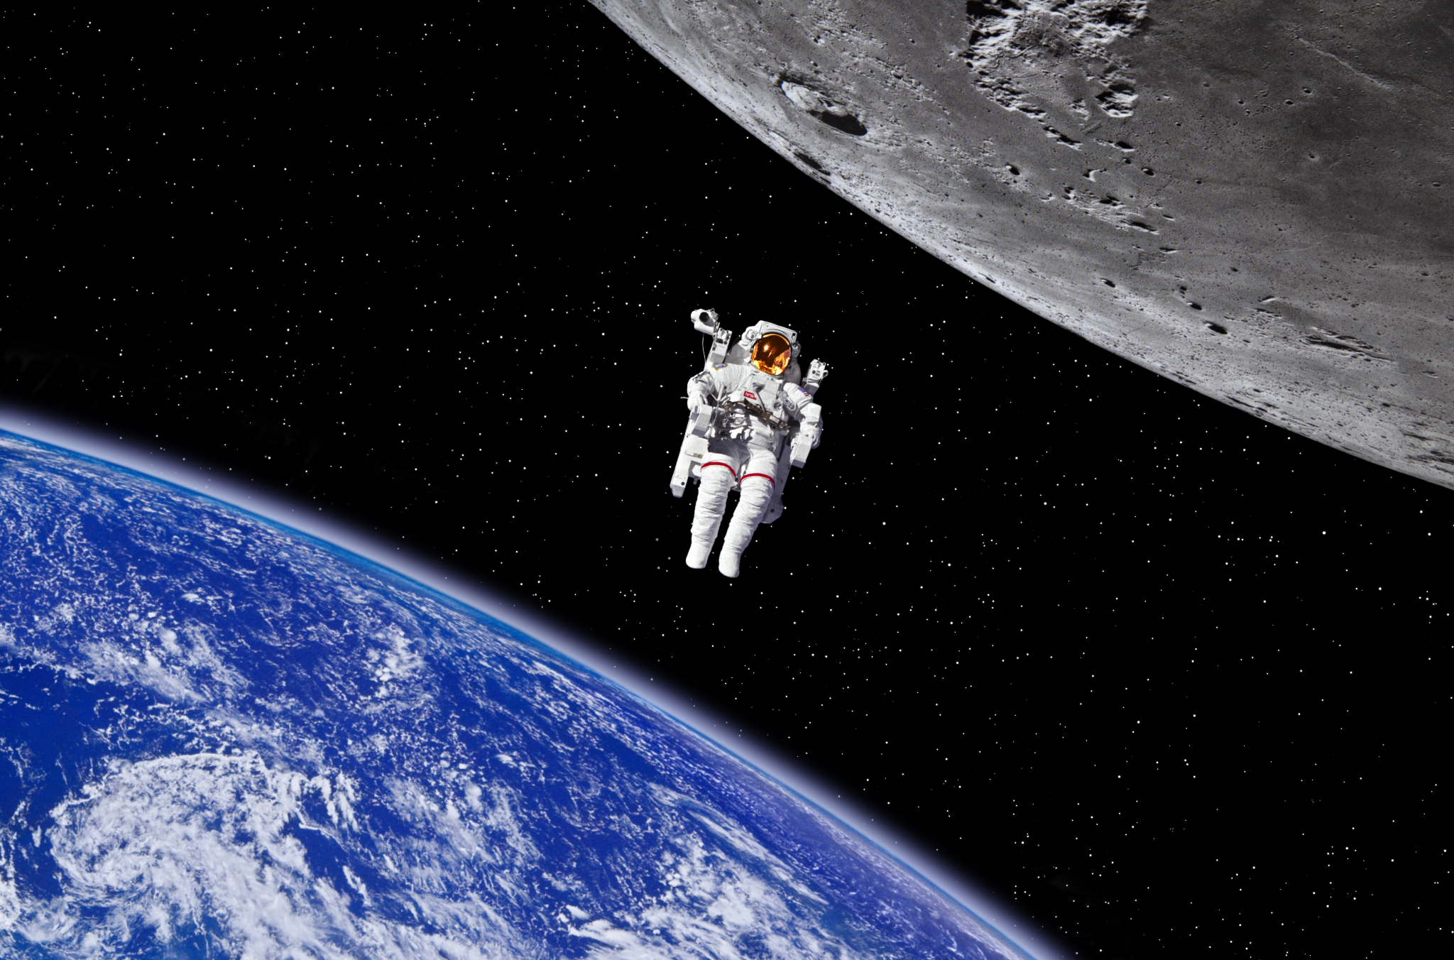
This is a non-example of friction. An astronaut in space doesn’t experience friction because there is no air or other materials to rub up against in space. This makes movement in space easier and smoother than on Earth.
Notes:
This is a non-example of friction. An astronaut in space doesn’t experience friction because there is no air or other materials to rub up against in space. This makes movement in space easier and smoother than on Earth.

Slide 41
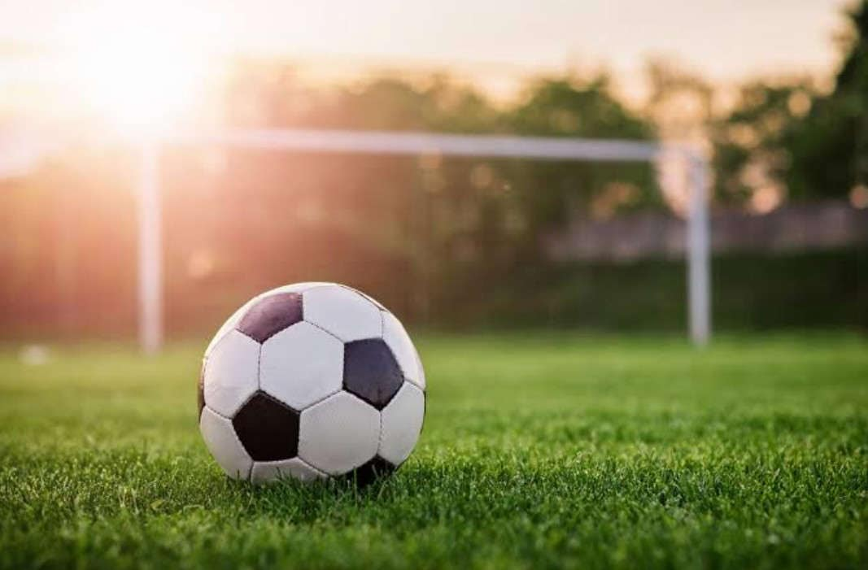
Here is another non-example of friction. The ball is not in motion, so it is not rubbing up against the grass or another surface. Without movement, no friction is created.
Notes:
Here is another non-example of friction. The ball is not in motion, so it is not rubbing up against the grass or another surface. Without movement, no friction is created.

Slide 42
Notes:
Now let’s pause for a moment to check your understanding.

Slide 43
What is friction?
Notes:
What is friction?
[A force that opposes the motion of an object]

Slide 44
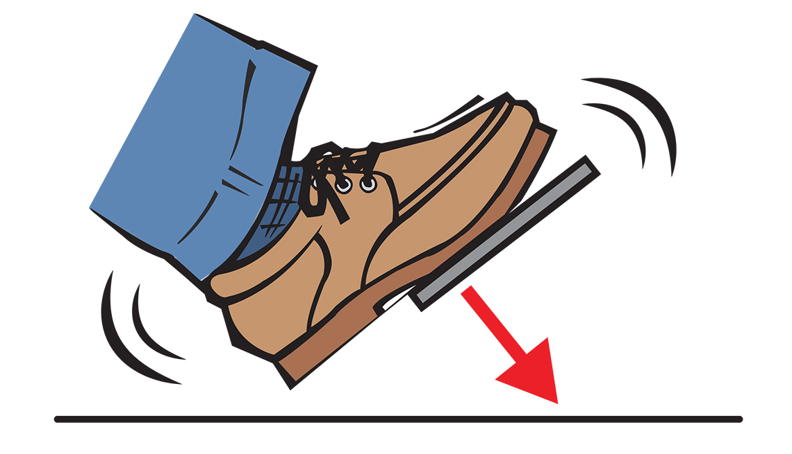
Which one is NOT an example of a friction?
Car Brakes
Making Fire
Still
Ball
Notes:
Which one is NOT an example of a friction?
[a still ball]

Slide 45
Which one is NOT an example of a friction?
Car Brakes
Making Fire
Still
Ball
Notes:
Which one is NOT an example of a friction? A still ball

Slide 46
Remember!!!
Notes:
So remember!

Slide 47
Friction: a force that opposes the motion of an object
Notes:
Friction is a force that opposes the motion of an object.

Slide 48
Notes:
We will now complete this concept map, called a Frayer model, to summarize and further clarify what you have learned about the term friction.

Slide 49
Definition
Picture
Friction
Example
How does friction impact my life?
Notes:
To complete the Frayer model, we will choose from four choices the correct picture, definition, example, and response to the question, “How does friction impact my life?” Select the best response for each question using the information you just learned. As we select responses, we will see how this model looks filled in for the term friction.

Slide 50
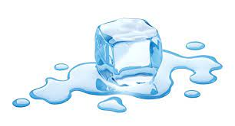
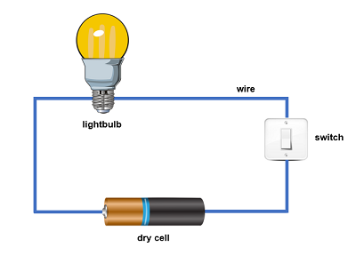
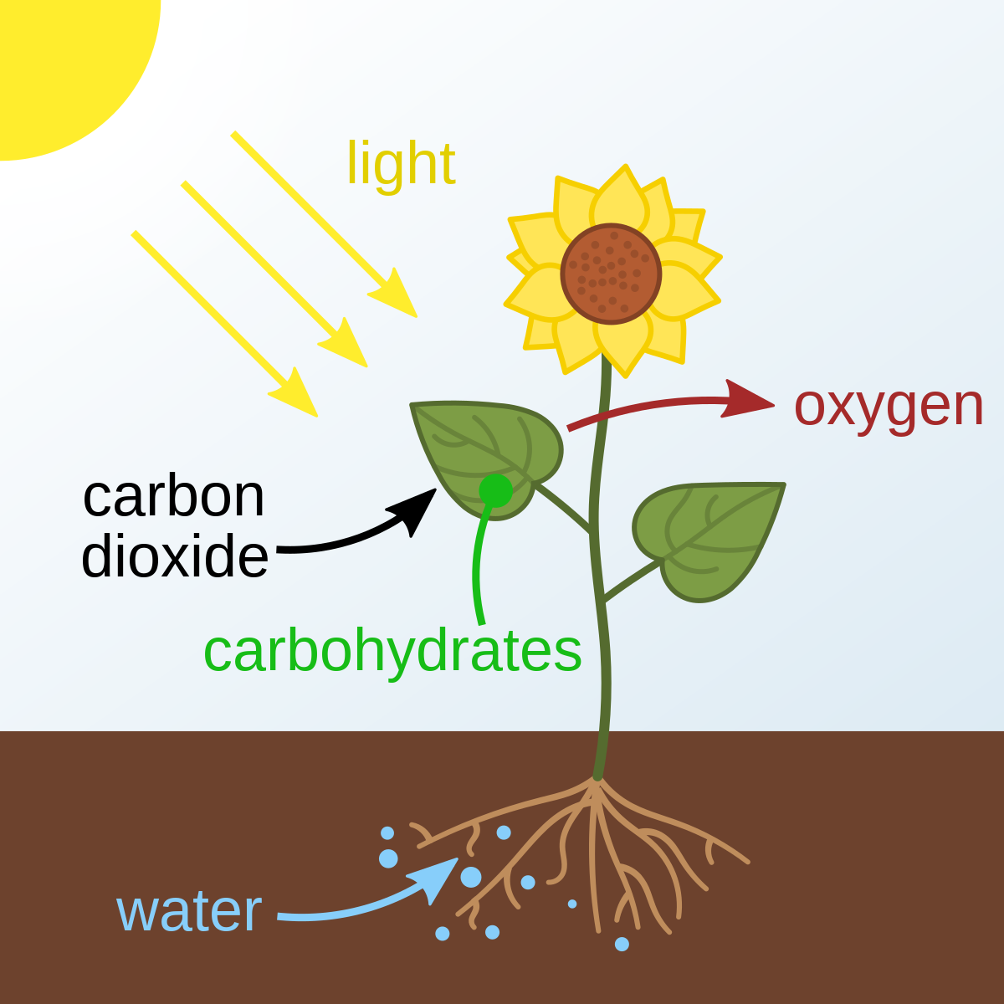
Directions: Choose the correct picture of friction from the choices below.
A
B
C
D
Notes:
Choose the one correct picture of friction from these four choices.

Slide 51
Directions: Choose the correct picture of friction from the choices below.
A
B
C
D
Notes:
This is the picture that shows friction.

Slide 52
Definition
Picture
Friction
Example
How does friction impact my life?
Notes:
Here is the Frayer model filled in with a picture of friction.

Slide 53
Directions: Choose the correct definition of friction from the choices below.
A
the process of breaking down rock over long periods of time
B
anything that has mass and takes up space
C
an electric current can follow only one path
D
a force that opposes the motion of an object
Notes:
Choose the one correct definition of friction from these four choices.

Slide 54
Directions: Choose the correct definition of friction from the choices below.
A
the process of breaking down rock over long periods of time
B
anything that has mass and takes up space
C
an electric current can follow only one path
D
a force that opposes the motion of an object
Notes:
“A force that opposes the motion of an object against another surface” is correct! This is the definition of friction.

Slide 55
Definition
Picture
a force that opposes the motion of an object
Friction
Example
How does friction impact my life?
Notes:
Here is the Frayer Model with a picture and the definition filled in for friction: a force that opposes the motion of an object.

Slide 56
Directions: Choose the correct example of friction from the choices below.
A
A pot of water that boils on the stove
B
A light bulb that lights up when the switch is turned on
C
A child using the brakes on their bicycle
D
A thunderstorm producing rain and lightning
Notes:
Choose the one correct example of friction from these four choices.

Slide 57
Directions: Choose the correct example of friction from the choices below.
A
A pot of water that boils on the stove
B
A light bulb that lights up when the switch is turned on
C
A child using the brakes on their bicycle
D
A thunderstorm producing rain and lightning
Notes:
“A child using the brakes on their bicycle” is correct! This is an example of friction.

Slide 58
Definition
Picture
a force that opposes the motion of an object
Friction
A child using the brakes on their bicycle
Example
How does friction impact my life?
Notes:
Here is the Frayer Model with a picture, definition, and an example of friction: a child using the brakes on their bicycle.

Slide 59
Directions: Choose the correct response for “how does friction impact my life?” from the choices below.
A
Friction helps our ears to vibrate so we can hear sound in our environment.
B
Friction is an important nutrient found in plants that animals need to get energy and stay healthy.
C
Friction helps keep Earth orbiting around the Sun so we experience all four seasons.
Friction helps us move around our world safely by helping us slow down and stop.
D
Notes:
Choose the one correct response for “how does friction impact my life?” from these four choices.

Slide 60
Directions: Choose the correct response for “how does friction impact my life?” from the choices below.
A
Friction helps our ears to vibrate so we can hear sound in our environment.
B
Friction is an important nutrient found in plants that animals need to get energy and stay healthy.
C
Friction helps keep Earth orbiting around the Sun so we experience all four seasons.
Friction helps us move around our world safely by helping us slow down and stop.
D
Notes:
“Friction helps us move around our world safely by helping us slow down and stop. ” That is correct! This is an example of how friction impacts your life.

Slide 61
Definition
Picture
a force that opposes the motion of an object
Friction
Friction helps us move around our world safely by helping us slow down and stop.
A child using the brakes on their bicycle
Example
How does friction impact my life?
Notes:
Here is the Frayer Model with a picture, definition, example, and a correct response to “how does friction impact my life?”:

Slide 62
Remember!!!
Notes:
So remember!

Slide 63
Friction: a force that opposes the motion of an object.
Notes:
Friction is a force that opposes the motion of an object.

Slide 64
Big Question: How do friction and resistance impact the way objects move through the world?
Notes:
Let’s reflect again on our big question. Our “big question” is: How do friction and resistance impact the way objects move through the world?

Slide 65
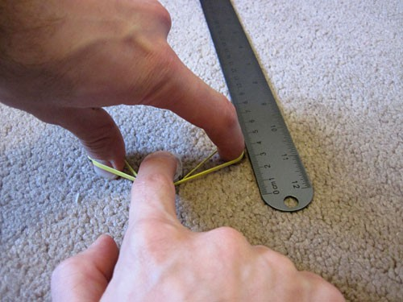
Simulation Activity
Friction Experiment
In this experiment, you will test the friction created when objects slides across different kinds of surfaces.
Make a hypothesis:
What kinds of surfaces (bumpy, smooth, etc.) will create the most friction? Which will create the least? Why?

Slide 66
Notes:
Thanks for watching, and please continue watching CAPs available from this website.

Slide 67
This Was Created With Resources From:
Questions or Comments
Michael Kennedy, Ph.D. MKennedy@Virginia.edu
Rachel L Kunemund, Ph.D. rk8vm@virginia.edu

