Slide 1
Intro
“Big Idea” Question
Review Concepts
Check-In Questions
Teacher Engagement
Vocabulary
Student-Friendly Definition
Examples & Non-Examples
Morphological Word Parts
Frayer Model
Simulation/Activity
Notes:
OK everyone, get ready for our next lesson. Just as a reminder, these are the different components that our lesson may include, and you’ll see these icons in the top left corner of each slide so that you can follow along more easily!

Slide 2
Intro
“Big Idea” Question
Review Concepts
Check-In Questions
Teacher Engagement
Vocabulary
Student-Friendly Definition
Examples & Non-Examples
Morphological Word Parts
Frayer Model
Simulation/Activity
Notes:
OK everyone, get ready for our next lesson. Just as a reminder, these are the different components that our lesson may include, and you’ll see these icons in the top left corner of each slide so that you can follow along more easily!

Slide 3
Intro
Inertia
Notes:
Today, we’ll be learning about the word: Inertia.

Slide 4
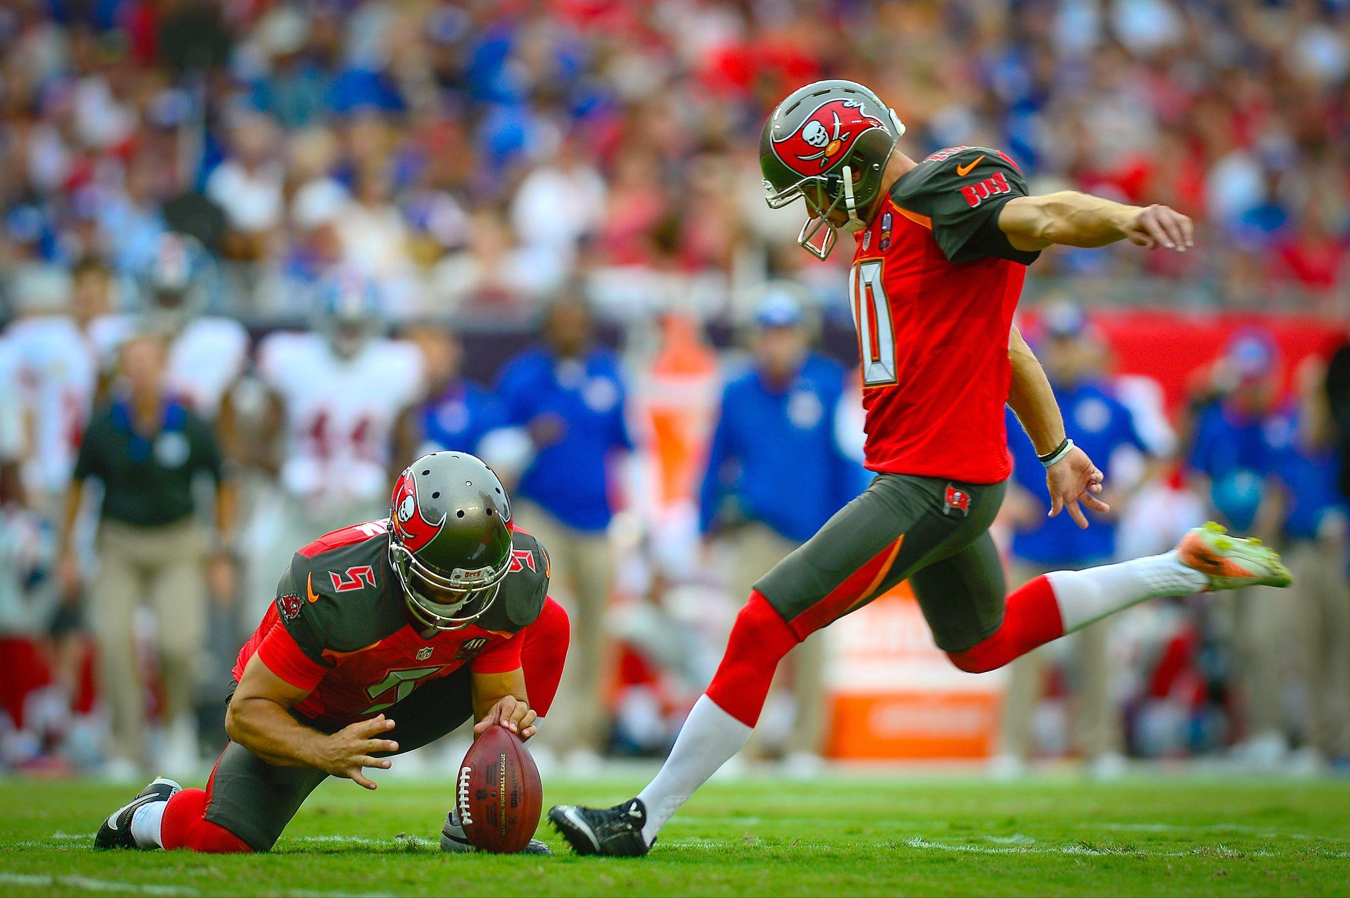
Big Question: Why do things keep moving or stay still unless a force acts on them?
Notes:
Our “big question” is: Why do things keep moving or stay still unless a force acts on them?
[Pause and illicit predictions from students.]
I love all these thoughtful scientific hypotheses! Be sure to keep this question and your predictions in mind as we move through these next few lessons, and we’ll continue to revisit it.

Slide 5
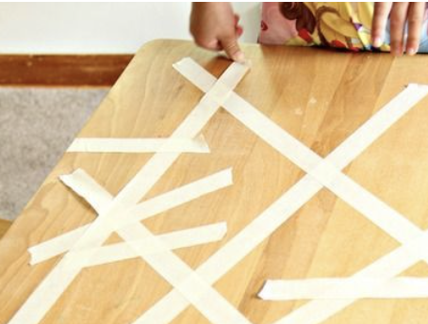
Demonstration
TEACHER DIRECTIONS:
Before viewing: Ask students to recall what they already know about inertia.
During: Engage in a class discussion about the observations. Ask questions such as: What happened when the object was at rest, and a force was applied?
What happened when the object was in motion, and a force was applied?
How did the object's mass influence its response to the applied force?
After: Tell students that today they will be learning more about the term inertia.
Notes:
To teach about inertia in the context of sources of energy, you can conduct a simple and engaging classroom demonstration using everyday objects. This demonstration will help students understand the concept of inertia, which is an object's tendency to resist changes in its state of motion. Here's a step-by-step guide for the demonstration:
Materials needed:
Small objects (e.g., a toy car, a ball, a book)
Smooth table or desk surface
Masking tape or ruler
Stopwatch or timer
Markers or chalk for labeling
Procedure:
Set Up the Experiment:
Place a small object (e.g., a toy car) on a smooth table or desk surface.
Use masking tape or a ruler to mark a starting line in front of the object.
Introduce Inertia:
Begin by discussing the concept of inertia with the students. Explain that inertia is an object's resistance to changes in its state of motion. Objects at rest tend to stay at rest, and objects in motion tend to stay in motion unless acted upon by an external force.
Predictions:
Ask students to predict what will happen when you apply a force to the object on the table.
Experiment - Part 1:
Apply a quick, gentle push to the object and observe its motion. Discuss what happens and how far the object travels.
Experiment - Part 2:
Apply a stronger force to the object and observe its motion. Discuss any differences in the object's behavior compared to the first trial.
Experiment - Part 3:
Apply a force in the opposite direction, attempting to stop the object. Discuss the challenges of stopping the object's motion.
Class Discussion:
Engage in a class discussion about the observations. Ask questions such as:
What happened when the object was at rest, and a force was applied?
What happened when the object was in motion, and a force was applied?
How did the object's mass influence its response to the applied force?
Connect to Energy:
Relate the concept of inertia to energy by discussing how changes in an object's state of motion require the application of force and, therefore, the transfer of energy.
Extension Activity:
Challenge students to experiment with different objects and surfaces to observe how inertia varies.
This hands-on demonstration allows students to experience and visualize the concept of inertia. It provides a foundation for understanding how inertia relates to energy and the role it plays in the behavior of objects in motion.

Slide 6
Notes:
Before we move on to our new topic, let’s review some other words & concepts that you already learned and make sure you are firm in your understanding.

Slide 7
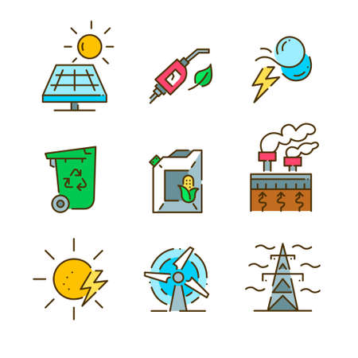
Energy: the ability to cause change
Notes:
Energy is the ability to cause change.

Slide 8
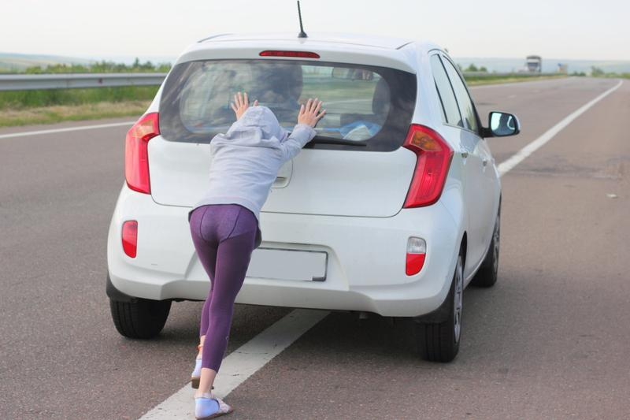
Force: push or pull on an object
Notes:
Force is a push or pull on an object.

Slide 9
Direction: where something moves or points
Notes:
Direction is where something moves or points.

Slide 10
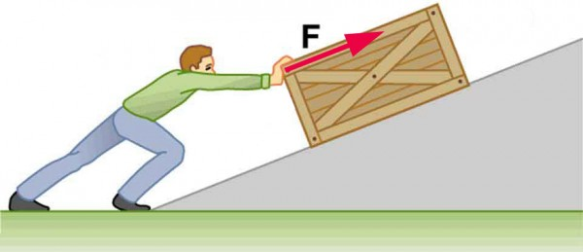
Work: a force acting upon an object causing the object to move in the direction of that force
Notes:
Work is a force acting upon an object causing the object to move in the direction of that force.

Slide 11
Notes:
Now let’s pause for a moment to review the information we have covered already.

Slide 12
True or False: Force is the push or pull of an object.
True
False
Notes:
True or False: Force is the push or pull of an object.

Slide 13
True or False: Force is the push or pull of an object.
True
False
Notes:
True or False: Force is the push or pull of an object.
[True]

Slide 14
______ is a force acting upon an object causing the object to move in the direction of that force.
Work
Energy
Notes:
_____ is a force acting upon an object causing the object to move in the direction of that force.
[Work]

Slide 15
______ is a force acting upon an object causing the object to move in the direction of that force.
Work
Energy
Notes:
[Work] is a force acting upon an object causing the object to move in the direction of that force.

Slide 16
Inertia
Notes:
Now that we’ve reviewed, let’s define the phrase inertia.

Slide 17
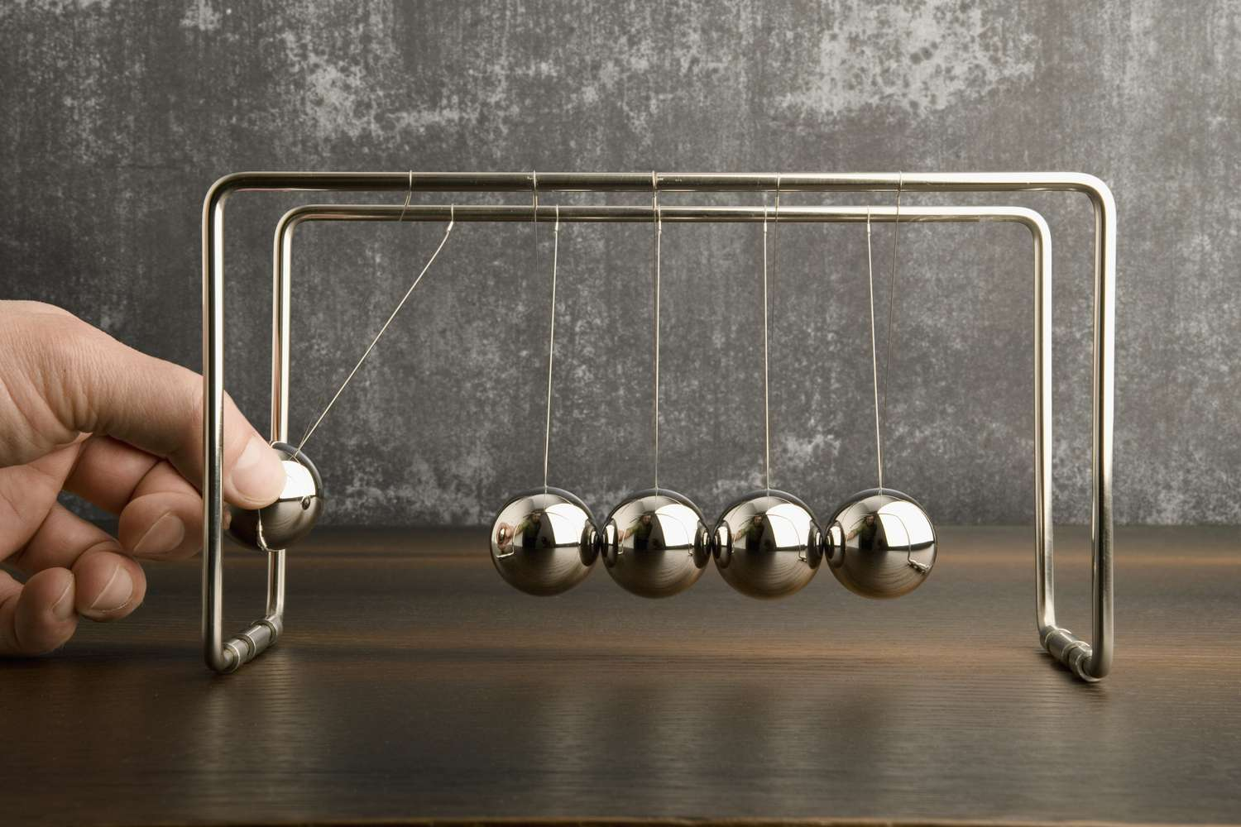
Inertia: tendency of an object to resist change in motion
Notes:
Inertia is the tendency of an object to resist change in motion.

Slide 18
Notes:
Let’s check-in for understanding.

Slide 19
What is inertia?
Notes:
What is inertia?
[Inertia is the tendency of an object to resist change in motion.]

Slide 20
Notes:
That is the basic definition, but there is a bit more you need to know.

Slide 21
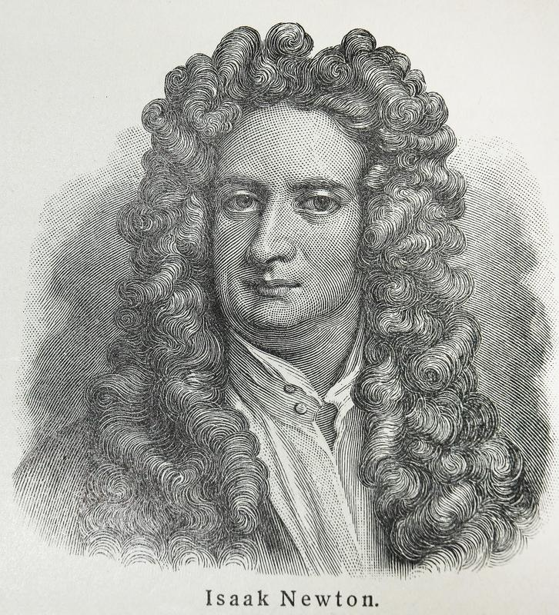
Newton's First Law of Motion is also known as the law of inertia. It says that an object will stay still or keep moving in a straight line unless a force pushes or pulls on it. In simpler terms, things like to stay the way they are unless something makes them change. For example, a soccer ball won't start rolling unless you kick it, and a car won't stop unless you hit the brakes because they both have this thing called inertia that makes them resist changes in motion.
Notes:
Newton's First Law of Motion is also known as the law of inertia. It says that an object will stay still or keep moving in a straight line unless a force pushes or pulls on it. In simpler terms, things like to stay the way they are unless something makes them change. For example, a soccer ball won't start rolling unless you kick it, and a car won't stop unless you hit the brakes because they both have this thing called inertia that makes them resist changes in motion.

Slide 22
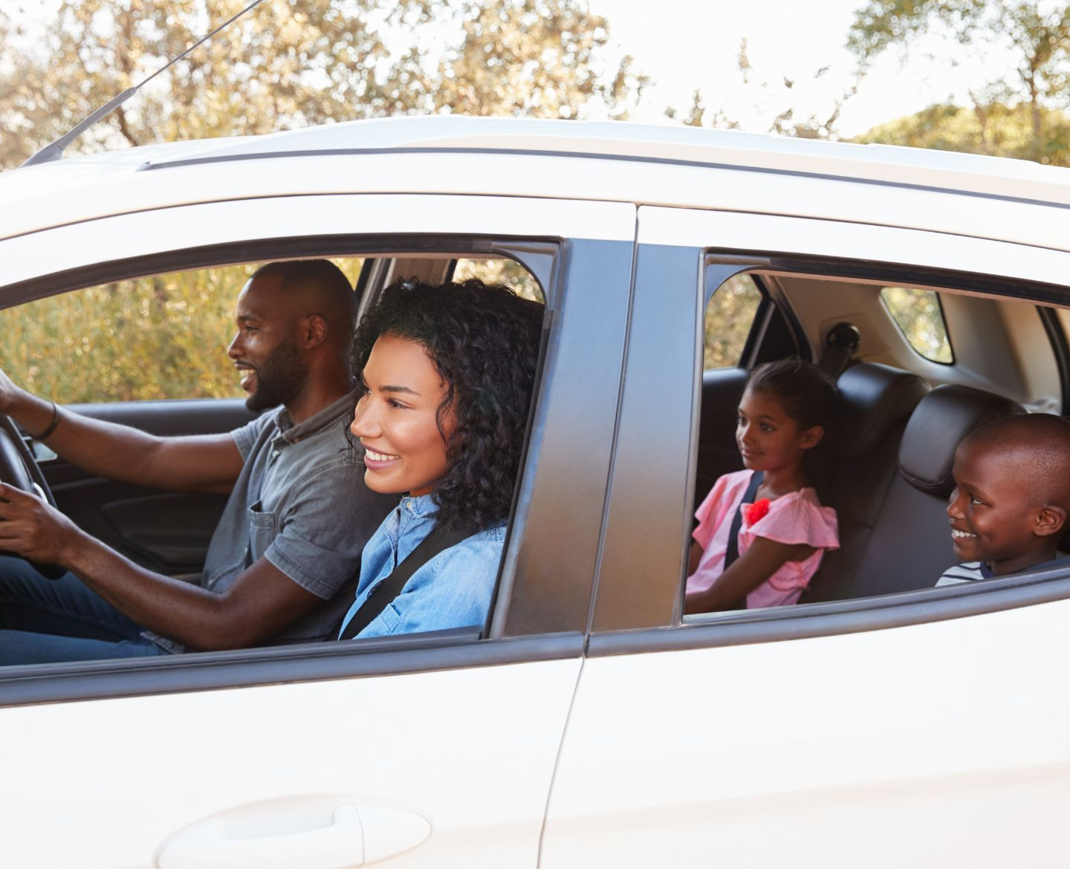
Inertia means things want to stay keep doing what they are doing. For example, if you're sitting in a car that's not moving, you stay still unless someone, usually the driver, pushes the gas pedal to make the car go. That's because you and the car have something called inertia. You want to stay still until something makes you move.
Notes:
Inertia means things want to stay keep doing what they are doing. For example, if you're sitting in a car that's not moving, you stay still unless someone, usually the driver, pushes the gas pedal to make the car go. That's because you and the car have something called inertia. You want to stay still until something makes you move.

Slide 23
But, if the car is already moving, and the driver suddenly stops, you feel like you're pushed forward. That's because, even though the car stopped, your body wants to keep moving at the same speed. Your body wanted to keep doing what it was doing, which was moving along with the car. Inertia is why you wear a seatbelt in the car. If the car suddenly stops, your seatbelt keeps you from flying forward because it's helping you overcome your inertia.
Notes:
But, if the car is already moving, and the driver suddenly stops, you feel like you're pushed forward. That's because, even though the car stopped, your body wants to keep moving at the same speed. Your body wanted to keep doing what it was doing, which was moving along with the car. Inertia is why you wear a seatbelt in the car. If the car suddenly stops, your seatbelt keeps you from flying forward because it's helping you overcome your inertia.

Slide 24
Inertia is like a "stay as you are" property. Objects like to stay still if they're still, and they like to stay moving if they're moving, until something else pushes or pulls them to change. For example, a baseball at rest on a field will stay at rest until someone picks it up. A baseball flying through the air will continue to fly through the air until it is caught or hits another object. Overall, inertia means objects resist change in the state of motion they are in.
Notes:
Inertia is like a "stay as you are" property. Objects like to stay still if they're still, and they like to stay moving if they're moving, until something else pushes or pulls them to change. For example, a baseball at rest on a field will stay at rest until someone picks it up. A baseball flying through the air will continue to fly through the air until it is caught or hits another object. Overall, inertia means objects resist change in the state of motion they are in.

Slide 25
Notes:
Let’s check-in for understanding.

Slide 26
True or False: Inertia is Newton’s First Law of Motion.
Notes:
True or False: Inertia is Newton’s First Law of Motion.
[True]

Slide 27
True: Inertia is Newton’s First Law of Motion.
Notes:
True: Inertia is Newton’s First Law of Motion.

Slide 28
Objects like to _____ still if they’re still and like to _____ moving if they are moving.
Notes:
Objects like to ______ still fio they’re still and like to ______ moving if they are moving.
[stay, stay]

Slide 29
Objects like to stay still if they’re still and like to stay moving if they are moving.
Notes:
Objects like to [stay] still fio they’re still and like to [stay] moving if they are moving.

Slide 30
Notes:
Now, let’s talk about some examples of inertia.

Slide 31
When you are driving in a car, your body is moving at the same speed as the car.
Notes:
When you are driving in a car, your body is moving at the same speed as the car.

Slide 32
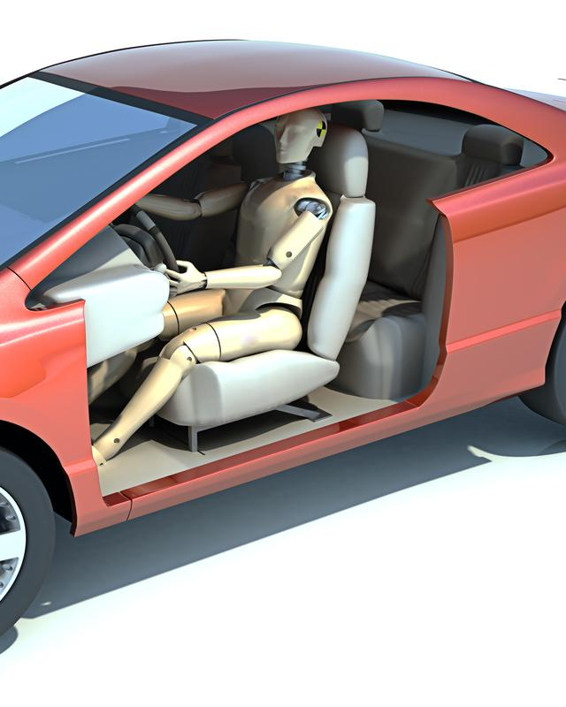
But, when you get in an accident, your car is hit by another force. Not you. You continue to move forward because of inertia – your body is resisting the change in motion.
Notes:
But, when you get in an accident, your car is hit by another force. Not you. You continue to move forward because of inertia – your body is resisting the change in motion.

Slide 33
Notes:
Let’s check-in for understanding.

Slide 34
What is inertia?
Notes:
What is inertia?
[Inertia is the tendency of an object to resist change in motion.]

Slide 35
Notes:
Now, let’s talk about some non-examples of inertia.

Slide 36
A person painting a picture is NOT an example of inertia. The person painting the picture starts and stops motion and staying at rest. They are choosing to exert force or not at different times.
Notes:
A person painting a picture is not an example of inertia. The person painting the picture starts and stops motion and staying at rest. They are choosing to exert force or not at different times.

Slide 37
A sunset is NOT an example of inertia. As the sun dips below the horizon, it reflects different light fragments that changes color of the sky. Objects are not moving or staying at rest.
Notes:
A sunset is not an example of inertia. As the sun dips below the horizon, it reflects different light fragments that changes color of the sky. Objects are not moving or staying at rest.

Slide 38
Notes:
Now let’s pause for a moment to check your understanding.

Slide 39
How does inertia apply to objects both at rest and in motion?
Notes:
How does inertia apply to objects both at rest and in motion?
[Inertia means objects resist change to the state of motion they are in. If they are at rest, they want to stay at rest. If they are in motion, they want to stay in motion. That is, until another force acts on them.]

Slide 40
Remember!!!
Notes:
So remember!

Slide 41
Inertia: tendency of an object to resist change in motion
Notes:
Inertia is a tendency of an object to resist change in motion.

Slide 42
Notes:
We will now complete this concept map, called a Frayer model, to summarize and further clarify what you have learned about the term inertia.

Slide 43
Definition
Picture
Inertia
Example
How does inertia impact my life?
Notes:
To complete the Frayer model, we will choose from four choices the correct picture, definition, example, and response to the question, “How does inertia impact my life?” Select the best response for each question using the information you just learned. As we select responses, we will see how this model looks filled in for the term inertia.

Slide 44
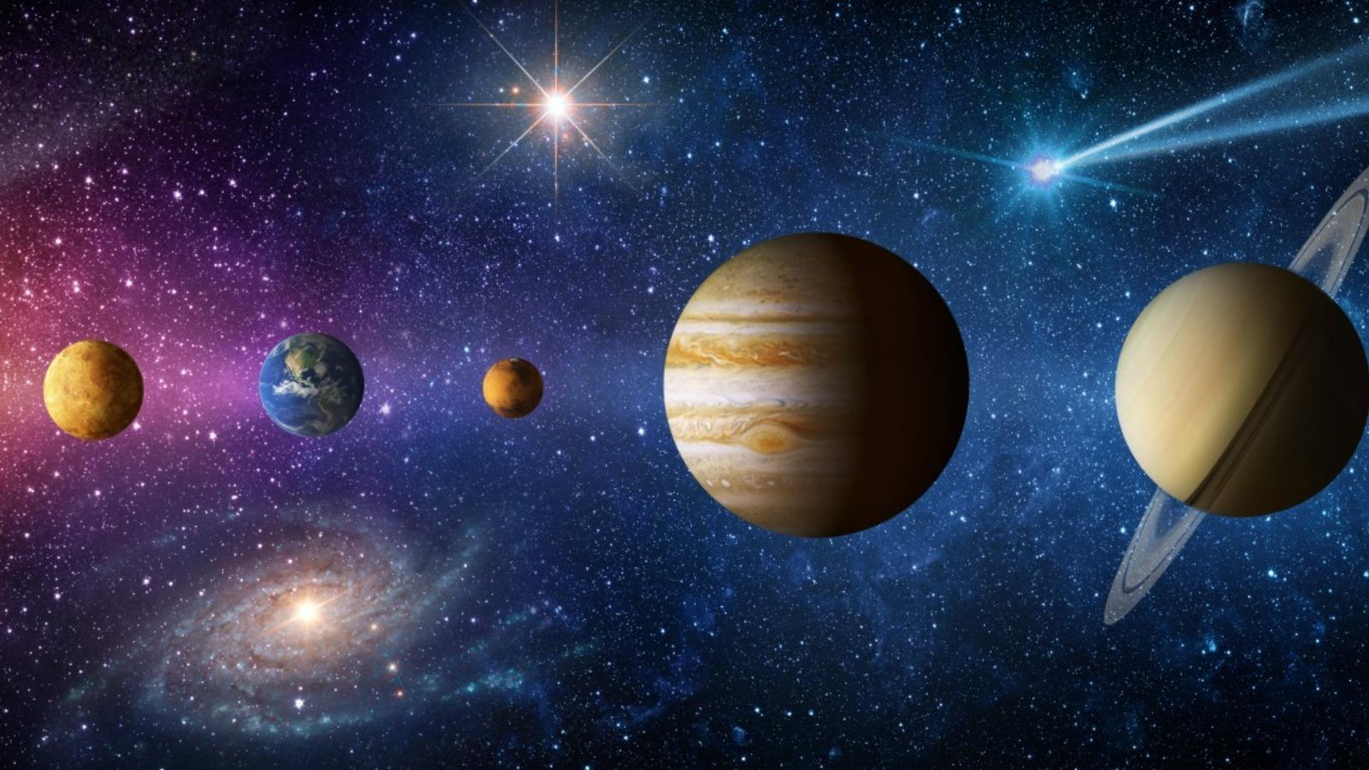
Directions: Choose the correct picture of Inertia from the choices below.
A
B
C
D
Notes:
Choose the one correct picture of inertia from these four choices.

Slide 45
Directions: Choose the correct picture of Inertia from the choices below.
A
B
C
D
Notes:
This is the picture that shows inertia.

Slide 46
Definition
Picture
Inertia
Example
How does inertia impact my life?
Notes:
Here is the Frayer model filled in with a picture of inertia.

Slide 47
Directions: Choose the correct definition of Inertia from the choices below.
A
The smallest unit of matter
B
Tendency of an object to resist change in motion
C
A push or pull of an object
D
Flows in only one direction
Notes:
Choose the one correct definition of inertia from these four choices.

Slide 48
Directions: Choose the correct definition of Inertia from the choices below.
A
The smallest unit of matter
B
Tendency of an object to resist change in motion
C
A push or pull of an object
D
Flows in only one direction
Notes:
“Tendency of an object to resist change in motion” is correct! This is the definition of inertia.

Slide 49
Definition
Picture
Tendency of an object to resist change in motion
Inertia
Example
How does inertia impact my life?
Notes:
Here is the Frayer Model with a picture and the definition filled in for tendency: Tendency of an object to resist change in motion.

Slide 50
Directions: Choose the correct example of Inertia from the choices below.
A
Clouds forming
B
Rain and wind
C
A parked car
D
Dreaming during sleep
Notes:
Choose the one correct example of inertia from these four choices.

Slide 51
Directions: Choose the correct example of Inertia from the choices below.
A
Clouds forming
B
Rain and wind
C
A parked car
D
Dreaming during sleep
Notes:
“A parked car” is correct! This is an example of inertia.

Slide 52
Definition
Picture
Tendency of an object to resist change in motion
Inertia
A parked car
Example
How does inertia impact my life?
Notes:
Here is the Frayer Model with a picture, definition, and an example of inertia: A parked car.

Slide 53
Directions: Choose the correct response for “how does inertia impact my life?” from the choices below.
A
Inertia is the force that protects Earth from outer space.
B
Inertia is responsible for the air we breathe in order to survive.
C
Inertia explains why it is hard to start moving, stop moving, or change how objects are moving.
Inertia demonstrates the power of the different types of weather in our environment.
D
Notes:
Choose the one correct response for “how does inertia impact my life?” from these four choices.

Slide 54
Directions: Choose the correct response for “how does inertia impact my life?” from the choices below.
A
Inertia is the force that protects Earth from outer space.
B
Inertia is responsible for the air we breathe in order to survive.
C
Inertia explains why it is hard to start moving, stop moving, or change how objects are moving.
Inertia demonstrates the power of the different types of weather in our environment.
D
Notes:
“Inertia explains why it is hard to start moving, stop moving, or change how objects are moving.” That is correct! This is an example of how inertia impacts your life.

Slide 55
Definition
Picture
Tendency of an object to resist change in motion
Inertia
Inertia explains why it is hard to start moving, stop moving, or change how objects are moving.
A parked car
Example
How does inertia impact my life?
Notes:
Here is the Frayer Model with a picture, definition, example, and a correct response to “how does inertia impact my life?”: Inertia explains why it is hard to start moving, stop moving, or change how objects are moving.

Slide 56
Remember!!!
Notes:
So remember!

Slide 57
Inertia: tendency of an object to resist change in motion
Notes:
Inertia is a tendency of an object to resist change in motion.

Slide 58
Big Question: Why do things keep moving or stay still unless a force acts on them?
Notes:
Let’s reflect once more on our big question. Our “big question” is: Why do things keep moving or stay still unless a force acts on them?
Does anyone have any additional examples to share that haven’t been discussed yet?

Slide 59
Simulation Activity
Newton’s 1st Law of Motion
(Physics Classroom)
Click the link above for a simulation to deepen your understanding of inertia, which is Newton’s First Law of Motion.
Notes:
Feedback: It is really helpful for students when you provided a rationale for this activity, as this really supports students' understanding of how it relates to the topic you're covering.

Slide 60
Notes:
Thanks for watching, and please continue watching CAPs available from this website.

Slide 61
This Was Created With Resources From:
Questions or Comments
Michael Kennedy, Ph.D. MKennedy@Virginia.edu
Rachel L Kunemund, Ph.D. rk8vm@virginia.edu

