Slide 1
Intro
“Big Idea” Question
Review Concepts
Check-In Questions
Teacher Engagement
Vocabulary
Student-Friendly Definition
Examples & Non-Examples
Morphological Word Parts
Frayer Model
Simulation/Activity
Notes:
OK everyone, get ready for our next lesson. Just as a reminder, these are the different components that our lesson may include, and you’ll see these icons in the top left corner of each slide so that you can follow along more easily!

Slide 2
Motion
Intro
Notes:
Next, we’ll be learning about the word: Motion.

Slide 3
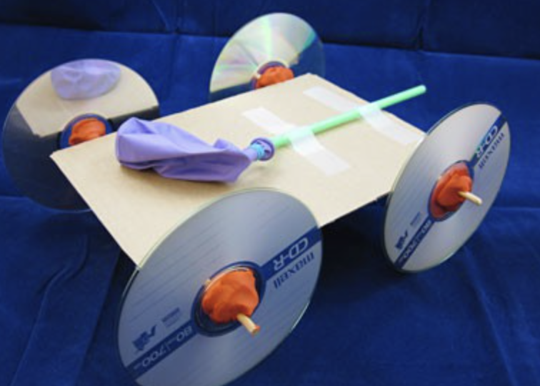
Demonstration
TEACHER DIRECTIONS:
Before viewing: Ask students to recall what they already know about motion.
During: Demonstrate how to inflate the balloon and then release the air, letting the escaping air propel the car forward.
Discuss with the students the motion of the cars and how the energy from the inflated balloon is transferred to the wheels, causing the car to move.
After: Tell students that today they will be learning more about the term motion.
Notes:
To teach about motion in the context of sources of energy, you can conduct a simple and engaging classroom demonstration using a homemade balloon-powered car. This demonstration will help students understand the basics of motion and how energy can be transferred to create movement. Here's a step-by-step guide for the demonstration:
Materials needed:
Balloons
Drinking straws
Plastic bottle caps
Wheels (you can use CDs, bottle caps, or cardboard circles)
Rubber bands
Tape
Scissors
Markers or stickers for decorating (optional)
Procedure:
Prepare the Balloon-Powered Cars:
Distribute materials to each student or group of students.
Instruct students to design and create their own balloon-powered cars using the materials provided. They can cut the drinking straws to use as axles, attach wheels to the axles, and use a plastic bottle cap as the body of the car.
Attach the Balloon:
Once the basic car is assembled, show students how to attach a deflated balloon to the rear of the car using a rubber band. Make sure the balloon opening faces backward.
Decorate (Optional):
Allow students to decorate their balloon-powered cars using markers or stickers. Encourage creativity in designing the appearance of the cars.
Demonstrate and Discuss:
Demonstrate how to inflate the balloon and then release the air, letting the escaping air propel the car forward.
Discuss with the students the motion of the cars and how the energy from the inflated balloon is transferred to the wheels, causing the car to move.
Experiment and Observe:
Have students experiment with different sizes of balloons, amounts of air, or wheel configurations to see how these factors affect the motion of their cars.
Encourage them to make predictions and observe the outcomes.
Class Discussion:
Lead a class discussion about motion, emphasizing key concepts such as:
How does the inflated balloon store energy?
What happens when the balloon is released?
How does the transfer of energy result in motion?
Relate to Energy Sources:
Connect the demonstration to sources of energy by discussing how the balloon-powered car represents a basic form of energy transfer and motion, similar to how other vehicles are powered by different energy sources.
Extension Activity:
Challenge students to modify their designs to improve the speed or distance traveled by their balloon-powered cars.
This hands-on demonstration allows students to directly observe the principles of motion and energy transfer. It also provides an opportunity for creativity and problem-solving as students design and test their balloon-powered cars.

Slide 4
Notes:
Before we move on to our new topic, let’s review some other words & concepts that you already learned and make sure you are firm in your understanding.

Slide 5
Direction: where something moves or points
Notes:
Direction is where something moves or points

Slide 6
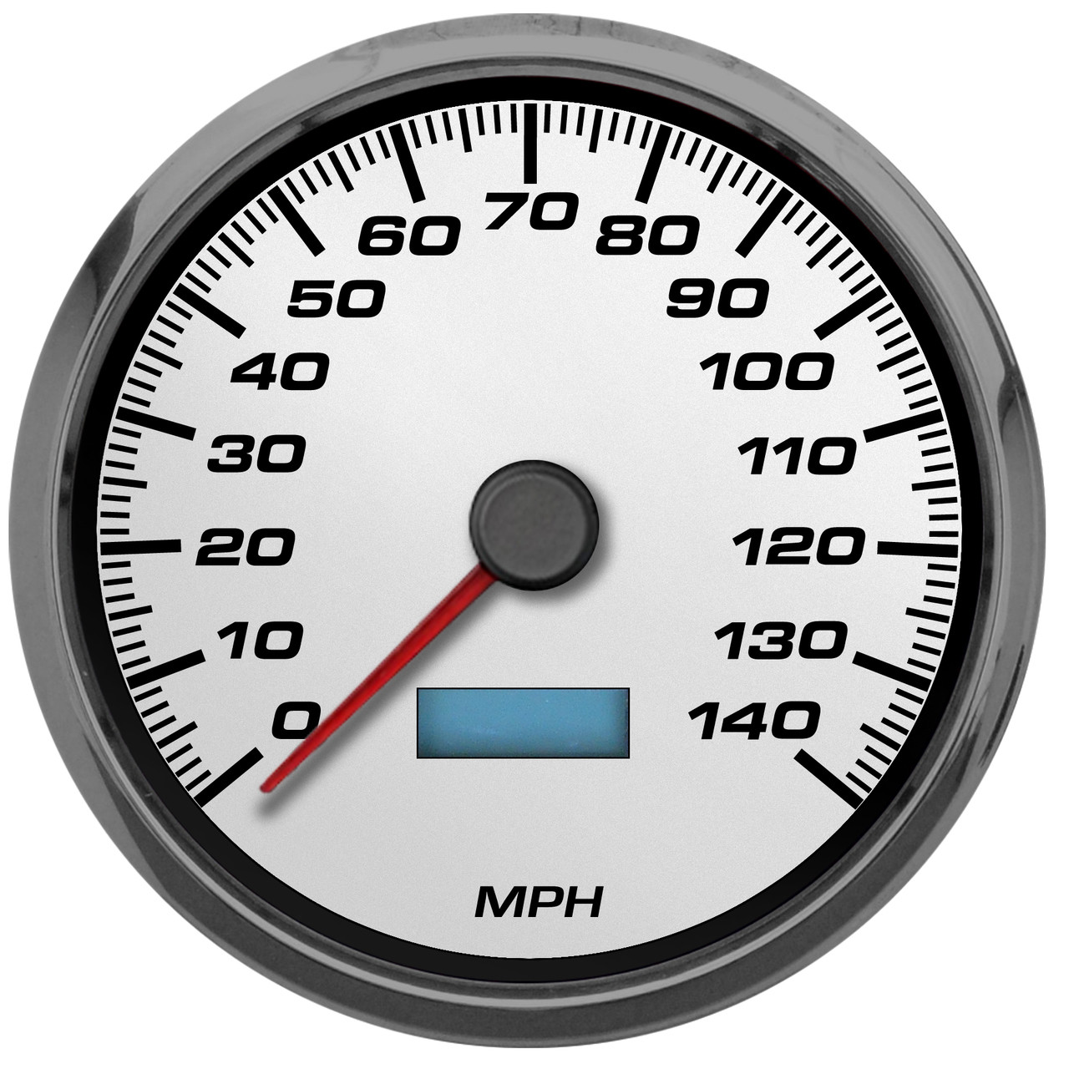
Speed: how fast an object moves
Notes:
Speed is how fast an object moves.

Slide 7
Notes:
Now let’s pause for a moment to review the information we have covered already.

Slide 8
True or False: Direction is where something moves or points.
A. True
B. False
Notes:
True or false: Direction is where something moves or points.
[True]

Slide 9
True or False: Direction is where something moves or points.
A. True
B. False
Notes:
True or false: Direction is where something moves or points.
[True]

Slide 10
A. Energy
B. Energy transformation
C. Speed
______ is how fast an object moves.
Notes:
_________ is how fast an object moves.
[Speed]

Slide 11
A. Energy
B. Energy transformation
C. Speed
______ is how fast an object moves.
Notes:
_________ is how fast an object moves.
[Speed]

Slide 12
Motion
Notes:
Now that we’ve reviewed, let’s define the phrase motion.

Slide 13
Motion: moving from one place to another
Notes:
Motion is moving from one place to another.

Slide 14
Notes:
Let’s check-in for understanding.

Slide 15
What is motion?
Notes:
What is motion?
[Motion is moving from one place to another..]

Slide 16
Notes:
That is the basic definition, but there is a bit more you need to know.

Slide 17
Motion of an object can be described by the object’s direction and speed.
Notes:
Motion of an object can be described by the object’s direction and speed. That is why it was important to first define the words direction and speed.

Slide 18
Forces between objects can cause a change in motion. When two objects interact, each exerts a force on the other. These forces can transfer energy between objects which can cause changes in their motion. For example, when a hammer hits a nail, there is a transfer of energy from the hammer to the nail causing the nail to change in motion. The nail moves into the piece of wood in this picture.
Notes:
Forces between objects can cause a change in motion. When two objects interact, each exerts a force on the other. These forces can transfer energy between objects which can cause changes in their motion. For example, when a hammer hits a nail, there is a transfer of energy from the hammer to the nail causing the nail to change in motion. The nail moves into the piece of wood in this picture.

Slide 19
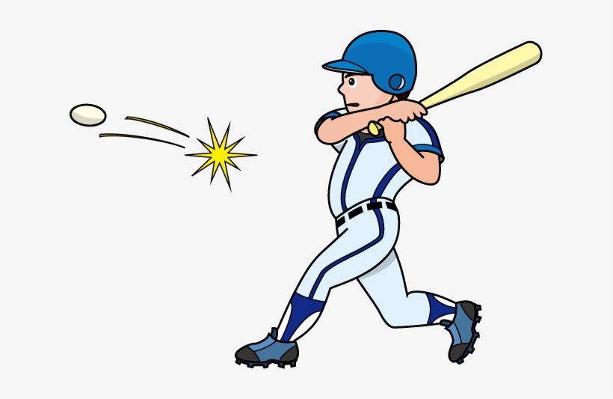
Objects in motion tend to stay in motion, unless acted on by a force. The greater the force, the greater the change in motion. An example of this fact is a collision. When a baseball is thrown, it is in motion. If the baseball collides with a swinging bat (the force), the motion of the ball changes - maybe even into a homerun!
Notes:
Objects in motion tend to stay in motion, unless acted on by a force. The greater the force, the greater the change in motion. An example of this fact is a collision. When a baseball is thrown, it is in motion. If the baseball collides with a swinging bat (the force), the motion of the ball changes - maybe even into a homerun!

Slide 20
Notes:
Let’s check-in for understanding.

Slide 21
Motion of an object can be described by the object’s ______ and ______.
Notes:
Motion of an object can be described by the object’s _______ and _______.
[direction, speed]

Slide 22
Motion of an object can be described by the object’s direction and speed.
Notes:
Motion of an object can be described by the object’s [direction] and [speed].
[direction, speed]

Slide 23
_______ between objects can cause a change in motion.
Differences
Similarities
Forces
Notes:
_______ between objects can cause a change in motion.
[Forces]

Slide 24
_______ between objects can cause a change in motion.
Differences
Similarities
Forces
Notes:
_______ between objects can cause a change in motion.
[Forces]

Slide 25
True or False: The greater the force, the greater the change in motion.
True
False
Notes:
True or False: The greater the force, the greater the change in motion.
True
False

Slide 26
True or False: The greater the force, the greater the change in motion.
True
False
Notes:
True: the greater the force, the greater the change in motion.

Slide 27
Notes:
Now, let’s talk about some examples of motion.

Slide 28
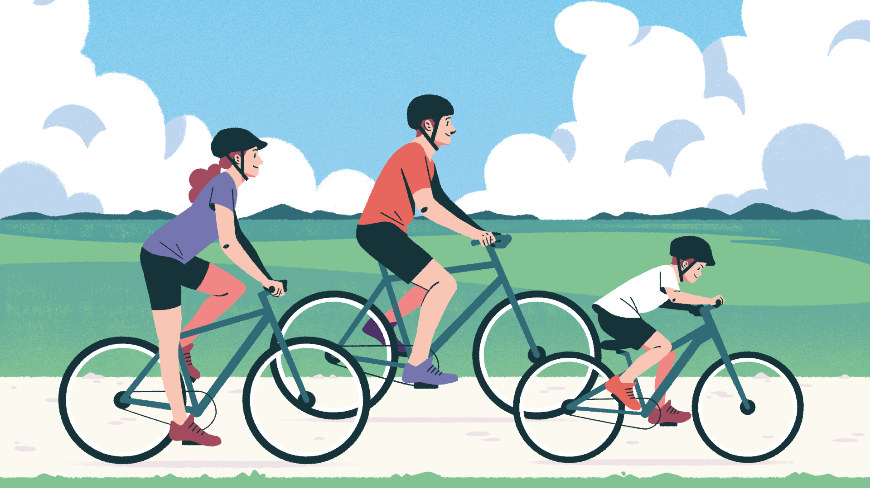
The three bicyclists are in motion. They are moving from one place to another.
Notes:
The three bicyclists are in motion. They are moving from one place to another.

Slide 29
The puppy is in motion. The puppy is moving from one place to another.
Notes:
The puppy is in motion. The puppy is moving from one place to another.

Slide 30
Notes:
Let’s check-in for understanding.

Slide 31
What is motion?
Notes:
What is motion?
[Motion is moving from one place to another.]

Slide 32
Notes:
Now, let’s talk about some non-examples of motion.

Slide 33
Trees in the woods are not in motion. They do not move from one place to another.
Notes:
Trees in the woods are not in motion. They do not move from one place to another.

Slide 34
The Statue of Liberty is not in motion. The statue does not move from one place to another.
Notes:
The Statue of Liberty is not in motion. The statue does not move from one place to another.

Slide 35
Notes:
Now let’s pause for a moment to check your understanding.

Slide 36
Why is the puppy in motion, but the Statue of Liberty is not?
Notes:
Why is the puppy in motion, but the Statue of Liberty is not?
[Because the puppy is moving from one place to another. The Statue of Liberty does not move.]

Slide 37
Remember!!!
Notes:
So remember!

Slide 38
Motion: moving from one place to another
Notes:
Motion is moving from one place to another.

Slide 39
Notes:
We will now complete this concept map, called a Frayer model, to summarize and further clarify what you have learned about the term motion.

Slide 40
Definition
Picture
Motion
Example
How does motion impact my life?
Notes:
To complete the Frayer model, we will choose from four choices the correct picture, definition, example, and response to the question, “How does motion impact my life?” Select the best response for each question using the information you just learned. As we select responses, we will see how this model looks filled in for the term motion.

Slide 41
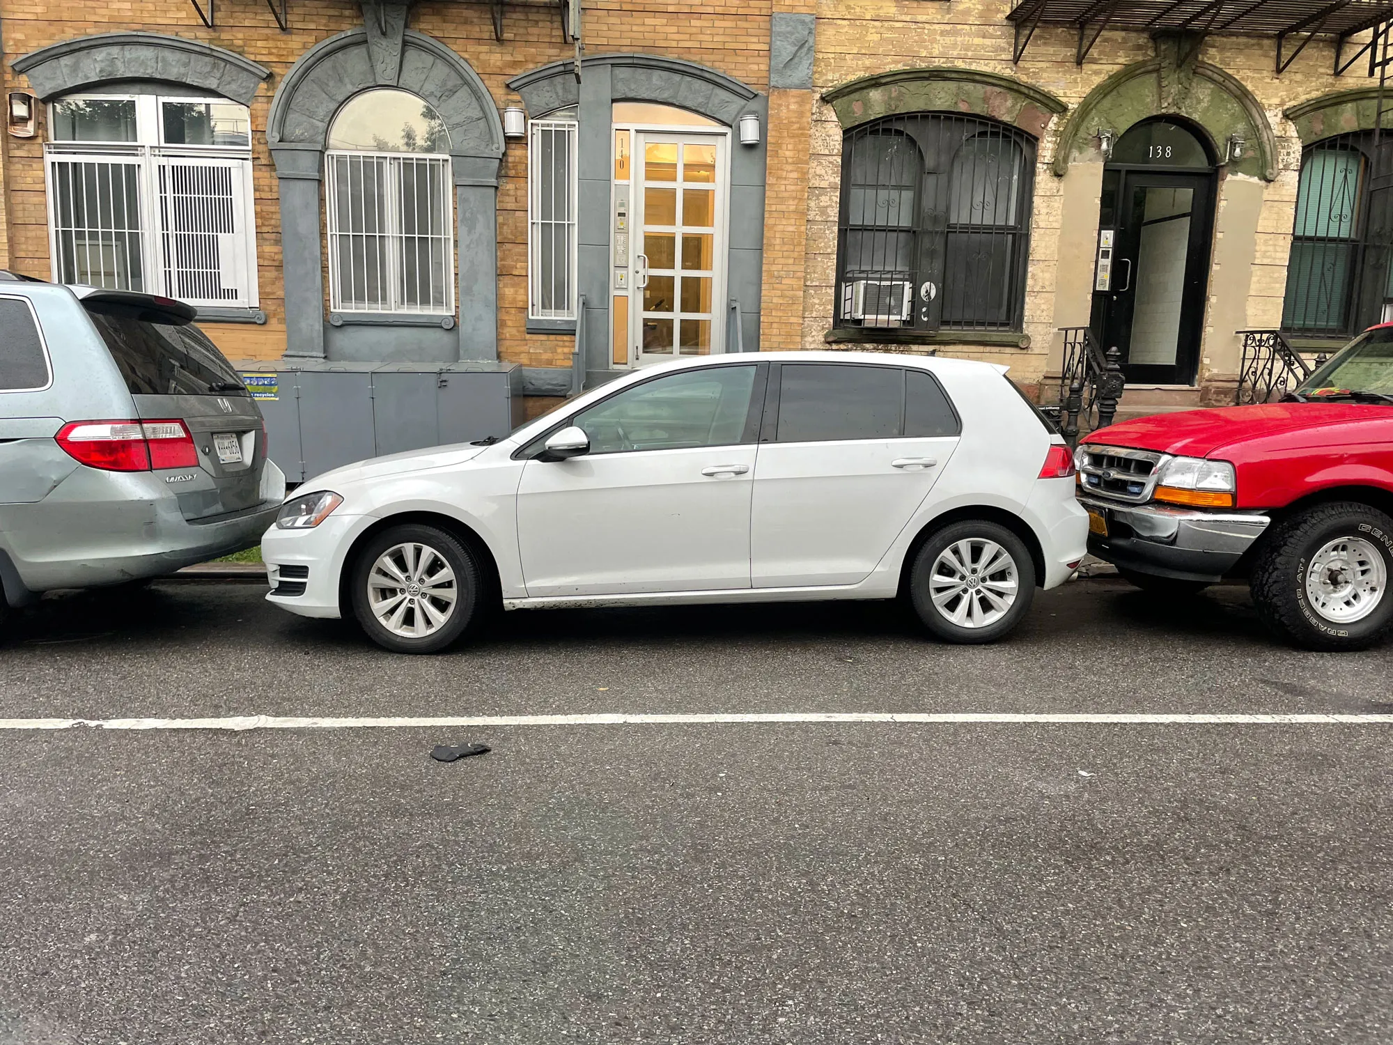
Directions: Choose the correct picture of motion from the choices below.
A
B
C
D
Notes:
Choose the one correct picture of motion from these four choices.

Slide 42
Directions: Choose the correct picture of motion from the choices below.
A
B
C
D
Notes:
This is the picture that shows motion.

Slide 43
Definition
Picture
Motion
Example
How does motion impact my life?
Notes:
Here is the Frayer model filled in with a picture of motion.

Slide 44
Directions: Choose the correct definition of Motion from the choices below.
A
Where an object points
B
The weight of an object
C
When an object stands still
D
Moving from one place to another
Notes:
Choose the one correct definition of motion from these four choices.

Slide 45
Directions: Choose the correct definition of Motion from the choices below.
A
Where an object points
B
The weight of an object
C
When an object stands still
D
Moving from one place to another
Notes:
“Moving from one place to another” is correct! This is the definition of motion.

Slide 46
Definition
Picture
Moving from one place to another
Motion
Example
How does motion impact my life?
Notes:
Here is the Frayer Model with a picture and the definition filled in for motion: Moving from one place to another.

Slide 47
Directions: Choose the correct example of Motion from the choices below.
A
Water flowing over a waterfall
B
A parked car
C
A shelf full of books
D
A cat that is taking a nap
Notes:
Choose the one correct example of motion from these four choices.

Slide 48
Directions: Choose the correct example of Motion from the choices below.
A
Water flowing over a waterfall
B
A parked car
C
A shelf full of books
D
A cat that is taking a nap
Notes:
“Water flowing over a waterfall” is correct! This is an example of motion.

Slide 49
Definition
Picture
Moving from one place to another
Motion
Water flowing over a waterfall
Example
How does motion impact my life?
Notes:
Here is the Frayer Model with a picture, definition, and an example of motion: Water flowing over a waterfall.

Slide 50
Directions: Choose the correct response for “how does motion impact my life?” from the choices below.
A
Motion helps us sleep every night
B
Motion gives us the ability to understand books
C
Motion helps us get out of bed and get to school
Motion helps us do math problems
D
Notes:
Choose the one correct response for “how does motion impact my life?” from these four choices.

Slide 51
Directions: Choose the correct response for “how does motion impact my life?” from the choices below.
A
Motion helps us sleep every night
B
Motion gives us the ability to understand books
C
Motion helps us get out of bed and get to school
Motion helps us do math problems
D
Notes:
“Motion helps us get out of bed and get to school.” That is correct! This is an example of how motion impacts your life.

Slide 52
Definition
Picture
Moving from one place to another
Motion
Water flowing over a waterfall
Motion helps us get out of bed and get to school
Example
How does motion impact my life?
Notes:
Here is the Frayer Model with a picture, definition, example, and a correct response to “how does motion impact my life?”: Motion helps us get out of bed and get to school.

Slide 53
Remember!!!
Notes:
So remember!

Slide 54
Motion: moving from one place to another
Notes:
Motion is moving from one place to another.

Slide 55
Big Question: How do direction and speed impact the motion of objects in the world around us?
Notes:
Let’s reflect once more on our big question. Our “big question” is: How do direction and speed impact the motion of objects in the world around us?
Does anyone have any additional examples to share that haven’t been discussed yet?

Slide 56
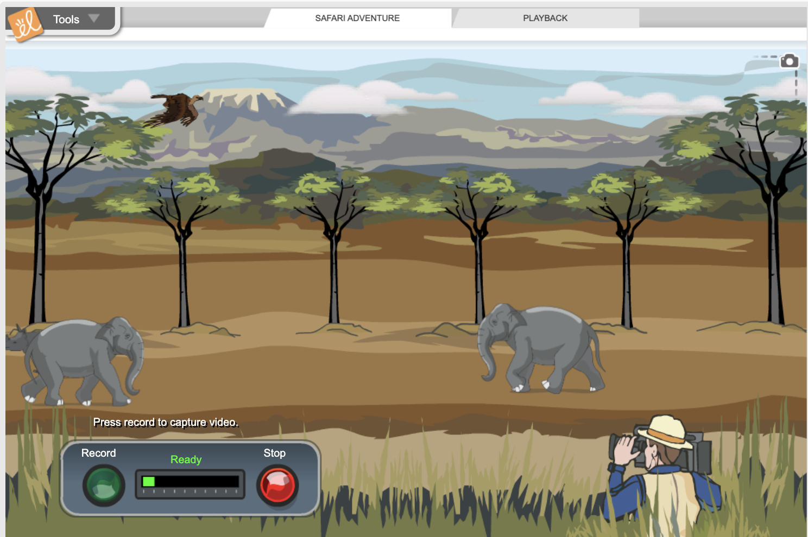
Simulation Activity
Motion
(Gizmos)
Click the link above for a simulation to explore motion.
In this activity, you will explore speed and motion of animals on an African safari.
Notes:
*This is the simulation for motion. Feel free to record different segments of the safari. Select ‘Playback’ (at the top) to view what you recorded. Be sure to emphasize the relationship between motion and speed (i.e. objects that appear to be moving quicker have a higher speed).

Slide 57
Notes:
Thanks for watching, and please continue watching CAPs available from this website.

Slide 58
This Was Created With Resources From:
Questions or Comments
Michael Kennedy, Ph.D. MKennedy@Virginia.edu
Rachel L Kunemund, Ph.D. rk8vm@virginia.edu

