Slide 1
Intro
“Big Idea” Question
Review Concepts
Check-In Questions
Teacher Engagement
Vocabulary
Student-Friendly Definition
Examples & Non-Examples
Frayer Model
Simulation/Activity
Notes:
OK everyone, get ready for our next lesson. Just as a reminder, these are the different components that our lesson may include, and you’ll see these icons in the top left corner of each slide so that you can follow along more easily!

Slide 2
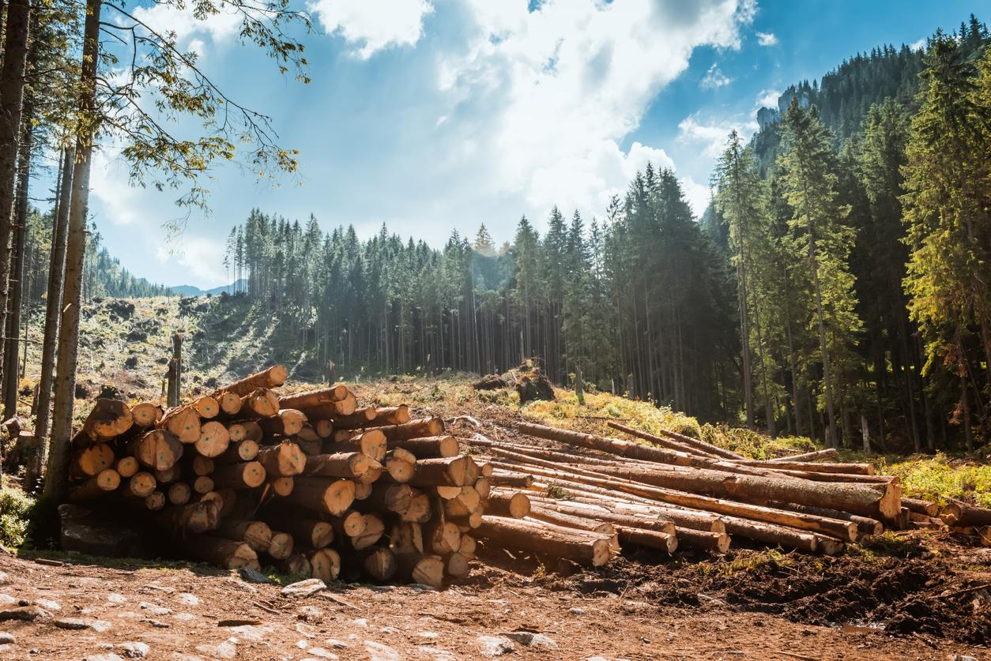
Intro
Natural Resources
Notes:
Today we are going to learn about Natural Resources.

Slide 3
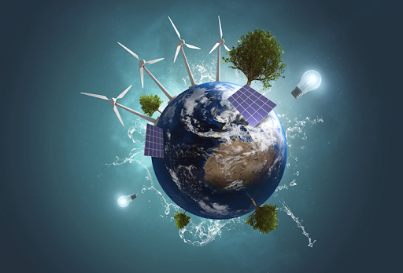
Big Question: How do we use Earth’s resources to create energy?
Notes:
Our “big question” is: How do we use Earth’s resources to create energy?
[Pause and illicit predictions from students.]
I love all these thoughtful scientific hypotheses! Be sure to keep this question and your predictions in mind as we move through these next few lessons, and we’ll continue to revisit it.

Slide 4
Demonstration
Making Paper
Using the materials and instructions listed on the website above, teachers will demonstrate how to make paper. Then, students can participate in the demonstration with supervision.
Notes:
Let’s do a quick demonstration that will help get our brains ready to think about natural resources, and how it relates to our big question. (Link to DIY activity: https://www.generationgenius.com/activities/natural-resources-activity-for-kids/)
Feedback: Have students make predictions about the demonstration and make sure all students are actively participating in this portion of the lesson.

Slide 5
Notes:
Before we move on to our new vocabulary term, let’s review some other words & concepts that you already learned and make sure you are firm in your understanding.
Feedback: Reviewing key background knowledge helps lay the context and sets the students up to make sense of the new content you are introducing, it also reinforces previously learned material.

Slide 6
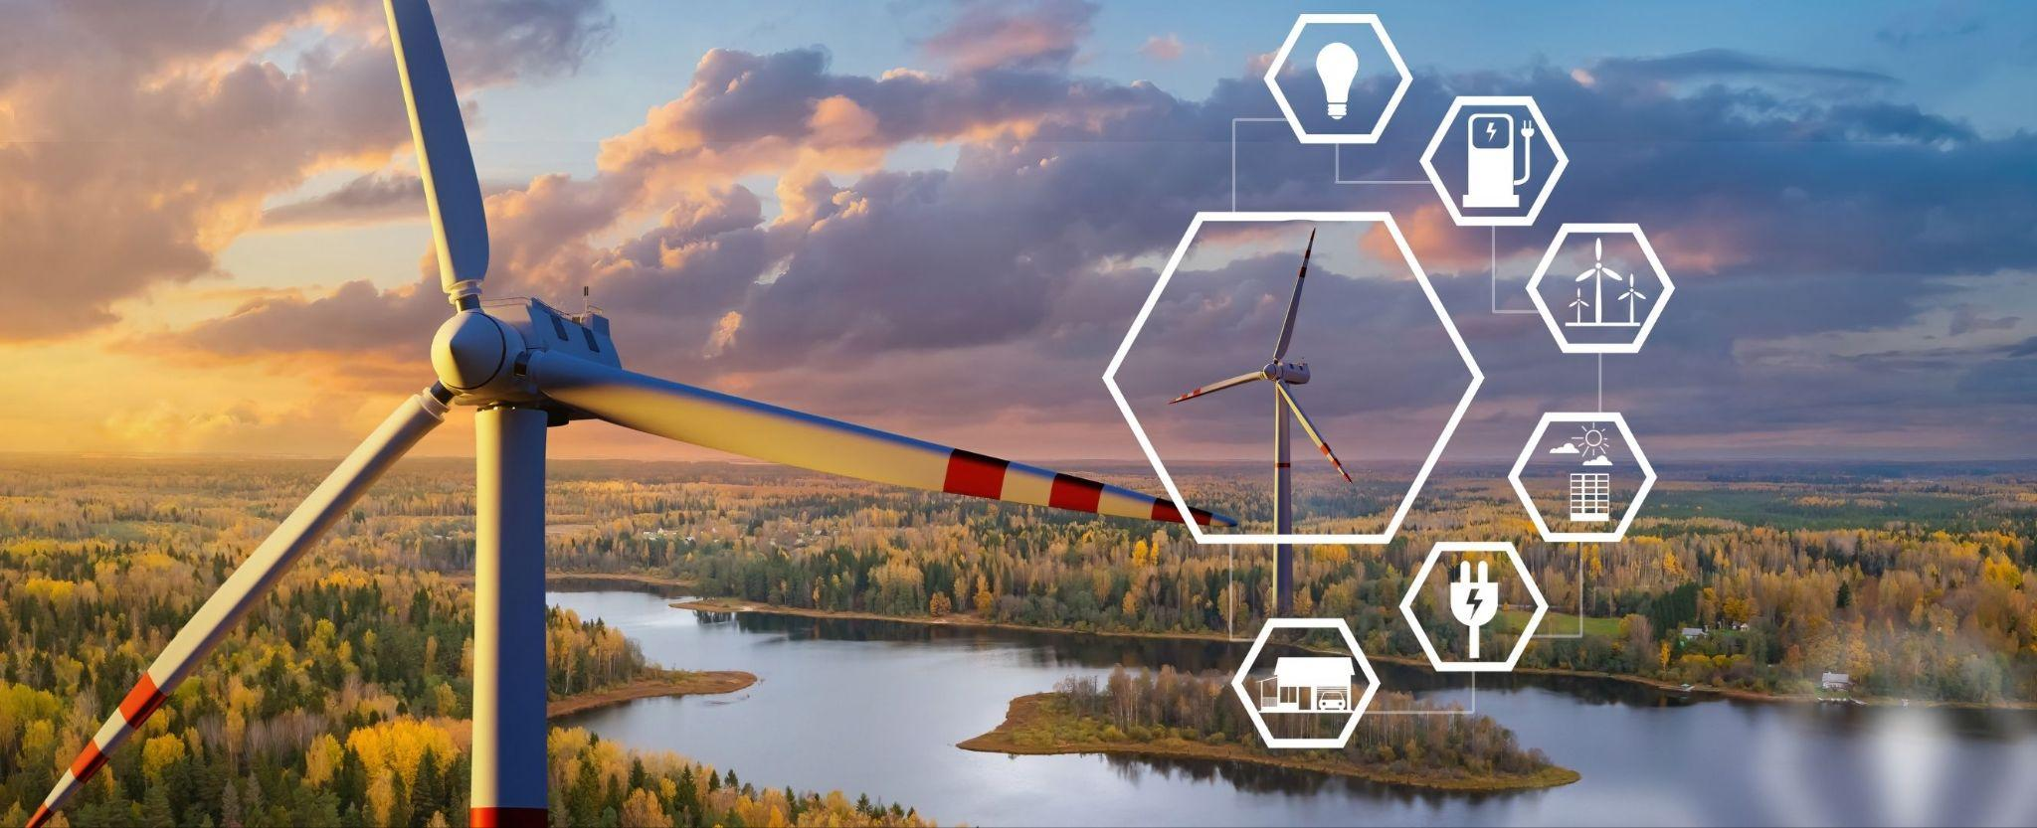
Energy: the ability to cause change
Notes:
Energy is the ability to cause change.

Slide 7
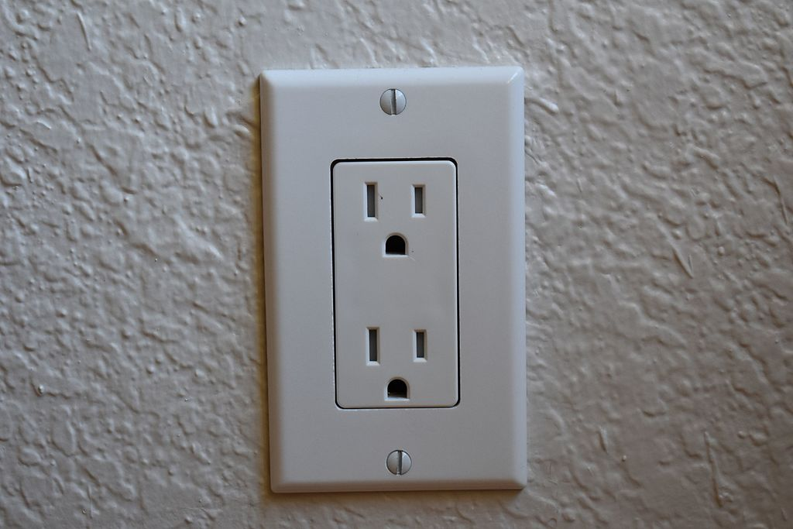
Resource: an energy source that is turned into power
Notes:
A resource is the energy source that is turned into power. In buildings, electrical power comes from the outlets, and the electricity in the outlets comes from a power station.

Slide 8
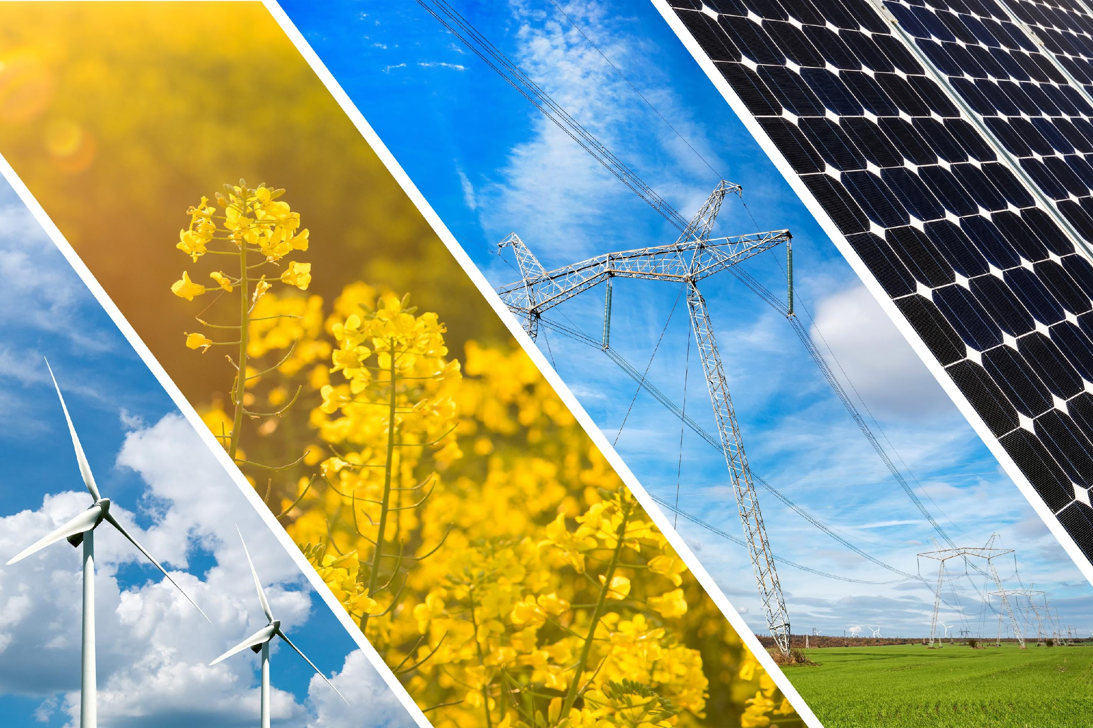
Renewable Resource: a resource that can be reused and replaced naturally
Notes:
A renewable resource is a resource that can be reused and replaced naturally.

Slide 9
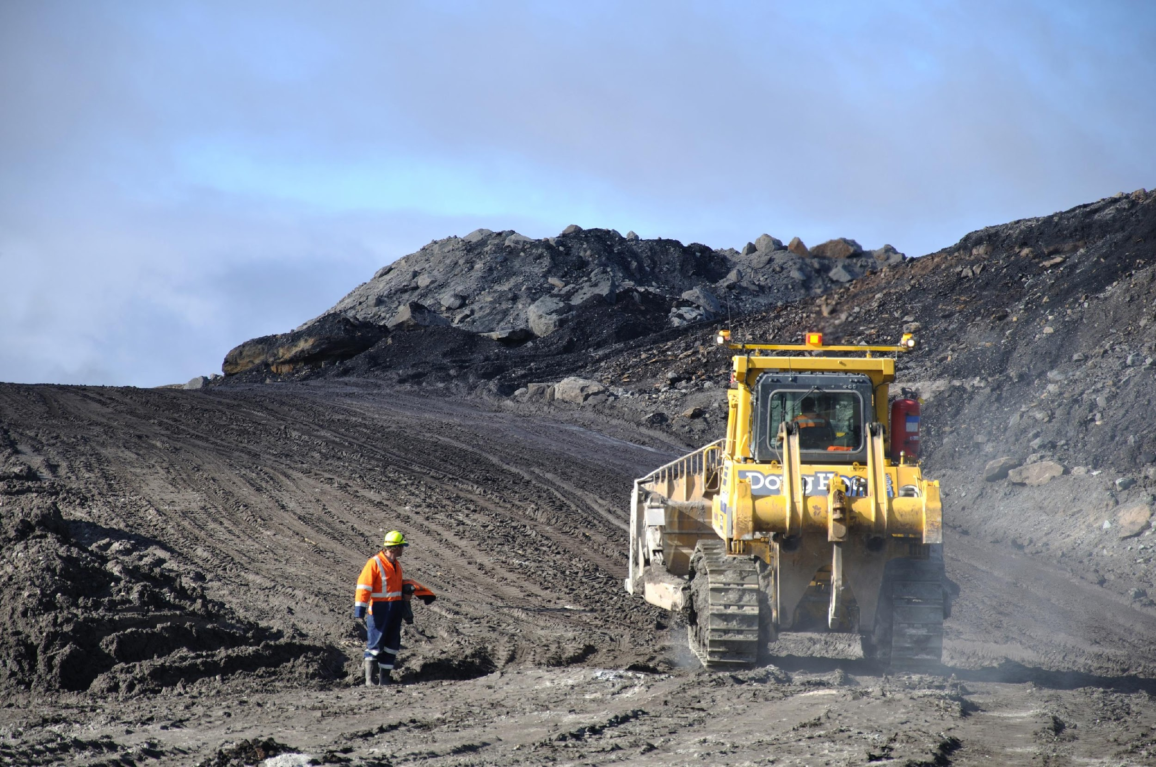
Non-Renewable Resource: a resource that is not replaced by nature quickly enough to match demand
Notes:
A non-renewable resource is a resource that is not replaced by nature quickly enough to match demand.

Slide 10
Notes:
Now, let’s pause for a moment to check your understanding.
Feedback: It is important to monitor understanding during this portion of the lesson to make sure students have a strong foundation on previous terms that will help them better understand today’s new content.

Slide 11
What is a the difference between
energy and a resource?
Notes:
What is the difference between energy and a resource?
[Energy is the ability to cause change, and resource is an energy source that is turned into power.]

Slide 12
A resource that can be reused and replaced naturally is…
A renewable resource
A non-renewable resource
Notes:
A resource that can be reused and replaced naturally is…
[A renewable resource]

Slide 13
A resource that can be reused and replaced naturally is…
A renewable resource
A non-renewable resource
Notes:
A resource that can be reused and replaced naturally is…
[A renewable resource]

Slide 14
A resource that is not replaced by nature quickly enough to match demand is…
A renewable resource
A non-renewable resource
Notes:
A resource that is not replaced by nature quickly enough to match demand is…
[A non-renewable resource]

Slide 15
A resource that is not replaced by nature quickly enough to match demand is…
A renewable resource
A non-renewable resource
Notes:
A resource that is not replaced by nature quickly enough to match demand is…
[A non-renewable resource]

Slide 16
Natural Resources
Notes:
Now that we’ve reviewed, let’s define our new term, natural resources.

Slide 17
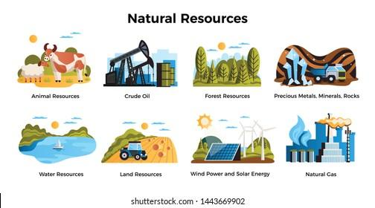
Natural Resources: things found in nature that can be used by people
Notes:
Natural resources are things found in nature that can be used by people.

Slide 18
Notes:
Let’s check-in for understanding.

Slide 19
What are natural resources?
Notes:
What are natural resources?
[Natural resources are things found in nature that can be used by people.]

Slide 20
Notes:
That’s the basic definition, but there’s more you need to know.

Slide 21
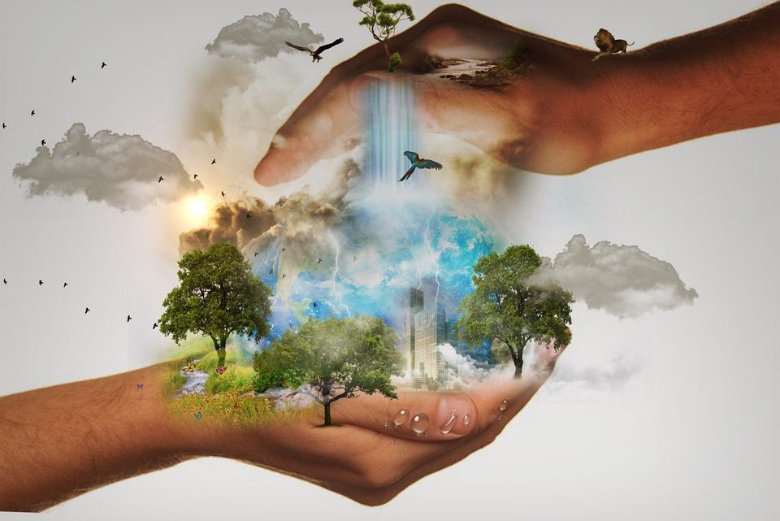
Natural resources are necessary or useful to humans. They can be used to meet our needs.
Notes:
Natural resources are necessary or useful to humans. They can be used to meet our needs. =

Slide 22
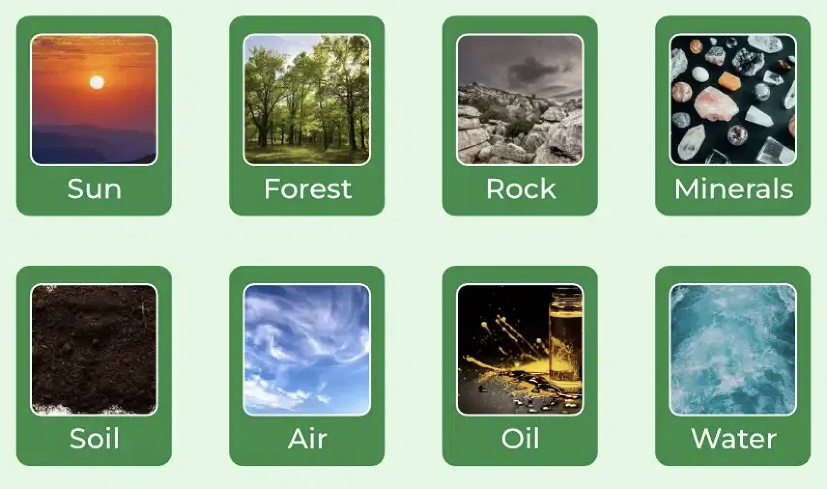
Natural resources can be materials like water, wood, or minerals, or even sources of energy like sunlight or wind.
Notes:
Natural resources can be materials like water, wood, or minerals, or even sources of energy like sunlight or wind.

Slide 23
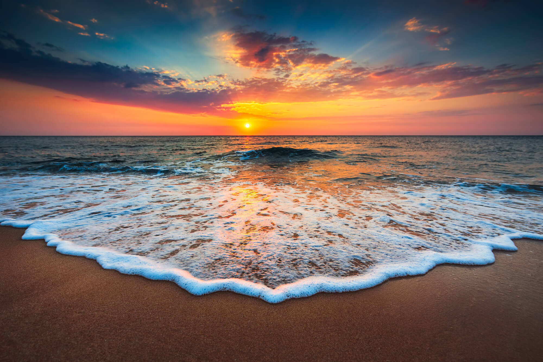
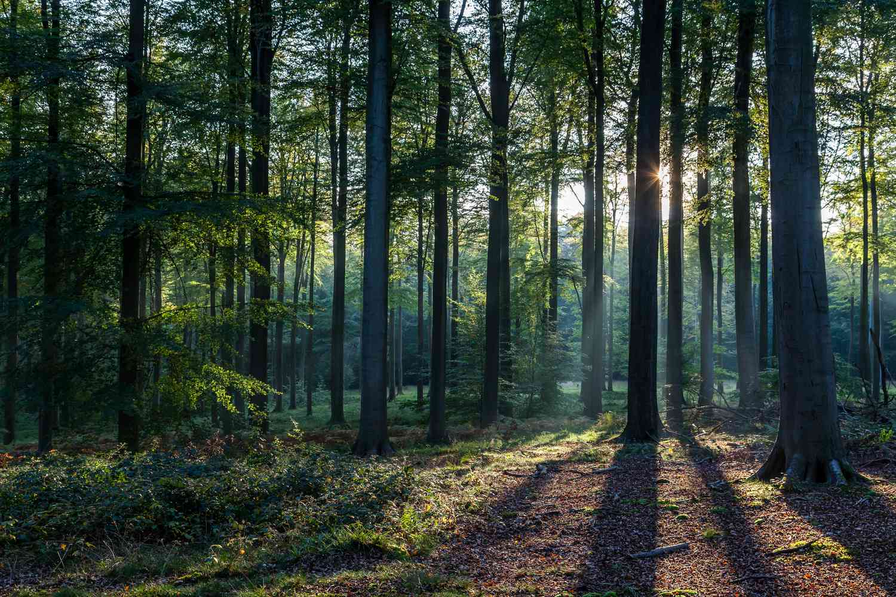
Many natural resources are distributed unevenly around the planet. For example, beaches have more sand and water than forests and forests have more wood than beaches.
Notes:
Many natural resources are distributed unevenly around the planet. For example, beaches have more sand and water than forests and forests have more wood than beaches.

Slide 24
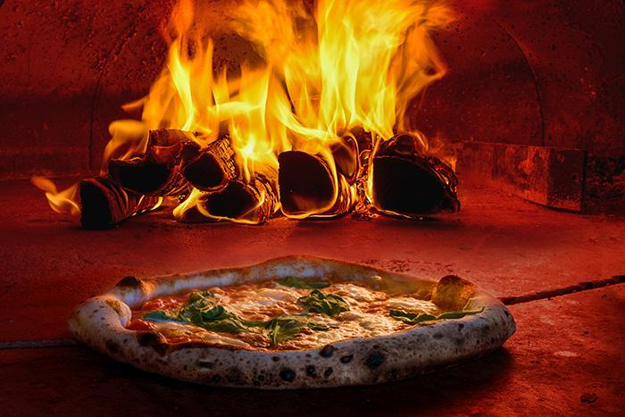
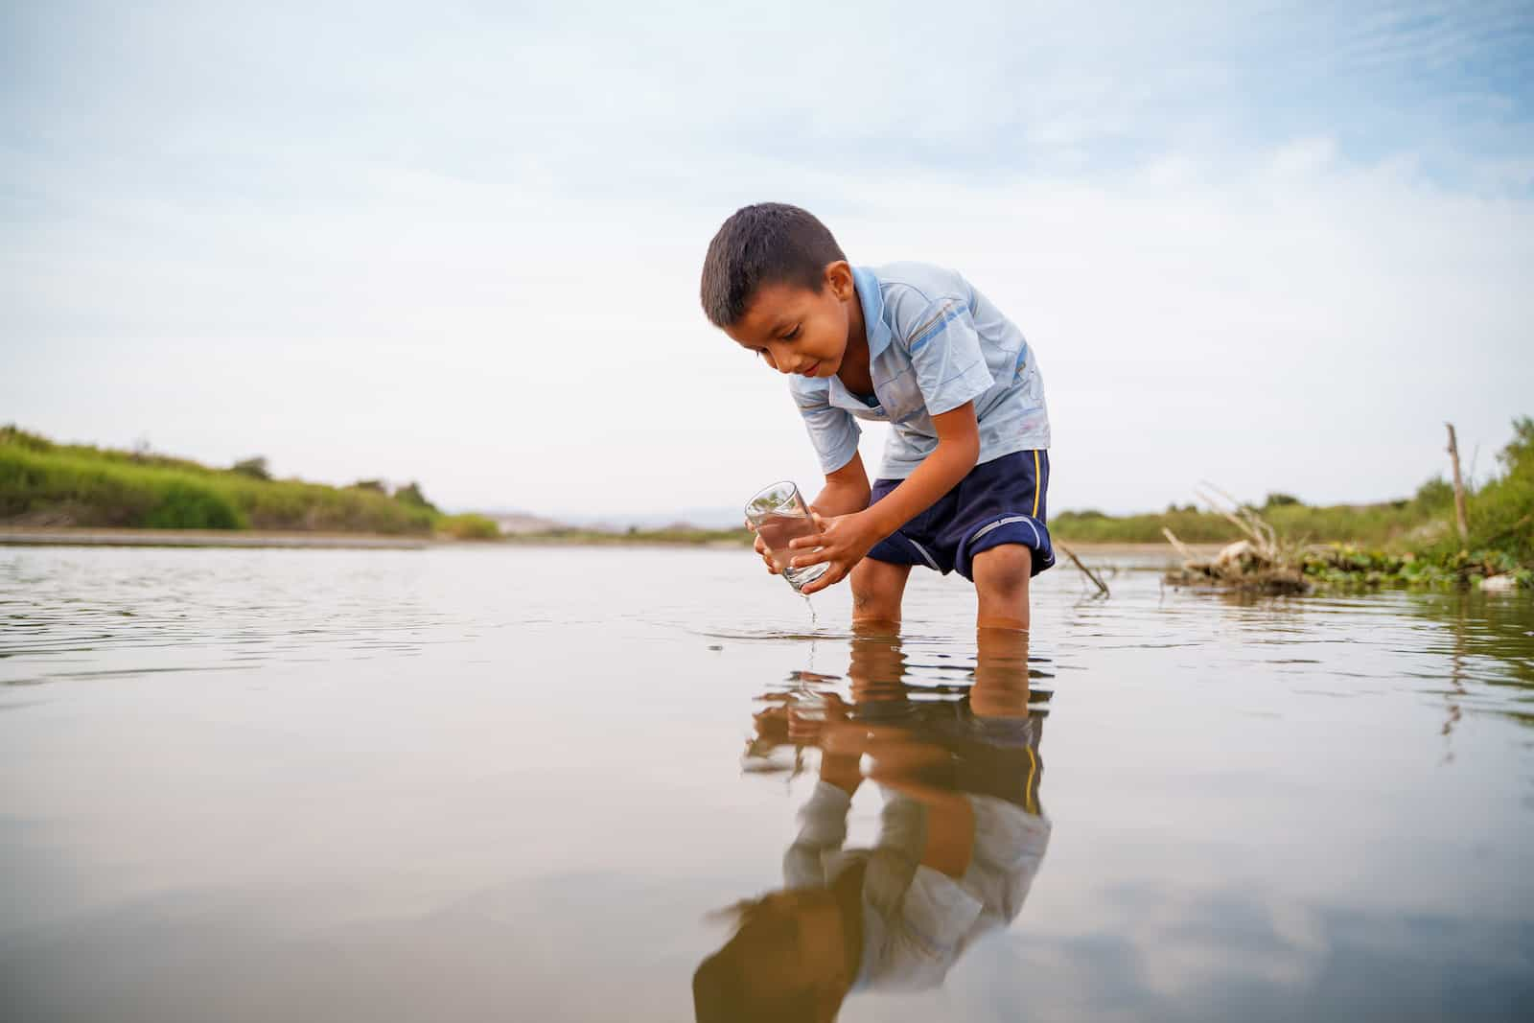
Natural resources are important because they provide the raw materials for making things we use every day and can help us meet our basic requirements for survival and development.
Notes:
Natural resources are important because they provide the raw materials for making things we use every day and can help us meet our basic requirements for survival and development.

Slide 25
Notes:
Let’s check-in for understanding.

Slide 26
True or False: Natural resources are necessary or useful to humans.
Notes:
True or false: Natural resources are necessary or useful to humans.
[true]

Slide 27
True or False: Natural resources are necessary or useful to humans.
Notes:
True or false: Natural resources are necessary or useful to humans.
[true]

Slide 28
Why are some natural resources unevenly distributed on the planet?
Notes:
Why are some natural resources unevenly distributed on the planet?
[Some areas have more of certain natural resources than others. For example, beaches have more water and sand than forests and forests have more wood than beaches.]

Slide 29
Notes:
Now, let’s talk about some examples of natural resources.

Slide 30
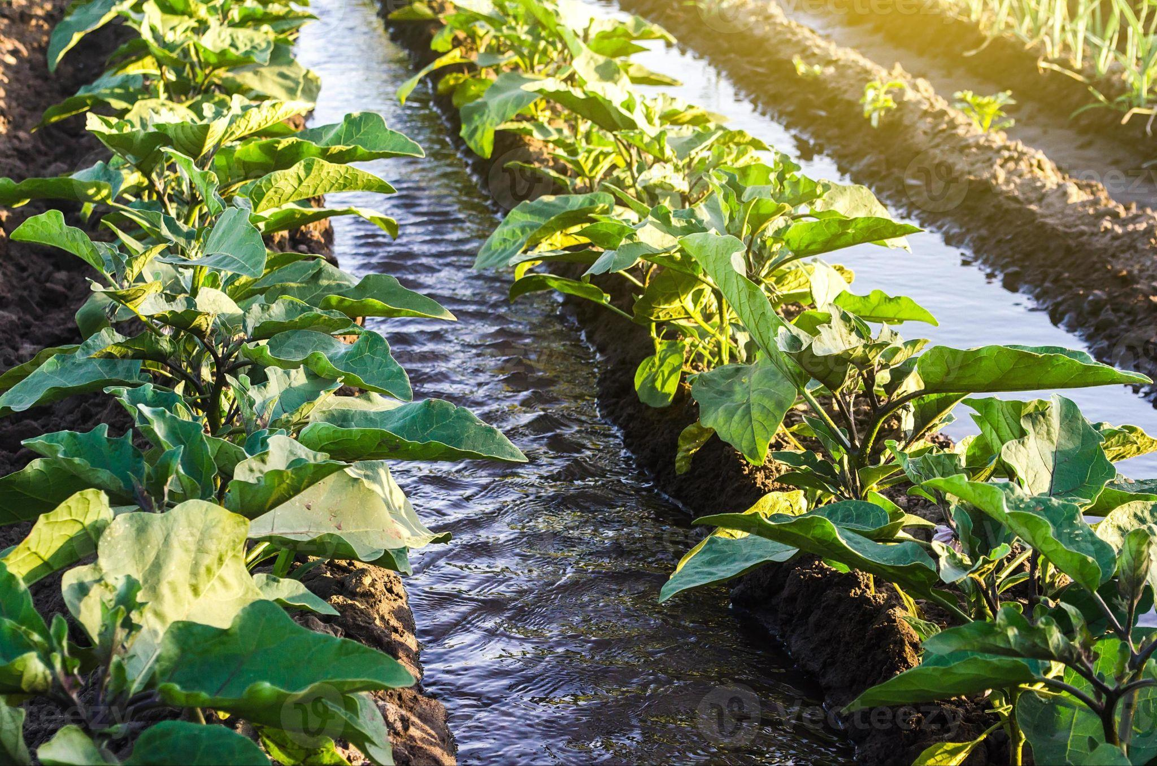
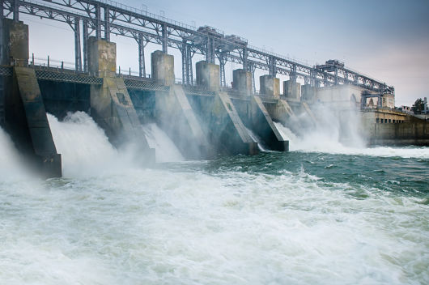
Water is an example of a natural resource. It can be found in rivers, oceans, lakes, and other sources. Water is necessary for our survival and is used for drinking, growing food, and as an energy source.
Notes:
Water is an example of a natural resource. It can be found in rivers, oceans, lakes, and other sources. Water is necessary for our survival and is used for drinking, growing food, and as an energy source.

Slide 31
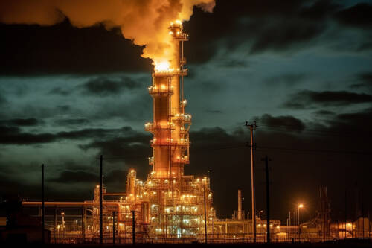
Natural gas is an example of a natural resource. It is found under the surface of the Earth. Natural gas is used for cooking and energy.
Notes:
Natural gas is an example of a natural resource. It is found under the surface of the Earth. Natural gas is used for cooking and energy.

Slide 32
Notes:
Next, let’s talk about some non-examples of natural resources.

Slide 33
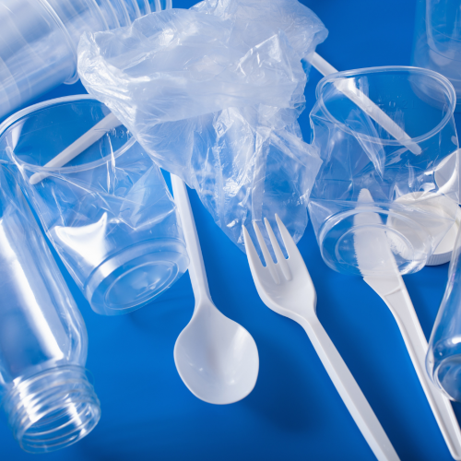
Plastic is not an example of a natural resource. Plastics are made by humans and not found in nature.
Notes:
Plastic is not an example of a natural resource. Plastics are made by humans and not found in nature.

Slide 34
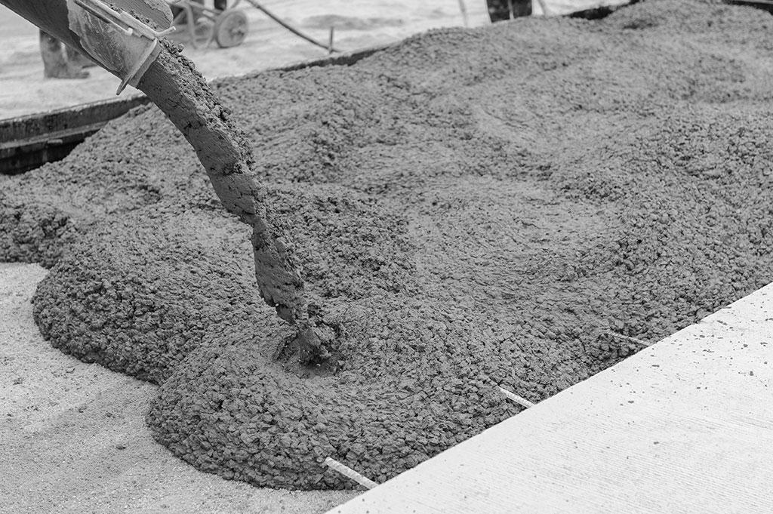
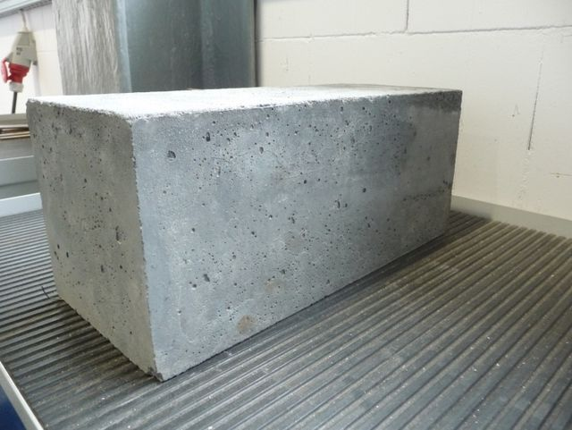
Concrete is not an example of a natural resource. It is made by humans mixing sand, water, and aggregate, and therefore not found in nature.
Notes:
Concrete is not an example of a natural resource. It is made by humans mixing sand, water, and aggregate, and therefore not found in nature.

Slide 35
Notes:
Let’s check-in for understanding.

Slide 36
Why is natural gas an example of a natural resource and plastic is not?
Notes:
Why is natural gas an example of natural resource and plastic is not?
[Natural gas is found in nature and used as an energy source. Plastic is not found in nature and instead is made by humans.]

Slide 37
Remember!!!
Notes:
So remember!

Slide 38
Natural Resources: things found in nature that can be used by people
Notes:
Natural resources are things found in nature that can be used by people.

Slide 39
Notes:
We will now complete this concept map, called a Frayer model, to summarize and further clarify what you have learned about the term natural resources.

Slide 40
Definition
Picture
Natural Resources
Example
How do natural resources impact my life?
Notes:
To complete the Frayer model, we will choose from four choices the correct picture, definition, example, and response to the question, “How do natural resources impact my life?” Select the best response for each question using the information you just learned. As we select responses, we will see how this model looks filled in for the term natural resources.

Slide 41
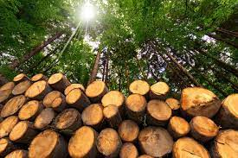
Directions: Choose the correct picture of natural resources from the choices below.
A
B
C
D
Notes:
Choose the one correct picture of natural resources from these four choices.

Slide 42
Directions: Choose the correct picture of natural resources from the choices below.
A
B
C
D
Notes:
This is the picture that shows natural resources.

Slide 43
Definition
Picture
Natural Resources
Example
How do natural resources impact my life?
Notes:
Here is the Frayer model filled in with a picture of natural resources.

Slide 44
Directions: Choose the correct definition of
natural resources from the choices below.
A
Things found in nature that can be used by people
B
The smallest unit of matter
C
The ability to cause change
D
A substance containing only one type of atom
Notes:
Choose the one correct definition of natural resources from these four choices.

Slide 45
Directions: Choose the correct definition of
natural resources from the choices below.
A
Things found in nature that can be used by people
B
The smallest unit of matter
C
The ability to cause change
D
A substance containing only one type of atom
Notes:
“Things found in nature that can be used by people” is correct! This is the definition of natural resources.

Slide 46
Definition
Picture
Things found in nature that can be used by people
Natural Resources
Example
How do natural resources impact my life?
Notes:
Here is the Frayer Model with a picture and the definition filled in for natural resources: Things found in nature that can be used by people.

Slide 47
Directions: Choose the correct example of
natural resources from the choices below.
A
A toy
B
A plastic wrapper
C
Soil
D
Sunglasses
Notes:
Choose the one correct example of natural resources from these four choices.

Slide 48
Directions: Choose the correct example of
natural resources from the choices below.
A
A toy
B
A plastic wrapper
C
Soil
D
Sunglasses
Notes:
“Soil” is correct! This is an example of natural resources.

Slide 49
Definition
Picture
Things found in nature that can be used by people
Natural Resources
Soil
Example
How do natural resources impact my life?
Notes:
Here is the Frayer Model with a picture, definition, and an example of natural resources: Soil.

Slide 50
Directions: Choose the correct response for “how do natural resources impact my life?” from the choices below.
A
Natural resources are created by humans to help improve our environment.
Humans depend on natural resources for things like food, shelter, energy, and materials to make products we use every day.
B
C
Energy patterns in the universe are explained by natural resources.
D
Natural resources explain how and why animals migrate and how their migration impacts our eating habits.
Notes:
Choose the one correct response for “how do natural resources impact my life?” from these four choices.

Slide 51
Directions: Choose the correct response for “how do natural resources impact my life?” from the choices below.
A
Natural resources are created by humans to help improve our environment.
Humans depend on natural resources for things like food, shelter, energy, and materials to make products we use every day.
B
C
Energy patterns in the universe are explained by natural resources.
D
Natural resources explain how and why animals migrate and how their migration impacts our eating habits.
Notes:
“Humans depend on natural resources for things like food, shelter, energy, and materials to make products we use every day.” That is correct! This is an example of how natural resources impact your life.

Slide 52
Definition
Picture
Things found in nature that can be used by people
Natural Resources
Humans depend on natural resources for things like food, shelter, energy, and materials to make products we use every day.
Soil
Example
How do natural resources impact my life?
Notes:
Here is the Frayer Model with a picture, definition, example, and a correct response to “how do natural resources impact my life?”: Humans depend on natural resources for things like food, shelter, energy, and materials to make products we use every day.

Slide 53
Remember!!!
Notes:
So remember!

Slide 54
Natural Resources: things found in nature that can be used by people
Notes:
Natural resources are things found in nature that can be used by people.

Slide 55
Big Question: How do we use Earth’s resources to create energy?
Notes:
Explicit cue to revisit the big question at the end of the lesson: Okay everyone. Now that we’ve learned the term, let’s reflect once more on our big question. Was there anything that we predicted earlier that was correct or incorrect? Do you have any new hypotheses to share?

Slide 56
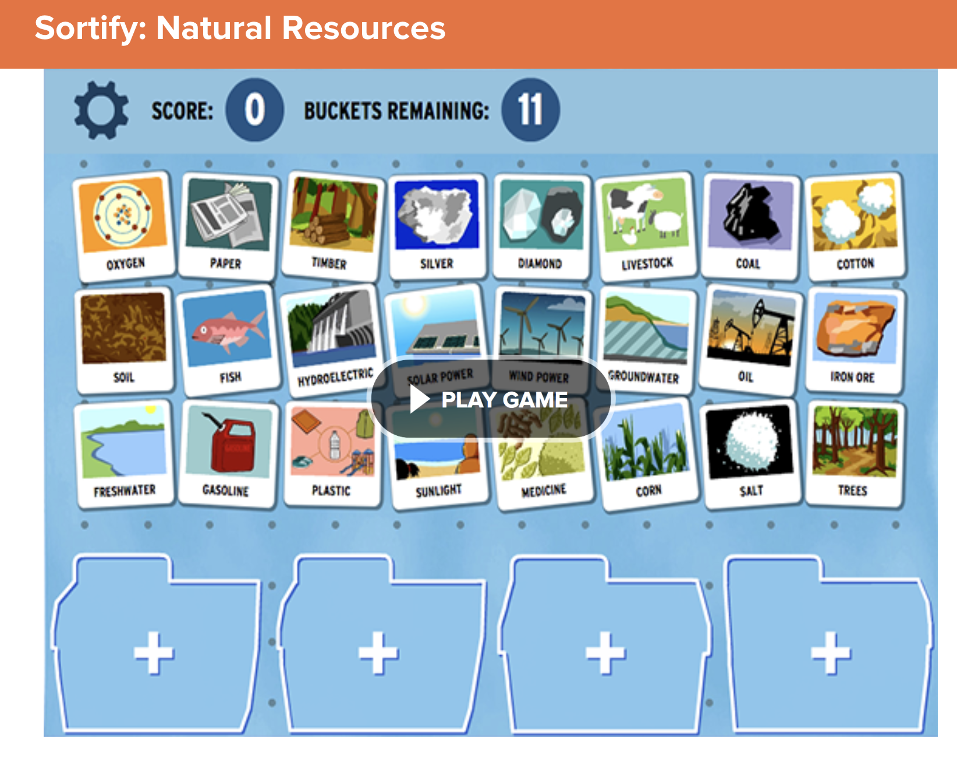
Simulation Activity
Sortify: Natural Resources
Students will sort different resources into categories, including natural resources.
Notes:
Students will sort different resources into categories, including natural resources. (Link to game: https://www.brainpop.com/games/sortifynaturalresources/ )
Feedback: Have students analyze and interpret data to elevate their understanding of the content and strengthen their critical thinking skills.

Slide 57
Notes:
Thanks for watching, and please continue watching CAPs available from this website.

Slide 58
This Video Was Created With Resources From:
Questions or Comments
Michael Kennedy, Ph.D. MKennedy@Virginia.edu
Rachel L Kunemund, Ph.D. rk8vm@virginia.edu

