Slide 1
Intro
“Big Idea” Question
Review Concepts
Check-In Questions
Teacher Engagement
Vocabulary
Student-Friendly Definition
Examples & Non-Examples
Morphological Word Parts
Frayer Model
Simulation/Activity
Notes:
OK everyone, get ready for our next lesson. Just as a reminder, these are the different components that our lesson may include, and you’ll see these icons in the top left corner of each slide so that you can follow along more easily!

Slide 2
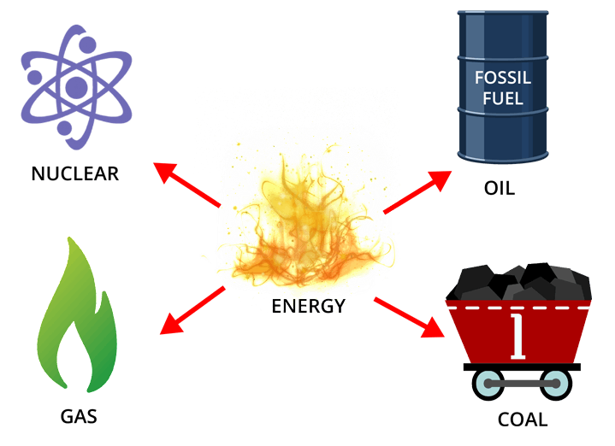
Nonrenewable Resource
Intro
Intro
Notes:
Today we are going to learn about nonrenewable resource.

Slide 3
Big Question: How do the resources we use affect humans and the environment?
Notes:
Our “big question” is: How do the resources we use affect humans and the environment?
[Pause and illicit predictions from students.]
I love all these thoughtful scientific hypotheses! Be sure to keep this question and your predictions in mind as we move through these next few lessons, and we’ll continue to revisit it.

Slide 4
Notes:
Before we move on to our new vocabulary term, let’s review some other words & concepts that you already learned and make sure you are firm in your understanding.

Slide 5
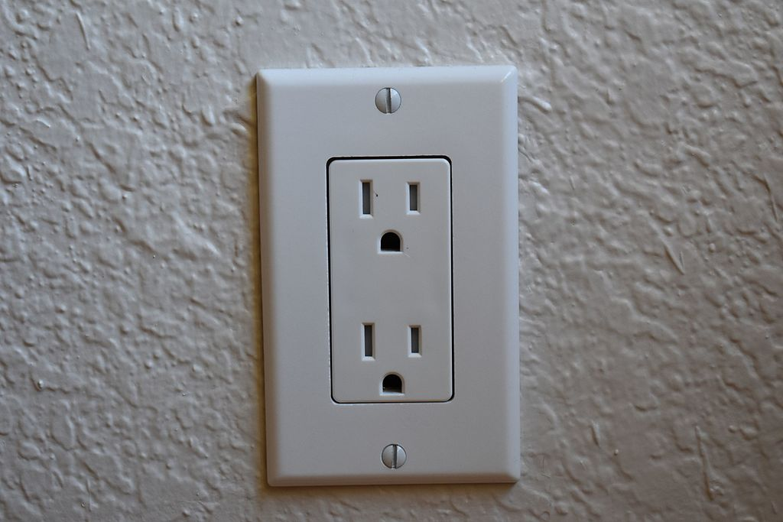
Resource: an energy source that is turned into power
Notes:
A resource is an energy source that is turned into power.

Slide 6
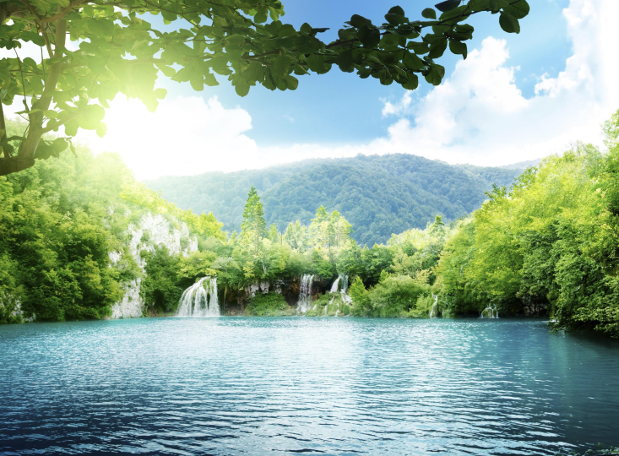
Natural resource: anything found in nature and used by humans
Notes:
A natural resource is anything found in nature and used by humans.

Slide 7
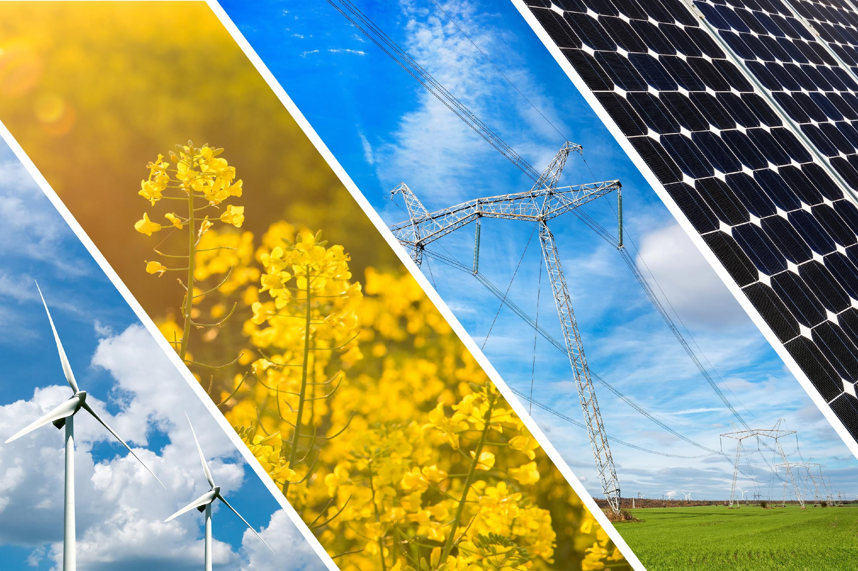
Renewable resource: a resource that can be reused and replaced naturally
Notes:
A renewable resource is a resource that can be reused and replaced naturally..

Slide 8
Notes:
Now let’s pause for a moment to check your understanding.

Slide 9
A resource is the energy source turned into _______.
Notes:
A resource is the energy source turned into _______.
[Power]

Slide 10
A resource is the energy source turned into power.
Notes:
A resource is the energy source turned into _______.
[Power]

Slide 11
True or false: Natural resources are anything found in nature and used by humans.
True
False
Notes:
True or false: Natural resources are anything found in nature and used by humans.
[A. True]

Slide 12
True or false: Natural resources are anything found in nature and used by humans.
True
False
Notes:
True or false: Natural resources are anything found in nature and used by humans.
[A. True]

Slide 13
A renewable resource is a resource that can be reused and ______ naturally .
reopened
recorded
replaced
Notes:
A renewable resource is a resource that can be reused and ______ naturally.
[C. replaced]

Slide 14
A renewable resource is a resource that can be reused and ______ naturally .
reopened
recorded
replaced
Notes:
A renewable resource is a resource that can be reused and ______ naturally.
[C. replaced]

Slide 15
Nonrenewable Resource
Notes:
Now that we’ve reviewed, let’s define our new term, nonrenewable resource.

Slide 16
Nonrenewable Resource: a natural resource that cannot be replaced after it is used
Intro
Notes:
A nonrenewable resource is a natural resource that cannot be replaced after it is used

Slide 17
Notes:
Now let’s pause for a moment to check your understanding.

Slide 18
What is a nonrenewable resource?
Intro
Notes:
A nonrenewable resource is a natural resource that cannot be replaced after it is used.

Slide 19
Notes:
That is the basic definition, but there is a bit more you need to know.

Slide 20
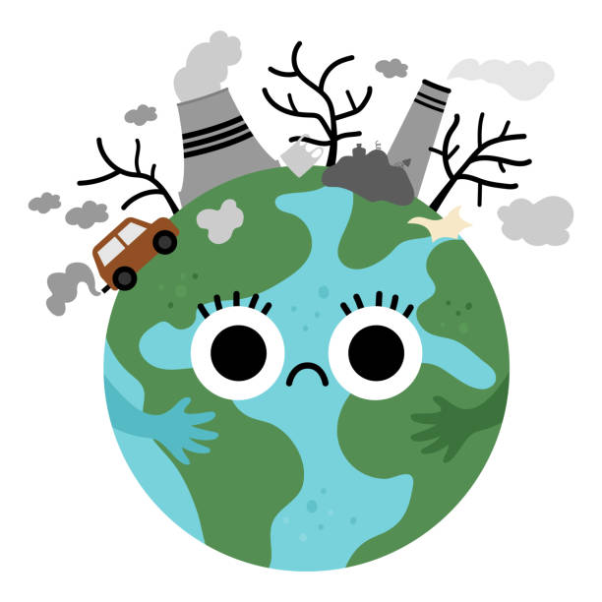
Nonrenewable resources have a high impact on the environment. They are less kind to the Earth when they are used.
Notes:
Nonrenewable resources have a high impact on the environment. They are less kind to the Earth when they are used.

Slide 21
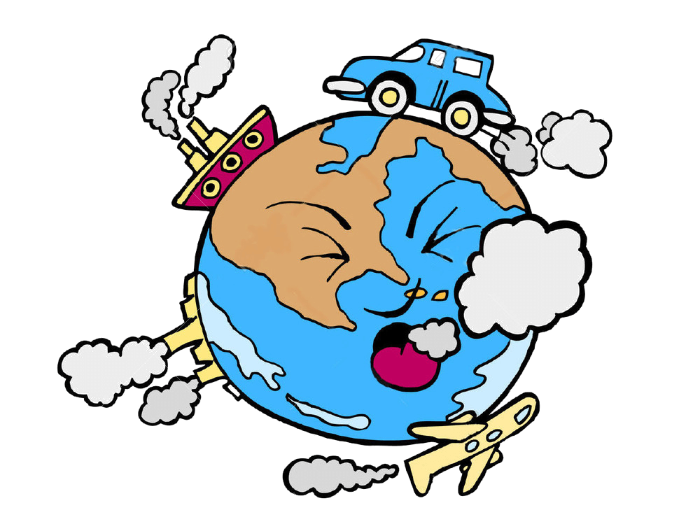
Nonrenewable resources contribute more to the production of greenhouse gasses.
Notes:
Nonrenewable resources contribute more to the production of greenhouse gasses.

Slide 22
Notes:
Let’s check-in for understanding.

Slide 23
Nonrenewable resources have a ____ impact on the environment. They are less kind to the Earth when they are used.
high
low
Notes:
Nonrenewable resources have a ____ impact on the environment. They are less kind to the Earth when they are used.
[A. high]

Slide 24
Nonrenewable resources have a ____ impact on the environment. They are less kind to the Earth when they are used.
high
low
Notes:
Nonrenewable resources have a ____ impact on the environment. They are less kind to the Earth when they are used.
[A. high]

Slide 25
Nonrenewable resources contribute ____ to the production of greenhouse gasses.
less
more
Notes:
Nonrenewable resources contribute _____ to the production of greenhouse gasses.
[B. more]

Slide 26
Nonrenewable resources contribute ____ to the production of greenhouse gasses.
less
more
Notes:
Nonrenewable resources contribute _____ to the production of greenhouse gasses.
[B. more]

Slide 27
Notes:
Now, let’s talk about some examples of nonrenewable resources.

Slide 28
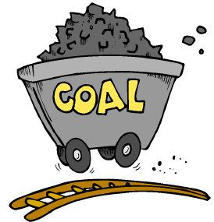
Coal, a fossil fuel, is a nonrenewable resource. Once used, it cannot be replaced.
Notes:
Coal, a fossil fuel, is a nonrenewable resource. Once used, it cannot be replaced.

Slide 29
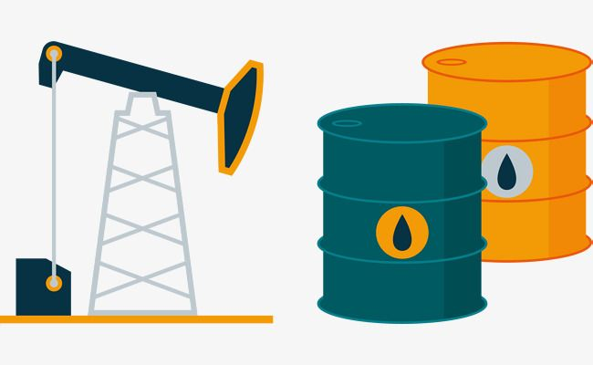
Oil, a fossil fuel, is a nonrenewable resource. Once used, it cannot be replaced.
Notes:
Oil, a fossil fuel, is a nonrenewable resource. Once used, it cannot be replaced.

Slide 30
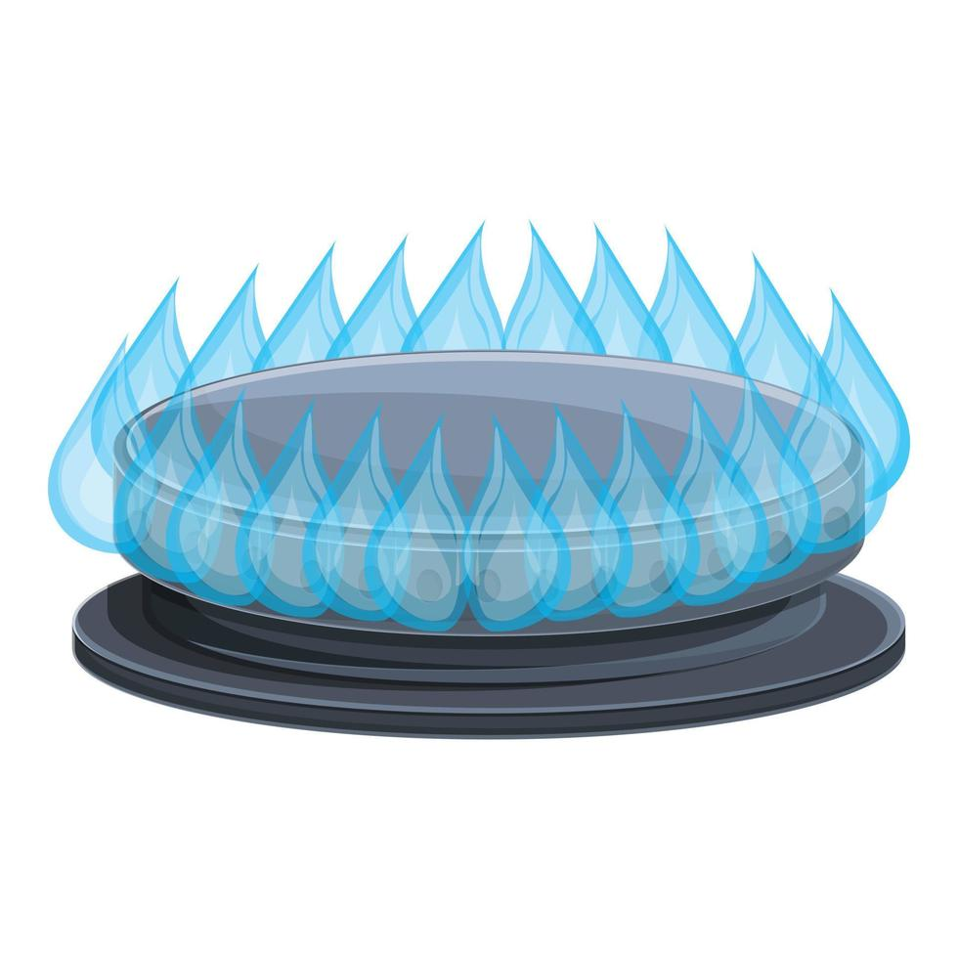
Natural gas, a fossil fuel, is a nonrenewable resource. Once used, it cannot be replaced.
Notes:
Natural gas, a fossil fuel, is a nonrenewable resource. Once used, it cannot be replaced.

Slide 31
Notes:
Next, let’s talk about some non-examples of nonrenewable resources.

Slide 32
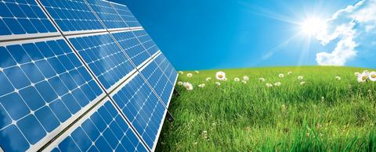
The sun is a non-example of a nonrenewable resource. The energy from the sun can be replaced naturally.
Notes:
The sun is a non-example of a nonrenewable resource. The energy from the sun can be replaced naturally.

Slide 33
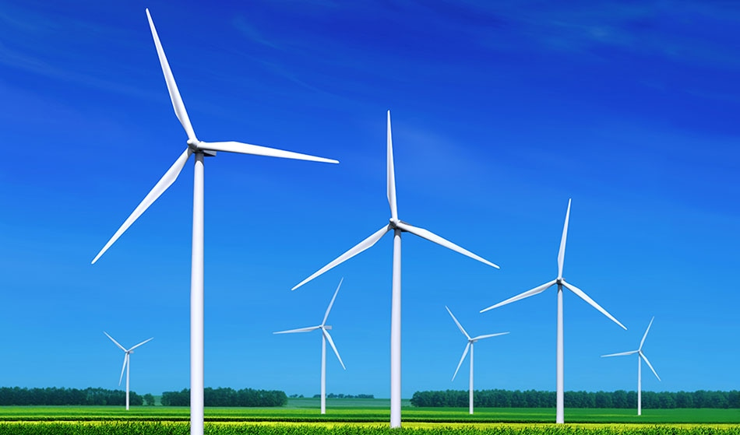
Wind is a non-example of a nonrenewable resource. The energy from the wind can be replaced naturally.
Notes:
Wind is a non-example of a nonrenewable resource. The energy from the wind can be replaced naturally.

Slide 34
Notes:
Now let’s pause for a moment to check your understanding.

Slide 35
Which is an example of a nonrenewable resource?
Notes:
Which is an example of a nonrenewable resource?
[Right picture]

Slide 36
Which is an example of a nonrenewable resource?
Notes:
Which is an example of a nonrenewable resource?
[Right picture]

Slide 37
Notes:
We can also break down the term renewable into different word parts to help us remember the meaning. Let’s take a look!

Slide 38
Nonrenewable
Non renew -able
(prefix)
(root word)
(suffix)
Notes:
The word nonrenewable can be broken down into three parts: The prefix “non-”, the root word “renew” and the suffix ”-able.”

Slide 39
Nonrenewable
Non renew -able
not
Notes:
The prefix “non-” means ”not.”

Slide 40
Nonrenewable
Non renew -able
to make new
Notes:
The root word “renew” means ”to make new.”

Slide 41
Nonrenewable
Non renew -able
Suffix that turns a verb (to not make new) into a adjective (non-renewed).
Notes:
The suffix “-able” turns a verb “to not make new” into an adjective “non-renewed.”

Slide 42
Non renew -able
Nonrenewable
Something that is not made new again.
Notes:
So when you add the suffix “-able” to the prefix “non-” and root word “renew,” this means something that is not not made new again.

Slide 43
Notes:
Let’s check-in for understanding.

Slide 44
How can we use the word parts of nonrenewable to help us remember the definition of the term?
Nonrenewable
Non renew able
Notes:
How can we use the word parts of nonrenewable to help us remember the definition of the term?
[Non = Not
Renew = to make new
able = turns word into an adjective
Nonrenewable means something that is not made new again.]

Slide 45
Remember!!!
Notes:
So remember!

Slide 46
Nonrenewable Resource: a natural resource that cannot be replaced after it is used
Notes:
A nonrenewable resource is a resource that cannot be replaced after it is used.

Slide 47
Notes:
We will now complete this concept map, called a Frayer model, to summarize and further clarify what you have learned about the term nonrenewable resource.

Slide 48
Definition
Picture
Nonrenewable
Resource
How do nonrenewable resources
impact my life?
Example
Notes:
To complete the Frayer model, we will choose from four choices the correct picture, definition, example, and response to the question, “How do nonrenewable resources impact my life?” Select the best response for each question using the information you just learned. As we select responses, we will see how this model looks filled in for the term nonrenewable resource.

Slide 49
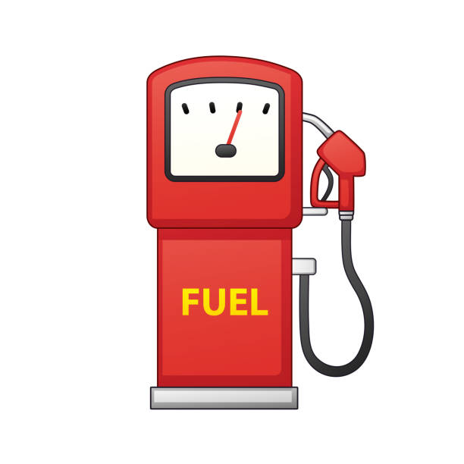
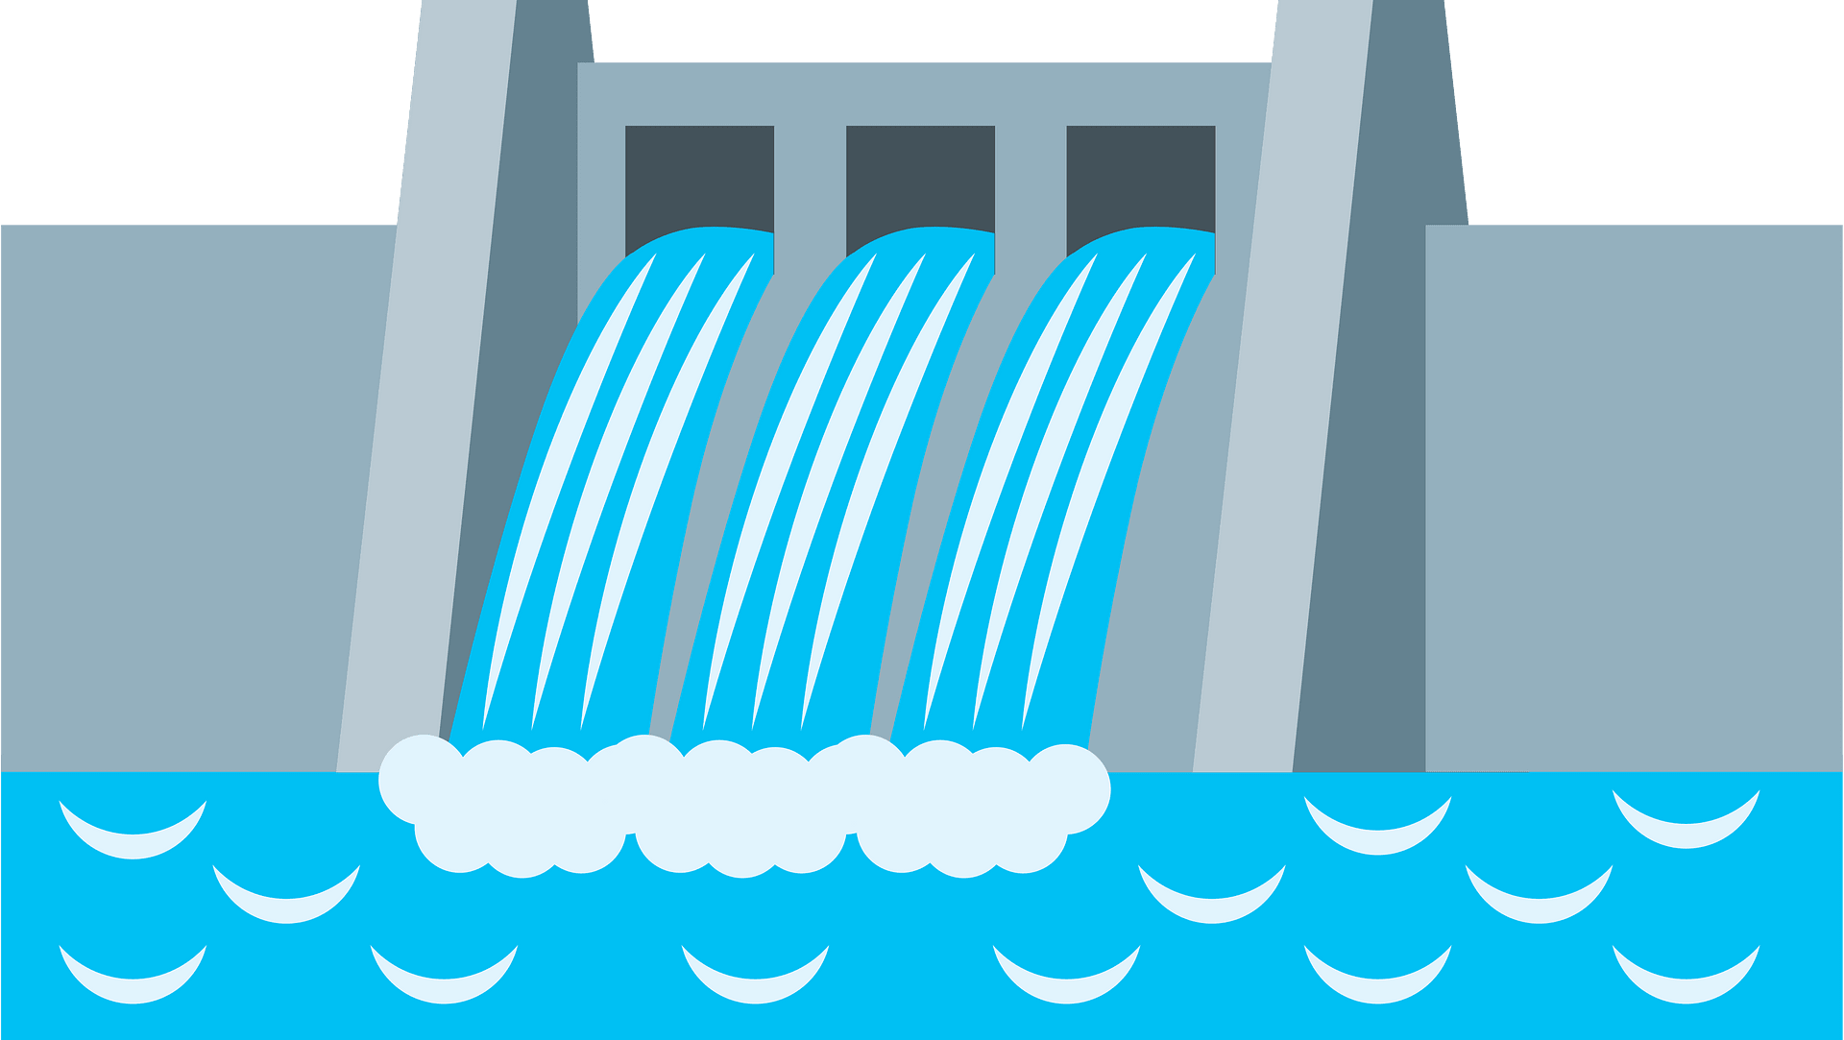
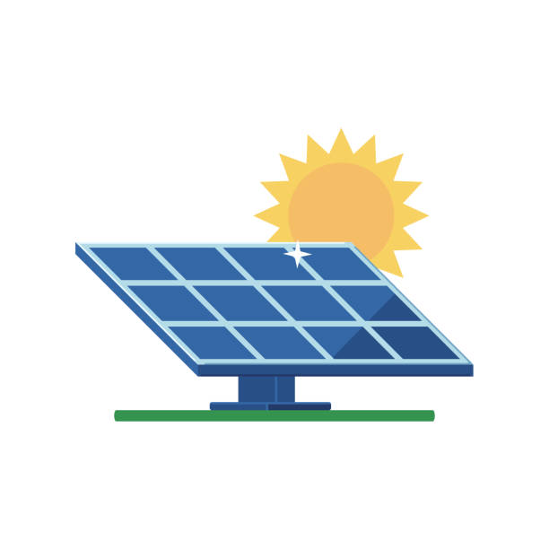
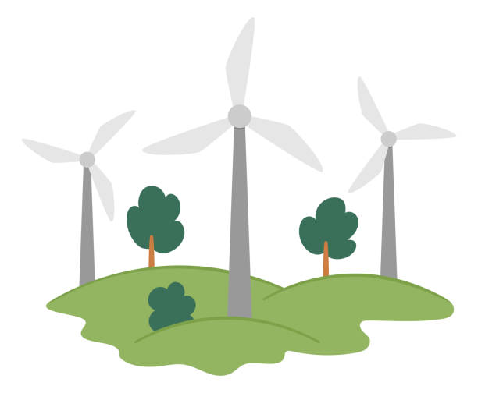
Directions: Choose the correct picture of nonrenewable resource from the choices below.
A
B
C
D
Notes:
Choose the one correct picture of nonrenewable resource from these four choices.

Slide 50
Directions: Choose the correct picture of nonrenewable resource from the choices below.
A
B
C
D
Notes:
Choose the one correct picture of nonrenewable resource from these four choices.

Slide 51
Definition
Picture
Nonrenewable
Resource
How do nonrenewable resources
impact my life?
Example
Notes:
Here is the Frayer model filled in with a picture of nonrenewable resource.

Slide 52
Directions: Choose the correct definition of nonrenewable resource from the choices below.
A
A resource that can be used over and over again
B
A resource that can be replaced after it is used
C
A resource that cannot be replaced after it is used
D
A resource that is helpful to the Earth
Notes:
Choose the one correct definition of nonrenewable resource from these four choices.

Slide 53
Directions: Choose the correct definition of nonrenewable resource from the choices below.
A
A resource that can be used over and over again
B
A resource that can be replaced after it is used
C
A resource that cannot be replaced after it is used
D
A resource that is helpful to the Earth
Notes:
“A resource that cannot be replaced after it is used” is correct! This is the definition of nonrenewable resource.

Slide 54
Definition
Picture
A resource that cannot be replaced after it is used
Nonrenewable
Resource
How do nonrenewable resources
impact my life?
Example
Notes:
Here is the Frayer Model with a picture and the definition filled in for nonrenewable resource: A resource that cannot be replaced after it is used.

Slide 55
Directions: Choose the correct example of nonrenewable resource from the choices below.
A
A gust of wind
B
A quart of oil
C
A sunny day
D
A flowing stream
Notes:
Choose the one correct example of nonrenewable resource from these four choices.

Slide 56
Directions: Choose the correct example of nonrenewable resource from the choices below.
A
A gust of wind
B
A quart of oil
C
A sunny day
D
A flowing stream
Notes:
“A quart of oil” is correct! This is an example of nonrenewable resource.

Slide 57
Definition
Picture
A resource that cannot be replaced after it is used
Nonrenewable
Resource
A quart of oil
How do nonrenewable resources
impact my life?
Example
Notes:
Here is the Frayer Model with a picture, definition, and an example of nonrenewable resource: A quart of oil

Slide 58
Directions: Choose the correct response for “how do nonrenewable resources impact my life?” from the choices below.
A
Nonrenewable resources help to make the air I breathe safer.
B
Nonrenewable resources make the air I breathe more dangerous.
C
Nonrenewable resources help me to get food.
D
Nonrenewable resources help me to get water.
Notes:
Choose the one correct response for “how do nonrenewable resources impact my life?” from these four choices.

Slide 59
Directions: Choose the correct response for “how do nonrenewable resources impact my life?” from the choices below.
A
Nonrenewable resources help to make the air I breathe safer.
B
Nonrenewable resources make the air I breathe more dangerous.
C
Nonrenewable resources help me to get food.
D
Nonrenewable resources help me to get water.
Notes:
You chose “Nonrenewable resources make the air I breathe more dangerous.” That is correct! This is an example of how nonrenewable resources impact your life.

Slide 60
Definition
Picture
A resource that cannot be replaced after it is used
Nonrenewable
Resource
A quart of oil
Nonrenewable resources make the air I breathe more dangerous
How do nonrenewable resources
impact my life?
Example
Notes:
Here is the Frayer Model with a picture, definition, example, and a correct response to “how do nonrenewable resources impact my life?”: Nonrenewable resources make the air I breathe more dangerous.

Slide 61
Remember!!!
Notes:
So remember!

Slide 62
Nonrenewable Resource: a natural resource that cannot be replaced after it is used
Notes:
Nonrenewable resource is a resource that cannot be replaced after it is used.

Slide 63
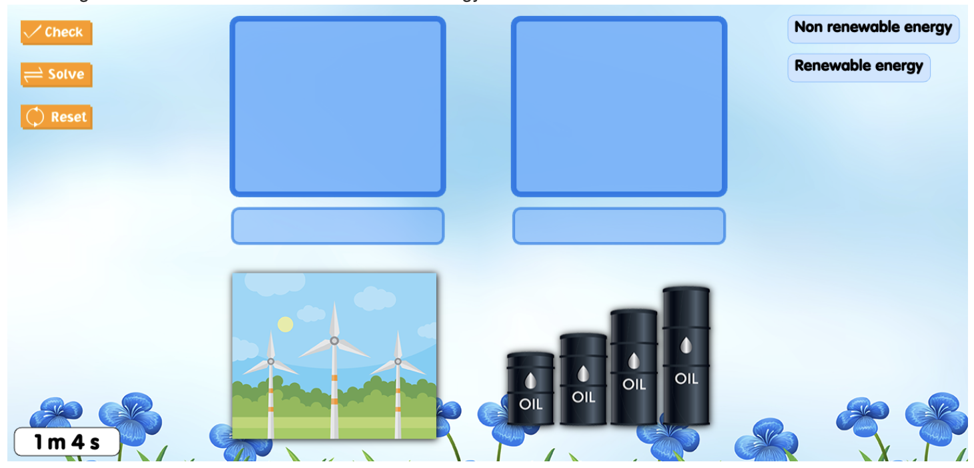
Simulation Game
Nonrenewable Resources
In this game, students will practice sorting different examples of renewable and nonrenewable resources.
Notes:
In this game, students will practice sorting different examples of renewable and nonrenewable resources.

Slide 64
Big Question: How do the resources we use affect humans and the environment?
Notes:
Now that we’ve learned our new term “nonrenewable resources”, let’s reflect on our big question. Our “big question” is: How do the resources we use affect humans and the environment?
Was there anything that we predicted earlier that was correct or incorrect? Do you have any new hypotheses to share?
[Pause and illicit predictions from students. They could mention renewable resources and how using them is better than using non-renewable resources for the environment.]
I love all these thoughtful scientific hypotheses! Be sure to keep this question and your predictions in mind as we move through these next few lessons, and we’ll continue to revisit it.

Slide 65
Notes:
Thanks for watching, and please continue watching CAPs available from this website.

Slide 66
This Video Was Created With Resources From:
Questions or Comments
Michael Kennedy, Ph.D. MKennedy@Virginia.edu
Rachel L Kunemund, Ph.D. rk8vm@virginia.edu

