Slide 1
Intro
“Big Idea” Question
Review Concepts
Check-In Questions
Teacher Engagement
Vocabulary
Student-Friendly Definition
Examples & Non-Examples
Morphological Word Parts
Frayer Model
Simulation/Activity
Notes:
OK everyone, get ready for our next lesson. Just as a reminder, these are the different components that our lesson may include, and you’ll see these icons in the top left corner of each slide so that you can follow along more easily!

Slide 2
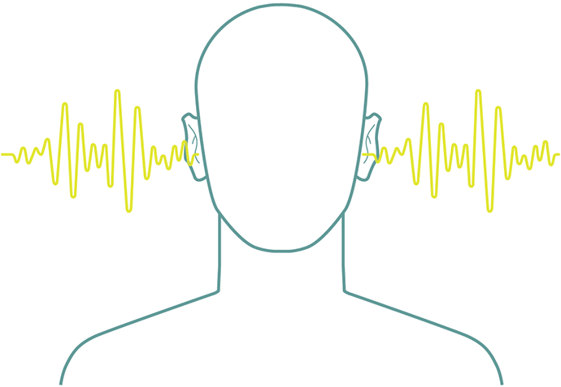
Pitch
Intro
Notes:
Today, we’ll be learning about the word: Pitch.
Feedback: Using clear and simple language when introducing content helps students understand what is expected.

Slide 3
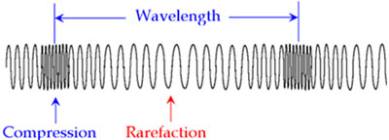
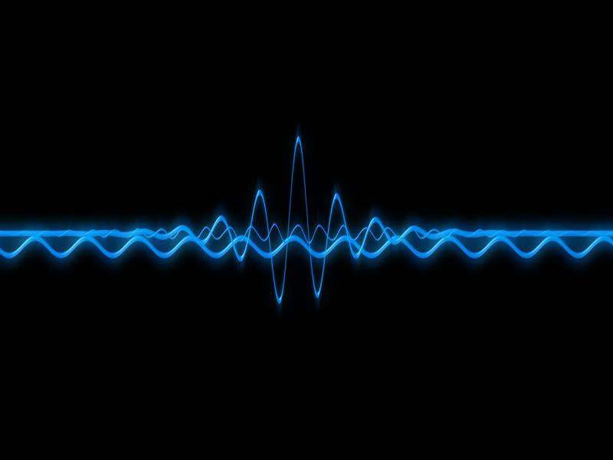
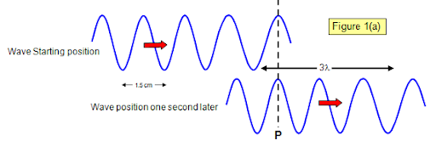
Big Question: What are the properties of waves and how are they related?
Notes:
Our “big question” is: What are the properties of waves and how are they related?
[Pause and illicit predictions from students.]
I love all these thoughtful scientific hypotheses! Be sure to keep this question and your predictions in mind as we move through these next few lessons, and we’ll continue to revisit it.

Slide 4
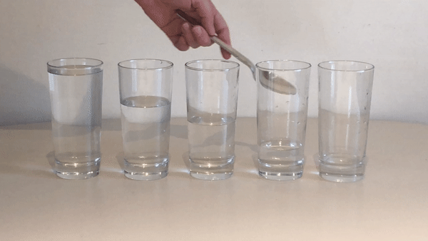
Demonstration
Materials Needed:
Glasses filled with different amounts of water, a metal utensil
Procedure:
Fill glasses with different amounts of water. Then hit each glass lightly with a metal utensil. Take note of the different pitches each glass makes.
Notes:
Now that we’ve learned about pitch, let’s do a demonstration.
On your tables, you have glasses filled with different amounts of water and a metal utensil. Fill glasses with different amounts of water. Then hit each glass lightly with a metal utensil. Take note of the different pitches each glass makes.
We will reflect on this activity on the next slide.

Slide 5
Notes:
Before we move on to our new topic, let’s review some other words & concepts that you already learned and make sure you are firm in your understanding.

Slide 6
Wavelength: the distance between two like points on a wave
Notes:
Wavelength is the distance between two like points on a wave.

Slide 7
Sound Waves: longitudinal waves that travel through mediums
Notes:
Sound waves are longitudinal waves that travel through mediums.

Slide 8
Compression: where particles are closely packed
Notes:
A sound wave is made of 2 main parts. Compressions where particles are closely packed,

Slide 9
Rarefaction: where particles are loosely packed
Notes:
And rarefaction where particles are loosely packed.

Slide 10
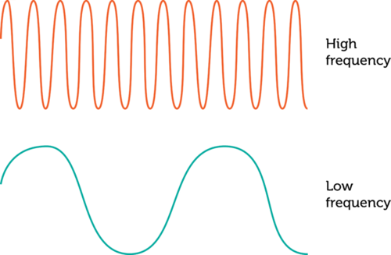
Frequency: the number of waves passing a set point in a specific amount of time
Notes:
Frequency is the number of waves passing a set point in a specific amount of time.

Slide 11
Vibration: Movement of particles that occurs in solids, liquids, or gases.
Notes:
Vibration is the movement of particles that occurs in solids, liquids, or gases.

Slide 12
Notes:
Now let’s pause for a moment to review the information we have covered already.

Slide 13
What are sound waves?
Notes:
What are sound waves?
[Sound waves are longitudinal waves that travel through mediums.]

Slide 14
Frequency is the _______ of waves passing a set point in a specific amount of _______.
number, time
time, number
Notes:
Frequency is the ______ of waves passing a set point in a specific amount of ______.
[number, time]

Slide 15
Frequency is the _______ of waves passing a set point in a specific amount of _______.
number, time
time, number
Notes:
Frequency is the [number] of waves passing a set point in a specific amount of [time].

Slide 16
True or False: Vibration is the movement of particles that occurs in solids, liquids, or gases.
Notes:
True or False: Vibration is the movement of particles that occurs in solids, liquids, or gases.
[True]

Slide 17
True or False: Vibration is the movement of particles that occurs in solids, liquids, or gases.
Notes:
True: Vibration is the movement of particles that occurs in solids, liquids, or gases.

Slide 18
Pitch
Notes:
Now that we’ve reviewed, let’s define the phrase pitch.

Slide 19
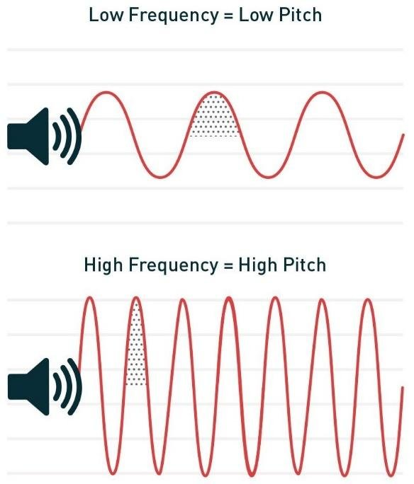
Pitch: how high or low a sound is
Notes:
Pitch is how high or low a sound is.

Slide 20
Notes:
Let’s check-in for understanding.

Slide 21
What is pitch?
Notes:
What is pitch?
[How high or low a sound is.]

Slide 22
Notes:
That is the basic definition, but there is a bit more you need to know.

Slide 23
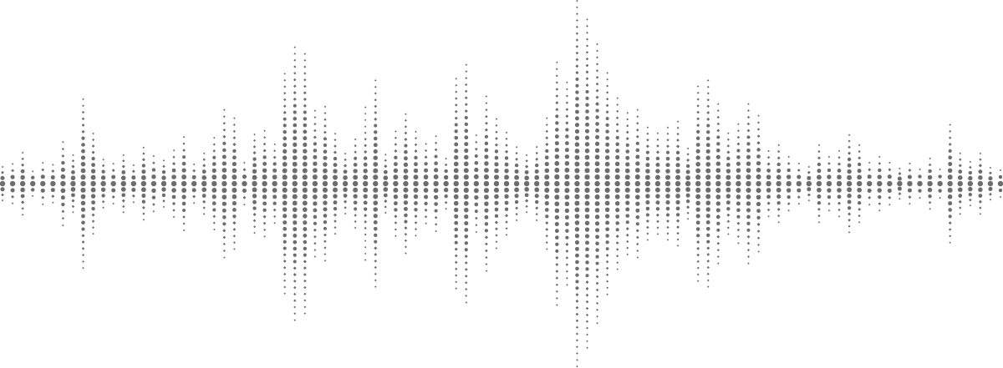
Pitch is determined by how fast something is vibrating to make a sound.
Notes:
Pitch is how we describe whether a sound is high or low. Pitch is determined by how fast something is vibrating, or moving, to make a sound.

Slide 24
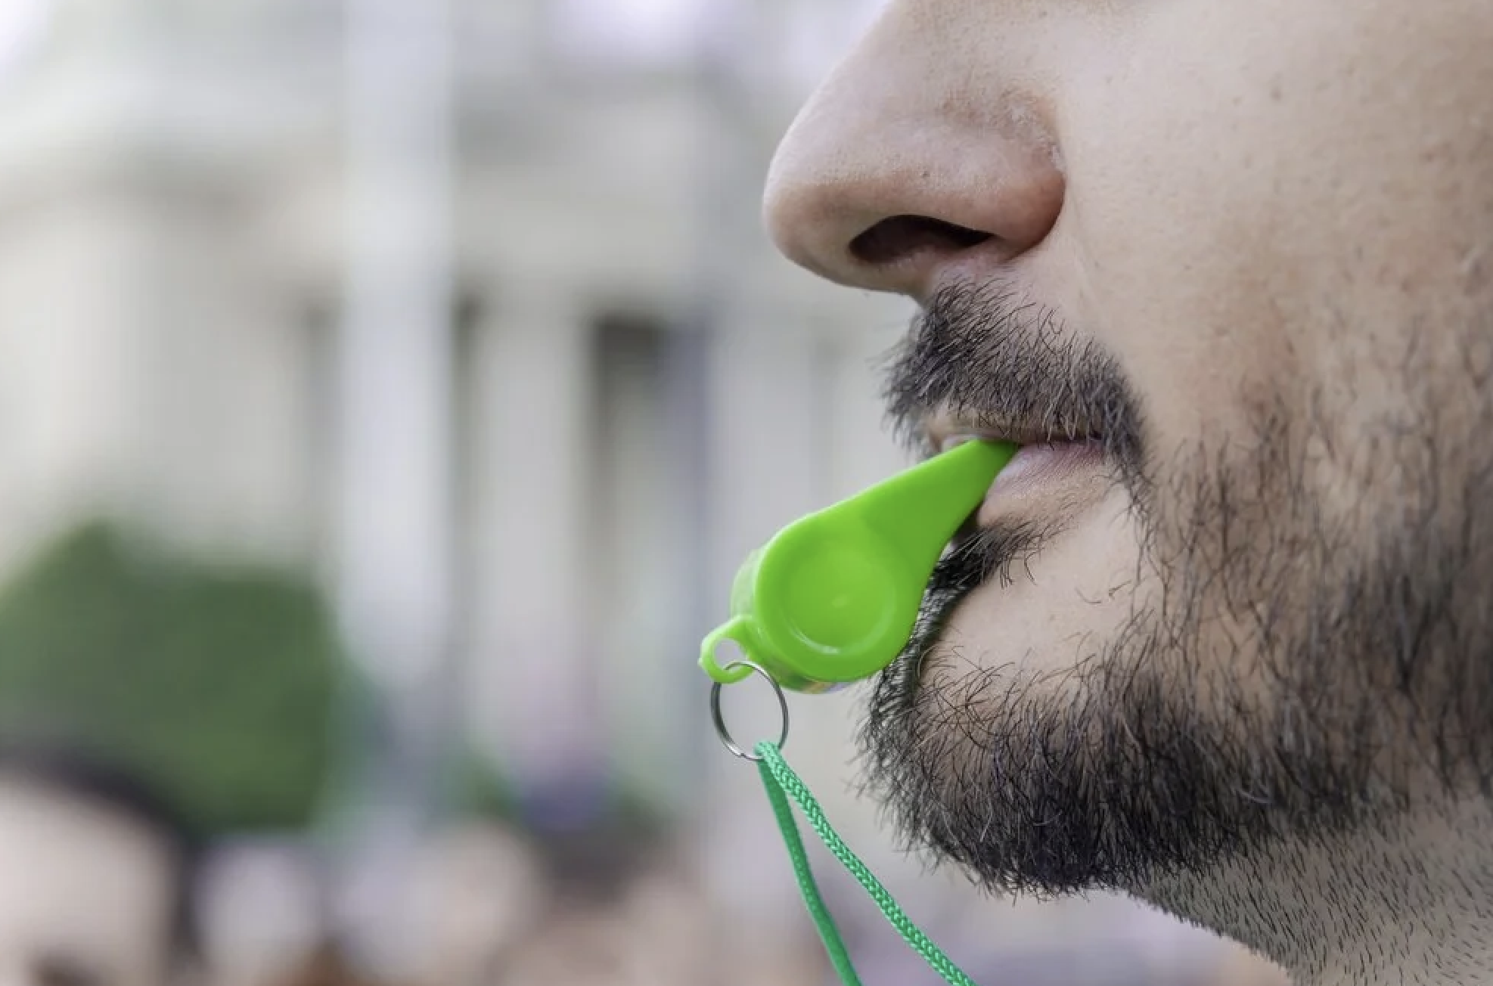
If something vibrates really quickly, it makes a high-pitched sound.
Notes:
If something vibrates really quickly, it makes a high-pitched sound. When a person blows a whistle, it makes a high-pitched sound meaning it vibrates quickly.

Slide 25
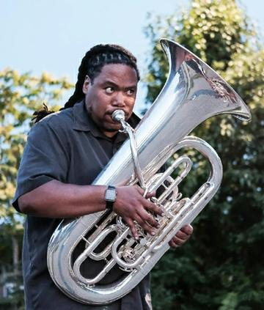
If something vibrates more slowly, it makes a low-pitched sound.
Notes:
If something vibrates more slowly, it makes a low-pitched sound. A tuba makes a low-pitched sound, which means it vibrates slowly.

Slide 26
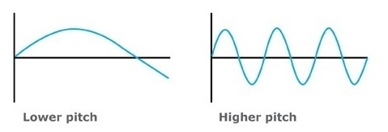
Sounds with lower pitch have bigger wavelengths, sounds with higher pitch have smaller wavelengths.
Notes:
Sounds with lower pitch have bigger wavelengths, sounds with higher pitch have smaller wavelengths.

Slide 27
Notes:
Let’s check-in for understanding.

Slide 28
Pitch is determined by how _____ something is vibrating to make a sound.
Fast
Much
High
Notes:
Pitch is determined by how _____ something is vibrating, or moving, to make a sound.
[Fast]

Slide 29
Pitch is determined by how _____ something is vibrating to make a sound.
Fast
Much
High
Notes:
Pitch is determined by how [fast] something is vibrating, or moving, to make a sound.

Slide 30
True or False: If something vibrates really quickly, it makes a high-pitched sound. If something vibrates more slowly, it makes a low-pitched sound.
True
False
Notes:
True or False: If something vibrates really quickly, it makes a high-pitched sound. If something vibrates more slowly, it makes a low-pitched sound.
[True]

Slide 31
True or False: If something vibrates really quickly, it makes a high-pitched sound. If something vibrates more slowly, it makes a low-pitched sound.
True
False
Notes:
True or False: If something vibrates really quickly, it makes a high-pitched sound. If something vibrates more slowly, it makes a low-pitched sound.
[True]

Slide 32
Notes:
Now, let’s talk about some examples of pitch.

Slide 33
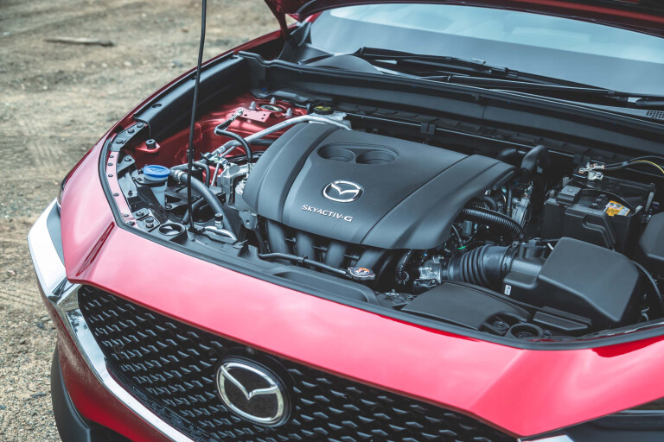
An example of a low pitch is a car engine. Car engines make deep, low sounds.
Notes:
An example of a low pitch is a car engine. Car engines make deep, low sounds.

Slide 34
An example of a high pitch are birds chirping.
Notes:
An example of a high pitch are birds chirping.

Slide 35
Notes:
Let’s check-in for understanding.

Slide 36
What is pitch?
Notes:
What is pitch?
[How high or low a sound is.]

Slide 37
Notes:
Now, let’s talk about some non-examples of pitch.

Slide 38
Color is NOT an example of pitch. It is a property of light, not sound, so it doesn’t have a pitch.
Notes:
Color is not an example of pitch. It is a property of light, not sound, so it doesn’t have a pitch.

Slide 39
Length is NOT an example of pitch. It is a measure of size or distance.
Notes:
Length is not an example of pitch. It is a measure of size or distance.

Slide 40
Notes:
Now let’s pause for a moment to check your understanding.

Slide 41
Why do bird chirps have pitch and color does not?
Notes:
Why do bird chirps have pitch and color does not?
[The bird chirps are sounds. Color is not a sound.]

Slide 42
Remember!!!
Notes:
So remember!

Slide 43
What is pitch?
Notes:
What is pitch?
[How high or low a sound is.]

Slide 44
Notes:
We will now complete this concept map, called a Frayer model, to summarize and further clarify what you have learned about the term pitch.

Slide 45
Definition
Picture
Pitch
Example
How does pitch impact my life?
Notes:
To complete the Frayer model, we will choose from four choices the correct picture, definition, example, and response to the question, “How does pitch impact my life?” Select the best response for each question using the information you just learned. As we select responses, we will see how this model looks filled in for the term pitch.

Slide 46
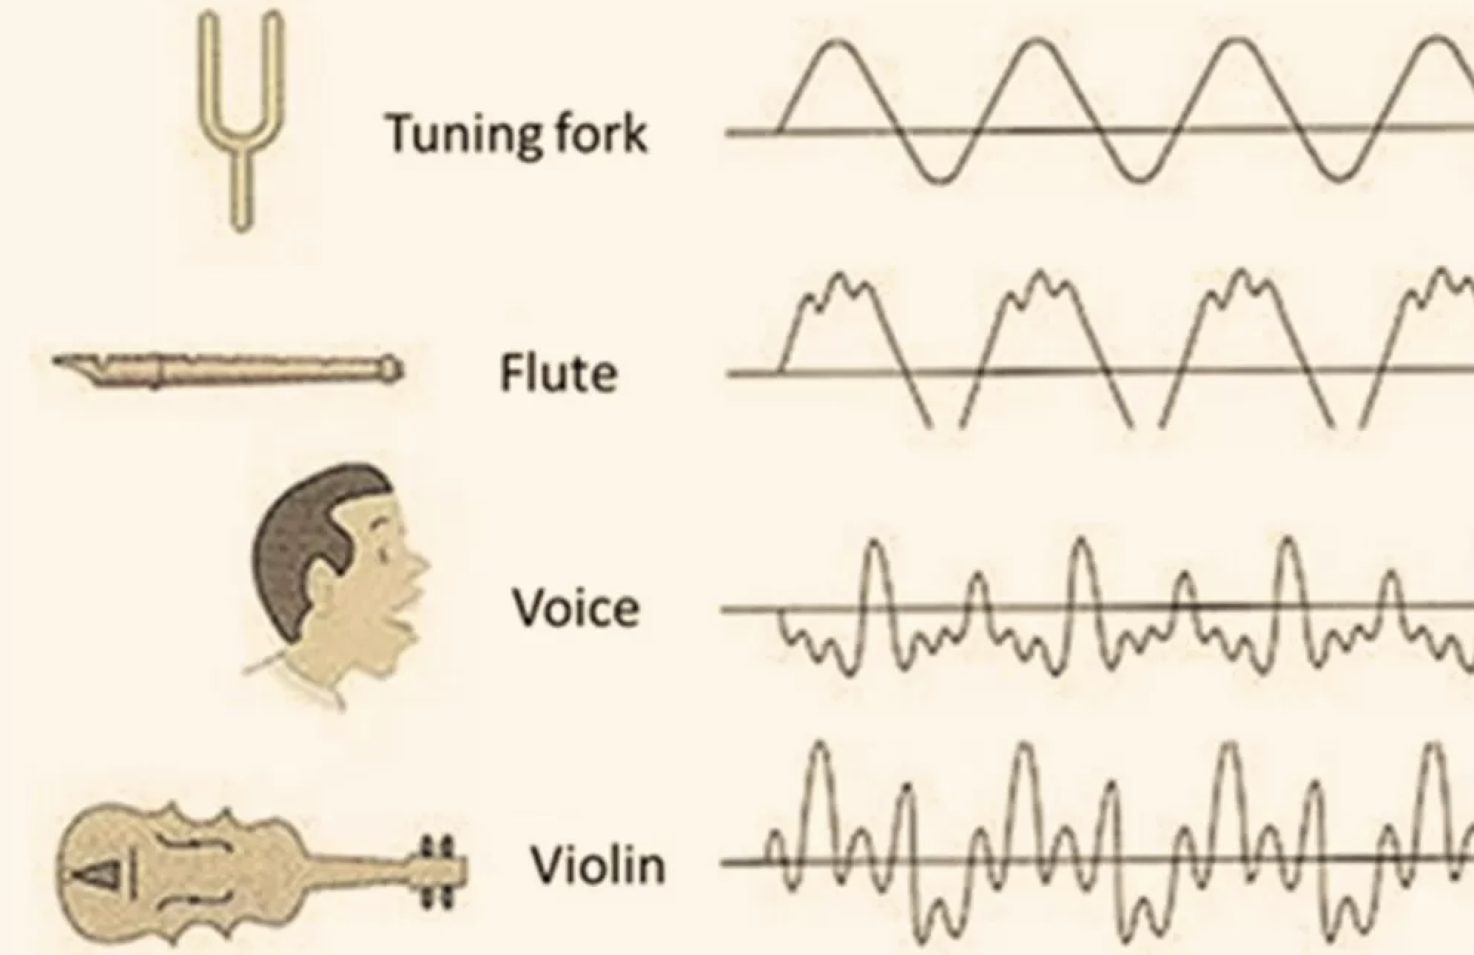
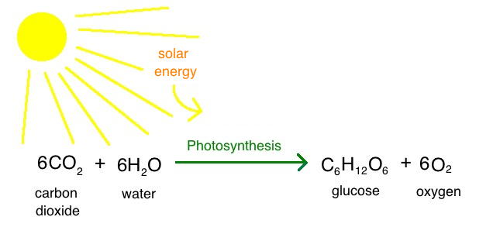
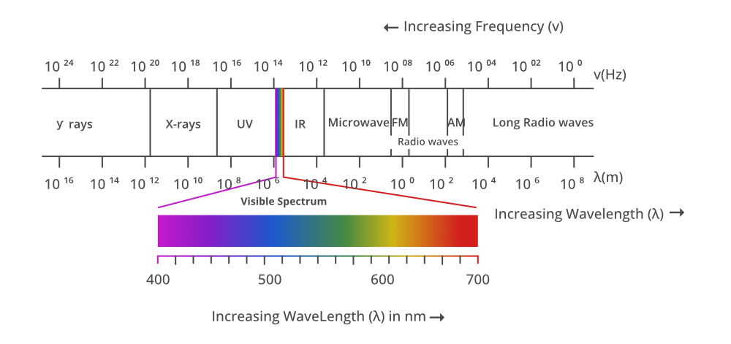
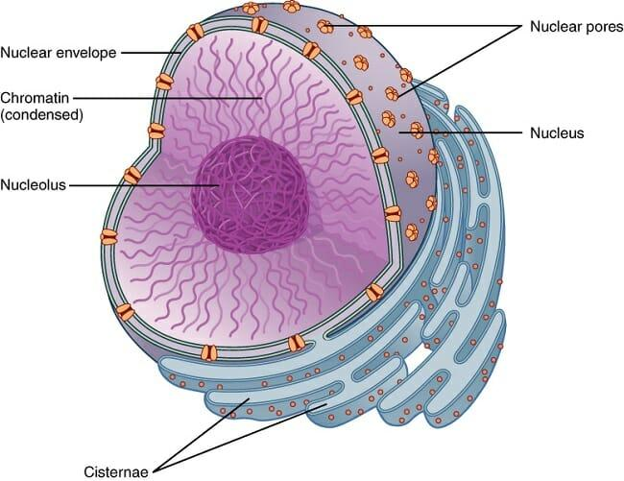
Directions: Choose the correct picture of pitch from the choices below.
A
B
C
D
Notes:
Choose the one correct picture of pitch from these four choices.

Slide 47
Directions: Choose the correct picture of pitch from the choices below.
A
B
C
D
Notes:
This is the picture that shows pitch.

Slide 48
Definition
Picture
Pitch
Example
How does pitch impact my life?
Notes:
Here is the Frayer model filled in with a picture of pitch.

Slide 49
Directions: Choose the correct definition of Pitch from the choices below.
A
How fast or slow an object is moving
B
How high or low a sound is
C
How heavy or light an object is
D
How hot or cold something is
Notes:
Choose the one correct definition of pitch from these four choices.

Slide 50
Directions: Choose the correct definition of Pitch from the choices below.
A
How fast or slow an object is moving
B
How high or low a sound is
C
How heavy or light an object is
D
How hot or cold something is
Notes:
“How high or low a sound is” is correct! This is the definition of pitch.

Slide 51
Definition
Picture
How high or low a sound is
Pitch
Example
How does pitch impact my life?
Notes:
Here is the Frayer Model with a picture and the definition filled in for pitch: how high or low a sound is.

Slide 52
Directions: Choose the correct example of Pitch from the choices below.
A
A cell phone ringing with a high sound
B
A cup of lemonade that tastes sweet
C
A sunset over the ocean
D
A baby crawling on the ground
Notes:
Choose the one correct example of pitch from these four choices.

Slide 53
Directions: Choose the correct example of Pitch from the choices below.
A
A cell phone ringing with a high sound
B
A cup of lemonade that tastes sweet
C
A sunset over the ocean
D
A baby crawling on the ground
Notes:
“A cell phone ringing with a high sound” is correct! This is an example of pitch.

Slide 54
Definition
Picture
How high or low a sound is
Pitch
A cell phone ringing with a high sound
Example
How does pitch impact my life?
Notes:
Here is the Frayer Model with a picture, definition, and an example of pitch: A cell phone ringing with a high sound

Slide 55
Directions: Choose the correct response for “how does pitch impact my life?” from the choices below.
A
Pitch helps us distinguish between different sounds in our lives.
B
Pitch explains how objects move on the surface of the planet.
C
Pitch determines how hot or cold it is outside.
D
Pitch helps us explain our thoughts and feelings.
Notes:
Choose the one correct response for “how does pitch impact my life?” from these four choices.

Slide 56
Directions: Choose the correct response for “how does pitch impact my life?” from the choices below.
A
Pitch helps us distinguish between different sounds in our lives.
B
Pitch explains how objects move on the surface of the planet.
C
Pitch determines how hot or cold it is outside.
D
Pitch helps us explain our thoughts and feelings.
Notes:
“Pitch helps us distinguish between different sounds in our lives.” That is correct! This is an example of how pitch impacts your life.

Slide 57
Definition
Picture
How high or low a sound is
Pitch
Pitch helps us distinguish between different sounds in our lives.
A cell phone ringing with a high sound
Example
How does pitch impact my life?
Notes:
Here is the Frayer Model with a picture, definition, example, and a correct response to “how does pitch impact my life?”: Pitch helps us distinguish between different sounds in our lives.

Slide 58
Remember!!!
Notes:
So remember!

Slide 59
What is pitch?
Notes:
What is pitch?
[How high or low a sound is.]

Slide 60
Big Question: What are the properties of waves and how are they related?
Notes:
Let’s reflect again on our big question. Our “big question” is: What are the properties of waves and how are they related?
Does anyone have any additional examples to share that haven’t been discussed yet?
In our “big question,” there are two more vocabulary words we need to explore before we move onto our simulation activity.

Slide 61
Reflection Activity
Ask yourselves…
Which glasses made the highest and lowest pitches?
Why might the pitch change depending on how much water is in the glass?
Notes:
Have students discuss these questions with a partner or with their table before calling on groups to share one of their responses with the class.
Ask yourselves…
Which glasses made the highest and lowest pitches?
Why might the pitch change depending on how much water is in the glass?

Slide 62
Notes:
Thanks for watching, and please continue watching CAPs available from this website.

Slide 63
This Was Created With Resources From:
Questions or Comments
Michael Kennedy, Ph.D. MKennedy@Virginia.edu
Rachel L Kunemund, Ph.D. rk8vm@virginia.edu

