Slide 1
Intro
“Big Idea” Question
Review Concepts
Check-In Questions
Teacher Engagement
Vocabulary
Student-Friendly Definition
Examples & Non-Examples
Frayer Model
Simulation/Activity
Notes:
OK everyone, get ready for our next lesson. Just as a reminder, these are the different components that our lesson may include, and you’ll see these icons in the top left corner of each slide so that you can follow along more easily!

Slide 2
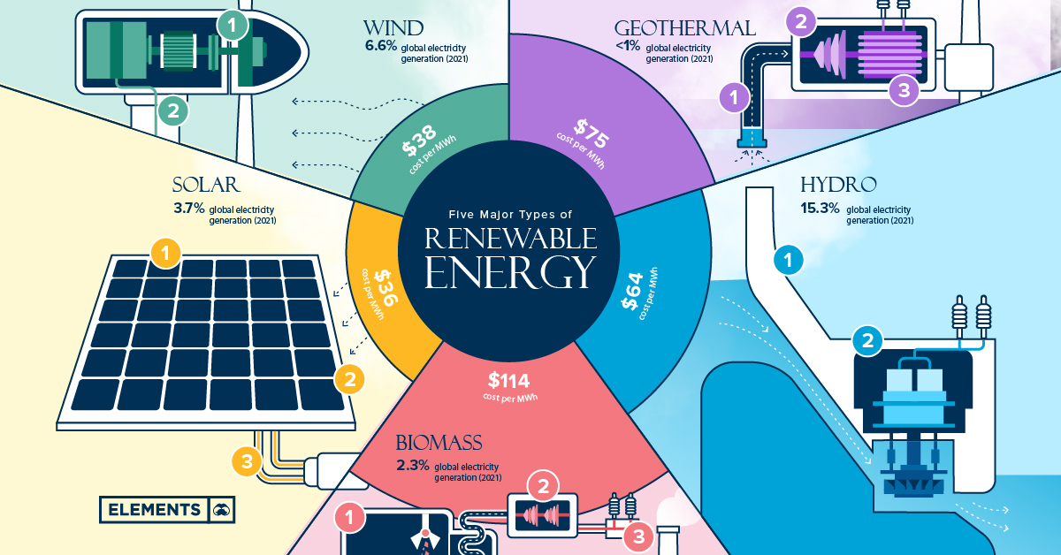
Renewable Energy
Intro
Notes:
Today we will be learning about Renewable Energy.

Slide 3
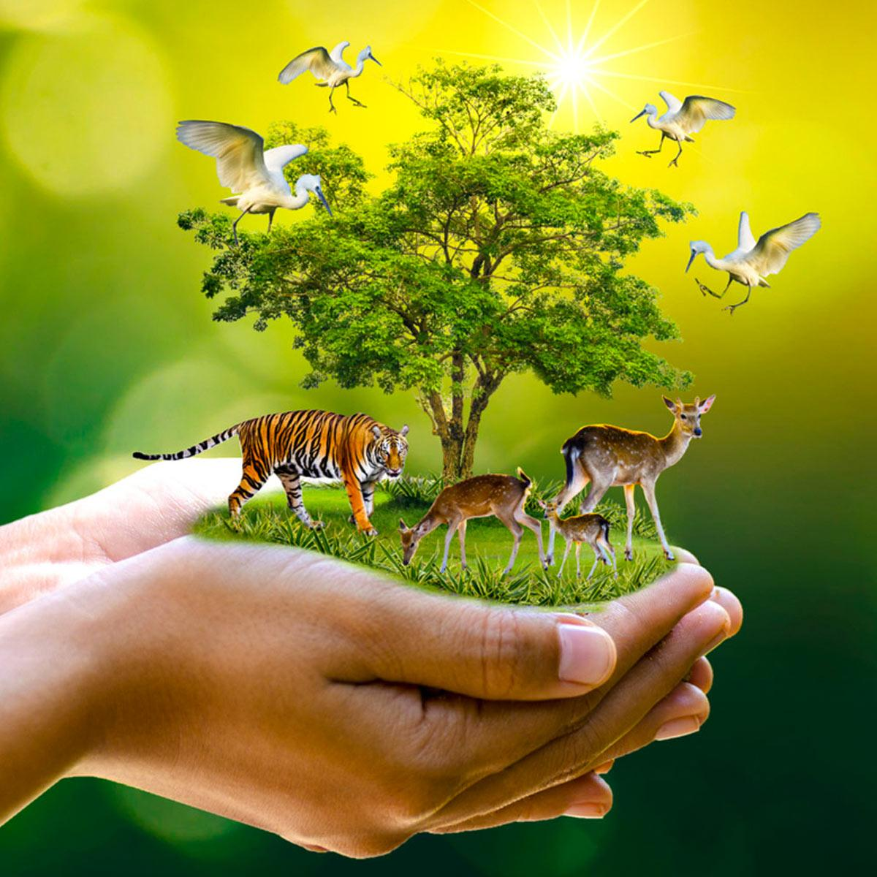
Big Question: How does the amount we use of different types of resources help us take care of our environment?
Notes:
Our “big question” is: How does the amount we use of different types of resources help us take care of our environment?
[Pause and illicit predictions from students.]
Be sure to keep this question and your predictions in mind as we move through this video and questions.

Slide 4
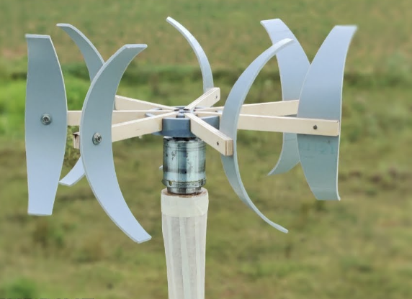
Demonstration
TEACHER DIRECTIONS:
Before viewing: Ask students to recall what they already know about energy.
During: Engage the class in a discussion about the demonstration. Ask questions such as: How does the wind turbine generate electricity? What happens when the wind blows on the propeller? Why is wind energy considered a renewable resource?
After: Tell students that today they will be learning more about the term energy.
Notes:
A feasible and effective classroom demonstration to teach about renewable energy can focus on the concept of harnessing wind energy. Here's a simple and engaging wind turbine demonstration for 5th-grade students:
Activity: Building a Paper Wind Turbine
Materials Needed:
Small DC motor (easily available in hobby stores)
Plastic propeller (alternatively, you can make one from lightweight materials)
Cardboard or foam board
Wooden or plastic skewer
Small LED light (optional)
Hot glue gun (adult supervision required)
Scissors
Masking tape
Markers or stickers for decoration (optional)
Procedure:
Introduction:
Begin by discussing the concept of wind energy with the students. Explain that wind energy is a renewable resource that can be harnessed to generate electricity.
Building the Wind Turbine:
Distribute the materials and guide students through the process of building a simple paper wind turbine.
Cut out a base from the cardboard or foam board.
Attach the small DC motor to the base using hot glue. Make sure the motor shaft is free to spin.
Attach the plastic propeller to the motor shaft.
Attach the base to a wooden or plastic skewer, creating a stand for the turbine.
Testing the Wind Turbine:
Set up a fan or use your breath to simulate wind. Place the wind turbine in front of the fan or blow on it gently to observe the rotation of the propeller. Explain that this rotation represents the conversion of wind energy into mechanical energy.
Connecting an LED (Optional):
If available, connect a small LED light to the terminals of the motor. When the wind turbine spins, it should generate enough electricity to light up the LED, demonstrating the conversion of wind energy into electrical energy.
Class Discussion:
Engage the class in a discussion about the demonstration. Ask questions such as:
How does the wind turbine generate electricity?
What happens when the wind blows on the propeller?
Why is wind energy considered a renewable resource?
Relate to Renewable Energy:
Relate the activity to renewable energy by explaining that wind is a natural and continuous source of energy. Unlike non-renewable resources like fossil fuels, the wind can be harnessed without depleting it.
Extension Activity:
Challenge students to experiment with different designs for the wind turbine blades to see how it affects the efficiency of capturing wind energy.
This hands-on activity allows students to explore the principles of renewable energy in a tangible way, making the concept of wind energy more accessible and engaging. It also provides an opportunity to discuss the advantages of renewable energy sources for sustainable power generation.

Slide 5
Notes:
Before we move on to our new vocabulary term, let’s review some other words & concepts that you already learned and make sure you are firm in your understanding.
Feedback: Reviewing key background knowledge helps lay the context and sets the students up to make sense of the new content you are introducing, it also reinforces previously learned material.

Slide 6
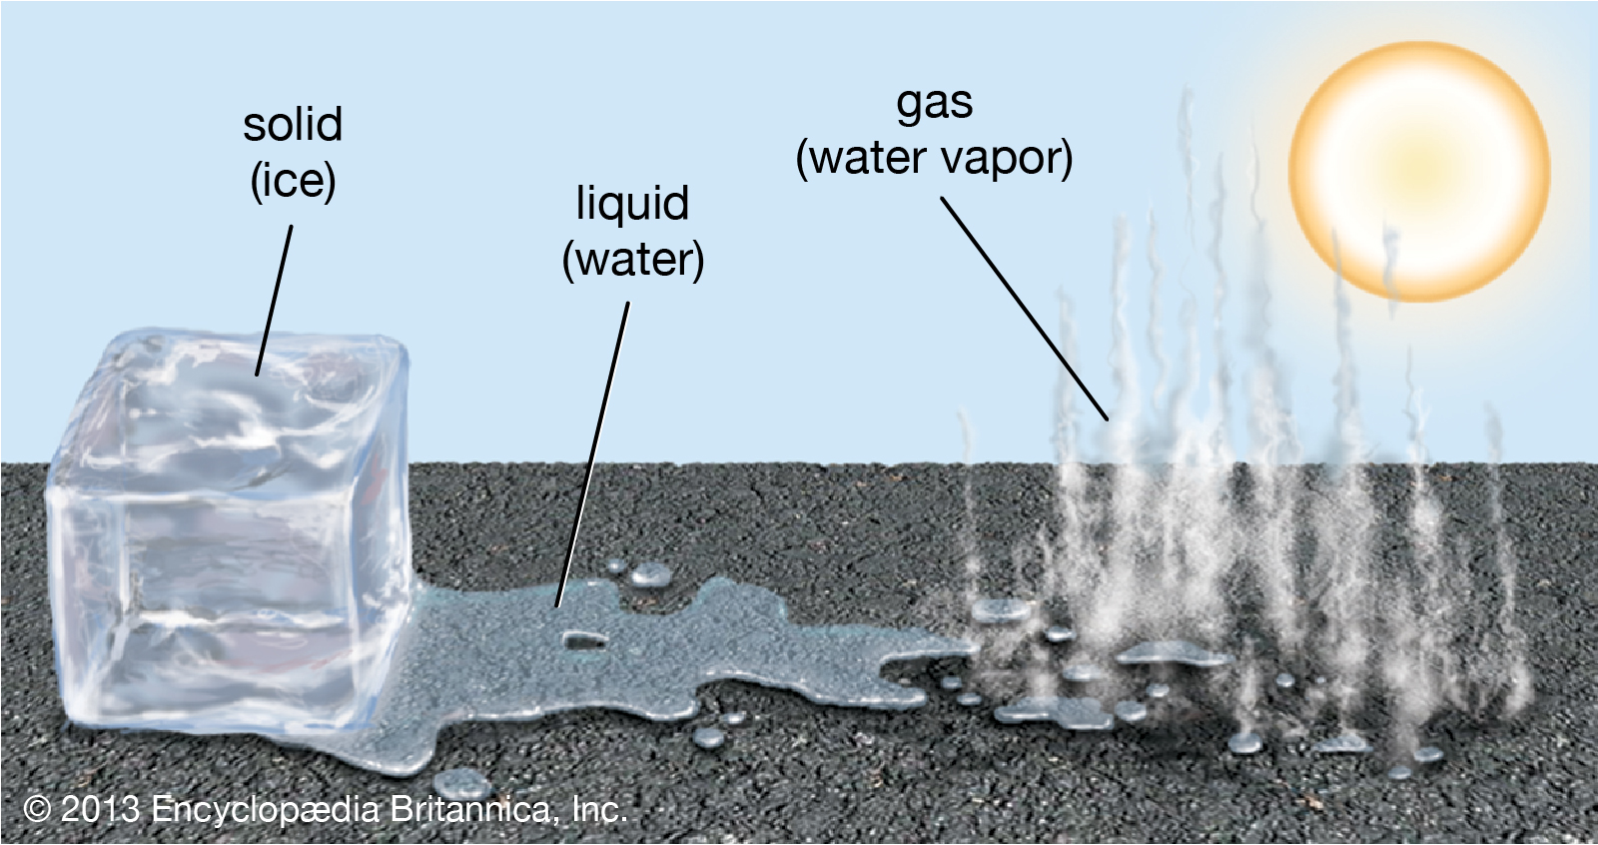
Water is the only compound that exists in all three states of matter: solid, liquid, and gas
Notes:
Water is the only compound that exists in all three states of matter: solid, liquid, and gas.

Slide 7
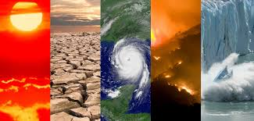
Climate: the average measurements of weather in a place over the course of years
Notes:
Climate is the average measurements of weather in a place over the course of years.

Slide 8
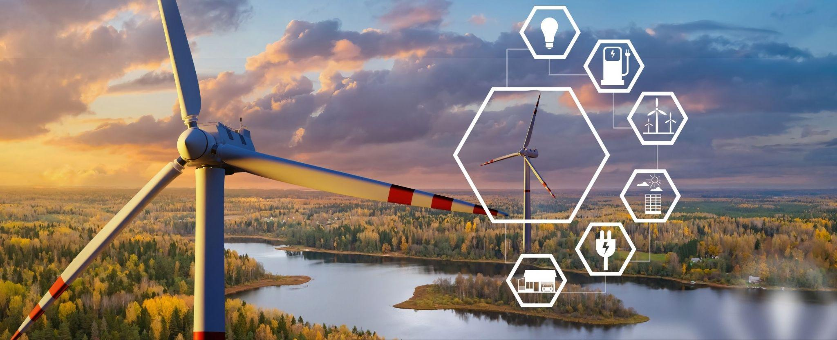
Energy: the ability to cause change
Notes:
Energy is the ability to cause change.

Slide 9
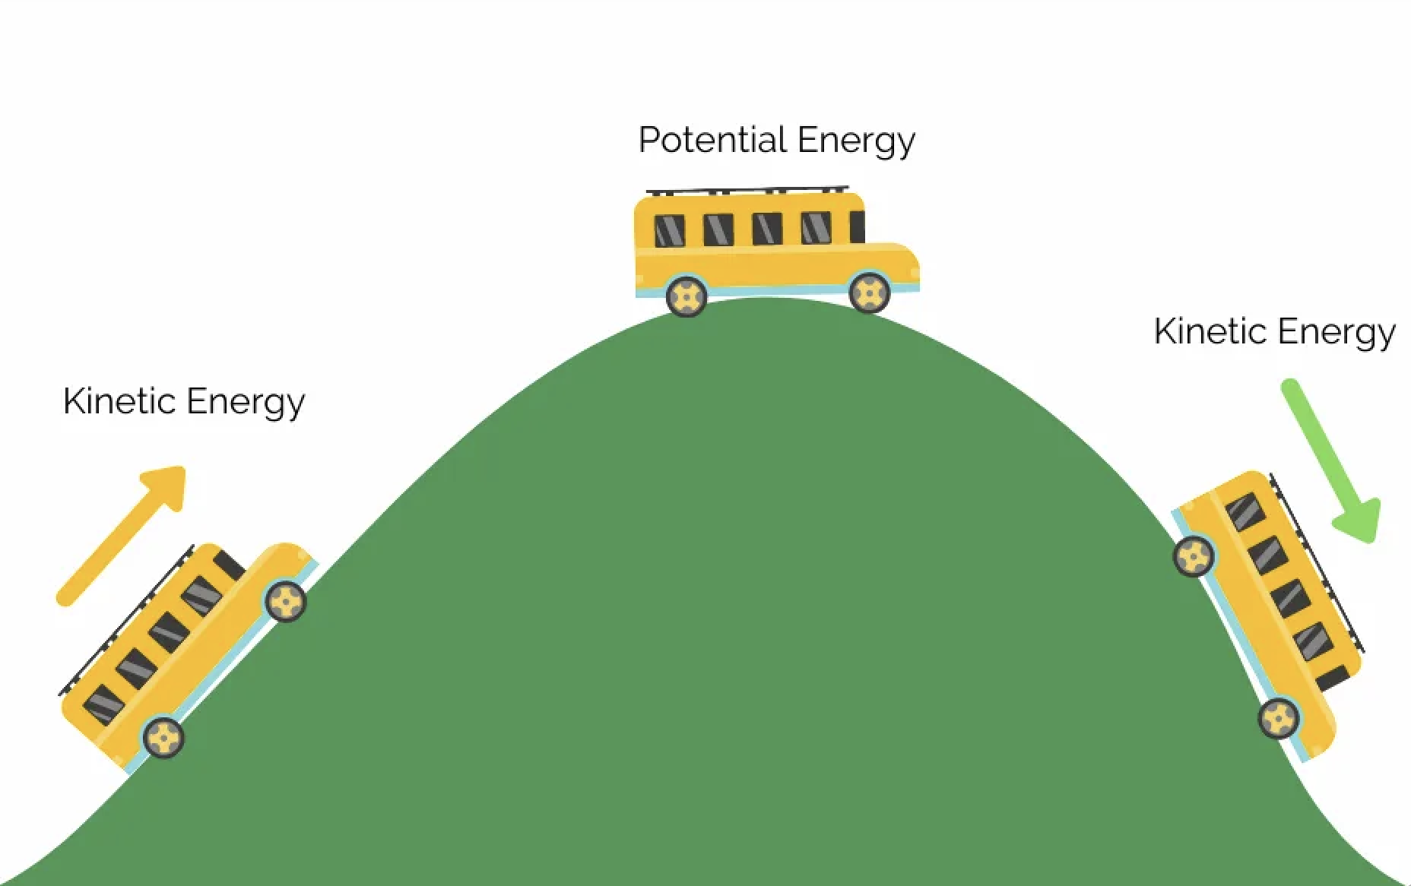
Kinetic Energy: energy of mass in motion
Notes:
Kinetic Energy is energy of mass in motion,.

Slide 10
Potential energy: stored energy
Notes:
Potential energy is stored energy.

Slide 11
Notes:
Let’s check-in for understanding.

Slide 12
______ is the only compound that exists in all three states of matter: solid, liquid, and gas.
Notes:
______ is the only compound that exists in all three states of matter: solid, liquid, and gas.

Slide 13
Water is the only compound that exists in all three states of matter: solid, liquid, and gas.
Notes:
Water is the only compound that exists in all three states of matter: solid, liquid, and gas.

Slide 14
What is climate?
Notes:
What is climate?
[The average measurements of weather in a place over the course of years.]

Slide 15
True or False: Energy is the ability to cause change
Notes:
True or False: Energy is the ability to cause change.
[True]

Slide 16
True or False: Energy is the ability to cause change
Notes:
True: Energy is the ability to cause change.

Slide 17
Kinetic Energy: energy of in motion
Notes:
Kinetic Energy is energy of in motion.
[mass]

Slide 18
Kinetic Energy: energy of mass in motion
Notes:
Kinetic Energy is energy of in motion.
[mass]

Slide 19
True or False: Potential energy is stored energy
Notes:
True or False: Potential energy is stored energy.
[True]

Slide 20
True or False: Potential energy is stored energy
Notes:
True: Potential energy is stored energy.

Slide 21
Renewable Energy
Notes:
Now let’s define our new term, Renewable Energy.

Slide 22
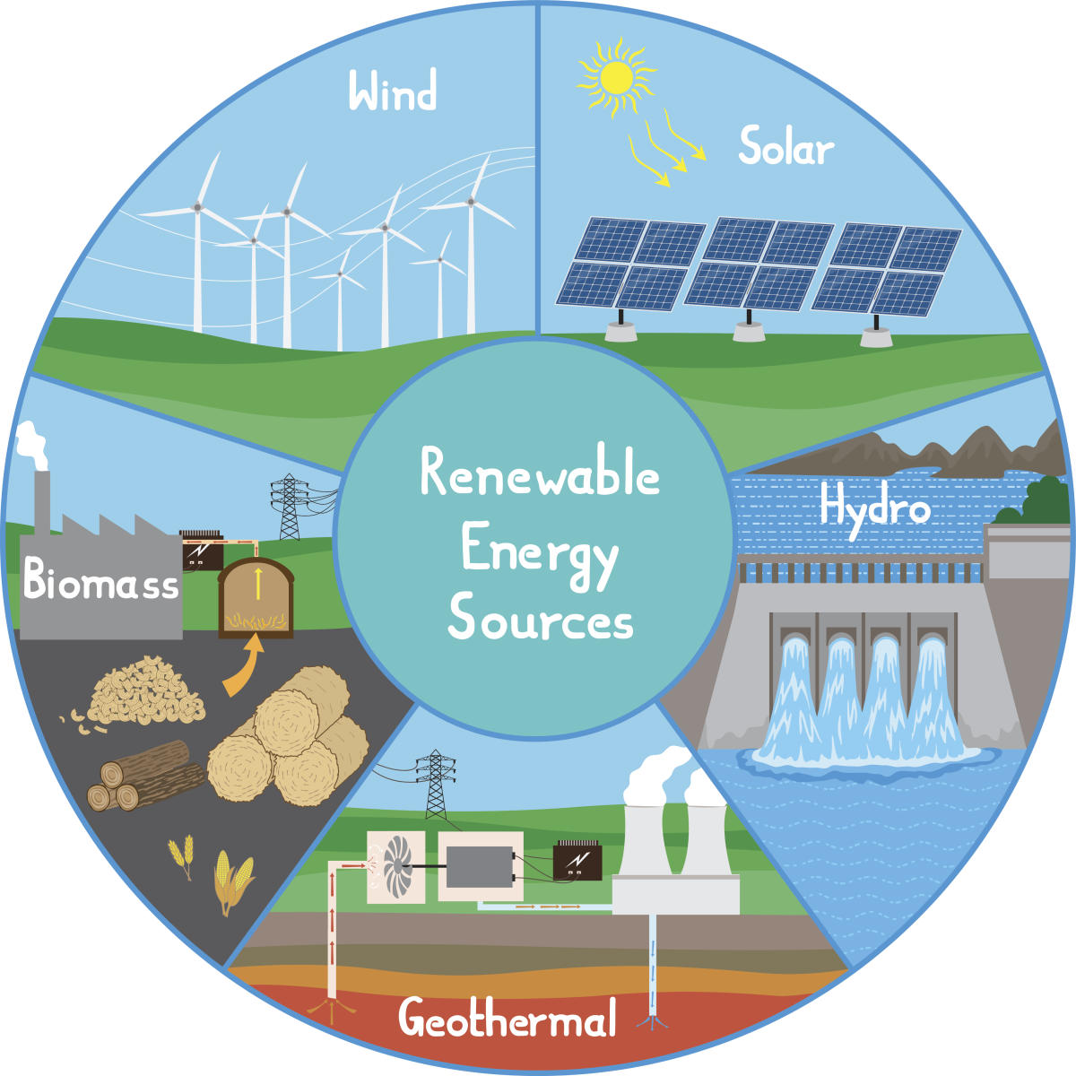
Renewable Energy: energy that comes from natural sources and will not run out
Notes:
Renewable Energy is energy that comes from natural sources and will not run out.

Slide 23
Notes:
Let’s check-in for understanding.

Slide 24
What is renewable energy?
Notes:
Renewable Energy is energy that comes from natural sources and will not run out.

Slide 25
Notes:
That is the basic definition, but there is a bit more you need to know.

Slide 26
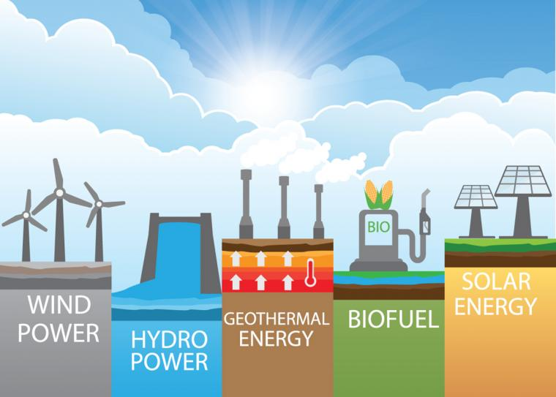
There are different types of power that renewable energy because they come from sources that will not run out.
Notes:
There are different types of power that renewable energy because they come from sources that will not run out.

Slide 27
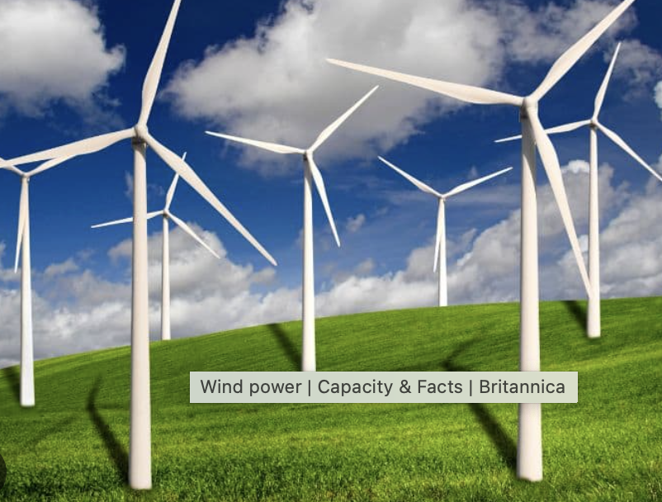
This includes wind power, which is power created from wind using windmills.
Notes:
This includes wind power, which is power created from wind using windmills.

Slide 28
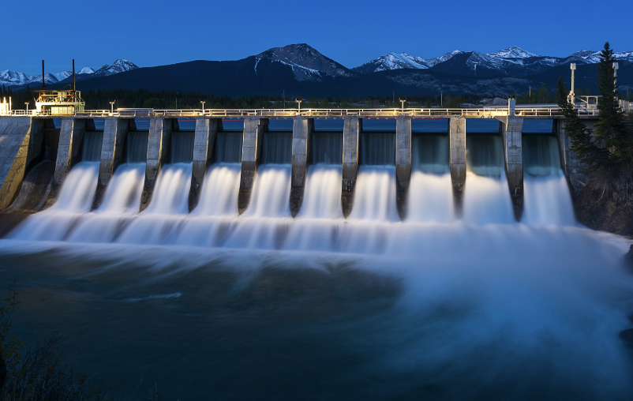
Hydro power, which is power created from the movement of water.
Notes:
Hydro power, which is power created from the movement of water.

Slide 29
Geothermal energy, which is power created from heat from Earth.
Notes:
Geothermal energy, which is power created from heat from Earth, and biofuel, which is power created from breaking down organic matter like plants.

Slide 30
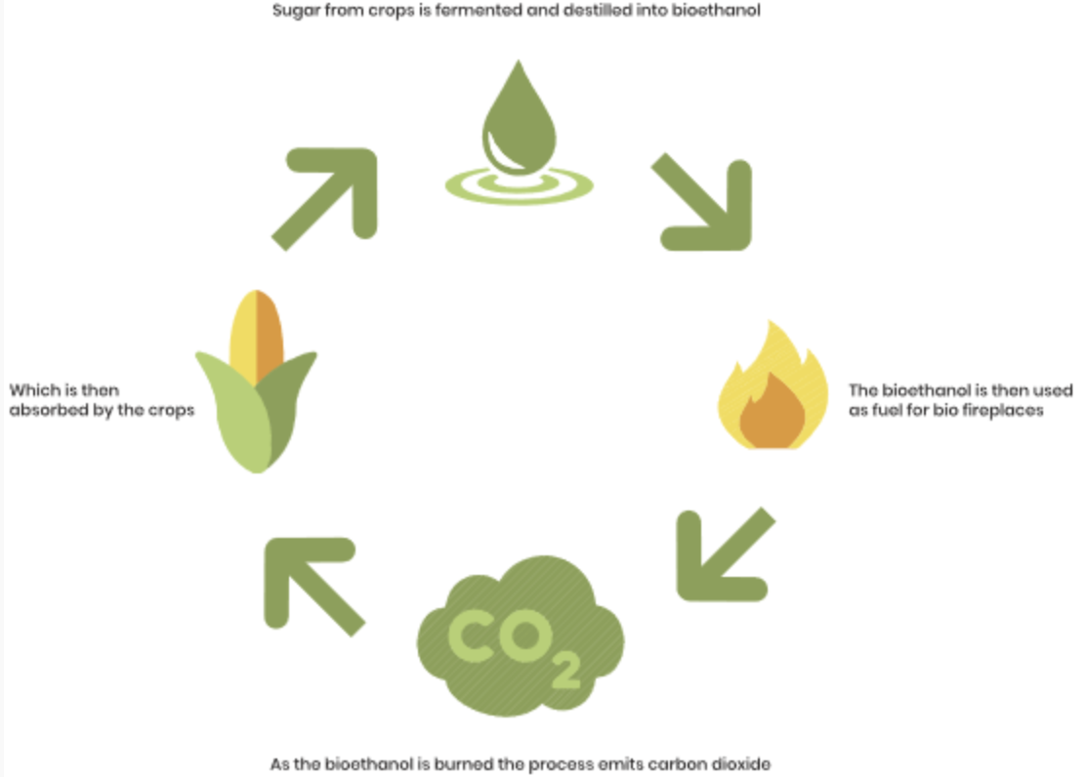
Biofuel, which is power created from breaking down organic matter like plants.
Notes:
Biofuel, which is power created from breaking down organic matter like plants.

Slide 31
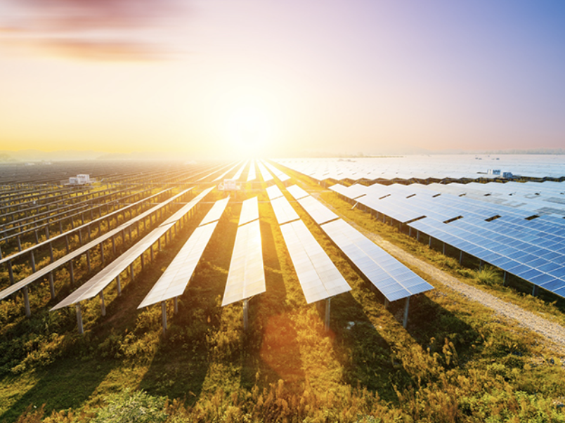
Solar energy, which is power created from using solar panels to capture sunlight.
Notes:
Solar energy, which is power created from using solar panels to capture sunlight.

Slide 32
Notes:
Let’s check-in for understanding.

Slide 33
What are the five different types of renewable energy mentioned?
Notes:
What are the five different types of renewable energy mentioned?
[Wind power, Hydro power, Geothermal energy, biofuel, solar energy]

Slide 34
Notes:
Now, let’s talk about some examples of renewable energy.

Slide 35
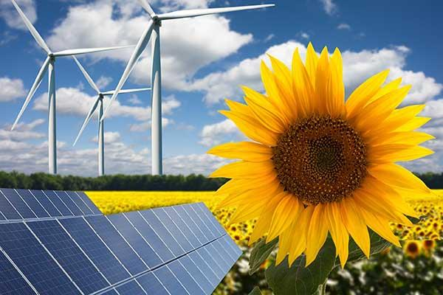
This is an example of renewable energy. A farmer uses windmills and solar power to help power the farm that grows sunflowers. Windmills and solar power are renewable energy sources from wind and the Sun, which are energy sources that will never run out.
Notes:
This is an example of renewable energy. A farmer uses windmills and solar power to help power the farm that grows sunflowers. Windmills and solar power are renewable energy sources from wind and the Sun, which are energy sources that will never run out.

Slide 36
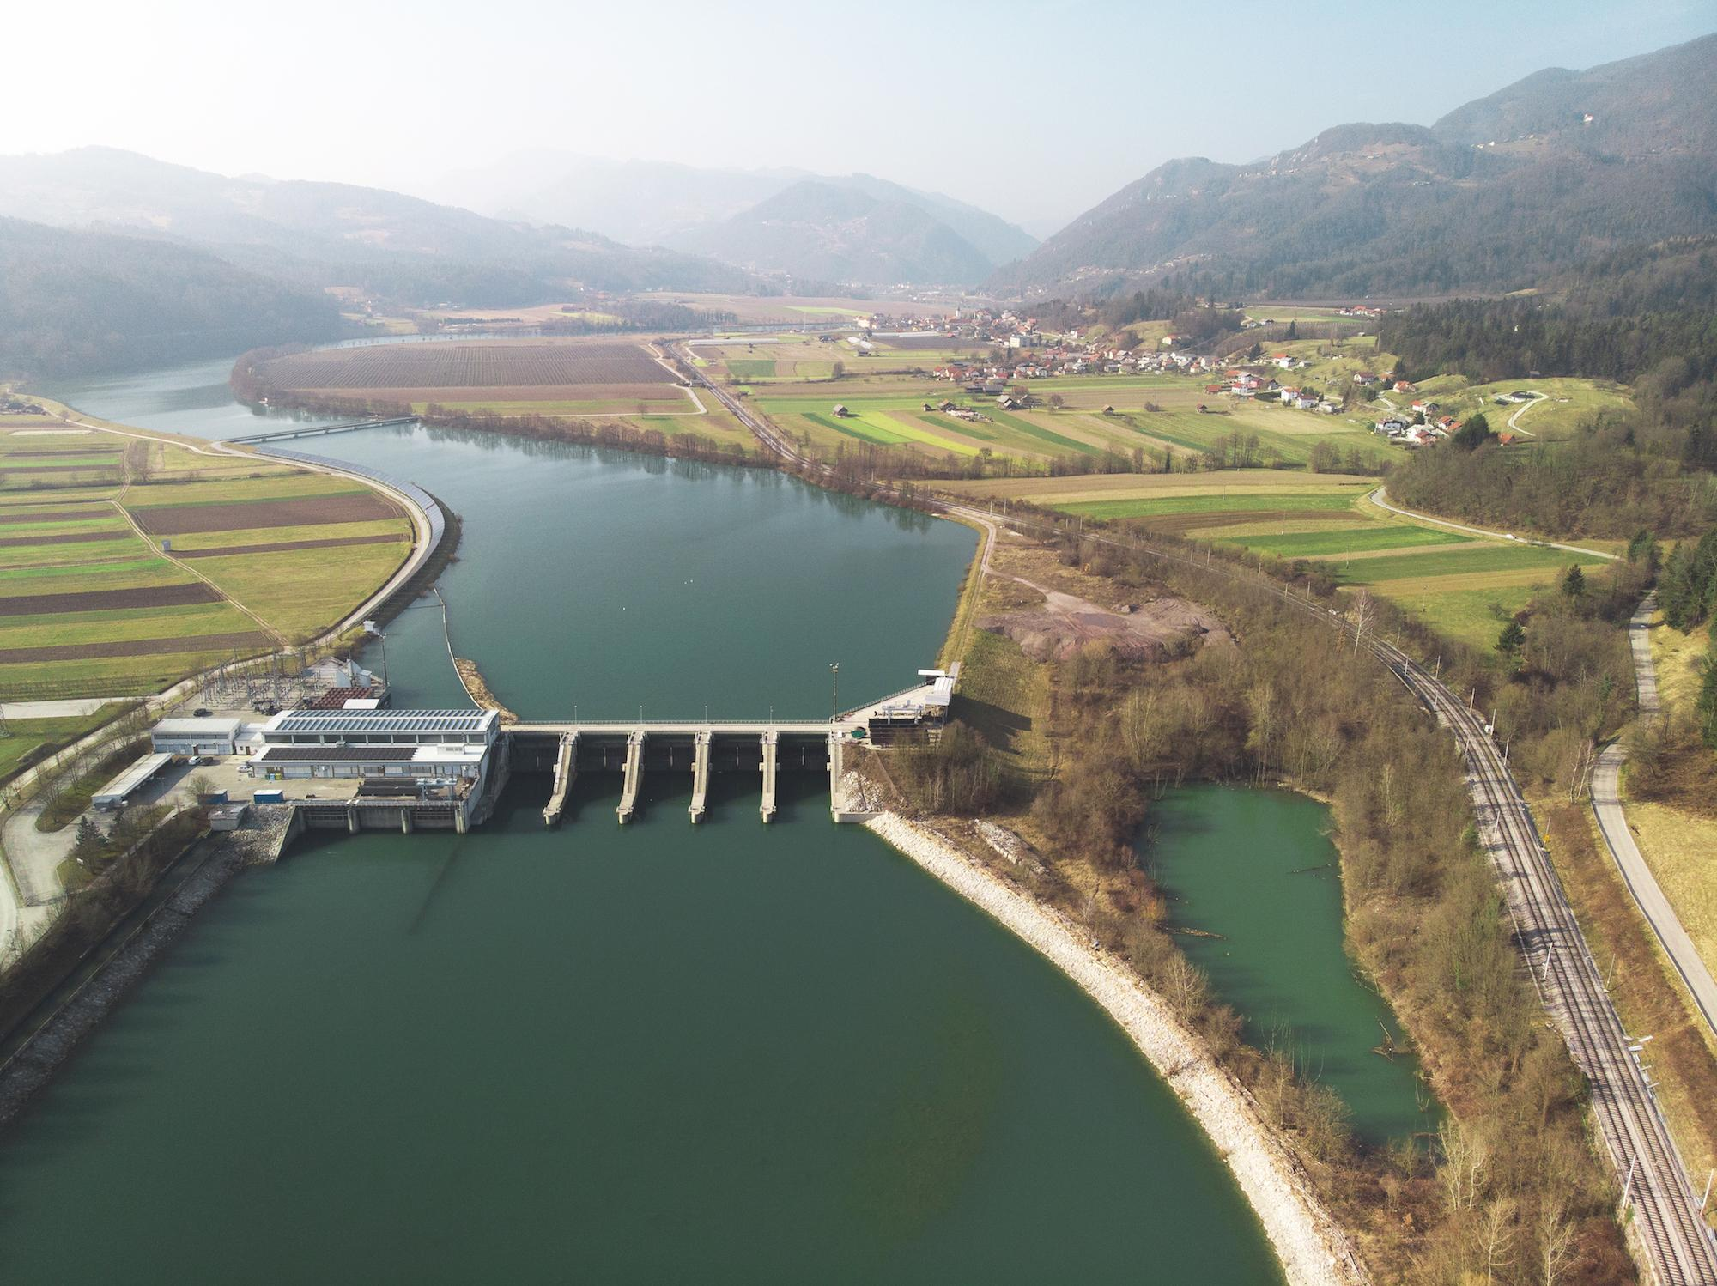
Here is another example of renewable energy. In this picture, we see a hydro power dam that creates energy from the movement of water. The energy from the dam helps power the nearby town.
Notes:
Here is another example of renewable energy. In this picture, we see a hydro power dam that creates energy from the movement of water. The energy from the dam helps power the nearby town.

Slide 37
Notes:
Now, let’s talk about some non-examples of renewable energy.

Slide 38
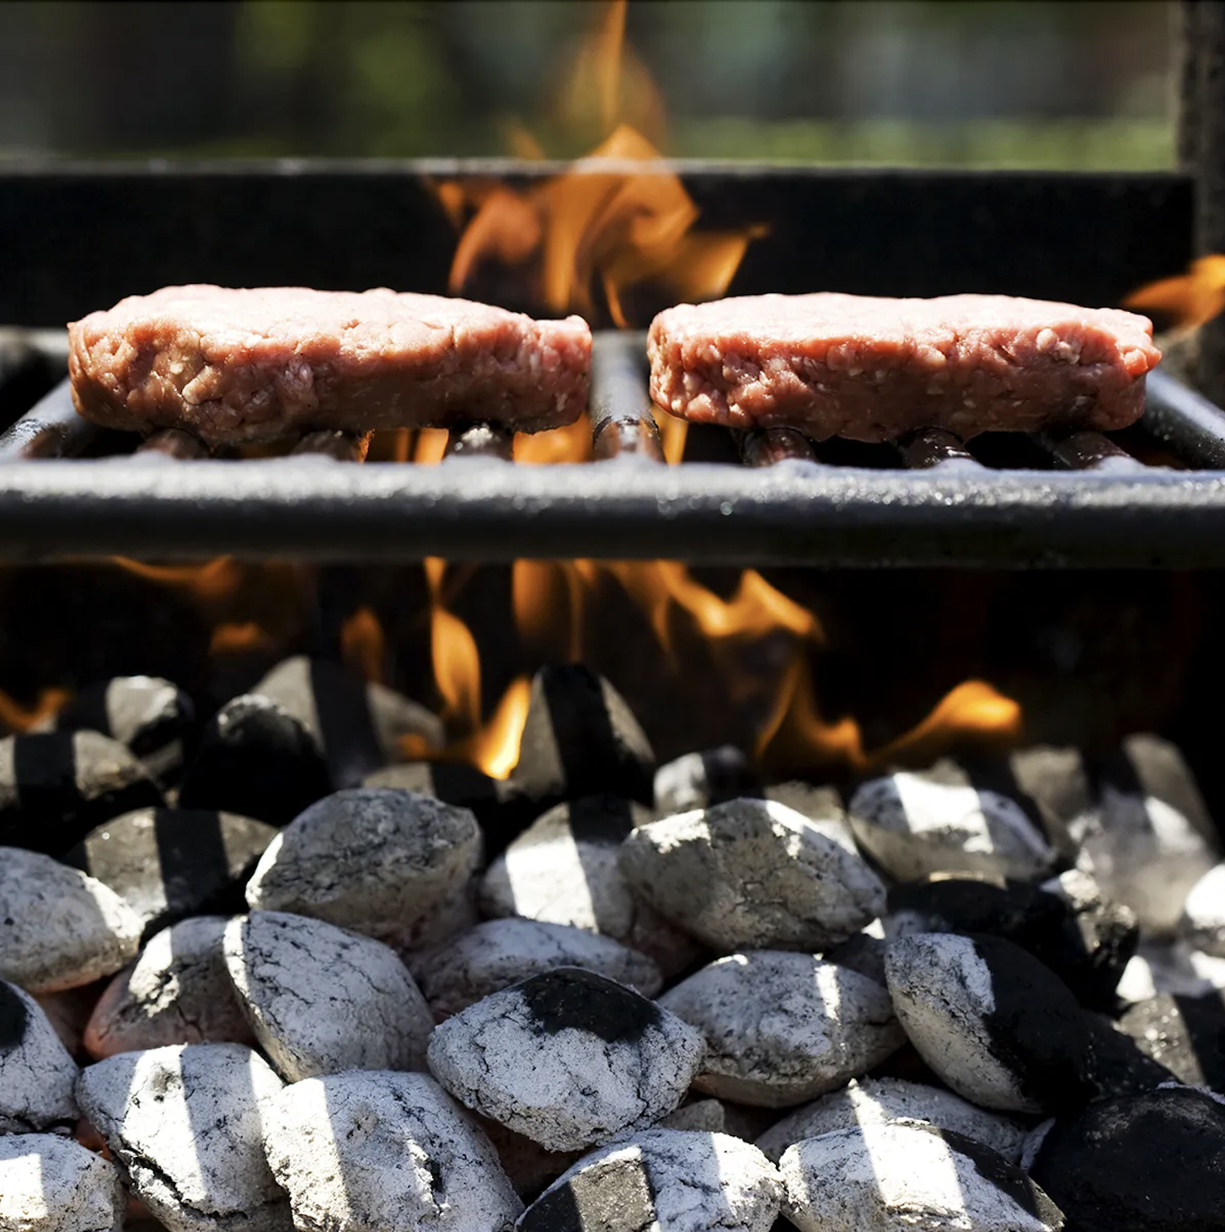
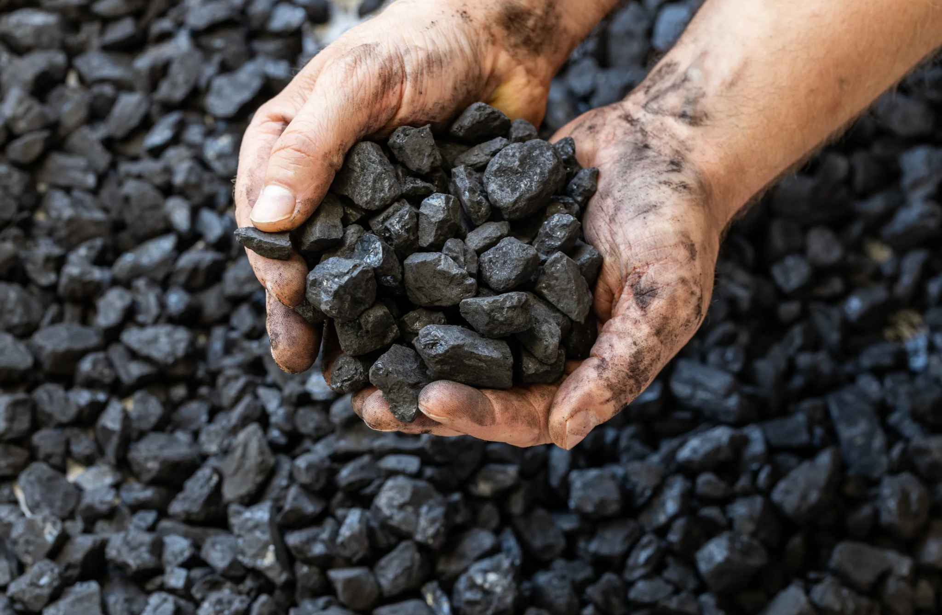
Coal is NOT an example of a renewable energy. It is mined from underground, and there is a limited amount of it which will eventually run out. Coal is used for many things, such as creating electricity. It can even be used for cooking, such as using charcoal when grilling food.
Notes:
Coal is NOT an example of a renewable resource. It is mined from underground, and there is a limited amount of it which will eventually run out. Coal is used for many things, such as creating electricity. It can even be used for cooking, such as using charcoal when grilling food.

Slide 39
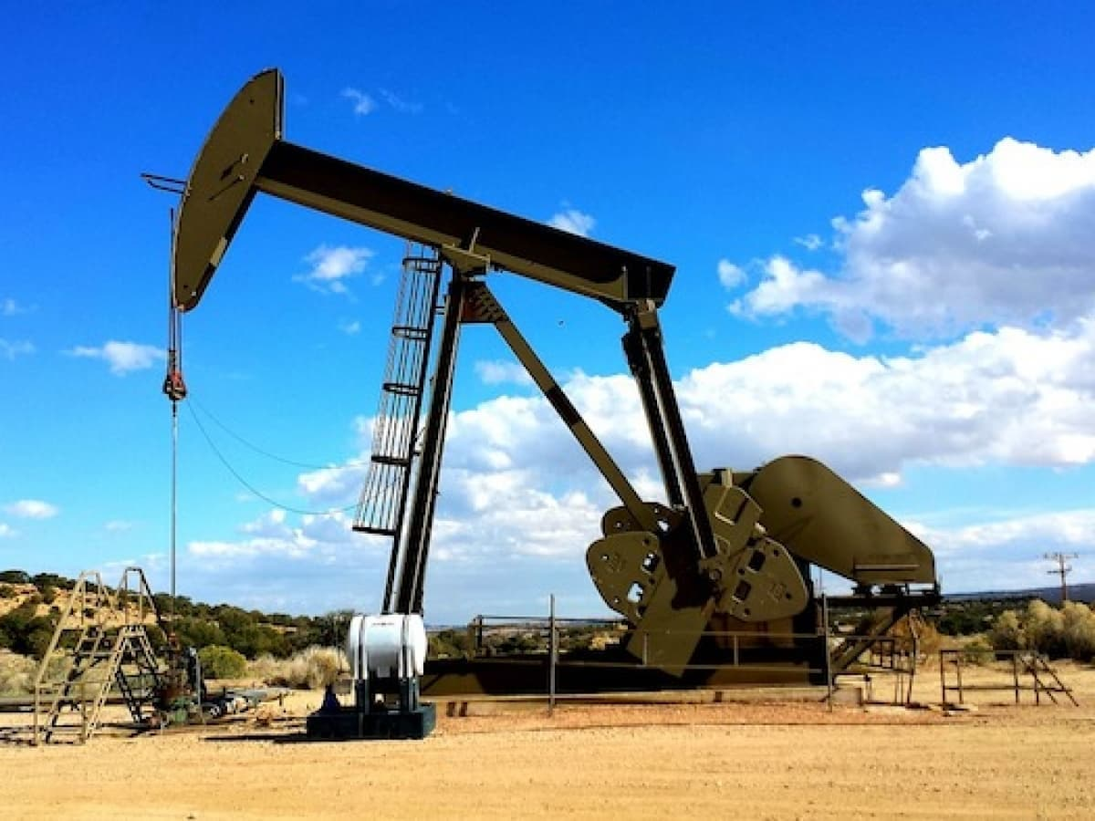
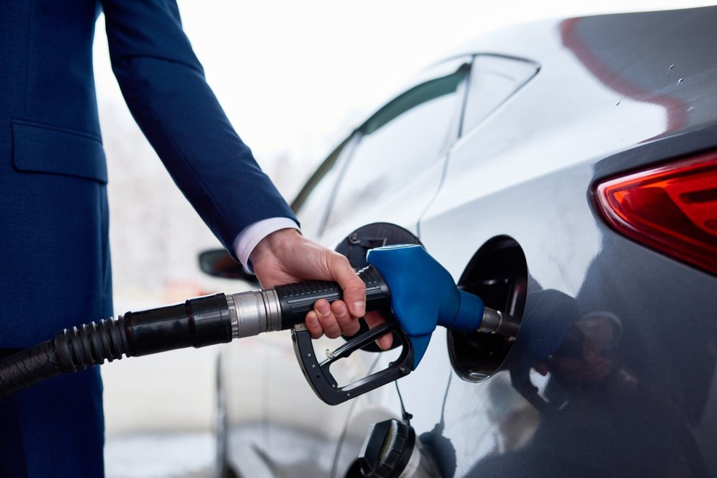
Oil is NOT an example of renewable energy. It comes from fossil fuels, which will eventually run out since we have a limited amount of them on Earth. This comes out of the ground and is processed through a large oil pump. It can then be used to power machines, such as cars.
Notes:
Oil is another example of Non-Renewable Energy. It comes from fossil fuels, which will eventually run out since we have a limited amount of them on Earth. This comes out of the ground and is processed through a large oil pump. It can then be used to power machines, such as cars.

Slide 40
Notes:
Now let’s pause for a moment to check your understanding.

Slide 41
Which one is an example of renewable energy?
Notes:
Which one is an example of renewable energy?

Slide 42
Which one is an example of renewable energy?
Notes:
Which one is an example of renewable energy?

Slide 43
Remember!!!
Notes:
So remember!

Slide 44
Renewable Energy: energy that comes from natural sources and will not run out
Notes:
Renewable Energy is energy that comes from natural sources and will not run out.

Slide 45
Notes:
We will now complete this concept map, called a Frayer model, to summarize and further clarify what you have learned about the term motion.

Slide 46
Definition
Picture
Renewable Energy
Example
How does renewable energy impact my life?
Notes:
To complete the Frayer model, we will choose from four choices the correct picture, definition, example, and response to the question, “How does renewable energy impact my life?” Select the best response for each question using the information you just learned. As we select responses, we will see how this model looks filled in for the term renewable energy.

Slide 47
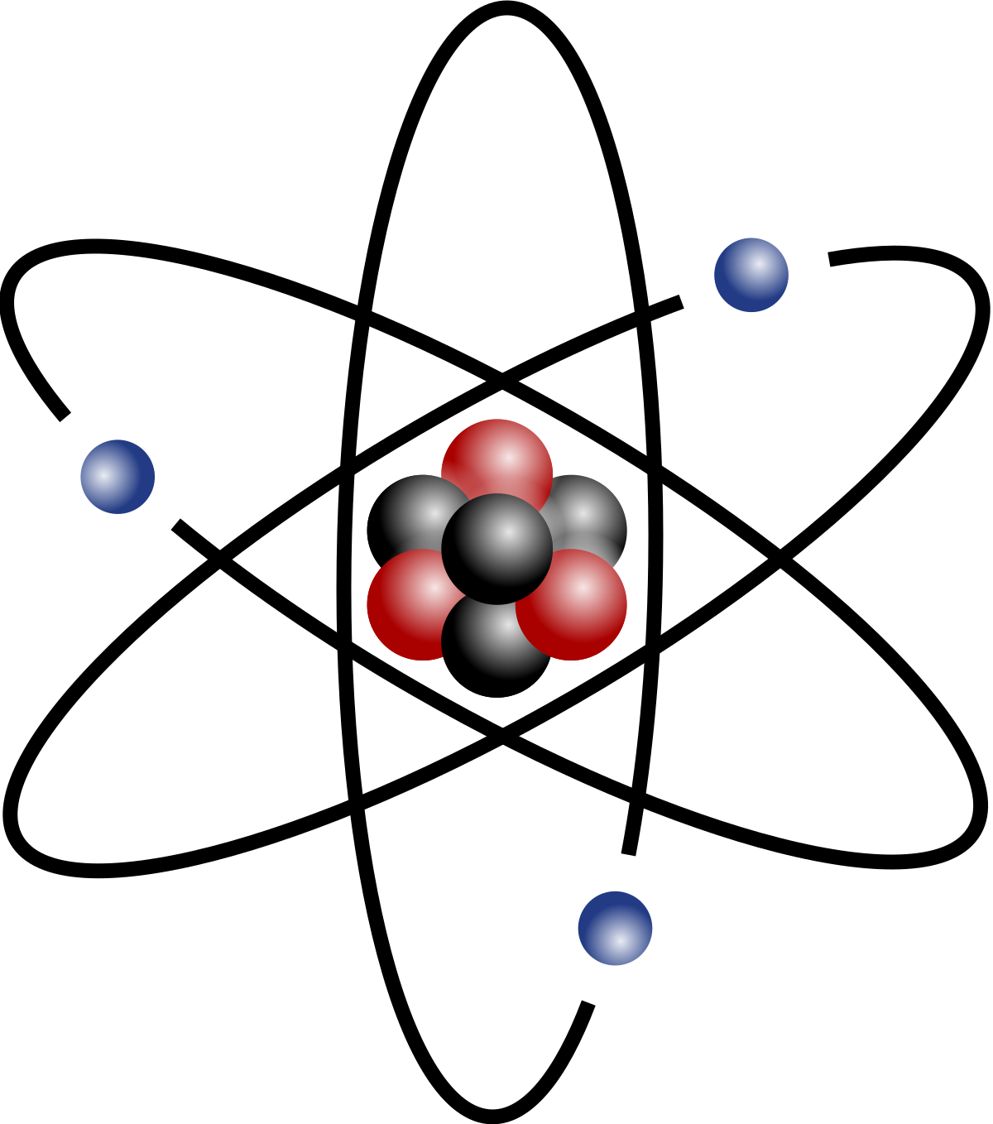
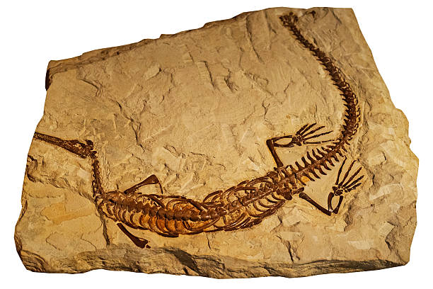
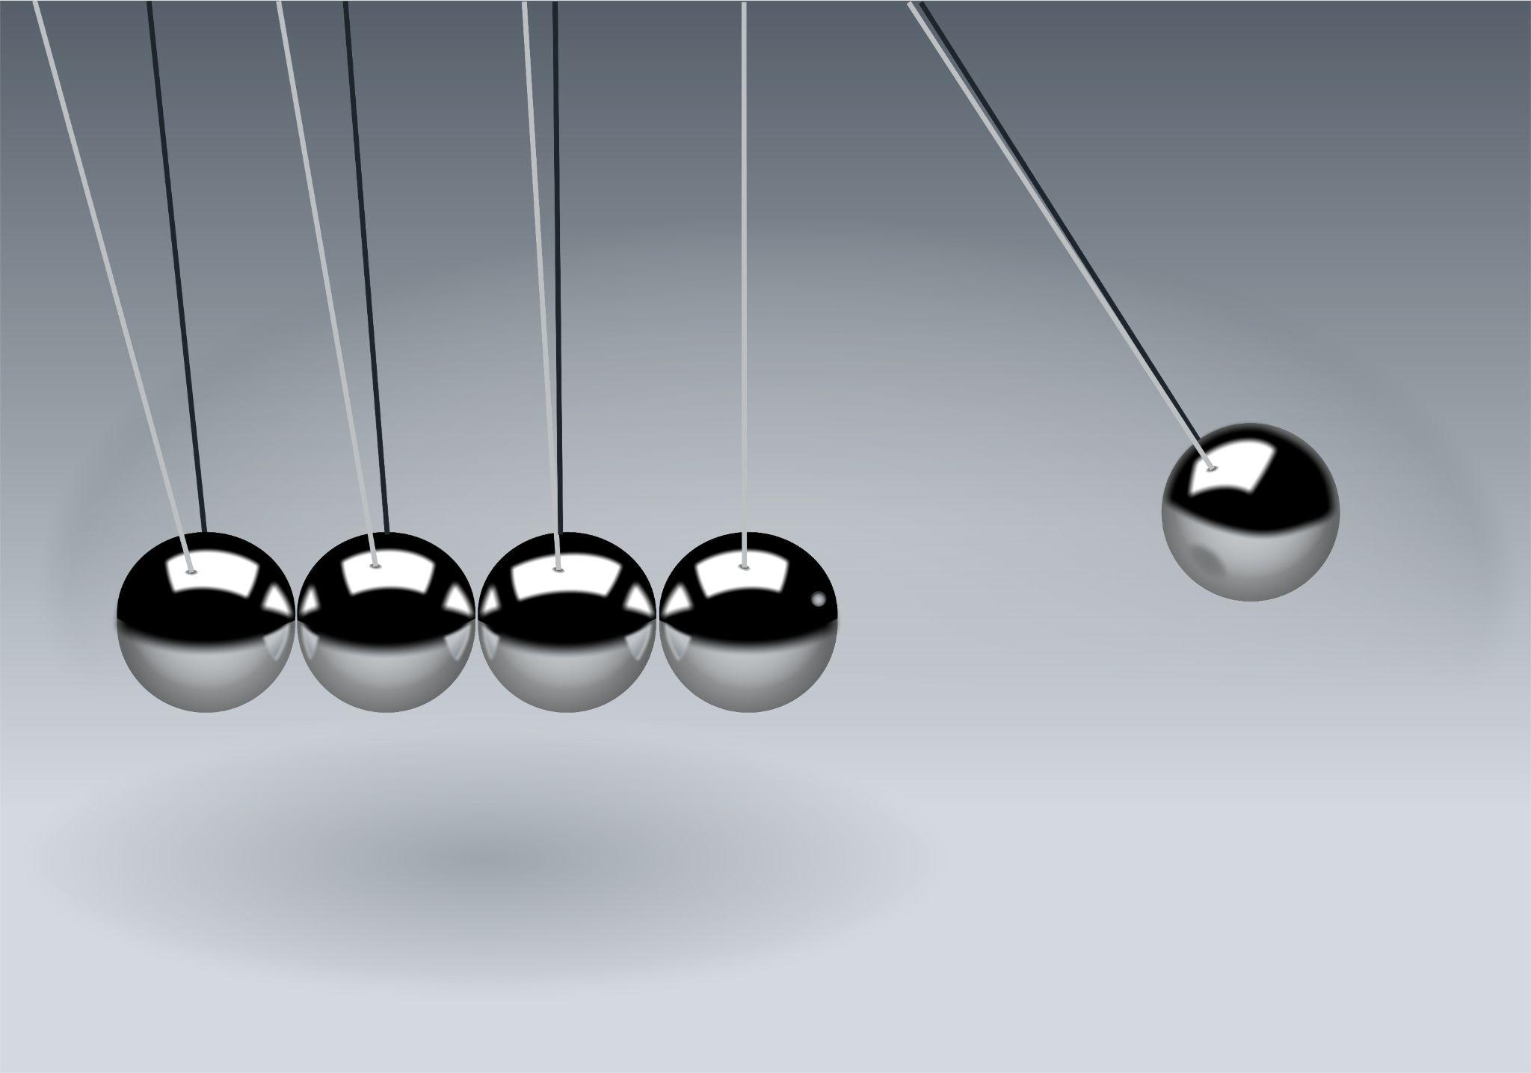
Directions: Choose the correct picture of Renewable Energy from the choices below.
A
B
C
D
Notes:
Choose the one correct picture of Renewable Energy from these four choices and drag and place it in the picture box below.

Slide 48
Directions: Choose the correct picture of Renewable Energy from the choices below.
A
B
C
D
Notes:
You chose the picture that shows renewable energy.

Slide 49
Definition
Picture
Renewable Energy
Example
How does renewable energy impact my life?
Notes:
Here is the Frayer Model filled in with a picture of renewable energy.

Slide 50
Directions: Choose the correct definition of Renewable Energy from the choices below.
A
Ability to do work from the Sun
B
Preserved remains of prehistoric life
C
Smallest whole unit of matter
D
Energy that comes from natural sources and will not run out
Notes:
Choose the one correct definition of renewable energy from these four choices and drag and place it in the definition box below.

Slide 51
Directions: Choose the correct definition of Renewable Energy from the choices below.
A
Ability to do work from the Sun
B
Preserved remains of prehistoric life
C
Smallest whole unit of matter
D
Energy that comes from natural sources and will not run out
Notes:
You chose “energy that comes from natural sources and will not run out” This is correct! This is the definition of renewable energy.

Slide 52
Definition
Picture
Energy that comes from natural sources and will not run out
Renewable Energy
Example
How does renewable energy impact my life?
Notes:
Here is the Frayer Model with a picture and the definition filled in for renewable energy: energy that comes from natural sources and will not run out.

Slide 53
Directions: Choose the correct example of Renewable Energy from the choices below.
A
Having solar panels on a house’s roof that powers it
B
Putting gas in your car
C
A prehistoric dinosaur preserved in rock
D
Eating only vegetables and fruits
Notes:
Choose the one correct example of Renewable Energy from these four choices and drag and place it in the example box below.

Slide 54
Directions: Choose the correct example of Renewable Energy from the choices below.
A
Having solar panels on a house’s roof that powers it
B
Putting gas in your car
C
A prehistoric dinosaur preserved in rock
D
Eating only vegetables and fruits
Notes:
You chose “Having solar panels on a house’s roof that powers it.” This is an example of renewable energy!

Slide 55
Definition
Picture
Energy that comes from natural sources and will not run out
Renewable Energy
Having solar panels on a house’s roof that powers it
Example
How does renewable energy impact my life?
Notes:
Here is the Frayer Model with a picture, definition, and an example of renewable energy: Having solar panels on a house’s roof that powers it.

Slide 56
Directions: Choose the correct response for “how does renewable energy impact my life?” from the choices below.
A
Renewable energy impacts my life by helping us learn about animals and plants from the past.
Renewable energy impacts my life by using energy from resources that will never run out, which helps protect the environment.
B
C
Renewable energy impacts my life by showing us how the Sun creates energy we can use.
D
Renewable energy impacts my life by providing me with healthy food to eat which helps my body grow.
Notes:
Choose the one correct response for “how does renewable energy impact my life?” from these four choices and drag and place it in the box below.

Slide 57
Directions: Choose the correct response for “how does renewable energy impact my life?” from the choices below.
A
Renewable energy impacts my life by helping us learn about animals and plants from the past.
Renewable energy impacts my life by using energy from resources that will never run out, which helps protect the environment.
B
C
Renewable energy impacts my life by showing us how the Sun creates energy we can use.
D
Renewable energy impacts my life by providing me with healthy food to eat which helps my body grow.
Notes:
You chose “Renewable energy impacts my life by using energy from resources that will never run out, which helps protect the environment.” That is correct! This is an example of how renewable energy impacts your life.

Slide 58
Definition
Energy that comes from natural sources and will not run out
Renewable Energy
Having solar panels on a house’s roof that powers it
Renewable energy impacts my life by using energy from resources that will never run out, which helps protect the environment.
Example
How does renewable energy impact my life?
Notes:
Here is the Frayer Model with a picture, definition, example, and a correct response to “how does TERM impact my life?”: Renewable energy impacts my life by using energy from resources that will never run out, which helps protect the environment.

Slide 59
Remember!!!
Notes:
So remember!

Slide 60
Renewable Energy: energy that comes from natural sources and will not run out
Notes:
Renewable Energy is energy that comes from natural sources and will not run out.

Slide 61
Big Question: How does the amount we use of different types of resources help us take care of our environment?
Notes:
Let’s reflect once more on our big question. Our “big question” is: How does the amount we use of different types of resources help us take care of our environment?
Does anyone have any additional examples to share that haven’t been discussed yet?

Slide 62
Notes:
Thanks for watching, and please continue watching CAPs available from this website.

Slide 63
This Was Created With Resources From:
Questions or Comments
Michael Kennedy, Ph.D. MKennedy@Virginia.edu
Rachel L Kunemund, Ph.D. rk8vm@virginia.edu

