Slide 1
Intro
“Big Idea” Question
Review Concepts
Check-In Questions
Teacher Demo
Vocabulary
Student-Friendly Definition
Examples & Non-Examples
Morphological Word Parts
Simulation/Activity
Notes:
OK everyone, get ready for our next lesson. Just as a reminder, these are the different components that our lesson may include, and you’ll see these icons in the top left corner of each slide so that you can follow along more easily!

Slide 2
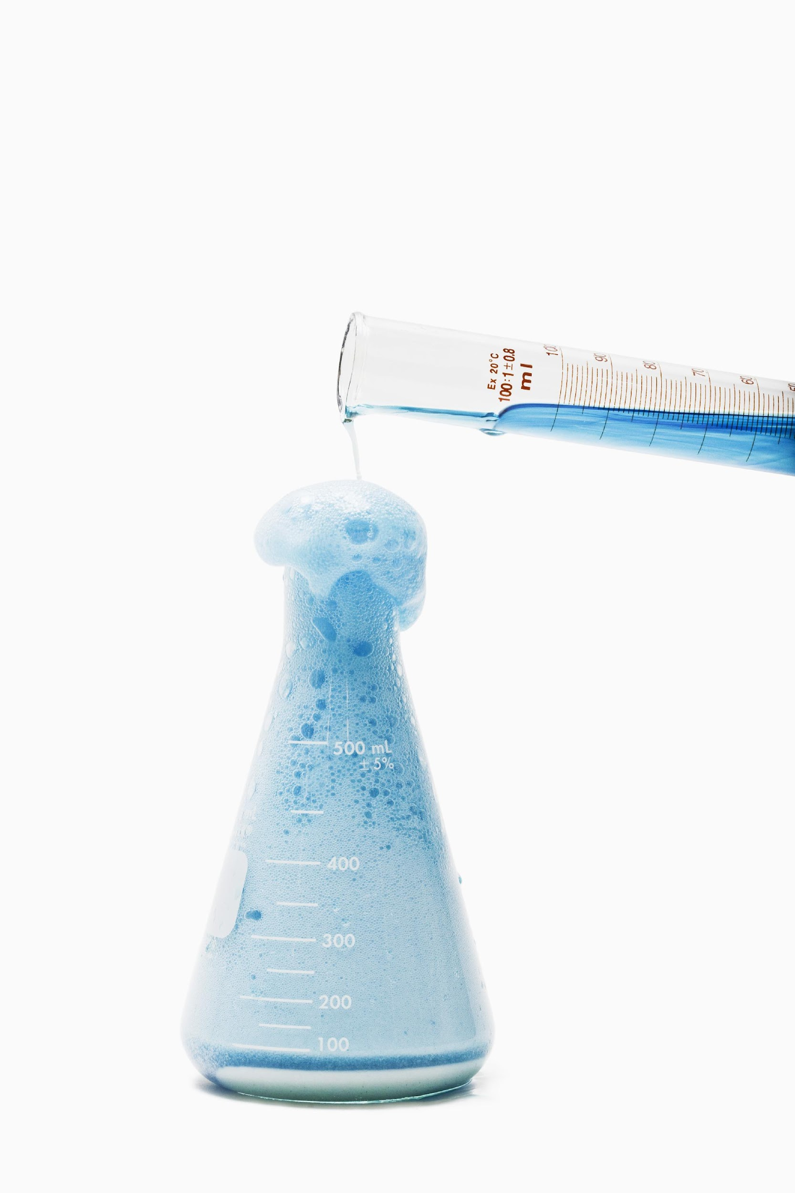
Intro
Acids
H⁺
H⁺
H⁺
H⁺
H⁺
H⁺
H⁺
H⁺
H⁺
H⁺
H⁺
H⁺
H⁺
H⁺
H⁺
H⁺
H⁺
H⁺
H⁺
H⁺
H⁺
H⁺
H⁺
H⁺
H⁺
H⁺
H⁺
H⁺
H⁺
H⁺
H⁺
H⁺
H⁺
H⁺
H⁺
H⁺
Notes:
Today we will learn about acids

Slide 3
Big Question: How do the pH of materials affect your everyday life? How are compounds classified, what is pH, and how can the pH of different substances be tested?
Notes:
Our “big question” is: How do the pH of materials affect your everyday life? How are compounds classified, what is pH, and how can the pH of different substances be tested?
[Pause and illicit predictions from students.]
I love all these thoughtful scientific hypotheses! Be sure to keep this question and your predictions in mind as we move through these next few lessons, and we’ll continue to revisit it.
Feedback: It is important to encourage students to make their own predictions about what will happen, this is an important step in helping them to understand the content.

Slide 4
Demonstration
Sulfuric Acid and Sugar Demo
TEACHER DIRECTIONS:
Before: Ask students what they already know about compounds/acids. Ask students what they will predict will happen when sulfuric acid is mixed with sugar.
During: (If you have the materials, this demonstration can be done in school). As you are watching/doing the experiment, describe what is happening as the reaction is taking place. (odor, strength of the acid, etc.). Explain that acids release hydrogen atoms when mixed with water, and sugar has water molecules, which is why sulfuric acids reacts when mixed with it.
After: Ask students what they noticed (other than what you described) when the sulfuric acid mixed with the sugar. Tell students that in this lesson, they will be learning more about acids.
Notes:
Let’s do a quick demonstration that will help get our brains ready to think about acids, and how it relates to our big question.
Youtube video - could also do the demonstration yourself in class
Feedback: It is important to give some background information or a related natural phenomena related to the topic of the activity/demonstration. This helps students make connections and is especially important because this demonstration comes before the new vocabulary.

Slide 5
Notes:
Before we move on to our new vocabulary term, let’s review some other words & concepts that you already learned and make sure you are firm in your understanding.

Slide 6
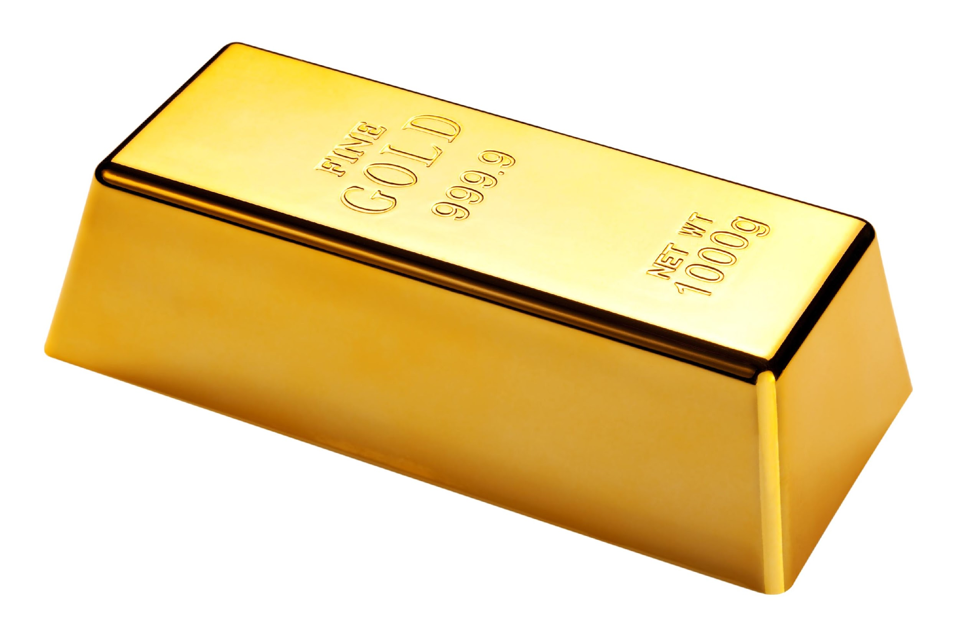
Element: Pure substance containing
only one type of atom
Notes:
An element is a pure substance containing only 1 type of atom.

Slide 7
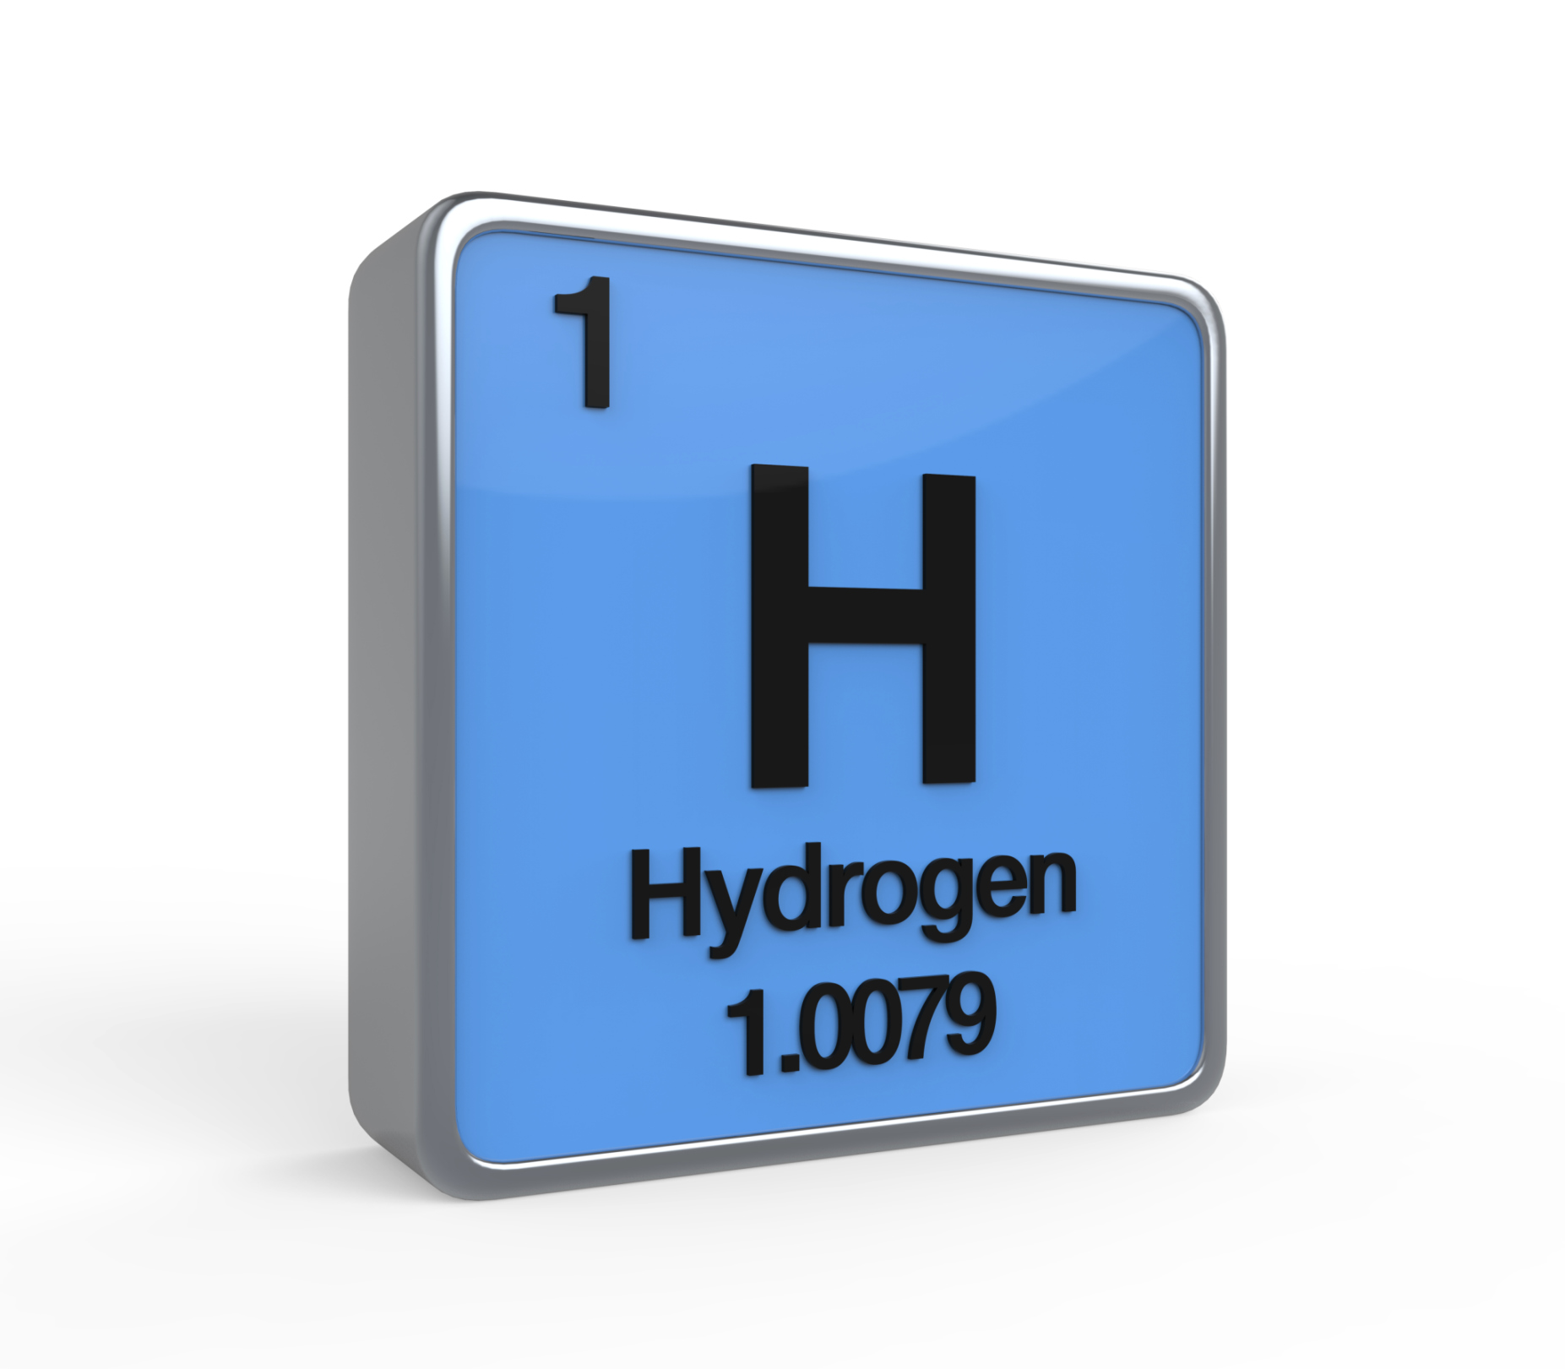
Chemical Symbol
Notes:
Elements are symbolized by a capital letter, sometimes followed by a lowercase letter, which is called its chemical symbol. For example, the chemical symbol of hydrogen is H.
Feedback: Referring to prior topics that are relevant and on topic helps students make connections to the new content they will be learning and tie it to prior knowledge.

Slide 8
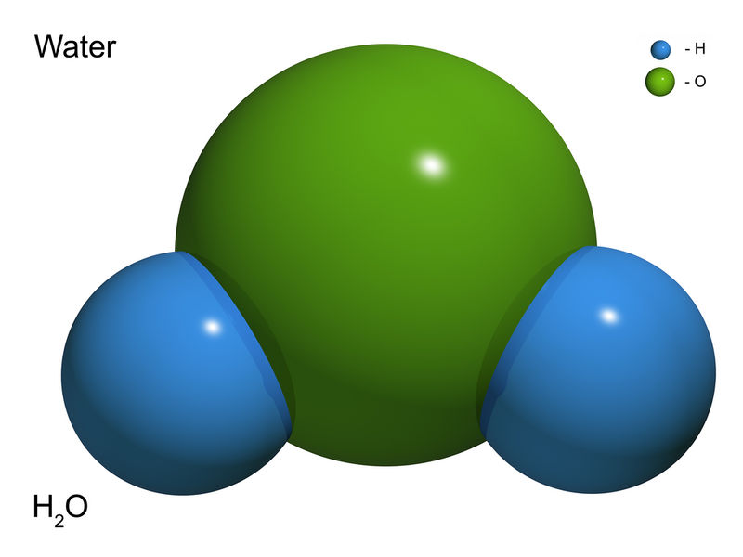
Compounds: pure substances made of two or more different elements that are chemically bonded (joined).
Notes:
Compounds are pure substances made of two or more different elements that are chemically bonded, or joined.

Slide 9
Molecule: a particle containing two or more atoms of the same OR different elements
SAME
DIFFERENT
Hydrogen
Oxygen
OR
Different
Elements
Hydrogen
Hydrogen
Notes:
A molecule is a particle containing 2 or more atoms of the same OR different elements.

Slide 10
A compound is a type of molecule.
O
H
H
Notes:
A compound is a type of molecule. For example, this is an H2O, or water, molecule.

Slide 11
But two or more different elements must be bonded to be considered a compound.
C
O
C
H
H
Compound
Molecule
Compound
Molecule
Notes:
But two or more different elements must be bonded for a molecule to be considered a compound. So, C2 is considered a molecule, but NOT compound; whereas H2O is considered a compound AND a molecule.

Slide 12
Ion: an atom or molecule with a positive or negative charge
Notes:
An ion is an atom or molecule that has a positive or negative charge.

Slide 13
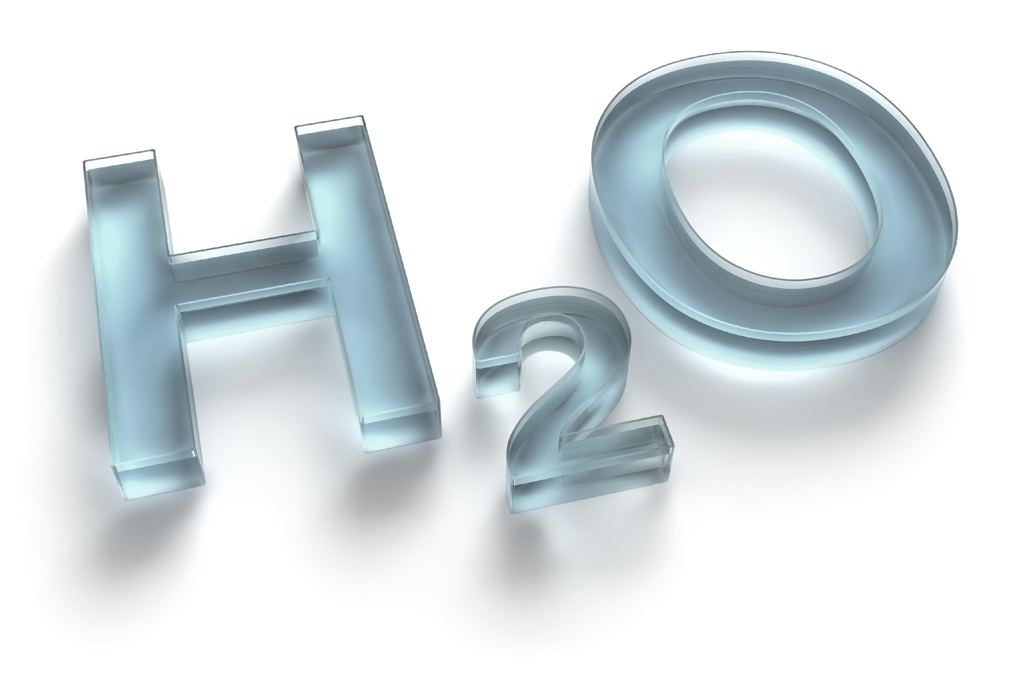
Chemical Formula: uses chemical symbols to represent a compound or molecule.
Notes:
A chemical formula uses chemical symbols to represent a compound or molecule. For example, the chemical formula of water is H2O, which tells us that a compound of water has two hydrogen atoms and one oxygen atom.

Slide 14
Notes:
Now let’s pause for a moment to check your understanding.

Slide 15
What is an element?
Notes:
What is an element?
[An element is a pure substance containing only 1 type of atom.]
Feedback: Remember to make adjustments to your lesson and content if you see some students not demonstrating understanding, this can help them make connections and prevent frustration.

Slide 16
What does a chemical symbol tell us about an element?
Chemical Symbol
Notes:
What does a chemical symbol tell us about an element?
[A chemical symbol, are just a shorter way to tell us what element something is. Elements are symbolized by a capital letter, sometimes followed by a lowercase letter, which is called its chemical symbol. For example, the chemical symbol of hydrogen is H.]

Slide 17
What is the difference between a molecule and compound?
C
C
Notes:
What is the difference between a molecule and a compound?
[A compound is a pure substance that contains two or more different elements but a molecule is a particle containing 2 or more atoms of the same OR different elements.]

Slide 18
A(n) ___________ is an atom or molecule with a positive or negative charge.
Notes:
A(n) _____ is an atom or molecule with a positive or negative charge.
[ion]

Slide 19
A(n) ion is an atom or molecule with a positive or negative charge.
Notes:
A(n) ion is an atom or molecule with a positive or negative charge.

Slide 20
What does a chemical formula represent?
Notes:
What does a chemical formula represent?
[A compound or molecule]

Slide 21
Acid
Notes:
Now that we’ve reviewed, let’s define our new term, acid.

Slide 22
Acid: a compound that releases hydrogen ions when mixed with water
H⁺
H⁺
H⁺
H⁺
H⁺
H⁺
H⁺
H⁺
H⁺
H⁺
H⁺
H⁺
H⁺
H⁺
H⁺
H⁺
H⁺
H⁺
H⁺
H⁺
H⁺
H⁺
H⁺
H⁺
H⁺
H⁺
H⁺
H⁺
H⁺
H⁺
H⁺
H⁺
H⁺
H⁺
H⁺
H⁺
Notes:
An acid is a compound that releases hydrogen ions when mixed with water.
Feedback: Longer more formal definitions are tricky so it is even more important to use clear language when providing the new definition.

Slide 23
Notes:
Now let’s pause for a moment to check your understanding.

Slide 24
What is an acid?
H⁺
H⁺
H⁺
H⁺
H⁺
H⁺
H⁺
H⁺
H⁺
H⁺
H⁺
H⁺
H⁺
H⁺
H⁺
H⁺
H⁺
H⁺
H⁺
H⁺
H⁺
H⁺
H⁺
H⁺
H⁺
H⁺
H⁺
H⁺
H⁺
H⁺
H⁺
H⁺
H⁺
H⁺
H⁺
H⁺
Notes:
What is an acid?
[An acid is a compound that releases hydrogen ions when mixed with water.]

Slide 25
Notes:
That’s the basic definition but there is more you need to know.

Slide 26
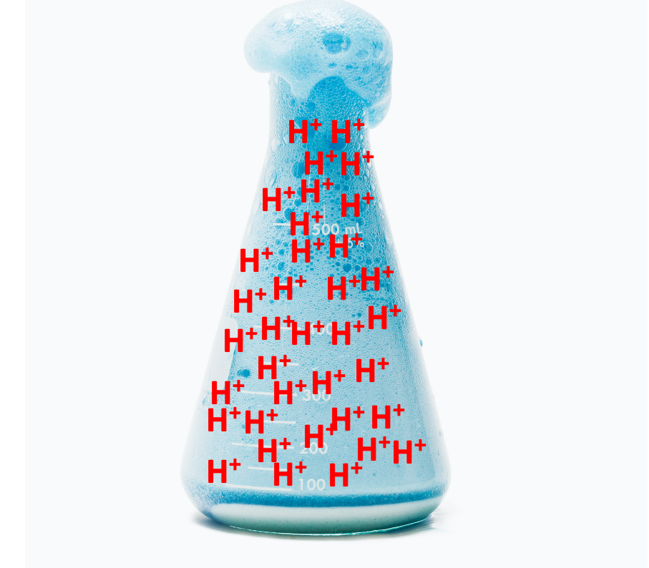
Acids = Hydrogen
Notes:
Most acids contain hydrogen. And when the compound is mixed with water, hydrogen ions are released into the resulting solution. Hydrogen ions have a positive charge.
Feedback: It can be helpful to break the definition down and explicitly explain each part to help students understand the whole definition.

Slide 27
Sour Taste
React with Metal
Notes:
Many acids have a sour taste and react with metals.

Slide 28
Burns skin
Notes:
Many acids burn skin upon contact.

Slide 29
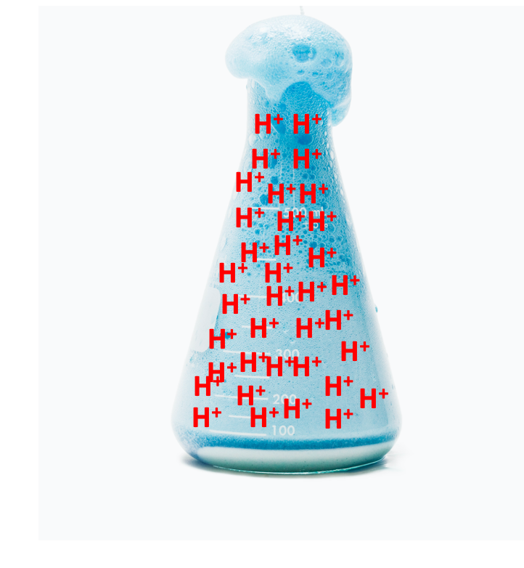
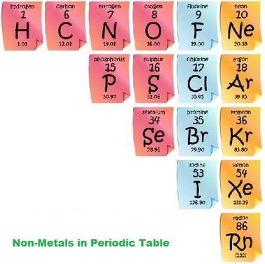
Notes:
Almost all acids are formed from non-metals.

Slide 30
Notes:
Now let’s pause for a moment to check your understanding.
Feedback: There are a lot of opportunities to respond throughout this portion of your lesson, which is so important for ensuring that your students are grasping this new content.

Slide 31
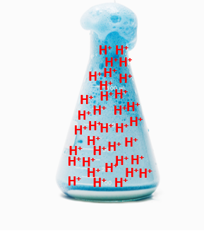
What is an acid?
Notes:
What is an acid?
[An acid is a compound that releases hydrogen ions when mixed with water.]

Slide 32
Which of these is true of acids?
Sour to taste
Burns skin upon contact
React with metal
All of the above
Notes:
Which of these is true of acids?

Slide 33
Which of these is true of acids?
Sour to taste
Burns skin upon contact
React with metal
All of the above
Notes:
Which of these is true of acids?
[All of the above]

Slide 34
Notes:
Now, let’s talk about some examples of acids.

Slide 35
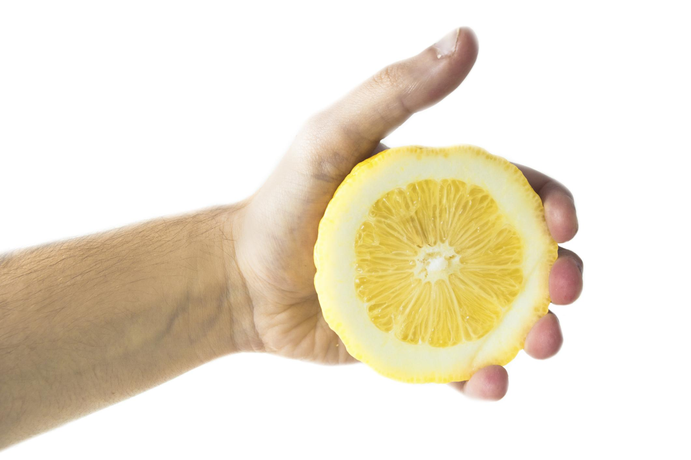
Hydrogen
C₆H₈O₇
Notes:
Lemon juice, which has citric acid in it, tastes sour. Tasting sour is a common characteristic of an acid. The chemical formula for citric acid is on the bottom right, notice how a citric acid compound has hydrogen atoms. Since it is an acid, when mixed with water, it will release hydrogen ions into the solution.
Feedback: It's great practice to introduce an example of the term WITH images to go along with it, this is a great way to help students make connections.

Slide 36
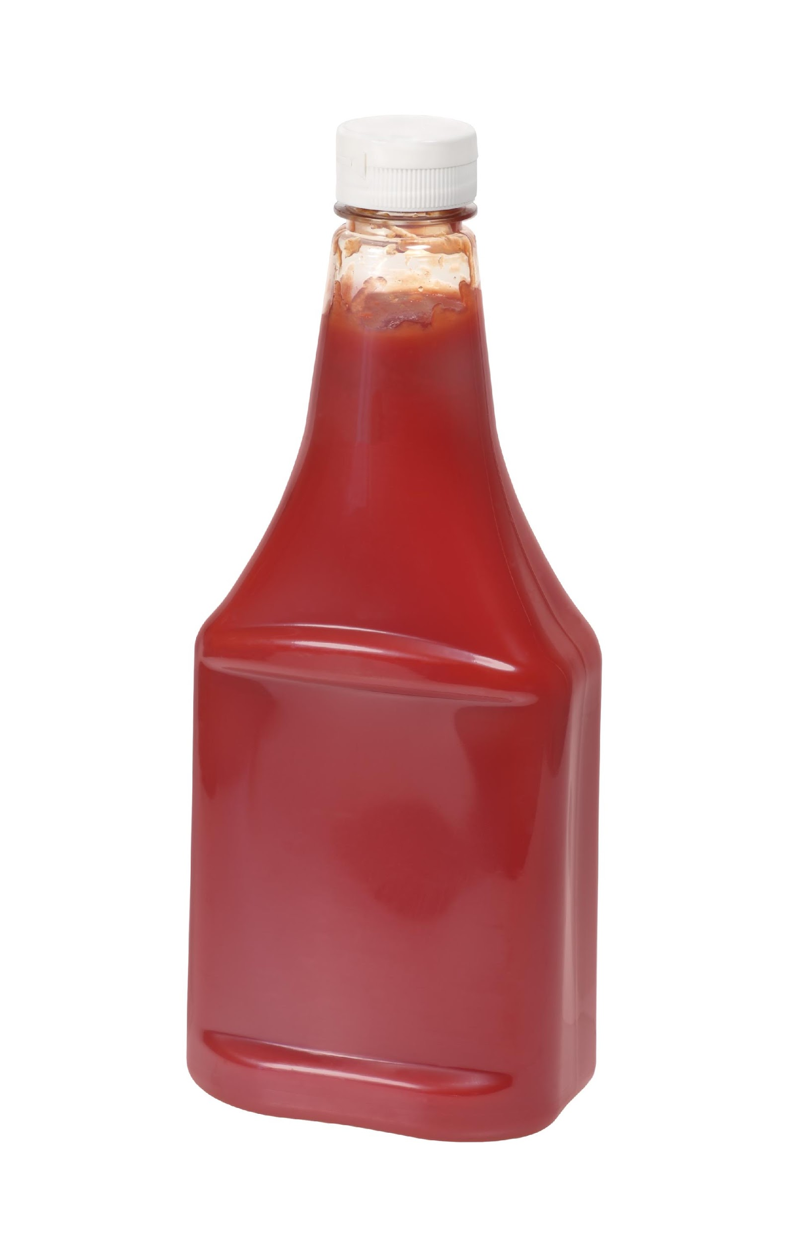
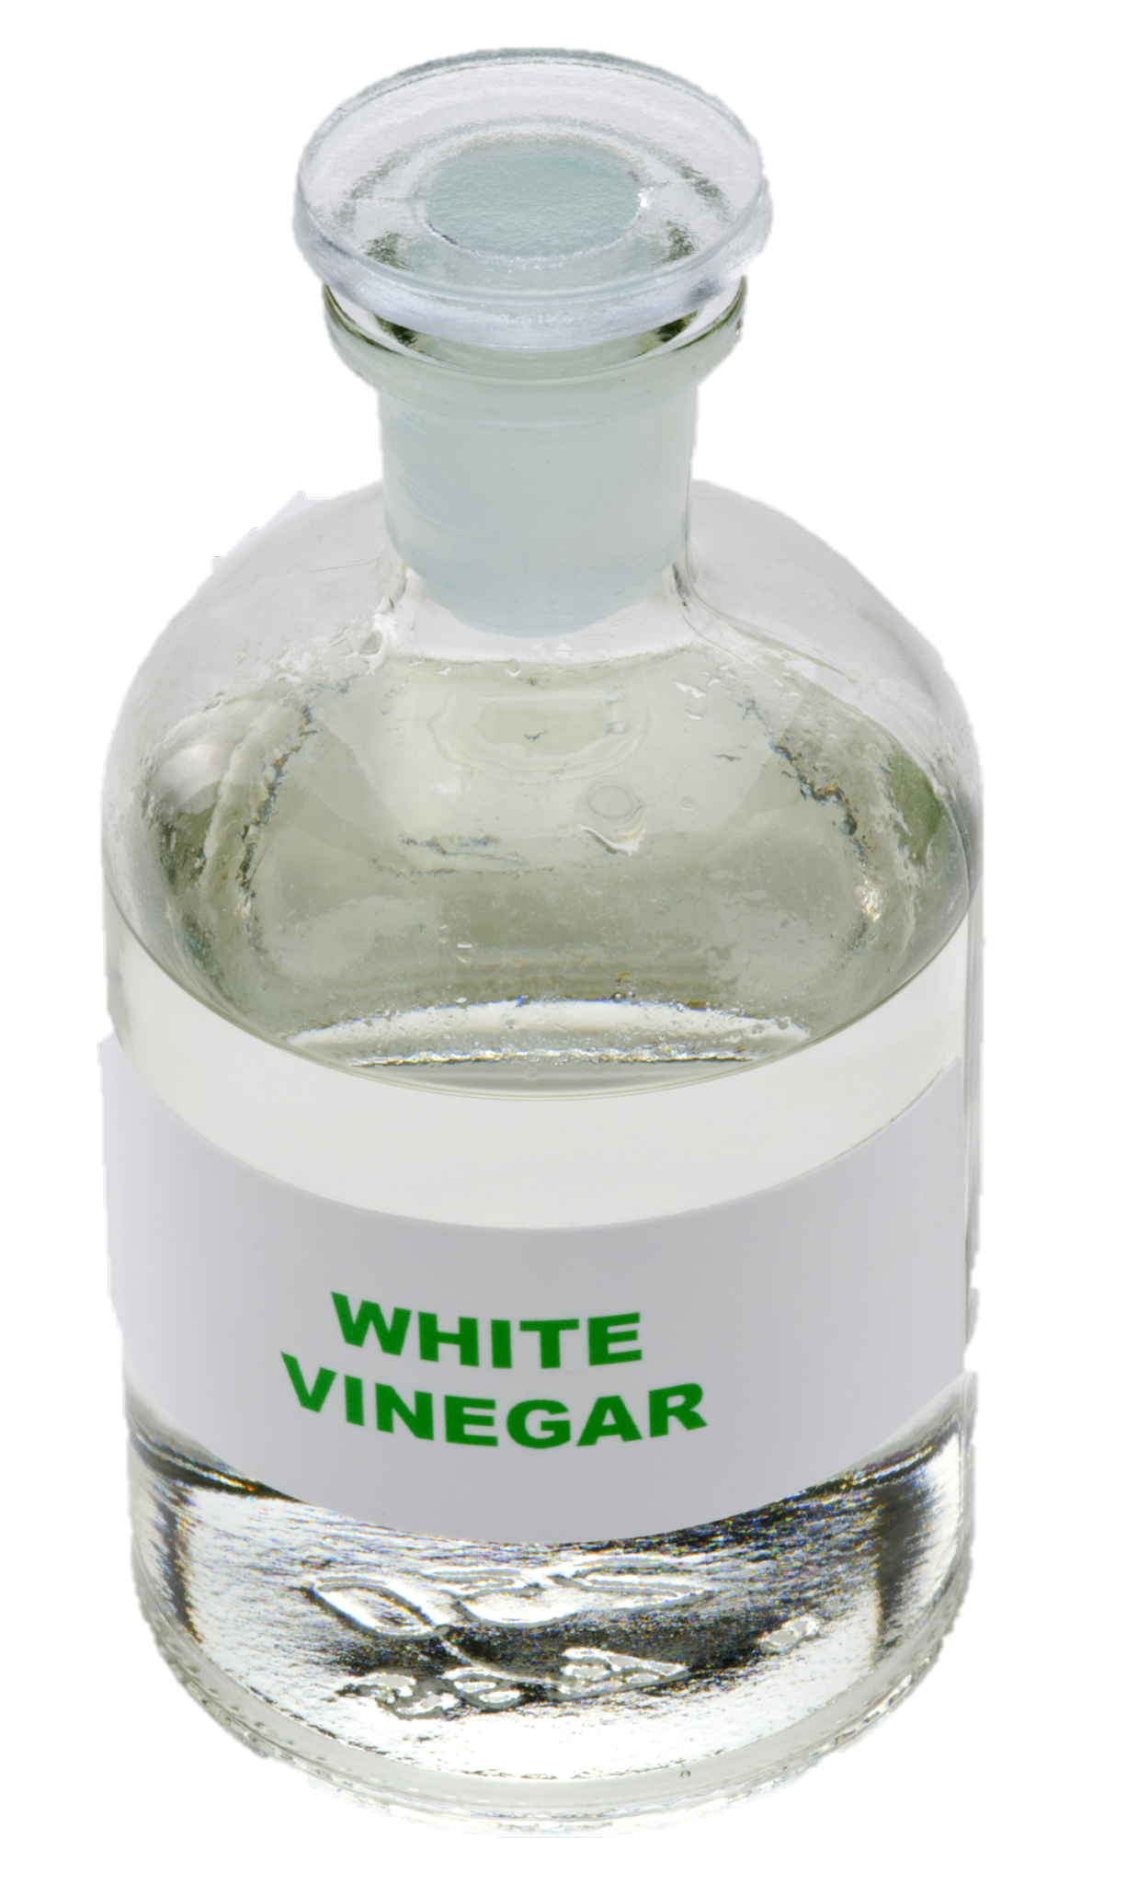
Hydrogen
CH₃COOH
Notes:
Acetic acid can be found in vinegar and in ketchup. The chemical formula for acetic acid is on the bottom right, notice how a acetic acid compound has hydrogen atoms. Since both of these are acids, when mixed with water, they will also release hydrogen ions into the solution.

Slide 37
Notes:
Next, let’s talk about some non-examples of acids.

Slide 38
C₃H₈
Notes:
Propane is not an acid. Propane is a molecule found in fuel and gas. Look at the chemical formula. It DOES have hydrogen atoms BUT not all compounds with hydrogen atoms are acids.
To repeat, all compounds that are acids have hydrogen atoms but not all compounds that have hydrogen atoms are acids.
Feedback: Non-examples often need some explanation to make it clear to students the difference. Using clear and simple language can help with this.

Slide 39
Notes:
Now let’s pause for a moment to check your understanding.

Slide 40
Which one of these is acidic? How do you know?
Propane
Ketchup
Notes:
Which one of these is acidic? How do you know?

Slide 41
Which one of these is acidic? How do you know?
Propane
Ketchup
Notes:
Which one of these is acidic? How do you know?
[Ketchup - it will release hydrogen ions when mixed with water]

Slide 42
What element do most acids contain?
Notes:
What element do most acids contain?
[Most acids contain hydrogen. And when the compound is mixed with water, hydrogen ions are released into the resulting solution. Hydrogen ions have a positive charge.]

Slide 43
What is an acid?
H⁺
H⁺
H⁺
H⁺
H⁺
H⁺
H⁺
H⁺
H⁺
H⁺
H⁺
H⁺
H⁺
H⁺
H⁺
H⁺
H⁺
H⁺
H⁺
H⁺
H⁺
H⁺
H⁺
H⁺
H⁺
H⁺
H⁺
H⁺
H⁺
H⁺
H⁺
H⁺
H⁺
H⁺
H⁺
H⁺
Notes:
What is an acid?
[An acid is a compound that releases hydrogen ions when mixed with water.]
Feedback: Providing feedback is tricky but crucial. Remember to give students with feedback on their response because it helps students know what answers you are actually looking for.

Slide 44
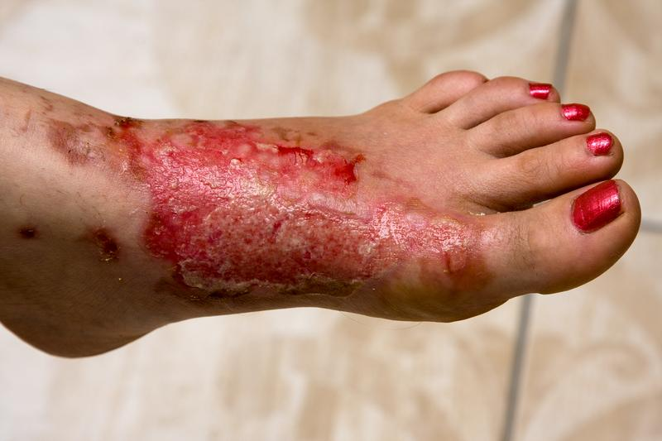
Name some characteristics of acids.
Notes:
Name some characteristics of acids.
[Acids have a sour taste, react with metals, and can be damaging to skin. NOT ALL ACIDS HAVE THESE CHARACTERISTICS.]

Slide 45
What types of elements are most acids formed from?
Notes:
What types of elements are most acids formed from?
[Almost all acids are formed from non-metals.]

Slide 46
Give your own example of an acid.
Notes:
Give your own example of an acid.
[Potential answers: lemon juice, vinegar, soda, ketchup, sulphuric acid, aspirin, battery acid, jelly, saliva]
Feedback: Having students generate their own examples is a great way of building connections between the content and their everyday lives. It also is an opportunity to test a deeper understanding.

Slide 47
Remember!!!
Notes:
So remember!

Slide 48
Acid: A compound that releases hydrogen ions when mixed with water
H⁺
H⁺
H⁺
H⁺
H⁺
H⁺
H⁺
H⁺
H⁺
H⁺
H⁺
H⁺
H⁺
H⁺
H⁺
H⁺
H⁺
H⁺
H⁺
H⁺
H⁺
H⁺
H⁺
H⁺
H⁺
H⁺
H⁺
H⁺
H⁺
H⁺
H⁺
H⁺
H⁺
H⁺
H⁺
H⁺
Notes:
An acid is a compound that releases hydrogen ions when mixed with water.

Slide 49
Simulation Activity
Chemical Changes Gizmo
(Explore Learning)
Click the link above to explore if different substances react to form an acid
In this simulation activity, you’ll mix different substances together and then determine if the reaction formed an acid. Observe what happens when two substances are combined and the product is an acid (nothing, gas, change color, etc.)
Notes:
Feedback: Remember, it is important to include some computational or mathematics concepts in the science activity so that students can apply these concepts as part of the problem solving process.

Slide 50
Big Question: How do the pH of materials affect your everyday life? How are compounds classified, what is pH, and how can the pH of different substances be tested?
Notes:
Our “big question” is: How do the pH of materials affect your everyday life? How are compounds classified, what is pH, and how can the pH of different substances be tested? [Pause and illicit predictions from students.]
Let’s go back to our big question. Did our hypotheses change? What did we already know?

Slide 51
Notes:
Thanks for watching, and please continue watching CAPs available from this website.

Slide 52
This Video Created With Resources From:
Questions or Comments
Michael Kennedy, Ph.D. MKennedy@Virginia.edu
Rachel L Kunemund, Ph.D. rk8vm@virginia.edu

Slide 53
Intro
“Big Idea” Question
Review Concepts
Check-In Questions
Teacher Demo
Vocabulary
Student-Friendly Definition
Examples & Non-Examples
Morphological Word Parts
Simulation/Activity
Notes:
OK everyone, get ready for our next lesson. Just as a reminder, these are the different components that our lesson may include, and you’ll see these icons in the top left corner of each slide so that you can follow along more easily!
Feedback: Explicit cues used at the beginning of each step makes it easy for students to follow along and be prepared to engage in the next part of the lesson.

Slide 54
Intro
Base
Notes:
Today we will learn about bases.

Slide 55
Big Question: How do the pH of materials affect your everyday life? How are compounds classified, what is pH, and how can the pH of different substances be tested?
Notes:
Our “big question” is: How do the pH of materials affect your everyday life? How are compounds classified, what is pH, and how can the pH of different substances be tested?
[Pause and illicit predictions from students.]
What have we learned about our big question? What do you think we will learn about today?

Slide 56
Demonstration
TEACHER DIRECTIONS:
Before: Ask students what they already know about compounds/bases
During: Find different household items/foods that are considered basic. Describe properties of the different items. Ask students what they notice that is similar between the different bases
After: Tell students that today’s lesson will teach them more about bases.
Notes:
Let’s do a quick demonstration that will help get our brains ready to think about bases, and how it relates to our big question.
Feedback: Remember to plan out the demonstration so that you are able to follow a logical order. This will help students make sense of the activity and not become lost.

Slide 57
Notes:
Before we move on to our new vocabulary term, let’s review some other words & concepts that you already learned and make sure you are firm in your understanding.

Slide 58
Element: Pure substance containing
only one type of atom
Notes:
An element is a pure substance containing only 1 type of atom.

Slide 59
Chemical Symbol
Notes:
Elements are symbolized by a capital letter, sometimes followed by a lowercase letter, which is called its chemical symbol. For example, the chemical symbol of hydrogen is H.

Slide 60
Compound: pure substance containing two or more different elements
Notes:
A compound is a pure substance containing 2 or more different elements.

Slide 61
Molecule: a particle containing two or more atoms of the same OR different elements
SAME
DIFFERENT
Hydrogen
Oxygen
OR
Different
Elements
Hydrogen
Hydrogen
Notes:
A molecule is a particle containing 2 or more atoms of the same OR different elements.

Slide 62
Ion: An atom or molecule with a positive or negative charge
Notes:
An ion is an atom or molecule that has a positive or negative charge.

Slide 63
Chemical Formula: uses chemical symbols to represent a compound or molecule
Notes:
A chemical formula uses chemical symbols to represent a compound or molecule. For example, the chemical formula of water is H2O, which tells us that a compound of water has two hydrogen atoms and one oxygen atom.

Slide 64
Acid: A compound that releases hydrogen ions when mixed with water
H⁺
H⁺
H⁺
H⁺
H⁺
H⁺
H⁺
H⁺
H⁺
H⁺
H⁺
H⁺
H⁺
H⁺
H⁺
H⁺
H⁺
H⁺
H⁺
H⁺
H⁺
H⁺
H⁺
H⁺
H⁺
H⁺
H⁺
H⁺
H⁺
H⁺
H⁺
H⁺
H⁺
H⁺
H⁺
H⁺
Notes:
An acid is a compound that releases hydrogen ions when mixed with water.

Slide 65
Notes:
Now let’s pause for a moment to check your understanding.
Feedback: Even during a review, it is important that students are held accountable by being given the opportunity to participate. This may take some encouragement on your part but I know you can get them to do it!

Slide 66
What is an element?
Notes:
What is an element?
[An element is a pure substance containing only 1 type of atom.]

Slide 67
What does a chemical symbol tell us about an element?
Chemical Symbol
Notes:
What does a chemical symbol tell us about an element?
[A chemical symbol, are just a shorter way to tell us what element something is. Elements are symbolized by a capital letter, sometimes followed by a lowercase letter, which is called its chemical symbol. For example, the chemical symbol of hydrogen is H.]

Slide 68
What is the difference between a molecule and compound?
C
C
Notes:
What is the difference between a molecule and compound?
[A compound is a pure substance that contains two or more different elements but a molecule is a particle containing 2 or more atoms of the same OR different elements.]

Slide 69
A(n) ___________ is an atom or molecule with a positive or negative charge.
Notes:
A(n) ______ is an atom or molecule with a positive or negative charge.

Slide 70
A(n) ion is an atom or molecule with a positive or negative charge.
Notes:
A(n) ______ is an atom or molecule with a positive or negative charge.

Slide 71
What does a chemical formula represent?
Notes:
What does a chemical formula represent?
[A compound or molecule]

Slide 72
What is an acid?
H⁺
H⁺
H⁺
H⁺
H⁺
H⁺
H⁺
H⁺
H⁺
H⁺
H⁺
H⁺
H⁺
H⁺
H⁺
H⁺
H⁺
H⁺
H⁺
H⁺
H⁺
H⁺
H⁺
H⁺
H⁺
H⁺
H⁺
H⁺
H⁺
H⁺
H⁺
H⁺
H⁺
H⁺
H⁺
H⁺
Notes:
What is an acid?
[A compound that releases hydrogen ions when mixed with water.]

Slide 73
Base
Notes:
Now that we’ve reviewed, let’s define our new term, base.

Slide 74
Base: a compound that releases hydroxide ions when mixed with water
Notes:
A base is a compound that releases hydroxide ions when mixed with water.
Feedback: Using clear language can take make formal more complicated definitions a little easier for students to understand.

Slide 75
Notes:
Now let’s pause for a moment to check your understanding.

Slide 76
What is a base?
H⁺
H⁺
H⁺
H⁺
H⁺
H⁺
H⁺
H⁺
H⁺
H⁺
H⁺
H⁺
H⁺
H⁺
H⁺
H⁺
H⁺
H⁺
H⁺
H⁺
H⁺
H⁺
H⁺
H⁺
H⁺
H⁺
H⁺
H⁺
H⁺
H⁺
H⁺
H⁺
H⁺
H⁺
H⁺
H⁺
Notes:
What is a base?
[A compound that releases hydroxide ions when mixed with water.]

Slide 77
Notes:
That is the basic definition, but there is a bit more you need to know.

Slide 78
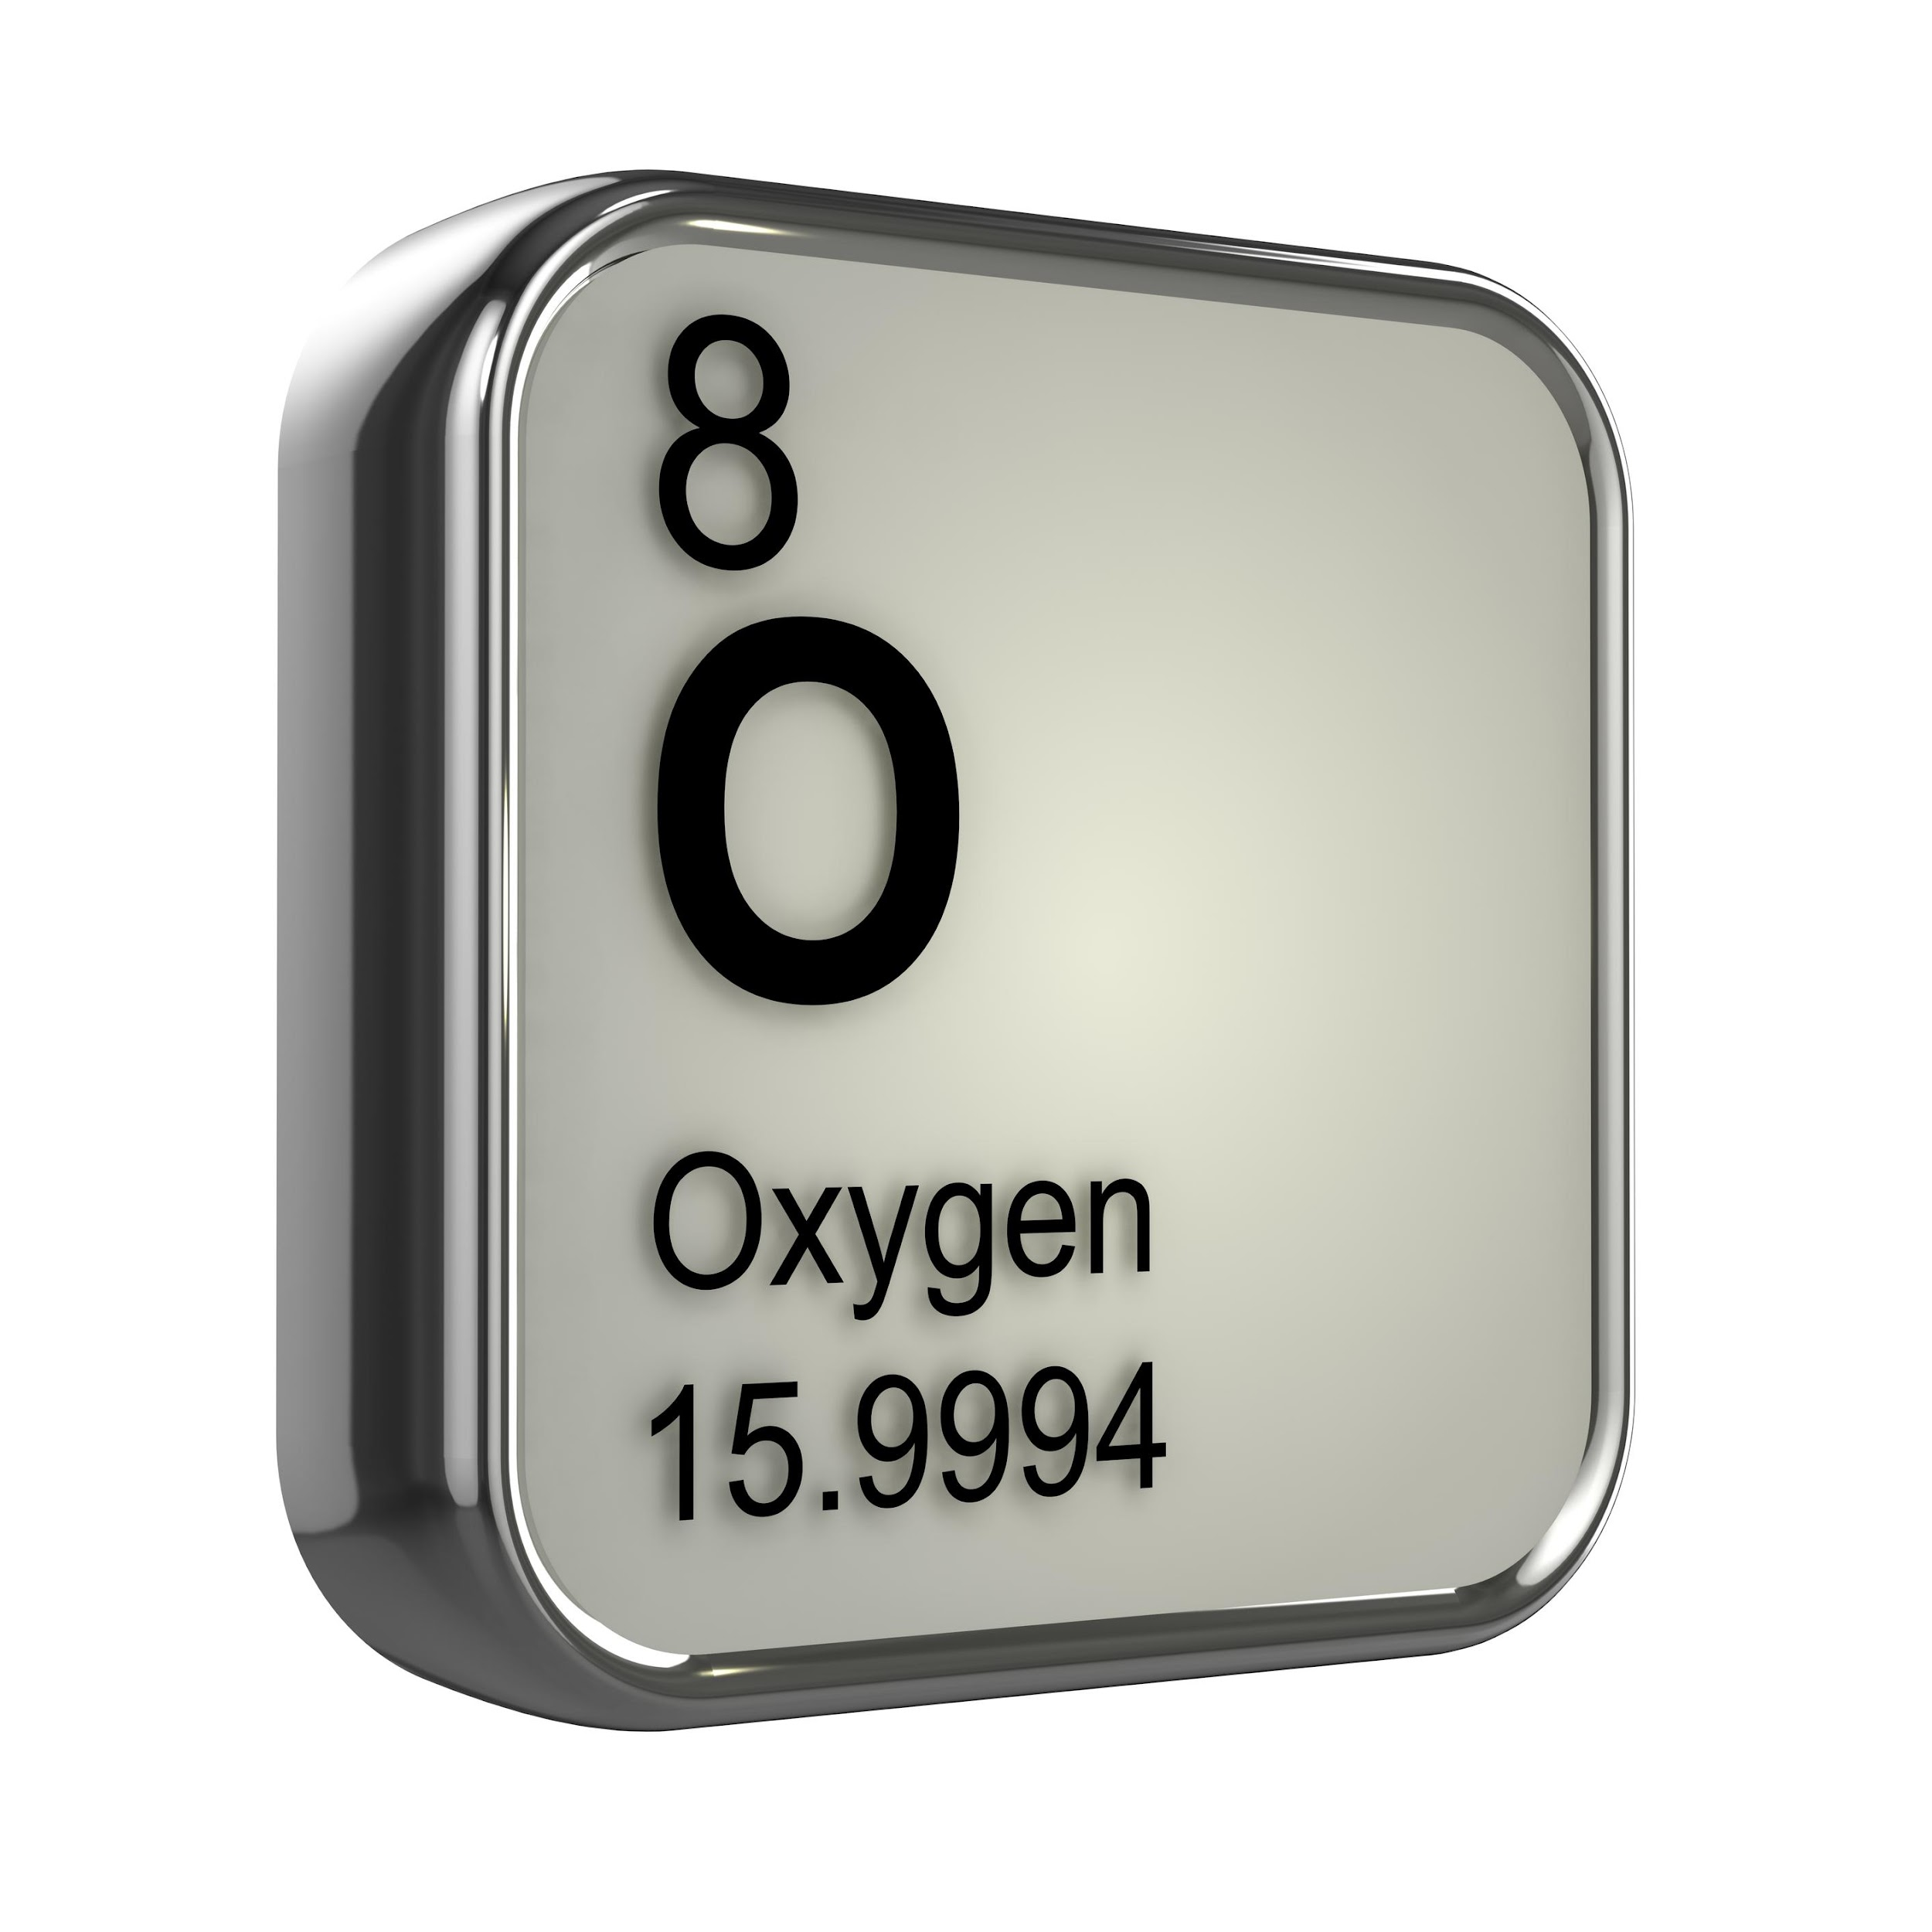
Notes:
The chemical formula of a base will always have a hydrogen atom and an oxygen atom in it, and carry a negative charge. The one exception is ammonia, which has hydrogen but not oxygen.

Slide 79
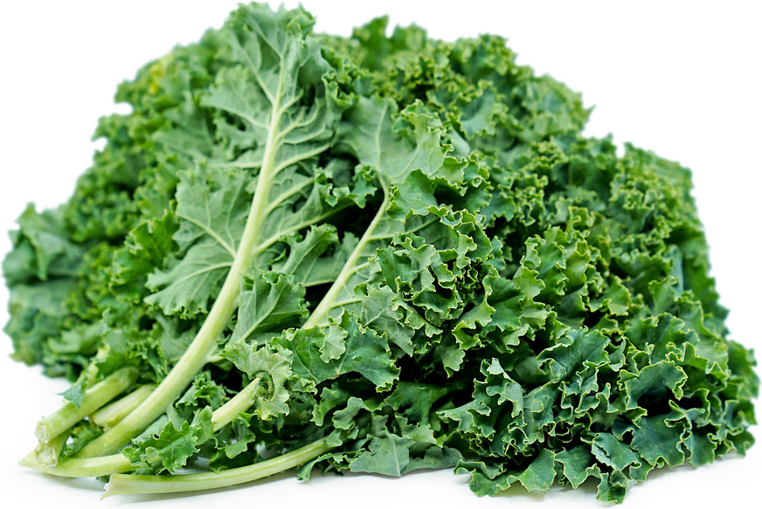
Bitter Taste
Notes:
Many bases have a bitter taste.
Feedback: It's great to consistently use images in your lesson, this helps students make connections to the words in the definition.

Slide 80
Feel Slippery
Notes:
Many bases feel slippery.

Slide 81
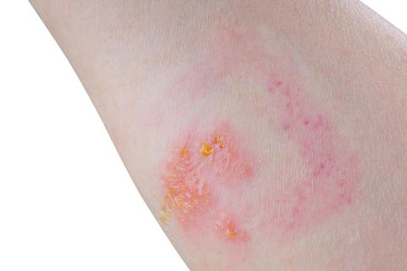
Corrosive to the Skin
Notes:
And they can be corrosive to (eat away at) the skin.

Slide 82
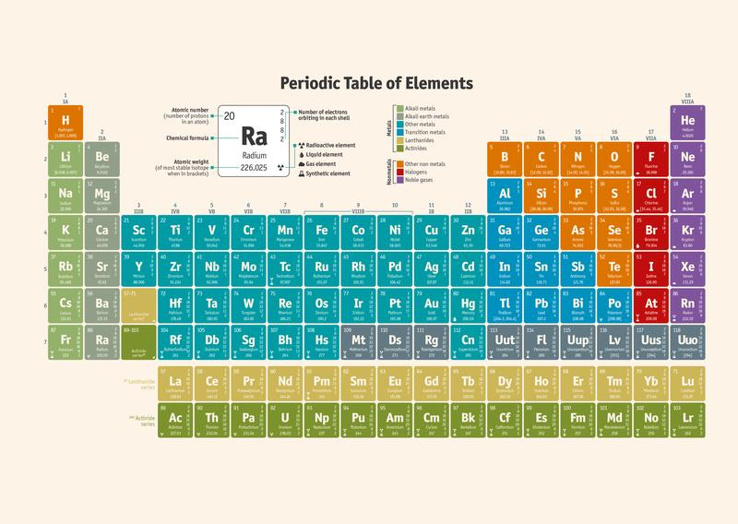
Base = Alkali Alkali
Notes:
Bases are also called alkali. Think about the alkali metals and alkali earth metals on the periodic table.

Slide 83
Notes:
Now let’s pause for a moment to check your understanding.

Slide 84
What is a base?
Notes:
What is a base?
[A base is a compound that releases hydroxide ions when mixed with water.]
Feedback: When introducing new vocabularies, it is crucial to require the students to give out their own interpretation. I would strongly encourage you to ask students to explain the concept in their own words.

Slide 85
Bases taste:
A. Sweet
B. Bitter
C. Sour
Notes:
Bases taste:
A. Sweet
B. Bitter
C. Sour

Slide 86
Bases taste:
A. Sweet
B. Bitter
C. Sour
Notes:
Bases taste:
[Bitter]

Slide 87
Notes:
Now, let’s talk about some examples of bases.

Slide 88
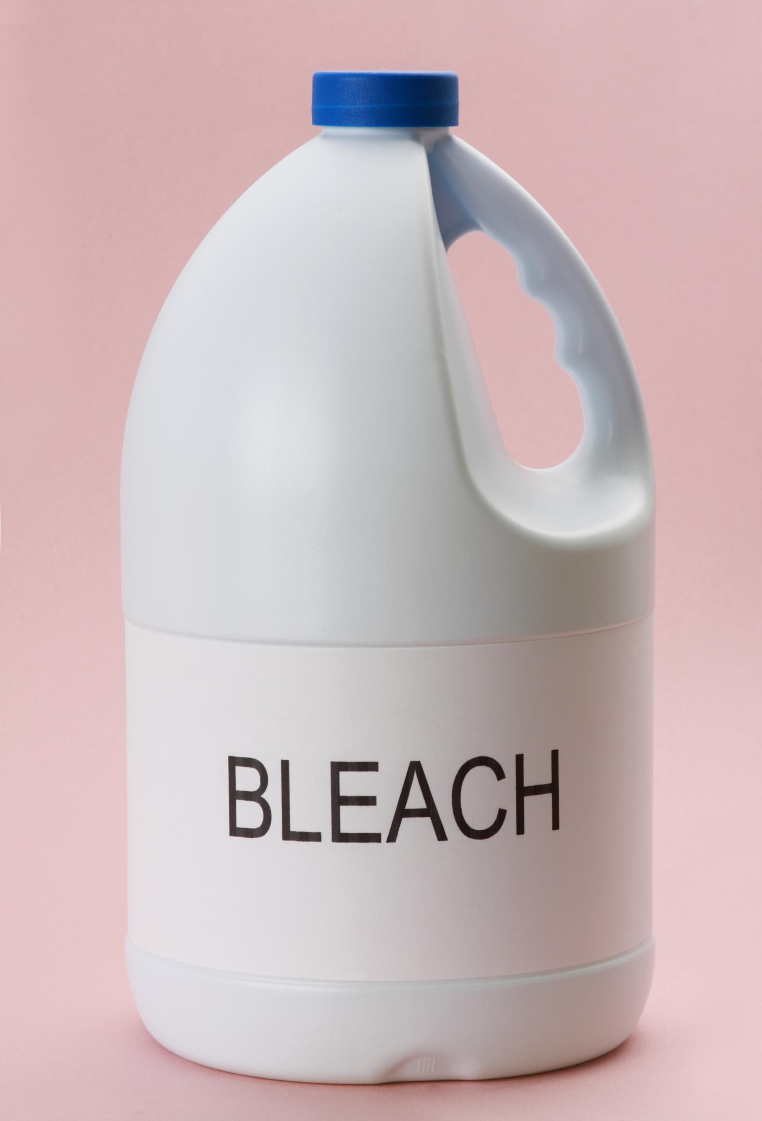
Notes:
Bleach is one example of a base. Bleach is a liquid that contains hydroxide ions. It is the hydroxide ions that give bleach its cleaning power. Since bleach is a base, it will release hydroxide ions when mixed with water.

Slide 89
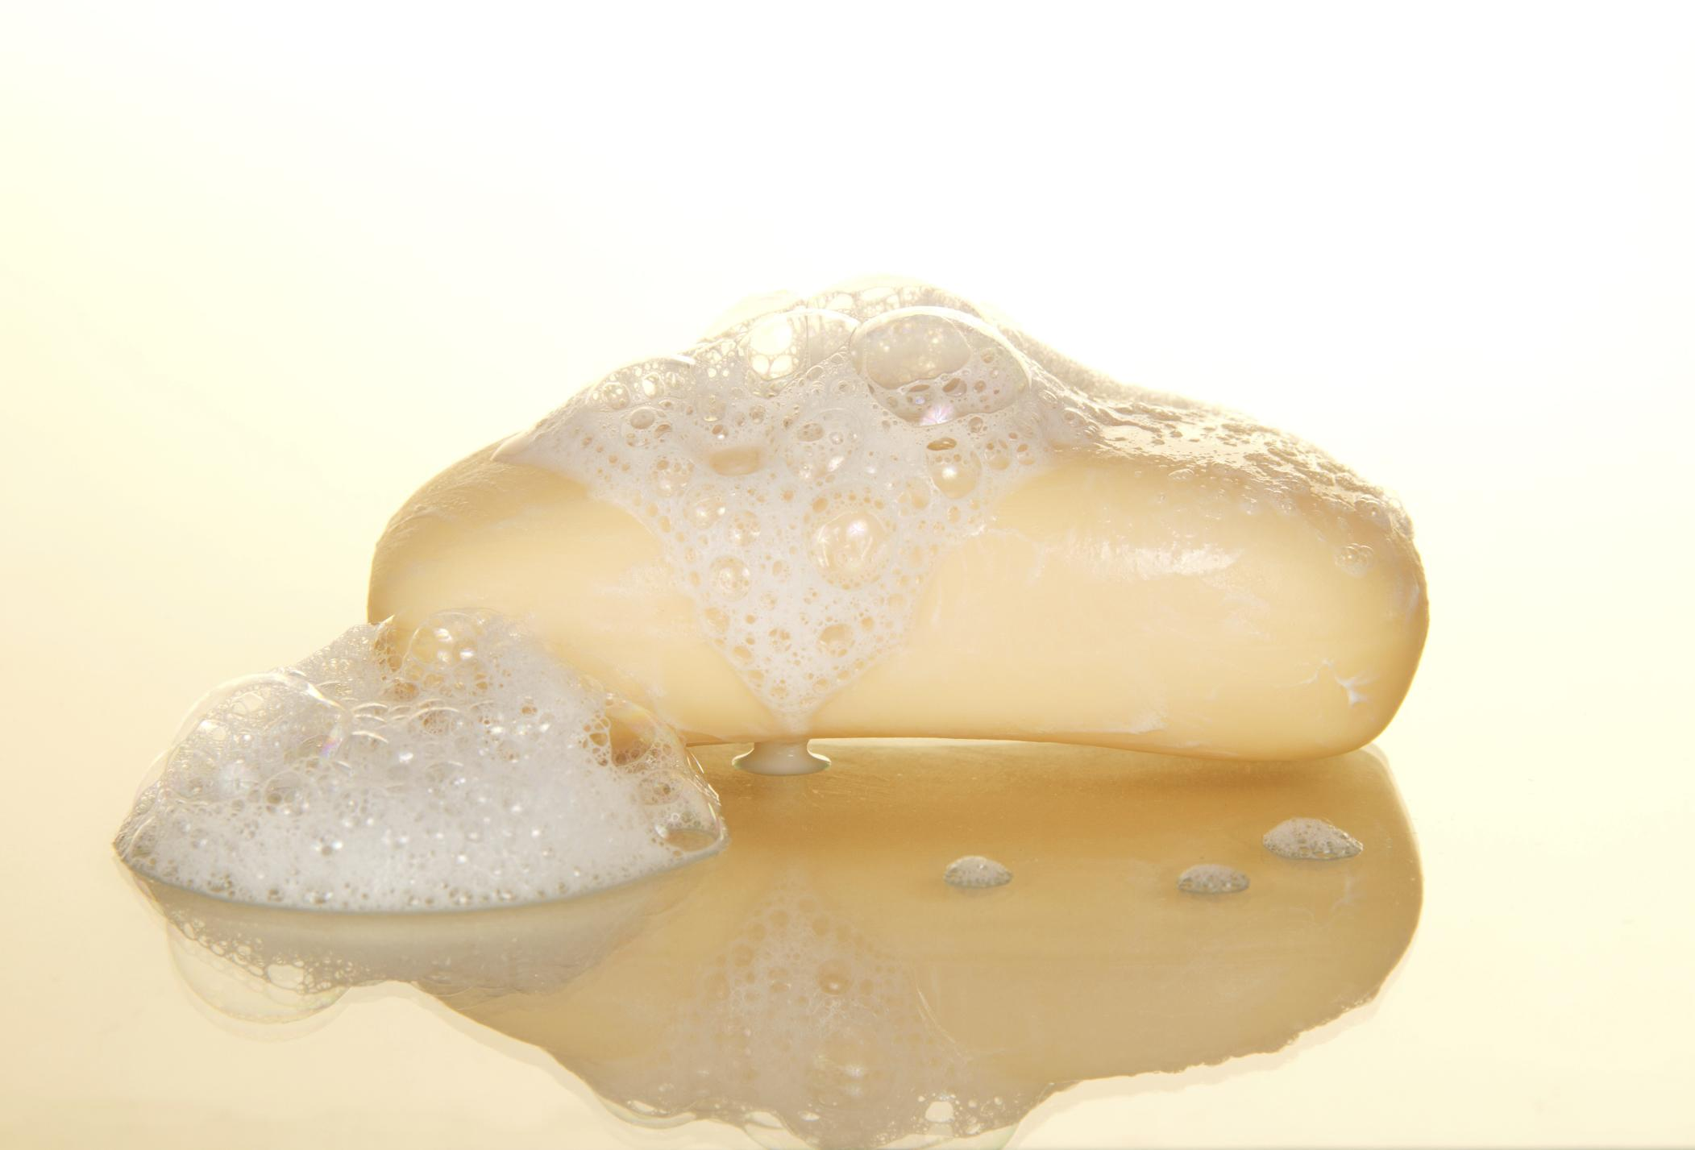
Notes:
Soap is also a base. Soap is slippery, which is a common characteristic of bases. Since soap is a base, it will release hydroxide ions when mixed with water.
Feedback: Remember to try and use phrasing and language that is clear and easy for students to understand when going over examples of term meaning.

Slide 90
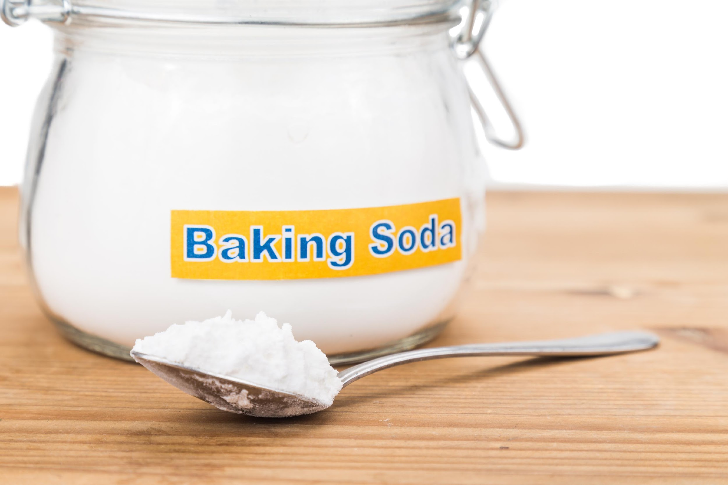
Notes:
Baking soda is a base too. Baking soda is bitter, which is another characteristic of bases. Since baking soda is a base, it will release hydroxide ions when mixed with water.

Slide 91
Notes:
Next, let’s talk about some non-examples of bases.

Slide 92
Sour Taste
React with Metal
Notes:
A lemon would not be a base. A lemon has a sour taste and reacts with metals. These are characteristics of acids, so a lemon is an acid.
Feedback: One important component of using non-examples is by clearly distinguishing similarities and explaining why it is a non-example.

Slide 93
Hydrogen
CH₃COOH
Notes:
This is not an example of a base, it is an example of an acid. Acetic acid can be found in vinegar and in ketchup. The chemical formula for acetic acid is on the bottom right, notice how a acetic acid compound has hydrogen atoms. Since both of these are acids, when mixed with water, they will also release hydrogen ions into the solution.

Slide 94
Notes:
Now let’s pause for a moment to check your understanding.

Slide 95
Identify all of the bases:
Notes:
Identify all of the bases.
Feedback: Activities should have a nice balance between "attainable" and "challenging", supporting those high expectations for your students' success.

Slide 96
Identify all of the bases:
Notes:
Identify all of the bases.

Slide 97
What is a base?
Notes:
What is a base?
[A base is a compound that releases hydroxide ions when mixed with water.]

Slide 98
What two types of atoms are always found in the chemical formula of a base?
Notes:
What two types of atoms are always found in the chemical formula of a base?
[The chemical formula of a base will always have a hydrogen atom and an oxygen atom in it, and carry a negative charge. The one exception is ammonia, which has hydrogen but not oxygen.]

Slide 99
What are the characteristics of bases?
Notes:
What are the characteristics of bases?
[Bitter taste, feels slippery, corrosive to the skin ]
Feedback: It's really important to make sure that you're providing students with frequent opportunities to respond as you're closing the lesson – it will help you know if they understood and made sense of the activity and where you can provide further instruction.

Slide 100
What are bases also called?
Notes:
What are bases also called?
[Bases are also called alkali. Think about the alkali metals and alkali earth metals on the periodic table.]

Slide 101
Remember!!!
Notes:
So remember!

Slide 102
Base: a compound that releases hydroxide ions when mixed with water
Notes:
Remember! A BASE is a compound that releases hydroxide ions when mixed with water.

Slide 103
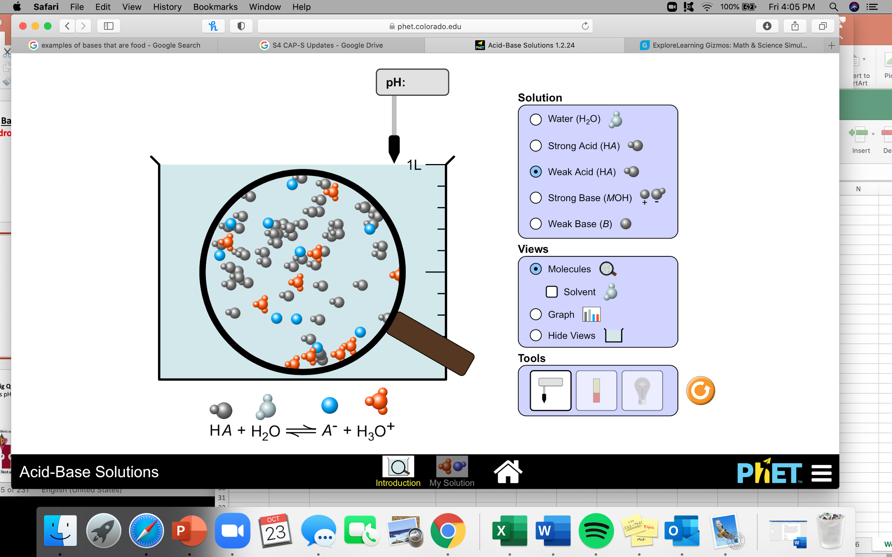
Simulation Activity
Acid-Base Solutions
(Phet Simulation)
Click the link above to explore acids and bases
In this simulation activity, you will look at the molecules of different acids and bases. What do you notice about the chemical equation for both acids and bases?
Notes:
Feedback: Remember to give the students an opportunity to construct their own explanations when solving an inquiry activity, it is an important step in learning how to apply their new content knowledge.

Slide 104
Big Question: How do the pH of materials affect your everyday life? How are compounds classified, what is pH, and how can the pH of different substances be tested?
Notes:
Our “big question” is: How do the pH of materials affect your everyday life? How are compounds classified, what is pH, and how can the pH of different substances be tested? [Pause and illicit predictions from students.]
Let’s go back to our big question. How did our hypotheses change? What do we already know?

Slide 105
Notes:
Thanks for watching, and please continue watching CAPs available from this website.

Slide 106
This Video Created With Resources From:
Questions or Comments
Michael Kennedy, Ph.D. MKennedy@Virginia.edu
Rachel L Kunemund, Ph.D. rk8vm@virginia.edu

Slide 107
Intro
“Big Idea” Question
Review Concepts
Check-In Questions
Teacher Demo
Vocabulary
Student-Friendly Definition
Examples & Non-Examples
Morphological Word Parts
Simulation/Activity
Notes:
OK everyone, get ready for our next lesson. Just as a reminder, these are the different components that our lesson may include, and you’ll see these icons in the top left corner of each slide so that you can follow along more easily!

Slide 108
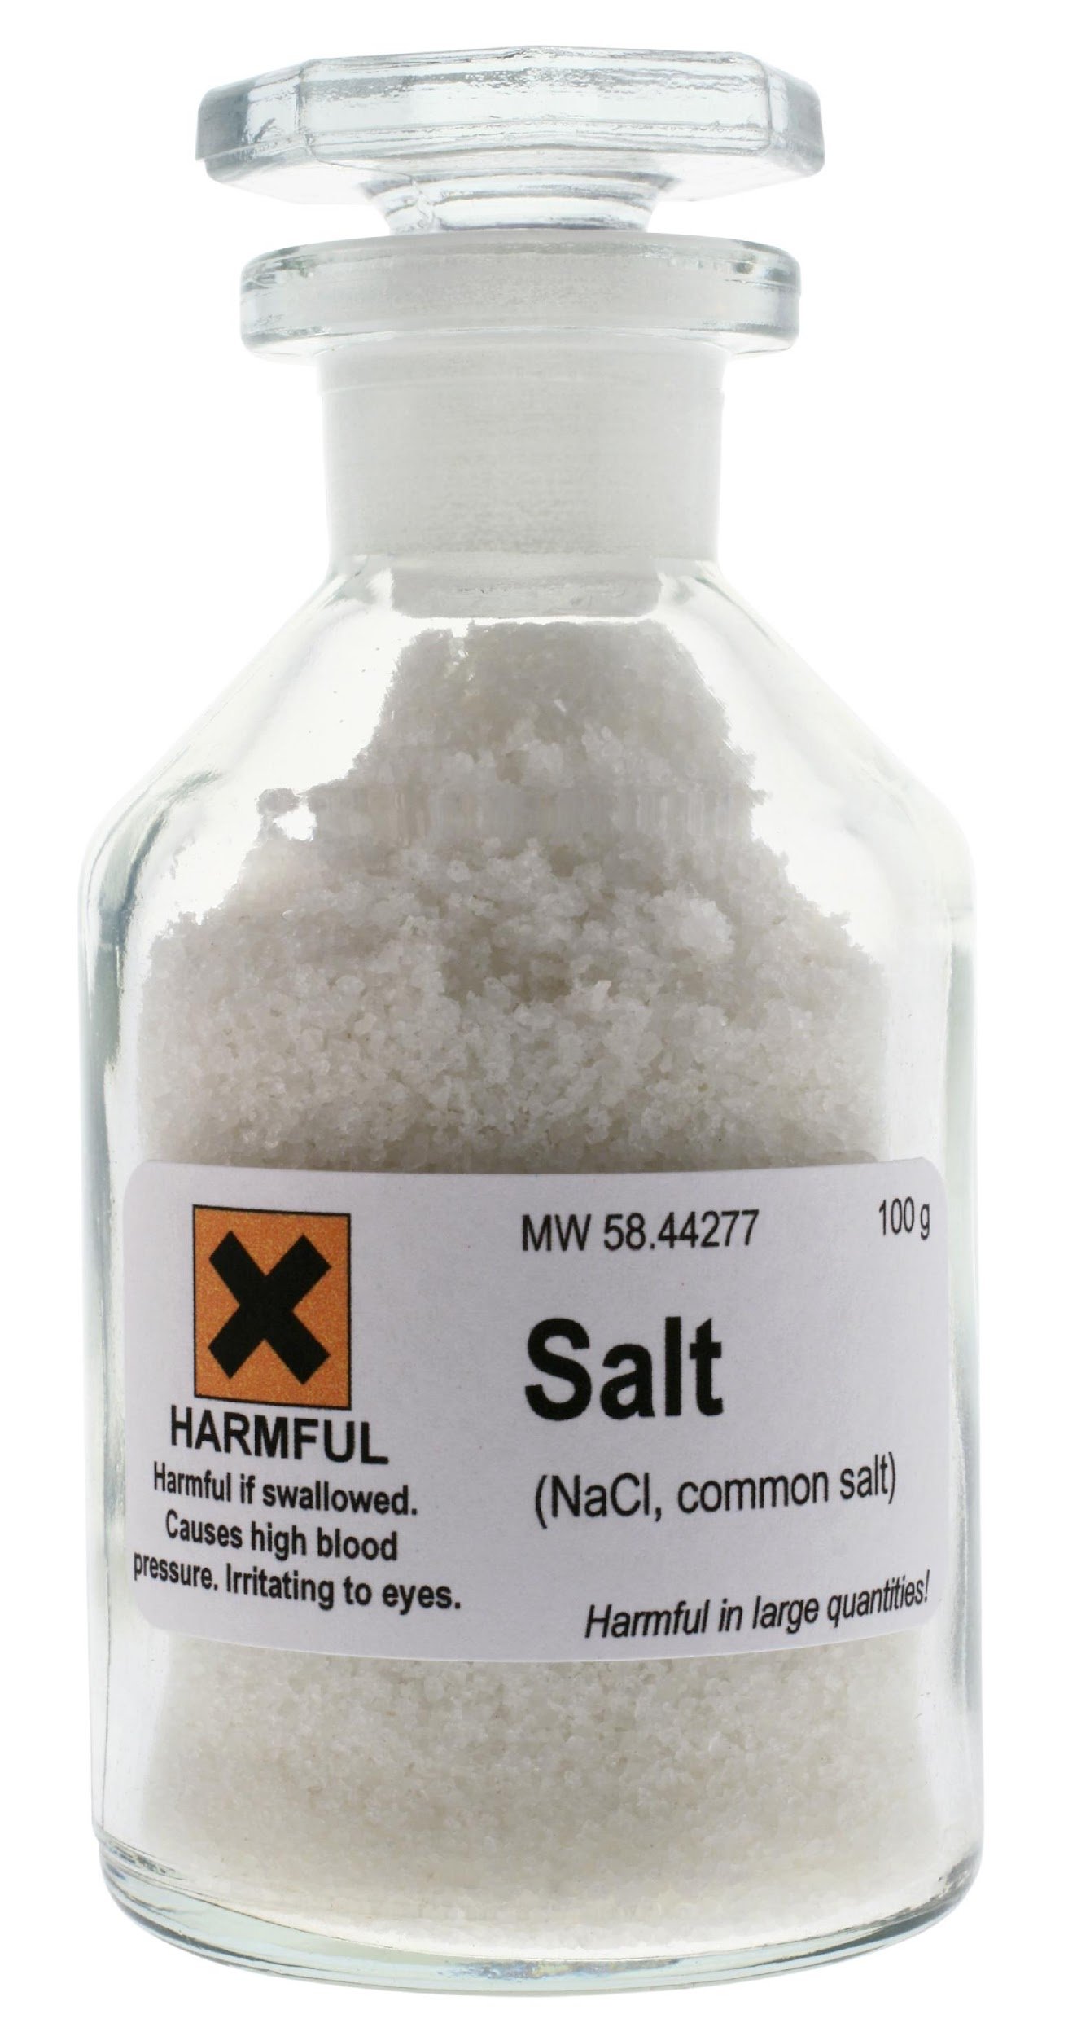
Salt
Intro
Notes:
Today we will learn about salts.

Slide 109
Big Question: How do the pH of materials affect your everyday life? How are compounds classified, what is pH, and how can the pH of different substances be tested?
Notes:
Our “big question” is: How do the pH of materials affect your everyday life? How are compounds classified, what is pH, and how can the pH of different substances be tested?
[Pause and illicit predictions from students.]
What have we learned about our big question? What do you think we will learn today?
Feedback: Providing a specific goal for use is crucial to letting students know what's expected and why this lesson is important.

Slide 110
Demonstration
TEACHER DIRECTIONS:
To activate background knowledge, you could ask students what they already know about salt. Then, ask students if they know how salts are related to acids and bases, and tell them that they will learn more about salts in this lesson.
Notes:
Let’s get our brains ready to think about salts, and how it relates to our big question.
Feedback: Creating an organized demonstration that is clear and well structured is key to promoting student understanding.

Slide 111
Notes:
Before we move on to our new vocabulary term, let’s review some other words & concepts that you already learned and make sure you are firm in your understanding.

Slide 112
Element: pure substance containing
only one type of atom
Notes:
An element is a pure substance containing only 1 type of atom.

Slide 113
Chemical Symbol
Notes:
Elements are symbolized by a capital letter, sometimes followed by a lowercase letter, which is called its chemical symbol. For example, the chemical symbol of hydrogen is H.

Slide 114
Compound: pure substance containing two or more different elements
Notes:
A compound is a pure substance containing 2 or more different elements.

Slide 115
Molecule: a particle containing two or more atoms of the same OR different elements
SAME
DIFFERENT
Hydrogen
Oxygen
OR
Different
Elements
Hydrogen
Hydrogen
Notes:
A molecule is a particle containing 2 or more atoms of the same OR different elements.
Feedback: If you notice some students struggling to keep up when you activating prior knowledge, it is important to remember to make adjustments and scaffold your content to meet students current level of understanding.

Slide 116
Ion: an atom or molecule with a positive or negative charge
Notes:
An ion is an atom or molecule that has a positive or negative charge.

Slide 117
Chemical Formula: uses chemical symbols to represent a compound or molecule
Notes:
A chemical formula uses chemical symbols to represent a compound or molecule. For example, the chemical formula of water is H2O, which tells us that a compound of water has two hydrogen atoms and one oxygen atom.

Slide 118
Acid: a compound that releases hydrogen ions when mixed with water
H⁺
H⁺
H⁺
H⁺
H⁺
H⁺
H⁺
H⁺
H⁺
H⁺
H⁺
H⁺
H⁺
H⁺
H⁺
H⁺
H⁺
H⁺
H⁺
H⁺
H⁺
H⁺
H⁺
H⁺
H⁺
H⁺
H⁺
H⁺
H⁺
H⁺
H⁺
H⁺
H⁺
H⁺
H⁺
H⁺
Notes:
An acid is a compound that releases hydrogen ions when mixed with water.

Slide 119
Base: a compound that releases hydroxide ions when mixed with water
Notes:
A base is a compound that releases hydroxide ions when mixed with water.

Slide 120
Notes:
Now let’s pause for a moment to check your understanding.
Feedback: It is important when reviewing previously learned material that you pause and check for understanding, if students are grasping previous material you may need to tailor your instruction.

Slide 121
What is an element?
Notes:
What is an element?
[An element is a pure substance containing only 1 type of atom.]

Slide 122
What does a chemical symbol tell us about an element?
Chemical Symbol
Notes:
What does a chemical symbol tell us about an element?
[A chemical symbol, are just a shorter way to tell us what element something is. Elements are symbolized by a capital letter, sometimes followed by a lowercase letter, which is called its chemical symbol. For example, the chemical symbol of hydrogen is H]

Slide 123
What is the difference between a molecule and compound?
C
C
Notes:
What is the difference between a molecule and compound?
[A compound is a pure substance that contains two or more different elements but a molecule is a particle containing 2 or more atoms of the same OR different elements.]

Slide 124
A(n) ___________ is an atom or molecule with a positive or negative charge.
Notes:
A(n) ______ is an atom or molecule with a positive or negative charge.

Slide 125
A(n) ion is an atom or molecule with a positive or negative charge.
Notes:
A(n) ion is an atom or molecule with a positive or negative charge.

Slide 126
What does a chemical formula represent?
Notes:
What does a chemical formula represent?
[A compound or molecule]

Slide 127
What is an acid?
H⁺
H⁺
H⁺
H⁺
H⁺
H⁺
H⁺
H⁺
H⁺
H⁺
H⁺
H⁺
H⁺
H⁺
H⁺
H⁺
H⁺
H⁺
H⁺
H⁺
H⁺
H⁺
H⁺
H⁺
H⁺
H⁺
H⁺
H⁺
H⁺
H⁺
H⁺
H⁺
H⁺
H⁺
H⁺
H⁺
Notes:
What is an acid?
[A compound that releases hydrogen ions when mixed with water]

Slide 128
What is the difference between an acid and a base?
H⁺
H⁺
H⁺
H⁺
H⁺
H⁺
H⁺
H⁺
H⁺
H⁺
H⁺
H⁺
H⁺
H⁺
H⁺
H⁺
H⁺
H⁺
H⁺
H⁺
H⁺
H⁺
H⁺
H⁺
H⁺
H⁺
H⁺
H⁺
H⁺
H⁺
H⁺
H⁺
H⁺
H⁺
H⁺
H⁺
Notes:
What is the difference between an acid and a base?
[An acid releases hydrogen ions when mixed with water, but a base is a compound that releases hydroxide ions when mixed with water]
Feedback: Making connections between the new content and past terms/content is important for helping students understand the bigger picture.

Slide 129
Salt
Notes:
Now that we’ve reviewed, let’s define our new term, salt.

Slide 130
Salt: a compound that forms from the chemical reaction of an acid and a base
Notes:
A salt is a compound that forms from the chemical reaction of an acid and a base.
Feedback: When providing more student-friendly definitions, it is helpful to provide students with cues so that they can be prepared and know what to expect and be ready to copy down the information.

Slide 131
Notes:
That’s the basic definition but there is more you need to know.

Slide 132
Acid
Base
Salt
Ionic Bond
Metallic Bond
Notes:
We have talked about acids, bases, and salts so now let’s put it all together. Let’s talk about how acids, bases, and salts are related. Let’s think about how these terms are similar and different.

Slide 133
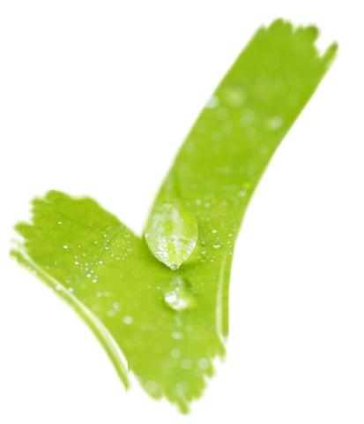
Compound?
Acid
Base
Salt
Notes:
They are all compounds, but they are not the same thing because…

Slide 134
Compound?
Ions Released
Acid
Base
Salt
Hydrogen Ions
Hydroxide Ions
Notes:
Acids and bases both release ions when mixed with water, but salts do not. Acids release hydrogen ions but bases release hydroxide ions.

Slide 135
Result of the Reaction of an Acid and Base?
Ions Released
Compound?
Acid
Base
Salt
Hydrogen Ions
Hydroxide Ions
Notes:
When an acid and base are mixed together the properties of the acid and base are neutralized, and salt (and water) are produced.
Feedback: Visualizing similarities and differences between new and past content is a great way to build connections and increase understanding.

Slide 136
Notes:
Now let’s pause for a moment to check your understanding.
Feedback: Remember, students might look like they are understanding the definition but it is important that you check for understanding yourself by asking questions or providing them with other opportunities to respond.

Slide 137
What is a salt?
Notes:
What is a salt?
[A compound that forms from the chemical reaction of an acid and a base.]

Slide 138
Notes:
Now, let’s talk about some examples of salts.

Slide 139
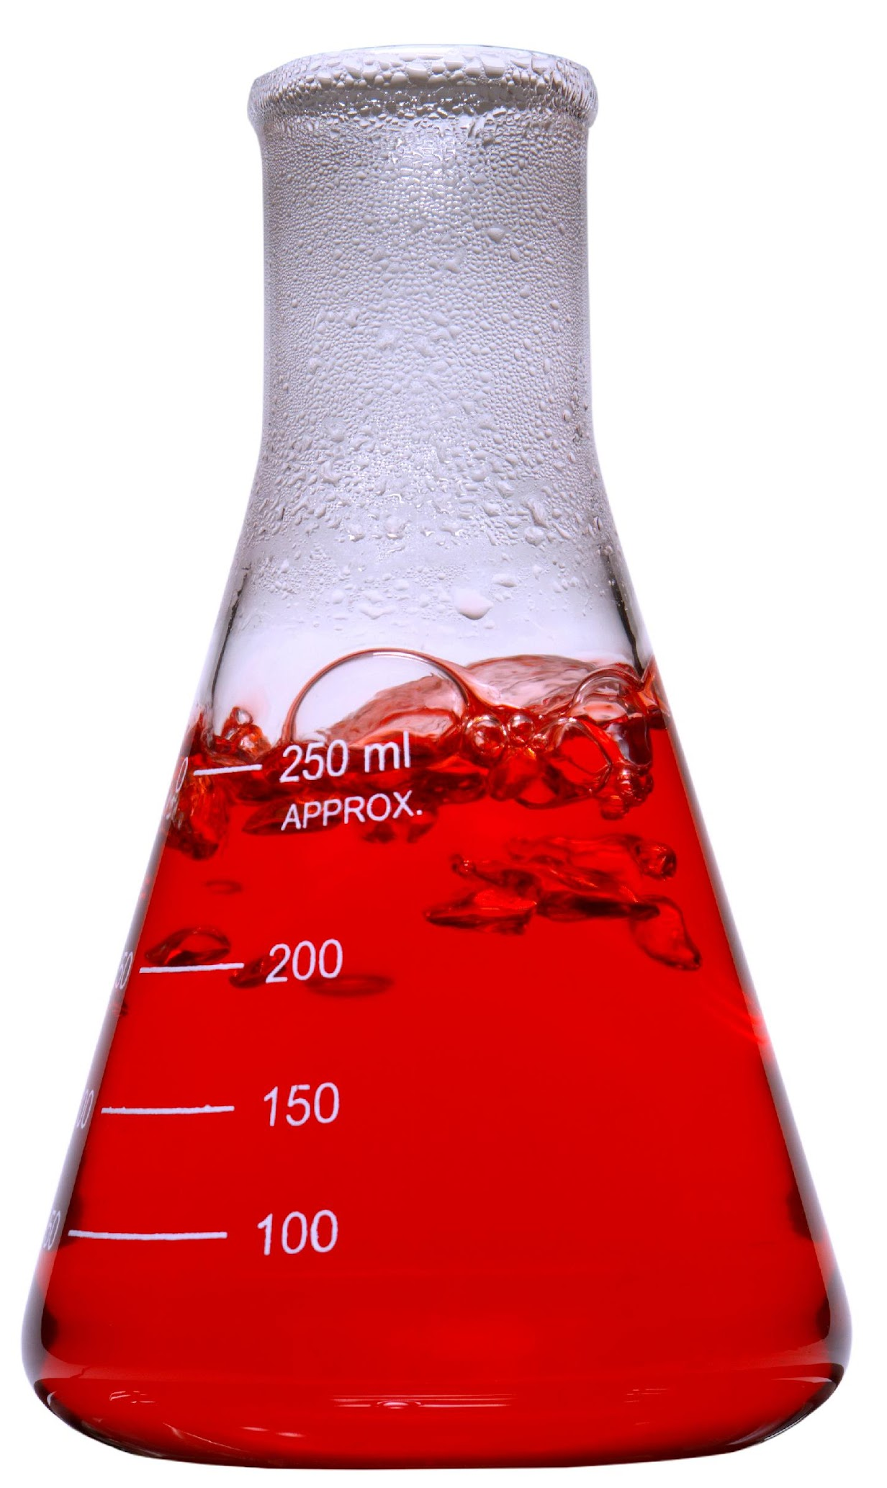
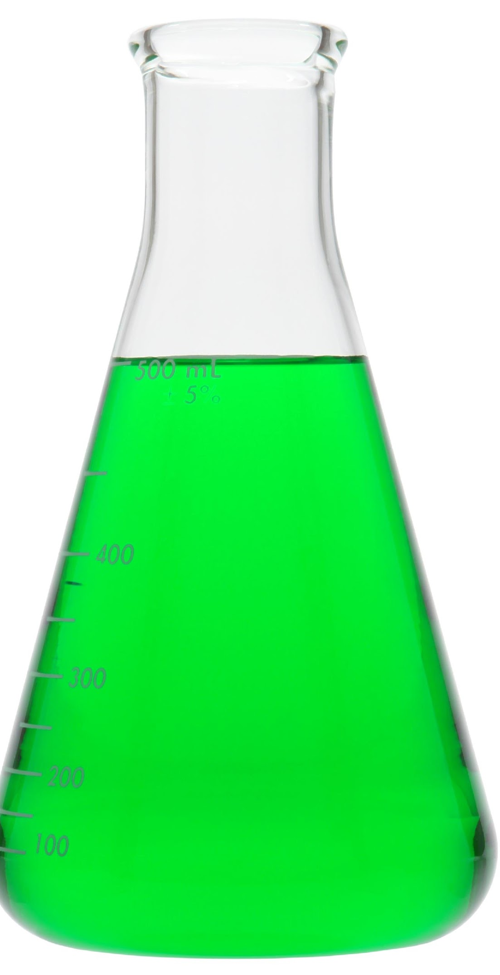
HCl
NaOH
Acid
Base
Notes:
Hydrochloric acid (HCl) is an acid while sodium hydroxide (NaOH) is a base.

Slide 140
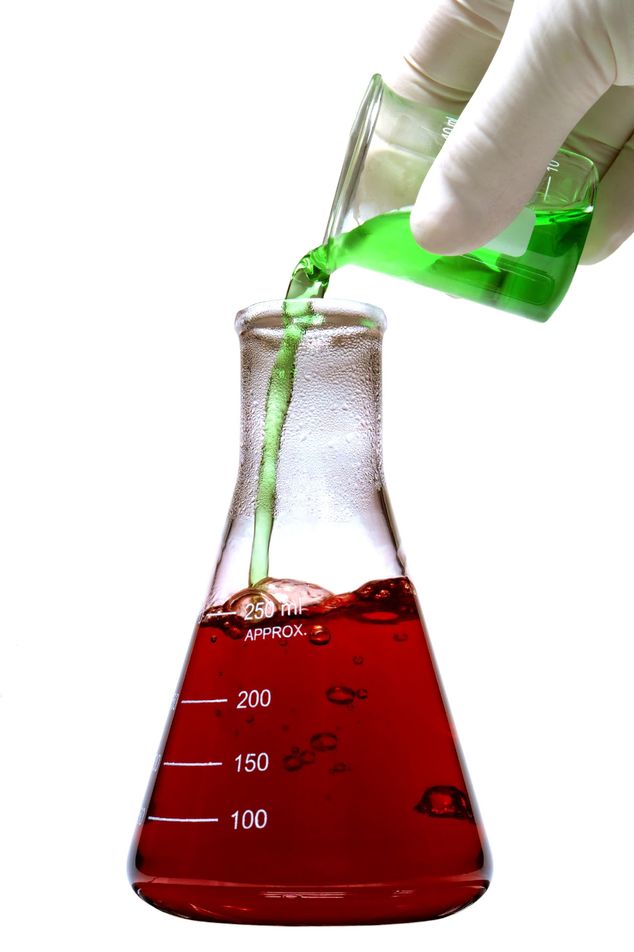
Cl⁻
Cl⁻
OH⁻
OH⁻
Na⁺
Na⁺
H⁺
H⁺
OH⁻
H⁺
OH⁻
Na⁺
Cl⁻
OH⁻
H⁺
Na⁺
H⁺
Cl⁻
Na⁺
Cl⁻
Notes:
When they are mixed together, the acid HCl release hydrogen ions and Cl ions while the base NaOH releases hydroxide ions and sodium ions into the solution.

Slide 141
H⁺
OH⁻
Notes:
The acid’s hydrogen ions and the base’s hydroxide ions react to form water🡪 H2O is the formula for water!!

Slide 142
Cl⁻
Na⁺
NaCl
Notes:
Meanwhile, the chlorine ion and the sodium ion also combine to form sodium chloride (NaCl)🡪 since this is the compound that forms from an acid and base combining, it is called a salt!!!
Feedback: Explaining WHY something is an example of a vocabulary word is as important as explaining that it is an example.

Slide 143
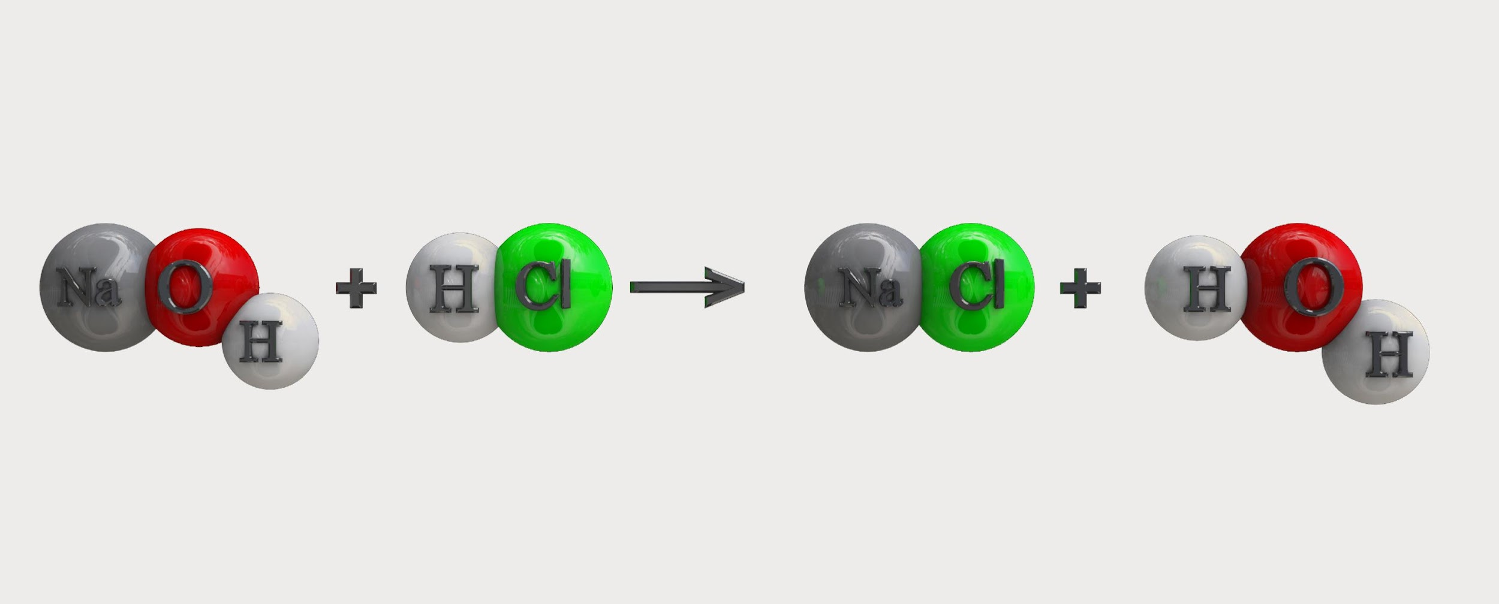
Base
Acid
Salt
Water
Notes:
Here is the full chemical equation—a base and acid reacting together to form the products of a salt and water.

Slide 144
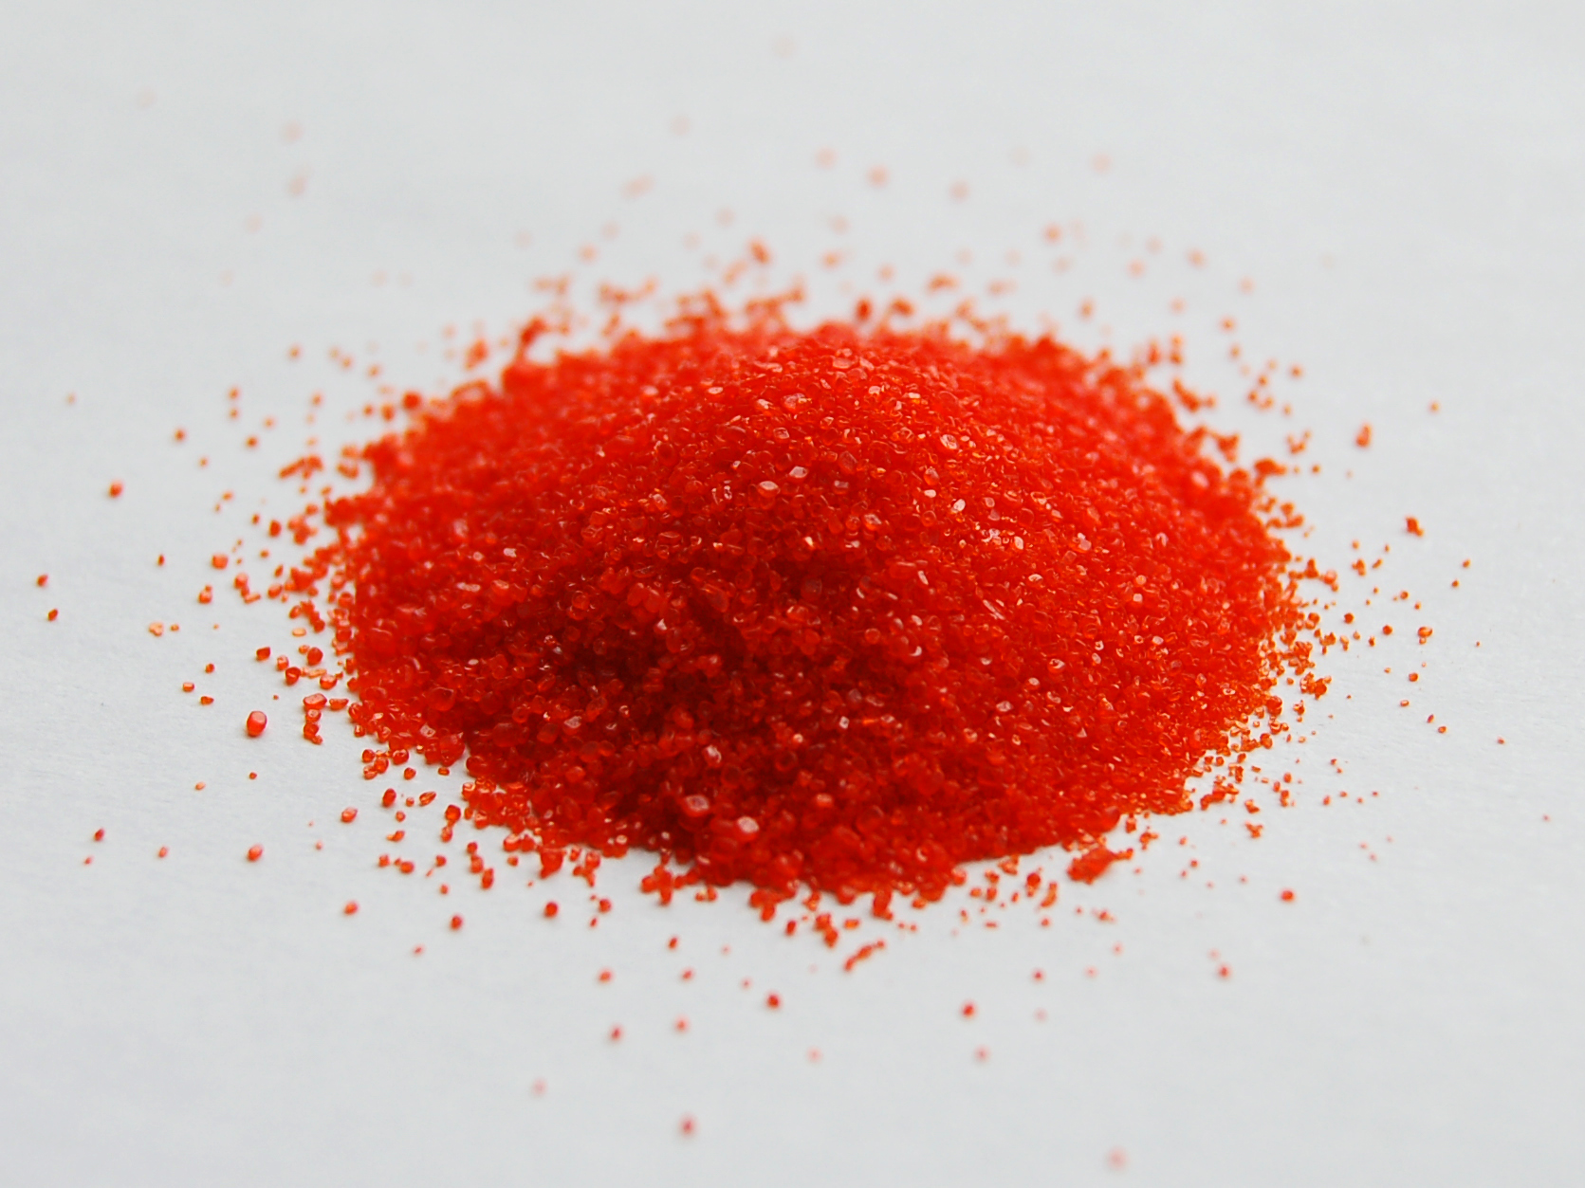
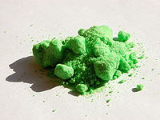
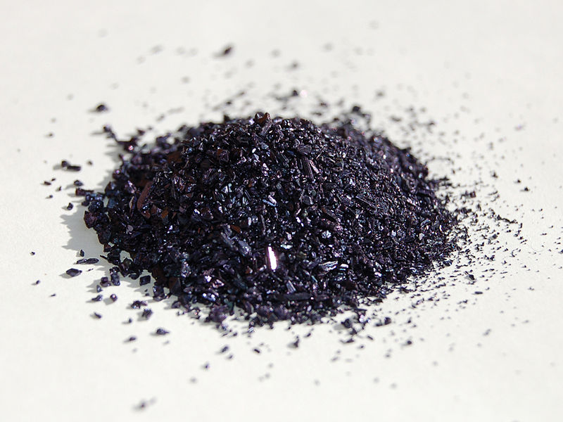
Potassium dichromate
Nickel Chloride
Potassium permanganate
Notes:
Other examples of salts include potassium dichromate, potassium permanganate, and nickel chloride. The new bonds formed between the acids and bases allow for salts to come in a variety of colors.

Slide 145
Notes:
Now let’s pause for a moment to check your understanding.

Slide 146
Fill in the equation.
Notes:
Fill in the equation.
Feedback: Explicitly modeling these skills for students provides them with visual of the strategy.

Slide 147
Fill in the equation.
Base
Acid
Salt
Water
Notes:
Fill in the equation.
[Here is the full chemical equation—a base and acid reacting together to form the products of a salt and water.]

Slide 148
How do salts form?
Notes:
How do salts form?
[Salt is a compound that forms from the chemical reaction of an acid and a base]

Slide 149
When a base and acid react, what two products are formed?
Base
Acid
Notes:
When a base and acid react, what two products are formed?
[Here is the full chemical equation—a base and acid reacting together to form the products of a salt and water.]

Slide 150
What are the similarities and differences between acids, bases, and salts?
Acid
Base
Salt
Hydrogen Ions
Hydroxide Ions
Notes:
What are the similarities and differences between acids, bases, and salts?
[Acids, bases, and salts, are all compounds. Salts do not release ions, but both acids and bases release ions. Acids release hydrogen ions and bases release hydroxide ions. The final difference is that salts are the result of the reaction of an acid and a base.]

Slide 151
Remember!!!
Notes:
So remember!
Feedback: Intentionally repeating key information when engaging in this part of the lesson highlights what is important for the students.

Slide 152
Salt: a compound that forms from the chemical reaction of an acid and a base
Notes:
A salt is a compound that forms from the chemical reaction of an acid and a base.

Slide 153
Big Question: How do the pH of materials affect your everyday life? How are compounds classified, what is pH, and how can the pH of different substances be tested?
Notes:
Our “big question” is: How do the pH of materials affect your everyday life? How are compounds classified, what is pH, and how can the pH of different substances be tested? [Pause and illicit predictions from students.]
Let’s go back to our big question. How did our hypotheses change? What do we know?
Feedback: Providing your students with some reflection time at the end of the lesson is crucial in helping them to put the pieces together and make sense of the activity.

Slide 154
Notes:
Thanks for watching, and please continue watching CAPs available from this website.

Slide 155
This Video Created With Resources From:
Questions or Comments
Michael Kennedy, Ph.D. MKennedy@Virginia.edu
Rachel L Kunemund, Ph.D. rk8vm@virginia.edu

