Slide 1
“Big Idea” Question
Review Concepts
Check-In Questions
Teacher Demo
Vocabulary
Student-Friendly Definition
Examples & Non-Examples
Morphological Word Parts
Simulation/Activity
Notes:
OK everyone, get ready for our next lesson. Just as a reminder, these are the different components that our lesson may include, and you’ll see these icons in the top left corner of each slide so that you can follow along more easily!

Slide 2
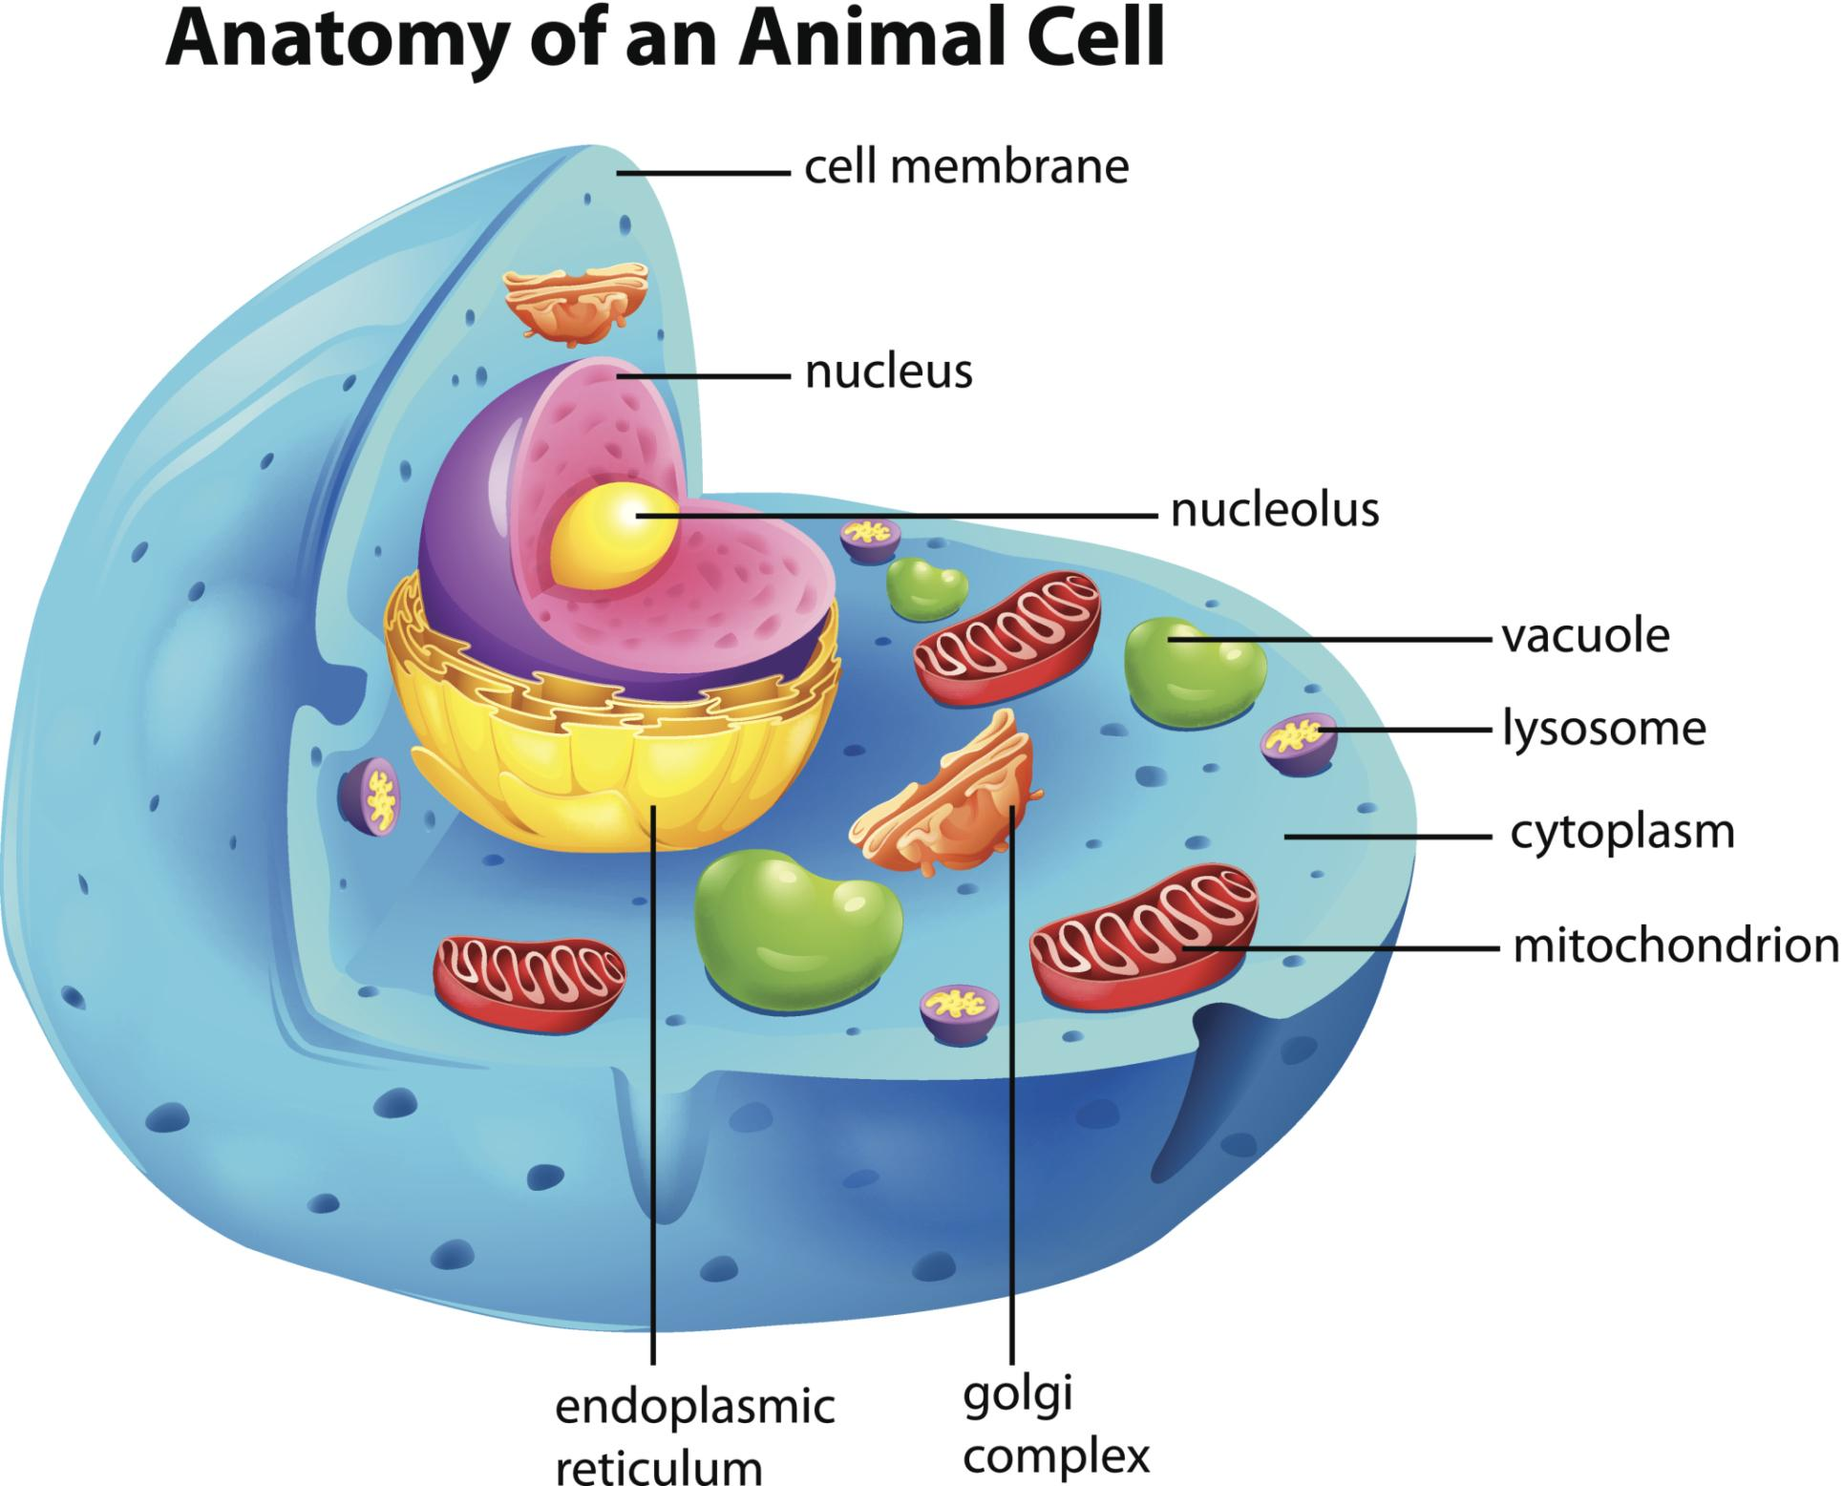
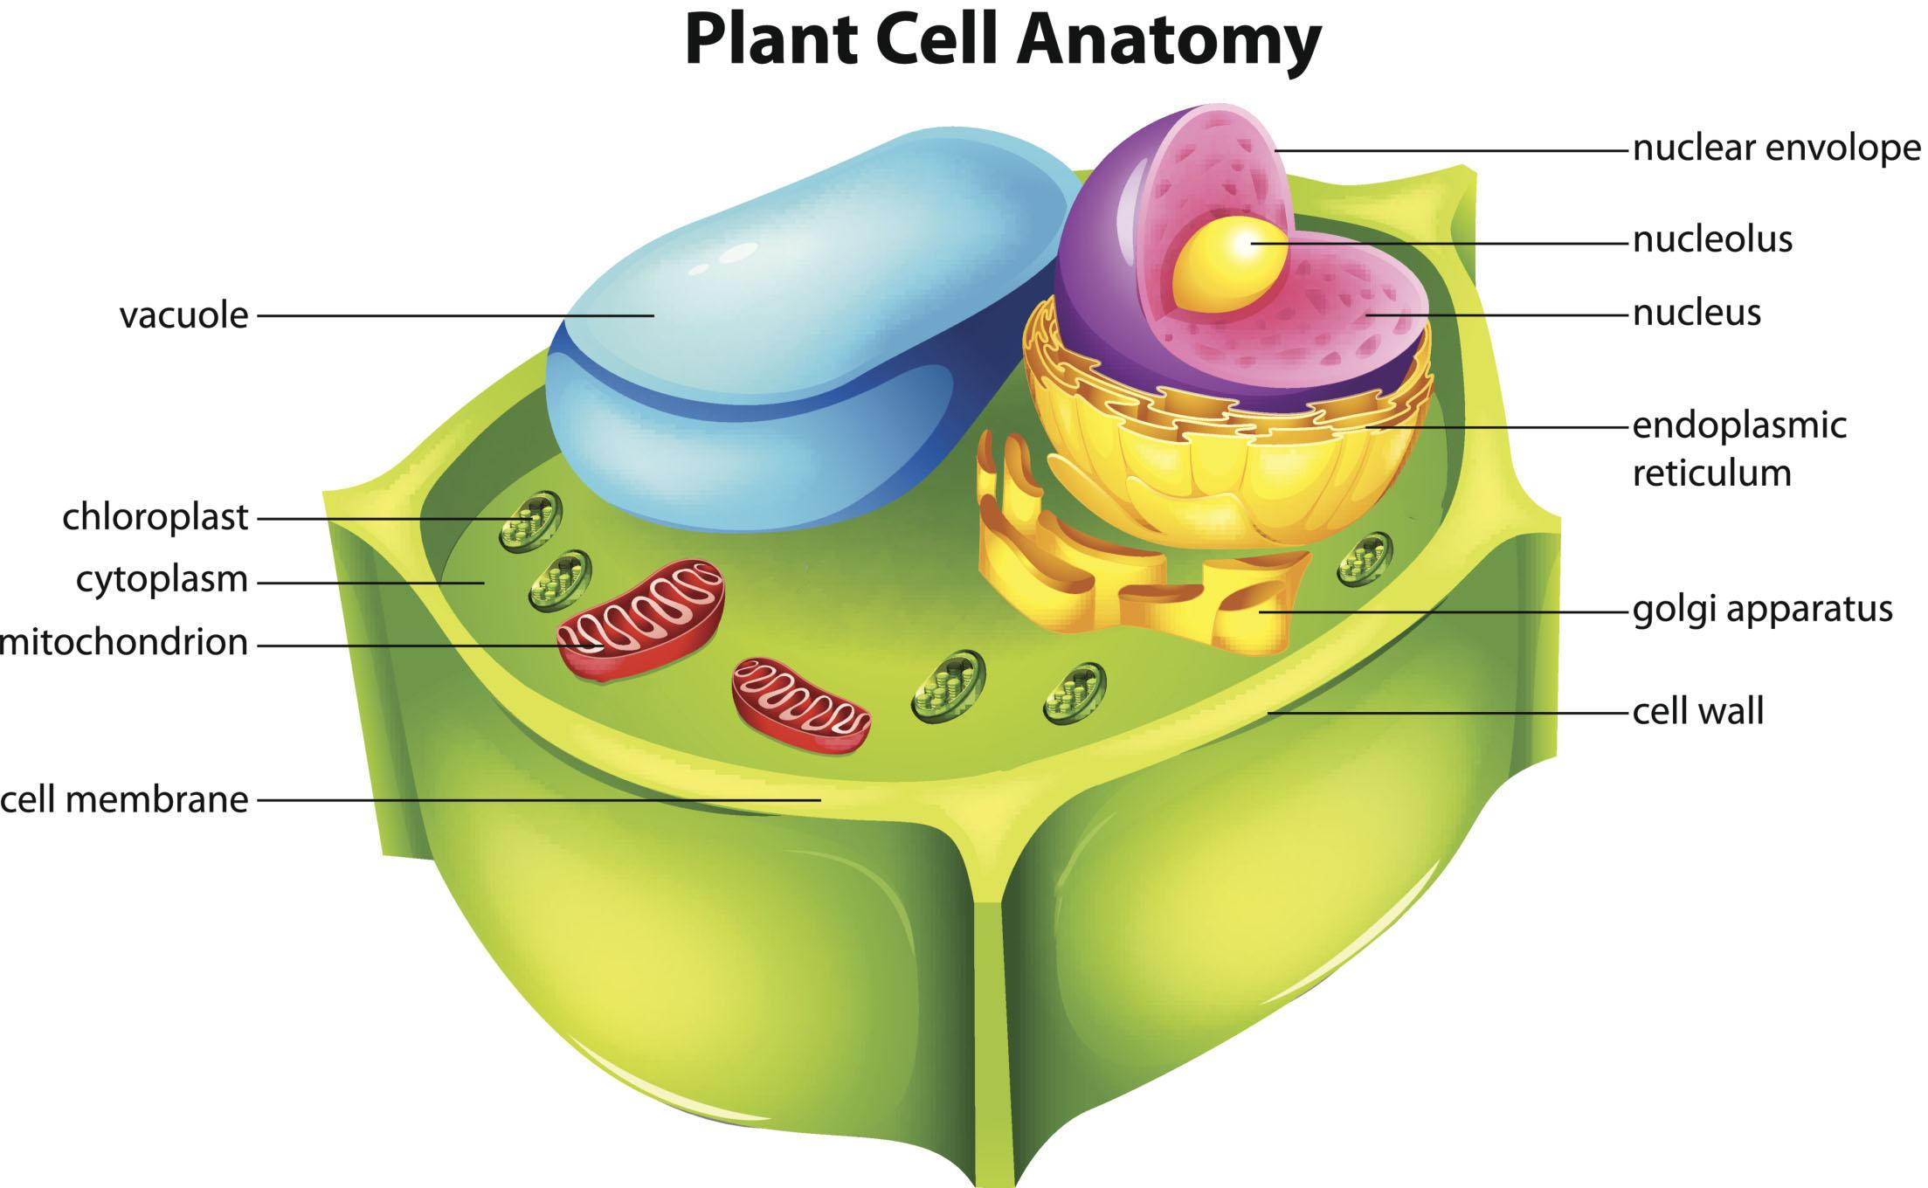
Different Organelles
Notes:
In this lesson, we’re going to learn about the organelles that are different in animal cells and plant cells.

Slide 3
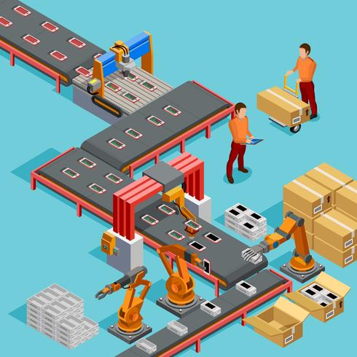
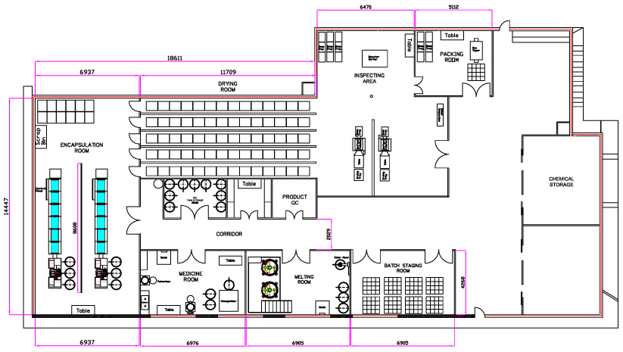
Notes:
Just as we did in our last lesson, we’ll relate the jobs that these organelles perform to examples of similar jobs in factories to help us remember each one. These examples will be provided after each definition, and will have these example icons on each slide.
Feedback: Including cues helps students to prepare for what is coming next!

Slide 4
Big Question: How do the different organelles found in your cells help you function?
Notes:
Our “big question” is: How do the different organelles found in your cells help you function?
[Pause and illicit predictions from students.]
I love all these thoughtful scientific hypotheses! Be sure to keep this question and your predictions in mind as we move through these next few lessons, and we’ll continue to revisit it.
Feedback: Asking students to make predictions about how the different organelles help you function is a great way to activate and elicit student ideas and prior knowledge. This type of activity is evidence of the teacher planning for students’ engagement with science ideas.

Slide 5
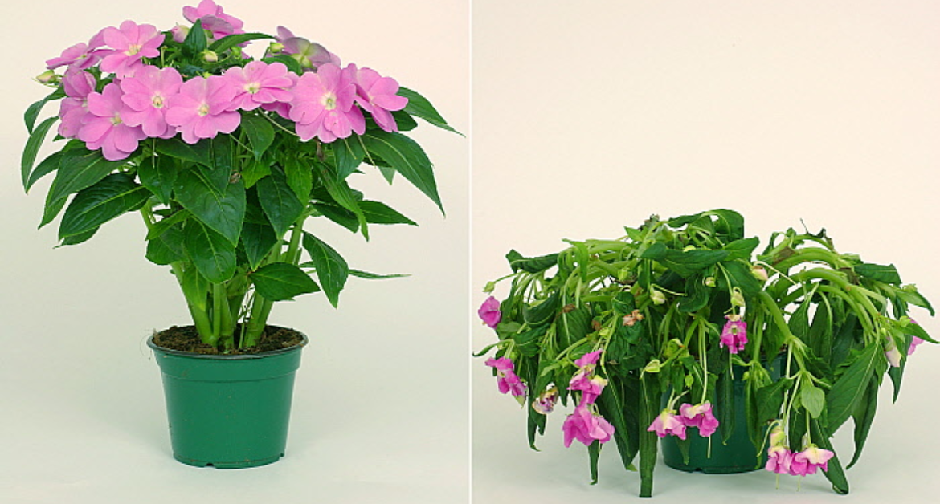
Demonstration
What organelles are responsible for the rigid structure and green color of plants?
Have you ever noticed how plants lose their structure when they are not properly watered? Have you ever thought about why so many plants are green in color?
Today we are going to learn about some of the organelles that contribute to these common plant features.
Notes:
Have you ever noticed how plants lose their structure when they are not properly watered? Have you ever thought about why so many plants are green in color?
Today we are going to learn about some of the organelles that contribute to these common plant features.
Feedback: Use either the picture provided or two real plants to demonstrate how plants lose their structure and to observe green coloration. Allow students to propose guesses as to why these features exist among plants before diving into the content. This is a great way to elicit and activate students’ prior knowledge about the science phenomenon.

Slide 6
Notes:
Before we jump into these new terms, let’s review the common organelles to make sure you’re firm in your understanding.

Slide 7
Organelles: parts of the cell, each with their own job that helps the cell function
Notes:
Organelles are parts of the cell, each with their own job that helps the cell function.

Slide 8
Organelles
“Little Organs”
Notes:
We can remember the meaning of the word organelles by thinking of organelles as “little organs” in a cell that help the cell function as it should.

Slide 9
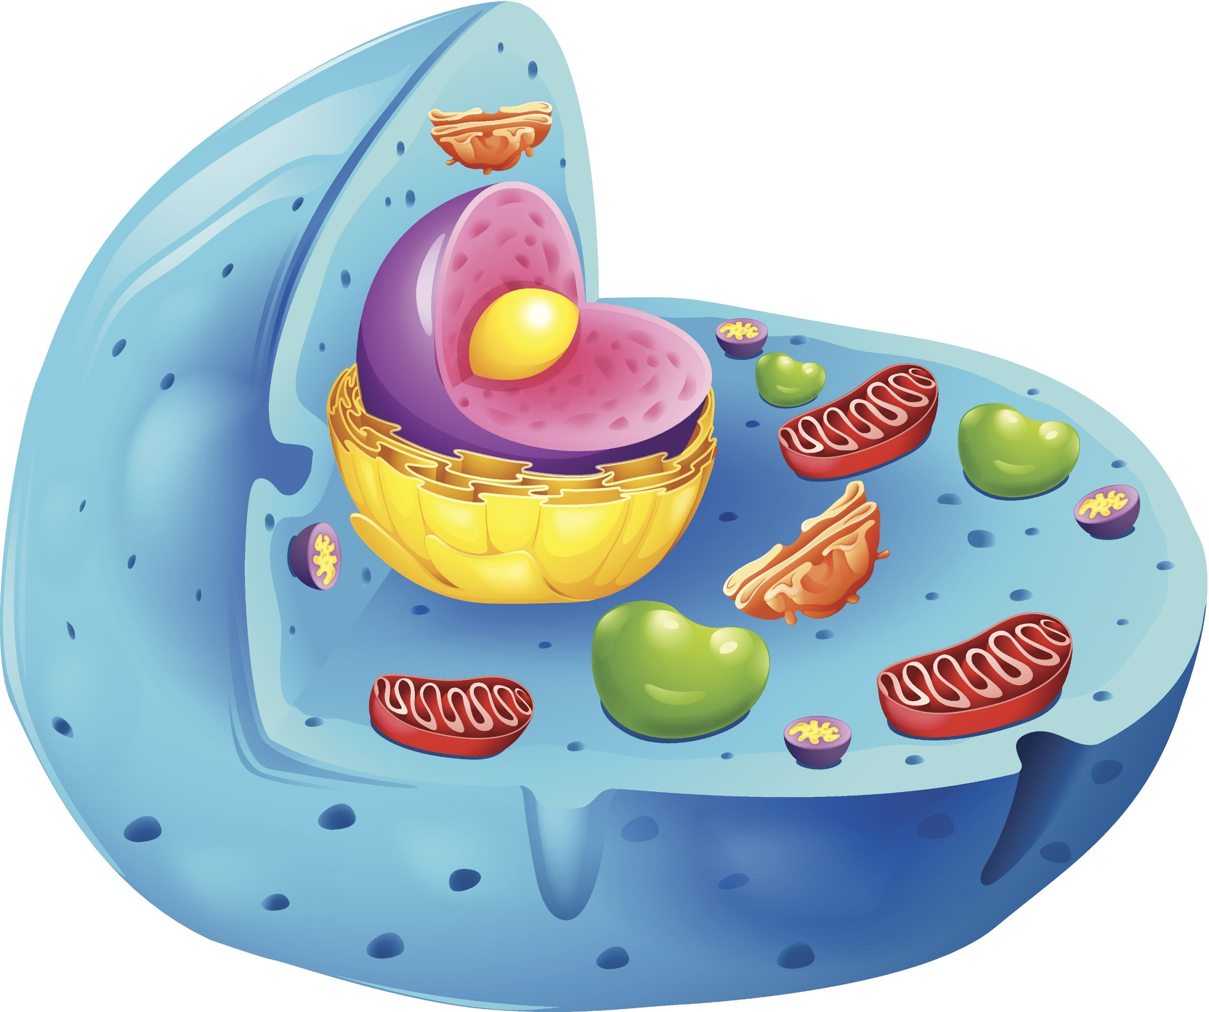
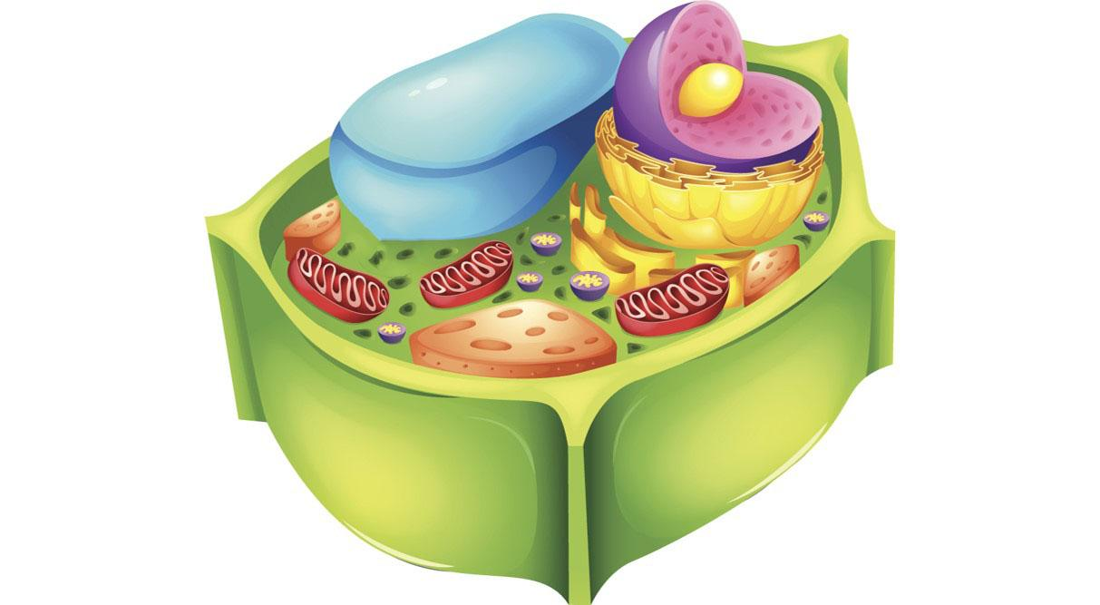
Cell Membrane: controls what enters and exits the cell
Notes:
The cell membrane controls what enters and exits the cell.

Slide 10
Cell Membrane = Doors
Notes:
The cell membrane is like the doors to a factory, since the doors control what enters and exits the factory.

Slide 11
Cytoplasm: jelly-like substance that materials in the cell move through
Notes:
The cytoplasm is a jelly-like substance that materials in the cell move through.

Slide 12
Cytoplasm = Hall or Floor Space
Notes:
The cytoplasm is like the hall or floor space of a factory, where materials and employees move through.

Slide 13
Nucleus: directs the cell’s activities and is home to the cell’s genetic material (DNA)
Notes:
The nucleus directs the cell’s activities and is home to the cell’s genetic material, called DNA.

Slide 14
Nucleus = Manager
Notes:
The nucleus is like the manager of the factory because managers direct the activities of all the other employees in a factory to make sure it keeps running.

Slide 15
Chromatin: located inside the nucleus; contains genetic material (DNA); involved in cell division
Notes:
Chromatin are located inside the nucleus and contain genetic material, or DNA. Chromatin are involved in the cell division process, which we’ll be learning more about in some of our lessons coming up in this unit. Remember, as we learned about in cell theory, all cells come from other cells – this is where chromatin come in!

Slide 16
Chromatin = Blueprints
Notes:
Chromosomes are like the blueprints of a factory’s layout. Just like blueprints tell us how a factory should be set up to function properly, chromosomes tell new cells exactly how they need to be set up to function properly.
Feedback: Including visuals is a great way to help students make connections between concepts as they are building new understandings.

Slide 17
Ribosomes: make proteins for the cells
Notes:
Ribosomes make proteins for the cells.

Slide 18
Ribosomes = Production Machines
Notes:
The ribosomes are like productions machines in a factory, as they produce essential protein materials for a cell.

Slide 19
Golgi Bodies: package proteins to transport and use outside the cell
Notes:
The golgi bodies package proteins (made by the ribosomes) to transport and use outside the cell.
Feedback: It is important to use clear, concise language when explaining new terms.

Slide 20
Golgi Bodies = Packaging Department
Notes:
The golgi bodies are like the packaging department in a factory.

Slide 21
Endoplasmic Reticulum (ER): system that monitors the production of proteins
Notes:
The endoplasmic reticulum, or the ER, is a membrane-bound organelle that checks proteins to ensure they are formed correctly.
There are actually two types of ERs – a smooth ER and a rough ER. The only difference between the two is that the rough ER has ribosomes attached to it.

Slide 22
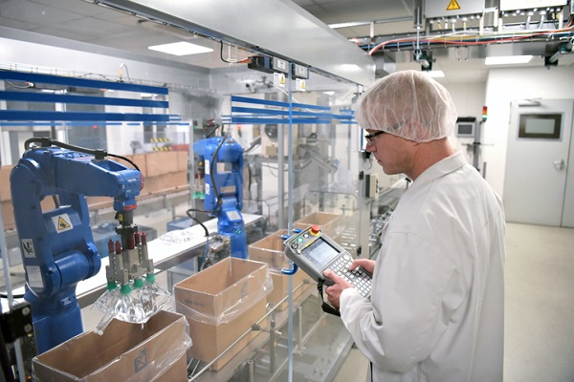
Endoplasmic Reticulum (ER) = Quality Control
Notes:
If we think of proteins as the products that cells are making, we can think of the ER as quality control - ensuring that products are created correctly before being sent out.

Slide 23
Mitochondrion: produce energy for the cell
Notes:
Mitochondrion produce energy for the cell. This energy is needed so that plant and animal cells can perform different cell processes, like cell division.

Slide 24
Mitochondrion = Power Generators
Notes:
We can think of mitochondrion as the power generators of the factory, just like these cooling towers are part of power generation in the factory.

Slide 25
Notes:
Okay, now let’s check your understanding.
Feedback: The above slides offered analogies as a powerful tool in furthering student understanding. It is critical to remember to be intentional when selecting analogies and ensuring they make sense with the current content.

Slide 26
What are organelles?
Notes:
What are organelles?
[Organelles are parts of a cell, each with their own job that helps the cell function.]

Slide 27
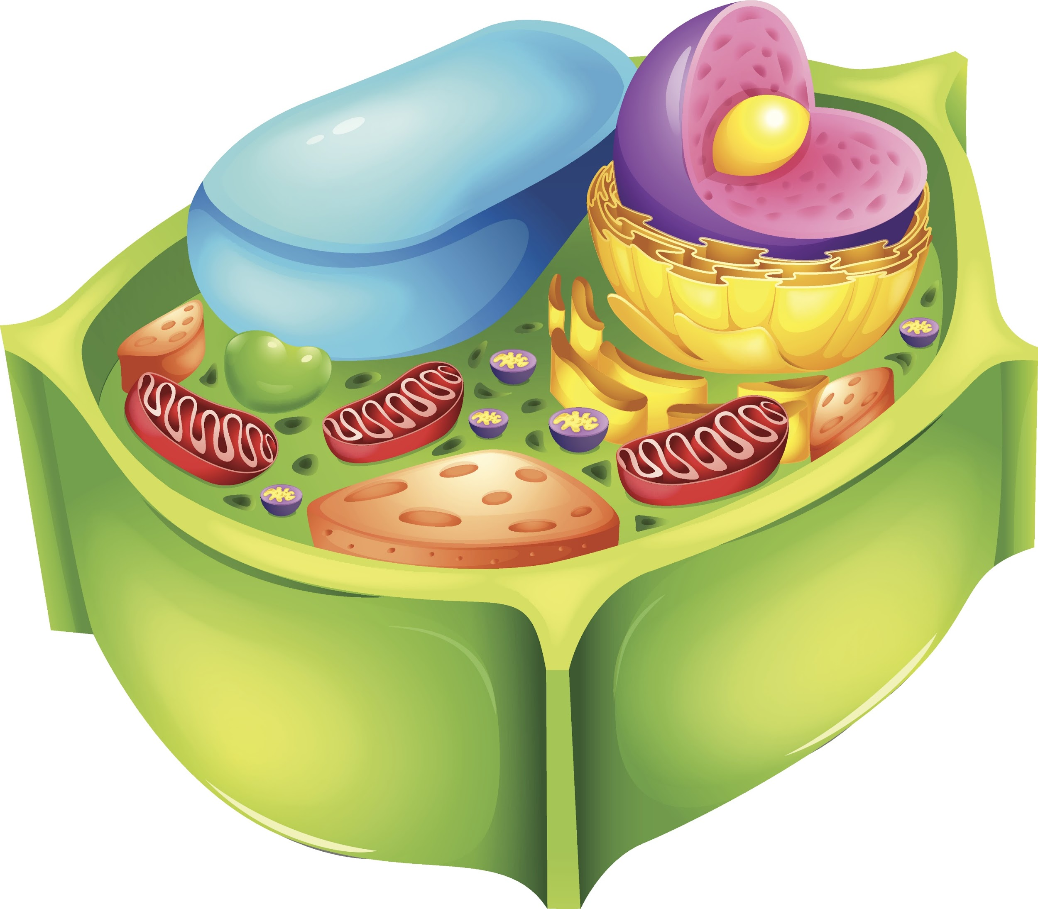
True/False: Plant and animal cells have many common organelles, but they also have some that are different.
Notes:
True/False: Plant and animal cells have many common organelles, but they also have some that are different.

Slide 28
True/False: Plant and animal cells have many common organelles, but they also have some that are different.
Notes:
True/False: Plant and animal cells have many common organelles, but they also have some that are different.
[True]

Slide 29
Match the organelle with its part/job in the factory.
Nucleus
Chromatin
Cell Membrane
Cytoplasm
Golgi Bodies
Mitochondrion
Endoplasmic Reticulum
Ribosomes
___ Manager
___ Quality Control
___ Production Machines
___ Doors
___ Power Generators
___ Packaging Department
___ Hall or Floor Space
___ Blueprints
Notes:
Match the organelle with its part or job in the factory.

Slide 30
Match the organelle with its part/job in the factory.
A. (Nucleus) Manager
G. (ER) Quality Control
H. (Ribosomes) Production Machines
C. (Cell Membrane) Doors
F. (Mitochondrion) Power Generators
E. (Golgi Bodies) Packaging Department
D. (Cytoplasm) Hall or Floor Space
B. (Chromatin) Blueprints
Notes:
The manager is A. Nucleus
Quality control is G. Endoplasmic Reticulum, or ER
Production machines are H. Ribosomes
Doors are C. Cell Membrane
Power Generators are F. Mitochondrion
The Packaging Department is E. Golgi Bodies
Hall or Floor Space is D. Cytoplasm
And Blueprints are B. Chromatin

Slide 31
What do ribosomes produce in cells?
(The golgi bodies package it!)
Notes:
What do ribosomes produce in cells? (The golgi bodies package it!)
[ Proteins ]

Slide 32
True/False: Cytoplasm is the genetic material found inside the nucleus.
Notes:
True/False: Cytoplasm is the genetic material found inside the nucleus.

Slide 33
True/False: Cytoplasm is the genetic material found inside the nucleus.
Notes:
True/False: Cytoplasm is the genetic material found inside the nucleus.
[False – Chromatin is the genetic material found inside the nucleus.]

Slide 34
Vacuole
Notes:
Let’s define the term vacuole.

Slide 35
Vacuole: membrane-enclosed sac that stores food, water, and other materials
Notes:
The vacuole is a membrane-enclosed sac that stores food, water, and other materials inside plant and animal cells. You can see in these pictures that, even though both cells have vacuoles, they look a bit different. That’s because plant cells have one large, central vacuole, while animal cells have a few, smaller vacuoles.

Slide 36
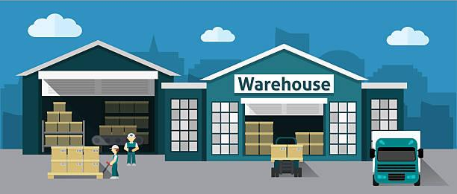
Vacuole = Storage Warehouse
Notes:
We can think of the vacuole like the factory warehouse, as both the vacuole and the warehouse store things. Plants use their large vacuoles to increase pressure inside of cells and to increase support for the structure of the plant.

Slide 37
Lysosomes
Notes:
Next, let’s define the term lysosomes.

Slide 38
Lysosomes: help maintain and repair cell structures by digesting waste and parts that are worn-out
Notes:
Lysosomes help maintain and repair cell structures by digesting waste and parts that are worn-out. Plant cells rarely have lysosomes because they have cell walls that help keep waste out of the cell, but animal cells always have lysosomes.

Slide 39
Lysosomes =
Recycling & Maintenance Centers
Notes:
We can think of the lysosomes as the recycling and maintenance centers of factories, since both help to break down waste.

Slide 40
Cell Wall
Notes:
Now we’ll define some terms that only apply to plant cells, beginning with cell wall.

Slide 41
Cell Wall: extra layer outside of the plant cell membrane; provides support and helps control what enters and exits
Notes:
The cell wall is an extra layer outside of the plant cell membrane. It provides support and helps control what enters and exits plant cells. Animal cells do not have a cell wall.

Slide 42
Cell Wall = Factory Walls
Notes:
The cell wall that surrounds a plant cell is like the walls of a factory – both support the structure and help keep things in or out as needed.

Slide 43
Chloroplasts
Notes:
Another organelle that’s only found in plant cells are chloroplasts. Let’s define it.

Slide 44
Chloroplasts: use the sun’s light energy to make food for the plant (photosynthesis)
Notes:
Chloroplasts use the sun’s energy to make food for the plant. This process is called photosynthesis, which you all learned about in 4th grade.
Feedback: This is a great opportunity for students to recall what they learned about photosynthesis from prior years.

Slide 45
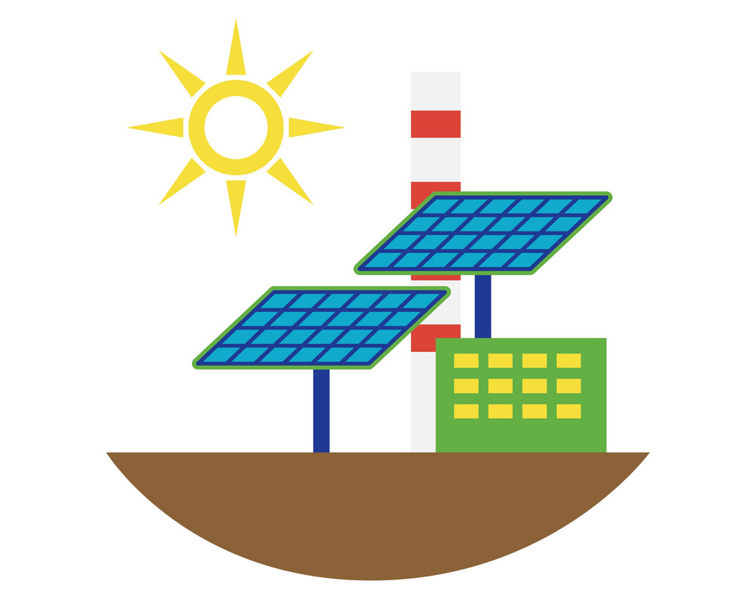
Chloroplasts =
Solar-Powered Generator
Notes:
We can remember chloroplasts as the solar-powered generator that helps our factory stay up and running!

Slide 46
Notes:
That is the basic definition but there is a bit more you need to know.

Slide 47
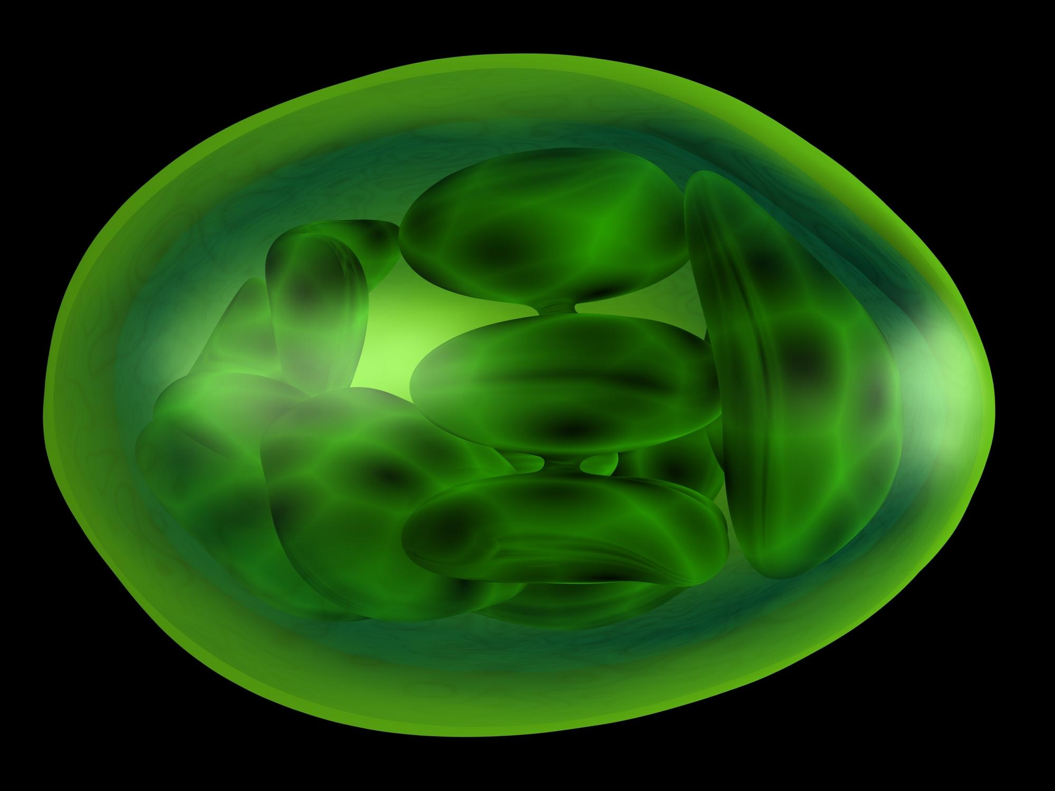
Chloroplasts
Notes:
Photosynthesis, or the process by which plants make their food, takes place in the chloroplasts of a plant cell.

Slide 48
Notes:
We can also break the word chloroplasts down into parts to help us remember the meaning. Let’s take a look.

Slide 49
Chloro-
-plasts
Notes:
Chloroplast has the word parts CHLORO and PLAST.

Slide 50
Chloro-
Notes:
The prefix chloro- means green… Anytime you see chloro- in a word in our science class, we know that term probably has something to do with the color green.
Feedback: Breaking down the vocabulary term into word parts and defining each part is essential in building student understanding of the word parts.

Slide 51
-plasts
Notes:
and the end of the word, -plasts, means forms or shapes.

Slide 52
Chloroplasts
Green + Shapes
Notes:
So, when we put the two word parts together, we can remember that chloroplasts are green shapes found inside plant cells.

Slide 53
Chlorophyll
Notes:
The last organelle we’ll define is chlorophyll.

Slide 54
Chlorophyll: green pigment inside chloroplasts that absorbs the sun’s light energy to make food
Notes:
Chlorophyll is green pigment inside chloroplasts that absorbs the sun’s light energy to make food.

Slide 55
Chlorophyll = Solar Panels
Notes:
We can think of chlorophyll as the solar panels at that help the solar-powered generator run as it should.
Chlorophyll and solar panels absorb the sun’s light energy to help the chloroplast, or the solar-powered generator, do what it’s supposed to do.

Slide 56
Notes:
That is the basic definition but there is a bit more you need to know.

Slide 57
Chlorophyll
Notes:
Chlorophyll is a green pigment that is found inside the chloroplasts of all green plants. Pigments are what make different colors.

Slide 58
Chlorophyll “FILLS”
Chloroplasts
Notes:
The end of the word chlorophyll, -phyll, sounds just like the word fill, as in “filling” something up, like a cup with water. So, a clever way to remember that chlorophyll is found inside of chloroplasts is by saying that chlorophyll “fills” chloroplasts.

Slide 59
Notes:
We can also break down the word chlorophyll into different parts to help us remember what it means.

Slide 60
Chlorophyll
Notes:
The first half of the word, our prefix chloro-, means green.

Slide 61
Chlorophyll
Notes:
The end of the word gives us another clue to the word meaning. Phyll means leaf.

Slide 62
Chlorophyll
Green + Leaf
Notes:
If you put the meaning of the word parts together, chlorophyll means green leaf. So, we know that chlorophyll is the green pigment present in all green plants.
Feedback: Reuniting the word parts is a crucial step in helping students understand the whole picture when reviewing morphological word parts.

Slide 63
Chlorophyll
Chloroplast
Notes:
Remember, chlorophyll is the green pigment found inside of the chloroplasts of a plant cell.

Slide 64
Notes:
Now let’s review what we’ve learned so far.

Slide 65
What is the difference between the vacuole in a plant cell versus an animal cell?
Notes:
What is the difference between the vacuole in a plant cell versus an animal cell?
[A plant cell has a large central vacuole while an animal cell has a few, smaller vacuoles.Plants often use their large vacuoles for structural support.]

Slide 66
What organelle is always found in animal cells, but rarely found in plant cells?
Cell wall
Lysosome
Vacuole
Chloroplast
Notes:
What organelle is always found in animal cells, but rarely found in plant cells?

Slide 67
What organelle is always found in animal cells, but rarely found in plant cells?
Cell wall
Lysosome
Vacuole
Chloroplast
Notes:
What organelle is always found in animal cells, but rarely found in plant cells?
[The answer is B., Lysosome.]

Slide 68
Which organelles are found in plant cells but not in animal cells?
nucleus, cell wall, cytoplasm
mitochondria, nucleus, cytoplasm
organelle, cytoplasm, cell wall
cell wall, chloroplast, chlorophyll
Notes:
Which organelles are only found in plant cells?

Slide 69
Which organelles are found in plant cells but not in animal cells?
nucleus, cell wall, cytoplasm
mitochondria, nucleus, cytoplasm
organelle, cytoplasm, cell wall
cell wall, chloroplast, chlorophyll
Notes:
What are organelles are found in plant cells but not in animal cells?
[The answer is D., the cell wall, chloroplasts, and chlorophyll are the organelles that are found in plant cells but not in animal cells.
*You may want to note that fungi also have cell walls, so that organelle is not specific to just plant cells.]

Slide 70
Where does photosynthesis take place?
Chlorophyll
Cell Wall
Chloroplast
Notes:
Where does photosynthesis take place?

Slide 71
Where does photosynthesis take place?
Chlorophyll
Cell Wall
Chloroplast
Notes:
Where does photosynthesis take place?

Slide 72
What does the cell wall do?
Notes:
What does the cell wall do?
[The cell wall provides support and extra protection to keep things from going in and out of the plant cell.]

Slide 73
What is the name of the green pigment inside chloroplasts?
Notes:
What is the name of the green pigment inside chloroplasts?
[Chlorophyll is the green pigment that fills the chloroplast and plays an important role in the process of photosynthesis!]

Slide 74
Match the organelle with its part/job in the factory.
___ Storage Warehouse
___ Solar Panels
___ Recycling & Maintenance Center
___ Factory Walls
___ Solar-Powered Generator
Chloroplasts
Chlorophyll
Cell Wall
Lysosomes
Vacuole
Notes:
Match the organelle with its part or job in the factory.

Slide 75
Match the organelle with its part/job in the factory.
E. (Vacuole) Storage Warehouse
B. (Chlorophyll) Solar Panels
D. (Lysosomes) Recycling & Maintenance Center
C. (Cell Wall) Factory Walls
A. (Chloroplasts) Solar-Powered Generator
Notes:
E. The vacuole is like the storage warehouse.
B. Chlorophyll are like the solar panels.
D. Lysosomes are the recycling & maintenance centers.
C. The cell wall is like the walls of the factory.
A. Chloroplasts are the solar-powered generator.

Slide 76
Remember!!!
Notes:
Now let us review what we have learned today!

Slide 77
Vacuole: membrane-enclosed sac that stores food, water, and other materials
Notes:
The vacuole is a membrane-enclosed sac that stores food, water, and other materials inside plant and animal cells. Plant cells have one large, central vacuole, while animal cells have a few, smaller vacuoles.

Slide 78
Vacuole = Storage Warehouse
Notes:
We can think of the vacuole like the factory warehouse, as both the vacuole and the warehouse store things.

Slide 79
Lysosomes: help maintain and repair cell structures by digesting waste and parts that are worn-out
Notes:
Lysosomes help maintain and repair cell structures by digesting waste and parts that are worn-out. Plant cells rarely have lysosomes because they have cell walls that help keep waste out of the cell, but animal cells always have lysosomes.

Slide 80
Lysosomes =
Recycling & Maintenance Centers
Notes:
We can think of the lysosomes as the recycling and maintenance centers of factories, since both help to break down waste.

Slide 81
Cell Wall: extra layer outside of the plant cell membrane; provides support and helps control what enters and exits
Notes:
The cell wall is an extra layer outside of the plant cell membrane. It provides support and helps control what enters and exits plant cells. Animal cells do not have a cell wall.

Slide 82
Cell Wall = Factory Walls
Notes:
The cell wall that surrounds a plant cell is like the walls of a factory – both support the structure and help keep things in or out as needed.

Slide 83
Chloroplasts: use the sun’s light energy to make food for the plant (photosynthesis)
Notes:
Chloroplasts use the sun’s energy to make food for the plant – a process called photosynthesis.

Slide 84
Chloroplasts =
Solar-Powered Generator
Notes:
We can remember chloroplasts as the solar-powered generator that helps our factory stay up and running!

Slide 85
Chlorophyll: green pigment inside chloroplasts that absorbs the sun’s light energy to make food
Notes:
Chlorophyll is green pigment inside chloroplasts that absorbs the sun’s light energy to make food.

Slide 86
Chlorophyll = Solar Panels
Notes:
We can think of chlorophyll as the solar panels at that help the solar-powered generator run as it should.
Chlorophyll and solar panels absorb the sun’s light energy to help the chloroplast, or the solar-powered generator, do what it’s supposed to do.

Slide 87
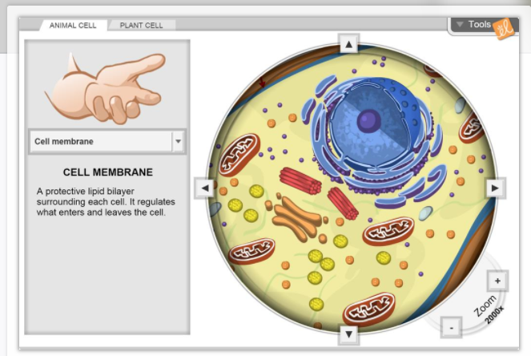
Simulation 1
Cell Structure Gizmo
Click the link above to access a Gizmo simulation activity about cell structure.
Students will select sample cells from a plant or animal and place the cells on a microscope to get a closer look inside. Information about their common structures is provided (and the structures are highlighted), but students will need to move the microscope slide to find all the different organelles.

Slide 88
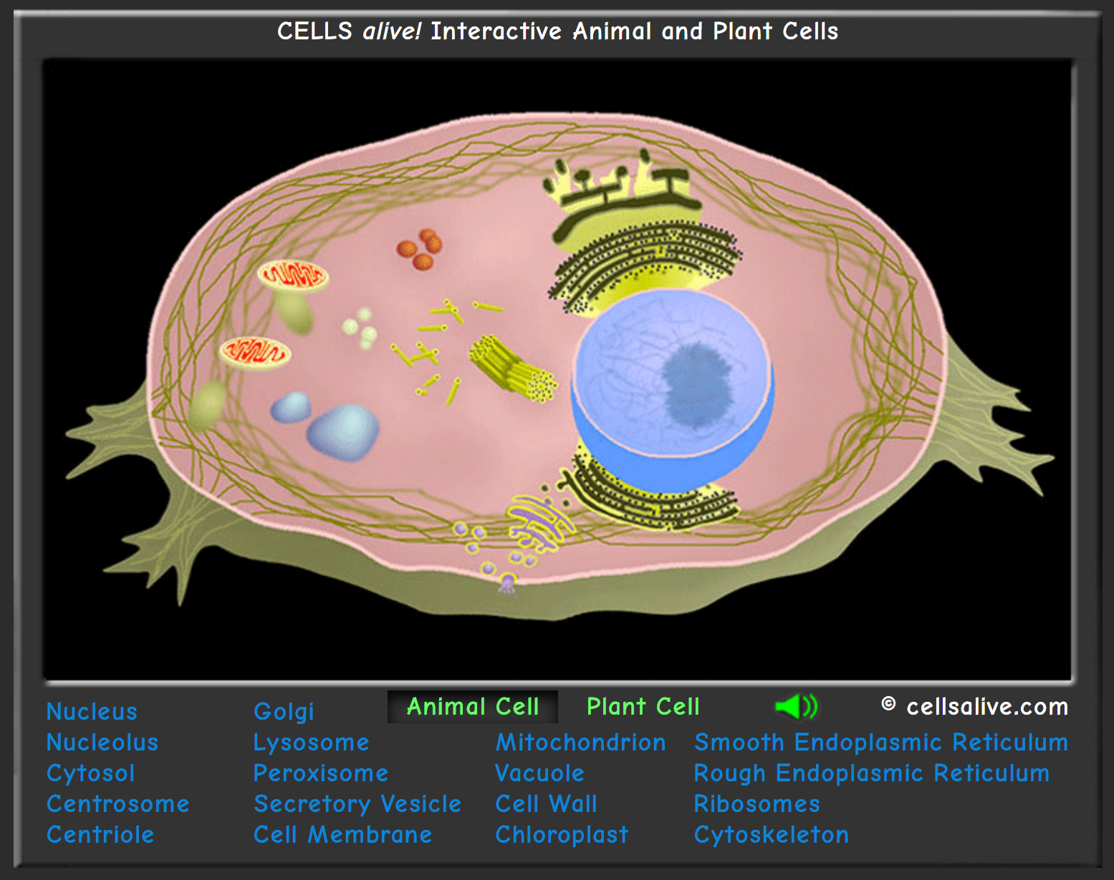
Simulation 2
Cells alive! Interactive
Click the link above to access this web-based activity. Students can explore the organelles mentioned in this lesson and compare their functions within plant and animal cells.
Note: Includes information about organelles that are not mentioned in this lesson. Students may benefit from having a list of specific organelles to explore.

Slide 89
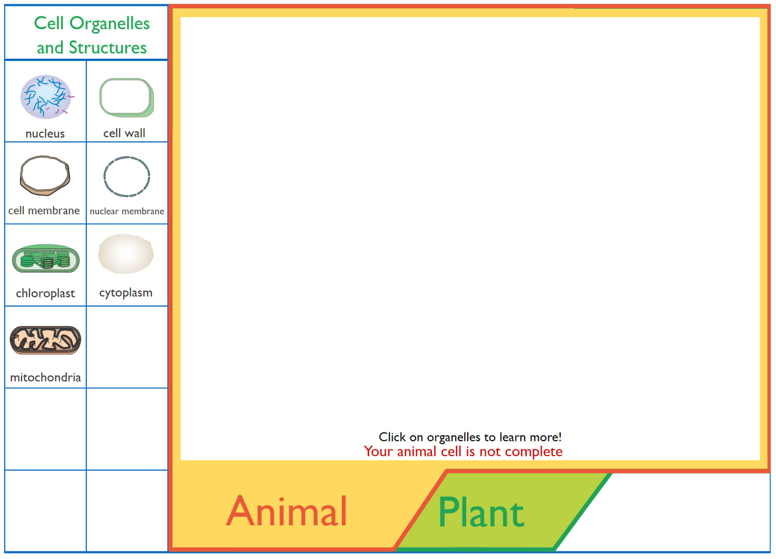
Reinforcement Activity
Interactive Animations: Cell Structure
Click the link above to access an interactive activity that reviews eukaryotic (plant and animal) cells.
Students can build their own cells and review the organelles that make up each type.
Notes:
Feedback: These simulations / reinforcement activities are a great way to differentiate for students based on their needs and / or interests. These activities can be offered in different places throughout the slides or unit as students finish early, need additional activities for understanding, or need to be engaged in the content in a different way.

Slide 90
Big Question: How do the different organelles found in your cells help you function?
Notes:
Explicit cue to revisit the big question at the end of the lesson: Okay everyone. Now that we’ve learned more about cell organelles, let’s reflect once more on our big question. Was there anything that we predicted earlier that was correct or incorrect? Do you have any new thoughts to share?
Feedback: Offering students an opportunity to evaluate their earlier hypotheses and make changes based on their new understandings is an important part of the iterative process in science. This is a great opportunity to help students build an epistemic understanding by explicitly stating how continuing to change and build on hypotheses as your knowledge grows is an important part of the discipline of science!

Slide 91
Notes:
Thanks for watching, and please continue watching CAPs available from this website.

Slide 92
This Video Was Created With Resources From:
Questions or Comments
Michael Kennedy, Ph.D. MKennedy@Virginia.edu
Rachel L Kunemund, Ph.D. rk8vm@virginia.edu

