Slide 1
Intro
“Big Idea” Question
Review Concepts
Check-In Questions
Teacher Engagement
Vocabulary
Student-Friendly Definition
Examples & Non-Examples
Morphological Word Parts
Frayer Model
Simulation/Activity
Notes:
OK everyone, get ready for our next lesson. Just as a reminder, these are the different components that our lesson may include, and you’ll see these icons in the top left corner of each slide so that you can follow along more easily!

Slide 2
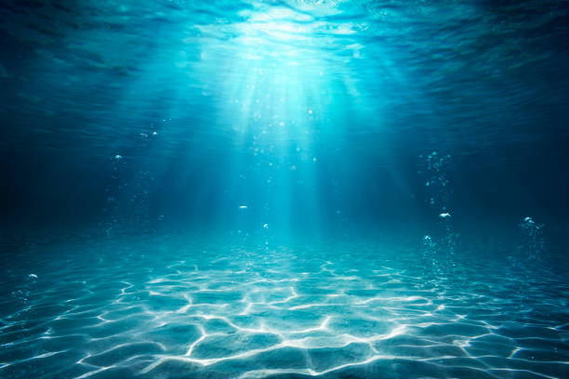
Intro
Aquatic
Notes:
Today, we’ll be learning about the word: Aquatic.

Slide 3
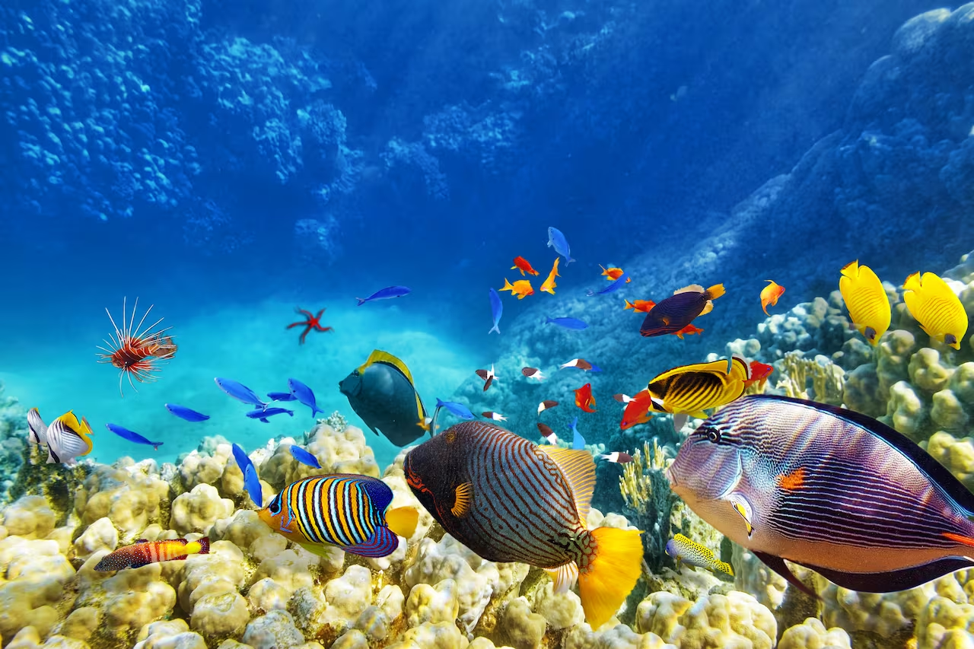
Big Question: What are key characteristics of the ocean environment?
Notes:
Our “big question” is: What are the key characteristics of the ocean environment?
[Pause and illicit predictions from students.]
I love all these thoughtful scientific hypotheses! Be sure to keep this question and your predictions in mind as we move through these next few lessons, and we’ll continue to revisit it.

Slide 4
Notes:
Before we move on to our new topic, let’s review some other words & concepts that you already learned and make sure you are firm in your understanding.

Slide 5
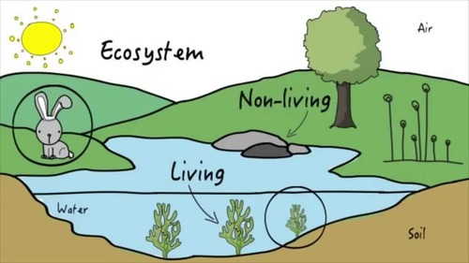
Ecosystem: an area where living and nonliving things interact
Notes:
Ecosystem is an area where living and nonliving things interact.

Slide 6
Organism: any living thing
Notes:
An organism is any living thing.

Slide 7
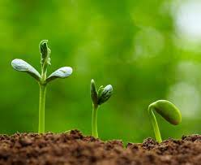
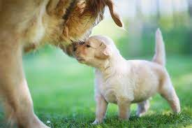
Living Things: organisms that grow, reproduce, and need food
Notes:
Living things are organisms that grow, reproduce, and need food.

Slide 8
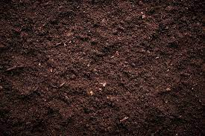
Nonliving Things: objects or other things that do not grow, reproduce, or need food
Notes:
Nonliving things are objects or other things that do not grow, reproduce, or need food.

Slide 9
Notes:
Now let’s pause for a moment to review the information we have covered already.

Slide 10
An ecosystem is an area where living and nonliving things ________.
investigate
interact
Notes:
An ecosystem is an area where living and nonliving things ______
[B. interact]

Slide 11
An ecosystem is an area where living and nonliving things ________.
investigate
interact
Notes:
An ecosystem is an area where living and nonliving things ______
[B. interact]

Slide 12
True or false: An organism is any living thing.
True
False
Notes:
True or false: An organism is any living thing.
[A. True]

Slide 13
True or false: An organism is any living thing.
True
False
Notes:
True or false: An organism is any living thing.
[A. True]

Slide 14
What are the differences between living and nonliving things?
Notes:
What are the differences between living and nonliving things?
[Living things grow, reproduce, and need food. Nonliving things do not.]

Slide 15
Aquatic
Notes:
Now that we’ve reviewed, let’s define the term aquatic.

Slide 16
Aquatic: living, growing, or often found in the water
Notes:
Aquatic means living, growing, or often found in the water.

Slide 17
Notes:
Let’s check-in for understanding.

Slide 18
What is aquatic?
Notes:
What is aquatic?
[Living, growing, or often found in the water.]

Slide 19
Notes:
That is the basic definition, but there is a bit more you need to know.

Slide 20
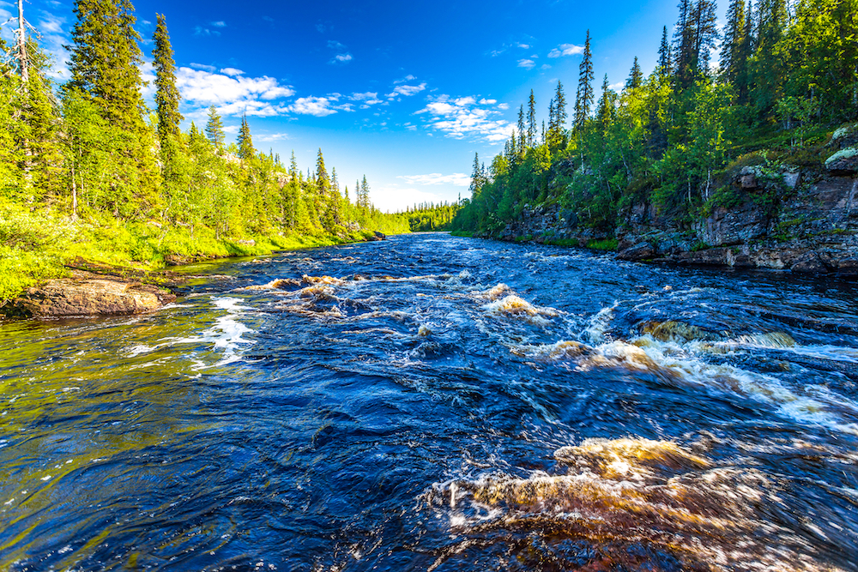
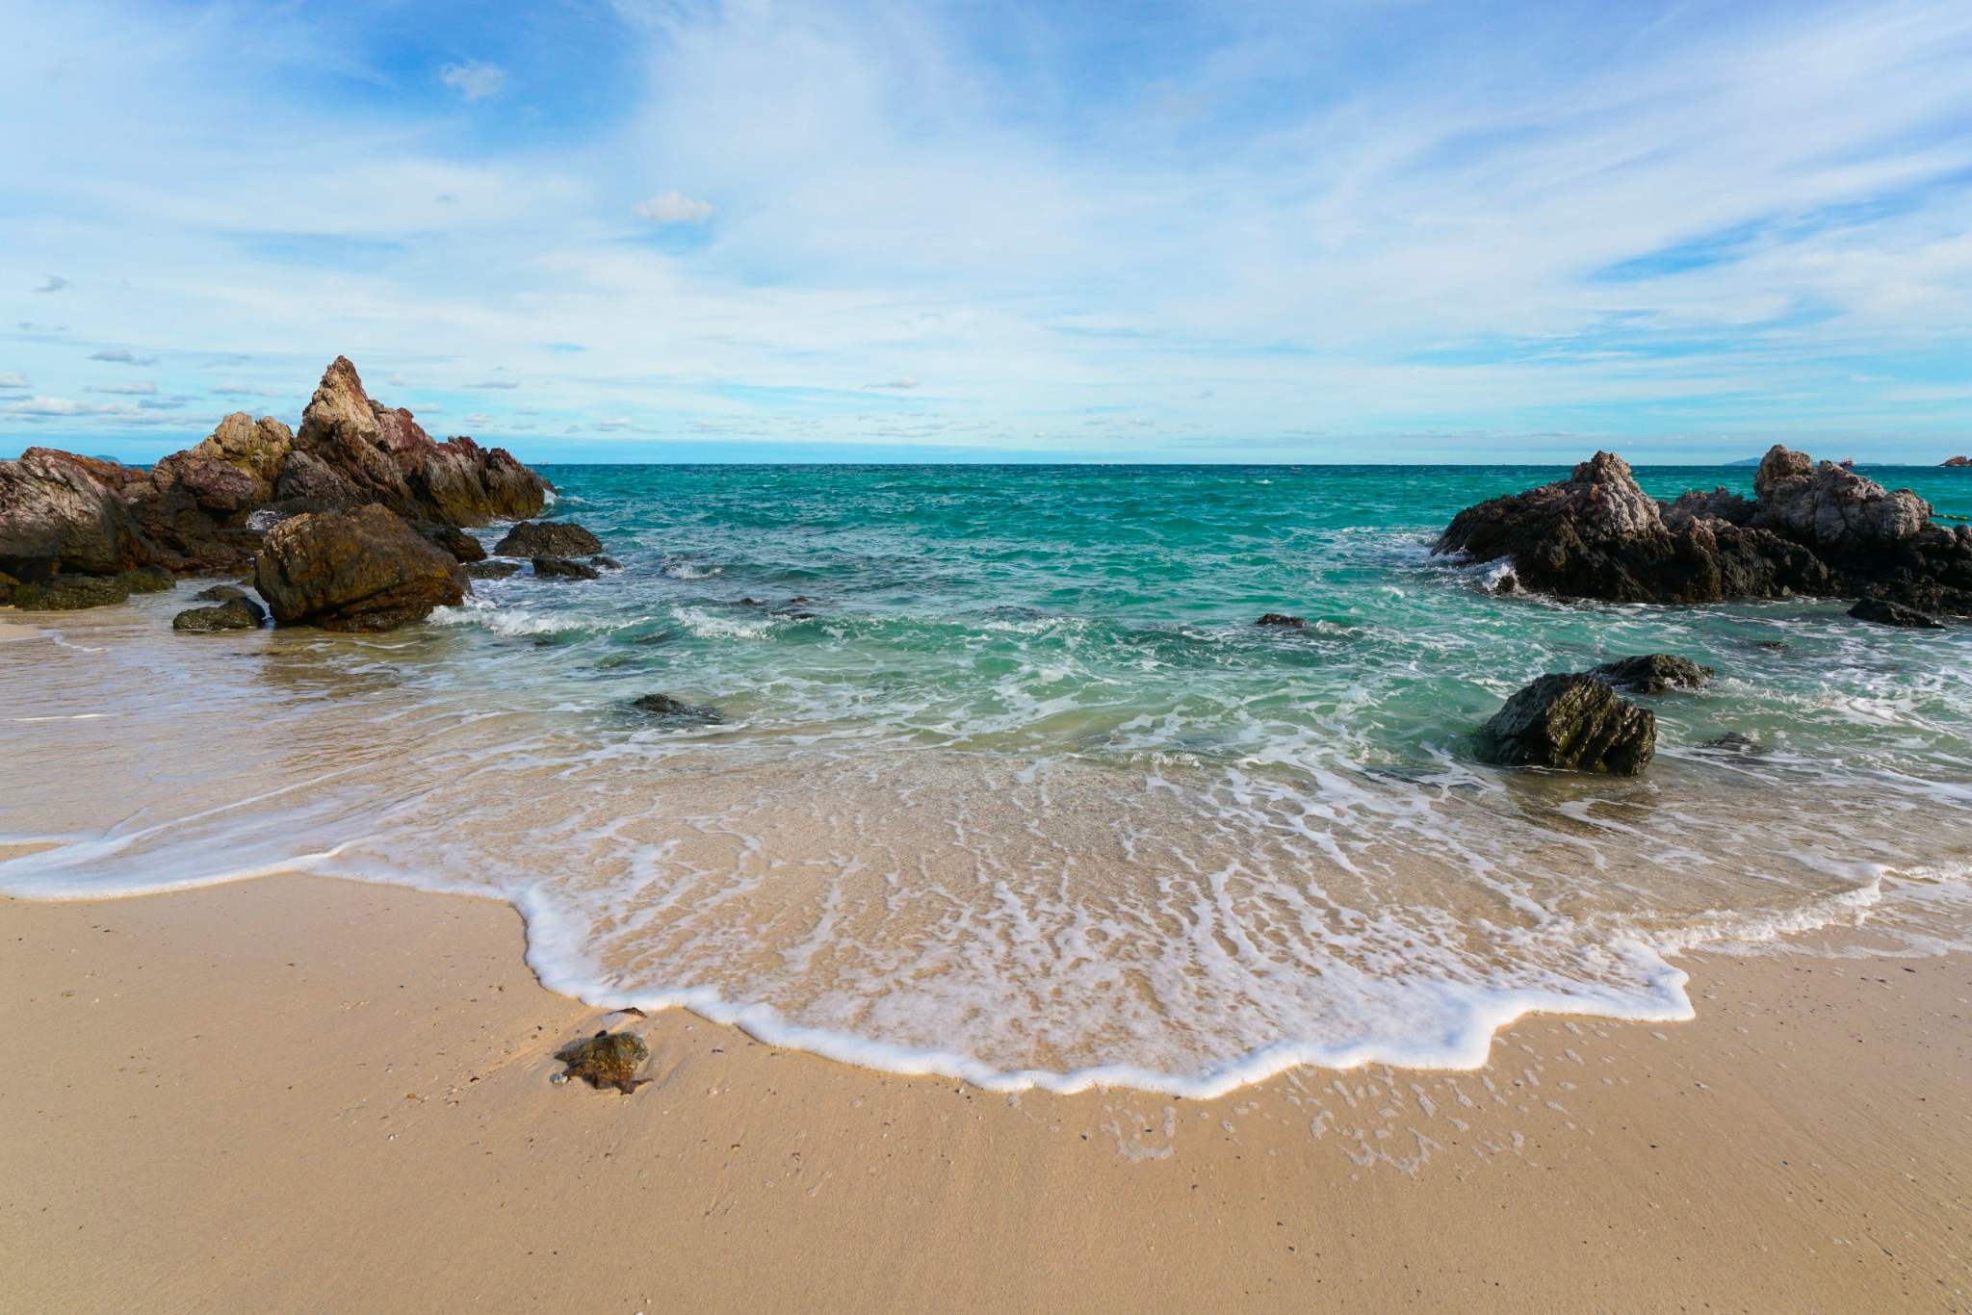
Aquatic ecosystems can be classified into freshwater or marine ecosystems.
Notes:
Aquatic ecosystems can be classified into freshwater or marine ecosystems.

Slide 21
Freshwater ecosystems have low salt (salinity) levels. Rivers, lakes, and ponds are different examples of freshwater ecosystems.
Notes:
Freshwater ecosystems have low salt (salinity) levels. Rivers, lakes, and ponds are different examples of freshwater ecosystems.

Slide 22
Marine ecosystems have high salt (salinity) levels. Oceans and seas are different examples of marine ecosystems.
Notes:
Marine ecosystems have high salt (salinity) levels. Oceans and seas are different examples of marine ecosystems.

Slide 23
Notes:
Let’s check-in for understanding.

Slide 24
What are the two types of aquatic ecosystems?
Notes:
What are the two types of aquatic ecosystems?

Slide 25
What are the two types of aquatic ecosystems?
Freshwater
Marine
Notes:
What are the two types of aquatic ecosystems? [Freshwater, Marine]

Slide 26
True or false: Freshwater ecosystems have low salt levels. Rivers, lakes, and ponds are examples.
True
False
Notes:
True or false: Freshwater ecosystems have low salt levels. Rivers, lakes, and ponds are examples.

Slide 27
True or false: Freshwater ecosystems have low salt levels. Rivers, lakes, and ponds are examples.
True
False
Notes:
True or false: Freshwater ecosystems have low salt levels. Rivers, lakes, and ponds are examples. [True]

Slide 28
Marine ecosystems have _____ salt levels. Oceans and seas are two examples.
low
high
Notes:
Marine ecosystems have _____ salt levels. Oceans and seas are two examples.
[B. high]

Slide 29
Marine ecosystems have _____ salt levels. Oceans and seas are two examples.
low
high
Notes:
Marine ecosystems have _____ salt levels. Oceans and seas are two examples.
[B. high]

Slide 30
Notes:
Now, let’s talk about some examples of aquatic.

Slide 31
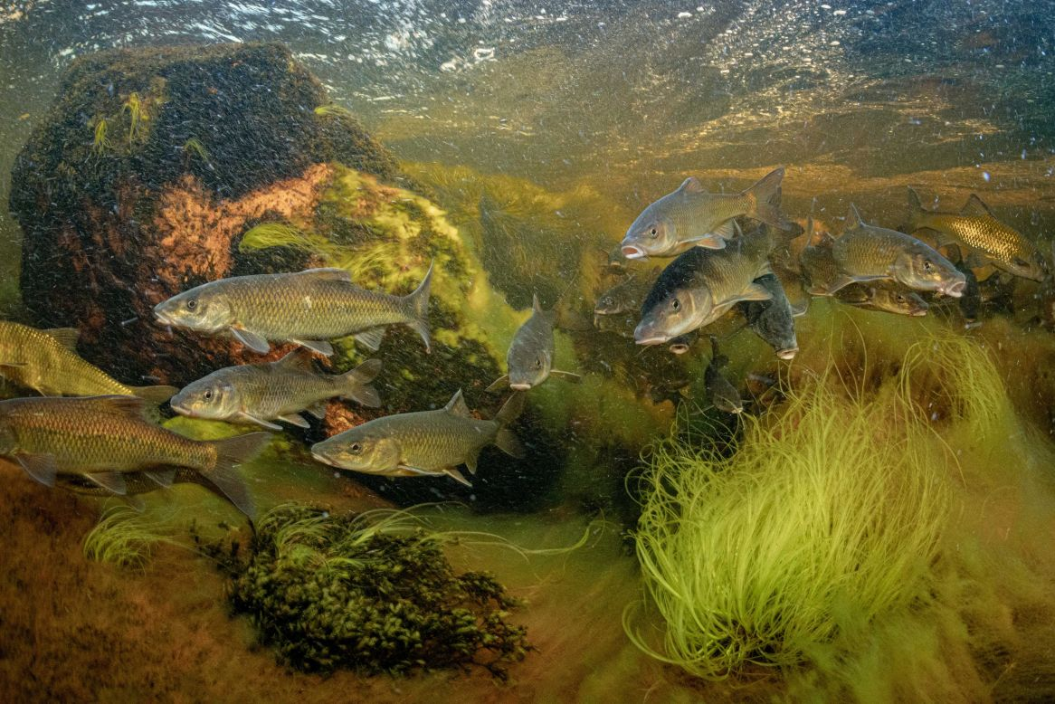
A river is an example of aquatic. The freshwater ecosystem is home to freshwater plants and animals.
Notes:
A river is an example of aquatic. The freshwater ecosystem is home to freshwater plants and animals.

Slide 32
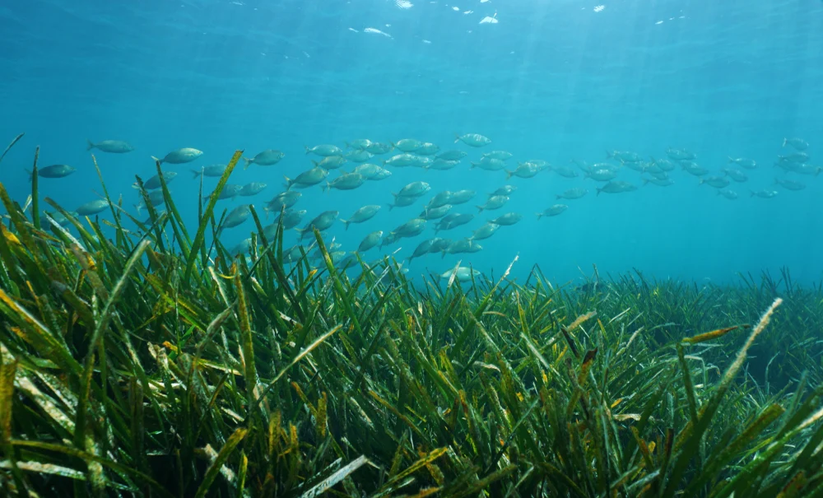
An ocean is an example of aquatic. The marine ecosystem is home to marine plants and animals.
Notes:
An ocean is an example of aquatic. The marie ecosystem is home to marine plants and animals.

Slide 33
Notes:
Now, let’s talk about some non-examples of aquatic.

Slide 34
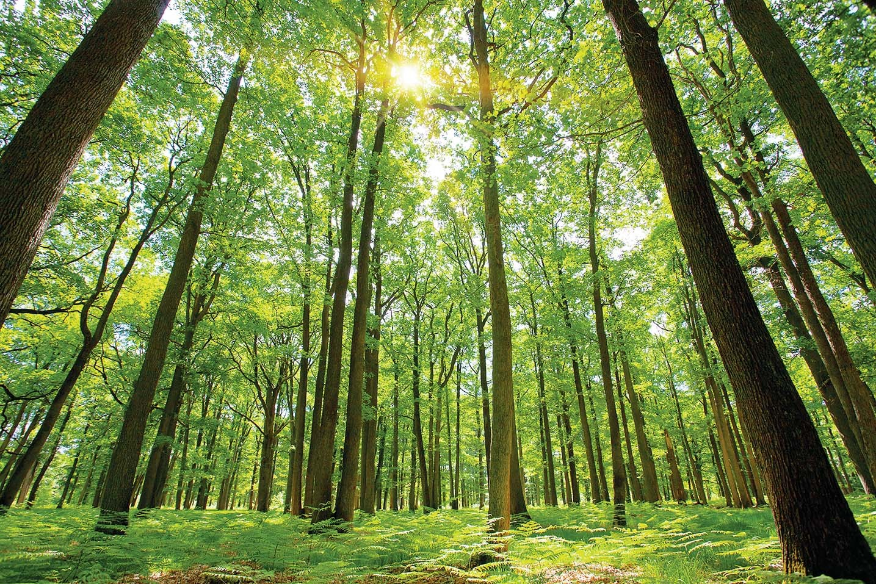
This is a non-example of aquatic. A forest is land-based and not water-based.
Notes:
This is a non-example of aquatic. A forest is land-based and not water-based.

Slide 35
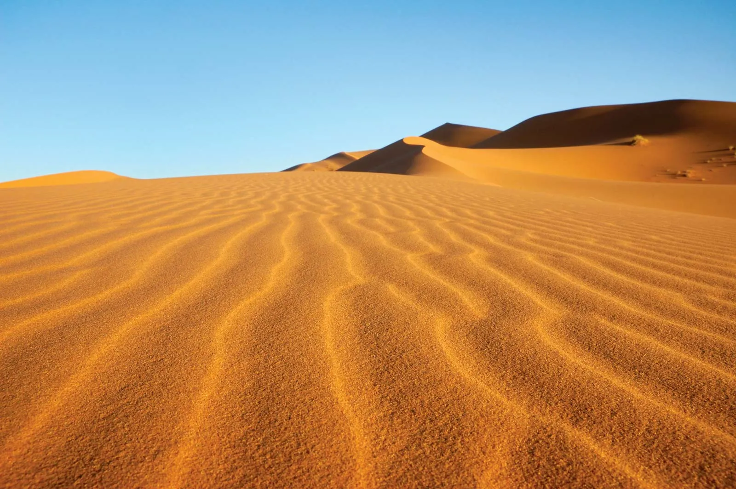
This is another non-example of aquatic. A desert is land-based and not water-based.
Notes:
This is another non-example of aquatic. A desert is land-based and not water-based.

Slide 36
Notes:
Now let’s pause for a moment to check your understanding.

Slide 37
Which is an example of aquatic?
Notes:
Which is an example of aquatic?

Slide 38
Which is an example of aquatic?
Notes:
Which is an example of aquatic?

Slide 39
Notes:
We can also break down the term aquatic into different word parts to help us remember the meaning. Let’s take a look!

Slide 40
Aquatic
(root)
(suffix)
Notes:
We can break up the term geology into two parts: a root and a suffix

Slide 41
Aquatic
Aquatic
Water
Notes:
The root, aqua, means water.

Slide 42
Aquatic
Aquatic
an association with
Notes:
The suffix, -tic, means an association with

Slide 43
Aqua tic
Aquatic
an association with water
Notes:
Aquatic is an association with water.

Slide 44
Notes:
Let’s check-in for understanding.

Slide 45
How can we use the word parts of aquatic to help us remember the definition of the term?
Aquatic
Aqua tic
Notes:
How can we use the word parts of aquatic to help us remember the definition of the term?
[Aqua = water
-tic = an association with
Aquatic means an association with water.]

Slide 46
Remember!!!
Notes:
So remember!

Slide 47
Aquatic: living, growing, or often found in the water
Notes:
Aquatic is living, growing, or often found in the water.

Slide 48
Notes:
We will now complete this concept map, called a Frayer model, to summarize and further clarify what you have learned about the term aquatic.

Slide 49
Definition
Picture
Aquatic
Example
How does aquatic impact my life?
Notes:
To complete the Frayer model, we will choose from four choices the correct picture, definition, example, and response to the question, “How does aquatic impact my life?” Select the best response for each question using the information you just learned. As we select responses, we will see how this model looks filled in for the term aquatic.

Slide 50
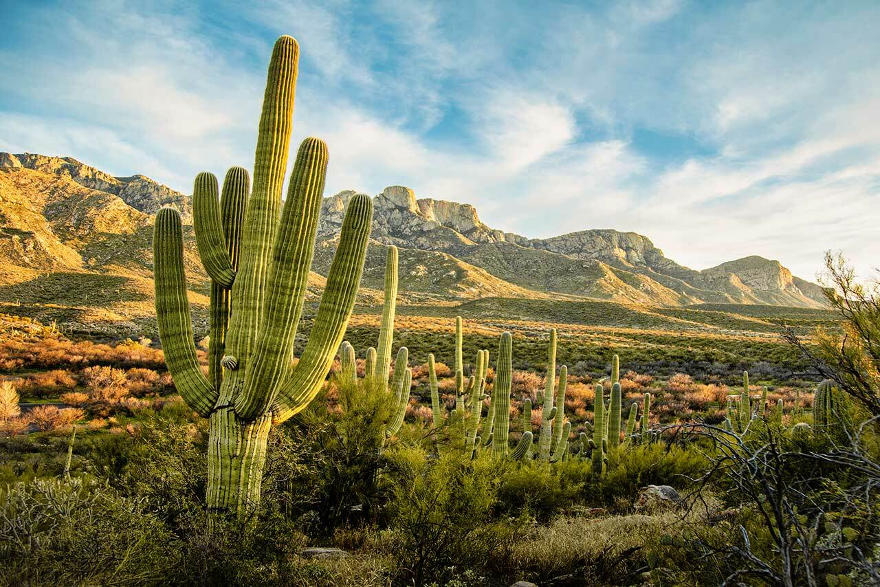
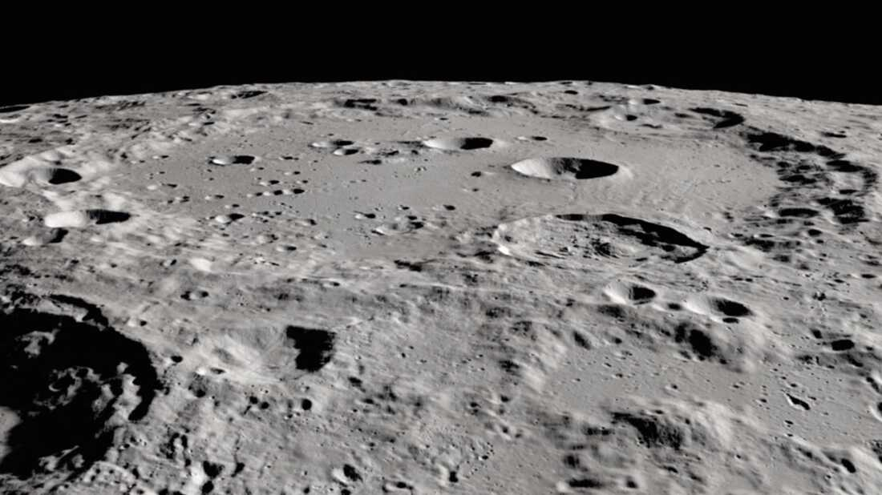
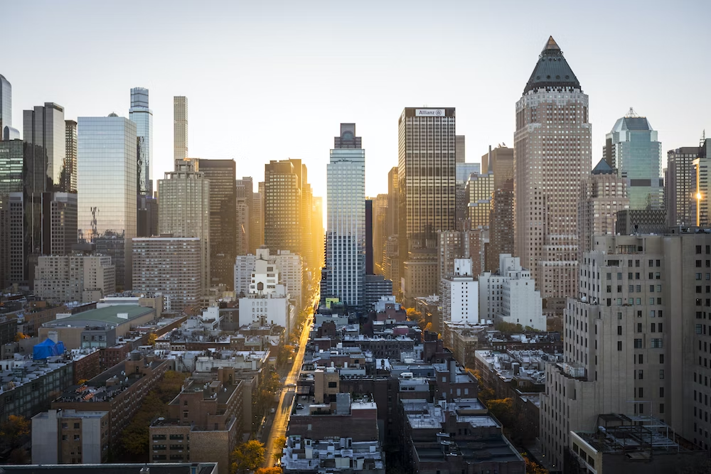
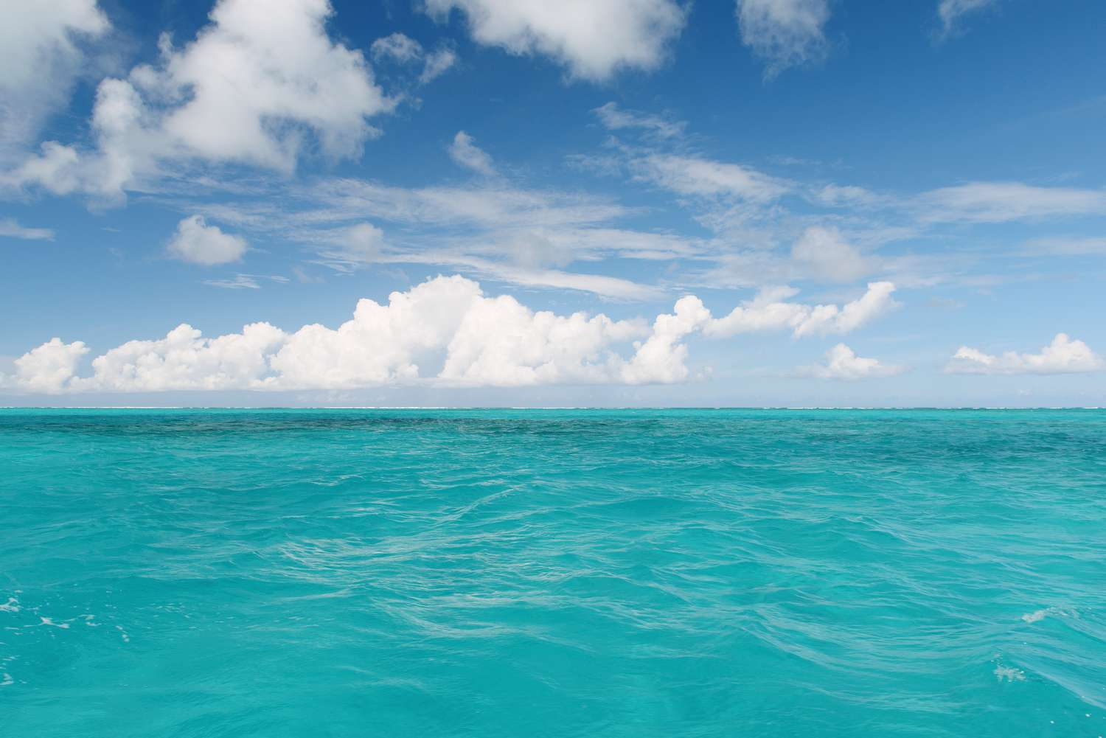
Directions: Choose the correct picture of aquatic from the choices below.
A
B
C
D
Notes:
Choose the one correct picture of aquatic from these four choices.

Slide 51
Directions: Choose the correct picture of aquatic from the choices below.
A
B
C
D
Notes:
Choose the one correct picture of aquatic from these four choices.

Slide 52
Definition
Picture
Aquatic
Example
How does aquatic impact my life?
Notes:
Here is the Frayer model filled in with a picture of aquatic.

Slide 53
Directions: Choose the correct definition of aquatic from the choices below.
A
Living, growing, or often found in sand
B
Living, growing, or often found in water
C
Living, growing, or often found in a forest
D
Living, growing, or often found in a city
Notes:
Choose the one correct definition of aquatic from these four choices.

Slide 54
Directions: Choose the correct definition of aquatic from the choices below.
A
Living, growing, or often found in sand
B
Living, growing, or often found in water
C
Living, growing, or often found in a forest
D
Living, growing, or often found in a city
Notes:
“Living, growing, or often found in water” is correct! This is the definition of aquatic.

Slide 55
Definition
Picture
Living, growing, or often found in water
Aquatic
Example
How does aquatic impact my life?
Notes:
Here is the Frayer Model with a picture and the definition filled in for aquatic: Living, growing, or often found in water.

Slide 56
Directions: Choose the correct example of aquatic from the choices below.
A
A singing bird
B
A growing tree
C
A flowing river
D
A crater on the moon
Notes:
Choose the one correct example of aquatic from these four choices.

Slide 57
Directions: Choose the correct example of aquatic from the choices below.
A
A singing bird
B
A growing tree
C
A flowing river
D
A crater on the moon
Notes:
“A flowing river” is correct! This is an example of aquatic.

Slide 58
Definition
Picture
Living, growing, or often found in water
Aquatic
A flowing river
Example
How does aquatic impact my life?
Notes:
Here is the Frayer Model with a picture, definition, and an example of aquatic: A flowing river.

Slide 59
Directions: Choose the correct response for “how does aquatic impact my life?” from the choices below.
A
Aquatic ecosystems provide us water to be able to drink.
B
Aquatic ecosystems provide us places to build homes.
C
Aquatic ecosystems provide us warmth in the winter.
D
Aquatic ecosystems provide us a place to keep farm animals
Notes:
Choose the one correct response for “how does aquatic impact my life?” from these four choices.

Slide 60
Directions: Choose the correct response for “how does aquatic impact my life?” from the choices below.
A
Aquatic ecosystems provide us water to be able to drink.
B
Aquatic ecosystems provide us places to build homes.
C
Aquatic ecosystems provide us warmth in the winter.
D
Aquatic ecosystems provide us a place to keep farm animals
Notes:
You chose “Aquatic ecosystems provide us water to be able to drink.” That is correct! This is an example of how aquatic impacts your life.

Slide 61
Definition
Picture
Living, growing, or often found in water
Aquatic
Aquatic ecosystems provide us water to be able to drink.
A flowing river
Example
How does aquatic impact my life?
Notes:
Here is the Frayer Model with a picture, definition, example, and a correct response to “how does aquatic impact my life?”: Aquatic ecosystems provide us water to be able to drink.

Slide 62
Remember!!!
Notes:
So remember!

Slide 63
Aquatic: living, growing, or often found in the water
Notes:
Aquatic is living, growing, or often found in the water.

Slide 64
Big Question: What are key characteristics of the ocean environment?
Notes:
Our “big question” is: What are the key characteristics of the ocean environment?
Does anyone have any additional examples to share that haven’t been discussed yet?

Slide 65
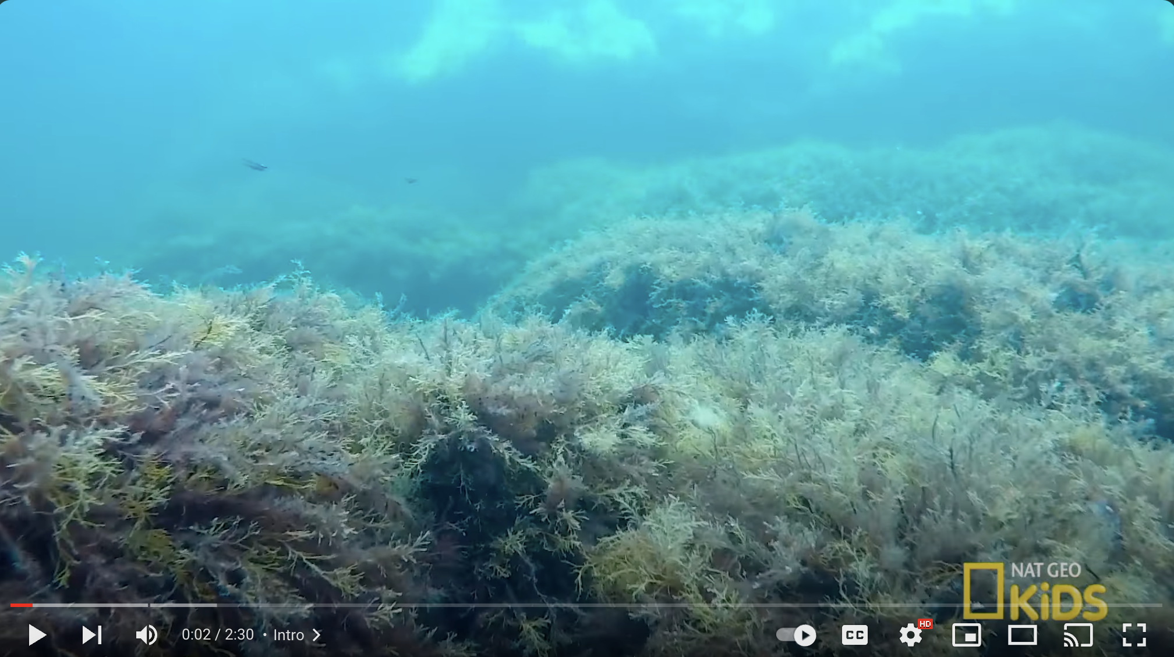
Extension Video
Ocean Exploration
(YouTube)
Click the link above for an extension video to deepen your understanding of marine aquatic ecosystems.
Watch the video and identify 1 or 2 different facts of marine aquatic ecosystems that were not yet discussed.

Slide 66
Notes:
Thanks, and please continue watching and using CAPs available from this website.

Slide 67
This Was Created With Resources From:
Questions or Comments
Michael Kennedy, Ph.D. MKennedy@Virginia.edu
Rachel L Kunemund, Ph.D. rk8vm@virginia.edu

