Slide 1
Intro
“Big Idea” Question
Review Concepts
Check-In Questions
Teacher Demo
Vocabulary
Student-Friendly Definition
Examples & Non-Examples
Morphological Word Parts
Simulation/Activity
Notes:
OK everyone, get ready for our next lesson. Just as a reminder, these are the different components that our lesson may include, and you’ll see these icons in the top left corner of each slide so that you can follow along more easily!

Slide 2
Dalton’s Atomic Theory
Notes:
Today, we are going to look at the development of the atomic theory. We’ll start by defining Dalton’s atomic model.

Slide 3
Thomson’s Atomic Model
-
+
+
-
-
-
+
+
-
+
+
+
-
-
+
+
Notes:
Then we are are going to look at Thomson’s modifications, or Thomson’s atomic model.

Slide 4
Rutherford Atomic Model
Notes:
Then we will define Rutherford’s Atomic Model.

Slide 5
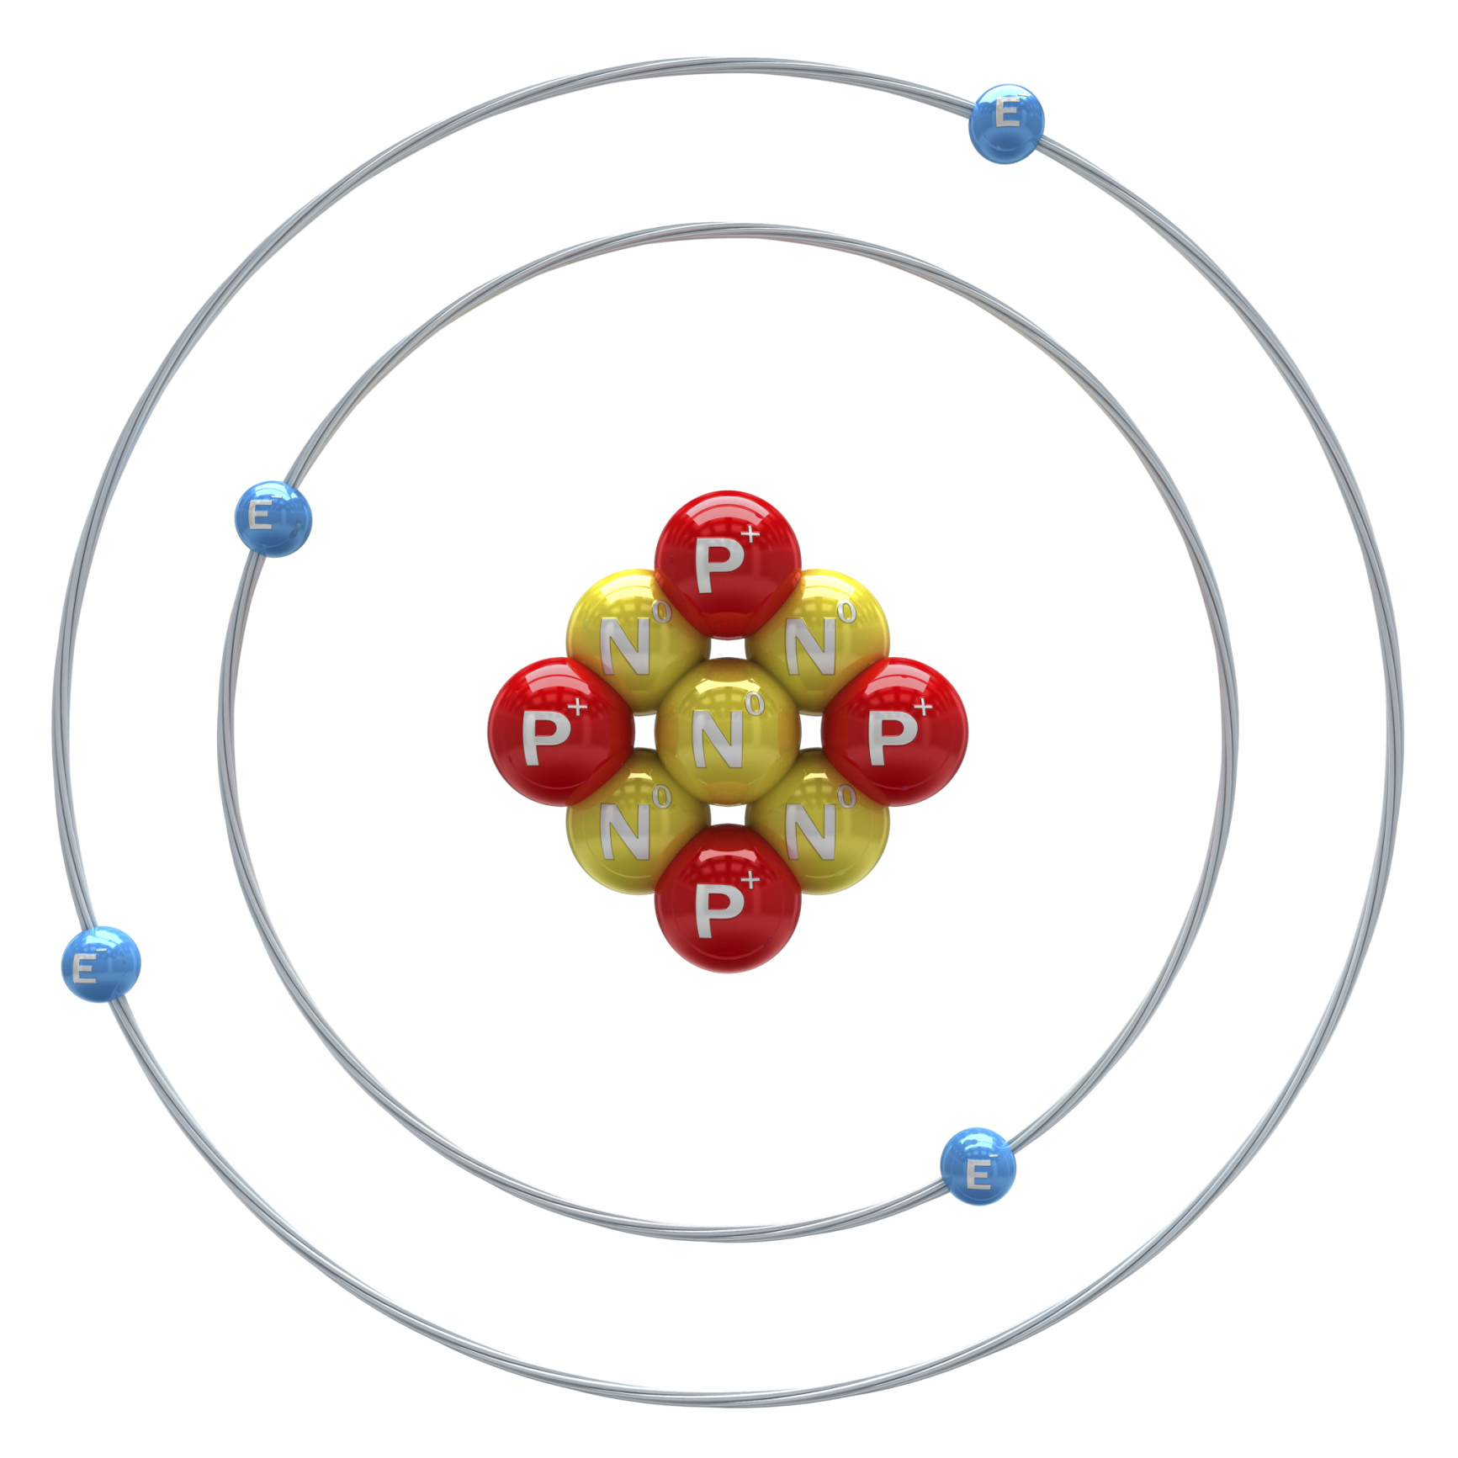
Bohr’s Atomic Model
Notes:
Bohr’s Atomic Model will also be discussed.

Slide 6
Modern Atomic Model
Notes:
And finally we will address the modern atomic model.

Slide 7
Big Question: How are the various atomic models related to what we know as the modern atomic model today?
Notes:
Our Big Question is: How are the various atomic models related to what we know as the modern atomic model today?
[Pause and illicit predictions from students.]
I love all these thoughtful scientific hypotheses! Be sure to keep this question and your predictions in mind as we move through these next few lessons, and we’ll continue to revisit it.

Slide 8
Atomic Model Development
Notes:
Let’s think through an example to get us ready to talk about this.

Slide 9
Model
Notes:
A model is a representation of characteristics of an object.

Slide 10
Model
Object
Notes:
Here the car on the left is a model for the car on the right.

Slide 11
Object
Notes:
To begin building a model, you need to know specific characteristics.

Slide 12
What are characteristics of the car?
Notes:
What are characteristics of the car?

Slide 13
What are characteristics of the atom?
Notes:
As scientists learned more about the characteristics of atoms, they built different models. These combined models help us to understand what we know about atoms today.

Slide 14
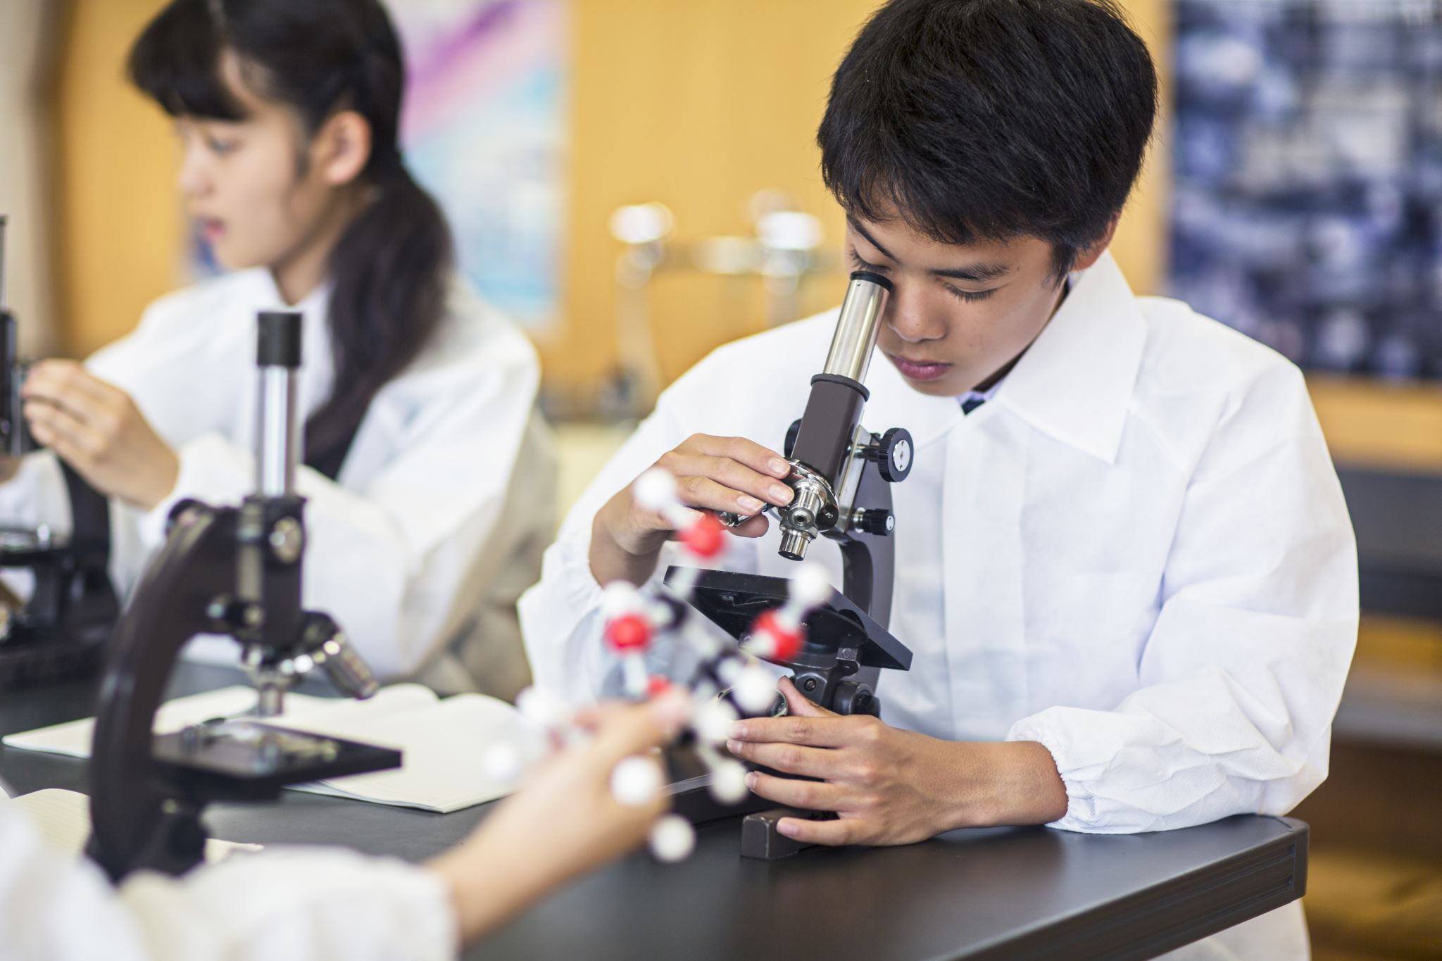
Notes:
As we define and explain each of the models, think about how the different scientists made observations that helped to build what we know about atoms today.

Slide 15
Notes:
Before we move on to our new vocabulary term, let’s review some other words & concepts that you already learned and make sure you are firm in your understanding.

Slide 16
Atom: smallest whole unit of matter
Notes:
An atom is the smallest whole unit of matter.

Slide 17
Protons: positively charged particles found in the nucleus, the center of the atom
Proton
Nucleus
Notes:
Protons are positively charged particles found in the nucleus, the center of the atom.

Slide 18
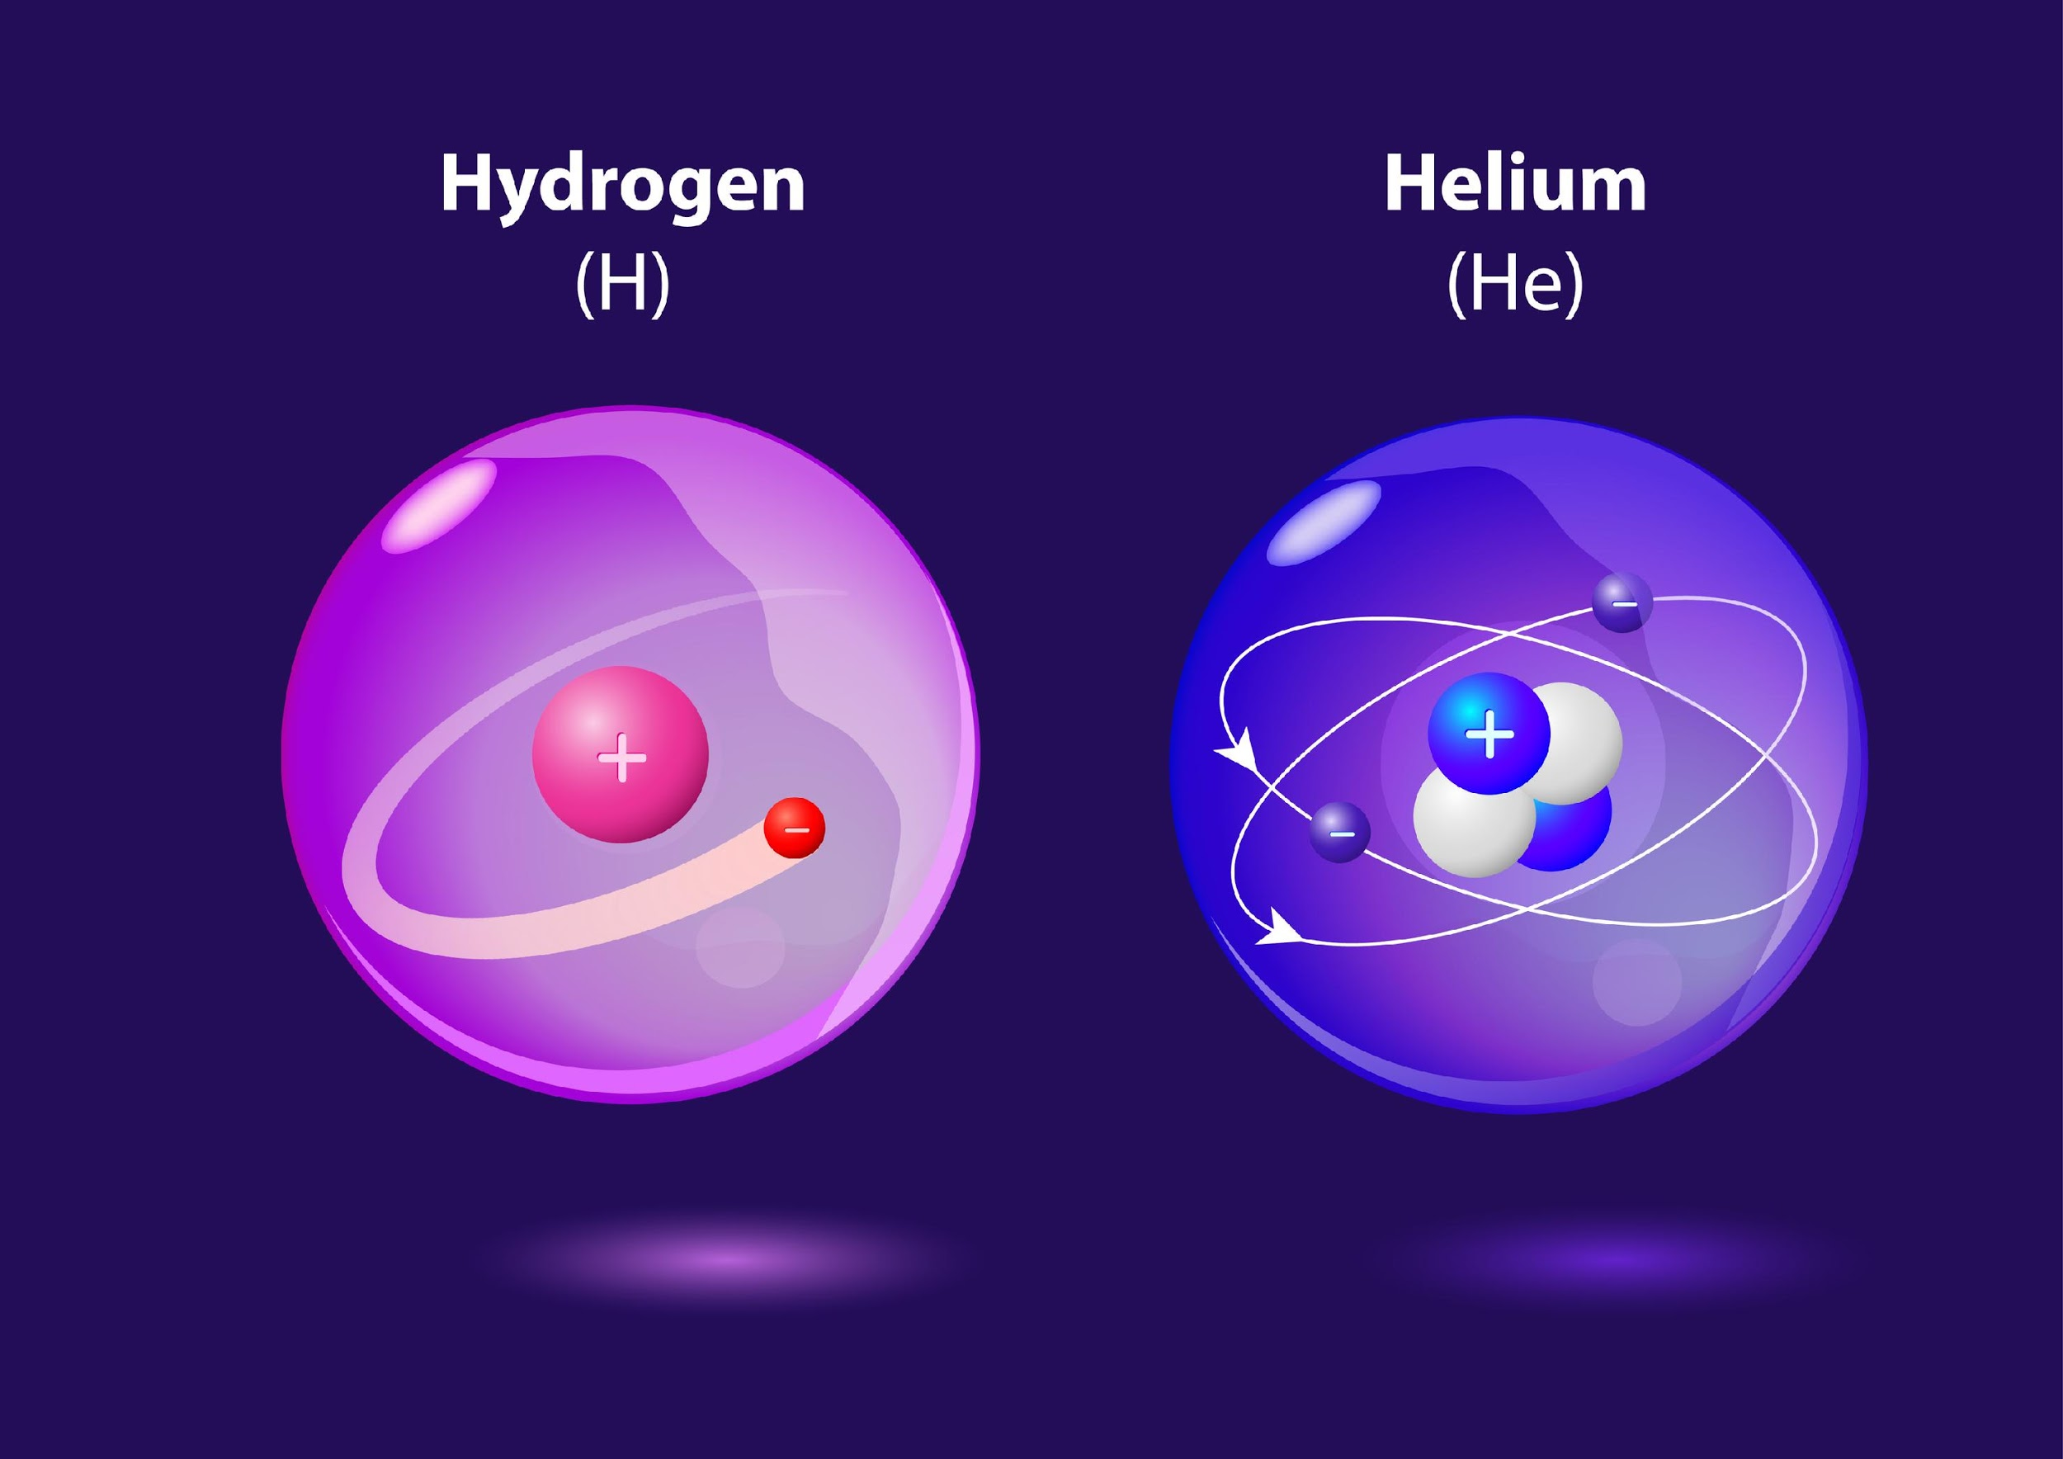
One proton = Hydrogen atom Two protons = Helium atom
Notes:
The number of protons in an atom lets you know which type of element it is. If two atoms have different numbers of protons, then that are different elements. For example, an atom of hydrogen has one proton and an atom of helium has two protons.

Slide 19
Notes:
Now let’s pause for a moment to check your understanding.

Slide 20
What is an atom?
Notes:
What is an atom?
[The smallest whole unit of matter.]

Slide 21
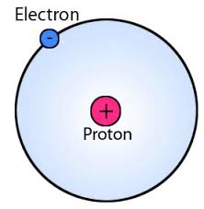
What is a proton? And what can the number of protons tell us?
Notes:
What is a proton? And what can the number of protons tell us?
[Protons are positively charged particles found in the nucleus, the center of the atom.
The number of protons in an atom lets you know which type of element it is. If two atoms have different numbers of protons, then that are different elements. For example, an atom of hydrogen has one proton and an atom of helium has two protons.]

Slide 22
Dalton’s Atomic Model
Notes:
Now that we’ve reviewed, let’s define our new term, Dalton’s Atomic Model.

Slide 23
Dalton’s Model: a list of observations that defines four characteristics of atoms
Notes:
Dalton made 4 observations about an atom’s characteristics.

Slide 24
Notes:
That is the basic definition, but there is a bit more you need to know.

Slide 25
1. Atoms cannot be divided, created, or destroyed.
Notes:
All matter is made of atoms that cannot be divided, created, or destroyed.

Slide 26
2. Chemical reactions rearrange atoms.
Notes:
Chemical reactions do not create or destroy atoms. Instead chemical reactions rearrange atoms.

Slide 27
3. All atoms of a single element are identical.
Notes:
All atoms of an element are identical and different from atoms of another element. i.e. All elements of gold and the same and all elements of silver are the same.

Slide 28
4. Atoms combine in specific ratios.
Notes:
4. Atoms combine in specific ratios—or mathematical proportions—to make compounds.

Slide 29
Notes:
Let’s review what Dalton’s Theory tells us.

Slide 30
Atoms cannot be created, divided or _______.
Notes:
Atoms cannot be created, divided or _______.

Slide 31
Atoms cannot be created, divided or destroyed.
Notes:
Atoms cannot be created, divided or destroyed.

Slide 32
Chemical reactions _______ atoms.
Notes:
Chemical reactions _______ atoms.

Slide 33
Chemical reactions rearrange atoms.
Notes:
Chemical reactions rearrange atoms.

Slide 34
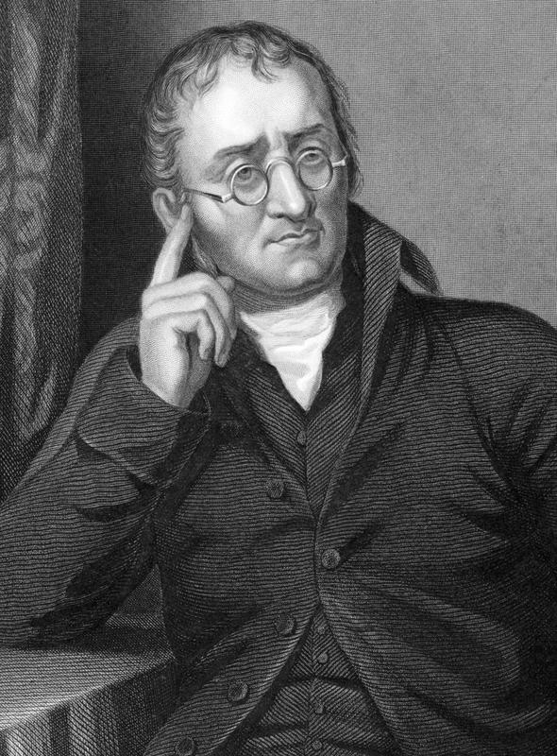
Which is not part of Dalton’s Theory?
Atoms cannot be divided, created, or destroyed.
All atoms of an element are identical.
Chemical reactions destroy matter.
Atoms combine in specific ratios.
Notes:
Which is not part of Dalton’s Theory?

Slide 35
Which is not part of Dalton’s Theory?
Atoms cannot be divided, created, or destroyed.
All atoms of an element are identical.
Chemical reactions destroy matter.
Atoms combine in specific ratios.
Notes:
Which is not part of Dalton’s Theory?
[3. chemical reactions destroy matter]

Slide 36
Thomson’s Atomic Model
Notes:
Now, let’s define our new term, Thomson’s Atomic Model.

Slide 37
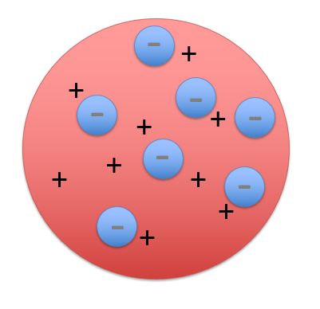
Thomson’s Atomic Model: an atom is a sphere with an evenly distributed positive charge and negative electrons mixed in
Notes:
Thomson’s Atomic Model said that an atom is a sphere with an evenly distributed positive charge with negative electrons mixed in.

Slide 38
Notes:
Now let’s pause for a moment to check your understanding.

Slide 39
What does Thomson’s Atomic Model state?
Notes:
What does Thomson’s Atomic Model state?
[An atom is a sphere with an evenly distributed positive charge and negative electrons mixed in.]

Slide 40
Notes:
That is the basic definition, but there is a bit more you need to know.

Slide 41
Cathode Ray Tube
Notes:
Thomson began experimenting on a cathode ray tube to see if rays had charges.

Slide 42
Cathode
Notes:
A cathode is the negatively charged end of a battery.

Slide 43
Cathode Ray Tube
Notes:
In his experiment, Thomson shot cathode rays through a tube and saw the wire bend towards the positive plate.

Slide 44
Opposites Attract
Notes:
Since opposites attract, he determined that cathodes have a negative charge.

Slide 45
Electrons
Notes:
Thomson’s experiment, lead him to believe cathodes were made of small negatively charged particles, electrons.

Slide 46
Overall Neutral Charge
Notes:
Thomson also new that the overall charge on the atom was neutral so there must also be a positive charge.

Slide 47
Thomson’s Atomic Model = Plum Pudding Model
Notes:
So he came up with the plum pudding model --- he thought an atom was like a pudding (the positive charge) with plums (the negatively charged electrons) mixed in.

Slide 48
Thomson’s Atomic Model: A sphere with an evenly distributed positive charge with negative electrons mixed in
-
-
-
-
-
-
-
Notes:
As a reminder, Thomson’s Atomic Model said that an atom is a sphere with an evenly distributed positive charge with negative electrons mixed in. Just like a plum pudding.

Slide 49
Notes:
Let’s review Thomson’s atomic model.

Slide 50
Why did Thomson’s experiment
lead him to believe cathodes were
negatively charged?
Notes:
Why did Thomson’s experiment lead him to believe cathodes were negatively charged?
[The wire bent towards the positive.]

Slide 51
Why are there both positive and negative charges?
Notes:
Why are there both positive and negative charges?
[The overall net charge of an atom is neutral.]

Slide 52
What charge (positive or negative) does the red section have?
Notes:
What charge does the red section have?
[Positive]

Slide 53
What is another name for Thomson’s model?
Notes:
What is another name for Thomson’s model?
[Plum Pudding Model]

Slide 54
Rutherford’s Atomic Model
Notes:
Now, let’s define our new term, Rutherford’s Atomic Model.

Slide 55
Rutherford’s Atomic Model: atoms consist of a positive center surrounded by electrons in negative space
Positive Center
Notes:
According to Rutherford’s Atomic Model, atoms consist of a positive center surrounded by electrons in a negative space.

Slide 56
Notes:
Now let’s pause for a moment to check your understanding.

Slide 57
What does Rutherford’s Atomic Model state?
Positive Center
Notes:
What does Rutherford’s Atomic Model state?
[According to Rutherford’s Atomic Model, atoms consist of a positive center surrounded by electrons in negative space.]

Slide 58
Notes:
That is the basic definition, but there is a bit more you need to know.

Slide 59
Thomson Rutherford
Notes:
Rutherford's model built off of Thomson’s idea of electrons.

Slide 60
Gold Foil Experiment
Notes:
In this experiment, Rutherford shot alpha particles at a piece of gold foil and expected the particles to travel straight through.

Slide 61
Reflection
Notes:
Instead the light was sometimes reflected.

Slide 62
Dense Space = Reflected by Foil
Notes:
This meant the alpha particle was hitting a dense space when it was reflected.

Slide 63
Empty Space = Through Foil
Notes:
This meant the alpha particle was hitting empty space, when it traveled through.

Slide 64
Positive central nucleus
Notes:
Rutherford concluded there was a positive central core, or the nucleus.

Slide 65
Electrons in empty space
Notes:
And also that there are electrons in the negative space.

Slide 66
Rutherford’s Atomic Model: atoms consist of a positive center surrounded by electrons in negative space
Positive Center
Notes:
So, he knew that atoms have a positive center surrounded by electrons in negative space.

Slide 67
Notes:
Let’s review what Rutherford's Model tells us.

Slide 68
Where is the positive charge located?
Notes:
Where is the positive charge located?
[The nucleus]

Slide 69
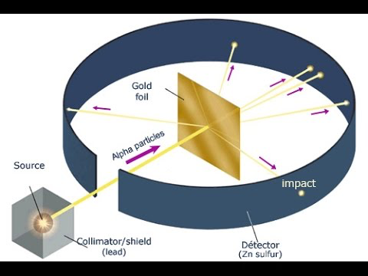
What experiment did Rutherford use to come to this model of the atom?
Notes:
What experiment did Rutherford use to come to this model of the atom?
[The Gold Foil Experiment]

Slide 70
How did Rutherford determine that the atom is mostly empty space?
Notes:
How did Rutherford determine that the atom is mostly empty space?
[Most of the particles went through the foil.]

Slide 71
Bohr’s Atomic Model
Notes:
Now, let’s define our new term, Bohr’s Atomic Model.

Slide 72
Bohr’s Atomic Model: electrons move in orbitals and, when they change orbitals, they gain energy
Energy
Energy
Notes:
Bohr’s Atomic Model states that as electrons move in orbitals and, when they change orbitals, they gain energy.

Slide 73
Notes:
Now let’s pause for a moment to check your understanding.

Slide 74
What does Bohr’s Atomic Model state?
Energy
Energy
Notes:
What does Bohr’s Atomic Model state?
[Bohr’s Atomic Model states that as electrons move in orbitals, or when they change orbitals, they gain energy.]

Slide 75
Notes:
That is the basic definition, but there is a bit more you need to know.

Slide 76
Unique Characteristics
Notes:
Scientists began to notice that elements give off different colors when heated. How could this be?

Slide 77
Orbitals = ENERGY LEVELS
Notes:
Bohr decided that electrons move in circular orbitals, or energy levels.

Slide 78
Orbitals
Notes:
Electrons changing orbitals would allow for different colors being emitted.

Slide 79
Increase level, gain energy
Notes:
This is because when an electron goes up an orbit it gains energy and is excited.

Slide 80
Notes:
Let’s review the definition of Bohr’s Model.

Slide 81
Bohr’s Atomic Model: electrons move in ______ and, when they change _______, they gain _____
Energy
Energy
Notes:
Bohr’s Atomic Model: electrons move in ________ and, when they change _________, they gain _________

Slide 82
Bohr’s Atomic Model: electrons move in orbitals and, when they change orbitals, they gain energy
Energy
Energy
Notes:
Bohr’s Atomic Model: electrons move in orbitals and, when they change orbitals, they gain energy

Slide 83
Modern Atomic Model
Notes:
Now, let’s define the Modern Atomic Model.

Slide 84
Modern Atomic Model: orbitals are clouds and show where electrons are most likely to be
Notes:
The modern model is similar to Bohr’s model except it looks at orbitals as clouds. Instead it shows the area where the electron is most likely to be.

Slide 85
Notes:
Now let’s pause for a moment to check your understanding.

Slide 86
What does the Modern Atomic Model state?
Notes:
What does the Modern Atomic Model state?

Slide 87
Notes:
That is the basic definition, but there is a bit more you need to know.

Slide 88
Notes:
As Bohr predicted, these clouds have various energy levels.

Slide 89
Notes:
The electrons move too fast and too unpredictably for us to know their location.

Slide 90
Notes:
Let’s review the definition of the Modern Atomic Model.

Slide 91
In the modern atomic model, orbitals are _____ and shows where electrons are _____________.
Notes:
In the modern atomic model, orbitals are _____ and shows where electrons are _____________.

Slide 92
In the modern atomic model orbitals are clouds and show where electrons are most likely to be.
Notes:
In the modern atomic model, orbitals are clouds and show where electrons are most likely to be.
The modern model is similar to Bohr’s model except it looks at orbitals as clouds. Instead it shows the area where the electron is most likely to be.

Slide 93
Why can’t we tell the exact location of electrons in the modern atomic model?
Notes:
Why can’t we tell the exact location of electrons in the modern atomic model?
[The electrons move too fast and too unpredictably for us to know their location.]

Slide 94
Notes:
Let’s check-in once more for understanding.

Slide 95
Dalton’s model states that atoms cannot be created, divided, or _______.
Notes:
Dalton’s model states that atoms cannot be created, divided or _______.

Slide 96
Dalton’s model states that atoms cannot be created, divided, or destroyed.
Notes:
Dalton’s model states that atoms cannot be created, divided or destroyed.

Slide 97
Which is not part of Dalton’s Theory?
Atoms cannot be divided, created, or destroyed.
All atoms of an element are identical.
Chemical reactions destroy matter.
Atoms combine in specific ratios.
Notes:
Which is not part of Dalton’s theory?

Slide 98
Which is not part of Dalton’s Theory?
Atoms cannot be divided, created, or destroyed.
All atoms of an element are identical.
Chemical reactions destroy matter.
Atoms combine in specific ratios.
Notes:
Which is not part of Dalton’s theory?
[3. chemical reactions destroy matter]

Slide 99
Which model of the atom is a positive sphere with negative charges?
Notes:
Which model has a positive sphere with negative charges?
[Thomson’s plum pudding model]

Slide 100
Which scientist introduced orbitals?
Notes:
Which scientist introduced orbitals?
[Rutherford]

Slide 101
What experiment did Rutherford use in his development of an atomic model?
Notes:
What experiment did Rutherford use in his development of an atomic model?
[The Gold Foil Experiment]

Slide 102
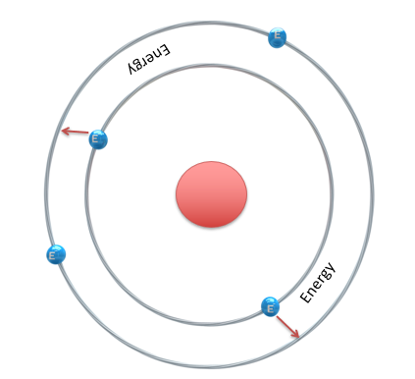
How is Bohr’s model of the atom different from Rutherford’s?
Notes:
How is Bohr’s model of the atom different from Rutherford’s?
[Bohr included orbitals.]

Slide 103
What is the key characteristic of modern
atomic theory?
Notes:
What is the key characteristic of modern atomic theory?
[an electron cloud]

Slide 104
Remember!!!
Notes:
So remember!

Slide 105
Dalton’s Model: A list of observations that defines four characteristics of atoms
Notes:
Dalton made 4 observations about an atom’s characteristics. Let’s review them in the next slides.

Slide 106
1. Atoms cannot be divided, created, or destroyed.
Notes:
All matter is made of atoms that cannot be divided, created, or destroyed.

Slide 107
2. Chemical reactions rearrange atoms.
Notes:
Chemical reactions do not create or destroy atoms. Instead chemical reactions rearrange atoms.

Slide 108
3. All atoms of a single element are identical.
Notes:
All atoms of an element are identical and different from atoms of another element. i.e. All elements of gold and the same and all elements of silver are the same.

Slide 109
4. Atoms combine in specific ratios.
Notes:
4. Atoms combine in specific ratios—or mathematical proportions—to make compounds.

Slide 110
Thomson’s Atomic Model: a sphere with an evenly distributed positive charge with negative electrons mixed in
-
-
-
-
-
-
-
Notes:
Thomson’s Atomic Model said that an atom is a sphere with an evenly distributed positive charge with negative electrons mixed in. Just like a plum pudding.

Slide 111
Rutherford’s Atomic Model: atoms consist of a positive center surrounded by electrons in negative space
Positive Center
Notes:
Rutherford discovered that atoms have a positive center surrounded by electrons in negative space.

Slide 112
Bohr’s Atomic Model: electrons move in orbitals and, when they change orbitals, they gain energy
Energy
Energy
Notes:
Bohr’s Atomic Model said that electrons move in orbitals and, when they change orbitals, they gain energy.

Slide 113
Modern Atomic Model: orbitals are clouds and shows where electrons are most likely to be
Notes:
And finally, the modern atomic model looks at orbitals as clouds and shows the area where the electron is most likely to be.

Slide 114
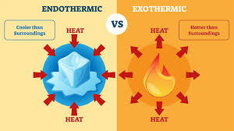
Big Question: How are the various atomic models related to what we know as the modern atomic model today?
Notes:
Our Big Question is: How are the various atomic models related to what we know as the modern atomic model today? [Pause and illicit predictions from students.]
I love all these thoughtful scientific hypotheses! Be sure to keep this question and your predictions in mind as we move through these next few lessons, and we’ll continue to revisit it.

Slide 115
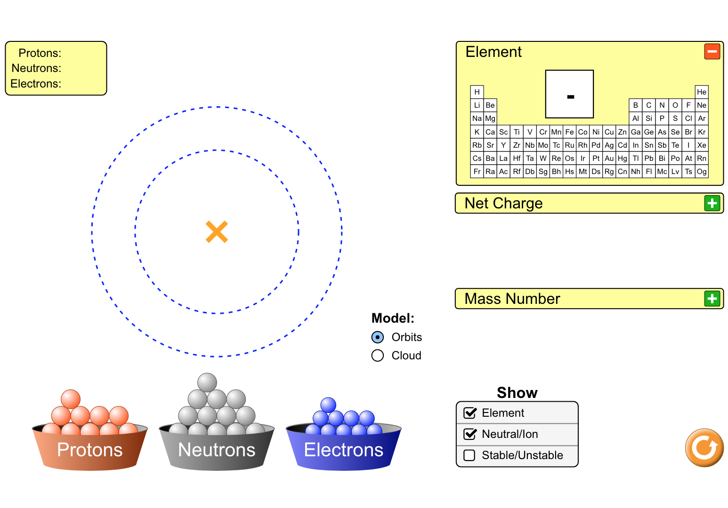
Simulation Activity
Build an Atom
Build an atom out of protons, neutrons, and electrons, and see how the element, charge, and mass change. Then play a game to test your ideas!

Slide 116
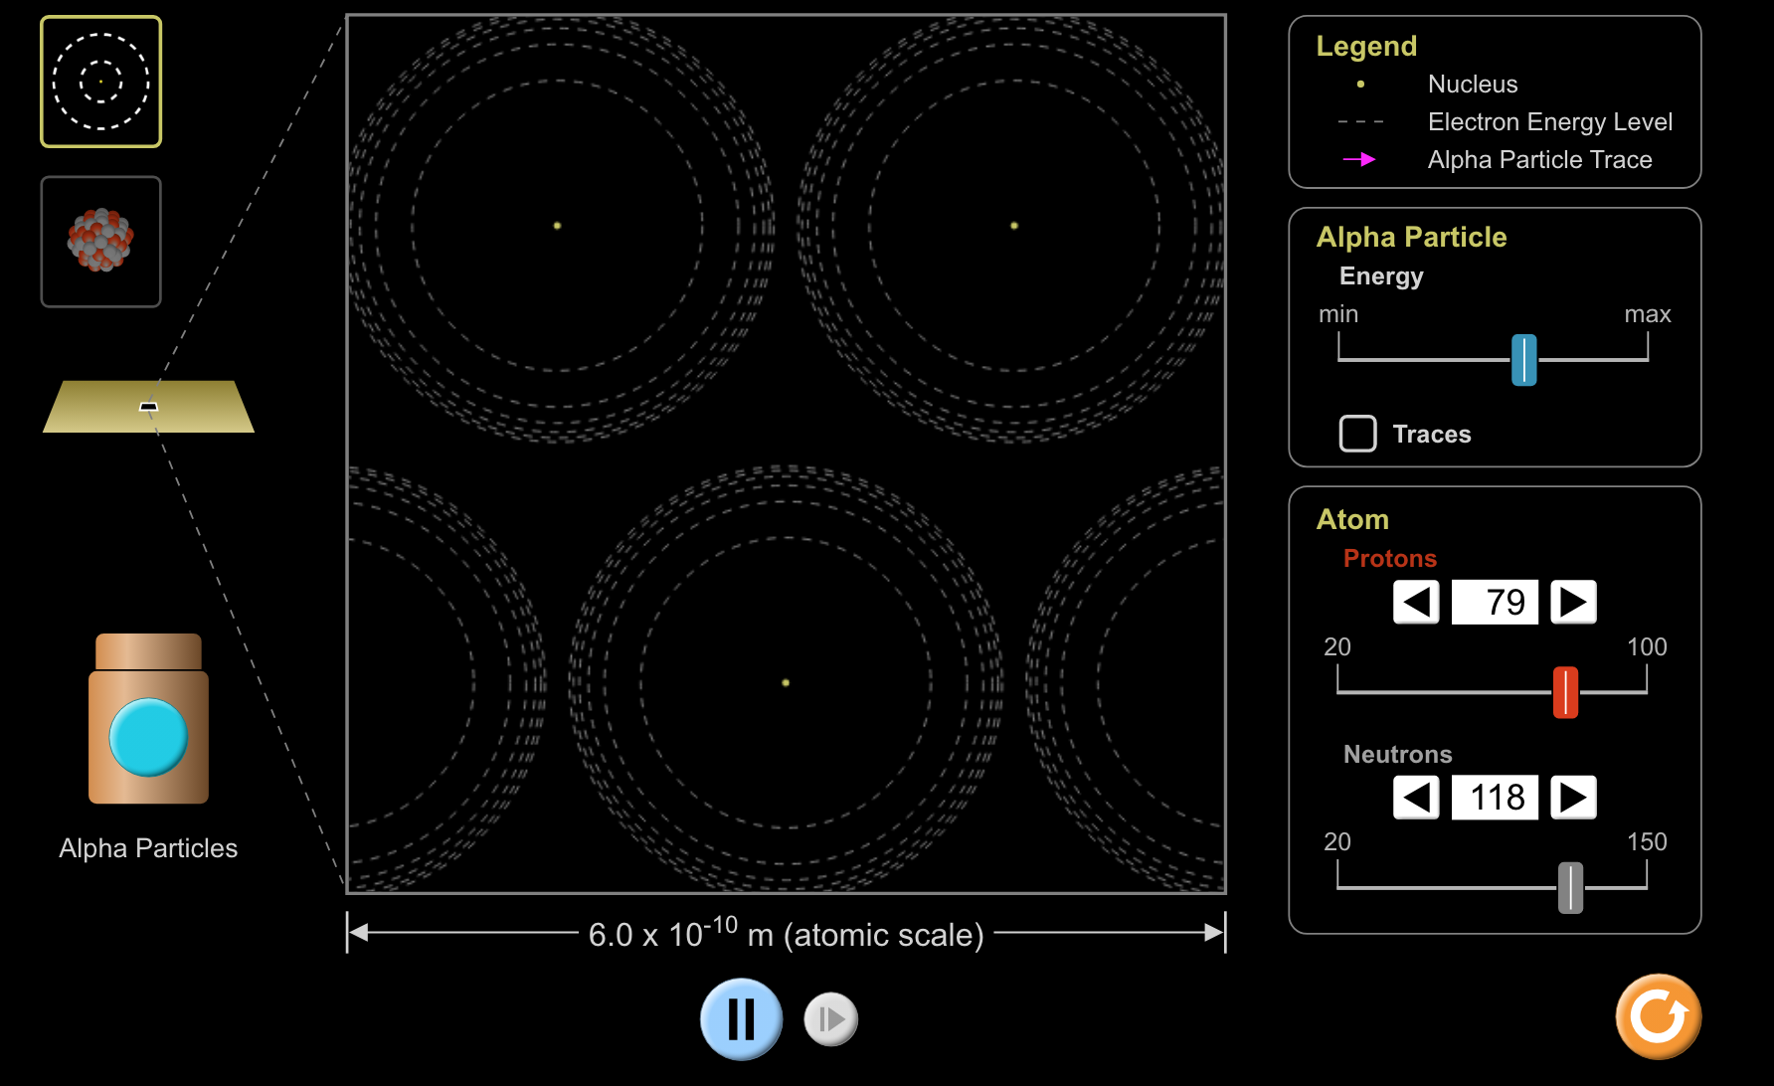
Simulation Activity
Rutherford Scattering
How did Rutherford figure out the structure of the atom without being able to see it? Simulate the famous experiment in which he disproved the Plum Pudding model of the atom by observing alpha particles bouncing off atoms and determining that they must have a small core.

Slide 117
Notes:
Thanks for watching, and please continue watching CAPs available from this website.

Slide 118
This Video Was Created With Resources From:
Questions or Comments
Michael Kennedy, Ph.D. MKennedy@Virginia.edu
Rachel L Kunemund, Ph.D. rk8vm@virginia.edu

