Slide 1
Intro
“Big Idea” Question
Review Concepts
Check-In Questions
Teacher Demo
Vocabulary
Student-Friendly Definition
Examples & Non-Examples
Morphological Word Parts
Simulation/Activity
Notes:
OK everyone, get ready for our next lesson. Just as a reminder, these are the different components that our lesson may include, and you’ll see these icons in the top left corner of each slide so that you can follow along more easily!

Slide 2
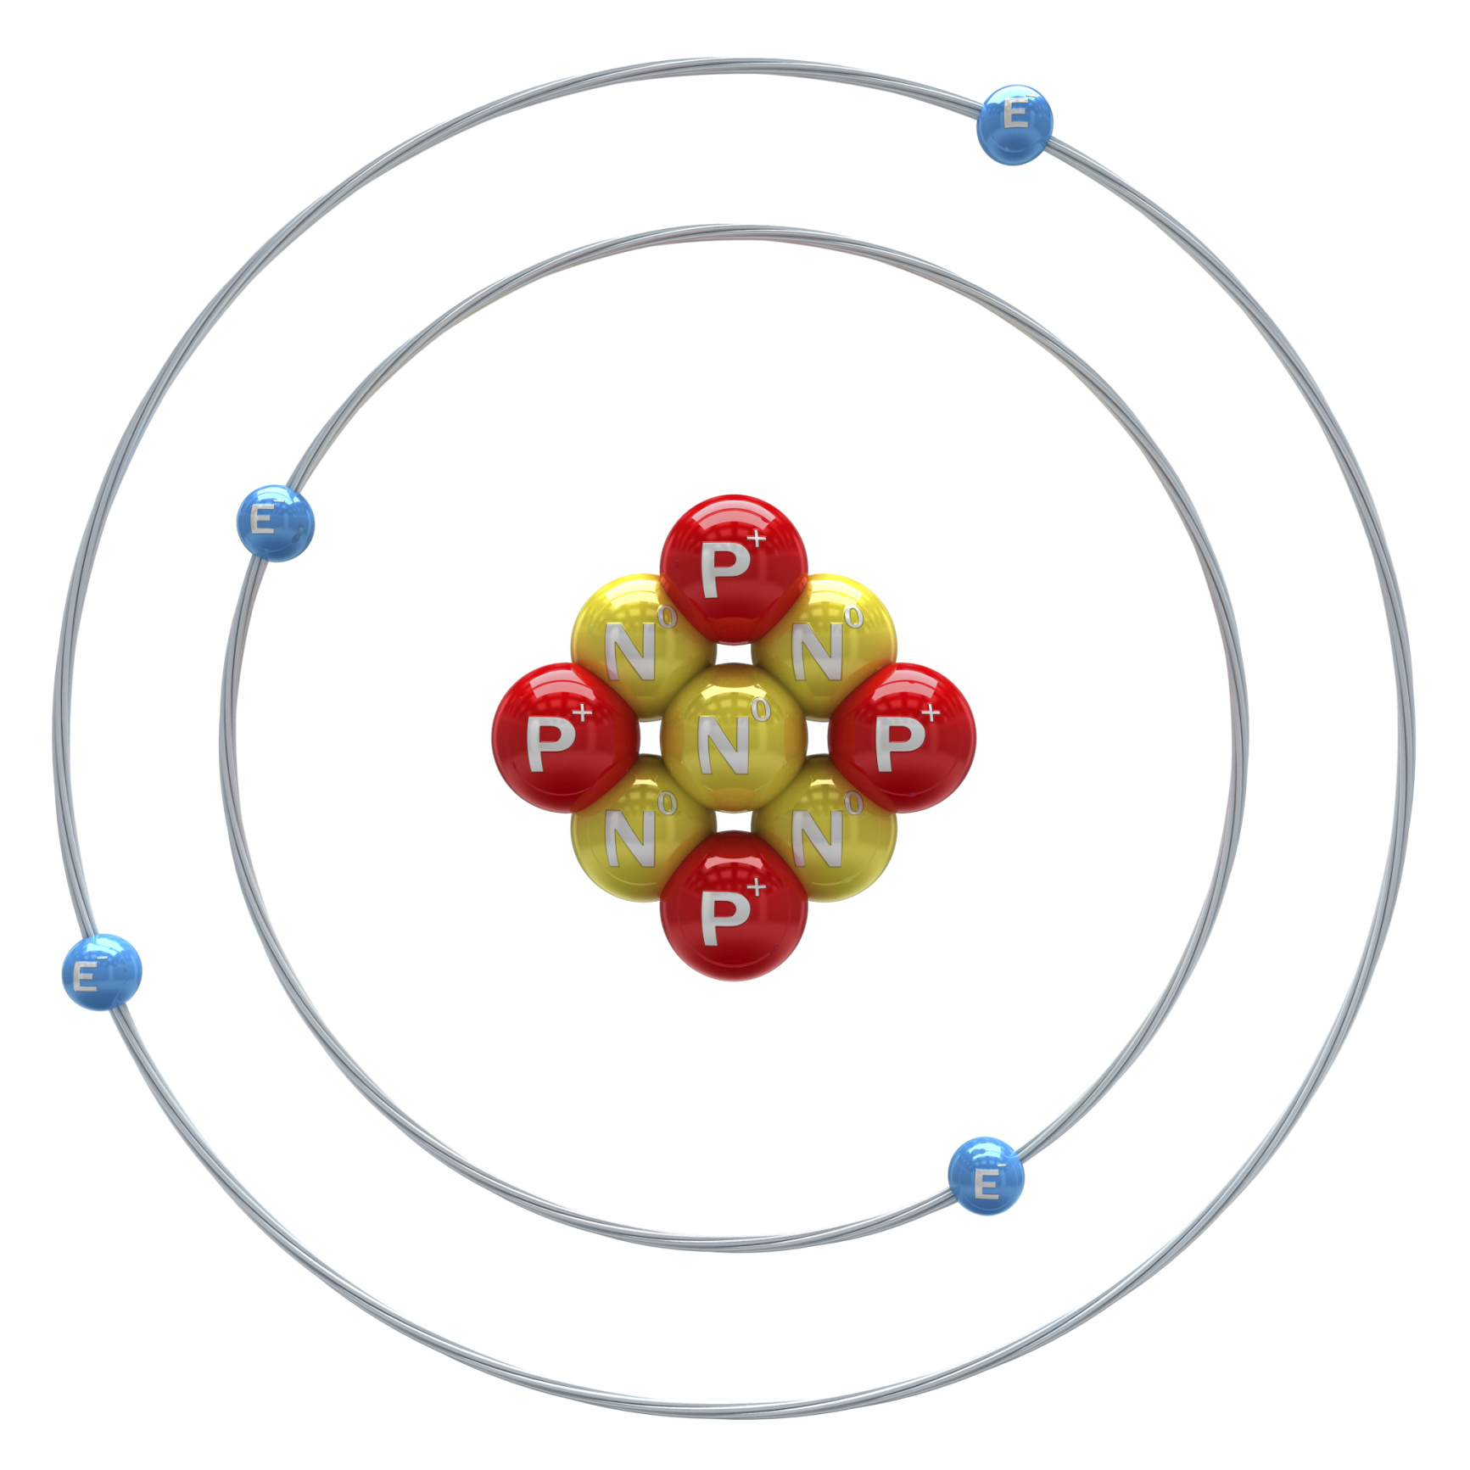
Intro
Atomic Nucleus
Nucleus
Notes:
Today we will learn about the atomic nucleus.

Slide 3
Subatomic Particles
Intro
Neutron
Proton
Electron
Notes:
To help us learn about this, we will be learning about the subatomic particles that make up an atom, which include electrons, protons, and neutrons.

Slide 4
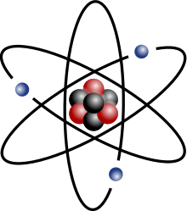
Big Question: What are the basic structural components of a typical atom?
Notes:
Our “big question” is: What are the basic structural components of a typical atom?
[Pause and illicit predictions from students.]
I love all these thoughtful scientific hypotheses! Be sure to keep this question and your predictions in mind as we move through this lesson, and we’ll revisit it.

Slide 5
Demonstration
Visualizing an Atom Activity
TEACHER DIRECTIONS:
Materials: rope or hula hoop and your students
Activity: In this activity, have a small group of students be protons and neutrons, and a small group of students be electrons. The rope or hula hoop represents the atomic nucleus. Have proton and neutron students stand closely together, mimicking a tight nucleus. Have electron students revolve around the students in the middle. Explain how this represents the structure of the atom.
Enduring Understanding:
The atomic nucleus is dense.
The protons and electrons attract each other.
The electrons move in a large space around the nucleus.
Note: This is a simple exercise to get students moving and visualizing the atom.
Notes:
Let’s do a quick demonstration that will help get our brains ready to think about the atomic nucleus and subatomic particles, and how they relate to our big question.
Feedback: This simulation can help make scientific concepts visible for students and engage them by physically taking part.

Slide 6
Notes:
Before we move on to our new vocabulary term, let’s review some other words & concepts that you already learned and make sure you are firm in your understanding.

Slide 7
Matter: has mass and takes up space
Notes:
Matter is anything that has mass and takes up space.

Slide 8
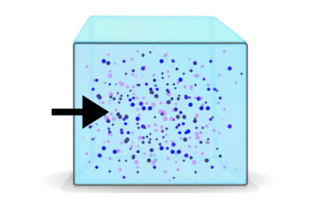
Mass: the amount of matter in an object
Notes:
Mass is the amount of matter in an object.

Slide 9
Atom: smallest whole unit of matter
Notes:
An atom is the smallest whole unit of matter.

Slide 10
Notes:
Now let’s pause for a moment to check your understanding.

Slide 11
What is an atom?
Notes:
What is an atom?
[An atom is the smallest whole unit of matter.]

Slide 12
How are mass and matter related?
Notes:
How are mass and matter related?
[Matter is anything that has mass and takes up space and mass is the amount of matter in an object.]
Feedback: Incorporating visuals is an important aspect of building conceptual understandings.

Slide 13
Atomic Nucleus
Notes:
Now that we’ve reviewed, let’s define our new term, atomic nucleus

Slide 14
Atomic Nucleus: the center of the atom
Nucleus
Notes:
The atomic nucleus is the center of the atom.

Slide 15
Notes:
Let’s check-in for understanding.

Slide 16
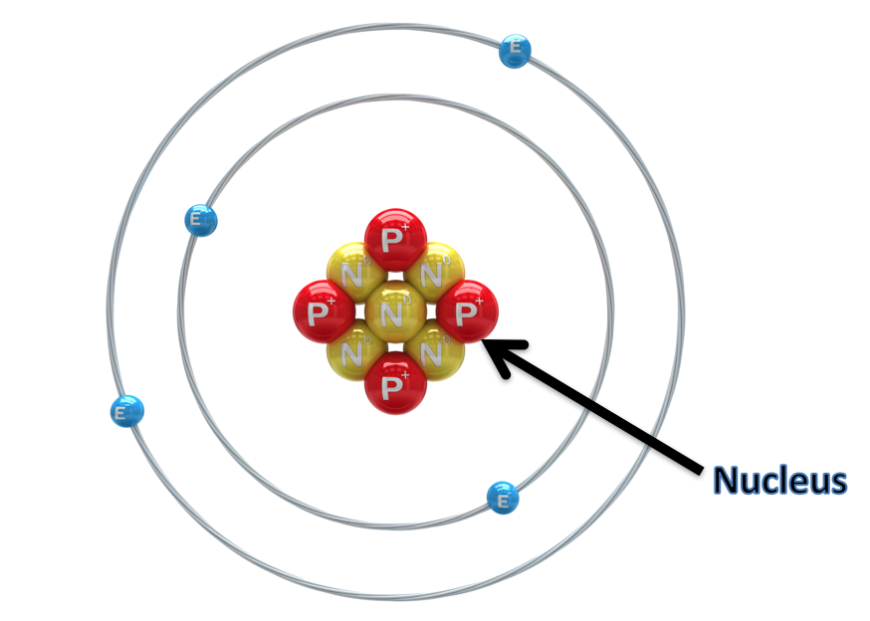
What is an atomic nucleus?
Notes:
What is an atomic nucleus?
[The atomic nucleus is the center of an atom.]
Feedback: Concise and clear language is important when building student understanding.

Slide 17
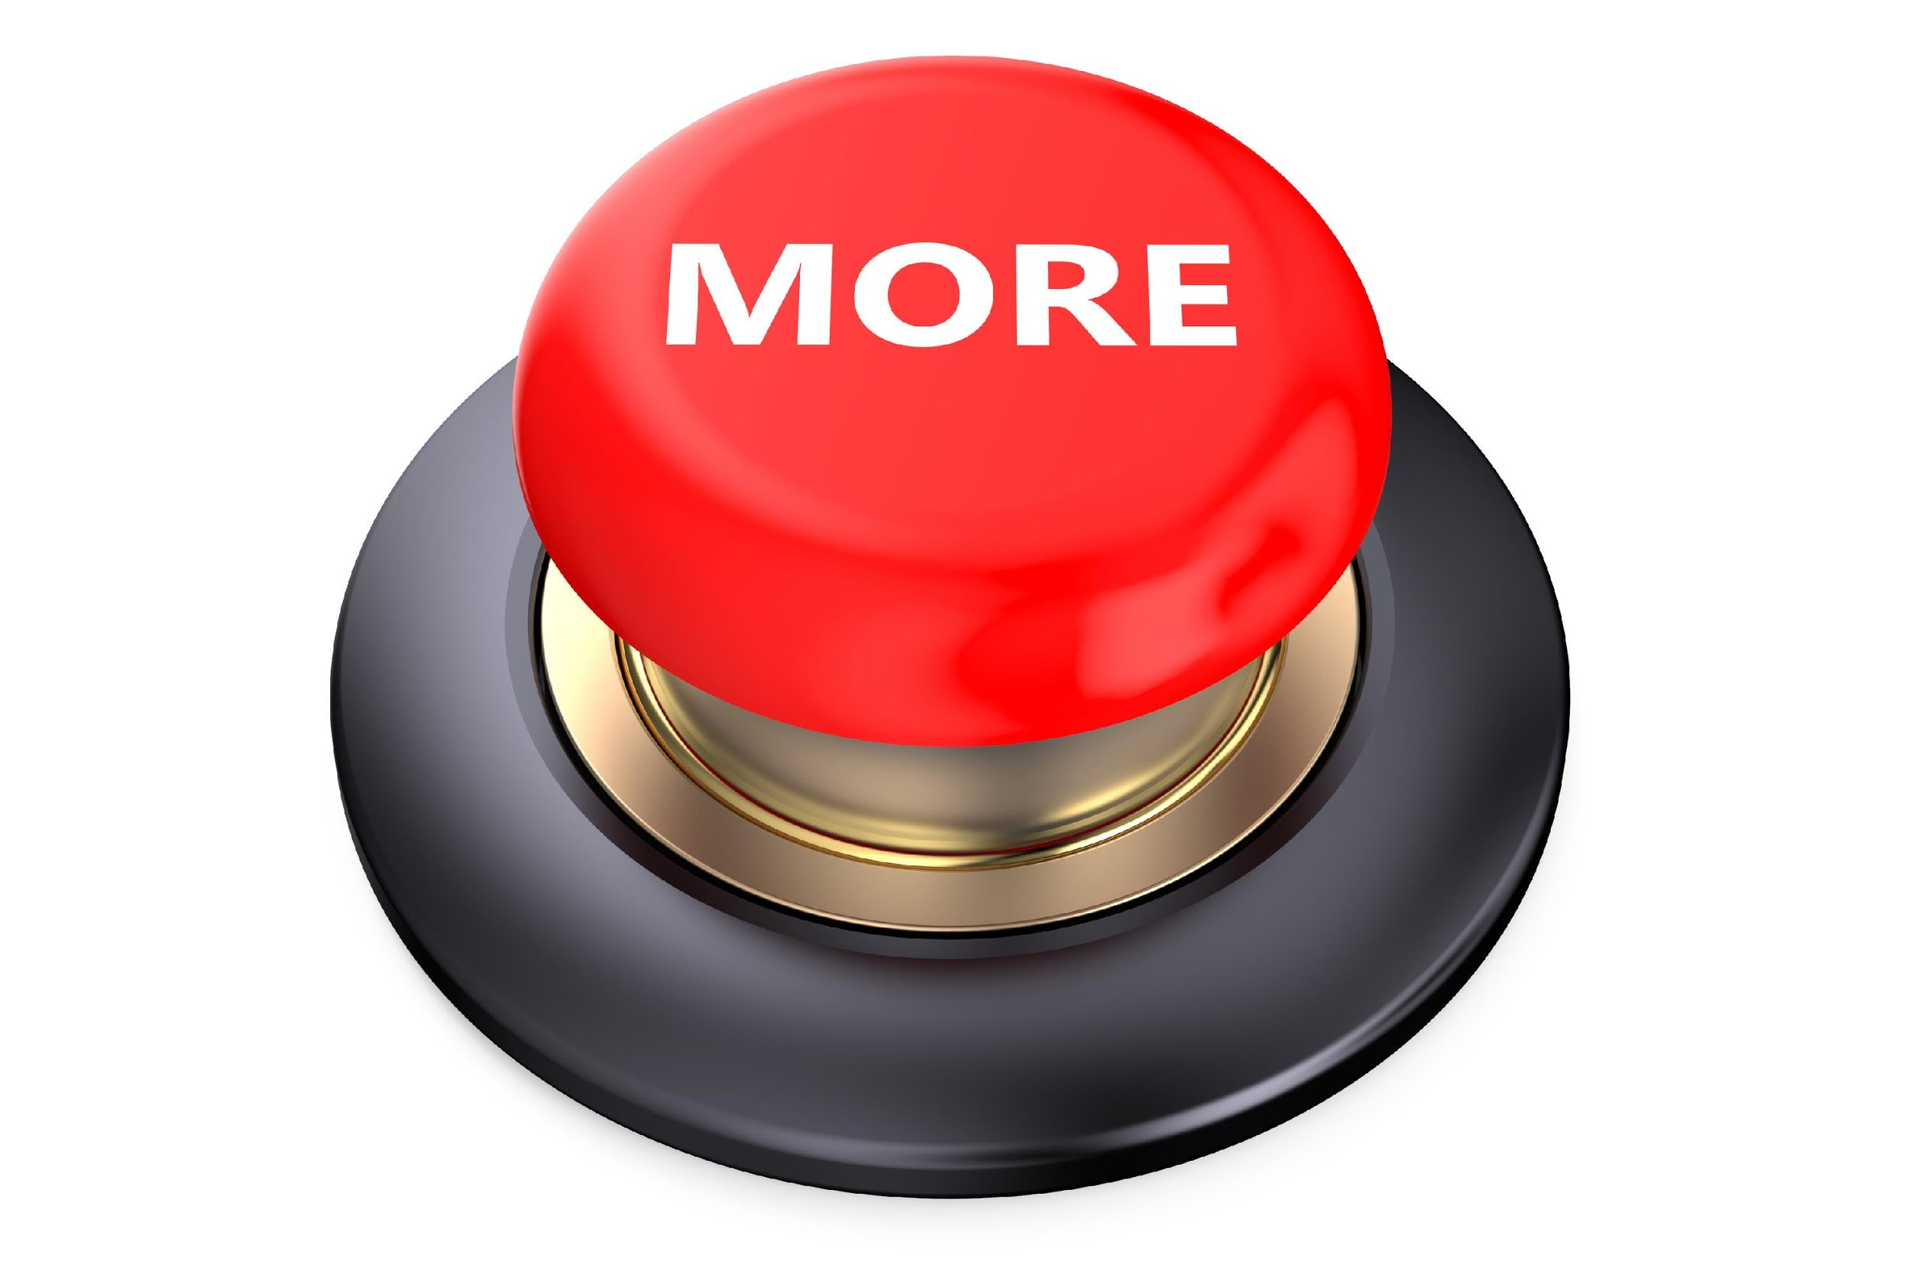
Notes:
That is the basic definition, but there is a bit more you need to know.

Slide 18
Subatomic Particle: particle smaller than an atom
Notes:
A subatomic particle is a particle smaller than an atom. Protons, neutrons, and electrons are the subatomic particles in an atom. Protons and neutrons are found in the atomic nucleus.

Slide 19
Notes:
Let’s check-in for understanding.

Slide 20
What is a subatomic particle?
Notes:
What is a subatomic particle?
[A subatomic particle is a particle smaller than an atom. Protons, neutrons, and electrons are the subatomic particles in an atom. Protons and neutrons are found in the atomic nucleus.]

Slide 21
Notes:
We can also break down the term subatomic into different word parts to help us remember the meaning. Let’s take a look!

Slide 22
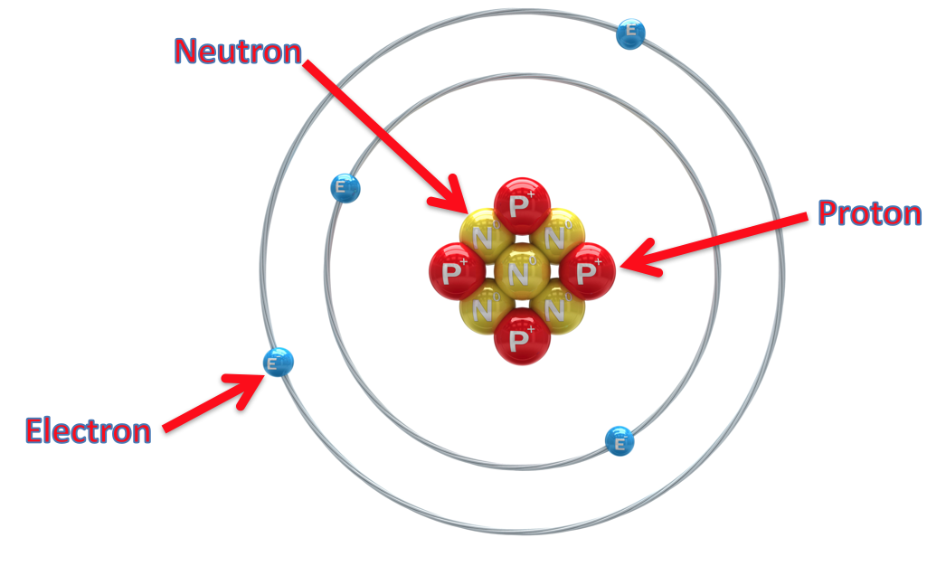
Subatomic
Under, smaller
Notes:
To figure out what subatomic means, look at its prefix, sub-. Sub means under or smaller. Any time you see a word that has the prefix sub-, you know it has something to do with being under or smaller.
Feedback: The use of morphological word parts is extremely beneficial for students; taking the time to break the word down and define each individual word part for students is extremely important to support understanding.

Slide 23
Subatomic
Notes:
You already know what an atom is, the smallest whole unit of matter.

Slide 24
Subatomic
Describing
Notes:
The suffix –ic means that the word is an adjective, or describing something.

Slide 25
Subatomic
= smaller than an atom
Under, smaller
Describing
Notes:
So subatomic basically means smaller than an atom.

Slide 26
Notes:
Let’s check-in for understanding.

Slide 27
How can we use the word subatomic to remember the definition of the term?
Notes:
How can we use the word subatomic to remember the definition of the term?
[Sub means under or smaller. Any time you see a word that has the prefix sub-, you know it has something to do with being under or smaller.
Atom is the smallest whole unit of matter.
The suffix –ic means that the word is an adjective, or describing something.
So subatomic basically means smaller than an atom.]
Feedback: Breaking down the vocabulary term into word parts and defining each part is essential in building student understanding of the word parts.

Slide 28
atomic nucleus
protons
neutrons
Notes:
The atomic nucleus is made up of protons and neutrons, two subatomic particles. This is because the neutrons keep the protons from repelling each other, and make the nucleus more dense. The atomic nucleus makes up most of an atom’s mass.

Slide 29
atomic nucleus
protons
neutrons
Notes:
Let’s look at protons first.

Slide 30
Proton: positively charged subatomic particle found in the nucleus of an atom
Proton
Notes:
A proton is a positively charged subatomic particle found in the nucleus of an atom.

Slide 31
Notes:
Let’s check-in for understanding.

Slide 32
What is a proton?
Proton
Notes:
What is a proton?
[A proton is a positively charged subatomic particle found in the nucleus of an atom.]

Slide 33
Notes:
We can also break down the term proton into different word parts to help us remember the meaning. Let’s take a look!

Slide 34
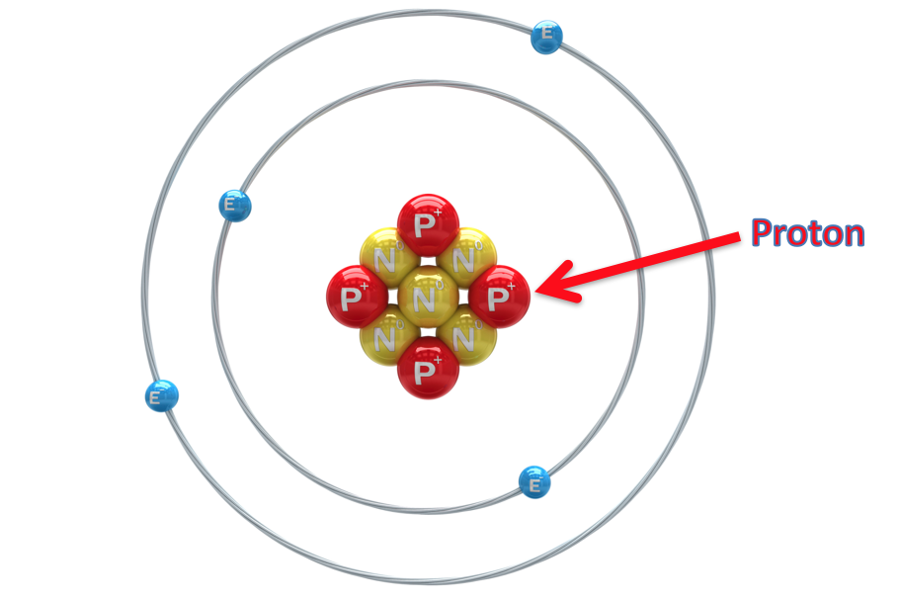
Proton
positive, for
Notes:
To figure out what proton means, look at its root word, pro-. Pro means positive, or in favor of. Any time you see a word that has the root word pro-, you know it has something to do with being positive or in favor of something.

Slide 35
Proton
= positive charge
positive, for
Notes:
So, you can remember that a proton has a positive charge.

Slide 36
Notes:
Let’s check-in for understanding.

Slide 37
How can we use the word proton to help us remember the definition of the term?
Proton
Notes:
How can we use the word proton to help us remember the definition of the term?
[Pro means positive, or in favor of. Any time you see a word that has the root word pro-, you know it has something to do with being positive or in favor of something.
So, you can remember that a proton has a positive charge.]
Feedback: Breaking down the vocabulary term into word parts and defining each part is essential in building student understanding of the word parts.

Slide 38
atomic nucleus
protons
neutrons
Notes:
Now let’s look at neutrons.

Slide 39
Neutron: subatomic particle with a neutral charge, found in the nucleus of an atom
Neutron
Notes:
A neutron is a subatomic particle with a neutral charge, found in the nucleus of an atom.

Slide 40
Notes:
Let’s check-in for understanding.

Slide 41
What is a neutron?
Neutron
Notes:
What is neutron?
[A neutron is a subatomic particle with a neutral charge, found in the nucleus of an atom.]

Slide 42
Notes:
We can also break down the term neutron into different word parts to help us remember the meaning. Let’s take a look!

Slide 43
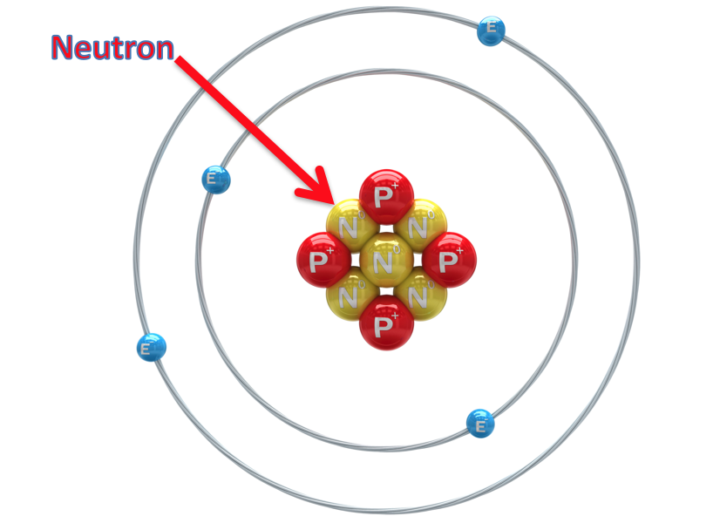
Neutron
Neutral, neither
Notes:
To figure out what neutron means, look at its root word, neu-. Neu means neutral, or neither. Any time you see a word that has the root word neu-, you know it has something to do with being neutral.

Slide 44
Neutron
= neutral (no) charge
Neutral, neither
Notes:
So you can remember that a neutron has a neutral, or no charge, because it is neither positive nor negative.

Slide 45
Notes:
Let’s check-in for understanding.

Slide 46
How can we use the word neutron to remember the definition of the term?
Neutron
Notes:
How can we use the word neutron to remember the definition of the term?
[Neu means neutral, or neither. Any time you see a word that has the root word neu-, you know it has something to do with being neutral.
So you can remember that a neutron has a neutral, or no charge, because it is neither positive nor negative.]
Feedback: Breaking down the vocabulary term into word parts and defining each part is essential in building student understanding of the word parts.

Slide 47
Electron: negatively charged particle that orbits the nucleus of an atom
Electron
Notes:
An electron is a negatively charged particle that orbits the nucleus. Like protons and neutrons, it is a subatomic particle, however, electrons are not located in the atomic nucleus like they are.

Slide 48
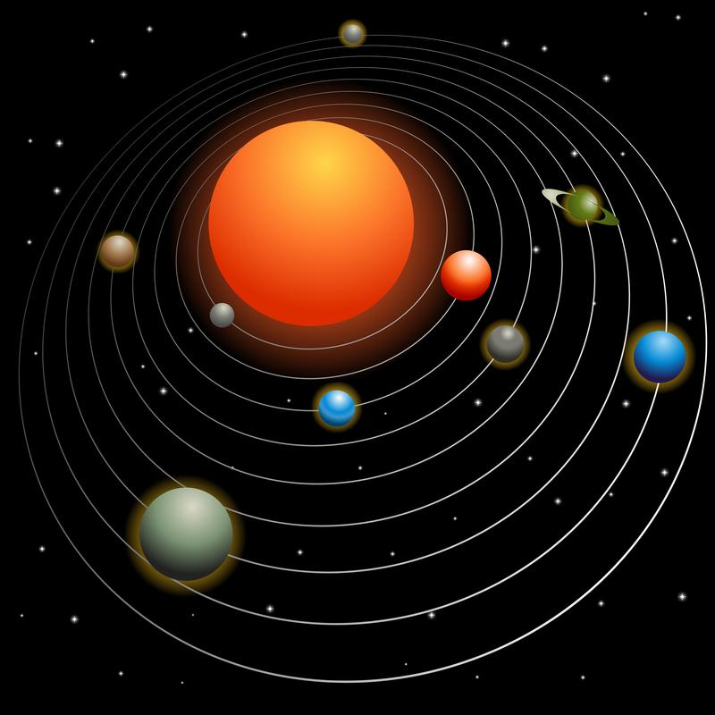
Notes:
Just like the earth orbits the sun, an electron orbits the center of the atom.
Feedback: Building connections between new concepts and students’ prior knowledge is an important way to help students build conceptual understanding.

Slide 49
Notes:
Let’s check-in for understanding.

Slide 50
What is an electron?
Electron
Notes:
What is an electron?
[An electron is a negatively charged particle that orbits the nucleus. Like protons and neutrons, it is a subatomic particle, however, electrons are not located in the atomic nucleus like they are.]

Slide 51
What is the difference between an electron and a proton?
Proton
Electron
Notes:
What is the difference between an electron and a proton?
[Both electrons and protons are subatomic particles. Electrons are negatively charged and orbit the the atomic nucleus. Protons are positively charged and are located in the atomic nucleus.]

Slide 52
What is a similarity between protons and neutrons?
Neutron
Proton
Notes:
What is a similarity between protons and neutrons?
[Location in the atom (nucleus) and their similar mass]

Slide 53
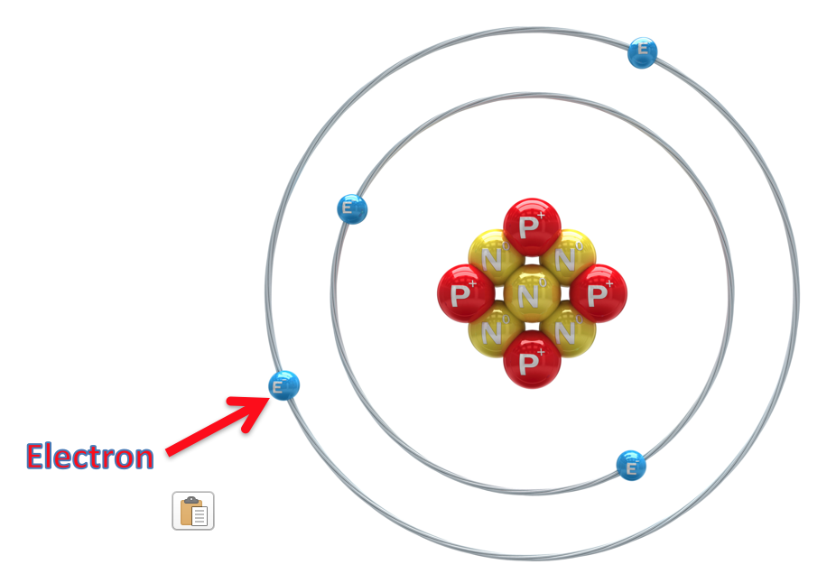
An electron has a ________ charge.
Positive
Neutral
Negative
Super
Notes:
An electron has a __________ charge.

Slide 54
An electron has a ________ charge.
Positive
Neutral
Negative
Super
Notes:
An electron has a __________ charge.
[Negative]

Slide 55
Where would you find an electron?
Notes:
Where would you find an electron?
[Orbiting the center, or atomic nucleus, of the atom]

Slide 56
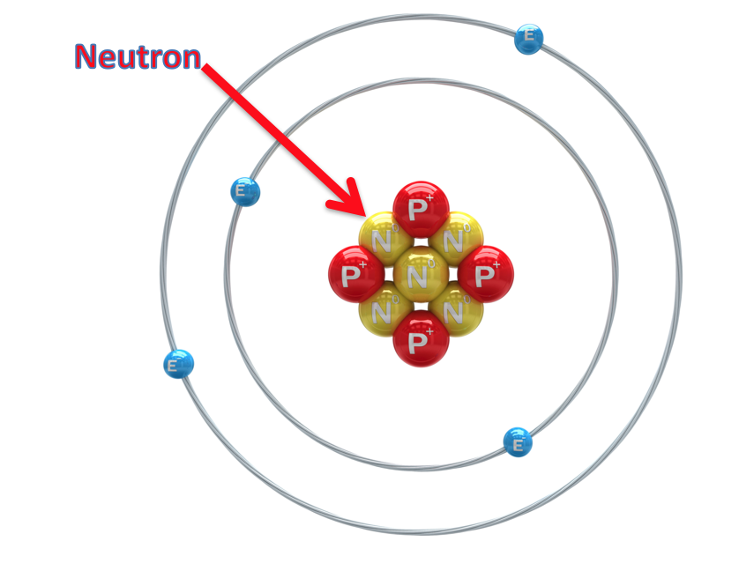
A neutron has a ________ charge.
Positive
Neutral
Negative
Super
Notes:
A neutron has a __________ charge.

Slide 57
A neutron has a ________ charge.
Positive
Neutral
Negative
Super
Notes:
A neutron has a __________ charge.
[Neutral]

Slide 58
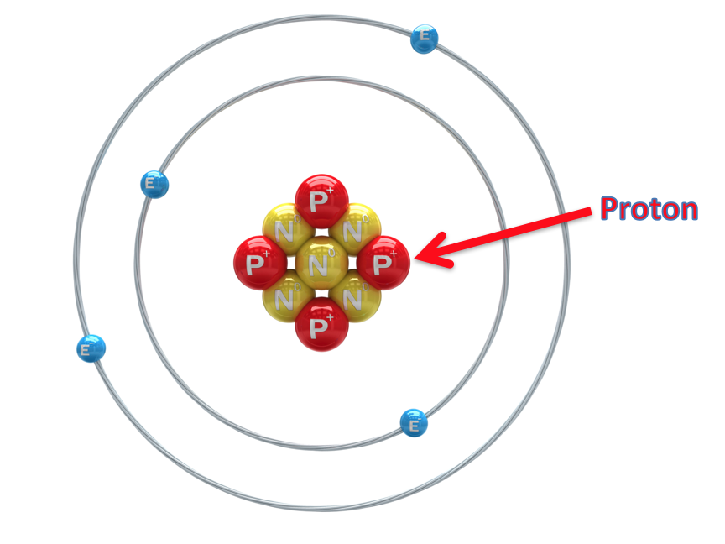
A proton has a ________ charge.
Positive
Neutral
Negative
Super
Notes:
A proton has a __________ charge.

Slide 59
A proton has a ________ charge.
Positive
Neutral
Negative
Super
Notes:
A proton has a __________ charge.
Positive

Slide 60
What is a subatomic particle?
Neutron
Proton
Electron
Notes:
What is a subatomic particle?
[A subatomic particle is a particle that is smaller than an atom. These are protons, neutrons, and electrons.]

Slide 61
Remember!!!
Notes:
So remember!

Slide 62
Atomic Nucleus: the center of the atom
Nucleus
Notes:
The atomic nucleus is the center of the atom.

Slide 63
Subatomic Particle: particle smaller than an atom
Notes:
A subatomic particle is a particle smaller than an atom. Protons, neutrons, and electrons are the subatomic particles in an atom. Protons and neutrons are found in the atomic nucleus.

Slide 64
Proton: positively charged subatomic particle found in the nucleus of an atom
Proton
Notes:
A proton is a positively charged subatomic particle found in the nucleus of an atom.

Slide 65
Neutron: subatomic particle with a neutral charge, found in the nucleus of an atom
Neutron
Notes:
A neutron is a subatomic particle with a neutral charge, found in the nucleus of an atom.

Slide 66
Electron: negatively charged particle that orbits the nucleus of an atom.
Electron
Notes:
An electron is a negatively charged particle that orbits the nucleus. Like protons and neutrons, it is a subatomic particle, however, electrons are not located in the atomic nucleus like they are.

Slide 67
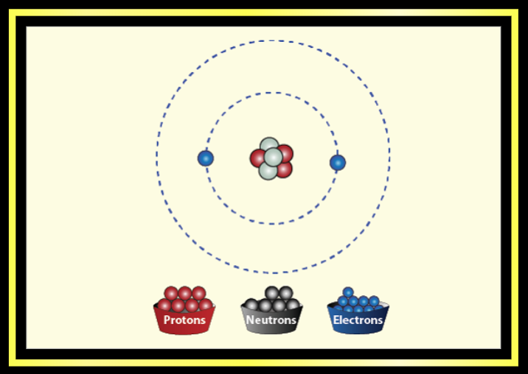
Simulation Activity
Build an Atom
Click the link above to explore atoms.
In this simulation activity, you’ll get to change the amount of protons, neutrons, and electrons in an atom and see how measures like atomic mass and number are affected.
Notes:
Feedback: Providing a simulation activity is a great way to make science thinking visible. In these simulations, students have the opportunity to build elements based on different particles and see how differing amounts of the particles affects the element. Both simulations are not necessary; students can be differentially assigned a certain simulation based on your assessment of students’ understanding and their needs.

Slide 68
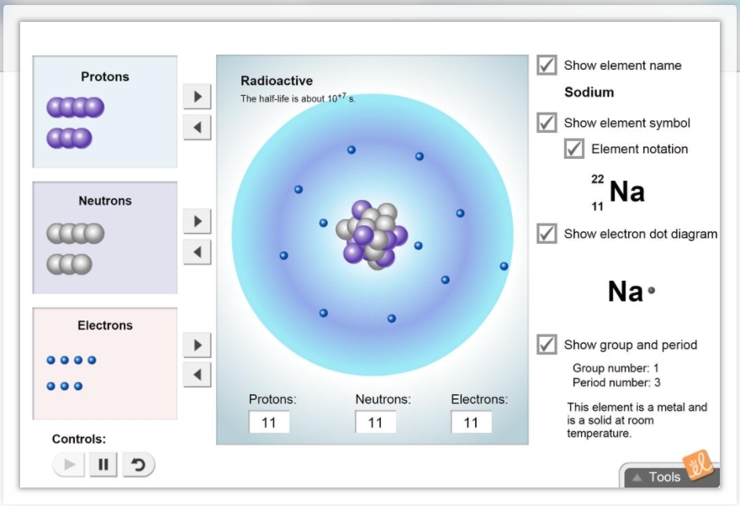
Simulation Activity
Element Builder
Click the link above to explore atoms.
In this simulation activity,
you’ll use protons, neutrons, and electrons to build elements. You’ll see how a change in the number of certain subatomic particles changes elements and their properties.

Slide 69
Big Question: What are the basic structural components of an atom?
Notes:
Explicit cue to revisit the big question at the end of the lesson: Okay everyone. Now that we’ve learned the term, let’s reflect once more on our big question. Was there anything that we predicted earlier that was correct or incorrect? Do you have any new hypotheses to share?

Slide 70
Notes:
Thanks for watching, and please continue watching CAPs available from this website.

Slide 71
This Video Was Created With Resources From:
Questions or Comments
Michael Kennedy, Ph.D. MKennedy@Virginia.edu
Rachel L Kunemund, Ph.D. rk8vm@virginia.edu

