Slide 1
Intro
“Big Idea” Question
Review Concepts
Check-In Questions
Teacher Demo
Vocabulary
Student-Friendly Definition
Examples & Non-Examples
Morphological Word Parts
Simulation/Activity
Notes:
OK everyone, get ready for our next lesson. Just as a reminder, these are the different components that our lesson may include, and you’ll see these icons in the top left corner of each slide so that you can follow along more easily!

Slide 2
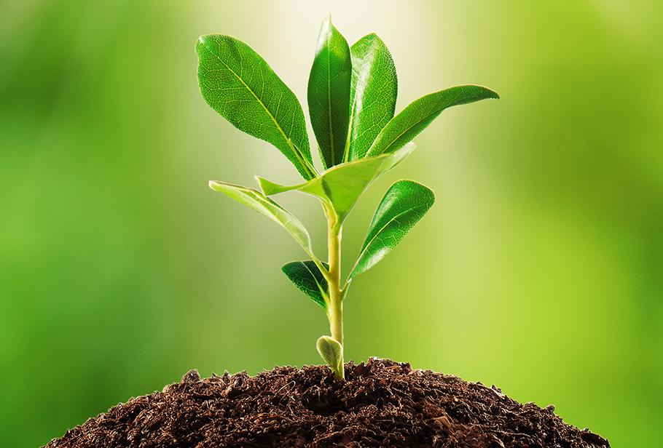
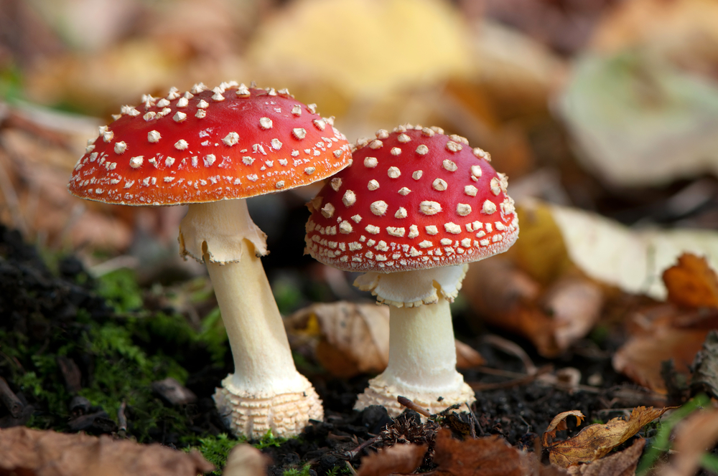
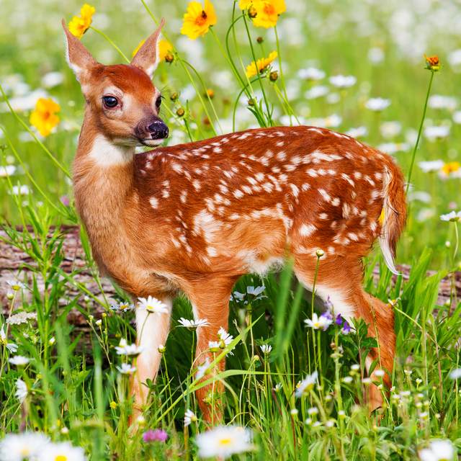
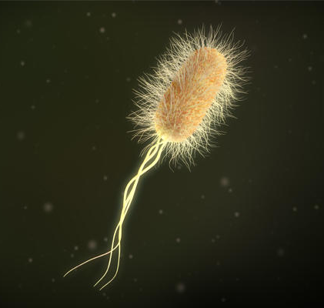
Intro
Biotic Factors
Notes:
Today we will learn about biotic factors.

Slide 3
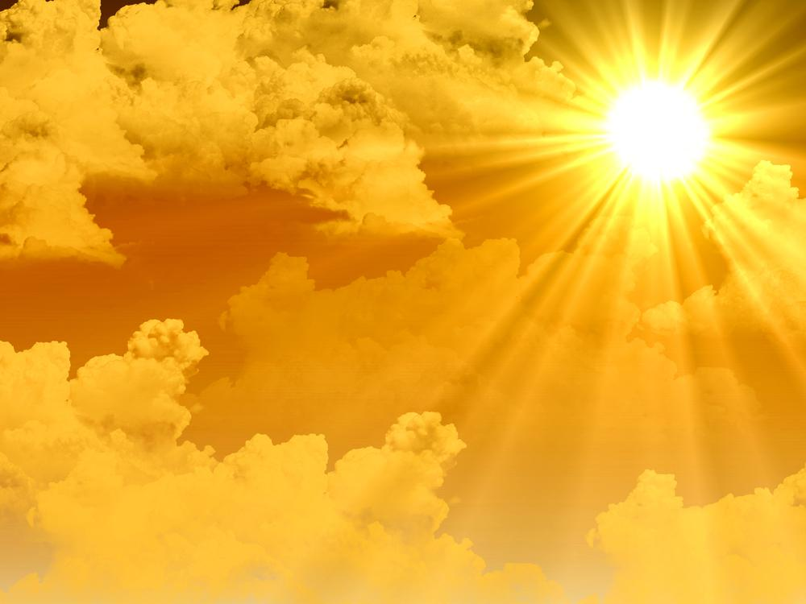
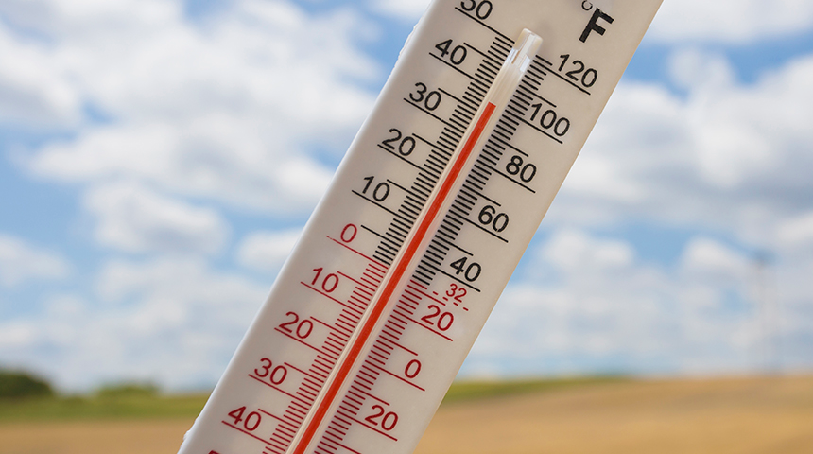
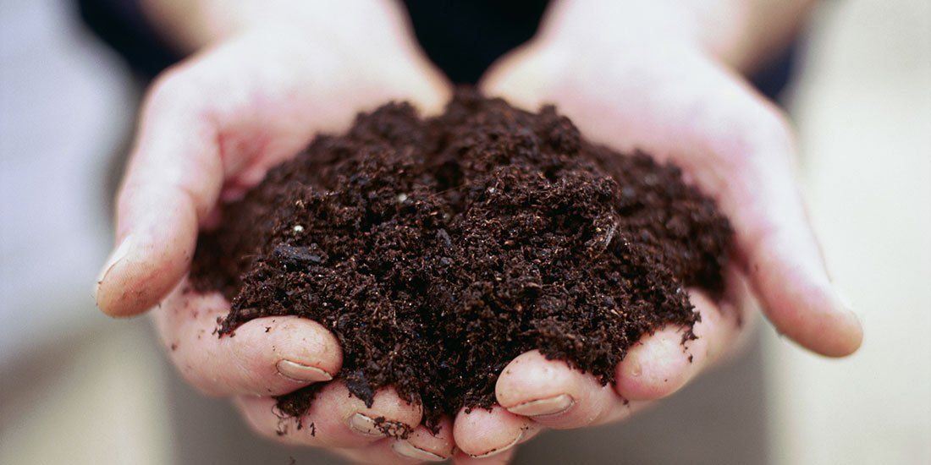
Big Question: What is the difference between biotic and abiotic factors?
Notes:
Our “big question” is: What is the difference between biotic and abiotic factors?
[Pause and illicit predictions from students.]
I love all these thoughtful scientific hypotheses! Be sure to keep this question and your predictions in mind as we move through these next few lessons, and we’ll continue to revisit it.
Feedback: Asking students to make predictions about the differences between these factors is a great way to activate and elicit student ideas and prior knowledge. This type of activity is evidence of the teacher planning for students’ engagement with science ideas.

Slide 4
Notes:
Before we move on to our new vocabulary term, let’s review some other words & concepts that you already learned and make sure you are firm in your understanding.

Slide 5
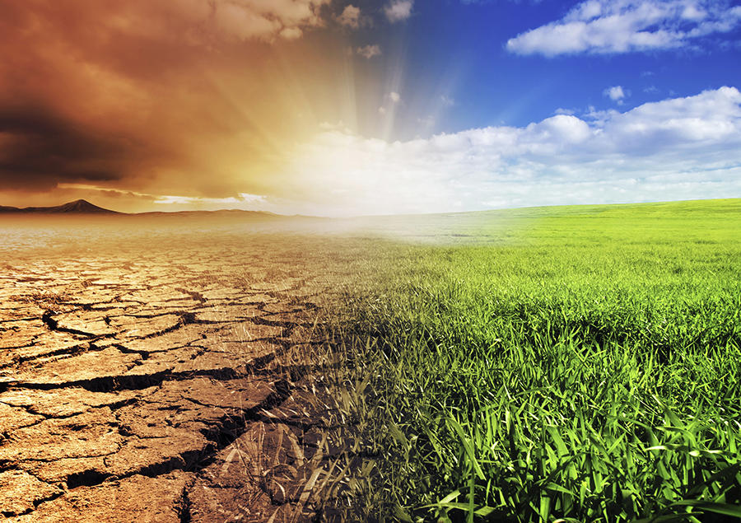
Environment: the surroundings of a person, animal, plant or thing
Notes:
An environment is the surroundings of a person, animal, plant or thing. An environment includes many factors, including temperature, moisture, soil, and the presence of other organisms.

Slide 6
Living Things: things that are made of cells, can grow, and can reproduce
Notes:
Living things are things that are made of cells, can grow, and can reproduce.

Slide 7
Notes:
Now let’s pause for a moment to check your understanding.

Slide 8
What is an environment?
Notes:
What is an environment?
[An environment is the surroundings of a person, animal, plant or thing.]

Slide 9
What is a living thing?
Notes:
What is a living thing?
[Living things are things that are made of cells, can grow, and can reproduce.]

Slide 10
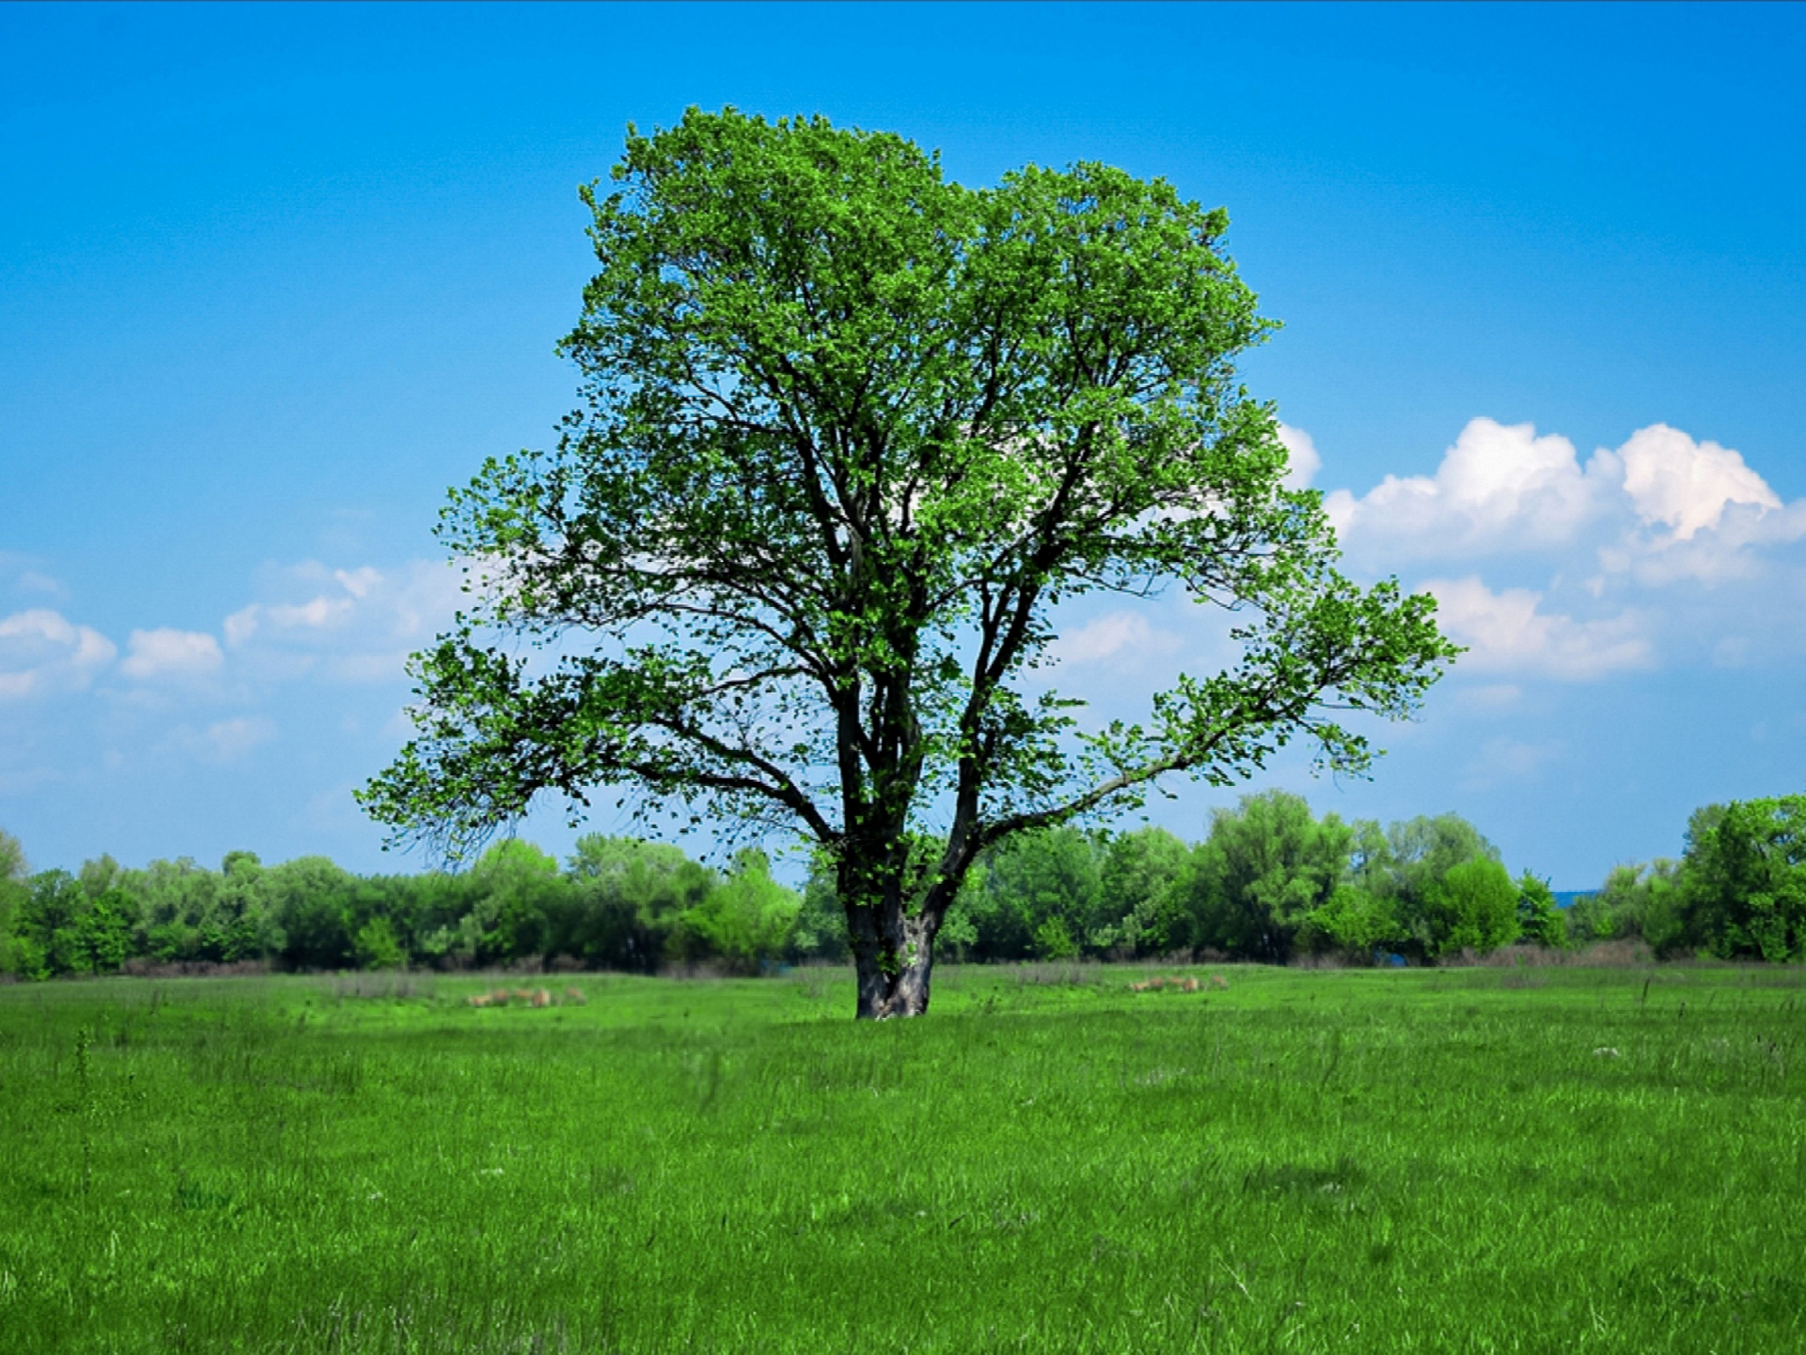
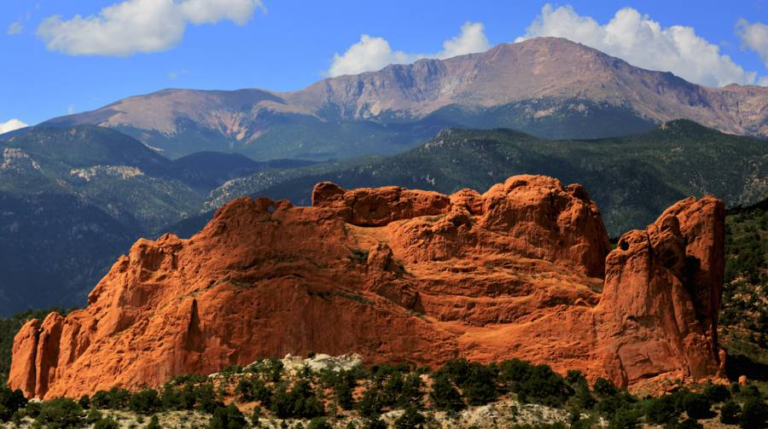
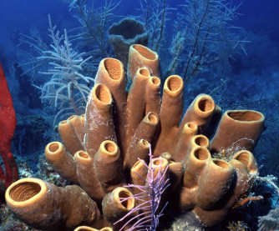
Demonstration
Living Things Review Presentation
Use the presentation linked above to ask students which items are living versus nonliving. As each item is discussed, consider reviewing the characteristics of life. How do the included items meet the requirements or fail to meet the requirements?
Notes:
Today we are going to do a little bit of review about the characteristics of living things. As I flip through the images, I want you all to tell be which items are living or nonliving and why you would categorize them in the way that you chose.
Feedback: There are several characteristics of living things that students may come across as they work through this topic. Through this demonstration, you provide examples and non-examples for each characteristic.

Slide 11
Biotic Factors
Notes:
Now that we’ve reviewed, let’s define our new term, biotic factors.
Feedback: Slides such as this are important for their use of cues with students. By telling students what is coming either with images or words, it helps them know what to expect.

Slide 12
Biotic Factors: living things that influence or affect an ecosystem
Notes:
Biotic factors are the living things that influence or affect an ecosystem. Don’t forget that living things include anything made of cells - including plants, animals, fungi, bacteria, and protists. We will learn more about ecosystems later in the unit.

Slide 13
Notes:
Let’s check-in for understanding.

Slide 14
What is a biotic factor?
Notes:
What is a biotic factor?
[Biotic factors are the living things that influence or affect an ecosystem.]

Slide 15
Notes:
Now, let’s talk about some examples of biotic factors.

Slide 16
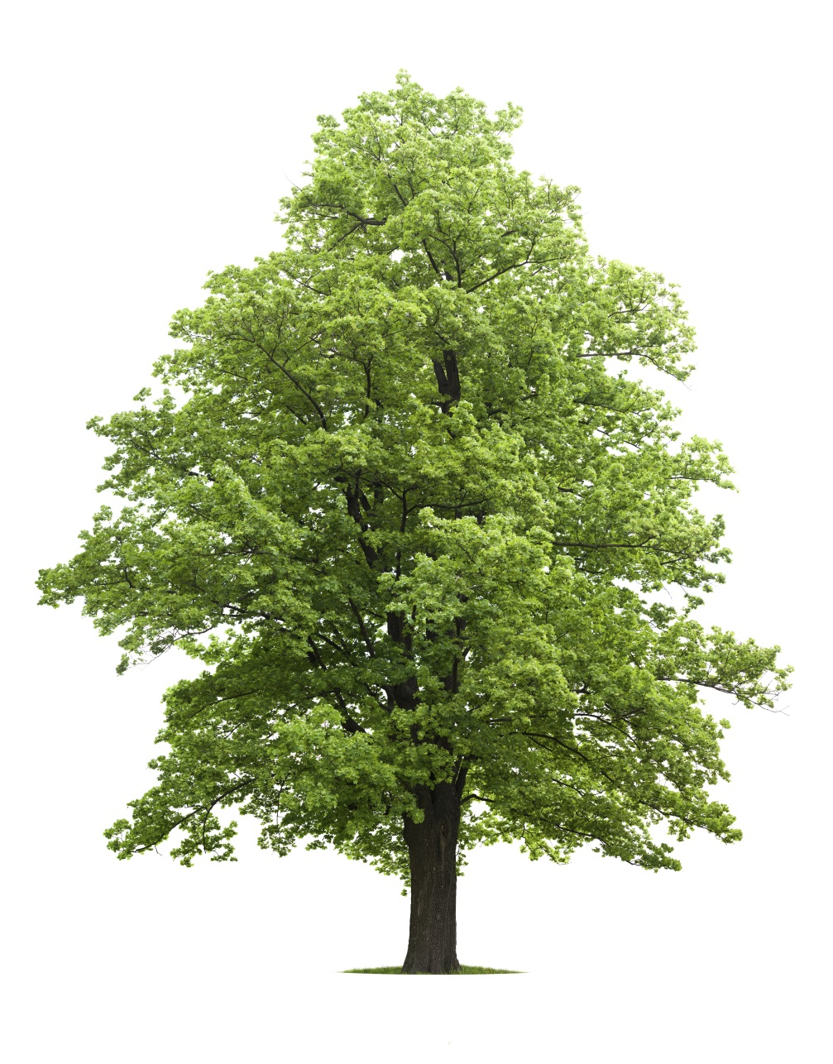
Is this tree a biotic factor?
Notes:
Is this tree a biotic factor?
[Yes – this tree is an example of a biotic factor. This is because trees are plants, which are living things.]
Feedback: It is important to explicitly explain why an example is an example.

Slide 17
Is this woman a biotic factor?
Notes:
Is this woman a biotic factor?
[Yes – this woman is an example of a biotic factor. This is because humans are living things.]

Slide 18
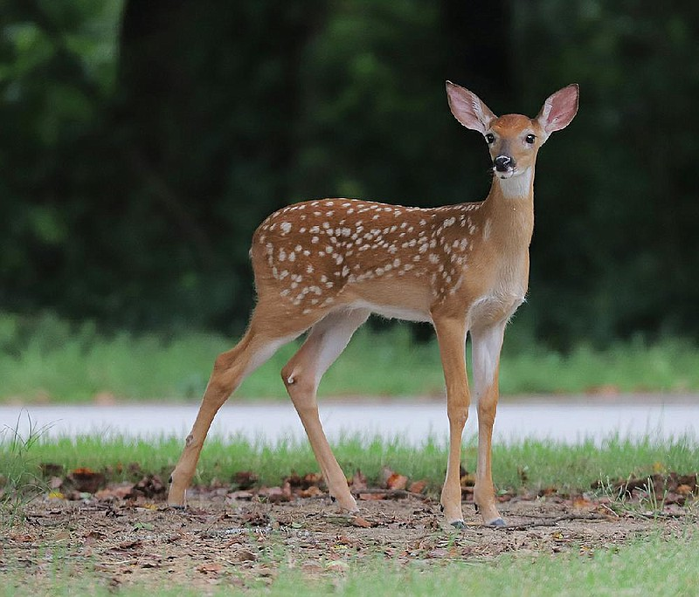
Is this deer a biotic factor?
Notes:
Is this deer a biotic factor?
[Yes – this deer is an example of a biotic factor. ]

Slide 19
Notes:
Next, let’s talk about some non-examples of biotic factors.

Slide 20
Is water a biotic factor?
Notes:
Is water a biotic factor?
[No – water is not an example of a biotic factor. It has no cells and is not a living thing.]
Feedback: Similarly, it is important to explicitly tell students or discuss with students why a non example is a non example.

Slide 21
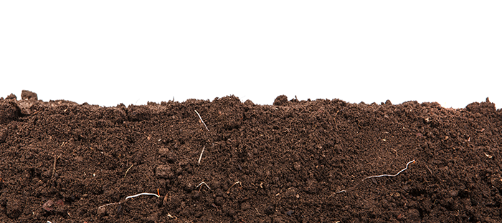
Is soil a biotic factor?
Notes:
Is soil a biotic factor?
[No – soil is not an example of biotic factors. It is not living.]

Slide 22
Notes:
Let’s check-in for understanding.

Slide 23
What are examples of biotic factors?
Notes:
What are examples of biotic factors?

Slide 24
What are non-examples of biotic factors?
NON
Notes:
What are non-examples of biotic factors?

Slide 25
Notes:
We can also break down the term biotic into different word parts to help us remember the meaning. Let’s take a look!

Slide 26
Biotic
Bio -ic
(root word)
(suffix)
Notes:
The word biotic can be broken into two parts. The root word, bio, and the suffix, -ic.

Slide 27
Biotic
Bio -ic
life
Notes:
The root word, bio, means “life.”

Slide 28
Biotic
Bio -ic
Indicates an adjective, or describing word
Notes:
The root word, bio, means “life.”
Feedback: When breaking words down into morphological parts, the use of clear language is essential.

Slide 29
Biotic -ic
Biotic
Describes things that are living
Notes:
So, when you add the suffix –ic to the root word bio, it describes things that are living.

Slide 30
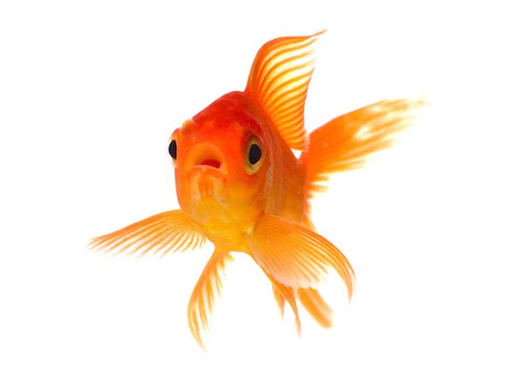
So, when we use the term biotic factors, we are talking about living things.
Notes:
So, when we use the term biotic factors, we are talking about living things.

Slide 31
Notes:
Let’s check-in for understanding.

Slide 32
How can we use the word parts of biotic to help us remember the definition of the term?
Notes:
How can we use the word parts of biotic to help us remember the definition of the term?
[The root word, bio, means “life.” The root word, bio, means “life.” So, when you add the suffix –ic to the root word bio, it describes things that are living.]
Feedback: Reuniting the word parts is a crucial step in helping students understand the whole picture when reviewing morphological word parts.

Slide 33
Notes:
Let’s check-in for understanding.

Slide 34
What is a biotic factor?
Notes:
What is a biotic factor?
[Biotic factors are the living things that influence or affect an ecosystem.]

Slide 35
List 3 examples of biotic factors.
Notes:
List three examples of biotic factors.

Slide 36
Remember!!!
Notes:
So remember!

Slide 37
Biotic Factors: living things, plants or animals, that influence or affect an ecosystem
Notes:
Biotic factors are the living things that influence or affect an ecosystem. And, we will learn more about ecosystems later in the unit.

Slide 38
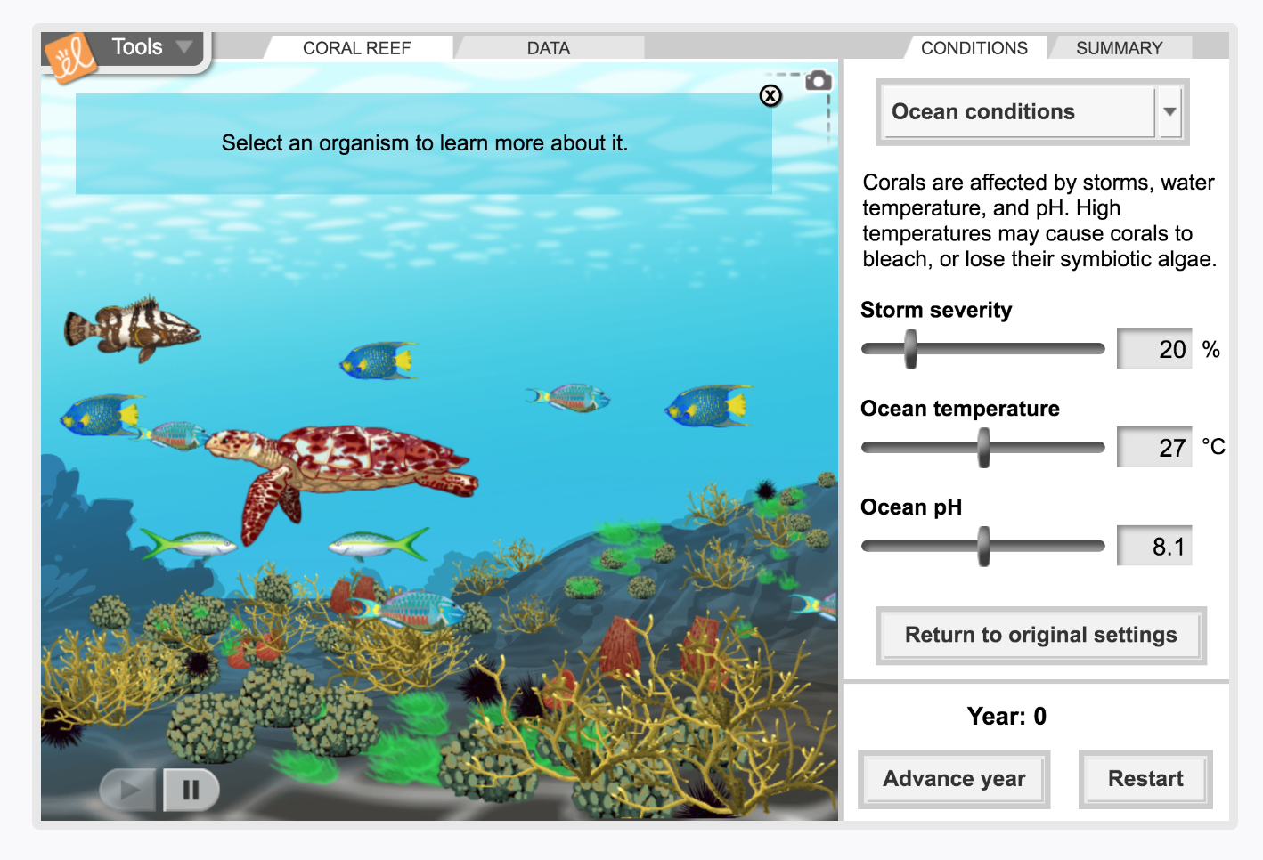
Simulation Activity
Biotic Factors
(Gizmos)
Click the link above to explore the different biotic factors in the coral reef.
In this simulation activity, you’ll learn about the characteristics of the biotic factors and how they are involved in the environment.
Notes:
Feedback: Providing a simulation activity is a great way to make science thinking visible. In this simulation, students have the opportunity to make predictions and apply an idea to a new situation by changing the variables in the simulation (i.e., storm severity, ocean temperature, ocean pH).

Slide 39
Big Question: What is the difference between biotic and abiotic factors?
Notes:
Explicit cue to revisit the big question at the end of the lesson: Okay everyone. Now that we’ve learned the term, biotic factors, let’s reflect once more on our big question. Was there anything that we predicted earlier that was correct or incorrect? Do you have any new hypotheses to share?

Slide 40
Notes:
Thanks for watching, and please continue watching CAPs available from this website.

Slide 41
This Video Was Created With Resources From:
Questions or Comments
Michael Kennedy, Ph.D. MKennedy@Virginia.edu
Rachel L Kunemund, Ph.D. rk8vm@virginia.edu

Slide 42
Intro
“Big Idea” Question
Review Concepts
Check-In Questions
Teacher Demo
Vocabulary
Student-Friendly Definition
Examples & Non-Examples
Morphological Word Parts
Simulation/Activity
Notes:
OK everyone, get ready for our next lesson. Just as a reminder, these are the different components that our lesson may include, and you’ll see these icons in the top left corner of each slide so that you can follow along more easily!

Slide 43
Abiotic Factors
Intro
Notes:
Today we’re going to learn about abiotic factors.

Slide 44
Big Question: What is the difference between biotic and abiotic factors?
Notes:
Before we start, let’s think about our “big question”: What is the difference between biotic and abiotic factors? We recently learned about biotic factors, so what predictions do you have to share about the the difference between biotic and abiotic factors? [Pause and illicit predictions from students.]
I love all these thoughtful scientific hypotheses! Be sure to keep this question and your predictions in mind as we move through this lesson, and we’ll revisit it.

Slide 45
Notes:
Before we move on to our new vocabulary term, let’s review some other words & concepts that you already learned and make sure you are firm in your understanding.

Slide 46
Environment: the surroundings of a person, animal, plant or thing
Notes:
An environment is the surroundings of a person, animal, plant or thing. An environment includes many factors, including temperature, moisture, soil, and the presence of other organisms.

Slide 47
Living Things: things that are made of cells, can grow, and can reproduce
Notes:
Living things are things that are made of cells, can grow, and can reproduce

Slide 48
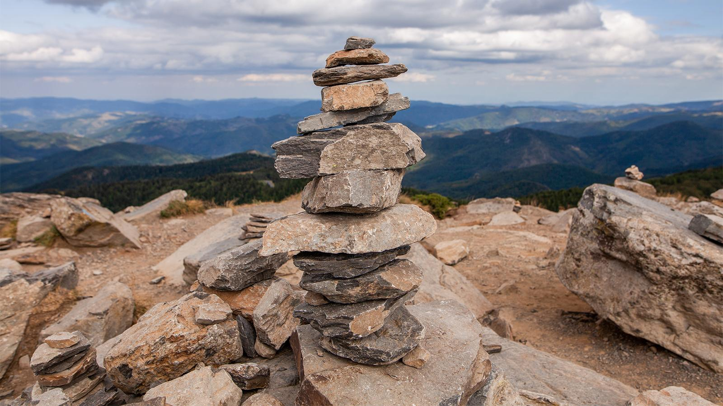
Non-Living Things: do not grow or reproduce and do not need food
Notes:
Non-living things do not grow or reproduce and do not need food.

Slide 49
Biotic Factors: living thing that influence or affect an ecosystem
Notes:
Biotic factors are the living things that influence or affect an ecosystem. We will learn more about ecosystems later in the unit.

Slide 50
Notes:
Now let’s pause for a moment to check your understanding.

Slide 51
What is the difference between living and nonliving?
Notes:
What is the difference between living and nonliving?
[Living things are things that can grow and reproduce. Non-living things do not grow or reproduce. Living things need food and nonliving things do not.]

Slide 52
What are biotic factors?
Notes:
What are biotic factors?
[Biotic factors are the living things, plants that influence or affect an ecosystem.]

Slide 53
Why is water NOT an example of a biotic factor?
Notes:
Why is water NOT an example of a biotic factor?
[Water is not a biotic factor because it is not a living thing - it is not made of cells, it does not grow and does not reproduce.]

Slide 54
Abiotic Factors
Notes:
Now that we’ve reviewed, let’s define our new term, abiotic factors.

Slide 55
Abiotic Factors: non-living things that influence or affect an ecosystem
Notes:
Abiotic factors are the non-living things that influence or affect an ecosystem. Abiotic factors include things such as sunlight, temperature, soil, and water. Though not living, these factors play an important role in determining what organisms can live in a certain environment. Remember, we will learn more about ecosystems later in the unit.

Slide 56
Notes:
Let’s check-in for understanding.

Slide 57
What are abiotic factors?
Notes:
What are abiotic factors?
[Abiotic factors are the non-living things that influence or affect an ecosystem.]

Slide 58
Notes:
Now, let’s talk about some examples of abiotic factors.

Slide 59
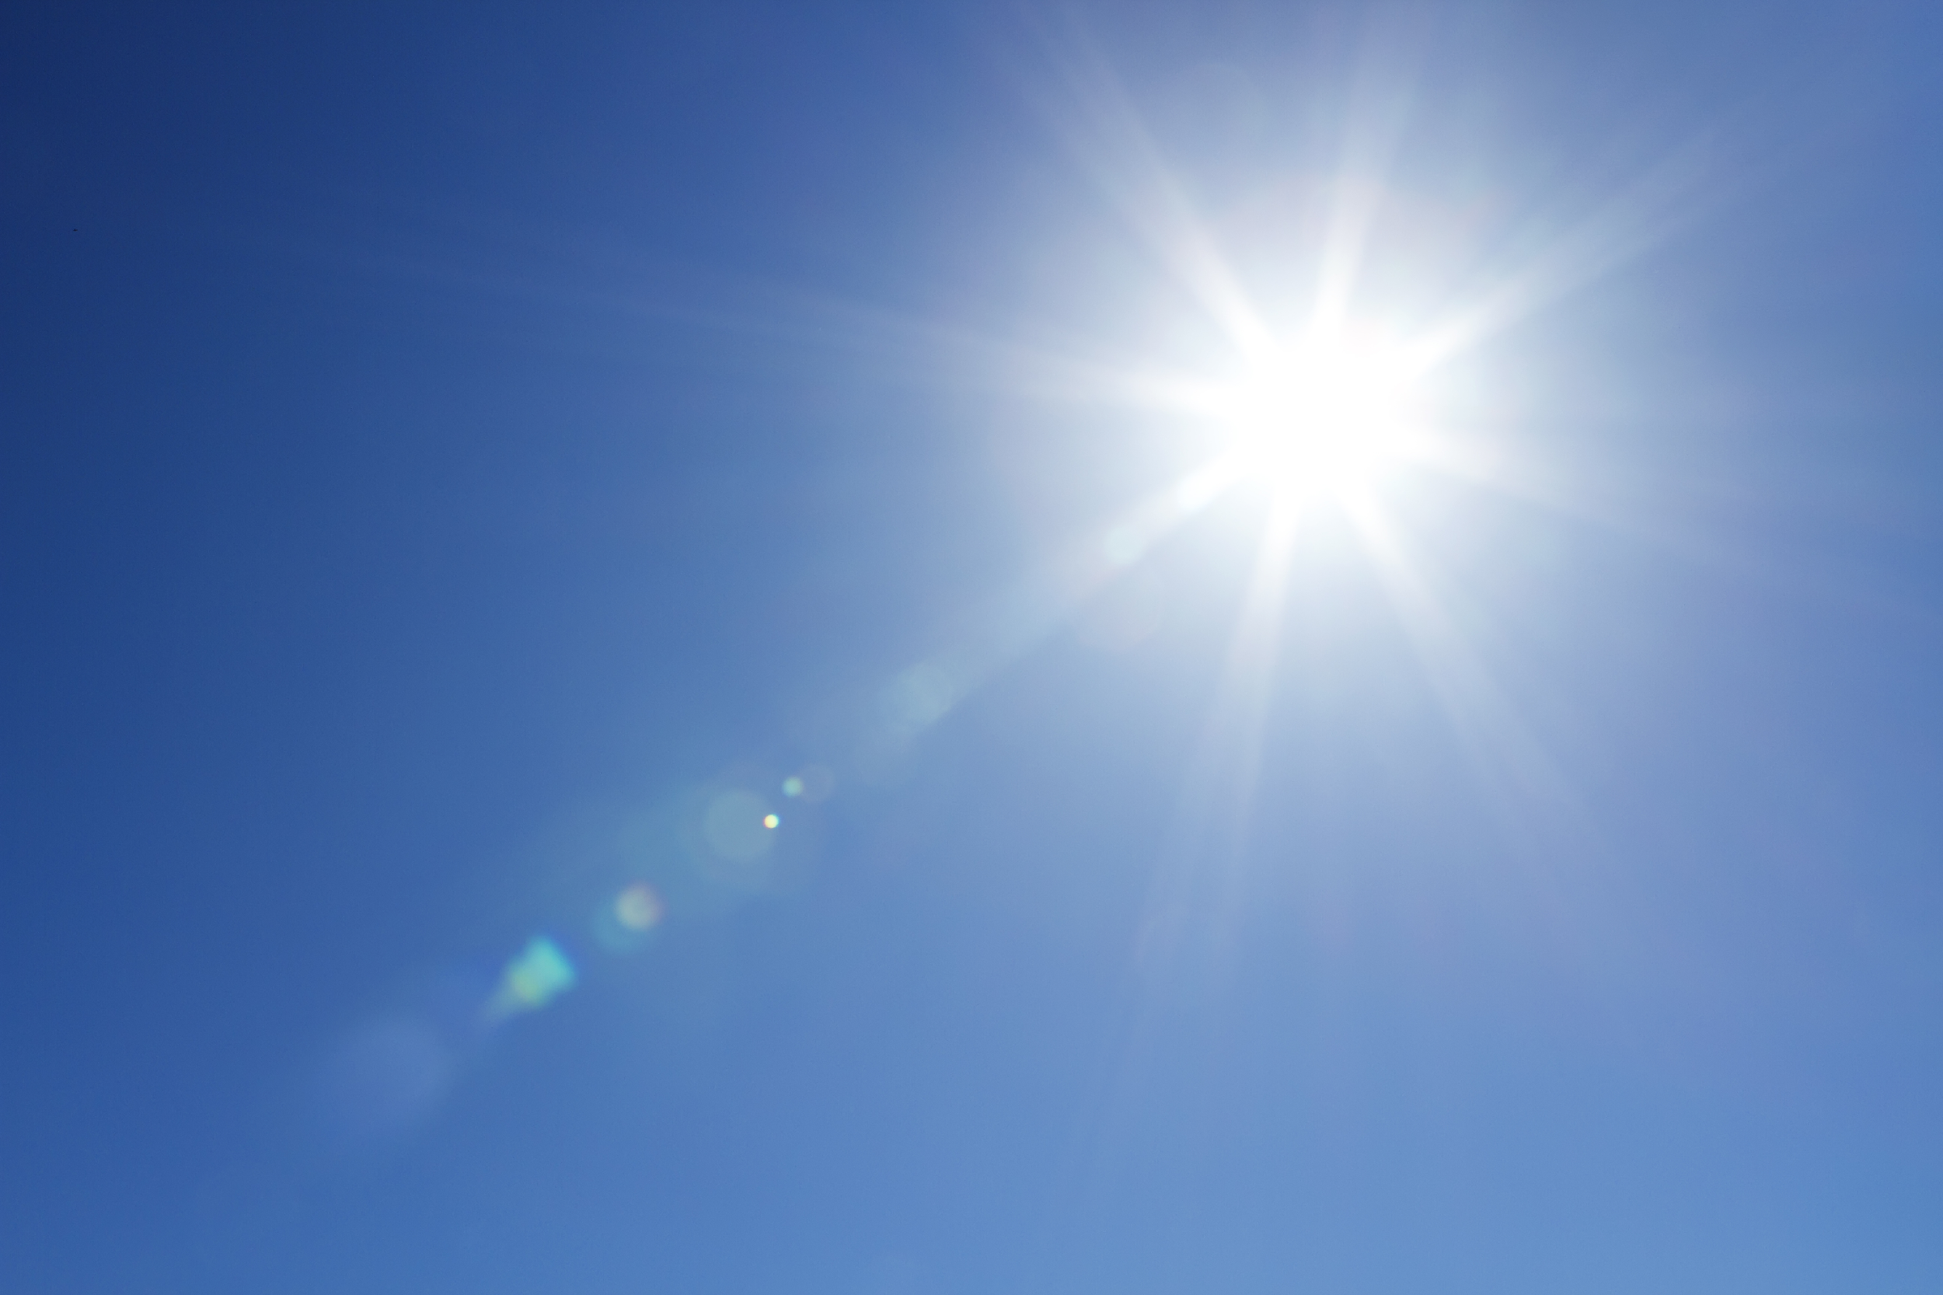
Is sunlight an abiotic factor?
Notes:
Is sunlight an abiotic factor?
[Yes – sunlight is an example of an abiotic factor. Sunlight is nonliving.]

Slide 60
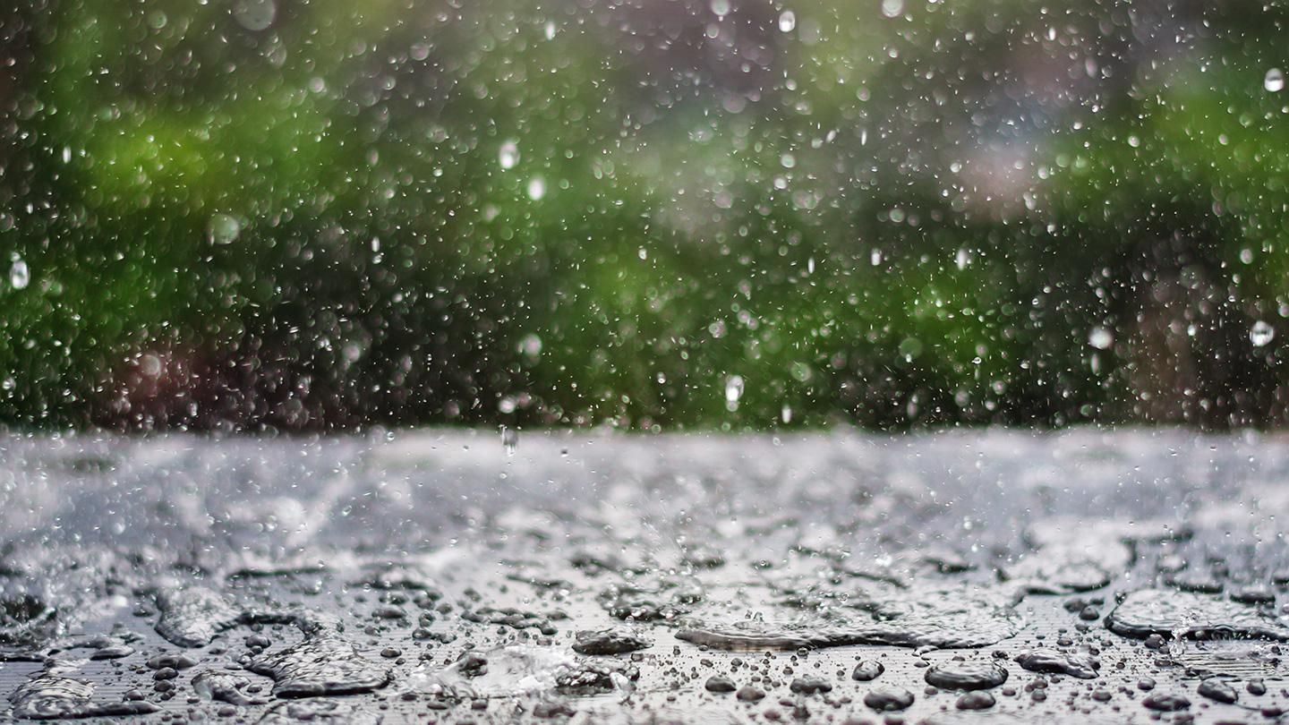
Is rain an abiotic factor?
Notes:
Is rain an abiotic factor?
[Yes – rain is an example of an abiotic factor. Rain is non-living.]

Slide 61
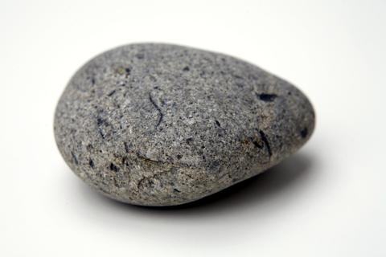
Is this rock an abiotic factor?
Notes:
Is rock an abiotic factor?
[Yes – this rock is an example of an abiotic factor. Rocks are non-living things.]

Slide 62
Notes:
Next, let’s talk about some non-examples of abiotic factors.

Slide 63
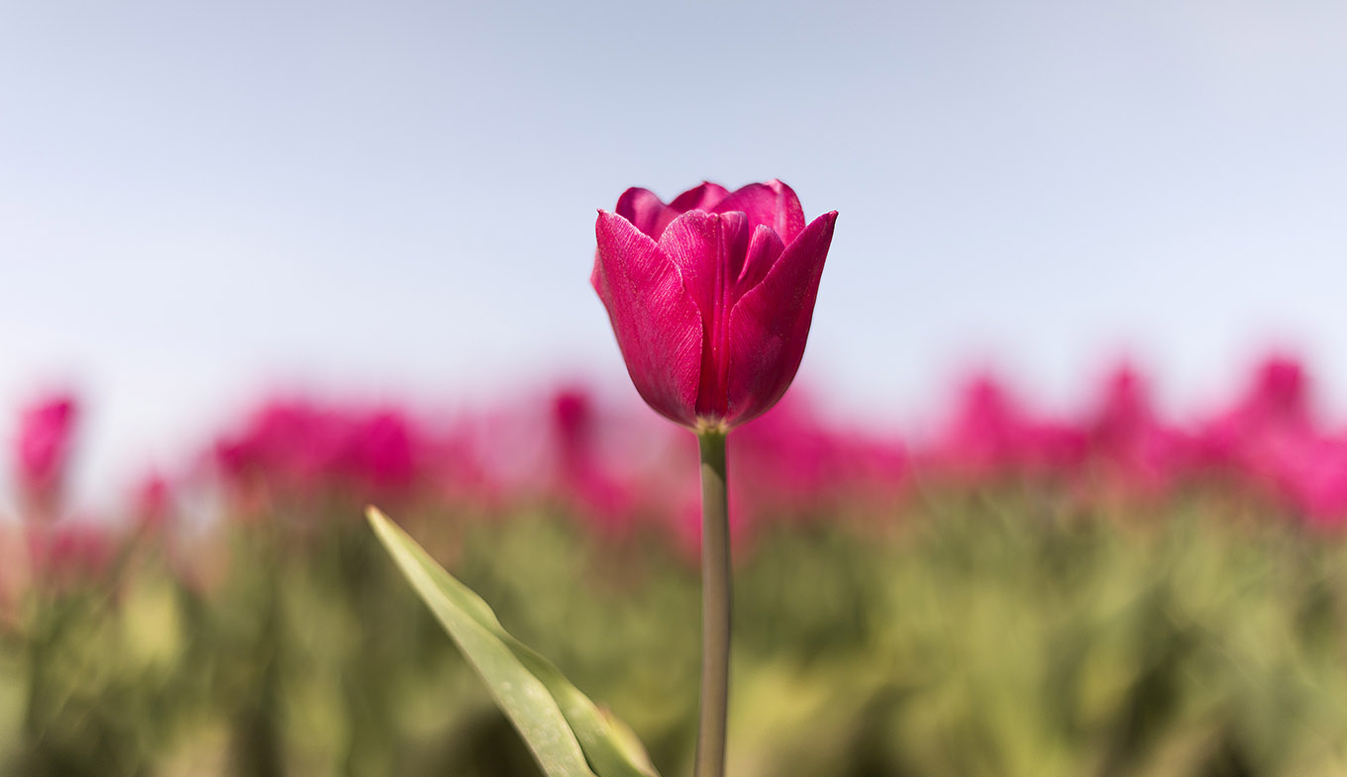
Is this flower an abiotic factor?
Notes:
Is this flower an abiotic factor?
[No – a flower is not an example of an abiotic factor. Flowers are living things, they are biotic factors.]

Slide 64
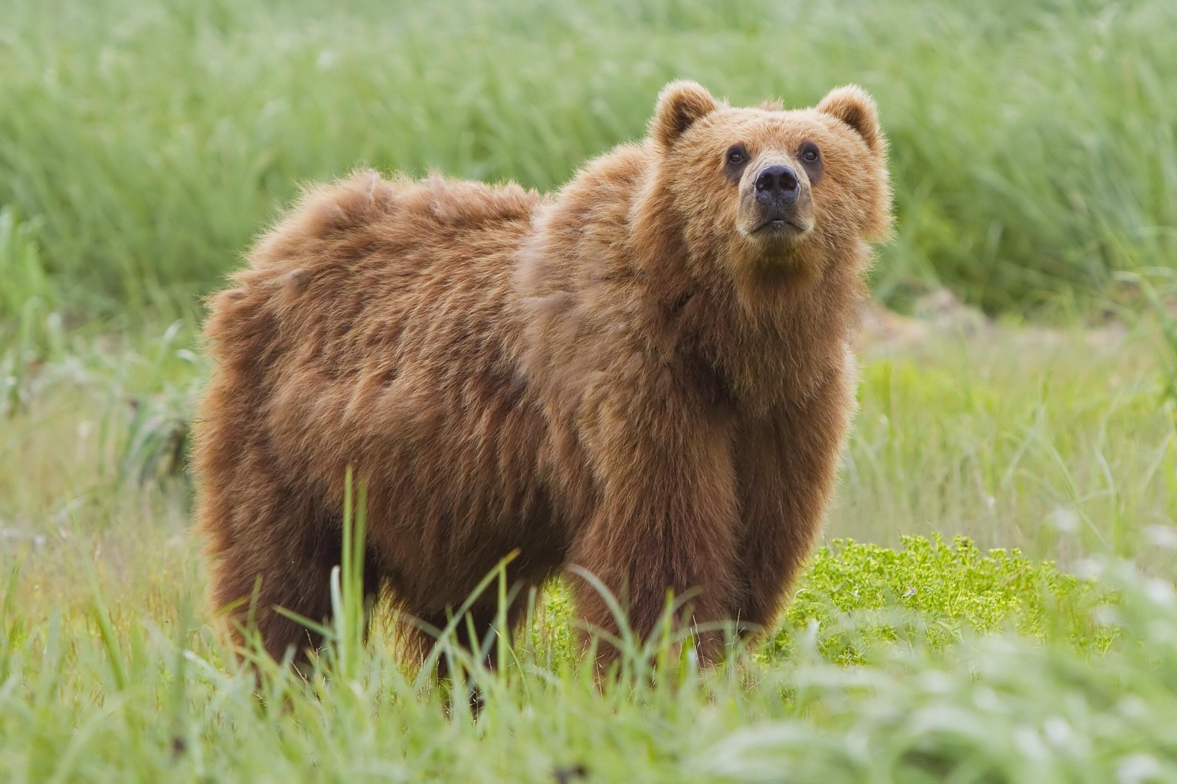
Is this bear an abiotic factor?
Notes:
Is this bear an abiotic factor?
[No – this bear is not an example of an abiotic factor. Bears are living things, they are biotic factors.]

Slide 65
Notes:
Let’s check-in for understanding.

Slide 66
What are examples of abiotic factors?
Notes:
What are examples of abiotic factors?

Slide 67
What are non-examples of abiotic factors?
NON
Notes:
What are non-examples of abiotic factors?

Slide 68
Notes:
We can break down the term abiotic into different word parts to help us remember the meaning. Let’s take a look!

Slide 69
Abiotic
A bio -ic
(prefix)
(root word)
(suffix)
Notes:
The word abiotic can be broken into three parts. The prefix a, root word, bio, and the suffix, -ic.

Slide 70
Abiotic
A bio -ic
Not or opposite
Notes:
The prefix, -a, means not or opposite.

Slide 71
Abiotic
A bio -ic
Life
Notes:
Remember, the root, bio, means life.

Slide 72
Abiotic
A bio -ic
Indicates an adjective, or describing word
Notes:
The suffix, -ic, indicates an adjective, or describing word.

Slide 73
A bio -ic
Abiotic
Describes things that are not living
Notes:
So, when you add the prefix a and the suffix –ic to the root word bio, it describes things that are not living.

Slide 74
Notes:
Let’s check-in for understanding.

Slide 75
How can we use the word parts of abiotic to help us remember the definition of the term?
Notes:
How can we use the word parts of abiotic to help us remember the definition of the term?
[The prefix, -a, means not or opposite. Remember, the root, bio, means life. The suffix, -ic, indicates an adjective, or describing word. So, when you add the prefix a and the suffix –ic to the root word bio, it describes things that are not living.]

Slide 76
Demonstration
Living Things Review Presentation
Use the presentation linked above to ask students which items are living versus nonliving. As each item is discussed, consider reviewing the characteristics of life. How do the included items meet the requirements or fail to meet the requirements?
Notes:
You can use the living things review presentation to once again refer back to the characteristics of living things.
Feedback: If you choose to utilize this demo a second time, it may be beneficial to include questions that extend student understanding in relation to biotic and abiotic factors. e.i. How does this item affect the ecosystem that it inhabits?

Slide 77
Notes:
Let’s check-in for understanding.

Slide 78
What are abiotic factors?
Notes:
What are abiotic factors?
[Abiotic factors are the non-living things that influence or affect an ecosystem.]

Slide 79
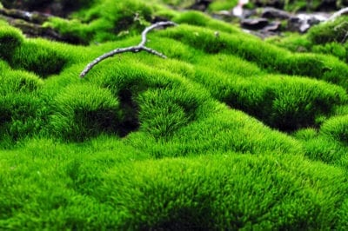
Is moss an abiotic factor or a biotic factor?
Notes:
Is moss an abiotic factor or a biotic factor?
[Moss is a biotic factor - it is a living thing.]

Slide 80
List 3 examples of abiotic factors.
Notes:
List three examples of abiotic factors.

Slide 81
Remember!!!
Notes:
So remember!

Slide 82
Abiotic Factors: non-living things that influence or affect an ecosystem
Notes:
Abiotic factors are the non-living things that influence or affect an ecosystem.

Slide 83
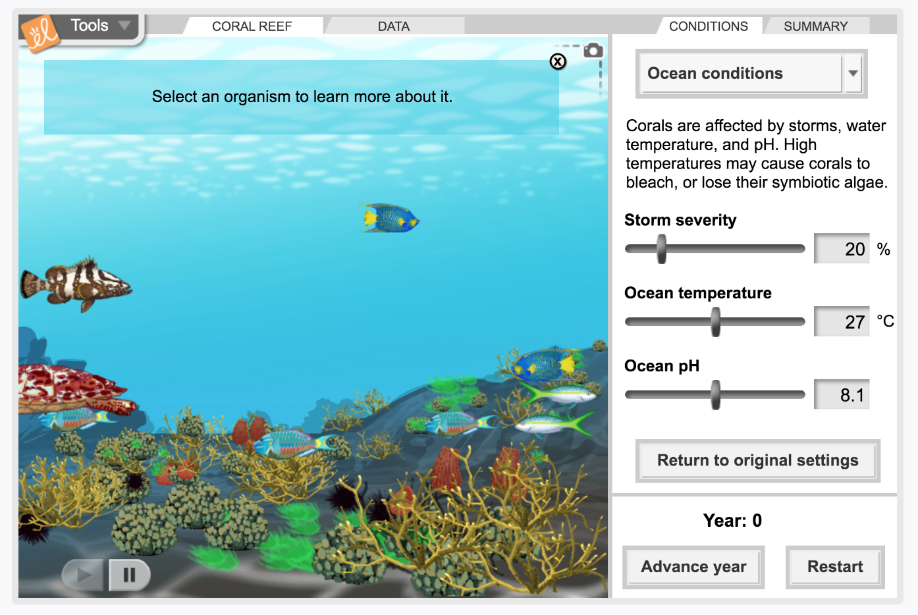
Simulation Activity
Abiotic Factors
(Gizmos)
Click the link above to explore the different abiotic factors in the coral reef.
Notes:
Feedback: Providing a simulation activity is a great way to make science thinking visible. In this simulation, students have the opportunity to make predictions and apply an idea to a new situation by changing the variables in the simulation (i.e., storm severity, ocean temperature, ocean pH).

Slide 84
Big Question: What is the difference between biotic and abiotic factors?
Notes:
Explicit cue to revisit the big question at the end of the lesson: Okay everyone. Now that we’ve learned the term, abiotic factors, let’s reflect once more on our big question. Was there anything that we predicted earlier that was correct or incorrect? Do you have any new hypotheses to share?
Feedback: Offering students an opportunity to evaluate their earlier hypotheses and make changes based on their new understandings is an important part of the iterative process in science. This is a great opportunity to help students build an epistemic understanding by explicitly stating how continuing to change and build on hypotheses as your knowledge grows is an important part of the discipline of science!

Slide 85
Notes:
Thanks for watching, and please continue watching CAPs available from this website.

Slide 86
This Video Was Created With Resources From:
Questions or Comments
Michael Kennedy, Ph.D. MKennedy@Virginia.edu
Rachel L Kunemund, Ph.D. rk8vm@virginia.edu

