Slide 1
Intro
“Big Idea” Question
Review Concepts
Check-In Questions
Teacher Demo
Vocabulary
Student-Friendly Definition
Examples & Non-Examples
Morphological Word Parts
Simulation/Activity
Notes:
OK everyone, get ready for our next lesson. Just as a reminder, these are the different components that our lesson may include, and you’ll see these icons in the top left corner of each slide so that you can follow along more easily!

Slide 2
Cell Membrane
Intro
Notes:
Today we are going to learn about the cell membrane.

Slide 3
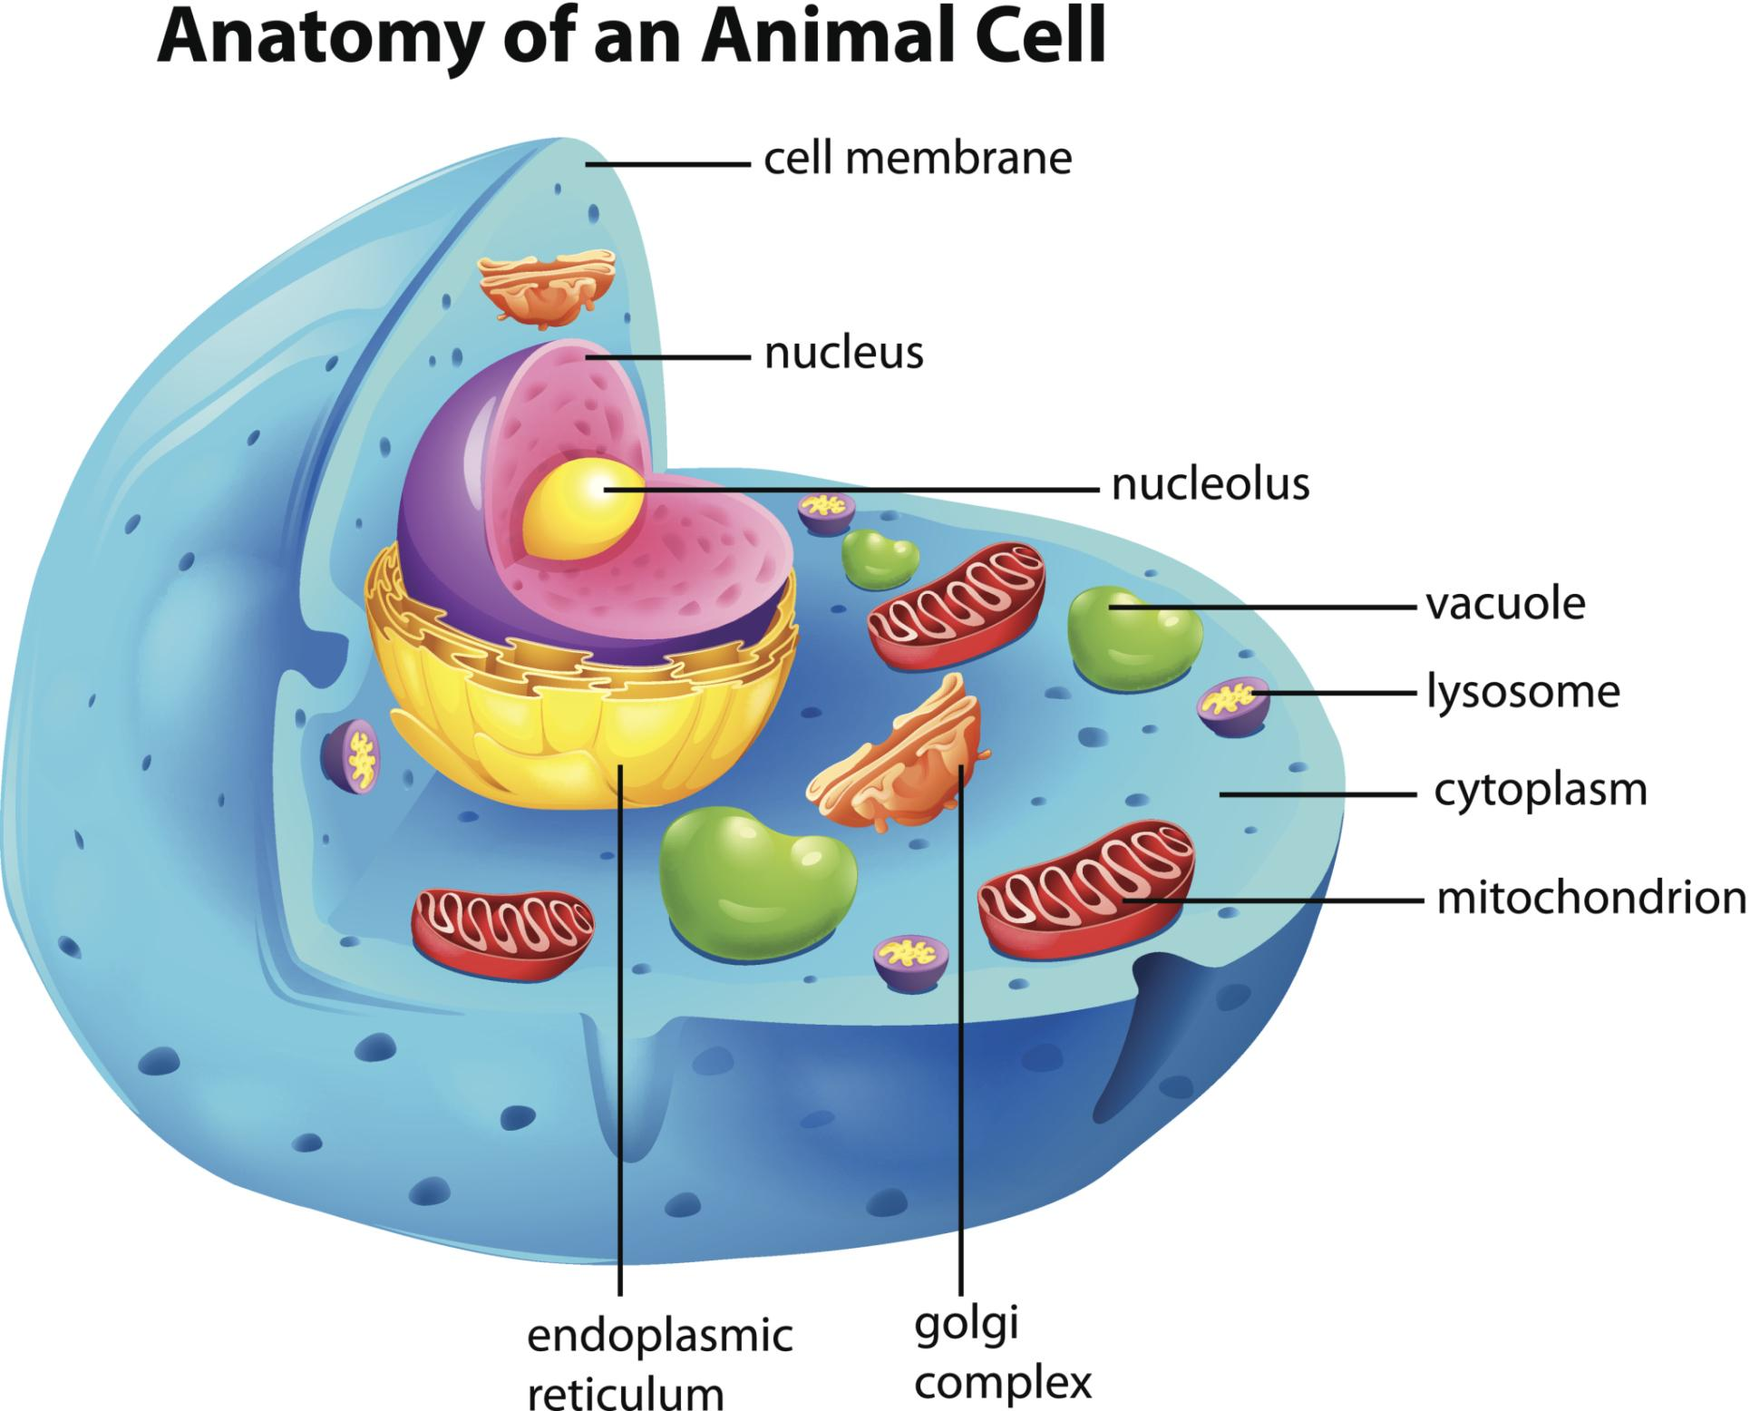
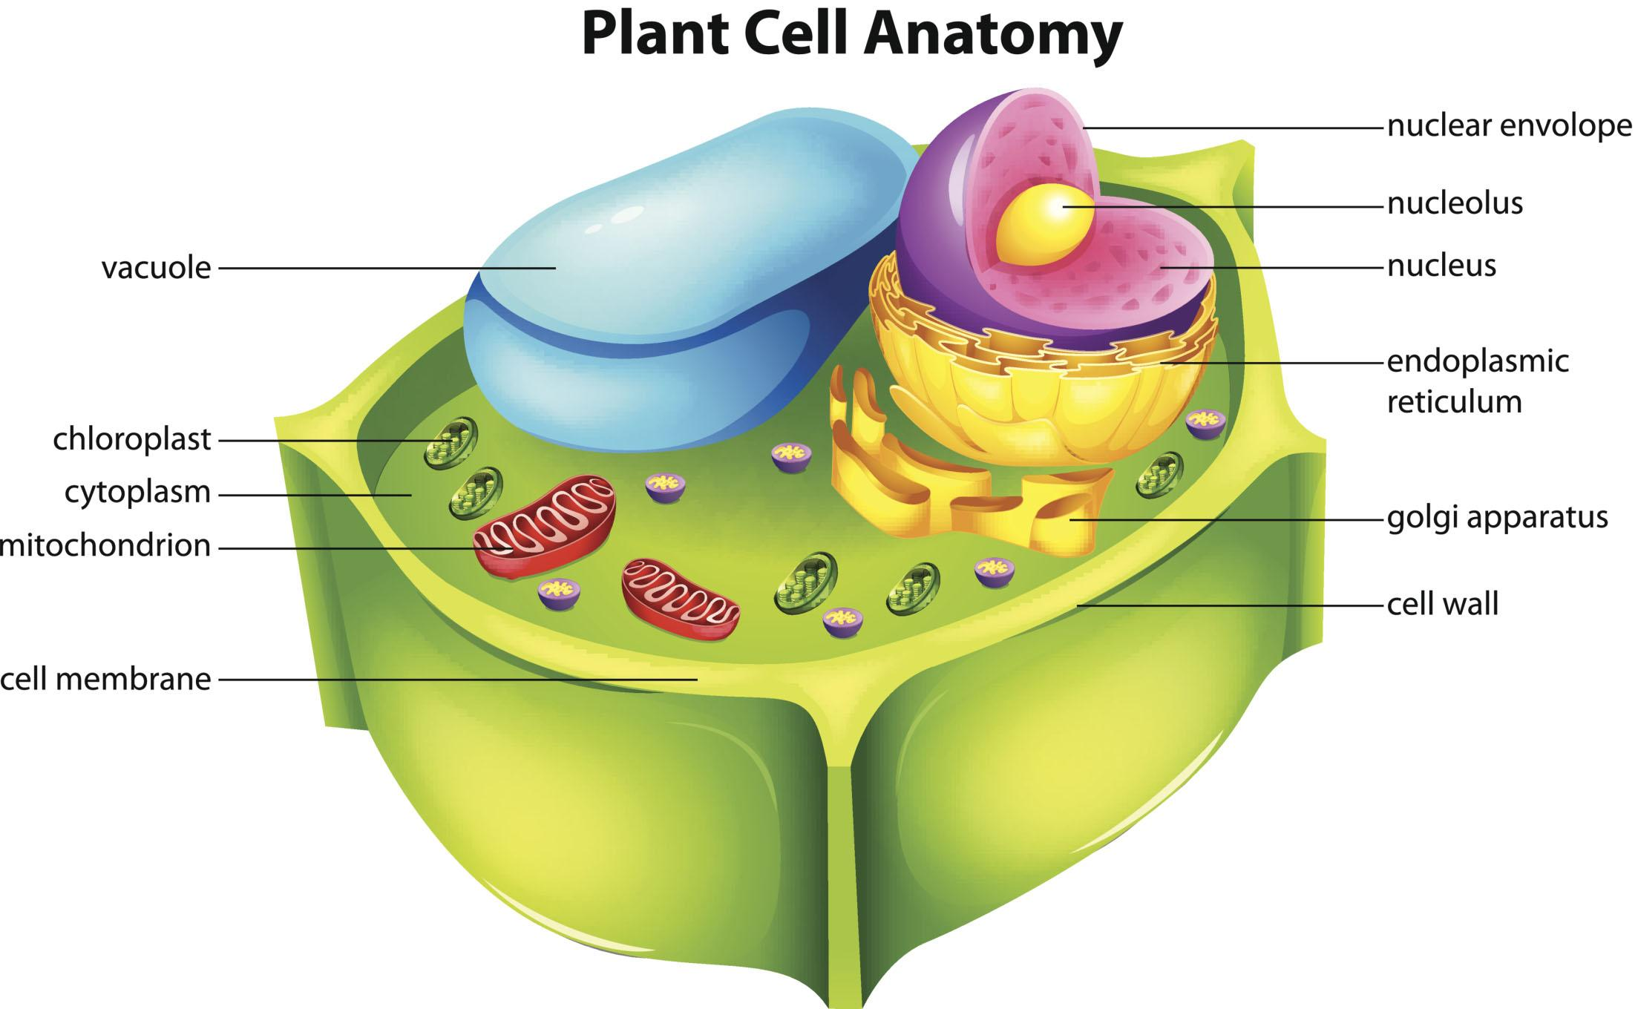
Big Question: How do the common organelles found in your cells help you function?
Notes:
Our “big question” is: How do the common organelles found in your cells help you function?
[Pause and illicit predictions from students.]
I love all these thoughtful scientific hypotheses! Be sure to keep this question and your predictions in mind as we move through these next few lessons, and we’ll continue to revisit it.

Slide 4
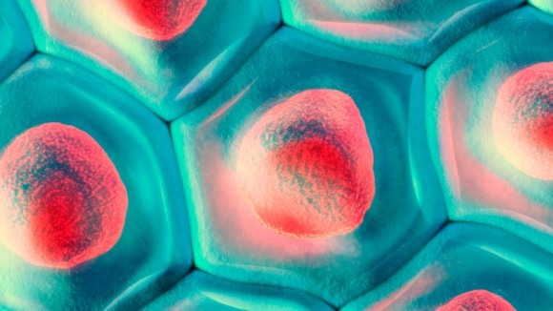
Demonstration
Recalling the Characteristics of Life
In order to get students thinking about the complexity of cells, it may be helpful to remind them that as the smallest unit of life, cells have the ability to carry out all processes necessary to support life. Drawing a comparison between and organism and a cell, challenge your students to consider the complex processes that cells need to achieve to qualify as life. If the organism carries out the process one way, how does the tiny cell do it?
Notes:
Have students recall the characteristics of life and make predictions about how tiny cells are able to carry out all the necessary functions to support life.

Slide 5
Notes:
Before we move on to our new vocabulary term, let’s review some other words & concepts that you already learned and make sure you are firm in your understanding.

Slide 6
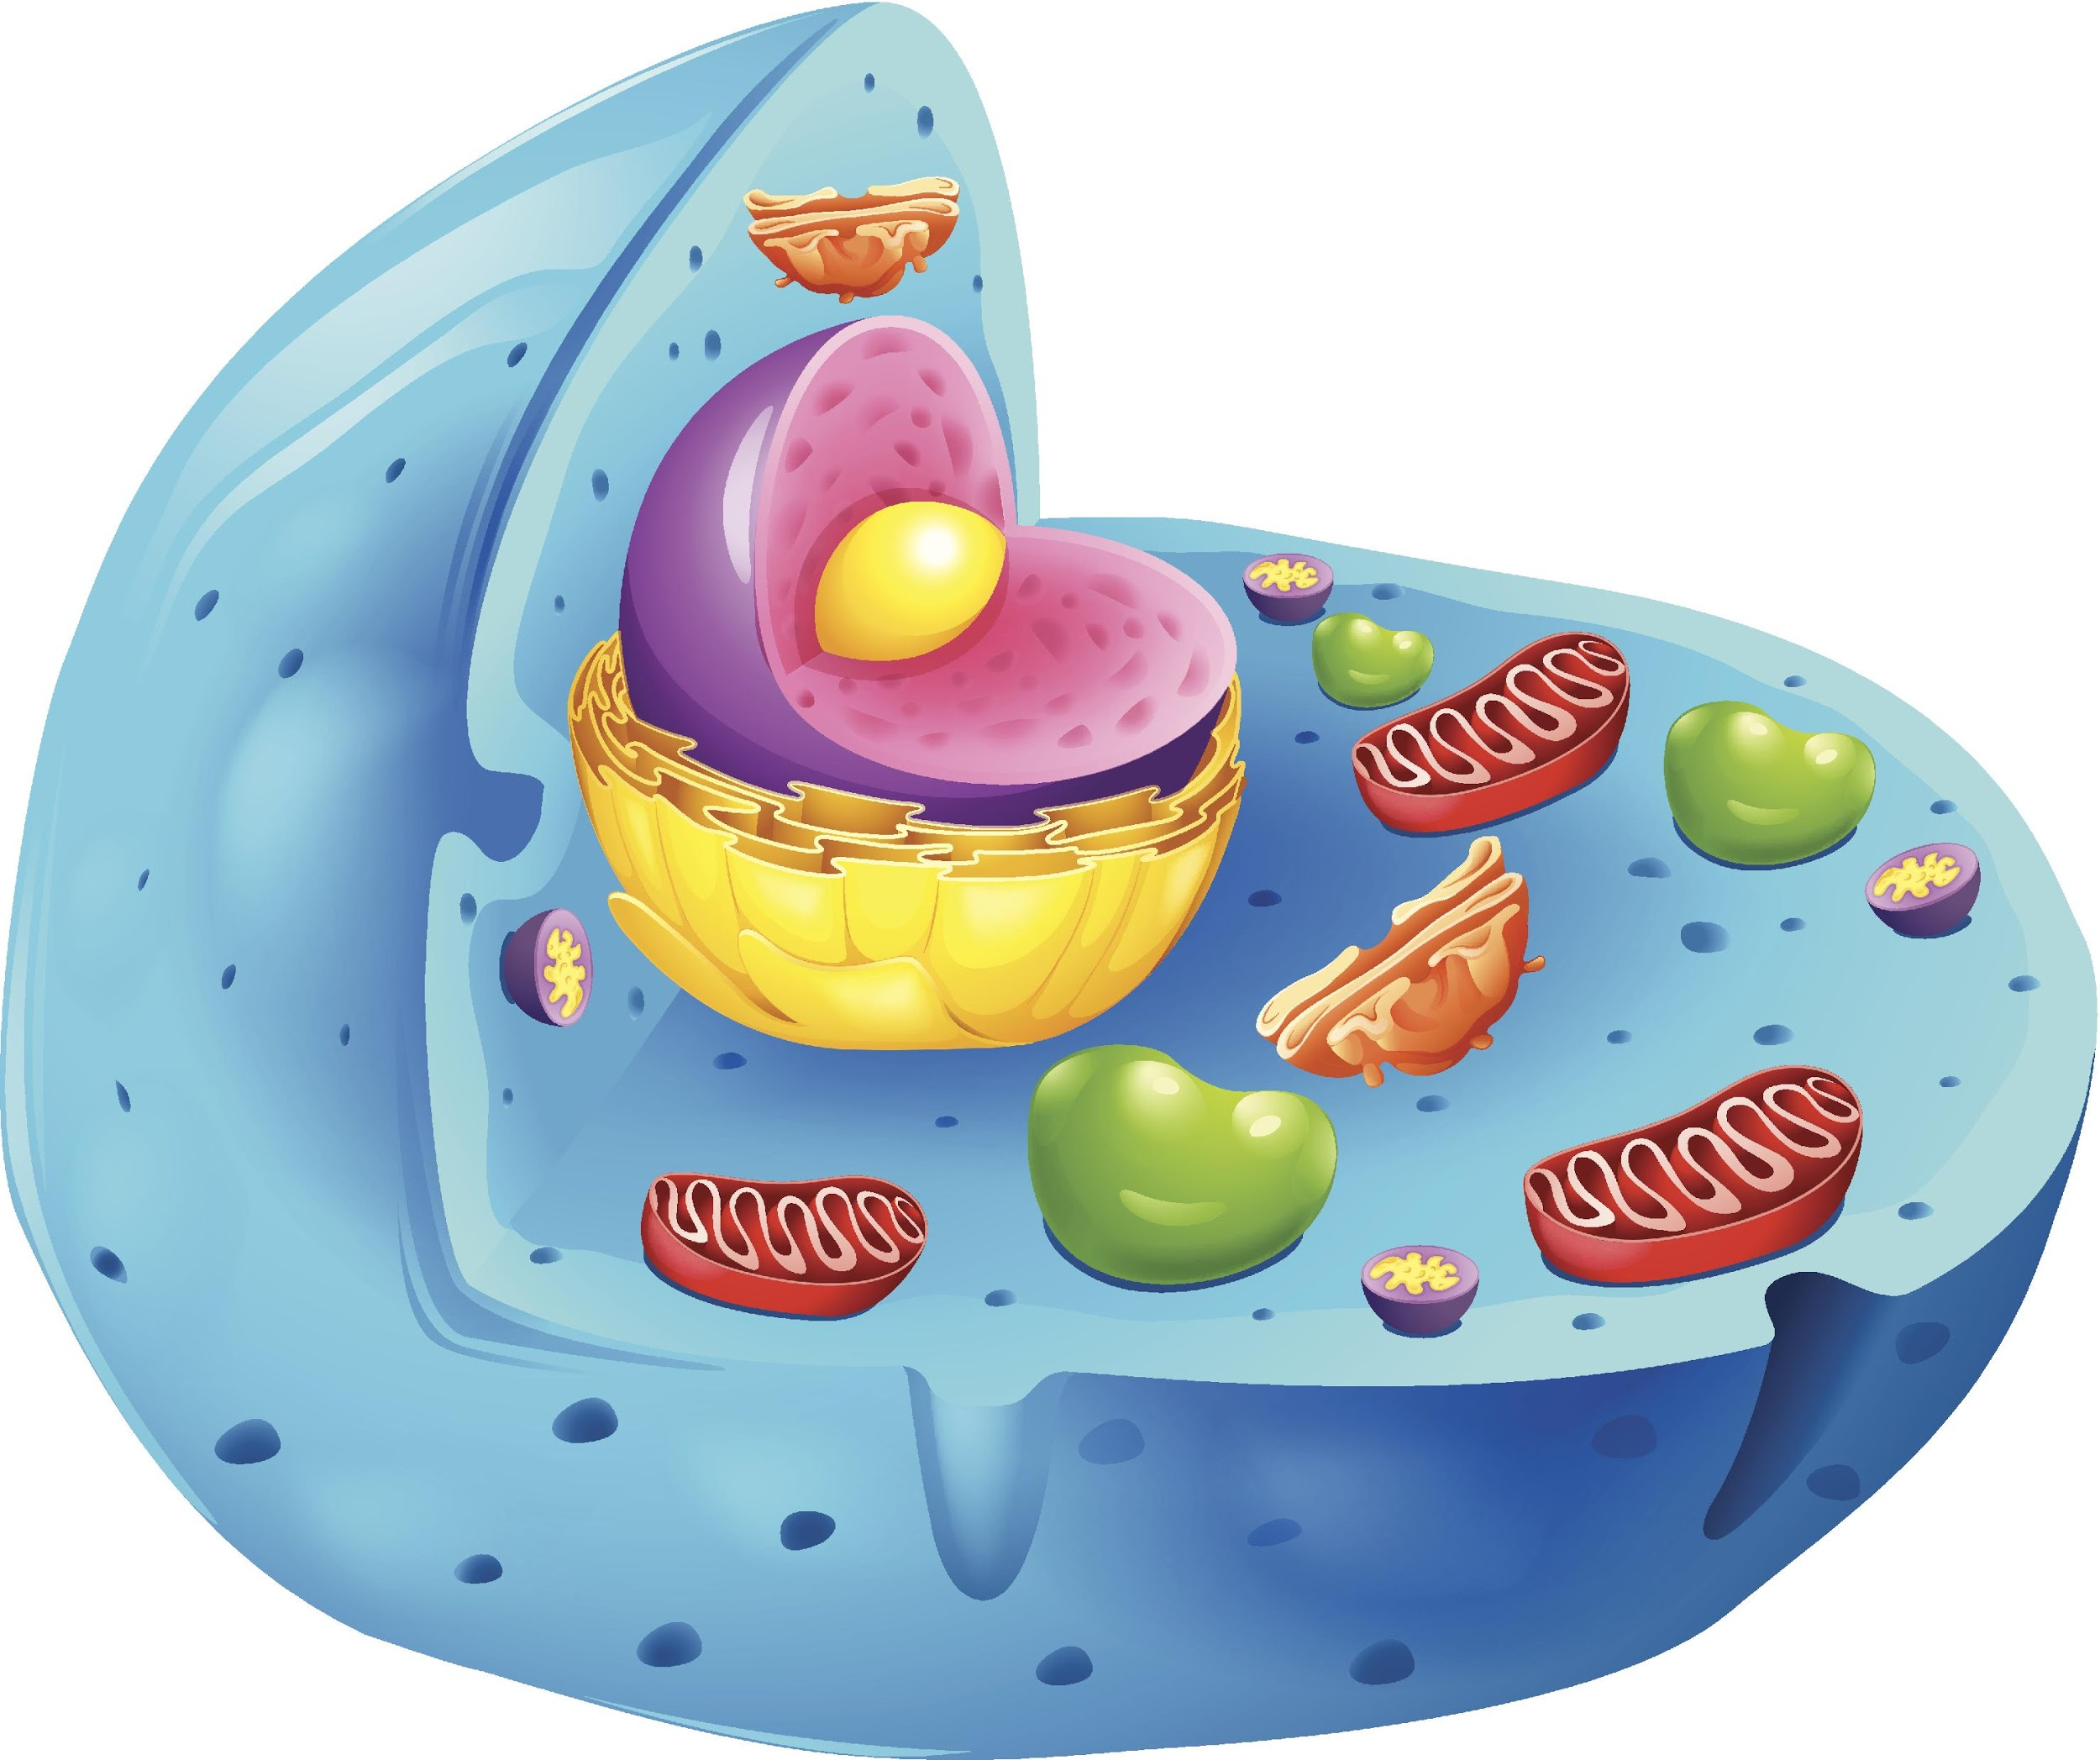
Cell: the basic unit of life
Notes:
A cell is the smallest unit of life. All living things are made up of cells.

Slide 7
Cell
animal cell
bacteria cell
plant cell
Notes:
There are many different types of cells, but we will focus primarily on three: animal cells, plant cells, and bacteria cells.

Slide 8
cell wall
chloroplast
nucleus
parts of a cell
vacuole
membrane
cytoplasm
endoplasmic reticulum
Notes:
Last class, we focused on organelles that are different in animal and plant cells.

Slide 9
cell wall
chloroplast
nucleus
parts of a cell
vacuole
membrane
cytoplasm
endoplasmic reticulum
Notes:
Now we are going to focus on organelles that are found in both animal and plant cells. We are going to look at the different roles these organelles have. Some organelles may be found in plant and animal cells but are absent in bacteria.

Slide 10
Notes:
Now let’s pause for a moment and check for understanding.

Slide 11
What is a cell?
An instrument for observing very small objects or organisms
A structure that protects the cell nucleus
The basic unit of life
Notes:
What is a cell?

Slide 12
What is a cell?
An instrument for observing very small objects or organisms
A structure that protects the cell nucleus
The basic unit of life
Notes:
What is a cell?
[A cell is the basic unit of life.]

Slide 13
Cell Membrane
Notes:
Now that we’ve reviewed, let’s define our new term, cell membrane.

Slide 14
Cell Membrane: surrounds & protects the cell and controls what enters & leaves the cell
Notes:
The cell membrane is the part of the cell that surrounds and protects the cell. It controls what enters and leaves the cell.

Slide 15
Notes:
Now let’s pause for a moment and check for understanding.

Slide 16
What is a cell membrane?
Notes:
What is a cell membrane?
[A cell membrane surrounds and protects the cell and controls what enters and leaves the cell.]

Slide 17
Notes:
That is the basic definition, but there is a bit more you need to know.

Slide 18
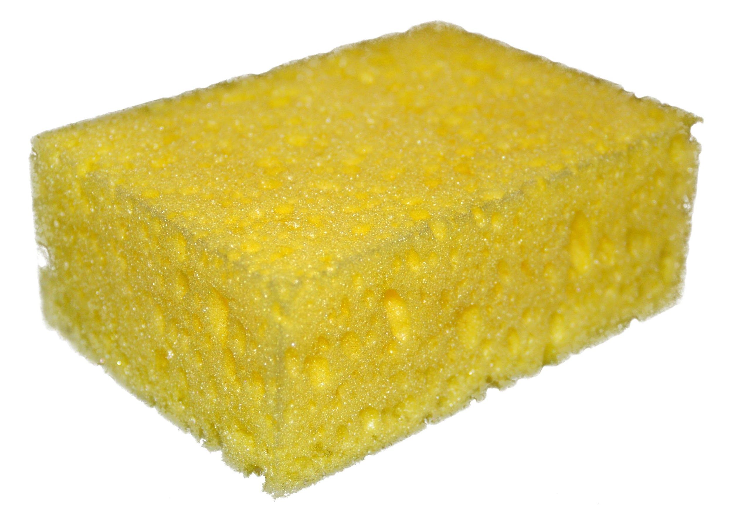
semi-permeable
somewhat, partially
porous
(has holes or gaps)
Notes:
The cell membrane is semi-permeable. Semi-permeable means that something is partially porous, or has some holes and gaps. Because of this, small particles can pass through the cell membrane, just like water can pass through a sponge.

Slide 19
Cell Membrane
Notes:
We can think of the cell membrane as the gatekeeper of the cell because it controls what enters and leaves the cell. Some substances are allowed to pass through the semipermeable membrane while others are not.

Slide 20
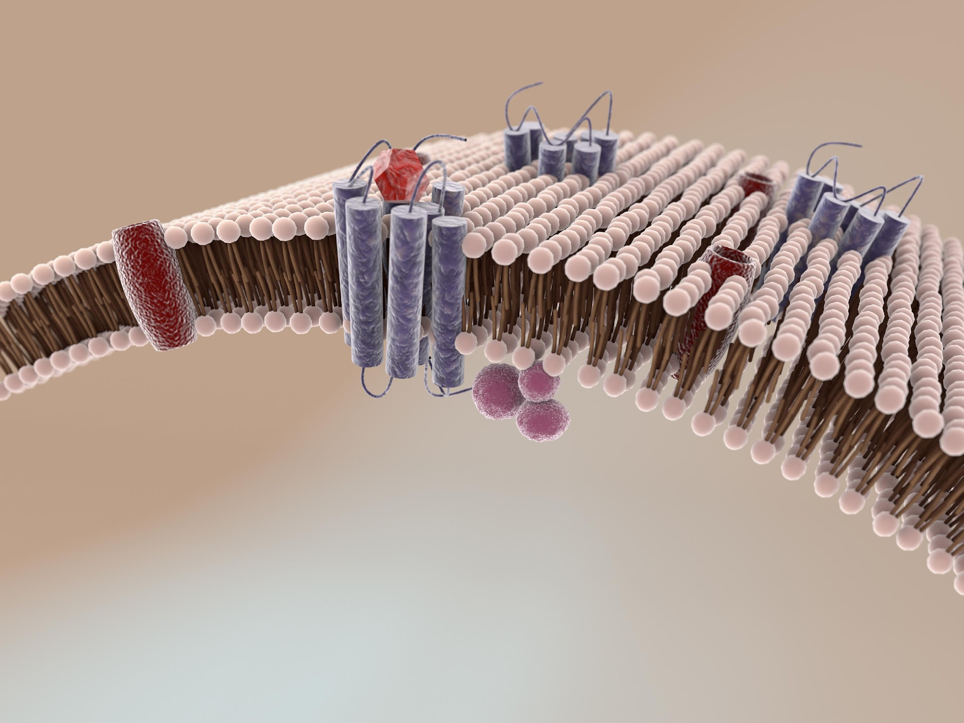
Cell Membrane
Notes:
If we were to zoom in on the cell membrane we would see this.

Slide 21
Two Types of Macromolecules
outer layer
inner layer
Notes:
The cell membrane is actually a double layer and is made up macromolecules. A macromolecule is a very large molecule. If you look at this image, you can see an outer layer and and an inner layer.

Slide 22
Protein Channels
Notes:
The protein channels are now circled in red in this image. For now, all you need to know is that protein channels allow things to exit and enter the cell. We will discuss the importance of the cell membrane structure in more detail later.

Slide 23
Notes:
Now let’s pause for a moment and check for understanding.

Slide 24
Which type of cells have a cell membrane?
Plant cells
Animal cells
Bacteria cells
All of these
Notes:
Which type of cells have a cell membrane?

Slide 25
Which type of cells have a cell membrane?
Plant cells
Animal cells
Bacteria cells
All of these
Notes:
Which type of cells have a cell membrane?
[All of these]

Slide 26
Why is the cell membrane like a gatekeeper?
Notes:
Why is the cell membrane like a gatekeeper?
[The cell membrane is like a gatekeeper of the cell because it controls what enters and leaves the cell.]

Slide 27
Notes:
Now, let’s look at some examples of cell membranes.

Slide 28
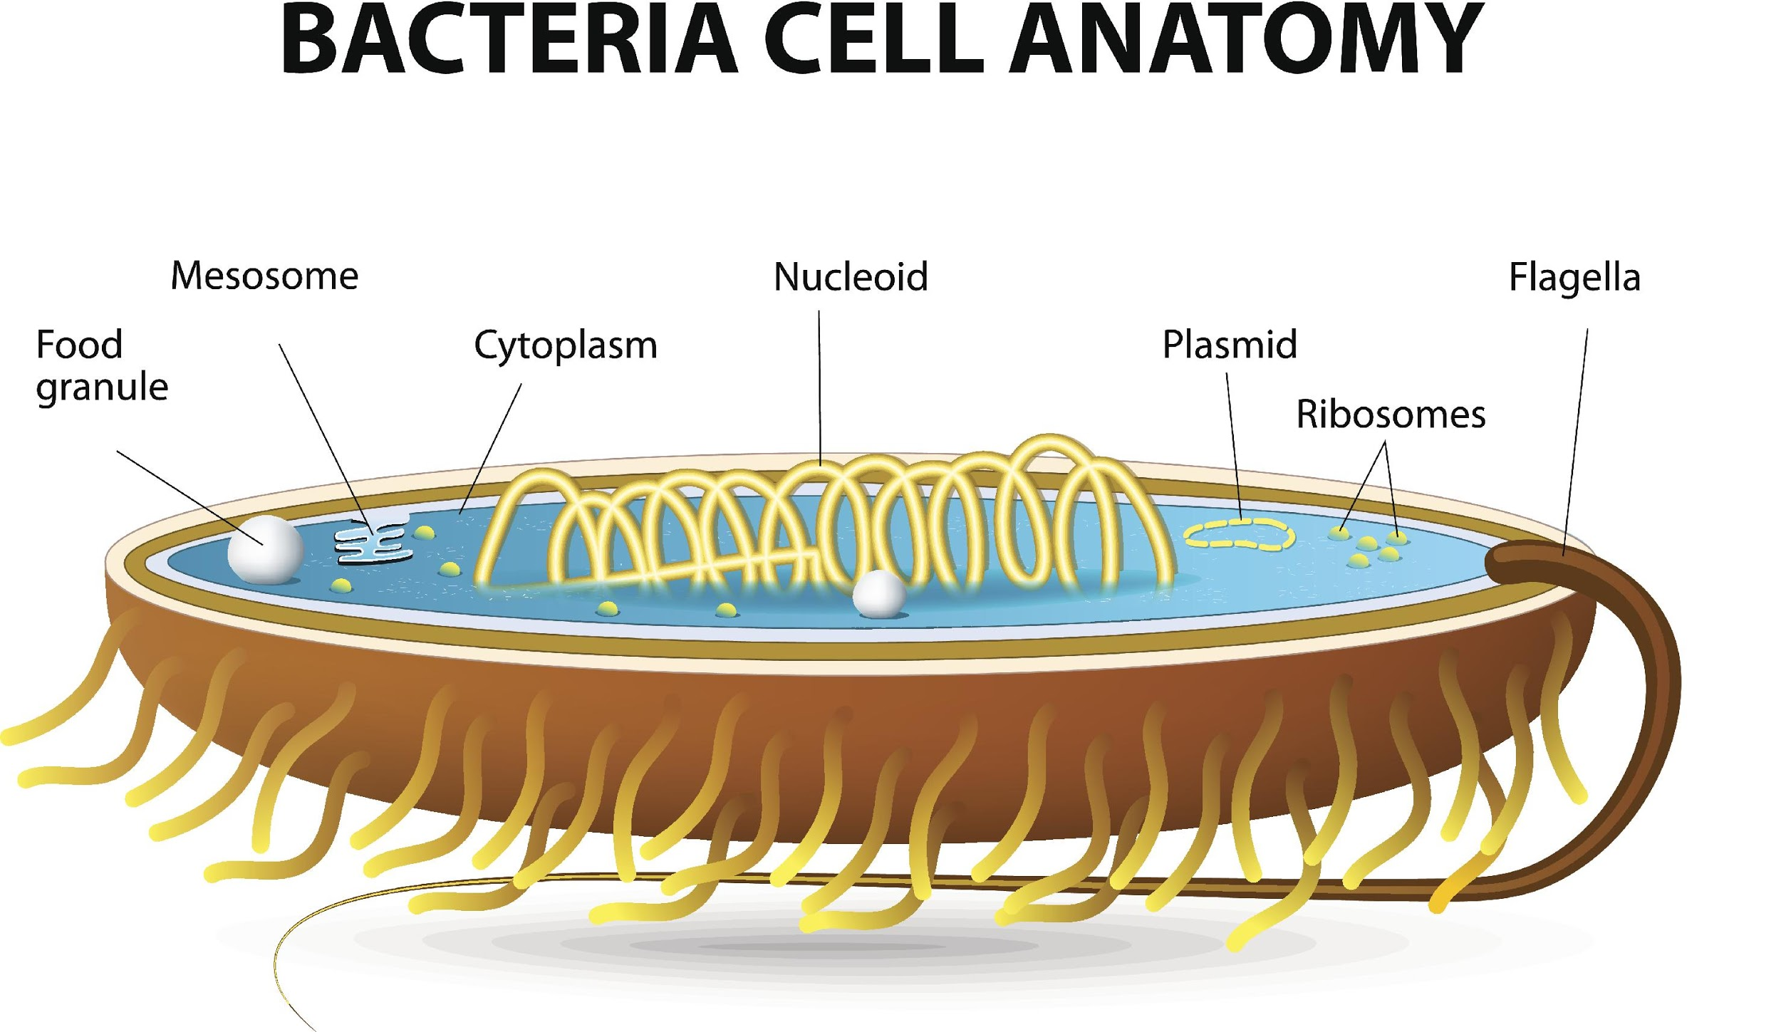
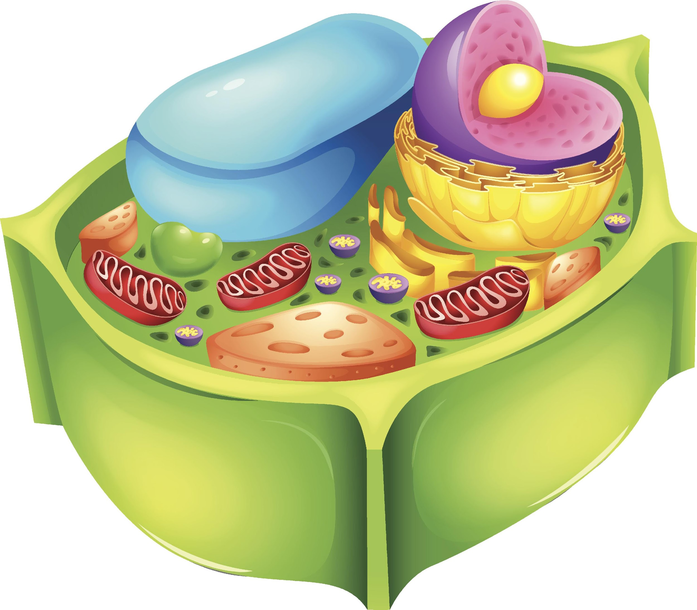
Types of Cells
Types of Cells
Prokaryotes
Eukaryotes
Animals (made of animal cells)
Plants (made of plant cells)
Bacteria (made of bacteria cells)
Notes:
Bacteria, animal, and plant cells all have a cell membrane.

Slide 29
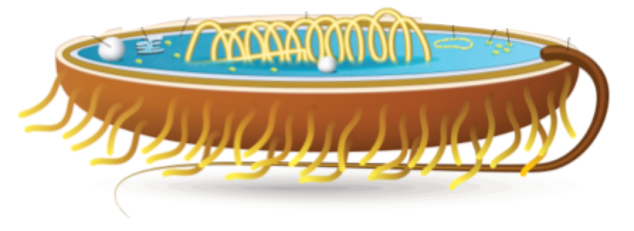
Bacteria Cell
Cell Membrane
Notes:
Bacteria cells have cell membranes.

Slide 30
Animal Cell
Cell Membrane
Notes:
Animal Cells have cell membranes

Slide 31
Plant Cell
Cell Membrane
Notes:
And plant cells have cell membranes.

Slide 32
Notes:
Next, let’s look at a non-example of cell membranes.

Slide 33
Cell Wall
Notes:
Plant cells and bacteria cells have a cell wall in addition to the cell membrane. They are similar and they do similar jobs, but they are NOT the same.

Slide 34
Cell Wall
Cell Membrane
Notes:
Here you can see the difference between the cell membrane and the cell wall. The cell membrane is the inner layer that surrounds and protects the cell and the cell wall is the outer layer, which provides structural support.

Slide 35
Notes:
Now let’s pause for a moment and check for understanding.

Slide 36
True/False: Only plant cells have cell membranes.
Notes:
True/False: Only plant cells have cell membranes.

Slide 37
True/False: Only plant cells have cell membranes.
Notes:
True/False: Only plant cells have cell membranes.
[False - Plant, animal, and bacteria cells have cell membranes.]

Slide 38
Cell Wall
What is the difference between a cell membrane and a cell wall?
Cell Membrane
Notes:
What is the difference between a cell membrane and a cell wall?
[The cell membrane is the inner layer that surrounds and protects the cell and the cell wall is the outer layer, which provides structural support.]

Slide 39
What is a cell membrane?
Notes:
What is a cell membrane?
[A cell membrane surrounds and protects the cell and controls what enters and leaves the cell.]

Slide 40
Why is the cell membrane like a gatekeeper?
Notes:
Why is the cell membrane like a gatekeeper?
[The cell membrane is like a gatekeeper of the cell because it controls what enters and leaves the cell.]

Slide 41
Remember!!!
Notes:
So remember!

Slide 42
Cell Membrane: surrounds & protects the cell and controls what enters & leaves the cell
Notes:
The cell membrane is the part of the cell that surrounds and protects the cell. It controls what enters and leaves the cell.

Slide 43
Cell Membrane
Notes:
We can think of the cell membrane as the gatekeeper of the cell because it controls what enters and leaves the cell.

Slide 44
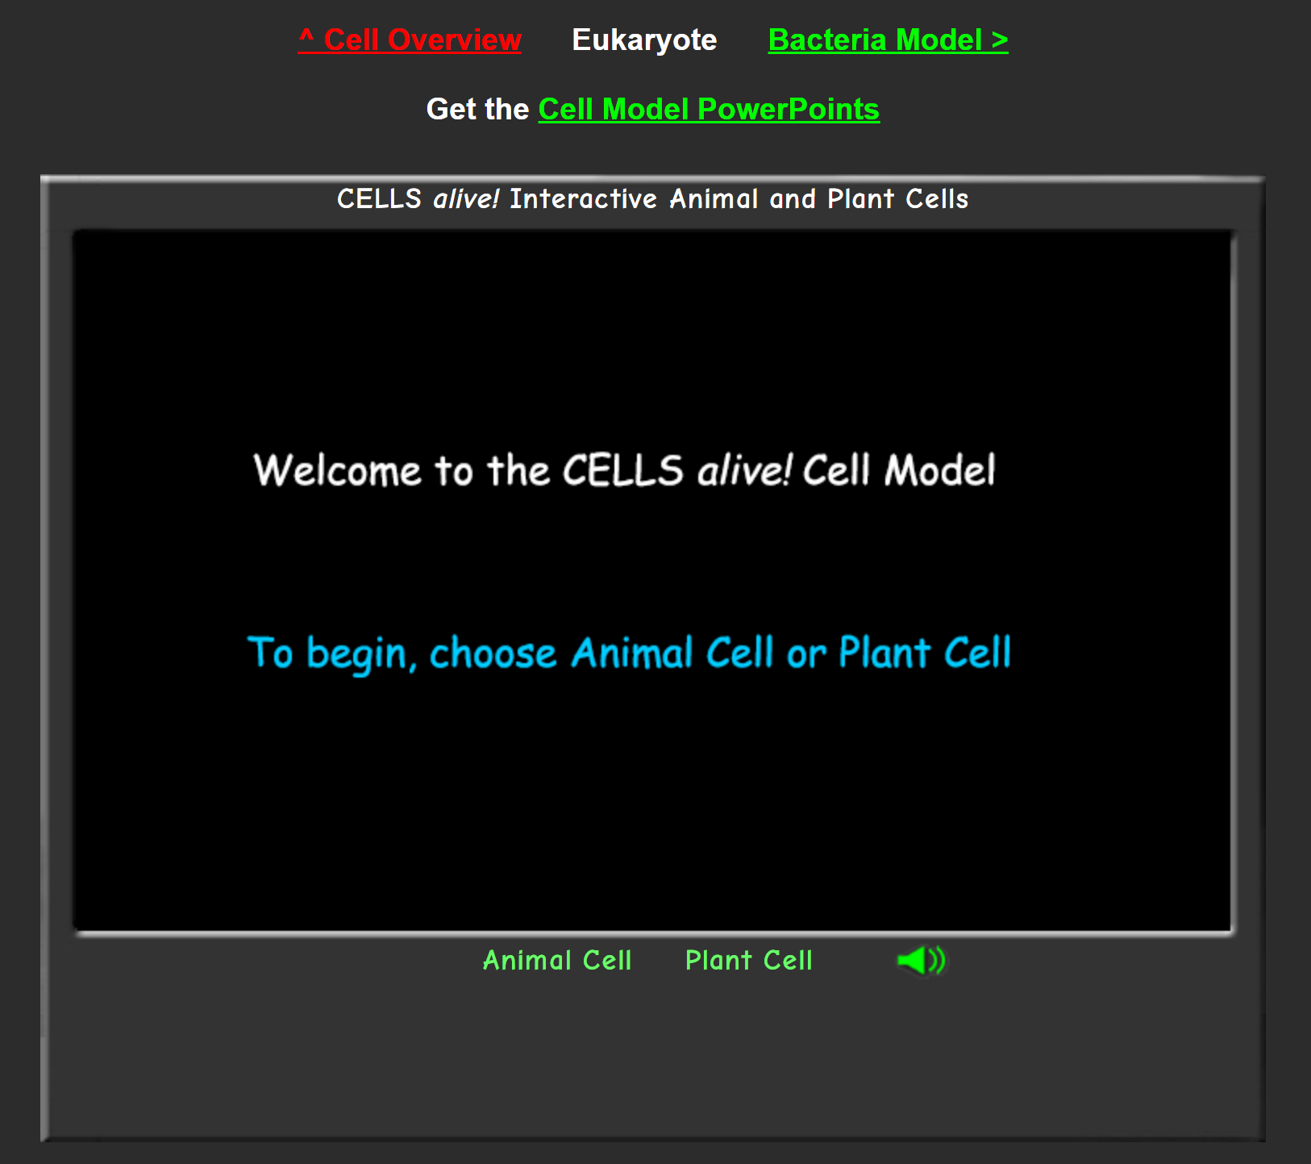
Simulation Activity
Animal, Plant, and Bacteria Cell Parts
Click the link above for a simulation to deepen your understanding of cell parts
Notes:
The cell simulation activity allows students to explore animal, plant, and bacteria cells. This resource can be used as a means for knowledge reinforcement or extension. Students can compare and contrast cell parts among the different models included.

Slide 45
Big Question: How do the common organelles found in your cells help you function?
Notes:
Explicit cue to revisit the big question at the end of the lesson: Okay everyone. Now that we’ve learned more about our term, let’s reflect once more on our big question. Was there anything that we predicted earlier that was correct or incorrect? Do you have any new thoughts to share?

Slide 46
Notes:
Thanks for watching, and please continue watching CAPs available from this website.

Slide 47
This Video Was Created With Resources From:
Questions or Comments
Michael Kennedy, Ph.D. MKennedy@Virginia.edu
Rachel L Kunemund, Ph.D. rk8vm@virginia.edu

Slide 48
Intro
“Big Idea” Question
Review Concepts
Check-In Questions
Teacher Demo
Vocabulary
Student-Friendly Definition
Examples & Non-Examples
Morphological Word Parts
Simulation/Activity
Notes:
OK everyone, get ready for our next lesson. Just as a reminder, these are the different components that our lesson may include, and you’ll see these icons in the top left corner of each slide so that you can follow along more easily!

Slide 49
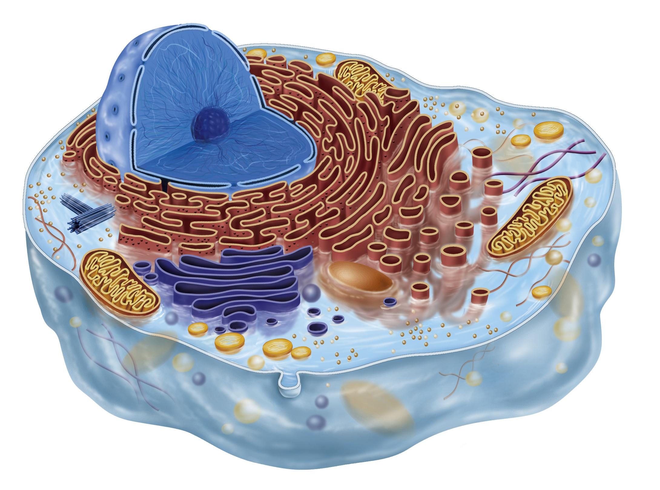
Cytosol
Intro
Notes:
Today we are going to learn about cytosol.

Slide 50
Big Question: How do the common organelles found in your cells help you function?
Notes:
Our “big question” is: How do the common organelles found in your cells help you function?
[Pause and illicit predictions from students.]
I love all these thoughtful scientific hypotheses! Be sure to keep this question and your predictions in mind as we move through these next few lessons, and we’ll continue to revisit it.

Slide 51
Notes:
Before we move on to our new vocabulary term, let’s review some other words & concepts that you already learned and make sure you are firm in your understanding.

Slide 52
Cell: the basic unit of life
Notes:
A cell is the smallest unit of life. All living things are made up of cells.

Slide 53
Cell
animal cell
bacteria cell
plant cell
Notes:
There are many different types of cells, but we will focus primarily on three: animal cells, plant cells, and bacteria cells.

Slide 54
cell wall
chloroplast
nucleus
parts of a cell
vacuole
membrane
cytoplasm
endoplasmic reticulum
Notes:
Last class, we focused on organelles that are different in animal and plant cells.

Slide 55
cell wall
chloroplast
nucleus
parts of a cell
vacuole
membrane
cytoplasm
endoplasmic reticulum
Notes:
Now we are going to focus on organelles that are found in both animal and plant cells. We are going to look at the different roles these organelles have. Some organelles may be found in plant and animal cells but are absent in bacteria.

Slide 56
Cell Membrane: surrounds & protects the cell and controls what enters & leaves the cell
Notes:
The cell membrane is the part of the cell that surrounds and protects the cell. It controls what enters and leaves the cell.

Slide 57
Notes:
Now let’s pause for a moment and check for understanding.

Slide 58
What is a cell?
An instrument for observing very small objects or organisms
A structure that protects the cell nucleus
The basic unit of life
Notes:
What is a cell?

Slide 59
What is a cell?
An instrument for observing very small objects or organisms
A structure that protects the cell nucleus
The basic unit of life
Notes:
What is a cell?
[A cell is the basic unit of life.]

Slide 60
What is a cell membrane?
Notes:
What is a cell membrane?
[A cell membrane surrounds and protects the cell and controls what enters and leaves the cell.]

Slide 61
Cytosol
Notes:
Now that we’ve reviewed, let’s define our new term, cytosol.

Slide 62
Cytosol: the gel-like fluid that fills up a cell and protects the organelles in it
Notes:
Cytosol is the gel-like fluid that fills up a cell and protects the organelles in it.

Slide 63
Notes:
Now let’s pause for a moment and check for understanding.

Slide 64
What is cytosol?
Notes:
What is cytosol?
[Cytosol is the gel-like fluid that fills up a cell and protects the organelles in it.]

Slide 65
Notes:
That is the basic definition, but there is a bit more you need to know.

Slide 66
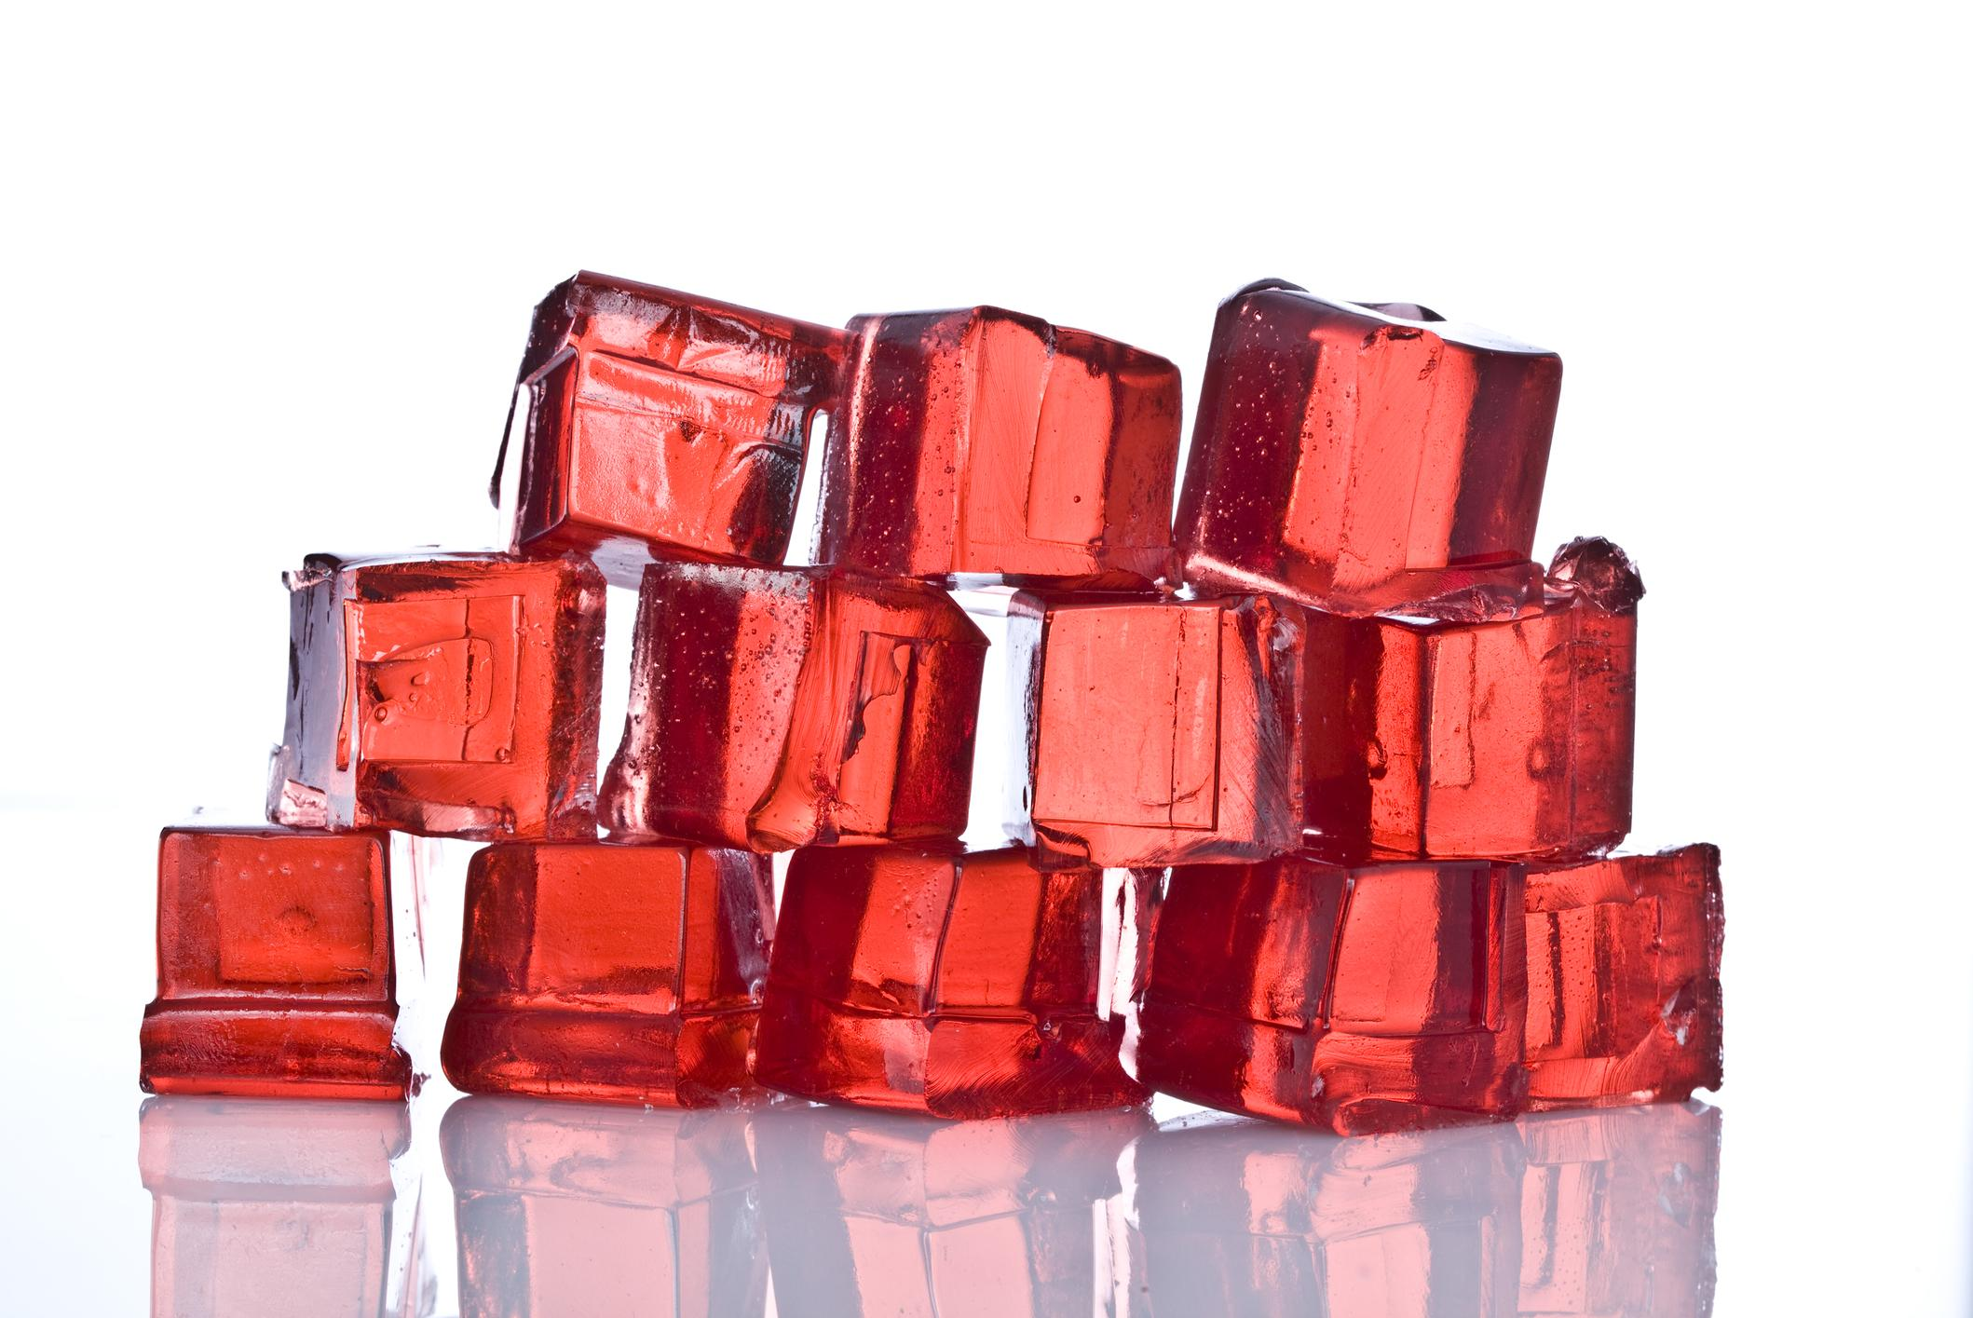
Cytosol
Notes:
We can think of the cytosol like gelatin or jelly because it is not totally liquid and has enough structure to hold and protect all the organelles in the cell.

Slide 67
Notes:
You may also here the term “cytoplasm”. The cytoplasm consists of all cell components inside the cell membrane, including the cytosol and the organelles that are suspended in the cytosol.

Slide 68
Cell wall
chloroplast
nucleus
mitochondria
parts of a cell
Golgi apparatus
vacuole
cytoplasm
membrane
endoplasmic reticulum
Notes:
All organelles besides the cell wall and cell membrane are found in the cytoplasm.

Slide 69
Notes:
Now let’s pause for a moment and check for understanding.

Slide 70
What is cytosol?
The control center of the cell
The gel-like fluid that fills up a cell and protects the organelles in it
The different parts of the cell that have different jobs
The outer protective layer of the cell
Notes:
What is cytosol?

Slide 71
What is cytosol?
The control center of the cell
The gel-like fluid that fills up a cell and protects the organelles in it
The different parts of the cell that have different jobs
The outer protective layer of the cell
Notes:
What is cytosol?
[Cytosol is the gel-like fluid that fills up a cell and protects the organelles in it.]

Slide 72
What is the cytoplasm?
The control center of the cell
The gel-like fluid that fills up a cell and protects the organelles in it
The outer protective layer of the cell
All components that make up the space inside the cell membrane
Notes:
What is the cytoplasm?

Slide 73
What is the cytoplasm?
The control center of the cell
The gel-like fluid that fills up a cell and protects the organelles in it
The outer protective layer of the cell
All components that make up the space inside the cell membrane
Notes:
What is the cytoplasm?
[Cytoplasm contains all the components that make up the space inside the cell membrane.]

Slide 74
Notes:
Now, let’s look at some examples of cytosol.

Slide 75
Types of Cells
Types of Cells
Prokaryotes
Eukaryotes
Animals (made of animal cells)
Plants (made of plant cells)
Bacteria (made of bacteria cells)
Notes:
Bacteria, animal, and plant cells all contain cytosol and the cytoplasm.

Slide 76
Bacteria Cell
cytosol
Notes:
Bacteria cells have cytosol and cytoplasm…

Slide 77
Animal Cell
cytosol
Notes:
Animal cells have cytosol and cytoplasm…

Slide 78
Plant Cell
cytosol
Notes:
And plant cells have cytosol and cytoplasm.

Slide 79
Notes:
Now let’s pause for a moment and check for understanding.

Slide 80
True/False: Plant, animal, and bacteria cells all contain both cytosol and cytoplasm.
Notes:
True/False: Plant, animal, and bacteria cells all contain both cytosol and cytoplasm.

Slide 81
True/False: Plant, animal, and bacteria cells all contain both cytosol and cytoplasm.
Notes:
True/False: Plant, animal, and bacteria cells all contain both cytosol and cytoplasm.

Slide 82
What is cytosol?
Notes:
What is cytosol?
[Cytosol is the gel-like fluid that fills up a cell and protects the organelles in it.]

Slide 83
Remember!!!
Notes:
So remember!

Slide 84
Cytosol: the gel-like fluid that fills up a cell and protects the organelles in it
Notes:
Cytosol is the gel-like fluid that fills up a cell and protects the organelles in it.

Slide 85
Notes:
You may also here the term “cytoplasm”. The cytoplasm consists of all cell components inside the cell membrane, including the cytosol and the organelles that are suspended in the cytosol.

Slide 86
Simulation Activity
Animal, Plant, and Bacteria Cell Parts
Click the link above for a simulation to deepen your understanding of cell parts
Notes:
The cell simulation activity allows students to explore animal, plant, and bacteria cells. This resource can be used as a means for knowledge reinforcement or extension. Students can compare and contrast cell parts among the different models included.

Slide 87
Big Question: How do the common organelles found in your cells help you function?
Notes:
Explicit cue to revisit the big question at the end of the lesson: Okay everyone. Now that we’ve learned more about our term, let’s reflect once more on our big question. Was there anything that we predicted earlier that was correct or incorrect? Do you have any new thoughts to share?

Slide 88
Notes:
Thanks for watching, and please continue watching CAPs available from this website.

Slide 89
This Video Was Created With Resources From:
Questions or Comments
Michael Kennedy, Ph.D. MKennedy@Virginia.edu
Rachel L Kunemund, Ph.D. rk8vm@virginia.edu

Slide 90
Intro
“Big Idea” Question
Review Concepts
Check-In Questions
Teacher Demo
Vocabulary
Student-Friendly Definition
Examples & Non-Examples
Morphological Word Parts
Simulation/Activity
Notes:
OK everyone, get ready for our next lesson. Just as a reminder, these are the different components that our lesson may include, and you’ll see these icons in the top left corner of each slide so that you can follow along more easily!

Slide 91
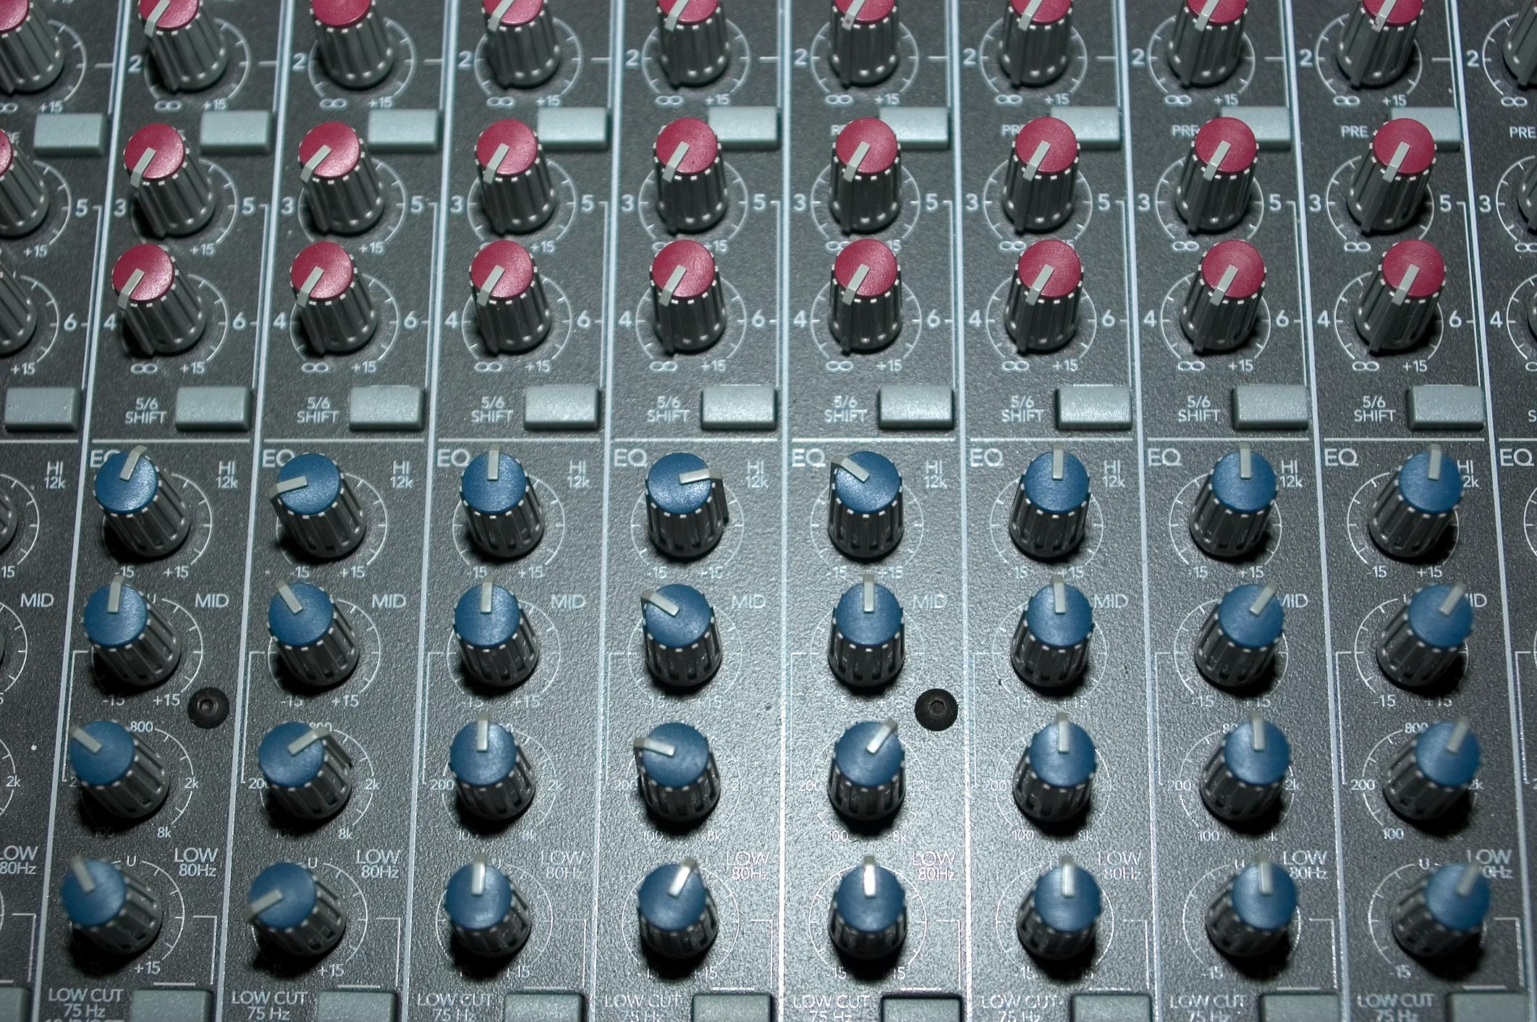
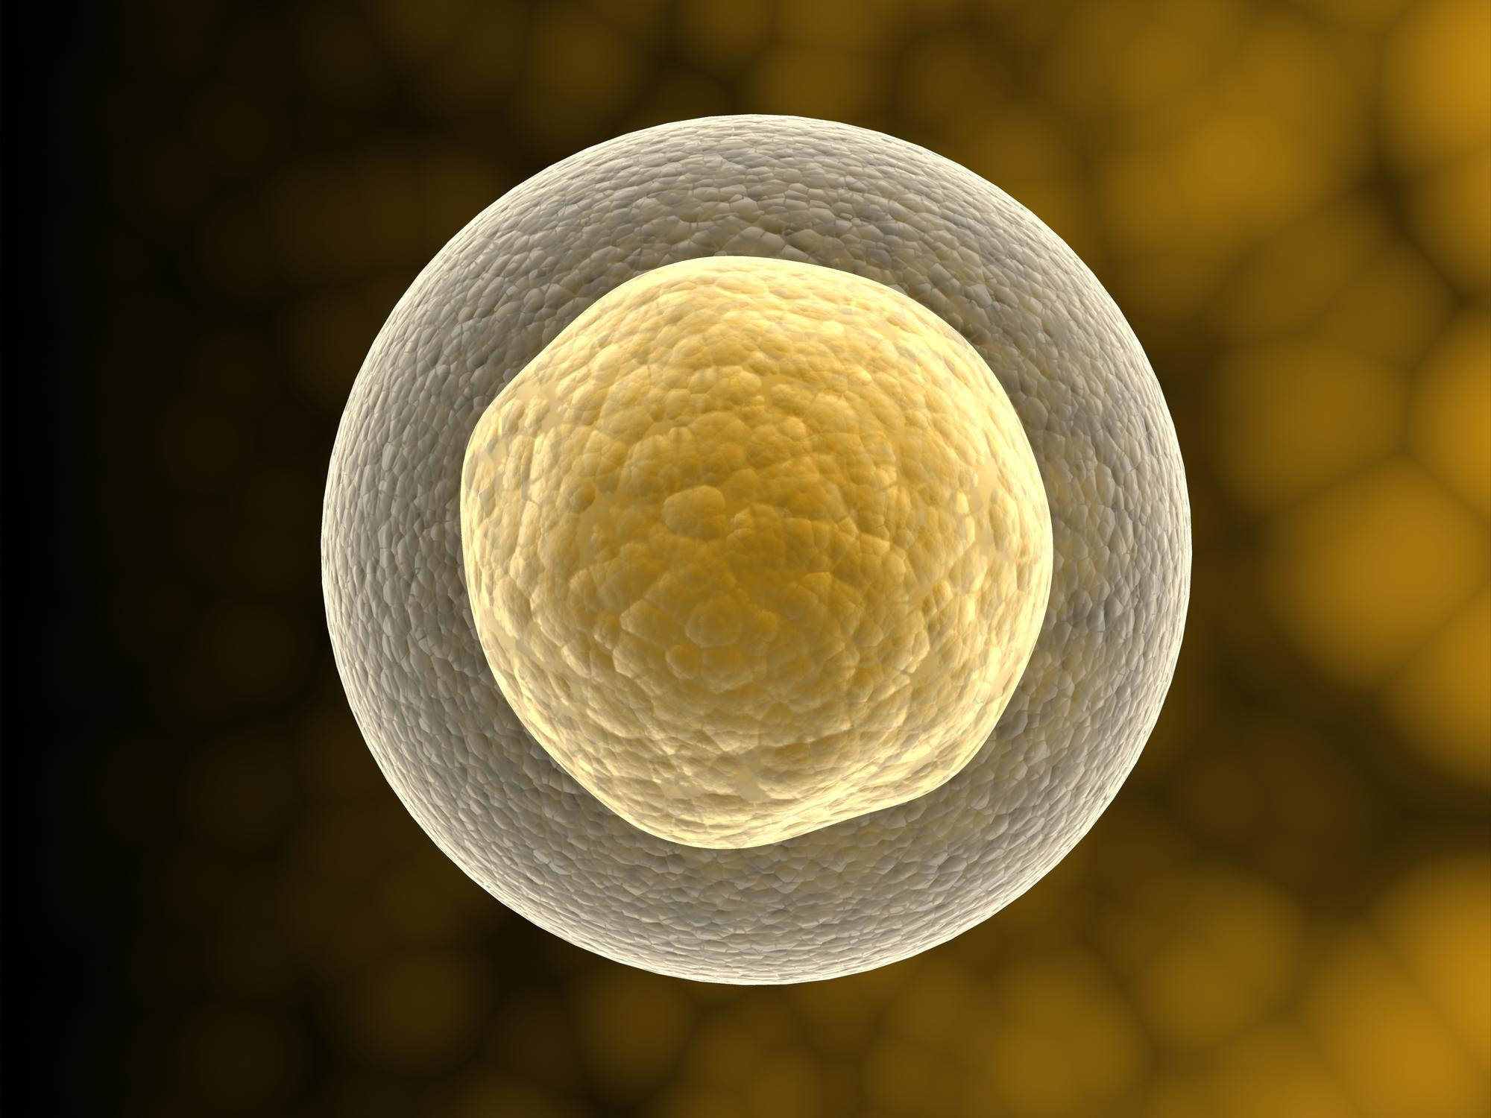
Nucleus
Intro
Notes:
Today we are going to learn about the nucleus.

Slide 92
Big Question: How do the common organelles found in your cells help you function?
Notes:
Our “big question” is: How do the common organelles found in your cells help you function?
[Pause and illicit predictions from students.]
I love all these thoughtful scientific hypotheses! Be sure to keep this question and your predictions in mind as we move through these next few lessons, and we’ll continue to revisit it.

Slide 93
Notes:
Before we move on to our new vocabulary term, let’s review some other words & concepts that you already learned and make sure you are firm in your understanding.

Slide 94
Cell: the basic unit of life
Notes:
A cell is the smallest unit of life. All living things are made up of cells.

Slide 95
Cell
animal cell
bacteria cell
plant cell
Notes:
There are many different types of cells, but we will focus primarily on three: animal cells, plant cells, and bacteria cells.

Slide 96
cell wall
chloroplast
nucleus
parts of a cell
vacuole
membrane
cytoplasm
endoplasmic reticulum
Notes:
Last class, we focused on organelles that are different in animal and plant cells.

Slide 97
cell wall
chloroplast
nucleus
parts of a cell
vacuole
membrane
cytoplasm
endoplasmic reticulum
Notes:
Now we are going to focus on organelles that are found in both animal and plant cells. We are going to look at the different roles these organelles have. Some organelles may be found in plant and animal cells but are absent in bacteria.

Slide 98
Cell Membrane: surrounds & protects the cell and controls what enters & leaves the cell
Notes:
The cell membrane is the part of the cell that surrounds and protects the cell. It controls what enters and leaves the cell.

Slide 99
Cytosol: the gel-like fluid that fills up a cell and protects the organelles in it
Notes:
Cytosol is the gel-like fluid that fills up a cell and protects the organelles in it.

Slide 100
Notes:
Now let’s pause for a moment and check for understanding.

Slide 101
What is a cell?
An instrument for observing very small objects or organisms
A structure that protects the cell nucleus
The basic unit of life
Notes:
What is a cell?

Slide 102
What is a cell?
An instrument for observing very small objects or organisms
A structure that protects the cell nucleus
The basic unit of life
Notes:
What is a cell?
[A cell is the basic unit of life.]

Slide 103
What is a cell membrane?
Notes:
What is a cell membrane?
[A cell membrane surrounds and protects the cell and controls what enters and leaves the cell.]

Slide 104
What is cytosol?
Notes:
What is cytosol?
[Cytosol is the gel-like fluid that fills up a cell and protects the organelles in it.]

Slide 105
Nucleus
Notes:
Now that we’ve reviewed, let’s define our new term, nucleus.

Slide 106
Nucleus: the control center of a cell
Notes:
The nucleus is the control center of the cell. It controls all the processes of all the cell parts, and it stores some of the genetic material, or DNA, of the cell.

Slide 107
Notes:
Now let’s pause for a moment and check for understanding.

Slide 108
What is the nucleus of a cell?
Notes:
What is the nucleus of a cell?
[The nucleus is the control center of the cell. It controls all the processes of all the cell parts, and it stores some of the genetic material, or DNA, of the cell.]

Slide 109
Notes:
That is the basic definition, but there is a bit more you need to know. <this slide may or may not be needed>

Slide 110
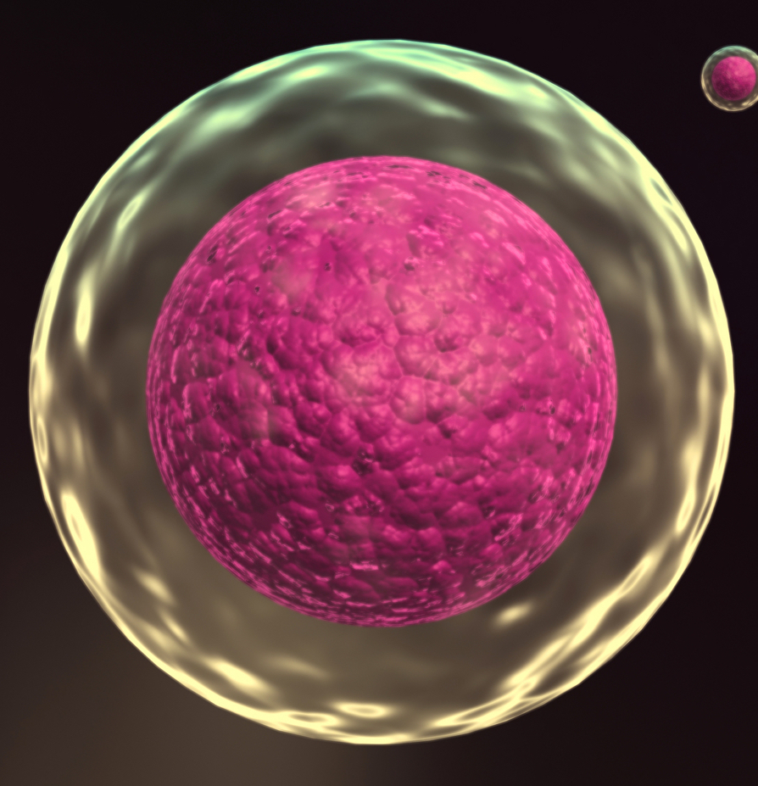
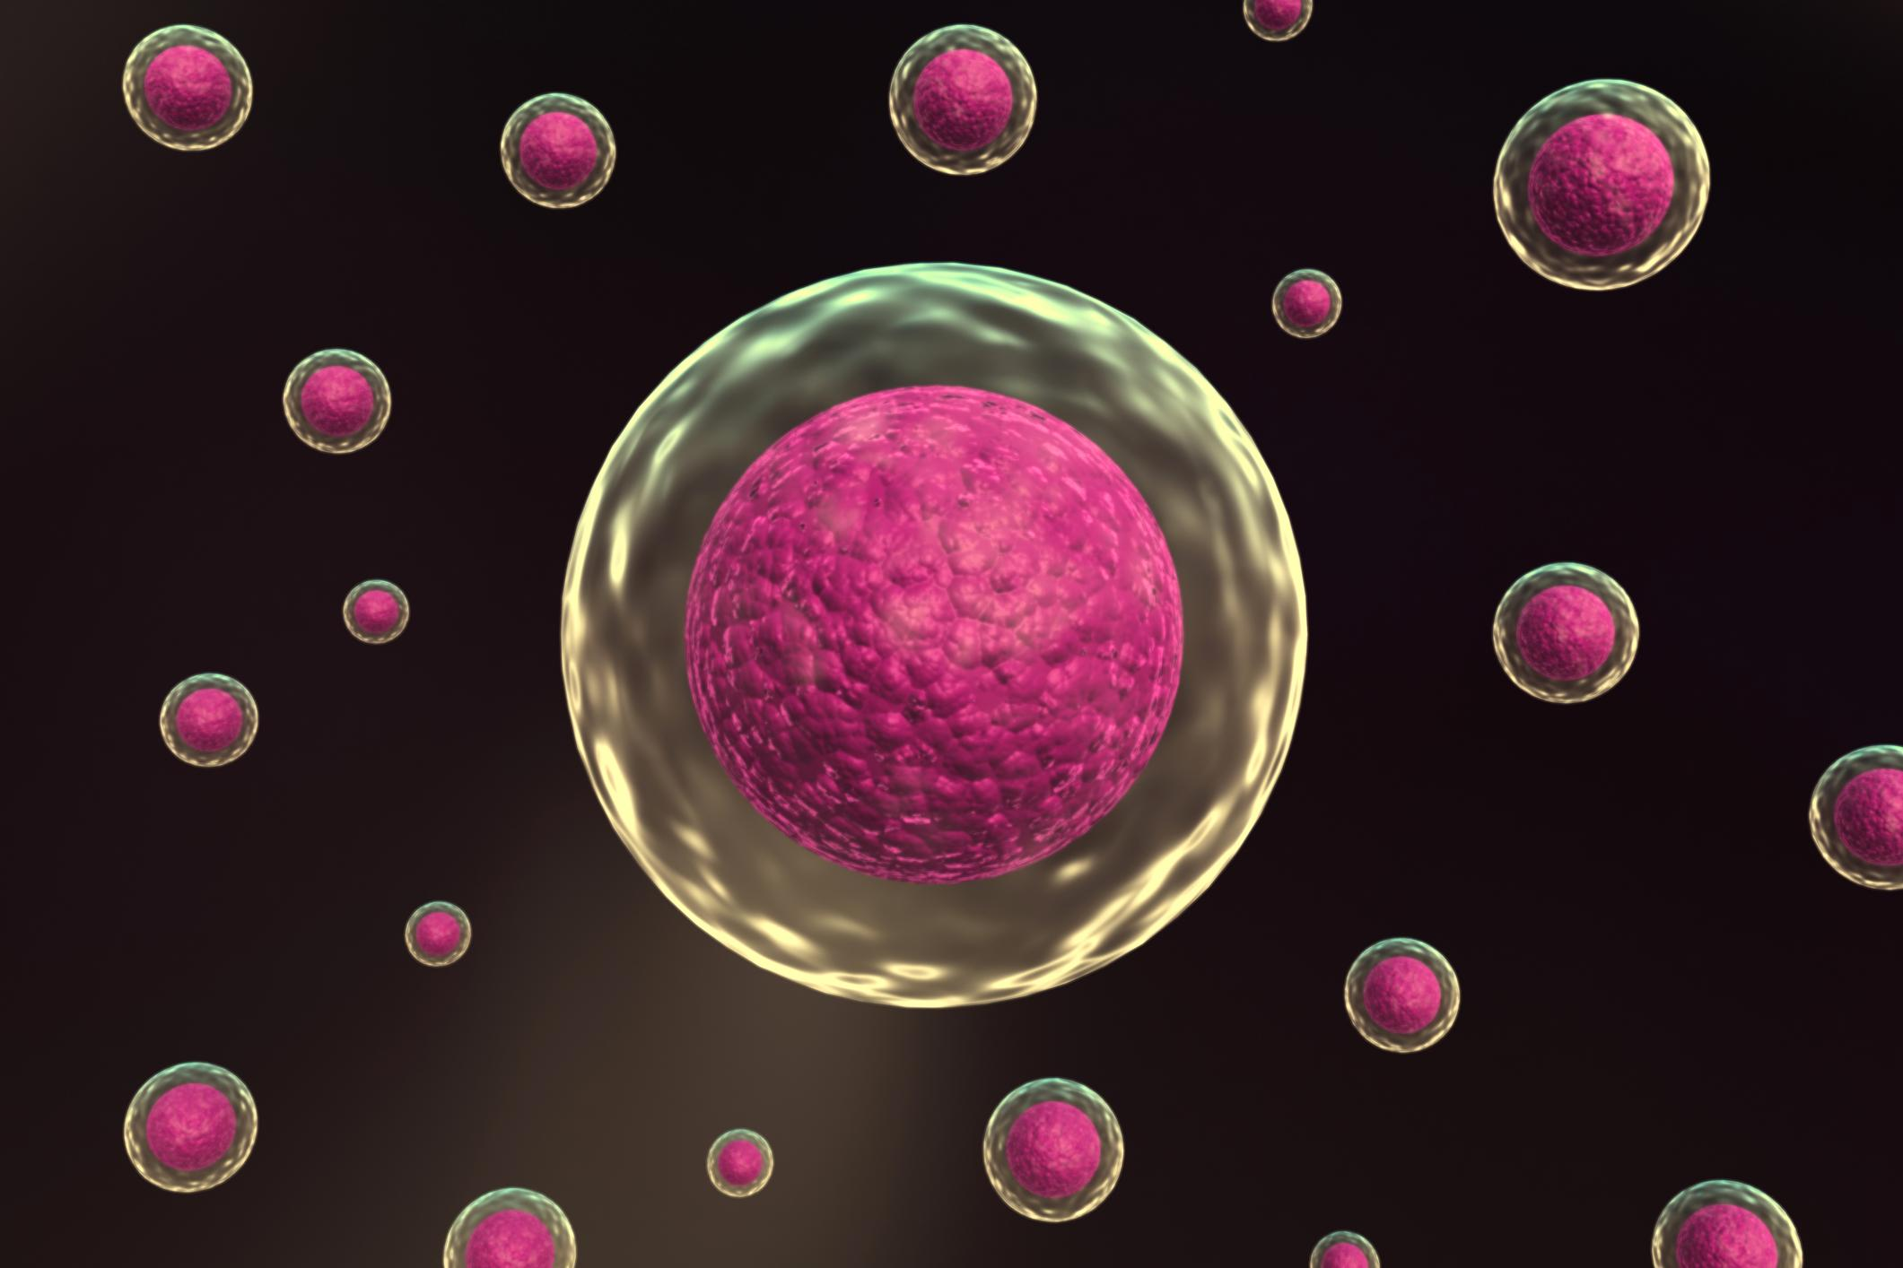
nucleus
nuclei
Notes:
The plural of the word “nucleus” is ”nuclei.”

Slide 111
Types of Cells
Types of Cells
Prokaryotes
Eukaryotes
Animals (made of animal cells)
Plants (made of plant cells)
Bacteria (made of bacteria cells)
Notes:
Not all cells have nuclei. Cells that do not have nuclei, like bacteria cells, are called prokaryotes. Cells that do have nuclei, like plant cells and animal cells, are called eukaryotes.

Slide 112
Notes:
Now let’s pause for a moment and check for understanding.

Slide 113
What is the nucleus?
The protective wall of a plant cell
The gel-like fluid that fills up the cell
The different parts of the cell that have different jobs
The control center of the cell
Notes:
What is the nucleus?

Slide 114
What is the nucleus?
The protective wall of a plant cell
The gel-like fluid that fills up the cell
The different parts of the cell that have different jobs
The control center of the cell
Notes:
What is the nucleus?
[The nucleus is the control center of the cell.]

Slide 115
Notes:
Now, let’s look at some examples of nuclei.

Slide 116
Animal Cell
nucleus
Notes:
Animal cells have a nucleus…

Slide 117
Plant Cell
nucleus
Notes:
And plant cells have a nucleus.

Slide 118
Notes:
Next, let’s look at a non-example of a nucleus.

Slide 119
Bacteria Cell
????
Notes:
Bacteria cells DO NOT have a nucleus. They are called prokaryotes.

Slide 120
Notes:
Now let’s pause for a moment and check for understanding.

Slide 121
True/False: Bacteria cells do not have nuclei.
Notes:
True/False: Bacteria cells do not have nuclei.

Slide 122
True/False: Bacteria cells do not have nuclei.
Notes:
True/False: Bacteria cells do not have nuclei.
[True - Bacteria cells do not and animal and plant cells do.]

Slide 123
What is the nucleus of a cell?
Notes:
What is the nucleus of a cell?
[The nucleus is the control center of the cell. It controls all the processes of all the cell parts, and it stores some of the genetic material, or DNA, of the cell.]

Slide 124
Remember!!!
Notes:
So remember!

Slide 125
Nucleus: the control center of a cell
Notes:
The nucleus is the control center of the cell. It controls all the processes of all the cell parts, and it stores some of the genetic material, or DNA, of the cell.

Slide 126
Types of Cells
Types of Cells
Prokaryotes
Eukaryotes
Animals (made of animal cells)
Plants (made of plant cells)
Bacteria (made of bacteria cells)
Notes:
Not all cells have nuclei. Cells that do not have nuclei, like bacteria cells, are called prokaryotes. Cells that do have nuclei, like plant cells and animal cells, are called eukaryotes.

Slide 127
Simulation Activity
Animal, Plant, and Bacteria Cell Parts
Click the link above for a simulation to deepen your understanding of cell parts
Notes:
The cell simulation activity allows students to explore animal, plant, and bacteria cells. This resource can be used as a means for knowledge reinforcement or extension. Students can compare and contrast cell parts among the different models included.

Slide 128
Big Question: How do the common organelles found in your cells help you function?
Notes:
Explicit cue to revisit the big question at the end of the lesson: Okay everyone. Now that we’ve learned more about cell organelles, let’s reflect once more on our big question. Was there anything that we predicted earlier that was correct or incorrect? Do you have any new thoughts to share?

Slide 129
Notes:
Thanks for watching, and please continue watching CAPs available from this website.

Slide 130
This Video Was Created With Resources From:
Questions or Comments
Michael Kennedy, Ph.D. MKennedy@Virginia.edu
Rachel L Kunemund, Ph.D. rk8vm@virginia.edu

