Slide 1
Intro
“Big Idea” Question
Review Concepts
Check-In Questions
Teacher Demo
Vocabulary
Student-Friendly Definition
Examples & Non-Examples
Morphological Word Parts
Reinforcement Activity
Notes:
OK everyone, get ready for our next lesson. Just as a reminder, these are the different components that our lesson may include, and you’ll see these icons in the top left corner of each slide so that you can follow along more easily!

Slide 2
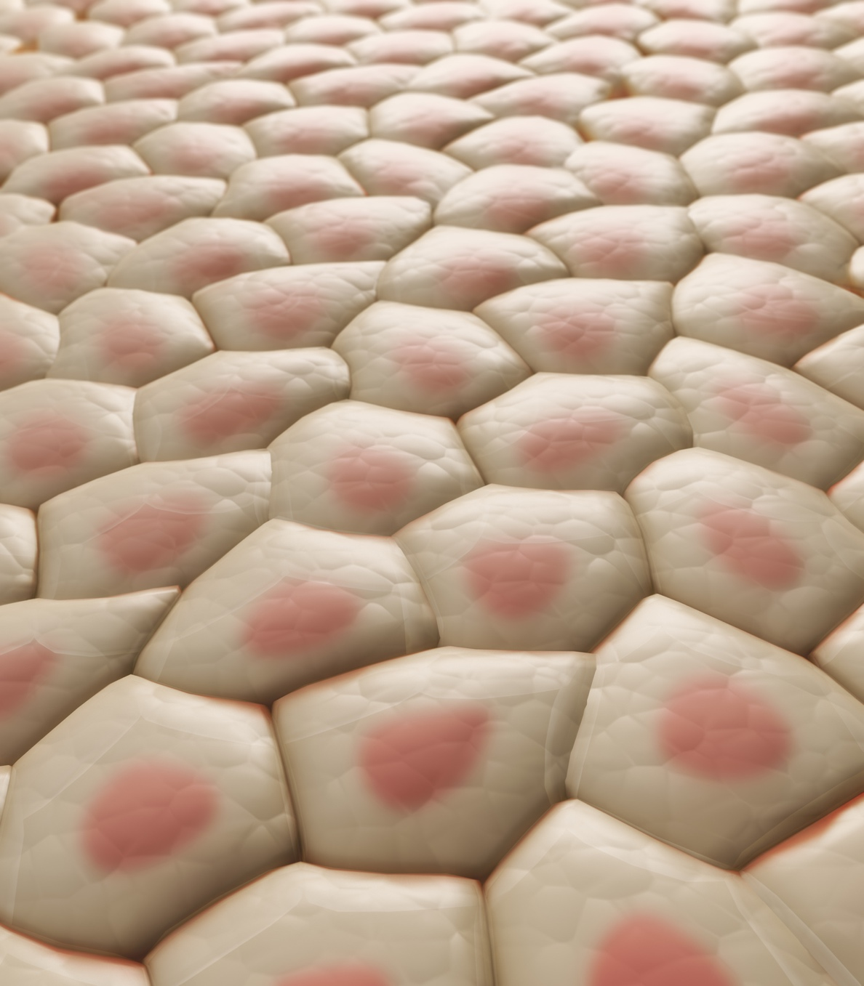
Intro
Tissue
Notes:
Today we will learn about tissue.

Slide 3
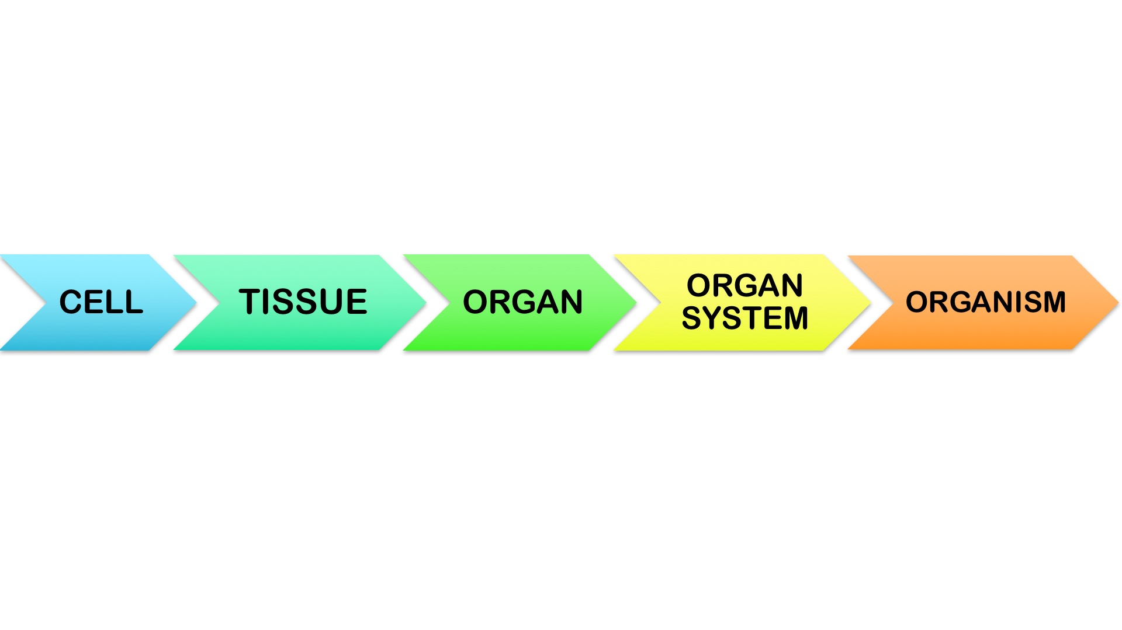
Big Question: What relationships exist between cells, tissues, organs, and organ systems?
Notes:
Our “big question” is: What relationships exist between cells, tissues, organs, and organ systems?
You may already have knowledge about one of these levels of organization that could assist you in making guesses about these relationships.
[Pause and illicit predictions from students.]
I love all these thoughtful scientific hypotheses! Be sure to keep this question and your predictions in mind as we move through these next few lessons, and we’ll continue to revisit it.
Feedback: Asking students to make predictions about what relationships exist is a great way to activate and elicit student ideas and prior knowledge. This type of activity is evidence of the teacher planning for students’ engagement with science ideas.

Slide 4
Demonstration
Tissue Types Exploration
If wanting to include some sort of demonstration (you may not feel it’s necessary for this term), you can access a copy of the presentation linked above. The presentation includes images of various human tissues. Prompt students to consider what tissues might be made of and how different types of tissue contribute to the functioning of our bodies.
Notes:
Let’s do a quick demonstration that will help get our brains ready to think about tissue, and how it relates to our big question.
Feedback: Providing an exploration activity is a great way to make science thinking visible.

Slide 5
Notes:
Before we move on to our new vocabulary term, let’s review some other words & concepts that you already learned and make sure you are firm in your understanding.

Slide 6
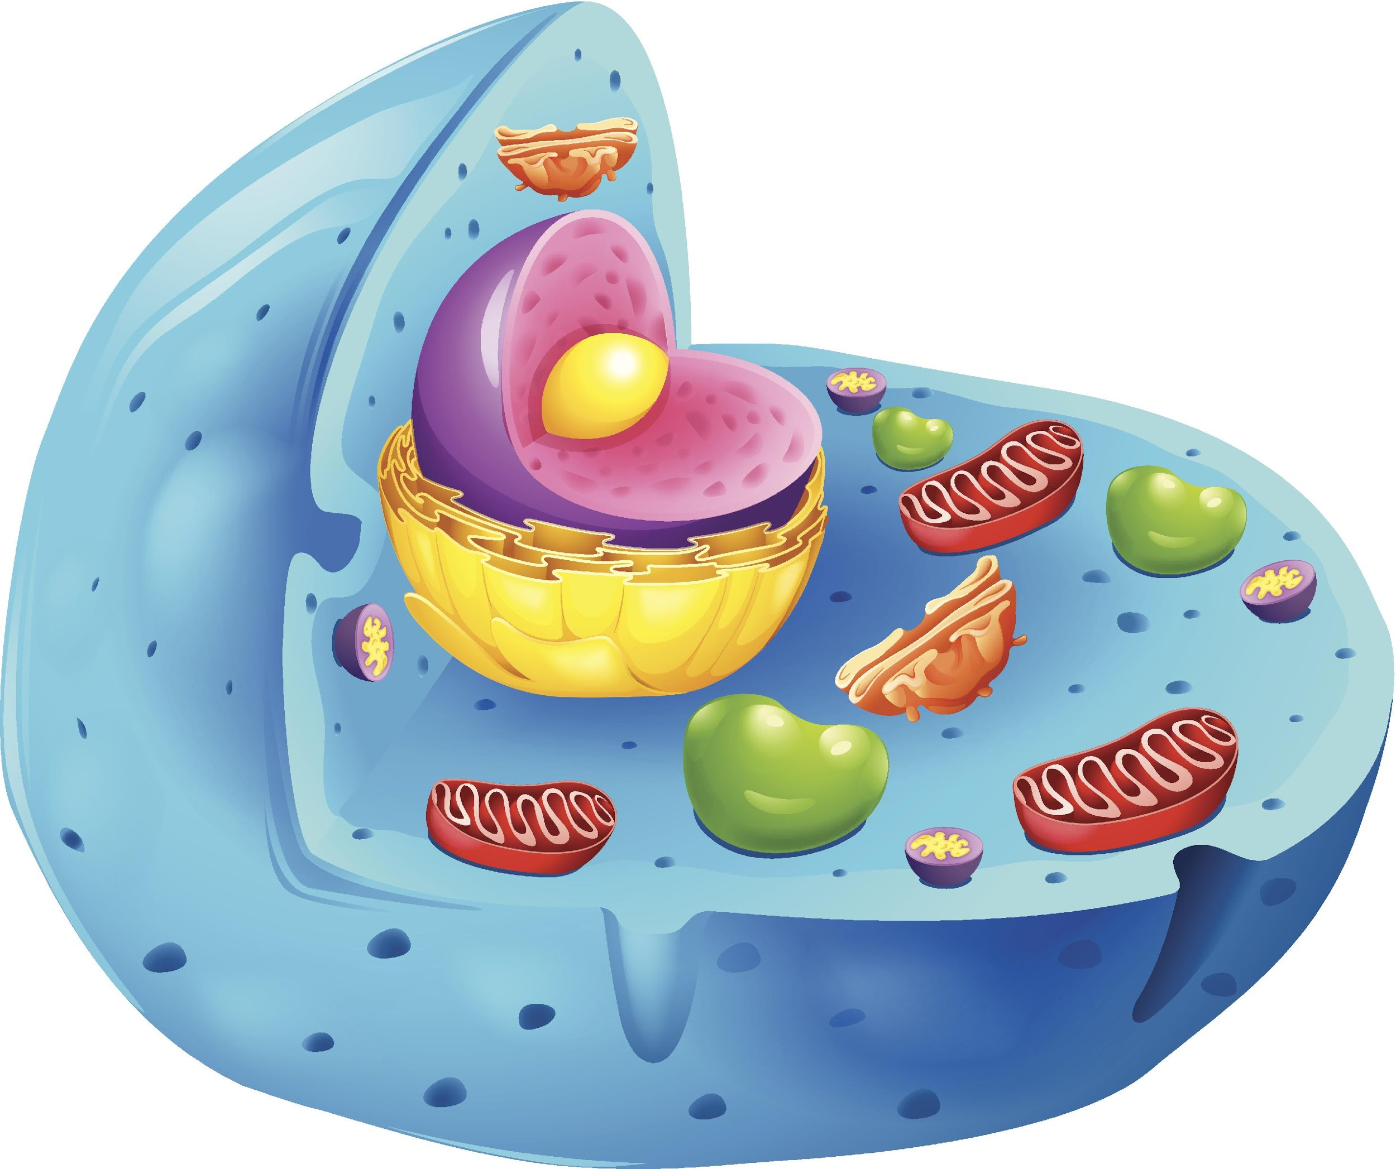
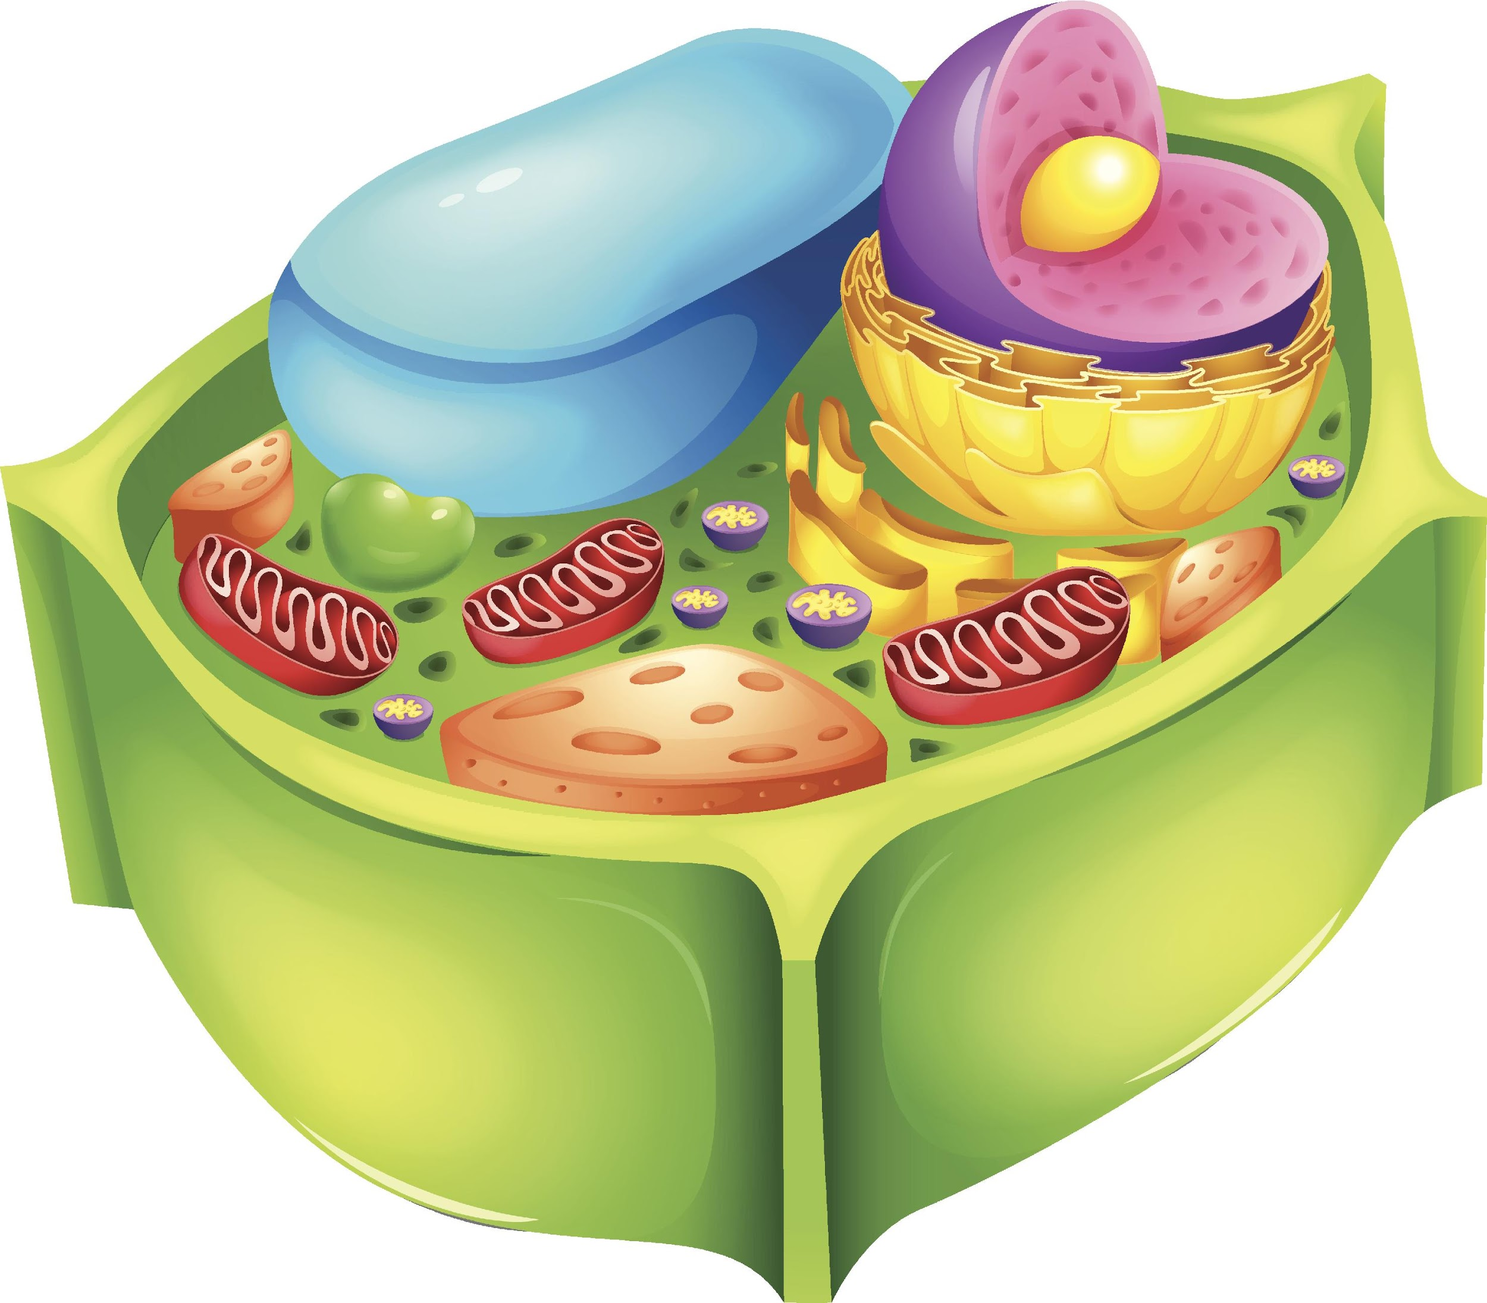
Cell: basic unit of life
Notes:
A cell is the basic unit of life. In living things one cell or many cells are responsible for carrying out all of the processes an organism needs to do in order to stay alive.

Slide 7
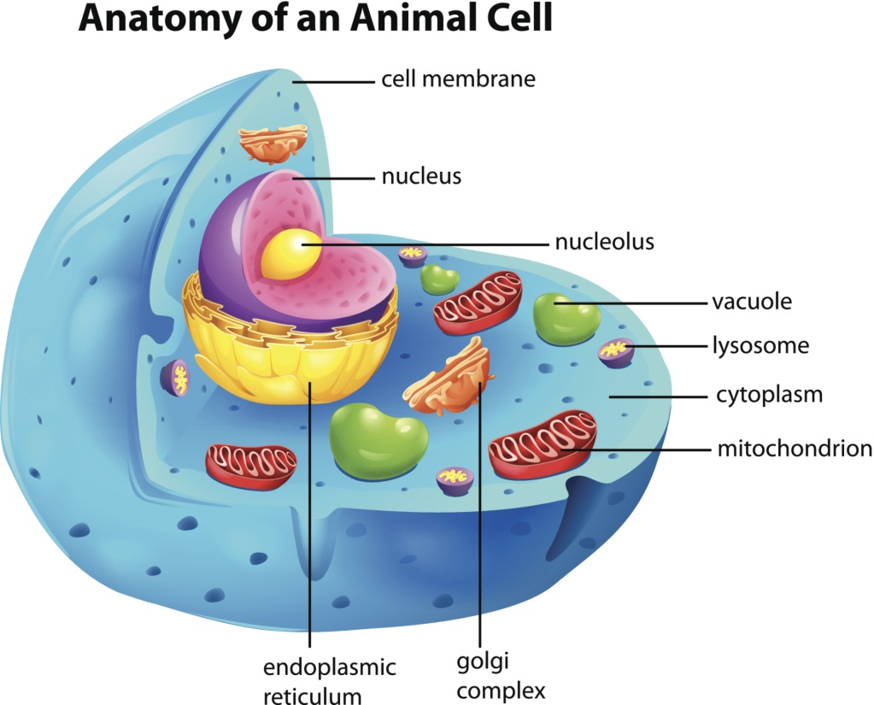
Organelles: smaller parts within the cell with their own job
Notes:
Organelles are the smaller parts within the cell with their own job.

Slide 8
Notes:
Now let’s pause for a moment to check your understanding.

Slide 9
What is a cell?
Notes:
What is a cell?
[Cells are the basic unit of life.]
Feedback: It is important to use clear, concise language when reviewing concepts.

Slide 10
What is the difference between a cell and an organelle?
Notes:
What is the difference between a cell and an organelle?
[A cell is the basic unit of life, but organelles are smaller parts within the cell with their own job. The organelles each play a role in the survival and function of the cell.]

Slide 11
Tissue
Notes:
Now that we’ve reviewed, let’s define our new term, tissue.

Slide 12
Tissue: group of similar cells that work together and have a specific function together.
Notes:
A tissue is a group of similar cells that work together and have a specific function together.

Slide 13
Notes:
Now let’s pause for a moment to check your understanding.

Slide 14
What are tissues?
Notes:
What are tissues?
[Tissues are a group of similar cells that work together and have a specific function together.]

Slide 15
Notes:
Now, let’s talk about some examples of tissues.

Slide 16
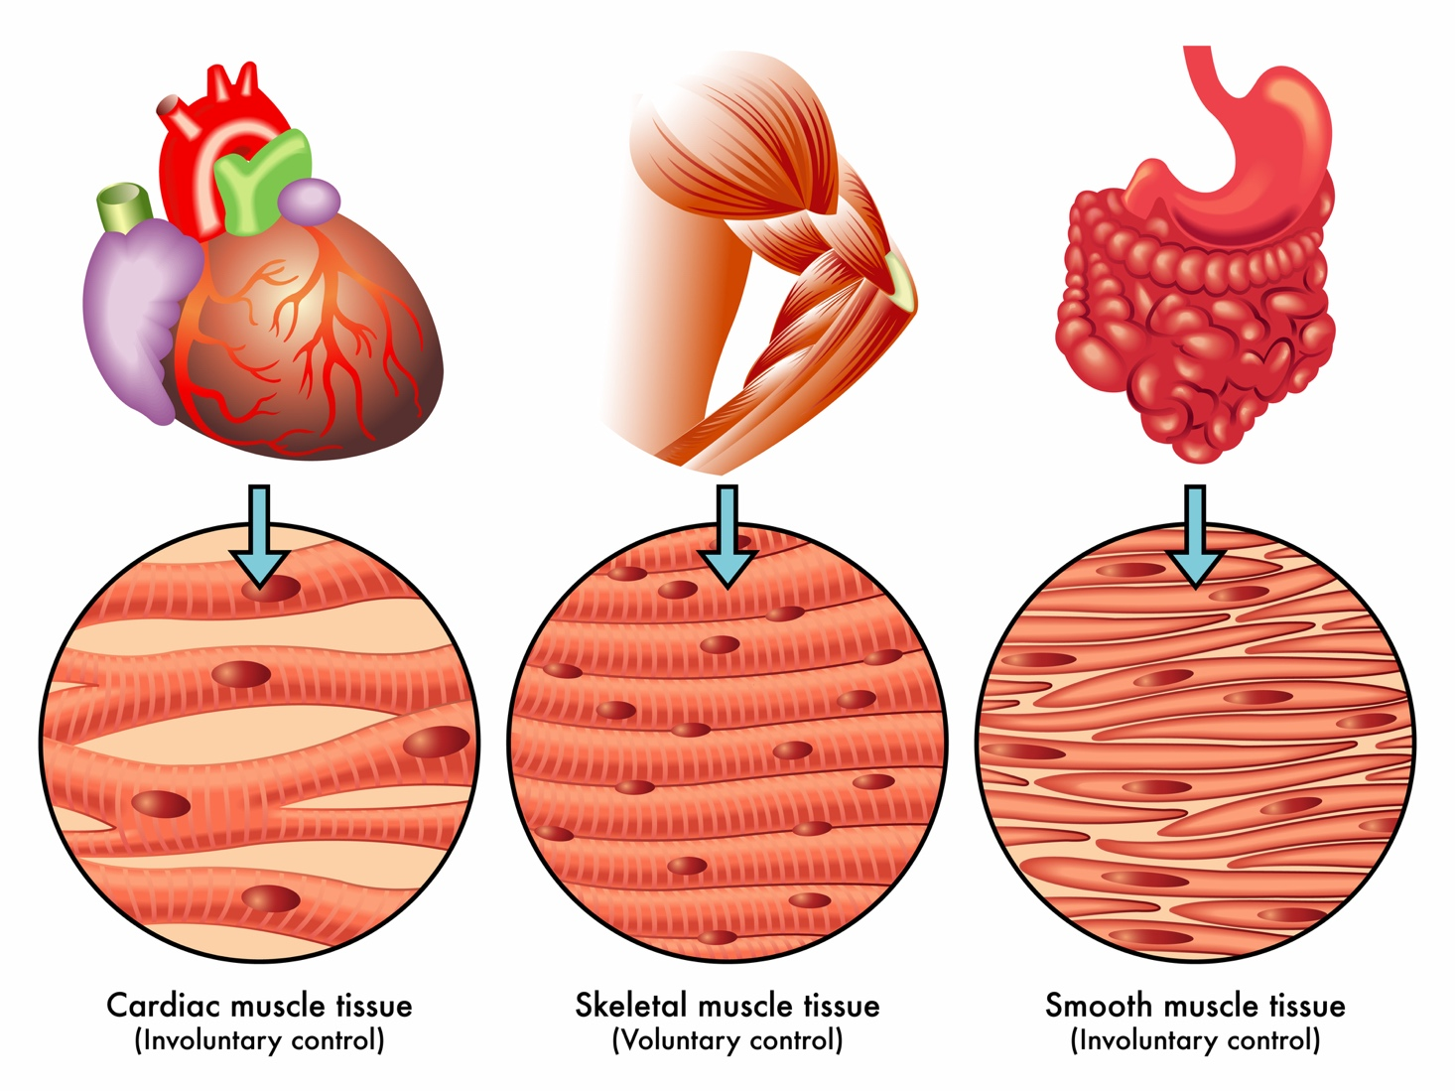
Heart
Cardiac muscle tissue
Notes:
Here are three examples of some types of tissue found in humans. Cells in the heart work together to form cardiac muscle tissue that keeps your heart pumping.

Slide 17
Muscles
Skeletal muscle tissue
Notes:
Cells in your muscles work together to form skeletal muscle tissue that you use to move your arms, legs, and other parts of your body.

Slide 18
Organs
Smooth muscle tissue
Notes:
Finally, cells in your other organs, such as the stomach and intestines shown in the picture, work together to help your body process food, energy, and waste.

Slide 19
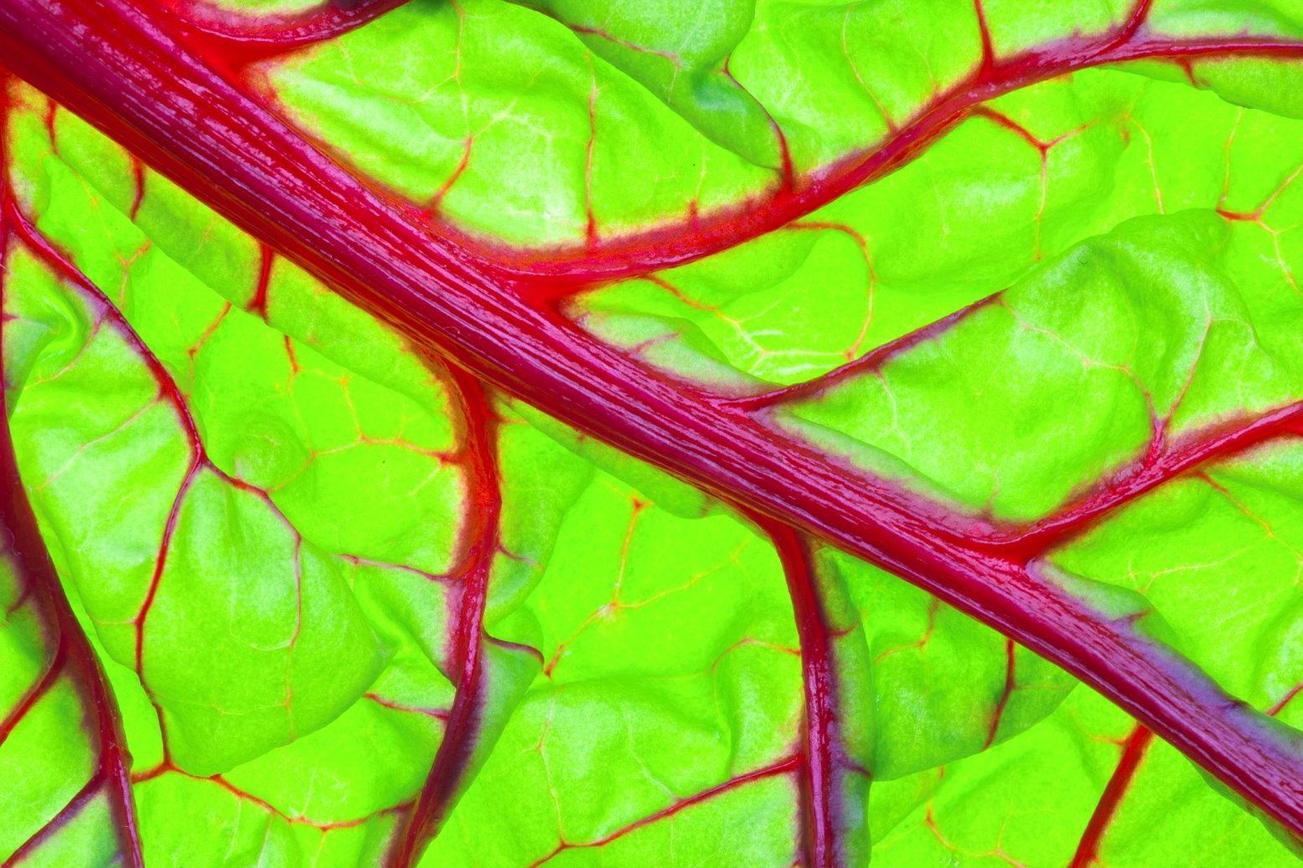
Notes:
Vascular tissue is another example of tissue made a group of cells. Vascular tissue is found only in plants. With that said, humans do have tissues that perform similar functions. In this picture, the red lines are the vascular tissue.

Slide 20
Notes:
Now let’s pause for a moment to check your understanding.

Slide 21
What kind of tissue is found in the heart?
Notes:
What kind of tissue is found in the heart?
[Cells in the heart work together to form cardiac muscle tissue that keeps your heart pumping.]

Slide 22
How do we know that skeletal muscle tissue is tissue?
Notes:
How do we know that skeletal muscle tissue is tissue?
[Cells in your muscles work together to form skeletal muscle tissue that you use to move your arms, legs, and other parts of your body. The cells are both working together AND performing a specific function → moving arms, legs, and other parts of the body.]

Slide 23
What is the function of smooth muscle tissue?
Notes:
What is the function of smooth muscle tissue?
[Cells in your other organs, such as the stomach and intestines shown in the picture, work together to help your body process food, energy, and waste.]

Slide 24
True/False: Plants do not have tissue.
Notes:
True/False: Plants do not have tissue.

Slide 25
True/False: Plants do not have tissue.
Notes:
True/False: Plants do not have tissue.
[False - Vascular tissue is another example of tissue made of a group of cells. Vascular tissue is found only in plants.]

Slide 26
Notes:
Next, let’s talk about some non-examples of tissues.
Feedback: Non-examples often need some explanation to make it clear to students the difference.

Slide 27
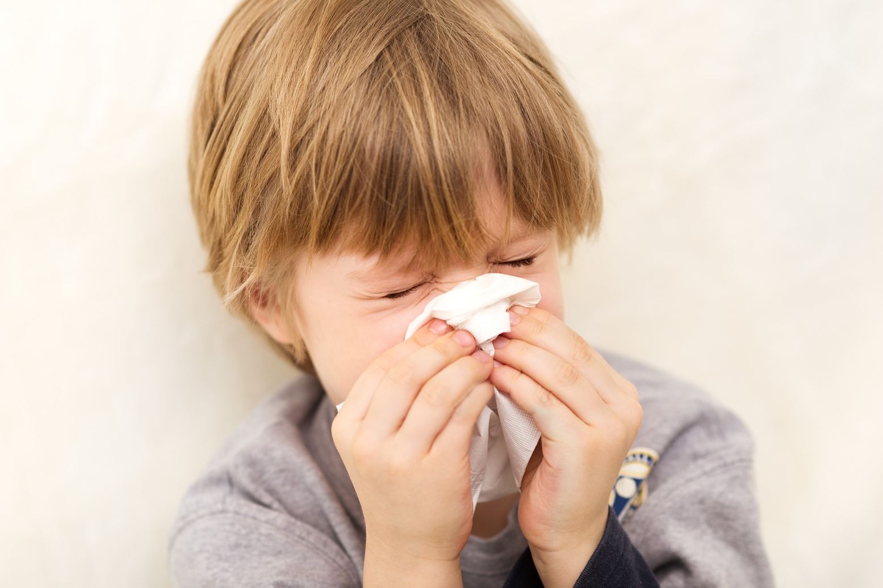
Tissue Paper
Notes:
You are probably familiar with tissue paper that we use every day.

Slide 28
Tissue Paper
Notes:
But this is not the same as the tissues in your body or in a plant. Cells are not found in tissue paper, so that would not be the type of tissue we are talking about here.

Slide 29
Notes:
Now let’s pause for a moment to check your understanding.

Slide 30
Explain why tissue paper is not the same as tissue found in plants and animals.
Notes:
Explain why tissue paper is not the same as tissue found in plants and animals.
[Cells are not found in tissue paper, so that would not be the type of tissue we are talking about here.]

Slide 31
Notes:
“Tissue” cannot be broken down, but you might present the origin of the word in order to increase understanding.

Slide 32
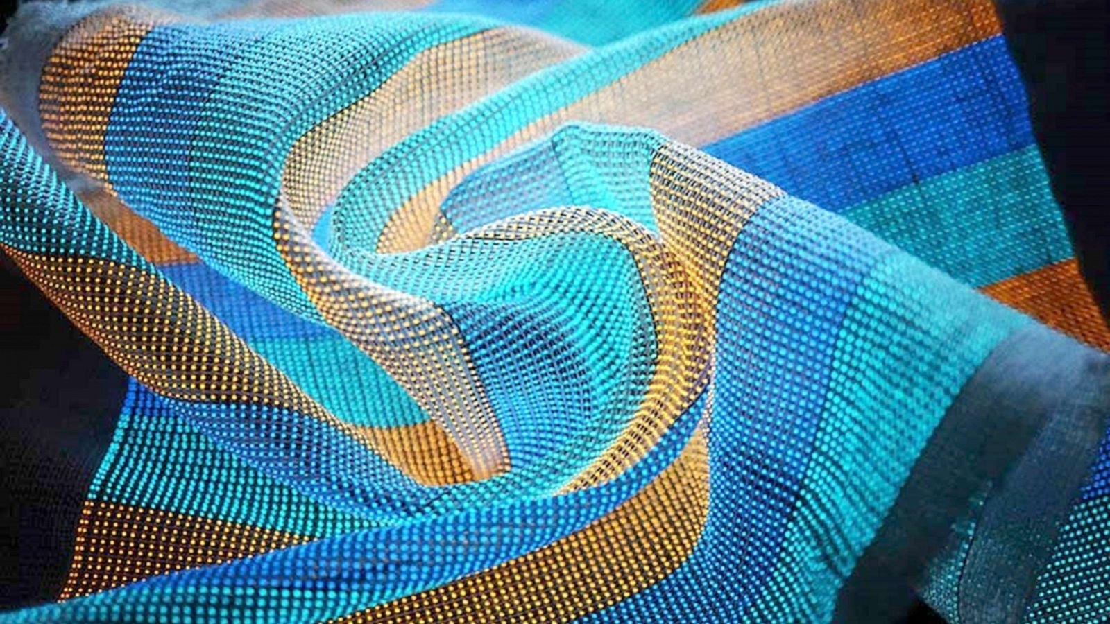
The word “tissue” comes from an old French word, “tissu”, which refers to a woven fabric.
Just like many fibers in a fabric give the material its function, the many cells in living tissue work together to perform a function.
Notes:
The word “tissue” comes from an old French word, “tissu”, which refers to woven fabric.
Just like many fibers in a fabric give the material its function, the many cells in living tissue work together to perform a function.

Slide 33
Notes:
Let’s check-in for understanding.

Slide 34
What is a tissue?
Notes:
What is a tissue?
[A tissue is a group of similar cells that work together and have a specific function together.]

Slide 35
What is the relationship between cells and tissue?
Notes:
What is the relationship between cells and tissue?
[A cell, is the basic unit of life in an organism, cells are important to tissue because a group of similar cells with similar functions work together to form tissue. So without those cells, you couldn’t have tissue.]

Slide 36
Remember!!!
Notes:
So remember!

Slide 37
Tissue: group of similar cells that work together and have a specific function together.
Notes:
A tissue is a group of similar cells that work together and have a specific function together.

Slide 38
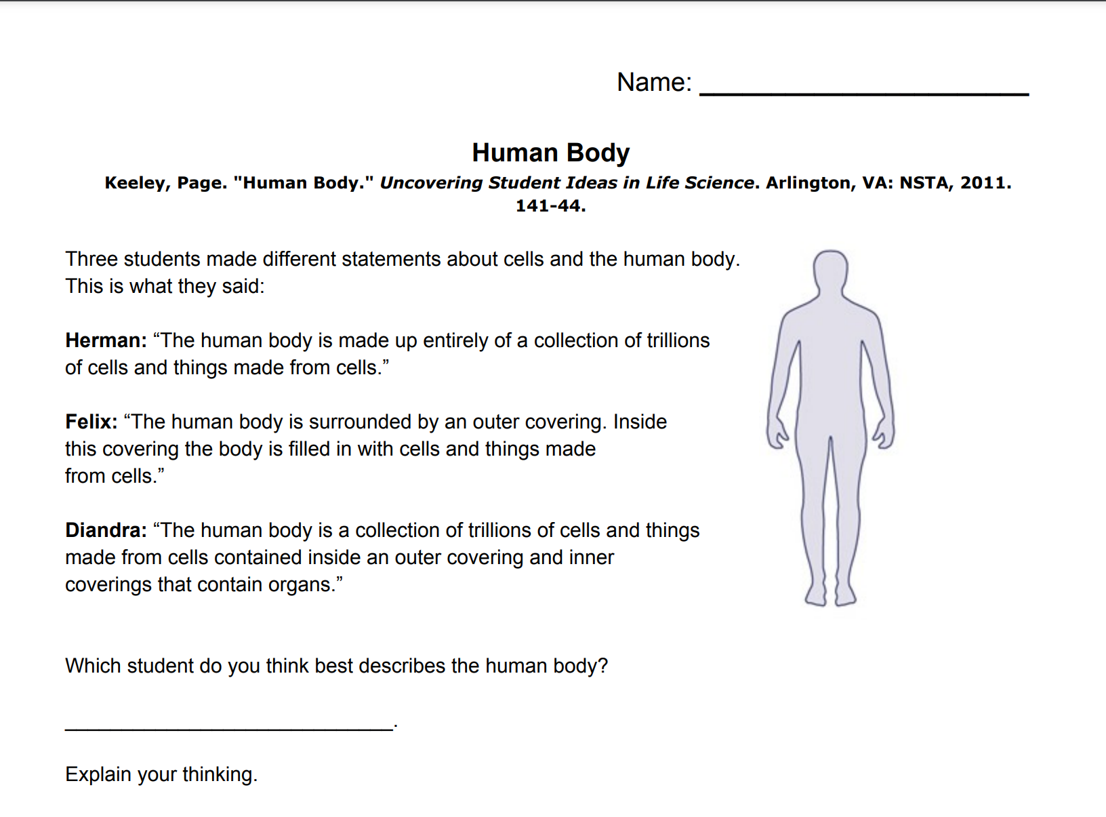
Reinforcement Activity
The Human Body Question
Click the link above to access a copy of the Human Body probing question. Allow students to respond to this question at the end of the tissues lesson and then make revisions following subsequent lessons.
For more on this activity, follow this link to BetterLesson.
Notes:
Feedback: Asking open-ended questions during or after reinforcement activities is a great way to gauge student understanding by requiring deeper thought than a rote opportunity to respond.

Slide 39
Big Question: What relationships exist between cells, tissues, organs, and organ systems?
Notes:
Explicit cue to revisit the big question at the end of the lesson: Okay everyone. Now that we’ve learned the term, let’s reflect once more on our big question. Was there anything that we predicted earlier that was correct or incorrect? Do you have any new hypotheses to share?

Slide 40
Notes:
Thanks for watching, and please continue watching CAPs available from this website.

Slide 41
This Video Was Created With Resources From:
Questions or Comments
Michael Kennedy, Ph.D. MKennedy@Virginia.edu
Rachel L Kunemund, Ph.D. rk8vm@virginia.edu

Slide 42
Intro
“Big Idea” Question
Review Concepts
Check-In Questions
Teacher Demo
Vocabulary
Student-Friendly Definition
Examples & Non-Examples
Morphological Word Parts
Reinforcement Activity
Notes:
OK everyone, get ready for our next lesson. Just as a reminder, these are the different components that our lesson may include, and you’ll see these icons in the top left corner of each slide so that you can follow along more easily!

Slide 43
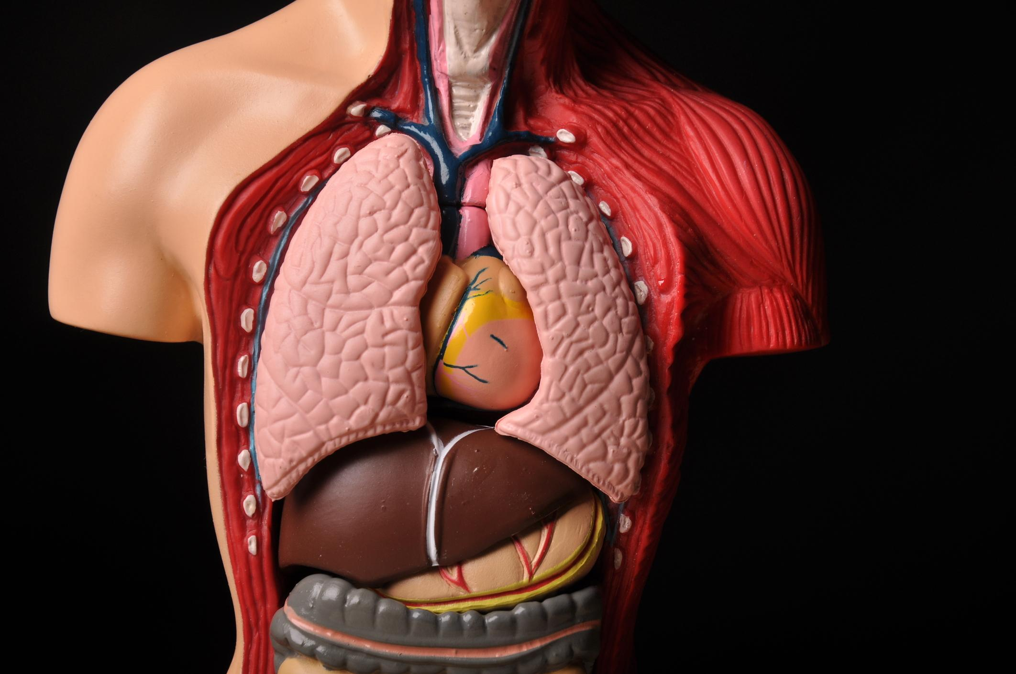
Intro
Organ
Notes:
Today we will learn about organs.

Slide 44
Big Question: What relationships exist between cells, tissues, organs, and organ systems?
Notes:
Our “big question” is: What relationships exist between cells, tissues, organs, and organ systems?
What did we learn yesterday? What did we already know and what did we learn?
[Pause and illicit predictions from students.]
I love all these thoughtful scientific hypotheses! Be sure to keep this question and your predictions in mind as we move through this lesson, and we’ll revisit it.

Slide 45
Demonstration
Cells, Tissues, and Organs
TEACHER DIRECTIONS:
Before viewing, ask students to recall information about what they have already learned about cells and tissues. After viewing, ask students to share any observations they made about the different organs. Tell students that they they will be learning more about organs today.
You may also choose to do this experiment live for students (on video meeting platform or face-to-face). You can set up the materials if you have access to a model of the organs in the body.
Notes:
Let’s do a quick demonstration that will help get our brains ready to think about organs, and how they relate to our big question.
Feedback: This demonstration offers lots of opportunities for differentiation for students with different individual needs. Some of these are listed in the slide above.

Slide 46
Notes:
Let’s check-in for understanding.

Slide 47
According to the video, what are all plants and animals made up of?
Notes:
According to the video, what are all plants and animals made up of?
[Different types of cells]

Slide 48
True/False: All of our inside parts (shown below) are made up of cells.
Notes:
True/False: All of our inside parts (shown below) are made up of cells.

Slide 49
True/False: All of our inside parts (shown below) are made up of cells.
Notes:
True/False: All of our inside parts (shown below) are made up of cells.
[True]

Slide 50
In the model below, what are those inside parts called?
Notes:
In the model below, what are those inside parts called?
[Organs]

Slide 51
Why are organs important?
Notes:
Why are organs important?
[They each have a different function that help us to survive. The lungs for example bring in oxygen that we need to breathe.]

Slide 52
Name an organ and describe why it is important.
Notes:
Name an organ and describe why it is important.
[Lungs → air to breath
Stomach → digest food so we can get important nutrients
Heart → pump blood, etc.]

Slide 53
Notes:
Before we move on to our new vocabulary term, let’s review some other words & concepts that you already learned and make sure you are firm in your understanding.

Slide 54
Cell: basic unit of life
Notes:
A cell is the basic unit of life. In living things one cell or many cells are responsible for carrying out all of the processes an organism needs to do in order to stay alive.

Slide 55
Organelles: smaller parts within the cell with their own job
Notes:
Organelles are the smaller parts within the cell with their own job.

Slide 56
Tissue: group of similar cells that work together and have a specific function together.
Notes:
A tissue is a group of similar cells that work together and have a specific function together.

Slide 57
Notes:
Now let’s pause for a moment to check your understanding.

Slide 58
What is a cell?
Notes:
What is a cell?
[Basic unit of life]

Slide 59
What is the difference between a cell and an organelle?
Notes:
What is the difference between a cell and an organelle?
[A cell is the basic unit of life, but organelles are smaller parts within the cell with their own job.]

Slide 60
What is the relationship between cells and tissue?
Notes:
What is the relationship between cells and tissue?
[A cell, is the basic unit of life in an organism, cells are important to tissue because a group of similar cells with similar functions work together to form tissue. So without those cells, you couldn’t have tissue.]

Slide 61
Organ
Notes:
Now that we’ve reviewed, let’s define our new term, organ.

Slide 62
Organ: group of different tissues that work together and have a specific function together
Notes:
An organ is a group of different tissues that work together and have a specific function together.

Slide 63
Notes:
Let’s check-in for understanding.

Slide 64
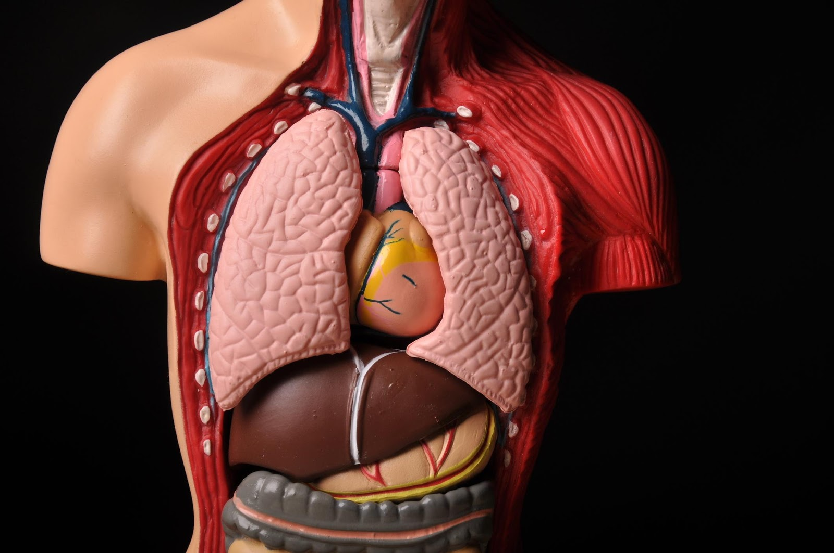
What is an organ?
Notes:
What is an organ?
[An organ is a group of different tissues that work together and have a specific function together.]

Slide 65
What is the difference between an organ and a tissue?
Notes:
What is the difference between an organ and a tissue?
[An organ is a group of different tissues that work together and have a specific function together but a tissue is a group of similar cells that work together and have a specific function together.]

Slide 66
Notes:
Now, let’s talk about some examples of organs.

Slide 67
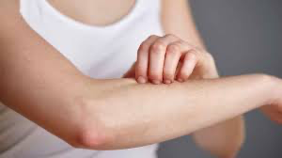
Notes:
Skin is the largest organ, covering our entire body.

Slide 68
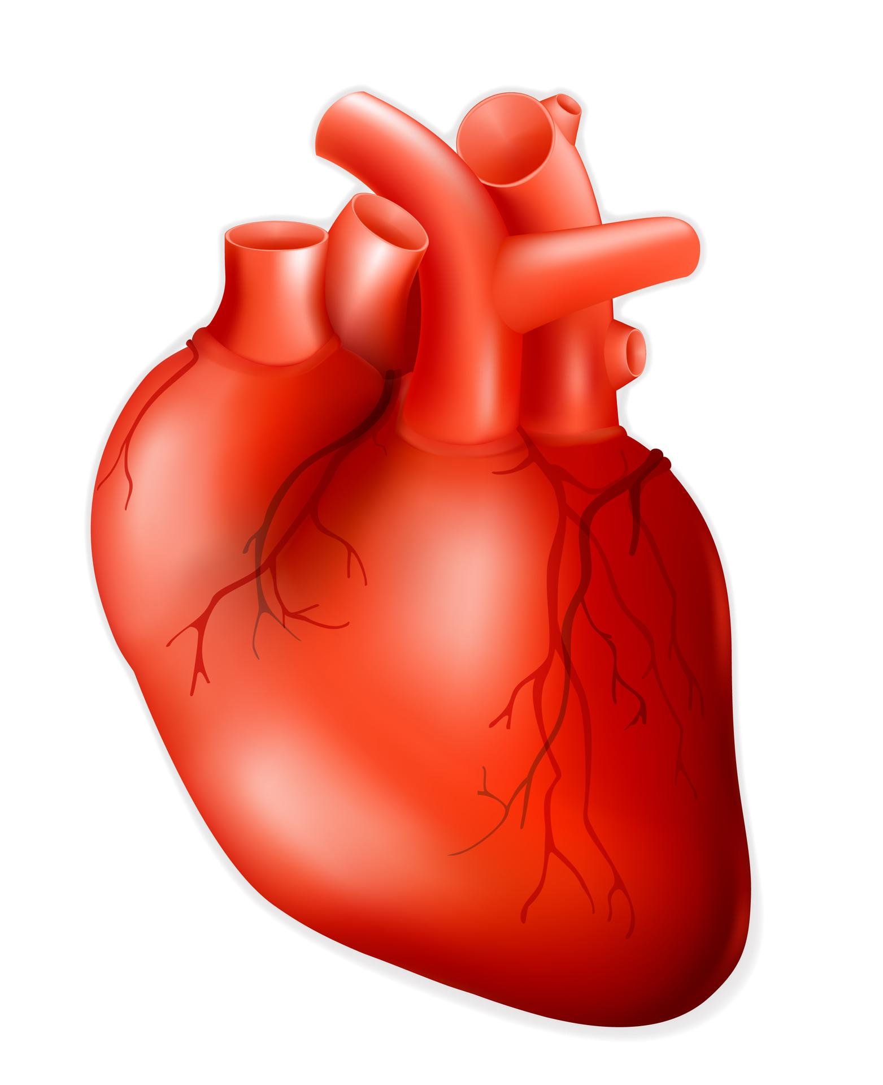
Notes:
Your heart is an example of an organ. Tissues in the heart work together, doing their different jobs, to keep your heart pumping.

Slide 69
Notes:
Another example is your lungs. Lungs are a collection of tissues that allow you to breathe.

Slide 70
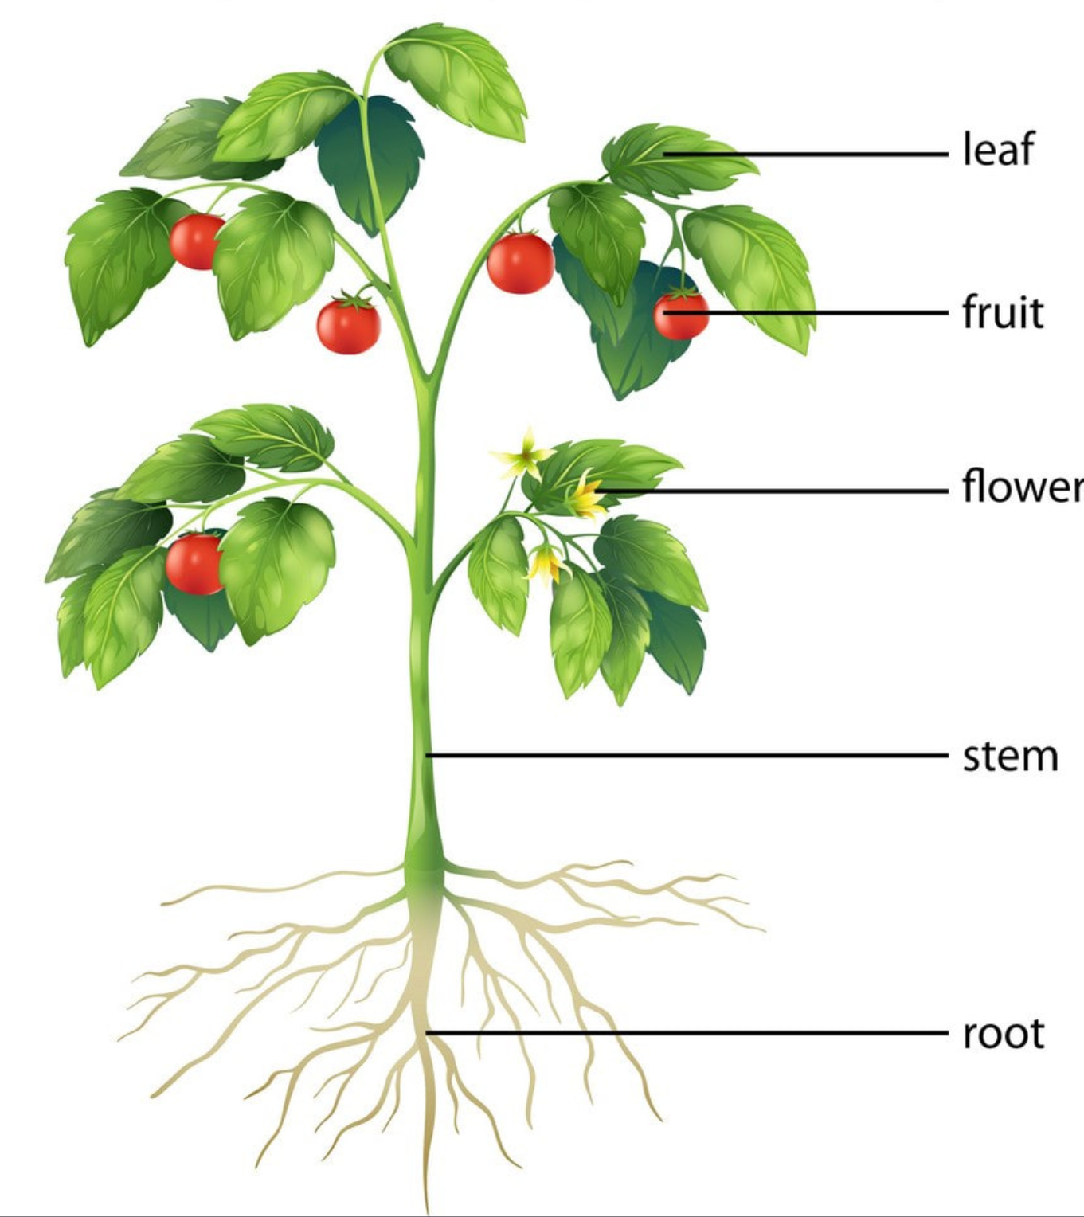
Notes:
Plants also have organs. Some of the organs in a plant are the root, stem, and leaf. The reproductive parts of a plant are also organs.

Slide 71
Notes:
Let’s check-in for understanding.

Slide 72
What is our largest organ?
Notes:
What is our largest organ?
[Skin is the largest organ.]

Slide 73
How is our heart an organ?
Notes:
How is our heart an organ?
[Your heart is an example of an organ because it is made up of tissues that work together and has a specific function. The specific function of tissue in the heart is to work together to keep your heart pumping.]

Slide 74
Why are lungs an important organ?
Notes:
Why are lungs an important organ?
[Lungs are a collection of tissues that allow you to breathe.]

Slide 75
Do plants have organs? If yes, name an organ a plant has.
Notes:
Do plants have organs? If yes, name an organ a plant has.
[Plants also have organs. Some of the organs in a plant are the root, stem, and leaf. The reproductive parts of a plant are also organs.]

Slide 76
Notes:
Next, let’s talk about some non-examples of organs.

Slide 77
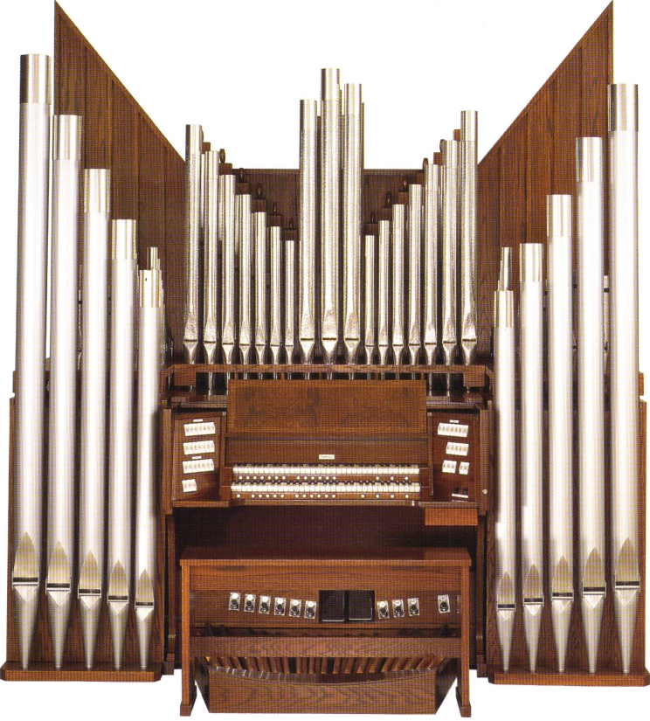
Notes:
You may be familiar with this musical instrument, which is also called an organ.

Slide 78
Notes:
But this is not the same as the organs in your body.

Slide 79
Notes:
A tissue is not an organ because it is a group of similar cells that work together and have a specific function together. Organs are made of tissues.
Feedback: It is important to clearly explain why a non example is not an example.

Slide 80
Notes:
Let’s check-in for understanding.

Slide 81
Is the the type of organ we have learned about today? Explain your answer.
Notes:
Is the type of organ we have learned about today? Explain your answer.
[You may be familiar with this musical instrument, which is also called an organ, but this is NOT the same as organs in our body. Remember, organs in our body are made of tissue, but this is a musical instrument and not what we are learning about today.]

Slide 82
Why is tissue NOT an organ?
Notes:
Why is tissue NOT an organ?
[A tissue is not an organ because it is a group of similar cells that work together and have a specific function together. Organs are made of tissues.]

Slide 83
Notes:
“Organ” cannot be broken down, but you might present the origin of the word in order to increase understanding.

Slide 84
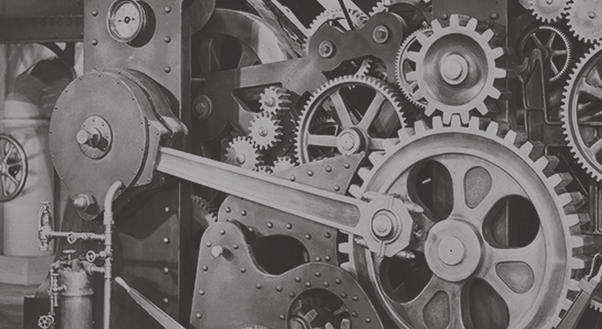
The word “organ” came from an old Greek word, “organon”, which was used to refer to a tool for making or doing something.
We can think of each of the organs in our bodies as tools that have a specific purpose in keeping the machine (our bodies) going.
Notes:
The word “organ” came from an old Greek word, “organon”, which was used to refer to a tool for making or doing something.
We can think of each of the organs in our bodies as tools that have a specific purpose in keeping the machine (our bodies) going.

Slide 85
Notes:
Let’s check-in for understanding.

Slide 86
What is an organ?
Notes:
What is an organ?
[An organ is a group of different tissues that work together and have a specific function together.]

Slide 87
True/False: Plants have organs.
Notes:
True/False: Plants have organs.

Slide 88
True/False: Plants have organs.
Notes:
True/False: Plants have organs.
[True - Plants also have organs!]

Slide 89
Give your own example of an organ.
Notes:
Can you think of organs that we have not talked about? – Stomach, skin, brain, liver, kidney, etc.

Slide 90
What is the relationship among cells, tissue, and organs?
Notes:
What is the relationship among cells, tissue, and organs?
[A cell is the basic unit of life in an organism. Cells are important to tissue because a group of similar cells with similar functions work together to form tissue. So without those cells, you couldn’t have tissue. Finally, a group of different tissues that work together and have a specific function together make up organs. So, without one (cell, tissue, organ) you couldn’t have the other.]

Slide 91
Remember!!!
Notes:
So remember!

Slide 92
Organ: group of different tissues that work together and have a specific function together
Notes:
An organ is a group of different tissues that work together and have a specific function together.

Slide 93
Reinforcement Activity
The Human Body Question
Click the link above to access a copy of the Human Body probing question. Allow students to respond to this question at the end of the tissues lesson and then make revisions following subsequent lessons.
For more on this activity, follow this link to BetterLesson.
Notes:
Feedback: If you chose to utilize the Human Body Question at the end of the tissues presentation, you may have students go back and decide whether they agree or disagree with their initial response. Alternatively, if this activity was not utilized previously you can have students respond to the question for the first time.

Slide 94
Big Question: What relationships exist between cells, tissues, organs, and organ systems?
Notes:
Explicit cue to revisit the big question at the end of the lesson: Okay everyone. Now that we’ve learned the term, let’s reflect once more on our big question. Was there anything that we predicted earlier that was correct or incorrect? Do you have any new hypotheses to share?

Slide 95
Notes:
Thanks for watching, and please continue watching CAPs available from this website.

Slide 96
This Video Was Created With Resources From:
Questions or Comments
Michael Kennedy, Ph.D. MKennedy@Virginia.edu
Rachel L Kunemund, Ph.D. rk8vm@virginia.edu

Slide 97
Intro
“Big Idea” Question
Review Concepts
Check-In Questions
Teacher Demo
Vocabulary
Student-Friendly Definition
Examples & Non-Examples
Morphological Word Parts
Simulation/Activity
Notes:
OK everyone, get ready for our next lesson. Just as a reminder, these are the different components that our lesson may include, and you’ll see these icons in the top left corner of each slide so that you can follow along more easily!

Slide 98
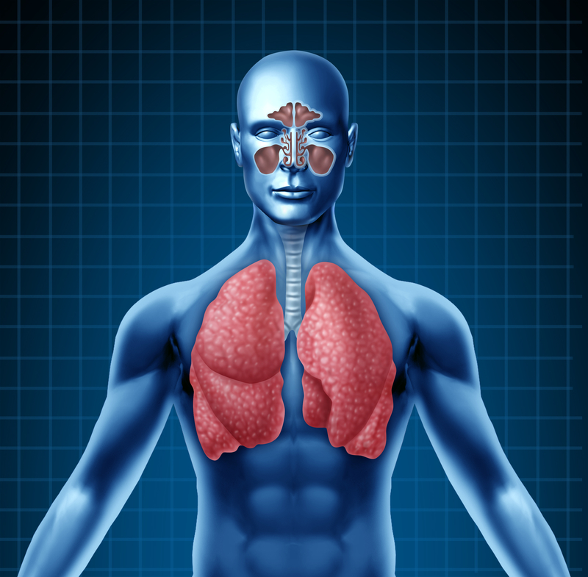
Intro
Organ System
Notes:
Today we will learn about the organ system.

Slide 99
Big Question: What relationships exist between cells, tissues, organs, and organ systems?
Notes:
Our “big question” is: What relationships exist between cells, tissues, organs, and organ systems?
What did we learn yesterday? What did we already know and what did we learn to help us answer our question?

Slide 100
Demonstration
Organ System Types Exploration
If wanting to include some sort of demonstration (you may not feel it’s necessary for this term), you can access a copy of the presentation linked above. The presentation includes images of various organ systems in humans. Prompt students to consider what organ systems are made up of and how they relate to the survival/functioning of the organism.
Notes:
Let’s do a quick demonstration that will help get our brains ready to think about tissue, and how it relates to our big question.

Slide 101
Notes:
Before we move on to our new vocabulary term, let’s review some other words & concepts that you already learned and make sure you are firm in your understanding.

Slide 102
Cell: basic unit of life
Notes:
A cell is the basic unit of life. In living things one cell or many cells are responsible for carrying out all of the processes an organism needs to do in order to stay alive.

Slide 103
Organelles: smaller parts within the cell with their own job
Notes:
Organelles are the smaller parts within the cell with their own job. Organelles are not alive by themselves, but they play an important role in keeping the cell alive.

Slide 104
Tissue: group of similar cells that work together and have a specific function together
Notes:
A tissue is a group of similar cells that work together and have a specific function together.

Slide 105
Organ: group of different tissues that work together and have a specific function together
Notes:
An organ is a group of different tissues that work together and have a specific function together.

Slide 106
Notes:
Now let’s pause for a moment to check your understanding.

Slide 107
What is a cell?
Notes:
What is a cell?
[Cells are the basic unit of life.]

Slide 108
What is the difference between a cell and an organelle?
Notes:
What is the difference between a cell and an organelle?
[A cell is the basic unit of life, but organelles are smaller parts within the cell with their own job]

Slide 109
What is the relationship among cells, tissue, and organs?
Notes:
What is the relationship among cells, tissue, and organs?
[A cell is the basic unit of life in an organism. Cells are important to tissue because a group of similar cells with similar functions work together to form tissue. So without those cells, you couldn’t have tissue. Finally, a group of different tissues that work together and have a specific function together make up organs. So, without one (cell, tissue, organ) you couldn’t have the other.]

Slide 110
Organ System
Notes:
Now that we’ve reviewed, let’s define our new term, organ system.

Slide 111
Organ System: a group of 2 or more organs that work together for a specific function
Notes:
An organ system is a group of two or more organs that work together for a specific function.

Slide 112
Notes:
Now let’s pause for a moment to check your understanding.

Slide 113
What is an organ system?
Notes:
What is an organ system?
[An organ system is a group of 2 or more organs that work together for a specific function.]

Slide 114
Notes:
That is the basic definition, but there is a bit more you need to know.

Slide 115
There are 11 organ systems in the human body.
Notes:
There are 11 organ systems in the human body. We will learn about these systems later.

Slide 116
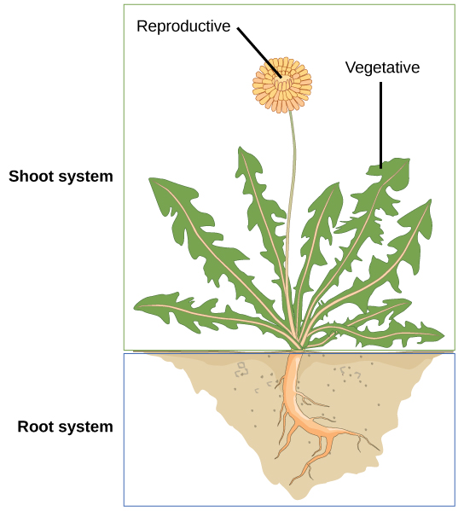
Plants have 2 organ systems
Notes:
Plants have only 2 organ systems: The shoot system and the root system. Notice that the root system is below ground while the shoot system is above ground.

Slide 117
Notes:
Now let’s pause for a moment to check your understanding.

Slide 118
How many organ systems are in the human body?
Notes:
How many organ systems are in the human body?
[There are 11 organ systems in the human body.]

Slide 119
What are the two organ systems found in plants?
Notes:
What are the two organ systems found in plants?
[Plants have only 2 organ systems: The shoot system and the root system.]

Slide 120
Notes:
Now, let’s talk about some examples of organ systems.

Slide 121
Notes:
The Respiratory System allows you to breathe in oxygen and expel carbon dioxide.

Slide 122
Notes:
The organs in the respiratory system include your lungs, throat, and nose.

Slide 123
Notes:
Next, let’s talk about some non-examples of organ systems.

Slide 124
Notes:
Lungs are not an organ system. They are an organ found in the respiratory system.

Slide 125
Notes:
Tissues are not an organ system. They are a collection of similar cells - not different organs.

Slide 126
Notes:
Now let’s pause for a moment to check your understanding.

Slide 127
What is an organ system?
Notes:
What is an organ system?
[An organ system is a group of 2 or more organs that work together for a specific function.]

Slide 128
What is the name of the organ system shown below?
Notes:
What is the name of the organ system shown below?
[Respiratory systems that allow you to breathe oxygen and expel carbon dioxide.]

Slide 129
What organs are included in the respiratory system?
Notes:
What organs are included in the respiratory system?
[Lungs, throat, and nose]

Slide 130
Why would a single organ (like lungs) not be considered an organ system?
Notes:
Why would a single organ (like lungs) not be considered an organ system?
[Lungs are not an organ system. They are an organ. In order to be an organ system, there has to be a group of 2 or more organs working together to perform a specific function, but here there is only one organ. Lungs, however, are an organ found in the respiratory system.]

Slide 131
Are tissues organ systems? Why or why not?
Notes:
Are tissues organ systems? Why or why not?
[Tissues are not organ systems. They are a collection of same cells not different organs.]

Slide 132
Notes:
Here, you could break down the term (not all terms can be broken down). It may be helpful to return to the origin of the word “organ” in expanding on the meaning of “organ system”.

Slide 133
Notes:
Let’s check-in for understanding.

Slide 134
What is an organ system?
Notes:
What is an organ system?
[An organ system is a group of 2 or more organs that work together for a specific function.]

Slide 135
What are the two plant organ systems called?
Notes:
What are the two plant organ systems called?
[Plants have only 2 organ systems: The shoot system and the root system.]

Slide 136
What is the relationship between cells, tissue, organs, and organ systems??
Notes:
What is the relationship between cells, tissue, organs, and organ systems?
[A cell is the basic unit of life in an organism. Cells are important to tissue because a group of similar cells with similar functions work together to form tissue. So without those cells, you couldn’t have tissue. A group of different tissues that work together and have a specific function together make up organs. Finally, organs that perform different functions but work together for a specific purpose are called organ systems.]

Slide 137
Remember!!!
Notes:
So remember!

Slide 138
Organ System: a group of 2 or more organs that work together for a specific function.
Notes:
Organ systems are groups of two or more organs that work together for a specific function.

Slide 139
Reinforcement Activity
The Human Body Question
Click the link above to access a copy of the Human Body probing question. Allow students to respond to this question at the end of the tissues lesson and then make revisions following subsequent lessons.
For more on this activity, follow this link to BetterLesson.
Notes:
Feedback: If you chose to utilize the Human Body Question at the end of a previous presentation, you may have students go back and decide whether they agree or disagree with their initial response. Alternatively, if this activity was not utilized previously you can have students respond to the question for the first time.

Slide 140
Notes:
Thanks for watching, and please continue watching CAPs available from this website.

Slide 141
This Video Was Created With Resources From:
Questions or Comments
Michael Kennedy, Ph.D. MKennedy@Virginia.edu
Rachel L Kunemund, Ph.D. rk8vm@virginia.edu

