Slide 1
Intro
“Big Idea” Question
Review Concepts
Check-In Questions
Teacher Demo
Vocabulary
Student-Friendly Definition
Examples & Non-Examples
Morphological Word Parts
Simulation/Activity
Notes:
OK everyone, get ready for our next lesson. Just as a reminder, these are the different components that our lesson may include, and you’ll see these icons in the top left corner of each slide so that you can follow along more easily!
Feedback: Explicit cues used at the beginning of each step makes it easy for students to follow along and be prepared to engage in the next part of the lesson.

Slide 2
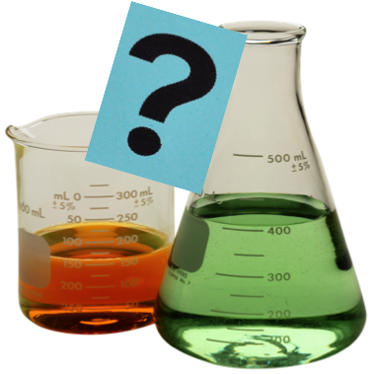
Intro
Chemical Property
Notes:
Today we will learn about chemical properties.

Slide 3
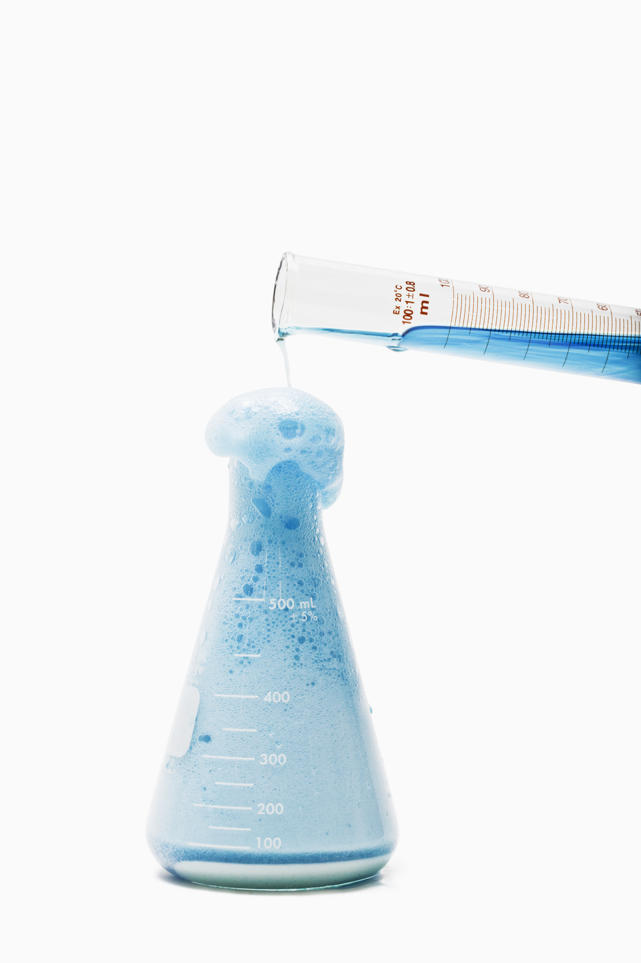
Big Question: What are the similarities and differences between physical and chemical properties and changes, and what do they tell us about a substance?
Physical Property vs Physical Change
H₂O
Chemical Property vs Chemical Change
Notes:
Our “big question” is: What are the similarities and differences between physical and chemical properties and changes, and what do they tell us about a substance?
[Pause and illicit predictions from students.]
I love all these thoughtful scientific hypotheses! Be sure to keep this question and your predictions in mind as we move through this lesson, and we’ll revisit it.
Feedback: Providing students with the opportunity to make predictions about what will happen allows them to think critically about the content.

Slide 4
Demonstration
Elephant Toothpaste
TEACHER DIRECTIONS
Before: Ask students what they have learned about physical properties. Ask students what they think a chemical property will be. How do they think it is the same/different from a physical property.
During: This demonstration can be done in the classroom or virtually. When demonstrating ask the student questions during to keep them engaged (i.e. what do you notice, do you see any physical changes, what did you notice during/after it foamed?).
After: Tell students that when all of the substances were put together to make “elephant toothpaste” all of those substance changed. The chemical property are the things we noticed during/after the elephant toothpaste foamed (turned into a new substance). Tell students they will learn more about chemical properties in this lesson.
Notes:
Let’s do a quick demonstration that will help get our brains ready to think about chemical properties, and how they relate to our big question.
Feedback: It is important to give some background information or a related natural phenomena related to the topic of the activity/demonstration. This helps students make connections.

Slide 5
Notes:
Before we move on to our new vocabulary term, let’s review some other words & concepts that you already learned and make sure you are firm in your understanding.

Slide 6
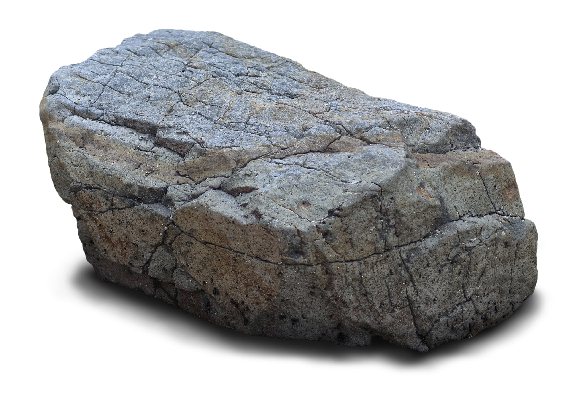
Matter: has mass and takes up space
Notes:
Matter is anything that has mass and takes up space.

Slide 7
Atom: smallest whole unit of matter
Notes:
All matter is made up of atoms. Atoms are the smallest whole unit of matter.

Slide 8
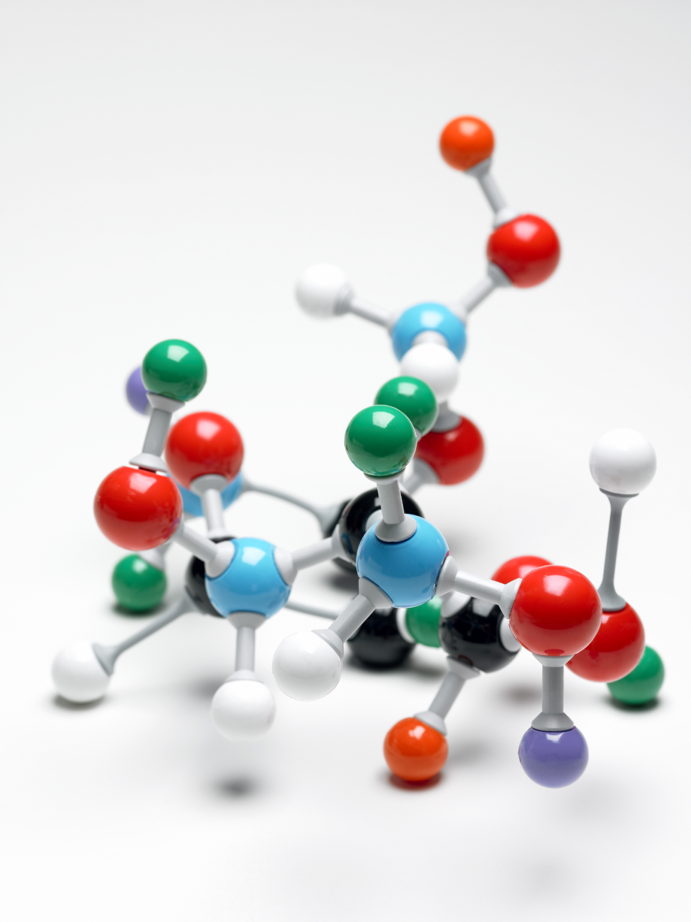
Notes:
All substances have unique properties because of the atoms they are made of.

Slide 9
Property: observed characteristics
chemical
physical
Notes:
Properties are observed characteristics. Properties can either be defined by their physical or chemical properties. They are used to describe what you see.
Feedback: It's really important to make sure that you're providing students with frequent opportunities to respond as you're activating prior knowledge – it will save so you so much time if you confirm understanding before asking them to try something independently.

Slide 10
Physical Property: a characteristic of matter that can be observed without the substance changing into a new substance
Notes:
A physical property is a characteristic of matter that can be observed without the substance changing into a new substance.

Slide 11
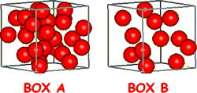
Density: mass per unit of volume
Notes:
Density is the mass per unit of volume of a substance. This will always remain constant - or the same - for a compound or element.

Slide 12
Physical Change: a substance is changed but does not form a new substance
H₂O
Notes:
A physical change is one that does not change the identity of a substance.

Slide 13
Notes:
Now let’s pause for a moment to check your understanding.

Slide 14
What is the relationship between matter and atoms?
Notes:
What is the relationship between matter and atoms?
[Matter has mass and takes up space, and atoms are the smallest whole unit of matter.]

Slide 15
What is a property?
Notes:
What is a property?
[Properties are observed characteristics. They are used to describe what you see. Properties can be defined by their physical or chemical traits.]

Slide 16
What are some examples of physical properties?
Notes:
What are some examples of physical properties?
Feedback: Remember to make adjustments to your lesson and content if you see some students not demonstrating understanding, this can help them make connections and prevent frustration.

Slide 17
What is density?
Notes:
What is density?
[Density is the mass per unit of volume of a substance. This will always remain constant - or the same - for a compound or element.]

Slide 18
Why is density a physical property?
Notes:
Why is density a physical property?
[It is constant for a given compound or element.]

Slide 19
A _______________ happens when a substance is changed but does not form a new substance.
H₂O
Notes:
A _____________________ happens when a substance is changed but does not form a new substance.

Slide 20
A physical change happens when a substance is changed but does not form a new substance.
H₂O
Notes:
A physical change happens when a substance is changed but does not form a new substance.

Slide 21
Chemical Property
Notes:
Now that we’ve reviewed, let’s define our new term, chemical property.

Slide 22
Chemical Property: characteristic of a substance that can only be observed during or after a reaction
Notes:
Chemical properties are characteristic that can only be observed during or after a reaction. They result in the formation of a new substance.
Feedback: Longer more formal definitions are tricky so it is even more important to use clear language when providing the new definition.

Slide 23
Notes:
Let’s check-in for understanding.

Slide 24
What are chemical properties?
Notes:
What are chemical properties?
[Chemical properties are characteristics that can only be observed during or after a reaction. They result in the formation of a new substance.]

Slide 25
Notes:
That is the basic definition, but there is a bit more you need to know.

Slide 26
Old Substances
New Substances
Notes:
Molecules interact with one another and can create new substances. This is called a chemical reaction - when one or more substances change into one or more different substances.

Slide 27
Notes:
Chemical properties can only be seen during or after a chemical reaction. They are not immediately seen like color or shape or able to be measured like density.

Slide 28
Notes:
Let’s check-in for understanding.

Slide 29
When can we see chemical properties?
Notes:
When can we see chemical properties?
[Chemical properties can only be seen during or after a chemical reaction. They are not immediately seen like color or shape or able to be measured like density.]

Slide 30
Notes:
Now, let’s talk about some examples of chemical properties.
Feedback: Remember to use explicit language when providing explanations of examples, it will help to simplify things for students.

Slide 31
Notes:
Flammability is an example of a chemical property. it describes how likely something is to react with something and catch on fire. You cannot know if a substance is likely to catch fire by measuring something or looking at it. It is something you have to test to observe, so it is a chemical property.

Slide 32
Notes:
Combustion is another example of a chemical property. It describes how likely a substance is to react with oxygen. You can only observe a substance’s combustion by observing how it reacts with oxygen, so combustion is a chemical property.

Slide 33
Notes:
Toxicity, or the ability of a substance to damage an organism, is a chemical property. To measure toxicity one would have to observe how a substance reacts with an organism to see if it has harmful effects. Since this can only be observed after a chemical reaction, toxicity is a chemical property.

Slide 34
Notes:
Now, let’s talk about non-some examples of chemical properties.
Feedback: Non-examples often need some explanation to make it clear to students the difference. Using clear and simple language can help with this.

Slide 35
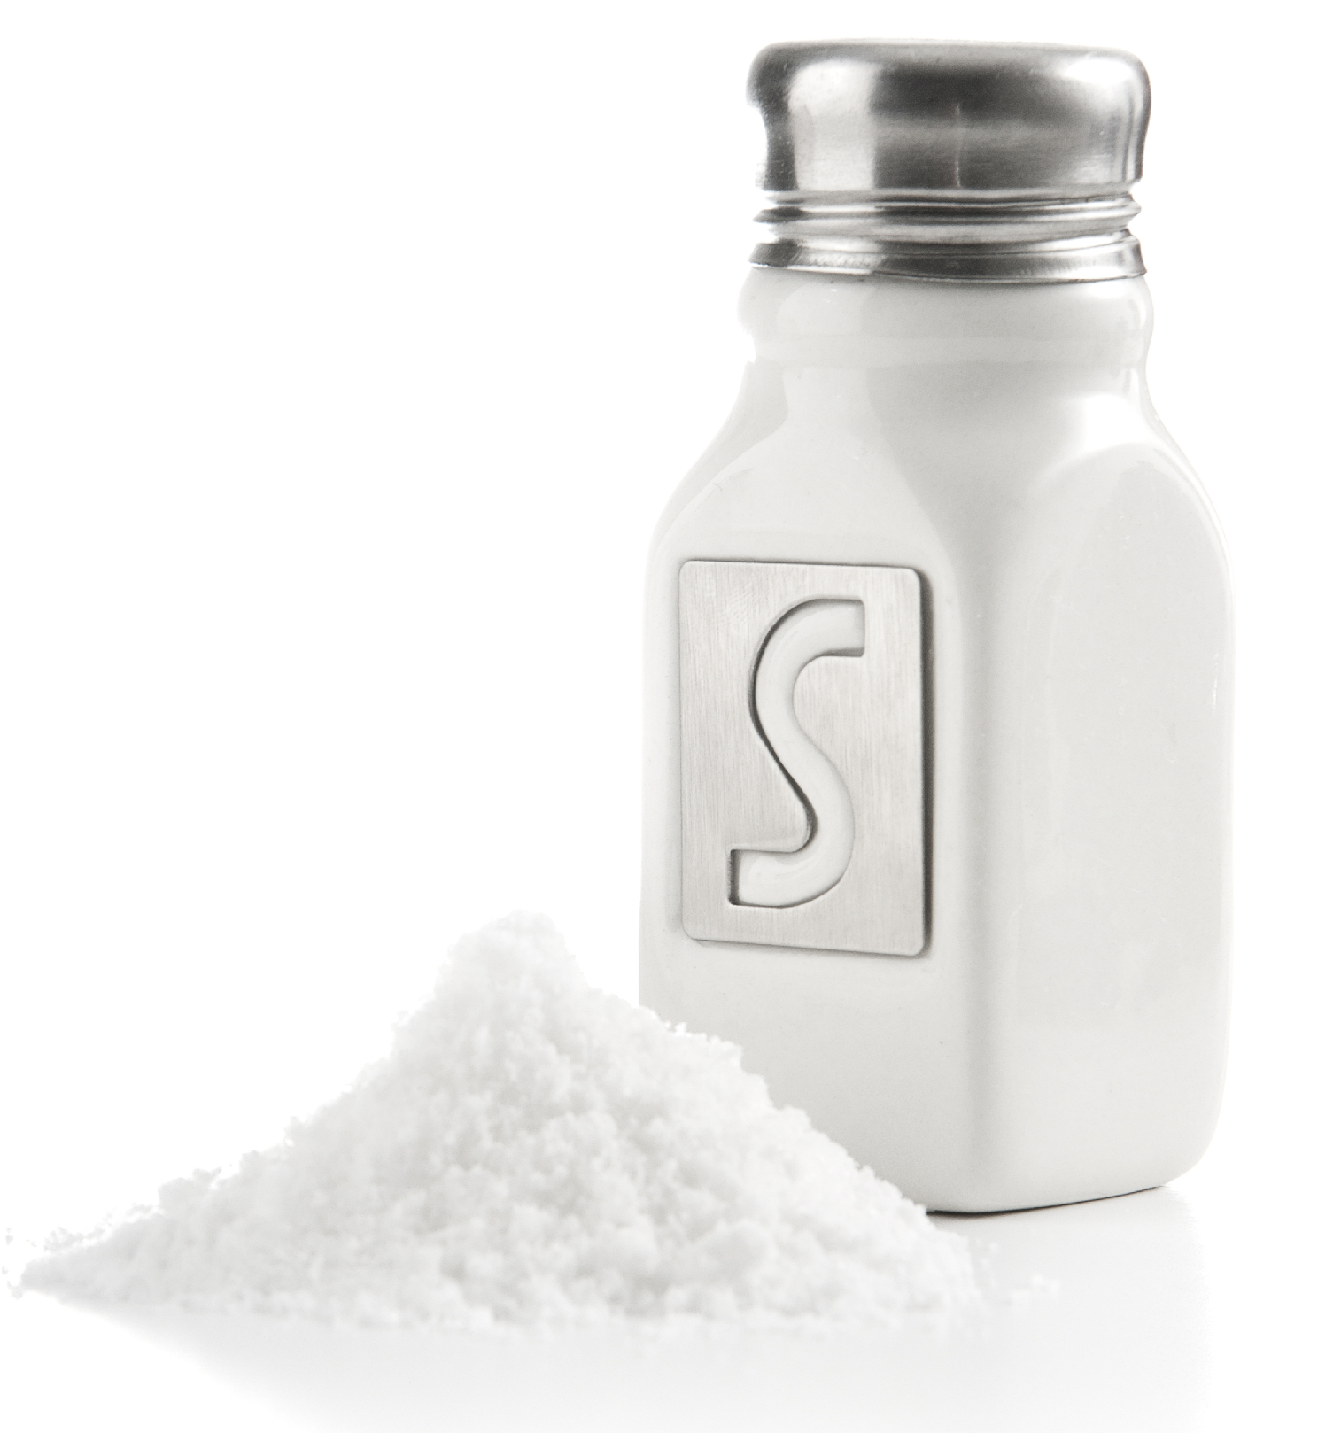
Notes:
The ability of salt to dissolve in water is not a chemical property because the salt is not reacting with the water. The salt does not change during this process.

Slide 36
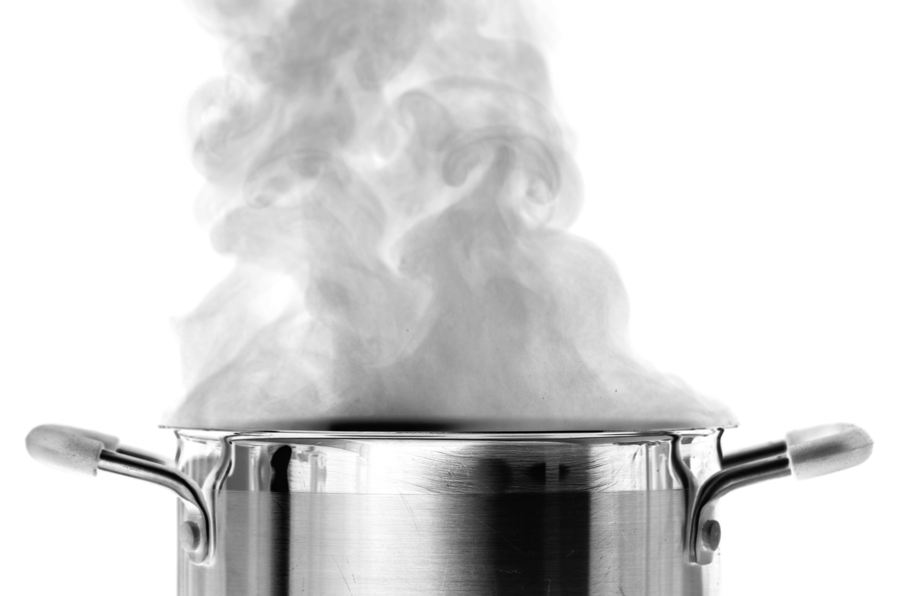
Notes:
Boiling point, or the temperature at which a substance boils, is not a chemical property. A substance boiling is not a chemical reaction as steam molecules and liquid molecules are the same - they do not change.

Slide 37
Notes:
Let’s check-in for understanding.

Slide 38
What are some examples of chemical properties?
Notes:
What are some examples of chemical properties?
Feedback: Having students generate their own examples is an engaged practice that also highlights connections between the content and student experiences.

Slide 39
What are chemical properties?
Notes:
What are chemical properties?
[Chemical properties are characteristics that can only be observed during or after a reaction. They result in the formation of a new substance.]

Slide 40
What is the difference between chemical properties and physical properties?
Notes:
What is the difference between chemical properties and physical properties?
[Chemical properties are characteristics that can only be observed during or after a reaction. A new substance is formed. If a property is a physical property, no new substance has been formed.]

Slide 41
Remember!!!
Notes:
So remember!

Slide 42
Chemical Property: characteristic of a substance that can only be observed during or after a reaction
Notes:
Chemical properties are characteristic that can only be observed during or after a reaction. They result in the formation of a new substance.

Slide 43
Big Question: What are the similarities and differences between physical and chemical properties and changes, and what do they tell us about a substance?
Physical Property vs Physical Change
H₂O
Chemical Property vs Chemical Change
Notes:
Explicit cue to revisit the big question at the end of the lesson: Okay everyone. Now that we’ve learned the term, let’s reflect once more on our big question. Was there anything that we predicted earlier that was correct or incorrect? Do you have any new hypotheses to share?

Slide 44
Notes:
Thanks for watching, and please continue watching CAPs available from this website!
Feedback: Remember, it is important that students have an opportunity to ask questions at the end of the lesson so that they can clarify their own understanding, some students may need a clear cue that it is their turn to ask questions.

Slide 45
This Video Created With Resources From:
Questions or Comments
Michael Kennedy, Ph.D. MKennedy@Virginia.edu
Rachel L Kunemund, Ph.D. rk8vm@virginia.edu

Slide 46
Intro
“Big Idea” Question
Review Concepts
Check-In Questions
Teacher Demo
Vocabulary
Student-Friendly Definition
Examples & Non-Examples
Morphological Word Parts
Simulation/Activity
Notes:
OK everyone, get ready for our next lesson. Just as a reminder, these are the different components that our lesson may include, and you’ll see these icons in the top left corner of each slide so that you can follow along more easily!

Slide 47
Intro
Chemical Change
Notes:
Today we will learn about chemical change.

Slide 48
Big Question: What are the similarities and differences between physical and chemical properties and changes, and what do they tell us about a substance?
Physical Property vs Physical Change
H₂O
Chemical Property vs Chemical Change
Notes:
Our “big question” is: What are the similarities and differences between physical and chemical properties and changes, and what do they tell us about a substance?
[Pause and illicit predictions from students.]
I love all these thoughtful scientific hypotheses! Be sure to keep this question and your predictions in mind as we move through this lesson, and we’ll revisit it.

Slide 49
Demonstration
Elephant Toothpaste
TEACHER DIRECTIONS
Before: Remind students that they have already seen this demonstration to talk about chemical properties.
During: This demonstration can be done in the classroom or virtually. When demonstrating ask the student questions during to keep them engaged (i.e. what do you notice, do you see any physical changes, when do you think the chemical change happened).
After: Tell students that when the “elephants toothpaste” foamed and changed, that’s when we could see the chemical change. Tell students that in today’s lesson they will learn more about chemical change.
Notes:
Let’s do a quick demonstration that will help get our brains ready to think about chemical change, and how they relate to our big question.
Feedback: Remember to continiously check for understanding throughout the demonstration to make sure that students are following along and understand the content.

Slide 50
Notes:
Before we move on to our new vocabulary term, let’s review some other words & concepts that you already learned and make sure you are firm in your understanding.

Slide 51
Matter: has mass and takes up space
Notes:
Matter is anything that has mass and takes up space.

Slide 52
Atom: smallest whole unit of matter
Notes:
All matter is made up of atoms. Atoms are the smallest whole unit of matter.
Feedback: Referring to prior topics that are relevant and on topic helps students make connections to the new content they will be learning and tie it to prior knowledge.

Slide 53
Notes:
All substances have unique properties because of the atoms they are made of.

Slide 54
Property: observed characteristics
chemical
physical
Notes:
Properties are observed characteristics. Properties can either be defined by their physical or chemical properties. They are used to describe what you see.

Slide 55
Physical Property: a characteristic of matter that can be observed without the substance changing into a new substance
Notes:
A physical property is a characteristic of matter that can be observed without the substance changing into a new substance.

Slide 56
Density: mass per unit of volume
Notes:
Density is the mass per unit of volume of a substance. This will always remain constant - or the same - for a compound or element.

Slide 57
Physical Change: a substance is changed but does not form a new substance
H₂O
Notes:
A physical change is one that does not change the identity of a substance.

Slide 58
Chemical Property: characteristic of a substance that can only be observed during or after a reaction
Notes:
Chemical properties are characteristic that can only be observed during or after a reaction. They result in the formation of a new substance.

Slide 59
Notes:
Now let’s pause for a moment to check your understanding.
Feedback: Even during a review, it is important that students are held accountable by being given the opportunity to participate. This may take some encouragement on your part but I know you can get them to do it!

Slide 60
What is the relationship between matter and atoms?
Notes:
What is the relationship between matter and atoms?
[Matter has mass and takes up space, and atoms are the smallest whole unit of matter.]

Slide 61
What is a property?
Notes:
What is a property?
[Properties are observed characteristics. They are used to describe what you see. Properties can be defined by their physical or chemical traits.]

Slide 62
What are some examples of physical properties?
Notes:
What are some examples of physical properties?

Slide 63
What is density?
Notes:
What is density?
[Density is the mass per unit of volume of a substance. This will always remain constant - or the same - for a compound or element.]

Slide 64
Why is density a physical property?
Notes:
Why is density a physical property?
[It is constant for a given compound or element.]

Slide 65
A _______________ happens when a substance is changed but does not form a new substance.
H₂O
Notes:
A _____________________ happens when a substance is changed but does not form a new substance.

Slide 66
A physical change happens when a substance is changed but does not form a new substance.
H₂O
Notes:
A physical change happens when a substance is changed but does not form a new substance.

Slide 67
What are chemical properties?
Notes:
What are chemical properties?
[Chemical properties are characteristics that can only be observed during or after a reaction. They result in the formation of a new substance.]

Slide 68
Chemical Change
Notes:
Now that we’ve reviewed, let’s define our new term, chemical change.

Slide 69
Chemical Change: rearranges the atoms in the original substance to make a new substance
Notes:
A chemical change rearranges the atoms in the original substance to make a new substance.
Feedback: Using clear language can take make formal more complicated definitions a little easier for students to understand.

Slide 70
Notes:
Let’s check-in for understanding.

Slide 71
What is a chemical change?
Notes:
What is a chemical change?
[A chemical change rearranges the atoms in the original substance to make a new substance.]
Feedback: Providing feedback is tricky but crucial. Remember to give students with feedback on their response because it helps students know what answers you are actually looking for.

Slide 72
Notes:
That is the basic definition, but there is a bit more you need to know.

Slide 73
Reactants → Products
Notes:
With all chemical changes a chemical reaction occurs. The original substances called reactants are changed to make something new called the products.

Slide 74
Notes:
Now, let’s talk about some examples of chemical changes.

Slide 75
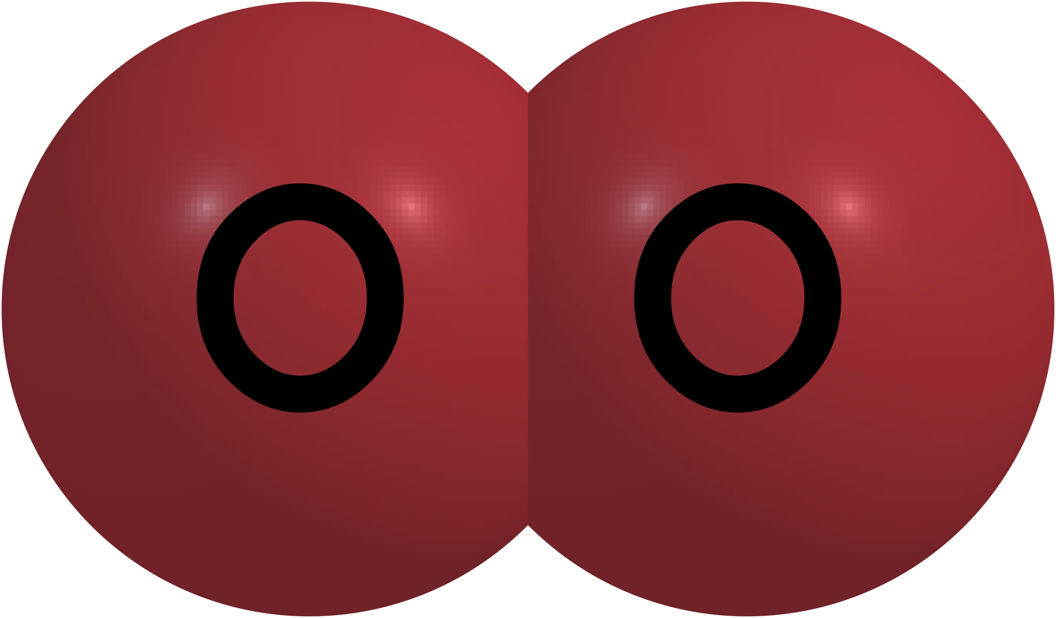
Notes:
One example of a chemical change is a nail rusting. The oxygen atoms in the air react with iron atoms on the nail to create rust wish is a new substance that has its own identity.

Slide 76
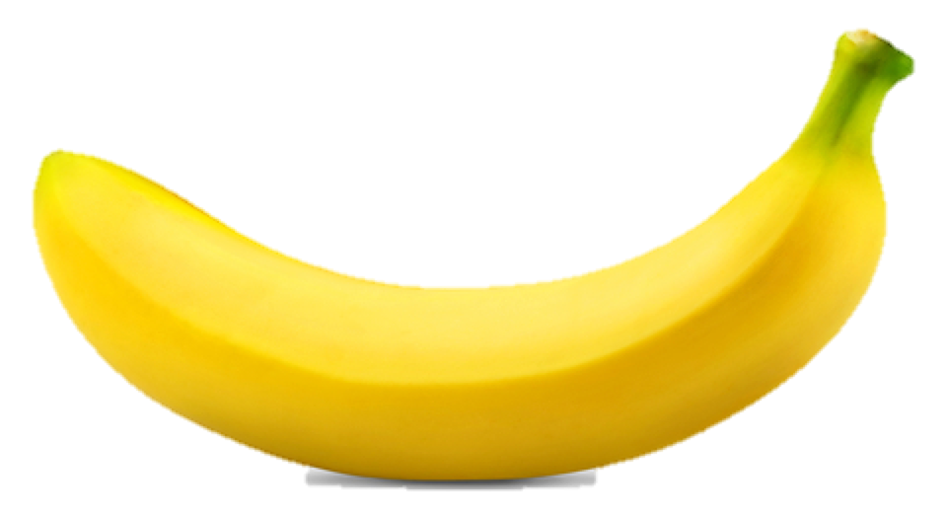
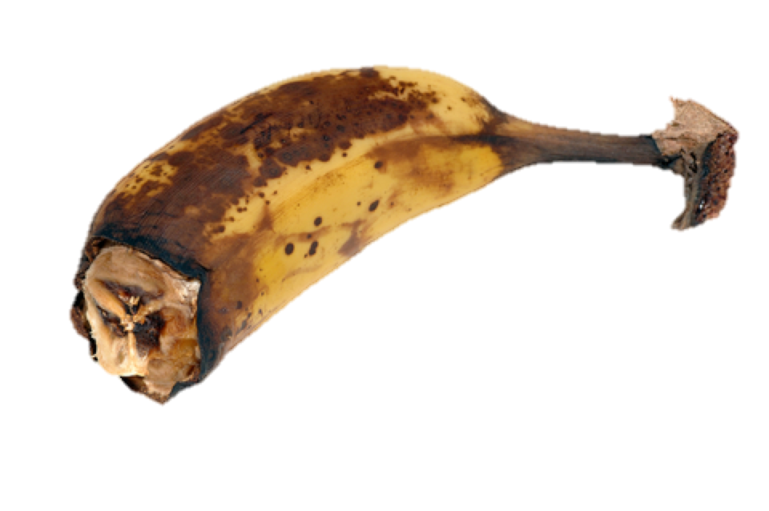
Notes:
Imagine you have several bananas. When you buy them they are ripe, but eventually they ripen to the point of becoming brown. The chemical makeup of the bananas has changed over time and this has made new molecules. Because of this, this particular banana can never be a banana again. This is an example of a chemical change. The banana did not keep its identity.
Feedback: It's great practice to introduce an example of the term WITH images to go along with it, this is a great way to help students make connections.

Slide 77
Notes:
Now, let’s talk about non-some examples of chemical changes.

Slide 78
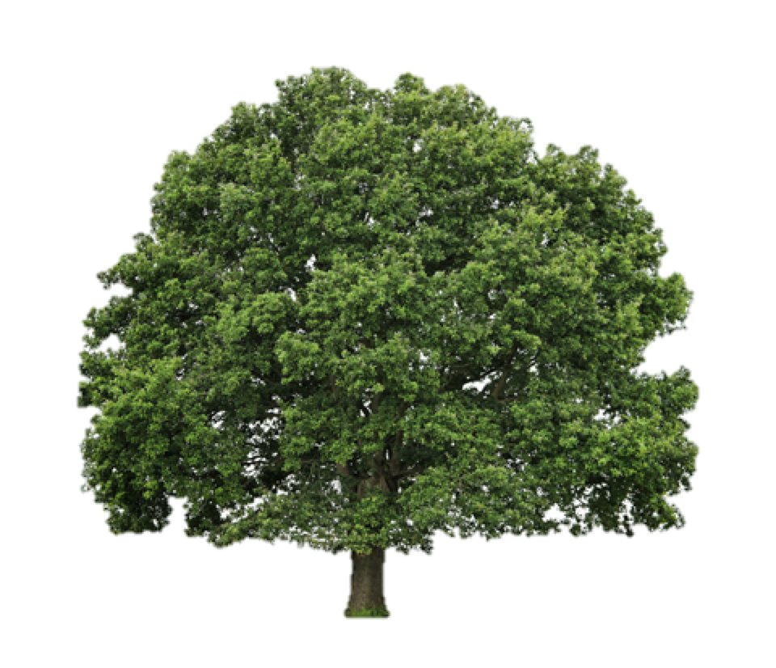
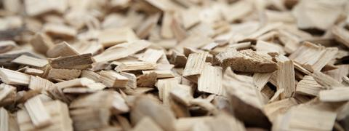
Chemical Change
Notes:
Shredding wood in a wood chipper is not an example of a chemical change. The wood keeps its identity, it just changes its shape. This is a physical change.

Slide 79
Notes:
Let’s check-in for understanding.

Slide 80
What are some examples of chemical changes?
Notes:
What are some examples of chemical changes?

Slide 81
What happens in a chemical change?
Notes:
What happens in a chemical change?
[A chemical change rearranges the atoms in the original substance to make a new substance.]

Slide 82
What must occur in ALL chemical changes?
Notes:
What must occur in ALL chemical changes?
[Chemical reactions]

Slide 83
What are the original and new substances called in a chemical reaction?
Notes:
What are the original and new substances called in a chemical reaction?
[The original substances called reactants are changed to make something new called products.]

Slide 84
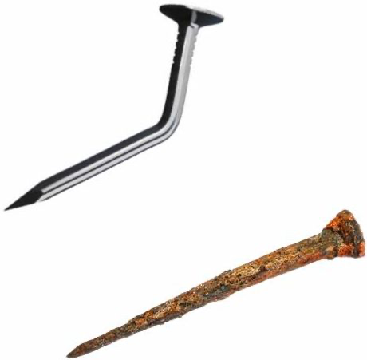
What is the relationship between a chemical property and a chemical change?
Notes:
What is the relationship between a chemical property and a chemical change?
[Chemical properties are something that can be observed about a substance during or after a chemical reaction.]
Feedback: Making connections between the new content and past terms/content is important for helping students understand the bigger picture.

Slide 85
Remember!!!
Notes:
So remember!

Slide 86
Chemical Change: rearranges the atoms in the original substance to make a new substance
Notes:
A chemical change rearranges the atoms in the original substance to make a new substance.

Slide 87
Simulation Activity
Physical/Chemical Changes Simulation
(Glencoe)
Click the link above to practice identifying chemical and physical changes
In this simulation activity, you’ll determine if something is going through a physical or chemical change. Use the checklist to help you determine if the change is physical or chemical.
Notes:
Feedback: Providing a rationale during this activity helps students make connections and promotes understanding of the content.

Slide 88
Big Question: What are the similarities and differences between physical and chemical properties and changes, and what do they tell us about a substance?
Physical Property vs Physical Change
H₂O
Chemical Property vs Chemical Change
Notes:
Explicit cue to revisit the big question at the end of the lesson: Okay everyone. Now that we’ve learned the term, let’s reflect once more on our big question. Was there anything that we predicted earlier that was correct or incorrect? Do you have any new hypotheses to share?

Slide 89
Notes:
Thanks for watching, and please continue watching CAPs available from this website!

Slide 90
This Video Created With Resources From:
Questions or Comments
Michael Kennedy, Ph.D. MKennedy@Virginia.edu
Rachel L Kunemund, Ph.D. rk8vm@virginia.edu

