Slide 1
Intro
“Big Idea” Question
Review Concepts
Check-In Questions
Teacher Demo
Vocabulary
Student-Friendly Definition
Examples & Non-Examples
Morphological Word Parts
Simulation/Activity
Notes:
OK everyone, get ready for our next lesson. Just as a reminder, these are the different components that our lesson may include, and you’ll see these icons in the top left corner of each slide so that you can follow along more easily!

Slide 2
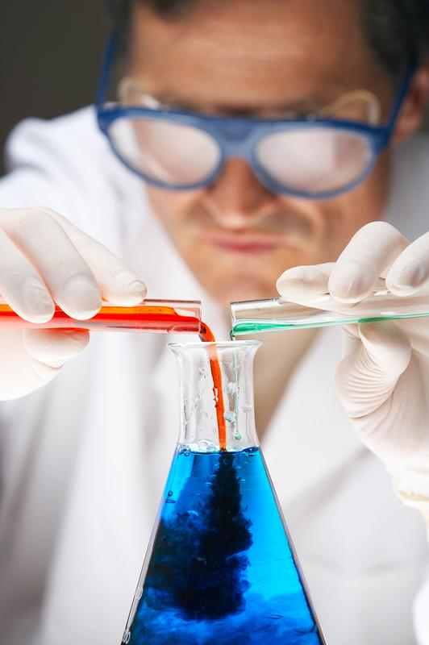
Intro
Chemical Reactions
Notes:
Today we will learn about chemical reactions.

Slide 3
Big Question: What is involved in a chemical reaction?
Notes:
Our “big question” is: What is involved in a chemical reaction?
[Pause and illicit predictions from students.]
I love all these thoughtful scientific hypotheses! Be sure to keep this question and your predictions in mind as we move through the lesson, and we’ll revisit it.
Feedback: Asking students to make predictions about what is involved in a chemical reaction is a great way to activate and elicit student ideas and prior knowledge. This type of activity is evidence of the teacher planning for students’ engagement with science ideas.

Slide 4
Demonstration
Chemical Reactions
TEACHER DIRECTIONS:
Materials: vinegar, baking soda, calcium chloride, water, thermometer, 4 small clear plastic cups, 1 measuring cup, measuring spoons
Activity: Students will work through 1 endothermic and 1 exothermic reaction to find similarities and differences based on data gathered.
Objective: Students will understand the difference between endothermic and exothermic and will be able to classify reactions based on temperature.
Notes:
Let’s do a quick demonstration that will help get our brains ready to think about chemical reactions, and how they relate to our big question.
Feedback: This demonstration is a great way to introduce students to an investigation. Supporting students to plan and conduct this investigation more independently is important since a large component of inquiry-based activities is encouraging student thinking and independence.

Slide 5
Notes:
Now let’s pause for a moment to check your understanding.

Slide 6
In this demonstration, what did you notice about chemical reactions?
Notes:
In this demonstration, what did you notice about chemical reactions?

Slide 7
Notes:
Before we move on to our new vocabulary term, let’s review some other words & concepts that you already learned and make sure you are firm in your understanding.

Slide 8
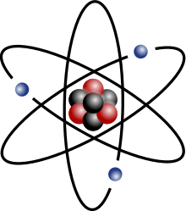
Atom: smallest whole unit of matter
Notes:
An atom is the smallest whole unit of matter. All matter is made up of atoms.

Slide 9
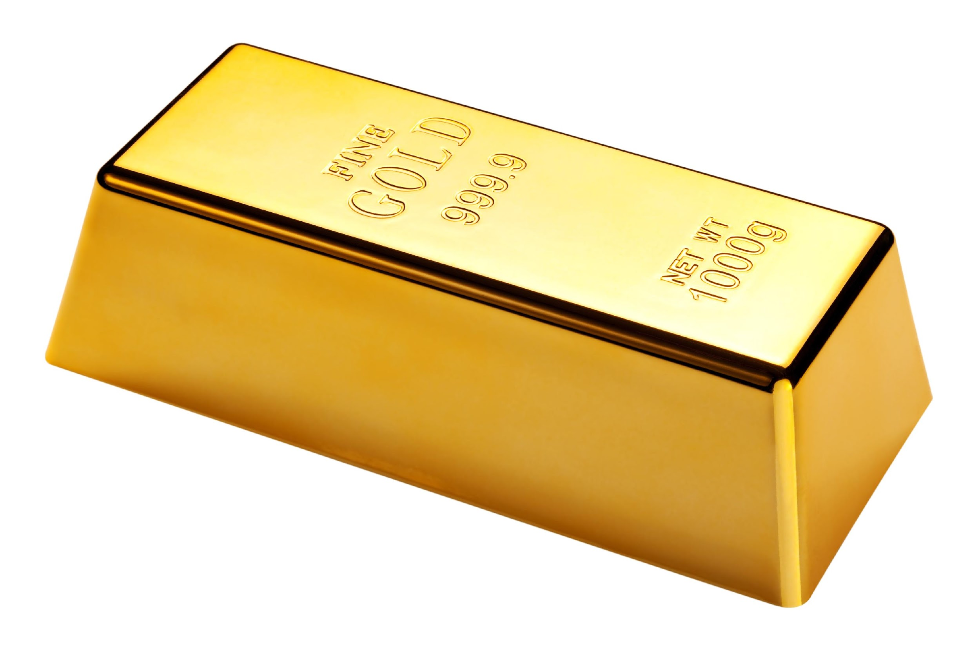
Element: a pure substance containing only one type of atom.
Notes:
An element is a pure substance containing only one type of atom.

Slide 10
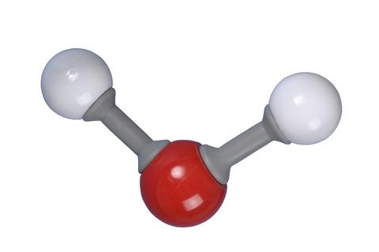
Molecule: a particle containing 2 or more atoms of the same OR different elements
Notes:
A molecule is a particle containing 2 or more atoms of the same OR different elements. Molecules are the smallest pieces of compounds.

Slide 11
Compound: substance that is made up of two or more different elements
Notes:
A compound is a substance that is made up of two or more different elements.

Slide 12
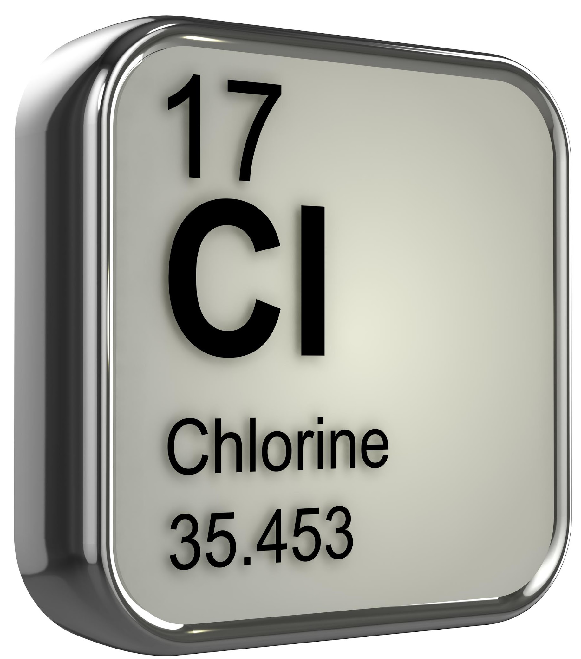
Chemical Symbol: elements are symbolized by a capital letter, sometimes followed by a lowercase letter
Notes:
Elements are symbolized by a capital letter, sometimes followed by a lowercase letter, which is called its chemical symbol. For example, the chemical symbol of chlorine is Cl.

Slide 13
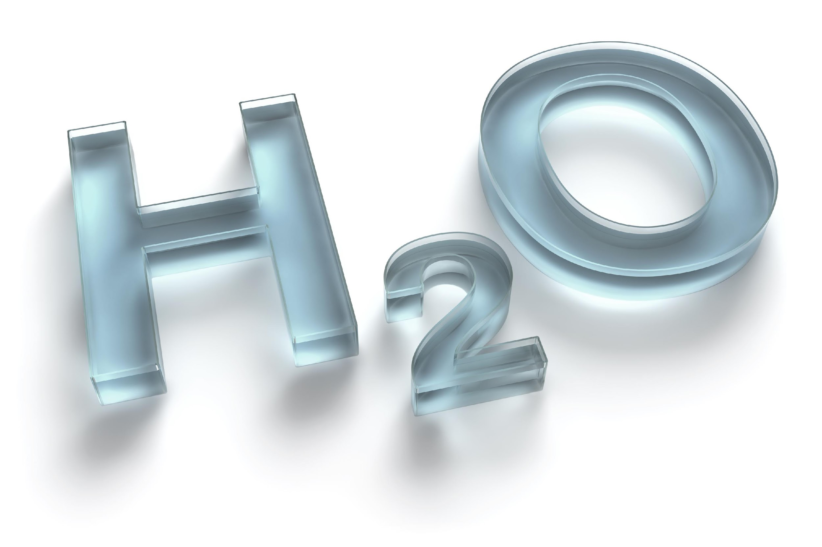
Chemical Formula: uses chemical symbols to represent a compound or molecule
Notes:
A chemical formula uses chemical symbols to represent a compound or molecule. For example, the chemical formula for water is H₂O.

Slide 14
Element
Chemical Symbol
Compound/
Molecule
Chemical Formula
Notes:
To put it all together, a chemical symbol represents an element while a chemical formula uses chemical symbols to represent molecules and compounds.

Slide 15
Notes:
Now let’s pause for a moment to check your understanding.
Feedback: It is important when reviewing previously learned material that you pause and check for understanding; if students are not grasping previous material you may need to tailor your instruction.

Slide 16
What is an element?
Notes:
What is an element?
[An element is a pure substance containing only one type of atom.]

Slide 17
What is the difference between a molecule and a compound?
Notes:
What is the difference between a molecule and a compound?
[A molecule is a particle containing 2 or more atoms of the same OR different elements. A compound is a substance that is made of up of two or more DIFFERENT elements.]

Slide 18
What is the difference between a chemical symbol and a chemical formula?
Notes:
What is the difference between a chemical symbol and a chemical formula?
[A chemical symbol represents an element, while a chemical formula uses chemical symbols to represent molecules and compounds.]

Slide 19
Chemical Reactions
Notes:
Now that we’ve reviewed, let’s define our new term, chemical reactions.

Slide 20
Chemical Reaction: chemical changes that happen when two or more elements are combined
Notes:
A chemical reaction is made up of chemical changes that happen when two or more elements are combined.

Slide 21
Notes:
Let’s check-in for understanding.

Slide 22
What is a chemical reaction?
Notes:
What is a chemical reaction?
[A chemical reaction is made up of chemical changes when two or more elements are combined.]

Slide 23
Notes:
That is the basic definition, but there is a bit more you need to know.

Slide 24
reactant
reactant
product
Notes:
Chemical reactions occur when old substances, or reactants, become new substances, or products. The products have unique properties from their original reactants.
Feedback: Including graphics is helpful for students to make sense of new information.

Slide 25
Notes:
Let’s check-in for understanding.

Slide 26
When do chemical reactions occur?
Notes:
When do chemical reactions occur?
[Chemical reactions occur when old substances, or reactants, become new substances, or products. The products have unique properties from their original reactants.]

Slide 27
Notes:
There are many factors that affect the rate of chemical reactions. The rate is how fast something happens.

Slide 28
Rate of Reaction
Notes:
In a chemical reaction, the rate of reaction is how long it takes for the product to form. As scientists you can change the rate of the chemical reaction by changing factors.

Slide 29
Rate of Reaction
Temperature
Surface Area
Concentration
Notes:
The rate of chemical reaction can be affected (or manipulated) by the temperature, concentration, and surface area of the reactants.

Slide 30
Rate of Reaction
Temperature
Surface Area
Concentration
Notes:
First, let’s look at how temperature impacts the rate of reaction.

Slide 31
Notes:
If you increase the temperature of a reaction, the rate of reaction will generally increase. This is because the particles move faster.

Slide 32
Rate of Reaction
Temperature
Surface Area
Concentration
Notes:
Now, let’s look at how concentration impacts the rate of reaction.

Slide 33
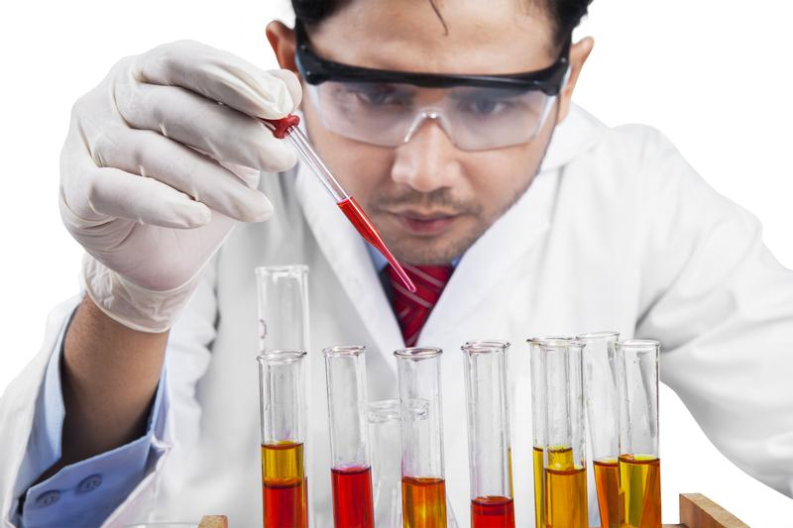
Notes:
Concentration is the quantity of something in a given substance. As you increase the concentration of the reactants, you increase the rate of reaction. This is because there are more particles moving together.

Slide 34
Rate of Reaction
Temperature
Surface Area
Concentration
Notes:
Finally, let’s look at how surface area impacts the rate of reaction.

Slide 35
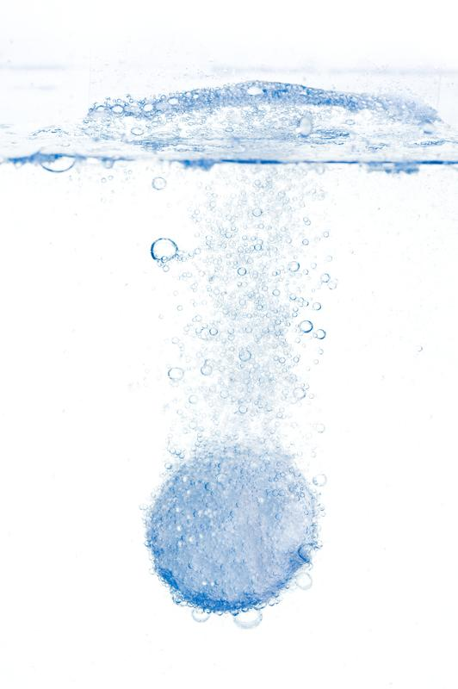
Notes:
Surface area affects the rate of reaction if one of the reactants is a solid, such as an alka-seltzer tablet. If you increase the surface area, then you increase the rate of the reaction.

Slide 36
Notes:
Let’s check-in for understanding.

Slide 37
What factors impact the rate of reaction?
Notes:
What factors impact the rate of reaction?
[Temperature, concentration, surface area]

Slide 38
Notes:
So, how do we know a chemical change is occurring?

Slide 39
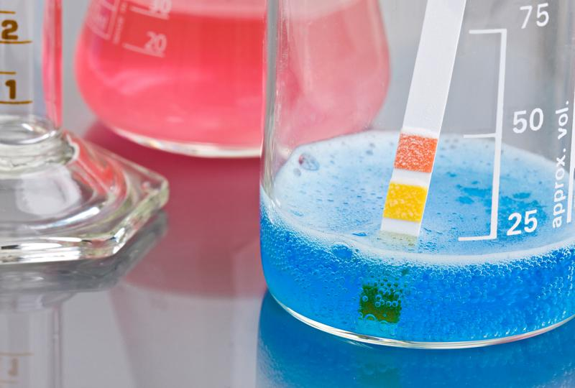
Notes:
If the mixture begins to bubble,

Slide 40
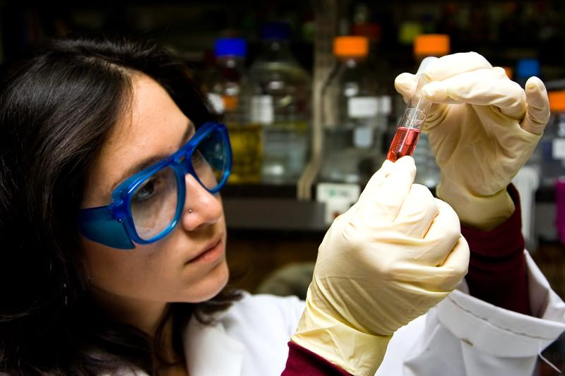
Notes:
if there is a color change,

Slide 41
Notes:
if the solution turns cloudy,

Slide 42
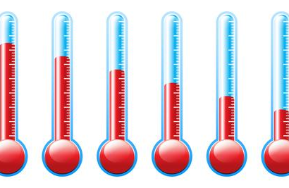
Notes:
or if there is a change in temperature.

Slide 43
Notes:
Let’s check-in for understanding.

Slide 44
How can we tell a chemical reaction is occurring?
Notes:
How can we tell a chemical reaction is occurring?
[If the mixture begins to bubble, if there is a change in color, if the solution turns cloudy, or if there is a change in temperature.]

Slide 45
Notes:
We’ve learned a lot about chemical reactions, but there is one last thing we should take about before we move on to some examples.

Slide 46
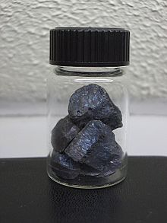
Chemical Equation
reactants
products
Fe
S
FeS
Notes:
Chemical equations can be used to model chemical changes, illustrating how elements become rearranged in a chemical reaction. Here we have iron reacting with sulfur to create iron sulfide. This is an example of a balanced equation, where the reactants equal the number of products.
Feedback: This is a great opportunity to build students’ epistemic knowledge regarding how mathematics is used in science to model chemical equations.

Slide 47
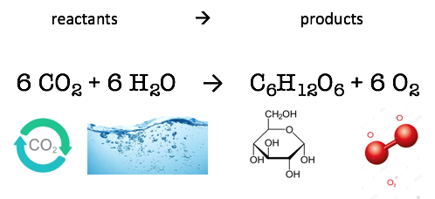
Chemical Equation
Notes:
Here is another chemical equation. This chemical equation is for photosynthesis (how plants get their nutrients), where a ratio of carbon dioxide and water creates glucose, or a type of sugar, and oxygen molecules. This is another example of a balanced equation, where the amount of products equal the amount of reactants.
Feedback: Students may not initially understand how this equation is balanced. Although balancing chemical equations is not part of this grade band, it may be helpful to briefly walk students through why the equation above is balanced.

Slide 48
Notes:
Now, let’s talk about some examples of chemical reactions.
Feedback: Before offering students examples, elicit their prior knowledge by asking them for examples that they know if in their everyday life.

Slide 49
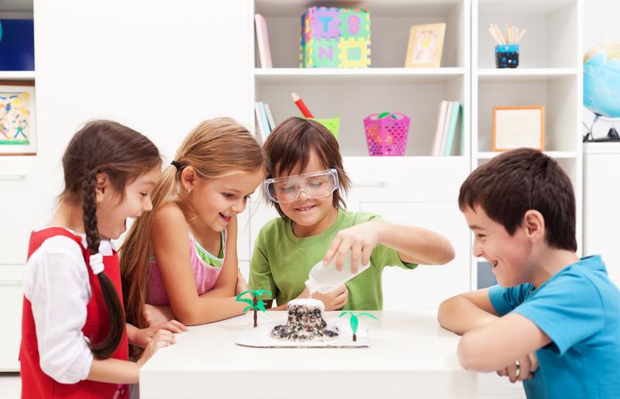
Baking soda and Vinegar
Notes:
Mixing baking soda and vinegar is an example of a chemical reaction. We can tell because the product of the two begins to bubble.

Slide 50
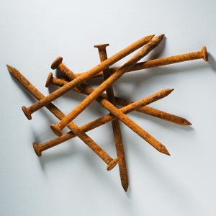
Rusted nails
Notes:
Rusted nails are an example of a chemical reaction. Iron and oxygen are reacting to create the rust. There is a color change.

Slide 51
Notes:
Next, let’s talk about some non-examples of chemical reactions.
Feedback: In the slides below, it is important explicitly distinguish between the similarities of the non-examples and the vocabulary term you were covering today. This helps students resolve any misconceptions they may have.

Slide 52
Cutting paper
Notes:
No, cutting paper is not a chemical reaction. No chemical change was made.

Slide 53
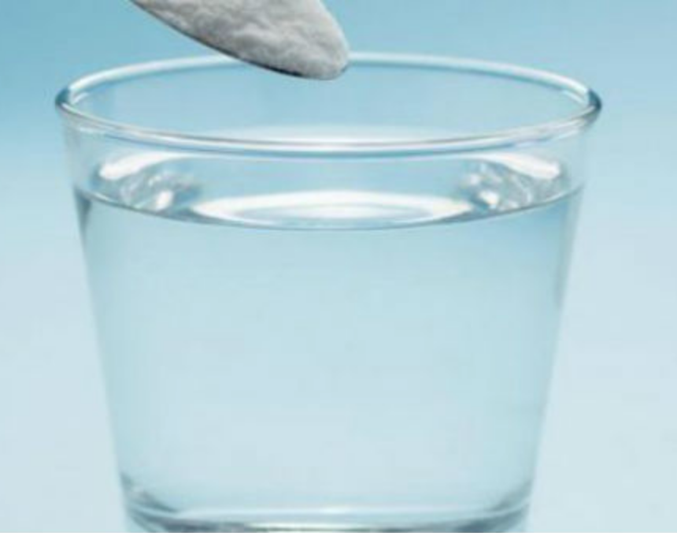
Sugar and water
Notes:
Sugar and water are not a chemical reaction. They are physically combined, not chemically combined. They are an example of a mixture.

Slide 54
Notes:
Let’s check-in for understanding.

Slide 55
What are some examples of chemical reactions?
Notes:
What are some examples of chemical reactions?

Slide 56
What are some non-examples of chemical reactions?
NON
Notes:
What are some non-examples of chemical reactions?

Slide 57
What is a chemical reaction?
Notes:
What is a chemical reaction?
[A chemical reaction is made up of chemical changes when two or more elements are combined.]

Slide 58
How do we know a chemical reaction has occurred?
Notes:
How do we know a chemical reaction has occurred?
[bubbles, color change, cloudy, temperature change]

Slide 59
Which of the following is an example of a chemical reaction?
Putting an ice cube in a glass of water
Building a dam on a river
Burning a piece of wood
Making a sandwich
Notes:
Which of the following is an example of a chemical reaction?

Slide 60
Which of the following is an example of a chemical reaction?
Putting an ice cube in a glass of water
Building a dam on a river
Burning a piece of wood
Making a sandwich
Notes:
Which of the following is an example of a chemical reaction?
[Burning a piece of wood]

Slide 61
What factors affect the rate of a chemical reaction?
Notes:
What factors affect the rate of chemical reaction?
[Temperature, concentration of the reactants, surface area of the reactants]

Slide 62
Remember!!!
Notes:
So remember!

Slide 63
Chemical Reaction: chemical changes that happen when two or more elements are combined
Notes:
A chemical reaction is made up of chemical changes that happen when two or more elements are combined.

Slide 64
Rate of Reaction
Notes:
In a chemical reaction, the rate of reaction is how long it takes for the product to form. As scientists you can change the rate of the chemical reaction by changing factors.

Slide 65
Chemical Equation
reactants
products
Fe
S
FeS
Notes:
Chemical equations can be used to model chemical changes, illustrating how elements become rearranged in a chemical reaction. Here we have iron reacting with sulfur to create iron sulfide. This is an example of a balanced equation, where the reactants equal the number of products.

Slide 66
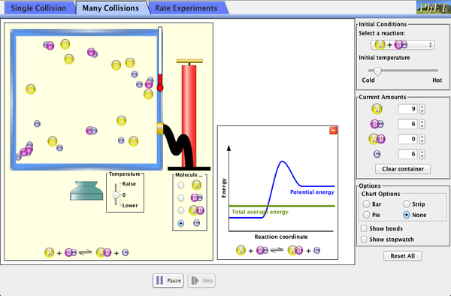
Simulation Activity
Reactions and Rates
Click the link above to deepen your understanding of reactions.
In this simulation activity, you’ll explore what makes a reaction happen by colliding atoms and molecules. Design experiments with different reactants, concentrations, and temperatures. When are reactions reversible? What affects the rate of a reaction?
Notes:
Feedback: Providing a simulation activity is a great way to make science thinking visible. In this simulation, students have the opportunity to make predictions and apply an idea to a new situation by changing the variables in the simulation. The questions in the slide are a great way to gauge student understanding.

Slide 67
Big Question: What is involved in a chemical reaction?
Notes:
Explicit cue to revisit the big question at the end of the lesson: Okay everyone. Now that we’ve learned the term, let’s reflect once more on our big question. Was there anything that we predicted earlier that was correct or incorrect? Do you have any new hypotheses to share?
Feedback: Offering students an opportunity to evaluate their earlier hypotheses and make changes based on their new understandings is an important part of the iterative process in science. This is a great opportunity to help students build an epistemic understanding by explicitly stating how continuing to change and build on hypotheses as your knowledge grows is an important part of the discipline of science!

Slide 68
Notes:
Thanks for watching, and please continue watching CAPs available from this website.

Slide 69
This Video Was Created With Resources From:
Questions or Comments
Michael Kennedy, Ph.D. MKennedy@Virginia.edu
Rachel L Kunemund, Ph.D. rk8vm@virginia.edu

