Slide 1
Intro
“Big Idea” Question
Review Concepts
Check-In Questions
Teacher Engagement
Vocabulary
Student-Friendly Definition
Examples & Non-Examples
Frayer Model
Simulation/Activity
Notes:
OK everyone, get ready for our next lesson. Just as a reminder, these are the different components that our lesson may include, and you’ll see these icons in the top left corner of each slide so that you can follow along more easily!

Slide 2
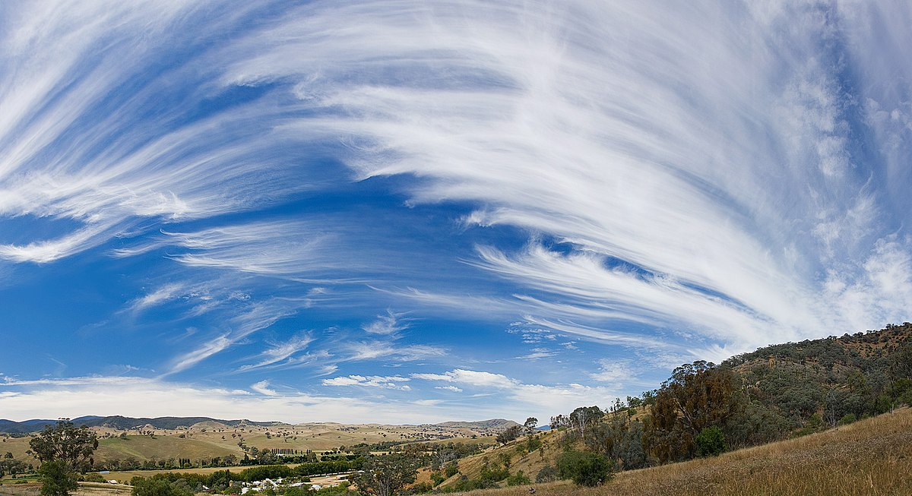
Intro
Cirrus clouds
Notes:
Today, we’ll be learning about the phrase: Cirrus clouds.

Slide 3
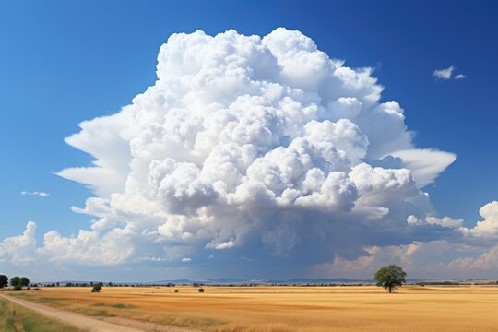
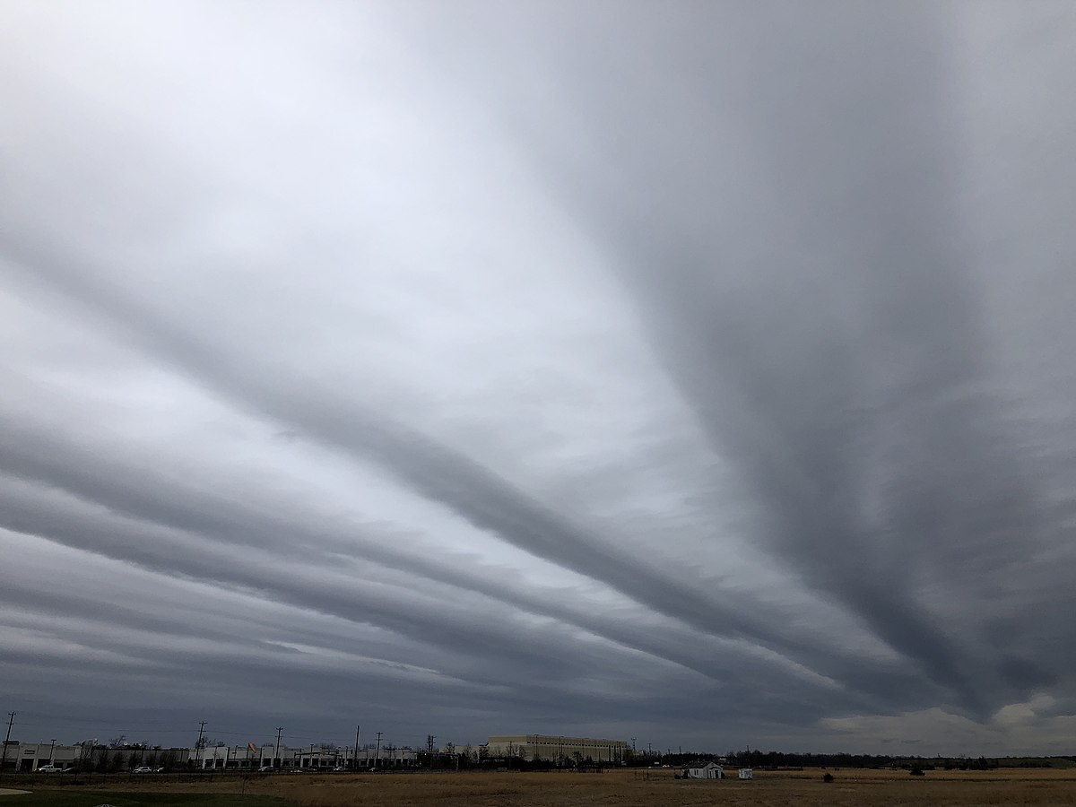
Big Question: How can I predict weather events by tracking weather conditions?
Notes:
Our “big question” is: How can I predict weather events by tracking weather conditions?
[Pause and illicit predictions from students.]
I love all these thoughtful scientific hypotheses! Be sure to keep this question and your predictions in mind as we move through these next few lessons, and we’ll continue to revisit it.

Slide 4
Notes:
Before we move on to our new topic, let’s review some other words & concepts that you already learned and make sure you are firm in your understanding.

Slide 5
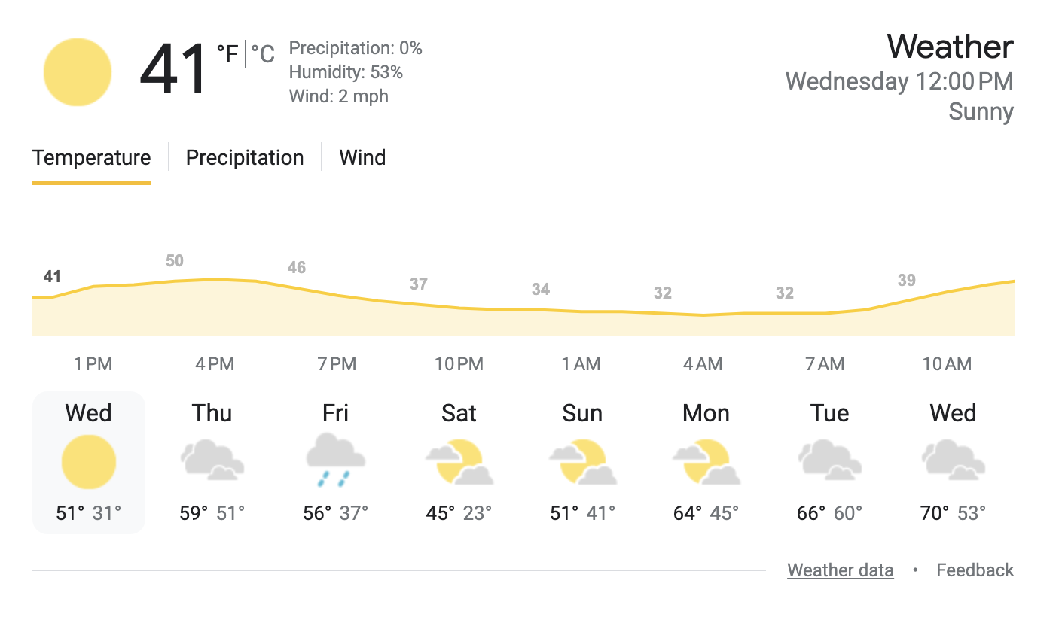
Forecast: A prediction or guess of what the weather will be
Notes:
Forecast is a prediction or guess of what the weather will be.

Slide 6
Cumulus clouds: fluffy, white clouds with flat bottoms
Notes:
Cumulus clouds are fluffy, white clouds with flat bottoms.

Slide 7
Cumulonimbus clouds: large, tall clouds with dark bottoms
Notes:
Cumulonimbus clouds are large, tall clouds with dark bottoms.

Slide 8
Stratus clouds: smooth, gray clouds that cover the whole sky
Notes:
Stratus clouds are smooth, gray clouds that cover the whole sky.

Slide 9
Notes:
Now let’s pause for a moment to review the information we have covered already.

Slide 10
A forecast is a _______ or guess of what the weather will be.
prediction
fact
Notes:
A forecast is a ________ or guess of what the weather will be.
[A. prediction]

Slide 11
A forecast is a _______ or guess of what the weather will be.
prediction
fact
Notes:
A forecast is a ________ or guess of what the weather will be.
[A. prediction]

Slide 12
Cumulus clouds are ______, white clouds with flat bottoms.
fluffy
wispy
Notes:
Cumulus clouds are ______, white clouds with flat bottoms.
[A. fluffy]

Slide 13
Cumulus clouds are ______, white clouds with flat bottoms.
fluffy
wispy
Notes:
Cumulus clouds are ______, white clouds with flat bottoms.
[A. fluffy]

Slide 14
Cumulonimbus clouds are large, ______ clouds with dark bottoms.
short
tall
Notes:
Cumulonimbus clouds are large, ______ clouds with dark bottoms.
[B. tall]

Slide 15
Cumulonimbus clouds are large, ______ clouds with dark bottoms.
short
tall
Notes:
Cumulonimbus clouds are large, ______ clouds with dark bottoms.
[B. tall]

Slide 16
True or false: Stratus clouds are smooth, gray clouds that cover the whole sky.
True
False
Notes:
True or false: Stratus clouds are smooth, gray clouds that cover the whole sky.
[A. True]

Slide 17
True or false: Stratus clouds are smooth, gray clouds that cover the whole sky.
True
False
Notes:
True or false: Stratus clouds are smooth, gray clouds that cover the whole sky.
[A. True]

Slide 18
Cirrus clouds
Notes:
Now that we’ve reviewed, let’s define the phrase cirrus clouds.

Slide 19
Cirrus clouds: high, feathery clouds
Notes:
Cirrus clouds are high, feathery clouds

Slide 20
Notes:
Let’s check-in for understanding.

Slide 21
What are cirrus clouds?
Notes:
What are cirrus clouds?
[High, feathery clouds.]

Slide 22
Notes:
That is the basic definition, but there is a bit more you need to know.

Slide 23
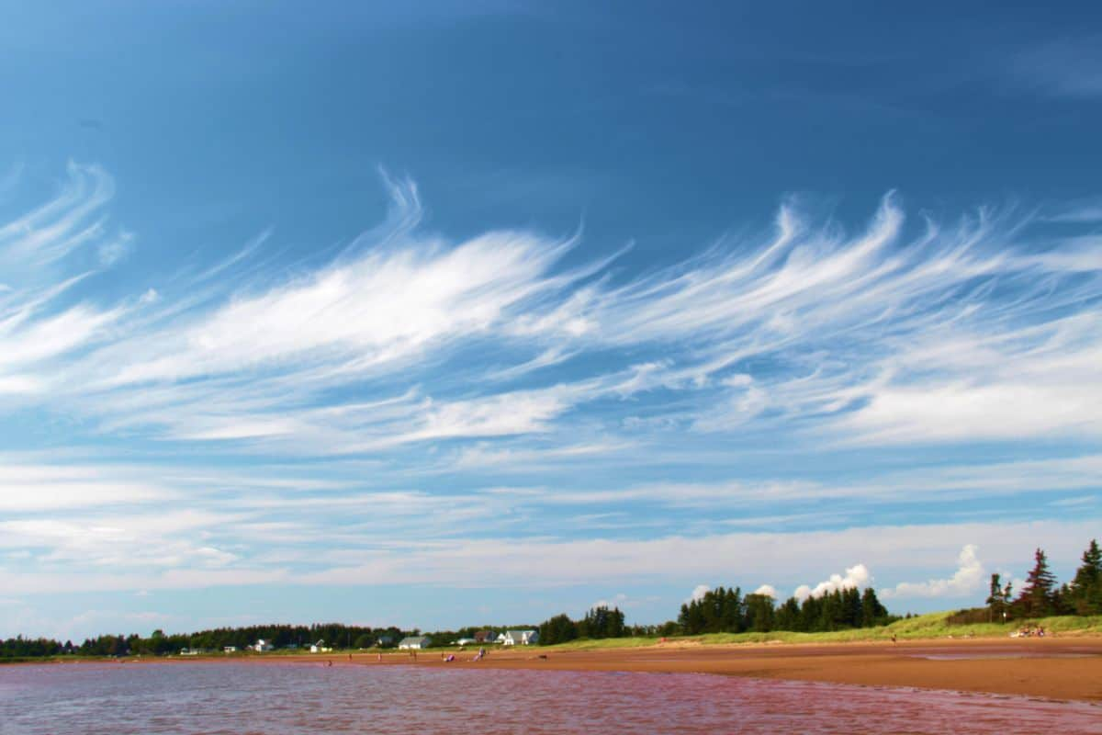
Sometimes cirrus clouds can have a distinctive "hook" or "tail" shape, resembling a comma or a fish hook.
hook/tail
Notes:
Sometimes cirrus clouds can have a distinctive "hook" or "tail" shape, resembling a comma or a fishhook.

Slide 24
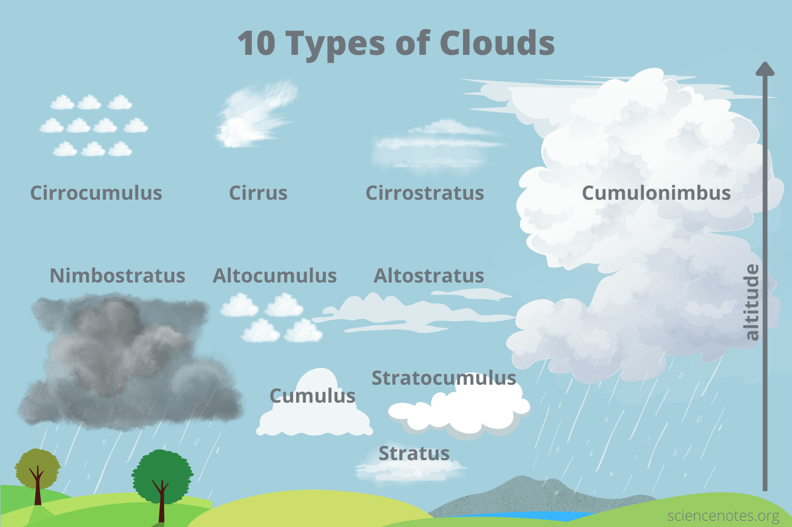
Cirrus clouds are high-level clouds. They often form above 20,000 feet in altitude.
high
level
Notes:
Cirrus clouds are high-level clouds. They often form above 20,000 feet in altitude.

Slide 25
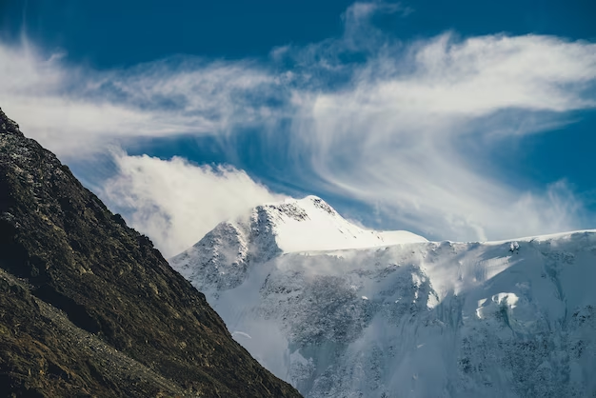
Cirrus clouds are associated with fair weather. They also indicate that rain or snow may fall within several hours.
Notes:
Cirrus clouds are associated with fair weather. They also indicate that rain or snow may fall within several hours.

Slide 26
Notes:
Let’s check-in for understanding.

Slide 27
True or false: Cirrus clouds have a distinctive shape that looks like a comma or a fish hook.
True
False
Notes:
True or false: Cirrus clouds have a distinctive shape that looks like a comma or a fish hook.
[A. True]

Slide 28
True or false: Cirrus clouds have a distinctive shape that looks like a comma or a fish hook.
True
False
Notes:
True or false: Cirrus clouds have a distinctive shape that looks like a comma or a fish hook.
[A. True]

Slide 29
Cirrus clouds are _____-level clouds. They often form above 20,000 feet in altitude.
low
medium
high
Notes:
Cirrus clouds are _____-level clouds. They often form above 20,000 feet in altitude.
[C. high]

Slide 30
Cirrus clouds are _____-level clouds. They often form above 20,000 feet in altitude.
low
medium
high
high
Notes:
Cirrus clouds are _____-level clouds. They often form above 20,000 feet in altitude.
[C. high]

Slide 31
True or false: Cirrus clouds are associated with fair weather. They also indicate that rain or snow may fall within several hours.
True
False
Notes:
True or false: Cirrus clouds are associated with fair weather. They also indicate that rain or snow may fall within several hours.
[A. True]

Slide 32
True or false: Cirrus clouds are associated with fair weather. They also indicate that rain or snow may fall within several hours.
True
False
Notes:
True or false: Cirrus clouds are associated with fair weather. They also indicate that rain or snow may fall within several hours.
[A. True]

Slide 33
Notes:
Now, let’s talk about some examples of cirrus clouds.

Slide 34
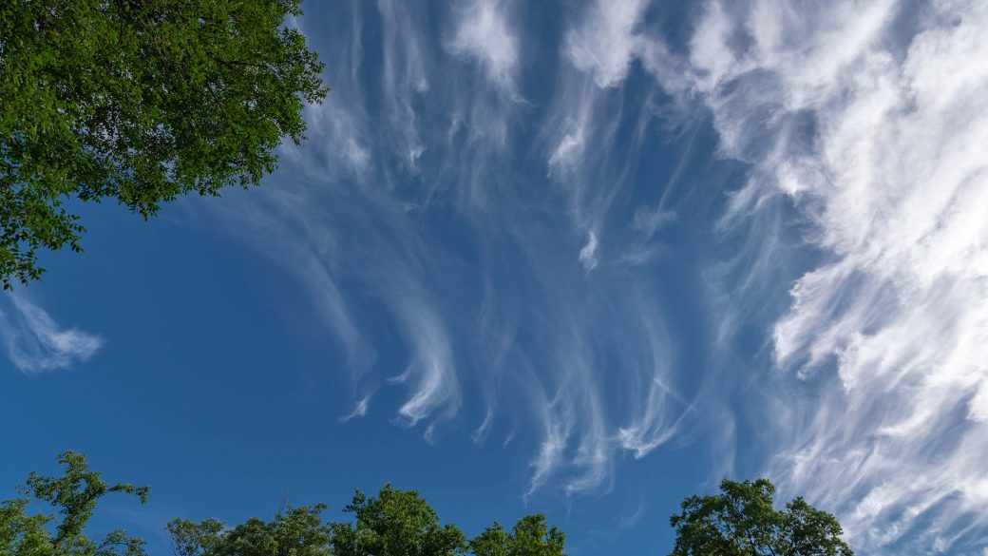
This is an example of cirrus clouds. They are high, feathery clouds.
Notes:
This is an example of cirrus clouds. They are high, feathery clouds.

Slide 35
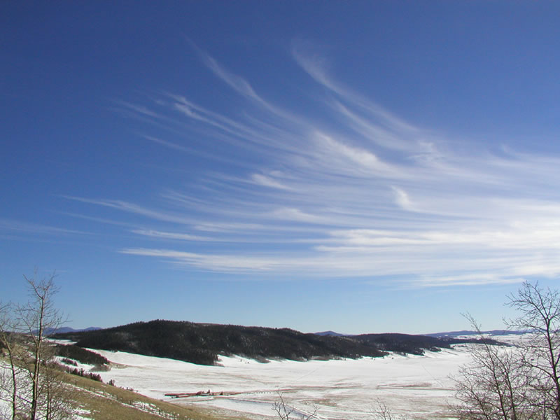
This is also an example of cirrus clouds. They are high, feathery clouds.
Notes:
This is also an example of cirrus clouds. They are high, feathery clouds.

Slide 36
Notes:
Now, let’s talk about some non-examples of cirrus clouds.

Slide 37
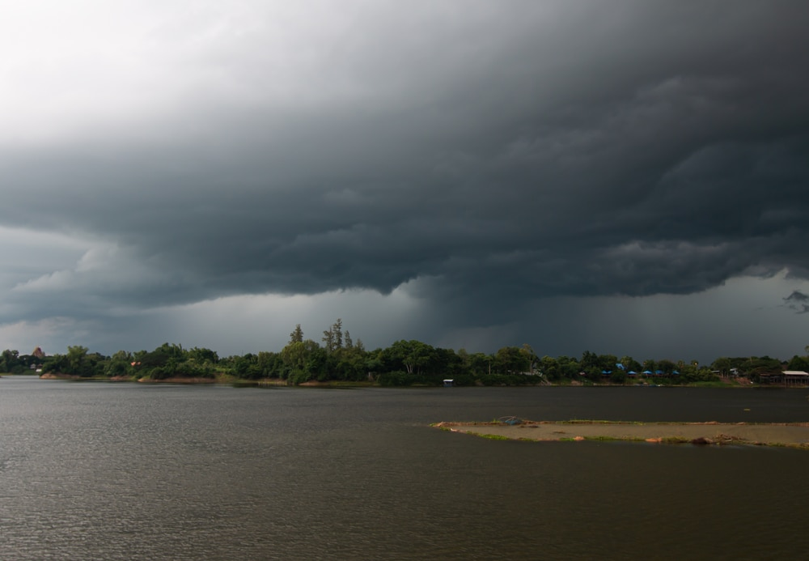
These are not cirrus clouds. They are not high, feathery clouds.
Notes:
These are not cirrus clouds. They are not high, feathery clouds.

Slide 38
These are also not cirrus clouds. They are not high, feathery clouds.
Notes:
These are also not cirrus clouds. They are not high, feathery clouds.

Slide 39
Notes:
Now let’s pause for a moment to check your understanding.

Slide 40
Which picture shows cirrus clouds?
Notes:
Which picture shows cirrus clouds?
[The left picture.]

Slide 41
Which picture shows cirrus clouds?
Notes:
Which picture shows cirrus clouds?
[The left picture.]

Slide 42
Remember!!!
Notes:
So remember!

Slide 43
Cirrus clouds: high, feathery clouds
Notes:
Cirrus clouds are high, feathery clouds.

Slide 44
Notes:
We will now complete this concept map, called a Frayer model, to summarize and further clarify what you have learned about the term cirrus clouds.

Slide 45
Definition
Picture
Cirrus
clouds
Example
How do cirrus clouds impact my life?
Notes:
To complete the Frayer model, we will choose from four choices the correct picture, definition, example, and response to the question, “How do cirrus clouds impact my life?” Select the best response for each question using the information you just learned. As we select responses, we will see how this model looks filled in for the term cirrus clouds.

Slide 46
Directions: Choose the correct picture of cirrus clouds from the choices below.
A
B
C
D
Notes:
Choose the correct picture of cirrus clouds from the choices below.

Slide 47
Directions: Choose the correct picture of cirrus clouds from the choices below.
A
B
C
D
Notes:
Choose the correct picture of cirrus clouds from the choices below.

Slide 48
Definition
Picture
Cirrus
clouds
Example
How do cirrus clouds impact my life?
Notes:
Here is the Frayer model filled in with a picture of cirrus clouds.

Slide 49
Directions: Choose the correct definition of cirrus clouds from the choices below.
A
Large, tall clouds with dark bottoms
B
High, feathery clouds
C
Fluffy, white clouds with flat bottoms
D
Smooth, gray clouds that cover the whole sky
Notes:
Choose the correct definition of cirrus clouds from the choices below.

Slide 50
Directions: Choose the correct definition of cirrus clouds from the choices below.
A
Large, tall clouds with dark bottoms
B
High, feathery clouds
C
Fluffy, white clouds with flat bottoms
D
Smooth, gray clouds that cover the whole sky
Notes:
Choose the correct definition of cirrus clouds from the choices below.

Slide 51
Definition
Picture
High, feathery clouds
Cirrus
clouds
Example
How do cirrus clouds impact my life?
Notes:
Here is the Frayer Model with a picture and the definition filled in for stratus clouds: Smooth, gray clouds that cover the whole sky.

Slide 52
Directions: Choose the correct example of cirrus clouds from the choices below.
A
Small clouds that look like cotton balls
B
Large clouds that look stormy
C
Clouds high in the sky that look wispy
D
Clouds that look like a big gray blanket across the sky
Notes:
Choose the correct example of cirrus clouds from the choices below.

Slide 53
Directions: Choose the correct example of cirrus clouds from the choices below.
A
Small clouds that look like cotton balls
B
Large clouds that look stormy
C
Clouds high in the sky that look wispy
D
Clouds that look like a big gray blanket across the sky
Notes:
“Clouds high in the sky that look wispy.” That is correct! This is an example of cirrus clouds.

Slide 54
Definition
Picture
High, feathery clouds
Cirrus
clouds
Clouds high in the sky that look wispy
Example
How do cirrus clouds impact my life?
Notes:
Here is the Frayer Model with a picture, definition, and an example of cirrus clouds: Clouds high in the sky that look wispy.

Slide 55
Directions: Choose the correct response for “How do cirrus clouds impact my life?” from the choices below.
A
Cirrus clouds tell me to look out for a severe storm.
B
Cirrus clouds tell me that rain or snow may fall.
C
Cirrus clouds tell me that I might not see the sun today.
D
Cirrus clouds tell me that it is going to be nice outside.
Notes:
Choose the one correct response for “how do cirrus clouds impact my life?” from these four choices.

Slide 56
Directions: Choose the correct response for “How do cirrus clouds impact my life?” from the choices below.
A
Cirrus clouds tell me to look out for a severe storm.
B
Cirrus clouds tell me that rain or snow may fall.
C
Cirrus clouds tell me that I might not see the sun today.
D
Cirrus clouds tell me that it is going to be nice outside.
Notes:
“Cirrus clouds tell me that rain or snow may fall.” That is correct! This is an example of how cirrus clouds impact your life.

Slide 57
Definition
Picture
High, feathery clouds
Cirrus
clouds
Clouds high in the sky that look wispy
Cirrus clouds tell me that rain or snow may fall.
Example
How do cirrus clouds impact my life?
Notes:
Here is the Frayer Model with a picture, definition, example, and a correct response to “how do cirrus clouds impact my life?”: Cirrus clouds tell me that rain or snow may fall.

Slide 58
Remember!!!
Notes:
So remember!

Slide 59
Cirrus clouds: high, feathery clouds
Notes:
Cirrus clouds are high, feathery clouds.

Slide 60
Big Question: How can I predict weather events by tracking weather conditions?
Notes:
Our “big question” is: How can I predict weather events by tracking weather conditions?
Does anyone have any additional examples to share that haven’t been discussed yet?
I love all these thoughtful scientific hypotheses! Be sure to keep this question and your predictions in mind as we move through these next few lessons, and we’ll continue to revisit it.

Slide 61
Extension Activity
Cirrus Clouds
Extension Video
Click the link above for an extension video on cirrus clouds.
Jot down 2 or 3 new facts that you learn about cirrus clouds.
Discuss them as a class.
Notes:
Click the link above for an extension video on cirrus clouds. Jot down 2 or 3 new facts that you learn about cirrus clouds. Discuss them as a class.

Slide 62
Notes:
Thanks for watching, and please continue watching CAPs available from this website.

Slide 63
This Was Created With Resources From:
Questions or Comments
Michael Kennedy, Ph.D. MKennedy@Virginia.edu
Rachel L Kunemund, Ph.D. rk8vm@virginia.edu

