Slide 1
Intro
“Big Idea” Question
Review Concepts
Check-In Questions
Teacher Engagement
Vocabulary
Student-Friendly Definition
Examples & Non-Examples
Morphological Word Parts
Frayer Model
Simulation/Activity
Notes:
OK everyone, get ready for our next lesson. Just as a reminder, these are the different components that our lesson may include, and you’ll see these icons in the top left corner of each slide so that you can follow along more easily!

Slide 2
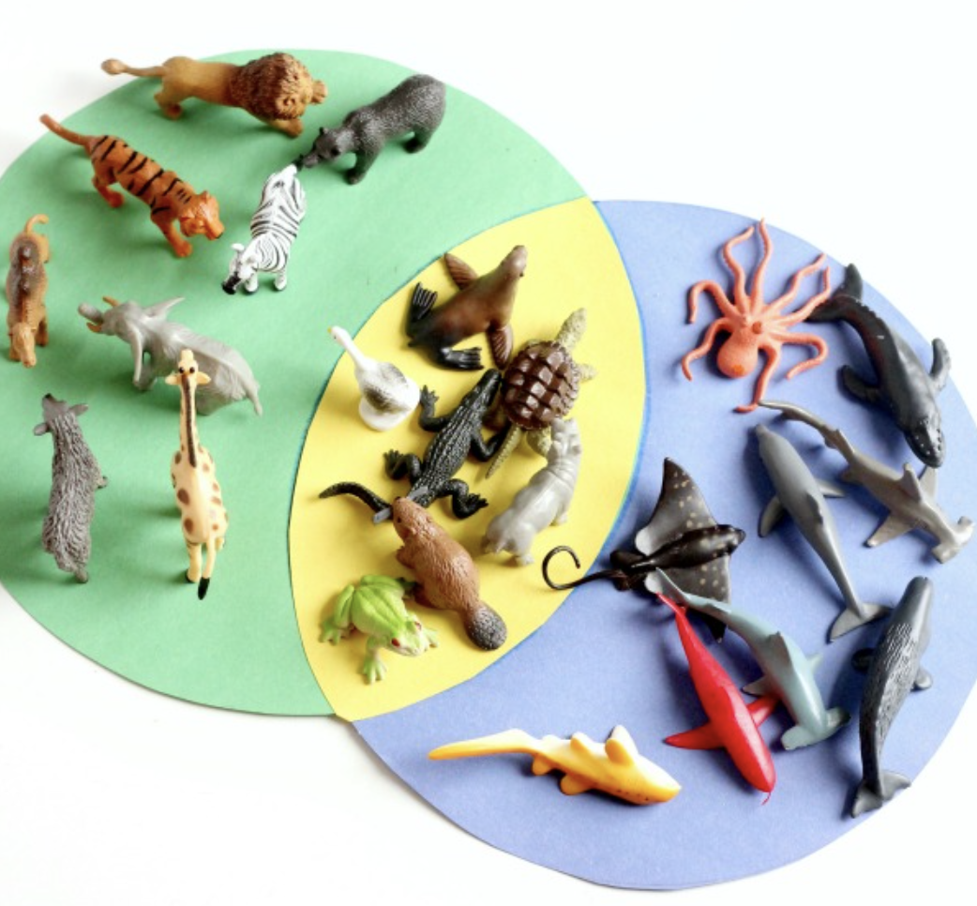
Intro
Classification
Notes:
Today, we’ll be learning about the word: Classification.

Slide 3
Big Question: How do we formulate scientific questions?
Notes:
Our “big question” is: How do we formulate scientific questions?
[Pause and illicit predictions from students.]
I love all these thoughtful scientific hypotheses! Be sure to keep this question and your predictions in mind as we move through these next few lessons, and we’ll continue to revisit it.

Slide 4
Notes:
Before we move on to our new topic, let’s review some other words & concepts that you already learned and make sure you are firm in your understanding.

Slide 5
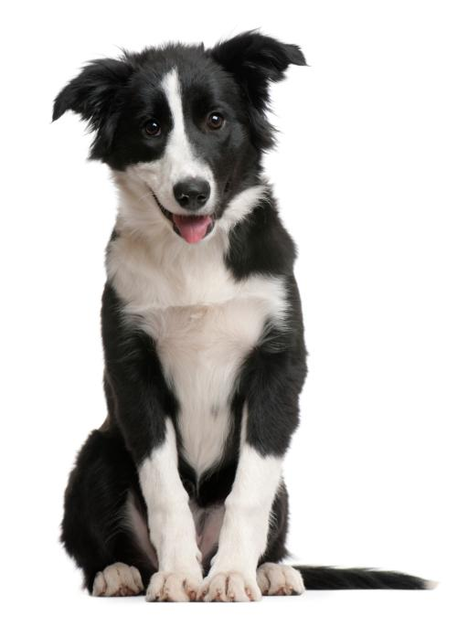
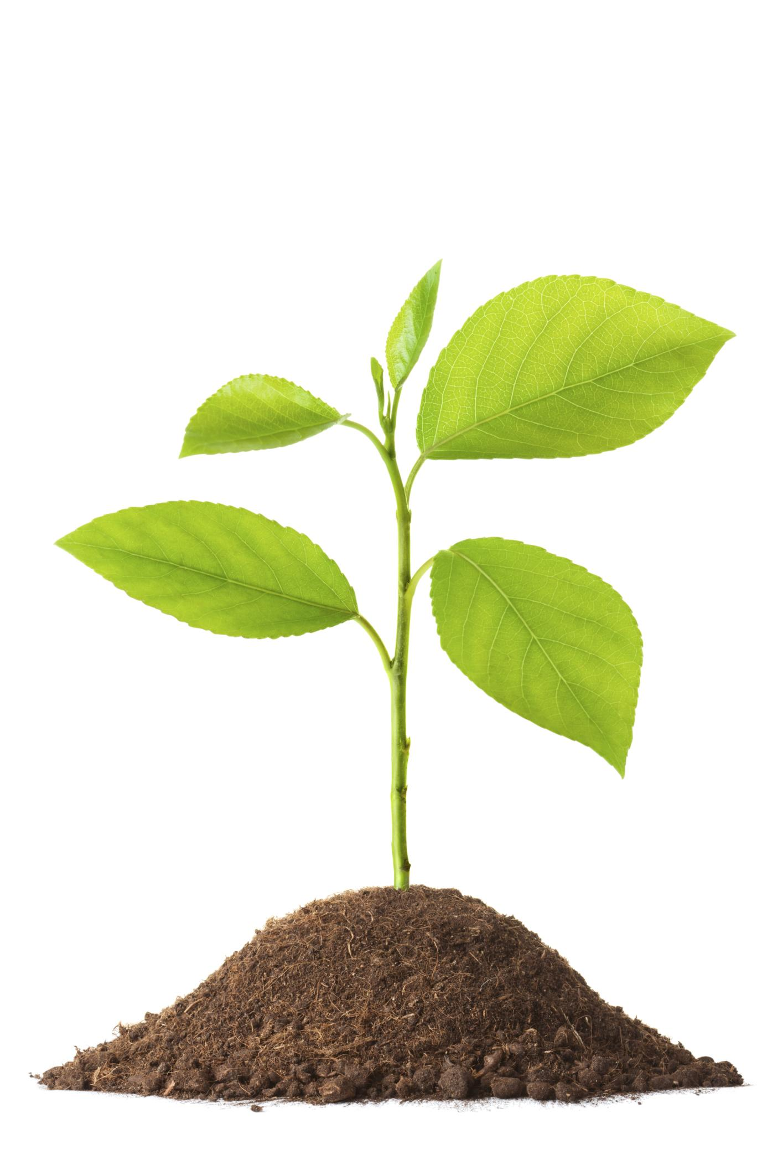
Organism: any living thing
Notes:
An organism is any living thing.

Slide 6
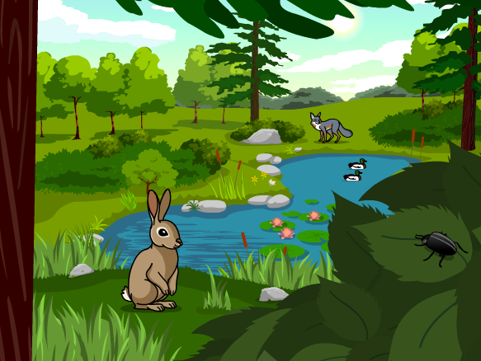
Ecosystem: an area where living and nonliving things interact.
Notes:
An ecosystem is an area where living and nonliving things interact.

Slide 7
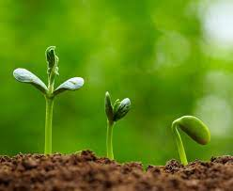
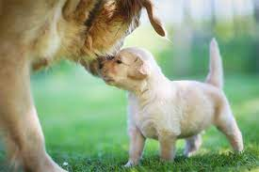
Living Thing: organisms that move, grow, change, and respond to its environment
Notes:
Living things are organisms that grow, change, and respond to its environment.

Slide 8
Non-living Thing: do not grow, reproduce, and need food
Notes:
Non-living things do not grow, reproduce, and need food.

Slide 9
Notes:
Now let’s pause for a moment to review the information we have covered already.

Slide 10
True or false: An organism is any living thing.
True
False
Notes:
True or false: An organism is any living thing.
[A. True]

Slide 11
True or false: An organism is any living thing.
True
False
Notes:
True or false: An organism is any living thing.
[A. True]

Slide 12
What is another word for an area where living and nonliving things interact?
System
Economy
Ecosystem
Notes:
What is another word for an area where living and nonliving things interact?
[C. Ecosystem]

Slide 13
What is another word for an area where living and nonliving things interact?
System
Economy
Ecosystem
Notes:
What is another word for an area where living and nonliving things interact? C. Ecosystem

Slide 14
_________ __________ are organisms that move, grow, change, and respond to the environment
Abiotic Factors
Living things
Non-living things
Notes:
______ _______ are organisms that move, grow, change, and respond to the environment.
[B. Living things]

Slide 15
_________ __________ are organisms that move, grow, change, and respond to the environment
Abiotic Factors
Living things
Non-living things
Notes:
Living things are organisms that move, grow, change, and respond to the environment.

Slide 16
_________ __________ are things that do not grow, reproduce, and need food
Abiotic Factors
Living things
Non-living things
Notes:
______ _______ are things that no not grow, reproduce, and need food.
[C. Non-living things]

Slide 17
_________ __________ are things that do not grow, reproduce, and need food
Abiotic Factors
Living things
Non-living things
Notes:
Non-living things are things that no not grow, reproduce, and need food.

Slide 18
Classification
Notes:
Now that we’ve reviewed, let’s define the word classification.

Slide 19
Classification: to organize organisms into groups
Notes:
Classification means to organize organisms into groups.

Slide 20
Notes:
Let’s check-in for understanding.

Slide 21
What is classification?
Notes:
What is classification?
[To organize organisms into groups.]

Slide 22
Notes:
That is the basic definition, but there is a bit more you need to know.

Slide 23
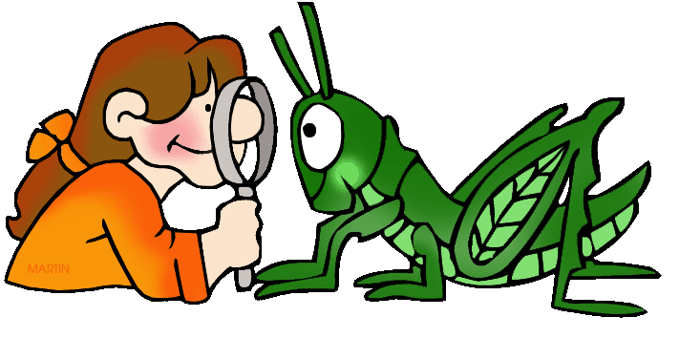
Classification relies on careful observations of patterns, similarities, and differences in organisms.
Notes:
Classification relies on careful observations of patterns, similarities, and differences in organisms.

Slide 24
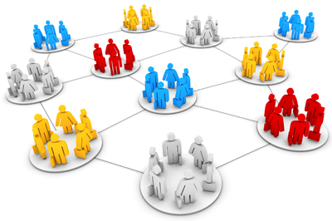
Classification is useful in explaining relationships by organizing objects or processes into groups.
Notes:
Classification is useful in explaining relationships by organizing objects or processes into groups.

Slide 25
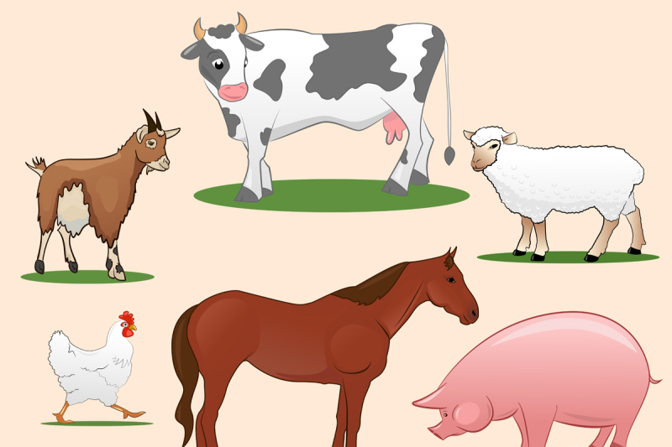
When in groups, it is easier to understand similarities and differences in organisms.
Notes:
When in groups, it is easier to understand similarities and differences in organisms. For example, this group of animals could have a classification of farm animals.

Slide 26
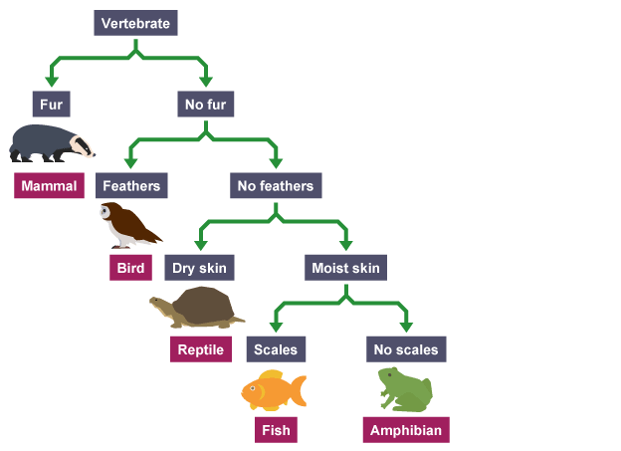
A dichotomous key is a tool used to classify organisms based on physical characteristics.
Notes:
A dichotomous key is a tool used to classify organisms based on physical characteristics For example, this dichotomous key could be used for vertebrates (animal with a backbone). If the vertebrate has fur, it is a mammal. If it does not, the vertebrate has feathers or does not. If the vertebrate has feathers, it is a bird. If the vertebrate does not have feathers, it could either have dry skin or moist skin (and so on…).

Slide 27
Notes:
Let’s check-in for understanding.

Slide 28
Classification relies on careful __________ of patterns, similarities, and differences in organisms.
Observations
Obstacles
Denial
Notes:
Classification relies on careful _________ of patterns, similarities, and differences in organisms.
[A. Observations]

Slide 29
Classification relies on careful observations of patterns, similarities, and differences in organisms.
Observations
Obstacles
Denial
Notes:
Classification relies on careful observations of patterns, similarities, and differences in organisms.
[A. Observations]

Slide 30
True or false: Classification is useful in explaining relationships by organizing objects or processes into groups.
True
False
Notes:
True or false: Classification is useful in explaining relationships by organizing objects or processes into groups..
[A. True]

Slide 31
True or false: Classification is useful in explaining relationships by organizing objects or processes into groups.
True
False
Notes:
True or false: Classification is useful in explaining relationships by organizing objects or processes into groups..
[A. True]

Slide 32
True or false: When in groups, it is difficult to understand similarities and differences in organisms.
True
False
Notes:
True or false: When in groups, it is difficult to understand similarities and differences in organisms.
[B. False]

Slide 33
True or false: When in groups, it is difficult to understand similarities and differences in organisms.
True
False
Notes:
True or false: When in groups, it is difficult to understand similarities and differences in organisms.
[B. False]
It is actually easier to understand similarities and differences in organisms when we classify them into groups.

Slide 34
A dichotomous key is a ______ used to classify organisms based on physical characteristics?
Token
Tool
Toy
Notes:
A dichotomous key is a ______ used to classify organisms based on physical characteristics?
[B. Tool]

Slide 35
A dichotomous key is a ______ used to classify organisms based on physical characteristics?
Token
Tool
Toy
Notes:
A dichotomous key is a ______ used to classify organisms based on physical characteristics?
[B. Tool]

Slide 36
Notes:
Now, let’s talk about some examples of classification

Slide 37
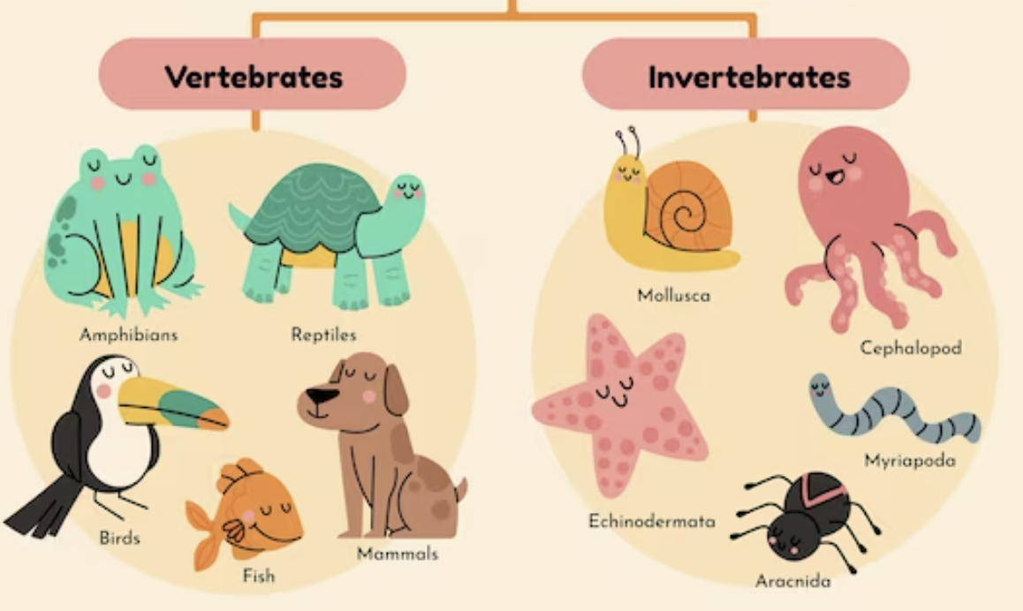
Notes:
Here is an example of classification. The animals on the left are classified as vertebrates (or animals with a backbone). The animals on the right are classified as invertebrates (or animals without a backbone).

Slide 38
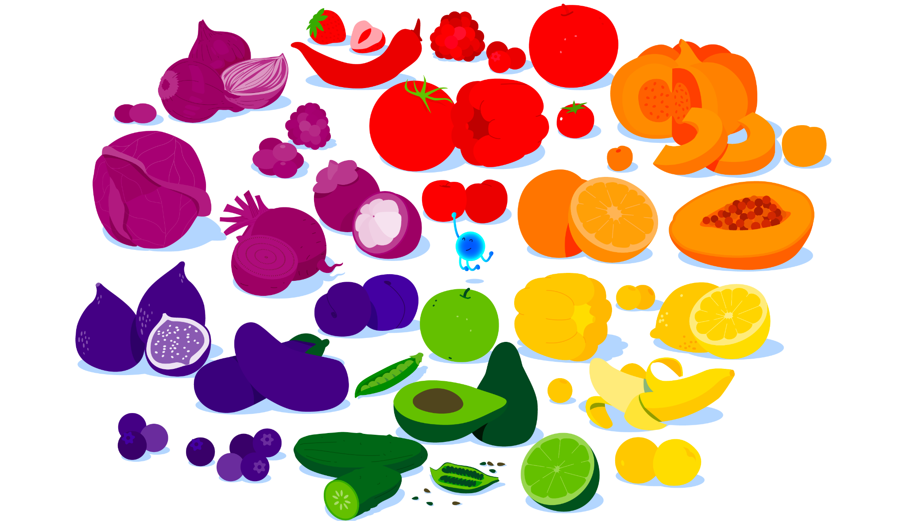
Notes:
Here is another example of classification. You can see that the fruits and vegetables are classified by their colors.

Slide 39
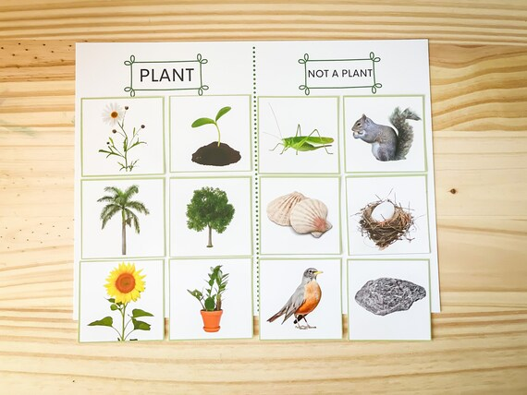
Notes:
Here is another example of classification. You can see that the pictures on the left are classified as plants and the pictures on the right are classified as not plants.

Slide 40
Notes:
Now, let’s talk about some non-examples of classification.

Slide 41
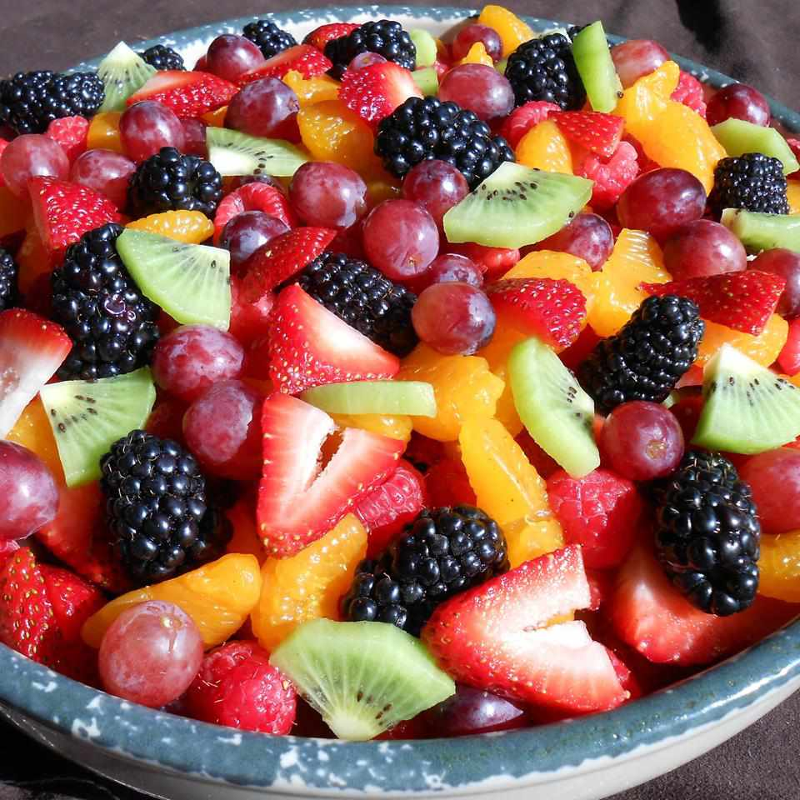
Notes:
This is a non-example of classification. Because the different types of fruit are not organized into groups of some type, they have not been classified.

Slide 42
Notes:
This is also a non-example of classification. Remember, classification is organizing organisms, and organisms are living things. This book shelf is full of books, which are not living things.

Slide 43
Notes:
Now let’s pause for a moment to check your understanding.

Slide 44
Which one is NOT an example of classification?
Vertebrates/
Invertebrates
Fruit Salad
Fruit by
color
Notes:
Which one is NOT an example of classification?
[Fruit Salad]

Slide 45
Which one is NOT an example of classification?
Vertebrates/
Invertebrates
Fruit Salad
Fruit by
color
Notes:
Which one is NOT an example of classification? Fruit salad is NOT an example of classification because though it is made up of organisms, the fruit salad is not organized
[Fruit Salad]

Slide 46
Notes:
We can also break down the term reproduction into different word parts to help us remember the meaning. Let’s take a look!

Slide 47
Classification
(root)
(suffix)
Notes:
We can break up the term classification into two parts: a root and a suffix

Slide 48
Classification
Classifi cation
arrange or categorize into groups
Notes:
The root, produc, means to create or produce.

Slide 49
Classification
Classifi cation
an act or process
Notes:
The suffix, ation, means an act or process.

Slide 50
Classifi cation
Classification
The process of arranging into groups
Notes:
Classification means the process of arranging into groups.

Slide 51
Notes:
Let’s check-in for understanding.

Slide 52
How can we use the word parts of classification to help us remember the definition of the term?
Classification
Classifi cation
Notes:
How can we use the word parts of classification to help us remember the definition of the term?
[Classifi = arrange or categorize into groups
Cation = an act or process
Classification is the process of arranging into groups.]

Slide 53
Remember!!!
Notes:
So remember!

Slide 54
Classification: to organize organisms into groups
Notes:
Classification means to organize organisms into groups.

Slide 55
Notes:
We will now complete this concept map, called a Frayer model, to summarize and further clarify what you have learned about the term classification.

Slide 56
Definition
Picture
Classification
Example
How does classification impact my life?
Notes:
To complete the Frayer model, we will choose from four choices the correct picture, definition, example, and response to the question, “How does classification impact my life?” Select the best response for each question using the information you just learned. As we select responses, we will see how this model looks filled in for the term classification.

Slide 57
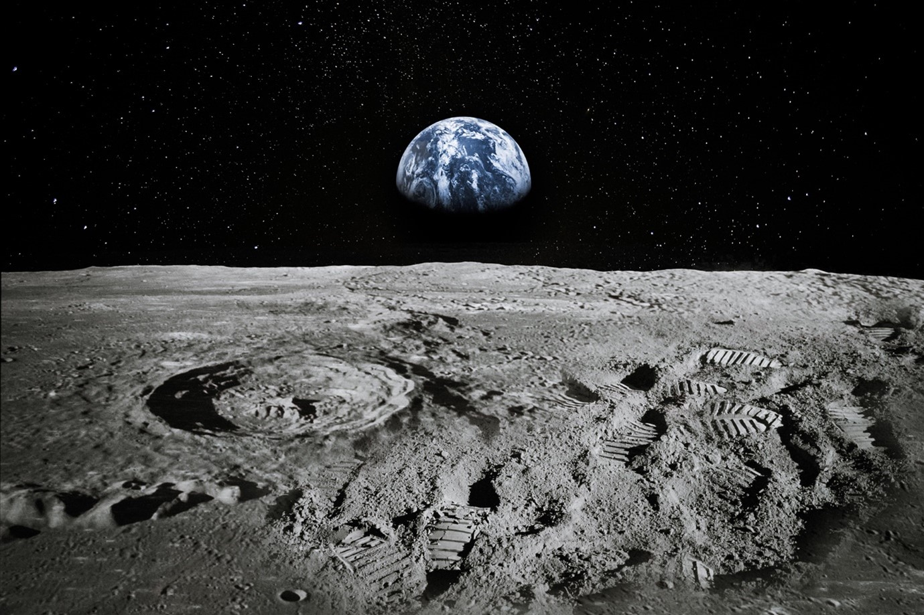
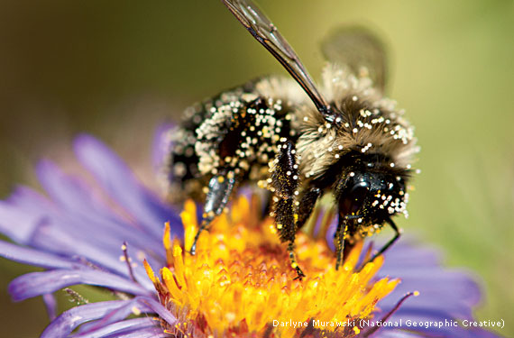
Directions: Choose the correct picture of classification from the choices below.
A
B
C
D
Notes:
Choose the one correct picture of classification from these four choices.

Slide 58
Directions: Choose the correct picture of classification from the choices below.
A
B
C
D
Notes:
This is the picture that shows classification.

Slide 59
Definition
Picture
Classification
Example
How does classification impact my life?
Notes:
Here is the Frayer model filled in with a picture of classification.

Slide 60
Directions: Choose the correct definition of classification from the choices below.
A
To disorganize organisms in groups
B
To put every organism into only one group
C
To organize books on a shelf
D
To organize organisms into groups
Notes:
Choose the one correct definition of classification from these four choices.

Slide 61
Directions: Choose the correct definition of classification from the choices below.
A
To disorganize organisms in groups
B
To put every organism into only one group
C
To organize books on a shelf
D
To organize organisms into groups
Notes:
“To organize organisms into groups” is correct! This is the definition of classification.

Slide 62
Definition
Picture
To organize organisms into groups
Classification
Example
How does classification impact my life?
Notes:
Here is the Frayer Model with a picture and the definition filled in for classification: To organize organisms into groups.

Slide 63
Directions: Choose the correct example of classification from the choices below.
A
Organizing trees based on their type of leaves
B
Organizing TVs by their brands
C
Organizing books on a shelf
D
Organizing apps on a smartphone
Notes:
Choose the one correct example of classification from these four choices.

Slide 64
Directions: Choose the correct example of classification from the choices below.
A
Organizing trees based on their type of leaves
B
Organizing TVs by their brands
C
Organizing books on a shelf
D
Organizing apps on a smartphone
Notes:
“Organizing trees based on their type of leaves” is correct! This is an example of classification.

Slide 65
Definition
Picture
To organize organisms into groups
Classification
Organizing trees based on their type of leaves
Example
How does classification impact my life?
Notes:
Here is the Frayer Model with a picture, definition, and an example of classification: Organizing trees based on their type of leaves.

Slide 66
Directions: Choose the correct response for “how does classification impact my life?” from the choices below.
A
Classification helps me to organize my bedroom.
B
Classification helps me to choose what to eat.
C
Classification helps me to understand differences between farm animals and house pets.
D
Classification helps me to answer questions at school.
Notes:
Choose the one correct response for “how does classification impact my life?” from these four choices.

Slide 67
Directions: Choose the correct response for “how does classification impact my life?” from the choices below.
A
Classification helps me to organize my bedroom.
B
Classification helps me to choose what to eat.
C
Classification helps me to understand differences between farm animals and house pets.
D
Classification helps me to answer questions at school.
Notes:
“Classification helps me to understand differences between farm animals and house pets.” That is correct! This is an example of how classification impacts your life.

Slide 68
Definition
Picture
To organize organisms into groups
Classification
Organizing trees based on their type of leaves
Classification helps me to understand differences between farm animals and house pets.
Example
How does classification impact my life?
Notes:
Here is the Frayer Model with a picture, definition, example, and a correct response to “how does classification impact my life?”: Classification helps me to understand differences between farm animals and house pets.

Slide 69
Remember!!!
Notes:
So remember!

Slide 70
Classification: to organize organisms into groups
Notes:
Classification means to organize organisms into groups.

Slide 71
Big Question: How do we formulate scientific questions?
Notes:
Let’s reflect once more on our big question. Our “big question” is: How do we formulate scientific questions?
Does anyone have any additional examples to share that haven’t been discussed yet?

Slide 72
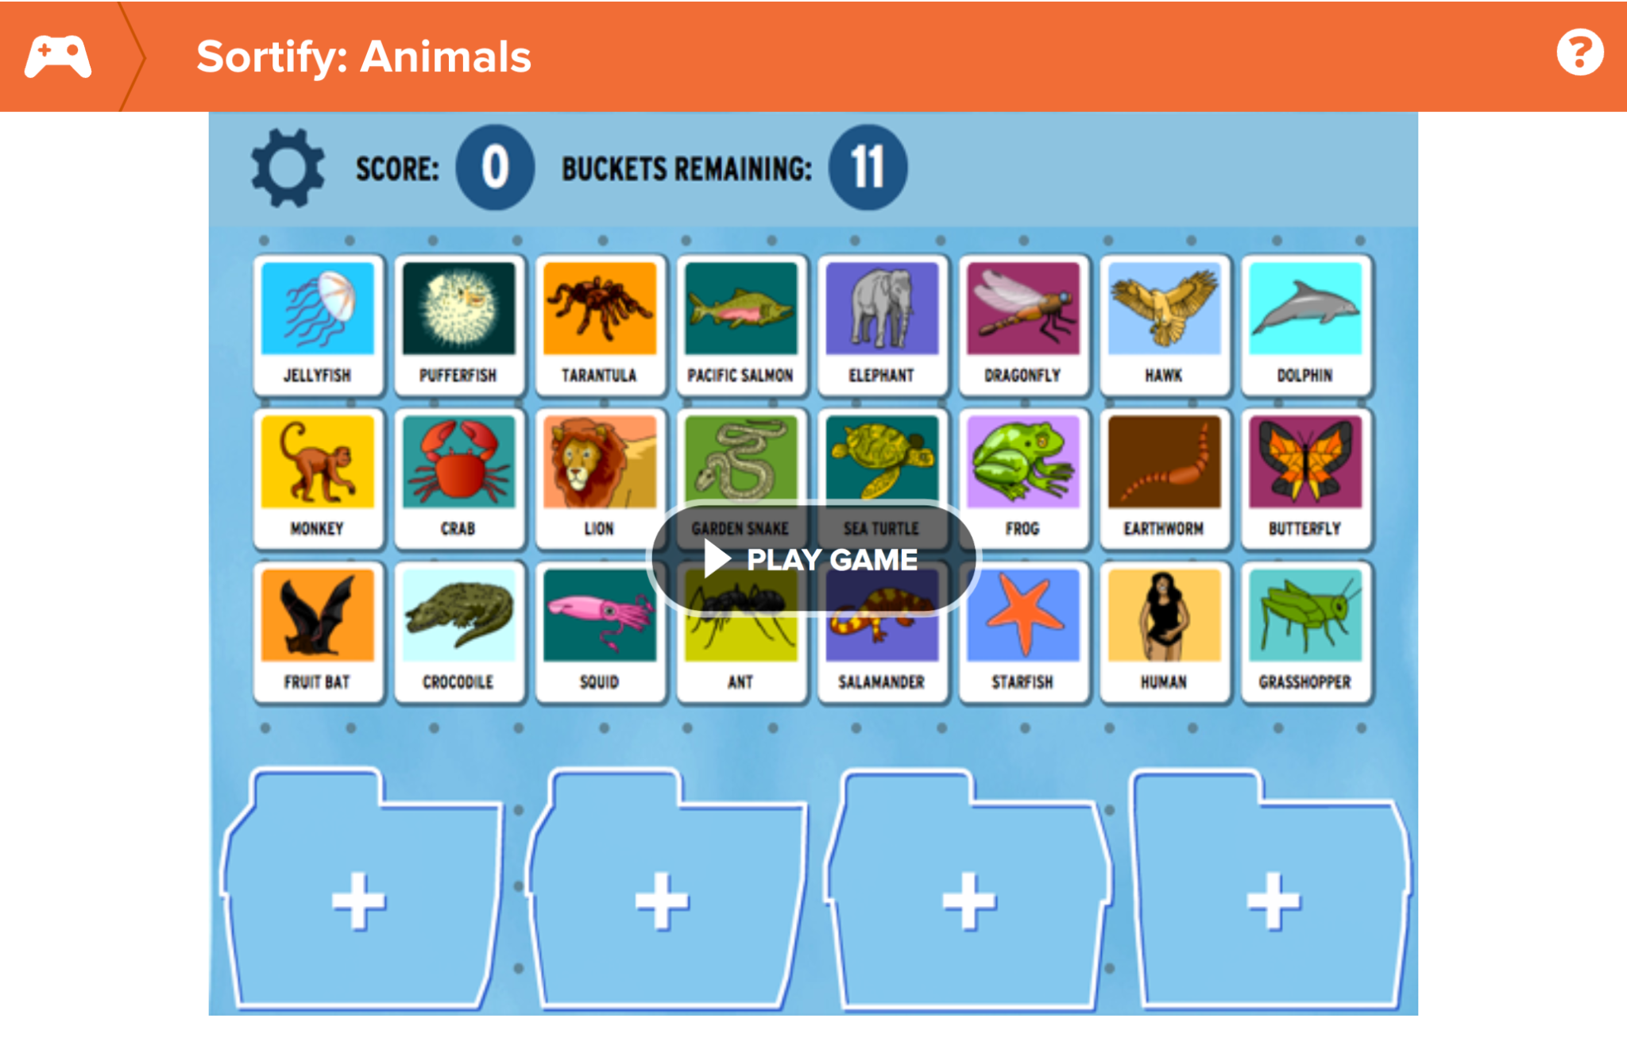
Classification Activity
Classification Activity (BrainPOP)
Click the link to play a classification game on sorting animals.
Notes:
Click the link to play a classification game with your students. Try different ways to classify the animals by organizing them into different folders.

Slide 73
Notes:
Thanks for watching, and please continue watching CAPs available from this website.

Slide 74
This Was Created With Resources From:
Questions or Comments
Michael Kennedy, Ph.D. MKennedy@Virginia.edu
Rachel L Kunemund, Ph.D. rk8vm@virginia.edu

