Slide 1
Intro
“Big Idea” Question
Review Concepts
Check-In Questions
Teacher Engagement
Vocabulary
Student-Friendly Definition
Examples & Non-Examples
Frayer Model
Simulation/Activity
Notes:
OK everyone, get ready for our next lesson. Just as a reminder, these are the different components that our lesson may include, and you’ll see these icons in the top left corner of each slide so that you can follow along more easily!

Slide 2
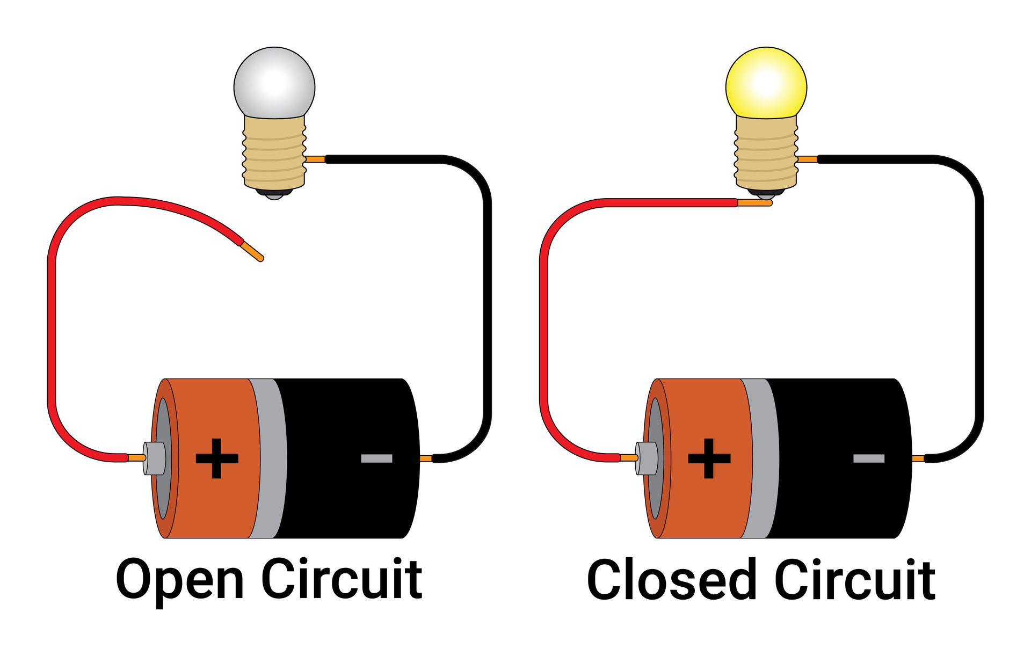
Intro
Closed Circuit
Notes:
Today, we’ll be learning about the word: Closed Circuit.

Slide 3
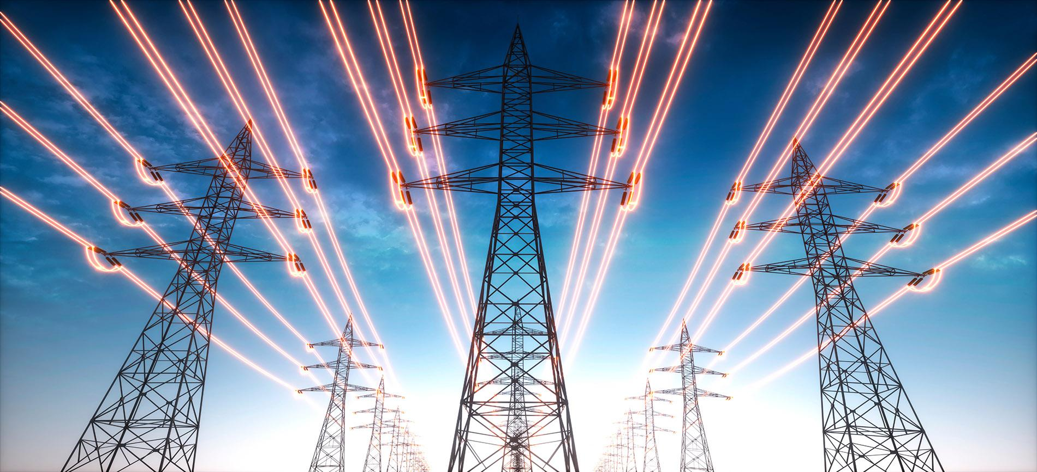
Big Question: How is electricity transmitted and used in daily life?
Notes:
Our “big question” is: How is electricity transmitted and used in daily life?
[Pause and illicit predictions from students.]
I love all these thoughtful scientific hypotheses! Be sure to keep this question and your predictions in mind as we move through these next few lessons, and we’ll continue to revisit it.

Slide 4
Demonstration
Watch this video detailing the difference between open and closed circuits.
What made the circuit closed?
What made the circuit open?
What happened in the circuit when it was open versus closed?
Notes:
YouTube link: https://www.youtube.com/watch?v=XnGiOe1WSbo

Slide 5
Notes:
Before we move on to our new topic, let’s review some other words & concepts that you already learned and make sure you are firm in your understanding.

Slide 6
Electricity: electrical energy transformed into different forms of energy to meet needs
Notes:
Electricity is electrical energy transformed into different forms of energy to meet needs.

Slide 7
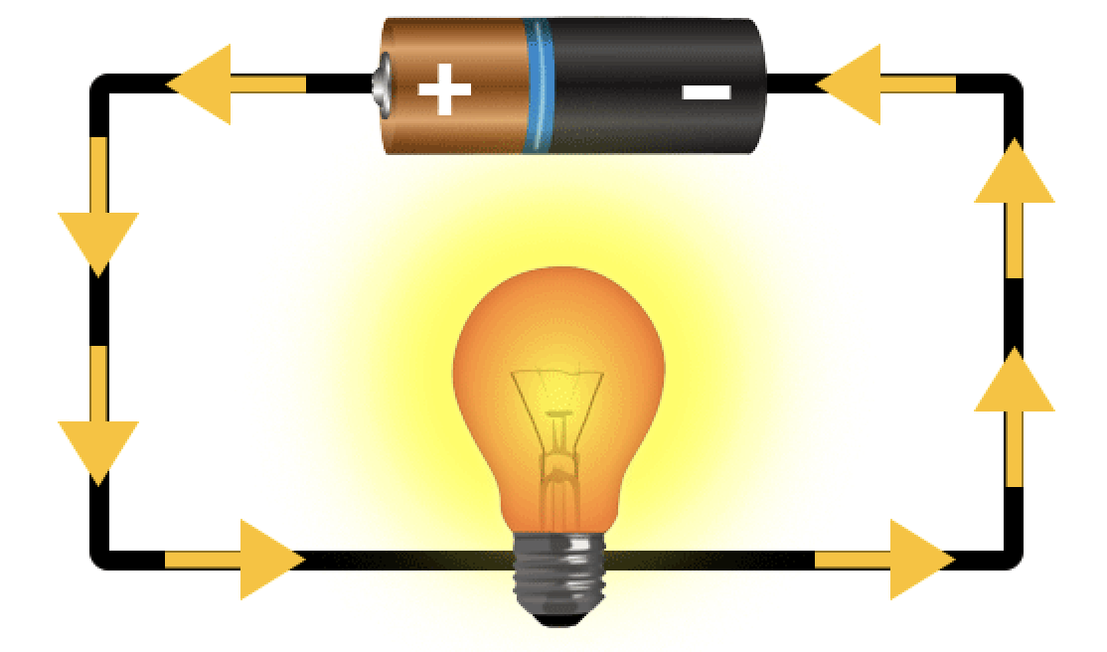
Current: an electrical charge in motion
Notes:
A current is an electrical charge in motion.

Slide 8
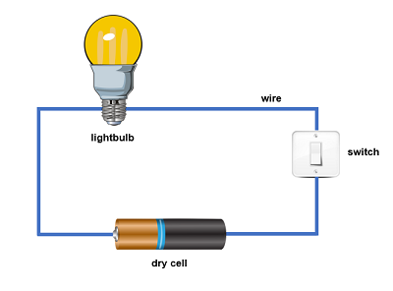
Circuit: the path electricity travels on
Notes:
A circuit is the path electricity travels on.

Slide 9
Notes:
Now let’s pause for a moment to review the information we have covered already.

Slide 10
True or False: Electricity is electrical energy transformed into different forms of energy to meet needs.
Notes:
True or False: Electricity is electrical energy transformed into different forms of energy to meet needs.
[True]

Slide 11
True or False: Electricity is electrical energy transformed into different forms of energy to meet needs.
Notes:
True: Electricity is electrical energy transformed into different forms of energy to meet needs.

Slide 12
A ______ is the path electricity travels on.
current
circuit
Notes:
A _____ is the path electricity travels on.
[circuit]

Slide 13
A ______ is the path electricity travels on.
current
circuit
Notes:
A [circuit] is the path electricity travels on.

Slide 14
Closed Circuit
Notes:
Now that we’ve reviewed, let’s define the phrase Closed Circuit.

Slide 15
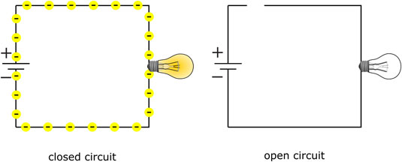
Closed Circuit: a circuit where electricity is flowing
Notes:
A closed circuit is a circuit where electricity is flowing.

Slide 16
Notes:
Let’s check-in for understanding.

Slide 17
What is a closed circuit?
Notes:
What is a closed circuit?
[A closed circuit is a circuit where electricity is flowing.]

Slide 18
Notes:
That is the basic definition, but there is a bit more you need to know.

Slide 19
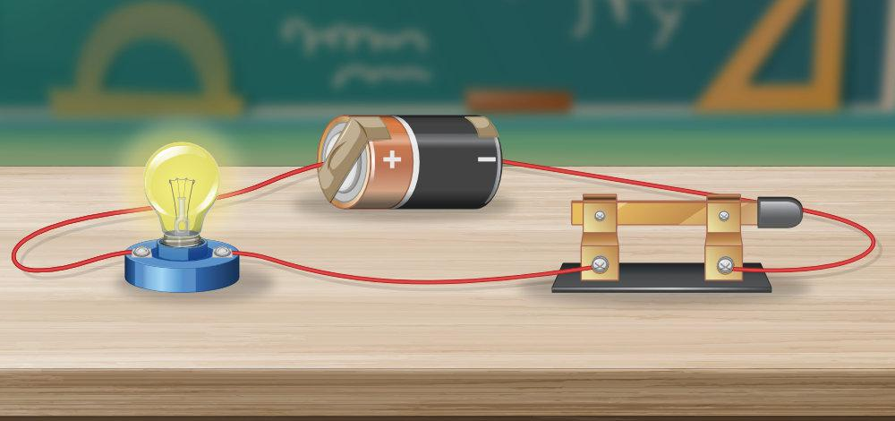
A closed circuit is like a complete loop for electricity. It’s when all the wires are connected, allowing the electric current to flow and power things like light bulbs or other devices. It’s like a full circle that lets the electricity go around and do its job.
Notes:
A closed circuit is like a complete loop for electricity. It's when all the wires are connected, allowing the electric current to flow and power things like light bulbs or devices. It's like a full circle that lets the electricity go around and do its job.

Slide 20
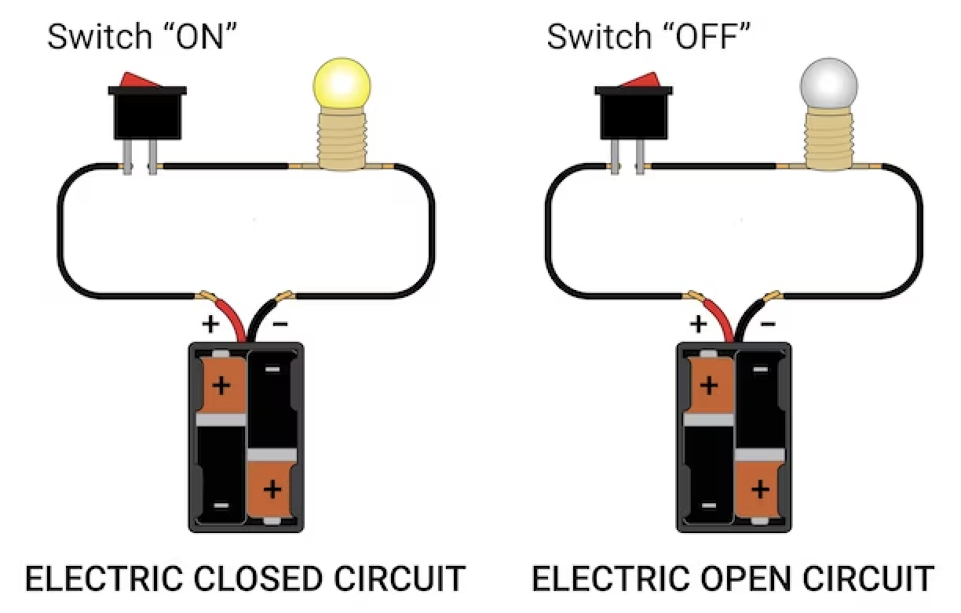
In a closed circuit, the switch is in the “on” position. This closes the circuit and allows electricity to flow. There is no break in the circuit or the flow of electricity.
Notes:
In a closed circuit, the switch is in the “on” position. This closes the circuit and allows electricity to flow. There is no break in the circuit or the flow of electricity.

Slide 21
Notes:
Let’s check-in for understanding.

Slide 22
How is a closed circuit like a complete loop for electricity?
Notes:
How is a closed circuit like a complete loop for electricity?
[A closed circuit is like a complete loop for electricity. It's when all the wires are connected, allowing the electric current to flow and power things like light bulbs or devices. It's like a full circle that lets the electricity go around and do its job.]

Slide 23
In a closed circuit, the switch is in the “___” position.
on
off
Notes:
In a closed circuit, the switch is in the “___” position.
[on]

Slide 24
In a closed circuit, the switch is in the “___” position.
on
off
Notes:
In a closed circuit, the switch is in the “on” position.

Slide 25
True or False: There is no break in a closed circuit. This allows for the electricity to flow.
Notes:
True or False: There is no break in a closed circuit. This allows for the electricity to flow.

Slide 26
True or False: There is no break in a closed circuit. This allows for the electricity to flow.
Notes:
True There is no break in a closed circuit. This allows for the electricity to flow.

Slide 27
Notes:
Now, let’s talk about some examples of closed circuits.

Slide 28
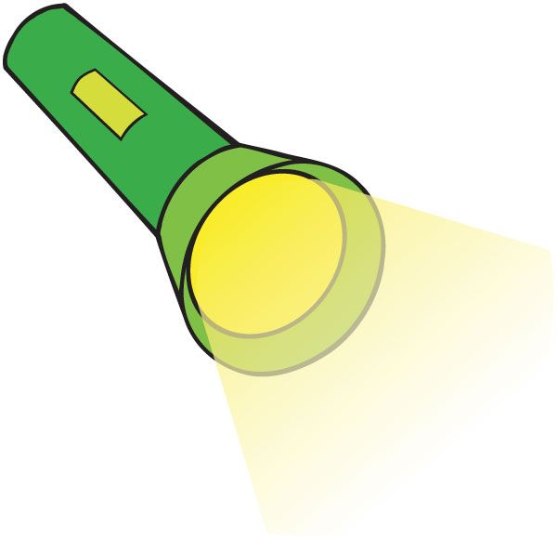
A flashlight is an example of a closed circuit.
Notes:
A flashlight is an example of a closed circuit. When you switch on the flashlight, you close the circuit, allowing electricity to flow and light up the bulb.

Slide 29
A television is an example of a closed circuit.
Notes:
A television is an example of a closed circuit. When you switch or turn on the TV, you close the circuit, allowing electricity to flow to the screen and speakers.

Slide 30
Notes:
Now, let’s talk about some non-examples of closed circuits.

Slide 31
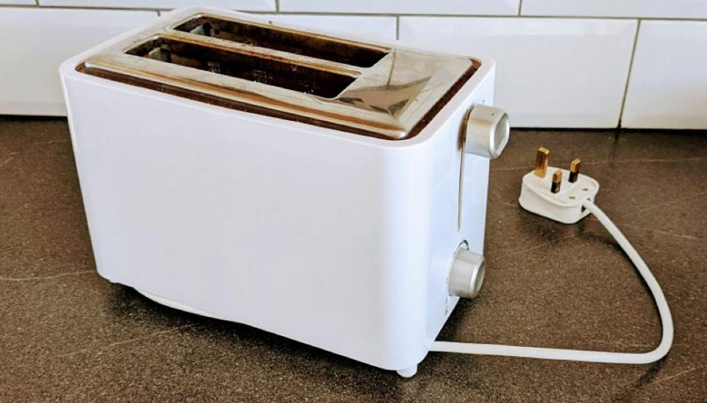
An unplugged toaster is NOT an example of a closed circuit.
Notes:
An unplugged toaster is not an example of a closed circuit. If a toaster is not plugged into an outlet, which is the power source, the circuit is broken and electricity cannot flow to the toaster in order to toast bread.

Slide 32
A television that is turned off is NOT an example of a closed circuit.
Notes:
A television that is turned off is not an example of a closed circuit.With the switch off, electricity cannot flow to the TV to power the light or sound.

Slide 33
Notes:
Now let’s pause for a moment to check your understanding.

Slide 34
Why is a TV that is on an example of a closed circuit and a TV that is off not an example of a closed circuit?
Notes:
Why is a TV that is on an example of a closed circuit and a TV that is off not an example of a closed circuit?
[A TV that is switched on has electricity flowing through it, making it a closed circuit. A TV that is switched off does not have electricity flowing through it, making it not a closed circuit.]

Slide 35
Remember!!!
Notes:
So remember!

Slide 36
Closed Circuit: a circuit where electricity is flowing
Notes:
A closed circuit is a circuit where electricity is flowing.

Slide 37
Notes:
We will now complete this concept map, called a Frayer model, to summarize and further clarify what you have learned about the term closed circuit.

Slide 38
Definition
Picture
Closed Circuit
Example
How do closed circuits impact my life?
Notes:
To complete the Frayer model, we will choose from four choices the correct picture, definition, example, and response to the question, “How do closed circuits impact my life?” Select the best response for each question using the information you just learned. As we select responses, we will see how this model looks filled in for the term closed circuit.

Slide 39
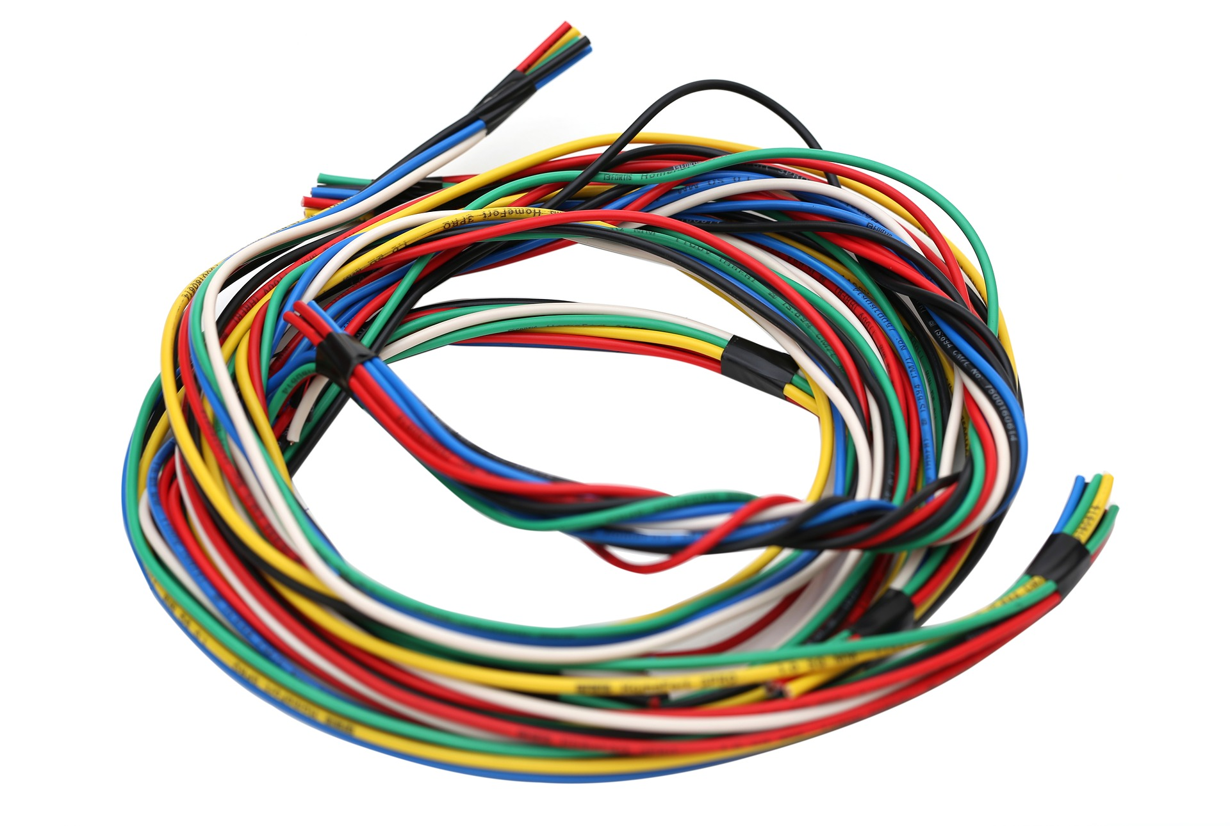
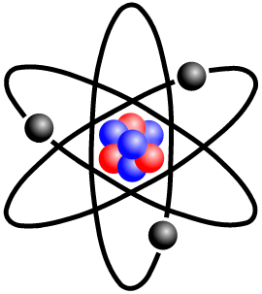
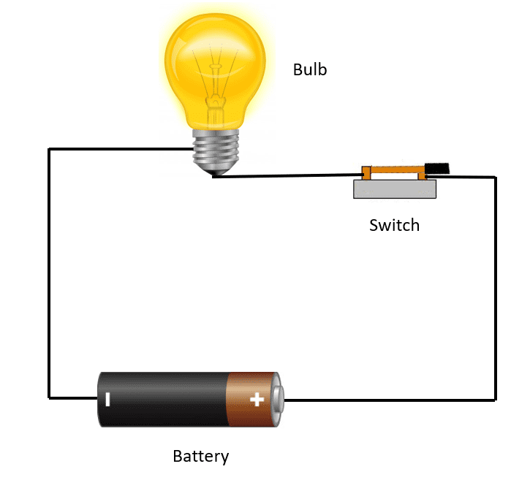
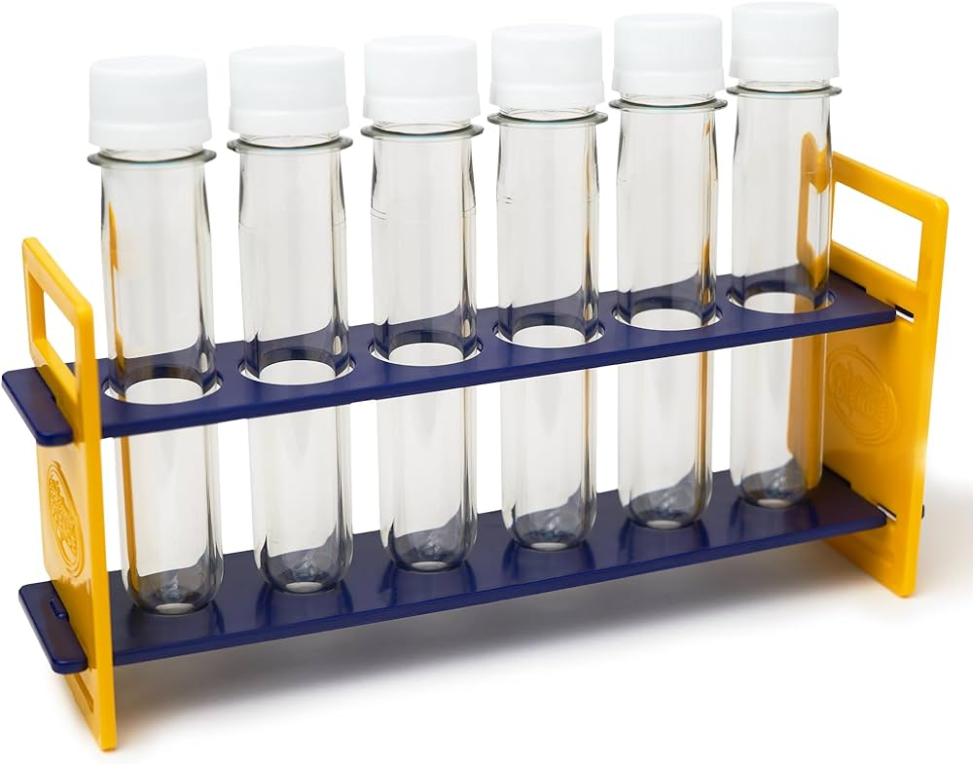
Directions: Choose the correct picture of a closed circuit from the choices below.
A
B
C
D
Notes:
Choose the one correct picture of a closed circuit from these four choices.

Slide 40
Directions: Choose the correct picture of a closed circuit from the choices below.
A
B
C
D
Notes:
This is the picture that shows a closed circuit.

Slide 41
Definition
Picture
Closed Circuit
Example
How do closed circuits impact my life?
Notes:
Here is the Frayer model filled in with a picture of a closed circuit.

Slide 42
Directions: Choose the correct definition of a
closed circuit from the choices below.
A
Negatively charged particle that orbits the nucleus of an atom
B
A circuit where electricity is flowing
C
Work being done
D
The process by which plants make their own food
Notes:
Choose the one correct definition of a closed circuit from these four choices.

Slide 43
Directions: Choose the correct definition of a
closed circuit from the choices below.
A
Negatively charged particle that orbits the nucleus of an atom
B
A circuit where electricity is flowing
C
Work being done
D
The process by which plants make their own food
Notes:
“A circuit where electricity is flowing” is correct! This is the definition of a closed circuit.

Slide 44
Definition
Picture
A circuit where electricity is flowing
Closed Circuit
Example
How do closed circuits impact my life?
Notes:
Here is the Frayer Model with a picture and the definition filled in for closed circuit: A circuit where electricity is flowing.

Slide 45
Directions: Choose the correct example of a
closed circuit from the choices below.
A
A treehouse in someone’s backyard
B
A table in a dining room
C
A babbling stream
D
A desktop computer that is plugged in and turned on
Notes:
Choose the one correct example of a closed circuit from these four choices.

Slide 46
Directions: Choose the correct example of a
closed circuit from the choices below.
A
A treehouse in someone’s backyard
B
A table in a dining room
C
A babbling stream
D
A desktop computer that is plugged in and turned on
Notes:
“A desktop computer that is plugged in and turned on” is correct! This is an example of a closed circuit.

Slide 47
Definition
Picture
A circuit where electricity is flowing
Closed Circuit
A desktop computer that is plugged in and turned on
Example
How do closed circuits impact my life?
Notes:
Here is the Frayer Model with a picture, definition, and an example of a closed circuit: A desktop computer that is plugged in and turned on.

Slide 48
Directions: Choose the correct response for “how do closed circuits impact my life?” from the choices below.
A
Closed circuits allow electricity to flow and power devices and machines we use in our everyday lives.
B
Closed circuits allow for gasoline to move through automobiles to take us from one place to another.
C
Closed circuits explain how our cells work together in our bodies to keep us healthy.
D
Closed circuits clean the air which help us breathe better.
Notes:
Choose the one correct response for “how do closed circuits impact my life?” from these four choices.

Slide 49
Directions: Choose the correct response for “how do closed circuits impact my life?” from the choices below.
A
Closed circuits allow electricity to flow and power devices and machines we use in our everyday lives.
B
Closed circuits allow for gasoline to move through automobiles to take us from one place to another.
C
Closed circuits explain how our cells work together in our bodies to keep us healthy.
D
Closed circuits clean the air which help us breathe better.
Notes:
You chose “Closed circuits allow electricity to flow and power devices and machines we use in our everyday lives.” That is correct! This is an example of how closed circuits impact your life.

Slide 50
Definition
Picture
A circuit where electricity is flowing
Closed Circuit
Closed circuits allow electricity to flow and power devices and machines we use in our everyday lives.
A desktop computer that is plugged in and turned on
Example
How do closed circuits impact my life?
Notes:
Here is the Frayer Model with a picture, definition, example, and a correct response to “how do closed circuits impact my life?”: Closed circuits allow electricity to flow and power devices and machines we use in our everyday lives.

Slide 51
Remember!!!
Notes:
So remember!

Slide 52
Closed Circuit: a circuit where electricity is flowing
Notes:
A closed circuit is a circuit where electricity is flowing.

Slide 53
Big Question: How is electricity transmitted and used in daily life?
Notes:
Our “big question” is: How is electricity transmitted and used in daily life?
Does anyone have any additional examples to share that haven’t been discussed yet?

Slide 54
Activity
Open vs. Closed Circuits Lesson Plan
Following the directions and using the materials on the lesson plan above, teachers will demonstrate different types of circuits. Students will explore the differences between open and closed circuits.
Notes:
Link to lesson plan: https://www.teachengineering.org/activities/view/cub_electricity_lesson03_activity1

Slide 55
Notes:
Thanks, and please continue watching and using CAPs available from this website.

Slide 56
This Was Created With Resources From:
Questions or Comments
Michael Kennedy, Ph.D. MKennedy@Virginia.edu
Rachel L Kunemund, Ph.D. rk8vm@virginia.edu

