Slide 1
Intro
“Big Idea” Question
Review Concepts
Check-In Questions
Teacher Engagement
Vocabulary
Student-Friendly Definition
Examples & Non-Examples
Morphological Word Parts
Frayer Model
Simulation/Activity
Notes:
OK everyone, get ready for our next lesson. Just as a reminder, these are the different components that our lesson may include, and you’ll see these icons in the top left corner of each slide so that you can follow along more easily!

Slide 2
Community
Intro
Notes:
Today, we’ll be learning about the word: Community.

Slide 3
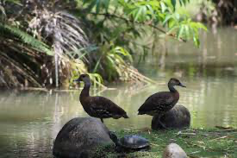
Big Question: How do living things work together in a community?
Notes:
Our “big question” is: How do living things work together in a community?
[Pause and illicit predictions from students.]
I love all these thoughtful scientific hypotheses! Be sure to keep this question and your predictions in mind as we move through these next few lessons, and we’ll continue to revisit it.

Slide 4
Notes:
Before we define the term population, let’s review some other words that you already learned, and make sure you are firm in your understanding.

Slide 5
Organism: any living thing
Notes:
An organism is any living thing.

Slide 6
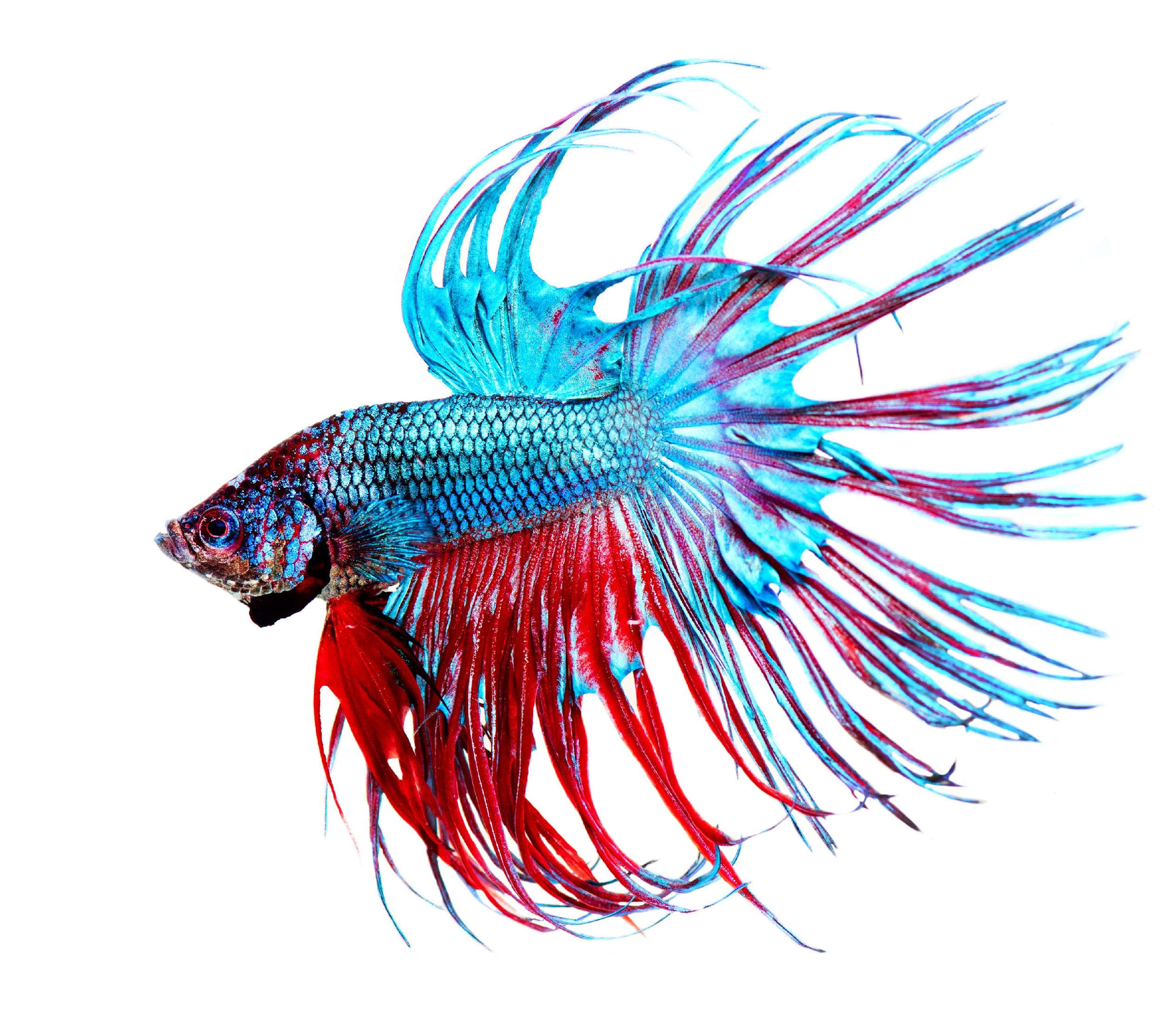
Individual: a single organism
Notes:
An individual is a single organism. This fish is an example of an individual organism.

Slide 7
Population: a group of the same types of organisms living in a certain area
Notes:
Population is a group of the types of organisms living in a certain area. So, one of these fish would be an individual, but a group of them would makes up a population.

Slide 8
Notes:
Now let’s pause for a moment to check your understanding.

Slide 9
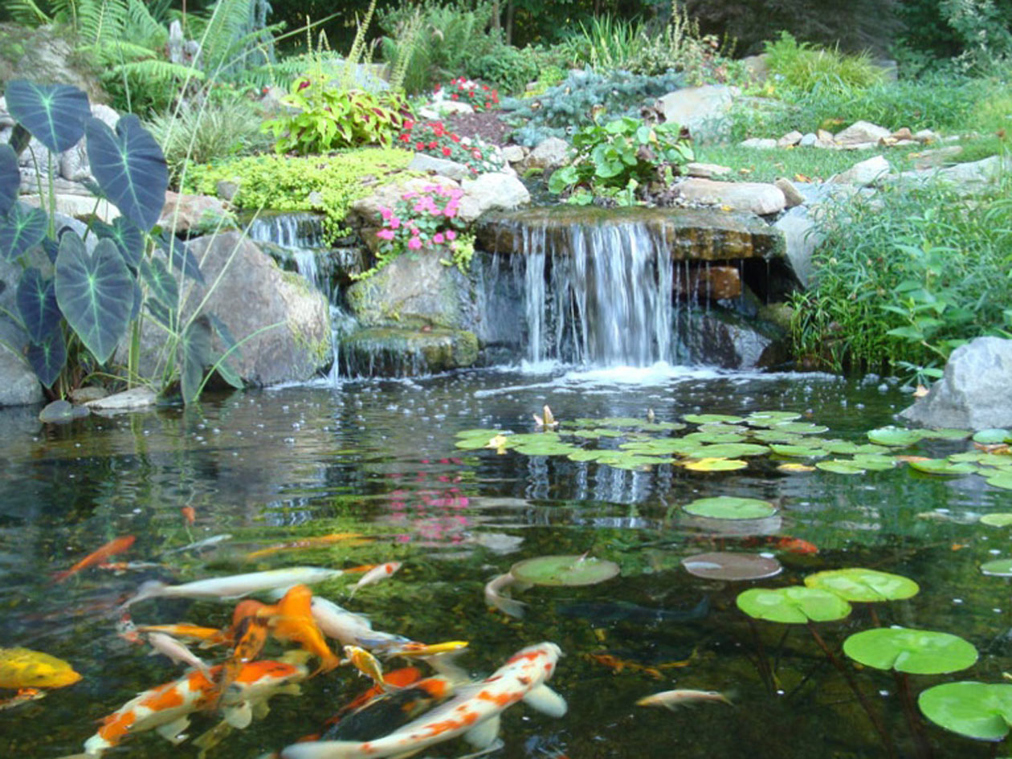
Why is this photo not an example of individuals?
Notes:
Why is this photo not an example of individuals?
[Because there are many different types of organisms in this picture.]

Slide 10
An organism is any
thing
Notes:
An organism is any ____________ thing.
[living]

Slide 11
An organism is any
living thing
Notes:
An organism is any [living] thing.

Slide 12
Describe the difference between an individual and a population.
Notes:
Describe the difference between an individual and a population.
[An individual is a single organism, and a population is a group of the same type of organism living in a certain area.]

Slide 13
Community
Notes:
Now that we’ve reviewed, let’s define community.

Slide 14
Community: a group of different populations living in the same place
Notes:
A community is a group of different populations living in the same place. All the animals in this photo are part of a community.

Slide 15
Notes:
Now let’s pause for a moment to check your understanding.

Slide 16
What is a community?
Notes:
What is a community?
[A community is a group of different populations living in the same place.]

Slide 17
Notes:
That is the basic definition, but there is a bit more you need to know.

Slide 18
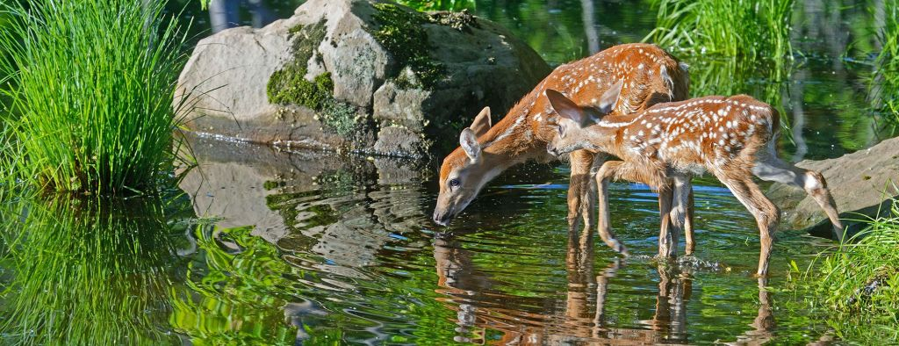
Only living things are part of a community.
Notes:
Only living things are part of a community.

Slide 19
So, these deer and grasses are part of this community because they are living things...
Notes:
So, these deer and grasses are part of this community because they are living things...

Slide 20
...but the rock and the water are not part of the community, because they are non-living things.
Notes:
...but the rock and the water are not part of the community, because they are non-living things.

Slide 21
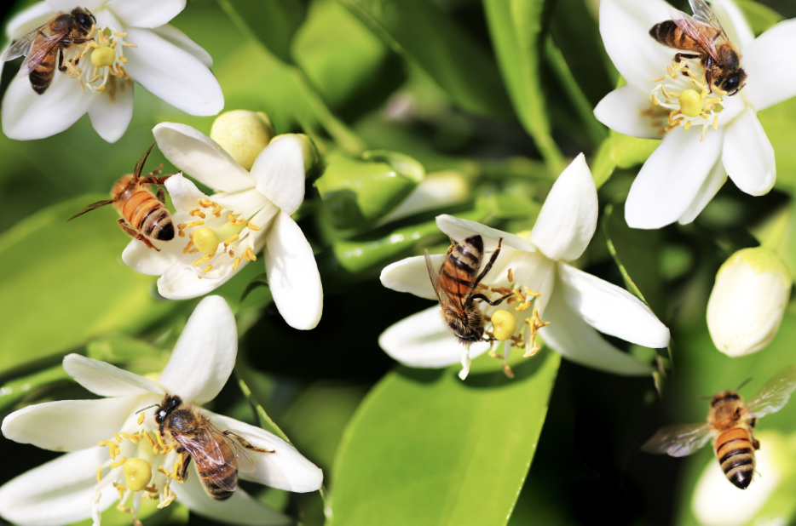
Communities work together to create a more secure environment for all that live in them.
Notes:
Communities work together to create a more secure environment for all that live in them.
Animal communities help maintain a balance in the environment by controlling populations of other species. Some animals and insects in communities help to provide food for humans and other animals, such as bees that provide pollen to plants in their communities. if there aren't enough bees in a community, to provide pollen to plants, it could make it harder for us to grow crops and have food to eat. This could also affect the other animals in the community that rely on those plants for food.
Additionally, when the population of living things changes in a community, it can affect the environment and the other living things in that community.
For example, if there are too many insects in a community, they might eat too many plants, which could make it harder for other animals to find food. This could cause some animals to move to a different area or even become in danger of dying out.

Slide 22
Notes:
Now, let’s talk about some examples of communities.

Slide 23
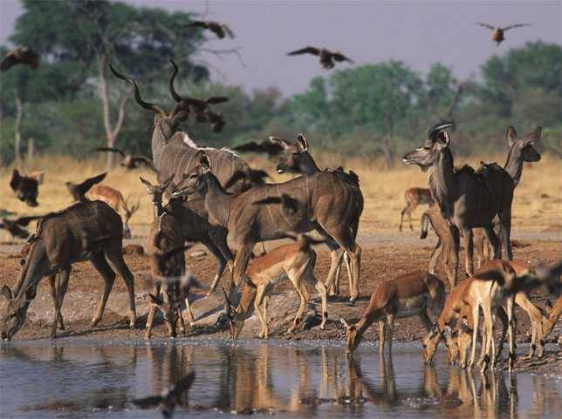
Animals at a watering hole are an example of a community.
Notes:
The animals at this watering hole are an example of a community because they are many different organisms living together.

Slide 24
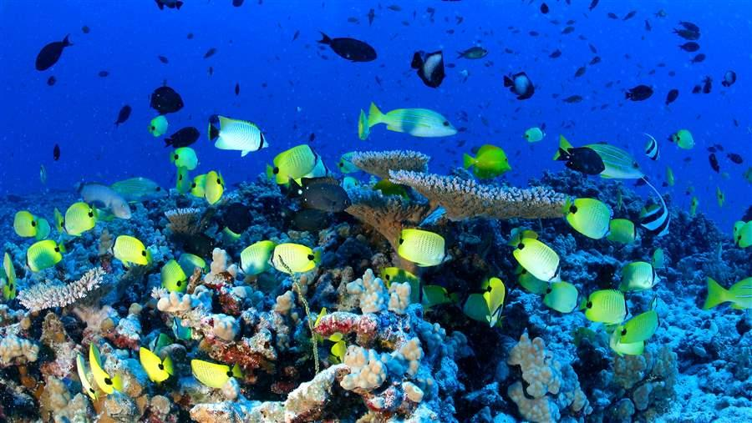
All the fish and coral are an example of a community
Notes:
All the fish and coral are an example of a community because there are many different living things living together.

Slide 25
Notes:
Let’s talk about some non-examples of communities.

Slide 26
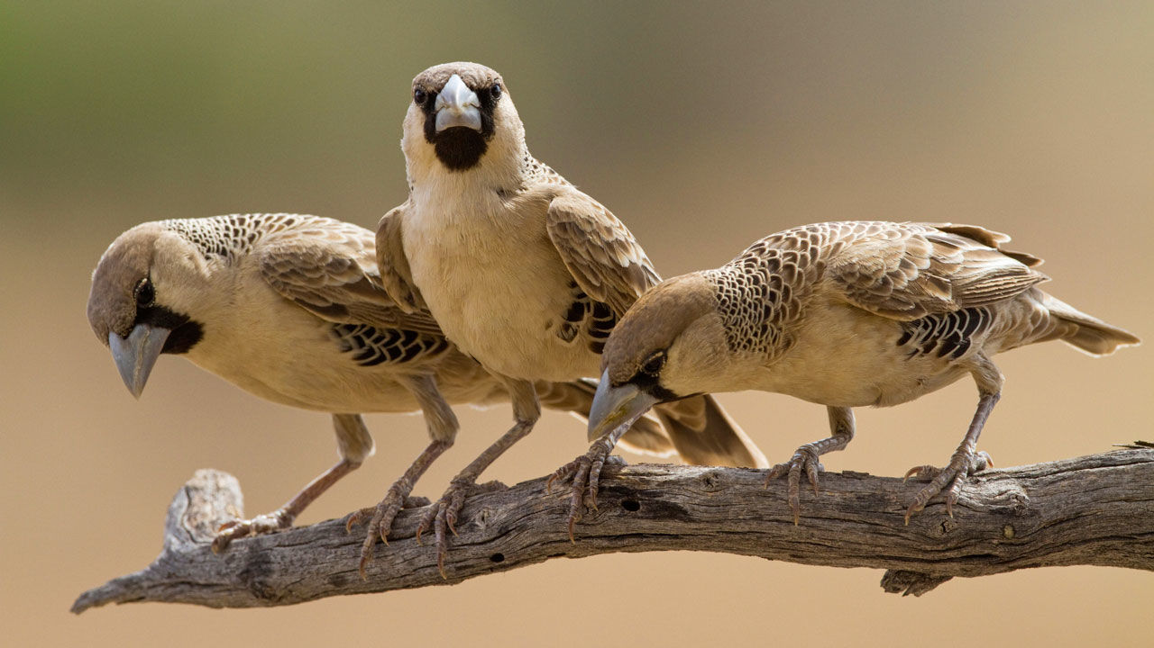
These birds are NOT an example
of a community because they are a group of organisms that are the same species.
Notes:
These birds are not an example of a community because they are a group of organisms that are the same species.

Slide 27
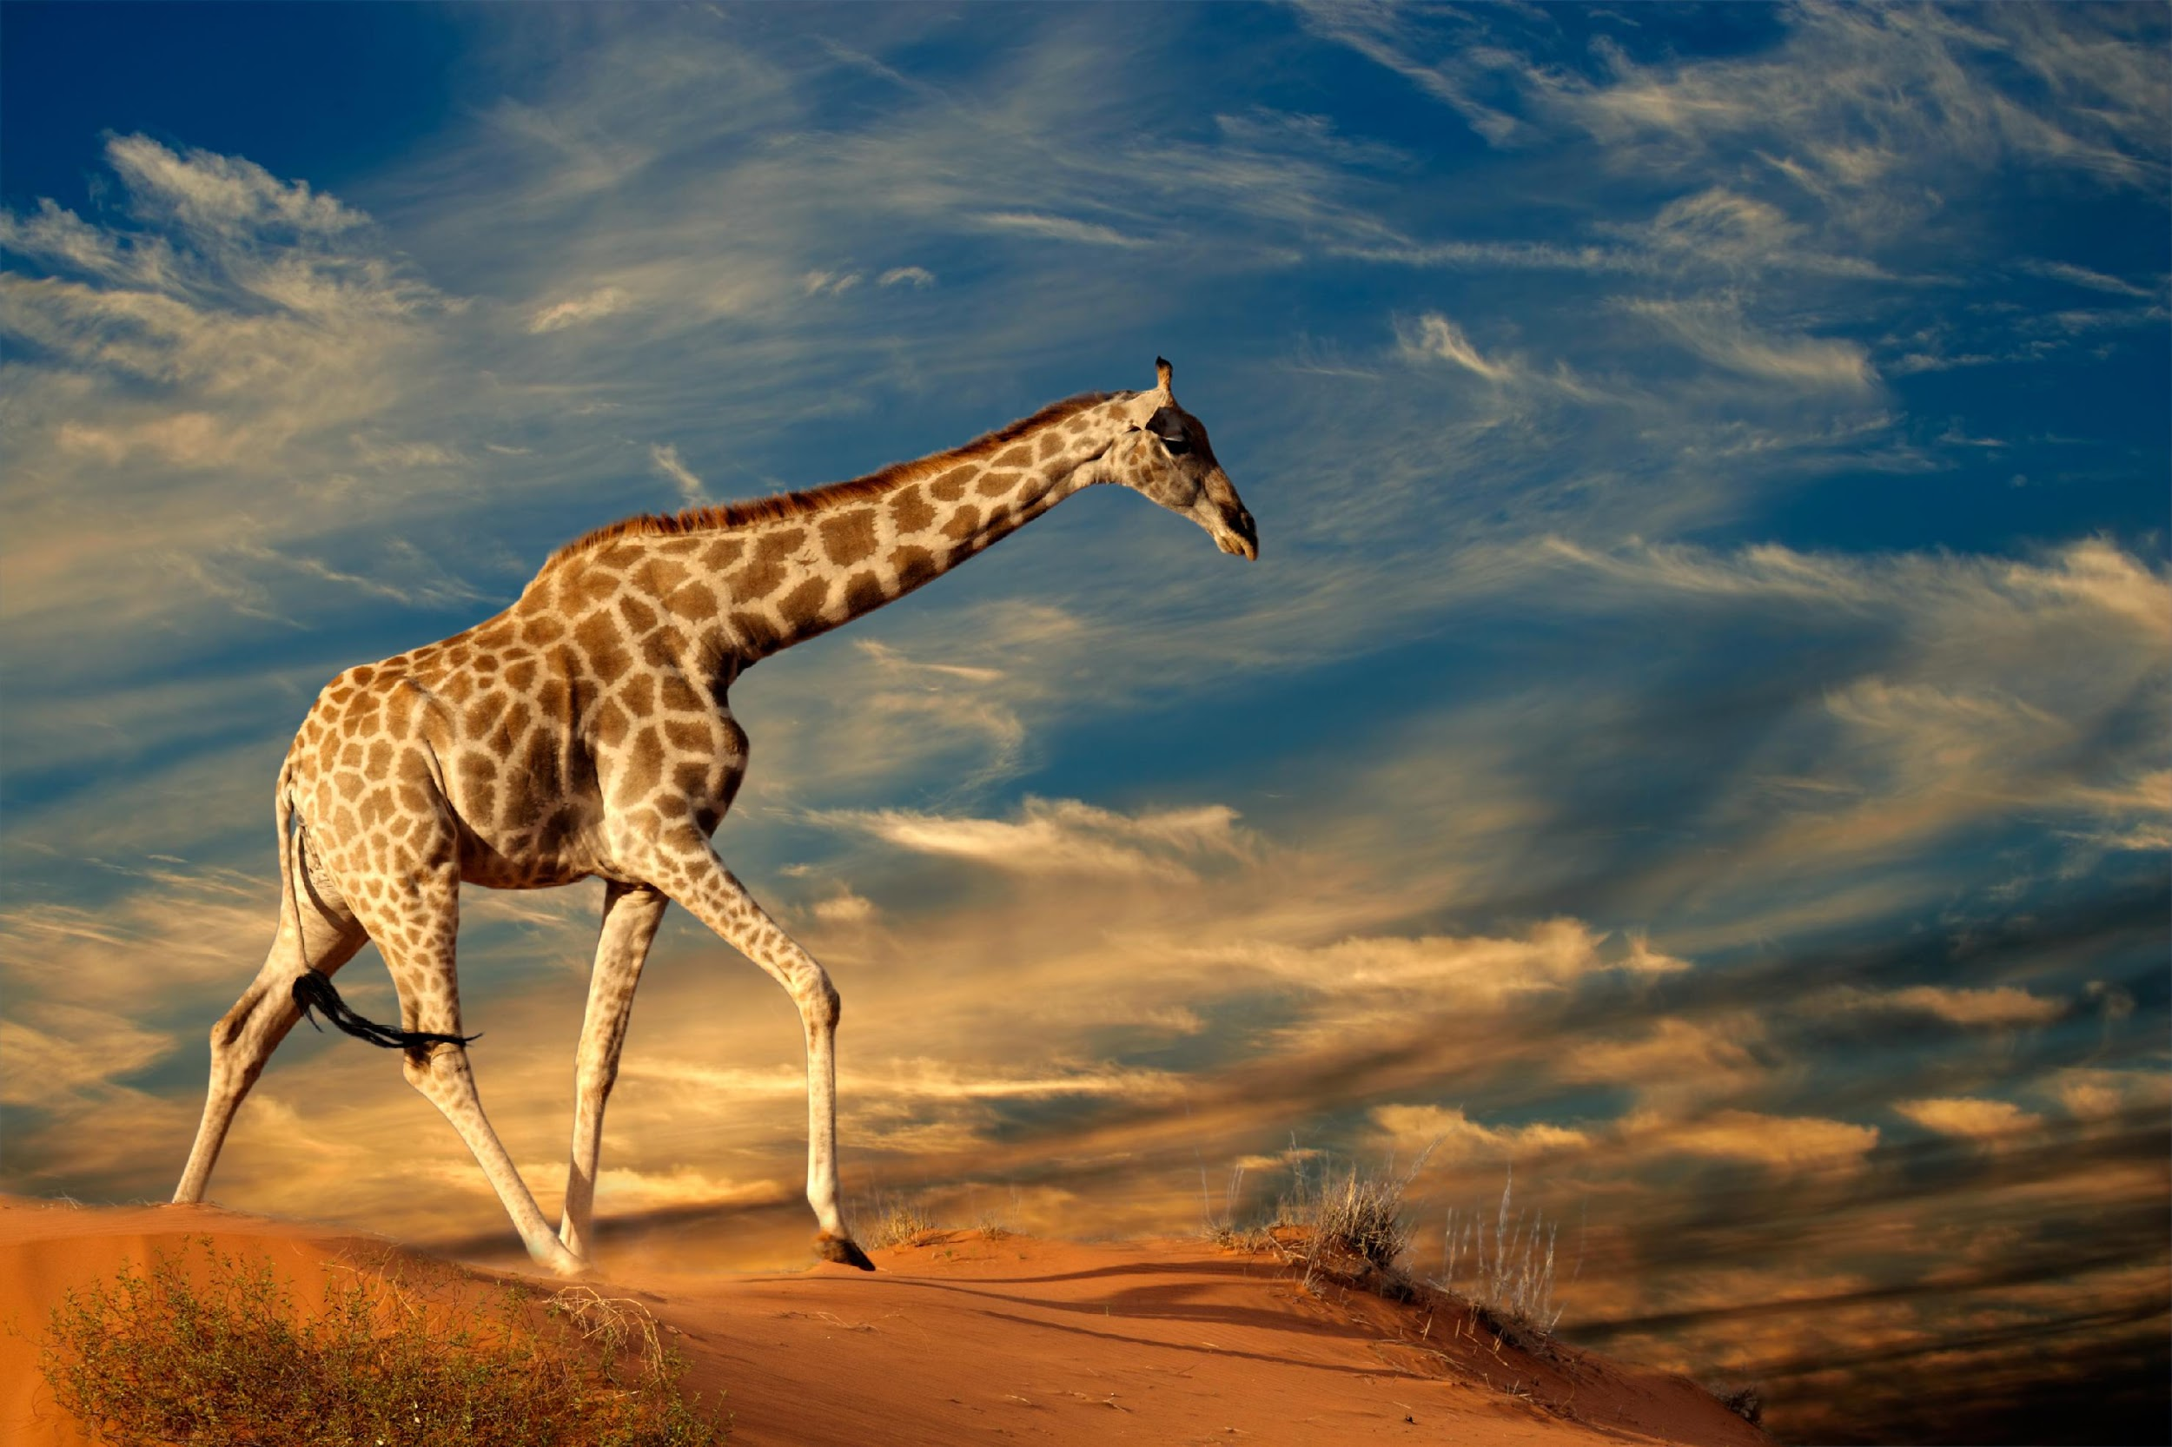
This is an individual giraffe and is NOT an example of a community.
Notes:
This is an individual giraffe and is NOT an example of a community.

Slide 28
Notes:
Now let’s pause for a moment to check your understanding.

Slide 29
True/False: These animals at a watering hole are an example of a community.
Notes:
The animals at this watering hole are an example of a community because they are many different organisms living together.

Slide 30
True/False: These animals at a watering hole are an example of a community.
Notes:
True, these animals at this watering hole are an example of a community because they are many different organisms living together.

Slide 31
True/False: This group of birds is an example of a community.
Notes:
True/False: This group of birds is an example of a community.

Slide 32
True/False: This group of birds is an example of a community.
Notes:
True/False: This group of birds is an example of a community.
[False – they are a population because they are the same type of bird.]

Slide 33
Explain the difference between an individual, a population, and a community.
Notes:
Explain the difference between an individual, a population, and a community.
[An individual is a single organism; a population is a group of the same type organism; and a community is a group of different populations living in the same place.]

Slide 34
Remember!!!
Notes:
So remember!

Slide 35
Community: a group of different populations living in the same place
Notes:
A community is a group of different populations living in the same place. All the animals in this photo are part of a community.

Slide 36
Only living things are part of a community.
Notes:
Only living things are part of a community.

Slide 37
Notes:
We will now complete this concept map, called a Frayer model, to summarize and further clarify what you have learned about the term community.

Slide 38
Definition
Picture
Community
Example
How do communities impact my life?
Notes:
To complete the Frayer model, we will choose from four choices the correct picture, definition, example, and response to the question, “How do communities impact my life?” Select the best response for each question using the information you just learned. As we select responses, we will see how this model looks filled in for the term community.

Slide 39
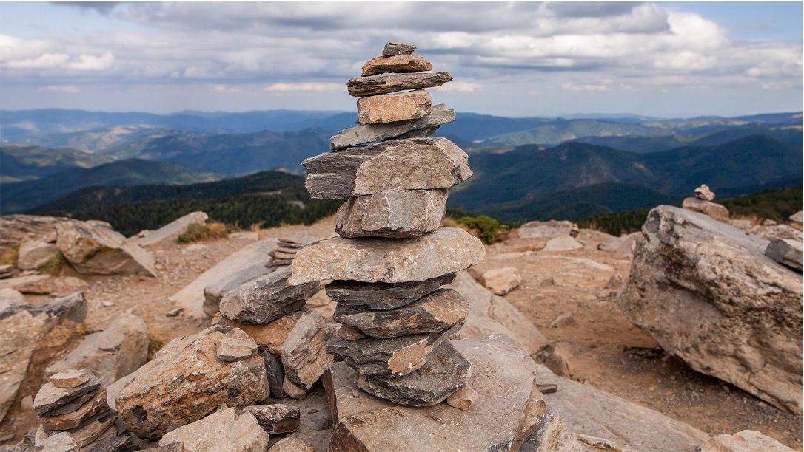
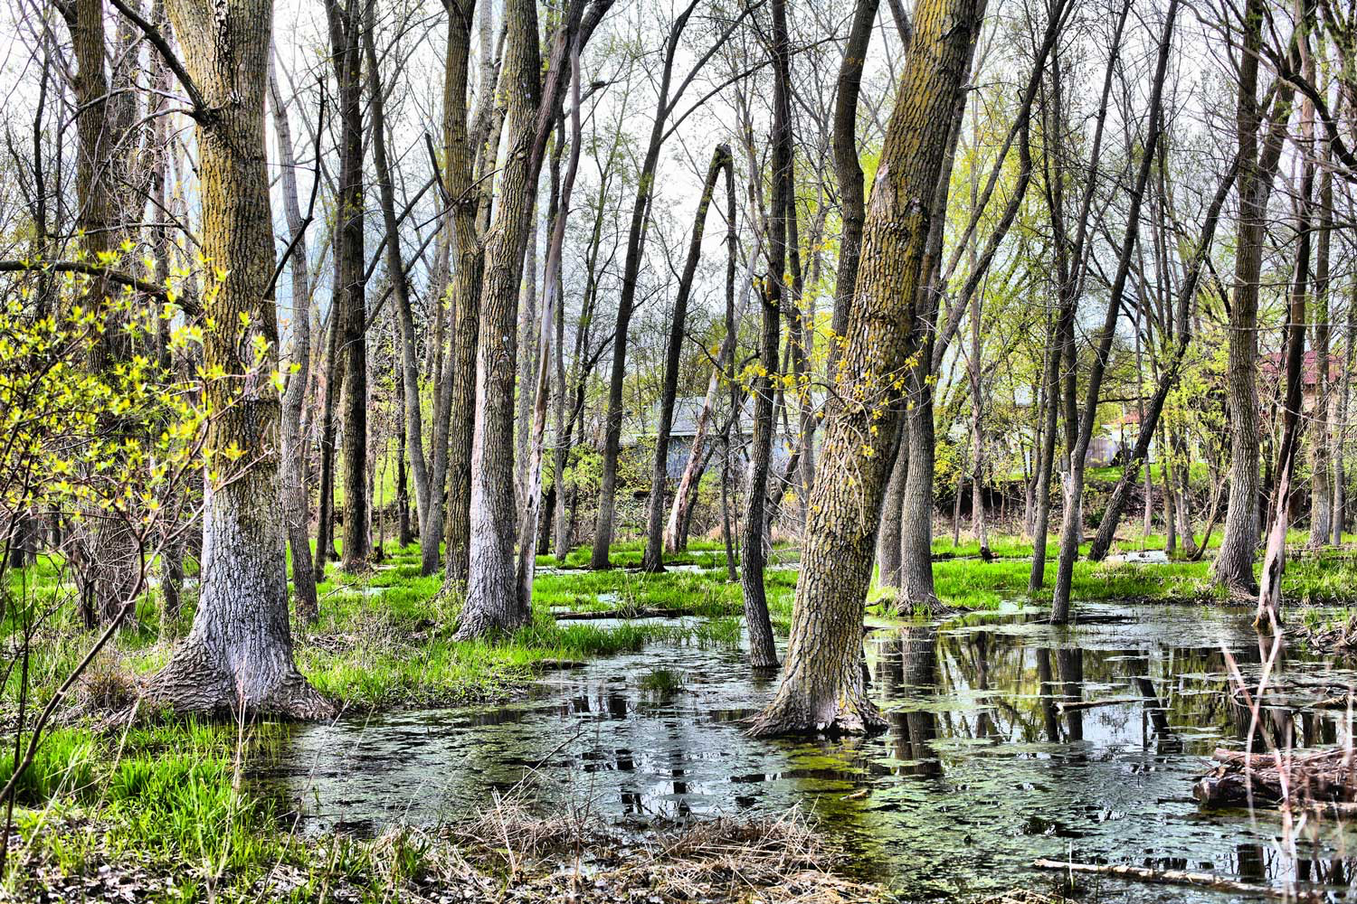
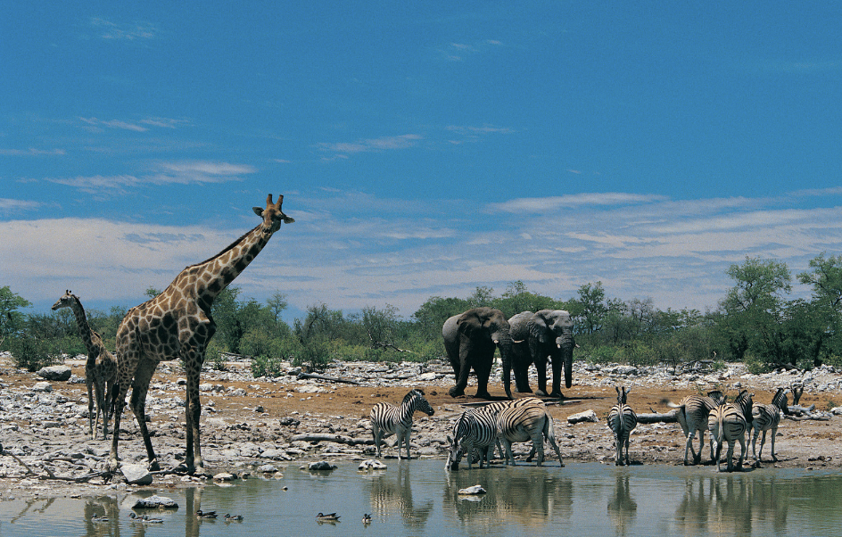
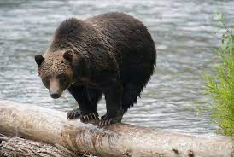
Directions: Choose the correct picture of a community from the choices below.
A
B
C
D
Notes:
Choose the one correct picture of a community from these four choices and drag and place it in the picture box below.

Slide 40
Directions: Choose the correct picture of a community from the choices below.
A
B
C
D
Notes:
You are correct! The picture of different animals at a watering hole and is a picture of a community.

Slide 41
Definition
Picture
Community
Example
How do communities impact my life?
Notes:
Here is the Frayer model filled in with a picture of many different animals living in the same place.

Slide 42
Directions: Choose the correct definition of a community from the choices below.
A
Things do not grow or reproduce and do not need food.
B
A group of the same types of organisms within a certain area
C
Necessary life process that transforms light energy into chemical energy
D
A group of different populations living in the same place
Notes:
Choose the one correct definition of community from these four choices.

Slide 43
Directions: Choose the correct definition of a community from the choices below.
A
Things do not grow or reproduce and do not need food.
B
A group of the same types of organisms within a certain area
C
Necessary life process that transforms light energy into chemical energy
D
A group of different populations living in the same place
Notes:
You are correct! A community is a groups of different populations living in the same place.

Slide 44
Definition
Picture
A group of different populations living in the same place
Community
Example
How do communities impact my life?
Notes:
Here is the Frayer model filled in with a picture of and the definition of community: a group of different populations living in the same place.

Slide 45
Directions: Choose the correct example of a community thing from the choices below.
A
A person living by himself
B
A group of giraffes, deer, and elephants living on a field.
C
A place where nothing lives there
D
A group of bisons
Notes:
Choose the one correct example of a community from these four choices

Slide 46
Directions: Choose the correct example of a community thing from the choices below.
A
A person living by himself
B
A group of giraffes, deer, and elephants living on a field.
C
A place where nothing lives there
D
A group of bisons
Notes:
You are correct! A group of giraffes deer, and elephants living on a filed is an example of a community.

Slide 47
Definition
Picture
A group of different populations living in the same place
Community
A group of giraffes, deers, and elephants living on a field.
Example
How do communities impact my life?
Notes:
Here is the Frayer model filled in with a picture of, the definition of, and an example of a community: a group of giraffes, deer, and elephants living on a field.

Slide 48
Directions: Choose the correct response for “how does community impact my life?” from the choices below.
A
Living in a community makes me move faster.
Living in a community makes me feel connected with my neighbors. We also help take care of each other and where we live.
B
C
Living in a community makes allows me to be alone all the time
D
Living in a community means I don’t have to go to school
Notes:
Choose the one correct response for “how does community impact my life?” from these four choices

Slide 49
Directions: Choose the correct response for “how does community impact my life?” from the choices below.
A
Living in a community makes me move faster.
B
Bees and other living things in our community help plants to grow and help to provide food for me to eat.
C
Living in a community makes allows me to be alone all the time
D
Living in a community means I don’t have to go to school
Notes:
Choose the one correct response for “how does community impact my life?” from these four choices

Slide 50
Directions: Choose the correct response for “how does community impact my life?” from the choices below.
A
Living in a community makes me move faster.
B
Bees and other living things in our community help plants to grow and help to provide food for me to eat.
C
Living in a community makes allows me to be alone all the time
D
Living in a community means I don’t have to go to school
Notes:
You are correct! Animals and other living things in our community help to provide food for me to eat.

Slide 51
Definition
Picture
A group of different populations living in the same place
Community
A group of giraffes, deers, and elephants living on a field.
Bees and other living things in our community help plants to grow and help to provide food for me to eat.
Example
How do communities impact my life?
Notes:
Here is the completed Frayer model for community. It is filled in with a picture of, the definition of, an example of, and a correct response to “how do communities impact my life?”: Bees and other living things in our community help plants to grow and help to provide food for me to eat.

Slide 52
Remember!!!
Notes:
So remember!

Slide 53
Community: a group of different populations living in the same place
Notes:
A community is a group of different populations living in the same place. All the animals in this photo are part of a community.

Slide 54
Only living things are part of a community.
Notes:
Only living things are part of a community.

Slide 55
Big Question: How do living things work together in a community?
Notes:
Now that we’ve learned the term, community, let’s reflect once more on our big question. Our “big question” is: How do living things work together in a community?
Does anyone have any additional examples to share that haven’t been discussed yet?

Slide 56
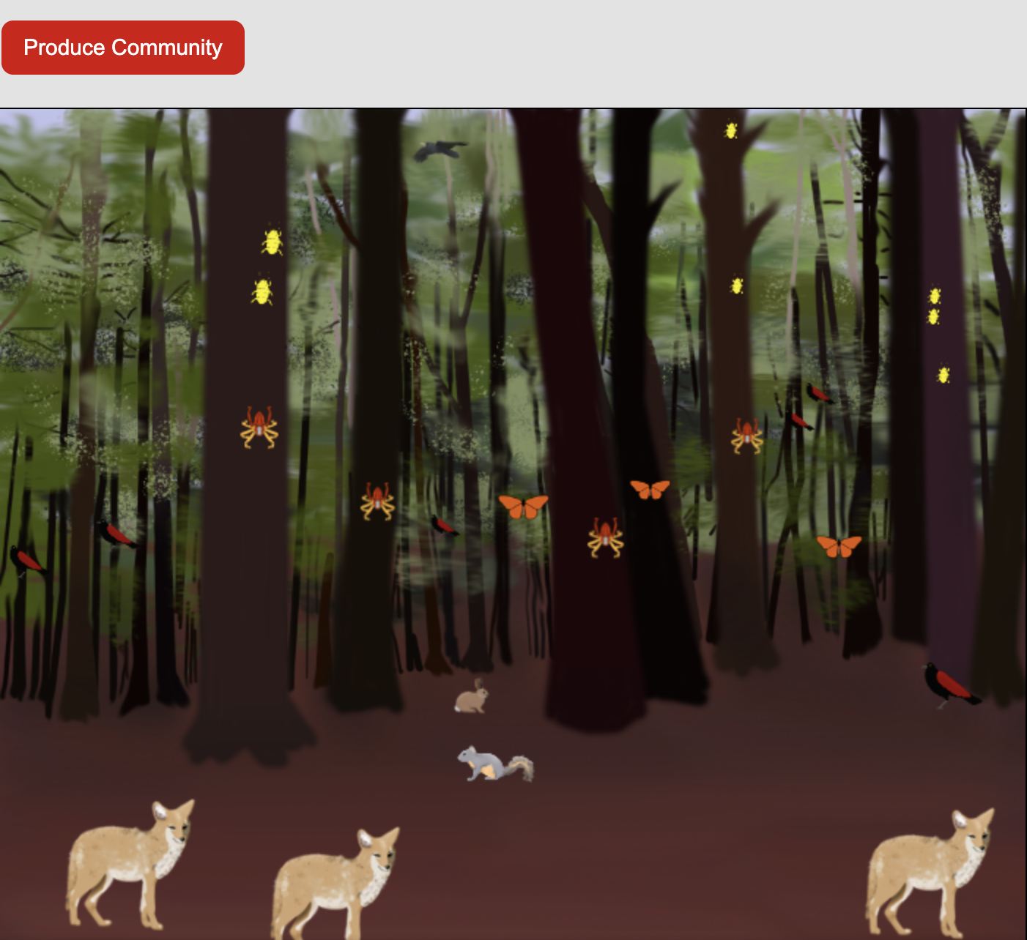
Simulation Activity
Produce a community
Click the link above for a simulation to deepen your understanding of community.
Notes:
Click the link above for a simulation to deepen your understanding of community.
Feedback: Providing a simulation activity is a great way to make science thinking visible. In this simulation, students have the opportunity to make predictions and apply an idea to a new situation by changing the variables in the simulation (i.e., the amount of different living things present in the simulated community).

Slide 57
Notes:
Thanks for watching!

Slide 58
This Video Was Created With Resources From:
Questions or Comments
Michael Kennedy, Ph.D. MKennedy@Virginia.edu
Rachel L Kunemund, Ph.D. rk8vm@virginia.edu

