Slide 1
Intro
“Big Idea” Question
Review Concepts
Check-In Questions
Teacher Engagement
Vocabulary
Student-Friendly Definition
Examples & Non-Examples
Frayer Model
Simulation/Activity
Notes:
OK everyone, get ready for our next lesson. Just as a reminder, these are the different components that our lesson may include, and you’ll see these icons in the top left corner of each slide so that you can follow along more easily!

Slide 2
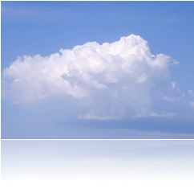
Condensation
Intro
Intro
Notes:
Today we are going to learn about condensation.

Slide 3
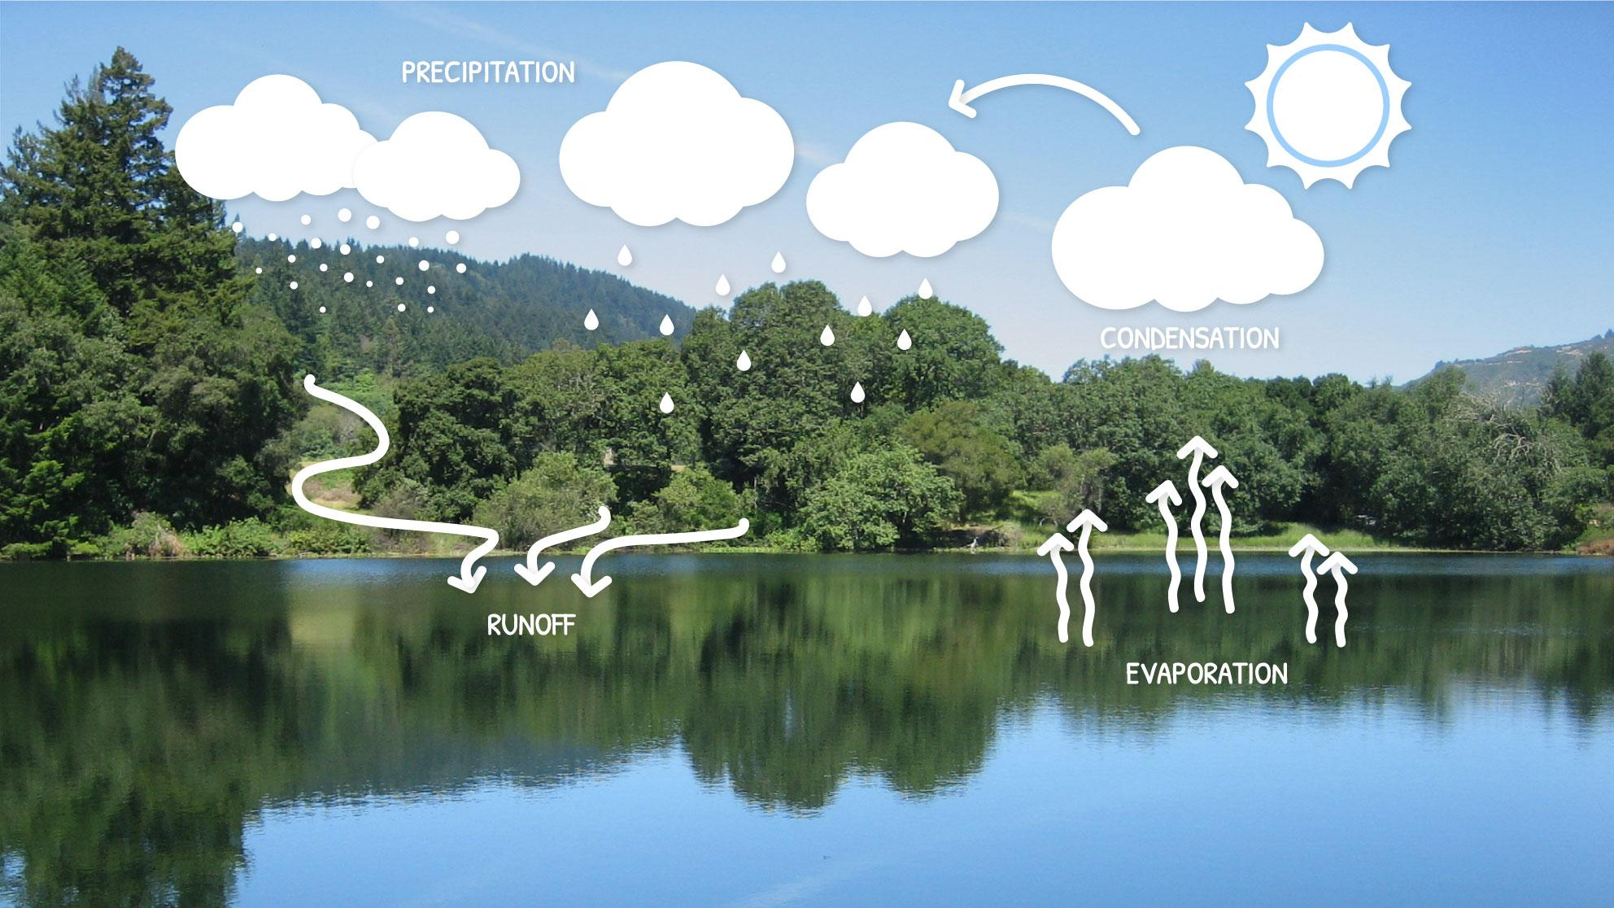
Big Question: How does water move throughout Earth’s atmosphere?
Notes:
Our “big question” is: How does water move throughout Earth’s atmosphere?
[Pause and illicit predictions from students.]
I love all these thoughtful scientific hypotheses! Be sure to keep this question and your predictions in mind as we move through these next few lessons, and we’ll continue to revisit it.

Slide 4
Notes:
Before we move on to our new vocabulary term, let’s review some other words & concepts that you already learned and make sure you are firm in your understanding.

Slide 5
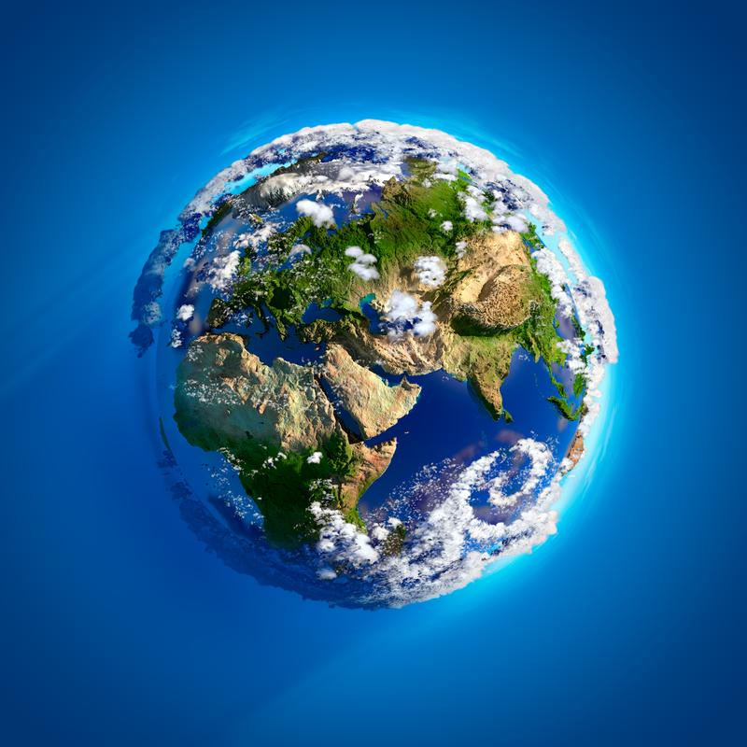
Atmosphere: the layers of gas surrounding the Earth’s surface
Notes:
Atmosphere is the layers of gas surrounding the Earth’s surface. Sometimes, the atmosphere is called a “blanket” of gases.

Slide 6
Cycles: events that happen in the same order over and over again
Notes:
Much of life on Earth depends on cycles. Cycles are events that happen in the same order over and over again. The end of one cycle marks the beginning of another.

Slide 7
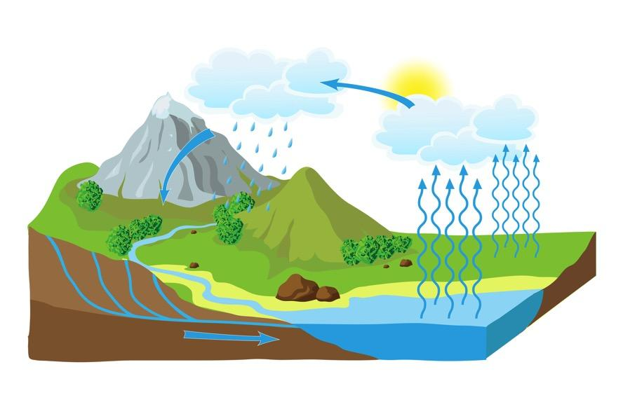
Water Cycle: the process through which water moves from Earth through the atmosphere and returns to Earth
Notes:
The water cycle is the process through which water moves from Earth through the atmosphere and returns to Earth

Slide 8
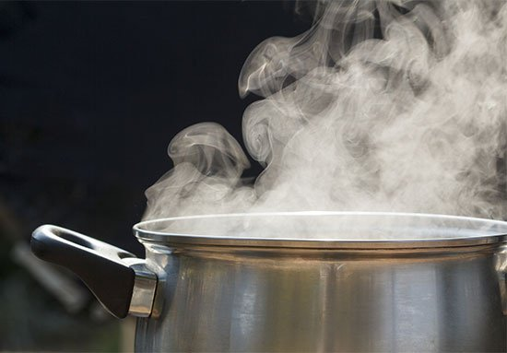
Water Vapor: an invisible gas that is made up of heated water particles
Notes:
Water Vapor is an invisible gas that is made up of heated water particles.

Slide 9
Clouds: groups of cooled water vapor that have turned into water droplets in the sky
Notes:
Clouds are groups of cooled water vapor that have turned into water droplets in the sky.

Slide 10
Notes:
Now let’s pause for a moment to check your understanding.

Slide 11
True or False: The Water Cycle is the process through which water moves from Earth through the atmosphere and returns to Earth
True
False
Notes:
True or false: The Water Cycle is the process through which water moves from Earth through the atmosphere and returns to Earth.
[A. True]

Slide 12
True or False: The Water Cycle is the process through which water moves from Earth through the atmosphere and returns to Earth
True
False
Notes:
True or false: The Water Cycle is the process through which water moves from Earth through the atmosphere and returns to Earth.
[A. True]

Slide 13
Clouds are groups of _______ water vapor that have turned into water droplets in the sky.
Cooled
Warmed
Notes:
Clouds are groups of _________ water vapor that have turned into water droplets in the sky.
[A. Cooled]

Slide 14
Clouds are groups of _______ water vapor that have turned into water droplets in the sky.
Cooled
Warmed
Notes:
Clouds are groups of _________ water vapor that have turned into water droplets in the sky.
[A. Cooled]

Slide 15
Condensation
Notes:
Now that we’ve reviewed, let’s define our new term, condensation.

Slide 16
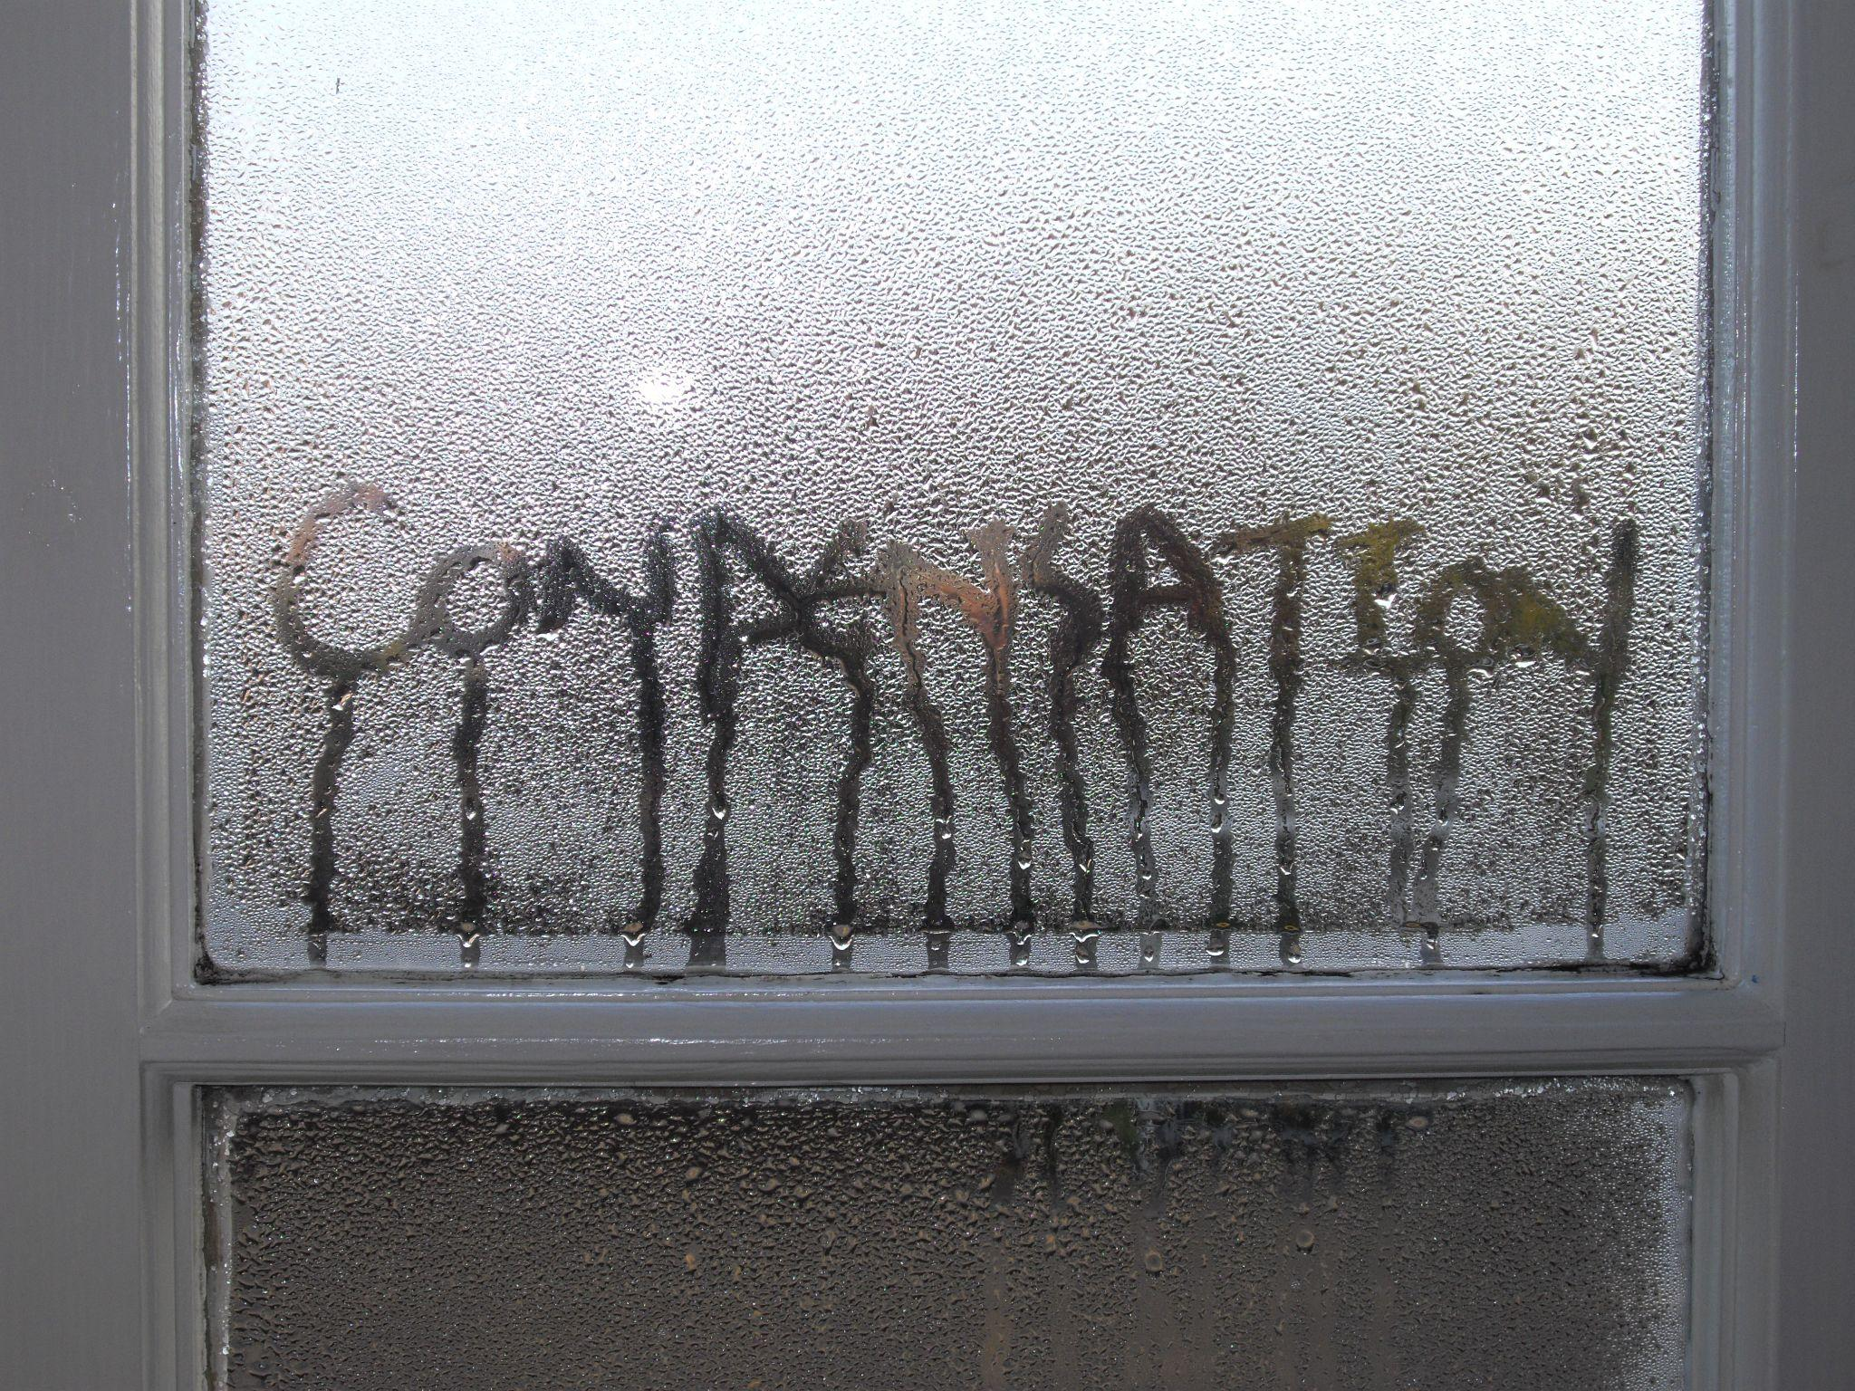
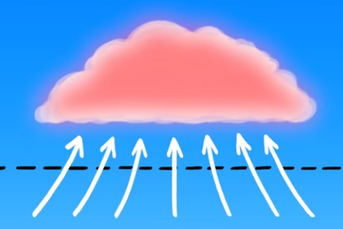
Intro
Condensation: when water vapor in the air cools down and turns back into tiny water droplets
Notes:
Condensation is when water vapor in the air cools down and turns back into tiny water droplets. In the water cycle, this results in clouds.

Slide 17
Notes:
Now let’s pause for a moment to check your understanding.

Slide 18
What is condensation?
Intro
Notes:
Condensation is when water vapor in the air cools down and turns back into tiny water droplets. In the water cycle, this results in clouds.

Slide 19
Notes:
That is the basic definition, but there is a bit more you need to know.

Slide 20
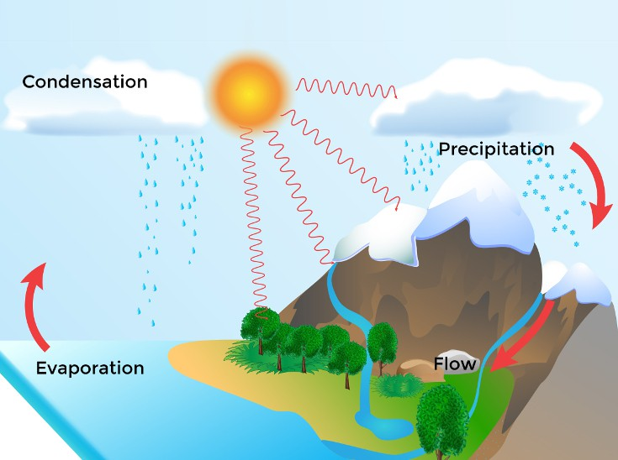
Condensation is a key step in the water cycle that helps make clouds. When the sun warms up water from oceans, lakes, and rivers, it turns into invisible water vapor and rises up into the sky.
Notes:
Condensation is a key step in the water cycle that helps make clouds. When the sun warms up water from oceans, lakes, and rivers, it turns into invisible water vapor and rises up into the sky.

Slide 21
Then, as this water vapor cools down high up in the air, it changes back into tiny water droplets through condensation. These tiny droplets come together to form clouds.
Notes:
Then, as this water vapor cools down high up in the air, it changes back into tiny water droplets through condensation. These tiny droplets come together to form clouds.

Slide 22
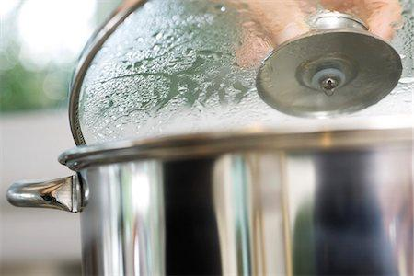
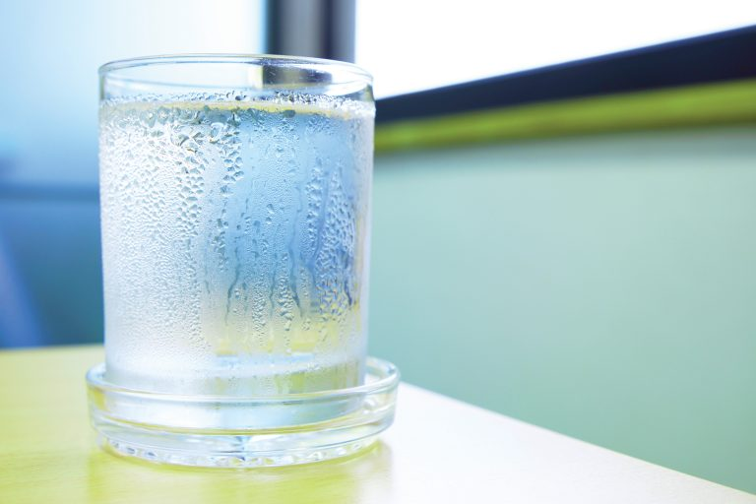
Condensation also happens when water vapor is heated up in other processes, like water droplets collecting on a pot lid when cooking or on the outside of a cold drink on a hot day.
Notes:
Condensation also happens when water vapor is heated up in other processes, like water droplets collecting on a pot lid when cooking or on the outside of cold drink on a hot day.

Slide 23
Notes:
Let’s check-in for understanding.

Slide 24
True or False: Condensation is a key step in the water cycle that helps make clouds.
True
False
Notes:
True or False: Condensation is a key step in the water cycle that helps make clouds.
[True]

Slide 25
True or False: Condensation is a key step in the water cycle that helps make clouds.
True
False
Notes:
True or False: Condensation is a key step in the water cycle that helps make clouds.
[True]

Slide 26
Condensation happens when water vapor ______ ______ into water droplets, either in the sky as clouds or on things like the outside of cool drinks on hot days.
heats up
cools down
Notes:
Condensation happens when water vapor ____ _____ into water droplets, either in the sky as clouds or on things like the outside of cool drinks on hot days.
[B. cools down]

Slide 27
Condensation happens when water vapor ______ ______ into water droplets, either in the sky as clouds or on things like the outside of cool drinks on hot days.
heats up
cools down
Notes:
Condensation happens when water vapor ____ _____ into water droplets, either in the sky as clouds or on things like the outside of cool drinks on hot days.

Slide 28
Notes:
Now, let’s talk about some examples of the condensation.

Slide 29
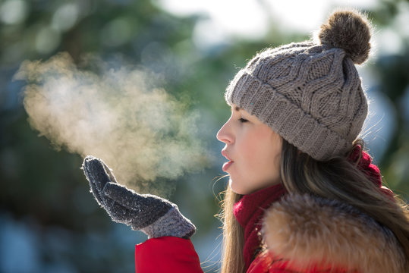
Breathing when it is cold outside is an example of condensation. The hot water vapor from your body is released into the cold air and creates tiny water droplets that you can see.
Notes:
Breathing when it is cold outside is an example of condensation. The hot water vapor from your body is released into the cold air and creates tiny water droplets that you can see.

Slide 30
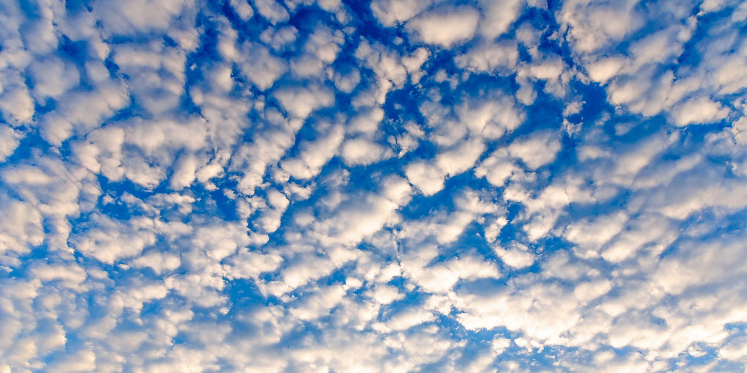
Clouds are an example of condensation. This is when water vapor cools down into water droplets in the sky.
Notes:
Clouds are an example of condensation. This is when water vapor cools down into water droplets in the sky.

Slide 31
Notes:
Next, let’s talk about some non-examples of condensation.

Slide 32
Rain is not an example of condensation. This is when water droplets fall to Earth when the atmosphere is warmer, and is an example of precipitation.
Notes:
Rain is not an example of condensation. This is when water droplets fall to Earth when the atmosphere is warmer, and is an example of precipitation.

Slide 33
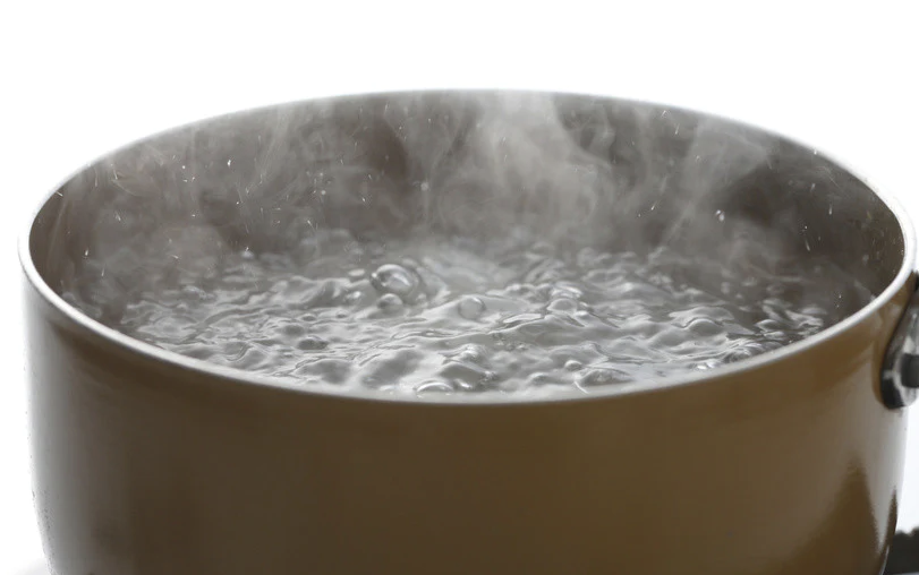
Boiling water is not an example of condensation. The water heats up and creates water vapor as it goes into the air. This is an example of evaporation.
Notes:
Boiling water is not an example of condensation. The water heats up and creates water vapor as it goes into the air. This is an example of evaporation.

Slide 34
Notes:
Now let’s pause for a moment to check your understanding.

Slide 35
Why is boiling water not an example of condensation but the water on a pot lid is?
Notes:
Why is boiling water not an example of condensation but the water on a pot lid is?
[Boiling water is when water is heated up into water vapor, the water on a pot lid is when water vapor has cooled down into water droplets.]

Slide 36
Remember!!!
Notes:
So remember!

Slide 37
Condensation: when water vapor in the air cools down and turns back into tiny water droplets
Notes:
Condensation is when water vapor in the air cools down and turns back into tiny water droplets.

Slide 38
Notes:
We can also break down the term condensation into different word parts to help us remember the meaning. Let’s take a look!

Slide 39
Condensation
Condens -ation
(root word)
(suffix)
Notes:
The word “condensation” can be broken down into two parts. The root word, “condens”, and the suffix, “-ation.”

Slide 40
Condensation
Condens -ation
to thicken
Notes:
The root word, condens, means ”to thicken.”

Slide 41
Condensation
Condes -ation
result of an action
Notes:
The suffix, -ation, means “result of an action.”

Slide 42
Condens -ation
Condensation
The act of water thickening
Notes:
So, when you add the suffix “-ation” to the root word “condens” it means “the act of water thickening”

Slide 43
Notes:
Let’s check-in for understanding.

Slide 44
How can we use the word parts of condensation to help us remember the definition of the term?
Condensation
Condens ation
Notes:
How can we use the word parts of condensation to help us remember the definition of the term?
[Condens = to thicken
ation = the result of an action
Condensation means the act of water thickening.]

Slide 45
Remember!!!
Notes:
So remember!

Slide 46
Condensation: when water vapor in the air cools down and turns back into tiny water droplets
Notes:
Condensation is when water vapor in the air cools down and turns back into tiny water droplets.

Slide 47
Notes:
We will now complete this concept map, called a Frayer model, to summarize and further clarify what you have learned about the term condensation.

Slide 48
Definition
Picture
Condensation
Example
How does condensation impact my life?
Notes:
To complete the Frayer model, we will choose from four choices the correct picture, definition, example, and response to the question, “How does condensation impact my life?” Select the best response for each question using the information you just learned. As we select responses, we will see how this model looks filled in for the term condensation.

Slide 49
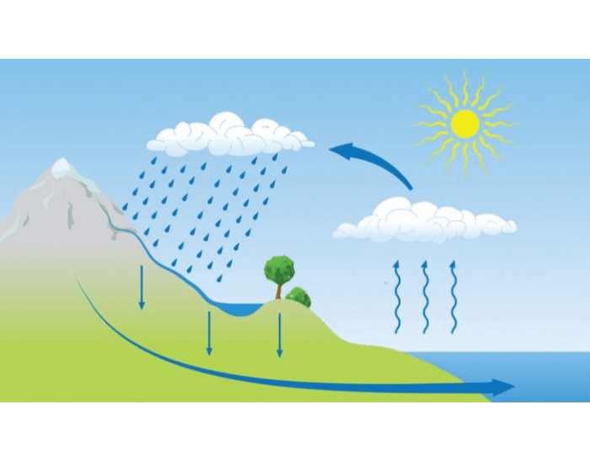
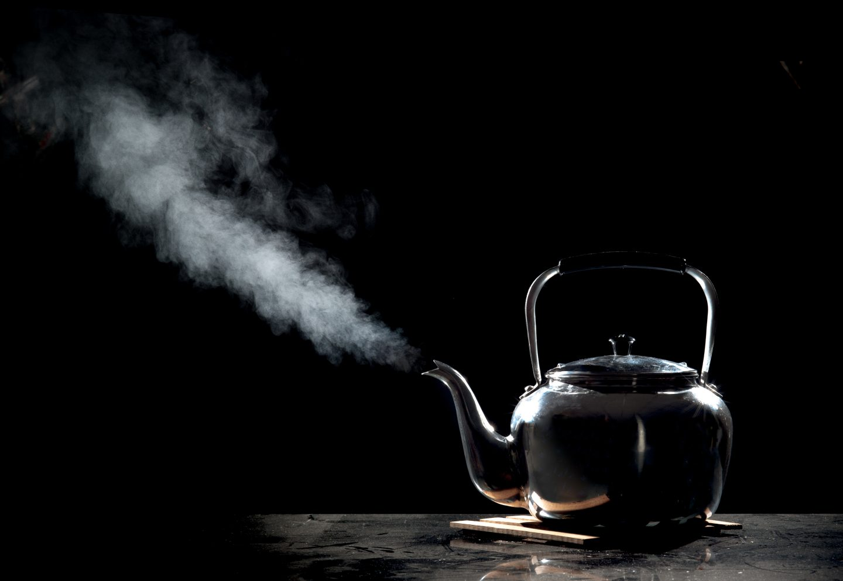
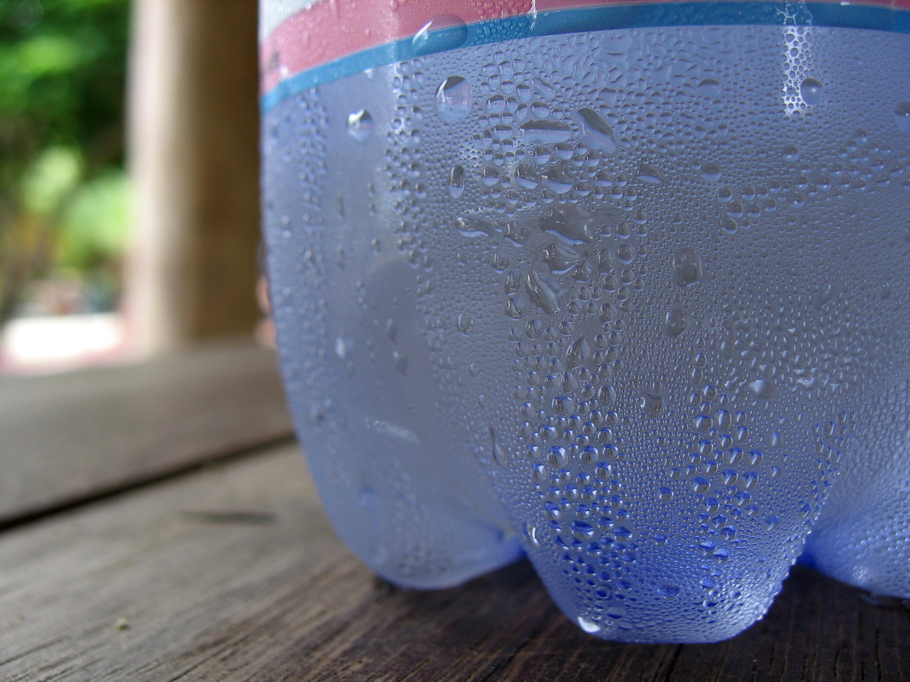
Directions: Choose the correct picture of condensation from the choices below.
A
B
C
D
Notes:
Choose the one correct picture of condensation from these four choices.

Slide 50
Directions: Choose the correct picture of condensation from the choices below.
A
B
C
D
Notes:
This is the correct picture of condensation.

Slide 51
Definition
Picture
Condensation
Example
How does condensation impact my life?
Notes:
Here is the Frayer model filled in with a picture of condensation.

Slide 52
Directions: Choose the correct definition of condensation from the choices below.
A
The breaking of a rock from frozen water
B
How water moves through the Earth’s atmosphere
C
The edge of a continent underwater
D
When water vapor in the air cools down and turns back into tiny water droplets
Notes:
Choose the one correct definition of condensation from these four choices.

Slide 53
Directions: Choose the correct definition of condensation from the choices below.
A
The breaking of a rock from frozen water
B
How water moves through the Earth’s atmosphere
C
The edge of a continent underwater
D
When water vapor in the air cools down and turns back into tiny water droplets
Notes:
“When water vapor in the air cools down and turns back into tiny water droplets” is correct! This is the definition of condensation.

Slide 54
Definition
Picture
When water vapor in the air cools down and turns back into tiny water droplets
Condensation
Example
How does condensation impact my life?
Notes:
Here is the Frayer Model with a picture and the definition filled in for condensation: When water vapor in the air cools down and turns back into tiny water droplets.

Slide 55
Directions: Choose the correct example of condensation from the choices below.
A
Clouds
B
Wind
C
Snow
D
Sunshine
Notes:
Choose the one correct example of condensation from these four choices.

Slide 56
Directions: Choose the correct example of condensation from the choices below.
A
Clouds
B
Wind
C
Snow
D
Sunshine
Notes:
“Clouds” is correct! This is an example of condensation.

Slide 57
Definition
Picture
When water vapor in the air cools down and turns back into tiny water droplets
Condensation
Clouds
Example
How does condensation impact my life?
Notes:
Here is the Frayer Model with a picture, definition, and an example of condensation: Clouds.

Slide 58
Directions: Choose the correct response for “how does condensation impact my life?” from the choices below.
A
Condensation explains how the movement of water shapes valleys and other geographic features on our planet.
B
Condensation helps make clouds that give us water for drinking, growing plants, and filling up rivers and lakes.
C
Condensation shows how water is released into outer space to help make sure Earth always has water on it.
D
Condensation creates an environment in which water can freeze into ice which helps cool the planet.
Notes:
Choose the one correct response for “how does condensation impact my life?” from these four choices.

Slide 59
Directions: Choose the correct response for “how does condensation impact my life?” from the choices below.
A
Condensation explains how the movement of water shapes valleys and other geographic features on our planet.
B
Condensation helps make clouds that give us water for drinking, growing plants, and filling up rivers and lakes.
C
Condensation shows how water is released into outer space to help make sure Earth always has water on it.
D
Condensation creates an environment in which water can freeze into ice which helps cool the planet.
Notes:
You chose “Condensation helps make rain clouds that give us water for drinking, growing plants, and filling up rivers and lakes.” That is correct! This is an example of how condensation impacts your life.

Slide 60
Definition
Picture
When water vapor in the air cools down and turns back into tiny water droplets
Condensation
Condensation helps make rain clouds that give us water for drinking, growing plants, and filling up rivers and lakes.
Clouds
Example
How does condensation impact my life?
Notes:
Here is the Frayer Model with a picture, definition, example, and a correct response to “how does condensation impact my life?”: Condensation helps make rain clouds that give us water for drinking, growing plants, and filling up rivers and lakes.

Slide 61
Remember!!!
Notes:
So remember!

Slide 62
Condensation: when water vapor in the air cools down and turns back into tiny water droplets
Notes:
Condensation is when water vapor in the air cools down and turns back into tiny water droplets.

Slide 63
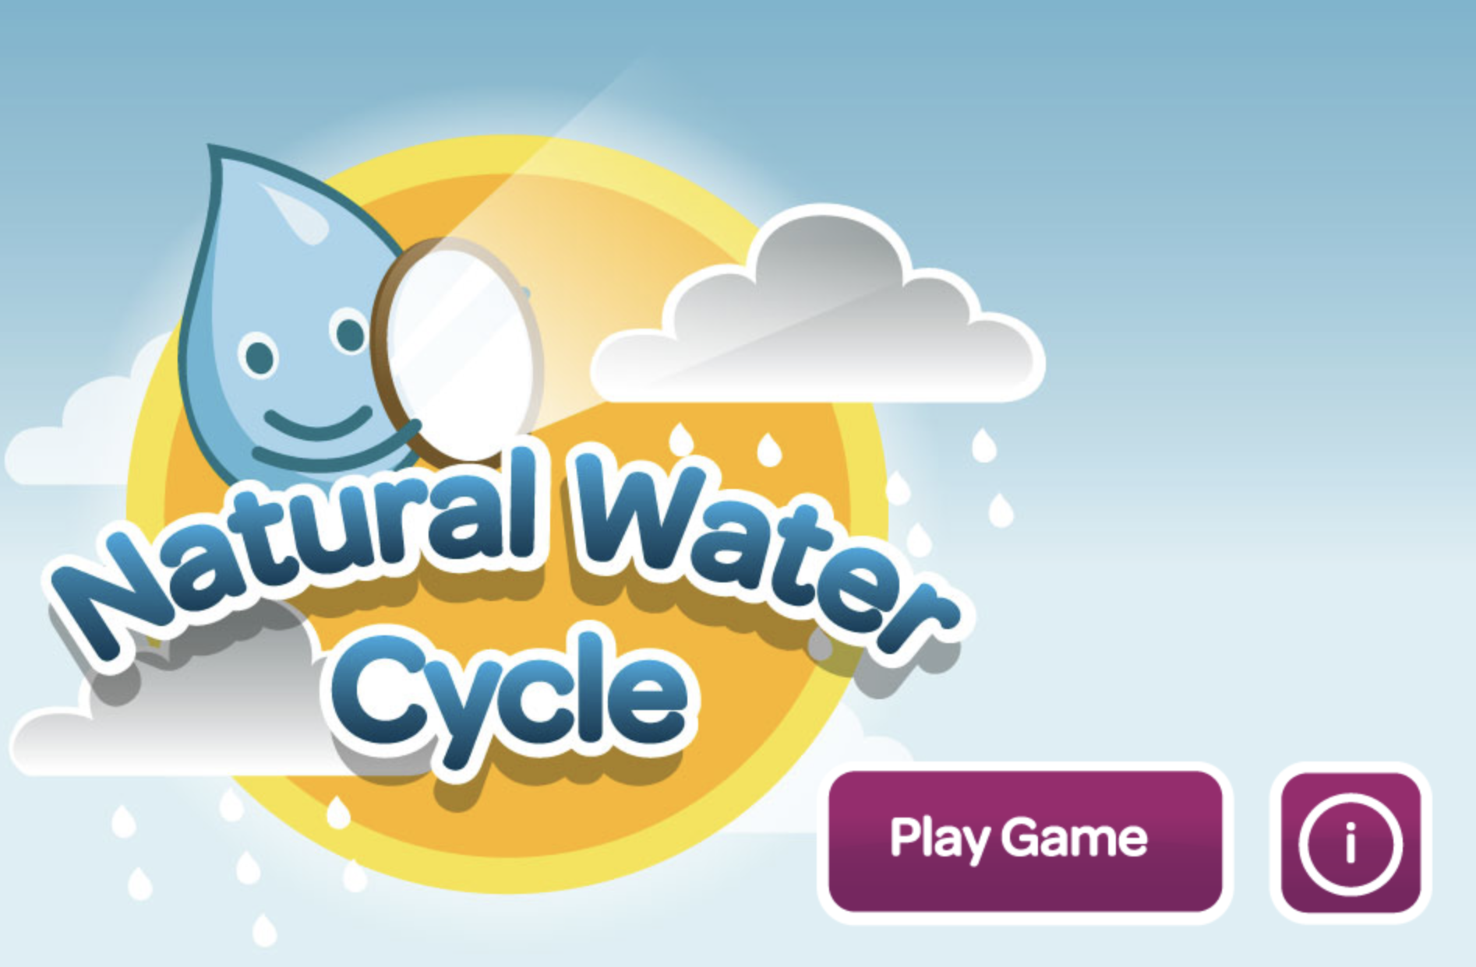
Simulation Activity
Natural Water Cycle Game
In this online game, students go through the different parts of the Water Cycle including evaporation, condensation, and precipitation using the water droplet character, Whoosh to show how water moves through the different parts of the cycle.
Notes:
In this online game, students go through the different parts of the Water Cycle including evaporation, condensation, and precipitation using the water droplet character, Whoosh to show how water moves through the different parts of the cycle.

Slide 64
Big Question: How does water move throughout Earth’s atmosphere?
Notes:
Now that we’ve learned our new term “water cycle”, let’s reflect on our big question. Our “big question” is: How does water move throughout Earth’s atmosphere?
Was there anything that we predicted earlier that was correct or incorrect? Do you have any new hypotheses to share?
I love all these thoughtful scientific hypotheses! Be sure to keep this question and your predictions in mind as we move through these next few lessons, and we’ll continue to revisit it.

Slide 65
Notes:
Thanks for watching, and please continue watching CAPs available from this website.

Slide 66
This Video Was Created With Resources From:
Questions or Comments
Michael Kennedy, Ph.D. MKennedy@Virginia.edu
Rachel L Kunemund, Ph.D. rk8vm@virginia.edu

