Slide 1
“Big Idea” Question
Teacher Demo
Review Concepts
Check-In Questions
Vocabulary
Student-Friendly Definition
Examples & Non-Examples
Morphological Word Parts
Simulation/Activity
Notes:
OK everyone, get ready for our next lesson. Just as a reminder, these are the different components that our lesson may include, and you’ll see these icons in the top left corner of each slide so that you can follow along more easily!

Slide 2
Intro
Conduction
Notes:
Today we will learn about conduction.
Feedback: Right away, including visuals can help students begin to build understanding of the vocabulary terms.

Slide 3
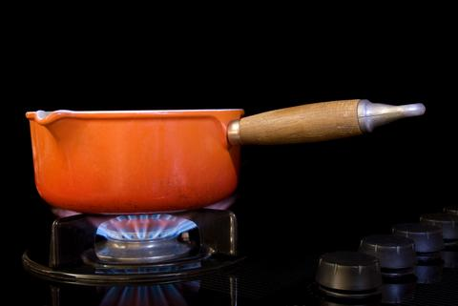
Intro
Convection
Notes:
We will also learn about convection.

Slide 4
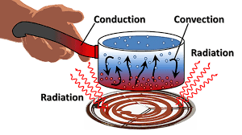
Big Question: How might you use conduction and/or convection everyday?
Notes:
Our Big Question is: How might you use conduction and/or convection everyday?
[Pause and illicit predictions from students.]
I love all these thoughtful scientific hypotheses! Be sure to keep this question and your predictions in mind as we move through these next few lessons, and we’ll continue to revisit it.

Slide 5
Demonstration
Instructions for demonstration:
Convection Demonstration Directions
Materials:
Clear container of water
Ice
Small container with cold water and food coloring
Small container with hot water and food coloring
Notes:
Let’s get out brains ready to think about convection, and how it relates to our big question.
[On the next slides are some questions to ask about the demonstration as you walk through it]
Feedback: This demonstration offers opportunities for students to more closely engage in carrying out investigations. Using the questions on the following slides throughout the demonstration offer students opportunity to demonstrate their understanding. This is important to ensure that they are making sense of this new content!

Slide 6
Notes:
Now let’s pause for a moment to check your understanding and make some predictions about this demonstration.

Slide 7
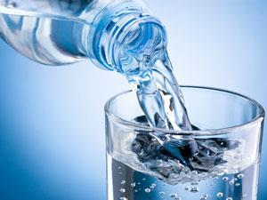
What do you think will happen when I add cold water? Why did that happen?
Notes:
What do you think will happen when I add cold water? Why did that happen?

Slide 8
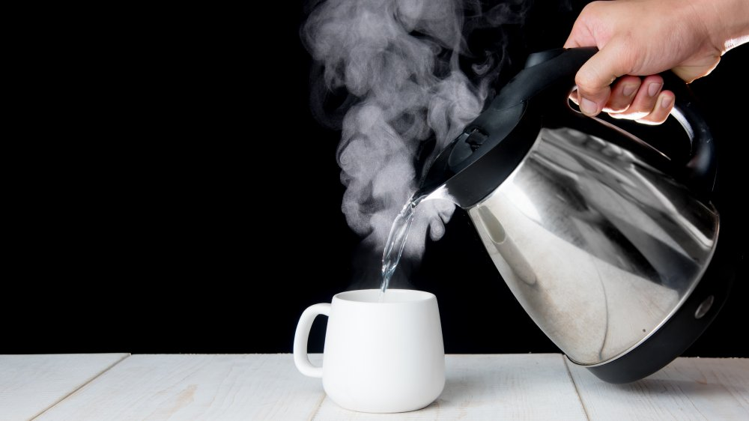
What do you think will happen when I add hot water? Why do you think that happened?
Notes:
What do you think will happen when I add hot water? Why do you think that happened?

Slide 9
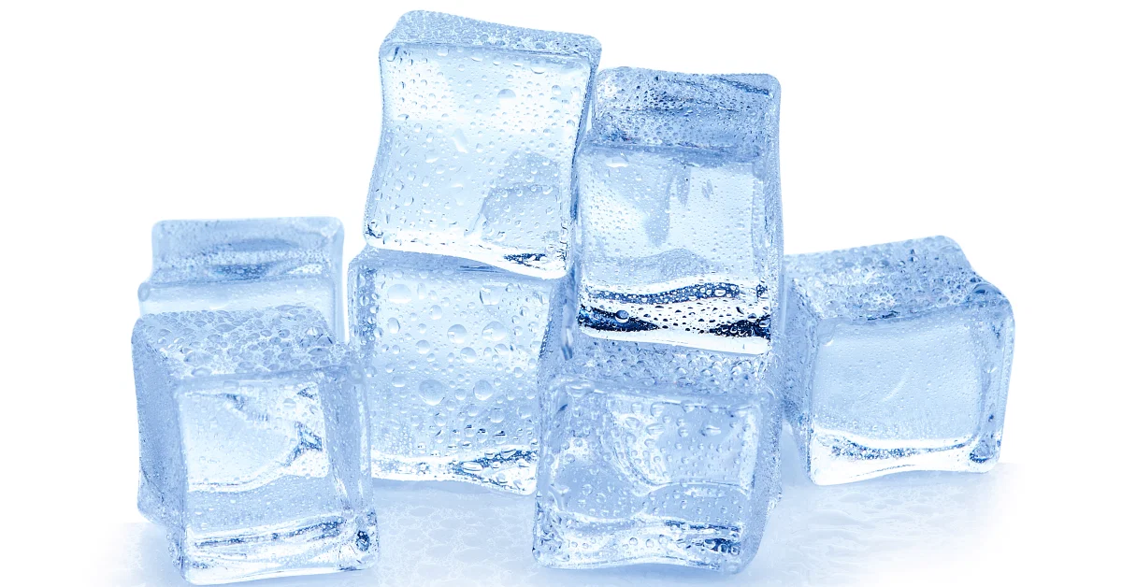
What do you think will happen when I add ice water? Why do you think that happened?
Notes:
What do you think will happen when I add ice water? Why do you think that happened?

Slide 10
Notes:
Before we move on to our new vocabulary term, let’s review some other words & concepts that you already learned and make sure you are firm in your understanding.

Slide 11
Energy Transfer
Conduction
Convection
Radiation
Notes:
There are three ways that energy can be transferred. They are conduction, convection, and radiation.

Slide 12
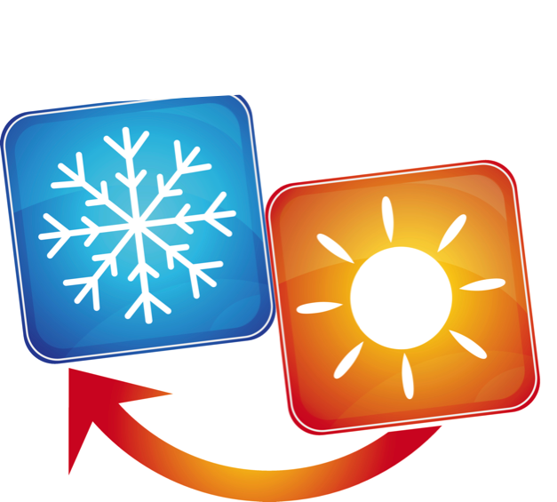
Notes:
Energy can be transferred from one object to another. When a thermal, or heat transfer occurs, heat moves from the warmer object to the colder object.

Slide 13
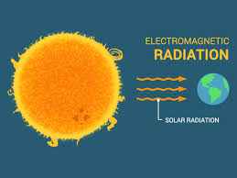
Radiation travels in waves
Notes:
Radiation travels in waves.

Slide 14
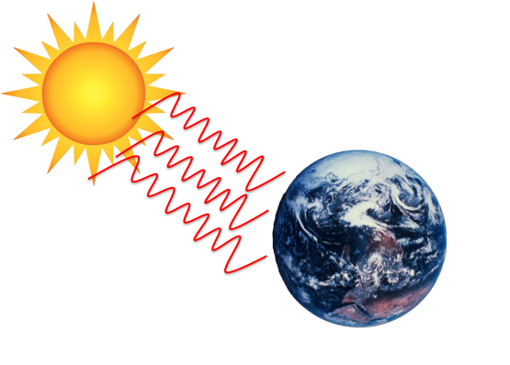
Radiation: the transfer of energy as waves
Notes:
Radiation is the transfer of energy as waves.

Slide 15
Energy Transfer
Conduction
Convection
Radiation
Notes:
Today, we will learn about conduction and convection.

Slide 16
Notes:
Now let’s pause for a moment to check your understanding.

Slide 17
Energy Transfer
________
_________
_________
Notes:
What are the three ways energy can be transferred? Which will we be focusing on today?

Slide 18
Energy Transfer
Conduction
Convection
Radiation
Notes:
What are the three ways energy can be transferred? Which will we be focusing on today?
[There are three ways that energy can be transferred. They are conduction, convection, and radiation.]

Slide 19
What occurs when heat moves from the warmer object to the colder one?
Notes:
What occurs when heat moves from the warmer object to the colder one?
[Energy can be transferred from one object to another. When a thermal, or heat transfer occurs, heat moves from the warmer object to the colder object.]

Slide 20
How does radiation travel?
In straight lines
In waves
Through a medium (solid, liquid, or gas)
In living organisms
Notes:
How does radiation travel?

Slide 21
How does radiation travel?
In straight lines
In waves
Through a medium (solid, liquid, or gas)
In living organisms
Notes:
How does radiation travel?
In straight lines
In waves
Through a medium (solid, liquid, or gas)
In living organisms

Slide 22
Conduction
Notes:
Now that we’ve reviewed, let’s define our new term, conduction.

Slide 23
Conduction: the transfer of heat energy through touch
Notes:
Conduction is the transfer of heat energy through touch.

Slide 24
Notes:
Let’s check-in for understanding.

Slide 25
What is conduction?
Notes:
What is conduction?
[Conduction is the transfer of energy through touch.]

Slide 26
Notes:
That is the basic definition, but there is a bit more you need to know.

Slide 27
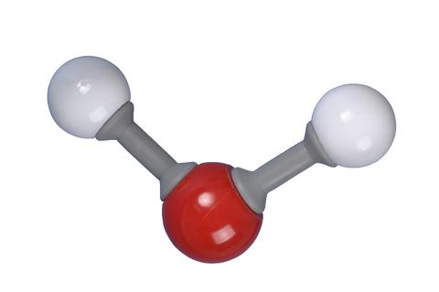
warmer particle
Conduction
cooler particles
Notes:
When a particle warms up, it moves around very quickly, and some of its energy moves to the particles around it. When the heat reaches those cooler particles, they speed up too.

Slide 28
Notes:
Let’s check-in for understanding.

Slide 29
What is conduction? How is conduction happening here?
Notes:
What is conduction? How is conduction happening here?
[Conduction is the transfer of heat energy through touch. The heat energy is being transferred to the person’s hands because they are touching the hot mug.]

Slide 30
warmer particle
Do warmer particles move faster or slower than cold particles?
cooler particles
Notes:
Do warmer particles move faster or slower than cold particles?
[Faster]

Slide 31
Notes:
Now, let’s talk about an example of the conduction.

Slide 32
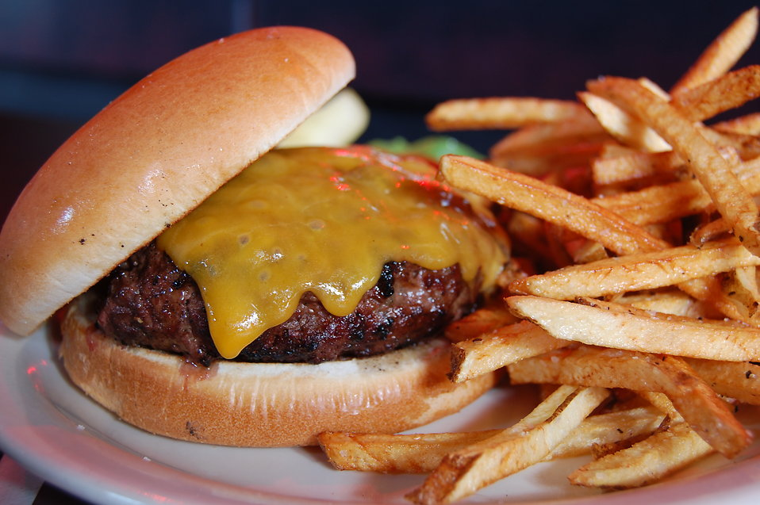
Notes:
When you put a cold slice of cheese on a hot hamburger, the cheese melts. Conduction is how the heat from the burger gets to the cheese and melts it.
Feedback: This example is a great way to connect to students’ prior knowledge. This would also be an opportunity to elicit student examples.

Slide 33
Notes:
Now, let’s talk about a non-example of the conduction.
Feedback: Explicit and clear explanations for non-examples is a great way to help students make sense of the new content.

Slide 34
Notes:
A fire is not an example of conduction. It is a heat source.

Slide 35
Notes:
Let’s check-in for understanding.

Slide 36
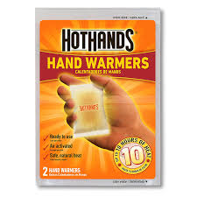
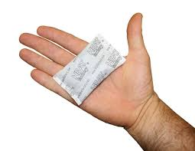
Is this an example of conduction? Why or why not?
Notes:
Is this an example of conduction? Why or why not?

Slide 37
Can you think of another example of conduction we have not covered?
Notes:
Can you think of another example of conduction we have not covered?

Slide 38
Convection
Notes:
Now, let’s define convection.

Slide 39
Convection: the heating and cooling of a liquid or a gas in a cycle
Notes:
Convection is the heating and cooling of a liquid or a gas in a cycle.

Slide 40
Notes:
Let’s check-in for understanding.

Slide 41
What is convection?
Notes:
What is convection?
[Convection is the heating and cooling of a liquid or a gas in a cycle.]

Slide 42
Notes:
That is the basic definition, but there is a bit more you need to know.

Slide 43
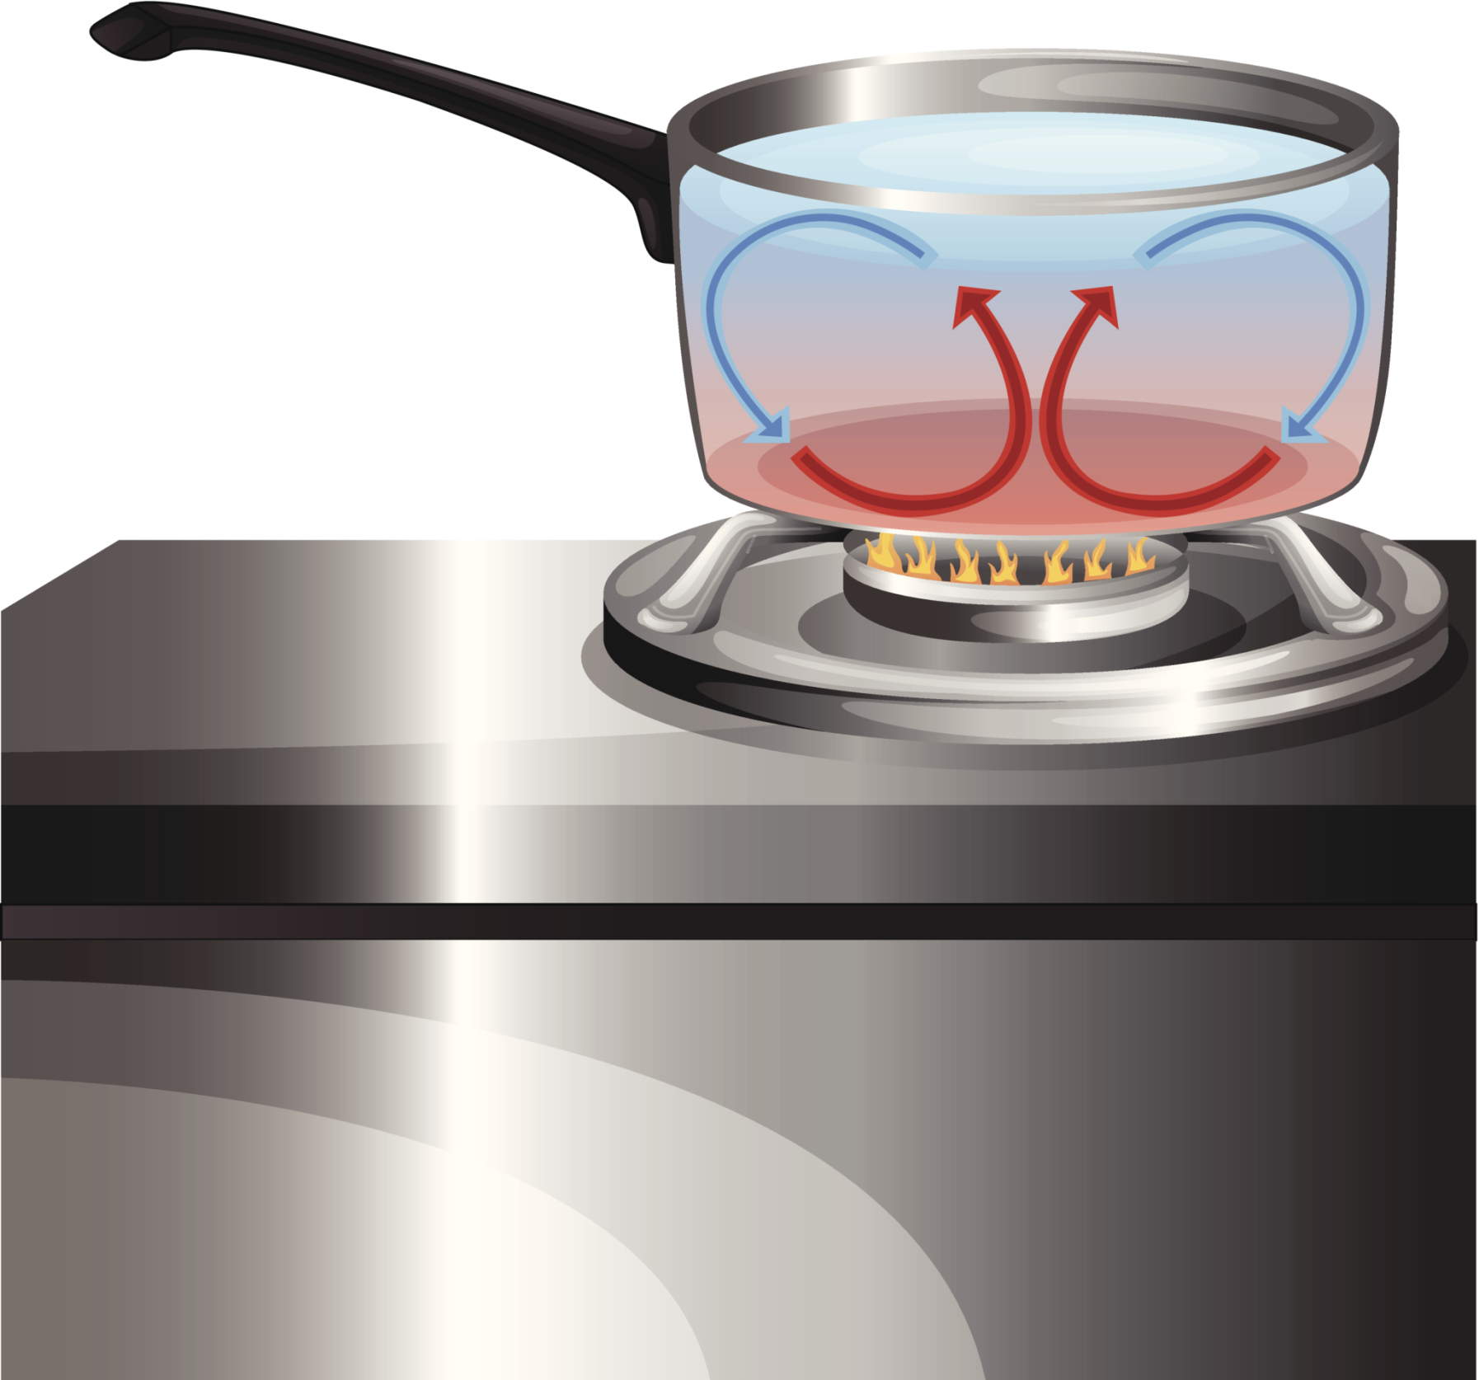
Notes:
An important factor of convection is that the heat transfer is driven by a heat source. A heat source could be a campfire, a stove, or anything that produces heat.

Slide 44
Warming and rising
Notes:
For example as a campfire heats the nearby air, the particles in the air spread out, which causes the air to rise.

Slide 45
Cooling
and sinking
Warming and rising
Notes:
However, as the air gets farther from the heat source, it begins to cool. As you’ll remember, a cooler fluid will sink, so the air will sink back toward the heat source.

Slide 46
Convection
Cooling
and sinking
Warming and rising
Notes:
The cycle of convection is completed when the air is warmed again and rises.
Feedback: Including a model of the scientific phenomenon is helpful for students as they build knowledge of each aspect.

Slide 47
Notes:
Let’s check-in for understanding.

Slide 48
What is convection? Explain how convection is occurring here?
Notes:
What is convection? Explain how Convection is occurring here.
[Convection is the he heating and cooling of a liquid or a gas in a cycle.]

Slide 49
How does the cycle of convection works?
?
?
?
Notes:
How does the cycle of convection work?
[Here, as a campfire heats the nearby air, the particles in the air spread out, which causes the air to rise. However, as the air gets farther from the heat source, it begins to cool. The the air will sink back toward the heat source.
The cycle of convection is completed when the air is warmed again and rises.]

Slide 50
Notes:
Now, let’s talk about an example of convection.

Slide 51
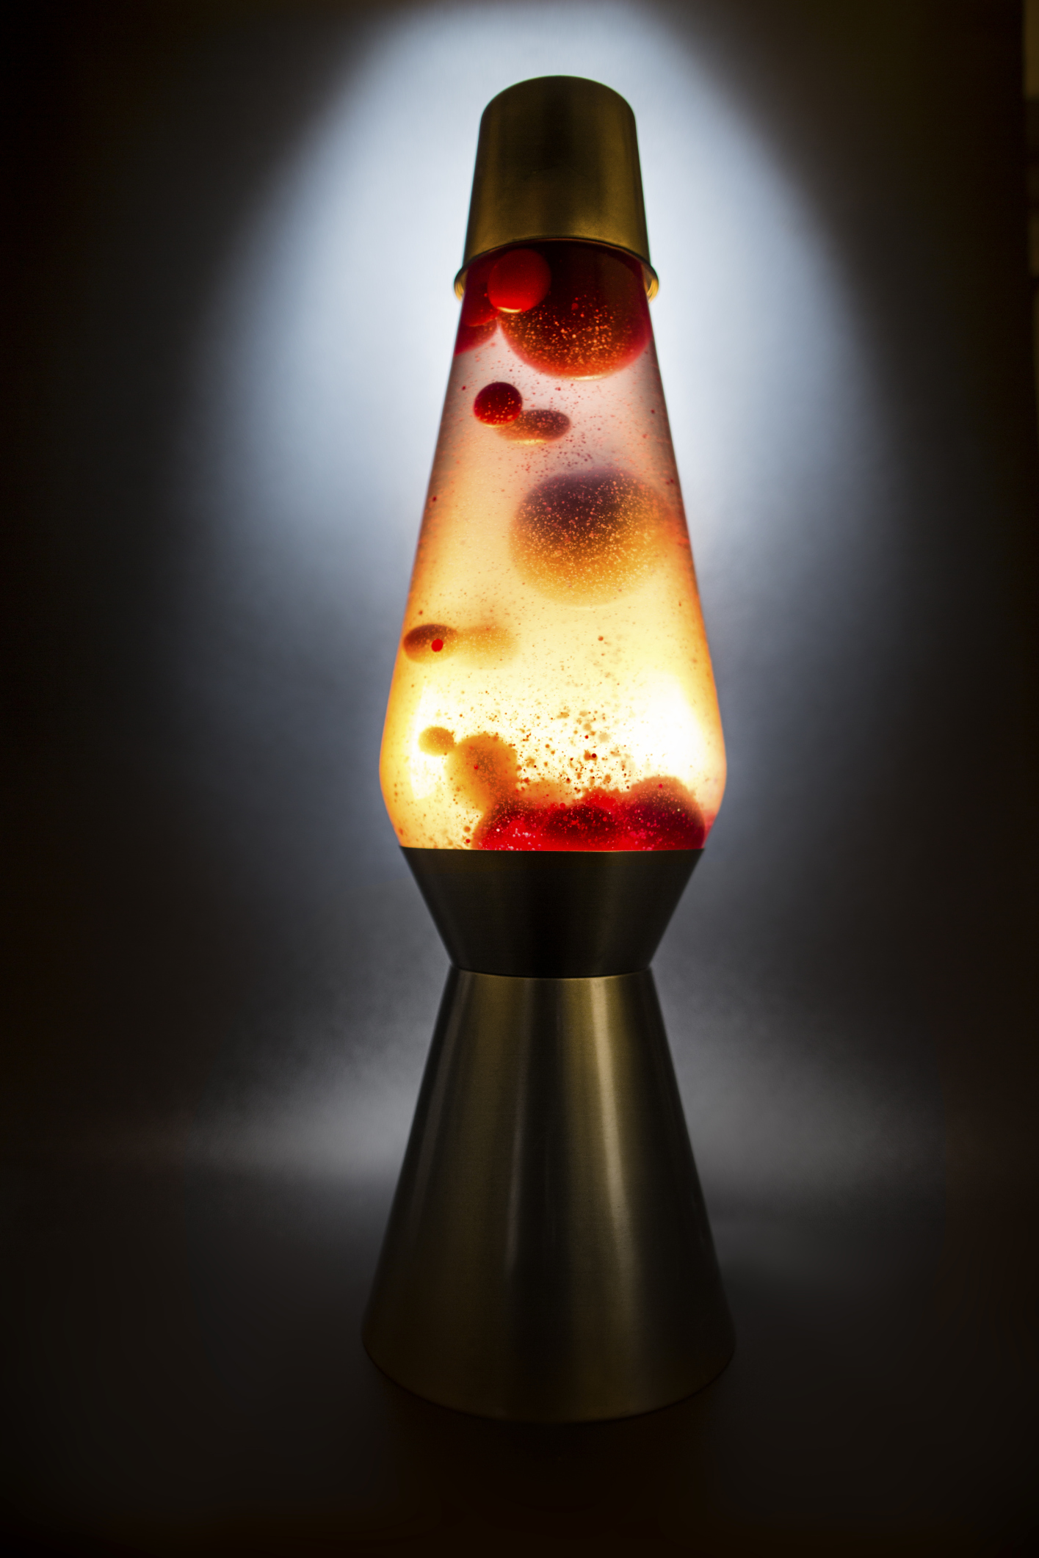
Notes:
Remember that convection can happen in liquids too; a common example of convection is a lava lamp. The heat source is at the bottom of the lamp, and heats the fluids.

Slide 52
Notes:
As the liquid warms up, the blobs rise—just like in our previous example!

Slide 53
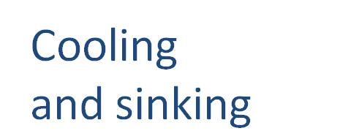
Notes:
Once the blobs get far enough away from the heat source, they cool and begin to sink back towards the heat source. They are reheated as they approach the light, and rise once again.
Feedback: Incorporating an example into the model of the scientific phenomenon is terrific!

Slide 54
Notes:
Here you may include relevant non-examples of convection.

Slide 55
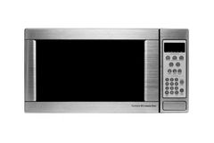
Notes:
Microwaves do not use convection. Yes, a microwave does heat up food. But a microwave does not heat liquids with circular motion.
Feedback: Explaining non-examples with concise, specific language is important.

Slide 56
Notes:
Let’s check-in for understanding.

Slide 57
Which one is convection and why?
Notes:
Which one is convection and why?

Slide 58
Which one is convection and why?
Notes:
Which one is convection and why?

Slide 59
When you hold a mug of hot chocolate to warm up your hands, this is an example of ________.
conduction
convection
condensation
evaporation
Notes:
When you hold a mug of hot chocolate to warm up your hands, this is an example of ________.

Slide 60
When you hold a mug of hot chocolate to warm up your hands, this is an example of ________.
conduction
convection
condensation
evaporation
Notes:
When you hold a mug of hot chocolate to warm up your hands, this is an example of conduction.

Slide 61
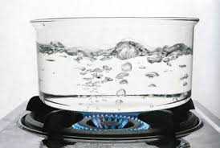
When you boil water on the stove, this is an example of ________.
conduction
convection
condensation
evaporation
Notes:
When you boil water on the stove, this is an example of ________.

Slide 62
When you boil water on the stove, this is an example of ________.
conduction
convection
condensation
evaporation
Notes:
When you boil water on the stove, this is an example of convection.

Slide 63
Remember!!!
Notes:
So remember!

Slide 64
Conduction: the transfer of heat energy through touch
Notes:
Conduction is the transfer of heat energy through touch.

Slide 65
Convection: the heating and cooling of a liquid or a gas in a cycle
Notes:
Convection is the heating and cooling of a liquid or a gas in a cycle.

Slide 66
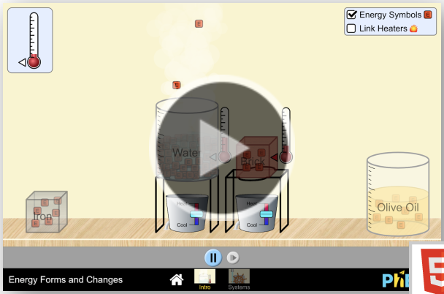
Simulation Activity
Energy Forms and Changes
Explore how heating and cooling iron, brick, water, and olive oil adds or removes energy. See how energy is transferred between objects. Build your own system, with energy sources, changers, and users. Track and visualize how energy flows and changes through your system.
Notes:
Explore how heating and cooling iron, brick, water, and olive oil adds or removes energy. See how energy is transferred between objects. Build your own system, with energy sources, changers, and users. Track and visualize how energy flows and changes through your system.
Feedback: Providing a simulation activity is a great way to make science thinking visible. In this simulation, students have the opportunity to make predictions and apply an idea to a new situation by changing the variables in the simulation (i.e., energy sources).

Slide 67
Big Question: How might you use conduction and/or convection everyday?
Notes:
Explicit cue to revisit the big question at the end of the lesson: Okay everyone. Now that we’ve learned the term, let’s reflect once more on our big question. Was there anything that we predicted earlier that was correct or incorrect? Do you have any new hypotheses to share?

Slide 68
Notes:
Thanks for watching, and please continue watching CAPs available from this website.

Slide 69
This Video Was Created With Resources From:
Questions or Comments
Michael Kennedy, Ph.D. MKennedy@Virginia.edu
Rachel L Kunemund, Ph.D. rk8vm@virginia.edu

