Slide 1
Intro
“Big Idea” Question
Review Concepts
Check-In Questions
Teacher Engagement
Vocabulary
Student-Friendly Definition
Examples & Non-Examples
Morphological Word Parts
Frayer Model
Simulation/Activity
Notes:
OK everyone, get ready for our next lesson. Just as a reminder, these are the different components that our lesson may include, and you’ll see these icons in the top left corner of each slide so that you can follow along more easily!

Slide 2
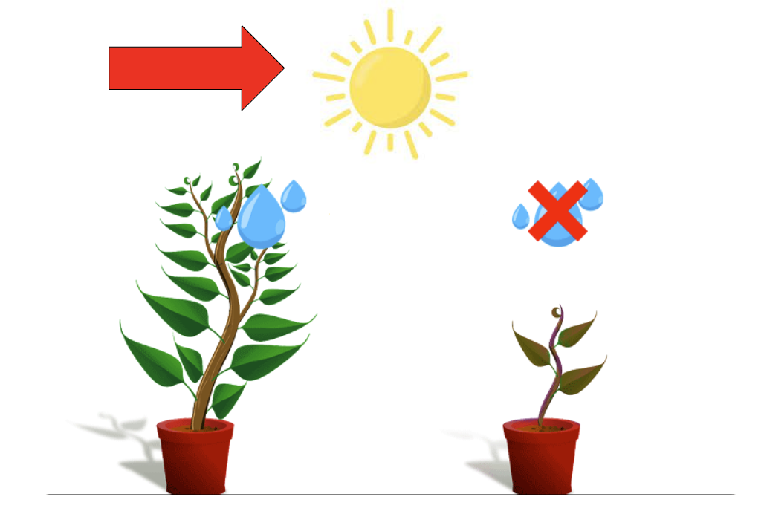
Constants
Intro
Notes:
Today, we’ll be learning about the word: constants.

Slide 3
Big Question: How do constants help us understand the results of science experiments?
Notes:
Our “big question” is: How do constants help us understand the results of science experiments?
[Pause and illicit predictions from students.]
I love all these thoughtful guesses! Be sure to keep this question and your predictions in mind as we move through these next few lessons, and we’ll continue to revisit it.

Slide 4
Notes:
Before we move on to our new topic, let’s review some other words & concepts that you already learned and make sure you are firm in your understanding.

Slide 5
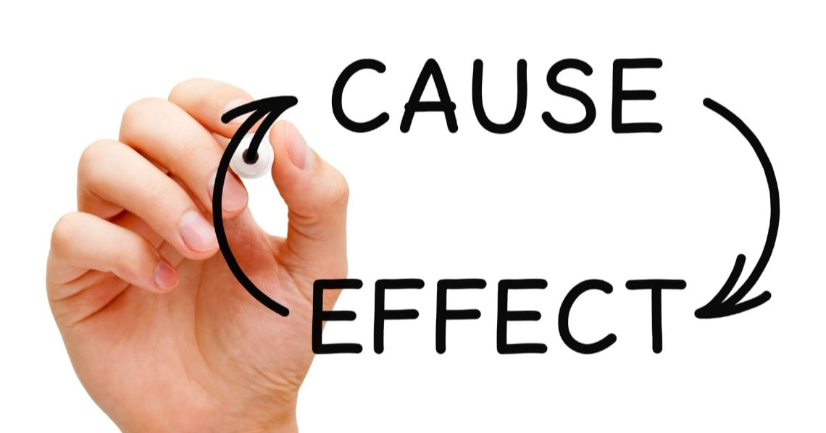
Notes:
"Cause-and-effect" is a way to understand how one thing leads to another. It's like figuring out why something happens. The "cause" is the reason, action, or event that makes something else happen, which we call the "effect." Understanding cause-and-effect helps us learn how things are connected and why certain things happen in the world around us.

Slide 6
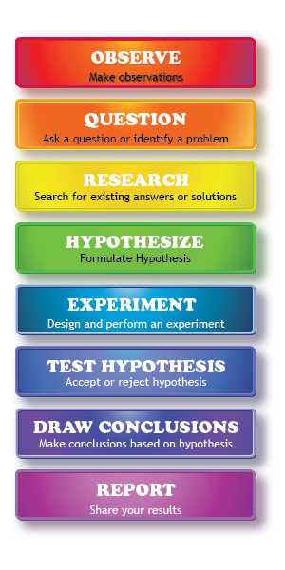
Scientific Method: steps that investigators follow to answer questions about the natural world
Notes:
One term that you’ve likely heard year after year in science class is the scientific method. The scientific method is a series of steps that investigators follow to answer questions about the natural world. By following the same steps, investigators are able to copy and check the work that is done by others. Let’s do a quick review of some of these steps.

Slide 7
Hypothesis
Notes:
A hypothesis is a suggested explanation or idea that can be tested through an experiment. It’s super important to note that a hypothesis must be able to be tested! The hypothesis predicts what will happen and why.

Slide 8
Experiment
Notes:
Next, you test your hypothesis in an experiment. Experiments are well-planned and each step is written down so other scientists can test the results. Data is recorded so you can decide if you hypothesis was correct.

Slide 9
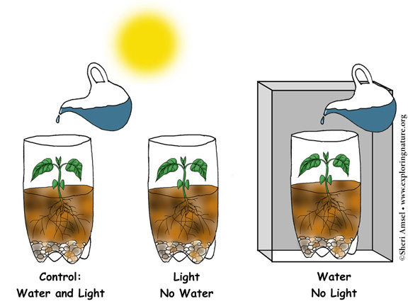
Variable
Notes:
A variable is something that can change or be changed in an experiment.

Slide 10
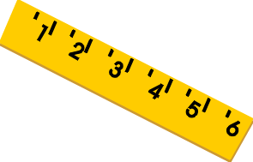
Three kinds of variables:
Independent
Variable
Dependent
Variable
Control
Variable
Notes:
There are three different kinds of variables in an experiment: independent, dependent, and control variables.

Slide 11
Independent Variable
Notes:
An independent variable is the part of the experiment that the scientist controls or changes.

Slide 12
Dependent Variable
Notes:
A dependent variable is the part of an experiment that is being measured or observed to see how it changes.

Slide 13
Cause
Effect
Independent Variable
Dependent Variable
Notes:
Independent variables are the “cause” part of the experiment. Scientists make changes to the independent variable to see what the results will be. Dependent variables are the “effect” part of the experiment. The scientists don’t make any changes to the dependent variable. Instead, they carefully watch and measure the changes the happen. In this example, the Sun is the independent variable which is causing the ice to melt, which is the dependent variable.

Slide 14
Notes:
Now let’s pause for a moment to review the information we have covered already.

Slide 15
A variable is…
Something that can change or be changed in an experiment
Something that stays the same in an experiment
Notes:
A variable is…
Something that can change or be changed in an experiment
Something that stays the same in an experiment

Slide 16
A variable is…
Something that can change or be changed in an experiment
Something that stays the same in an experiment
Notes:
A variable is…[Something that can change or be changed in an experiment]

Slide 17
______
______
Independent Variable
Dependent Variable
Notes:
Independent variables are the “______” part of the experiment. Scientists make changes to the independent variable to see what the results will be. Dependent variables are the “_____” part of the experiment. The scientists don’t make any changes to the dependent variable. Instead, they carefully watch and measure the changes the happen. In this example, the Sun is the independent variable which is causing the ice to melt, which is the dependent variable.

Slide 18
Cause
Effect
Independent Variable
Dependent Variable
Notes:
Independent variables are the “[cause]” part of the experiment. Scientists make changes to the independent variable to see what the results will be. Dependent variables are the “[effect]” part of the experiment. The scientists don’t make any changes to the dependent variable. Instead, they carefully watch and measure the changes the happen. In this example, the Sun is the independent variable which is causing the ice to melt, which is the dependent variable.

Slide 19
Constants
Notes:
Now that we’ve reviewed, let’s define the phrase constants.

Slide 20
Constants: Things that stay the same in an experiment
Notes:
A constant is something that stays the same in an experiment. In this example, sunlight is constant. Both plants get the same amount of sunlight while one plant gets water and the other gets no water.

Slide 21
Notes:
Let’s check-in for understanding.

Slide 22
A constant is something that _____ the _____ in an experiment.
Notes:
A constant is something that ____ the _____ in an experiment.

Slide 23
A constant is something that stays the same in an experiment.
Notes:
A constant is something that [stays] the [same] in an experiment.

Slide 24
In this example below, the constant is…
Notes:
In this example below, the constant is…
[Sunlight. Both plants get the same amount of sunlight but different amounts of water. The amount of sunlight stays the same.]

Slide 25
Notes:
That is the basic definition, but there is a bit more you need to know.

Slide 26
Constants are similar to, but not the same as, control variables.
Constant
Control Variable
Control Variable
light
dark
Notes:
Constants are similar to, but not the same as, control variables. Constants are the factors that remain the same throughout an experiment. Here, the amount of sunlight is a constant since both plants receive the same amount of sunlight per day. However, depending on the day, the amount of sunlight may change due to weather conditions. In contrast, control variables are things that the scientist decides not to change during the experiment. Here, each plant gets the same amount of water and because water is the same for both plants it is a control variable. The scientists in this experiment are able to control the water and not the sunlight.

Slide 27
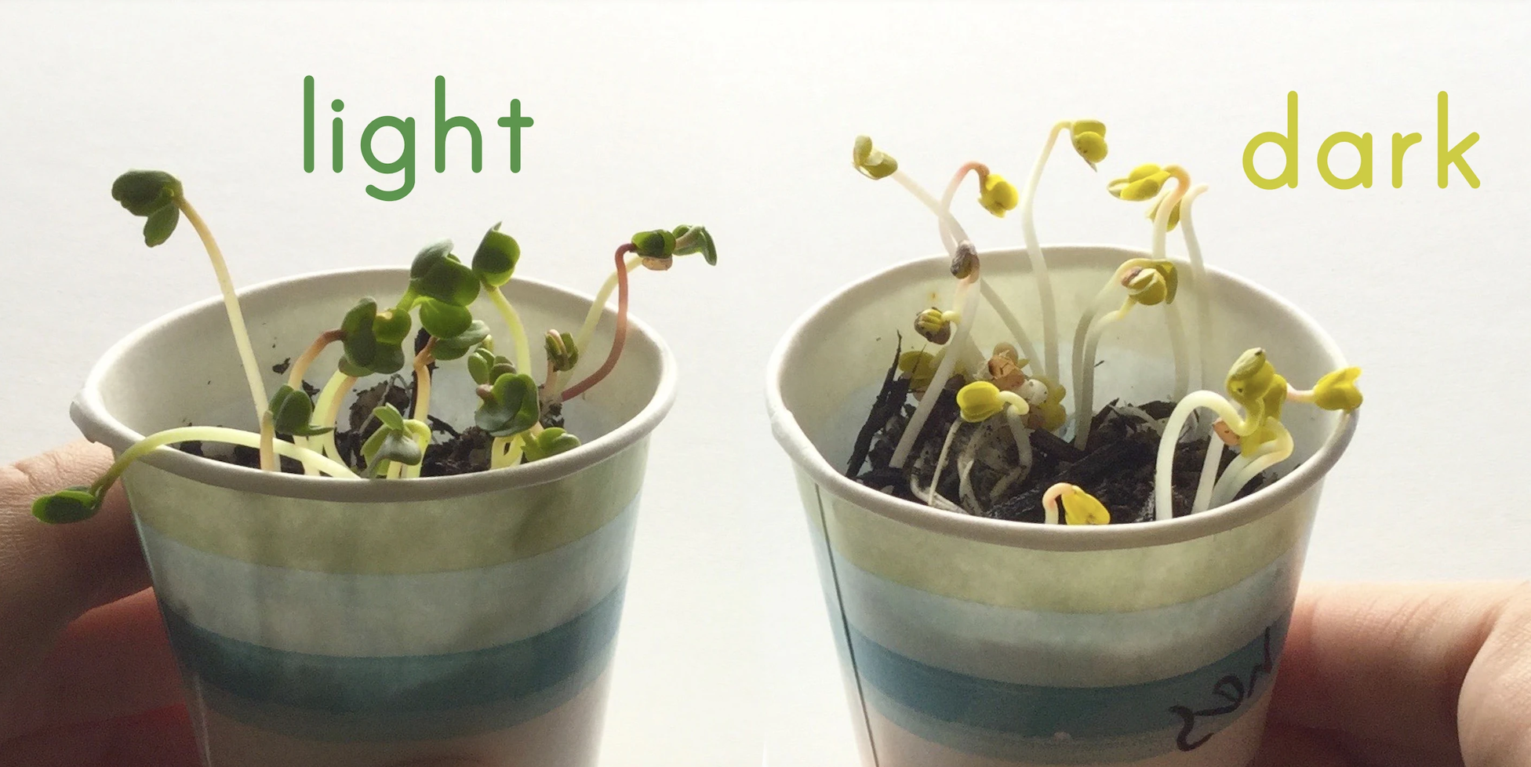
Constants can help us better understand cause-and-effect relationships.
Notes:
Constants can help us better understand cause-and-effect relationships. This is because by keeping things the same, we can isolate the differences to make sure the effects from our independent variable are accurately causing what is happening to the dependent variable. In this example, the constants are the amount of seeds and soil used in each cup and the same size of both cups. The independent variable is whether the plant was grown in the light or in the dark, and the dependent variables are the colors and height of the plants. Therefore, whether the plant was grown in the light or dark effected how it grew. Yet, making sure the same amount of seeds and soil as well as the same size cup help us make sure that it is either the light or dark impacting the growth of the plant.

Slide 28
Notes:
Let’s check-in for understanding.

Slide 29
What is a constant?
Notes:
What is a constant?
[A constant is something that stays the same in an experiment.]

Slide 30
Constant
Control Variable
Control Variable
light
dark
A scientist keeps this the same in an experiment…
Constant
Control variable
Notes:
A scientist keeps this the same in an experiment…
A. Constant
B. Control variable

Slide 31
Constant
Control Variable
Control Variable
light
dark
A scientist keeps this the same in an experiment…
Constant
Control variable
Notes:
[Control variable]

Slide 32
Notes:
Now, let’s talk about some examples of constants.

Slide 33
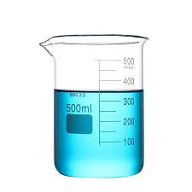
Using the same amount of a substance.
Notes:
An example of a constant is using the same amount of a substance. In this picture, we see two beakers filled with the same amount of liquid. The amount of liquid is constant. In the experiment, one beaker may get treated with the independent variable and the other beaker may remain as the control without having anything done to the liquid in it.

Slide 34
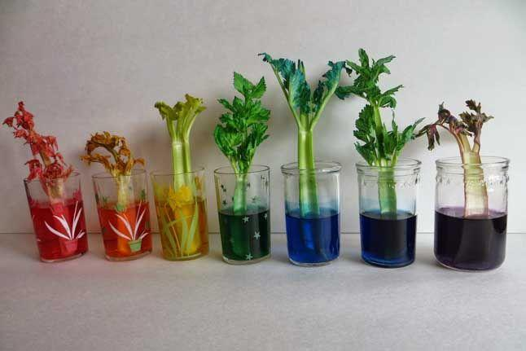
Using the same amount of time.
Notes:
An example of a constant is using the same amount of time. In this picture, we see seven cups with celery sitting in water and food dye. Each of these cups have sat for the same amount of time. Time is the constant. The independent variable is the food dye color and the dependent variable is the color the celery turned. This experiment does not appear to have a control, which would be celery in a cup of water without food dye. Since we know the celery sat for the same amount of time, we can see that certain dyes, such as red, had a stronger effect on the celery than other dyes that are lighter.

Slide 35
Notes:
Let’s check-in for understanding.

Slide 36
Constants can help us better understand _____-___-_____ relationships.
Notes:
Constants can help us better understand ___-__-___ relationships.

Slide 37
Constants can help us better understand cause-and-effect relationships.
Notes:
[cause-and-effect]

Slide 38
Notes:
Now, let’s talk about some non-examples of constants.

Slide 39
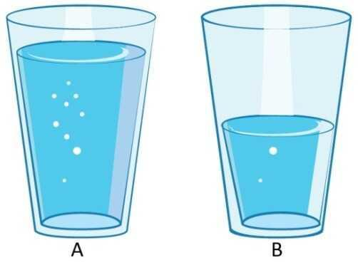
Using different amounts of substances.
Notes:
Using different amounts of substances in a experiment is not an example of a constant. The amount of substance, or in this case liquid, is not the same. Constants are things that stay the same in an experiment.

Slide 40
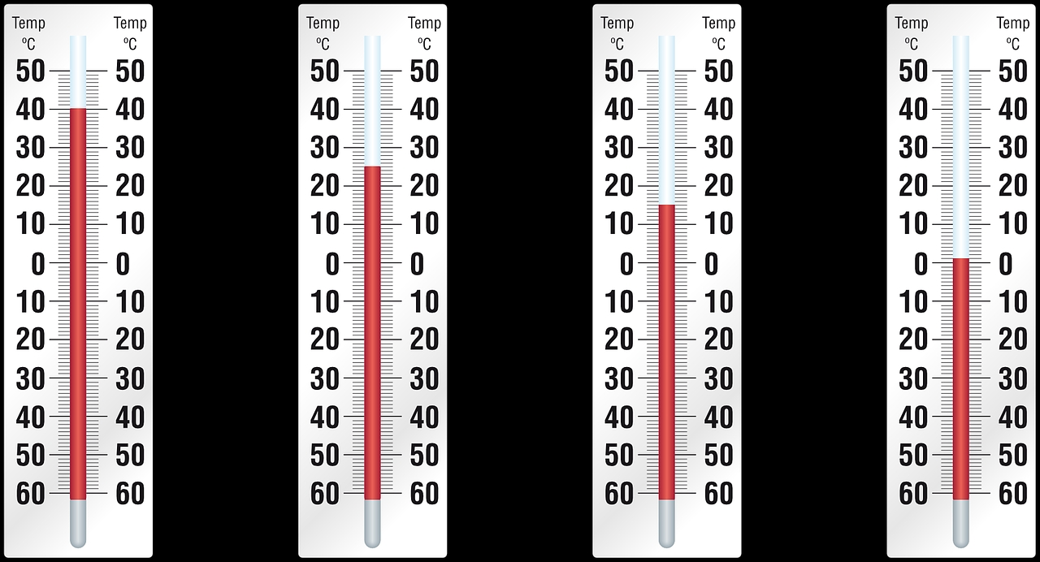
Using different temperatures.
Notes:
Using different temperatures in a plant growing experiment is not is not an example of a constant. Constants are things that stay the same in an experiment.

Slide 41
Notes:
Now let’s pause for a moment to check your understanding.

Slide 42
Why is using different temperatures not an example of constants?
What is this an example of instead?
Notes:
Why is this not an example of a hypothesis? What is this an example of instead?
[Constants are things that stay the same, so since the temperatures are different they are not constants. Instead, they could be independent variables seeing which temperature helps the plants grow best.]

Slide 43
Notes:
We can also break down the term constants into different word parts to help us remember the meaning. Let’s take a look!

Slide 44
Constants
(root)
(suffix)
Notes:
We can break up the term constants into two parts: root and suffix.

Slide 45
Constants
Constant = something that remains the same or does not change
Notes:
First, we have the root “constant” which means something that remains the same or does not change. In this word, it indicates that constants are things that stay the same.

Slide 46
Constants
-s = plural, more than one
Notes:
-s is the suffix. The “-s” suffix means something is plural, or more than one thing. Now let’s put it all together.

Slide 47
Constant s
Constants
Things that remain the same
Notes:
So when we put it all together, constants means things that remain the same.

Slide 48
Notes:
Let’s check-in for understanding.

Slide 49
How can we use the word parts of constants to help us remember the definition of the term?
Constants
(root)
(suffix)
Notes:
How can we use the word parts of the atmosphere to help us remember the definition of the term?
[The root constant means something that remains the same or does not change.
-S is the suffix meaning plural, more than one.
So when we put it all together, constants means things that remain the same.]

Slide 50
Remember!!!
Notes:
So remember!

Slide 51
Constants: Things that stay the same in an experiment
Notes:
A constant is something that stays the same in an experiment. In this example, sunlight is constant. Both plants get the same amount of sunlight while one plant gets water and the other gets no water.

Slide 52
Notes:
We will now complete this concept map, called a Frayer model, to summarize and further clarify what you have learned about the term constants.

Slide 53
Definition
Picture
Constants
Example
How do constants impact my life?
Notes:
To complete the Frayer model, we will choose from four choices the correct picture, definition, example, and response to the question, “How do constants impact my life?” Select the best response for each question using the information you just learned. As we select responses, we will see how this model looks filled in for the term constants.

Slide 54
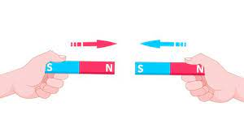
Directions: Choose the correct picture of
Constants from the choices below.
A
B
C
D
Notes:
Choose the one correct picture of constants from these four choices.

Slide 55
Directions: Choose the correct picture of
Constants from the choices below.
A
B
C
D
Notes:
This is the picture that shows constants.

Slide 56
Definition
Picture
Constants
Example
How do constants impact my life?
Notes:
Here is the Frayer model filled in with a picture of constants.

Slide 57
Directions: Choose the correct definition of
Constants from the choices below.
A
A place where plants and animals live
B
The smallest unit of matter
C
A push or pull of an object
D
Things that stay the same in an experiment
Notes:
Choose the one correct definition of constants from these four choices.

Slide 58
Directions: Choose the correct definition of
Constants from the choices below.
A
A place where plants and animals live
B
The smallest unit of matter
C
A push or pull of an object
D
Things that stay the same in an experiment
Notes:
“Things that stay the same in an experiment” is correct! This is the definition of constants.

Slide 59
Definition
Picture
Things that stay the same in an experiment
Constants
Example
How do constants impact my life?
Notes:
Here is the Frayer Model with a picture and the definition filled in for constants: Things that stay the same in an experiment.

Slide 60
Directions: Choose the correct example of
Constants from the choices below.
A
Having one plant grow in the light and one in the dark
B
Using the same amount of fertilizer for both plants
C
Changing the temperature for one plant and not the other
D
Hydrating one plant with water and the other with soda
Notes:
Choose the one correct example of constants from these four choices.

Slide 61
Directions: Choose the correct example of
Constants from the choices below.
A
Having one plant grow in the light and one in the dark
B
Using the same amount of fertilizer for both plants
C
Changing the temperature for one plant and not the other
D
Hydrating one plant with water and the other with soda
Notes:
“Using the same amount of fertilizer for both plants” is correct! This is an example of constants.

Slide 62
Definition
Picture
Things that stay the same in an experiment
Constants
Using the same amount of fertilizer for both plants
Example
How do constants impact my life?
Notes:
Here is the Frayer Model with a picture, definition, and an example of constants: Using the same amount of fertilizer for both plants.

Slide 63
Directions: Choose the correct response for “how do
constants impact my life?” from the choices below.
A
Constants explain how the different seasons impact the Earth.
B
Constants explain how plants and other organisms grow or develop.
C
Constants help us accurately understand cause and effect relationships in science experiments.
D
Constants explain how objects in our environment move and interact with each other.
Notes:
Choose the one correct response for “how do constants impact my life?” from these four choices.

Slide 64
Directions: Choose the correct response for “how do
constants impact my life?” from the choices below.
A
Constants explain how the different seasons impact the Earth.
B
Constants explain how plants and other organisms grow or develop.
C
Constants help us accurately understand cause and effect relationships in science experiments.
D
Constants explain how objects in our environment move and interact with each other.
Notes:
“Constants help us accurately understand cause and effect relationships in science experiments.” That is correct! This is an example of how constans impact your life.

Slide 65
Definition
Picture
Things that stay the same in an experiment
Constants
Constants help us accurately understand cause and effect relationships in science experiments.
Using the same amount of fertilizer for both plants
Example
How do constants impact my life?
Notes:
Here is the Frayer Model with a picture, definition, example, and a correct response to “how do constants impact my life?”: Constants help us accurately understand cause and effect relationships in science experiments.

Slide 66
Remember!!!
Notes:
So remember!

Slide 67
Constants: Things that stay the same in an experiment
Notes:
A constant is something that stays the same in an experiment. In this example, sunlight is constant. Both plants get the same amount of sunlight while one plant gets water and the other gets no water.

Slide 68
Big Question: How do constants help us understand the results of science experiments?
Notes:
Let’s reflect once more on our big question. Our “big question” is: How do constants help us understand the results of science experiments?
Does anyone have any additional examples to share that haven’t been discussed yet?
[Pause and illicit predictions from students.]

Slide 69
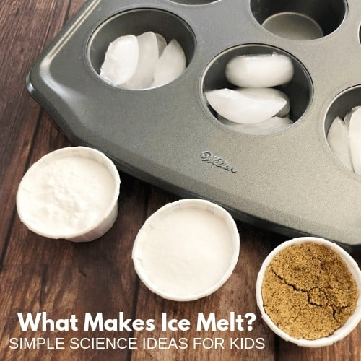
Demonstration
Materials Needed:
Muffin tin or four same size cups, 12 ice cubes, 2 tbsp salt, 2 tbsp baking soda, 2 tbsp sand, timer
Procedure:
Fill four cups (or muffin tin sections) with five ice cubes in each. Sprinkle salt on one cup, sand on another cup, baking soda on another cup, and leave the last cup plain. Check on the ice cubes every few minutes during a 30 minute period. Time how long it takes for each ice cube to melt. Record how many minutes it takes for each cup to melt.
Notes:
Now that we’ve learned about constants, let’s do a demonstration.
On your tables, you have four cups/a muffin tin, 12 ice cubes, 2 tbsp salt, 2 tbsp, baking soda, 2 tbsp sand, a timer, and recording sheets.
Fill four cups (or muffin tin sections) with five ice cubes in each. Sprinkle salt on one cup, sand on another cup, baking soda on another cup, and leave the last cup plain. Check on the ice cubes every few minutes during a 30 minute period. Time how long it takes for each ice cube to melt. Record how many minutes it takes for each cup to melt.
We will reflect on this activity on the next slide.

Slide 70
Reflection Activity
Ask yourselves…
What are the independent, dependent, and control variables in this experiment?
Are there any constants? If so, what are they? How do they help us understand the results of the experiment?
Notes:
Have students discuss these questions with a partner or with their table before calling on groups to share one of their responses with the class.
Ask yourselves…
What are the independent, dependent, and control variables in this experiment?
Are there any constants? If so, what are they? How do they help us understand the results of the experiment?
This small and simple experiment teaches us about variables and constants. In this experiment, the independent variables are the salt, baking soda, and sand. The dependent variable is how quickly the ice melted. The control variable is the one cup of ice that did not have anything on it. The constants are the amount of ice and substances you used. If we had used more ice or substances, like salt versus sand, this may have given us inaccurate results. Keeping the amount of ice and substances constant help us draw accurate conclusions from this experiment.

Slide 71
Notes:
Thanks for watching, and please continue watching CAPs available from this website.

Slide 72
This Was Created With Resources From:
Questions or Comments
Michael Kennedy, Ph.D. MKennedy@Virginia.edu
Rachel L Kunemund, Ph.D. rk8vm@virginia.edu

