Slide 1
Intro
“Big Idea” Question
Review Concepts
Check-In Questions
Teacher Engagement
Vocabulary
Student-Friendly Definition
Examples & Non-Examples
Morphological Word Parts
Frayer Model
Simulation/Activity
Notes:
OK everyone, get ready for our next lesson. Just as a reminder, these are the different components that our lesson may include, and you’ll see these icons in the top left corner of each slide so that you can follow along more easily!

Slide 2
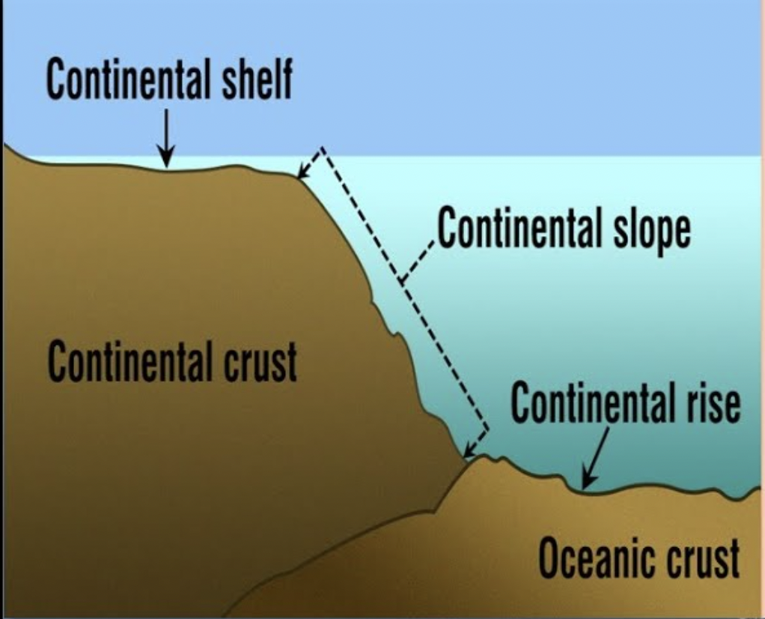
Intro
Continental Rise
Notes:
Today, we’ll be learning about the word: Continental Rise.

Slide 3
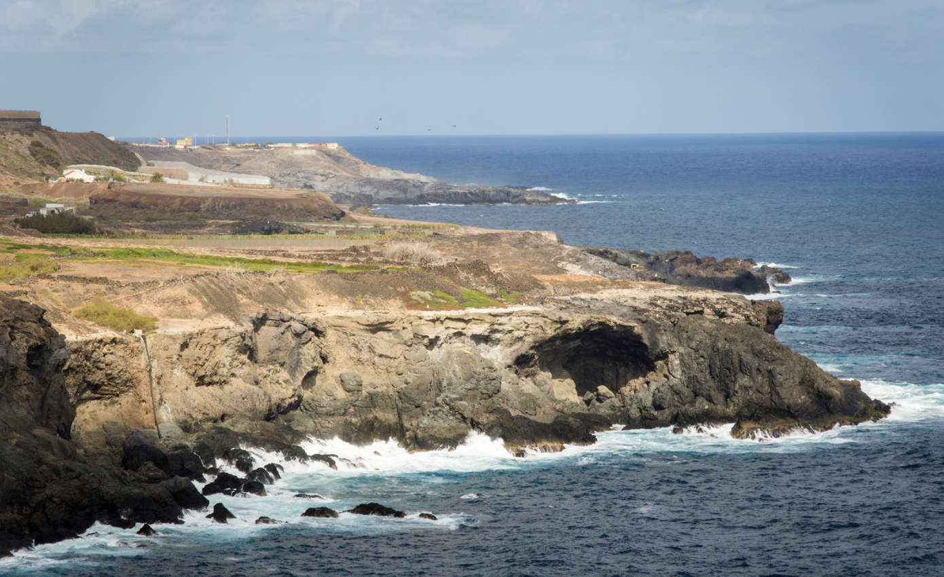
Big Question: How does the continental rise in the ocean affect the animals and resources we rely on every day?
Notes:
Our “big question” is: How does the continental rise in the ocean affect the animals and resources we rely on every day?
[Pause and illicit predictions from students.]
I love all these thoughtful scientific hypotheses! Be sure to keep this question and your predictions in mind as we move through these next few lessons, and we’ll continue to revisit it.

Slide 4
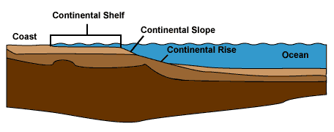
Demonstration
TEACHER DIRECTIONS:
Before viewing: Ask students what they already know about continental rises. Tell students today they will be learning about continental rises.
During: Discuss with students how the continental rise provides a smooth transition between the steeper continental slope and the flat ocean floor, creating a habitat for sea creatures.
After: Tell students that today they will be learning more about continental rises.
Notes:
Materials needed:
Large, shallow container (representing the ocean floor)
Sand or soil
Water
Small particles or objects (representing sediments)
Small toy figures or marine animal toys
Procedure:
Fill the large container with water, creating an "ocean floor."
Pour a layer of sand or soil on one side of the container, representing the continental slope.
Gradually slope the sand towards the center of the container, creating a gentle slope.
Sprinkle small particles or objects (sediments) onto the gentle slope, explaining that these are materials that settle on the continental rise.
Introduce small toy figures or marine animal toys onto the continental rise, emphasizing how this area supports marine life.
Discuss with students how the continental rise provides a smooth transition between the steeper continental slope and the flat ocean floor, creating a habitat for sea creatures.
This hands-on demonstration allows students to visualize the continental rise, understand its role in collecting sediments, and grasp its significance as a habitat for marine life. It also provides an opportunity for interactive discussions and questions.

Slide 5
Notes:
Before we move on to our new topic, let’s review some other words & concepts that you already learned and make sure you are firm in your understanding.

Slide 6
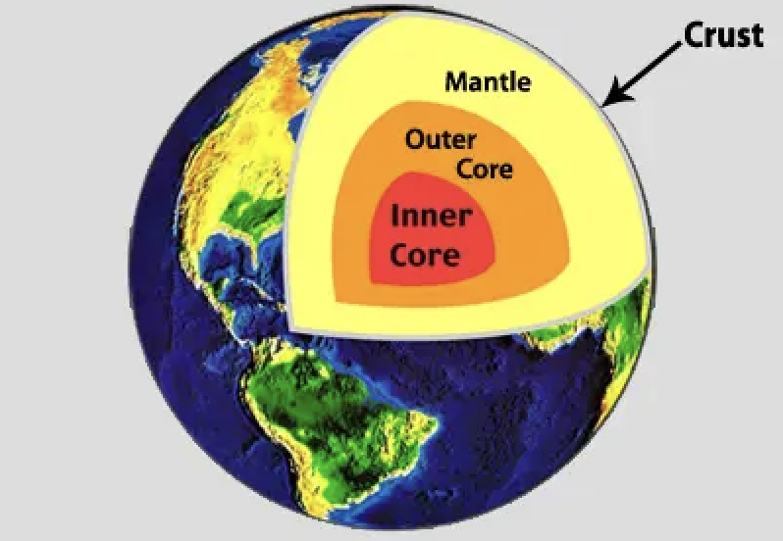
Crust: The outermost shell of the Earth
Notes:
Crust is the outermost shell of the Earth

Slide 7
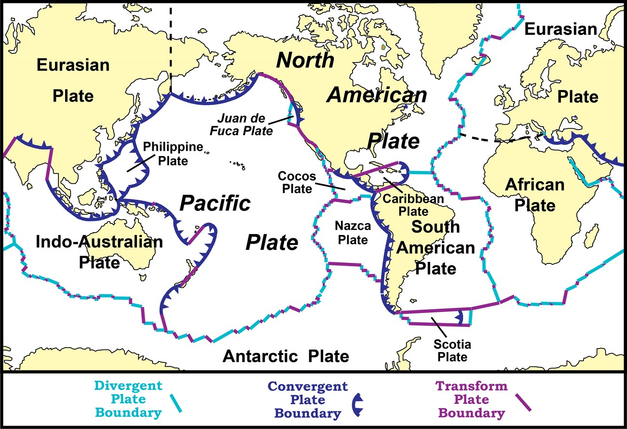
Tectonic Plates: Huge pieces of the Earth's surface that fit together like a puzzle and move very slowly over time
Notes:
Tectonic plates are huge pieces of the Earth’s surface that fit together like a puzzle an d move very slowly over time.

Slide 8
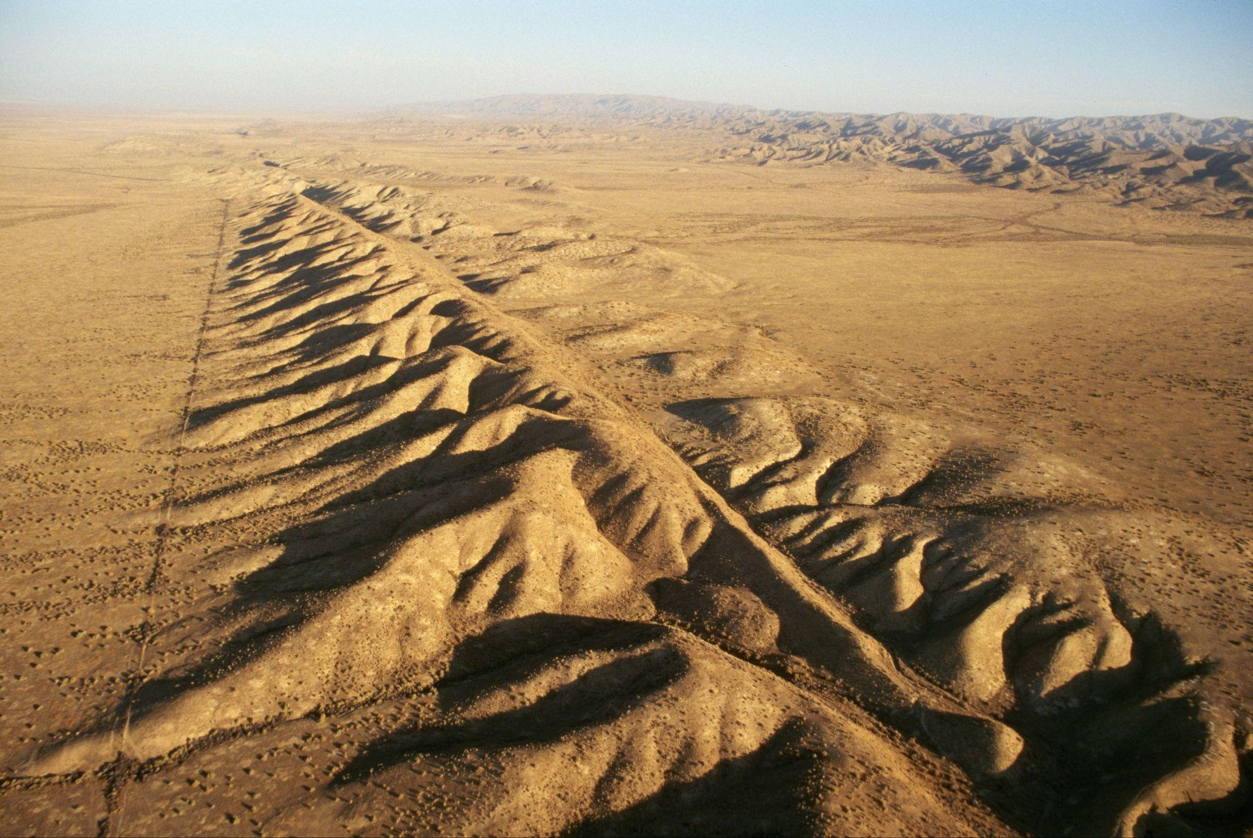
Fault: Long crack in the surface of the Earth
Notes:
A fault is a long crack in the surface of the Earth.

Slide 9
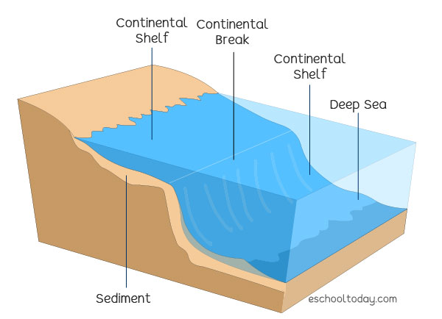
Continental Shelf: The edge of a continent that is underwater
Notes:
A continental shelf is the edge of a continent that is underwater

Slide 10
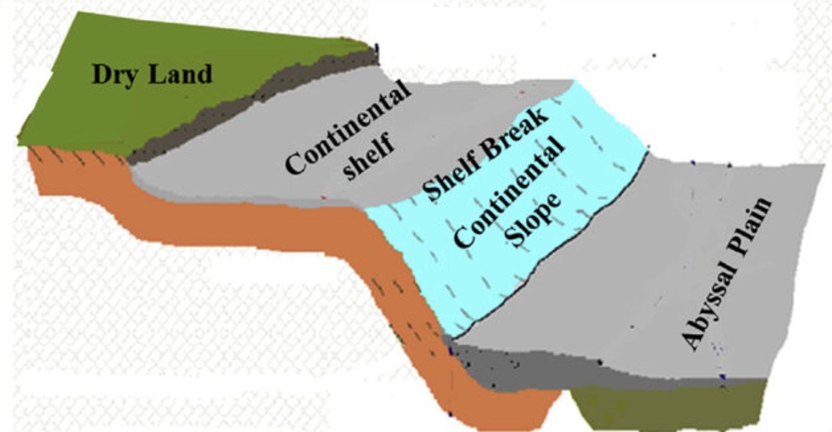
Solangi et al. (2018)
Continental Slope: a steep underwater hill that goes down from the edge of the continent into the deeper parts of the ocean
Notes:
A continental slope is a steep underwater hill that goes down from the edge of the continent into the deeper parts of the ocean
Image source: Solangi, S. H., Nazeer, A., Abbasi, S., & Zulkifil, M. M. (2019). Morphological features of continental shelf margin: Examples from the Pakistan Offshore. Geodesy and Geodynamics, 10(1), 77-91.

Slide 11
Notes:
Now let’s pause for a moment to review the information we have covered already.

Slide 12
The outermost shell of the Earth is called the…
Crust
Core
Notes:
The outermost shell of the Earth is called the…
[Crust]

Slide 13
The outermost shell of the Earth is called the…
Crust
Core
Notes:
The outermost shell of the Earth is called the…
[Crust]

Slide 14
True or False: Tectonic plates are huge pieces of the Earth's surface that fit together like a puzzle and move very slowly over time.
Notes:
True or False: Huge pieces of the Earth's surface that fit together like a puzzle and move very slowly over time.
[True]

Slide 15
True or False: Tectonic plates are huge pieces of the Earth's surface that fit together like a puzzle and move very slowly over time.
Notes:
True or False: Huge pieces of the Earth's surface that fit together like a puzzle and move very slowly over time.
[True]

Slide 16
A _____ is a long _____ in the surface of the Earth.
fault, crack
crack, fault
Notes:
A _____ is a long _____ in the surface of the Earth.
[fault, crack]

Slide 17
A _____ is a long _____ in the surface of the Earth.
fault, crack
crack, fault
Notes:
A _____ is a long _____ in the surface of the Earth.
[fault, crack]

Slide 18
Continental Shelf: The of a continent that is underwater
Notes:
A continental shelf is the of a continent that is underwater
[edge]

Slide 19
Continental Shelf: The edge of a continent that is underwater
Notes:
A continental shelf is the edge of a continent that is underwater

Slide 20
Solangi et al. (2018)
True or False: A continental slope is a steep underwater hill that goes down from the edge of the continent into the deeper parts of the ocean
Notes:
True or False: A continental slope is a steep underwater hill that goes down from the edge of the continent into the deeper parts of the ocean
[True]
Image source: Solangi, S. H., Nazeer, A., Abbasi, S., & Zulkifil, M. M. (2019). Morphological features of continental shelf margin: Examples from the Pakistan Offshore. Geodesy and Geodynamics, 10(1), 77-91.

Slide 21
Solangi et al. (2018)
True or False: A continental slope is a steep underwater hill that goes down from the edge of the continent into the deeper parts of the ocean
Notes:
True: A continental slope is a steep underwater hill that goes down from the edge of the continent into the deeper parts of the ocean
Image source: Solangi, S. H., Nazeer, A., Abbasi, S., & Zulkifil, M. M. (2019). Morphological features of continental shelf margin: Examples from the Pakistan Offshore. Geodesy and Geodynamics, 10(1), 77-91.

Slide 22
Continental Rise
Notes:
Now that we’ve reviewed, let’s define the phrase continental rise.

Slide 23
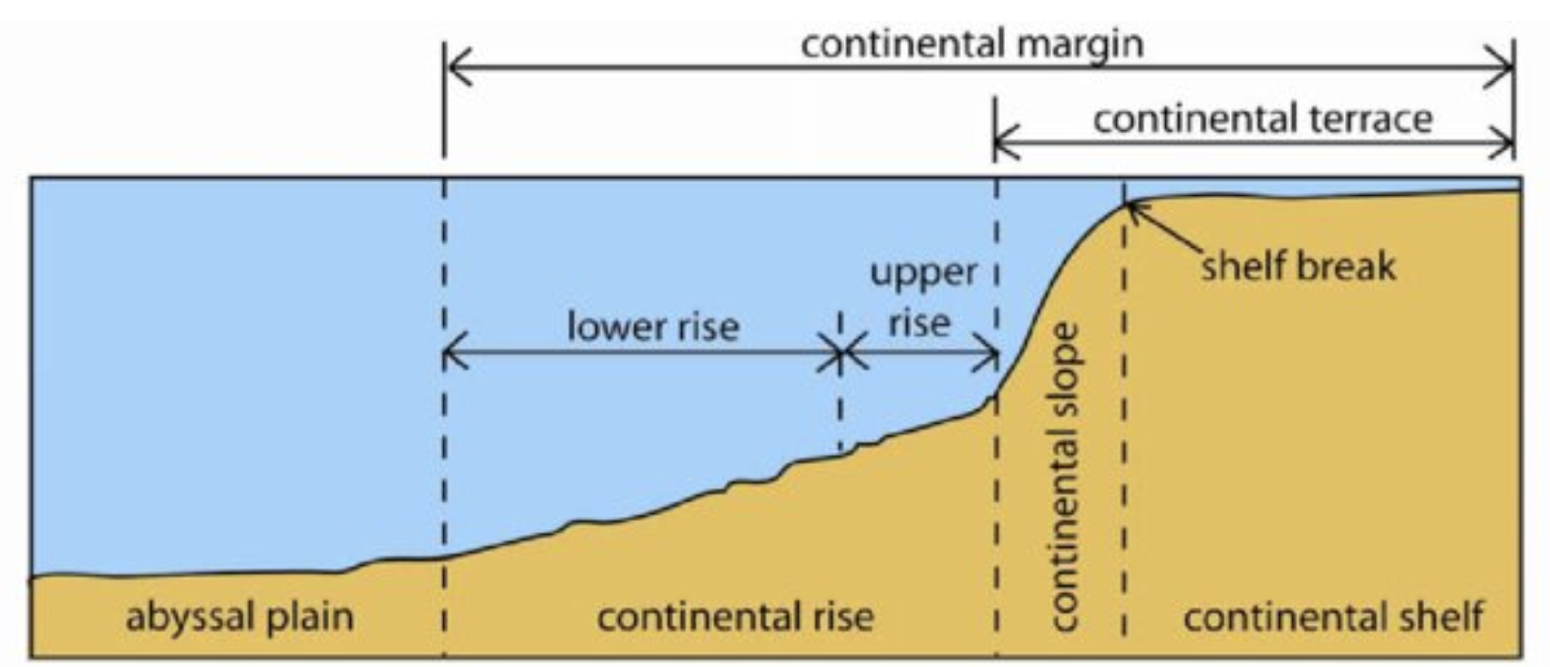
Woo (2005)
Continental Rise: a gentle slope at the ocean's bottom where sand and mud collect
Notes:
A continental rise is a gentle slope at the ocean's bottom where sand and mud collect
Image source: Woo, L. M. (2005). Summer circulation and water masses along the West Australian coast (Doctoral dissertation, University of Western Australia).
Chicago

Slide 24
Notes:
Let’s check-in for understanding.

Slide 25
Woo (2005)
What is a continental rise?
Notes:
What is a continental rise?
[A continental rise is a gentle slope at the ocean's bottom where sand and mud collect]
Image source: Woo, L. M. (2005). Summer circulation and water masses along the West Australian coast (Doctoral dissertation, University of Western Australia).
Chicago

Slide 26
Notes:
That is the basic definition, but there is a bit more you need to know.

Slide 27
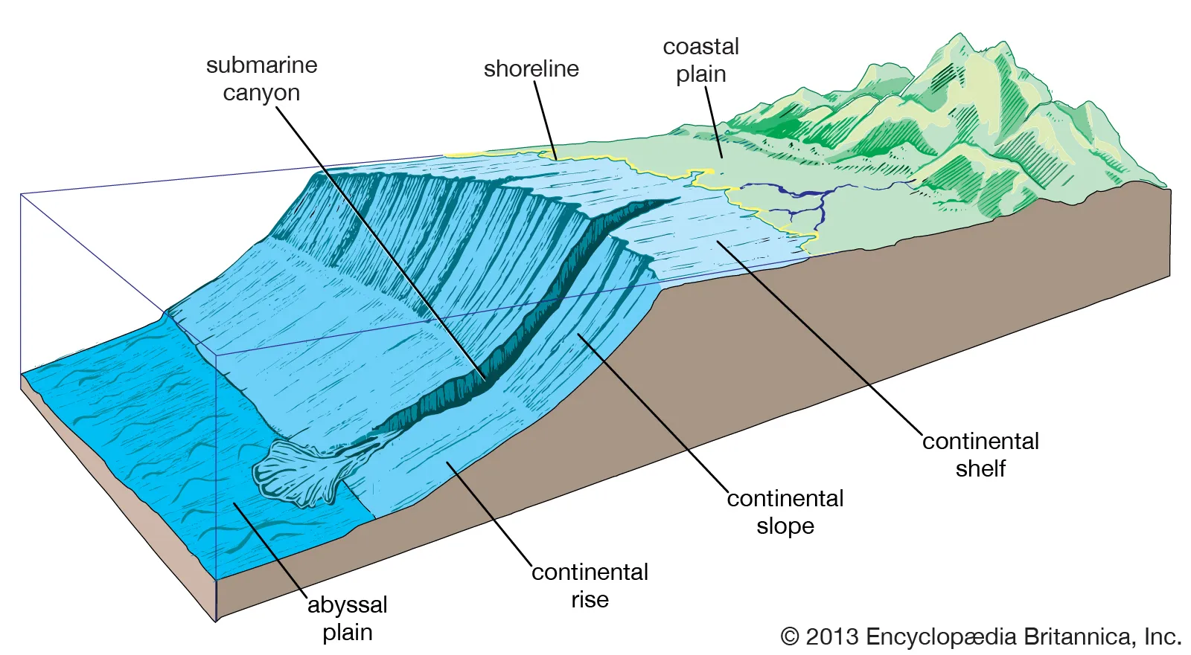
The continental rise is like the bottom of a hill where the land gently slopes downward. This area is special because it's where tiny bits of sand, mud, and other sediments slowly come to rest.
Notes:
The continental rise is like the bottom of a hill where the land gently slopes downward. This area is special because it's where tiny bits of sand, mud, and other sediments slowly come to rest.

Slide 28
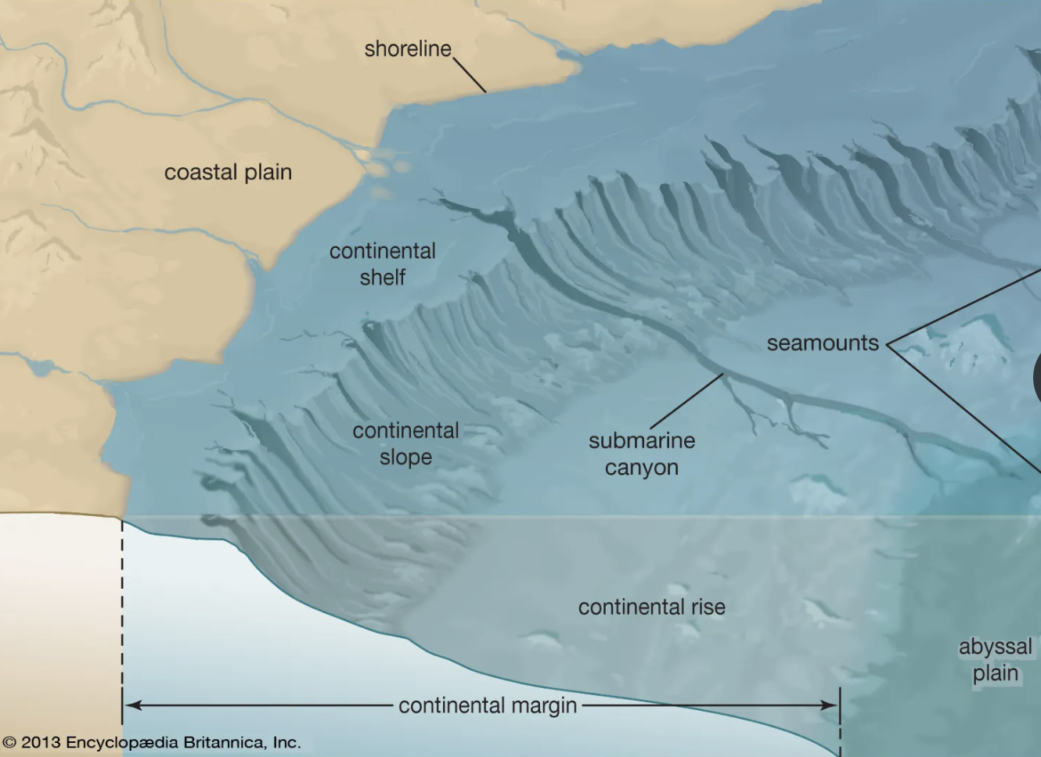
When rivers bring rocks and soil into the ocean, or when tiny ocean creatures die, their remains drift down to this gentle slope and settle there. Over time, these collected sediments create a smooth transition between the steeper continental slope and the flat ocean floor.
Notes:
When rivers bring rocks and soil into the ocean, or when tiny ocean creatures die, their remains drift down to this gentle slope and settle there. Over time, these collected sediments create a smooth transition between the steeper continental slope and the flat ocean floor.

Slide 29
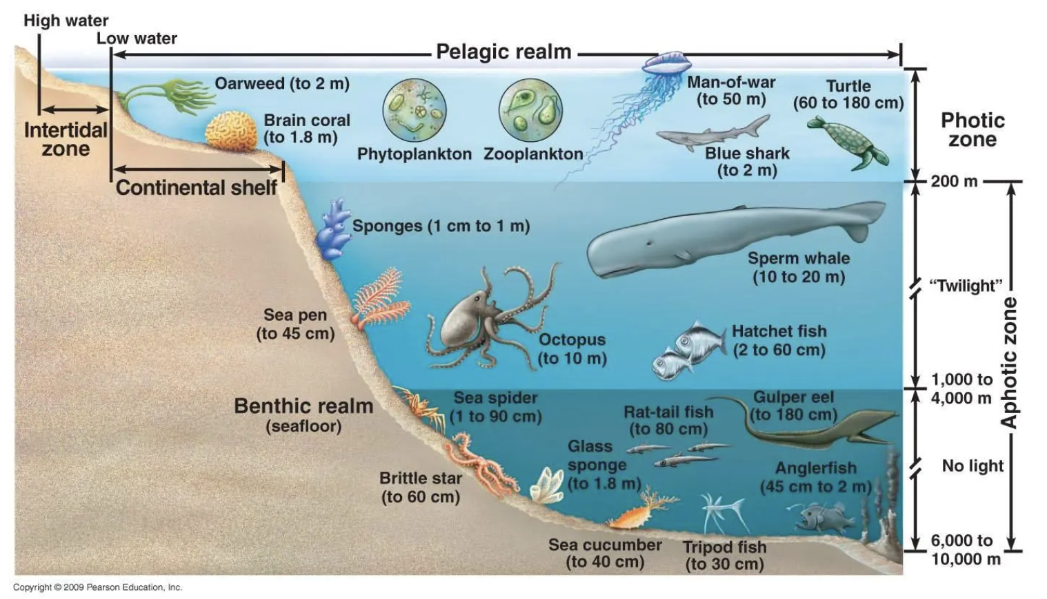
The continental rise is an essential part of the ocean's recycling system. The sediments that gather on the continental rise become a cozy home for various sea creatures. It's like a bustling neighborhood where animals find food and shelter. Plus, the rise plays a crucial role in keeping the ocean environment balanced and healthy.
Notes:
The continental rise is an essential part of the ocean's recycling system. The sediments that gather on the continental rise become a cozy home for various sea creatures. It's like a bustling neighborhood where animals find food and shelter. Plus, the rise plays a crucial role in keeping the ocean environment balanced and healthy.

Slide 30
Notes:
Let’s check-in for understanding.

Slide 31
True or False: The continental rise is like the top of a hill where the land gently slopes upward.
Notes:
True or False: The continental rise is like the top of a hill where the land gently slopes upward.
[False]

Slide 32
True or False: The continental rise is like the top of a hill where the land gently slopes upward.
Notes:
False: The continental rise is like the bottom of a hill where the land gently slopes downward.

Slide 33
Over time, collected sediments on the continental rise create a smooth transition between the steeper continental and the flat ocean .
Notes:
Over time, collected sediments on the continental rise create a smooth transition between the steeper continental and the flat ocean .
[slope, floor]

Slide 34
Over time, collected sediments on the continental rise create a smooth transition between the steeper continental slope and the flat ocean floor.
Notes:
Over time, collected sediments on the continental rise create a smooth transition between the steeper continental slope and the flat ocean floor.

Slide 35
Notes:
Now, let’s talk about some examples of a continental shelf.

Slide 36
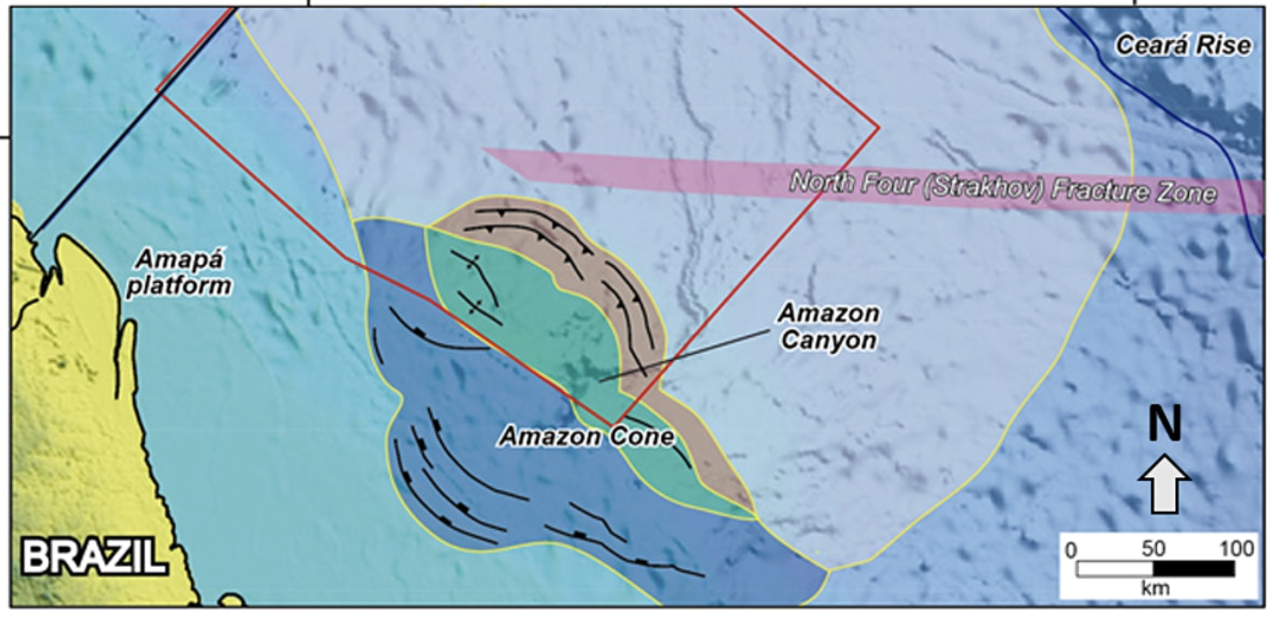
The Amazon Cone is an example of a continental rise. It is located off the coast of Brazil and the Amazon River’s rocks and soil adds to this rise’s large size.
Notes:
The Amazon Cone is an example of a continental rise. It is located off the coast of Brazil and the Amazon River’s rocks and soil adds to this rise’s large size.
Image Source: https://cgnhouston.org/event/cretaceous-plays/

Slide 37
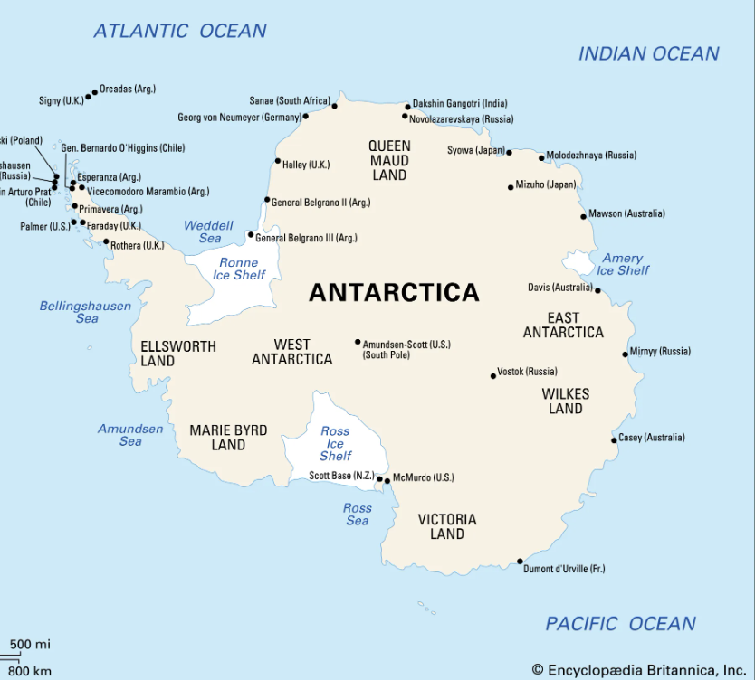
Another example of a continental rise can be found around Antarctica. It goes all around Antarctica and covers 39.4% of the Southern Ocean.
Photo: Georgia Coast Atlas
Notes:
Another example of a continental rise can be found around Antarctica. It goes all around Antarctica and covers 39.4% of the Southern Ocean.
Image Source: © Encyclopedia Britannica, Inc.

Slide 38
Notes:
Now, let’s talk about some non-examples of continental shelf.

Slide 39
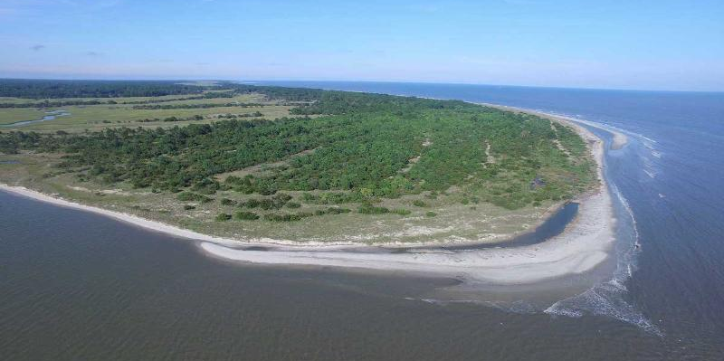
The Georgia Continental Shelf is NOT an example of a continental rise. It is a continental shelf which is the edge of a continent that is underwater.
Notes:
The Georgia Continental Shelf is NOT an example of a continental rise. It is a continental shelf which is the edge of a continent that is underwater.

Slide 40
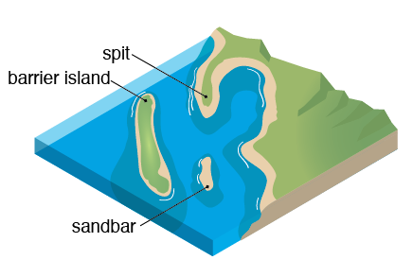
A sandbar is NOT an example of a continental rise. Sandbars are shallow underwater formations found near shorelines. They are often temporary and can shift with tides and currents, whereas continental shelves are more stable and extend for greater distances from the coastline.
Notes:
A sandbar is not an example of a continental rise. Sandbars are often temporary and can shift with tides and currents, whereas continental shelves are more stable and extend for greater distances from the coastline.

Slide 41
Notes:
Now let’s pause for a moment to check your understanding.

Slide 42
Why are sandbars and the Georgia Continental Shelf not examples of a continental rise?
Notes:
Why are sandbars and the Georgia Continental Shelf not examples of a continental rise?
[Sandbars are underwater or partially exposed ridges of sand that may be found near coastlines, in estuaries, or along the ocean floor and the Georgia Continental Shelf is a continental shelf which is the edge of a continent that is underwater. While a continental rise is a gentle slope at the ocean's bottom where sand and mud collect]

Slide 43
Remember!!!
Notes:
So remember!

Slide 44
Woo (2005)
Continental Rise: a gentle slope at the ocean's bottom where sand and mud collect
Notes:
A continental rise is a gentle slope at the ocean's bottom where sand and mud collect
Image source: Woo, L. M. (2005). Summer circulation and water masses along the West Australian coast (Doctoral dissertation, University of Western Australia).
Chicago

Slide 45
Notes:
We will now complete this concept map, called a Frayer model, to summarize and further clarify what you have learned about the term continental rise.

Slide 46
Definition
Picture
Continental Rise
Example
How do continental rises impact my life?
Notes:
To complete the Frayer model, we will choose from four choices the correct picture, definition, example, and response to the question, “How do continental rises impact my life?” Select the best response for each question using the information you just learned. As we select responses, we will see how this model looks filled in for the term continental rise.

Slide 47
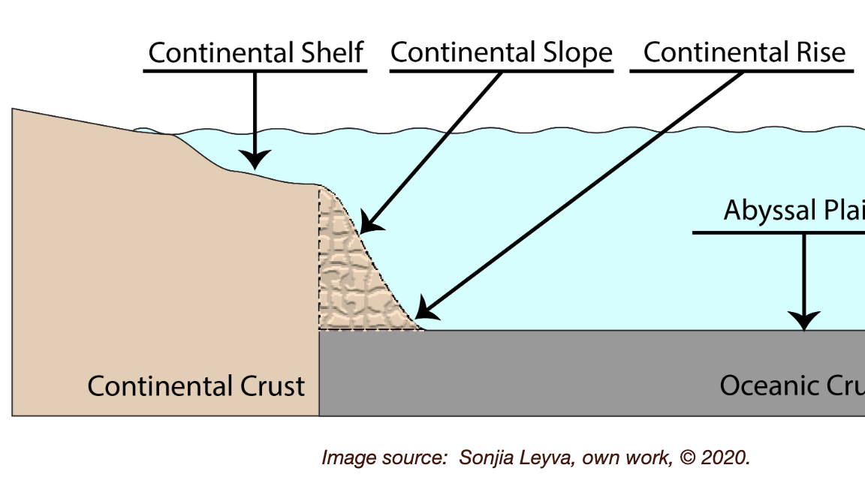
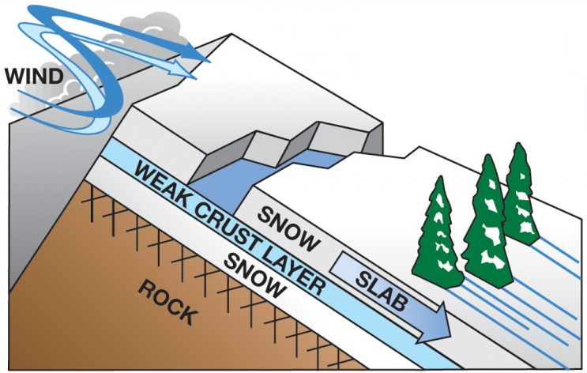
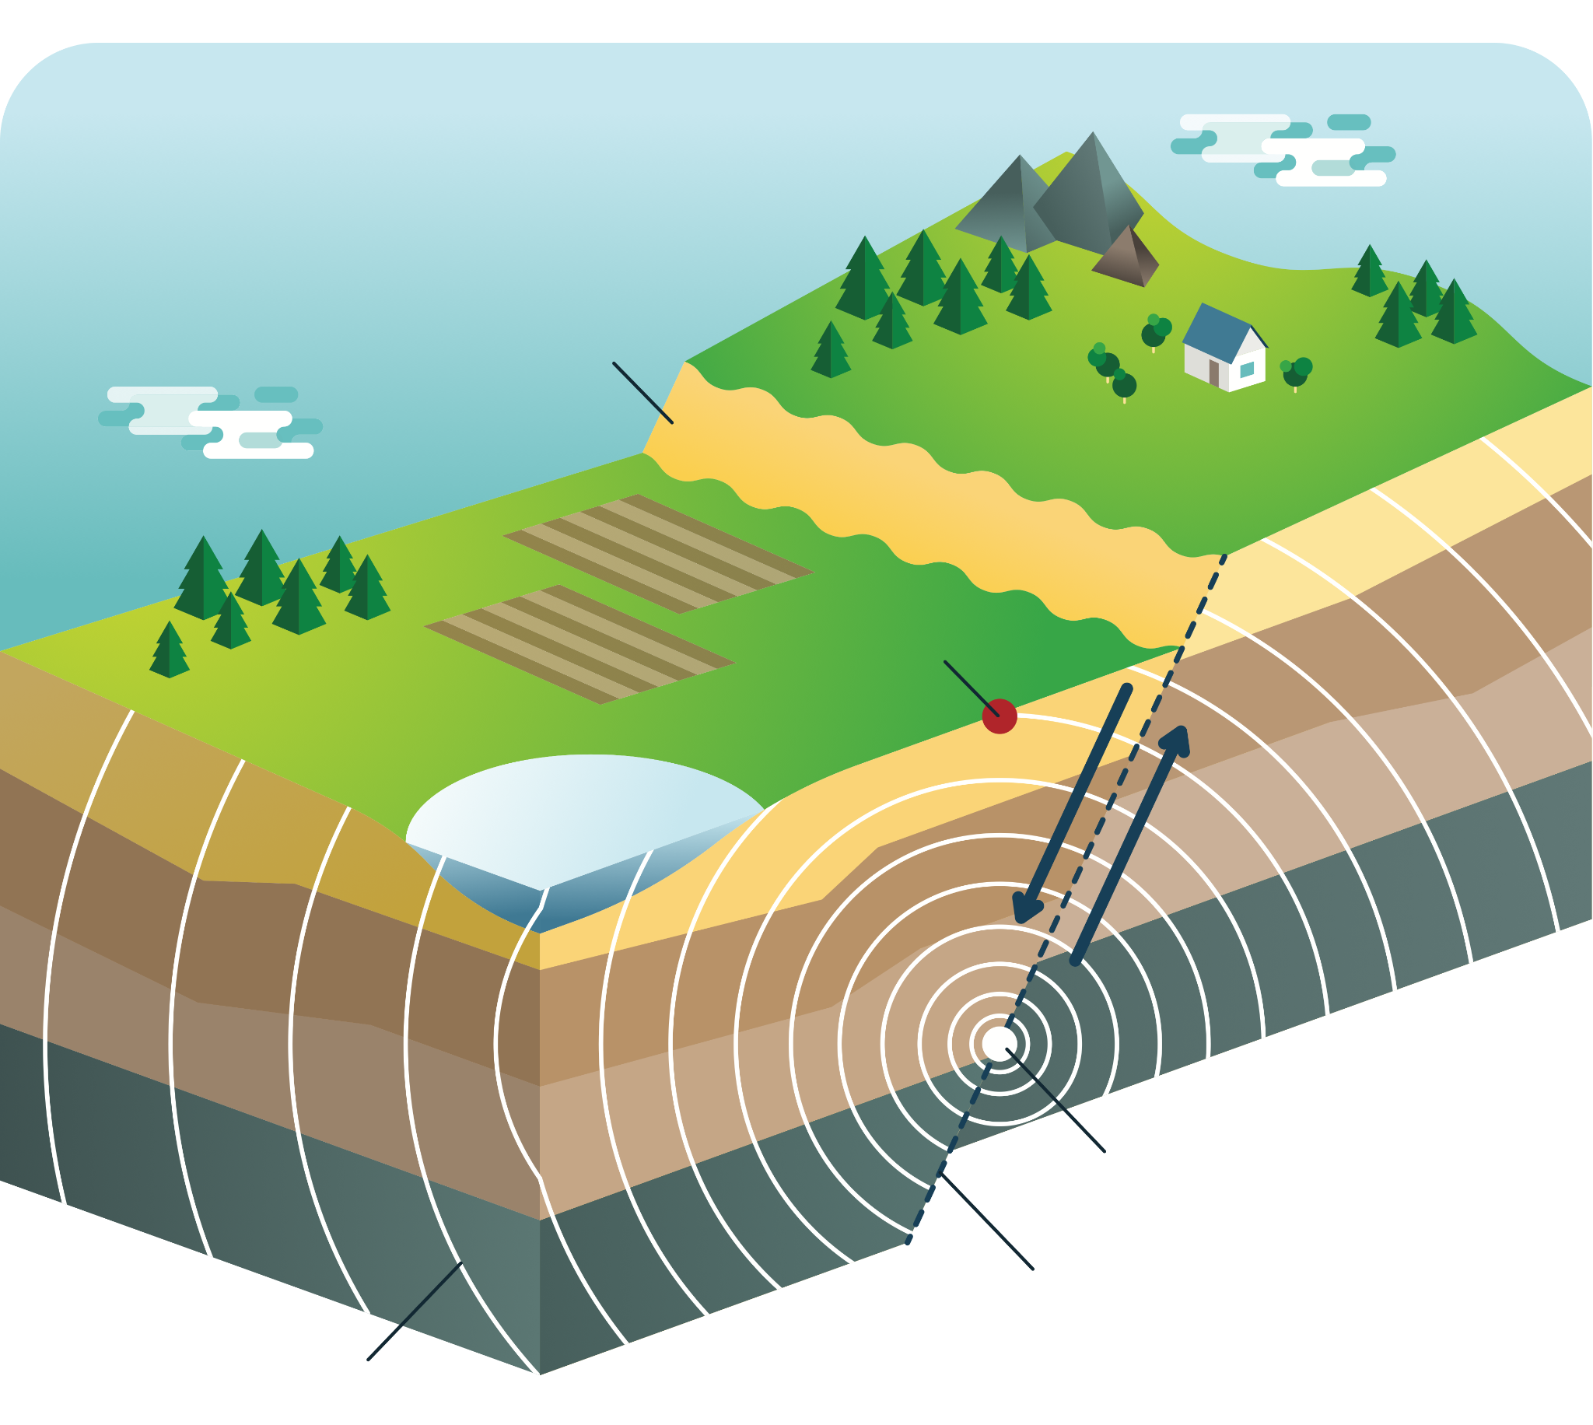
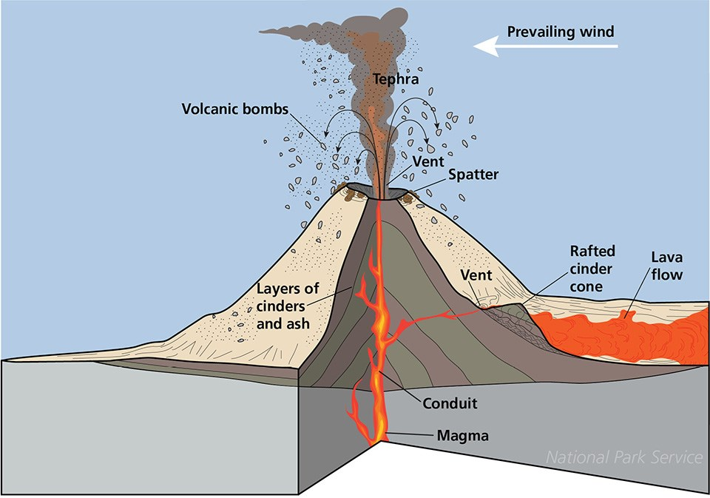
Directions: Choose the correct picture of an continental rise from the choices below.
A
B
C
D
Notes:
Choose the one correct picture of a continental rise from these four choices.

Slide 48
Directions: Choose the correct picture of an continental rise from the choices below.
A
B
C
D
Notes:
This is the picture that shows a continental rise.

Slide 49
Definition
Picture
Continental Rise
Example
How do continental rises impact my life?
Notes:
Here is the Frayer model filled in with a picture of a continental rise.

Slide 50
Directions: Choose the correct definition of a continental rise from the choices below.
A
A steep underwater hill that goes down from the edge of the continent into the deeper parts of the ocean
B
The edge of a continent that is underwater
C
A gentle slope at the ocean's bottom where sand and mud collect
D
Deep, steep-sided valleys carved into the seafloor by erosion.
Notes:
Choose the correct definition of a continental rise from the choices below.

Slide 51
Directions: Choose the correct definition of a continental rise from the choices below.
A
A steep underwater hill that goes down from the edge of the continent into the deeper parts of the ocean
B
The edge of a continent that is underwater
C
A gentle slope at the ocean's bottom where sand and mud collect
D
Deep, steep-sided valleys carved into the seafloor by erosion.
Notes:
“A gentle slope at the ocean's bottom where sand and mud collect” is correct! This is the definition of a continental rise.

Slide 52
Definition
Picture
A gentle slope at the ocean's bottom where sand and mud collect
Continental Rise
Example
How do continental rises impact my life?
Notes:
Here is the Frayer Model with a picture and the definition filled in for a continental rise: A gentle slope at the ocean's bottom where sand and mud collect.

Slide 53
Directions: Choose the correct example of a continental rise from the choices below.
A
Snow sliding down a plane
B
North Sea Continental Shelf
C
Strong winds that tear down trees
D
The Amazon Cone
Notes:
Choose the correct example of a continental rise from the choices below.

Slide 54
Directions: Choose the correct example of a continental rise from the choices below.
A
Snow sliding down a plane
B
North Sea Continental Shelf
C
Strong winds that tear down trees
D
The Amazon Cone
Notes:
“The Amazon Cone” is correct! This is an example of a continental rise.

Slide 55
Definition
Picture
A gentle slope at the ocean's bottom where sand and mud collect
Continental Rise
The Amazon Cone
Example
How do continental rises impact my life?
Notes:
Here is the Frayer Model with a picture, definition, and an example of a continental rise: The Amazon Cone

Slide 56
Directions: Choose the correct response for “How do continental rises impact my life?” from the choices below.
A
Continental rises help protect the coast from big waves, making beaches safer for activities like swimming and playing.
B
Continental rises explain how movement of animals on our planet impacts food and crops we have available to us.
Continental rises help sea animals thrive, making the ocean a healthy home for fish. This is important because it ensures a variety of seafood to eat.
C
Continental rises create different trenches and ranges in the ocean which influences weather patterns on Earth.
D
Notes:
Choose the one correct response for “how do continental rises impact my life?” from these four choices.

Slide 57
Directions: Choose the correct response for “How do continental rises impact my life?” from the choices below.
A
Continental rises help protect the coast from big waves, making beaches safer for activities like swimming and playing.
B
Continental rises explain how movement of animals on our planet impacts food and crops we have available to us.
Continental rises help sea animals thrive, making the ocean a healthy home for fish. This is important because it ensures a variety of seafood to eat.
C
Continental rises create different trenches and ranges in the ocean which influences weather patterns on Earth.
D
Notes:
“Continental rises help sea animals thrive, making the ocean a healthy home for fish. This is important because it ensures a variety of seafood to eat..” That is correct! This is an example of how continental rises impacts your life.

Slide 58
Definition
Picture
A gentle slope at the ocean's bottom where sand and mud collect
Continental Rise
Continental rises help sea animals thrive, making the ocean a healthy home for fish. This is important because it ensures a variety of seafood to eat.
The Amazon Cone
Example
How do continental rises impact my life?
Notes:
Here is the Frayer Model with a picture, definition, example, and a correct response to “how do continental rises impact my life?”: Continental rises help sea animals thrive, making the ocean a healthy home for fish. This is important because it ensures a variety of seafood to eat.

Slide 59
Remember!!!
Notes:
So remember!

Slide 60
Woo (2005)
Continental Rise: a gentle slope at the ocean's bottom where sand and mud collect
Notes:
A continental rise is a gentle slope at the ocean's bottom where sand and mud collect
Image source: Woo, L. M. (2005). Summer circulation and water masses along the West Australian coast (Doctoral dissertation, University of Western Australia).
Chicago

Slide 61
Big Question: How does the continental rise in the ocean affect the animals and resources we rely on every day?
Notes:
Let’s reflect once more on our big question. Our “big question” is: How does the continental rise in the ocean affect the animals and resources we rely on every day?
Does anyone have any additional examples to share that haven’t been discussed yet?
I love all these thoughtful scientific hypotheses! Be sure to keep this question and your predictions in mind as we move through these next few lessons, and we’ll continue to revisit it.

Slide 62
Notes:
Thanks for watching, and please continue watching CAPs available from this website.

Slide 63
This Was Created With Resources From:
Questions or Comments
Michael Kennedy, Ph.D. MKennedy@Virginia.edu
Rachel L Kunemund, Ph.D. rk8vm@virginia.edu

