Slide 1
Intro
“Big Idea” Question
Review Concepts
Check-In Questions
Teacher Demo
Vocabulary
Student-Friendly Definition
Examples & Non-Examples
Morphological Word Parts
Simulation/Activity
Notes:
OK everyone, get ready for our next lesson. Just as a reminder, these are the different components that our lesson may include, and you’ll see these icons in the top left corner of each slide so that you can follow along more easily!
Feedback: Using clear and consistent language when introducing today's content helps students understand what is expected.

Slide 2
Covalent Bond
Intro
Notes:
Today we will be looking at covalent bonds.

Slide 3
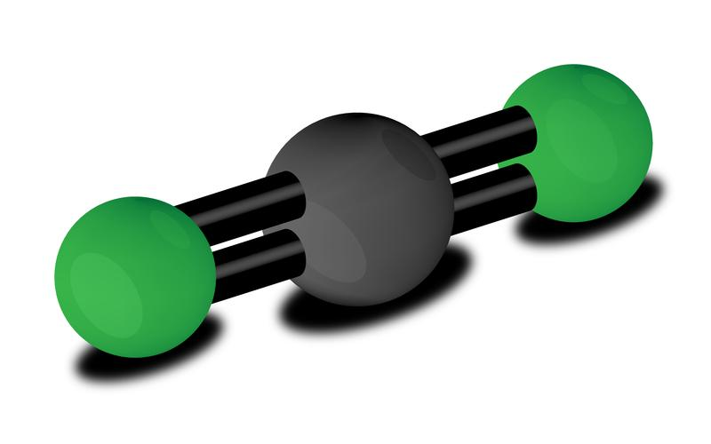
Big Question: How can learning about covalent bonds, molecules, and chemical formulas help us learn more about the importance of atoms?
H₂O
Notes:
Our “big question” is: How can learning about covalent bonds, molecules, and chemical formulas help us learn more about the importance of atoms?
[Pause and illicit predictions from students.]
I love all these thoughtful scientific hypotheses! Be sure to keep this question and your predictions in mind as we move through these next few lessons, and we’ll continue to revisit it.
Feedback: Providing a rationale during the anticipatory set makes it clear to students what is expected of them and what they should focus on learning.

Slide 4
Notes:
Before we move on to our new vocabulary term, let’s review some other words & concepts that you already learned and make sure you are firm in your understanding.

Slide 5
Matter: has mass and takes up space
Notes:
Matter is anything that has mass and takes up space.

Slide 6
Atom: smallest whole unit of matter
Atom
Atom
Atom
Atom
Atom
Notes:
An atom is the smallest whole unit of matter. Atoms have three particles: neutrons, protons, and electrons

Slide 7
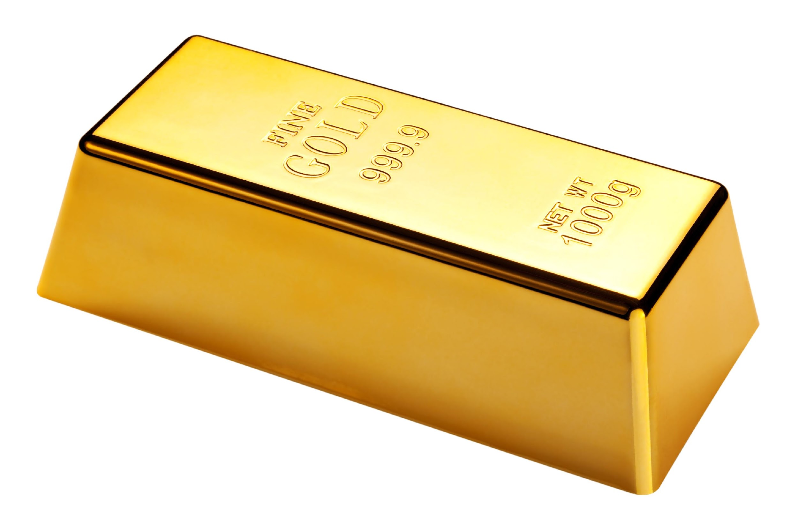
Element: a pure substance containing only one type of individual atoms
Notes:
An element is a pure substance containing only 1 type of individual atoms.
Feedback: It is important when reviewing previously learned material that you pause and check for understanding, if students are grasping previous material you may need to tailor your instruction.

Slide 8
Notes:
All of the known elements are found on the periodic table of elements. There are currently 118 known elements.

Slide 9
Electron
Notes:
Electrons orbit the nucleus and have a negative charge.

Slide 10
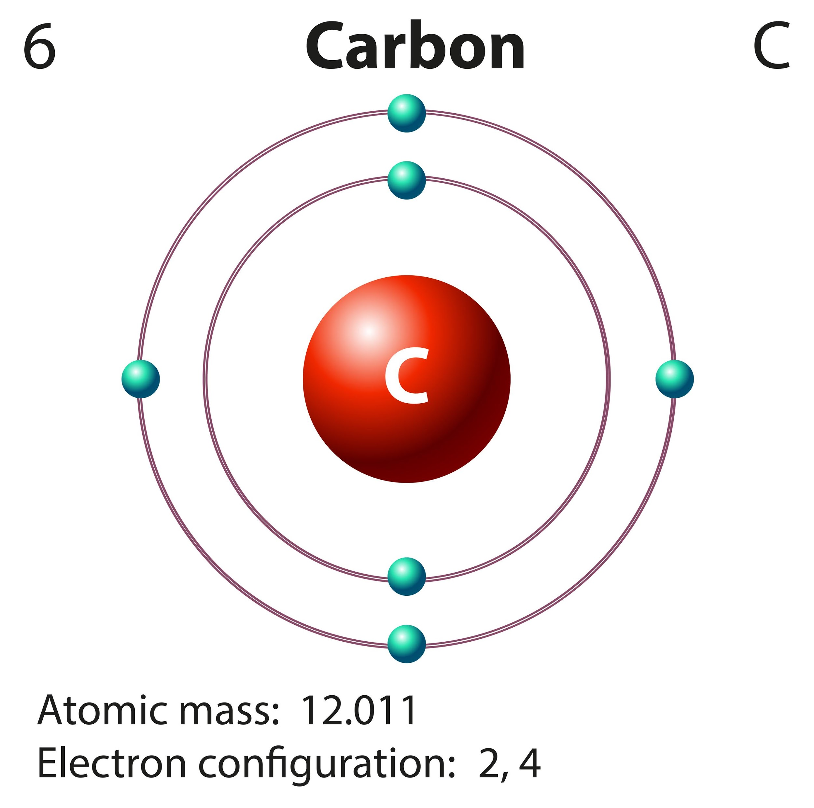
Valence Electrons: electrons in the outermost shell of an atom
Notes:
Valence electrons are the electrons in the outermost shell of an atom.

Slide 11
1 2 3 4 5 6 7 8
Notes:
The highest number of valence electrons an atom can have is eight, and atoms that have eight valence electrons are more stable than atoms with less than eight valence electrons.

Slide 12
Molecule: particle containing two or more atoms of the same OR different elements
OR
Notes:
A molecule is a particle containing 2 or more atoms of the same OR different elements.

Slide 13
Notes:
The atoms in a molecule are linked or held together through chemical bonds, which are visually represented by the red lines above

Slide 14
Chemical Bonds
Ionic Bonds
Covalent Bonds
Notes:
There are two types of chemical bonds: ionic bonds and covalent bonds. Today we will learn about covalent bonds.

Slide 15
Notes:
Now let’s pause for a moment to check your understanding.
Feedback: Remember to make adjustments to your lesson and content if you see some students not demonstrating understanding, this can help them make connections and prevent frustration.

Slide 16
What are the two characteristics of matter?
Notes:
What are the two characteristics of matter?
[Matter is anything that has mass and takes up space.]

Slide 17
True/False: An element is the smallest unit of matter.
Notes:
True/False: An element is the smallest unit of matter.

Slide 18
True/False: An element is the smallest unit of matter.
Notes:
True/False: An element is the smallest unit of matter.
[False: An atom is the smallest unit of matter]

Slide 19
What is an element?
Notes:
What is an element?
[An element is a pure substance containing only 1 type of individual atoms]

Slide 20
What table shows and organizes all the known elements?
Notes:
What table shows and organizes all the known elements?
[All of the known elements are found on the periodic table of elements. There are currently 118 known elements.]

Slide 21
What particle orbits the nucleus and has a negative charge?
Notes:
What particle orbits the nucleus and has a negative charge?
[Electrons orbit the nucleus and have a negative charge.]

Slide 22
What are valence electrons?
Notes:
What are valence electrons?
[Valence electrons are the electrons in the outermost shell of an atom.]

Slide 23
What is a molecule?
OR
Notes:
What is a molecule?
[A molecule is a particle containing 2 or more atoms of the same OR different elements.]

Slide 24
How are molecules linked together?
Notes:
How are molecules linked together?
[The atoms in a molecule are linked or held together through chemical bonds, which are visually represented by the red lines above.]

Slide 25
What are the two types of chemical bonds?
Chemical Bonds
?
?
Notes:
What are the two types of chemical bonds?
[There are two types of chemical bonds: ionic bonds and covalent bonds.]

Slide 26
Covalent Bond
Notes:
Now that we’ve reviewed, let’s define our new term, covalent bond.

Slide 27
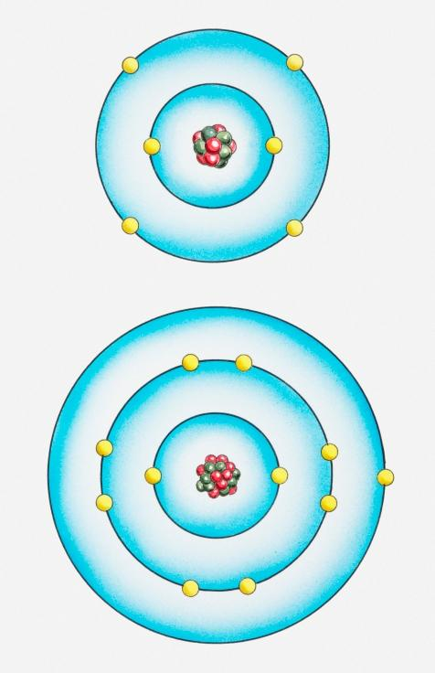
Covalent Bond: A chemical bond in which two atoms come together and share valence electrons
Shared
Come Together
Come Together
Notes:
A covalent bond is a chemical bond in which two or more atoms come together and share outer electrons, or valence electrons.
Feedback: Remember to use images with introducing new content such as student-friendly definitions it can help students remember key points and make sense of the new information.

Slide 28
Notes:
Let’s check-in for understanding.

Slide 29
What happens during a covalent bond?
Shared
Come Together
Come Together
Notes:
What happens during a covalent bond?
[A covalent bond is a chemical bond in which two or more atoms come together and share outer electrons, or valence electrons.]

Slide 30
Notes:
Now, let’s talk about some examples of a covalent bond.
Feedback: Clear and explicit explanations take the guesswork out of it for students. Using explicit descriptions makes it easier for students to grasp the content

Slide 31
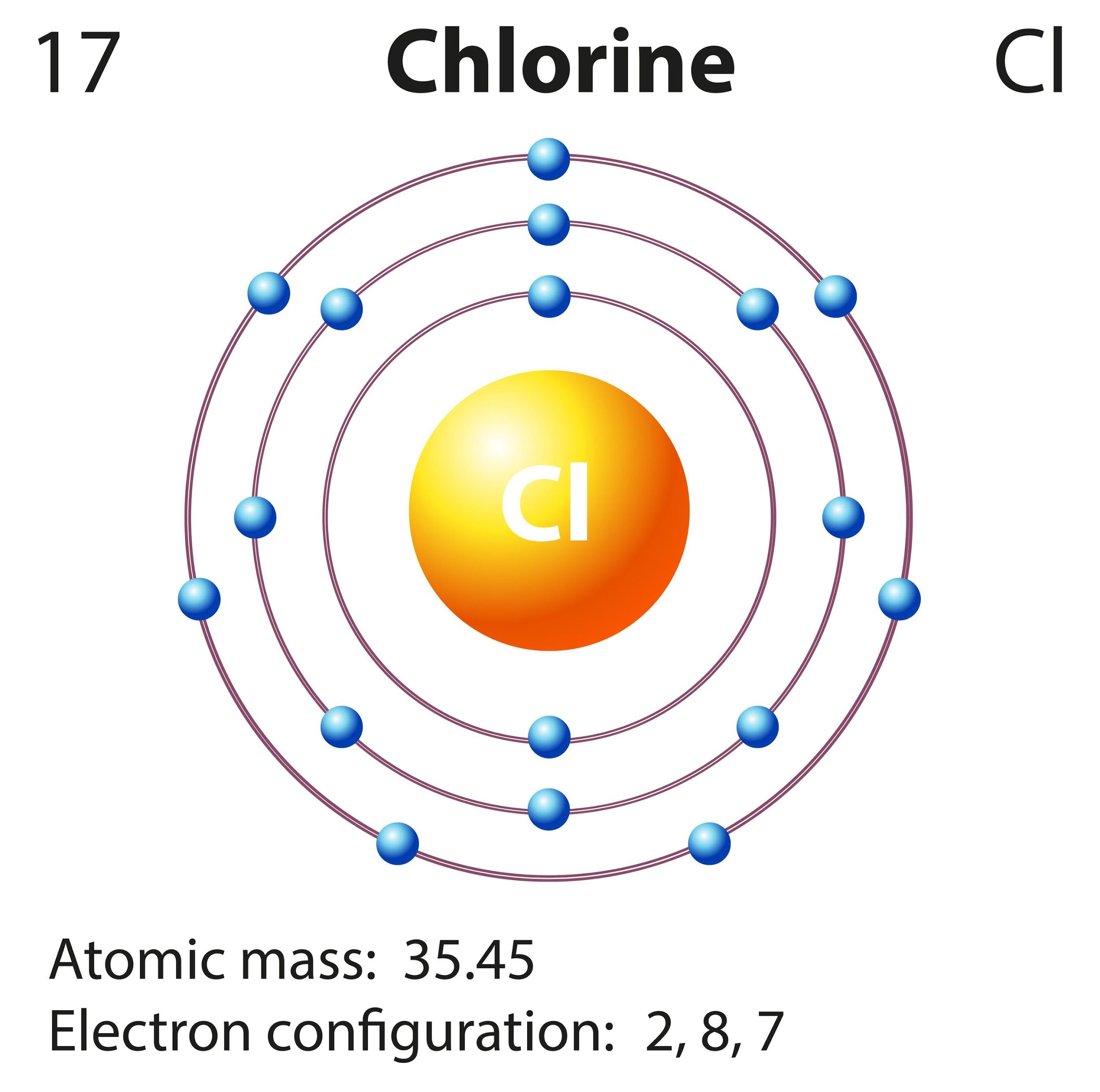
Notes:
A chlorine atom has seven valence electrons—it is unstable because it does not have eight valence electrons

Slide 32
Notes:
BUT what if two chlorine atoms are near each other?

Slide 33
Notes:
They can share electrons!! If they each share one electron with one another then they can both have eight valence electrons and be stable.

Slide 34
Cl
Cl
Two Chlorine Atoms
Covalent Bond Formed
Cl
Cl
One Chlorine Gas Molecule
Notes:
A bond made through sharing electrons is called a covalent bond! Now the two chlorine atoms are a chlorine gas molecule

Slide 35
Notes:
Now let’s pause for a moment to check your understanding.
Feedback: Keep in mind, it is important to continuously ask students questions and check for understanding. This will let you know if further instruction on certain content is needed.

Slide 36
Which electrons could these chlorine atoms share?
Notes:
Which electrons could these chlorine atoms share?
[The can share the outside or valence electrons.]

Slide 37
What happens when the two chlorine atoms share a valence electron?
Notes:
What happens when the two chlorine atoms share a valence electron?
[If they each share one electron with one another then they can both have eight valence electrons and be stable.
So the two chlorine atoms stick close together and form a bond]

Slide 38
What is the name of the bond made through sharing electrons?
Cl
Cl
Two Chlorine Atoms
Cl
Cl
Notes:
What is the name of the bond made through sharing electrons?
[A bond made through sharing electrons is called a covalent bond!]

Slide 39
What happens to the chlorine atoms after a covalent bond has been formed?
Cl
Cl
Two Chlorine Atoms
Cl
Cl
Notes:
What happens to the chlorine atoms after a covalent bond has been formed?
[The chlorine atoms were bonded by a covalent bond and turned into a chlorine gas molecule]

Slide 40
Notes:
Next, let’s talk about some non-examples of covalent bond.

Slide 41
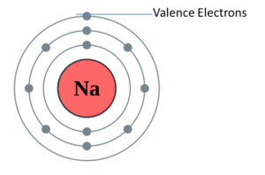
Notes:
Here is a single sodium atom. This is not an example of a covalent bond, because there has to be another atom that the sodium atom would be able to share a valence electron with
Feedback: Remember to take a moment to explicitly distinguish between the similarities of the non-examples and the vocabulary term you were covering today. This helps students resolve any misconceptions they may have.

Slide 42
Notes:
Again, there is no covalent bond, this is just a chlorine atom

Slide 43
Notes:
Now let’s pause for a moment to check your understanding.

Slide 44
What is a covalent bond?
Shared
Come Together
Come Together
Notes:
What is a covalent bond?
[A covalent bond is a chemical bond in which two or more atoms come together and share outer electrons, or valence electrons.]

Slide 45
Is this an example of a covalent bond? Explain.
Notes:
Is this an example of a covalent bond? Explain.
[There is no covalent bond, this is just a chlorine atom. A covalent bond bonds multiple atoms.]

Slide 46
Notes:
Let’s break down the word parts of covalent.

Slide 47
Covalent
Cov
valent
(prefix)
(root word)
Notes:
The word covalent can be broken up into two parts: the prefix “co” and the root word “valent”.
Feedback: Breaking down the vocabulary term into word parts and defining each part is essential in building student understanding of the word parts.

Slide 48
Covalent
Cov
valent
with or together
Notes:
The prefix “co” means with or together.

Slide 49
Covalent
Cov
valent
strong
Notes:
The root word valent comes from the Latin word meaning “strong”.

Slide 50
Co valent
Covalent
Strong together
Notes:
When you put the prefix co with the root word valent, we get the meaning “strong together.” So, we can remember that covalent bonds are strong bonds because valence electrons have to come together to form a strong bond.
Feedback: Reuniting the word parts is a crucial step in helping students understand the whole picture when reviewing morphological word parts.

Slide 51
Notes:
Let’s check-in for understanding.

Slide 52
Explain how breaking up the word parts in the word “covalent” can help you remember what it means.
Covalent
Cov
valent
(prefix)
(root word)
Notes:
Explain how breaking up the word parts in the word “covalent” can help you remember what it means.
[When you put the prefix co with the root word valent, we get the meaning “strong together.” So, we can remember that covalent bonds are strong bonds because valence electrons have to come together to form a strong bond.]

Slide 53
What are the two types of chemical bonds?
Chemical Bonds
?
?
Notes:
What are the two types of chemical bonds?
[There are two types of chemical bonds: ionic bonds and covalent bonds.]

Slide 54
What happens during a covalent bond?
Shared
Come Together
Come Together
Notes:
What happens during a covalent bond?
[A covalent bond is a chemical bond in which two or more atoms come together and share outer electrons, or valence electrons.]

Slide 55
Can these two chlorine atoms form a covalent bond? Explain.
Notes:
Can these two chlorine atoms form a covalent bond? Explain.
[Yes, they can form a covalent bond because they can share the valence electrons.]

Slide 56
How many valence electrons are needed for an atom to be stable?
Notes:
How many valence electrons are needed for an atom to be stable?
[8 Valence electrons]
Feedback: Repeating important information/questions is a great way to draw students' attention to key content.

Slide 57
Why is this sodium atom not an example of a covalent bond?
Notes:
Why is this sodium atom not an example of a covalent bond?
[Here is a single sodium atom. This is not an example of a covalent bond, because there has to be another atom that the sodium atom would be able to share a valence electron with.]

Slide 58
Remember!!!
Notes:
So remember!

Slide 59
Covalent Bond: A chemical bond in which two atoms come together and share valence electrons
Shared
Come Together
Come Together
Notes:
A covalent bond is a chemical bond in which two or more atoms come together and share outer electrons, or valence electrons.

Slide 60
Simulation Activity
Covalent Bonds Gizmo
Explore Learning
Click the link above to create covalent bonds
In this simulation activity, you’ll practice creating covalent bonds by moving valence electrons. You will do this with different substances. Use the check button to make sure you have created a stable bond.
Notes:
Feedback: Providing a rationale during this activity helps students make connections and promotes understanding of the content.

Slide 61
Big Question: How can learning about covalent bonds, molecules, and chemical formula help us learn more about the importance of atoms?
H₂O
Notes:
Explicit cue to revisit the big question at the end of the lesson: Okay everyone. Now that we’ve learned the term, let’s reflect once more on our big question. Was there anything that we predicted earlier that was correct or incorrect? Do you have any new hypotheses to share?
Feedback: It’s important to look back on students’ original predictions. This will show them how much they’ve learned and allow them to use their new knowledge.

Slide 62
Notes:
Thanks for watching, and please continue watching CAPs available from this website.

Slide 63
This Video Created With Resources From:
Questions or Comments
Michael Kennedy, Ph.D. MKennedy@Virginia.edu
Rachel L Kunemund, Ph.D. rk8vm@virginia.edu

Slide 64
Intro
“Big Idea” Question
Review Concepts
Check-In Questions
Teacher Demo
Vocabulary
Student-Friendly Definition
Examples & Non-Examples
Morphological Word Parts
Simulation/Activity
Notes:
OK everyone, get ready for our next lesson. Just as a reminder, these are the different components that our lesson may include, and you’ll see these icons in the top left corner of each slide so that you can follow along more easily!

Slide 65
Chemical Formula
Intro
H₂O
Notes:
Today we will learn about chemical formulas.

Slide 66
Big Question: How can learning about covalent bonds, molecules, and chemical formula help us learn more about the importance of atoms?
H₂O
Notes:
Our “big question” is: How can learning about covalent bonds, molecules, and chemical formulas help us learn more about the importance of atoms? [Pause and illicit predictions from students.]
I love all these thoughtful scientific hypotheses! Be sure to keep this question and your predictions in mind as we move through these next few lessons, and we’ll continue to revisit it.

Slide 67
Notes:
Before we move on to our new vocabulary term, let’s review some other words & concepts that you already learned and make sure you are firm in your understanding.

Slide 68
Matter: has mass and takes up space
Notes:
Matter is anything that has mass and takes up space.

Slide 69
Atom: smallest whole unit of matter
Atom
Atom
Atom
Atom
Atom
Notes:
An atom is the smallest whole unit of matter. Atoms have three particles: neutrons, protons, and electrons

Slide 70
Element: a pure substance containing only 1 type of individual atoms
Notes:
An element is a pure substance containing only 1 type of individual atoms.

Slide 71
Notes:
All of the known elements are found on the periodic table of elements. There are currently 118 known elements.

Slide 72
Electron
Notes:
Electrons orbit the nucleus and have a negative charge.

Slide 73
Valence Electrons: wlectrons in the outermost shell of an atom
Notes:
Valence electrons are the electrons in the outermost shell of an atom.

Slide 74
1 2 3 4 5 6 7 8
Notes:
The highest number of valence electrons an atom can have is eight, and atoms that have eight valence electrons are more stable than atoms with less than eight valence electrons.

Slide 75
Molecule: particle containing 2 or more atoms of the same OR different elements
OR
Notes:
A molecule is a particle containing 2 or more atoms of the same OR different elements.

Slide 76
Notes:
The atoms in a molecule are linked or held together through chemical bonds, which are visually represented by the red lines above.

Slide 77
Chemical Bonds
Ionic Bonds
Covalent Bonds
Notes:
There are two types of chemical bonds: ionic bonds and covalent bonds.
Feedback: This is a long section of review. It may be helpful to check for understanding throughout the section to keep students engaged and assess prior knowledge.

Slide 78
Covalent Bond: A chemical bond in which two atoms come together and share valence electrons
Shared
Come Together
Come Together
Notes:
A covalent bond is a chemical bond in which two or more atoms come together and share outer electrons, or valence electrons.

Slide 79
Polar Molecule: a molecule that does not share electrons equally
Notes:
A polar molecule is a molecule that has a partial positive and negative end because they do not share electrons equally.

Slide 80
Nonpolar Molecule: a molecule that equally shares electrons
O
C
O
Notes:
Nonpolar molecules equally share electrons.

Slide 81
Notes:
Now let’s pause for a moment to check your understanding.

Slide 82
What are the two characteristics of matter?
Notes:
What are the two characteristics of matter?
[Matter is anything that has mass and takes up space.]

Slide 83
True/False: An element is the smallest unit of matter.
Notes:
True/False: An element is the smallest unit of matter.

Slide 84
True/False: An element is the smallest unit of matter.
Notes:
True/False: An element is the smallest unit of matter.
[False: An atom is the smallest unit of matter.]

Slide 85
What is an element?
Notes:
What is an element?
[An element is a pure substance containing only 1 type of individual atoms]
Feedback: Providing your students with lots of opportunities to respond is critical to this part of your lesson as it helps you determine whether students understand the relevant prior knowledge before you ask them to apply it.

Slide 86
What table shows and organizes all the known elements?
Notes:
What table shows and organizes all the known elements?
[All of the known elements are found on the periodic table of elements. There are currently 118 known elements.]

Slide 87
What orbits the nucleus and has a negative charge?
Notes:
What particle orbits the nucleus and has a negative charge?
[Electrons orbit the nucleus and have a negative charge.]

Slide 88
What are valence electrons?
Notes:
What are valence electrons?
[The electrons in the outermost shell of an atom.]

Slide 89
What is a molecule?
OR
Notes:
What is a molecule?
[A molecule is a particle containing 2 or more atoms of the same OR different elements.]

Slide 90
How are molecules linked together?
Notes:
How are molecules linked together?
[The atoms in a molecule are linked or held together through chemical bonds, which are visually represented by the red lines above.]

Slide 91
What are the two types of chemical bonds?
Chemical Bonds
?
?
Notes:
What are the two types of chemical bonds?
[ionic bonds and covalent bonds]

Slide 92
What is a covalent bond?
Shared
Come Together
Come Together
Notes:
What is a covalent bond?
[A covalent bond is a chemical bond in which two or more atoms come together and share outer electrons, or valence electrons.]

Slide 93
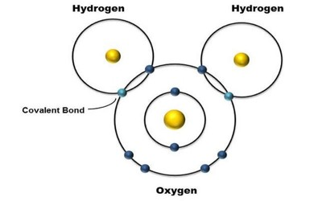
Explain why this is an example of a molecule
Notes:
Explain why this is an example of a molecule?
[Here we have one hydrogen atom bonded with the oxygen atom (covalent bond) and a separate hydrogen atom bonded with the oxygen atom (covalent bond).]

Slide 94
Why is this an example of a polar molecule?
Notes:
Why is this an example of a polar molecule?
[We can see it does not share electrons equally, which is why it had a partially positive charge and is a polar molecule.]

Slide 95
Why is this an example of a nonpolar molecule?
Notes:
Why is this an example of a nonpolar molecule?
[It is nonpolar because electrons are equally shared and there are no partial charges.]

Slide 96
Chemical Formula
Notes:
Now that we’ve reviewed, let’s define our new term, chemical formula.
Feedback: Remember to provide students with instructional cues that give them a chance to prepare for what is coming up next in the lesson, this will help orient them and be better able to engage with the content.

Slide 97
Chemical Formula: is a group of chemical symbols and numbers that represent a compound
H₂O
Notes:
A chemical formula is a group of chemical symbols and numbers that represent a compound.

Slide 98
Notes:
Now let’s pause for a moment to check your understanding.

Slide 99
What is a chemical formula?
H₂O
Notes:
What is a chemical formula?
[A chemical formula is a group of chemical symbols and numbers that represent a compound.]

Slide 100
Notes:
That’s the basic definition, but there is more you need to know.

Slide 101
Water
H₂O
Notes:
Let’s look at the chemical formula for water.

Slide 102
Notes:
Using the periodic table we can locate what O and H represent.

Slide 103
Hydrogen
Notes:
H is for hydrogen.

Slide 104
Oxygen
Notes:
O is for Oxygen.

Slide 105
Subscript
H₂O
Notes:
The subscript tells us we have more than 1 hydrogen atoms. We have two hydrogen atoms.
Feedback: Reading a chemical formula is an important skill from this lesson. Explicitly modeling this skill for students provides them with visual representation of the strategy.

Slide 106
2 atoms of Hydrogen
1 atom of Oxygen
H₂O
Notes:
So water is made of 2 atoms of hydrogen and 1 atom of oxygen.

Slide 107
Notes:
Now let’s pause for a moment to check your understanding.

Slide 108
How can we determine what the symbols in the chemical formula mean?
H₂O
Notes:
How can we determine what the symbols in the chemical formula mean?
[By looking at the periodic table to see which elements they symbols stand for]

Slide 109
Notes:
Next, let’s talk about some examples of chemical formulas.

Slide 110
Notes:
This is an example of a chemical formula. It uses the chemical symbols for Na – sodium and Cl – chlorine. There are no numbers which mean there is just one atom of sodium and one atom of chlorine. (This is the chemical formula for salt)

Slide 111
Notes:
This is an example of a chemical formula because it is a group of chemical symbols and numbers that represent a compound. There are 6 atoms of Carbon, 12 atoms of hydrogen, and 6 atoms of oxygen. (This is the chemical formula for sugar)

Slide 112
Notes:
Next, let’s talk about some non-examples of chemical formulas.

Slide 113
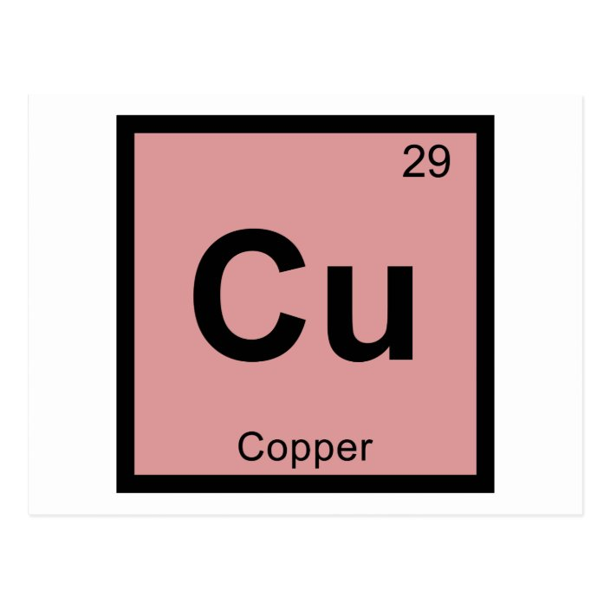
Notes:
This is not an example of a chemical formula. Cu is the chemical symbol for Copper. It is not a chemical formula because it does not not represent a compound, it represents a single element.
Feedback: One important component of using non-examples is by clearly distinguishing similarities and explaining why it is a non-example.

Slide 114
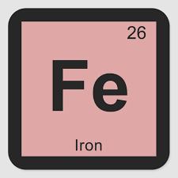
Notes:
This is also not an example of a chemical formula. We have the chemical symbol for Iron, but it does not represent a compound, it just represents a single element.

Slide 115
Notes:
Now let’s pause for a moment to check your understanding.

Slide 116
Is the example below an example of a chemical formula? Why or why not?
Notes:
Is the example below an example of a chemical formula? Why or why not?
[Yes, it uses the chemical symbols for Na – sodium and Cl – chlorine. There are no numbers which mean there is just one atom of sodium and one atom of chlorine. (This is the chemical formula for salt)]

Slide 117
Is the example below an example of a chemical formula? Why or why not?
Notes:
Is the example below an example of a chemical formula? Why or why not?
[It is because it is a group of chemical symbols and numbers that represent a compound. There are 6 atoms of Carbon, 12 atoms of hydrogen, and 6 atoms of oxygen. (This is the chemical formula for sugar)]
Feedback: Having students explain WHY something is an example or non-example is very important for assessing understanding.

Slide 118
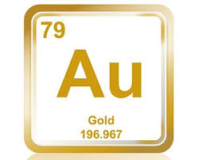
Is the example below an example of a chemical formula? Why or why not?
Notes:
Is the example below an example of a chemical formula? Why or why not?
[It is not a chemical formula because it is the chemical symbol for gold. It does not represent a compound, so it is not a chemical formula.]

Slide 119
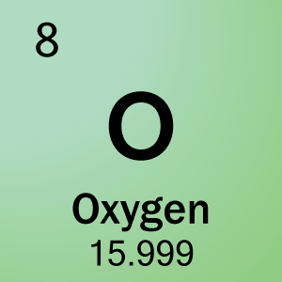
Is the example below an example of a chemical formula? Why or why not?
Notes:
Is the example below an example of a chemical formula? Why or why not?
[No, it is the chemical symbol for oxygen. It does not represent a chemical compound, so it cannot be a chemical formula.]

Slide 120
What is a chemical formula?
H₂O
Notes:
What is a chemical formula?
[A chemical formula is a group of chemical symbols and numbers that represent a compound.]

Slide 121
How can we determine what the symbols in the chemical formula mean?
H₂O
Notes:
How can we determine what the symbols in the chemical formula mean?
[By looking at the periodic table to see which elements they symbols stand for]

Slide 122
What does the subscript tell us?
H₂O
Notes:
What does the subscript tell us?
[The subscript tells us we have more than 1 hydrogen atoms. We have two hydrogen atoms.]
Feedback: It's really important to make sure that you're providing students with frequent opportunities to respond as you're closing the lesson – it will help you know if they understood and made sense of the activity and where you can provide further instruction.

Slide 123
Is the example below an example of a chemical formula? Why or why not?
Notes:
Is the example below an example of a chemical formula? Why or why not?
[Yes, it uses the chemical symbols for Na – sodium and Cl – chlorine. There are no numbers which mean there is just one atom of sodium and one atom of chlorine. (This is the chemical formula for salt)]

Slide 124
Is the example below an example of a chemical formula? Why or why not?
Notes:
Is the example below an example of a chemical formula? Why or why not?
[It is not a chemical formula because it is the chemical symbol for gold. It does not represent a compound, so it is not a chemical formula.]

Slide 125
Remember!!!
Notes:
So remember!

Slide 126
Chemical Formula: is a group of chemical symbols and numbers that represent a compound
H₂O
Notes:
A chemical formula is a group of chemical symbols and numbers that represent a compound.

Slide 127
Big Question: How can learning about covalent bonds, molecules, and chemical formula help us learn more about the importance of atoms?
H₂O
Notes:
Explicit cue to revisit the big question at the end of the lesson: Okay everyone. Now that we’ve learned the term, let’s reflect once more on our big question. Was there anything that we predicted earlier that was correct or incorrect? Do you have any new hypotheses to share?
Feedback: Remember to take the time to link this part of the lesson to other content that is related to the current topic. This is great as it helps students make connections!

Slide 128
Notes:
Thanks for watching, and please continue watching CAPs available from this website.

Slide 129
This Video Created With Resources From:
Questions or Comments
Michael Kennedy, Ph.D. MKennedy@Virginia.edu
Rachel L Kunemund, Ph.D. rk8vm@virginia.edu

