Slide 1
Intro
“Big Idea” Question
Review Concepts
Check-In Questions
Teacher Engagement
Vocabulary
Student-Friendly Definition
Examples & Non-Examples
Frayer Model
Simulation/Activity
Notes:
OK everyone, get ready for our next lesson. Just as a reminder, these are the different components that our lesson may include, and you’ll see these icons in the top left corner of each slide so that you can follow along more easily!

Slide 2
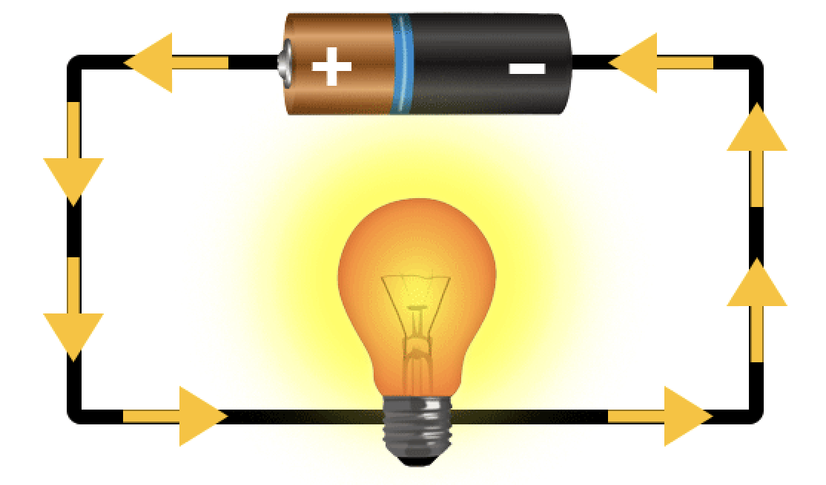
Intro
Current: an electrical charge in motion
Notes:
Today, we’ll be learning about the word: Current.

Slide 3
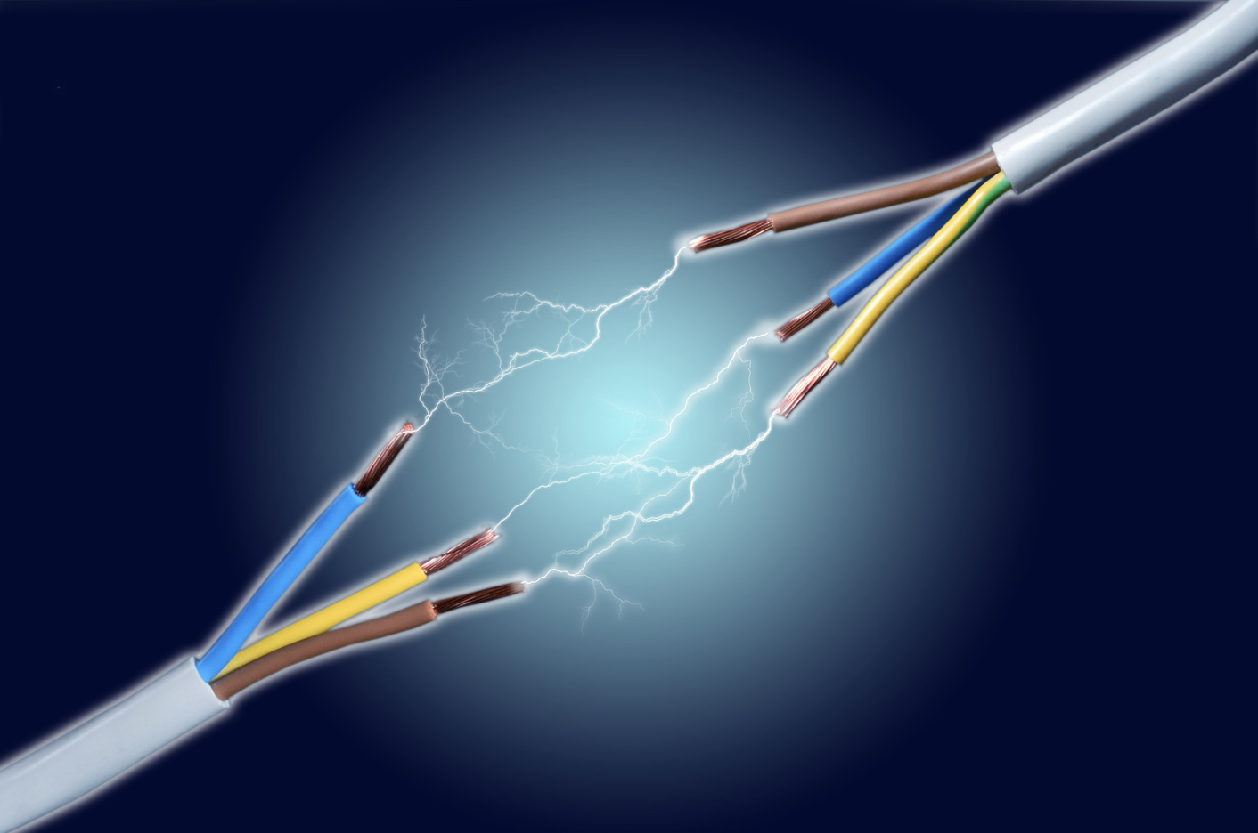
Big Question: How does electricity moving through wires make things work, and why is it important for us to know about it to use electricity safely at home?
Notes:
Our “big question” is: How does electricity moving through wires make thingswork, and why is it important for us to know about it to use electricity safely at home?
[Pause and illicit predictions from students.]
I love all these thoughtful scientific hypotheses! Be sure to keep this question and your predictions in mind as we move through these next few lessons, and we’ll continue to revisit it.

Slide 4
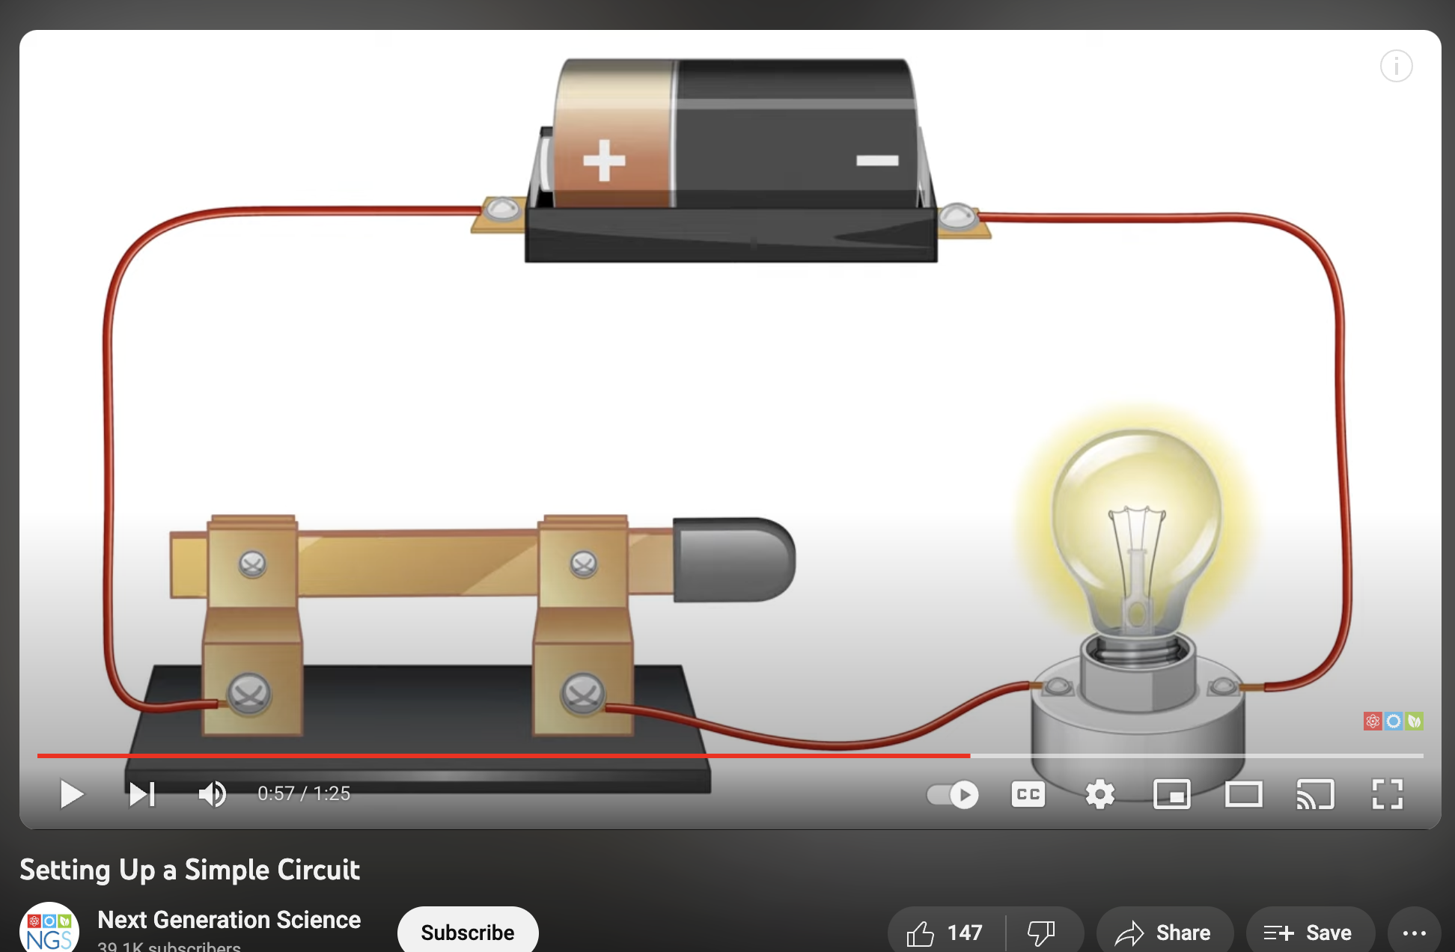
Demonstration
TEACHER DIRECTIONS:
Before viewing: Ask students what they already know about currents. Tell students today they will be learning about currents.
During: Ask students to think about how the bulb lights up when you bridge the gap with the paperclip or foil.
Encourage students to think of how this is like the way switches work in our homes.
After: Tell students that today they will be learning more about the term current.
Notes:
Demonstration: Light Up Your Circuit!
Materials Needed:
Battery (AA or AAA works well)
Battery holder
Bulb (with bulb holder)
Wires with alligator clips (or any wire with exposed ends)
Paperclips or aluminum foil
Steps:
Setting Up the Circuit:
Attach the bulb to its holder.
Connect one wire from the bulb holder to the positive terminal of the battery.
Connect the other wire from the bulb holder to the negative terminal of the battery.
Creating a Switch:
Use a paperclip or a small piece of aluminum foil to bridge the gap in the circuit. Place it between the exposed ends of the wires, but don't let it touch both ends simultaneously.
Observing the Light:
When the paperclip or aluminum foil is not touching both ends, the circuit is open, and the bulb is off.
When the paperclip or foil connects both ends, completing the circuit, the bulb lights up.
Explanation: This demonstration shows how an electric current flows in a circuit. The battery acts as a source of energy, and the circuit is completed when the paperclip or aluminum foil bridges the gap. This simple setup mimics the basics of how switches work in our homes to control the flow of electricity.
Safety Tips:
Always supervise the students during the activity.
Make sure the bulb doesn't get too hot.
Remind students not to touch the exposed wire ends directly to avoid electric shocks.
This hands-on activity allows students to see and understand the concept of an electric circuit and how a switch can control the flow of electricity to light up a bulb.

Slide 5
Notes:
Before we move on to our new topic, let’s review some other words & concepts that you already learned and make sure you are firm in your understanding.

Slide 6
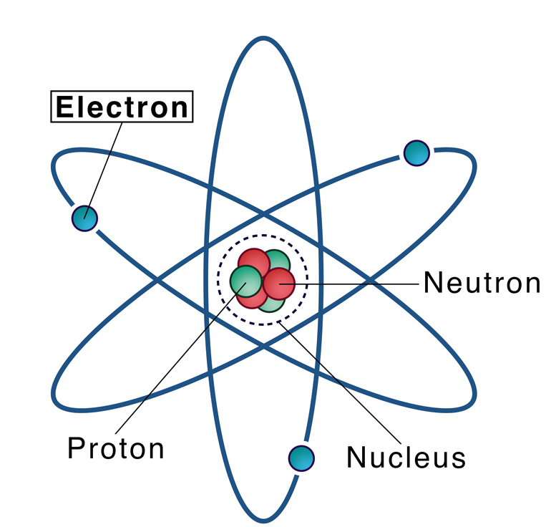
Electron: negatively charged particle that orbits the nucleus of an atom
Notes:
An electron is a negatively charged particle that orbits the nucleus of an atom

Slide 7
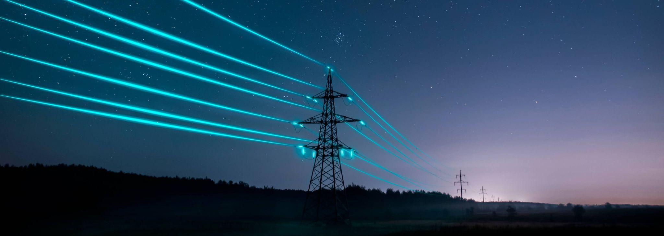
Electricity: electrical energy transformed into different forms of energy to meet needs
Notes:
Electricity is electrical energy transformed into different forms of energy to meet needs.

Slide 8
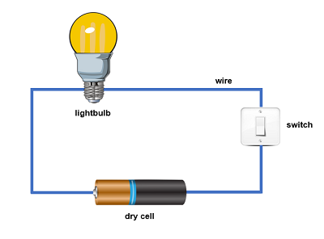
Circuit: the path electricity travels on
Notes:
A circuit is the path electricity travels on.

Slide 9
Notes:
Now let’s pause for a moment to review the information we have covered already.

Slide 10
__________ is electrical energy transformed into different forms of energy to meet needs.
Current
Electricity
Notes:
_________ is electrical energy transformed into different forms of energy to meet needs.
[Electricity]

Slide 11
__________ is electrical energy transformed into different forms of energy to meet needs.
Current
Electricity
Notes:
[Electricity] is electrical energy transformed into different forms of energy to meet needs.

Slide 12
A Circuit is:
The path electricity travels on
A negatively charged particle that orbits the nucleus of an atom
Notes:
A Circuit is:
The path electricity travels on
A negatively charged particle that orbits the nucleus of an atom
[The path electricity travels on]

Slide 13
A Circuit is:
The path electricity travels on
A negatively charged particle that orbits the nucleus of an atom
Notes:
A circuit is
A. The path electricity travels on.

Slide 14
Current
Notes:
Now that we’ve reviewed, let’s define the phrase Circuit.

Slide 15
Current: an electrical charge in motion
Notes:
A current is an electrical charge in motion.

Slide 16
Notes:
Let’s check-in for understanding.

Slide 17
What is a current?
Notes:
What is a current?
[A current is an electrical charge in motion]

Slide 18
Notes:
That is the basic definition, but there is a bit more you need to know.

Slide 19
Current flows in a specific direction, like water in a river.
Notes:
Current flows in a specific direction, like water in a river. It's important to understand this flow because it determines how electricity moves and does work.

Slide 20
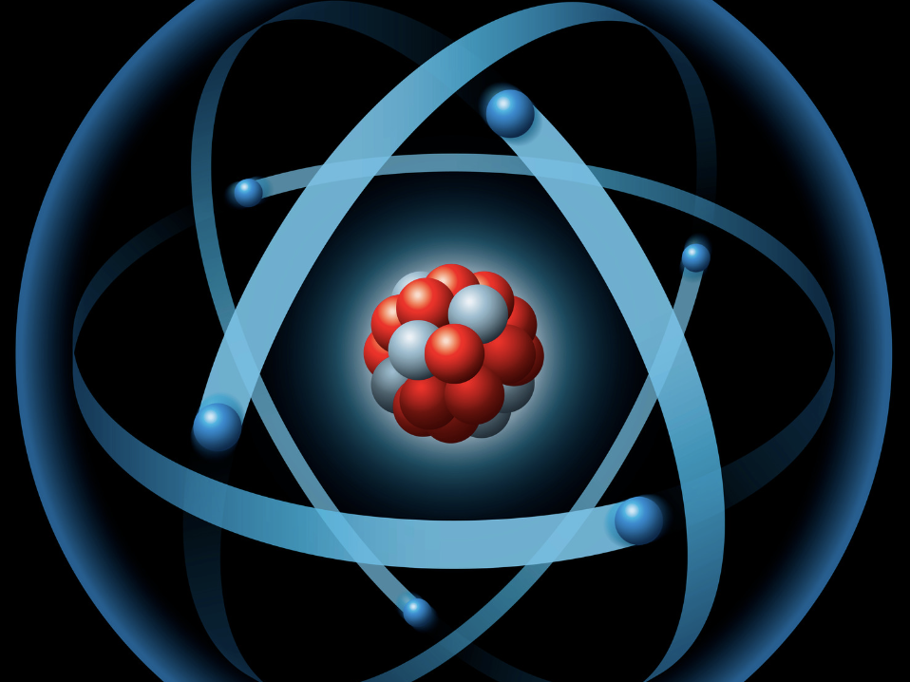
Even though the electrons move fast, each individual electron doesn't travel very quickly.
Notes:
Even though the electrons move really fast, each individual electron doesn't travel very quickly. It's more like a relay race, where one electron passes the energy to the next, creating a chain reaction.

Slide 21
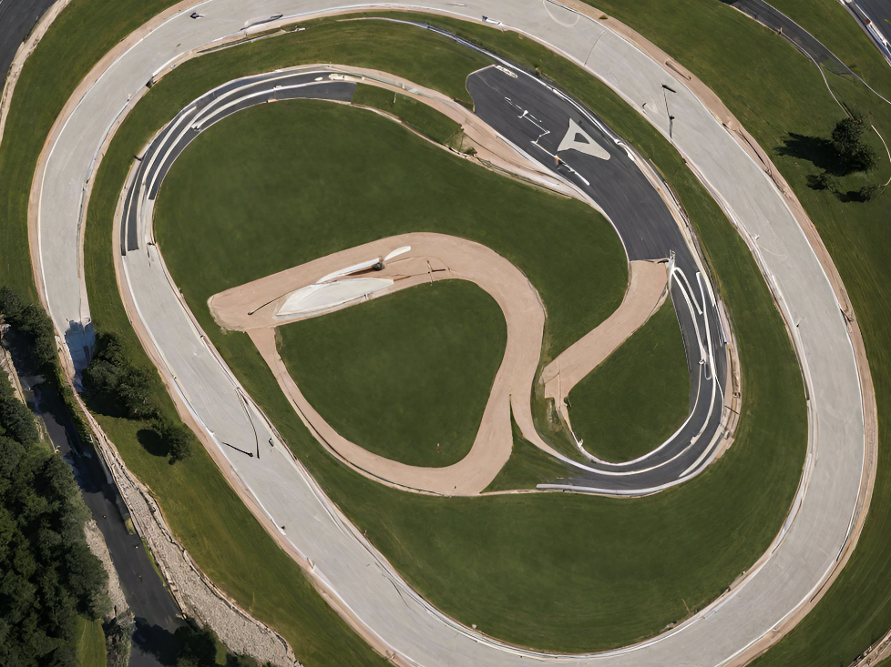
For current to flow, there needs to be a complete path for the electrons to follow.
Notes:
For current to flow, there needs to be a complete path for the electrons to follow. It's like a loop in a race track; if there's a break in the loop, the current stops.

Slide 22
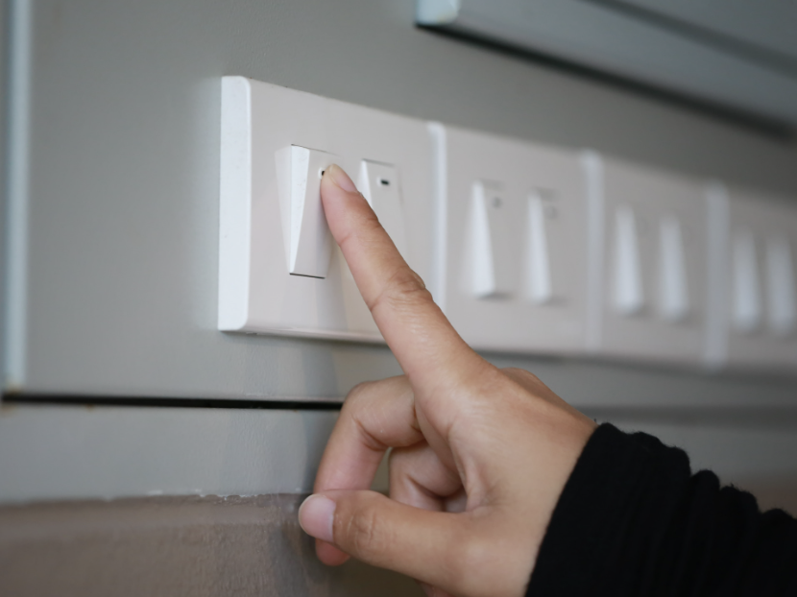
We use switches to control the flow of current.
Notes:
We use switches to control the flow of current. When you turn on a light switch, you're allowing the electrons to move and light up the bulb. Turning it off stops the flow.

Slide 23
Current is the energy that powers our devices.
Notes:
Current is the energy that powers our devices. Whether it's the TV, computer, or a simple flashlight, they all need a flow of electrons to work.

Slide 24
There are two main types of current –
Direct Current (DC) and Alternating Current (AC).
Notes:
There are two main types of current - direct current (DC) and alternating current (AC). DC flows in one direction, like a straight line, while AC changes direction regularly, like a waving flag.

Slide 25
Understanding current helps us use electricity safely
Notes:
Understanding current helps us use electricity safely. We learn not to play with electrical outlets and to use appliances properly, keeping the flow of electrons in check.

Slide 26
Even though we can't see current, its effects are everywhere.
Notes:
Even though we can't see current, its effects are everywhere. From the humming sound of your computer to the warmth of a light bulb, these are signs of electrons at work.

Slide 27
Notes:
Let’s check-in for understanding.

Slide 28
Current is the that powers our devices.
Notes:
Current is the that powers our devices.
[Energy]

Slide 29
Current is the energy that powers our devices.
Notes:
Current is the energy that powers our devices.

Slide 30
True/False: Current flows in a specific direction, like water in a river.
Notes:
True/False: Current flows in a specific direction, like water in a river.
[True]

Slide 31
True/False: Current flows in a specific direction, like water in a river.
Notes:
True: Current flows in a specific direction, like water in a river.

Slide 32
What are the two main types of current?
Notes:
What are the two main types of current?
[There are two main types of current - direct current (DC) and alternating current (AC). DC flows in one direction, like a straight line, while AC changes direction regularly, like a waving flag]

Slide 33
The two main types of current are
Direct Current (DC) and Alternating Current (AC).
Notes:
There are two main types of current - direct current (DC) and alternating current (AC). DC flows in one direction, like a straight line, while AC changes direction regularly, like a waving flag

Slide 34
Notes:
Now, let’s talk about some examples of circuits.

Slide 35
When you turn on a light switch in your home, the energy that flows through the wires to power the light is an example of a current.
Notes:
When you turn on a light switch in your home, the energy that flows through the wires to power the light is an example of a current.

Slide 36
When you plug your phone or tablet into a charger, it is an example of current flowing through to charge it, providing it with the energy it needs.
Notes:
When you plug your phone or tablet into a charger, it is an example of current flowing through to charge it, providing it with the energy it needs.

Slide 37
Notes:
Now, let’s talk about some non-examples of circuits.

Slide 38
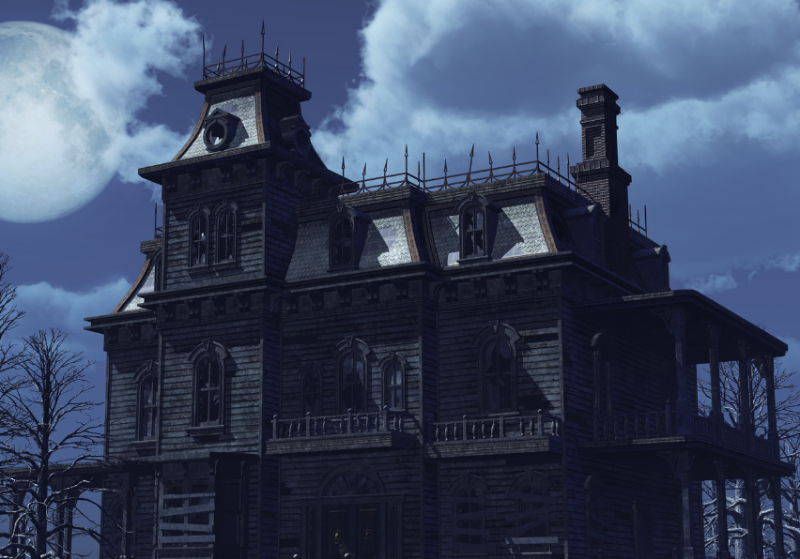
When the main electrical power is turned off in a building, preventing the flow of electricity, it is a NOT an example of a current.
Notes:
When the main electrical power is turned off in a building, preventing the flow of electricity, it is a NOT an example of a current.

Slide 39
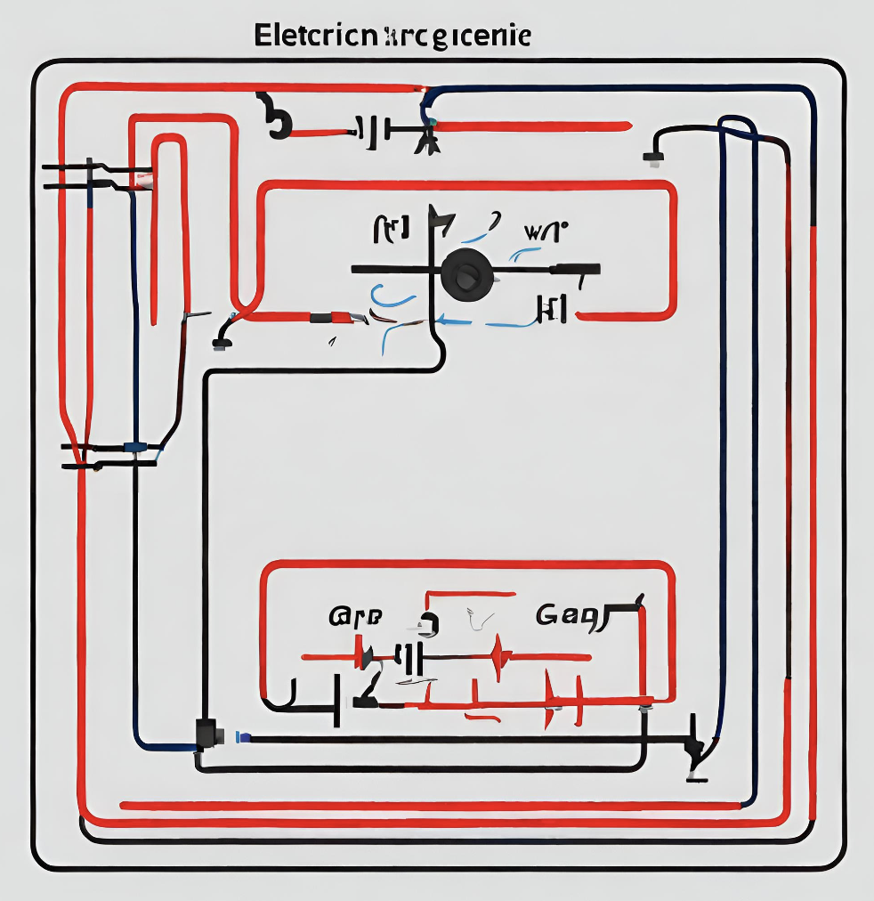
If there's a break or gap in a circuit, it is NOT an example of a current
Notes:
If there's a break or gap in a circuit, preventing the flow of electric current, it is NOT an example of a current.

Slide 40
Notes:
Now let’s pause for a moment to check your understanding.

Slide 41
When you turn on a light switch in your home, the energy that through the wires to
the light is an example of a current.
Notes:
When you turn on a light switch in your home, the energy that through the wires to the light is an example of a current.
[flows, power]

Slide 42
When you turn on a light switch in your home, the energy that flows through the wires to
power the light is an example of a current.
Notes:
When you turn on a light switch in your home, the energy that flows through the wires to power the light is an example of a current.

Slide 43
True/False: The main electrical power turned off in a building is an example of when a current is flowing through the wires of the building.
Notes:
True/False: The main electrical power turned off in a building is an example of when a current is flowing through the wires of the building.
[False]

Slide 44
True/False: The main electrical power turned off in a building is an example of when a current is flowing through the wires of the building.
Notes:
False: When the main electrical power is turned off in a building there is no current flowing through the wires of the building.

Slide 45
Remember!!!
Notes:
So remember!

Slide 46
Current: an electrical charge in motion
Notes:
A current is an electrical charge in motion.

Slide 47
Notes:
We will now complete this concept map, called a Frayer model, to summarize and further clarify what you have learned about the term current.

Slide 48
Definition
Picture
Current
Example
How do currents impact my life?
Notes:
To complete the Frayer model, we will choose from four choices the correct picture, definition, example, and response to the question, “How do currents impact my life?” Select the best response for each question using the information you just learned. As we select responses, we will see how this model looks filled in for the term current.

Slide 49
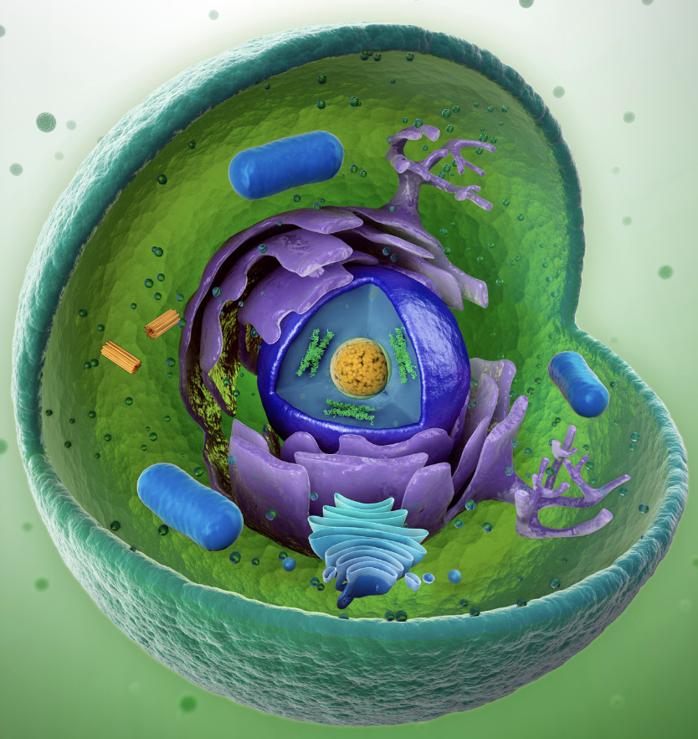
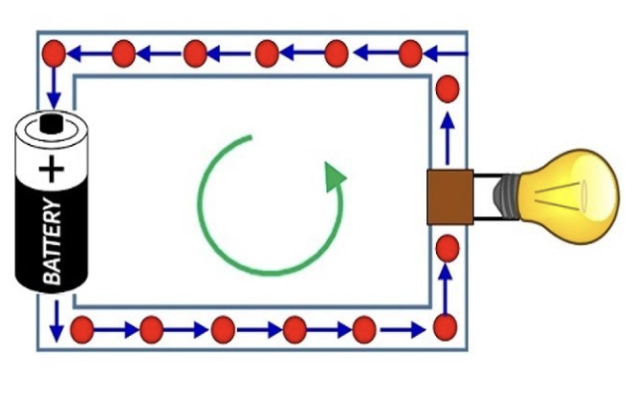
Directions: Choose the correct picture of a current from the choices below.
A
B
C
D
Notes:
Choose the one correct picture of a current from these four choices.

Slide 50
Directions: Choose the correct picture of a current from the choices below.
A
B
C
D
Notes:
This is the picture that shows a current.

Slide 51
Definition
Picture
Current
Example
How do currents impact my life?
Notes:
Here is the Frayer model filled in with a picture of a circuit.

Slide 52
Directions: Choose the correct definition of a
current from the choices below.
A
The path electricity travels on
B
The process by which a plant grows
C
An electrical charge in motion
D
Negatively charged particle that orbits the nucleus of an atom
Notes:
Choose the one correct definition of a current from these four choices.

Slide 53
Directions: Choose the correct definition of a
current from the choices below.
A
The path electricity travels on
B
The process by which a plant grows
C
An electrical charge in motion
D
Negatively charged particle that orbits the nucleus of an atom
Notes:
“An electrical charge in motion” is correct! This is the definition of a current.

Slide 54
Definition
Picture
An electrical charge in motion
Current
Example
How do currents impact my life?
Notes:
Here is the Frayer Model with a picture and the definition filled in for current: An electrical charge in motion

Slide 55
Directions: Choose the correct example of a
current from the choices below.
A
A fish swimming in the sea
B
A bonfire
C
Someone opening an umbrella
D
The flow of energy through wires to light up a lamp
Notes:
Choose the one correct example of a current from these four choices.

Slide 56
Directions: Choose the correct example of a
current from the choices below.
A
A fish swimming in the sea
B
A bonfire
C
Someone opening an umbrella
D
The flow of energy through wires to light up a lamp
Notes:
“The flow of energy through wires to light up a lamp” is correct! This is an example of a current.

Slide 57
Definition
Picture
An electrical charge in motion
Current
The flow of energy through wires to light up a lamp
Example
How do currents impact my life?
Notes:
Here is the Frayer Model with a picture, definition, and an example of a current: The flow of energy through wires to light up a lamp

Slide 58
Directions: Choose the correct response for “how do currents impact my life?” from the choices below.
A
Currents teach us how weather works so we can build environments to protect ourselves and live life in.
B
Currents make lights work and charge your devices making your everyday activities more convenient.
C
Currents are the powerhouse of the cell and help my cells divide to heal my injuries.
D
Currents show us how animals and plants work and live together in one spot.
Notes:
Choose the one correct response for “how do current impact my life?” from these four choices.

Slide 59
Directions: Choose the correct response for “how do currents impact my life?” from the choices below.
A
Currents teach us how weather works so we can build environments to protect ourselves and live life in.
B
Currents make lights work and charge your devices making your everyday activities more convenient.
C
Currents are the powerhouse of the cell and help my cells divide to heal my injuries.
D
Currents show us how animals and plants work and live together in one spot.
Notes:
You chose “Currents make lights work and charge your devices making your everyday activities more convenient..” That is correct! This is an example of how currents impact your life.

Slide 60
Definition
Picture
An electrical charge in motion
Current
The flow of energy through wires to light up a lamp
Currents make lights work and charge your devices making your everyday activities more convenient.
Example
How do currents impact my life?
Notes:
Here is the Frayer Model with a picture, definition, example, and a correct response to “how do currents impact my life?”: Currents make lights work and charge your devices making your everyday activities more convenient.

Slide 61
Remember!!!
Notes:
So remember!

Slide 62
Current: an electrical charge in motion
Notes:
A current is an electrical charge in motion.

Slide 63
Big Question: How does electricity moving through wires make things work, and why is it important for us to know about it to use electricity safely at home?
Notes:
Let’s reflect on our “big question”: How is electricity transmitted and used in daily life?
Does anyone have any additional examples to share that haven’t been discussed yet?

Slide 64
Simulation Activity
BrainPOP Circuit Builder
Click the link above for a simulation to deepen your understanding of circuits.

Slide 65
Notes:
Thanks, and please continue watching and using CAPs available from this website.

Slide 66
This Was Created With Resources From:
Questions or Comments
Michael Kennedy, Ph.D. MKennedy@Virginia.edu
Rachel L Kunemund, Ph.D. rk8vm@virginia.edu

