Slide 1
Intro
“Big Idea” Question
Review Concepts
Check-In Questions
Teacher Demo
Vocabulary
Student-Friendly Definition
Examples & Non-Examples
Morphological Word Parts
Frayer Model
Simulation/Activity
Notes:
OK everyone, get ready for our next lesson. Just as a reminder, these are the different components that our lesson may include, and you’ll see these icons in the top left corner of each slide so that you can follow along more easily!

Slide 2
Dependent Variable
Intro
Notes:
Today we will learn about dependent variables.

Slide 3
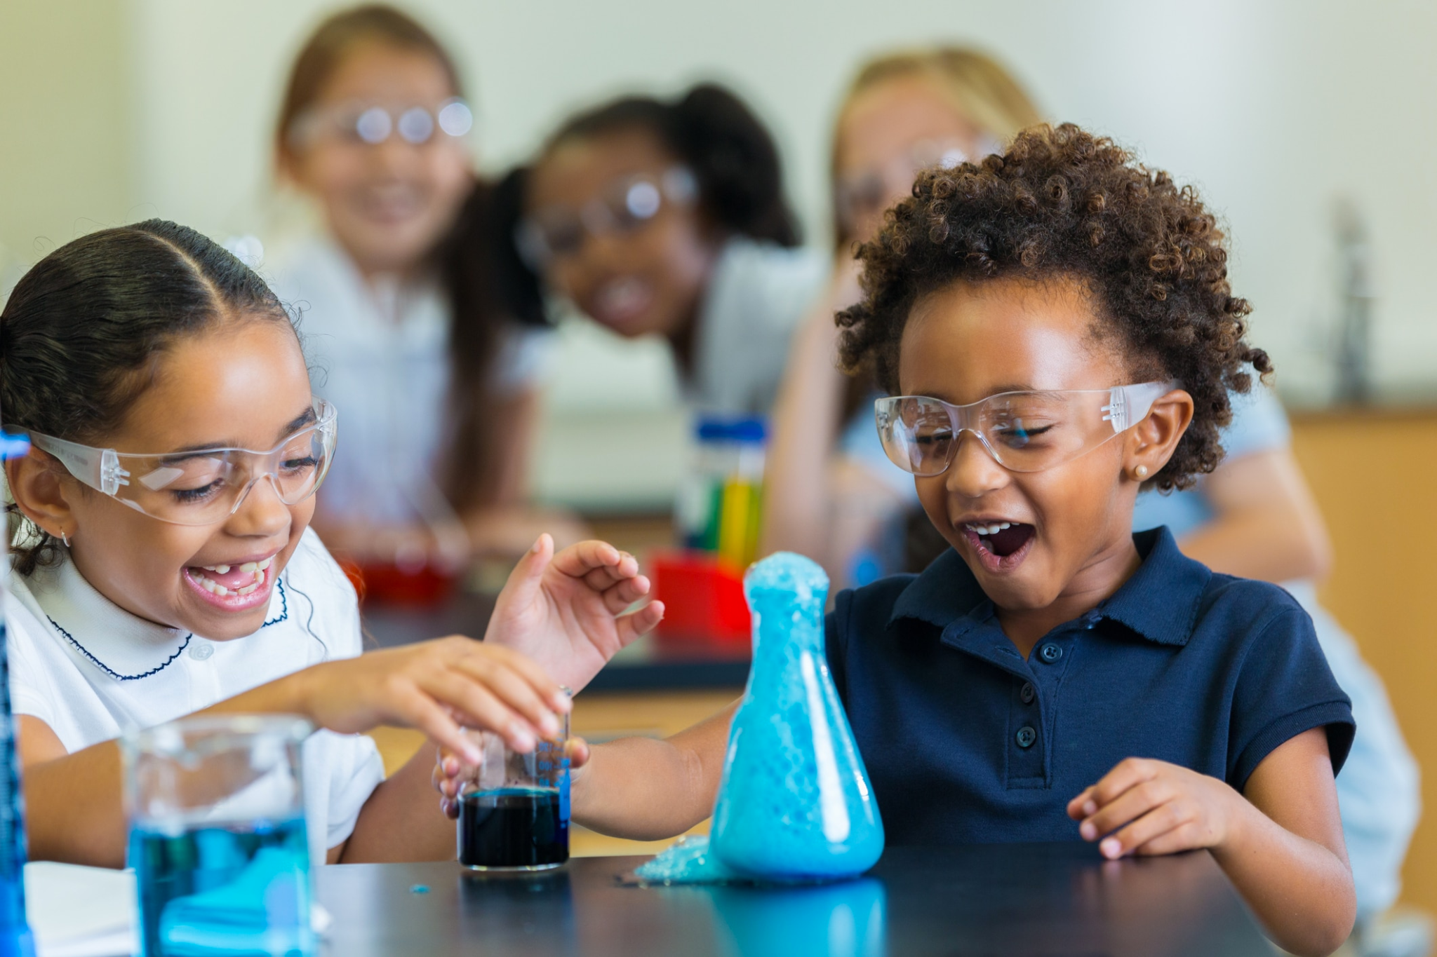
Big Question: How do variables in scientific experiments help us learn about our world?
Notes:
Our “big question” is: How do variables in scientific experiments help us learn about the world?
[Pause and illicit predictions from students.]
I love all these thoughtful scientific hypotheses! Be sure to keep this question and your predictions in mind as we move through these next few lessons, and we’ll continue to revisit it.
Feedback: Asking students to make predictions about how variables are related to our scientific knowledge is a great way to activate and elicit student ideas and prior knowledge. This type of activity is evidence of the teacher planning for students’ engagement with science ideas.

Slide 4
Notes:
Before we move on to our new vocabulary term, let’s review some other words & concepts that you already learned and make sure you are firm in your understanding.

Slide 5
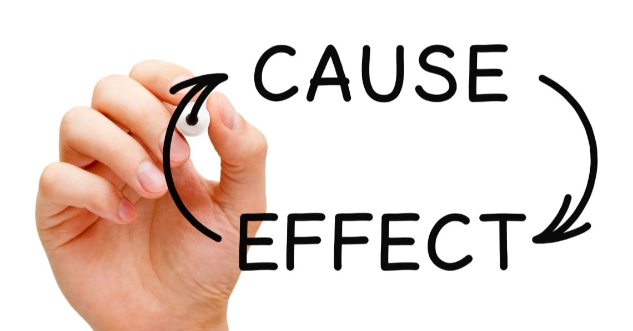
Notes:
"Cause-and-effect" explains the relationship between two things or events. The “cause” tells you why something happens, and the “effect” tells you the result. For example, if I place ice water in the sun (the cause), then the ice will begin to melt (the effect). Sciences helps us better understand these cause-and-effect relationships.

Slide 6
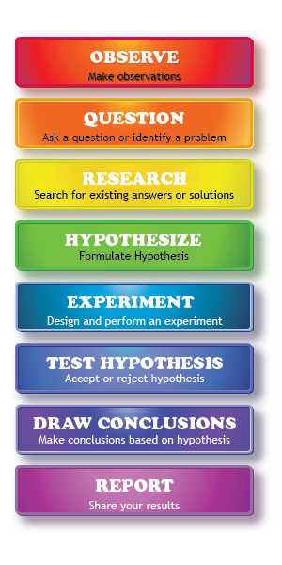
Scientific Method: steps that investigators follow to answer questions about the natural world
Notes:
The scientific method is a series of steps that investigators follow to answer questions about the natural world. By following the same steps, investigators are able to discover new things about our world and check the work of other scientists. A few of the steps are making observations, asking questions, making a hypothesis, and performing an experiment.

Slide 7
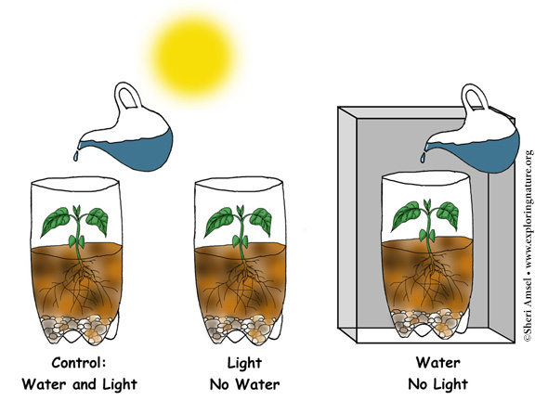
Variable: something that can change or be changed in an experiment
Notes:
A variable is something that can change or be changed in an experiment.

Slide 8
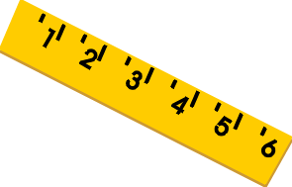
Three kinds of variables:
Independent
Variable
Dependent
Variable
Control
Variable
Notes:
There are three different kinds of variables in an experiment: independent, dependent, and control variables.

Slide 9
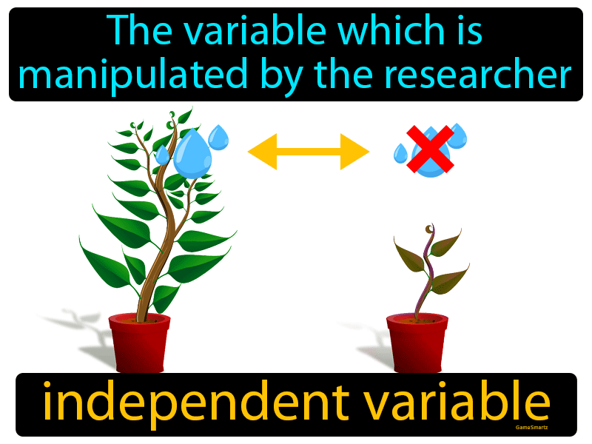
Independent Variable: the part of the experiment that the scientist controls or changes
Notes:
An independent variable is the part of the experiment that the scientist controls or changes.

Slide 10
Notes:
Now let’s pause for a moment to check your understanding.

Slide 11
The result of another event is called its _________.
Cause
Effect
Notes:
The result of another event is called its ___________.
[Effect]

Slide 12
The result of another event is called its _________.
Cause
Effect
Notes:
The result of another event is called its effect.

Slide 13
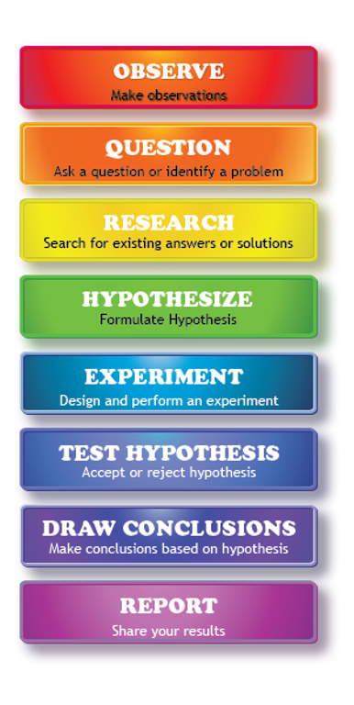
What are the steps that investigators follow to answer questions about the natural world called?
Hypothesis
Experiment
Scientific Method
Notes:
What are the steps that investigators follow to answer questions about the natural world called?
[c. scientific method]

Slide 14
What are the steps that investigators follow to answer questions about the natural world called?
Hypothesis
Experiment
Scientific Method
Notes:
What are the steps that investigators follow to answer questions about the natural world called? C. Scientific Method

Slide 15
Label the three kinds of variables
Notes:
Label the three kinds of variables.
[ Independent, dependent, and control.]
Feedback: Including some visual aids in this portion of the lesson is helpful for students to be able to understand the new content.

Slide 16
Label the three kinds of variables
Independent
Variable
Dependent
Variable
Control
Variable
Notes:
Label the three kinds of variables. Independent, dependent, and control.
Feedback: Including some visual aids in this portion of the lesson is helpful for students to be able to understand the new content.

Slide 17
An independent variable is the part of the experiment that the scientist _________ or _________.
Notes:
An independent variable is the part of the experiment that the scientist ________ or _________.
[Controls / Changes]

Slide 18
An independent variable is the part of the experiment that the scientist controls or changes.
Notes:
An independent variable is the part of the experiment that the scientist controls or changes.

Slide 19
Dependent Variable
Notes:
Now that we’ve reviewed, let’s define our new term, dependent variable.
Feedback: Using cues, such as on this slide, helps prepare students for what is coming up next in the lesson. This is important especially for students who may struggle with new vocabulary instruction.

Slide 20
Dependent Variable: the part of an experiment that is being measured or observed to see how it changes.
Notes:
A dependent variable is the part of an experiment that is being measured or observed to see how it changes.

Slide 21
Notes:
Now let’s pause for a moment to check your understanding.

Slide 22
The dependent variable is the part of an experiment that is being __________or ______________to see how it changes.
Notes:
The dependent variable is the part of an experiment that is being _________ or __________ to see how it changes.
[measured/observed]

Slide 23
The dependent variable is the part of an experiment that is being measured or observed to see how it changes.
Notes:
The dependent variable is the part of an experiment that is being _________ or __________ to see how it changes.
[measured/observed]

Slide 24
Notes:
That is the basic definition, but there is a bit more you need to know.

Slide 25
Cause
Effect
Notes:
Dependent variables are the “effect” part of the experiment. The scientists don’t make any changes to the dependent variable. Instead, they carefully watch and measure the changes the happen.

Slide 26
Notes:
Before beginning an experiment, scientists make a hypothesis, or educated guess, about what they think will happen. The dependent variable is an important part of the hypothesis. It tells about the outcome of the experiment, or how they expect the variable to change.

Slide 27
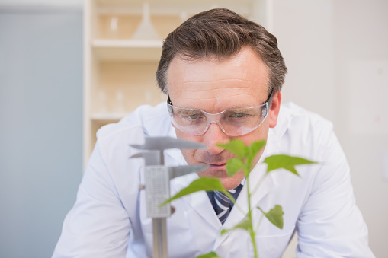
Notes:
The dependent variable is often the part of the experiment scientists are most interested in understanding. Measuring changes to the dependent variable helps them draw conclusions and better understand the relationship between the variables.

Slide 28
Notes:
Now let’s pause for a moment to check your understanding.

Slide 29
What is a dependent variable?
Notes:
What is a dependent variable?
[A dependent variable is the part of an experiment that is being measured or observed to see how it changes]

Slide 30
The dependent variable is the _______ of the experiment.
Notes:
The dependent variable is the _____ of the experiment.
[Effect.]

Slide 31
The dependent variable is the effect of the experiment.
Notes:
The dependent variable is the effect of the experiment.

Slide 32
Remember!!!
Notes:
Remember

Slide 33
Independent Variable: the part of the experiment that the scientist controls or changes
Notes:
An independent variable is the part of the experiment that the scientist controls or changes. Here, the scientist is controlling how much water each plant gets.

Slide 34
Dependent Variable: the part of an experiment that is being measured or observed to see how it changes.
Notes:
A dependent variable is the part of an experiment that is being measured or observed to see how it changes. In this example, the scientist measures how tall the plant grows. The plant grows because of how much water it gets, not because of the scientist.

Slide 35
Cause
Effect
Notes:
Changes in the independent variable cause changes in the dependent variable. So ask yourself, which one did the scientists change themselves?

Slide 36
Notes:
Now let’s pause for a moment to check your understanding.

Slide 37
Notes:
A boy listens to classical and rock music while studying for his science tests. He wants to see which kind of music helps him get a better grade.

Slide 38
What is the independent variable?
Different kinds of music
Test scores
Notes:
What is the independent variable?
[a. different kinds of music]

Slide 39
What is the independent variable?
Different kinds of music
Test scores
Notes:
What is the independent variable? a. different kinds of music

Slide 40
What is the dependent variable?
Different kinds of music
Test scores
Notes:
What is the dependent variable?
[b. test scores]

Slide 41
What is the dependent variable?
Different kinds of music
Test scores
Notes:
What is the dependent variable? b. test scores

Slide 42
Notes:
Now, let’s talk about some examples of dependent variables.

Slide 43
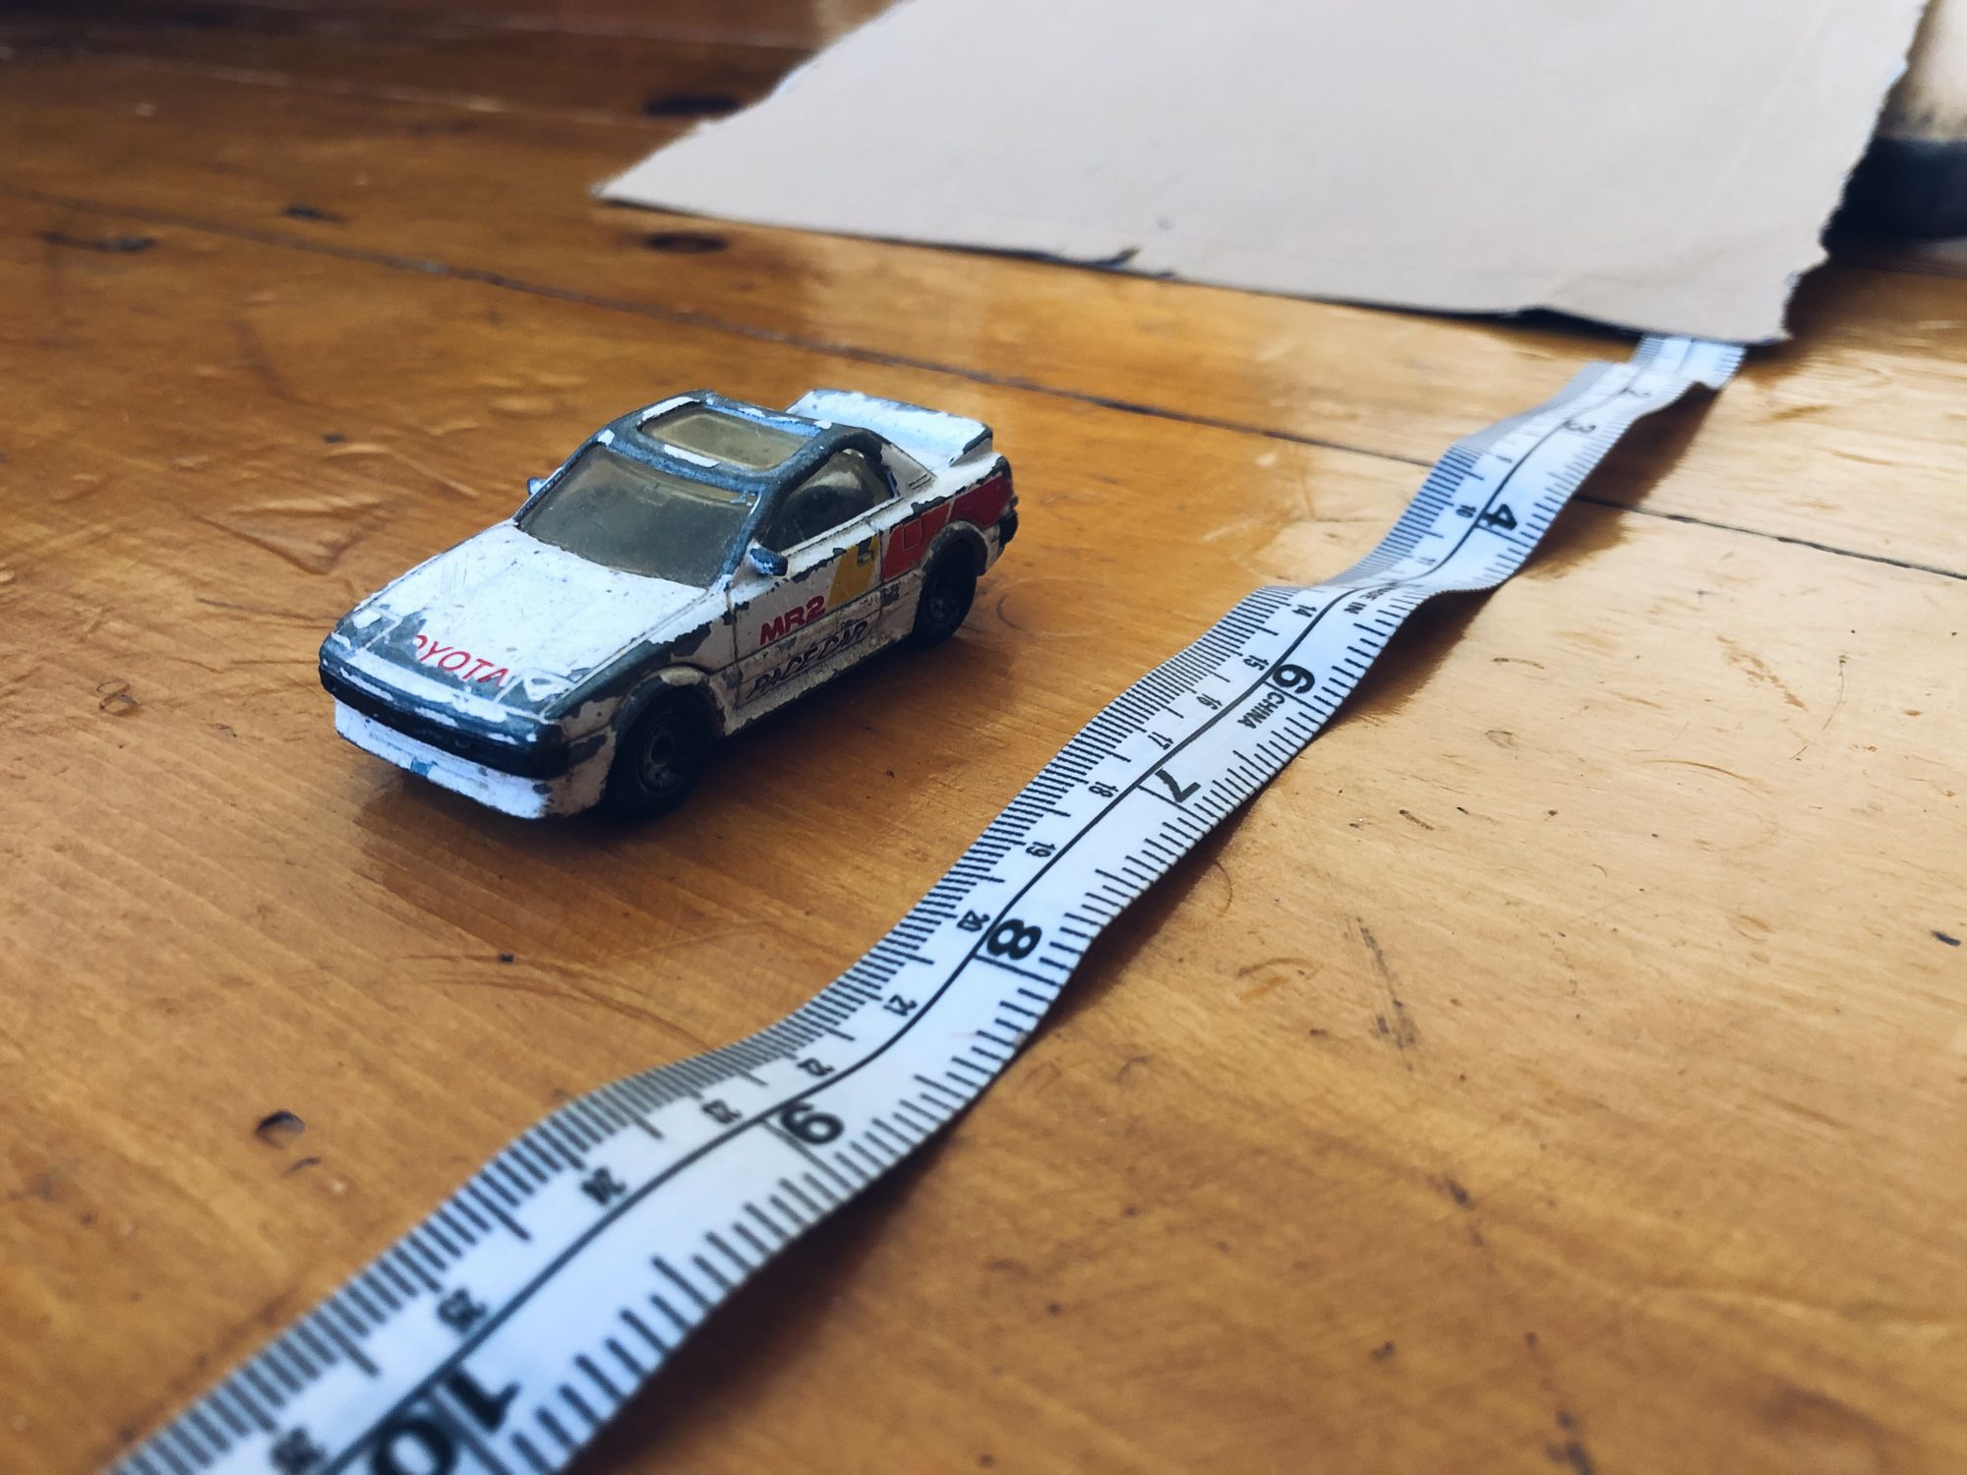
Notes:
This is an example of a dependent variable. Scientists measure how far the car goes at the bottom of the ramp. They do not control how far the car goes directly. Instead, the car’s distance is affected by the height of the ramp it goes down.

Slide 44
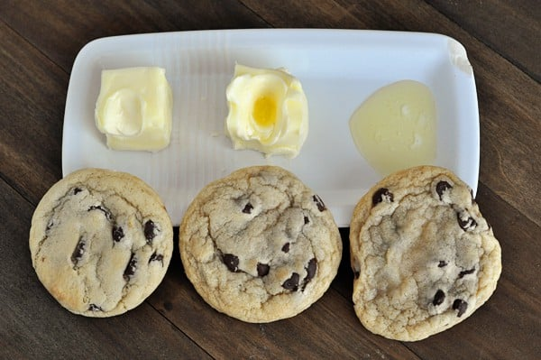
Notes:
This is another kind of dependent variable. The cookie’s shape and taste is the result of the kind of butter that was used in the cookie batter.

Slide 45
Notes:
Next, let’s talk about some non-examples of variables.
Feedback: Offering clear and explicit explanation for non-examples is a great way for students to make sense of the new content. Explanations for non-examples are provided in the slides below.

Slide 46
Notes:
Time of day is a non-example of a dependent variable. These daily changes happen naturally and are not the result of a changes made in an experiment.

Slide 47
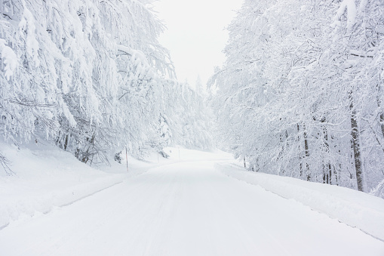
Notes:
This is another non-example of a dependent variable. Daily temperature changes, like a cold snowy day, are not something that a scientist measures or observes to see how it responds to changes in an experiment.

Slide 48
Notes:
Now let’s pause for a moment to check your understanding.

Slide 49
Which one of these is an example of a dependent variable?
Notes:
Which one of these is an example of a dependent variable?
[Height of the plant]

Slide 50
Which one of these is an example of a dependent variable?
Notes:
Which one of these is an example of a dependent variable?
[Height of the plant]

Slide 51
What is a dependent variable?
Notes:
What is a dependent variable?
[A dependent variable is the part of an experiment that is being measured or observed to see how it changes]

Slide 52
What are the three kinds of variables?
Notes:
What are the three kinds of variables?
[Independent, dependent, and control.]

Slide 53
What are the three kinds of variables?
Independent
Variable
Dependent
Variable
Control
Variable
Notes:
What are the three kinds of variables? Independent, dependent, and control.

Slide 54
Who can give me an example of a dependent variable and explain why it is one?
Notes:
Who can give me an example of a dependent variable and explain why it is one?
Pause and illicit student responses.

Slide 55
Remember!!!
Notes:
So remember!

Slide 56
Dependent Variable: the part of an experiment that is being measured or observed to see how it changes.
Notes:
A dependent variable is the part of an experiment that is being measured or observed to see how it changes.

Slide 57
Notes:
We can also break down the term variable into different word parts to help us remember the meaning. Let’s take a look!

Slide 58
Vari able
Vari = different or changing
-able = able to be
Notes:
Remember that the word “variable” is made up of two parts: The root word “vari” which means “changing” and the suffix “-able” means something “able to be”.

Slide 59
Vari able
Variable
able to be changed
Notes:
So when we put it all together, variable means something that is able to be changed. In an experiment, the variable is something that is able to be changed or observed changing by the investigators.

Slide 60
Dependent
Variable
Affected by
able to be changed
Notes:
Let’s look at both words together. Dependent means “affected by”. A variable is something that is able to be changed. If a variable is dependent, its change is affected by other changes in its environment.

Slide 61
Notes:
We will now complete this concept map, called a Frayer model, to summarize and further clarify what you have learned about the term variable.

Slide 62
Definition
Picture
Dependent Variable
How do
dependent variables impact my life?
Example
Notes:
To complete the Frayer model, we will choose from four choices the correct picture, definition, example, and response to the question, “How do dependent variables impact my life?” Select the best response for each question using the information you just learned. As we select responses, we will see how this model looks filled in for the term dependent variable.

Slide 63
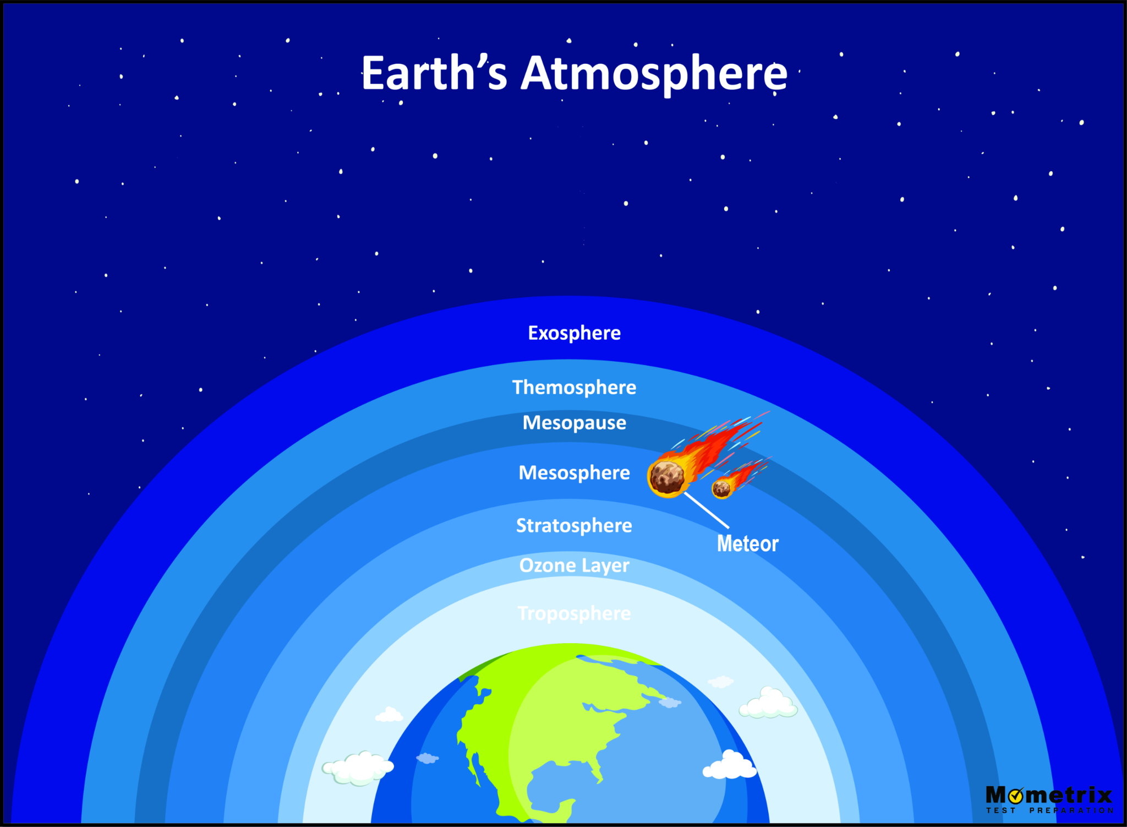
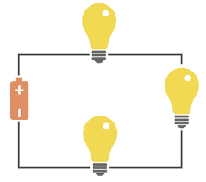
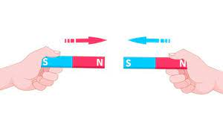
Directions: Choose the correct picture of a
dependent variable from the choices below.
A
B
C
D
Notes:
Choose the one correct picture of dependent variable from these four choices.

Slide 64
Directions: Choose the correct picture of a
dependent variable from the choices below.
A
B
C
D
Notes:
This is the picture that shows a dependent variable.

Slide 65
Definition
Picture
Dependent Variable
How do
dependent variables impact my life?
Example
Notes:
Here is the Frayer model filled in with a picture of variable.

Slide 66
Directions: Choose the correct definition of
dependent variable from the choices below.
A
a state of matter in which particles have strong bonds (or connections), vibrate in place, and are arranged in a pattern
B
the part of an experiment that is being measured or observed to see how it changes.
C
preserved remains of prehistoric life
D
a force that resists the motion of two surfaces that are touching
Notes:
Choose the one correct definition of dependent variable from these four choices.

Slide 67
Directions: Choose the correct definition of
dependent variable from the choices below.
A
a state of matter in which particles have strong bonds (or connections), vibrate in place, and are arranged in a pattern
B
the part of an experiment that is being measured or observed to see how it changes.
C
preserved remains of prehistoric life
D
a force that resists the motion of two surfaces that are touching
Notes:
“The part of an experiment that is being measured or observed to see how it changes” is correct! This is the definition of dependent variable.

Slide 68
Definition
Picture
the part of an experiment that is being measured or observed to see how it changes.
Dependent Variable
How do
dependent variables impact my life?
Example
Notes:
Here is the Frayer Model with a picture and the definition filled in for dependent variable: the part of an experiment that is being measured or observed to see how it changes.

Slide 69
Directions: Choose the correct example of
a dependent variable from the choices below.
A
The number of flowers a plant grows with different kinds of fertilizer
B
The number of eggs that a chicken lays
C
An Olympic swimmer’s lap time
D
Watching the sunrise
Notes:
Choose the one correct example of a dependent variable from these four choices.

Slide 70
Directions: Choose the correct example of
a dependent variable from the choices below.
A
The number of flowers a plant grows with different kinds of fertilizer
B
The number of eggs that a chicken lays
C
An Olympic swimmer’s lap time
D
Watching the sunrise
Notes:
“The number of flowers a plant grows with different kinds of fertilizer” is correct! This is an example of a dependent variable.

Slide 71
Definition
Picture
the part of an experiment that is being measured or observed to see how it changes.
Dependent Variable
The number of flowers a plant grows with different kinds of fertilizer
How do
dependent variables impact my life?
Example
Notes:
Here is the Frayer Model with a picture, definition, and an example of dependent variable: The number of flowers a plant grows with different kinds of fertilizer

Slide 72
Directions: Choose the correct response for “how do dependent variables impact my life?” from the choices below.
A
Dependent variables explain the flow of energy from plants to animals in an ecosystem.
B
Dependent variables explain why we experience day, night, and the seasons
C
Dependent variables explain how electricity moves so we can have light bulbs and other technologies.
D
Dependent variables help scientists understand how changes in one thing affects another.
Notes:
Choose the one correct response for “how do dependent variables impact my life?” from these four choices.

Slide 73
Directions: Choose the correct response for “how do dependent variables impact my life?” from the choices below.
A
Dependent variables explain the flow of energy from plants to animals in an ecosystem.
B
Dependent variables explain why we experience day, night, and the seasons
C
Dependent variables explain how electricity moves so we can have light bulbs and other technologies.
D
Dependent variables help scientists understand how changes in one thing affects another.
Notes:
“Dependent variables help scientists understand how changes in one thing affects another .” That is correct! This is an example of how dependent variables impact your life.

Slide 74
Definition
Picture
the part of an experiment that is being measured or observed to see how it changes.
Dependent Variable
Dependent
variables help scientists understand how changes in one thing affects another.
The number of flowers a plant grows with different kinds of fertilizer
How do
dependent variables impact my life?
Example
Notes:
Here is the Frayer Model with a picture, definition, example, and a correct response to “how do dependent variables impact my life?”: Dependent variables help scientists understand how changes in one thing affects another.

Slide 75
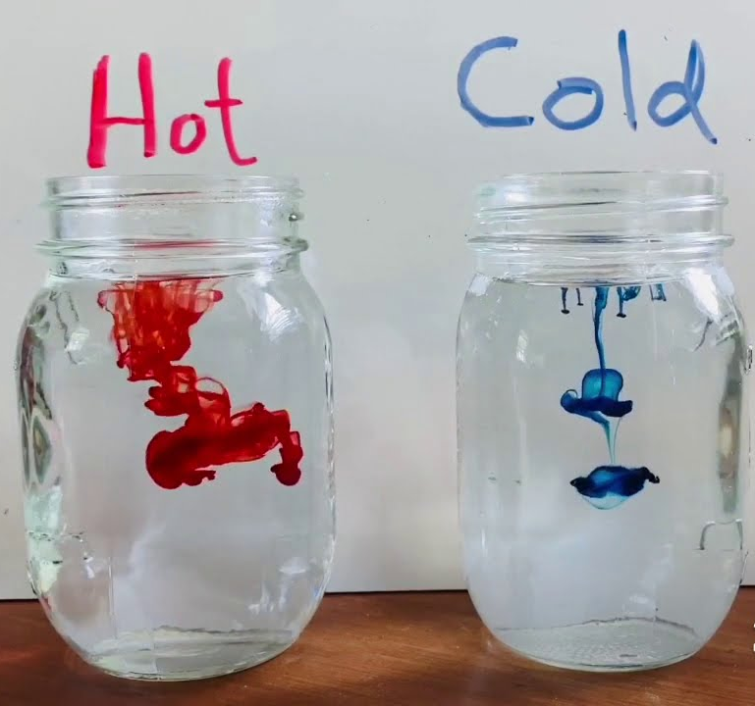
Demonstration Activity
Racing Molecules
Squeeze food coloring into hot and cold water. Which color will fill the jar first?
Ask yourself:
What is the independent variable?
What is the dependent variable?
What is my prediction? Why do I think that will happen?
Happy investigating, scientists!
Notes:
Feedback: Providing a demonstration activity is a great way to make science thinking visible. In this demonstration, students have the opportunity to identify the different kinds of variables in a real-time experiment and observe the cause-and-effect relationship between these two variables.

Slide 76
Big Question: How do science experiments help us learn about our world?
Notes:
Our “big question” is: How do science experiments help us learn about our world?
[Pause and illicit predictions from students.]
I love all these thoughtful scientific hypotheses! Be sure to keep this question and your predictions in mind as we move through these next few lessons, and we’ll continue to revisit it.

Slide 77
Notes:
Thanks for watching, and please continue watching CAPs available from this website.

Slide 78
This Video Was Created With Resources From:
Questions or Comments
Michael Kennedy, Ph.D. MKennedy@Virginia.edu
Rachel L Kunemund, Ph.D. rk8vm@virginia.edu

