Slide 1
Intro
“Big Idea” Question
Review Concepts
Check-In Questions
Teacher Demo
Vocabulary
Student-Friendly Definition
Examples & Non-Examples
Morphological Word Parts
Simulation/Activity
Notes:
OK everyone, get ready for our next lesson. Just as a reminder, these are the different components that our lesson may include, and you’ll see these icons in the top left corner of each slide so that you can follow along more easily!

Slide 2
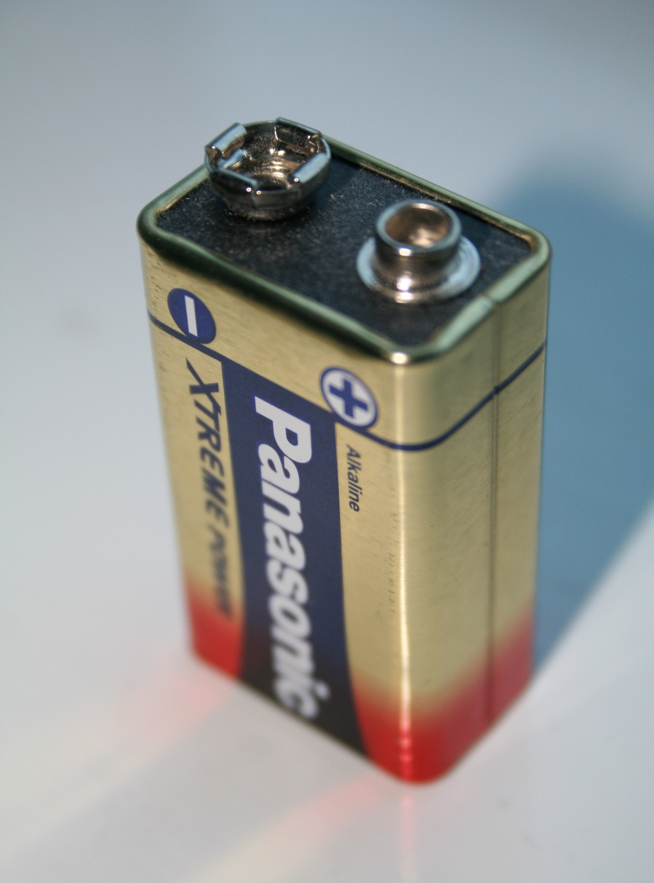
Direct Current
Intro
Notes:
Today we will learn about direct current.
Feedback: Using clear and simple language when introducing content helps students understand what is expected.

Slide 3
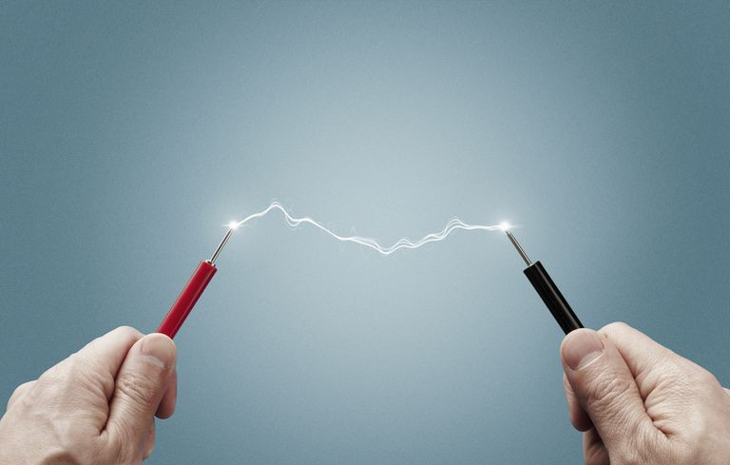
Big Question: How are direct current and alternating current beneficial to us through generators, motors, and transformers?
Notes:
Our “big question” is: How are direct current and alternating current beneficial to us through generators, motors, and transformers?
[Pause and illicit predictions from students.]
I love all these thoughtful scientific hypotheses! Be sure to keep this question and your predictions in mind as we move through these next few lessons, and we’ll continue to revisit it.

Slide 4
Notes:
Before we move on to our new vocabulary term, let’s review some other words & concepts that you already learned and make sure you are firm in your understanding.
Feedback: Referring to prior topics that are relevant and on topic helps students make connections to the new content they will be learning and tie it to prior knowledge.

Slide 5
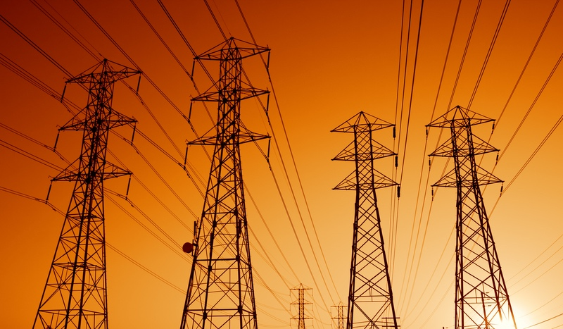
Electric Current: the movement of electrically charged particles
Notes:
Electric current is the movement of electrically charged particles.

Slide 6
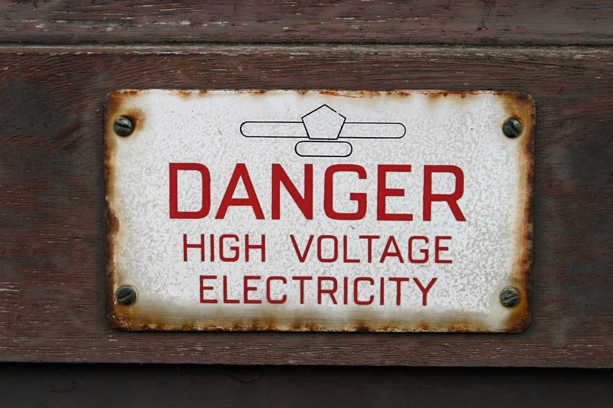
Voltage: the total energy needed to move a small electric charge along a path, divided by the size of the change
Notes:
Voltage is the total energy needed to move a small electric charge along a path, divided by the size of the charge. It is measured in volts.

Slide 7
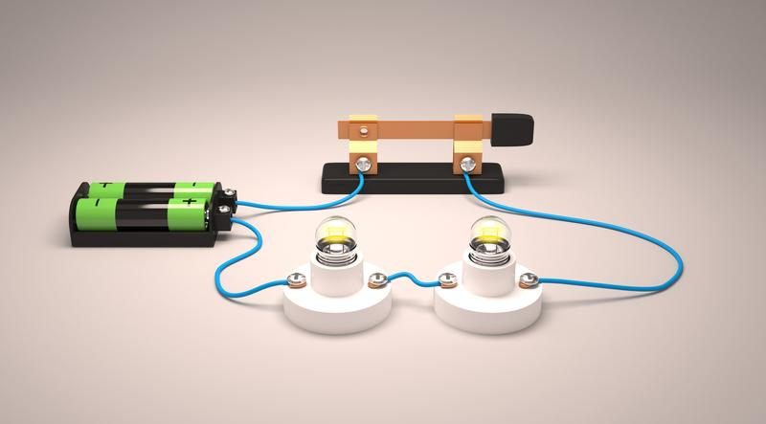
Series Circuit: an electric current follows only one path
Notes:
In a series circuit, an electric current can follow only one path.

Slide 8
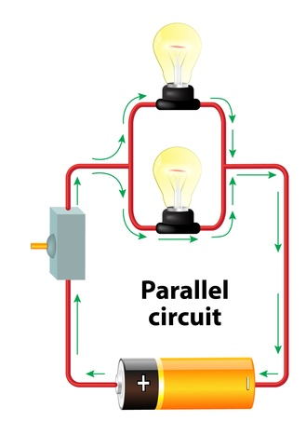
Parallel Circuit: an electric current can follow multiple paths
Notes:
In a parallel circuit, an electric current can follow multiple paths.

Slide 9
Notes:
Now let’s pause for a moment to check your understanding.
Feedback: It is important when reviewing previously learned material that you pause and check for understanding, if students are grasping previous material you may need to tailor your instruction.

Slide 10
What is voltage measured in?
Amps
Ohms
Volts
Notes:
What is voltage measured in?

Slide 11
What is voltage measured in?
Amps
Ohms
Volts
Notes:
What is voltage measured in?
[Volts]

Slide 12
If you have a series circuit and there is a break, will the light bulb remain on?
Notes:
If you have a circuit and there is a break, will the light bulb be on?
[No, there is only one path for the current to travel along.]

Slide 13
What is the difference between a series circuit and a parallel circuit?
Notes:
What is the difference between a series circuit and a parallel circuit?
[In a series circuit, an electric current can only follow one path. In contrast, in a parallel circuit, an electric current can follow multiple paths.]

Slide 14
Direct Current
Notes:
Now that we’ve reviewed, let’s define our new term, direct current.

Slide 15
Direct Current: flows in only one direction
Notes:
Direct current flows in only one direction. We abbreviate direct current as “DC”.
Feedback: When providing more student-friendly definitions, it is helpful to provide students with cues so that they can be prepared and know what to expect and be ready to copy down the information.

Slide 16
Notes:
Let’s check-in for understanding.

Slide 17
What is direct current?
Notes:
What is direct current?
[Direct current flows in only one direction. We abbreviate direct current as “DC”.]
Feedback: Remember, students might look like they are understanding the definition but it is important that you check for understanding yourself by asking questions or providing them with other opportunities to respond.

Slide 18
Notes:
Now, let’s talk about some examples of direct current.

Slide 19
Notes:
A battery is an example of a direct current. The current in batteries flow only in one direction.

Slide 20
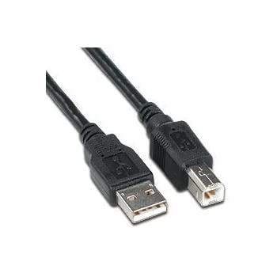
Notes:
Anything that uses a USB cable for power relies on a direct current.
Feedback: In addition to explaining that something is an example of the vocabulary term, it is important to explain WHY it is an example.

Slide 21
Notes:
Let’s check-in for understanding.

Slide 22
What is an example of direct current?
Notes:
What is an example of direct current?
[Battery, USB cable, etc.]

Slide 23
Demonstration
Notes:
Demonstration – Let’s see what direct current looks like!
For this demonstration, I need a power source, lightbulb, and two wires.
I need to connect them to create a simple circuit by connecting the first wire from the power source to the light bulb. Then I am going to connect the second wire from the light bulb to the other side of the power source.
In this circuit, current is only flowing in one direction (direct current).
Feedback: Make sure you pause during your demonstration and ask some questions to ensure your students are understanding the activity, this will help them benefit from the demonstration.

Slide 24
Notes:
Let’s check-in for understanding.

Slide 25
In this demonstration, what did you notice about direct current?
Notes:
In this demonstration, what did you notice about direct current?
[The battery forces the current to only move in one direction.]
Feedback: Remember, we want students to gather information and then be able to not only evaluate but also effectively communicate what they have learned from this activity.

Slide 26
What is direct current?
Notes:
What is direct current?
[Direct current flows in only one direction. We abbreviate direct current as “DC”.]

Slide 27
Remember!!!
Notes:
So remember!

Slide 28
Direct Current: flows in only one direction
Notes:
Direct current flows in only one direction. We abbreviate direct current as “DC”.

Slide 29
Simulation Activity
Direct Current
(Phet)
Click the link above for a simulation to deepen your understanding of direct current.
Notes:
Feedback: Giving students a chance to analyze and interpret data is a great way to help them to continue to independently problem solve.

Slide 30
Big Question: How are direct current and alternating current beneficial to us through generators, motors, and transformers?
Notes:
Explicit cue to revisit the big question at the end of the lesson: Okay everyone. Now that we’ve learned the term, direct current, let’s reflect once more on our big question. Was there anything that we predicted earlier that was correct or incorrect? Do you have any new hypotheses to share?

Slide 31
Notes:
Thanks for watching, and please continue watching CAPs available from this website.

Slide 32
This Video Was Created With Resources From:
Questions or Comments
Michael Kennedy, Ph.D. MKennedy@Virginia.edu
Rachel L Kunemund, Ph.D. rk8vm@virginia.edu

Slide 33
Intro
“Big Idea” Question
Review Concepts
Check-In Questions
Teacher Demo
Vocabulary
Student-Friendly Definition
Examples & Non-Examples
Morphological Word Parts
Simulation/Activity
Notes:
OK everyone, get ready for our next lesson. Just as a reminder, these are the different components that our lesson may include, and you’ll see these icons in the top left corner of each slide so that you can follow along more easily!
Feedback: Explicit cues used at the beginning of each step makes it easy for students to follow along and be prepared to engage in the next part of the lesson.

Slide 34
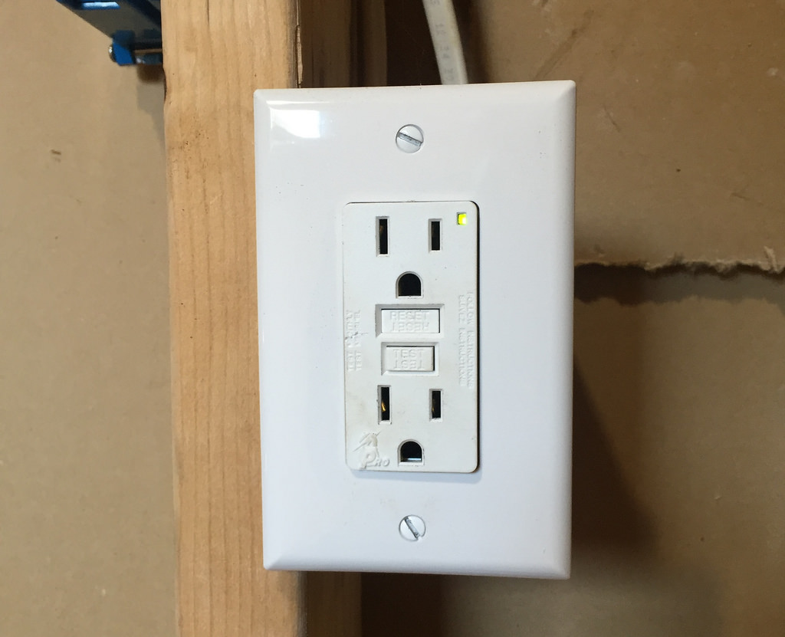
Intro
Alternating Current
Notes:
Today we’re going to learn about alternating current.

Slide 35
Big Question: How are direct current and alternating current beneficial to us through generators, motors, and transformers?
Notes:
Before we start, let’s think about our “big question”: How are direct current and alternating current beneficial to us through generators, motors, and transformers?
[Pause and illicit predictions from students.]
I love all these thoughtful scientific hypotheses! Be sure to keep this question and your predictions in mind as we move through these next few lessons, and we’ll continue to revisit it.

Slide 36
Notes:
Before we move on to our new vocabulary term, let’s review some other words & concepts that you already learned and make sure you are firm in your understanding.
Feedback: If you notice some students struggling to keep up when you activating prior knowledge, it is important to remember to make adjustments and scaffold your content to meet students current level of understanding.

Slide 37
Electric Current: the movement of electrically charged particles
Notes:
Electric current is the movement of electrically charged particles.

Slide 38
Voltage: the total energy needed to move a small electric charge along a path, divided by the size of the change
Notes:
Voltage is the total energy needed to move a small electric charge along a path, divided by the size of the charge. It is measured in volts.

Slide 39
Series Circuit: an electric current follows only one path
Notes:
In a series circuit, an electric current can follow only one path.

Slide 40
Parallel Circuit: an electric current can follow multiple paths
Notes:
In a parallel circuit, an electric current can follow multiple paths.

Slide 41
Direct Current: flows in only one direction
Notes:
Direct current flows in only one direction. We abbreviate direct current as “DC”.

Slide 42
Notes:
Now let’s pause for a moment to check your understanding.

Slide 43
What is electric current?
Notes:
What is electric current?
[Electric current is the movement of electrically charged particles.]
Feedback: There are a lot of opportunities to respond throughout this portion of your lesson, which is so important for ensuring that your students have grasped the key prior knowledge.

Slide 44
In a series circuit, current follows ____ path(s) and in a parallel circuit, current follows ____ path(s).
Notes:
In a series circuit, current follows ______ path(s) and in a parallel circuit, current follows ______ path(s).

Slide 45
In a series circuit, current follows one path(s) and in a parallel circuit, current follows multiple path(s).
Notes:
In a series circuit, current follows one path(s) and in a parallel circuit, current follows multiple path(s).

Slide 46
What is direct current?
Notes:
What is direct current?
[Direct current flows in only one direction. We abbreviate direct current as “DC”.]

Slide 47
Alternating Current
Notes:
Now that we’ve reviewed, let’s define our new term, alternating current.

Slide 48
Alternating Current: reverses direction in a regular pattern
Notes:
An alternating current is a current that reverses direction in a regular pattern. We abbreviate alternating current as “AC”.
Feedback: Using clear language can take make formal more complicated definitions a little easier for students to understand.

Slide 49
Notes:
Let’s check-in for understanding.

Slide 50
What is alternating current?
Notes:
What is alternating current? [An alternating current is a current that reverses direction in a regular pattern. We abbreviate alternating current as “AC”.]
Feedback: Providing feedback is tricky but crucial. Remember to give students with feedback on their response because it helps students know what answers you are actually looking for.

Slide 51
Notes:
Now, let’s talk about some examples of alternating current.

Slide 52
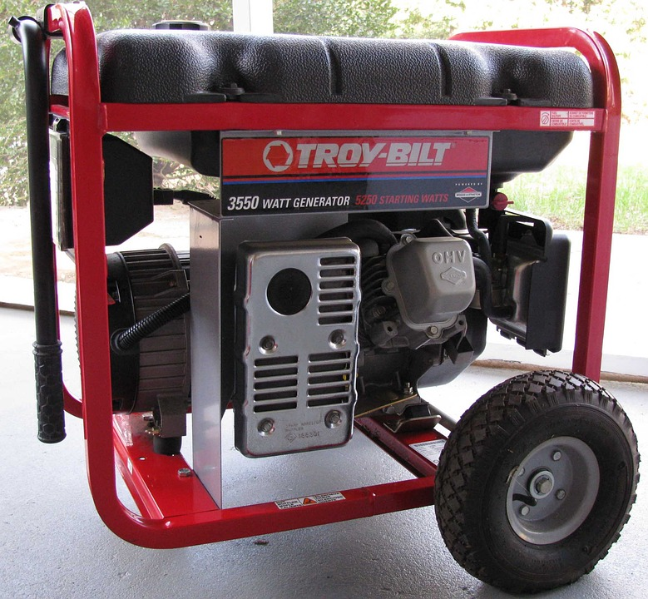
Notes:
An electric generator produces alternating current.
Feedback: It's great practice to introduce an example of the term WITH images to go along with it, this is a great way to help students make connections.

Slide 53
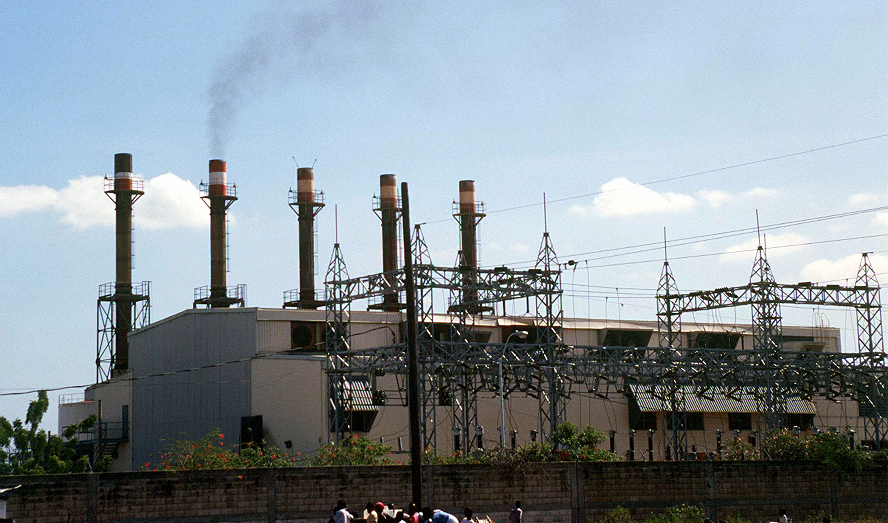
Notes:
A power plant produces alternating current.

Slide 54
Notes:
Your home is powered by the alternating current that comes from a power plant.

Slide 55
Notes:
Let’s check-in for understanding.

Slide 56
What is an example of alternating current?
Notes:
What is an example of alternating current? [Power plant, generator, most outlets, etc.]
Feedback: Having students generate their own examples tests higher order thinking skills and has students build connections between the content and their lives.

Slide 57
What electrical current do most generators create?
Notes:
What electrical current do most generators create? [Alternating current]

Slide 58
What is the difference between alternating current and direct current?
Notes:
What is the difference between alternating current and direct current?
[Alternating current is a current that reverses direction in a regular pattern. In contrast, direct current flows only in one direction.]
Feedback: Making connections between the new content and past terms/content is important for helping students understand the bigger picture.

Slide 59
Remember!!!
Notes:
So remember!

Slide 60
Alternating Current: reverses direction in a regular pattern
Notes:
An alternating current is a current that reverses direction in a regular pattern. We abbreviate alternating current as “AC”.

Slide 61
Simulation Activity
Alternating Current
(PHet)
Click the link above for a simulation to deepen your understanding of alternating current.
Notes:
Feedback: Remember to give the students an opportunity to construct their own explanations when solving an inquiry activity, it is an important step in learning how to apply their new content knowledge.

Slide 62
Big Question: How are direct current and alternating current beneficial to us through generators, motors, and transformers?
Notes:
Explicit cue to revisit the big question at the end of the lesson: Okay everyone. Now that we’ve learned the term, alternating current, let’s reflect once more on our big question. Was there anything that we predicted earlier that was correct or incorrect? Do you have any new hypotheses to share?

Slide 63
Notes:
Thanks for watching, and please continue watching CAPs available from this website.

Slide 64
This Video Was Created With Resources From:
Questions or Comments
Michael Kennedy, Ph.D. MKennedy@Virginia.edu
Rachel L Kunemund, Ph.D. rk8vm@virginia.edu

Slide 65
Intro
“Big Idea” Question
Review Concepts
Check-In Questions
Teacher Demo
Vocabulary
Student-Friendly Definition
Examples & Non-Examples
Morphological Word Parts
Simulation/Activity
Notes:
OK everyone, get ready for our next lesson. Just as a reminder, these are the different components that our lesson may include, and you’ll see these icons in the top left corner of each slide so that you can follow along more easily!

Slide 66
Intro
Electric Generator
Notes:
Today we’ll be learning about electric generators.

Slide 67
Big Question: How are direct current and alternating current used in generators, motors, and transformers?
Notes:
Before we start, let’s think about our “big question” again: How are direct current and alternating current used in generators, motors, and transformers?
[Pause and illicit predictions from students.]
I love all these thoughtful scientific hypotheses! Be sure to keep this question and your predictions in mind as we move through these next few lessons, and we’ll continue to revisit it.
Feedback: It is important to encourage students to make their own predictions about what will happen, this is an important step in helping them to understand the content.

Slide 68
Notes:
Let’s review some terms & concepts that you already learned and make sure you are firm in your understanding.

Slide 69
Electric Current: the movement of electrically charged particles.
Notes:
Electric current is the movement of electrically charged particles.

Slide 70
Series Circuit: electric current can follow only one path
Notes:
In a series circuit, electric current can follow only one path.

Slide 71
Parallel Circuit: electric current can follow multiple paths
Notes:
In a parallel circuit, an electric current can follow multiple paths.

Slide 72
Direct Current: flows in only one direction
Notes:
Direct current flows in only one direction. We abbreviate direct current as “DC”.
Feedback: Remember to make adjustments to your lesson and content if you see some students not demonstrating understanding, this can help them make connections and prevent frustration.

Slide 73
Alternating Current: reverses direction in a regular pattern
Notes:
Alternating current is a current that reverses direction in a regular pattern. We abbreviate alternating current as “AC”.

Slide 74
Notes:
Now let’s pause for a moment to check your understanding.

Slide 75
What is electric current?
Notes:
What is electric current?
[Electric current is the movement of electrically charged particles.]

Slide 76
Explain the difference between a series circuit and a parallel circuit.
Notes:
Explain the difference between a series circuit and a parallel circuit.
[In a series circuit, an electric current can follow only one path. In a parallel circuit, an electric current can follow multiple paths.]

Slide 77
Explain the difference between direct current and alternating current.
Notes:
Explain the difference between direct current and alternating current.
[Direct current is an electric current that flows in only one direction. Alternating current is a current that reverses direction in a regular pattern.]

Slide 78
A generator typically uses a(n) _______ current.
Direct
Alternating
Notes:
A generator typically uses a(n) __________ current.
Feedback: Even during a review, it is important that students are held accountable by being given the opportunity to participate. This may take some encouragement on your part but I know you can get them to do it!

Slide 79
A generator typically uses a(n) _______ current.
Direct
Alternating
Notes:
A generator typically uses a(n) __________ current.
[Alternating]

Slide 80
Electric Generator
Notes:
Now that we’ve reviewed, let’s define our new term, electric generator.

Slide 81
Electric Generator: a machine that uses a magnetic field to turn mechanical energy into electrical energy
Notes:
An electric generator is a machine that uses a magnetic field to turn mechanical energy into electrical energy.

Slide 82
Notes:
Let’s check-in for understanding.

Slide 83
What is an electric generator?
Notes:
What is an electric generator?
[An electric generator is a machine that uses a magnetic field to turn mechanical energy into electrical energy.]
Feedback: When introducing new vocabularies, it is crucial to require the students to give out their own interpretation. I would strongly encourage you to ask students to explain the concept in their own words.

Slide 84
Notes:
That is the basic definition, but there is a bit more you need to know.

Slide 85
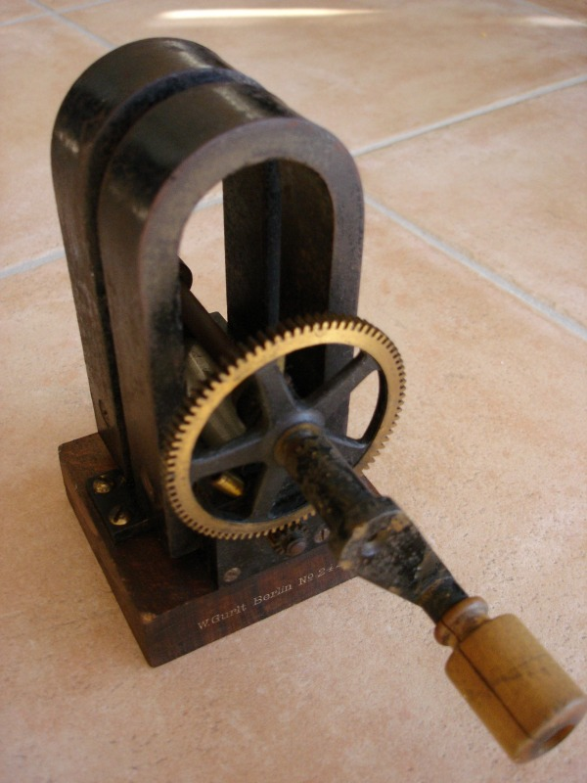
Notes:
Older generators had to be turned by hand. Turning the crank rotates wire coil around a magnetic inside the generator, producing the electric current.

Slide 86
Wind Turbine
Notes:
Today, wind turbines work very much the same way. The wind turns the turbine which generates an electric current from a magnet inside the tower.

Slide 87
Wind Turbine
Notes:
This turns the wind’s mechanical energy into electrical energy.

Slide 88
Notes:
Let’s check-in for understanding.

Slide 89
How did older generators work?
Notes:
How did older generators work?
[Older generators had to be turned by hand. Turning the crank rotates wire coil around a magnetic inside the generator, producing the electric current.]
Feedback: It's awesome to include many opportunities for students to demonstrate understanding, this can help you catch some confusion and get students back on track.

Slide 90
How does a wind turbine create current?
Notes:
How does a wind turbine create current?
[The wind turns the turbine which generates an electric current from a magnet inside the tower. This turns the wind’s mechanical energy into electrical energy.]

Slide 91
Notes:
Now, let’s talk about some examples of electric generators.

Slide 92
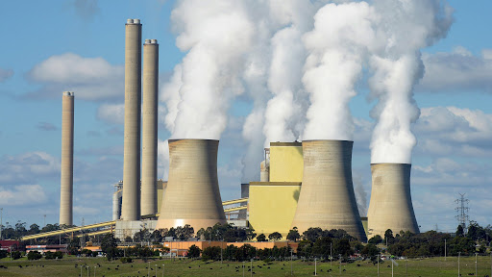
Notes:
A power plant converts mechanical energy into electrical energy so that we can use it.

Slide 93
Notes:
Let’s check-in for understanding.

Slide 94
What is an example of an electric generator?
Notes:
What is an example of an electric generator?
[Power plant, wind turbine, etc.]

Slide 95
A generator turns _______ energy into ________ energy.
Electrical; mechanical
Nuclear; mechanical
Mechanical; electrical
Mechanical; chemical
Notes:
A generator turns ________ energy into ________ energy.
Feedback: It's really important to make sure that you're providing students with frequent opportunities to respond as you're closing the lesson – it will help you know if they understood and made sense of the activity and where you can provide further instruction.

Slide 96
A generator turns _______ energy into ________ energy.
Electrical; mechanical
Nuclear; mechanical
Mechanical; electrical
Mechanical; chemical
Notes:
A generator turns ________ energy into ________ energy.
[mechanical; electrical]

Slide 97
A turbine turns _______ into electrical energy.
Notes:
A turbine turns ________ into electrical energy.

Slide 98
A turbine turns wind (mechanical energy) into electrical energy.
Notes:
A turbine turns wind (mechanical energy) into electrical energy.

Slide 99
Remember!!!
Notes:
So remember!

Slide 100
Electric Generator: a machine that uses a magnetic field to turn mechanical energy into electrical energy
Notes:
An electric generator is a machine that uses a magnetic field to turn mechanical energy into electrical energy.

Slide 101
Big Question: How are direct current and alternating current beneficial to us through generators, motors, and transformers?
Notes:
Explicit cue to revisit the big question at the end of the lesson: Okay everyone. Now that we’ve learned the term, electric generator, let’s reflect once more on our big question. Was there anything that we predicted earlier that was correct or incorrect? Do you have any new hypotheses to share?
Feedback: Providing your students with some reflection time at the end of the lesson is crucial in helping them to put the pieces together and make sense of the activity.

Slide 102
Notes:
Thanks for watching, and please continue watching CAPs available from this website.

Slide 103
This Video Was Created With Resources From:
Questions or Comments
Michael Kennedy, Ph.D. MKennedy@Virginia.edu
Rachel L Kunemund, Ph.D. rk8vm@virginia.edu

Slide 104
Intro
“Big Idea” Question
Review Concepts
Check-In Questions
Teacher Demo
Vocabulary
Student-Friendly Definition
Examples & Non-Examples
Morphological Word Parts
Simulation/Activity
Notes:
OK everyone, get ready for our next lesson. Just as a reminder, these are the different components that our lesson may include, and you’ll see these icons in the top left corner of each slide so that you can follow along more easily!

Slide 105
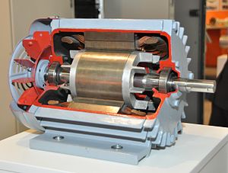
Intro
Electric Motor
Notes:
Today we’ll be learning about electric motors.
Feedback: Using clear and consistent language when introducing today's content helps students understand what is expected.

Slide 106
Big Question: How are direct current and alternating current beneficial to us through generators, motors, and transformers?
Notes:
Before we start, let’s think about our “big question” again: How are direct current and alternating current beneficial to us through generators, motors, and transformers?
[Pause and illicit predictions from students.]
I love all these thoughtful scientific hypotheses! Be sure to keep this question and your predictions in mind as we move through these next few lessons, and we’ll continue to revisit it.

Slide 107
Notes:
Let’s review some terms & concepts that you already learned and make sure you are firm in your understanding.

Slide 108
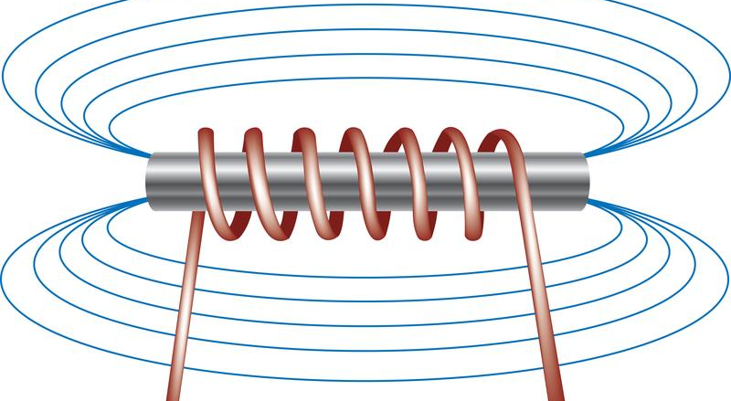
Electromagnet: a type of magnet in which the magnetic field is produced by an electric current
Notes:
An electromagnet is a type of magnet in which the magnetic field is produced by an electric current. It is created by wrapping a current-carrying wire around a metal core.

Slide 109
Electric Current: the movement of electrically charged particles.
Notes:
Electric current is the movement of electrically charged particles.

Slide 110
Direct Current: flows in only one direction
Notes:
Direct current flows in only one direction. We abbreviate direct current as “DC”.
Feedback: It is important to provide a quick review of background information before introducing your student-friendly definition. Doing so can help students make connections to previously learned material.

Slide 111
Alternating Current: reverses direction in a regular pattern
Notes:
Alternating current is a current that reverses direction in a regular pattern. We abbreviate alternating current as “AC”.

Slide 112
Electric Generator: a machine that uses a magnetic field to turn mechanical energy into electrical energy
Notes:
An electric generator is a machine that uses a magnetic field to turn mechanical energy into electrical energy.

Slide 113
Notes:
Now let’s pause for a moment to check your understanding.

Slide 114
What is an electromagnet?
Notes:
What is an electromagnet?
[An electromagnet is a type of magnet in which the magnetic field is produced by an electric current. It is created by wrapping a current-carrying wire around a metal core.]

Slide 115
What is electric current?
Notes:
What is electric current?
[Electric current is the movement of electrically charged particles.]

Slide 116
Explain the difference between direct current and alternating current.
Notes:
Explain the difference between direct current and alternating current.
[Direct current is an electric current that flows in only one direction. Alternating current is a current that reverses direction in a regular pattern.]

Slide 117
What is an electric generator?
Notes:
What is an electric generator?
[An electric generator is a machine that uses a magnetic field to turn mechanical energy into electrical energy.]

Slide 118
Electric Motor
Notes:
Now that we’ve reviewed, let’s define our new term, electric motor.

Slide 119
Electric Motor: a machine that converts electrical energy into mechanical energy
Notes:
An electric generator is a machine that converts electrical energy into mechanical energy.
Feedback: It can be helpful to break the definition down and explicitly explain each part to help students understand the whole definition.

Slide 120
Notes:
Let’s check-in for understanding.

Slide 121
What is an electric motor?
Notes:
What is an electric motor?
[An electric motor is a machine that converts electrical energy into mechanical energy.]

Slide 122
Notes:
That is the basic definition, but there is a bit more you need to know.

Slide 123
Repulsion
Notes:
In an electric motor, the repulsion between the electromagnet and the magnet poles keeps the motor spinning.

Slide 124
Notes:
Let’s check-in for understanding.

Slide 125
What is the role of repulsion in an electric motor?
Notes:
What is the role of repulsion in an electric motor?
[In an electric motor, the repulsion between the electromagnet and the magnet poles keeps the motor spinning.]

Slide 126
Notes:
Now, let’s talk about some examples of electric generators.
Feedback: It's good to pick a variety of examples to work through with your students. This prepares them for some types that might trip them up when they try it on their own.

Slide 127
Car Windows
Notes:
Car windows are powered by an electric motor to open and close them.

Slide 128
Windshield Wipers
Notes:
Windshield wipers are also powered by electric motors to move them back and forth on the window.

Slide 129
Notes:
Now, let’s talk about some non-examples of electric generators.

Slide 130
Car
Notes:
An entire car is not powered by an electric motor. Most cars are powered by gasoline.
Feedback: One important component of using non-examples is by clearly distinguishing similarities and explaining why it is a non-example.

Slide 131
Notes:
Let’s check-in for understanding.

Slide 132
What is an example of an electric motor?
Notes:
What is an example of an electric motor?
[Car windows, car windshield wipers, etc.]

Slide 133
What is a non-example of an electric motor?
NON
Notes:
What is a non-example of an electric motor?
[An entire car, a wind turbine, etc.]

Slide 134
Demonstration
Notes:
Demonstration – Let’s see what an electric motor looks like!
For this demonstration, all I am going to use is a fan.
When I plug the fan in, it uses electrical energy and turns it into mechanical energy.
Feedback: Remember to plan out the demonstration so that you are able to follow a logical order. This will help students make sense of the activity and not become lost.

Slide 135
Notes:
Let’s check-in for understanding.

Slide 136
In this demonstration, what did you notice about electric motors?
Notes:
In this demonstration, what did you notice about electric motors?
[The fan uses an electric motor. The electrical energy from the battery is converted into the blades spinning (mechanical energy).]

Slide 137
What is an electric motor?
Notes:
What is an electric motor?
[An electric motor is a machine that converts electrical energy into mechanical energy.]
Feedback: As you are closing the lesson, keep in mind to monitor students' understanding so that you can determine if more instruction is needed or if there are any misunderstandings.

Slide 138
True/False: Electric motors cannot be turned off.
Notes:
True/False: Electric motors cannot be turned off.

Slide 139
True/False: Electric motors cannot be turned off.
Notes:
True/False: Electric motors cannot be turned off.
[False – you can turn off the current needed to run the electric motor.]

Slide 140
Is a car that uses gasoline an example of an electric motor?
Notes:
Is a car that uses gasoline an example of an electric motor?
[No]

Slide 141
Remember!!!
Notes:
So remember!

Slide 142
Electric Motor: a machine that converts electrical energy into mechanical energy
Notes:
An electric generator is a machine that converts electrical energy into mechanical energy.
Feedback: Remember, it is important that students have an opportunity to ask questions at the end of the lesson so that they can clarify their own understanding, some students may need a clear cue that it is their turn to ask questions.

Slide 143
Repulsion
Notes:
In an electric motor, the repulsion between the electromagnet and the magnet poles keeps the motor spinning. This can be seen here.

Slide 144
Big Question: How are direct current and alternating current beneficial to us through generators, motors, and transformers?
Notes:
Explicit cue to revisit the big question at the end of the lesson: Okay everyone. Now that we’ve learned the term, electric motor, let’s reflect once more on our big question. Was there anything that we predicted earlier that was correct or incorrect? Do you have any new hypotheses to share?

Slide 145
Notes:
Thanks for watching, and please continue watching CAPs available from this website.

Slide 146
This Video Was Created With Resources From:
Questions or Comments
Michael Kennedy, Ph.D. MKennedy@Virginia.edu
Rachel L Kunemund, Ph.D. rk8vm@virginia.edu

Slide 147
Intro
“Big Idea” Question
Review Concepts
Check-In Questions
Teacher Demo
Vocabulary
Student-Friendly Definition
Examples & Non-Examples
Morphological Word Parts
Simulation/Activity
Notes:
OK everyone, get ready for our next lesson. Just as a reminder, these are the different components that our lesson may include, and you’ll see these icons in the top left corner of each slide so that you can follow along more easily!

Slide 148
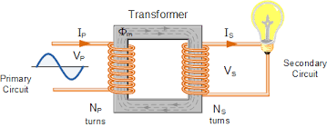
Intro
Transformer
Notes:
Today we’ll be learning about transformers.

Slide 149
Big Question: How are direct current and alternating current used in generators, motors, and transformers?
Notes:
Before we start, let’s think about our “big question” again: How are direct current and alternating current in used in generators, motors, and transformers?
[Pause and illicit predictions from students.]
I love all these thoughtful scientific hypotheses! Be sure to keep this question and your predictions in mind as we move through these next few lessons, and we’ll continue to revisit it.

Slide 150
Notes:
Let’s review some terms & concepts that you already learned and make sure you are firm in your understanding.
Feedback: Remember, it is important to have an organized and smooth transition to limit wasted time and reduce any disruptions. By having materials ready in advance and working on a routine with students you can easily get this done!

Slide 151
Electric Current: the movement of electrically charged particles.
Notes:
Electric current is the movement of electrically charged particles.

Slide 152
Voltage: the total energy needed to move a small electric charge along a path, divided by the size of the charge
Notes:
Voltage is the total energy needed to move a small electric charge along a path, divided by the size of the charge. It is measured in volts.

Slide 153
Series Circuit: electric current can follow only one path
Notes:
In a series circuit, electric current can follow only one path.

Slide 154
Parallel Circuit: electric current can follow multiple paths
Notes:
In a parallel circuit, an electric current can follow multiple paths.
Feedback: Using relevant topics and content to activate prior knowledge sets the students up to make important connections to new content.

Slide 155
Direct Current: flows in only one direction
Notes:
Direct current flows in only one direction. We abbreviate direct current as “DC”.

Slide 156
Alternating Current: reverses direction in a regular pattern
Notes:
Alternating current is a current that reverses direction in a regular pattern. We abbreviate alternating current as “AC”.

Slide 157
Notes:
Now let’s pause for a moment to check your understanding.
Feedback: It's really important to make sure that you're providing students with frequent opportunities to respond as you're activating prior knowledge – it will save so you so much time if you confirm understanding before asking them to try something independently.

Slide 158
What is electric current?
Notes:
What is electric current?
[Electric current is the movement of electrically charged particles.]

Slide 159
What is voltage?
Notes:
What is voltage?
[Voltage is the total energy needed to move a small electric charge along a path, divided by the size of the charge. It is measured in volts.]

Slide 160
How many paths can a current follow in a series circuit?
1
2
3
4
Notes:
How many paths can a current follow in a series circuit?

Slide 161
How many paths can a current follow in a series circuit?
1
2
3
4
Notes:
How many paths can a current follow in a series circuit?
[1]

Slide 162
In a parallel circuit, an electrical current can follow _______ paths.
Notes:
In a parallel circuit, an electric current can follow ________ paths.

Slide 163
In a parallel circuit, an electrical current can follow multiple paths.
Notes:
In a parallel circuit, an electric current can follow multiple paths.

Slide 164
Explain the difference between direct current and alternating current.
Notes:
Explain the difference between direct current and alternating current.
[Direct current is an electric current that flows in only one direction. Alternating current is a current that reverses direction in a regular pattern.]

Slide 165
Transformer
Notes:
Now that we’ve reviewed, let’s define our new term, transformer.
Feedback: Providing clear cues as to what was coming next in the lesson helps prepared students by letting them know what to expect.

Slide 166
Transformer: changes the voltage of an alternating current
Notes:
A transformer is a device that changes the voltage of an alternating current.

Slide 167
Notes:
Let’s check-in for understanding.

Slide 168
What is a transformer?
Notes:
What is a transformer?
[A transformer is a device that changes the voltage of an alternating current.]
Feedback: Provide clear and straightforward directions when asking students to explain the definitions. This helps to avoid confusion!

Slide 169
Notes:
That is the basic definition, but there is a bit more you need to know.

Slide 170
Increase or Decrease Voltage
Notes:
A transformer can either increase or decrease the voltage in the circuit.

Slide 171
Notes:
Let’s check-in for understanding.
Feedback: Cues are very important when teaching vocabulary, it helps the students prepare for what's next by giving them a hint as to what is coming.

Slide 172
What is the role of a transformer?
Notes:
What is the role of a transformer?
[To increase or decrease voltage]

Slide 173
Step-Up
Notes:
A step-up transformer makes the output voltage greater than the input voltage.

Slide 174
Notes:
Now, let’s look at an example of a step-up transformer.

Slide 175
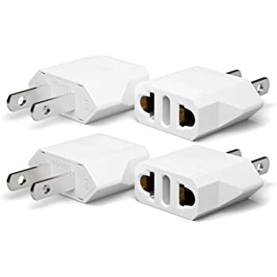
Notes:
These wall adapters can increase the voltage of a plug so that it can actually be plugged into the wall.
Feedback: Remember to try and use phrasing and language that is clear and easy for students to understand when going over examples of term meaning.

Slide 176
Step-Down
Notes:
A step-down transformer makes the output voltage less than the input voltage.

Slide 177
Notes:
Now, let’s look at an example of a step-down transformer.

Slide 178
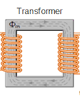
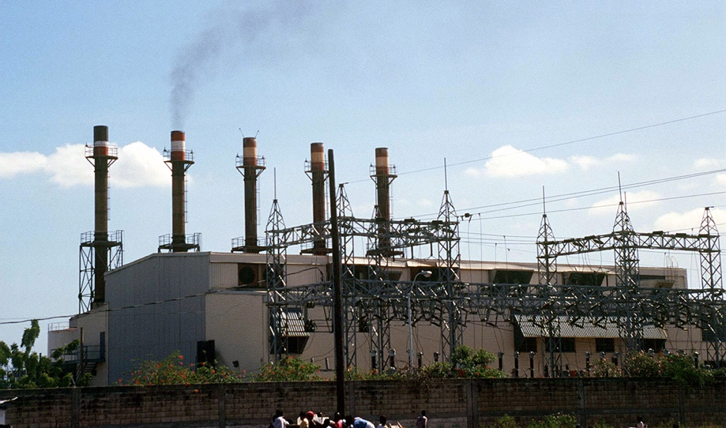
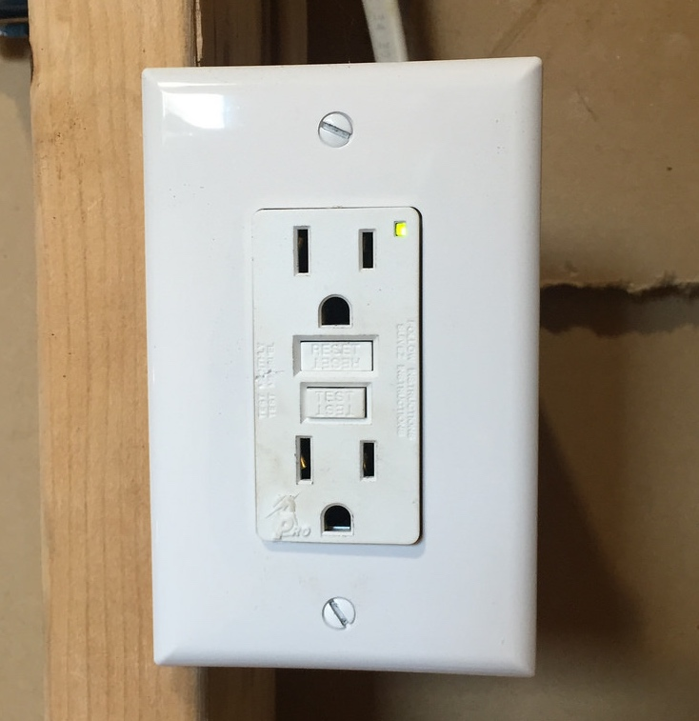
Notes:
A step-down transformer is needed to reduce the high voltage alternating current that flows into your house from the power plant.

Slide 179
Notes:
Let’s check-in for understanding.

Slide 180
What is the difference between a step-up and a step-down transformer?
Notes:
What is the difference between a step-up and a step-down transformer?
[A step-up transformer makes the output voltage greater than the input voltage.
A step-down transformer makes the output voltage less than the input voltage.]
Feedback: Asking students to draw comparisons between vocabulary terms targets higher order thinking skills and builds connections.

Slide 181
What is an example of a step-up transformer?
Notes:
What is an example of a step-up transformer?
[Blocks that plug your usb charger into the wall, etc.]

Slide 182
What is an example of a step-down transformer?
Notes:
What is an example of a step-down transformer?
[Power plant → wall outlets, etc.]

Slide 183
If you have a system that needs a 6 V battery but you have a 12 V battery, what would you need to use the battery?
Notes:
If you have a system that needs a 6 V battery but you have a 12 V battery, what would you need to use the battery?
[A step-down transformer]
Feedback: Confirming students' understanding with lots of opportunities to respond when closing a lesson is super important before asking them to try it on their own.

Slide 184
What is a transformer?
Notes:
What is a transformer?
[A transformer is a device that changes the voltage of an alternating current.]

Slide 185
Remember!!!
Notes:
So remember!
Feedback: A good general strategy for information retention is: 1) tell them what you're going to teach them, 2) teach them, and 3) tell them what you just taught them. Make sure to include the third and final step. While it is easy to think a quick review of what you just went over is unnecessary, it can be incredibly useful in helping the students remember the information over the long term.

Slide 186
Transformer: changes the voltage of an alternating current
Notes:
A transformer is a device that changes the voltage of an alternating current.

Slide 187
Step-Up
Notes:
A step-up transformer makes the output voltage greater than the input voltage.

Slide 188
Step-Down
Notes:
A step-down transformer makes the output voltage less than the input voltage.

Slide 189
Big Question: How are direct current and alternating current beneficial to us through generators, motors, and transformers?
Notes:
Explicit cue to revisit the big question at the end of the lesson: OK everyone. Now that we’ve learned the term, transformer, let’s reflect once more on our big question. Was there anything that we predicted earlier that was correct or incorrect? Do you have any new hypotheses to share?
Feedback: Remember to take the time to link this part of the lesson to other content that is related to the current topic. This is great as it helps students make connections!

Slide 190
This Video Was Created With Resources From:
Questions or Comments
Michael Kennedy, Ph.D. MKennedy@Virginia.edu
Rachel L Kunemund, Ph.D. rk8vm@virginia.edu

