Slide 1
Intro
“Big Idea” Question
Review Concepts
Check-In Questions
Teacher Engagement
Vocabulary
Student-Friendly Definition
Examples & Non-Examples
Morphological Word Parts
Frayer Model
Simulation/Activity
Notes:
OK everyone, get ready for our next lesson. Just as a reminder, these are the different components that our lesson may include, and you’ll see these icons in the top left corner of each slide so that you can follow along more easily!

Slide 2
Direction
Intro
Notes:
Today, we’ll be learning about the word: Direction.

Slide 3
Big Question: How do direction and speed impact the motion of objects in the world around us?
Notes:
Our “big question” is: How do direction and speed impact the motion of objects in the world around us?
[Pause and illicit predictions from students.]
I love all these thoughtful scientific hypotheses! Be sure to keep this question and your predictions in mind as we move through these next few lessons, and we’ll continue to revisit it.

Slide 4
Notes:
Before we move on to our new topic, let’s review some other words & concepts that you already learned and make sure you are firm in your understanding.

Slide 5
Energy: the ability to cause change
Notes:
Energy is the ability to cause change.

Slide 6
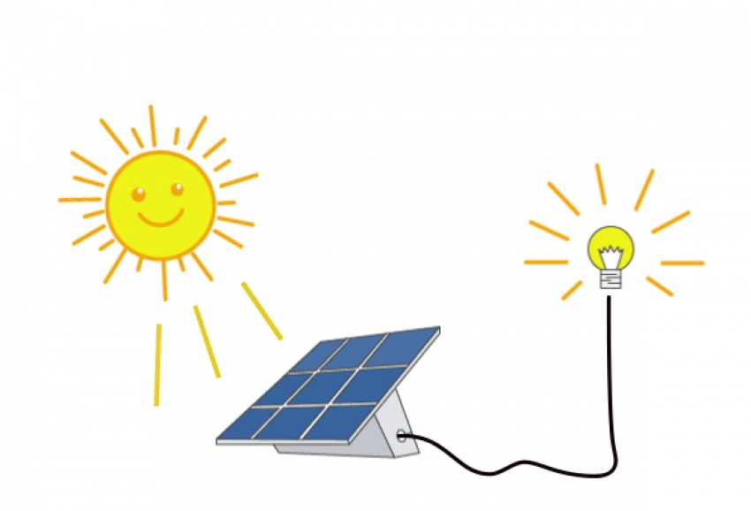
Energy transformation: changing energy from one form to another
Notes:
Energy transformation is when energy changes from one form to another.

Slide 7
Notes:
Now let’s pause for a moment to review the information we have covered already.

Slide 8
________ is the ability to cause change.
Energy
Work
Notes:
__________ is the ability to cause change.
[Energy]

Slide 9
________ is the ability to cause change.
Energy
Work
Notes:
__________ is the ability to cause change.
[Energy]

Slide 10
Energy transformation is changing energy from one form to another.
True
False
Notes:
Energy transformation is changing energy from one form to another.
[True]

Slide 11
Energy transformation is changing energy from one form to another.
True
False
Notes:
Energy transformation is changing energy from one form to another.
[True]

Slide 12
Direction
Notes:
Now that we’ve reviewed, let’s define the phrase direction.

Slide 13
Direction: where something moves or points
Notes:
Direction is where something moves or points.

Slide 14
Notes:
Let’s check-in for understanding.

Slide 15
What is direction?
Notes:
What is direction?
[Direction is where something moves or points.]

Slide 16
Notes:
That is the basic definition, but there is a bit more you need to know.

Slide 17
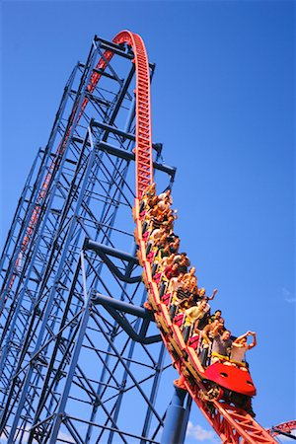
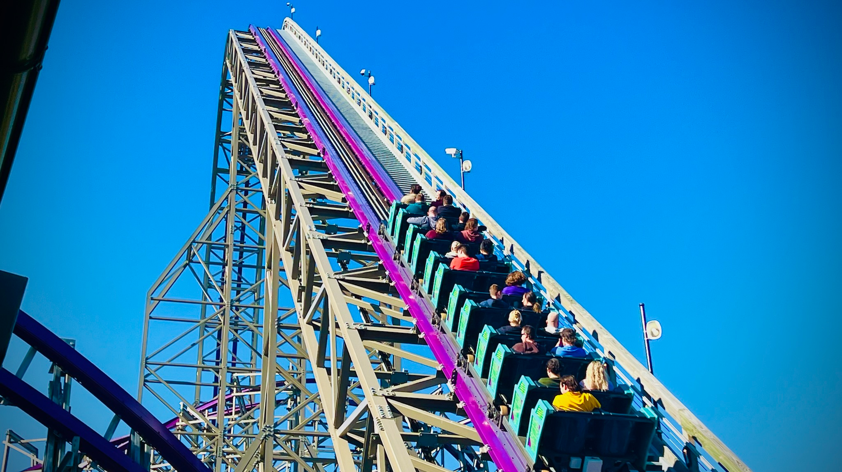
Notes:
Up and down are two ways to describe an object’s direction. For example, the position of the roller coaster car on the left is an example of the down direction - the roller coaster car is moving down. The roller coaster car on the right is an example of the up direction - the roller coaster car is moving up.

Slide 18
Notes:
Left and right are two other ways to describe direction. For example, the sign on the left is pointing in the left direction. The sign on the right is pointing in the right direction.

Slide 19
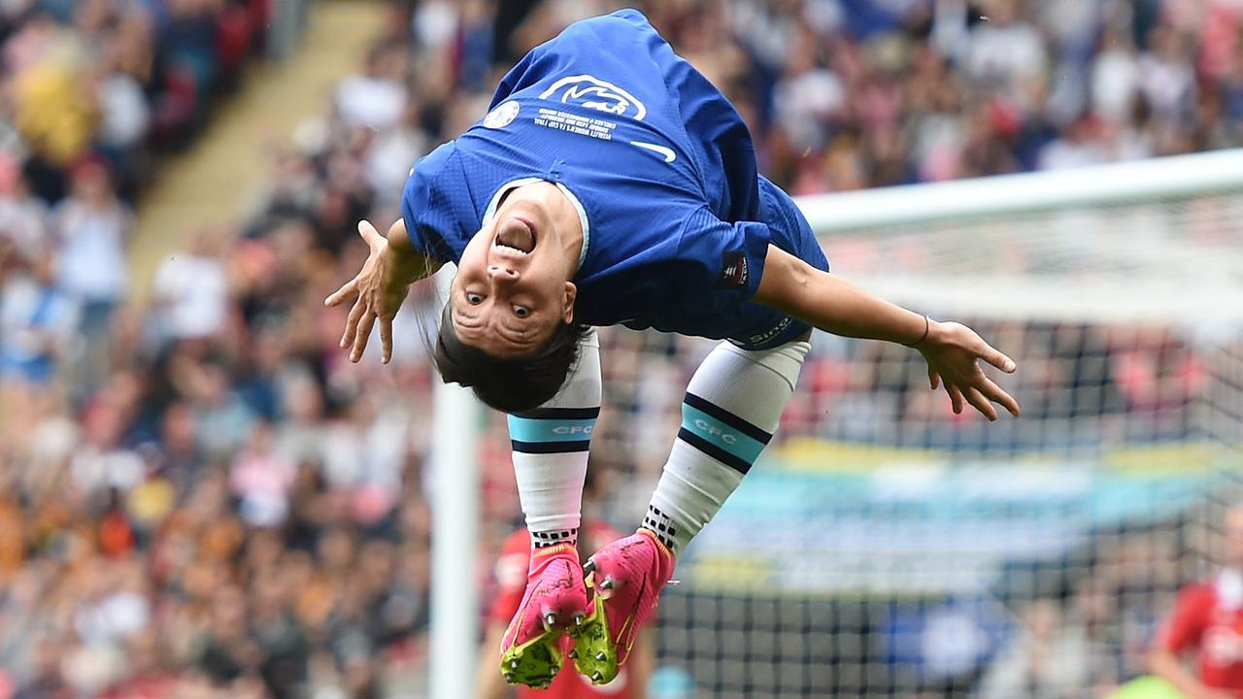
Notes:
Forwards and backwards are two other ways to describe direction. The runner is moving in the forward direction. The soccer player is flipping in the backward direction.

Slide 20
Notes:
Let’s check-in for understanding.

Slide 21
_____ and _____ are two ways to describe the direction of the roller coaster cars.
Notes:
_____ and _____ are two ways to describe the direction of the roller coaster cars.
[Up, down]

Slide 22
Up and down are two ways to describe the direction of the roller coaster cars.
Notes:
_____ and _____ are two ways to describe the direction of the roller coaster cars.
[Up, down]

Slide 23
True or False: Up and down describe the direction of the two arrows.
True
False
Notes:
True or False: Up and down describe the direction of the two arrows.
True
False

Slide 24
True or False: Up and down describe the direction of the two arrows.
True
False
Notes:
False: The direction of the two arrows is not up and down. The direction of the two arrows is left and right.

Slide 25
The ______ direction describes the runner and the ______ direction describes the soccer player.
Notes:
The _______ direction describes the runner and the _______ direction describes the soccer player.
[forward, backward]

Slide 26
The forward direction describes the runner and the backward direction describes the soccer player.
Notes:
The _______ direction describes the runner and the _______ direction describes the soccer player.
[forward, backwards]

Slide 27
Notes:
Now, let’s talk about some examples of direction.

Slide 28
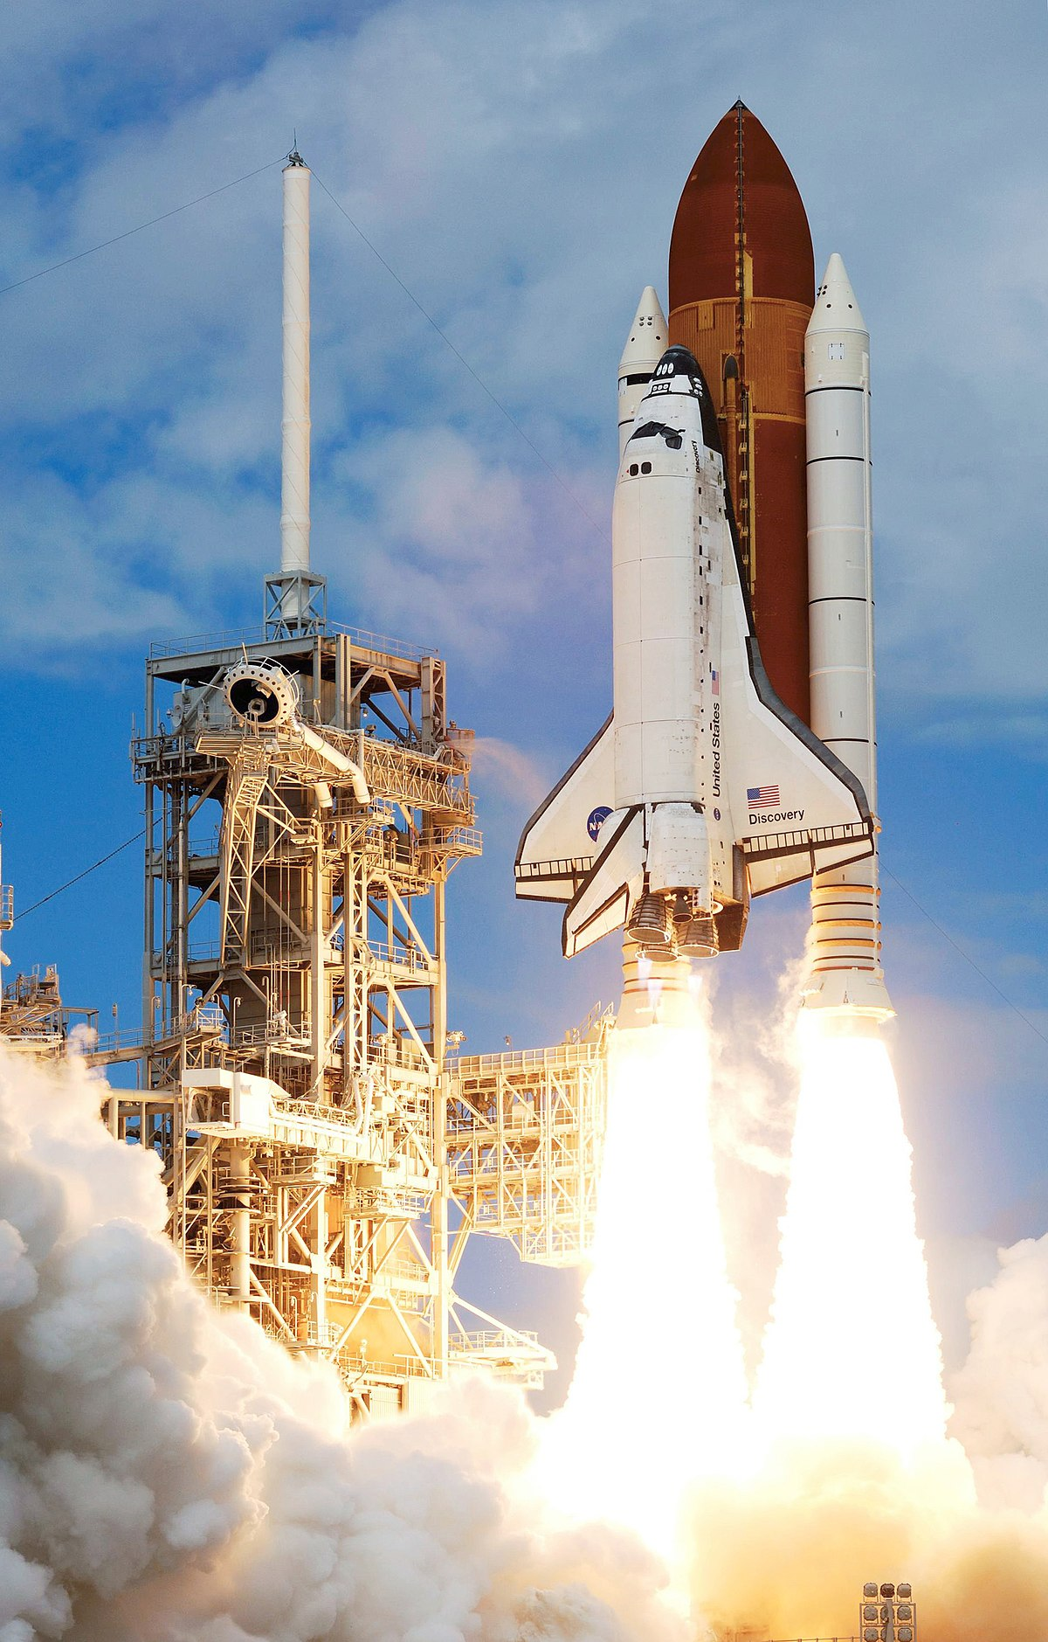
Notes:
The space shuttle is pointed and moving up. This tells us the direction of the space shuttle is up.

Slide 29
Notes:
The bowling ball is pointed and moving forward. This tells us the direction of the bowling ball is forward.

Slide 30
Notes:
Let’s check-in for understanding.

Slide 31
What is direction?
Notes:
What is direction?
[Direction is where something moves or points.]

Slide 32
Notes:
Now, let’s talk about some non-examples of direction.

Slide 33
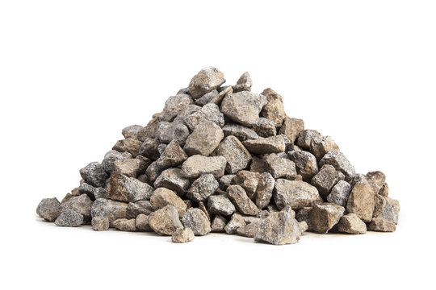
Notes:
The pile of rocks are not moving or pointing anywhere, so they do not have a direction.

Slide 34
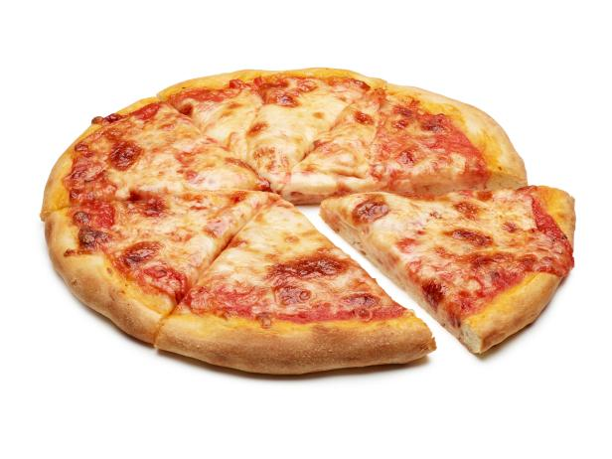
Notes:
The cheese pizza is not an example of direction. Remember, direction is where something moves or points. The cheese pizza is not moving and it is not pointing anywhere.

Slide 35
Notes:
Now let’s pause for a moment to check your understanding.

Slide 36
Why does the bowling ball have a direction, but the rocks do not?
Notes:
Why does the bowling ball have a direction, but the rocks do not?
[Because the bowling ball is pointing and moving forward. The rocks are not moving and they are not pointing anywhere]

Slide 37
Notes:
We can also break down the term direction into different word parts to help us remember the meaning. Let’s take a look!

Slide 38
Direction
(root)
(suffix)
Notes:
We can break up the term direction into two parts: root and suffix.

Slide 39
Direction
Direct = guiding or indicating a path or course
Notes:
First, we have the root “direct” which means guiding or indicating a path or course. In this word, it indicates that direction involves guiding or indicating.

Slide 40
Direction
-ion = an action, process, or result
Notes:
-ion is the suffix. The “-ion” suffix means an action, process, or result. Now let’s put it all together.

Slide 41
Direct ion
Direction
An action of guiding or indicating a path or course
Notes:
So when we put it all together, direction means an action of guiding or indicating a path or course .

Slide 42
Notes:
Let’s check-in for understanding.

Slide 43
How can we use the word parts of direction to help us remember the definition of the term?
Direction
(root)
(suffix)
Notes:
How can we use the word parts of direction to help us remember the definition of the term?
[The root direct means guiding or indicating a path or course.
-ion is the suffix meaning an action, process, or result.
So when we put it all together, direction is an action of guiding or indicating a path or course.]

Slide 44
Remember!!!
Notes:
So remember!

Slide 45
Direction: where something moves or points
Notes:
Direction is where something moves or points.

Slide 46
Notes:
We will now complete this concept map, called a Frayer model, to summarize and further clarify what you have learned about the term direction.

Slide 47
Definition
Picture
Direction
Example
How does direction impact my life?
Notes:
To complete the Frayer model, we will choose from four choices the correct picture, definition, example, and response to the question, “How does direction impact my life?” Select the best response for each question using the information you just learned. As we select responses, we will see how this model looks filled in for the term direction.

Slide 48
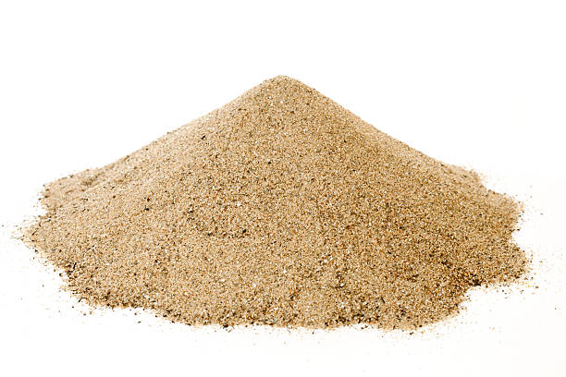
Directions: Choose the correct picture of direction from the choices below.
A
B
C
D
Notes:
Choose the one correct picture of direction from these four choices.

Slide 49
Directions: Choose the correct picture of direction from the choices below.
A
B
C
D
Notes:
This is the picture that shows direction.

Slide 50
Definition
Picture
Direction
Example
How does direction impact my life?
Notes:
Here is the Frayer model filled in with a picture of direction.

Slide 51
Directions: Choose the correct definition of Direction from the choices below.
A
Where something moves or points
B
The weight of an object
C
When an object stands still
D
The ability to cause change
Notes:
Choose the one correct definition of direction from these four choices.

Slide 52
Directions: Choose the correct definition of Direction from the choices below.
A
Where something moves or points
B
The weight of an object
C
When an object stands still
D
The ability to cause change
Notes:
“Where something moves or points” is correct! This is the definition of direction.

Slide 53
Definition
Picture
Where something moves or points
Direction
Example
How does direction impact my life?
Notes:
Here is the Frayer Model with a picture and the definition filled in for direction: Where something moves or points.

Slide 54
Directions: Choose the correct example of Direction from the choices below.
A
A puppy sleeping
B
A boat floating on water
C
A child sliding down a slide
D
A musician playing a piano
Notes:
Choose the one correct example of direction from these four choices.

Slide 55
Directions: Choose the correct example of Direction from the choices below.
A
A puppy sleeping
B
A boat floating on water
C
A child sliding down a slide
D
A musician playing a piano
Notes:
“A child sliding down a slide” is correct! This is an example of direction.

Slide 56
Definition
Picture
Where something moves or points
Direction
A child sliding down a slide
Example
How does direction impact my life?
Notes:
Here is the Frayer Model with a picture, definition, and an example of direction: A child sliding down a slide.

Slide 57
Directions: Choose the correct response for “how does direction impact my life?” from the choices below.
A
Direction helps us to understand what we read in a book
B
Direction gives us a way to describe where an object points or how an object moves
C
Direction creates a new way to see how trees grow
Direction shows us how water freezes to become ice
D
Notes:
Choose the one correct response for “how does direction impact my life?” from these four choices.

Slide 58
Directions: Choose the correct response for “how does direction impact my life?” from the choices below.
A
Direction helps us to understand what we read in a book
B
Direction gives us a way to describe where an object points or how an object moves
C
Direction creates a new way to see how trees grow
Direction shows us how water freezes to become ice
D
Notes:
“Direction gives us a way to describe where an object points or how an object moves.” That is correct! This is an example of how direction impacts your life.

Slide 59
Definition
Picture
Where something moves or points
Direction
A child sliding down a slide
Direction gives us a way to describe where an object points or how an object moves
Example
How does direction impact my life?
Notes:
Here is the Frayer Model with a picture, definition, example, and a correct response to “how does direction impact my life?”: Direction gives us a way to describe where an object points or how an object moves.

Slide 60
Remember!!!
Notes:
So remember!

Slide 61
Direction: where something moves or points
Notes:
Direction is where something moves or points.

Slide 62
Big Question: How do direction and speed impact the motion of objects in the world around us?
Notes:
Let’s reflect again on our big question. Our “big question” is: How do direction and speed impact the motion of objects in the world around us?
Does anyone have any additional examples to share that haven’t been discussed yet?
In our “big question,” there are two more vocabulary words we need to explore before we move onto our simulation activity

Slide 63
Simulation Activity
Direction
(Direction Game)
Click the link above for a simulation to explore direction.
In this activity, you will be asked to use directions to describe where certain buildings are.
Notes:
*This is the simulation for direction - please use the activity labeled 1: Directions Game.

Slide 64
Intro
“Big Idea” Question
Review Concepts
Check-In Questions
Teacher Engagement
Vocabulary
Student-Friendly Definition
Examples & Non-Examples
Morphological Word Parts
Frayer Model
Simulation/Activity
Notes:
OK everyone, get ready for our next lesson. Just as a reminder, these are the different components that our lesson may include, and you’ll see these icons in the top left corner of each slide so that you can follow along more easily!

Slide 65
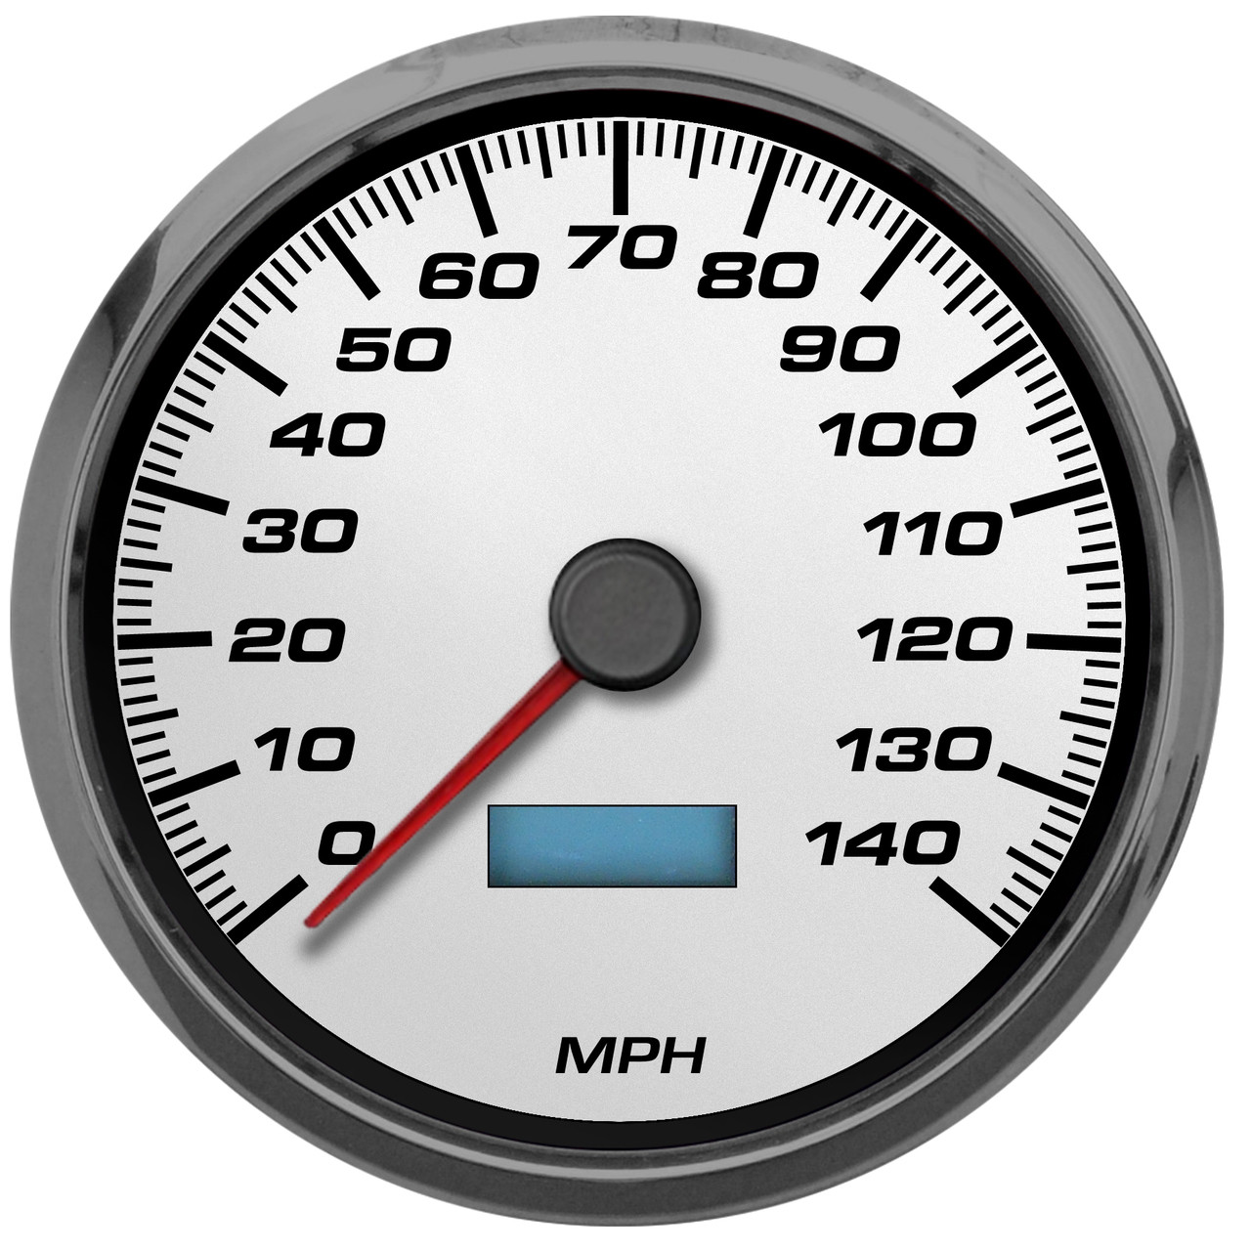
Speed
Intro
Notes:
Next, we’ll be learning about the word: Speed.

Slide 66
Notes:
Before we move on to our new topic, let’s review some other words & concepts that you already learned and make sure you are firm in your understanding.

Slide 67
Direction: where something moves or points
Notes:
Direction is where something moves or points

Slide 68
Energy: the ability to cause change
Notes:
Energy is the ability to cause change.

Slide 69
Energy transformation: changing energy from one form to another
Notes:
Energy transformation is when energy changes from one form to another.

Slide 70
Notes:
Now let’s pause for a moment to review the information we have covered already.

Slide 71
Energy is the ability to cause _______.
Similarities
Change
Emotions
Notes:
Energy is the ability to cause ________.
[Change]

Slide 72
Energy is the ability to cause _______.
Similarities
Change
Emotions
Notes:
Energy is the ability to cause ________.
[Change]

Slide 73
Energy transformation is keeping the form of energy the same.
True
False
Notes:
Energy transformation is keeping the form of energy the same.
[False]

Slide 74
Energy transformation is keeping the form of energy the same.
True
False
Notes:
False: Energy transformation is changing energy from one form to another.

Slide 75
Direction is where something ______ or ______.
Notes:
Direction is where something ______ or ______.
[moves, points]

Slide 76
Direction is where something moves or points.
Notes:
Direction is where something ______ or ______.
[moves, points]

Slide 77
Speed
Notes:
Now that we’ve reviewed, let’s define the phrase speed.

Slide 78
Speed: how fast an object moves
Notes:
Speed is how fast an object moves.

Slide 79
Notes:
Let’s check-in for understanding.

Slide 80
What is speed?
Notes:
What is speed?
[Speed is how fast an object moves.]

Slide 81
Notes:
That is the basic definition, but there is a bit more you need to know.

Slide 82
Speed is a measurement that describes a relationship between how far you go and how long it takes you to get there.
Notes:
Speed is a measurement that describes a relationship between how far you go and how long it takes you to get there.

Slide 83
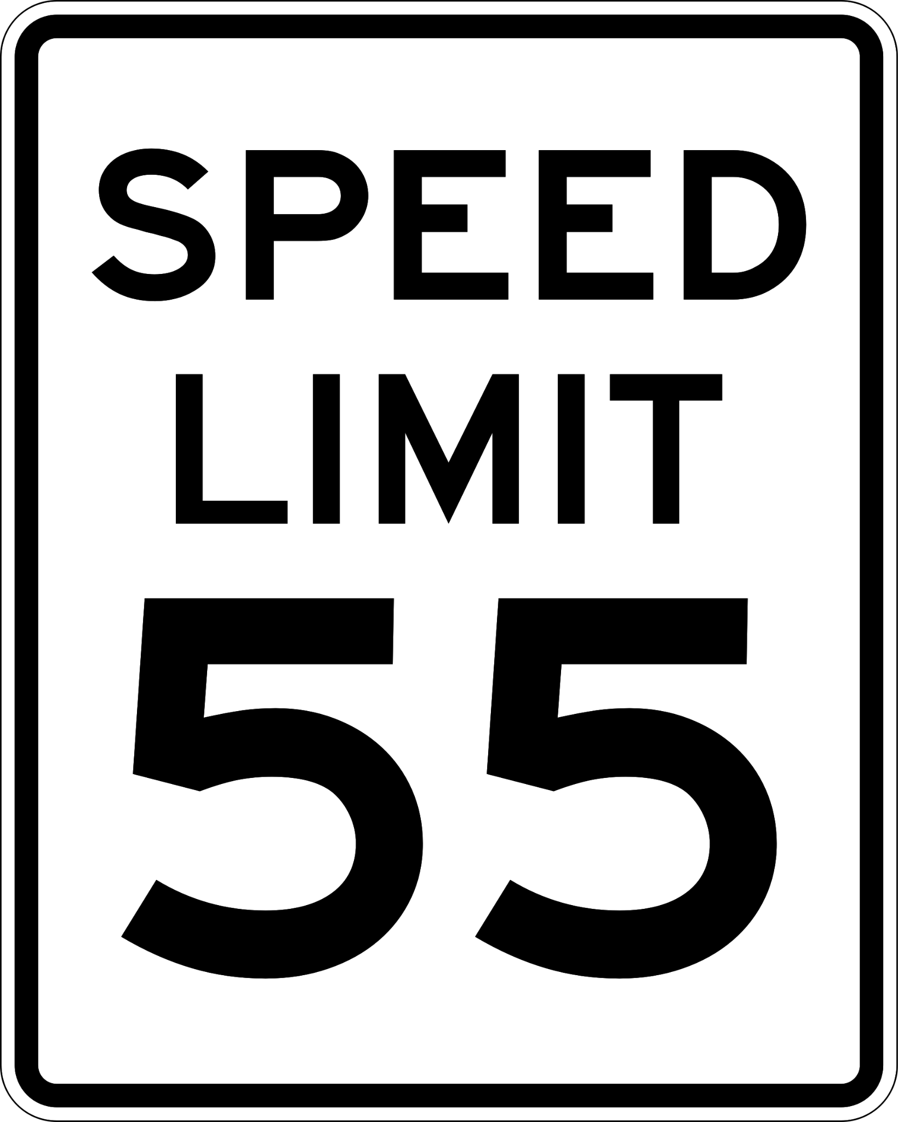
You might see the word speed all around you. For example, signs like this tell drivers they need to drive a speed of 55 miles per hour.
Notes:
You might see the word speed all around you. For example, signs like this tell drivers they need to drive a speed of 55 miles per hour.

Slide 84
The speed of an object can be described as increasing, decreasing, or remaining the same.
Notes:
The speed of an object can be described as increasing, decreasing, or remaining the same. For example, runners have an increasing speed when they run a race. Cars have decreasing speed when they use their brakes. If you take a nap, your speed is remaining the same - you aren’t moving!

Slide 85
Notes:
Let’s check-in for understanding.

Slide 86
Speed is a ___________ that describes a relationship between how far you go and how long it takes you to get there.
Clock
Measurement
Ruler
Notes:
Speed is a ___________ that describes a relationship between how far you go and how long it takes you to get there.
[Measurement]

Slide 87
Speed is a ___________ that describes a relationship between how far you go and how long it takes you to get there.
Clock
Measurement
Ruler
Notes:
Speed is a [measurement[ that describes a relationship between how far you go and how long it takes you to get there.
[Measurement]

Slide 88
True or False: The speed of an object can be described as increasing, decreasing, or remaining the same.
True
False
Notes:
True or False: The speed of an object can be described as increasing, decreasing, or remaining the same.

Slide 89
True or False: The speed of an object can be described as increasing, decreasing, or remaining the same.
True
False
Notes:
True: The speed of an object can be described as increasing, decreasing, or remaining the same.

Slide 90
Notes:
Now, let’s talk about some examples of speed.

Slide 91
Notes:
Airplanes are objects that move. When airplanes are way up in the sky, they can be traveling at a speed of almost 550 miles per hour!

Slide 92
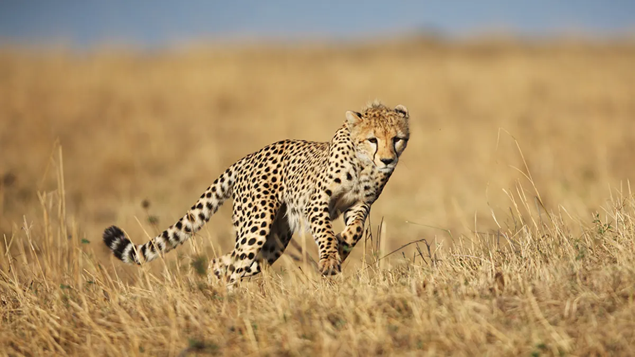
Notes:
Cheetahs are objects that move. Cheetahs are the fastest land animal and can run at a speed of about 70 miles per hour!

Slide 93
Notes:
Let’s check-in for understanding.

Slide 94
What is speed?
Notes:
What is speed?
[Speed is how fast an object moves.]

Slide 95
Notes:
Now, let’s talk about some non-examples of speed.

Slide 96
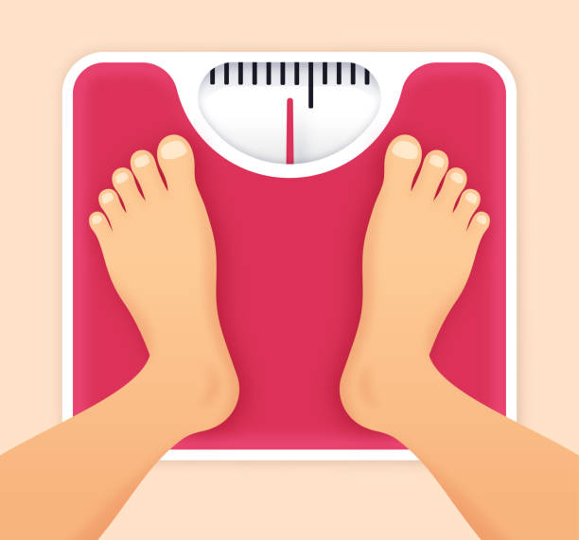
Notes:
Measuring the weight of an object does not tell you how fast it goes, so weight is not a measurement of speed.

Slide 97
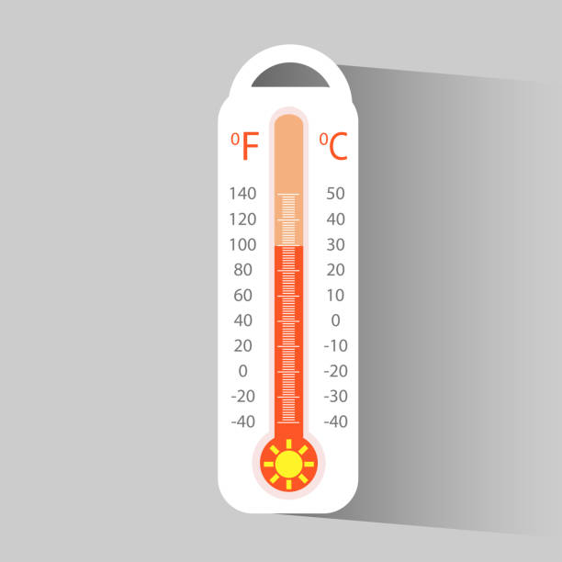
Notes:
Measuring how hot it is outside does not tell you how fast an object moves, so temperature is not a measurement of speed.

Slide 98
Notes:
Now let’s pause for a moment to check your understanding.

Slide 99
Why does the cheetah show speed, but the thermometer does not?
Notes:
Why does the cheetah show speed, but the thermometer does not?
[Because the cheetah is an object moving. The thermometer is showing temperature]

Slide 100
Notes:
We can also break down the term speed into different word parts to help us remember the meaning. Let’s take a look!

Slide 101
Speed
(root)
Notes:
We can break up the term speed into one part: the root.

Slide 102
Speed
Speed = how fast an object moves
Notes:
The root “speed” means how fast an object moves.

Slide 103
Speed
How fast an object moves
Notes:
So when look at the word speed it means how fast an object moves.

Slide 104
Notes:
Let’s check-in for understanding.

Slide 105
How can we use the word parts of speed to help us remember the definition of the term?
Speed
(root)
Notes:
How can we use the word parts of speed to help us remember the definition of the term?
[The root speed means how fast an object moves.
So when we put it all together, speed is how fast an object moves.]

Slide 106
Remember!!!
Notes:
So remember!

Slide 107
Speed: how fast an object moves
Notes:
Speed is how fast an object moves.

Slide 108
Notes:
We will now complete this concept map, called a Frayer model, to summarize and further clarify what you have learned about the term speed.

Slide 109
Definition
Picture
Speed
Example
How does speed impact my life?
Notes:
To complete the Frayer model, we will choose from four choices the correct picture, definition, example, and response to the question, “How does speed impact my life?” Select the best response for each question using the information you just learned. As we select responses, we will see how this model looks filled in for the term speed.

Slide 110
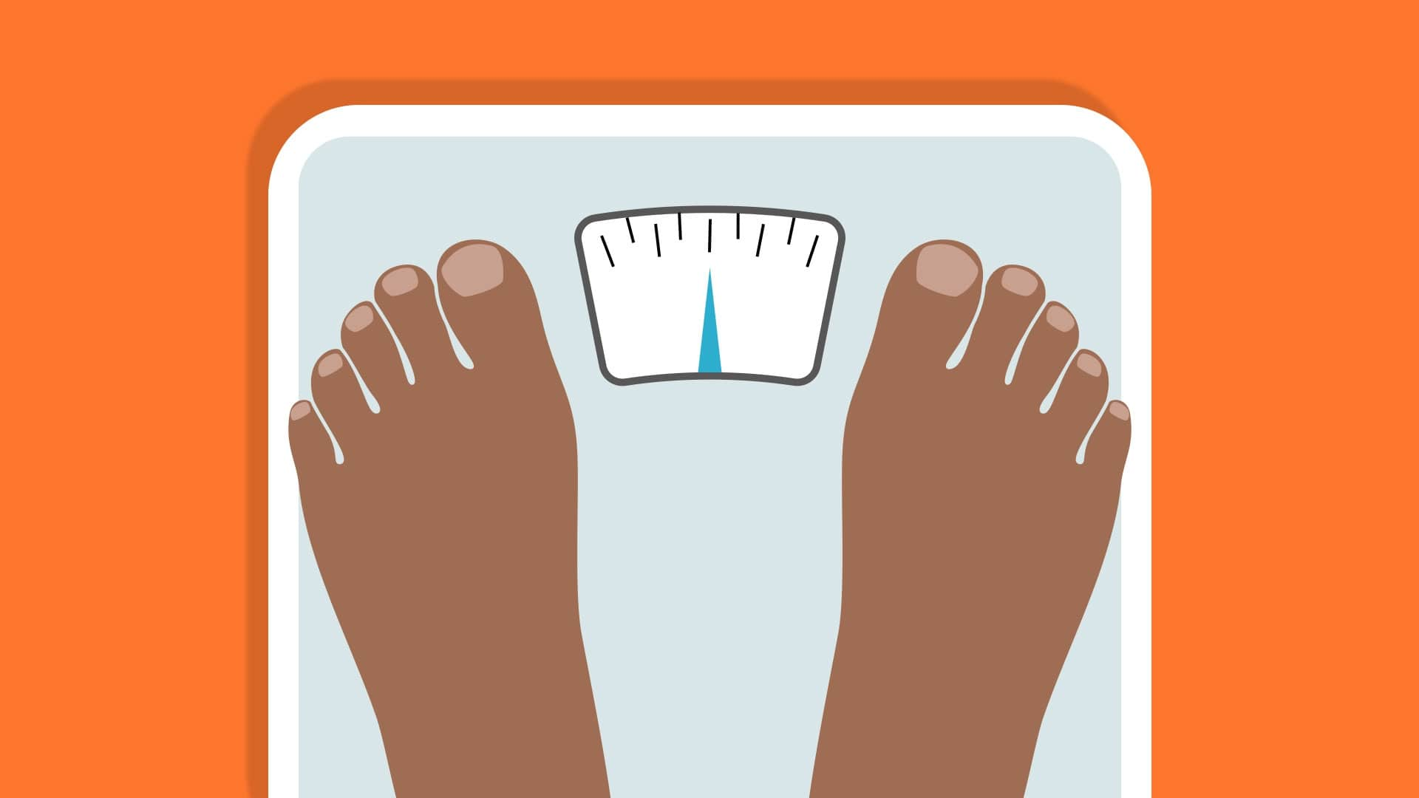
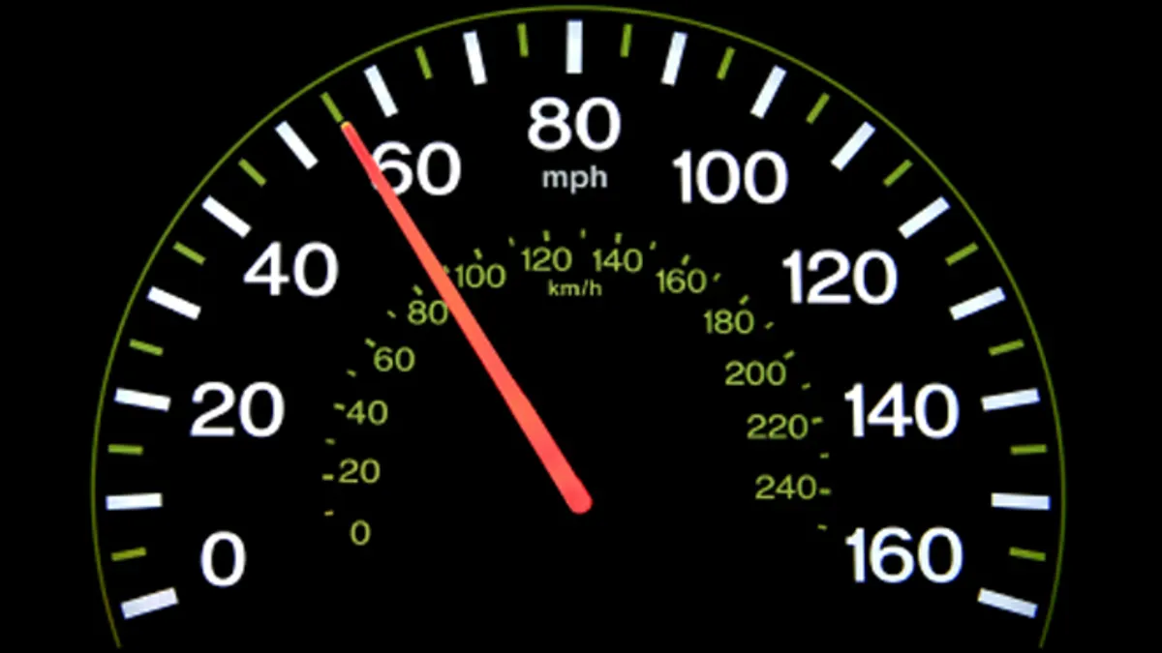
Directions: Choose the correct picture of speed from the choices below.
A
B
C
D
Notes:
Choose the one correct picture of speed from these four choices.

Slide 111
Directions: Choose the correct picture of speed from the choices below.
A
B
C
D
Notes:
This is the picture that shows speed.

Slide 112
Definition
Picture
Speed
Example
How does speed impact my life?
Notes:
Here is the Frayer model filled in with a picture of speed.

Slide 113
Directions: Choose the correct definition of Speed from the choices below.
A
How noisy an object is
B
How hot an object is
C
How heavy an object is
D
How fast an object moves
Notes:
Choose the one correct definition of speed from these four choices.

Slide 114
Directions: Choose the correct definition of Speed from the choices below.
A
How noisy an object is
B
How hot an object is
C
How heavy an object is
D
How fast an object moves
Notes:
“How fast an object moves” is correct! This is the definition of speed.

Slide 115
Definition
Picture
How fast an object moves
Speed
Example
How does speed impact my life?
Notes:
Here is the Frayer Model with a picture and the definition filled in for speed: how fast an object moves.

Slide 116
Directions: Choose the correct example of Speed from the choices below.
A
A train moving at 50 miles per hour
B
A cup of lemonade that tastes sweet
C
A singer singing a song
D
A bag of french fries that weighs 3 pounds
Notes:
Choose the one correct example of speed from these four choices.

Slide 117
Directions: Choose the correct example of Speed from the choices below.
A
A train moving at 50 miles per hour
B
A cup of lemonade that tastes sweet
C
A singer singing a song
D
A bag of french fries that weighs 3 pounds
Notes:
“A train moving at 50 miles per hour” is correct! This is an example of speed.

Slide 118
Definition
Picture
How fast an object moves
Speed
A train moving at 50 miles per hour
Example
How does speed impact my life?
Notes:
Here is the Frayer Model with a picture, definition, and an example of speed: A train moving at 50 miles per hour.

Slide 119
Directions: Choose the correct response for “how does speed impact my life?” from the choices below.
A
Speed helps us determine how much an object weighs
B
Speed describes how fast a vehicle gets us to school
C
Speed shows us how cold it is outside
Speed gives us a way to describe the taste of food
D
Notes:
Choose the one correct response for “how does speed impact my life?” from these four choices.

Slide 120
Directions: Choose the correct response for “how does speed impact my life?” from the choices below.
A
Speed helps us determine how much an object weighs
B
Speed describes how fast a vehicle gets us to school
C
Speed shows us how cold it is outside
Speed gives us a way to describe the taste of food
D
Notes:
“Speed describes how fast a vehicle gets us to school.” That is correct! This is an example of how speed impacts your life.

Slide 121
Definition
Picture
How fast an object moves
Speed
A train moving at 50 miles per hour
Speed describes how fast a vehicle gets us to school
Example
How does speed impact my life?
Notes:
Here is the Frayer Model with a picture, definition, example, and a correct response to “how does speed impact my life?”: Speed describes how fast a vehicle gets us to school.

Slide 122
Remember!!!
Notes:
So remember!

Slide 123
Speed: how fast an object moves
Notes:
Speed is how fast an object moves.

Slide 124
Big Question: How do direction and speed impact the motion of objects in the world around us?
Notes:
Let’s reflect again on our big question. Our “big question” is: How do direction and speed impact the motion of objects in the world around us?
Does anyone have any additional examples to share that haven’t been discussed yet?
In our “big question,” there is one more vocabulary word we need to explore.

Slide 125
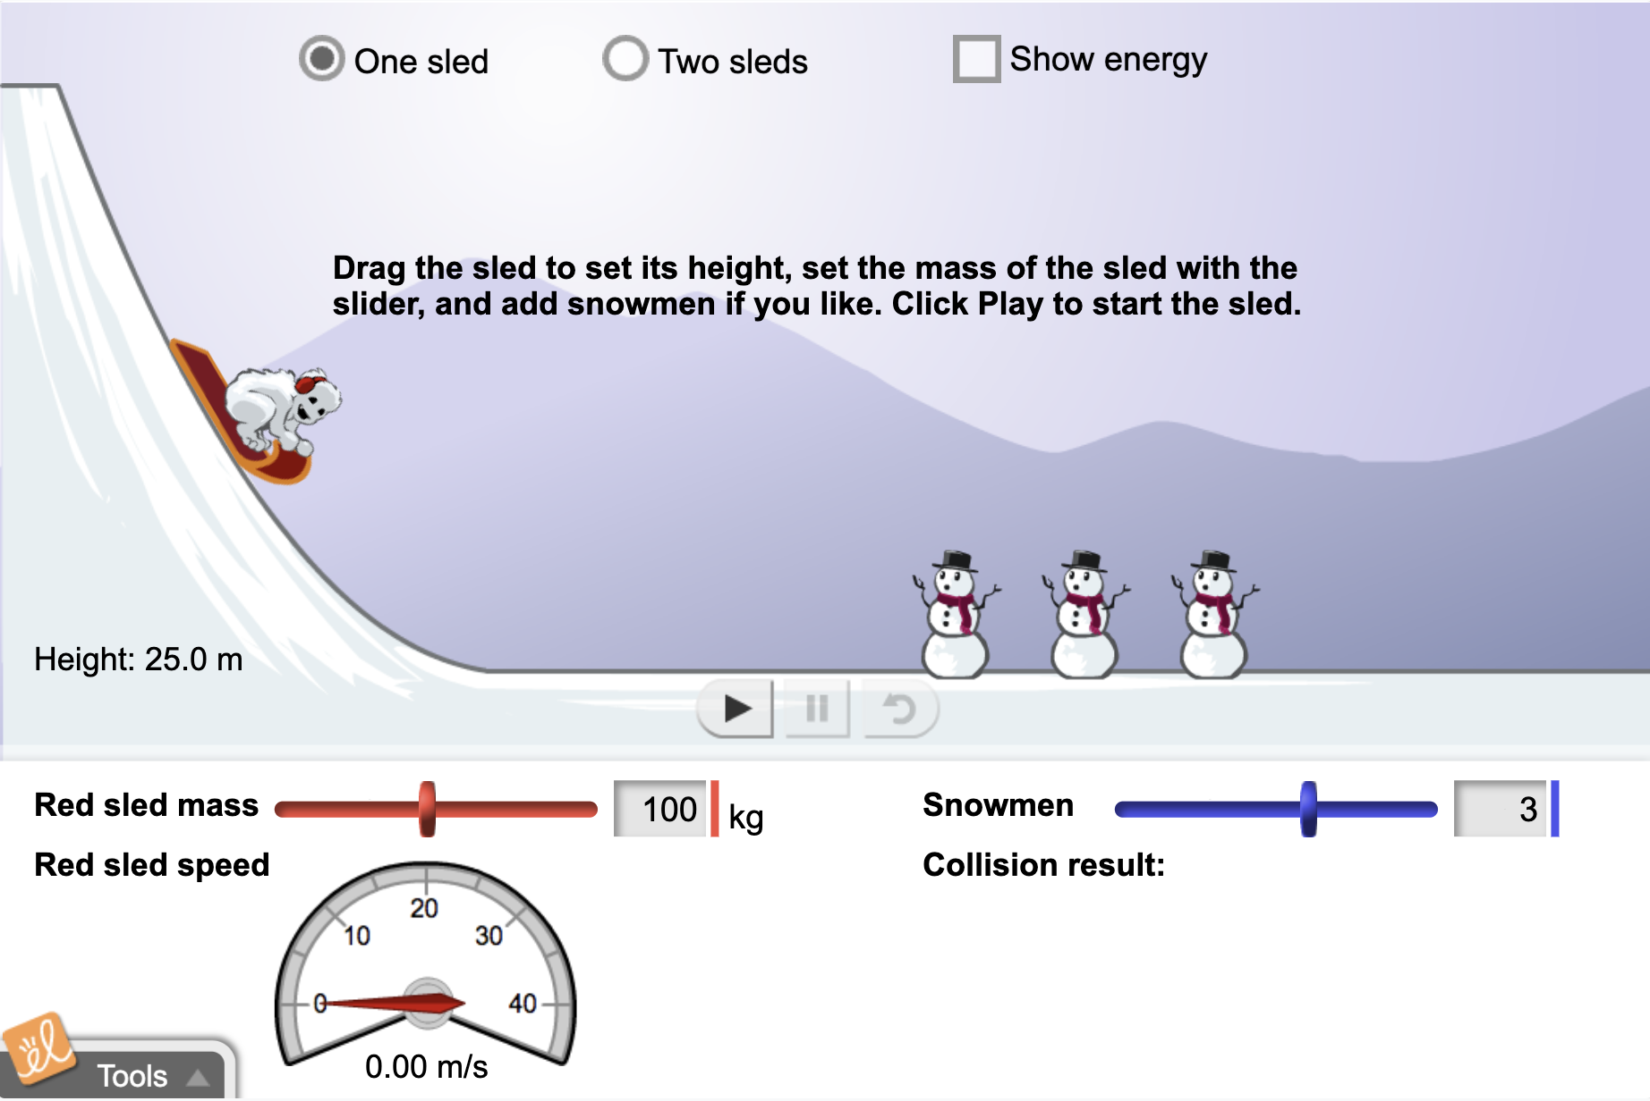
Simulation Activity
Speed
(Gizmos)
Click the link above for a simulation to explore speed.
In this activity, you will explore how changing certain variables can impact the speed of sleds.
Notes:
*This is the simulation for speed. Feel free to explore changing the height of the sled and the mass of the sled to see how those changes impact the speed of the sled. Also, try selecting “Two sleds” to have students compare speeds.

Slide 126
Intro
“Big Idea” Question
Review Concepts
Check-In Questions
Teacher Engagement
Vocabulary
Student-Friendly Definition
Examples & Non-Examples
Morphological Word Parts
Frayer Model
Simulation/Activity
Notes:
OK everyone, get ready for our next lesson. Just as a reminder, these are the different components that our lesson may include, and you’ll see these icons in the top left corner of each slide so that you can follow along more easily!

Slide 127
Motion
Intro
Notes:
Next, we’ll be learning about the word: Motion.

Slide 128
Notes:
Before we move on to our new topic, let’s review some other words & concepts that you already learned and make sure you are firm in your understanding.

Slide 129
Direction: where something moves or points
Notes:
Direction is where something moves or points

Slide 130
Speed: how fast an object moves
Notes:
Speed is how fast an object moves.

Slide 131
Notes:
Now let’s pause for a moment to review the information we have covered already.

Slide 132
True or False: Direction is where something moves or points.
A. True
B. False
Notes:
True or false: Direction is where something moves or points.
[True]

Slide 133
True or False: Direction is where something moves or points.
A. True
B. False
Notes:
True or false: Direction is where something moves or points.
[True]

Slide 134
A. Energy
B. Energy transformation
C. Speed
______ is how fast an object moves.
Notes:
_________ is how fast an object moves.
[Speed]

Slide 135
A. Energy
B. Energy transformation
C. Speed
______ is how fast an object moves.
Notes:
_________ is how fast an object moves.
[Speed]

Slide 136
Motion
Notes:
Now that we’ve reviewed, let’s define the phrase motion.

Slide 137
Motion: moving from one place to another
Notes:
Motion is moving from one place to another.

Slide 138
Notes:
Let’s check-in for understanding.

Slide 139
What is motion?
Notes:
What is motion?
[Motion is moving from one place to another..]

Slide 140
Notes:
That is the basic definition, but there is a bit more you need to know.

Slide 141
Motion of an object can be described by the object’s direction and speed.
Notes:
Motion of an object can be described by the object’s direction and speed. That is why it was important to first define the words direction and speed.

Slide 142
Notes:
Forces between objects can cause a change in motion. When two objects interact, each exerts a force on the other. These forces can transfer energy between objects which can cause changes in their motion. For example, when a hammer hits a nail, there is a transfer of energy from the hammer to the nail causing the nail to change in motion. The nail moves into the piece of wood in this picture.

Slide 143
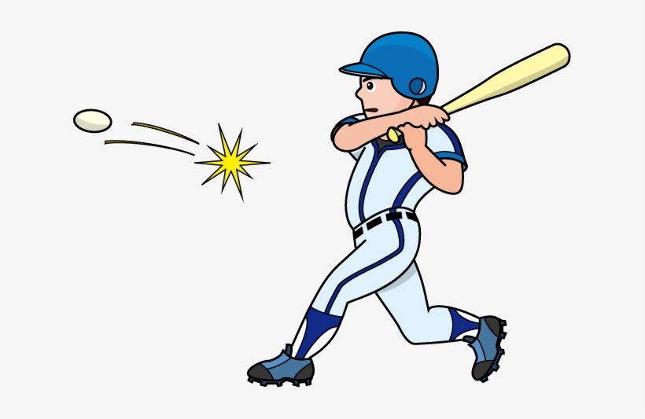
Notes:
Objects in motion tend to stay in motion, unless acted on by a force. The greater the force, the greater the change in motion. An example of this fact is a collision. When a baseball is thrown, it is in motion. If the baseball collides with a swinging bat (the force), the motion of the ball changes - maybe even into a homerun!

Slide 144
Notes:
Let’s check-in for understanding.

Slide 145
Motion of an object can be described by the object’s ______ and ______.
Notes:
Motion of an object can be described by the object’s _______ and _______.
[direction, speed]

Slide 146
Motion of an object can be described by the object’s direction and speed.
Notes:
Motion of an object can be described by the object’s [direction] and [speed].
[direction, speed]

Slide 147
_______ between objects can cause a change in motion.
Differences
Similarities
Forces
Notes:
_______ between objects can cause a change in motion.
[Forces]

Slide 148
_______ between objects can cause a change in motion.
Differences
Similarities
Forces
Notes:
_______ between objects can cause a change in motion.
[Forces]

Slide 149
True or False: The greater the force, the greater the change in motion.
True
False
Notes:
True or False: The greater the force, the greater the change in motion.
True
False

Slide 150
True or False: The greater the force, the greater the change in motion.
True
False
Notes:
True: the greater the force, the greater the change in motion.

Slide 151
Notes:
Now, let’s talk about some examples of motion.

Slide 152
Notes:
The three bicyclists are in motion. They are moving from one place to another.

Slide 153
Notes:
The puppy is in motion. The puppy is moving from one place to another.

Slide 154
Notes:
Let’s check-in for understanding.

Slide 155
What is motion?
Notes:
What is motion?
[Motion is moving from one place to another.]

Slide 156
Notes:
Now, let’s talk about some non-examples of motion.

Slide 157
Notes:
Trees in the woods are not in motion. They do not move from one place to another.

Slide 158
Notes:
The Statue of Liberty is not in motion. The statue does not move from one place to another.

Slide 159
Notes:
Now let’s pause for a moment to check your understanding.

Slide 160
Why is the puppy in motion, but the Statue of Liberty is not?
Notes:
Why is the puppy in motion, but the Statue of Liberty is not?
[Because the puppy is moving from one place to another. The Statue of Liberty does not move.]

Slide 161
Notes:
We can also break down the term motion into different word parts to help us remember the meaning. Let’s take a look!

Slide 162
Motion
(root)
(suffix)
Notes:
We can break up the term motion into two parts: root and suffix.

Slide 163
Motion
Mot = movement or change in position
Notes:
First, we have the root “mot” which means movement or change in position. In this word, it indicates that motion involves movement or a change in position.

Slide 164
Motion
-ion = an action, process, or result
Notes:
-ion is the suffix. The “-ion” suffix means an action, process, or result. Now let’s put it all together.

Slide 165
Mot ion
Motion
The action of moving or changing position
Notes:
So when we put it all together, motion means the action of moving or changing position.

Slide 166
Notes:
Let’s check-in for understanding.

Slide 167
How can we use the word parts of motion to help us remember the definition of the term?
Motion
(root)
(suffix)
Notes:
How can we use the word parts of motion to help us remember the definition of the term?
[The root mot means movement or change in position.
-ion is the suffix meaning an action, process, or result.
So when we put it all together, motion is the action of moving or changing position.]

Slide 168
Remember!!!
Notes:
So remember!

Slide 169
Motion: moving from one place to another
Notes:
Motion is moving from one place to another.

Slide 170
Notes:
We will now complete this concept map, called a Frayer model, to summarize and further clarify what you have learned about the term motion.

Slide 171
Definition
Picture
Motion
Example
How does motion impact my life?
Notes:
To complete the Frayer model, we will choose from four choices the correct picture, definition, example, and response to the question, “How does motion impact my life?” Select the best response for each question using the information you just learned. As we select responses, we will see how this model looks filled in for the term motion.

Slide 172
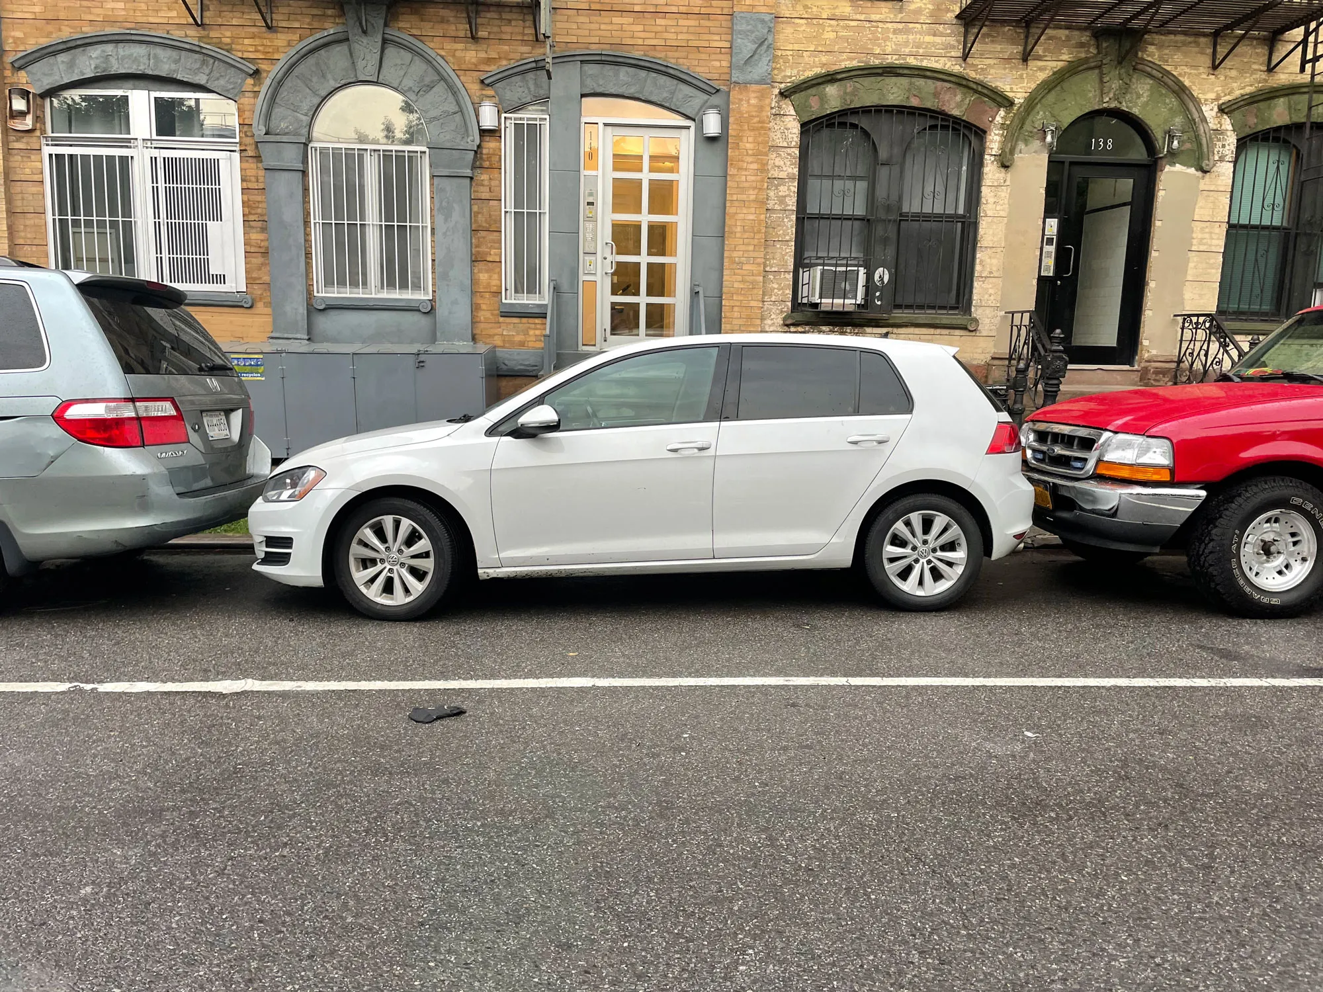
Directions: Choose the correct picture of motion from the choices below.
A
B
C
D
Notes:
Choose the one correct picture of motion from these four choices.

Slide 173
Directions: Choose the correct picture of motion from the choices below.
A
B
C
D
Notes:
This is the picture that shows motion.

Slide 174
Definition
Picture
Motion
Example
How does motion impact my life?
Notes:
Here is the Frayer model filled in with a picture of motion.

Slide 175
Directions: Choose the correct definition of Motion from the choices below.
A
Where an object points
B
The weight of an object
C
When an object stands still
D
Moving from one place to another
Notes:
Choose the one correct definition of motion from these four choices.

Slide 176
Directions: Choose the correct definition of Motion from the choices below.
A
Where an object points
B
The weight of an object
C
When an object stands still
D
Moving from one place to another
Notes:
“Moving from one place to another” is correct! This is the definition of motion.

Slide 177
Definition
Picture
Moving from one place to another
Motion
Example
How does motion impact my life?
Notes:
Here is the Frayer Model with a picture and the definition filled in for motion: Moving from one place to another.

Slide 178
Directions: Choose the correct example of Motion from the choices below.
A
Water flowing over a waterfall
B
A parked car
C
A shelf full of books
D
A cat that is taking a nap
Notes:
Choose the one correct example of motion from these four choices.

Slide 179
Directions: Choose the correct example of Motion from the choices below.
A
Water flowing over a waterfall
B
A parked car
C
A shelf full of books
D
A cat that is taking a nap
Notes:
“Water flowing over a waterfall” is correct! This is an example of motion.

Slide 180
Definition
Picture
Moving from one place to another
Motion
Water flowing over a waterfall
Example
How does motion impact my life?
Notes:
Here is the Frayer Model with a picture, definition, and an example of motion: Water flowing over a waterfall.

Slide 181
Directions: Choose the correct response for “how does motion impact my life?” from the choices below.
A
Motion helps us sleep every night
B
Motion gives us the ability to understand books
C
Motion helps us get out of bed and get to school
Motion helps us do math problems
D
Notes:
Choose the one correct response for “how does motion impact my life?” from these four choices.

Slide 182
Directions: Choose the correct response for “how does motion impact my life?” from the choices below.
A
Motion helps us sleep every night
B
Motion gives us the ability to understand books
C
Motion helps us get out of bed and get to school
Motion helps us do math problems
D
Notes:
“Motion helps us get out of bed and get to school.” That is correct! This is an example of how motion impacts your life.

Slide 183
Definition
Picture
Moving from one place to another
Motion
Water flowing over a waterfall
Motion helps us get out of bed and get to school
Example
How does motion impact my life?
Notes:
Here is the Frayer Model with a picture, definition, example, and a correct response to “how does motion impact my life?”: Motion helps us get out of bed and get to school.

Slide 184
Remember!!!
Notes:
So remember!

Slide 185
Motion: moving from one place to another
Notes:
Motion is moving from one place to another.

Slide 186
Big Question: How do direction and speed impact the motion of objects in the world around us?
Notes:
Let’s reflect once more on our big question. Our “big question” is: How do direction and speed impact the motion of objects in the world around us?
Does anyone have any additional examples to share that haven’t been discussed yet?

Slide 187
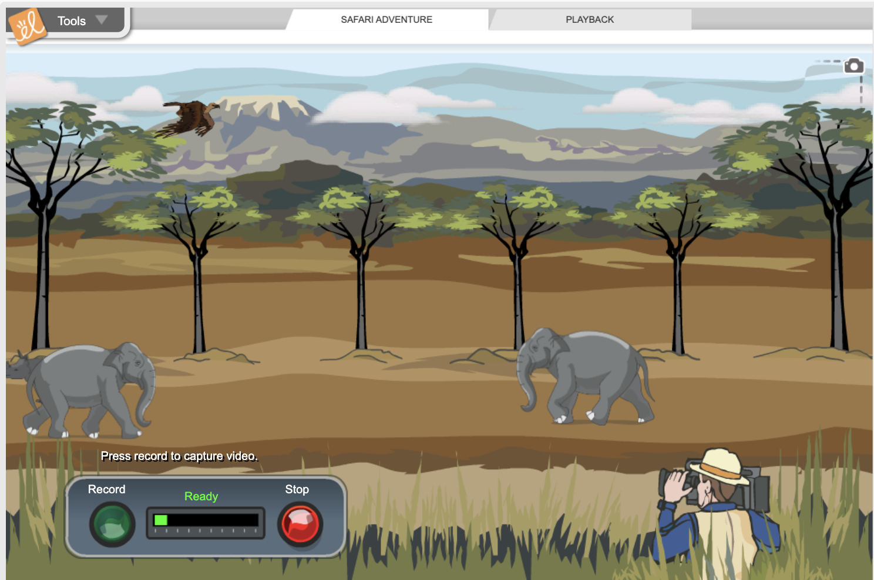
Simulation Activity
Motion
(Gizmos)
Click the link above for a simulation to explore motion.
In this activity, you will explore speed and motion of animals on an African safari.
Notes:
*This is the simulation for motion. Feel free to record different segments of the safari. Select ‘Playback’ (at the top) to view what you recorded. Be sure to emphasize the relationship between motion and speed (i.e. objects that appear to be moving quicker have a higher speed).

Slide 188
Notes:
Thanks for watching, and please continue watching CAPs available from this website.

Slide 189
This Was Created With Resources From:
Questions or Comments
Michael Kennedy, Ph.D. MKennedy@Virginia.edu
Rachel L Kunemund, Ph.D. rk8vm@virginia.edu

