Slide 1
Intro
“Big Idea” Question
Review Concepts
Check-In Questions
Teacher Engagement
Vocabulary
Student-Friendly Definition
Examples & Non-Examples
Morphological Word Parts
Frayer Model
Simulation/Activity
Notes:
OK everyone, get ready for our next lesson. Just as a reminder, these are the different components that our lesson may include, and you’ll see these icons in the top left corner of each slide so that you can follow along more easily!

Slide 2
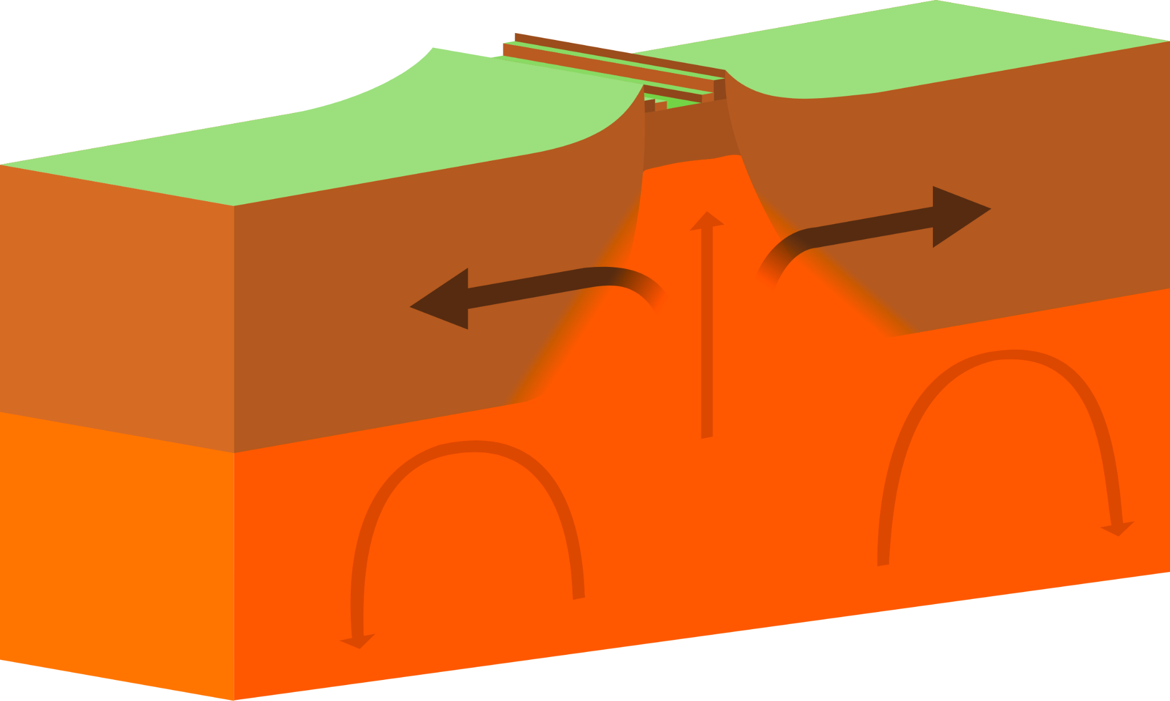
Intro
Divergent Boundary
Notes:
Today, we’ll be learning about the word: Divergent Boundary.

Slide 3
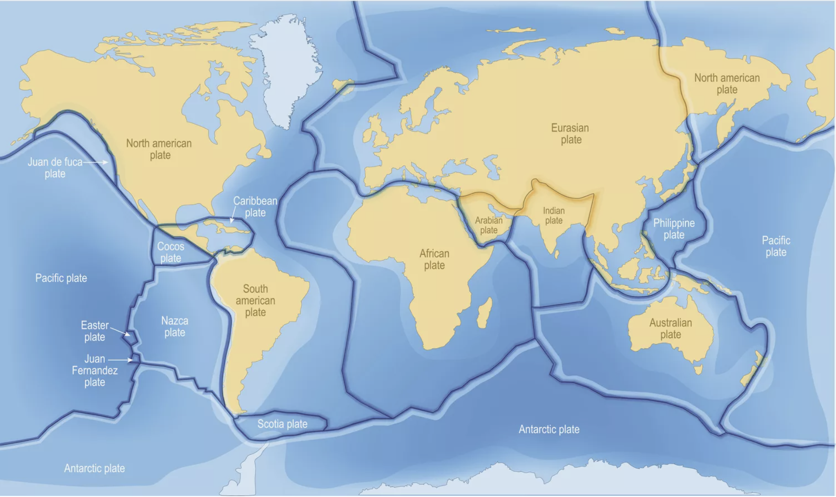
Big Question: What happens when tectonic plates shift?
Notes:
Our “big question” is: What happens when tectonic plates shift?
[Pause and illicit predictions from students.]
I love all these thoughtful scientific hypotheses! Be sure to keep this question and your predictions in mind as we move through these next few lessons, and we’ll continue to revisit it.

Slide 4
Notes:
Before we move on to our new topic, let’s review some other words & concepts that you already learned and make sure you are firm in your understanding.

Slide 5
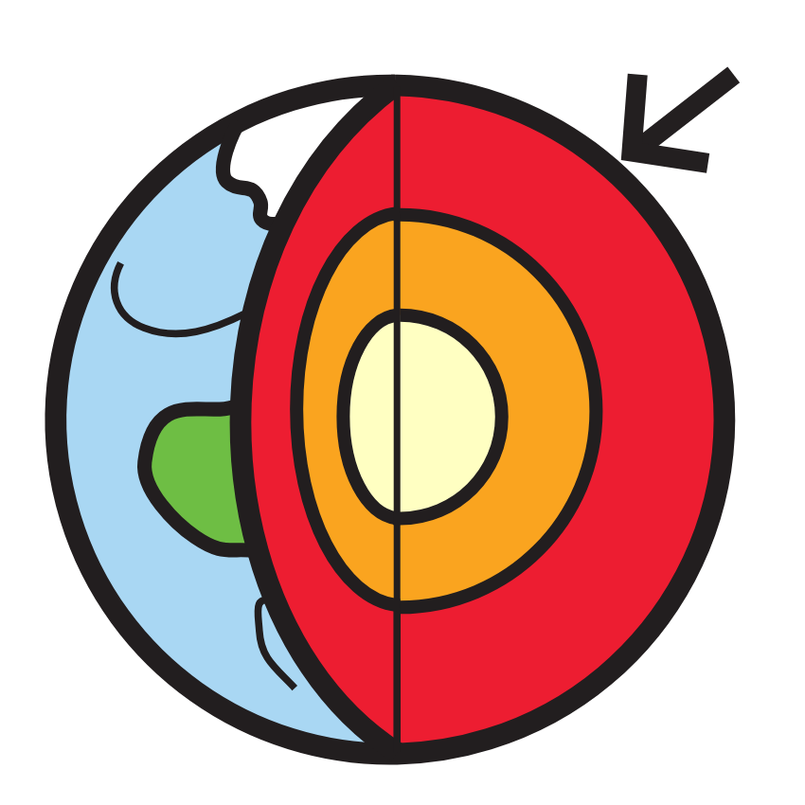
Crust: the outermost shell of the Earth
Notes:
Crust is the outermost shell of the Earth.

Slide 6
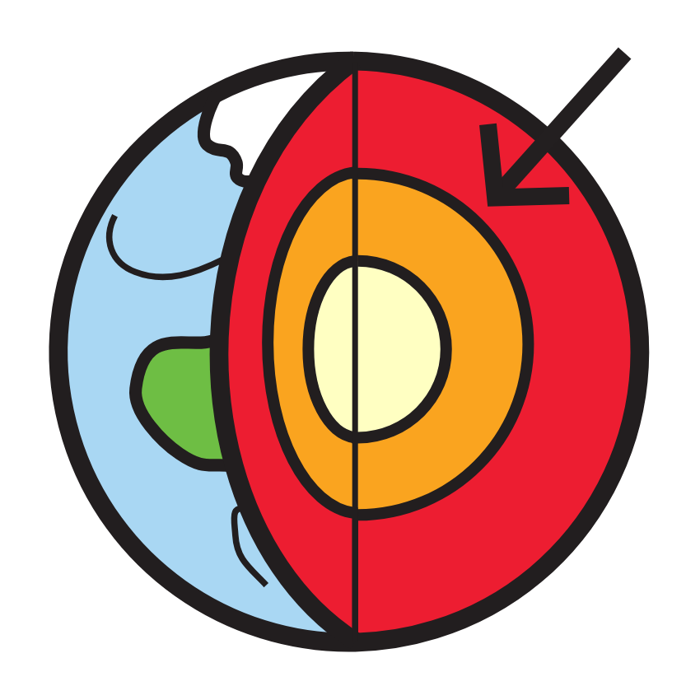
Mantle: the layer of rock between the crust and the outer core
Notes:
Mantle is the layer of rock between the crust and the outer core.

Slide 7
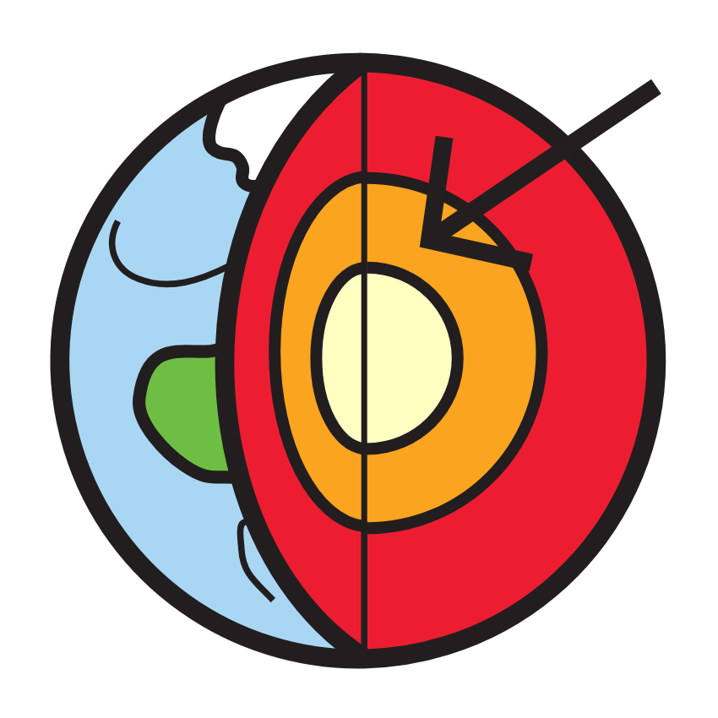
Outer Core: the third layer of the Earth made of liquid iron and nickel
Notes:
The outer core is the third layer of the Earth made of liquid iron and nickel.

Slide 8
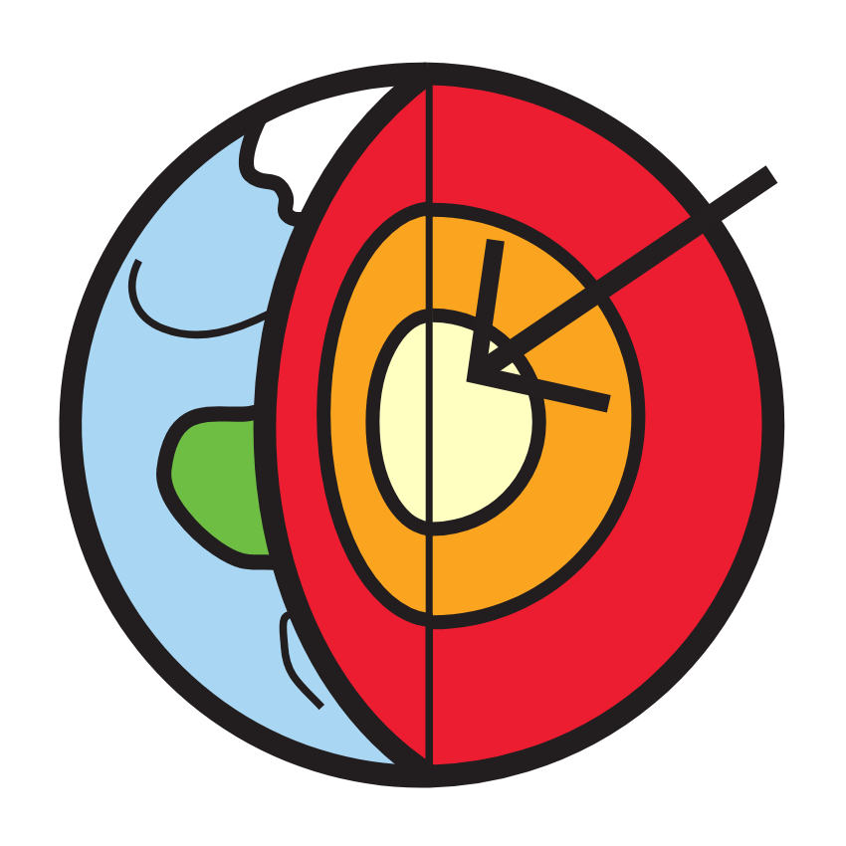
Inner Core: the innermost layer of the Earth
Notes:
The inner core is the innermost layer of the Earth.

Slide 9
Tectonic Plates: huge pieces of the Earth’s surface that fit together like a puzzle and move very slowly over time
Notes:
Tectonic plates are huge pieces of the Earth’s surface that fit together like a puzzle and move very slowly over time.

Slide 10
Notes:
Now let’s pause for a moment to review the information we have covered already.

Slide 11
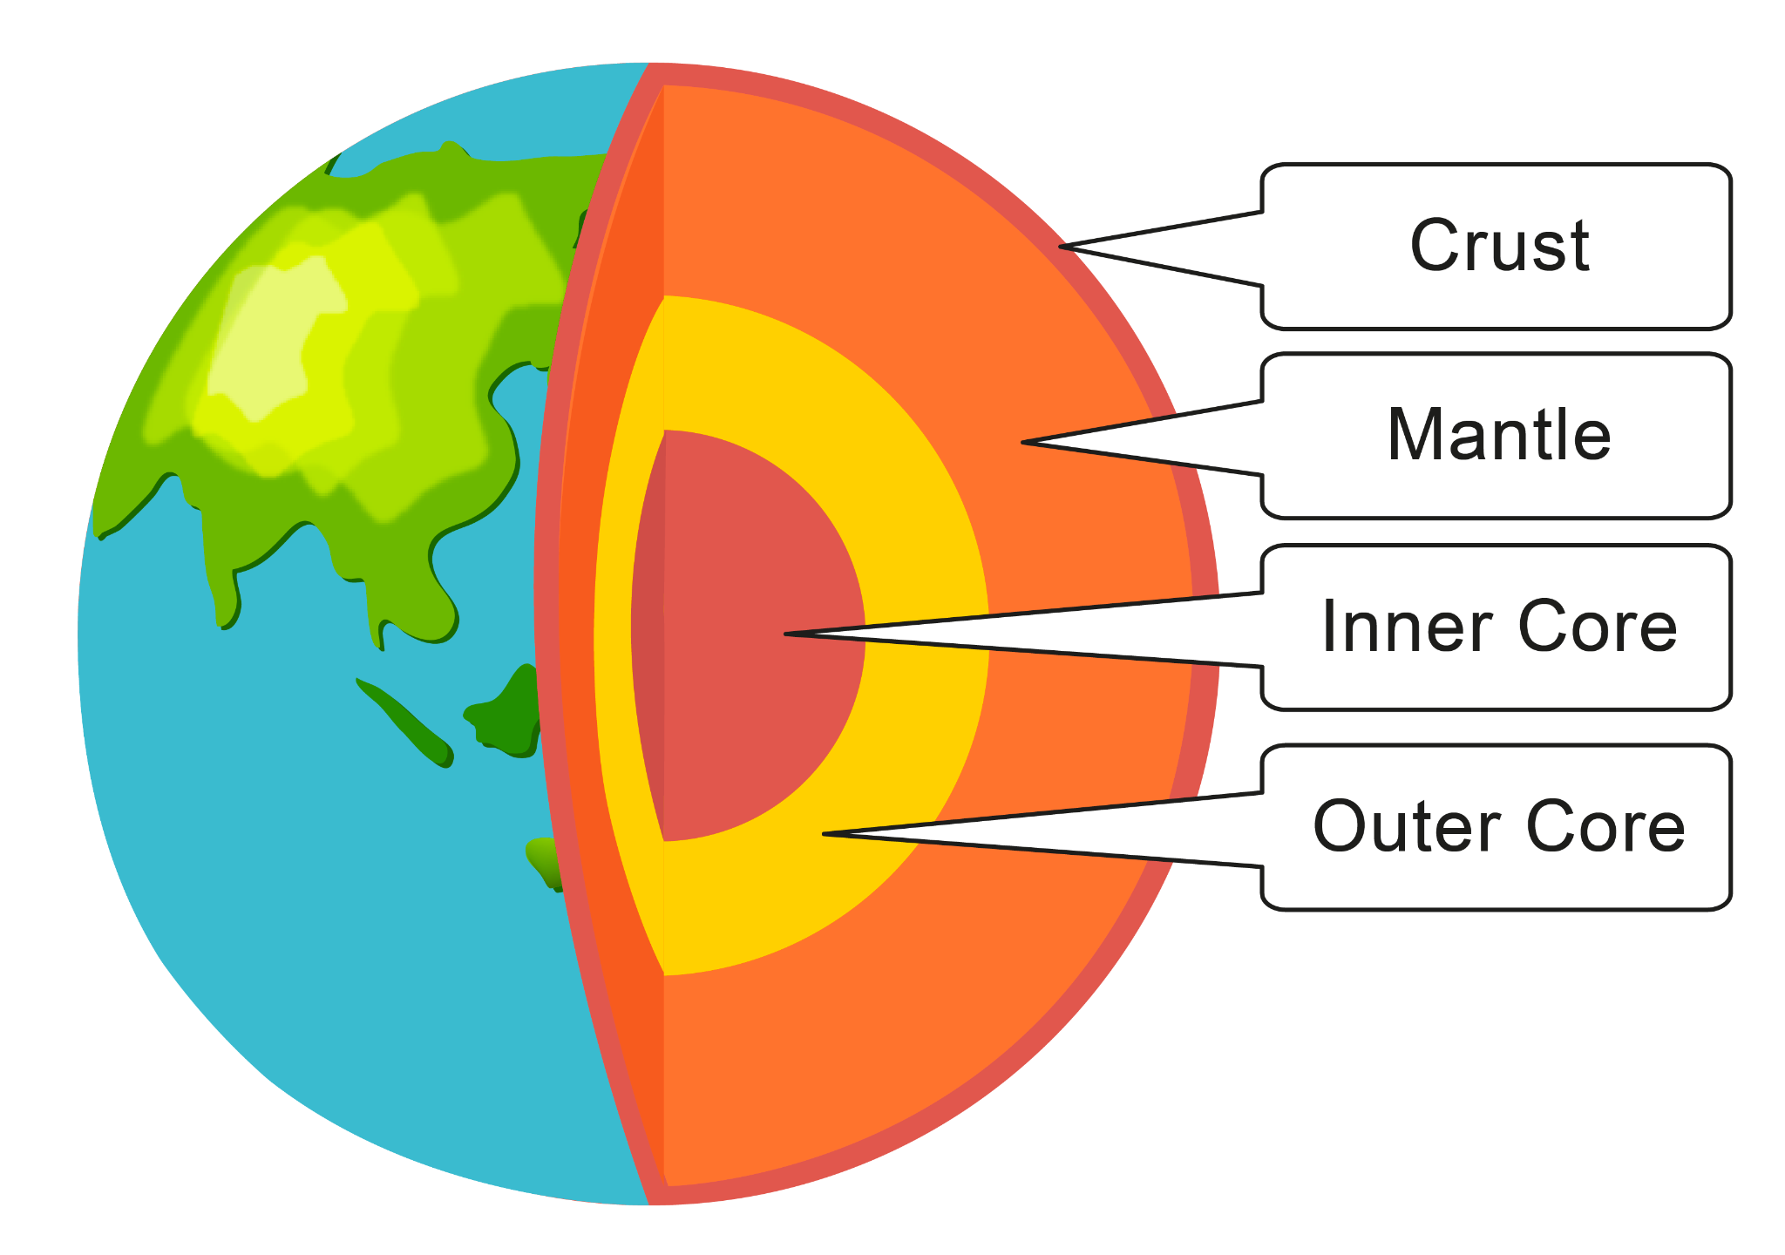
What are the four layers of the Earth?
Notes:
What are the four layers of the Earth?

Slide 12
What are the four layers of the Earth?
Notes:
What are the four layers of the Earth? Crust, Mantle, Inner Core, Outer Core.

Slide 13
Tectonic plates are huge pieces of the Earth’s _______ that fit together like a puzzle and move very slowly over time.
Core
Surface
Notes:
Tectonic plates are huge pieces of the Earth’s [surface] that fit together like a puzzle and move very slowly over time.

Slide 14
Tectonic plates are huge pieces of the Earth’s _______ that fit together like a puzzle and move very slowly over time.
Core
Surface
Notes:
Tectonic plates are huge pieces of the Earth’s [surface] that fit together like a puzzle and move very slowly over time.

Slide 15
Divergent Boundary
Notes:
Now that we’ve reviewed, let’s define the phrase Divergent Boundary.

Slide 16
Divergent Boundary: form when two tectonic plates move away from each other
Notes:
Divergent boundaries form when two tectonic plates move away from each other.

Slide 17
Notes:
Let’s check-in for understanding.

Slide 18
What is a divergent boundary?
Notes:
What is a divergent boundary?
[Form when two tectonic plates move away from each other.]

Slide 19
Notes:
That is the basic definition, but there is a bit more you need to know.

Slide 20
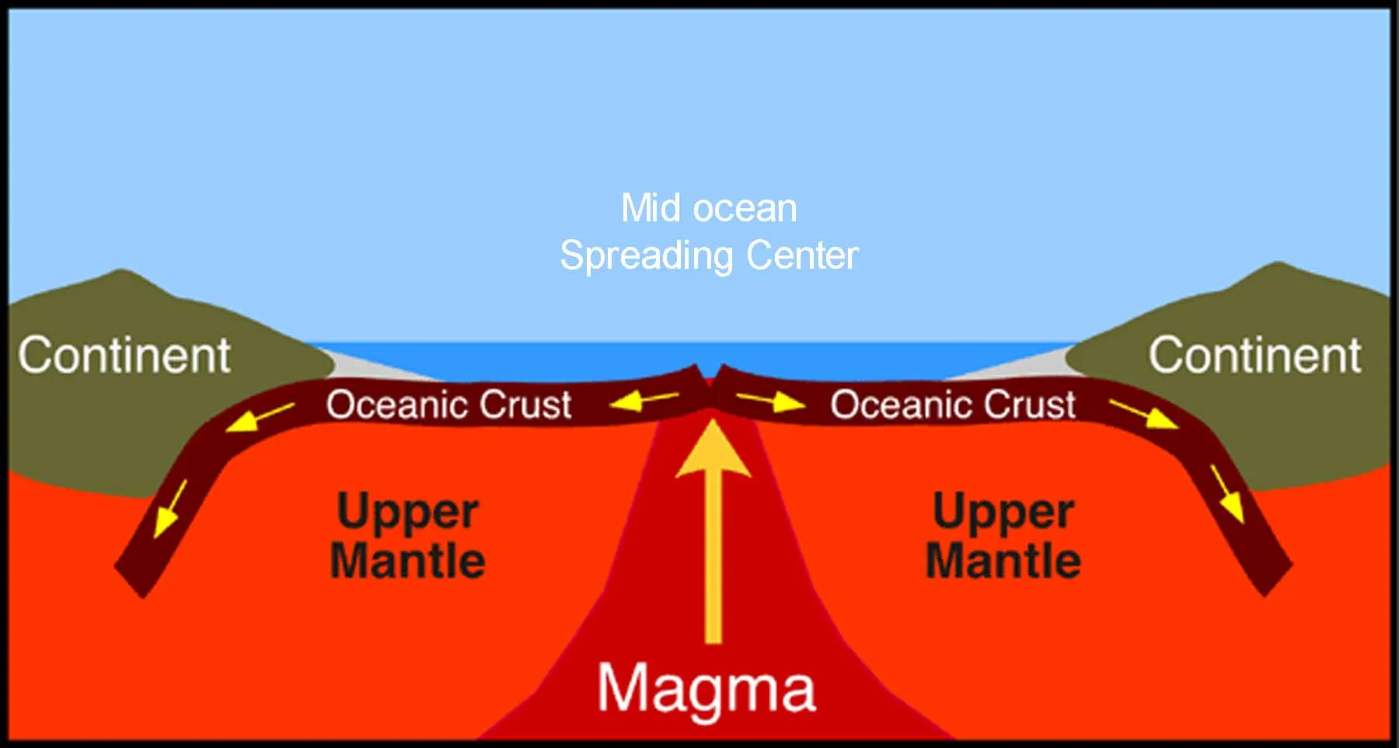
When tectonic plates separate, magma rises to fill the gap, solidifies, and forms new crust.
Notes:
When tectonic plates separate, magma rises to fill the gap, solidifies, and forms new crust.

Slide 21
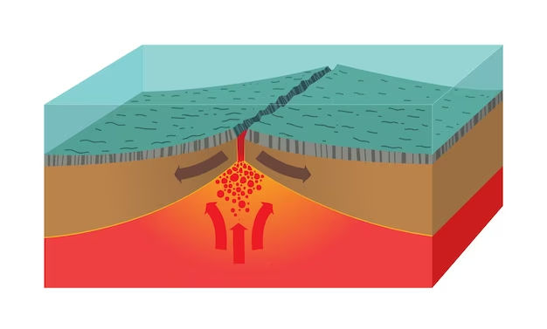
Divergent boundaries are often found along mid-ocean ridges, where they create oceanic ridges.
oceanic ridge
Notes:
Divergent boundaries are often found along mid-ocean ridge, where they create oceanic ridges.

Slide 22
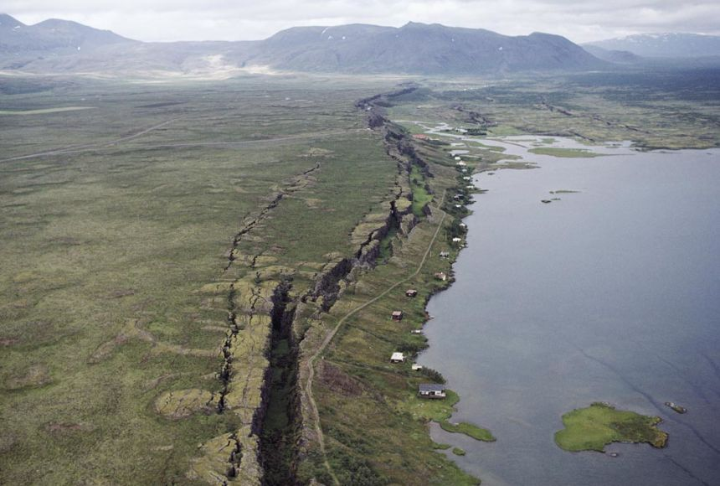
However, they can also occur on continents, leading to the formation of rift valleys.
rift valley
Notes:
However, they can also occur on continents, leading to the formation of rift valleys.

Slide 23
Notes:
Let’s check-in for understanding.

Slide 24
When tectonic plates separate, ______ rises to fill the gap, solidifies, and forms new crust.
mantle
magma
Notes:
When tectonic plates separate, _______ rises to fill the gap, solidifies, and forms new crust.
[B. magma]

Slide 25
When tectonic plates separate, ______ rises to fill the gap, solidifies, and forms new crust.
mantle
magma
Notes:
When tectonic plates separate, _______ rises to fill the gap, solidifies, and forms new crust.
[B. magma]

Slide 26
True or false: Divergent boundaries are often found along mid-ocean ridges, where they create oceanic ridges.
True
False
Notes:
True or false: Divergent boundaries are often found along mid-ocean ridges, where they create oceanic ridges.

Slide 27
True or false: Divergent boundaries are often found along mid-ocean ridges, where they create oceanic ridges.
oceanic ridge
True
False
Notes:
True or false: Divergent boundaries are often found along mid-ocean ridges, where they create oceanic ridges. [True]

Slide 28
Divergent boundaries can also occur on continents, leading to the formation of ____ _______.
rift valleys
rim valleys
Notes:
Divergent boundaries can also occur on continents, leading to the formation of ____ _______.

Slide 29
Divergent boundaries can also occur on continents, leading to the formation of ____ _______.
rift valleys
rim valleys
rift valley
Notes:
Divergent boundaries can also occur on continents, leading to the formation of ____ _______. [rift valleys]

Slide 30
Notes:
Now, let’s talk about some examples of divergent boundaries.

Slide 31
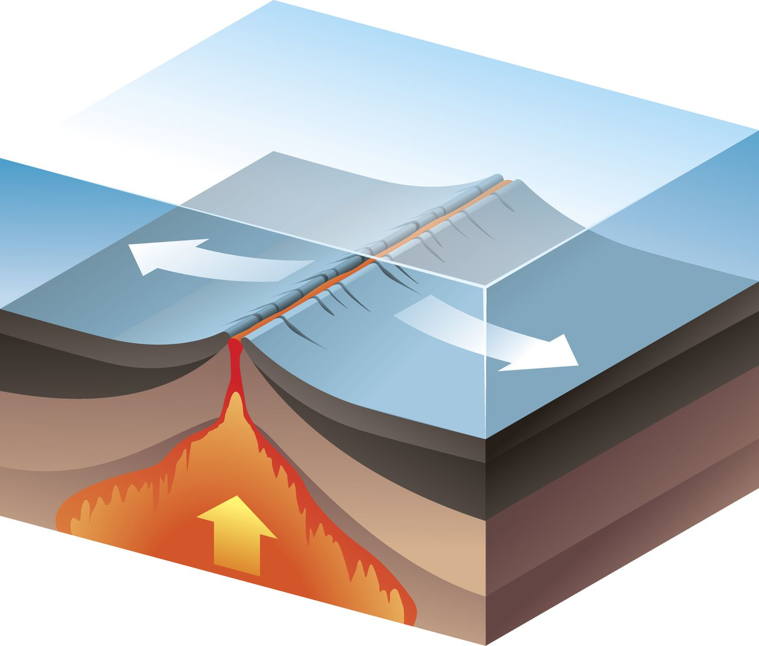
This is an example of a divergent boundary in the ocean. The plates are moving away from each other.
Notes:
This is an example of a divergent boundary in the ocean. The plates are moving away from each other.

Slide 32
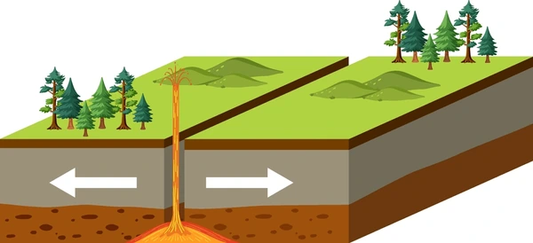
This is an example of a divergent boundary on land. Again, the plates are moving away from each other.
Notes:
This is an example of a divergent boundary on land. Again, the plates are moving away from each other.

Slide 33
Notes:
Now, let’s talk about some non-examples of divergent boundaries.

Slide 34
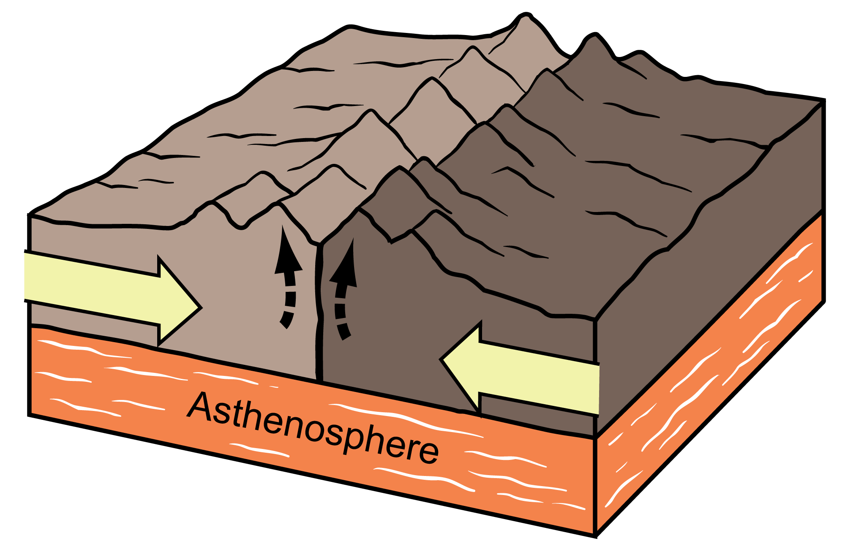
This is a non-example of a divergent boundary. Here, the plates are moving towards each other.
Notes:
This is a non-example of a divergent boundary. Here, the plates are moving towards each other.

Slide 35
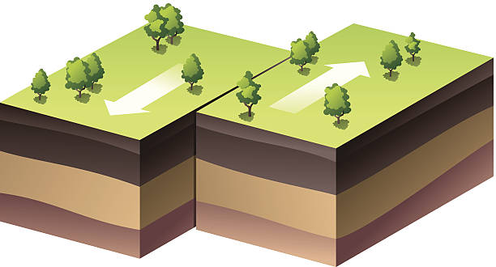
This is another non-example of a divergent boundary. Here, the plates are sliding along or past each other and not away from each other.
Notes:
This is another non-example of a divergent boundary. Here, the plates are sliding along or past each other and not away from each other.

Slide 36
Notes:
Now let’s pause for a moment to check your understanding.

Slide 37
Which is an example of a divergent boundary?
Notes:
Which is an example of a divergent boundary?

Slide 38
Which is an example of a divergent boundary?
Notes:
Which is an example of a divergent boundary?

Slide 39
Notes:
We can also break down the term divergent boundary into different word parts to help us remember the meaning. Let’s take a look!

Slide 40
Divergent Boundary
(root)
(suffix)
Notes:
We can break up the term divergent into two parts: a root and a suffix

Slide 41
Divergent Boundary
Divergent
separate or move away
Notes:
The root, diverge, means to separate or move away

Slide 42
Divergent Boundary
Divergent
a quality of
Notes:
The suffix, -ent, means a quality of (it makes the root an adjective)

Slide 43
Diverg ent Boundary
Divergent Boundary
a boundary that has the quality of separating
Notes:
Divergent boundary is a boundary that has the quality of separating.

Slide 44
Notes:
Let’s check-in for understanding.

Slide 45
How can we use the word parts of divergent boundary to help us remember the definition of the term?
Divergent Boundary
Diverg ent Boundary
Notes:
How can we use the word parts of divergent boundary to help us remember the definition of the term?
[Diverge = to separate or move away
-ent = a quality of
Divergent boundary is a boundary that has the quality of separating.]

Slide 46
Remember!!!
Notes:
So remember!

Slide 47
Divergent Boundary: form when two tectonic plates move away from each other
Notes:
Divergent boundaries form when two tectonic plates move away from each other.

Slide 48
Notes:
We will now complete this concept map, called a Frayer model, to summarize and further clarify what you have learned about the term divergent boundary.

Slide 49
Definition
Picture
Divergent Boundary
How does divergent boundary
impact my life?
Example
Notes:
To complete the Frayer model, we will choose from four choices the correct picture, definition, example, and response to the question, “How does divergent boundary impact my life?” Select the best response for each question using the information you just learned. As we select responses, we will see how this model looks filled in for the term divergent boundary.

Slide 50
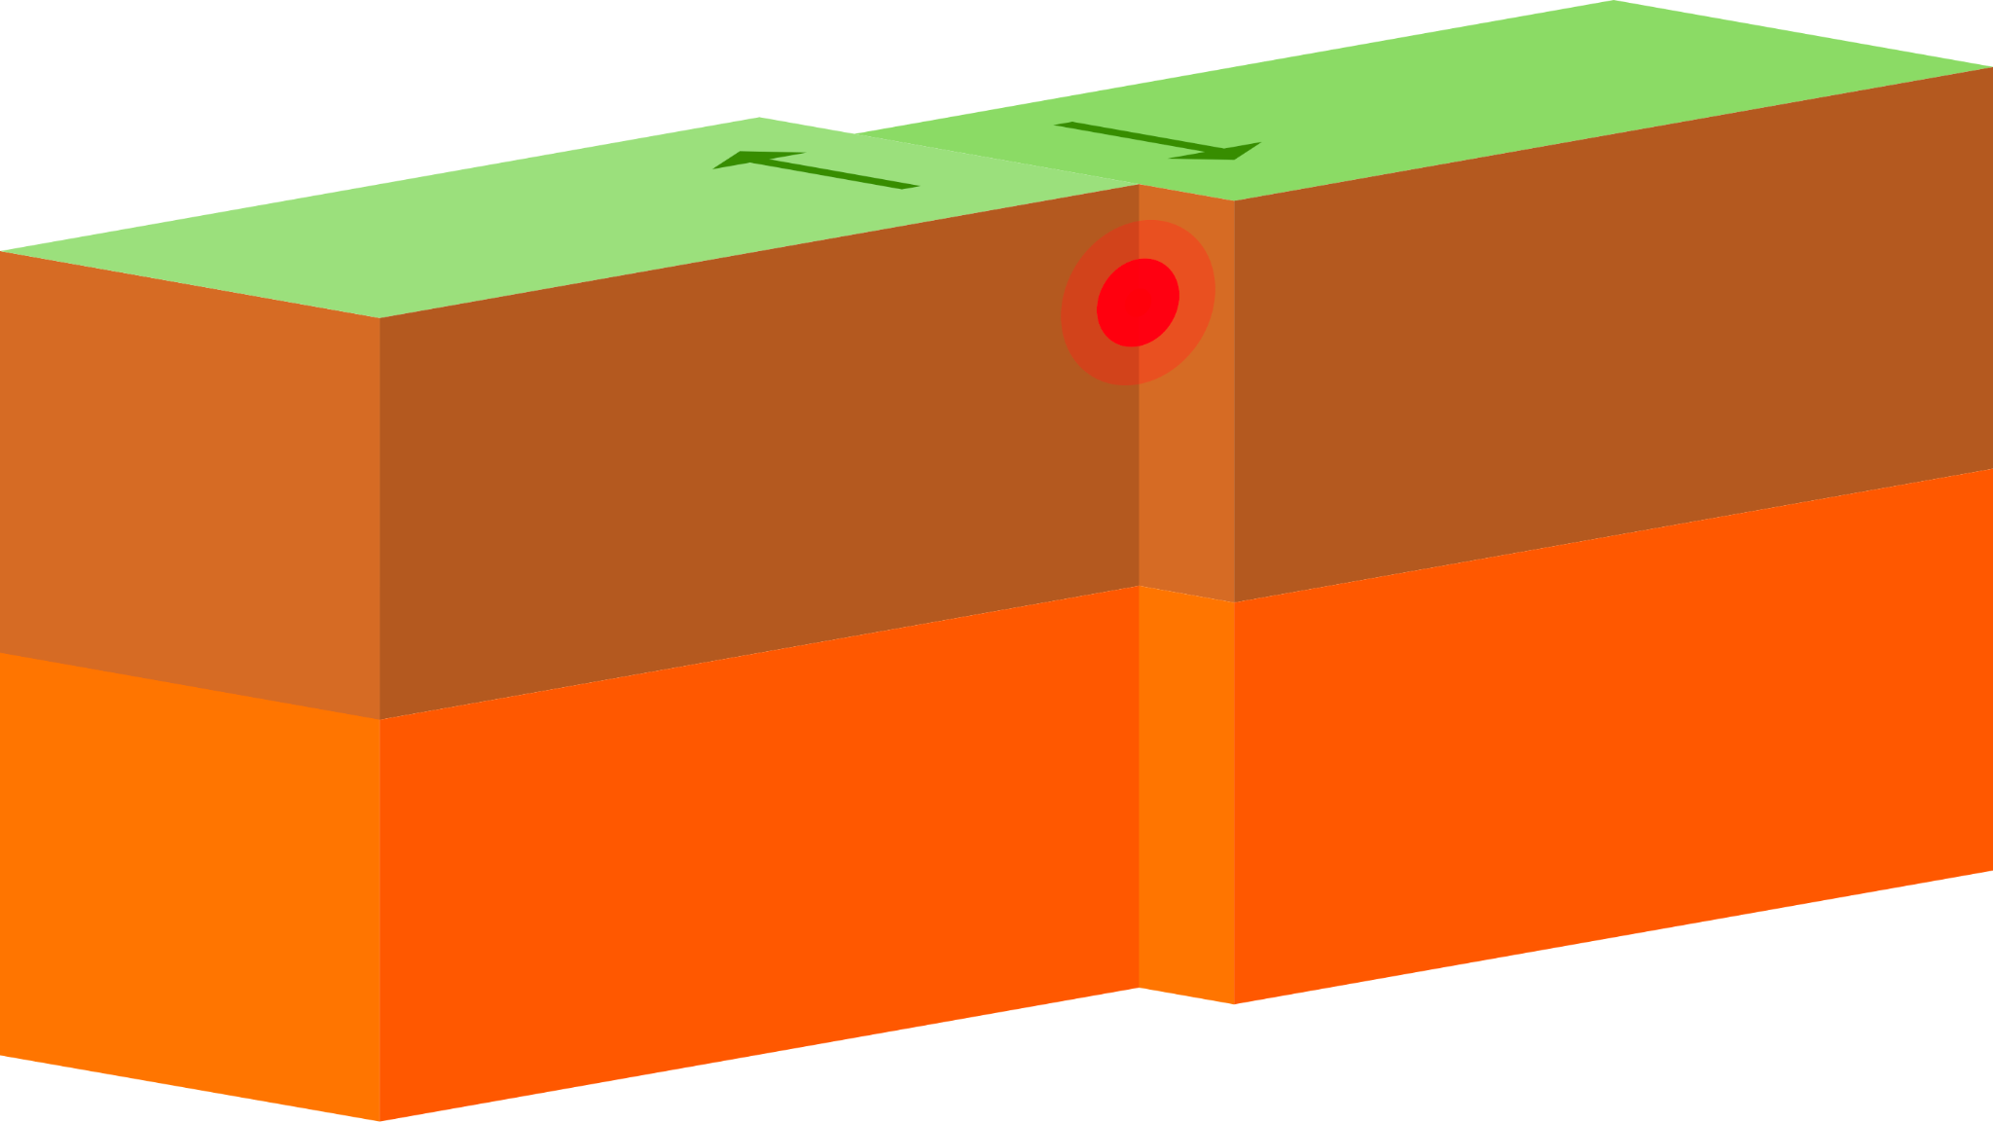
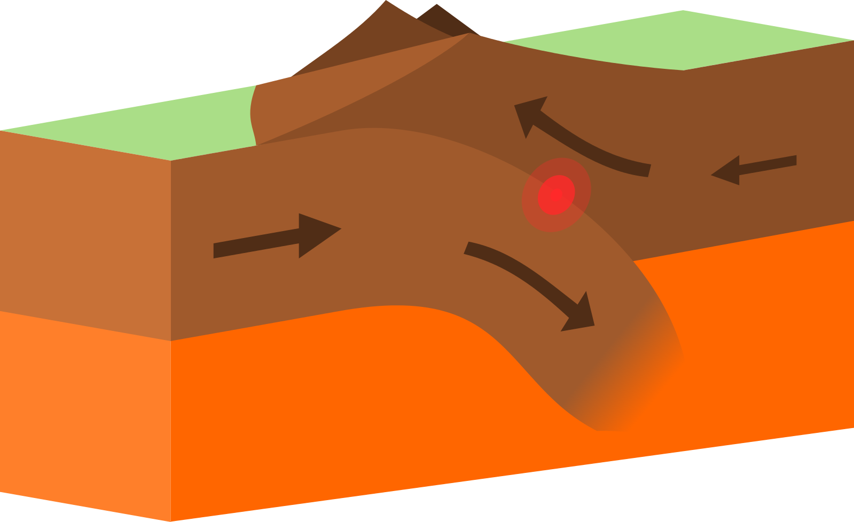
Directions: Choose the correct picture of divergent boundary from the choices below.
A
B
C
D
Notes:
Choose the one correct picture of divergent boundary from these four choices.

Slide 51
Directions: Choose the correct picture of divergent boundary from the choices below.
A
B
C
D
Notes:
Choose the one correct picture of divergent boundary from these four choices.

Slide 52
Definition
Picture
Divergent Boundary
How does divergent boundary
impact my life?
Example
Notes:
Here is the Frayer model filled in with a picture of divergent boundary.

Slide 53
Directions: Choose the correct definition of divergent boundary from the choices below.
A
Forms when two tectonic plates move toward each other
B
Forms when two tectonic plates move away from each other
C
Forms when two tectonic plates move along or past each other
D
Forms when two tectonic plates create a mountain
Notes:
Choose the one correct definition of divergent boundary from these four choices.

Slide 54
Directions: Choose the correct definition of divergent boundary from the choices below.
A
Forms when two tectonic plates move toward each other
B
Forms when two tectonic plates move away from each other
C
Forms when two tectonic plates move along or past each other
D
Forms when two tectonic plates create a mountain
Notes:
“Forms when two tectonic plates move away from each other” is correct! This is the definition of divergent boundary.

Slide 55
Definition
Picture
Forms when two tectonic plates move away from each other
Divergent Boundary
How does divergent boundary
impact my life?
Example
Notes:
Here is the Frayer Model with a picture and the definition filled in for divergent boundary: Forms when two tectonic plates move away from each other.

Slide 56
Directions: Choose the correct example of divergent boundary from the choices below.
A
A mountain
B
A ridge in the ocean
C
A volcano
D
A island in the ocean
Notes:
Choose the one correct example of divergent boundary from these four choices.

Slide 57
Directions: Choose the correct example of divergent boundary from the choices below.
A
A mountain
B
A ridge in the ocean
C
A volcano
D
A island in the ocean
Notes:
“A ridge in the ocean” is correct! This is an example of divergent boundary.

Slide 58
Definition
Picture
Forms when two tectonic plates move away from each other
Divergent Boundary
A ridge in the ocean
How does divergent boundary
impact my life?
Example
Notes:
Here is the Frayer Model with a picture, definition, and an example of divergent boundary: A ridge in the ocean.

Slide 59
Directions: Choose the correct response for “how does divergent boundary impact my life?” from the choices below.
A
Divergent boundaries give food to plants.
B
Divergent boundaries give food to animals.
C
Divergent boundaries help the Earth look the way that it does.
D
Divergent boundaries give the Earth warmth
Notes:
Choose the one correct response for “how does divergent boundary impact my life?” from these four choices.

Slide 60
Directions: Choose the correct response for “how does divergent boundary impact my life?” from the choices below.
A
Divergent boundaries give food to plants.
B
Divergent boundaries give food to animals.
C
Divergent boundaries help the Earth look the way that it does.
D
Divergent boundaries give the Earth warmth
Notes:
You chose “Divergent boundaries help the Earth look the way that it does.” That is correct! This is an example of how divergent boundaries impacts your life.

Slide 61
Definition
Picture
Forms when two tectonic plates move away from each other
Divergent Boundary
Divergent boundaries help the Earth look the way that it does.
A ridge in the ocean
How does divergent boundary
impact my life?
Example
Notes:
Here is the Frayer Model with a picture, definition, example, and a correct response to “how does divergent boundary impact my life?”: Divergent boundaries help the Earth look the way that it does.

Slide 62
Remember!!!
Notes:
So remember!

Slide 63
Divergent Boundary: form when two tectonic plates move away from each other
Notes:
Divergent boundaries form when two tectonic plates move away from each other.

Slide 64
Big Question: What happens when tectonic plates shift?
Notes:
Our “big question” is: What happens when tectonic plates shift?
Does anyone have any additional examples to share that haven’t been discussed yet?

Slide 65
Simulation Activity
The Lawrence Hall of Science
Divergent Boundary
Click the link above for a simulation to deepen your understanding of divergent boundaries.
Have students select divergent boundaries from the options and see what happens with divergent boundaries as time passes.
Make notes of observations and wonderings as you change values of time.

Slide 66
Notes:
Thanks, and please continue watching and using CAPs available from this website.

Slide 67
This Was Created With Resources From:
Questions or Comments
Michael Kennedy, Ph.D. MKennedy@Virginia.edu
Rachel L Kunemund, Ph.D. rk8vm@virginia.edu

