Slide 1
Intro
“Big Idea” Question
Review Concepts
Check-In Questions
Teacher Demo
Vocabulary
Student-Friendly Definition
Examples & Non-Examples
Morphological Word Parts
Simulation/Activity
Notes:
OK everyone, get ready for our next lesson. Just as a reminder, these are the different components that our lesson may include, and you’ll see these icons in the top left corner of each slide so that you can follow along more easily!

Slide 2
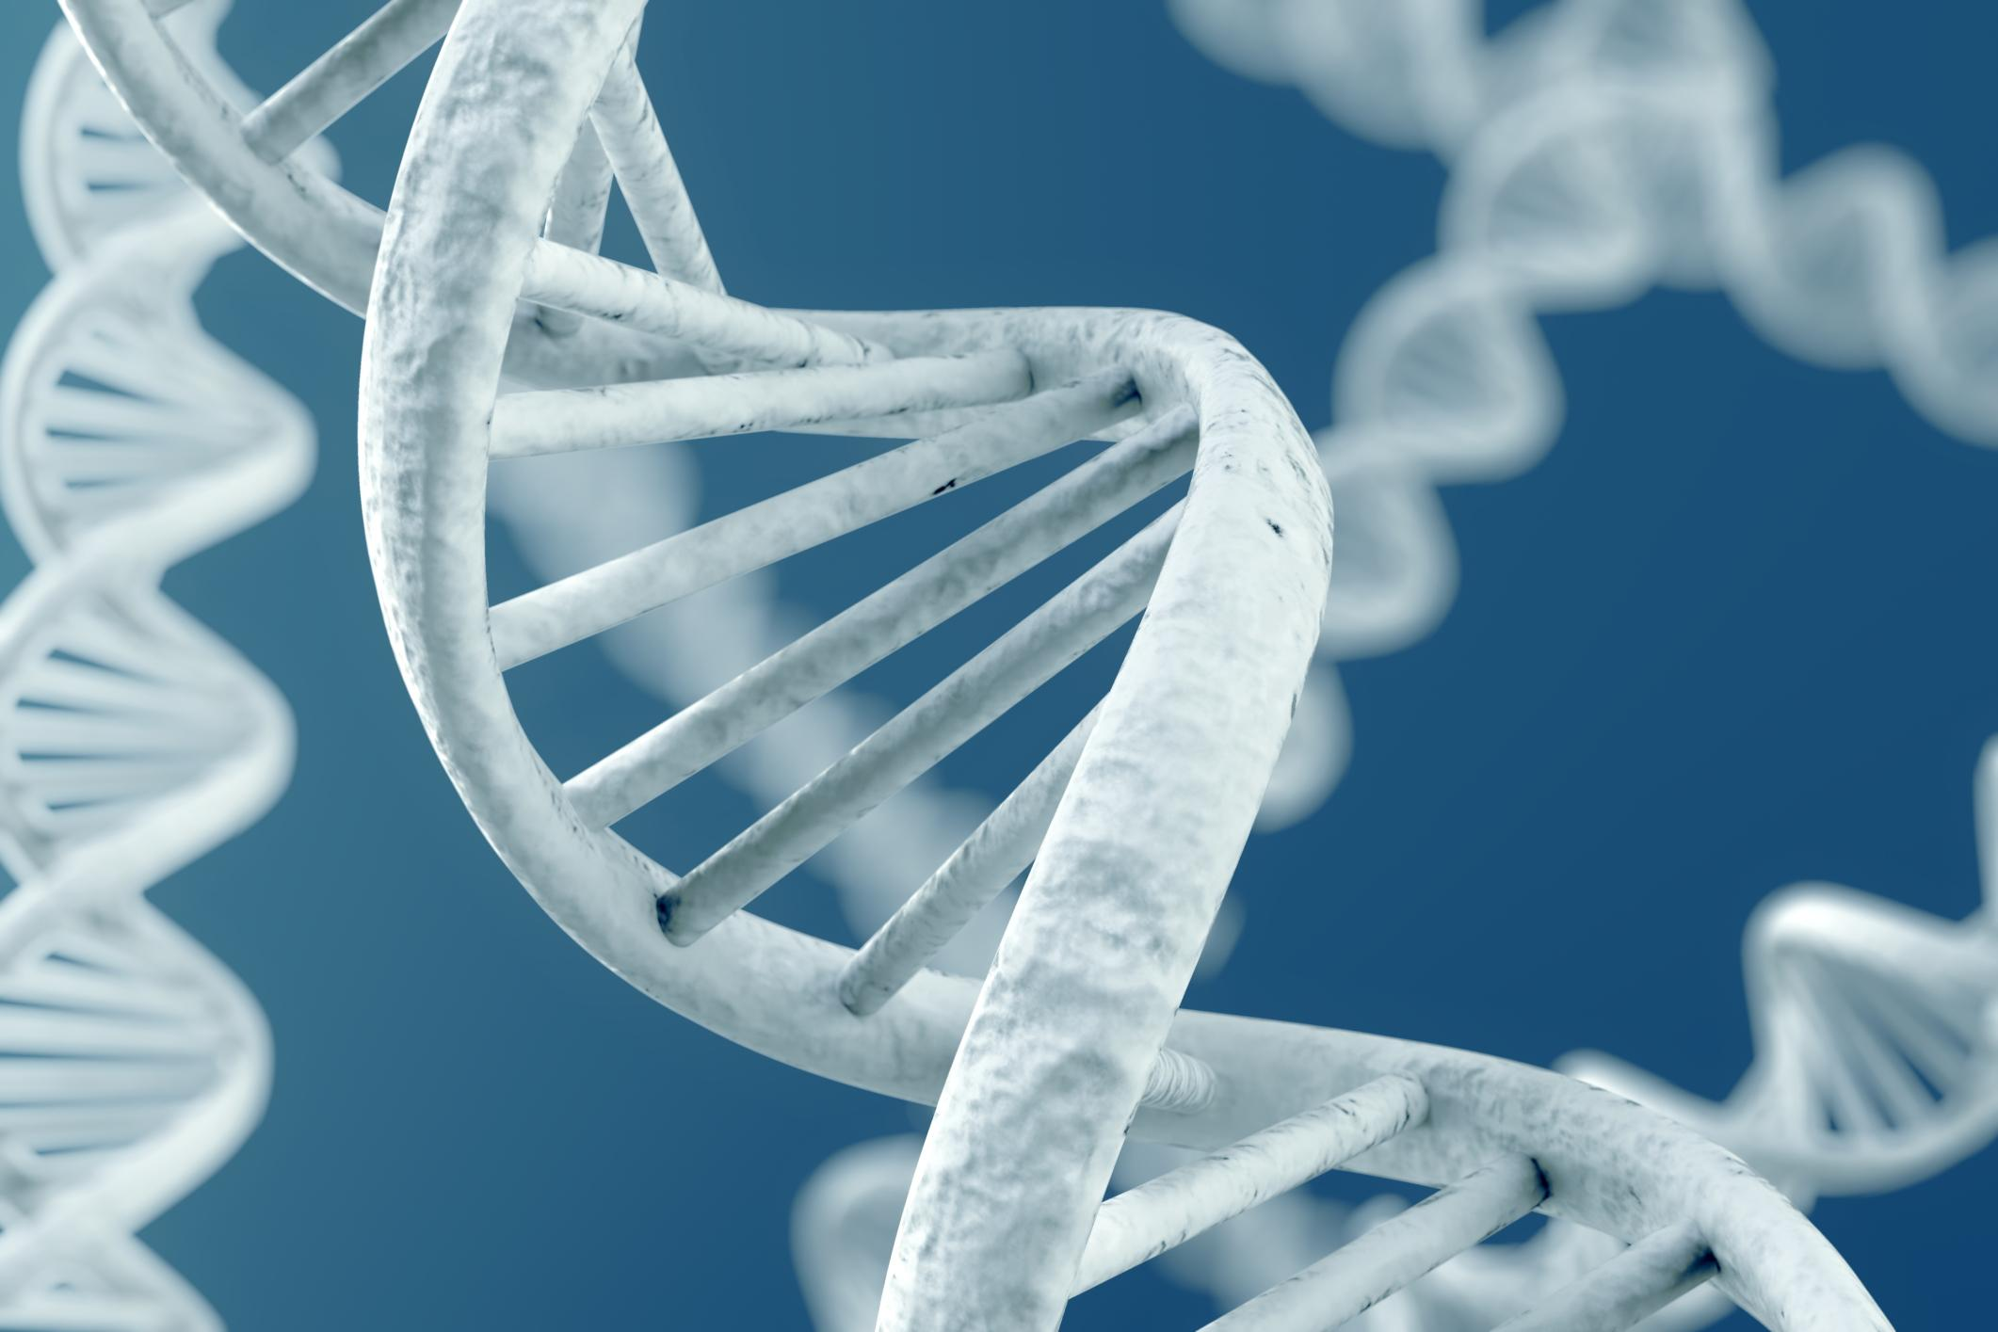
Intro
DNA
Notes:
Today we will learn about DNA, or deoxyribonucleic acid.

Slide 3
Big Question: What is the importance of DNA in the continuity of life?
Notes:
Our “big question” is: What is the importance of DNA in the continuity of life?
[Pause and illicit predictions from students.]
I love all these thoughtful scientific hypotheses! Be sure to keep this question and your predictions in mind as we move through these next few lessons, and we’ll continue to revisit it.
Feedback: Asking students to make predictions about the importance of DNA in the continuity of life is a great way to activate and elicit student ideas and prior knowledge. This type of activity is evidence of the teacher planning for students’ engagement with science ideas.

Slide 4
Notes:
Before we move on to our new vocabulary term, let’s review some other words & concepts that you already learned and make sure you are firm in your understanding.

Slide 5
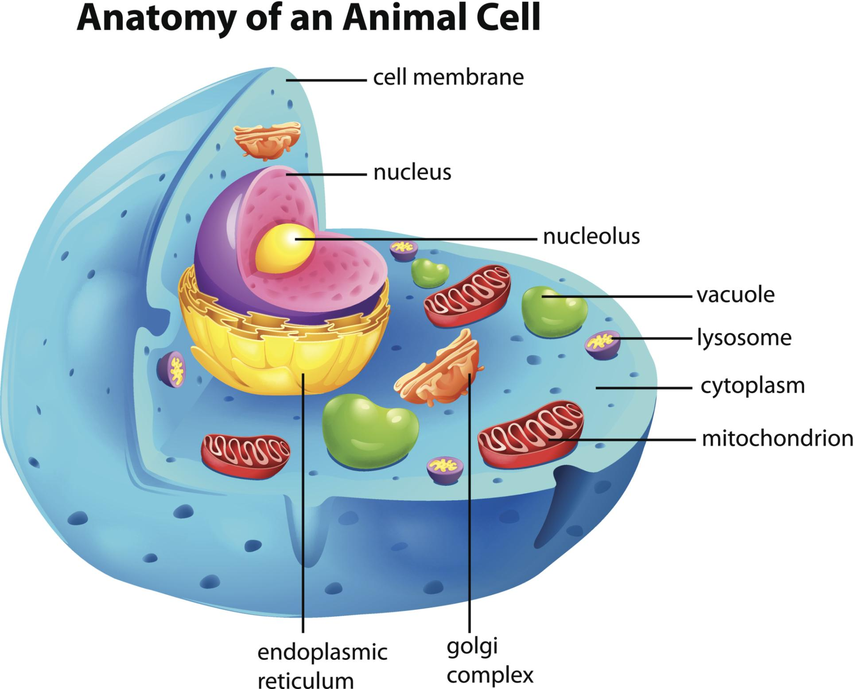
Cells: are the smallest unit of life which carry out a variety of functions in organisms
Notes:
Cells are the smallest unit of life which carry out a variety of functions in organisms.

Slide 6
Nucleus: the organelle in a cell that is in charge of all activities in the cell
Nucleus
Notes:
The nucleus is the organelle in a cell that is in charge of all activities in the cell.

Slide 7
Notes:
Now let’s pause for a moment to check your understanding.

Slide 8
What are cells?
Notes:
What are cells?
[Cells are the smallest unit of life which carry out a variety of functions in organisms.]

Slide 9
What is the nucleus of a cell?
Nucleus
Notes:
What is the nucleus of a cell?
[The nucleus is the organelle in a cell that is in charge of all activities in the cell.]

Slide 10
DNA
Notes:
Now that we’ve reviewed, let’s define our new term, DNA.

Slide 11
DNA: the hereditary material in almost all organisms
Notes:
DNA is the hereditary material in almost all organisms. It contains coded instructions that store and pass on genetic information from one generation to the next.

Slide 12
Notes:
Let’s check-in for understanding.

Slide 13
What is DNA?
Notes:
What is DNA?
[DNA is the hereditary material in almost all organisms. It contains coded instructions that store and pass on genetic information from one generation to the next.]

Slide 14
Notes:
That is the basic definition, but there is a bit more you need to know.

Slide 15
Nucleus
Notes:
DNA is found in the nucleus of the cell.
Feedback: Using similar, consistent visuals throughout a unit (i.e., different parts of the cells) helps students to build a strong foundation of understanding and make connections between the other concepts they have learned and will learned.

Slide 16
Notes:
Let’s check-in for understanding.

Slide 17
Where in the cell is DNA located?
Notes:
Where in the cell is DNA located?
[The nucleus]

Slide 18
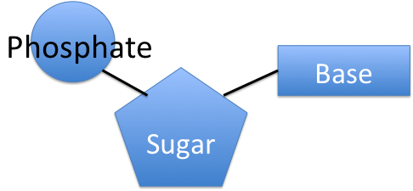
Notes:
Information in DNA is stored in a code of 4 chemical bases.

Slide 19
Notes:
Each base pairs with a sugar molecule,

Slide 20
Notes:
and a phosphate molecule.

Slide 21
Nucleotide
Notes:
This is called a nucleotide. Many nucleotides bond together to form a nucleic acid. DNA is one type of nucleic acid.

Slide 22
Notes:
Let’s check-in for understanding.

Slide 23
What makes up a nucleotide? Select all that apply.
Base
Sugar
Carbonate
Phosphate
Notes:
What makes up a nucleotide? Select all that apply.

Slide 24
What makes up a nucleotide? Select all that apply.
Base
Sugar
Carbonate
Phosphate
Notes:
What makes up a nucleotide? Select all that apply.
[Base, sugar, and phosphate]

Slide 25
Nucleotides
create
double helix
Notes:
The nucleotides are arranged in two long strands that form a spiral called a double helix.
Feedback: This is a good opportunity to ask students if they have seen a double helix before and make connections to their prior knowledge and real life experiences.

Slide 26
Notes:
Now, let’s talk about some examples of traits that DNA codes for.

Slide 27
Hair Color
Notes:
Your hair color is an example of DNA trait.

Slide 28
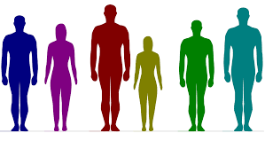
Height
Notes:
Your height is an example of DNA trait.

Slide 29
Notes:
Let’s check-in for understanding.

Slide 30
What is an example of DNA?
Notes:
What is an example of a trait that DNA codes for?

Slide 31
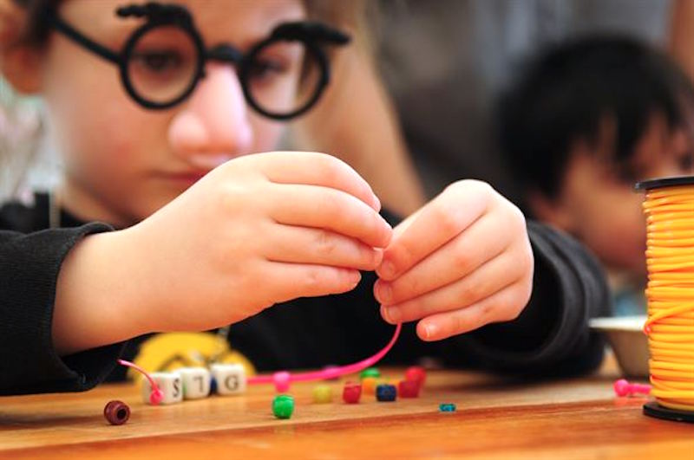
Demonstration
DNA Coding Activity
Linked above is an activity that will draw connections between DNA coding and computer coding! Students will work to code their own names and consider the similarities and differences between the binary computer code and the four-base DNA code. Use the activity to expand upon the purpose of the DNA molecule - to provide important instructions for creating proteins that ultimately make us who we are!
Notes:
Feedback: Feedback: This demonstration offers a clear and logical order of steps that help students make sense of the activity and stay engaged. Be sure to keep the students engaged throughout the demonstration, high levels of engagement are important for student understanding and participation.

Slide 32
Notes:
Let’s check-in for understanding.

Slide 33
What is the shape of DNA?
Notes:
What is the shape of DNA?
[Double helix]

Slide 34
Remember!!!
Notes:
So remember!

Slide 35
DNA: the hereditary material in almost all organisms
Notes:
DNA is the hereditary material in almost all organisms. It contains coded instructions that store and pass on genetic information from one generation to the next.

Slide 36
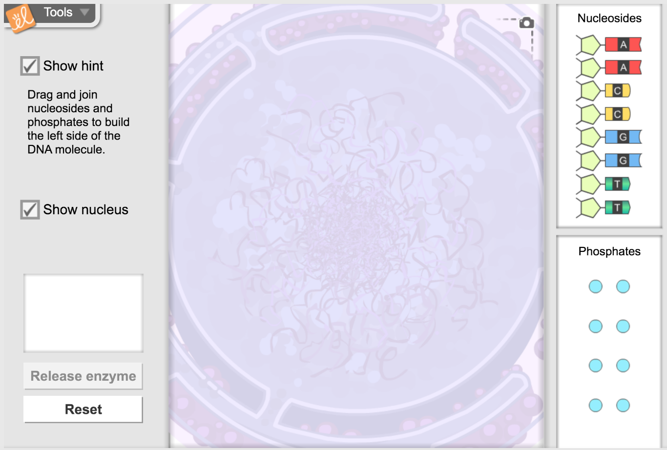
Simulation Activity
Building DNA
(Gizmos)
Click the link above for a simulation to deepen your understanding of DNA.
Notes:
Feedback: This simulation is a great way to help students make their science thinking visible.

Slide 37
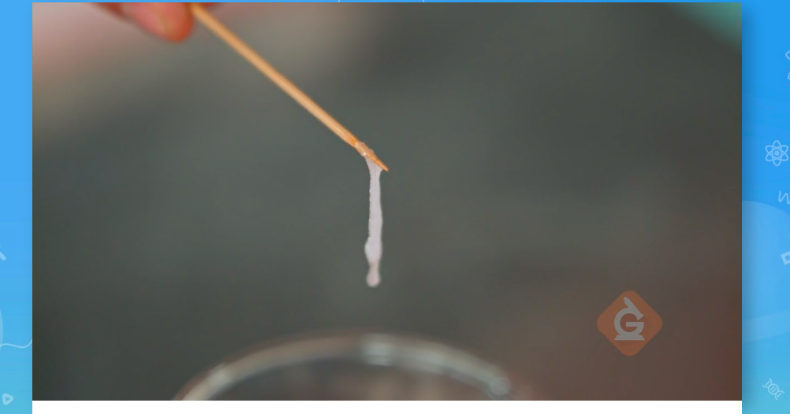
Simulation Activity
Strawberry DNA Extraction
Notes:
Feedback: This activity is a great way to build students’ epistemic understanding of what scientists do by engaging in investigation practices as a scientist. In this quick lab, students follow simple instructions to extract DNA from strawberries. This activity is very engaging for students and offers great opportunities for discussion. It can be used as an introduction to the lesson as well.
Epistemic information:
To get the DNA from a cell, scientists typically rely on one of many DNA extraction kits available from biotechnology companies.
During a DNA extraction, a detergent will cause the cell to pop open, or lyse, so that the DNA is released into solution.
Then alcohol added to the solution causes the DNA to precipitate out.
In this activity, strawberries are best to be used because each strawberry cell has eight copies of the genome, giving them a lot of DNA per cell. (Most organisms only have one genome copy per cell.)

Slide 38
Big Question: What is the importance of DNA in the continuity of life?
Notes:
Explicit cue to revisit the big question at the end of the lesson: Okay everyone. Now that we’ve learned the term, DNA, let’s reflect once more on our big question. Was there anything that we predicted earlier that was correct or incorrect? Do you have any new hypotheses to share?

Slide 39
Notes:
Thanks for watching!

Slide 40
This Video Was Created With Resources From:
Questions or Comments
Michael Kennedy, Ph.D. MKennedy@Virginia.edu
Rachel L Kunemund, Ph.D. rk8vm@virginia.edu

Slide 41
Intro
“Big Idea” Question
Review Concepts
Check-In Questions
Teacher Demo
Vocabulary
Student-Friendly Definition
Examples & Non-Examples
Morphological Word Parts
Extension Activity
Notes:
OK everyone, get ready for our next lesson. Just as a reminder, these are the different components that our lesson may include, and you’ll see these icons in the top left corner of each slide so that you can follow along more easily!

Slide 42
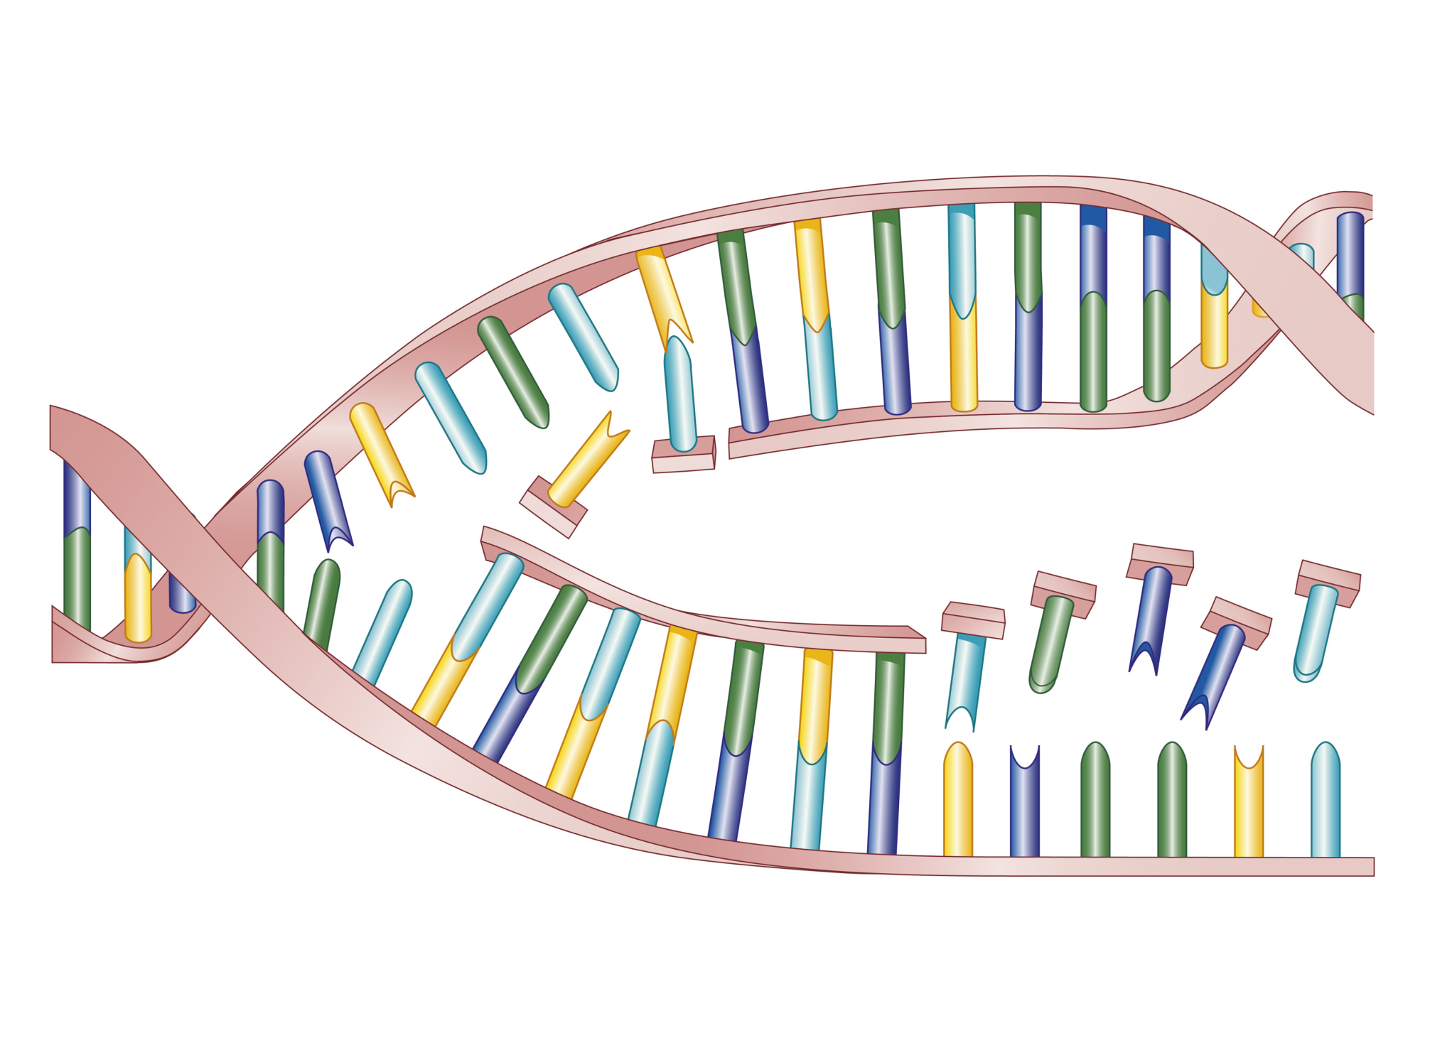
Intro
DNA Replication
Notes:
Today we’re going to learn about DNA replication.

Slide 43
Big Question: What is the importance of DNA in the continuity of life?
Notes:
Before we start, let’s think about our “big question”: What is the importance of DNA in the continuity of life? We recently learned about DNA, so what predictions do you have to share about DNA replication?
[Pause and illicit predictions from students.]
I love all these thoughtful scientific hypotheses! Be sure to keep this question and your predictions in mind as we move through these next few lessons, and we’ll continue to revisit it.

Slide 44
Notes:
Before we move on to our new vocabulary term, let’s review some other words & concepts that you already learned and make sure you are firm in your understanding.

Slide 45
Cells: are the smallest unit of life which carry out a variety of functions in organisms
Notes:
Cells are the smallest unit of life which carry out a variety of functions in organisms.

Slide 46
Nucleus: the organelle in a cell that is in charge of all activities in the cell
Nucleus
Notes:
The nucleus is the organelle in a cell that is in charge of all activities in the cell.

Slide 47
DNA: the hereditary material in almost all organisms
Notes:
DNA is the hereditary material in almost all organisms. It contains coded instructions that store and pass on genetic information from one generation to the next.

Slide 48
Notes:
Now let’s pause for a moment to check your understanding.

Slide 49
What are cells?
Notes:
What are cells?
[Cells are the smallest unit of life which carry out a variety of functions in organisms.]

Slide 50
What is the nucleus of a cell?
Nucleus
Notes:
What is the nucleus of a cell?
[The nucleus is the organelle in a cell that is in charge of all activities in the cell.]

Slide 51
What is DNA?
Notes:
What is DNA?
[DNA is the hereditary material in almost all organisms. It contains coded instructions that store and pass on genetic information from one generation to the next.]

Slide 52
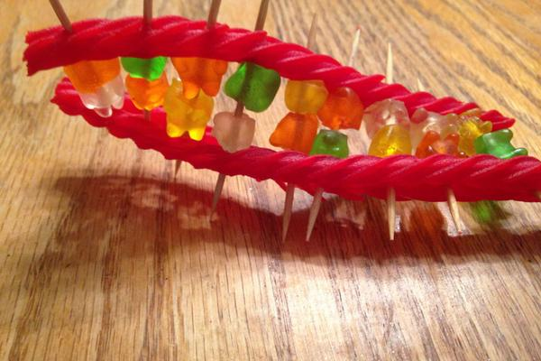
Demonstration
Creating Candy DNA
It’s important for students to understand complementary base pairs before learning about DNA replication. One way to help them learn is by creating a DNA model using candy. Assigning a base (adenine, thymine, cytosine, guanine) to different colors of candies, you can engage them in learning about the proper pairing of bases as you guide them through model construction. Linked above is a video for you to reference!

Slide 53
DNA Replication
Notes:
Now that we’ve reviewed, let’s define our new term, DNA replication.

Slide 54
DNA Replication: the process in which the double helix unzips and a DNA molecule is copied
Notes:
DNA Replication is the process in which the double helix unzips and a DNA molecule is copied, creating identical DNA molecules.

Slide 55
Notes:
Let’s check-in for understanding.

Slide 56
What is DNA replication?
Notes:
What is DNA replication?
[DNA Replication is the process in which the double helix unzips and a DNA molecule is copied, creating identical DNA molecules.]

Slide 57
Notes:
That is the basic definition, but there is a bit more you need to know.

Slide 58
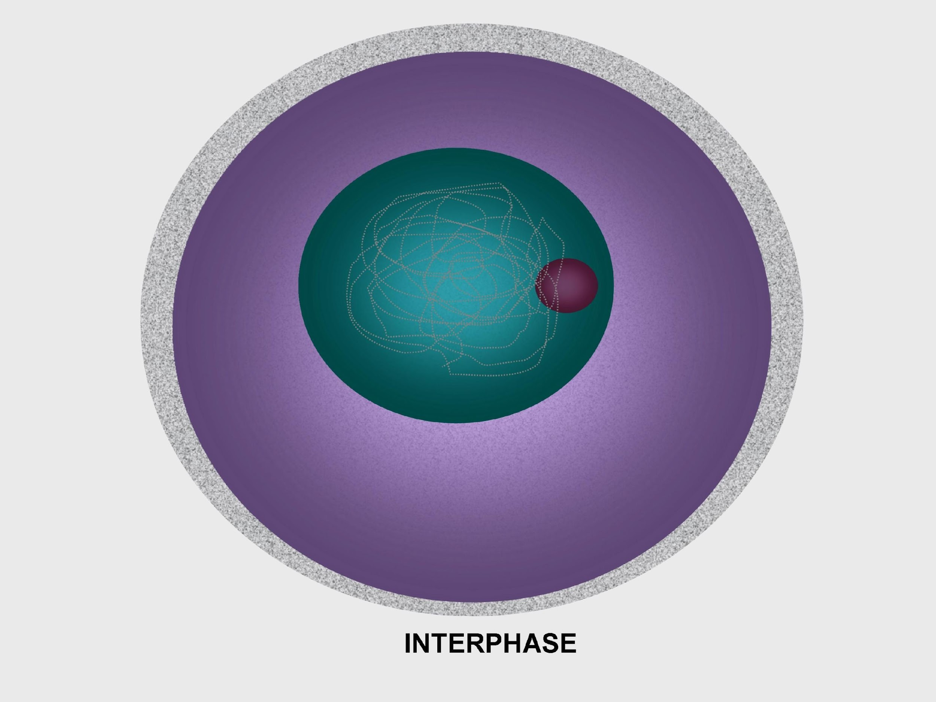
Notes:
DNA replication happens during Interphase, so it happens BEFORE cell division. It specifically happens during the Synthesis, or “S”, phase. You might recall that to synthesize means to build - the cell builds identical DNA molecules.

Slide 59
One Strand
Second Strand
Notes:
Notice how, when in the double helix form, there are two strands of DNA.

Slide 60
DNA Replication: involves two steps
Notes:
DNA replication involves two steps. The first step is the unzipping of the molecule. This means that it is no longer in its double helix shape and the two strands are separated from each other.

Slide 61
DNA Replication: involves two steps
Notes:
In the second step, a complementary strand is added to each original strand.

Slide 62
Original DNA
Copy
Copy
Notes:
So, one original DNA molecule is made into copies which are identical. Each of the copies has one strand from the original and one new strand.

Slide 63
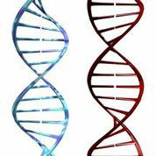
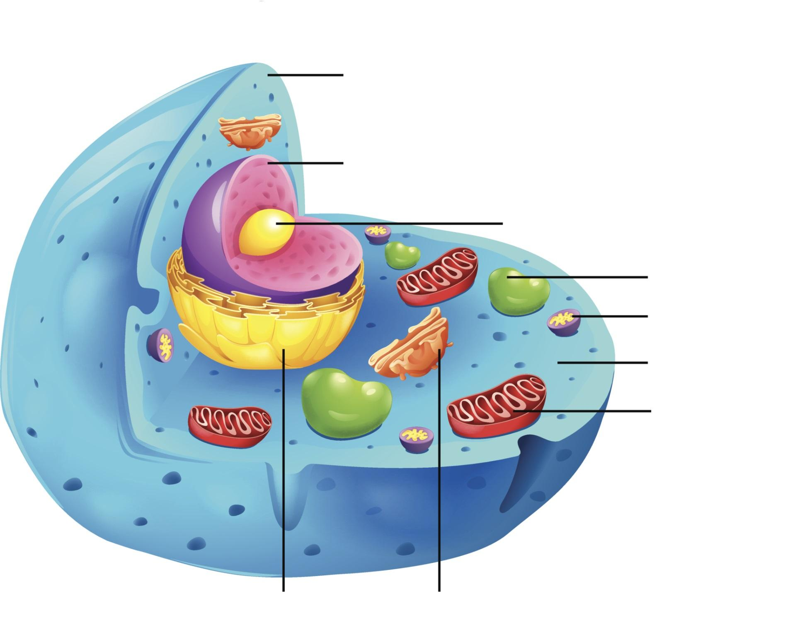
Duplicates All DNA
DNA
Same DNA
Same DNA
Notes:
DNA replication is important because now, when the cell divides, each new cell has a copy of the same DNA.

Slide 64
Notes:
DNA replication happens in all living organisms. This is how DNA is passed down from parent to offspring.

Slide 65
Notes:
Let’s check-in for understanding.

Slide 66
What is DNA replication?
Notes:
What is DNA replication?
[DNA Replication is the process in which the double helix unzips and a DNA molecule is copied, creating identical DNA molecules.]

Slide 67
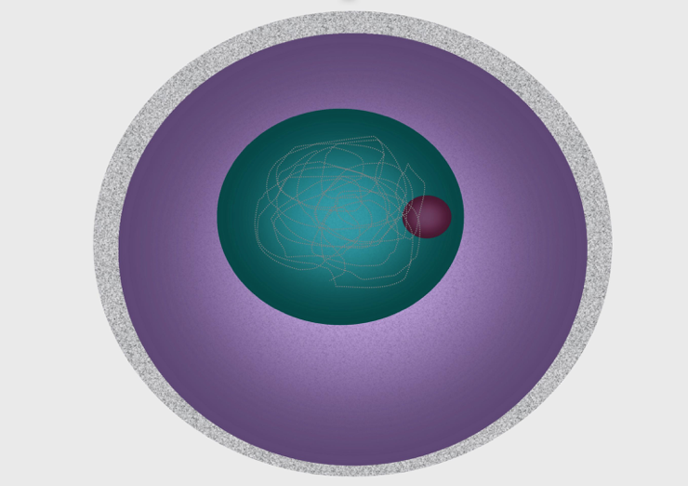
When does DNA replication occur?
During mitosis
During meiosis
Always occurring
During interphase
Notes:
When does DNA replication occur?

Slide 68
When does DNA replication occur?
During mitosis
During meiosis
Always occurring
During interphase
Notes:
When does DNA replication occur?
[During interphase]

Slide 69
True/False: DNA replication happens in all living organisms.
Notes:
True/False: DNA replication happens in all living organisms.

Slide 70
True/False: DNA replication happens in all living organisms.
Notes:
True/False: DNA replication happens in all living organisms.
[True]

Slide 71
What are the two steps involved in DNA replication?
Notes:
What are the two steps involved in DNA replication?
[1) The DNA strand unzips so that it is no longer in a double helix and 2) a complementary strand is added to each of the original strands]

Slide 72
Remember!!!
Notes:
So remember!

Slide 73
DNA Replication: the process in which the double helix unzips and a DNA molecule is copied
Notes:
DNA Replication is the process in which the double helix unzips and a DNA molecule is copied, creating identical DNA molecules.

Slide 74
DNA Replication: involves two steps
Notes:
DNA replication involves two steps. The first step is the unzipping of the molecule. This means that it is no longer in its double helix shape and the two strands are separated from each other.

Slide 75
DNA Replication: involves two steps
Notes:
[1) The DNA strand unzips so that it is no longer in a double helix and 2) a complementary strand is added to each of the original strands]

Slide 76
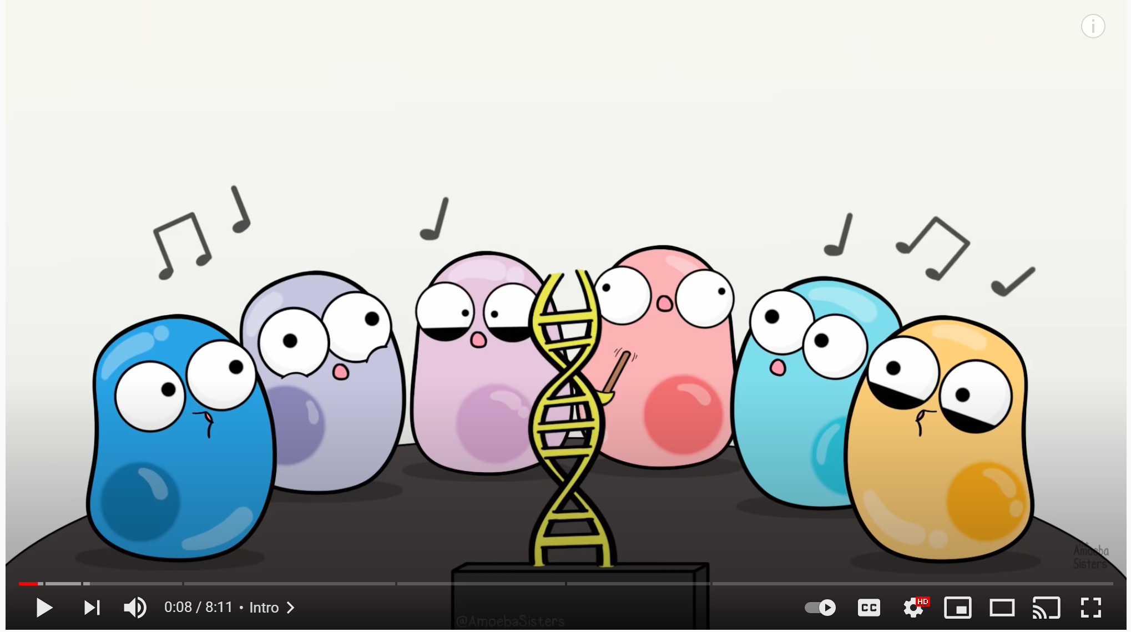
Extension Activity
Amoeba Sisters Explain DNA Replication
The video linked above goes into greater detail about the DNA replication process and can be used to extend student knowledge or clarify confusion about how the process takes place.

Slide 77
Big Question: What is the importance of DNA in the continuity of life?
Notes:
Explicit cue to revisit the big question at the end of the lesson: Okay everyone. Now that we’ve learned the term, DNA replication, let’s reflect once more on our big question. Was there anything that we predicted earlier that was correct or incorrect? Do you have any new hypotheses to share?
Feedback: Offering students an opportunity to evaluate their earlier hypotheses and make changes based on their new understandings is an important part of the iterative process in science. This is a great opportunity to help students build an epistemic understanding by explicitly stating how continuing to change and build on hypotheses as your knowledge grows is an important part of the discipline of science!

Slide 78
Notes:
Thanks for watching!

Slide 79
This Video Was Created With Resources From:
Questions or Comments
Michael Kennedy, Ph.D. MKennedy@Virginia.edu
Rachel L Kunemund, Ph.D. rk8vm@virginia.edu

