Slide 1
Intro
“Big Idea” Question
Review Concepts
Check-In Questions
Teacher Engagement
Vocabulary
Student-Friendly Definition
Examples & Non-Examples
Morphological Word Parts
Frayer Model
Simulation/Activity
Notes:
OK everyone, get ready for our next lesson. Just as a reminder, these are the different components that our lesson may include, and you’ll see these icons in the top left corner of each slide so that you can follow along more easily!

Slide 2
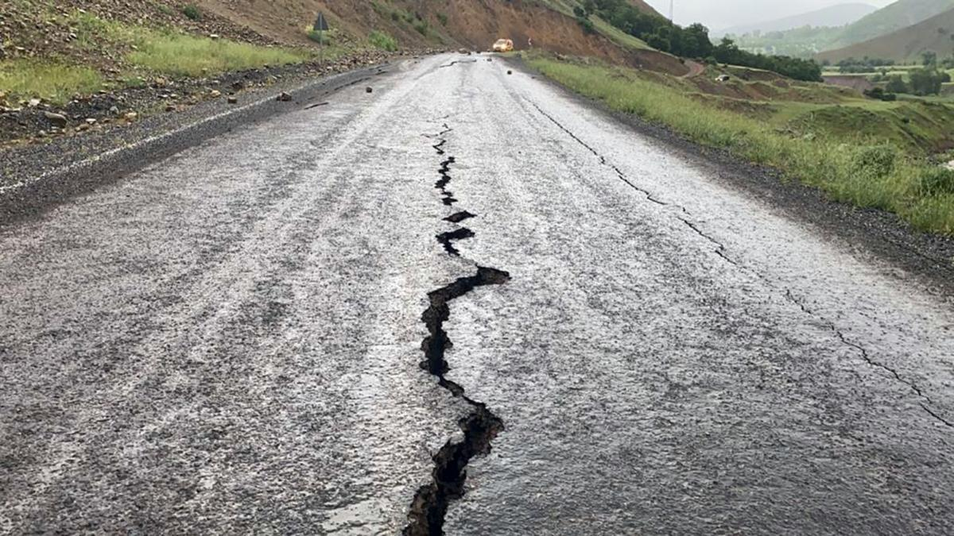
Intro
Earthquake
Notes:
Today, we’ll be learning about the word: Earthquake.

Slide 3
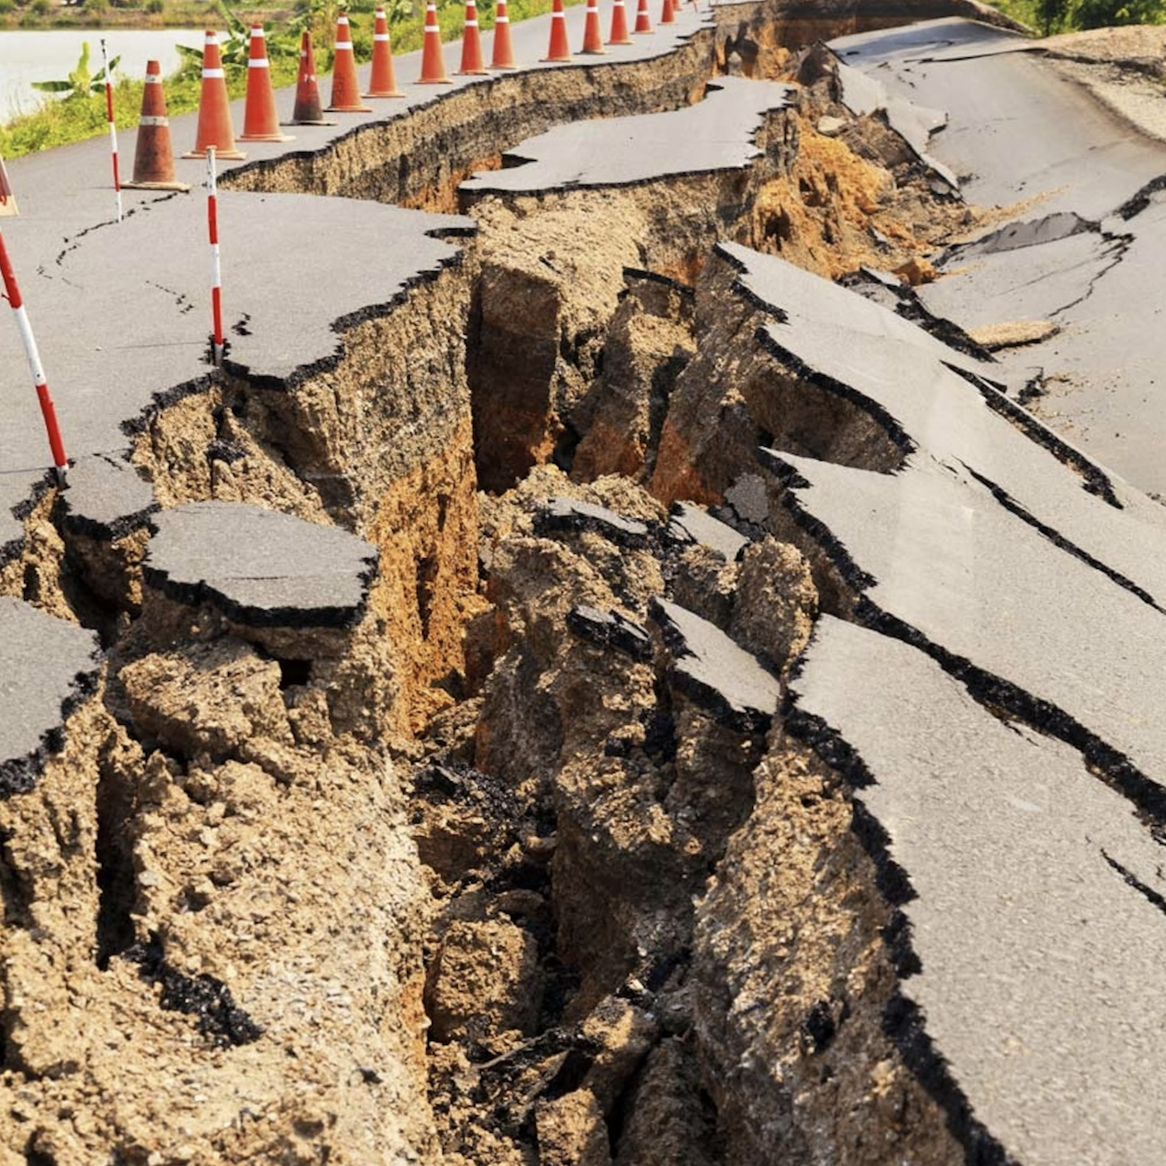
Big Question: How do earthquakes show us how different parts of the Earth move and interact with each other?
Notes:
Our “big question” is: How do earthquakes show us how different parts of the Earth move and interact with each other?
[Pause and illicit predictions from students.]
I love all these thoughtful scientific hypotheses! Be sure to keep this question and your predictions in mind as we move through these next few lessons, and we’ll continue to revisit it.

Slide 4
Notes:
Before we move on to our new topic, let’s review some other words & concepts that you already learned and make sure you are firm in your understanding.

Slide 5
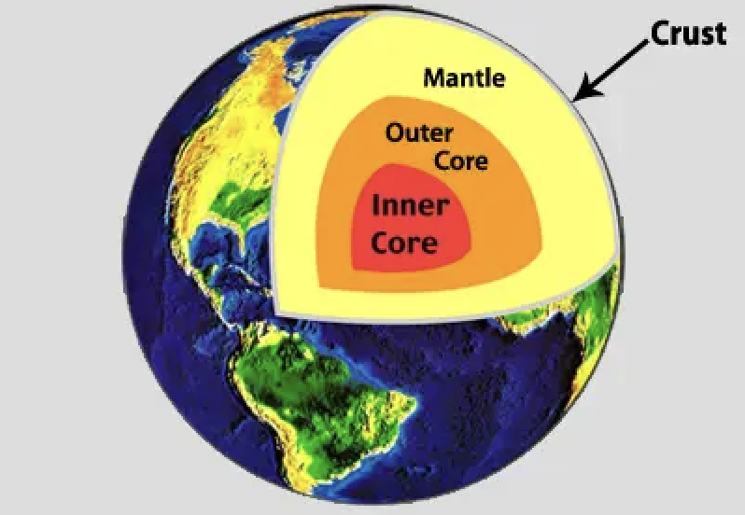
Crust: The outermost shell of the Earth
Notes:
Crust is the outermost shell of the Earth

Slide 6
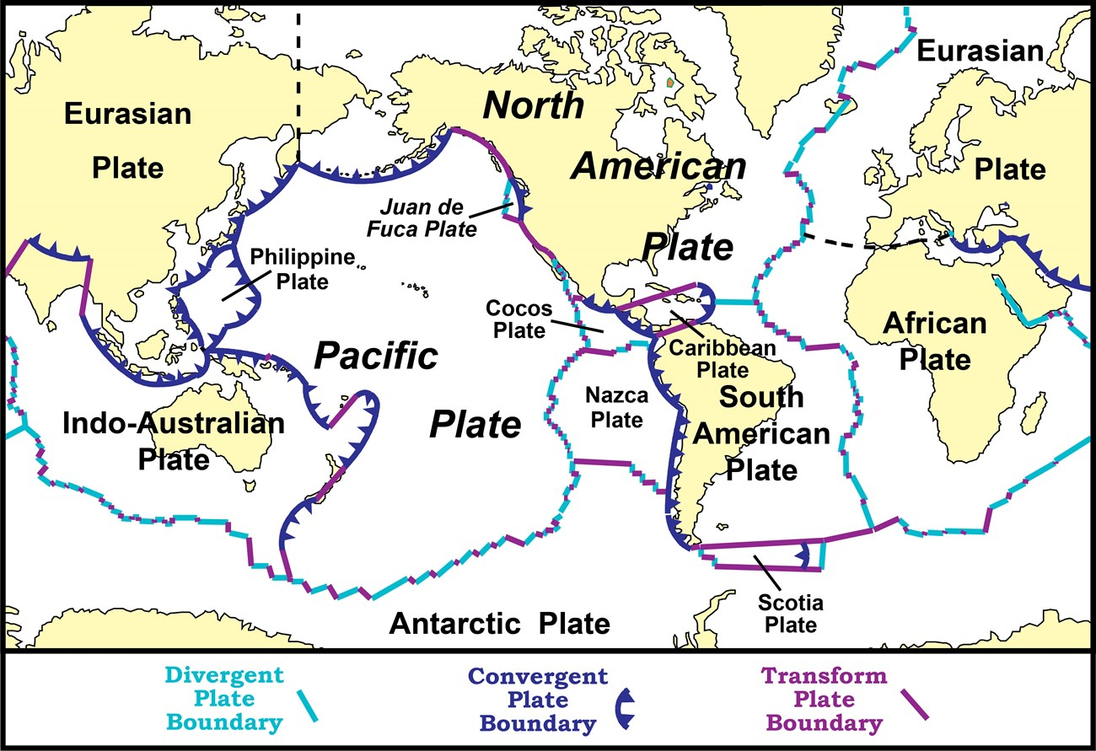
Tectonic Plates: Huge pieces of the Earth's surface that fit together like a puzzle and move very slowly over time
Notes:
Tectonic plates are huge pieces of the Earth’s surface that fit together like a puzzle an d move very slowly over time.

Slide 7
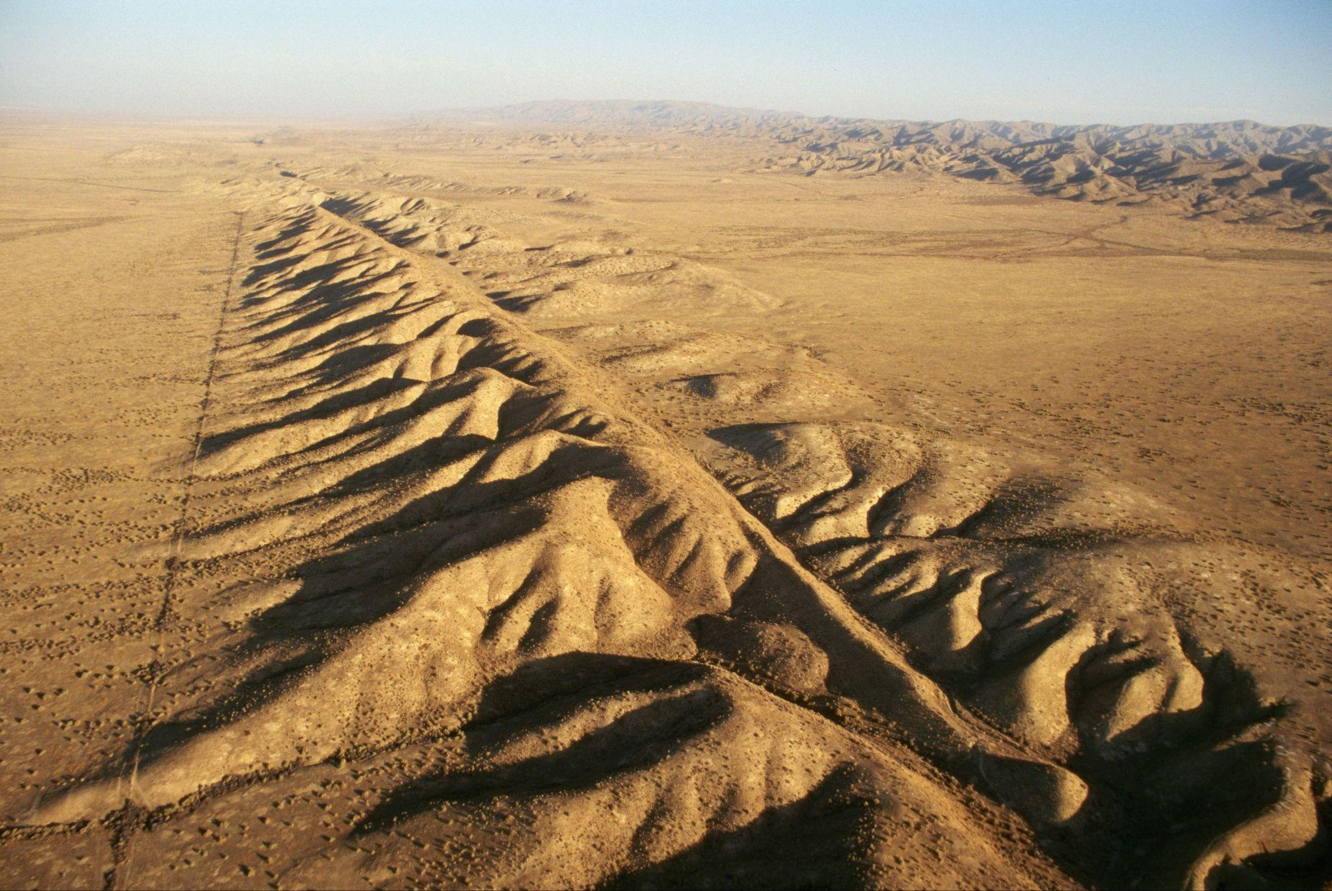
Fault: Long crack in the surface of the Earth
Notes:
A fault is a long crack in the surface of the Earth.

Slide 8
Notes:
Now let’s pause for a moment to review the information we have covered already.

Slide 9
The outermost shell of the Earth is called the…
Crust
Core
Notes:
The outermost shell of the Earth is called the…
[Crust]

Slide 10
The outermost shell of the Earth is called the…
Crust
Core
Notes:
The outermost shell of the Earth is called the…
[Crust]

Slide 11
True or False: Tectonic plates are huge pieces of the Earth's surface that fit together like a puzzle and move very slowly over time.
Notes:
True or False: Huge pieces of the Earth's surface that fit together like a puzzle and move very slowly over time.
[True]

Slide 12
True or False: Tectonic plates are huge pieces of the Earth's surface that fit together like a puzzle and move very slowly over time.
Notes:
True or False: Huge pieces of the Earth's surface that fit together like a puzzle and move very slowly over time.
[True]

Slide 13
A _____ is a long _____ in the surface of the Earth.
fault, crack
crack, fault
Notes:
A _____ is a long _____ in the surface of the Earth.
[fault, crack]

Slide 14
A _____ is a long _____ in the surface of the Earth.
fault, crack
crack, fault
Notes:
A _____ is a long _____ in the surface of the Earth.
[fault, crack]

Slide 15
Earthquake
Notes:
Now that we’ve reviewed, let’s define the phrase earthquake.

Slide 16
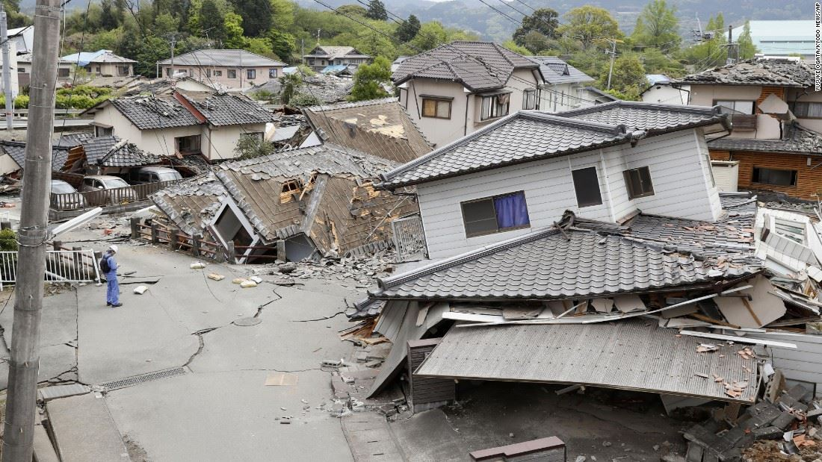
Earthquake: Sudden shaking of the ground caused by the movement of Earth's tectonic plates
Notes:
An earthquake is the sudden shaking of the ground cause by the movement of Earth’s tectonic plates.

Slide 17
Notes:
Let’s check-in for understanding.

Slide 18
What is an earthquake?
Notes:
What is an earthquake?
[An earthquake is sudden shaking of the ground caused by the movement of Earth’s tectonic plates.]

Slide 19
Notes:
That is the basic definition, but there is a bit more you need to know.

Slide 20
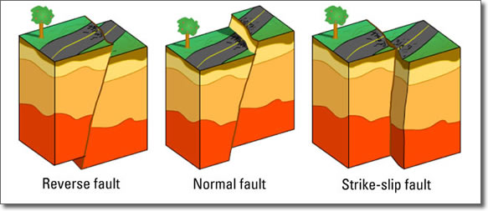
Earthquakes are caused when the Earth's tectonic plates, which are huge pieces of land, move or bump into each other. This movement happens along lines called faults, which are like cracks or breaks where two plates meet.
Notes:
Earthquakes are caused when the Earth's tectonic plates, which are huge pieces of land, move or bump into each other. This movement happens along lines called faults, which are like cracks or breaks where two plates meet.

Slide 21
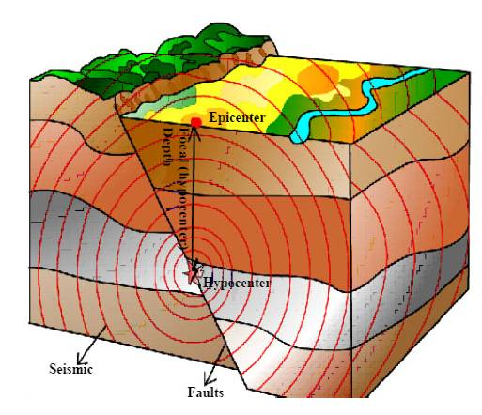
When these plates suddenly slip past each other at a fault, it releases a lot of energy, causing the ground to shake. This is what we feel as an earthquake. The place right where the plates slip is called the focus of the earthquake, and the point right above it on the Earth's surface is the epicenter.
Notes:
When these plates suddenly slip past each other at a fault, it releases a lot of energy, causing the ground to shake. This is what we feel as an earthquake. The place right where the plates slip is called the focus of the earthquake, and the point right above it on the Earth's surface is the epicenter.

Slide 22
The shaking can be gentle, making things just slightly tremble, or it can be very strong, causing buildings to sway, roads to crack, and sometimes even making the ground split open. Scientists measure how strong an earthquake is, or the magnitude of it, on a scale.
Notes:
The shaking can be gentle, making things just slightly tremble, or it can be very strong, causing buildings to sway, roads to crack, and sometimes even making the ground split open. Scientists measure how strong an earthquake is, or the magnitude of it, on a scale.

Slide 23
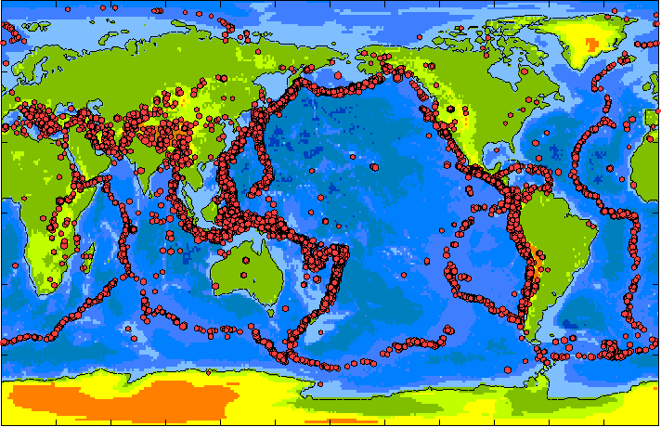
Earthquakes can happen anywhere, but they are more common near the edges of tectonic plates, as seen on this map. By studying earthquakes, scientists learn more about how our planet works and how the movements of these giant plates shape the Earth's surface.
Notes:
Earthquakes can happen anywhere, but they are more common near the edges of tectonic plates, as seen on this map. By studying earthquakes, scientists learn more about how our planet works and how the movements of these giant plates shape the Earth's surface.

Slide 24
Notes:
Let’s check-in for understanding.

Slide 25
Earthquakes happen along ______ which are cracks or breaks where two _______ ______ meet.
Notes:
Earthquakes happen along ______ which are cracks of breaks where two _____ ______ meet.
[faults, tectonic plates]

Slide 26
Earthquakes happen along faults which are cracks or breaks where two tectonic plates meet.
Notes:
Earthquakes happen along [faults] which are cracks of breaks where two [tectonic plates] meet.

Slide 27
Magnitude of an earthquake is how _____ it is, and is measured on a _____:
strong, scale
scale, strong
Notes:
Magnitude of an earthquake is how _____ it is, and is measured on a _____:
[strong, scale]

Slide 28
Magnitude of an earthquake is how _____ it is, and is measured on a _____:
strong, scale
scale, strong
Notes:
Magnitude of an earthquake is how _____ it is, and is measured on a _____:
[strong, scale]

Slide 29
True or False: Earthquakes can happen anywhere, but they are more common near the edges of tectonic plates.
Notes:
True or False: Earthquakes can happen anywhere, but they are more common near the edges of tectonic plates.
[True]

Slide 30
True or False: Earthquakes can happen anywhere, but they are more common near the edges of tectonic plates.
Notes:
True or False: Earthquakes can happen anywhere, but they are more common near the edges of tectonic plates.
[True]

Slide 31
Notes:
Now, let’s talk about some examples of earthquakes.

Slide 32
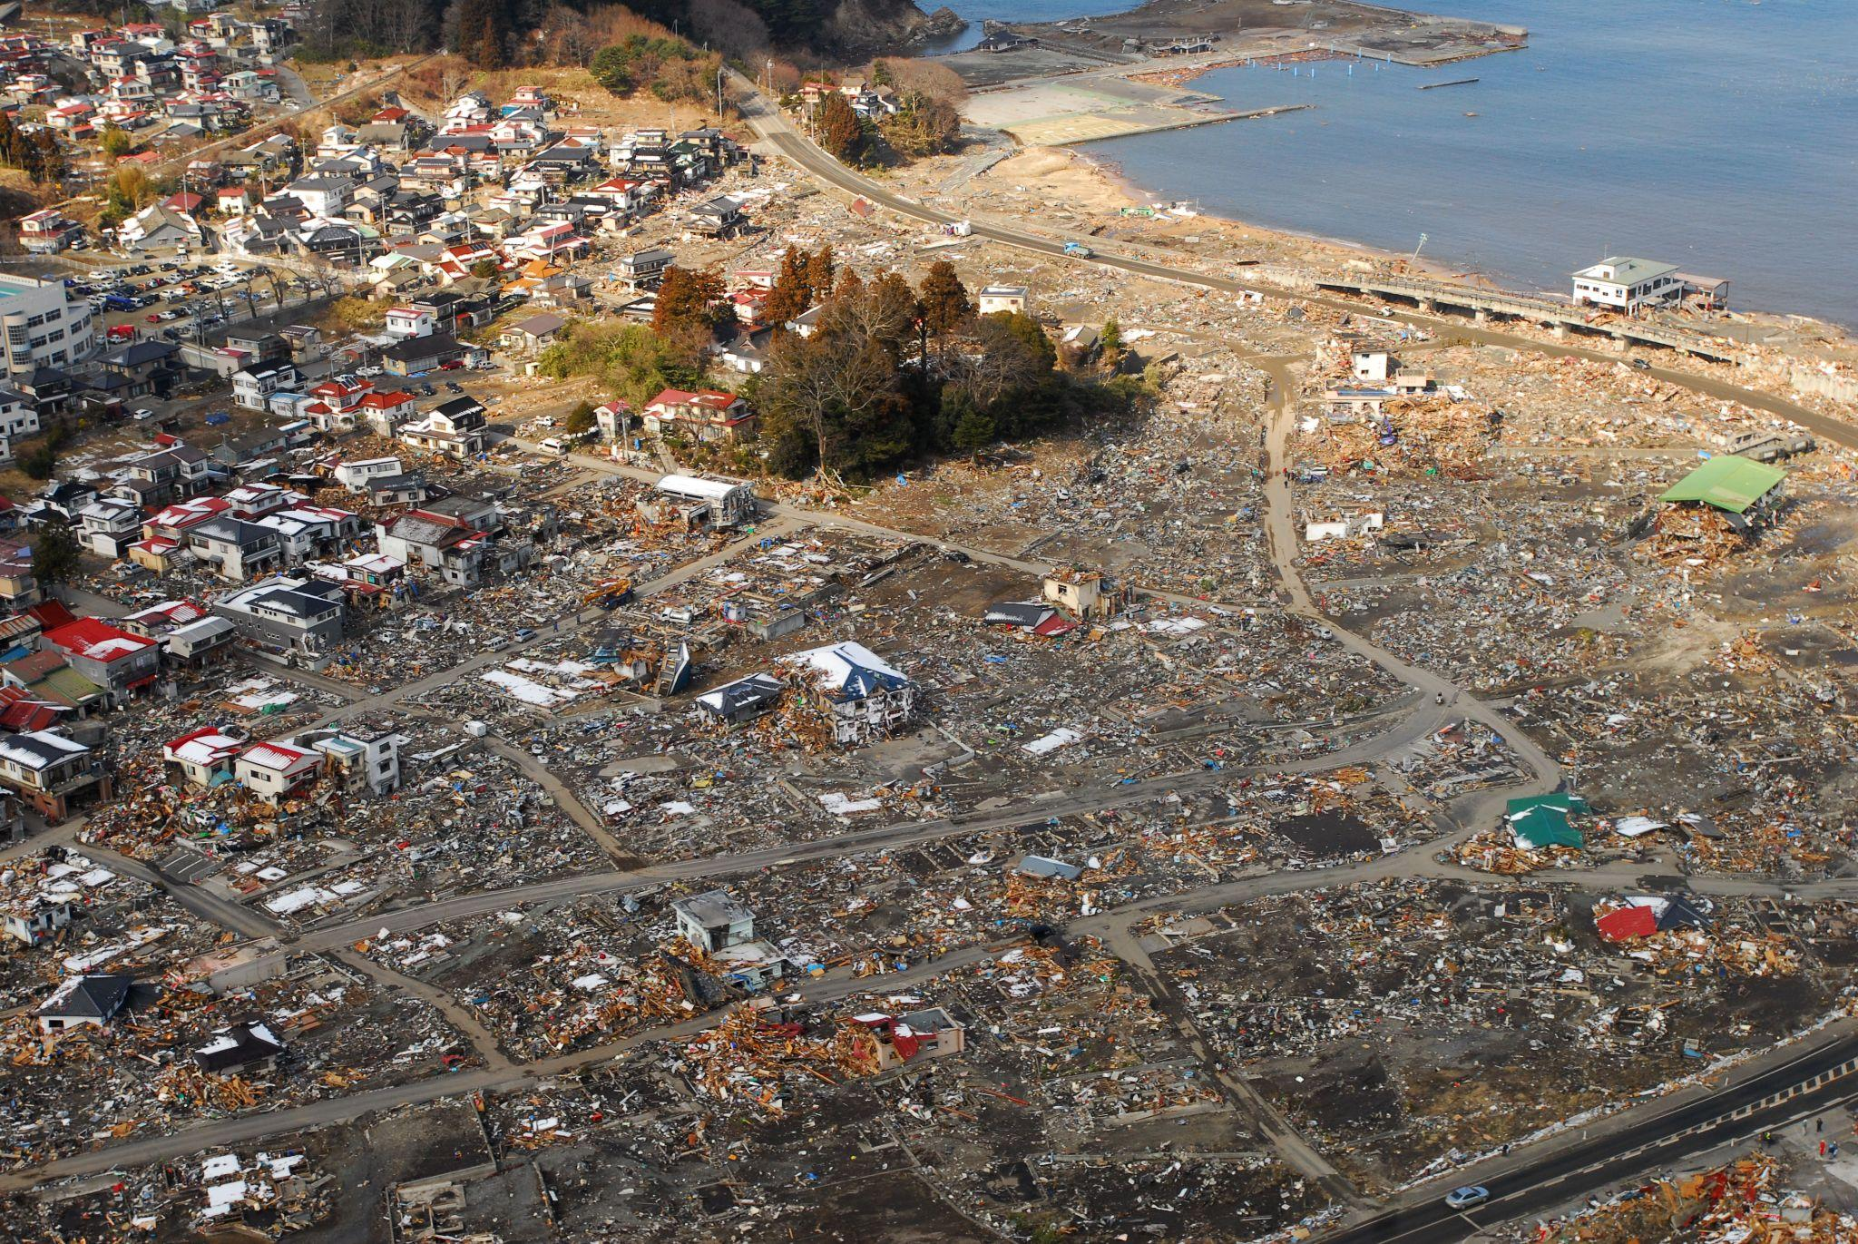
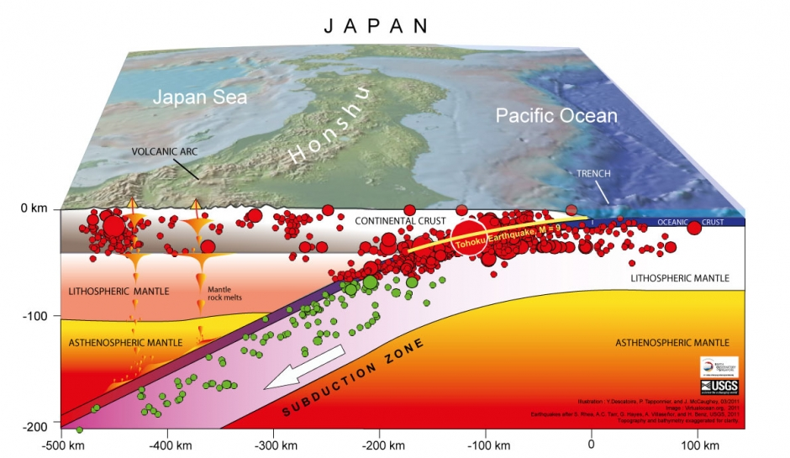
An example of an earthquake is the 2011 Tōhoku Earthquake in Japan. This 9.0–9.1 magnitude earthquake on March 11, 2011, triggered a massive tsunami, leading to the Fukushima nuclear disaster. It was one of the most powerful earthquakes ever recorded.
Notes:
An example of an earthquake is the 2011 Tōhoku Earthquake in Japan. This 9.0–9.1 magnitude earthquake on March 11, 2011, triggered a massive tsunami, leading to the Fukushima nuclear disaster. It was one of the most powerful earthquakes ever recorded.

Slide 33
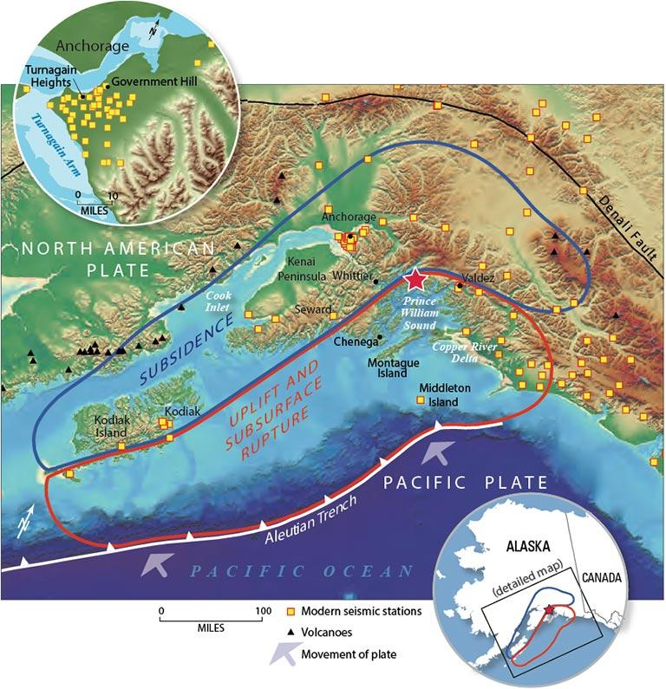
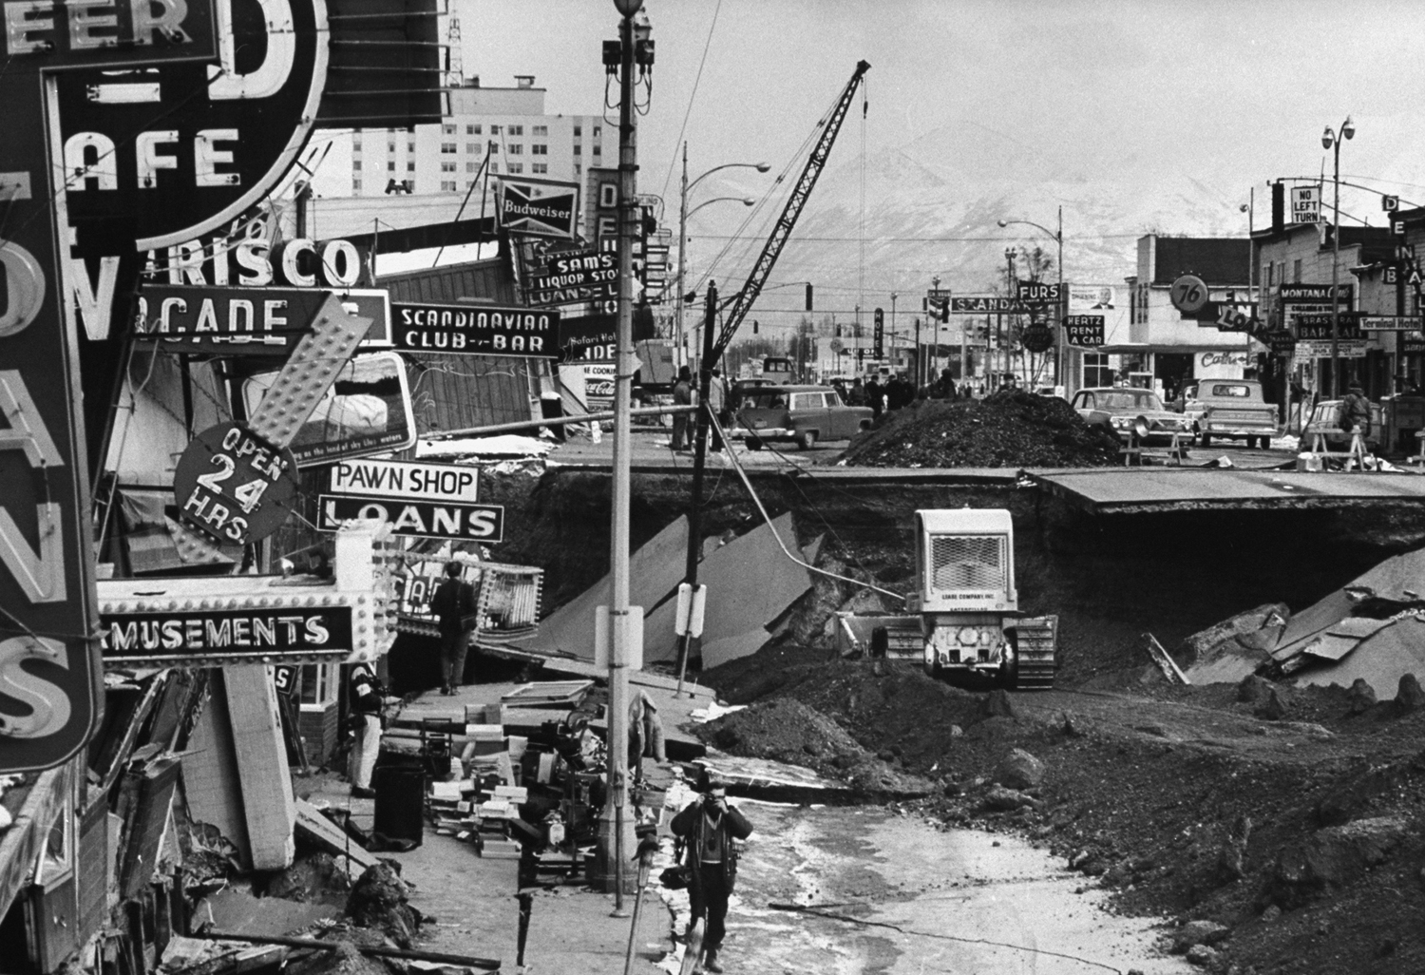
Another example of an earthquake occurred on March 27, 1964, in Prince William Sound, Alaska in the United States. Known as the Great Alaska Earthquake or the 1964 Alaskan Earthquake, it had a magnitude of 9.2, making it the second most powerful earthquake ever recorded. This massive quake caused widespread destruction, particularly in the city of Anchorage.
Notes:
Another example of an earthquake occurred on March 27, 1964, in Prince William Sound, Alaska in the United States. Known as the Great Alaska Earthquake or the 1964 Alaskan Earthquake, it had a magnitude of 9.2, making it the second most powerful earthquake ever recorded. This massive quake caused widespread destruction, particularly in the city of Anchorage.

Slide 34
Notes:
Now, let’s talk about some non-examples of earthquakes.

Slide 35
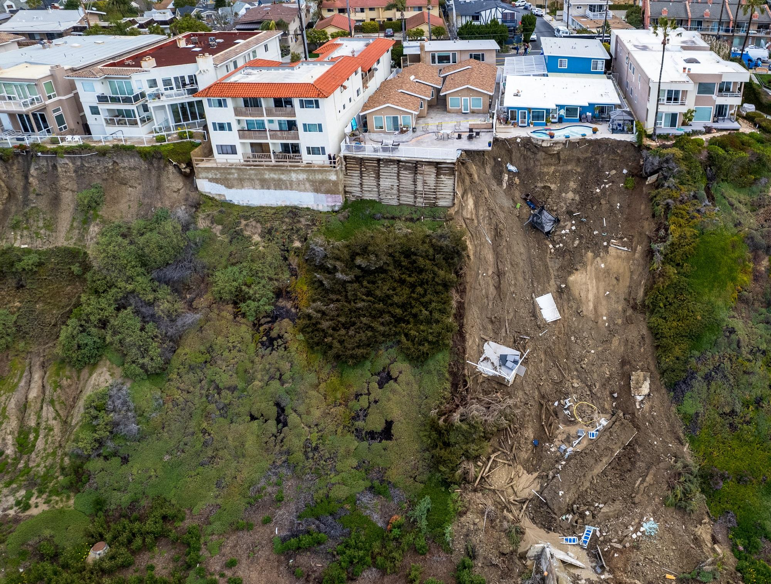
A landslide is not an example of an earthquake. Landslides involve the movement of soil, rock, and debris down a slope, which can be triggered by earthquakes but can also occur independently due to factors like rain or human activity.
Notes:
A landslide is not an example of an earthquake. Landslides involve the movement of soil, rock, and debris down a slope, which can be triggered by earthquakes but can also occur independently due to factors like rain or human activity.

Slide 36
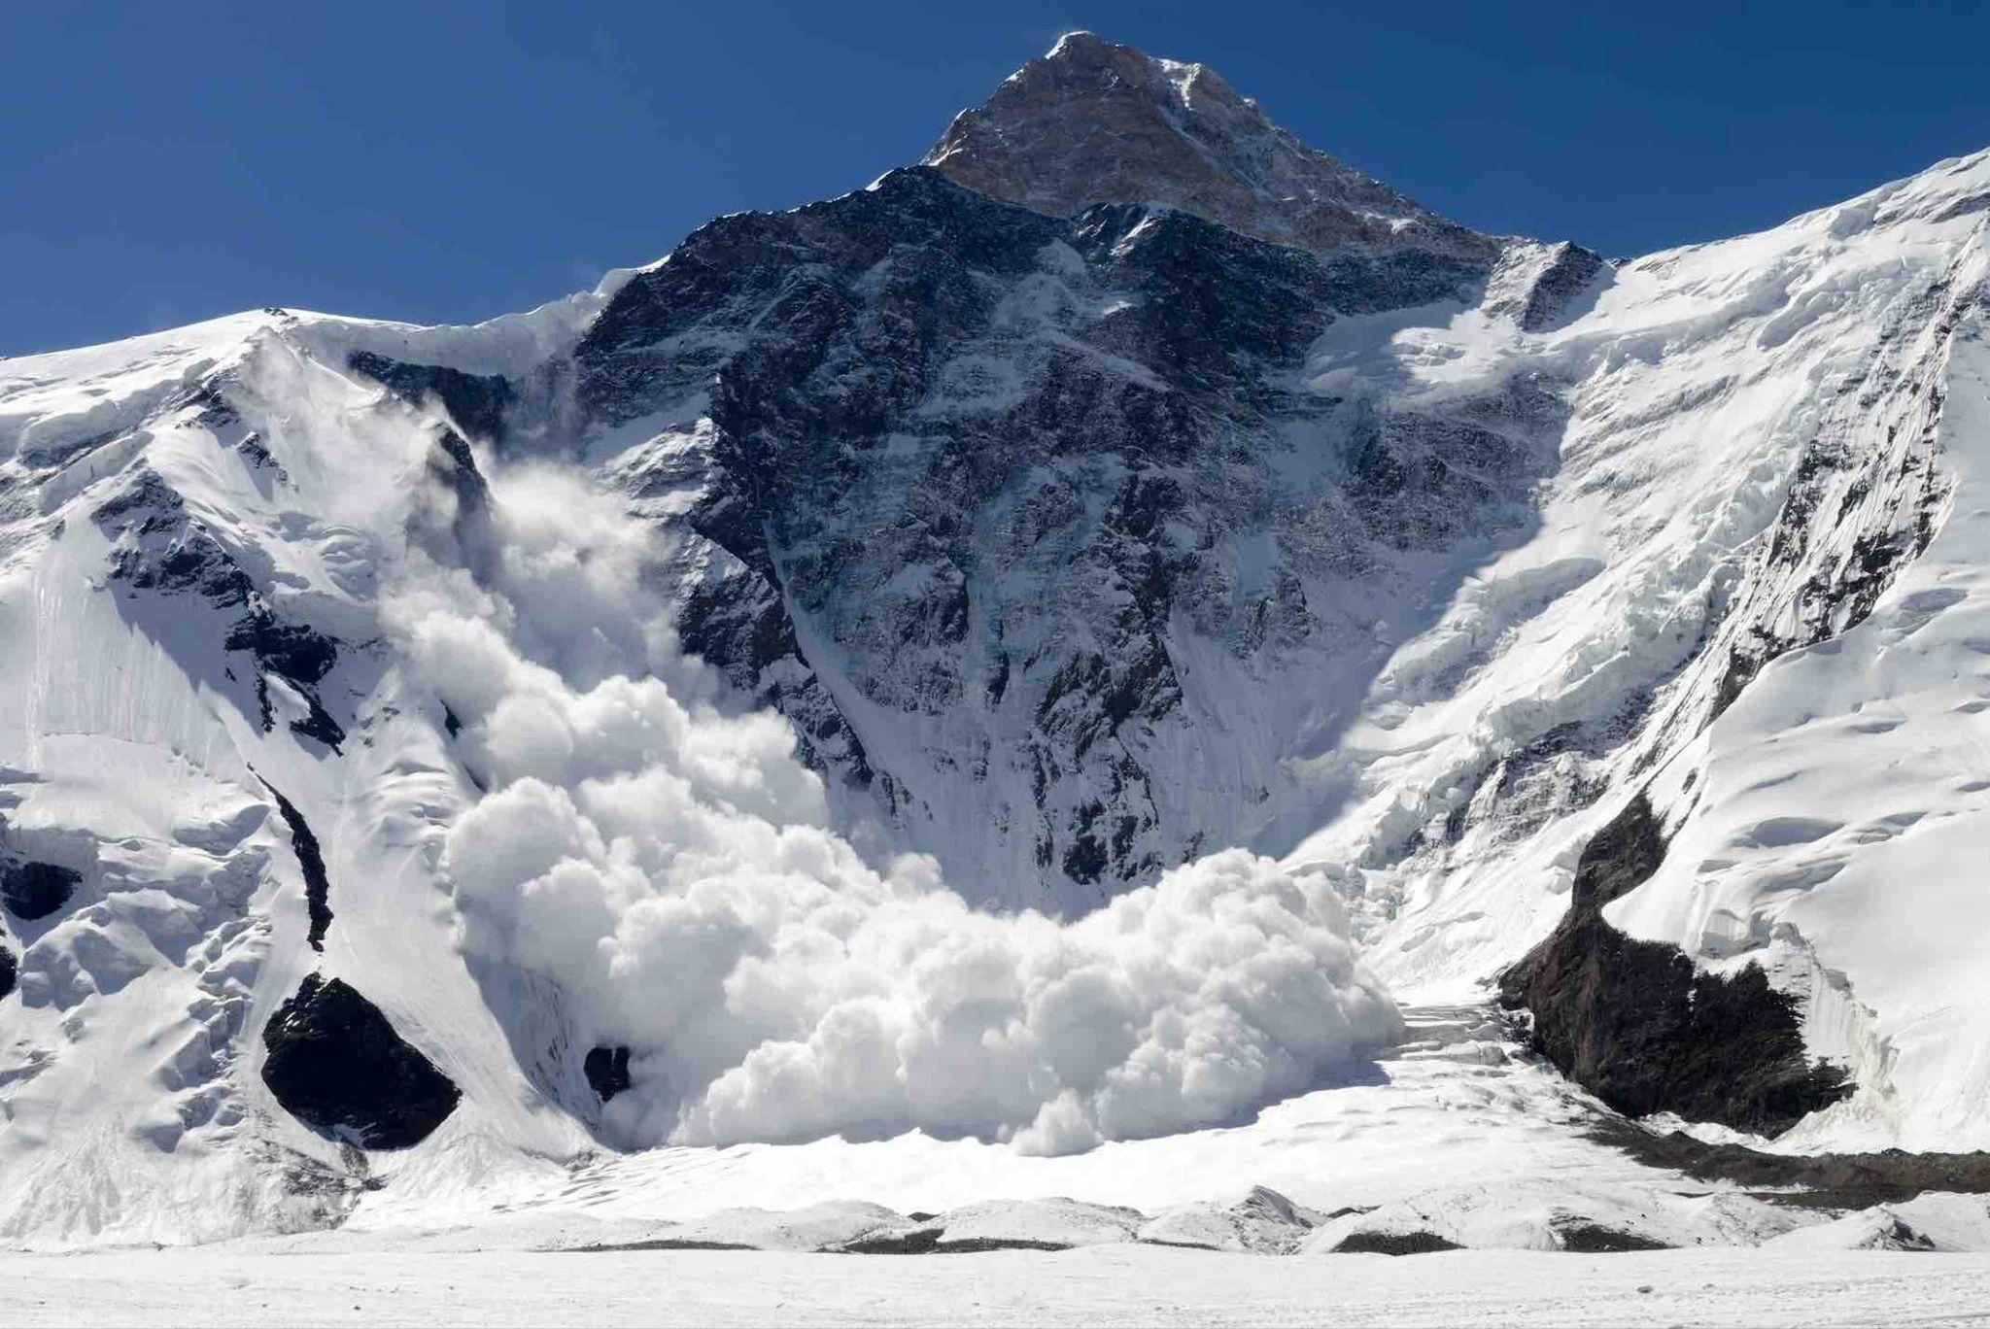
An avalanche is not an example of an earthquake. Avalanches are sudden flows of snow down a slope and can be mistaken for earthquakes in mountainous areas but are not related to movements of the Earth's crust.
Notes:
An avalanche is not an example of an earthquake. Avalanches are sudden flows of snow down a slope and can be mistaken for earthquakes in mountainous areas but are not related to movements of the Earth's crust.

Slide 37
Notes:
Now let’s pause for a moment to check your understanding.

Slide 38
Why are landslides and avalanches not examples of earthquakes?
Notes:
Why are landslides and avalanches not examples of earthquakes?
[Landslides and avalanches involve movement of land or snow down a slope, whereas earthquakes result from tectonic plates moving against each other.]

Slide 39
Remember!!!
Notes:
So remember!

Slide 40
Earthquake: Sudden shaking of the ground caused by the movement of Earth's tectonic plates
Notes:
An earthquake is sudden shaking of the ground caused by the movement of Earth’s tectonic plates.

Slide 41
Notes:
We will now complete this concept map, called a Frayer model, to summarize and further clarify what you have learned about the term earthquake.

Slide 42
Definition
Picture
Earthquake
Example
How do earthquakes impact my life?
Notes:
To complete the Frayer model, we will choose from four choices the correct picture, definition, example, and response to the question, “How do earthquakes impact my life?” Select the best response for each question using the information you just learned. As we select responses, we will see how this model looks filled in for the term earthquake.

Slide 43
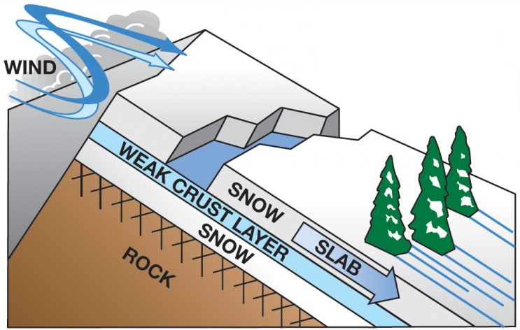
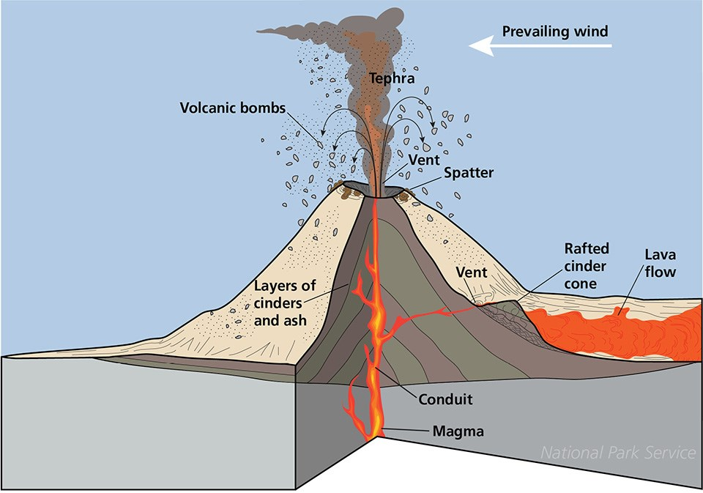
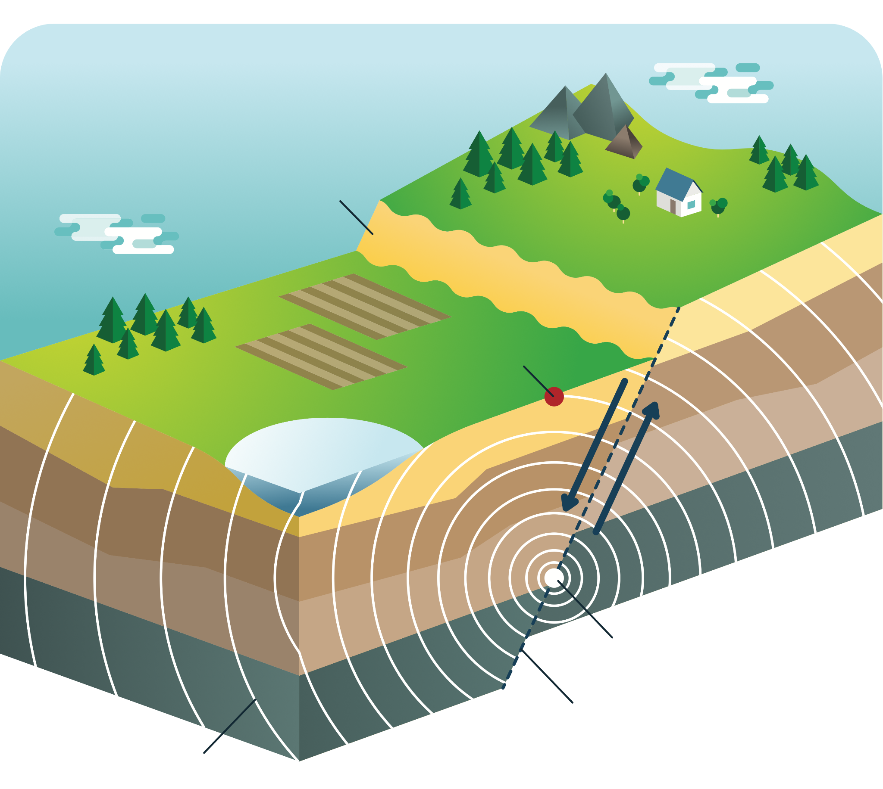
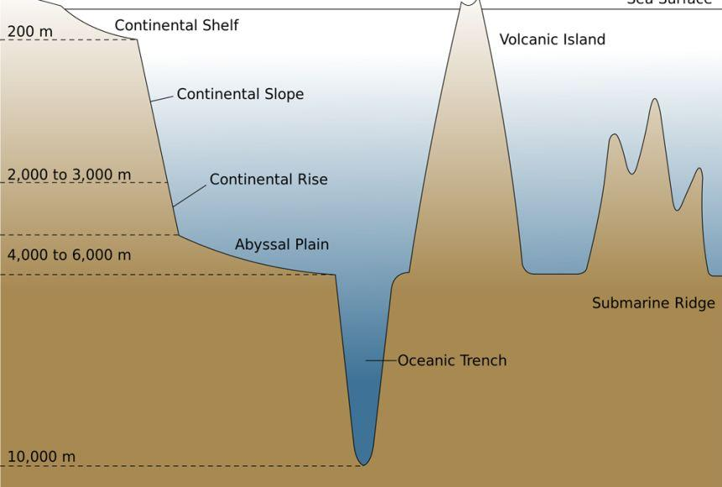
Directions: Choose the correct picture of an earthquake from the choices below.
A
B
C
D
Notes:
Choose the one correct picture of an earthquake from these four choices.

Slide 44
Directions: Choose the correct picture of an earthquake from the choices below.
A
B
C
D
Notes:
This is the picture that shows an earthquake.

Slide 45
Definition
Picture
Earthquake
Example
How do earthquakes impact my life?
Notes:
Here is the Frayer model filled in with a picture of an earthquake.

Slide 46
Directions: Choose the correct definition of an earthquake from the choices below.
A
A solid collection of minerals
B
The outermost shell of Earth
C
The process of breaking down a rock over a long period of time
D
Sudden shaking of the ground caused by the movement of the Earth’s tectonic plates
Notes:
Choose the one correct definition of an earthquake from these four choices.

Slide 47
Directions: Choose the correct definition of an earthquake from the choices below.
A
A solid collection of minerals
B
The outermost shell of Earth
C
The process of breaking down a rock over a long period of time
D
Sudden shaking of the ground caused by the movement of the Earth’s tectonic plates
Notes:
“Sudden shaking of the ground caused by the movement of the Earth’s tectonic plates” is correct! This is the definition of an earthquake.

Slide 48
Definition
Picture
Sudden shaking of the ground caused by the movement of the Earth’s tectonic plates
Earthquake
Example
How do earthquakes impact my life?
Notes:
Here is the Frayer Model with a picture and the definition filled in for an earthquake: Sudden shaking of the ground caused by the movement of the Earth’s tectonic plates.

Slide 49
Directions: Choose the correct example of an earthquake from the choices below.
A
Snow sliding down a plane
B
Shaking of the ground that tumbles buildings
C
Strong winds that tear down trees
D
Dirt and other land mass falling into the ocean off a cliff
Notes:
Choose the one correct example of an earthquake from these four choices.

Slide 50
Directions: Choose the correct example of an earthquake from the choices below.
A
Snow sliding down a plane
B
Shaking of the ground that tumbles buildings
C
Strong winds that tear down trees
D
Dirt and other land mass falling into the ocean off a cliff
Notes:
“Shaking of the ground that tumbles buildings” is correct! This is an example of an earthquake.

Slide 51
Definition
Picture
Sudden shaking of the ground caused by the movement of the Earth’s tectonic plates
Earthquake
Shaking of the ground that tumbles buildings
Example
How do earthquakes impact my life?
Notes:
Here is the Frayer Model with a picture, definition, and an example of an earthquake: Shaking of the ground that tumbles buildings.

Slide 52
Directions: Choose the correct response for “how do earthquakes impact my life?” from the choices below.
Earthquakes can shake buildings, break roads, and sometimes cause power outages, making it important for us to be prepared and know how to stay safe during these shakes.
A
B
Earthquakes explain how movement of animals on our planet impacts food and crops we have available to us.
C
Earthquakes account for the amount of land we have on our planet versus ocean, and tells us where to build habitats.
Earthquakes create different trenches and ranges in the ocean which influences weather patterns on Earth.
D
Notes:
Choose the one correct response for “how do earthquakes impact my life?” from these four choices.

Slide 53
Directions: Choose the correct response for “how do earthquakes impact my life?” from the choices below.
Earthquakes can shake buildings, break roads, and sometimes cause power outages, making it important for us to be prepared and know how to stay safe during these shakes.
A
B
Earthquakes explain how movement of animals on our planet impacts food and crops we have available to us.
C
Earthquakes account for the amount of land we have on our planet versus ocean, and tells us where to build habitats.
Earthquakes create different trenches and ranges in the ocean which influences weather patterns on Earth.
D
Notes:
“Earthquakes can shake buildings, break roads, and sometimes cause power outages, making it important for us to be prepared and know how to stay safe during these shakes.” That is correct! This is an example of how earthquakes impacts your life.

Slide 54
Definition
Picture
Sudden shaking of the ground caused by the movement of the Earth’s tectonic plates
Earthquake
Shaking of the ground that tumbles buildings
Earthquakes can shake buildings, break roads, and sometimes cause power outages, making it important for us to be prepared and know how to stay safe during these shakes.
Example
How do earthquakes impact my life?
Notes:
Here is the Frayer Model with a picture, definition, example, and a correct response to “how do earthquakes impact my life?”: Earthquakes can shake buildings, break roads, and sometimes cause power outages, making it important for us to be prepared and know how to stay safe during these shakes.

Slide 55
Remember!!!
Notes:
So remember!

Slide 56
Earthquake: Sudden shaking of the ground caused by the movement of Earth's tectonic plates
Notes:
An earthquake is sudden shaking of the ground caused by the movement of Earth’s tectonic plates.

Slide 57
Big Question: How do earthquakes show us how different parts of the Earth move and interact with each other?
Notes:
Let’s reflect once more on our big question. Our “big question” is: How do earthquakes show us the how different parts of the Earth move and interact with each other?
Does anyone have any additional examples to share that haven’t been discussed yet?

Slide 58
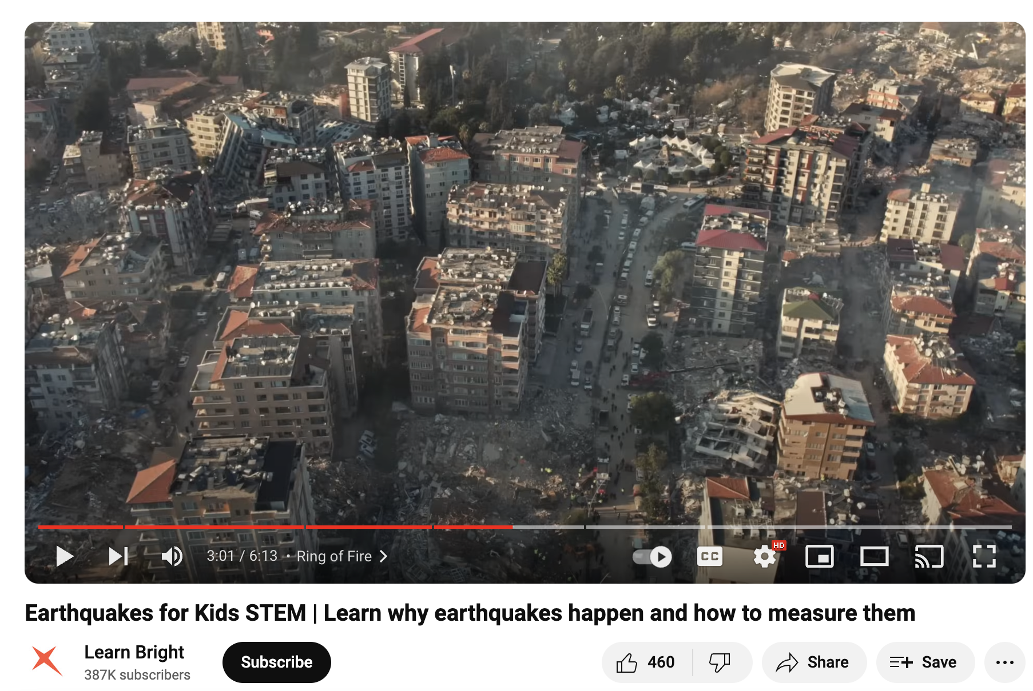
Demonstration
As you watch this video, answer the following questions:
How do earthquakes happen?
What is seismic activity and how is it measured?
After the video, repeat the seismic activity demonstration at the end of the video for the class and have students share their reflections.
Notes:
Have students watch the video (link: https://www.youtube.com/watch?v=jlLpZ9S2slQ ) and answer the questions on the slide, then repeat the demonstration.

Slide 59
Simulation Activity
Earthquake Simulator
Click the link above for a simulation to deepen your knowledge of earthquakes.
Notes:
Click the link above for a simulation to deepen your understanding of earthquakes. In this simulation, you will adjust the length, depth, offset, and rigidity values to estimate the magnitude of the earthquake.

Slide 60
Notes:
Thanks for watching, and please continue watching CAPs available from this website.

Slide 61
This Was Created With Resources From:
Questions or Comments
Michael Kennedy, Ph.D. MKennedy@Virginia.edu
Rachel L Kunemund, Ph.D. rk8vm@virginia.edu

