Slide 1
“Big Idea” Question
Teacher Demo
Review Concepts
Check-In Questions
Vocabulary
Student-Friendly Definition
Examples & Non-Examples
Morphological Word Parts
Simulation/Activity
Notes:
OK everyone, get ready for our next lesson. Just as a reminder, these are the different components that our lesson may include, and you’ll see these icons in the top left corner of each slide so that you can follow along more easily!

Slide 2
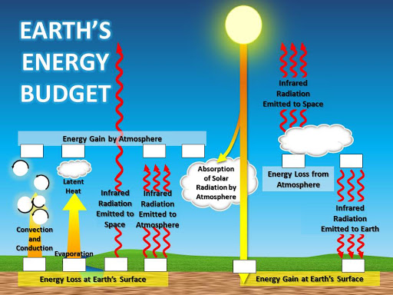
Intro
Energy Budget
Notes:
Today we are going to learn about Earth’s energy budget.

Slide 3
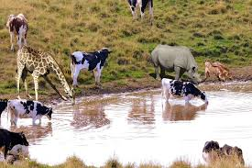
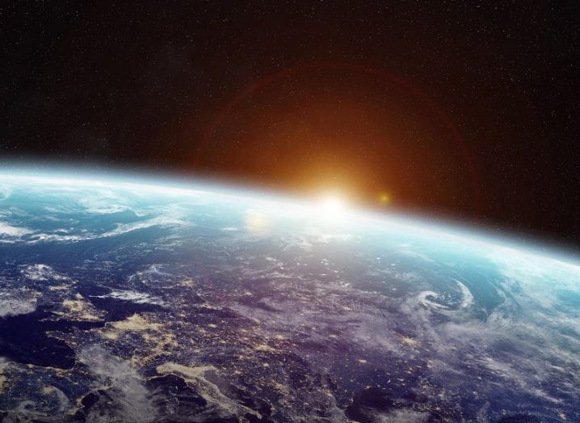
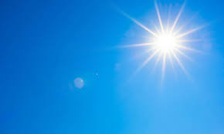
Big Question: How does the earth’s energy budget relate to both living systems and earth’s processes?
Notes:
Our Big Question is: How does the earth’s energy budget relate to both living systems and earth’s processes?
[Pause and illicit predictions from students.]
I love all these thoughtful scientific hypotheses! Be sure to keep this question and your predictions in mind as we move through these next few lessons, and we’ll continue to revisit it.
Feedback: Asking students to make predictions about how the earth’s energy budget relate to both living systems and the earth’s processes is a great way to activate and elicit student ideas and prior knowledge. This type of activity is evidence of the teacher planning for students’ engagement with science ideas.

Slide 4
Demonstration
Greenhouse Effect Experiment
Set up the materials for the demonstration ahead of class time. Perform the demonstration as shown in the video. Engage students in questioning as you perform the demonstration.
Notes:
Let’s do a quick demonstration that will help get our brains ready to think about radiation, and how it relates to our big question.
Feedback: This demonstration is a great way to introduce students to an experiment. In your classroom, you may encourage students to plan and conduct this experiment more independently since a large component of inquiry-based activities is encouraging student thinking and independence. As far as engaging students in questioning, beginning with open-ended questions, followed by providing explicit explanations, and then asking probing questions is a great way to engage students in a discussion while also providing clear explanations.

Slide 5
Notes:
Now, let’s pause for a moment to check your understanding.

Slide 6
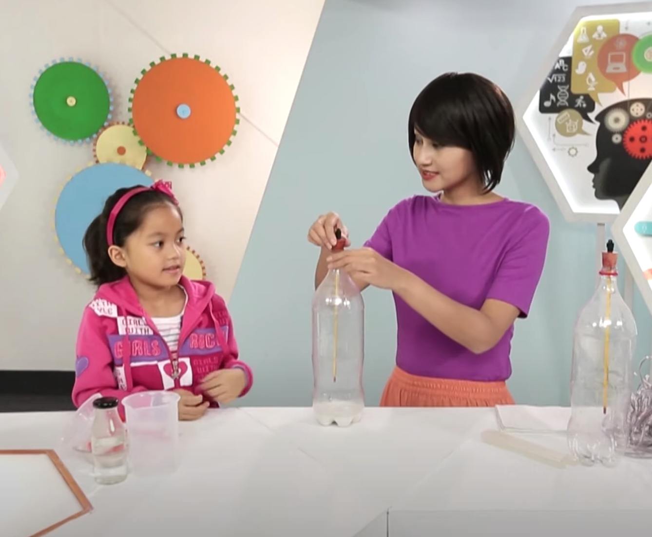
What gas is released when baking soda and vinegar react?
Notes:
What gas is released when baking soda and vinegar react?
[Carbon dioxide (CO2)]

Slide 7
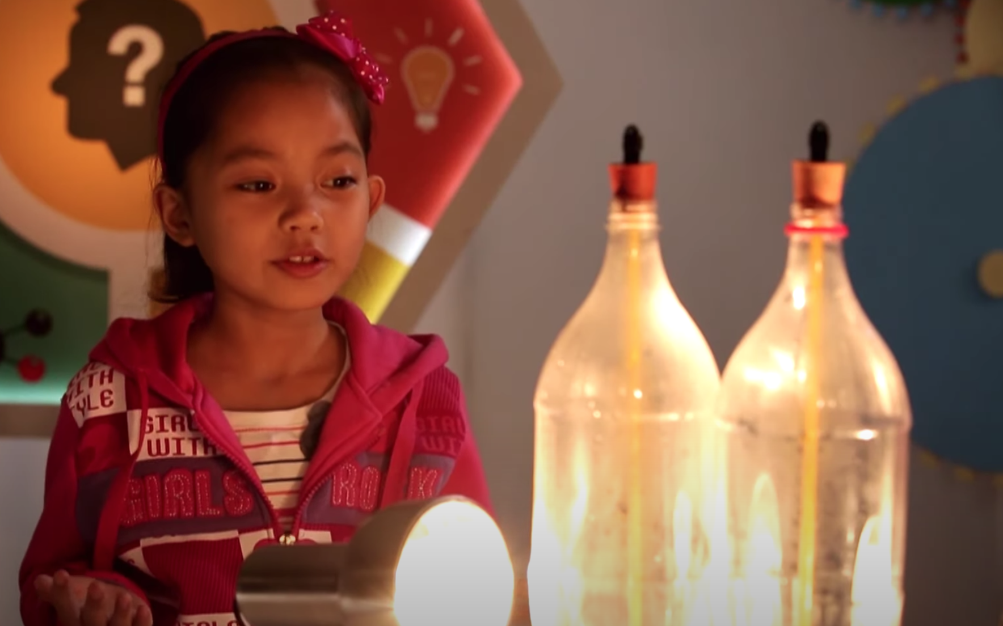
Why did we use sunlamps?
Notes:
Why did we use sunlamps?
[We used sunlight to heat up the bottles just like the sun heats up the Earth.]

Slide 8
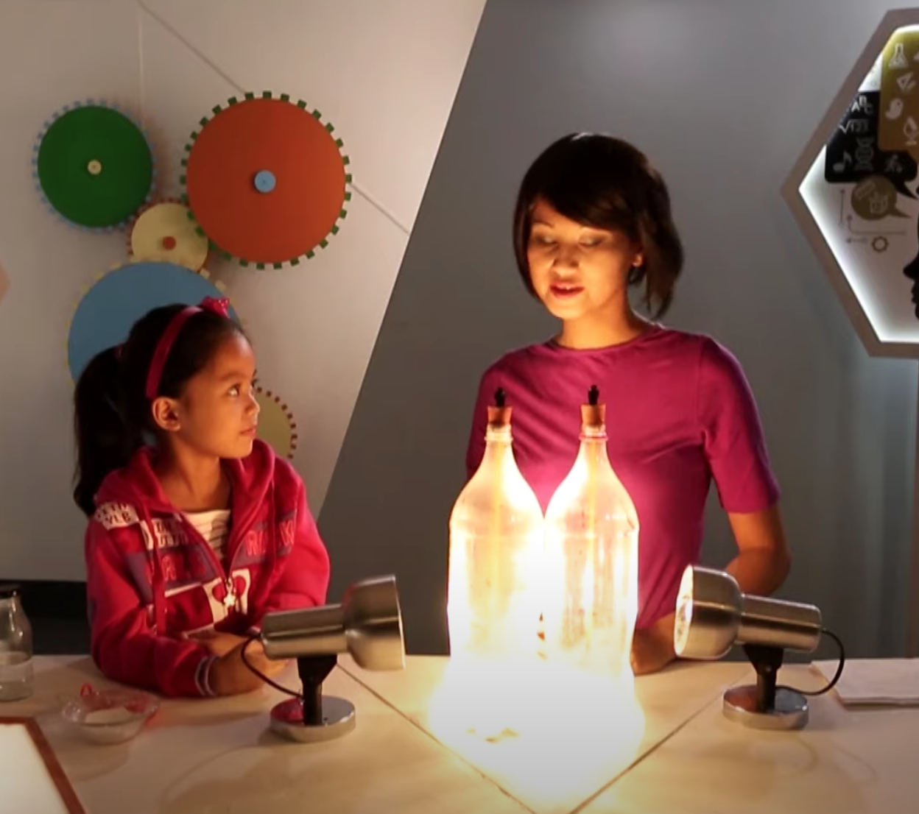
How did the temperature differ between the bottle with just air and the bottle with baking soda and vinegar?
Notes:
How did the temperature differ between the bottle with just air and the bottle with baking soda and vinegar?
[The temperature in the bottle with baking soda and vinegar was higher than the temperature in the bottle with just air.]
Feedback: These visuals are important to help students make connections between the experiment and the terms.

Slide 9
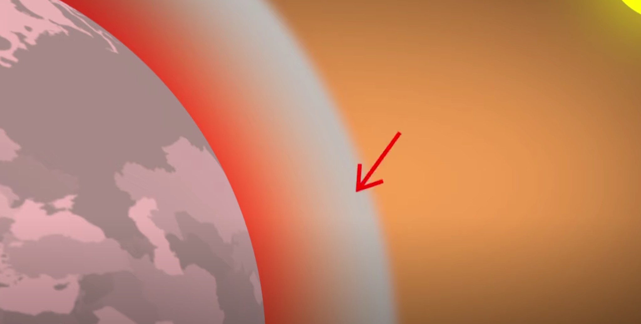
The greenhouse gases trap the _____ of the _____.
Notes:
The greenhouse gases trap the _____ of the _____.

Slide 10
The greenhouse gases trap the heat of the sun.
Notes:
The greenhouse gases trap the heat of the sun.

Slide 11
Notes:
Before we move on to our new vocabulary term, let’s review some other words & concepts that you already learned and make sure you are firm in your understanding.

Slide 12
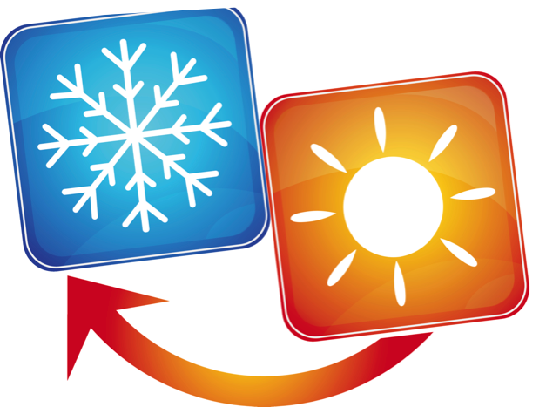
Notes:
Energy can be transferred from one object to another. When a thermal, or heat transfer occurs, heat moves from the warmer object to the colder object.

Slide 13
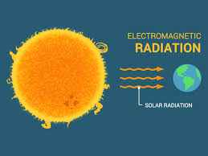
Radiation travels in waves.
Notes:
Radiation travels in waves.

Slide 14
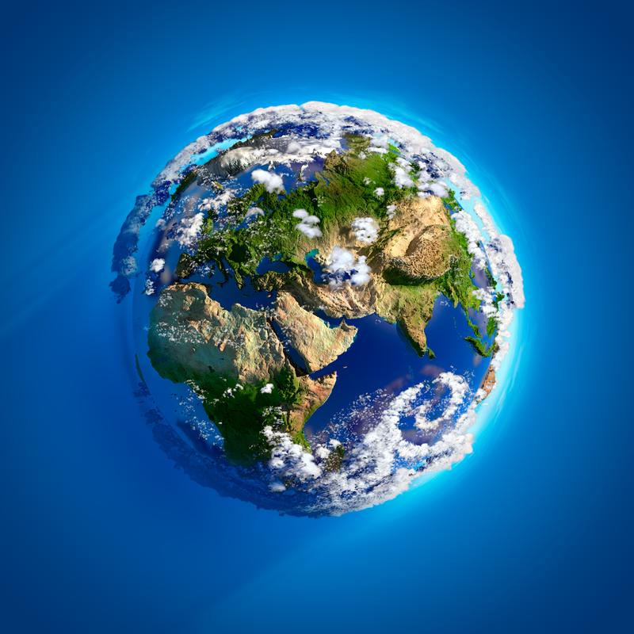
Atmosphere: the layers of gas, that have distinct characteristics, surrounding the earth’s surface
Notes:
The atmosphere is the layers of gas, that have distinct characteristics, surrounding the earth’s surface. Sometimes the atmosphere is called a “blanket” of gases.

Slide 15
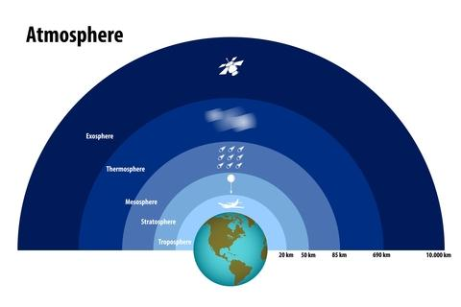
Notes:
Earth’s atmosphere has multiple layers.

Slide 16
Notes:
Now, let’s pause for a moment to check your understanding.

Slide 17
What occurs when heat moves from the warmer object to the colder one?
Notes:
What occurs when heat moves from the warmer object to a colder one?
[When a thermal, or heat transfer occurs, heat moves from the warmer object to the colder object.]

Slide 18
How does radiation travel?
Notes:
How does radiation travel?
[Radiation travels in waves.]

Slide 19
What is the atmosphere made up of?
Notes:
What is the atmosphere made up of?
[Earth’s atmosphere is made up of several different gases.]

Slide 20
Energy Budget
Notes:
Now that we’ve reviewed, let’s define our new term, energy budget.
Feedback: Telling students what is coming, either with images or words, helps them know what to expect.

Slide 21
Energy budget: the balance between the energy the earth gets from the sun and how much energy the earth then radiates back into space
Notes:
Energy budget is the balance between the energy the earth gets from the sun and how much energy the earth then radiates back into space.

Slide 22
Notes:
Now, let’s pause for a moment to check your understanding.

Slide 23
What is the energy budget?
Notes:
What is the energy budget?
[The Earth’s energy budget is the balance between the energy the earth gets from the sun and how much energy the earth radiates back into space.]

Slide 24
Notes:
That is the basic definition, but there is a bit more you need to know.

Slide 25
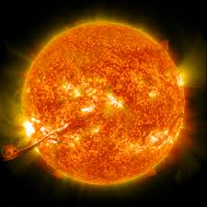
Notes:
Energy budget includes the solar energy entering and exiting the earth’s atmosphere.

Slide 26
Notes:
Earth’s atmosphere tries to keep a balance of energy but when that balance becomes off due to environment events or human action (such as pollution on earth) that budget becomes unbalanced and leads to things like …..(next slide)

Slide 27
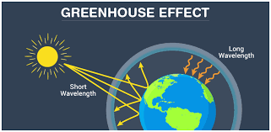
Notes:
Excess gas in the earth’s atmosphere such as carbon dioxide can impact the earth's energy and lead to the greenhouse effect.

Slide 28
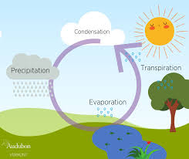
Notes:
The energy budget influences how much energy reaches the earth and then how much water is evaporated - effecting how much precipitation or rain we then get.

Slide 29
Notes:
Let’s review the definition of energy budget.

Slide 30
Energy budget: the balance between the energy the earth gets from the _______ and how much energy the earth then _______ ______ into space.
Notes:
Energy budget: the balance between the energy the earth gets from the _______ and how much energy the earth then _______ ______ into space.

Slide 31
Energy budget: the balance between the energy the earth gets from the sun and how much energy the earth then radiates back into space.
Notes:
Energy budget: the balance between the energy the earth gets from the sun and how much energy the earth then radiates back into space.
is the transfer of energy as waves.

Slide 32
Why does the energy budget need to stay balanced?
Notes:
Why does the energy budget need to stay balanced?
[Unbalanced energy budgets can impact the amount of rain we have, impact the greenhouse effect.]

Slide 33
Notes:
Now, let’s talk about an example of the earth’s energy budget.

Slide 34
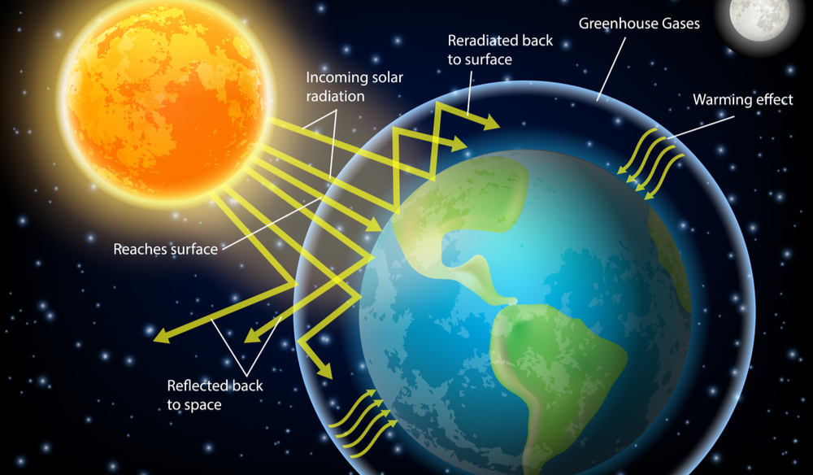
Notes:
Here is an example of the earth’s energy budget - the radiant energy is entering the earth’s atmosphere from the sun and some of it reaches the earth. You can see where the greenhouse gasses are in the atmosphere-trapping the radiant energy and creating a warming effect.
Feedback: Visuals, while helpful to give students multiple entry ways to understanding, can be overwhelming. Offer students opportunities to ask questions and break down the visual.

Slide 35
Notes:
Now, let’s talk about a non-example of the earth’s energy budget.

Slide 36
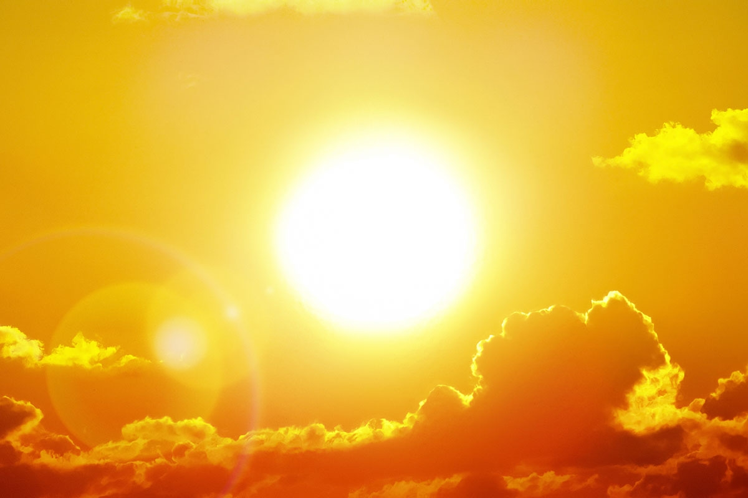
Notes:
The sun by itself is not an example of the earth’s energy budget. Earth’s energy budget involves the balance of energy between the energy from the sun and the energy from earth radiated back into space. Therefore, the energy from the earth and sun are both important for the earth’s energy budget.
Feedback: Offering non-examples and explaining how they fit into the larger picture of the concepts is important.

Slide 37
Notes:
Let’s check-in for understanding.

Slide 38
Explain what is happening here in this diagram of the earth’s energy budget.
Notes:
Explain what is happening here in this diagram of the earth’s energy budget.
[Here is the earth’s energy budget - the radiant energy is entering the earth’s atmosphere from the sun and some of it reaches the earth. You can see where the greenhouse gasses are in the atmosphere-trapping the radiant energy and creating a warming effect.]

Slide 39
What is the energy budget? How might it impact you on a daily basis?
Notes:
What is the energy budget? How might it impact you on a daily basis?
[Energy budget is the balance between the energy the earth gets from the sun and how much energy the earth then radiates back into space.]

Slide 40
Why does the energy budget need to stay balanced?
Notes:
Why does the energy budget need to stay balanced?
[Unbalanced energy budgets can impact the amount of rain we have, impact the greenhouse effect.]

Slide 41
Remember!!!
Notes:
So remember!

Slide 42
Energy budget: the balance between the energy the earth gets from the sun and how much energy the earth then radiates back into space
Notes:
Energy budget is the balance between the energy the earth gets from the sun and how much energy the earth then radiates back into space.

Slide 43
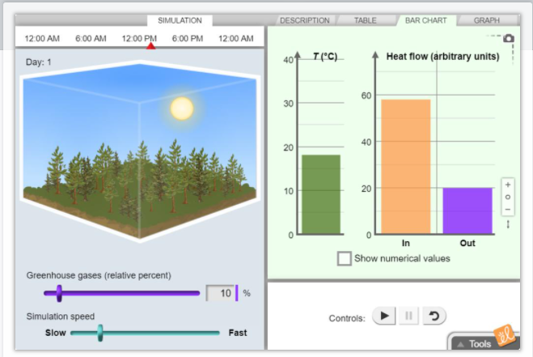
Simulation Activity
Greenhouse simulation
Within this simulated region of land, daytime's rising temperature and the falling temperature at night can be measured, along with heat flow in and out of the system. The amount of greenhouse gases present in the atmosphere can be adjusted through time, and the long-term effects can be investigated.
Notes:
Feedback: Providing a simulation activity is a great way to make science thinking visible. In this simulation, students have the opportunity to make predictions and apply an idea to a new situation by changing the variables in the simulation (i.e., greenhouse gases, speed).

Slide 44
Big Question: How does the earth’s energy budget relate to both living systems and earth’s processes?
Notes:
Explicit cue to revisit the big question at the end of the lesson: Okay everyone. Now that we’ve learned the term, let’s reflect once more on our big question. Was there anything that we predicted earlier that was correct or incorrect? Do you have any new hypotheses to share?

Slide 45
Notes:
Thanks for watching, and please continue watching CAPs available from this website.

Slide 46
This Video Was Created With Resources From:
Questions or Comments
Michael Kennedy, Ph.D. MKennedy@Virginia.edu
Rachel L Kunemund, Ph.D. rk8vm@virginia.edu

