Slide 1
Intro
“Big Idea” Question
Review Concepts
Check-In Questions
Teacher Demo
Vocabulary
Student-Friendly Definition
Examples & Non-Examples
Morphological Word Parts
Simulation/Activity
Notes:
OK everyone, get ready for our next lesson. Just as a reminder, these are the different components that our lesson may include, and you’ll see these icons in the top left corner of each slide so that you can follow along more easily!

Slide 2
Intro
Earth’s Energy Resources
Notes:
Today we will learn about Earth’s energy resources.

Slide 3
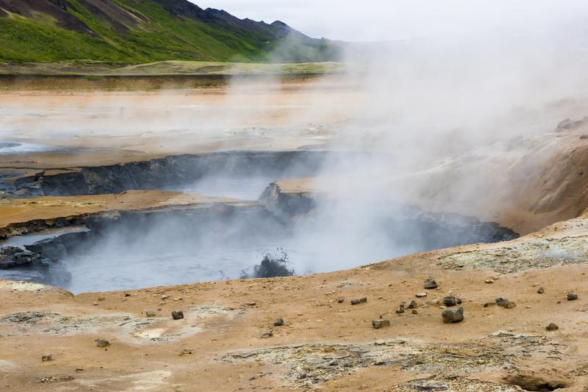
Intro
Geothermal Energy
Notes:
We will also learn about geothermal energy.

Slide 4
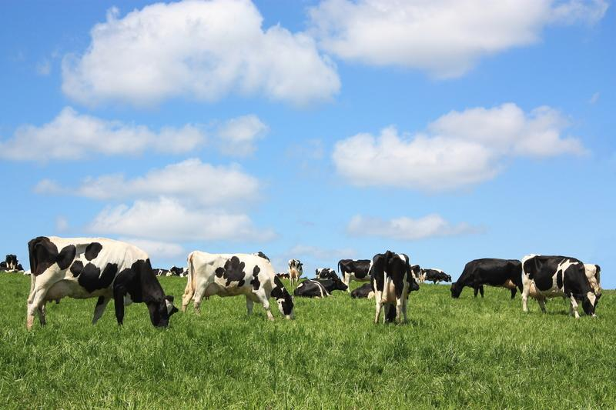
Big Question: Compare and contrast two types of Earth’s energy resources and explain why knowing how to determine efficiency is important.
Efficiency = Actual/Expected x 100%
Notes:
Our “big question” is: Compare and contrast two types of Earth’s energy resources and explain why knowing how to determine efficiency is important. [Pause and illicit predictions from students.]
I love all these thoughtful scientific hypotheses! Be sure to keep this question and your predictions in mind as we move through these next few lessons, and we’ll continue to revisit it.

Slide 5
Demonstration
How does Geothermal Energy Work?
TEACHER DIRECTIONS:
Before viewing: Ask students what they already know about natural resources and energy. Tell students today they will be learning about two of Earth’s energy resources. First, they will be looking at geothermal energy.
During: As students are watching the short video be sure to pause it and ask questions to check for understanding.
After: Tell students that today they will be learning more about geothermal energy.
Notes:
Let’s do a quick demonstration that will help get our brains ready to think about Earth’s energy resources and how it relates to our big question.
Feedback: It is important to provide the demonstration with a logical sequence of events, this helps students follow along and make connections.

Slide 6
Notes:
Now, let’s pause for a moment to check your understanding.
Feedback: By providing a lot of opportunities to respond throughout demonstration you help ensure that your students are grasping this new content.

Slide 7
What is the earth’s crust made up of?
Notes:
What is the earth’s crust made up of?
[Water and rock]

Slide 8
What is below the Earth’s crust?
Notes:
What is below the Earth’s crust?
[Hot molten rock called magma.]

Slide 9
Which has more energy: geothermal energy or energy from natural gas?
Notes:
Which has more energy: geothermal energy or energy from natural gas?
[Geothermal energy]

Slide 10
What are 3 reasons why geothermal energy is good to use?
Notes:
What are 3 reasons why geothermal energy is good to use?
[Pollution free
Renewable
Consistently reliable]

Slide 11
Notes:
Before we move on to our new vocabulary term, let’s review some other words & concepts that you already learned and make sure you are firm in your understanding.
Feedback: It is important for students to review content from previous lessons that may be important to understanding this new content.

Slide 12
Natural Resource: found in nature
Notes:
A natural resource is anything found in nature.

Slide 13
Natural resources --> used by humans
Notes:
…and used by humans.

Slide 14
Natural Resources
Renewable
Nonrenewable
Notes:
There are two types of natural resources, renewable and nonrenewable.

Slide 15
Natural Resources
Renewable
Nonrenewable
Notes:
Nonrenewable resources cannot be replaced quickly. They take millions of years to be replaced. Some of them cannot be replaced at all!

Slide 16
Natural Resources
Renewable
Nonrenewable
Notes:
Renewable resources can be replaced quickly.

Slide 17
Notes:
Now, let’s pause for a moment to check your understanding.
Feedback: Monitoring understanding during review is an important step before moving on to new material.

Slide 18
What are natural resources?
Notes:
What are natural resources?
[A natural resource is anything found in nature and used by humans.]

Slide 19
Give an example of how we use natural resources.
Notes:
Give an example of how we use natural resources.

Slide 20
What are the two types of natural resources?
Natural Resources
?
?
Notes:
What are the two types of natural resources?
[there are two types of natural resources, renewable and nonrenewable.]

Slide 21
Can nonrenewable resources be replaced quickly? Explain your answer.
Natural Resources
Renewable
Nonrenewable
Notes:
Can non renewable resources be replaced quickly? Explain your answer.
[Nonrenewable resources cannot be replaced quickly. They take millions of years to be replaced. Some of them cannot be replaced at all!]

Slide 22
True/False: Renewable resources can’t be replaced quickly.
Natural Resources
Renewable
Nonrenewable
Notes:
True/False: Renewable resources can’t be replaced quickly.

Slide 23
True/False: Renewable resources can’t be replaced quickly.
Natural Resources
Renewable
Nonrenewable
Notes:
True/False: Renewable resources can’t be replaced quickly.
[False: Renewable resources can be replaced quickly.]

Slide 24
Earth’s Energy Resources
Notes:
Now that we’ve reviewed, let’s define our new term, Earth’s energy resources.

Slide 25
Earth’s Energy Resources
Notes:
Earth’s energy resources come from the earth.

Slide 26
Earth’s Energy Resources
Notes:
Resources are sources of wealth such as land, water, and forests. Today, we will be learning about different types of Earth’s energy resources.
Feedback: I liked how you took the time to break the definition down and explicitly explain each part to help the students understand the whole definition.

Slide 27
Notes:
Now, let’s pause for a moment to check your understanding.

Slide 28
Where do Earth’s energy resources come from?
Notes:
Where do Earth’s energy resources come from?
[Earth’s energy resources come from the earth.]

Slide 29
What are resources?
Notes:
What are resources?
[Resources are sources of wealth such as land, water, and forests.]

Slide 30
Geothermal Energy
Notes:
Now that we know what we mean by Earth’s energy resources, let’s talk about one type of earth’s energy resources: geothermal energy.

Slide 31
Geothermal Energy: heat from inside the Earth
Notes:
Geothermal energy is heat from inside the Earth.
Feedback: Using clear language can take make formal more complicated definitions a little easier for students to understand.

Slide 32
Notes:
Now, let’s pause for a moment to check your understanding.

Slide 33
What is geothermal energy?
Notes:
What is geothermal energy?
[Geothermal energy is heat from inside the earth.]

Slide 34
Notes:
That is the basic definition, but there is a bit more you need to know.

Slide 35
Renewable
Notes:
Geothermal energy is a renewable resource.
Feedback: When making connections with other contents you used simple and clear language that made it easy for students to understand.

Slide 36
Notes:
Now, let’s pause for a moment to check your understanding.

Slide 37
What is geothermal energy?
Notes:
What is geothermal energy?
Geothermal energy is heat from inside the Earth.

Slide 38
True/False: Geothermal energy is a nonrenewable resource.
Notes:
True/False: Geothermal energy is a nonrenewable resource.

Slide 39
True/False: Geothermal energy is a nonrenewable resource.
Notes:
True/False: Geothermal energy is a nonrenewable resource.
False: It is a renewable resource because it can be easily replenished.

Slide 40
Notes:
Now, let’s look at an example of geothermal energy.
Feedback: Use clear and easy to understand language when introducing examples.

Slide 41
Hot Springs
Notes:
Hot springs are a type of geothermal energy. The water is heated from the earth’s core releasing heat. The earth’s core heats up the water creating hot pockets.

Slide 42
Notes:
Some homes can be heated by geothermal energy. In these homes a coil system is filled with water and buried in the yard. The water moves through the coil system and the earth naturally keeps the temperature stable.

Slide 43
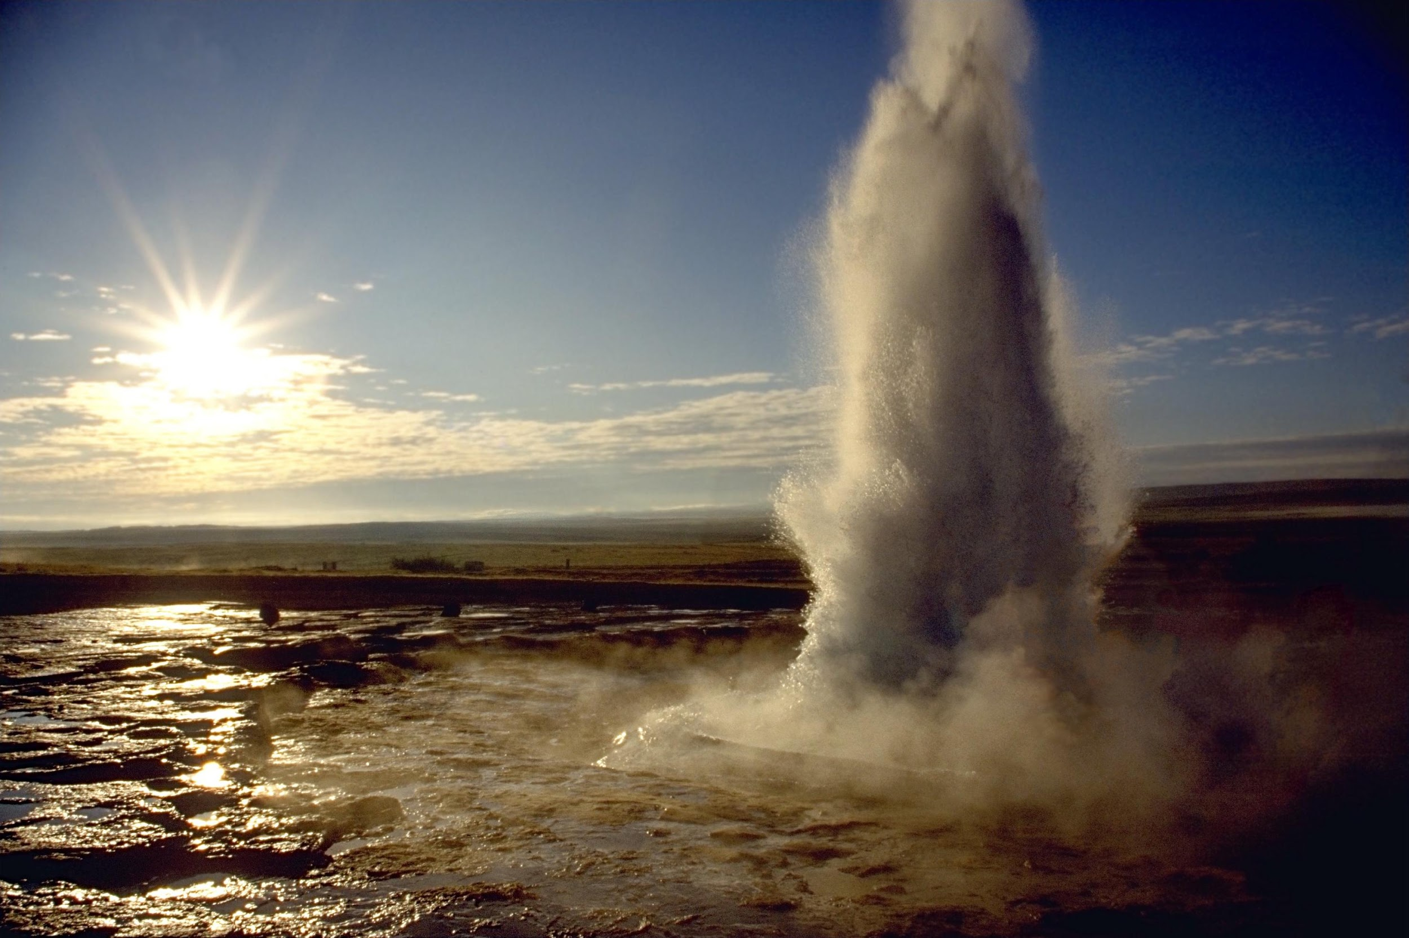
Geysers
Notes:
Geysers are a form of geothermal energy because the earth’s crust heats the water releasing heat. Geysers are similar to hot springs because it is the release of hot water from the earth’s crust, but the water is so hot that it is projected into the air in a long column of steam and water.

Slide 44
Notes:
Next, let’s talk about a non-example of geothermal energy.
Feedback: One important component of using non-examples is by clearly distinguishing similarities and explaining why it is a non-example.

Slide 45
Bathtub
Notes:
Your bathtub is not an example of geothermal energy. It does not use the Earth's energy to heat the water. Water is heated using unnatural sources---like electricity!
Feedback: You did such a great job using clear language as you introduced the non-example which made it easier for student to make sense of the difference.

Slide 46
Notes:
Now, let’s pause for a moment to check your understanding.

Slide 47
Why are hot springs an example of geothermal energy?
Notes:
Why are hot springs an example of geothermal energy?
[Hot springs are a type of geothermal energy. The water is heated from the Earth’s core releasing heat. The earth’s core heats up the water creating hot pockets.]

Slide 48
Is running hot water in your bathtub an example of geothermal energy? Explain.
Notes:
Is running hot water in your bathtub an example of geothermal energy? Explain.
[Your bathtub is not an example of geothermal energy. It does not use the Earth’s energy to heat the water. Water is heated using an unnatural sources---like electricity!]

Slide 49
Give another example of geothermal energy that we talked about. Explain why it is geothermal energy.
Notes:
Give another example of geothermal energy that we talked about. Explain why it is geothermal energy.

Slide 50
Notes:
Let’s breakdown the words parts of geothermal to help us remember what geothermal energy is.
Feedback: Your use of morphological word parts is extremely beneficial for students, you took the time to break the word down and define each individual word part for students.

Slide 51
Geothermal
Geo
therm
al
Notes:
The word geothermal is made up of three parts: the roots geo and therm and the suffix al.

Slide 52
Geothermal
Geo
Relating to the earth
Notes:
Geo means relating to the earth.

Slide 53
Geothermal
Therm
Relating to heat
Notes:
Therm means relating to heat. So geothermal energy is energy from the earth from heat.

Slide 54
Geothermal
-al
Coming from
Notes:
The suffix –al means coming from.

Slide 55
Geo therm al
Coming
From
Energy that comes from the heat of the Earth
Notes:
So geothermal energy is energy that comes from the heat of the Earth.
Feedback: Reuniting the word parts is a crucial step in helping students understand the whole picture when reviewing morphological word parts.

Slide 56
Notes:
Now, let’s pause for a moment to check your understanding.

Slide 57
Geothermal
How can we use the word parts of geothermal to help us remember the definition of the term?
Geo
therm
al
Notes:
How can we use the word parts of geothermal to help us remember the definition of the term?
[Geo means relating to the earth.
Therm means relating to heat. So geothermal energy is energy from the earth from heat.
The suffix –al means coming from.
So geothermal energy is energy that comes from the heat of the Earth.]
Feedback: As you brake down the vocab term into parts it important to take a second and confirm student understanding before moving on.

Slide 58
True/False: Geothermal energy is a type of Earth’s energy resources.
Notes:
True/False: Geothermal energy is a type of Earth’s energy resources.

Slide 59
True/False: Geothermal energy is a type of Earth’s energy resources.
Notes:
True/False: Geothermal energy is a type of Earth’s energy resources.
[True. Geothermal energy is a type of Earth’s energy resources because it can be replenished and comes from the earth.]

Slide 60
What is geothermal energy?
Notes:
What is geothermal energy?
[Geothermal energy is heat from inside the Earth.]

Slide 61
What kind of energy heats this house?
Notes:
What kind of energy heats this house?
[Some homes can be heated by geothermal energy. In these homes a coil system is filled with water and buried in the yard. The water moves through the coil system and the earth naturally keeps the temperature stable.]

Slide 62
Are geysers a form of geothermal energy? Explain.
Notes:
Are geysers a form of geothermal energy? Explain.
[Geysers are a form of geothermal energy because the earth’s crust heats the water releasing heat. Geysers are similar to hot springs because it is the release of hot water from the earth’s crust, but the water is so hot that it is projected into the air in a long column of steam and water.]
Feedback: Confirming students' understanding with lots of opportunities to respond when closing a lesson is super important before asking them to try it on their own.

Slide 63
Remember!!!
Notes:
So remember!
Feedback: Always review content at the end of the lesson to help students better understand the purpose of the lesson.

Slide 64
Geothermal Energy: heat from inside the Earth
Notes:
Geothermal energy is heat from inside the Earth.

Slide 65
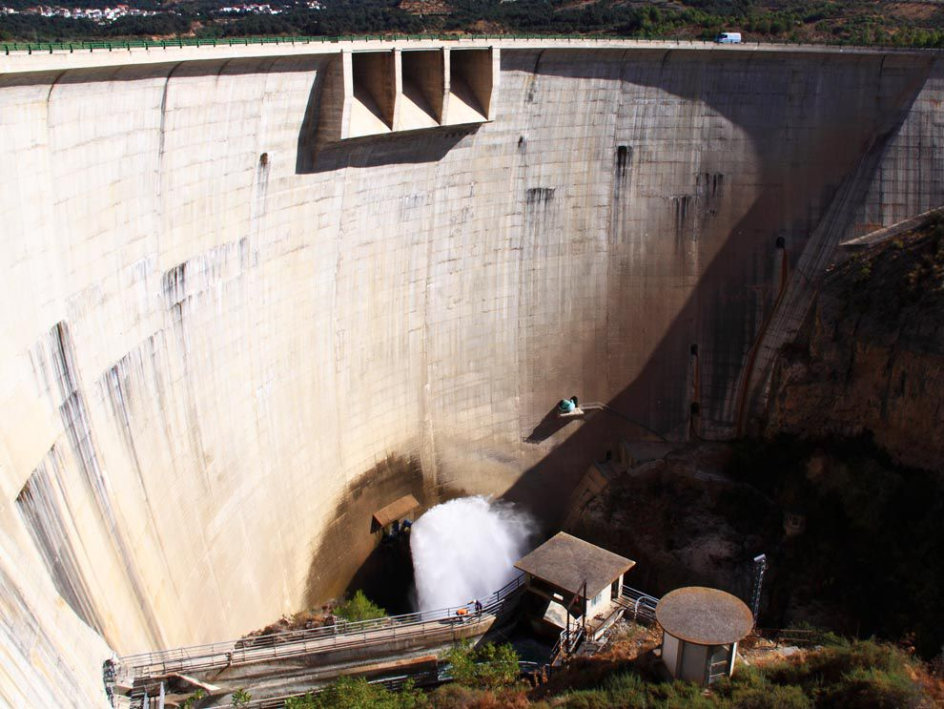
Simulation Activity
Hydroelectric and Geothermal: Benefits and Drawbacks
Students analyze the benefits and drawbacks of hydroelectric and geothermal energy and the environmental impacts on a specific geographic location. They create a multimedia presentation to share what they have learned.
Notes:
Students explore data from the Energy Information Administration (EIA) on electricity flows and electricity consumption in the United States. Using the data, students propose how electricity generation and use can be made more efficient.

Slide 66
Big Question: Compare and Contrast two types of Earth’s energy resources and explain why knowing how to determine efficiency is important.
Efficiency = Actual/ Expected x 100%
Notes:
Explicit cue to revisit the big question at the end of the lesson: Okay everyone. Now that we’ve learned the term, let’s reflect once more on our big question. Was there anything that we predicted earlier that was correct or incorrect? Do you have any new hypotheses to share?

Slide 67
Notes:
Thanks for watching, and please continue watching CAPs available from this website.

Slide 68
This Video Was Created With Resources From:
Questions or Comments
Michael Kennedy, Ph.D. MKennedy@Virginia.edu
Rachel L Kunemund, Ph.D. rk8vm@virginia.edu

Slide 69
Intro
“Big Idea” Question
Review Concepts
Check-In Questions
Teacher Demo
Vocabulary
Student-Friendly Definition
Examples & Non-Examples
Morphological Word Parts
Simulation/Activity
Notes:
OK everyone, get ready for our next lesson. Just as a reminder, these are the different components that our lesson may include, and you’ll see these icons in the top left corner of each slide so that you can follow along more easily!

Slide 70
Intro
Natural Gas
Notes:
Today we are going to learn about natural gas.

Slide 71
Big Question: Compare and Contrast two types of Earth’s energy resources and explain why knowing how to determine efficiency is important.
Efficiency = Actual/ Expected x 100%
Notes:
Our “big question” is: Compare and contrast two types of Earth’s energy resource and explain why knowing how to determine efficiency is important.
What are our current hypotheses? Today we are learning about natural gas. How do you think our hypotheses will change after learning about natural gas?

Slide 72
Demonstration
What is natural gas?
TEACHER DIRECTIONS:
Before viewing: Ask students what they already know about energy. Tell students today they will be learning about one of Earth’s energy resources, natural gas.
During: As students are watching the short video be sure to pause it and ask questions to check for understanding.
After: Tell students that today they will be learning more about natural gas.
Notes:
Let’s do a quick demonstration that will help get our brains ready to think about natural gas and how it relates to our big question.
Feedback: It is important to provide the demonstration with a logical sequence of events, this helps students follow along and make connections.

Slide 73
Notes:
Now, let’s pause for a moment to check your understanding.

Slide 74
Which carbon compound is natural gas primarily made up of?
Notes:
Which carbon compound is natural gas primarily made up of?
[Methane (CH4)]

Slide 75
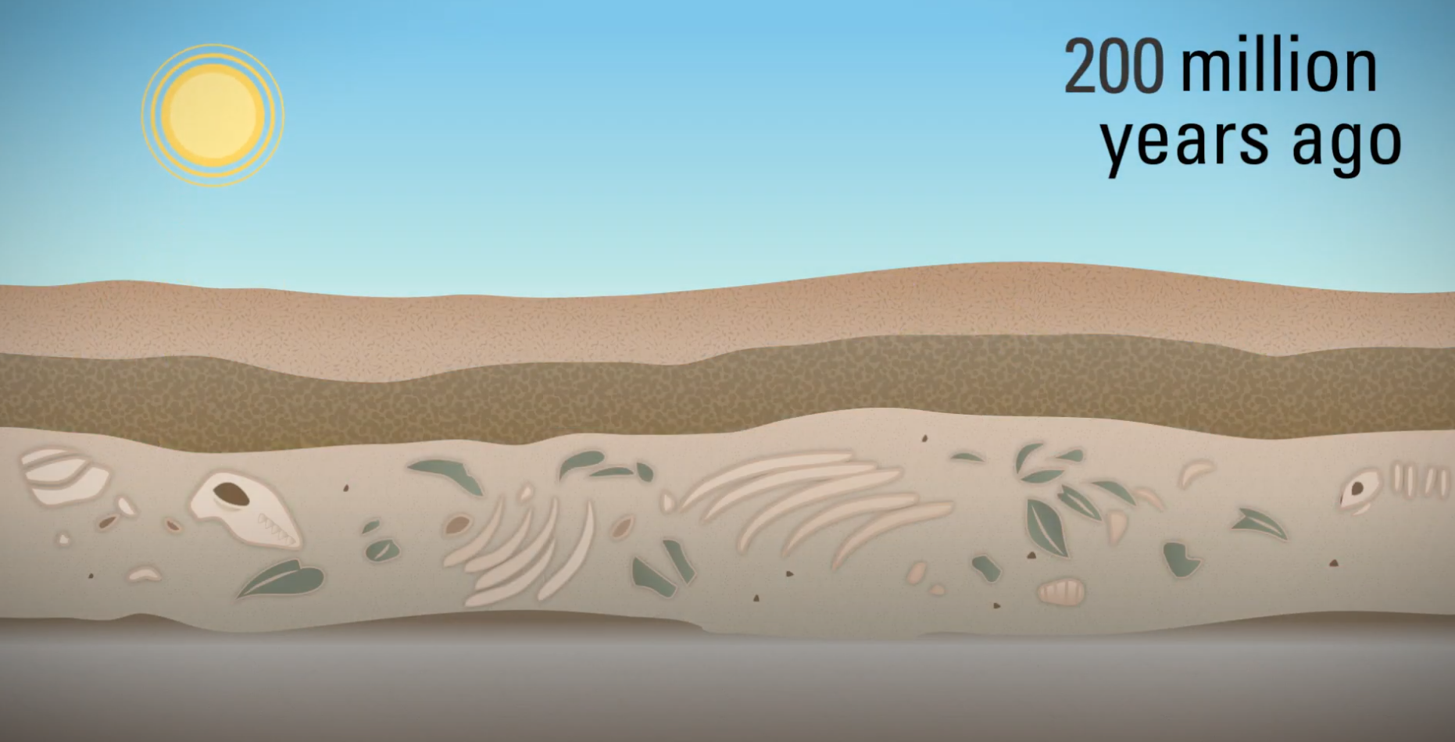
Natural gas is made from the _____ of dead organisms. Therefore it is called a _____ fuel.
Notes:
Natural gas is made from the _____ of dead organism. Therefores it is called a _____ fuel.

Slide 76
Natural gas is made from the fossils of dead organisms. Therefore it is called a fossil fuel.
Notes:
Natural gas is made from the fossils of dead organism. Therefores it is called a fossil fuel.

Slide 77
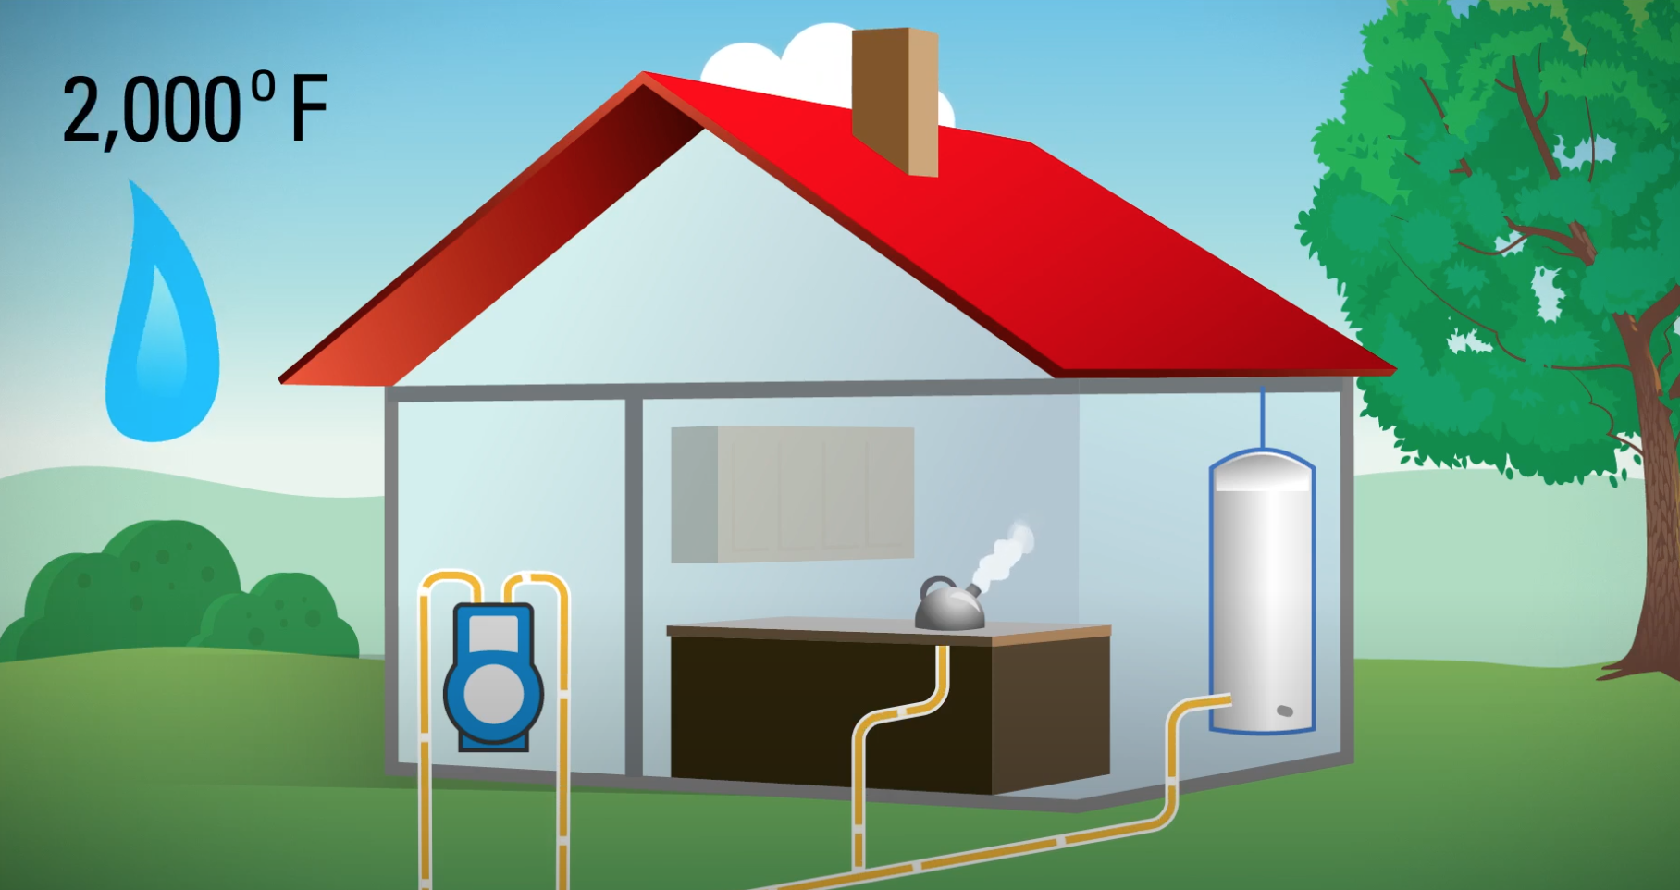
Natural gas is the _____ source for water heaters, furnaces, and stoves.
Notes:
Natural gas is the _____ source for water heaters, furnaces, and stoves.

Slide 78
Natural gas is the energy source for water heaters, furnaces, and stoves.
Notes:
Natural gas is the energy source for water heaters, furnaces, and stoves.

Slide 79
True/False: Natural gas produces less CO2 than coal or oil.
Notes:
True/False: Natural gas produces less CO2 than coal or oil.

Slide 80
True/False: Natural gas produces less CO2 than coal or oil.
Notes:
True/False: Natural gas produces less CO2 than coal or oil.
True.

Slide 81
Notes:
Before we move on to our new vocabulary term, let’s review some other words & concepts that you already learned and make sure you are firm in your understanding.
Feedback: It is important to review old terms that are relevant to make sure students are firm in their understanding of past content.

Slide 82
Natural Resource: found in nature
Notes:
A natural resource is anything found in nature

Slide 83
Natural resources --> used by humans
Notes:
…and used by humans.

Slide 84
Natural Resources
Renewable
Nonrenewable
Notes:
There are two types of natural resources, renewable and nonrenewable.

Slide 85
Natural Resources
Renewable
Nonrenewable
Notes:
Nonrenewable resources cannot be replaced quickly. They take millions of years to be replaced. Some of them cannot be replaced at all!

Slide 86
Natural Resources
Renewable
Nonrenewable
Notes:
Renewable resources can be replaced quickly.

Slide 87
Earth’s Energy Resources
Notes:
Earth’s energy resources come from the earth.

Slide 88
Earth’s Energy Resources
Notes:
Resources are sources of wealth such as land, water, and forests. Today, we will be learning about different types of Earth’s energy resources.

Slide 89
Geothermal Energy: heat from inside the Earth
Notes:
Geothermal energy is heat from inside the Earth.

Slide 90
Notes:
Now, let’s pause for a moment to check your understanding.

Slide 91
What are natural resources?
Notes:
What are natural resources?
[A natural resource is anything found in nature and used by humans.]

Slide 92
Give an example of how we use natural resources.
Notes:
Give an example of how we use natural resources.

Slide 93
What are the two types of natural resources?
Natural Resources
?
?
Notes:
What are the two types of natural resources?
[There are two types of natural resources, renewable and nonrenewable.]

Slide 94
Can nonrenewable resources be replaced quickly? Explain your answer.
Natural Resources
Renewable
Nonrenewable
Notes:
Can non renewable resources be replaced quickly? Explain your answer.
[Nonrenewable resources cannot be replaced quickly. They take millions of years to be replaced. Some of them cannot be replaced at all!]

Slide 95
True/False: Renewable resources can’t be replaced quickly.
Natural Resources
Renewable
Nonrenewable
Notes:
True/False: Renewable resources can’t be replaced quickly.

Slide 96
True/False: Renewable resources can’t be replaced quickly.
Natural Resources
Renewable
Nonrenewable
Notes:
True/False: Renewable resources can’t be replaced quickly.
[False: Renewable resources can be replaced quickly.]

Slide 97
Where do Earth’s energy resources come from?
Notes:
Where do Earth’s energy resources come from?
[Earth’s energy resources come from the Earth.]

Slide 98
What are resources?
Notes:
What are resources?
[Resources are sources of wealth such as land, water, and forests.]

Slide 99
_______ is heat from inside the Earth.
Notes:
______ is heat from inside the Earth.

Slide 100
Geothermal energy is heat from inside the Earth.
Notes:
Geothermal energy is heat from inside the Earth.

Slide 101
Natural Gas
Notes:
Now that we’ve reviewed, let’s learn about natural gas, which is another type of Earth’s energy resources.
Feedback: Use clear and simple language when introducing today's content, this helps students understand what is expected.

Slide 102
Natural Gas: gas made from fossils
Notes:
Natural gas is gas made from fossils.

Slide 103
Notes:
Now, let’s pause for a moment to check your understanding.

Slide 104
What is natural gas?
Notes:
What is natural gas?
[Natural gas is gas made from fossils.]

Slide 105
Notes:
That is the basic definition, but there is a bit more you need to know.

Slide 106
Ionic Bond
Geothermal Energy
Natural Gas
Metallic Bond
Notes:
Now let’s talk about how geothermal energy and natural gas are related. Let’s think about how these terms are similar and different.

Slide 107
Found in Nature
Geothermal
Energy
Natural
Gas
Notes:
They are both found in nature.

Slide 108
Found in Nature
Notes:
They are both found in nature, but they are not the same thing. There is a very important difference.

Slide 109
Clean
Doesn’t need
Fossil fuels
Found in Nature
Geothermal
Energy
Natural
Gas
Notes:
Geothermal energy is clean. This means it does not need fossil fuels to be produced. This is a safer bet that using natural gas!

Slide 110
Clean
Doesn’t need
Fossil fuels
Found in Nature
Geothermal
Energy
Natural
Gas
Notes:
Natural gas needs fossil fuels to be produced. This means it is NOT clean energy.
Feedback: Comparison charts are a great way to help students differentiate between two terms.

Slide 111
Notes:
Now let’s pause for a moment to check your understanding.

Slide 112
What is natural gas made from?
Notes:
What is natural gas made from?
[Natural gas is gas made from fossils.]

Slide 113
How are geothermal energy and natural gas similar?
Geothermal
Energy
Natural
Gas
Notes:
How are geothermal energy and natural gas similar?
[They are both found in nature.]

Slide 114
Notes:
Now, let’s look at an example of natural gas.
Feedback: When introducing examples, be sure to use clear and easy to understand language.

Slide 115
Methane
Notes:
Methane is part of natural gas. Gas stove tops use methane to cook with because the methane releases energy when you cook with it to heat your food, which is why it is considered one of Earth’s energy resources.

Slide 116
Notes:
Next, let’s talk about a non-example of natural gas.
Feedback: Use explicit and clear explanations for the non-example, this is a great way to help students make sense of the new content.

Slide 117
Notes:
This home is heated by geothermal energy. Remember geothermal energy comes from heat in the earth, so it is different than energy produced by natural gas.

Slide 118
Notes:
Now let’s pause for a moment to check your understanding.

Slide 119
True/False: Geothermal energy is the same as energy released from natural gas.
Notes:
True/False: Geothermal energy is the same as energy released from natural gas?

Slide 120
True/False: Geothermal energy is the same as energy released from natural gas.
Notes:
True/False: Geothermal energy is the same as energy released from natural gas?
[False: Geothermal energy comes from heat in the earth, but natural gas comes from fossils, which makes them different.]

Slide 121
True/False: Methane is part of natural gas.
Notes:
True/False: Methane is part of natural gas.
True.

Slide 122
True/False: Methane is part of natural gas.
Notes:
True/False: Methane is part of natural gas.
[True.]

Slide 123
What is natural gas made from?
Notes:
What is natural gas made from?
[Natural gas is gas made from fossils.]

Slide 124
How are geothermal energy and natural gas similar?
Geothermal
Energy
Natural
Gas
Notes:
How are geothermal energy and natural gas similar?
[They are both found in nature.]

Slide 125
How are geothermal energy and natural gas different?
Found in Nature
?
Geothermal
Energy
Natural
Gas
Notes:
How are geothermal energy and natural gas different?
[Natural gas needs fossil fuels to be produced, but geothermal energy does not. This means natural gas is NOT clean energy.]

Slide 126
Give an example of natural gas.
Notes:
Give an example of natural gas.
[Methane]

Slide 127
Remember!!!
Notes:
So remember!

Slide 128
Natural Gas: gas made from fossils
Notes:
Natural gas is gas made from fossils.

Slide 129
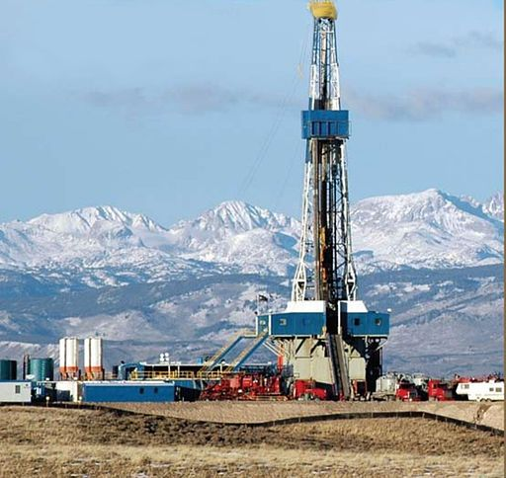
Simulation Activity
Evaluating Natural Gas
Students use an interactive computational model and real-world data to evaluate the environmental impact of extracting natural gas to generate electricity. Students explore some of the relative benefits of natural gas and some of the potential environmental costs of extracting natural gas.
Notes:
Students use an interactive computational model and real-world data to evaluate the environmental impact of extracting natural gas to generate electricity. Students explore some of the relative benefits of natural gas and some of the potential environmental costs of extracting natural gas.

Slide 130
Big Question: Compare and Contrast two types of Earth’s energy resources and explain why knowing how to determine efficiency is important.
Efficiency = Actual/ Expected x 100%
Notes:
Explicit cue to revisit the big question at the end of the lesson: Okay everyone. Now that we’ve learned the term, let’s reflect once more on our big question. Was there anything that we predicted earlier that was correct or incorrect? Do you have any new hypotheses to share?

Slide 131
Notes:
Thanks for watching, and please continue watching CAPs available from this website.

Slide 132
This Video Was Created With Resources From:
Questions or Comments
Michael Kennedy, Ph.D. MKennedy@Virginia.edu
Rachel L Kunemund, Ph.D. rk8vm@virginia.edu

Slide 133
Intro
“Big Idea” Question
Review Concepts
Check-In Questions
Teacher Demo
Vocabulary
Student-Friendly Definition
Examples & Non-Examples
Morphological Word Parts
Simulation/Activity
Notes:
OK everyone, get ready for our next lesson. Just as a reminder, these are the different components that our lesson may include, and you’ll see these icons in the top left corner of each slide so that you can follow along more easily!

Slide 134
Intro
Efficiency
Notes:
Today, we will learn about efficiency.

Slide 135
Big Question: Compare and Contrast two types of Earth’s energy resources and explain why knowing how to determine efficiency is important.
Efficiency = Actual/Expected x 100%
Notes:
Our “big question” is: Compare and contrast two types of Earth’s energy resource and explain why knowing how to determine efficiency is important. [Pause and illicit predictions from students.]
Today we are learning about efficiency. How do you think learning about efficiency will change our hypotheses?

Slide 136
Demonstration
Energy Efficiency of Lightbulbs
TEACHER DIRECTIONS:
Before viewing: Ask students what they already know about energy. Tell students today they will be learning about energy efficiency.
During: As students are watching the short video be sure to pause it and ask questions to check for understanding.
After: Tell students that today they will be learning more about energy efficiency.
Notes:
Let’s do a quick demonstration that will help get our brains ready to think about efficiency and how it relates to our big question.

Slide 137
Notes:
Now, let’s pause for a moment to check your understanding.
Feedback: Provide your students with plenty of opportunities to demonstrate their understanding through questions and other opportunities to respond throughout the demonstration. This is so important for ensuring that your students are grasping this new skill.

Slide 138
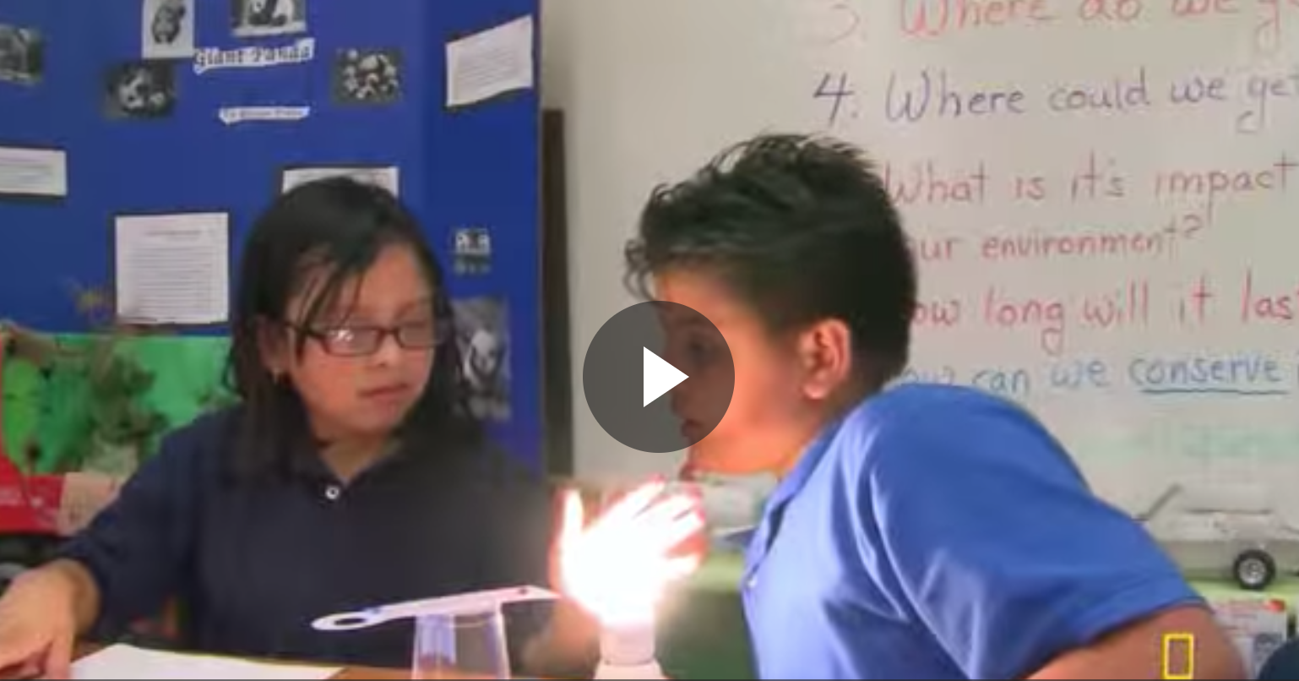
Which light bulb is more energy efficient? Explain.
Notes:
Which light bulb is more energy efficient? Explain.

Slide 139
Notes:
Before we move on to our new vocabulary term, let’s review some other words & concepts that you already learned and make sure you are firm in your understanding.

Slide 140
Natural Resource: found in nature
Notes:
A natural resource is anything found in nature

Slide 141
Natural resources --> used by humans
Notes:
…and used by humans.

Slide 142
Natural Resources
Renewable
Nonrenewable
Notes:
There are two types of natural resources, renewable and nonrenewable.

Slide 143
Natural Resources
Renewable
Nonrenewable
Notes:
Nonrenewable resources cannot be replaced quickly. They take millions of years to be replaced. Some of them cannot be replaced at all!

Slide 144
Natural Resources
Renewable
Nonrenewable
Notes:
Renewable resources can be replaced quickly.

Slide 145
Earth’s Energy Resources
Notes:
Earth’s energy resources come from the earth.

Slide 146
Earth’s Energy Resources
Notes:
Resources are sources of wealth such as land, water, and forests. Today, we will be learning about different types of Earth’s energy resources.

Slide 147
Geothermal Energy: heat from inside the Earth
Notes:
Geothermal energy is heat from inside the Earth.

Slide 148
Natural Gas: gas made from fossils
Notes:
Natural gas is gas made from fossils.

Slide 149
Notes:
Now, let’s pause for a moment to check your understanding.

Slide 150
What are natural resources?
Notes:
What are natural resources?
[A natural resource is anything found in nature and used by humans.]

Slide 151
Give an example of how we use natural resources.
Notes:
Give an example of how we use natural resources.

Slide 152
What are the two types of natural resources?
Natural Resources
?
?
Notes:
What are the two types of natural resources?
[There are two types of natural resources, renewable and nonrenewable.]

Slide 153
Can nonrenewable resources be replaced quickly? Explain your answer.
Natural Resources
Renewable
Nonrenewable
Notes:
Can non renewable resources be replaced quickly? Explain your answer.
[Nonrenewable resources cannot be replaced quickly. They take millions of years to be replaced. Some of them cannot be replaced at all!]

Slide 154
True/False: Renewable resources can’t be replaced quickly.
Natural Resources
Renewable
Nonrenewable
Notes:
True/False: Renewable resources can’t be replaced quickly.

Slide 155
True/False: Renewable resources can’t be replaced quickly.
Natural Resources
Renewable
Nonrenewable
Notes:
True/False: Renewable resources can’t be replaced quickly.
[False: Renewable resources can be replaced quickly.]

Slide 156
Where do Earth’s energy resources come from?
Notes:
Where do Earth’s energy resources come from?
[Earth’s energy resources come from the Earth.]

Slide 157
What are resources?
Notes:
What are resources?
[Resources are sources of wealth such as land, water, and forests.]

Slide 158
_______ is heat from inside the Earth.
Notes:
______ is heat from inside the Earth.

Slide 159
Geothermal energy is heat from inside the Earth.
Notes:
Geothermal energy is heat from inside the Earth.

Slide 160
What is natural gas made from?
Notes:
What is natural gas made from?
[Natural gas is gas made from fossils.]

Slide 161
Efficiency
Notes:
Now that we’ve reviewed, let’s define our new term, efficiency.

Slide 162
Efficiency: the amount of usable energy compared to potential total energy
Notes:
Efficiency is the amount of usable energy compared to potential total energy.
Feedback: Using clear language can take make formal more complicated definitions a little easier for students to understand.

Slide 163
Notes:
Now, let’s pause for a moment to check your understanding.

Slide 164
What is efficiency?
Notes:
What is efficiency?
[Efficiency is the amount of usable energy compared to the potential total energy.]

Slide 165
Notes:
That is the basic definition, but there is a bit more you need to know.

Slide 166
Notes:
100% efficiency means that the total potential energy produced is equal to the total energy produced.

Slide 167
100% Efficiency
Notes:
Meaning that if you expected to make 4 ears of corn then you created 4 ears of corn. You had 100% efficiency.

Slide 168
75% efficiency
3
4
Notes:
But if you thought you were creating 4 ears of corn but only made 3 ears of corn, then you have a 75% efficiency because you produced 3/4th of what you expected. The same principles can be applied to energy.
Feedback: Analogies can be tricky, you were able to use relevant analogies during your course instructions to help students get familiar with the concepts.

Slide 169
Efficiency = Actual/Expected x 100%
Notes:
The formula for efficiency is Efficiency = Actual/Expected x 100%

Slide 170
Notes:
Now, let’s pause for a moment to check your understanding.

Slide 171
What is efficiency?
Notes:
What is efficiency?
[Efficiency is the amount of usable energy compared to potential total energy.]

Slide 172
What does it mean if something has 100% efficiency?
Notes:
What does it mean if something has 100% efficiency?
[100% efficiency means that the total potential energy produced is equal to the total energy produced.]

Slide 173
What is the formula for efficiency?
Efficiency = ?
Notes:
What is the formula for efficiency?

Slide 174
What is the formula for efficiency?
Efficiency = Actual/Expected x 100%
Notes:
What is the formula for efficiency?
[The formula for efficiency is Efficiency = Actual/Expected x 100%]

Slide 175
Notes:
Let’s look at an example of efficiency.
Feedback: It is good to not only introduce an example of the term but also included images to go along with it, this is a great way to help students make connections.

Slide 176
Efficiency = Actual/Expected x 100%
3 ears of corn
Notes:
Let’s look at the corn example. If you have 3 ears of corn

Slide 177
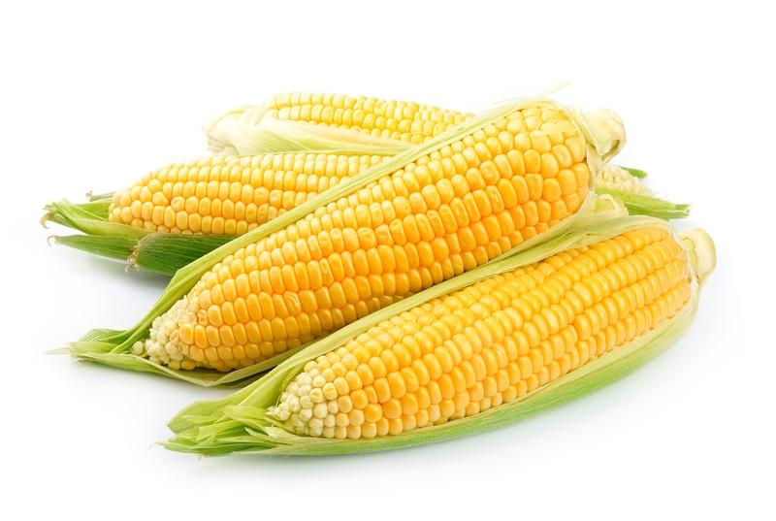
Efficiency = Actual/Expected x 100%
3 ears of corn
4 ears of corn
Notes:
but expected 4 ears of corn

Slide 178
Efficiency = Actual/Expected x 100%
/
=
3 ears of corn
4 ears of corn
X 100%
= 75% efficiency
Notes:
you would be 75% efficient.
Feedback: It is important to work through a problem with students before for having them tackle it on their own.

Slide 179
Notes:
Let’s check-in for understanding.

Slide 180
If you are expected to make 4 ears of corn, but only make 1 ear of corn, how would you set up the equation?
1 ear of corn
4 ears of corn
Notes:
If you are expected to make 4 ears of corn, but only make 1 ear of corn, how would you set up the equation?
[Efficiency = Actual/Expected x 100%. Efficiency =1 ear of corn /4 ears of corn x 100%]

Slide 181
Solve the equation for the previous problem to find the efficiency.
1 ear of corn
4 ears of corn
Notes:
Solve the equation for the previous problem to find the efficiency.
[Efficiency = Actual/Expected x 100%. Efficiency =1 ear of corn /4 ears of corn x 100% = 25%.]

Slide 182
What are two types of earth’s energy resources?
Notes:
What are two types of earth’s energy resources?
[Geothermal energy and natural gases]

Slide 183
What is efficiency?
Notes:
What is efficiency?
[Efficiency is the amount of usable energy compared to potential total energy.]

Slide 184
What does it mean if something has 100% efficiency?
Notes:
What does it mean if something has 100% efficiency?
[100% efficiency means that the total potential energy produced is equal to the total energy produced.]

Slide 185
What is the equation for efficiency?
Efficiency = ?
Notes:
What is the equation for efficiency?
[Efficiency = Actual/Potential X 100%]

Slide 186
If you have the potential to create 10 J of energy but you only produce 8 J of energy, what is your efficiency? (Show your work)
Efficiency = ?
Notes:
If you have the potential to create 10 J of energy but you only produce 8 J of energy, what is your efficiency? (Show your work)
[Efficiency = Actual/Potential X 100%
Efficiency = 8J/10J X 100%
Efficiency = 80%]

Slide 187
Remember!!!
Notes:
So remember!

Slide 188
Efficiency: the amount of usable energy compared to potential total energy
Notes:
Efficiency is the amount of usable energy compared to potential total energy.

Slide 189
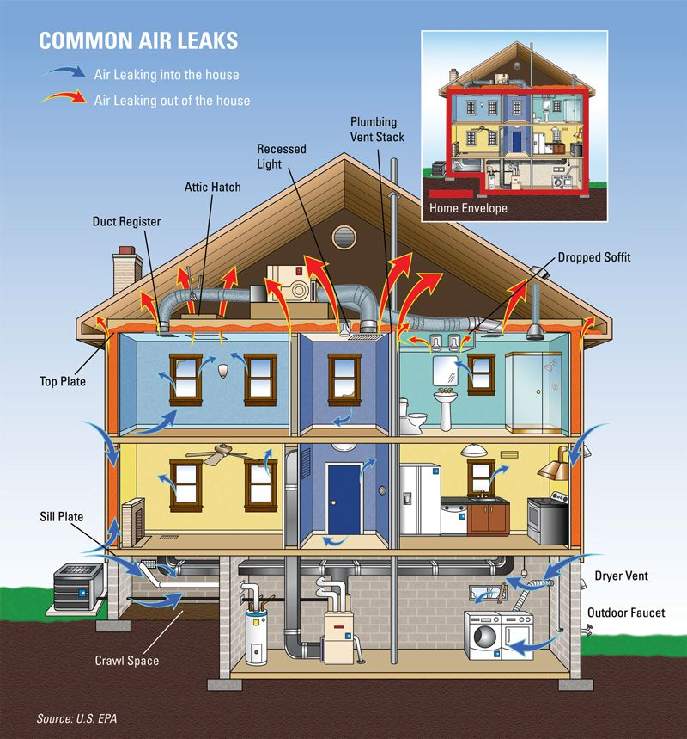
Simulation Activity
Energy Efficiency
Students explore data from the Energy Information Administration (EIA) on electricity flows and electricity consumption in the United States. Using the data, students propose how electricity generation and use can be made more efficient.
Notes:
Students explore data from the Energy Information Administration (EIA) on electricity flows and electricity consumption in the United States. Using the data, students propose how electricity generation and use can be made more efficient.
Feedback: Have students analyze and interpret data, this is a great way to help them to continue to independently problem solve.

Slide 190
Big Question: Compare and Contrast two types of Earth’s energy resources and explain why knowing how to determine efficiency is important.
Efficiency = Actual/Expected x 100%
Notes:
Explicit cue to revisit the big question at the end of the lesson: Let’s look at our big question one last time. First, let’s compare and contrast our two types of earth’s energy resources. What are the two types? How are they similar? How are they different? Now we know how to find efficiency, but why do you think knowing how to find efficiency is important (discuss with the group)?

Slide 191
Notes:
Thanks for watching, and please continue watching CAPs available from this website.

Slide 192
This Video Was Created With Resources From:
Questions or Comments
Michael Kennedy, Ph.D. MKennedy@Virginia.edu
Rachel L Kunemund, Ph.D. rk8vm@virginia.edu

