Slide 1
Intro
“Big Idea” Question
Review Concepts
Check-In Questions
Teacher Engagement
Vocabulary
Student-Friendly Definition
Examples & Non-Examples
Morphological Word Parts
Frayer Model
Simulation/Activity
Notes:
OK everyone, get ready for our next lesson. Just as a reminder, these are the different components that our lesson may include, and you’ll see these icons in the top left corner of each slide so that you can follow along more easily!

Slide 2
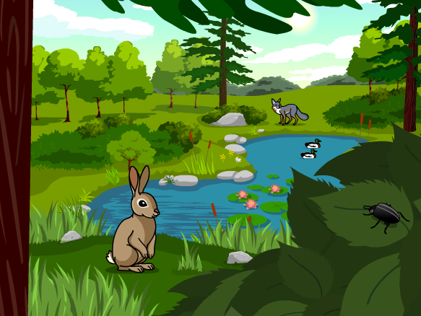
Intro
Ecosystem
Notes:
Today, we’ll be learning about the word: Ecosystem.

Slide 3
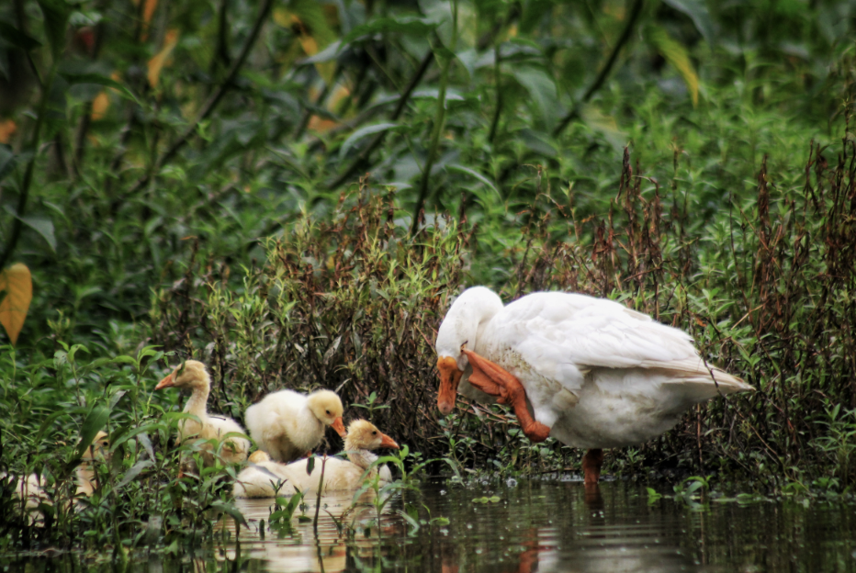
Big Question: Why is it important to understand the living and nonliving things around us?
Notes:
Our “big question” is: Why is it important to understand the living and nonliving things around us?
[Pause and illicit predictions from students.]
I love all these thoughtful scientific hypotheses! Be sure to keep this question and your predictions in mind as we move through these next few lessons, and we’ll continue to revisit it.

Slide 4
Demonstration
Fighting Fire with Fire
TEACHER DIRECTIONS:
Before viewing, ask students what they already know about environments.
After viewing, Ask students what they observed (what types of animals did they notice, how did they animals and plants interact, what is unique about what the plants and animals need in the video?)
Tell students the video showed an ecosystem. Tell students they will learn more about an ecosystem in this lesson, but keep in mind how the plants, animals and other nonliving things (like the fire) interacted as they learn more about ecosystems.
Notes:
Let’s do a quick demonstration that will help get our brains ready to think about Ecosystems, and how they relate to our big question.
Feedback: This demonstration is a great way to introduce students to the content. As suggested by the slide, beginning with open-ended questions, followed by providing explicit explanations, and then asking probing questions is a great way to engage students in a discussion while also providing clear explanations.

Slide 5
Notes:
Before we move on to our new topic, let’s review some other words & concepts that you already learned and make sure you are firm in your understanding.

Slide 6
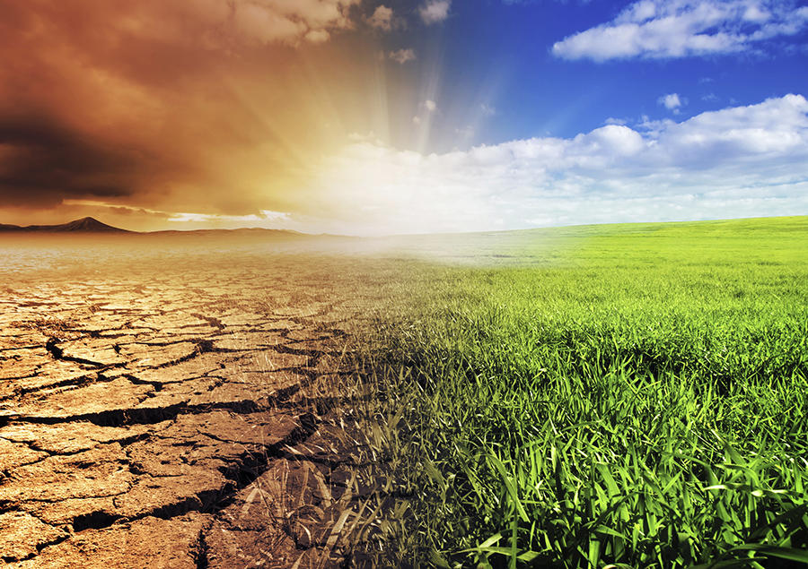
Environment: the surroundings of a person, animal, plant or thing
Notes:
An environment is the surroundings of a person, animal, plant or thing.

Slide 7
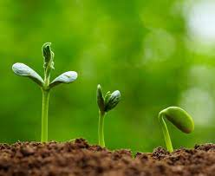
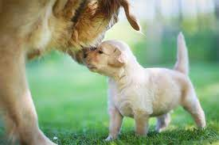
Living Things: organisms that move, grow, change, and respond to the environment
Notes:
Living things are organisms that grow, change, and respond to the environment.

Slide 8
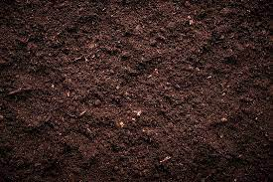
Nonliving Things: objects or other things that do not grow or change
Notes:
Nonliving things are objects or things that do not grow or change.

Slide 9
Notes:
Now let’s pause for a moment to review the information we have covered already.

Slide 10
The environment is the surroundings of a person, animal, plant, or thing.
True
False
Notes:
The environment is the surroundings of a person, animal, plant or thing.
[True]

Slide 11
The environment is the surroundings of a person, animal, plant, or thing.
True
False
Notes:
The environment is the surroundings of a person, animal, plant or thing.
[True]

Slide 12
________ ________ are organisms that move, grow, change, and respond to the environment.
Nonliving Things
Living Things
Notes:
______ ______ are organisms that move, grow, change, and respond to the environment.
[Living things]

Slide 13
________ ________ are organisms that move, grow, change, and respond to the environment.
Nonliving Things
Living Things
Notes:
Living things are organisms that move, grow, change, and respond to the environment.

Slide 14
Nonliving things are objects or other things that do not grow or change.
True
False
Notes:
Nonliving things are objects or other things that do not grow or change.
[True]

Slide 15
Nonliving things are objects or other things that do not grow or change.
True
False
Notes:
Nonliving things are objects or other things that do not grow or change.
[True]

Slide 16
Ecosystem
Notes:
Now that we’ve reviewed, let’s define the phrase ecosystem.

Slide 17
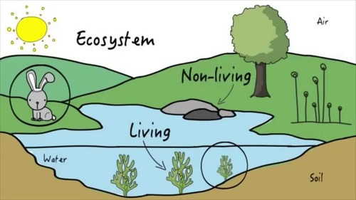
Ecosystem: an area where living and nonliving things interact
Notes:
An ecosystem is the area where living and nonliving things interact.

Slide 18
Notes:
Let’s check-in for understanding.

Slide 19
What is an ecosystem?
Notes:
What is an ecosystem?
[An ecosystem is an area where living and nonliving things interact.]

Slide 20
Notes:
That is the basic definition, but there is a bit more you need to know.

Slide 21
An ecosystem consists of living and nonliving things.
Notes:
An ecosystem consists of living and nonliving things.

Slide 22
In an ecosystem, living things include animals, plants, and other organisms.
Notes:
In an ecosystem, living things include animals, plants, and other organisms. In this picture, the rabbit and the plants in the pond.

Slide 23
In an ecosystem, nonliving things include rocks, air, and other things that do not grow or change.
Notes:
In an ecosystem, living things include animals, plants, and other organisms. In this picture, the rabbit and the plants in the pond.

Slide 24
Living and nonliving things share everything they need to survive in one place, this is an ecosystem.
Notes:
Living and nonliving things share everything they need to survive in one place, this is an ecosystem.

Slide 25
Notes:
Let’s check-in for understanding.

Slide 26
There are _______ and ________ things in an ecosystem.
Notes:
There are _____ and _______ things in an ecosystem.
[Living and nonliving OR nonliving and living]

Slide 27
There are living and nonliving things in an ecosystem.
Notes:
There are _____ and _______ things in an ecosystem.
[Living and nonliving OR nonliving and living]

Slide 28
In an ecosystem, living and nonliving things _____ what they need to _____.
Share, survive
Survive, share
Notes:
In an ecosystem, living and nonliving things _____ what they need to _______.
[share, survive]

Slide 29
In an ecosystem, living and nonliving things _____ what they need to _____.
Share, survive
Survive, share
Notes:
In an ecosystem, living and nonliving things [share] what they need to [survive].

Slide 30
Notes:
Now, let’s talk about some examples of ecosystem.

Slide 31
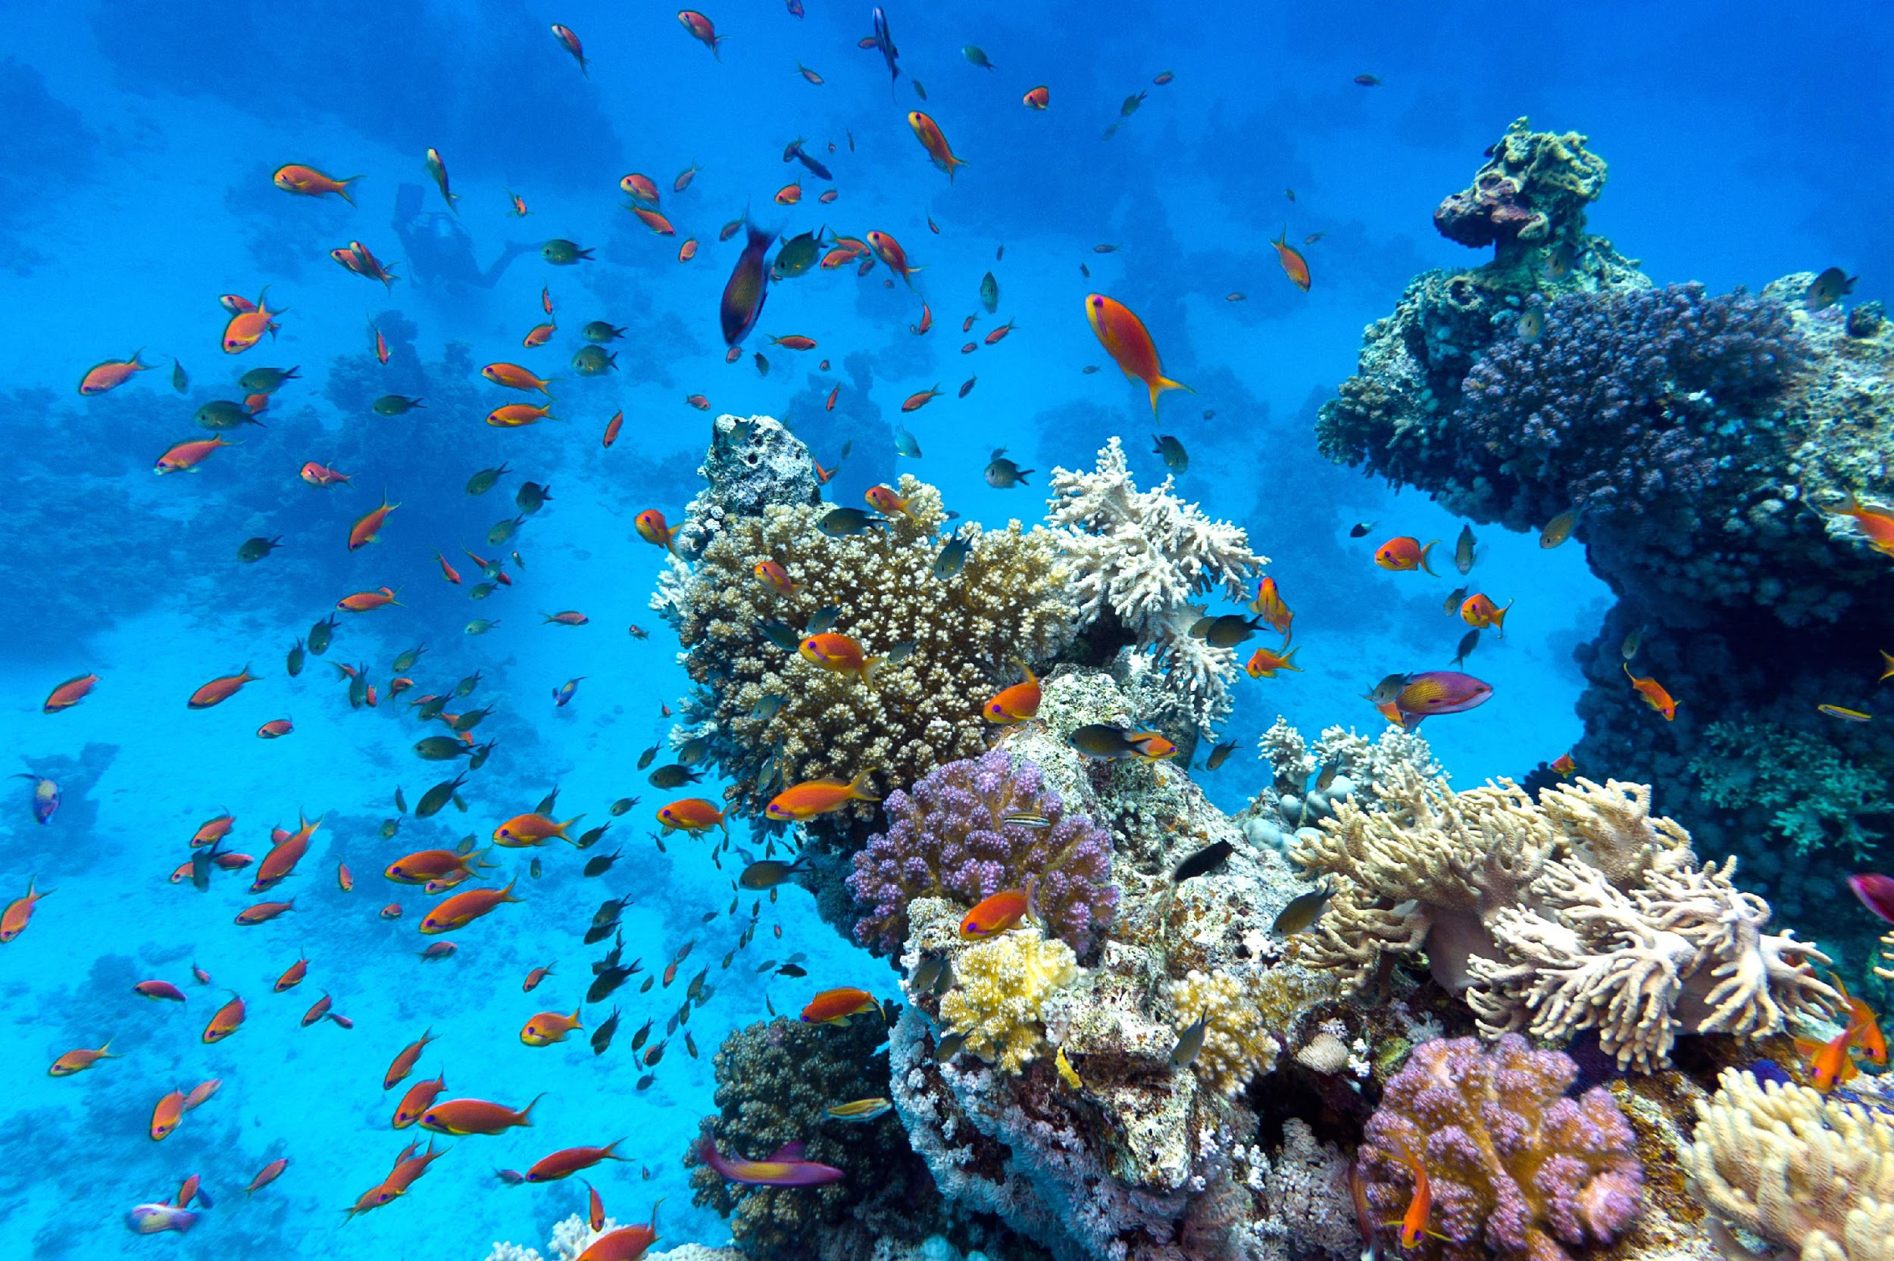
The ocean is an example of an ecosystem. The fish and coral are living things that interact with the water and rocks that are not living things.
Notes:
The ocean is an example of an ecosystem. The fish and coral are living things that interact with the water and rocks that are not living things.

Slide 32
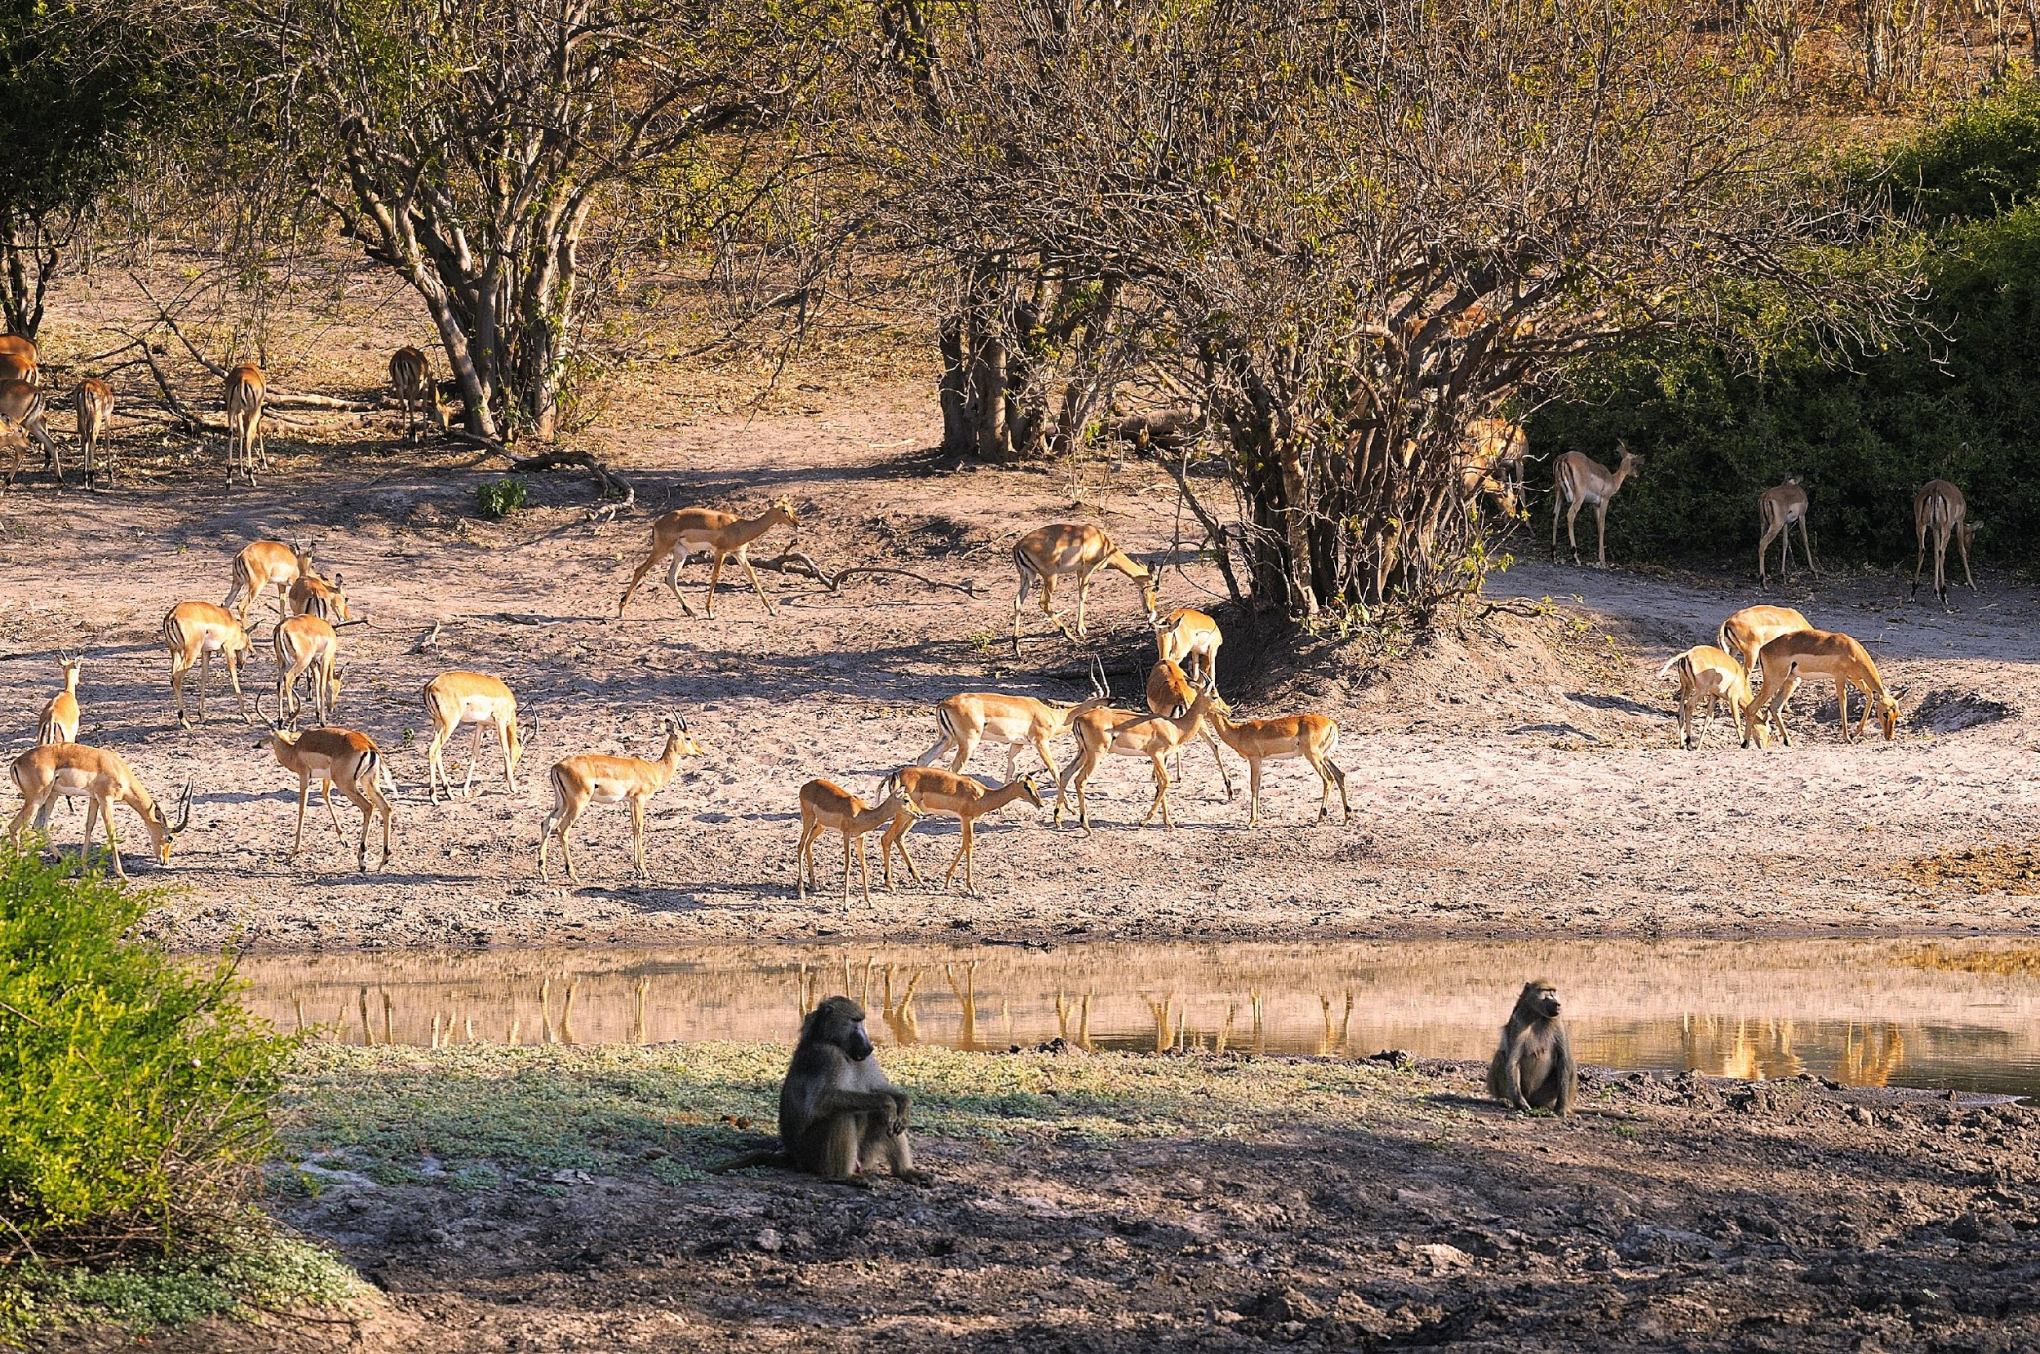
The savanna is another example of an ecosystem. The animals and trees are living things that interact with the soil, sunlight, weather, and water which are nonliving things.
Notes:
The savanna is another example of an ecosystem. The animals and trees are living things that interact with the soil, sunlight, weather, and water which are nonliving things.

Slide 33
Notes:
Now, let’s talk about some non-examples of ecosystems.

Slide 34
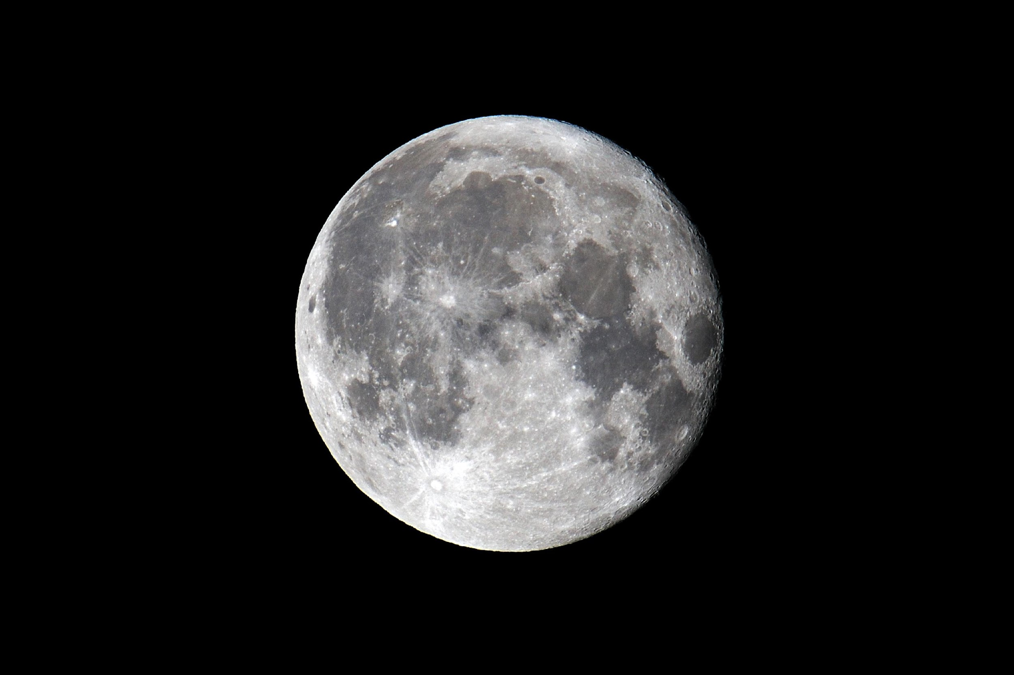
The moon is not an example of an ecosystem. There are no living things on the moon.
Notes:
The moon is not an example of an ecosystem. There are no living things on the moon.

Slide 35
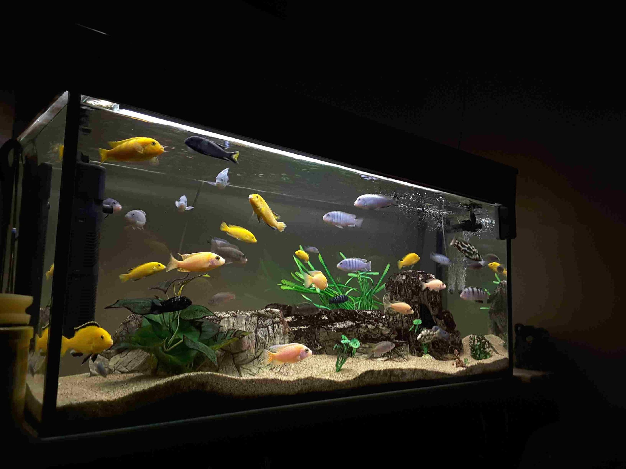
An aquarium is not an example of an ecosystem. Although there are living and nonliving things, it is manmade and because of that, it is not an ecosystem.
Notes:
An aquarium is not an example of an ecosystem. Although there are living and nonliving things, it is manmade and because of that, it is not an ecosystem.

Slide 36
Notes:
Now let’s pause for a moment to check your understanding.

Slide 37
What are examples of ecosystems?
Notes:
What are examples of ecosystems?
[coral reef, grassland, forest, etc.]

Slide 38
What are non-examples of ecosystems?
NON
Notes:
What are non-examples of ecosystems?
[the moon, aquarium, zoo enclosures]

Slide 39
Notes:
We can also break down the term ecosystem into different word parts to help us remember the meaning. Let’s take a look!

Slide 40
Ecosystem
Eco
system
Notes:
The word ecosystem can be broken down into two parts.

Slide 41
Ecosystem
Eco
system
Habitat or environment
Notes:
The prefix “eco” is used to describe a habitat or specific type of environment.

Slide 42
Ecosystem
Eco
system
Group of things working together
Notes:
The word “system” refers to a group of things that are working together.

Slide 43
Eco
system
Ecosystem
Things that are working together in the same space
Notes:
These definitions tell us that an ecosystem involves things that are working together in the same space.
Feedback: Reuniting the word parts is a crucial step in helping students understand the whole picture when reviewing morphological word parts.

Slide 44
Notes:
Let’s check-in for understanding.

Slide 45
How can we use the word parts of ecosystem to help us remember the definition of the term?
Ecosystem
Eco
system
Notes:
How can we use the word parts of ecosystem to help us remember the definition of the term?
[The word ecosystem can be broken down into two parts.
The prefix “eco” is used to describe a habitat or specific type of environment.
The word “system” refers to a group of things that are working together.
These definitions tell us that an ecosystem involves things that are working together in the same space.]

Slide 46
Remember!!!
Notes:
So remember!

Slide 47
Ecosystem: an area where living and nonliving things interact
Notes:
An ecosystem is the area where living and nonliving things interact.

Slide 48
Notes:
We will now complete this concept map, called a Frayer model, to summarize and further clarify what you have learned about the term ecosystem.

Slide 49
Definition
Picture
Ecosystem
Example
How do ecosystems impact my life?
Notes:
To complete the Frayer model, we will choose from four choices the correct picture, definition, example, and response to the question, “How do ecosystems impact my life?” Select the best response for each question using the information you just learned. As we select responses, we will see how this model looks filled in for the term ecosystem.

Slide 50
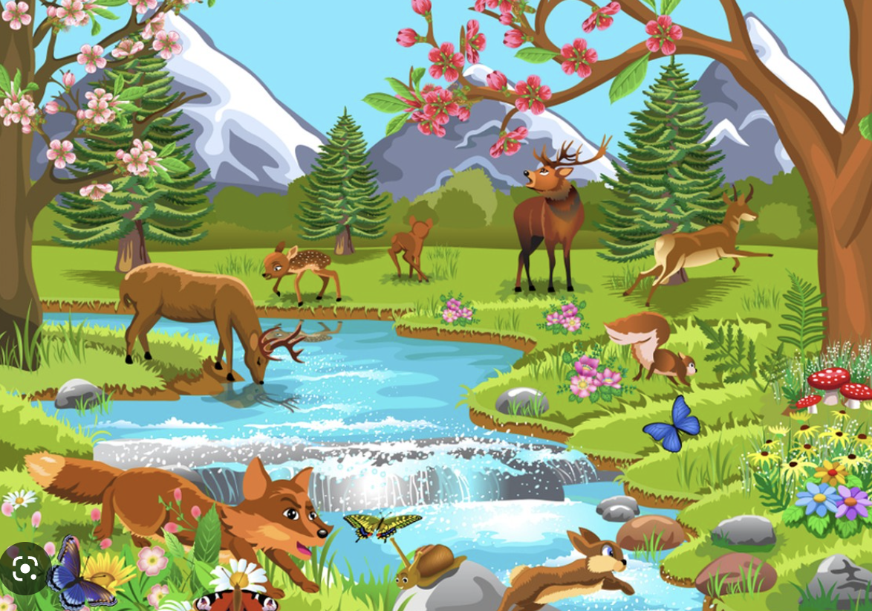
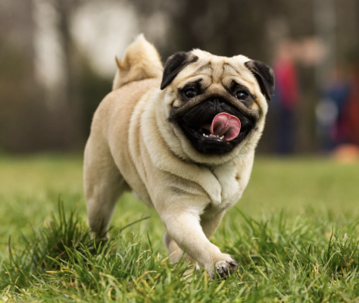
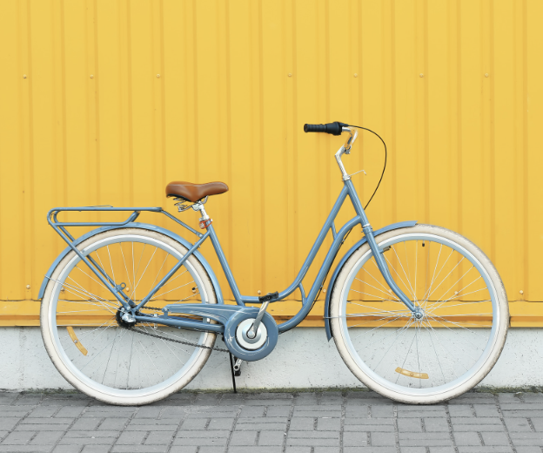
Directions: Choose the correct picture of an Ecosystem from the choices below.
A
B
C
D
Notes:
Choose the one correct picture of ecosystem from these four choices.

Slide 51
Directions: Choose the correct picture of an Ecosystem from the choices below.
A
B
C
D
Notes:
This is the picture that shows an ecosystem.

Slide 52
Definition
Picture
Ecosystem
Example
How do ecosystems impact my life?
Notes:
Here is the Frayer model filled in with a picture of ecosystem.

Slide 53
Directions: Choose the correct definition of Ecosystem from the choices below.
A
An area where living and nonliving things interact
B
Tiny “building block” of life that makes up plants and animals
C
A green pigment found in plants
D
A type of organism that can reproduce viable offspring
Notes:
Choose the one correct definition of ecosystem from these four choices.

Slide 54
Directions: Choose the correct definition of Ecosystem from the choices below.
A
An area where living and nonliving things interact
B
Tiny “building block” of life that makes up plants and animals
C
A green pigment found in plants
D
A type of organism that can reproduce viable offspring
Notes:
“An area where living and nonliving things interact” is correct! This is the definition of ecosystem.

Slide 55
Definition
Picture
An area where living and nonliving things interact
Ecosystem
Example
How do ecosystems impact my life?
Notes:
Here is the Frayer Model with a picture and the definition filled in for ecosystem: an area where living and nonliving things interact.

Slide 56
Directions: Choose the correct example of an Ecosystem from the choices below.
A
Jupiter’s moons
B
A forest full of plants and animals
C
Roads and highways
D
A shopping mall
Notes:
Choose the one correct example of an ecosystem from these four choices.

Slide 57
Directions: Choose the correct example of an Ecosystem from the choices below.
A
Jupiter’s moons
B
A forest full of plants and animals
C
Roads and highways
D
A shopping mall
Notes:
“A forest full of plants and animals” is correct! This is an example of an ecosystem.

Slide 58
Definition
Picture
An area where living and nonliving things interact
Ecosystem
A forest full of plants and animals
Example
How do ecosystems impact my life?
Notes:
Here is the Frayer Model with a picture, definition, and an example of ecosystem: An area where living and nonliving things interact.

Slide 59
Directions: Choose the correct response for “how do ecosystems impact my life?” from the choices below.
A
Ecosystems help the cells in my body move around.
B
Ecosystems give me fresh air and food to eat which are two things I need to live.
C
Ecosystems explain the motions of the Earth in our solar system.
D
Ecosystems explain how the seasons work together.
Notes:
Choose the one correct response for “how do ecosystems impact my life?” from these four choices.

Slide 60
Directions: Choose the correct response for “how do ecosystems impact my life?” from the choices below.
A
Ecosystems help the cells in my body move around.
B
Ecosystems give me fresh air and food to eat which are two things I need to live.
C
Ecosystems explain the motions of the Earth in our solar system.
D
Ecosystems explain how the seasons work together.
Notes:
“Ecosystems give me fresh air and food to eat which are two things I need to live.” That is correct! This is an example of how ecosystems impact your life.

Slide 61
Definition
Picture
An area where living and nonliving things interact
Ecosystem
Ecosystems give me fresh air and food to eat which are two things I need to live.
A forest full of plants and animals
Example
How do ecosystems impact my life?
Notes:
Here is the Frayer Model with a picture, definition, example, and a correct response to “how do ecosystems impact my life?”: Ecosystems give me fresh air and good to eat which are two things I need to live.

Slide 62
Remember!!!
Notes:
So remember!

Slide 63
Ecosystem: an area where living and nonliving things interact
Notes:
An ecosystem is the area where living and nonliving things interact.

Slide 64
Big Question: Why is it important to understand the living and nonliving things around us?
Notes:
Let’s reflect once more on our big question. Our “big question” is: What do plants need to survive?
Does anyone have any additional examples to share that haven’t been discussed yet?

Slide 65
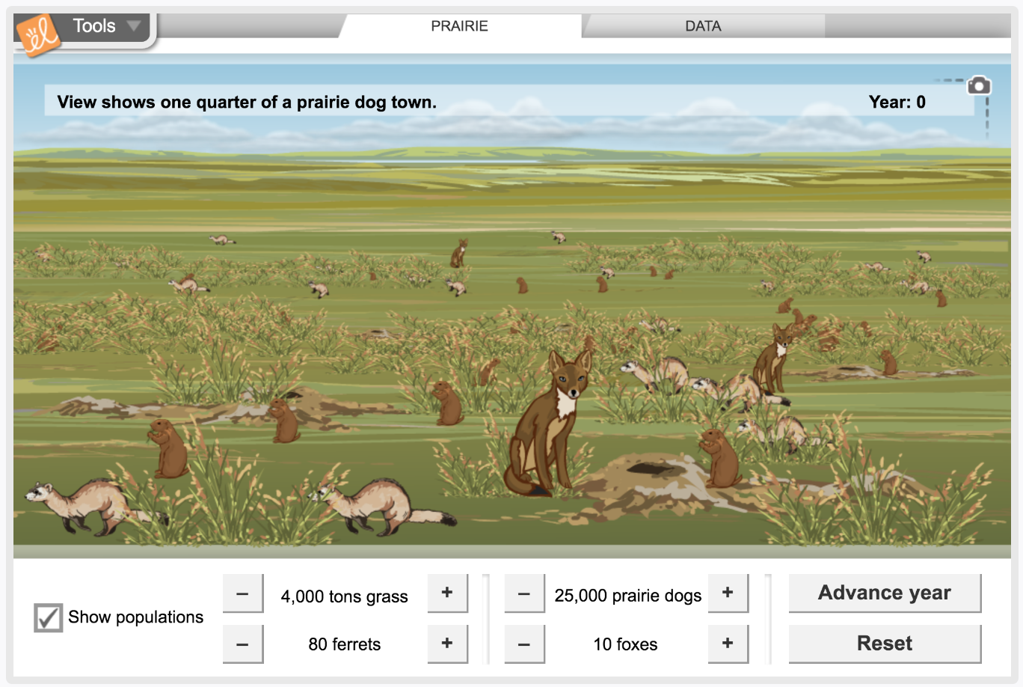
Simulation Activity
Ecosystems
(Gizmos)
Click the link above to explore the ecosystem of a prairie.
In this simulation activity, you’ll get to observe the population of the biotic factors as well as the food chain.
Notes:
Click the link above to explore the ecosystem. In this simulation activity, you’ll get to observe the population of the biotic factors as well as the food chain.
Feedback: Providing a simulation activity is a great way to make science thinking visible. In this simulation, students have the opportunity to make predictions and apply an idea to a new situation by changing the variables in the simulation (i.e., number of prairie dogs, number of foxes).

Slide 66
Notes:
Thanks for watching, and please continue watching CAPs available from this website.

Slide 67
This Was Created With Resources From:
Questions or Comments
Michael Kennedy, Ph.D. MKennedy@Virginia.edu
Rachel L Kunemund, Ph.D. rk8vm@virginia.edu

