Slide 1
Intro
“Big Idea” Question
Review Concepts
Check-In Questions
Teacher Demo
Vocabulary
Student-Friendly Definition
Examples & Non-Examples
Morphological Word Parts
Simulation/Activity
Notes:
OK everyone, get ready for our next lesson. Just as a reminder, these are the different components that our lesson may include, and you’ll see these icons in the top left corner of each slide so that you can follow along more easily!

Slide 2
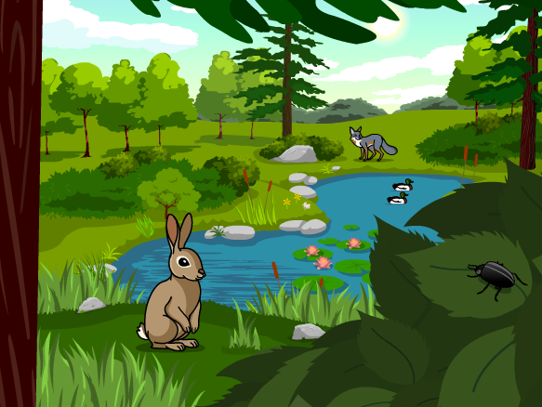
Intro
Ecosystems
Notes:
Today we will learn about ecosystems.

Slide 3
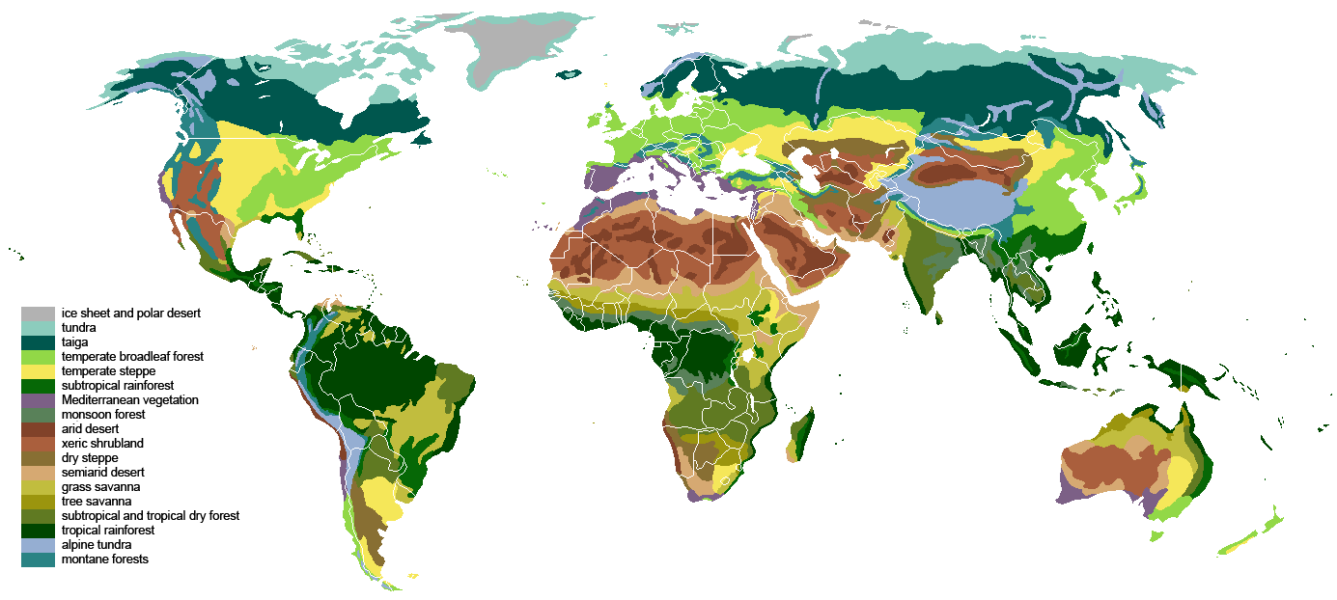
Big Questions: What ecosystem and biome do you live in? What is the difference between ecosystems and biomes?
Notes:
Our “big question” is: What is the relationship between ecosystems and biomes?
[Pause and illicit predictions from students.]
I love all these thoughtful scientific hypotheses! Be sure to keep this question and your predictions in mind as we move through these next few lessons, and we’ll continue to revisit it.

Slide 4
Demonstration
Fighting Fire with Fire
TEACHER DIRECTIONS:
Before viewing, ask students what they already know about environments.
After viewing, Ask students what they observed (what types of animals did they notice, how did they animals and plants interact, what is unique about what the plants and animals need in the video?)
Tell students the video showed an ecosystem. Tell students they will learn more about an ecosystem in this lesson, but keep in mind how the plants, animals and other nonliving things (like the fire) interacted as they learn more about ecosystems.
Notes:
Let’s do a quick demonstration that will help get our brains ready to think about Ecosystems, and how they relate to our big question.
Feedback: This demonstration is a great way to introduce students to the content. As suggested by the slide, beginning with open-ended questions, followed by providing explicit explanations, and then asking probing questions is a great way to engage students in a discussion while also providing clear explanations.

Slide 5
Notes:
Now let’s pause for a moment to check your understanding.

Slide 6
What plants/animals did you see in the video?
Notes:
What plants/animals did you see in the video?
[Birds, tortoise, grasses, trees, etc.]

Slide 7
How did the plants and animals interact with each other?
Notes:
How did the plants and animals interact with each other?
[I.e. tortoise needs plants for food, ground for a home….etc.]

Slide 8
What do these plants and animals depend on?
Notes:
What do these plants and animals depend on?
[Fire]

Slide 9
Notes:
Before we move on to our new vocabulary term, let’s review some other words & concepts that you already learned and make sure you are firm in your understanding.
Feedback: Cues are an important way to prepare students for what is coming next.

Slide 10
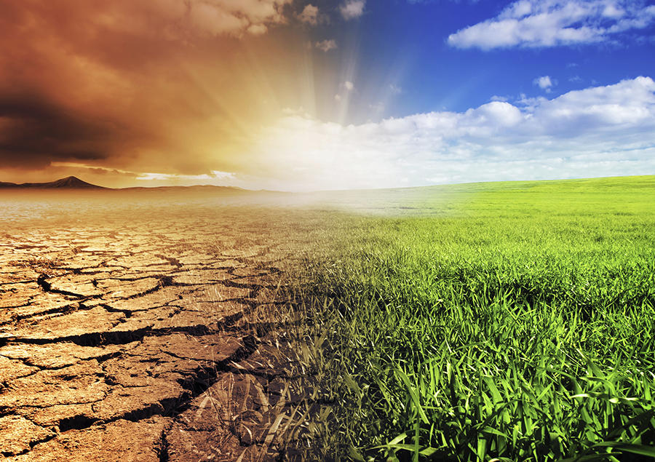
Environment: the surroundings of a person, animal, plant or thing
Notes:
An environment is the surroundings of a person, animal, plant or thing.

Slide 11
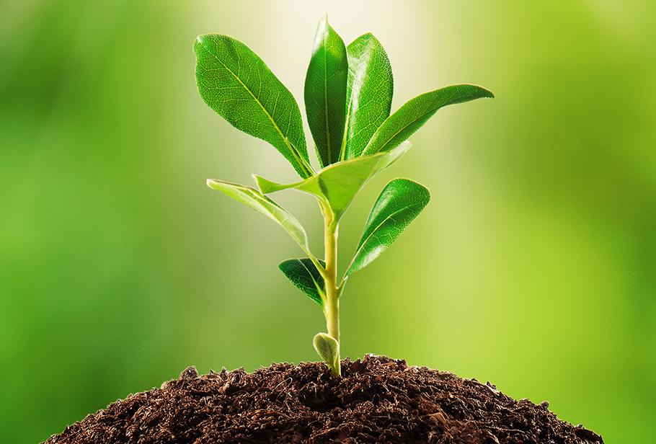
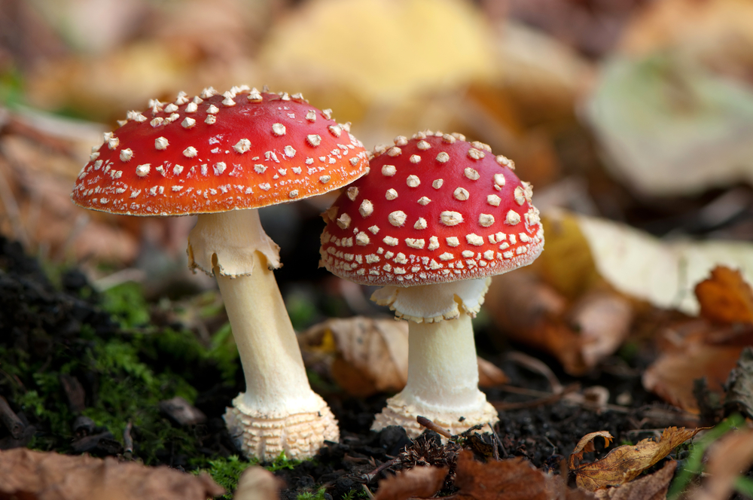
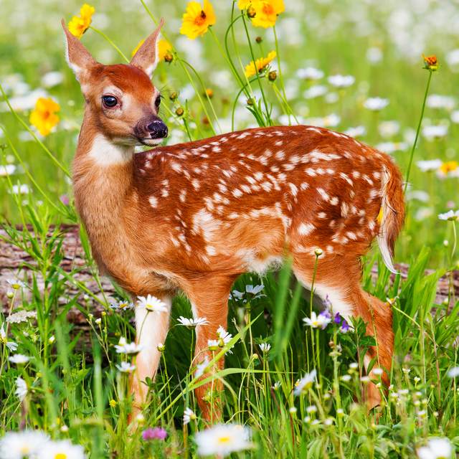
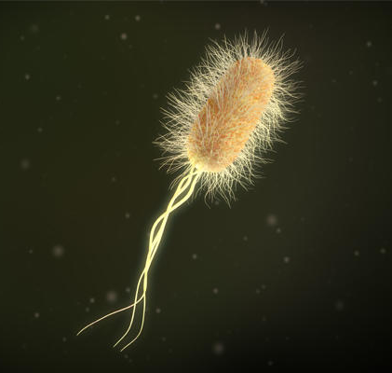
Biotic Factors: living things, plants or animals, that influence or affect an ecosystem
Notes:
Biotic factors are the living things, plants or animals, that influence or affect an ecosystem.

Slide 12
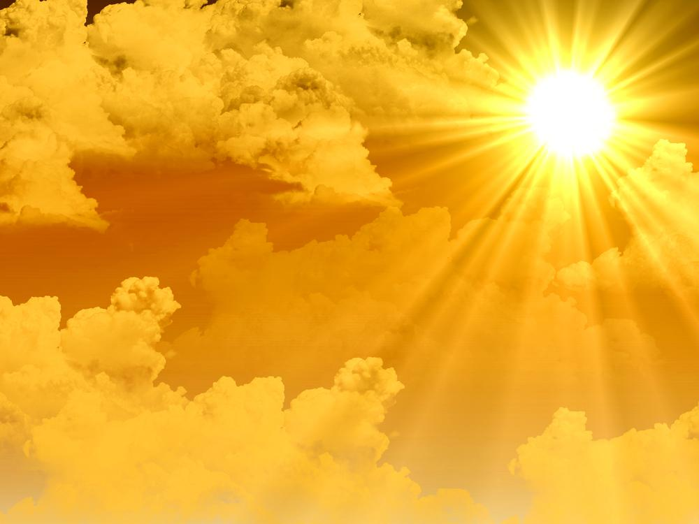
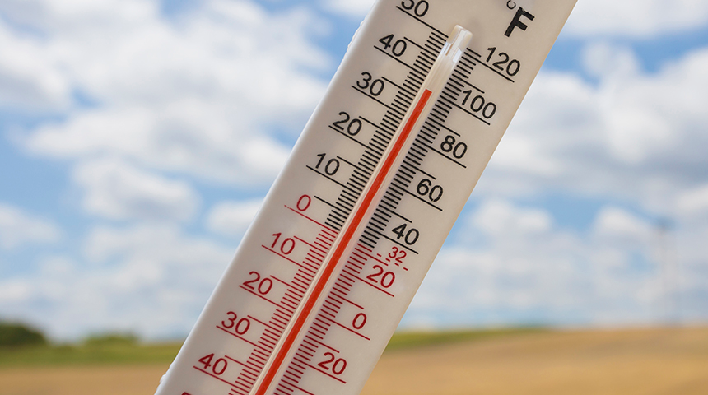
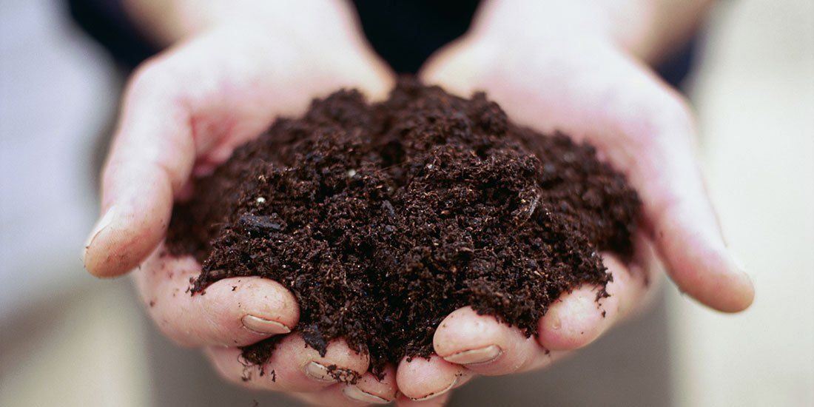
Abiotic Factors: non-living things that influence or affect an ecosystem
Notes:
Abiotic factors are the non-living things that influence or affect an ecosystem. These factors include sunlight, temperature, water, and nutrients.

Slide 13
Notes:
Now let’s pause for a moment to check your understanding.

Slide 14
What is an environment?
Notes:
What is an environment?
[An environment is the surroundings of a person, animal, plant or thing.]

Slide 15
What is the difference between biotic and abiotic factors?
Notes:
What is the difference between biotic and abiotic factors?
[Biotic factors are the living things, plants or animals, that influence or affect an ecosystem. Abiotic factors are the non-living things that influence or affect an ecosystem.]

Slide 16
Ecosystem
Notes:
Now that we’ve reviewed, let’s define our new term, ecosystem.

Slide 17
Ecosystem: community of living and non-living things interacting with each other in an environment
Notes:
An ecosystem is a community of living and non-living things interacting with each other in an environment.
Feedback: When introducing new terms, it is important to use clear and concise language.

Slide 18
Notes:
Let’s check-in for understanding.

Slide 19
What is an ecosystem made up of?
Notes:
What is an ecosystem made up of?
[An ecosystem is a community of living and non-living things interacting with each other in an environment.]

Slide 20
Notes:
That is the basic definition, but there is a bit more you need to know.

Slide 21
Living Things = Biotic Factors
Notes:
Remember, living things are biotic factors. So, biotic factors are an important part of an ecosystem.
What are some biotic factors do you see in this ecosystem?
[Bunny, bug, ducks, fox, trees, grass, bushes, etc.]

Slide 22
Non-Living Things = Abiotic Factors
Notes:
Remember, non-living things are abiotic factors. So, abiotic factors are an important part of an ecosystem.
What are some abiotic factors do you see in this ecosystem?
[Water, rocks, sun, clouds, etc.]

Slide 23
Notes:
Let’s check-in for understanding.

Slide 24
What is an ecosystem?
Notes:
What is an ecosystem made up of?
[An ecosystem is a community of living and non-living things interacting with each other in an environment.]

Slide 25
How are biotic and abiotic factors related to an ecosystem?
Notes:
How are biotic and abiotic factors related to an ecosystem?
[Remember, living things are biotic factors. So, biotic factors are an important part of an ecosystem.
Remember, non-living things are abiotic factors. So, abiotic factors are an important part of an ecosystem.]

Slide 26
Notes:
Now, let’s talk about some examples of ecosystems.

Slide 27
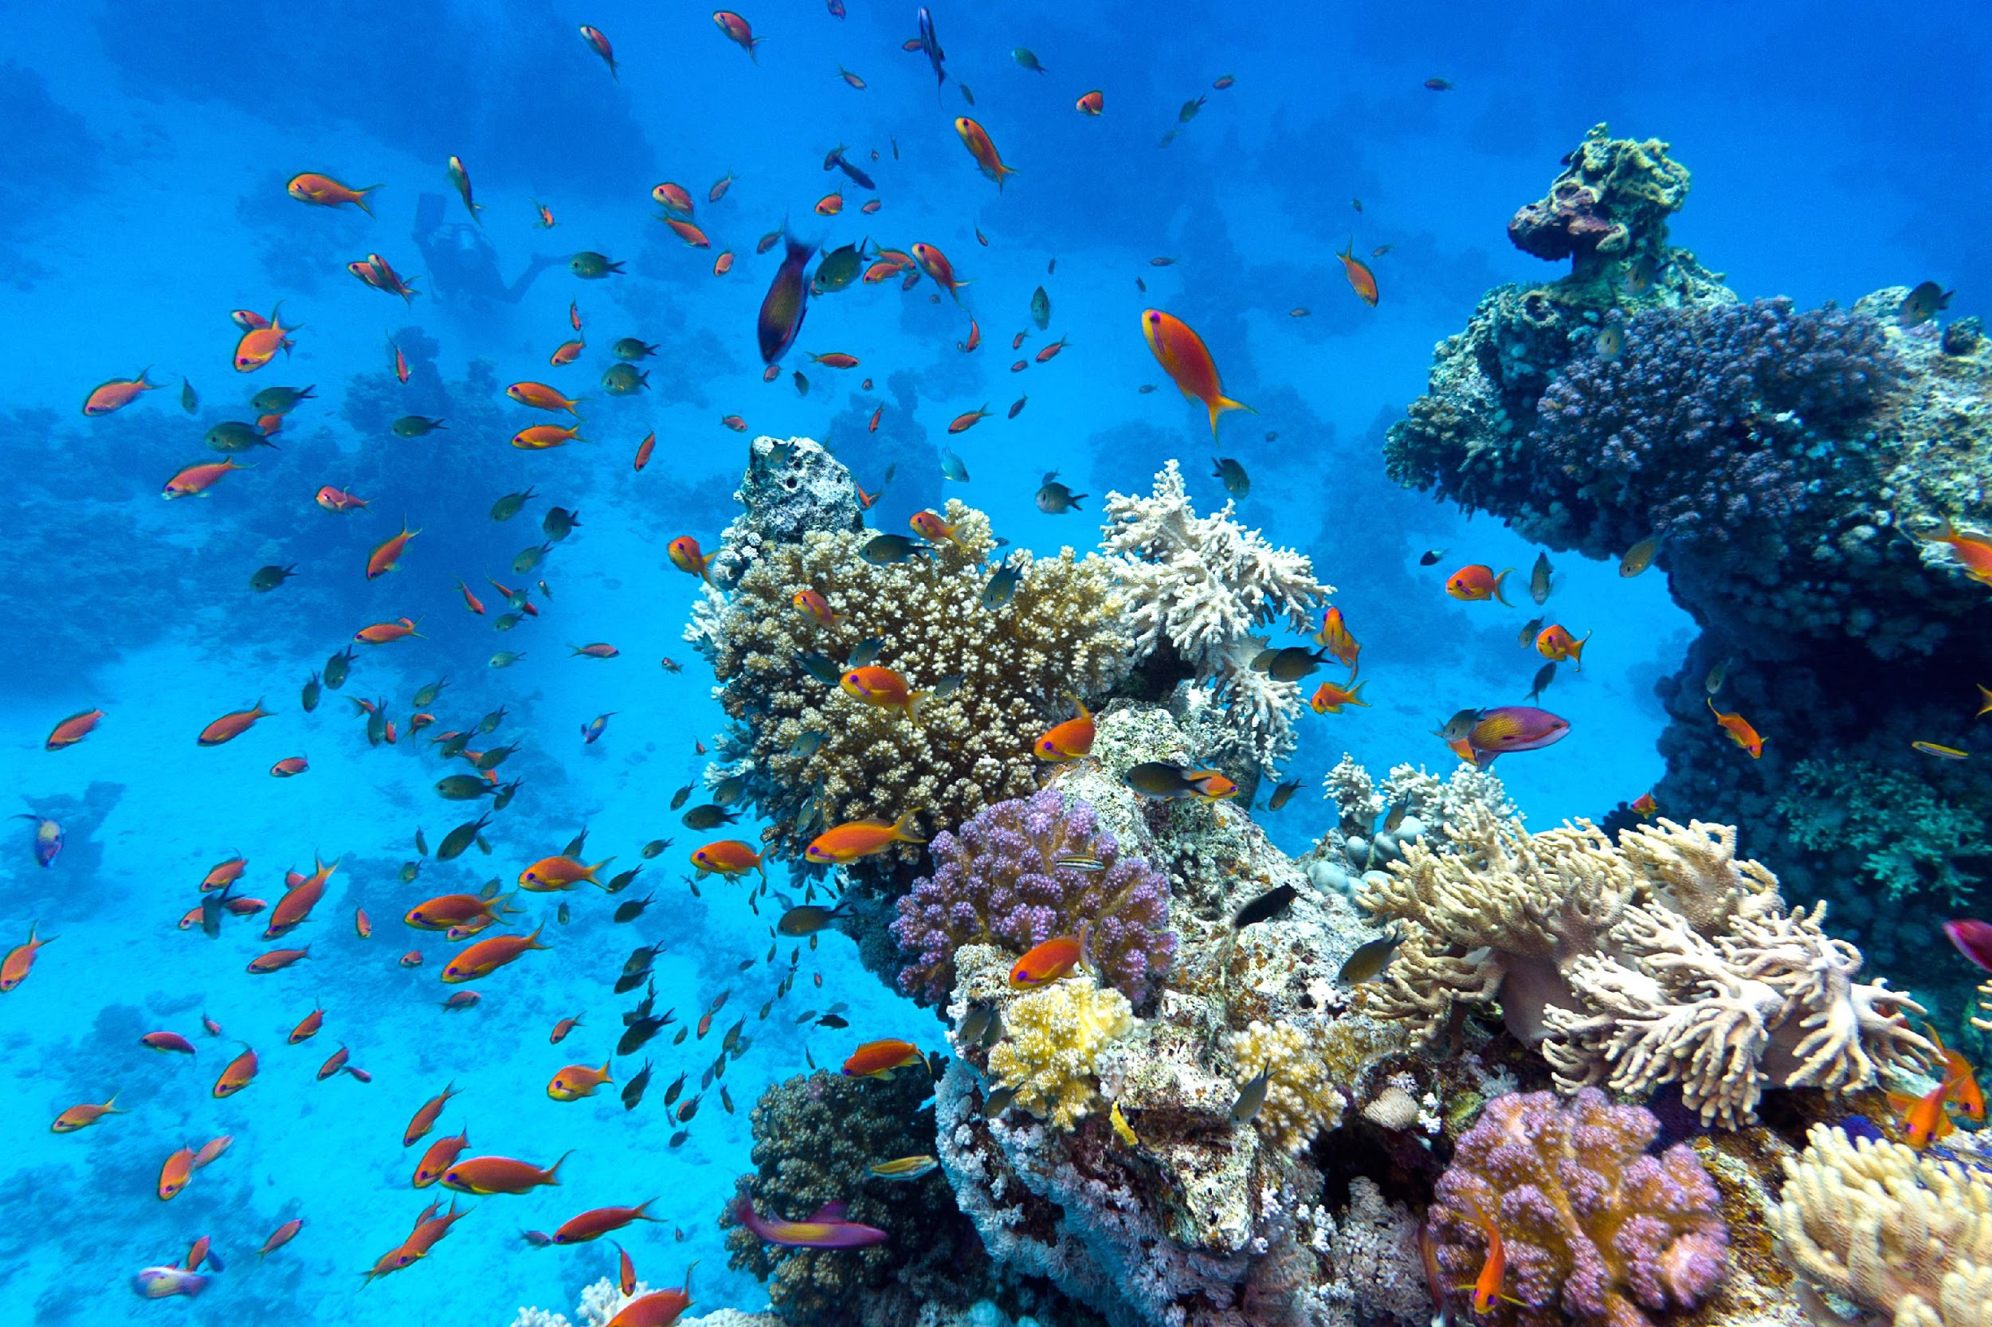
Notes:
This is an example of an ecosystem. The fish and coral (which is living) are the biotic factors that interact with the water and rocks that are the abiotic factors.
Feedback: Including visuals with examples helps students to make connections and build understanding.

Slide 28
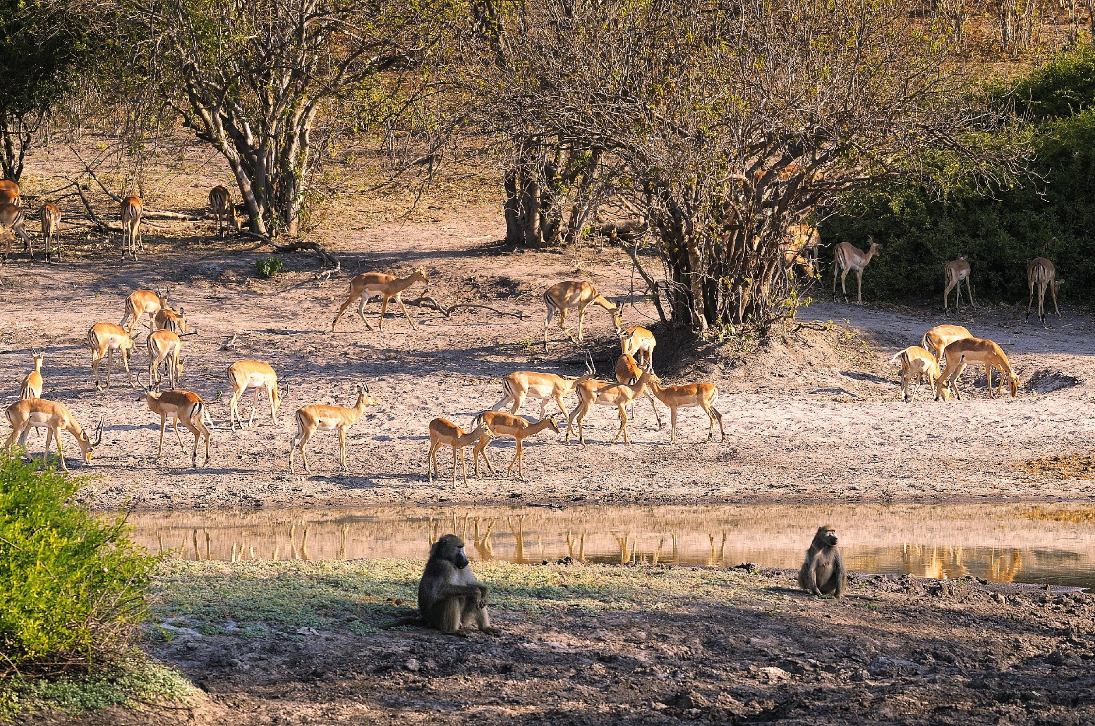
Notes:
This is an example of an ecosystem. The animals and trees (the biotic factors) interact with the soil, sunlight, weather, and water (abiotic factors).

Slide 29
Notes:
Next, let’s talk about some non-examples of ecosystems.

Slide 30
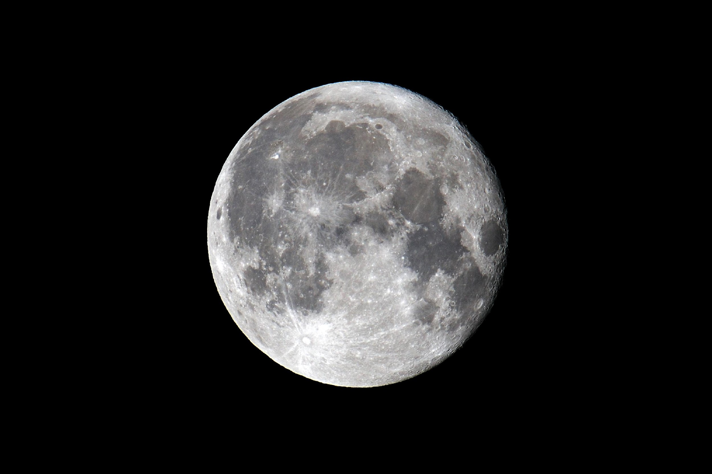
Notes:
The moon is not an example of an ecosystem. There are no biotic factors on the moon.
Feedback: It is important with non examples to explain why it is not an example.

Slide 31
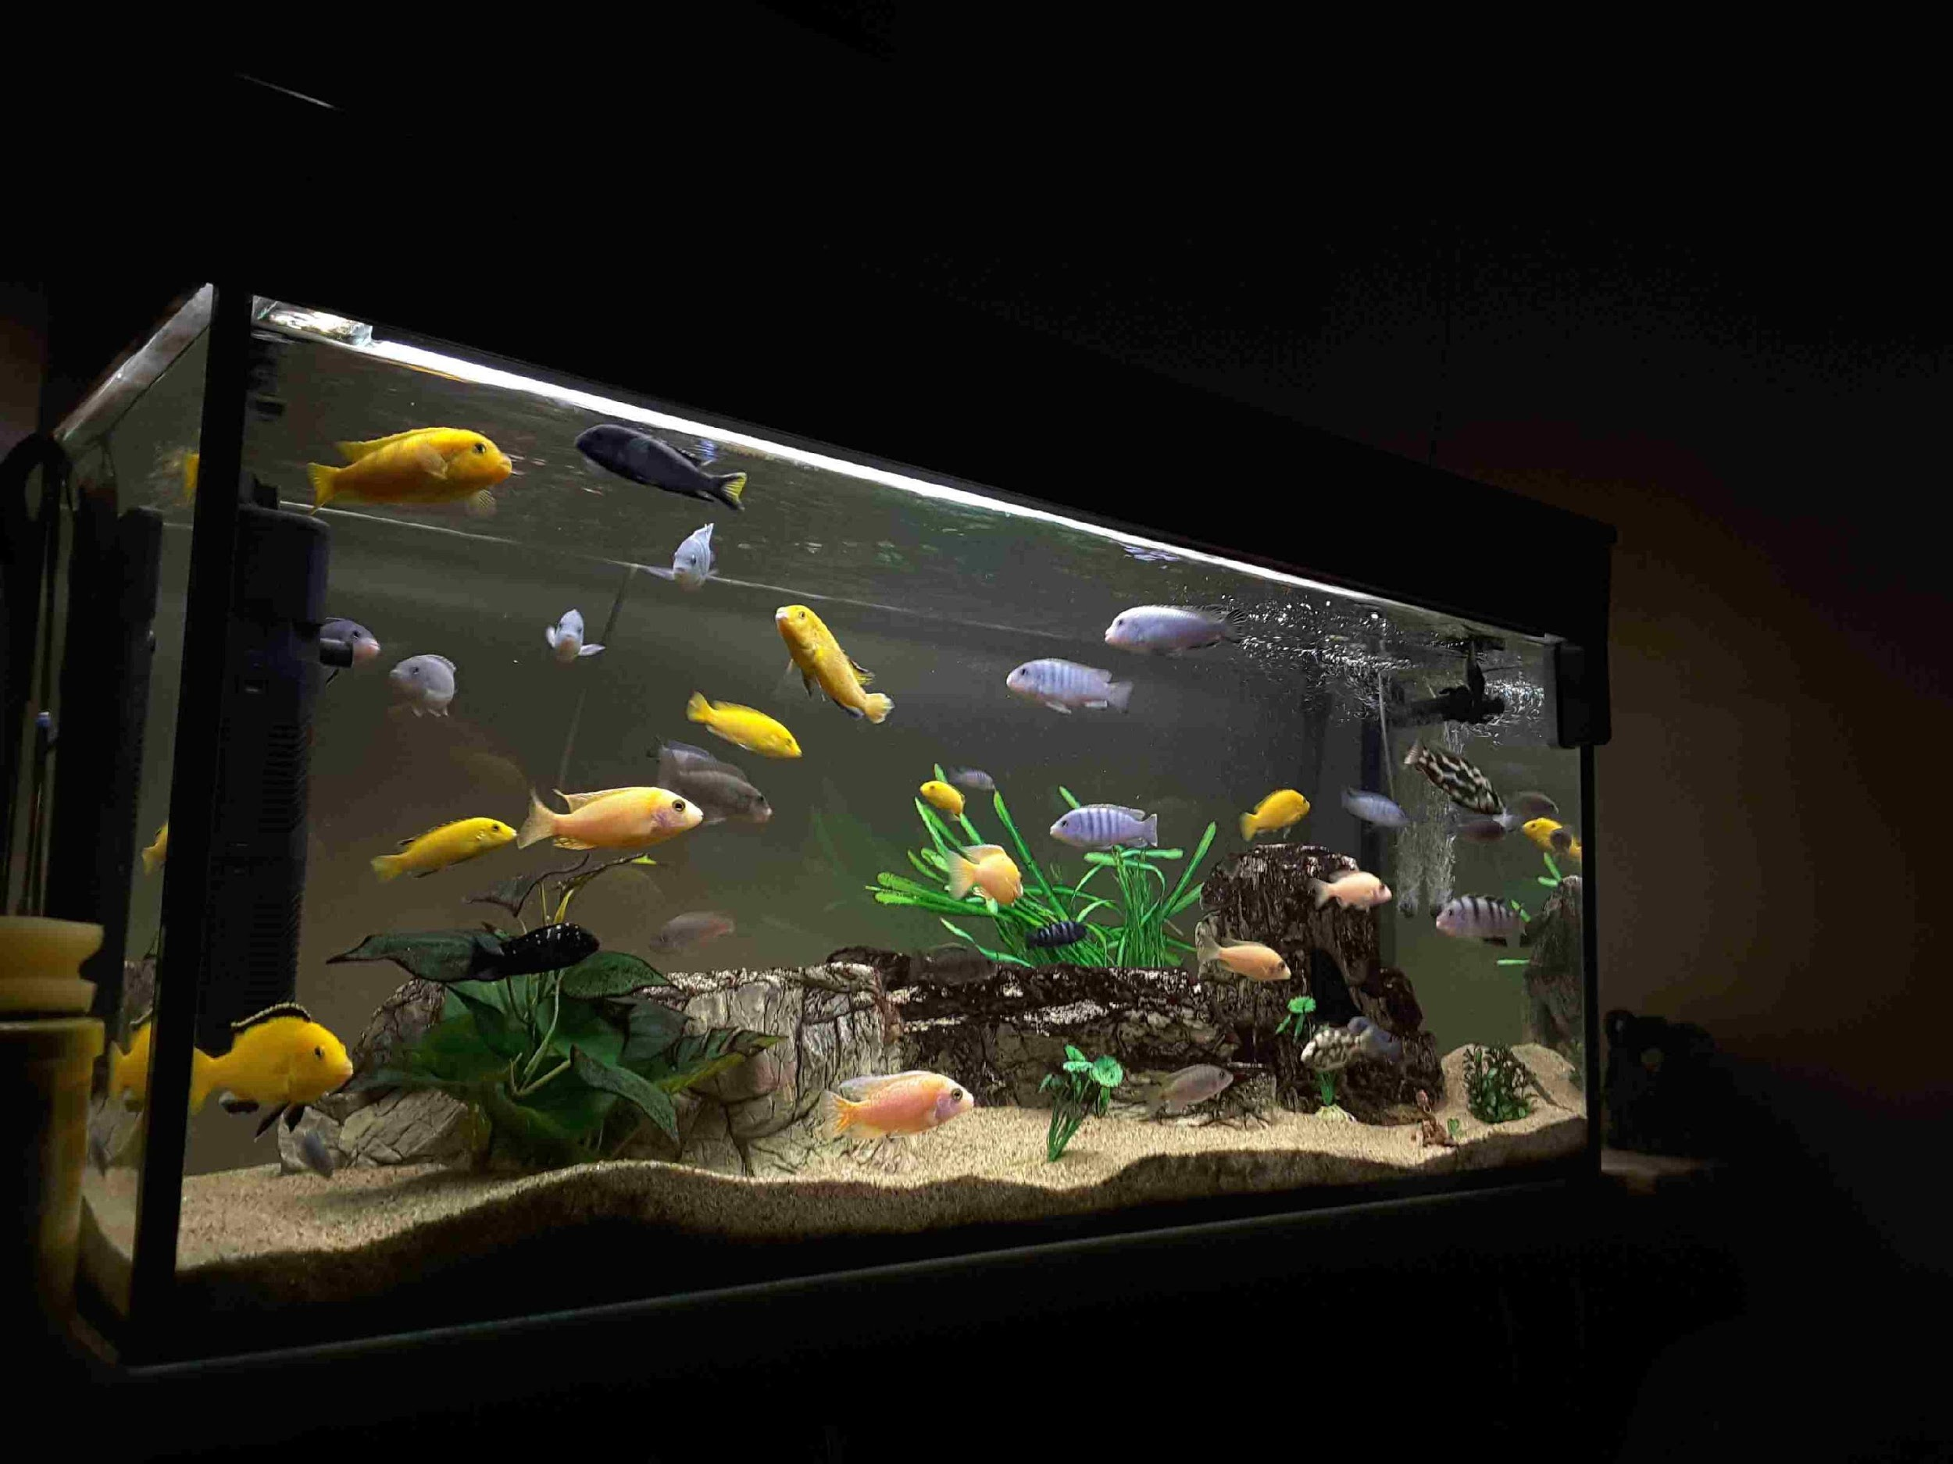
Notes:
An aquarium is not an example of an ecosystem. Although there are biotic and abiotic factors, it is manmade and because of that, it is not an ecosystem.

Slide 32
Notes:
Let’s check-in for understanding.

Slide 33
What are examples of ecosystems?
Notes:
What are examples of ecosystems?
[coral reef, grassland, forest, etc.]

Slide 34
What are non-examples of ecosystems?
NON
Notes:
What are non-examples of ecosystems?
[the moon, aquarium, zoo enclosures]

Slide 35
Notes:
Let’s break down the word ecosystem into parts to help us remember the definition of the term.

Slide 36
Ecosystem
Eco
system
Notes:
The word ecosystem can be broken down into two parts.

Slide 37
Ecosystem
Eco
system
Habitat or environment
Notes:
The prefix “eco” is used to describe a habitat or specific type of environment.
Feedback: An important part of successfully using morphological word parts is defining each part for the students. Be sure and try to incorporate these smaller definitions in the future.

Slide 38
Ecosystem
Eco
system
Group of things working together
Notes:
The word “system” refers to a group of things that are working together.

Slide 39
Eco
system
Ecosystem
Things that are working together in the same space
Notes:
These definitions tell us that an ecosystem involves things that are working together in the same space.
Feedback: Reuniting the word parts is a crucial step in helping students understand the whole picture when reviewing morphological word parts.

Slide 40
Notes:
Let’s check-in for understanding.

Slide 41
How can we use the word parts of ecosystem to help us remember the definition of the term?
Ecosystem
Eco
system
Notes:
How can we use the word parts of ecosystem to help us remember the definition of the term?
[The word ecosystem can be broken down into two parts.
The prefix “eco” is used to describe a habitat or specific type of environment.
The word “system” refers to a group of things that are working together.
These definitions tell us that an ecosystem involves things that are working together in the same space.]

Slide 42
What is an ecosystem?
Notes:
What is an ecosystem?
[An ecosystem is a community of living and non-living things interacting with each other in an environment.]

Slide 43
What are the two main characteristics of an ecosystem?
Notes:
What are the two main characteristics of an ecosystem?
[Biotic and abiotic factors]

Slide 44
Why is the moon NOT an example of an ecosystem?
Notes:
Why is the moon NOT an example of an ecosystem?
[The moon is not an example of an ecosystem because there are no biotic factors on the moon.]

Slide 45
Remember!!!
Notes:
So remember!

Slide 46
Ecosystem: community of living and non-living things interacting with each other in an environment
Notes:
An ecosystem is a community of living and non-living things interacting with each other in an environment.

Slide 47
Living Things = Biotic Factors
Notes:
Remember, living things are biotic factors. So, biotic factors are an important part of an ecosystem.

Slide 48
Non-Living Things = Abiotic Factors
Notes:
Remember, non-living things are abiotic factors. So, abiotic factors are an important part of an ecosystem.

Slide 49
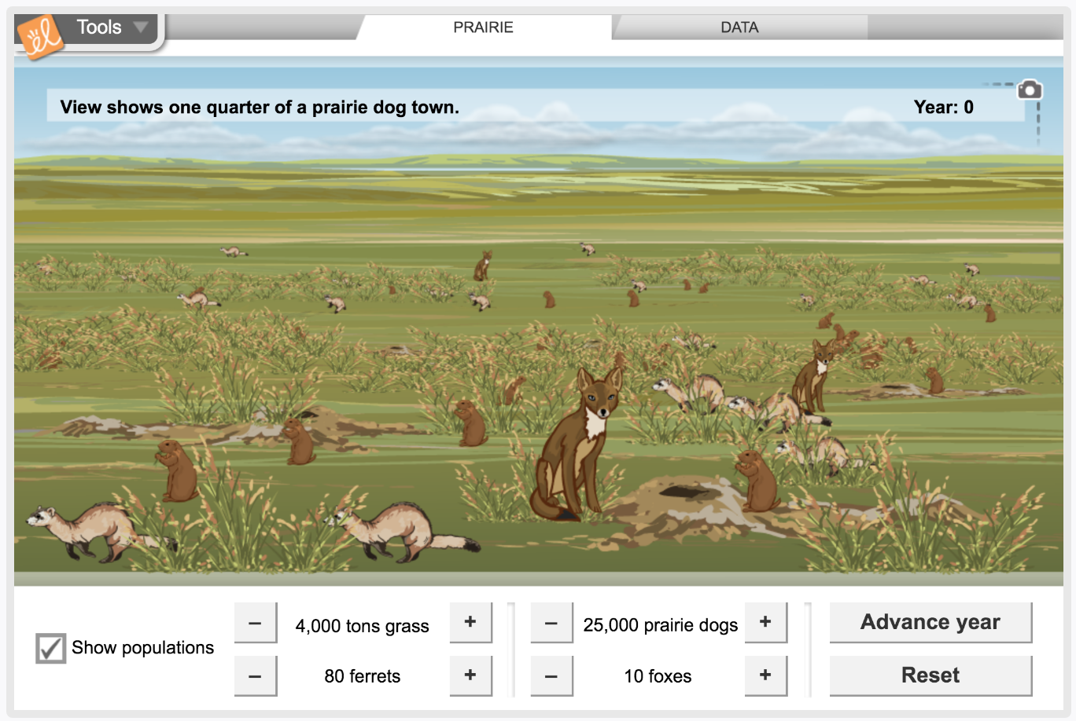
Simulation Activity
Ecosystems
(Gizmos)
Click the link above to explore the ecosystem of a prairie.
In this simulation activity, you’ll get to observe the population of the biotic factors as well as the food chain.
Notes:
Click the link above to explore the ecosystem. In this simulation activity, you’ll get to observe the population of the biotic factors as well as the food chain.
Feedback: Providing a simulation activity is a great way to make science thinking visible. In this simulation, students have the opportunity to make predictions and apply an idea to a new situation by changing the variables in the simulation (i.e., number of prairie dogs, number of foxes).

Slide 50
Big Question: What is the relationship between ecosystems and biomes?
Notes:
Explicit cue to revisit the big question at the end of the lesson: Okay everyone. Now that we’ve learned the term, ecosystems, let’s reflect once more on our big question. Was there anything that we predicted earlier that was correct or incorrect? Do you have any new hypotheses to share?

Slide 51
Notes:
Thanks for watching, and please continue watching CAPs available from this website.

Slide 52
This Video Was Created With Resources From:
Questions or Comments
Michael Kennedy, Ph.D. MKennedy@Virginia.edu
Rachel L Kunemund, Ph.D. rk8vm@virginia.edu

Slide 53
Intro
“Big Idea” Question
Review Concepts
Check-In Questions
Teacher Demo
Vocabulary
Student-Friendly Definition
Examples & Non-Examples
Morphological Word Parts
Simulation/Activity
Notes:
OK everyone, get ready for our next lesson. Just as a reminder, these are the different components that our lesson may include, and you’ll see these icons in the top left corner of each slide so that you can follow along more easily!

Slide 54
Intro
Biomes
Notes:
Today we’re going to learn about biomes.

Slide 55
Big Question: What is the relationship between ecosystems and biomes?
Notes:
Before we start, let’s think about our “big question”: What is the relationship between ecosystems and biomes? We recently learned about ecosystems, so what predictions do you have to share about the relationship between ecosystems and biomes?
[Pause and illicit predictions from students.]
I love all these thoughtful scientific hypotheses! Be sure to keep this question and your predictions in mind as we move through the lesson, and we’ll revisit it.

Slide 56
Demonstration
Biomes: Where in the world are they?
Included here is an optional demonstration for biomes. The linked presentation shows a comparison of biomes that exist in different parts of the world. You might have students find similarities between the pictures that are included or guess where in the world the pictures were take before you reveal the true locations. This presentation is designed to increase understanding of the fact that similar ecosystem types can be found in locations that are not very close to one another.
Notes:
Included here is an optional demonstration for biomes. The linked presentation shows a comparison of biomes that exist in different parts of the world.
Feedback: You might have students find similarities between the pictures that are included or guess where in the world the pictures were take before you reveal the true locations. This presentation is designed to increase understanding of the fact that similar ecosystem types can be found in locations that are not very close to one another.

Slide 57
Notes:
Before we move on to our new vocabulary term, let’s review some other words & concepts that you already learned and make sure you are firm in your understanding.

Slide 58
Environment: the surroundings of a person, animal, plant or thing
Notes:
An environment is the surroundings of a person, animal, plant or thing.

Slide 59
Ecosystem: a community of organisms that interact with each other and their environment
Notes:
An ecosystem is a community of organisms that interact with each other and their environment.

Slide 60
Biotic factors are the...
Ecosystem: a community of organisms that interact with each other and their environment
Notes:
Within an ecosystem, the biotic factors are the organisms that interact with each other...

Slide 61
Abiotic factors are the...
Ecosystem: a community of organisms that interact with each other and their environment
Notes:
... While abiotic factors are the non-living things in the environment that organisms interact with. These factors include sunlight, temperature, water, and nutrients.

Slide 62
Notes:
Now let’s pause for a moment to check your understanding.

Slide 63
What is the difference between biotic and abiotic factors in an ecosystem?
Notes:
What is the difference between biotic and abiotic factors in an ecosystem?
[Biotic factors are the living things, or organisms, that interact with each other in an ecosystem. Abiotic factors are the non-living things in an ecosystem’s environment that organisms interact with.]

Slide 64
What is an ecosystem?
Notes:
What is an ecosystem?
[An ecosystem is a community of organisms that interact with each other and their environment.]

Slide 65
Why is the moon NOT an example of an ecosystem?
Notes:
Why is the moon NOT an example of an ecosystem?
[The moon is not an example of an ecosystem because there are no biotic factors on the moon.]

Slide 66
Biomes
Notes:
Now that we’ve reviewed, let’s define our new term, biomes.

Slide 67
Biomes: large region of Earth that has a certain climate and living things that have adapted to live in that environment.
Notes:
Biomes are large regions (or areas) of Earth that have a certain climate and livings things that have adapted to live in that environment. This means that not only do biomes have similar abiotic factors, but they also have biotic factors that have adapted to survive in those specific conditions.

Slide 68
Notes:
Let’s check-in for understanding.

Slide 69
What is a biome?
Notes:
What is a biome?
[Biomes are large regions of earth that have a certain climate and living things that have adapted to live in that environment.]

Slide 70
Notes:
That is the basic definition, but there is a bit more you need to know.

Slide 71
Biomes: large region of Earth that has a certain climate and living things that have adapted to live in that environment.
Notes:
Climate is key in the definition of biome. The climate determines the characteristics of the biome and includes things such as temperature and precipitation.

Slide 72
Notes:
So, how are biomes different from ecosystems?

Slide 73
Forest Biome
Ecosystem 1 (i.e., pond)
Ecosystem 2
(i.e., marsh)
Ecosystem 3
(i.e., river)
Biome (forest)
Notes:
Both biomes and ecosystems contain regions of the Earth, but biomes are much larger because they contain multiple ecosystems. Let’s take a look at this forest example. At a quick glance, we can see that there are three DIFFERENT ecosystems, although there are probably more. The pond, marsh, and river are all different ecosystems within the same biome (forest).

Slide 74
Forest
Grassland
Desert
Tundra
Major Biomes
Notes:
There are four major biomes. Each biome is home to different organisms, able to live in the biomes based on the climate.

Slide 75
Notes:
Let’s check-in for understanding.

Slide 76
What does climate determine?
Notes:
What does climate determine?
[The climate determines the characteristics of the biome.]

Slide 77
What are the four major biomes?
?
?
?
?
Major Biomes
Notes:
What are the four major biomes?
[The four major biomes are desert, forest, grassland, and tundra.]

Slide 78
What is the difference between biomes and ecosystems?
Notes:
What is the difference between biomes and ecosystems?
[Both biomes and ecosystems contain regions of the Earth, but biomes are much larger because they contain multiple ecosystems and describe similar ecosystems that exist in different parts of the world.]

Slide 79
Notes:
Now, let’s talk about some examples of the major biomes.

Slide 80
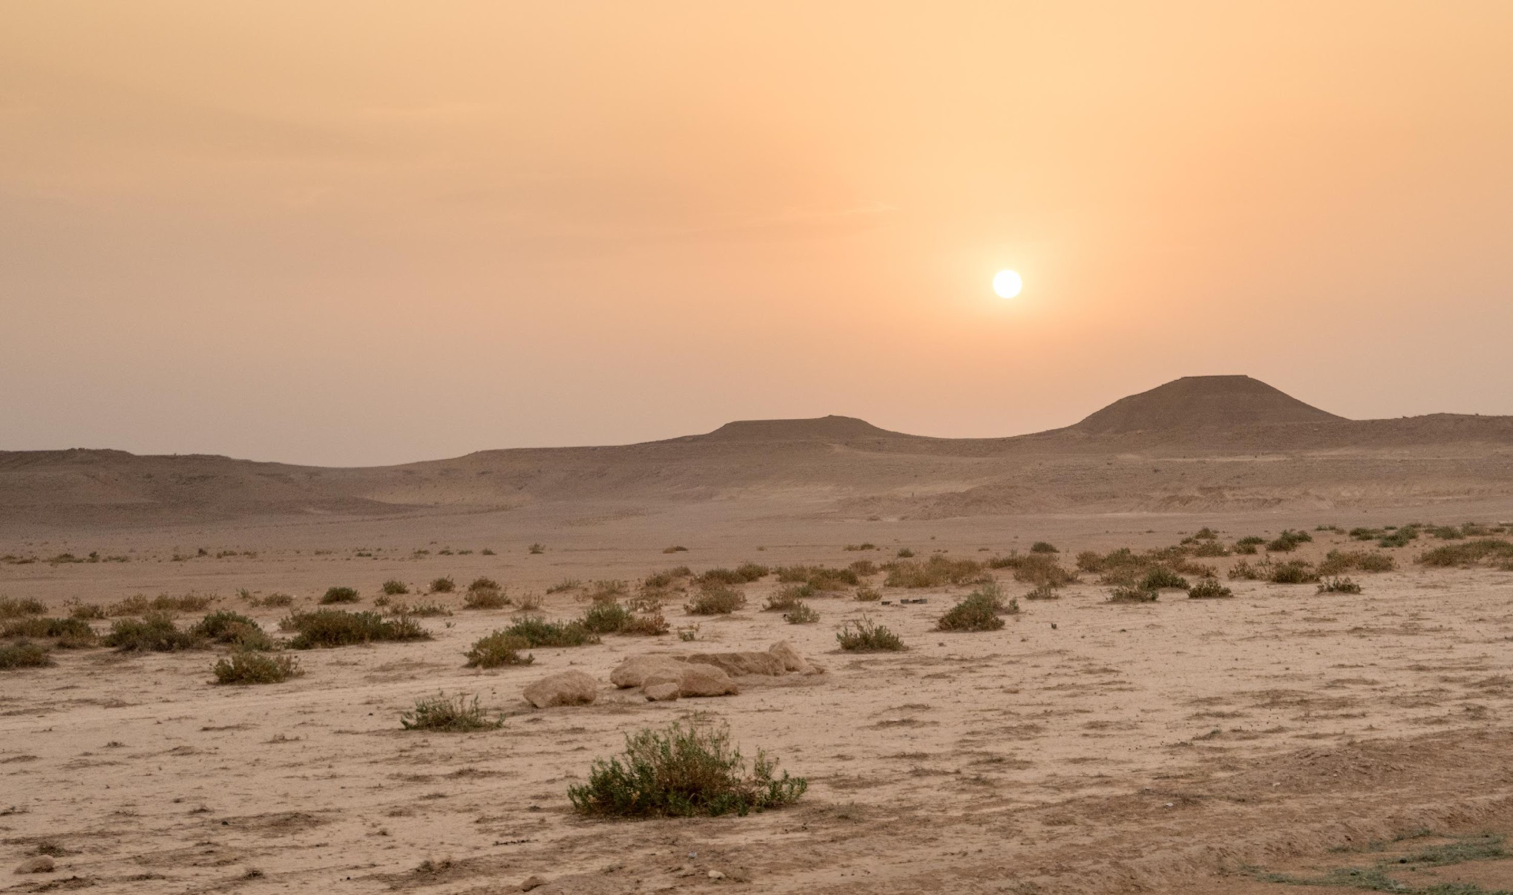
Desert
Notes:
Deserts are one of the major biomes. Consider this: Which organisms are able to live in this biome because of the climate?

Slide 81
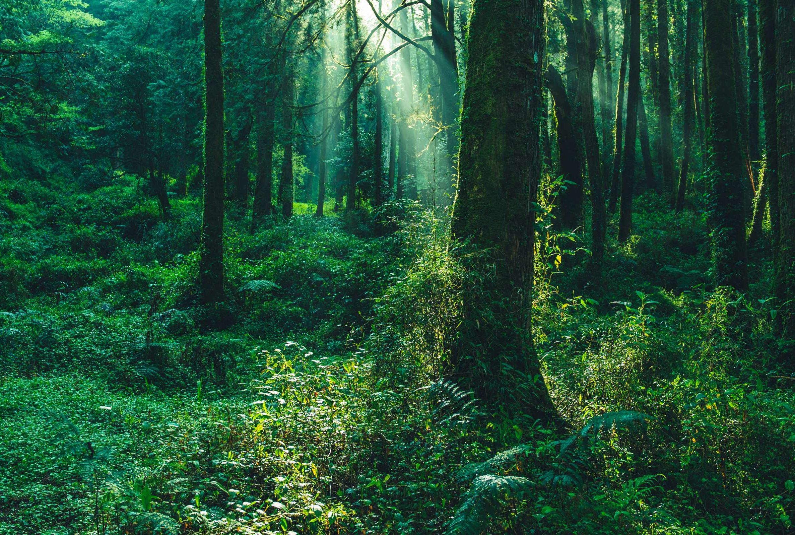
Forest
Notes:
Forests are the second of the four major biomes. Consider this: Which organisms are able to live in this biome because of the climate?
Feedback: Asking open-ended questions allows you to gauge student understanding and increases student engagement. For the scientific practice of argumentation, ask students to give evidence based on their prior experiences and/or what they see in the picture.

Slide 82
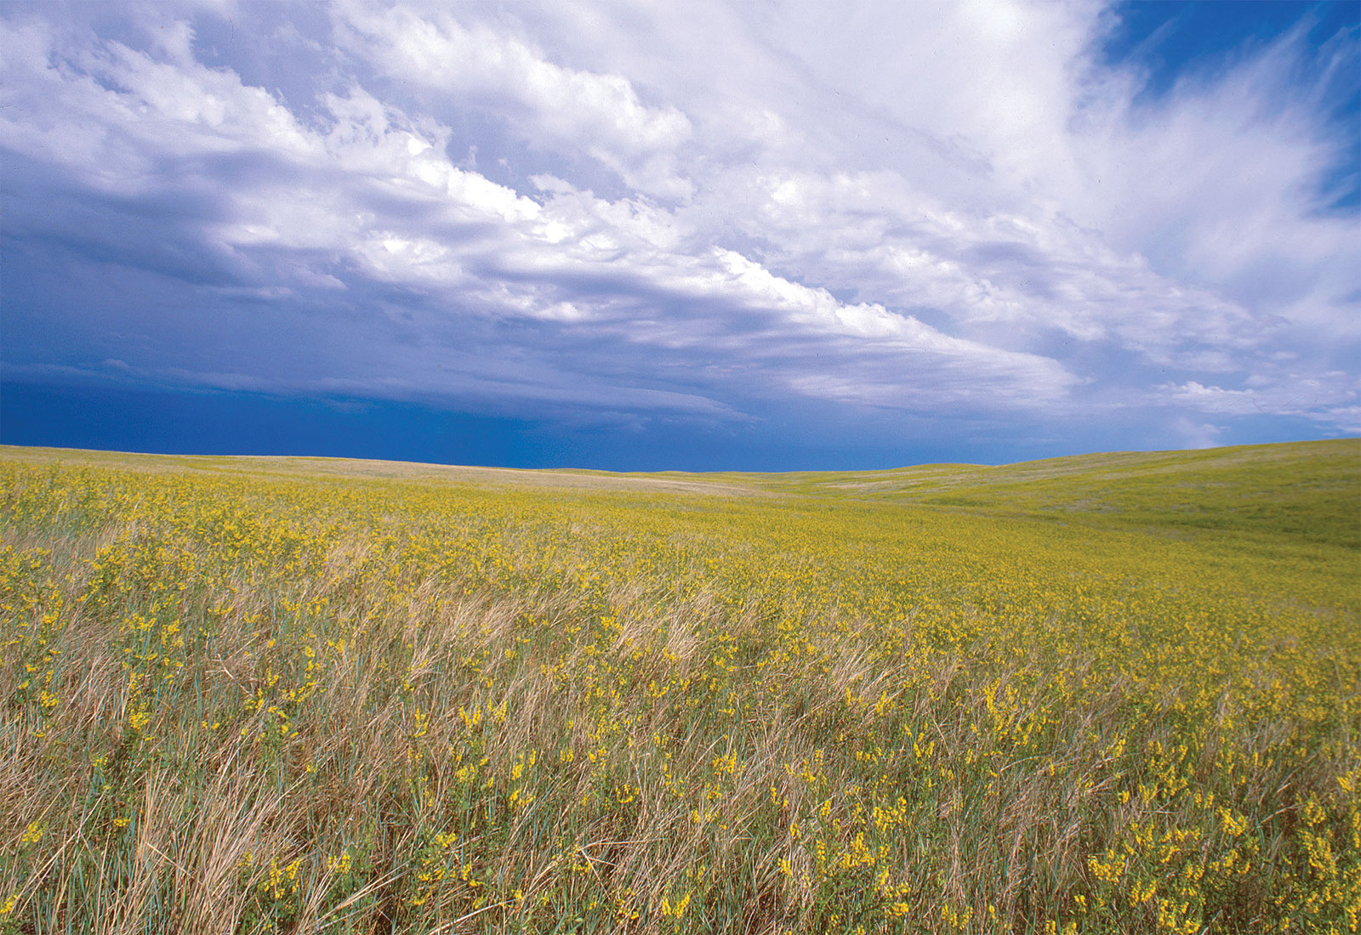
Grassland
Notes:
Grasslands are the third of the major biomes. Consider this: Which organisms are able to live in this biome because of climate?

Slide 83
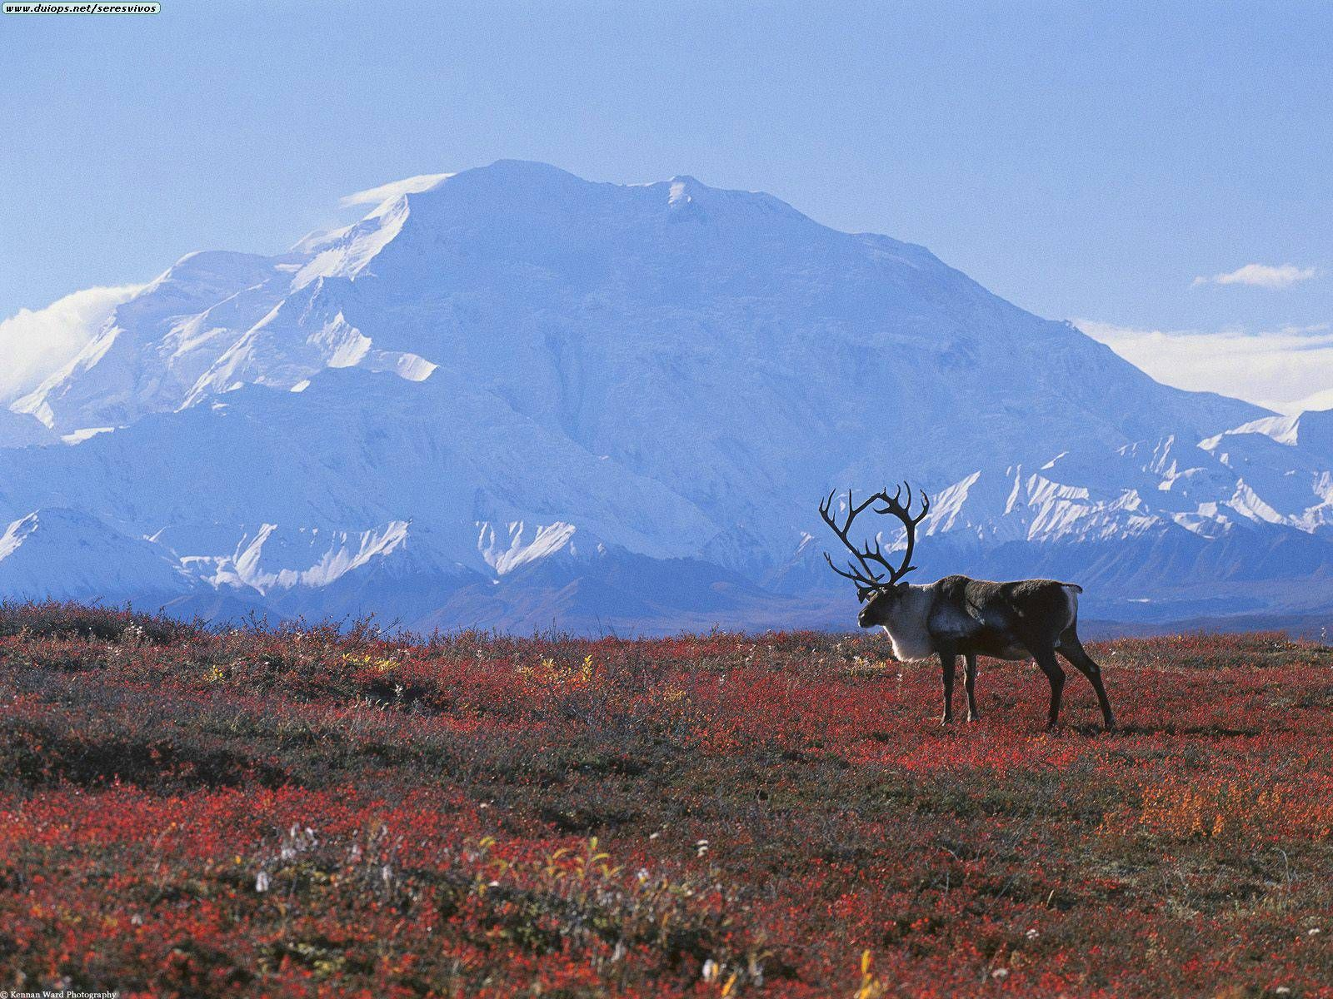
Tundra
Notes:
Tundra are the last of the major biomes. Consider this: Which organisms are able to live in this biome because of climate?

Slide 84
Notes:
Next, let’s talk about some non-examples of biomes.

Slide 85
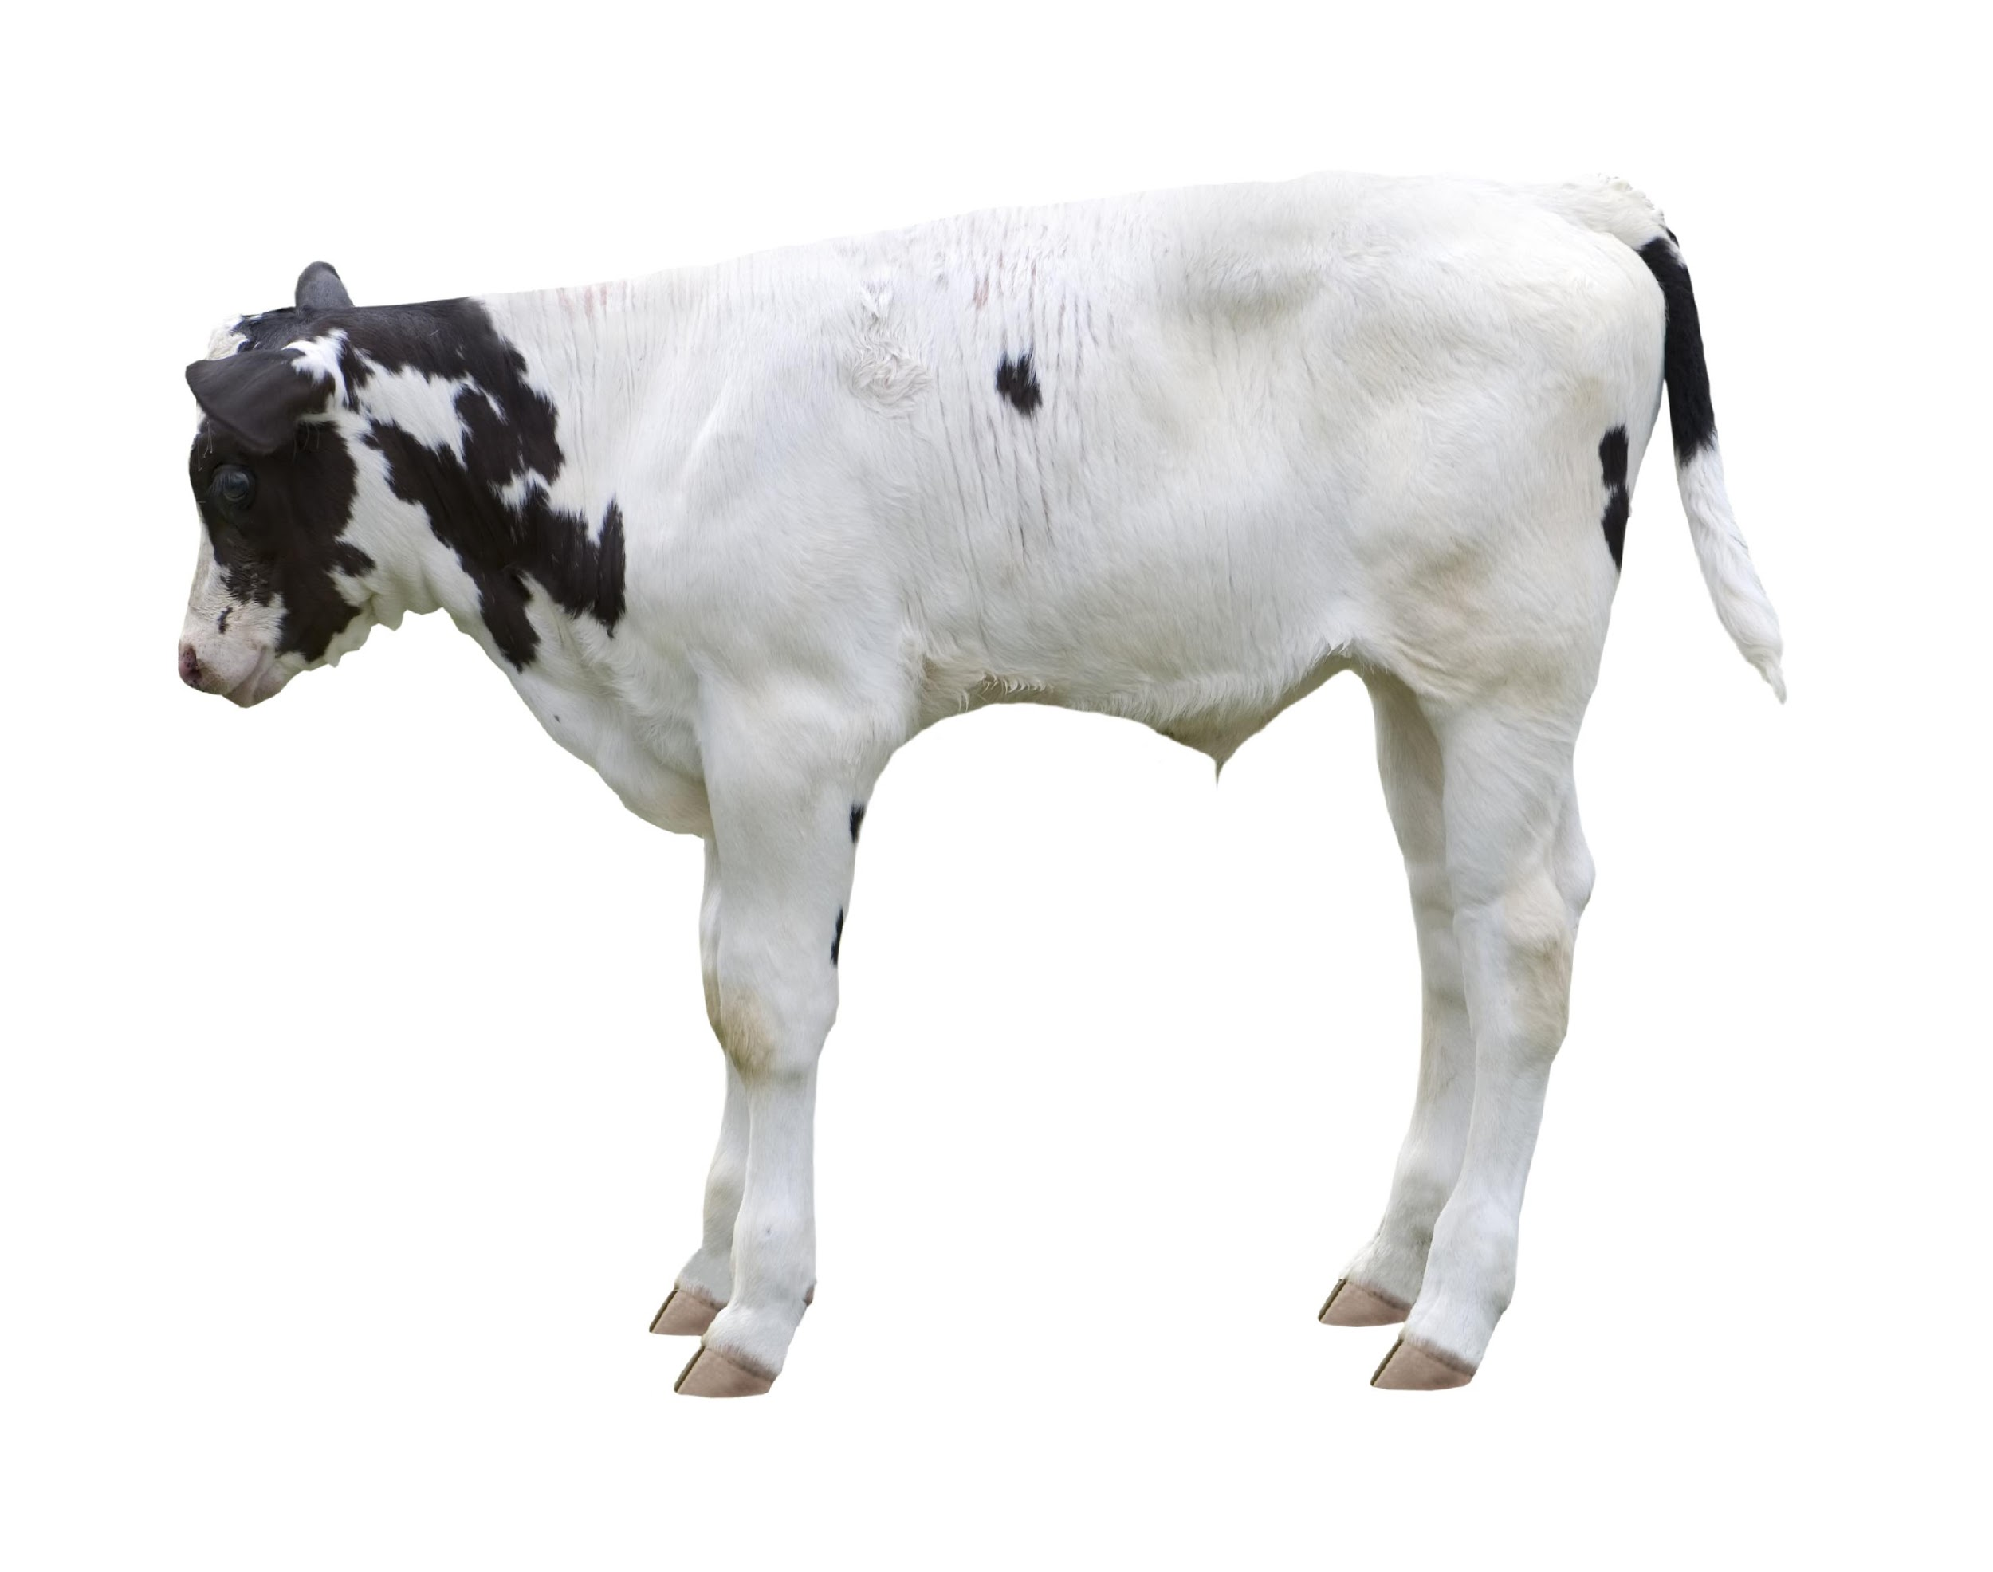
Notes:
This cow is not a biome. Animals cannot be biomes because biomes are regions on Earth.

Slide 86
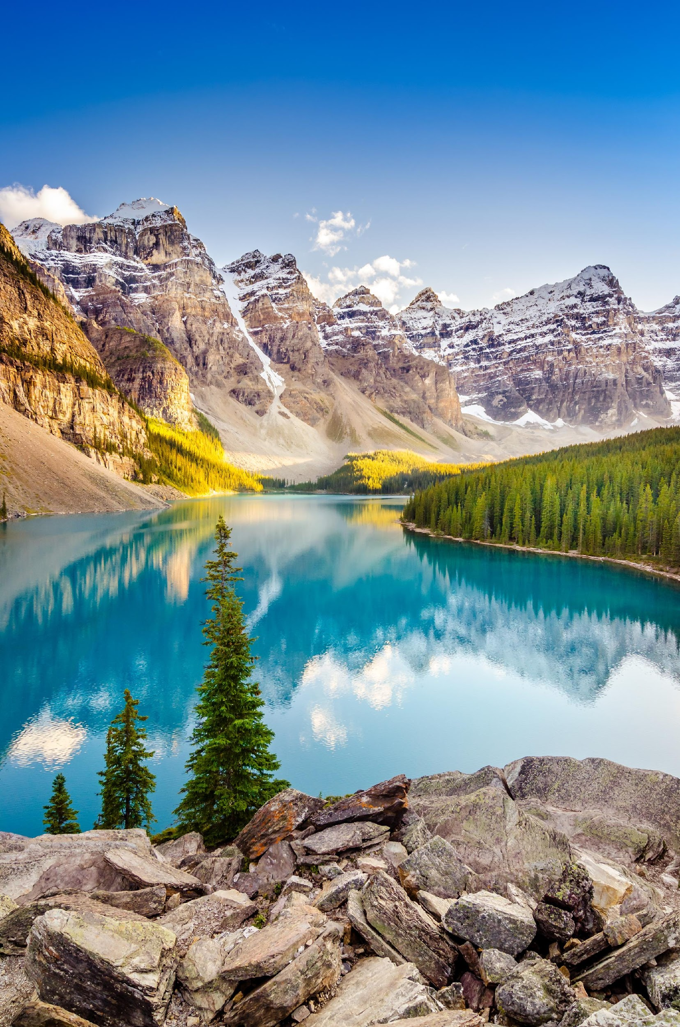
Notes:
These mountains are not an example of a biome. While they are home to many animals, they are not biomes because biomes are much bigger and include many more animal habitats.
Feedback: It is important to explain why a non example is not an example.

Slide 87
Notes:
Let’s check-in for understanding.

Slide 88
What are examples of biomes?
Notes:
What are examples of biomes?

Slide 89
What are non-examples of biomes?
NON
Notes:
What are non-examples of biomes?

Slide 90
What is a biome?
Notes:
What is a biome?
[Biomes are large regions characterized by certain conditions, including a range of climate and ecological communities adapted to those conditions. The major ecosystems are classified into different biomes.]

Slide 91
What are the four major biomes?
Notes:
What are the four major biomes?
[Desert, forest, grassland, tundra]

Slide 92
What is the difference between a biome and an ecosystem?
Notes:
What is the difference between a biome and an ecosystem?
[An ecosystem is a community of organisms that interact with each other and their environment. Biomes are large regions characterized by certain conditions, including a range of climate and ecological communities adapted to those conditions. While they are both regions, biomes are much larger and contain multiple ecosystems.]

Slide 93
Remember!!!
Notes:
So remember!

Slide 94
Biomes: large regions characterized by certain conditions, including a range of climate and ecological communities adapted to those conditions
Notes:
Biomes are large regions characterized by certain conditions, including a range of climate and ecological communities adapted to those conditions. The major ecosystems are classified into different biomes.

Slide 95
Forest
Grassland
Desert
Tundra
Major Biomes
Notes:
There are four major biomes. Each biome is home to different organisms, able to live in the biomes based on the climate.

Slide 96
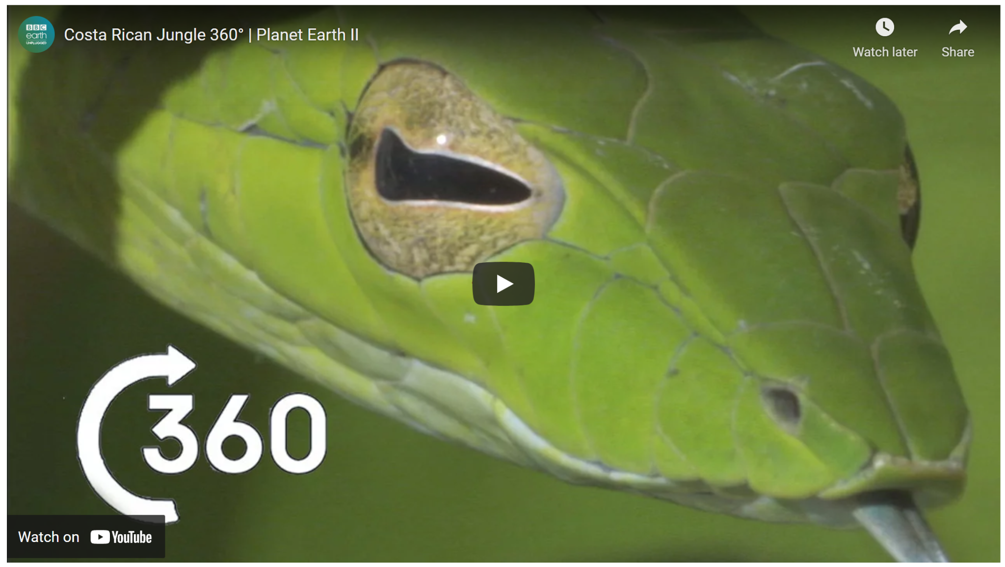
Simulation Activity
Biomes VR Experience
The website linked above allows students to explore each of the biomes and includes 360 degree videos that provide an immersive learning experience for each environment.
Notes:
Feedback: This resource can be explored ahead of time if you wish to provide students with links to specific videos or with questions to extend their learning.

Slide 97
Big Question: What is the relationship between ecosystems and biomes?
Notes:
Explicit cue to revisit the big question at the end of the lesson: Okay everyone. Now that we’ve learned the term, biomes, let’s reflect once more on our big question. Was there anything that we predicted earlier that was correct or incorrect? Do you have any new hypotheses to share?
Feedback: Offering students an opportunity to evaluate their earlier hypotheses and make changes based on their new understandings is an important part of the iterative process in science. This is a great opportunity to help students build an epistemic understanding by explicitly stating how continuing to change and build on hypotheses as your knowledge grows is an important part of the discipline of science!

Slide 98
Notes:
Thanks for watching, and please continue watching CAPs available from this website.

Slide 99
This Video Was Created With Resources From:
Questions or Comments
Michael Kennedy, Ph.D. MKennedy@Virginia.edu
Rachel L Kunemund, Ph.D. rk8vm@virginia.edu

