Slide 1
Intro
“Big Idea” Question
Review Concepts
Check-In Questions
Teacher Demo
Vocabulary
Student-Friendly Definition
Examples & Non-Examples
Morphological Word Parts
Simulation/Activity
Notes:
OK everyone, get ready for our next lesson. Just as a reminder, these are the different components that our lesson may include, and you’ll see these icons in the top left corner of each slide so that you can follow along more easily!

Slide 2
Intro
Electromagnetic Spectrum
Notes:
Today, we will learn about the electromagnetic spectrum.

Slide 3
Big Question: What is the electromagnetic spectrum? How do we experience it in everyday life?
Notes:
Our “big question” is: What is the electromagnetic spectrum? How do we experience it in everyday life?
[Pause and illicit predictions from students.]
I love all these thoughtful scientific hypotheses! Be sure to keep this question and your predictions in mind as we move through these next few lessons, and we’ll continue to revisit it.

Slide 4
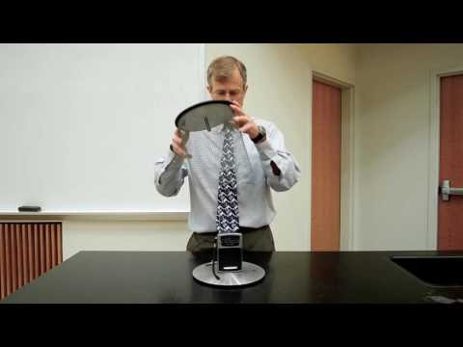
Demonstration
Faraday Cage
The Faraday cage blocks the electromagnetic waves from reaching the radio antenna.
Notes:
The Faraday cage blocks the electromagnetic waves from reaching the radio antenna.
Feedback: Ask questions throughout the demonstration and encourage students to make predictions. This will set the, up to better understand today’s content.

Slide 5
Notes:
Before we move on to our new vocabulary term, let’s review some other words & concepts that you already learned and make sure you are firm in your understanding.
Feedback: It is important to take time and review key relevant information for this new term.

Slide 6
Energy: the ability to do work
Notes:
Energy is the ability to do work. An example can include a man has energy that helps him do his work.

Slide 7
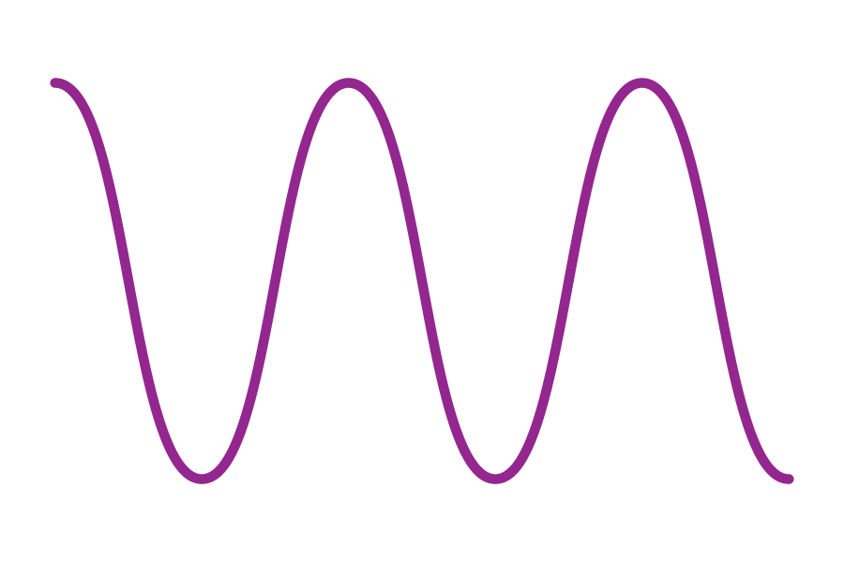
Waves: disturbances that travel through a medium, transporting energy from one location to another without transporting matter
Notes:
Waves are disturbances that travel through a medium, transporting energy from one location to another without transporting matter.

Slide 8
Medium: any material that waves can travel through
Notes:
A medium is any material that waves can travel through.

Slide 9
Vibration: movement of particles that occurs in solids, liquids, or gases
Notes:
Vibration is the movement of particles that occurs in solids, liquids, or gases.

Slide 10
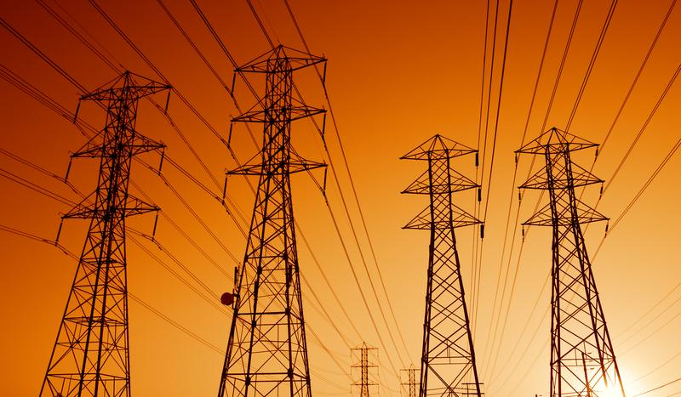
Electric Current: the movement of electrically charged particles
Notes:
Electric current is the movement of electrically charged particles.

Slide 11
Magnet: attracts metal objects
Notes:
A magnet attracts metal objects. It has two poles on opposite ends – one positive, one negative.

Slide 12
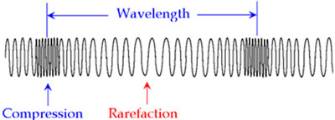
Wavelength: the distance between two like points on a wave
Notes:
Wavelength is the distance between two like points on a wave.

Slide 13
Frequency: the number of wavelengths that pass a set point per second
Notes:
Frequency is the number of wavelengths that pass a set point per second.

Slide 14
Notes:
Now, let’s pause for a moment to check your understanding.
Feedback: Monitoring understanding during review is an important step before moving on to new material.

Slide 15
Energy is the ability to do _______.
Notes:
Energy is the ability to do _________.

Slide 16
Energy is the ability to do work.
Notes:
Energy is the ability to do work.

Slide 17
What are waves?
Notes:
What are waves?
[Waves are disturbances that travel through a medium, transporting energy from one location to another without transporting matter.]

Slide 18
What is a medium?
Notes:
What is a medium?
[A medium is any material that waves can travel through.]

Slide 19
Vibration is the _________ that occurs in solids, liquids, or gases.
Notes:
Vibration is the ______________ that occurs in solids, liquids, or gases.

Slide 20
Vibration is the movement of particles that occurs in solids, liquids, or gases.
Notes:
Vibration is the movement of particles that occurs in solids, liquids, or gases.

Slide 21
Electric current is the ________ of electrically charged particles.
Notes:
Electric current is the __________ of electrically charged particles.

Slide 22
Electric current is the movement of electrically charged particles.
Notes:
Electric current is the movement of electrically charged particles.

Slide 23
What is a magnet?
Notes:
What is a magnet?
[A magnet attracts metal objects. It has two poles on opposite ends – one positive, one negative.]

Slide 24
What is wavelength?
Notes:
What is wavelength?
[Wavelength is the distance between two like points on a wave.]

Slide 25
What is frequency?
Notes:
What is frequency?
[Frequency is the number of wavelengths that pass a set point per second.]

Slide 26
Electromagnetic Spectrum
Notes:
Now that we’ve reviewed, let’s define our new term, electromagnetic spectrum.

Slide 27
Electromagnetic Spectrum: range of all types of electromagnetic waves
Notes:
The electromagnetic spectrum is the range of all types of electromagnetic waves.
Feedback: Longer more formal definitions are tricky, use clear language when providing the new definition.

Slide 28
Notes:
Let’s check-in for understanding.

Slide 29
What is the electromagnetic spectrum?
Notes:
What is the electromagnetic spectrum?
[The electromagnetic spectrum is the range of all types of electromagnetic waves. These are created as result of vibrations between an electric field and a magnetic field.]

Slide 30
Notes:
That is the basic definition, but there is a bit more you need to know.

Slide 31
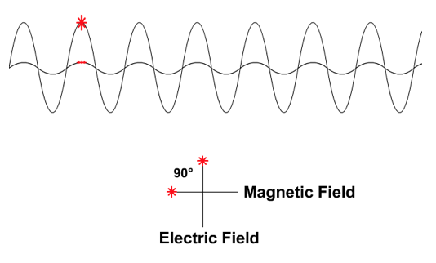
Electromagnetic Waves
Notes:
Electromagnetic waves are waves that are created as a result of vibrations between an electric field and a magnetic field.

Slide 32
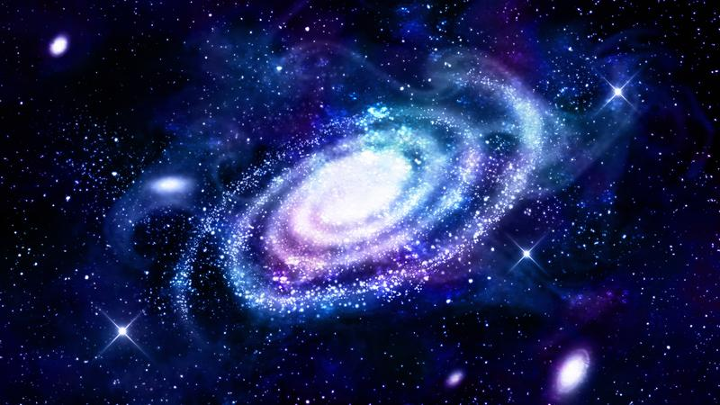
Notes:
Electromagnetic waves do not need a medium to be seen.

Slide 33
Notes:
Let’s check-in for understanding.

Slide 34
What is the relationship between a magnetic field and an electric field?
Notes:
What is the relationship between a magnetic field and an electric field?
[Electromagnetic waves are waves that are created as a result of vibrations between an electric field and a magnetic field.]

Slide 35
True/False: Electromagnetic waves do not need a medium to be seen.
Notes:
True/False: Electromagnetic waves do not need a medium to be seen.

Slide 36
True/False: Electromagnetic waves do not need a medium to be seen.
Notes:
True/False: Electromagnetic waves do not need a medium to be seen.
[True]

Slide 37
Notes:
Now, let’s talk about some examples of waves on the electromagnetic spectrum.
Feedback: When introducing examples, use clear and easy to understand language!

Slide 38
Notes:
We are going to begin with radio waves.

Slide 39
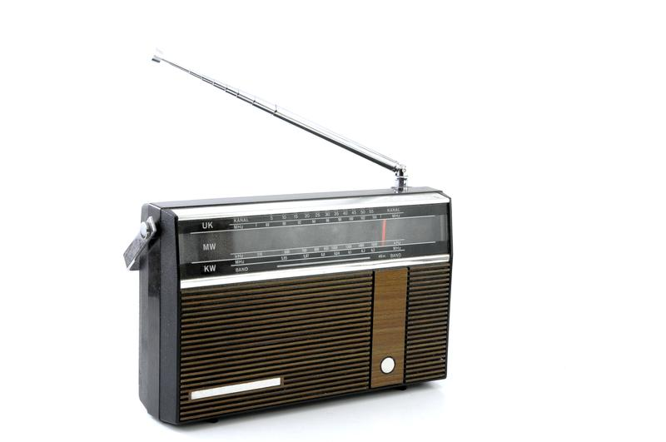
Radio Waves
Notes:
Radio waves have the lowest frequency, lowest energy, and largest wavelengths.

Slide 40
Radio Waves
Notes:
They are great for communication because they are not harmful since they have such a low frequency. There are radio waves passing through you right now.

Slide 41
Notes:
Next, we are going to look at microwaves.

Slide 42
Microwaves
Notes:
Microwaves, like radio waves, also have low frequencies, low energy, and low wavelengths. Microwaves can typically be distinguished from radio waves by technologies used to access them.

Slide 43
Microwaves
Notes:
Microwaves are good for cell phone communication, although most people easily recognize microwaves used to heat up our food. They are anywhere between 1 mm and 30 cm in length.

Slide 44
Notes:
Now, we are going to look at infrared radiation.

Slide 45
Infrared Radiation
Notes:
Infrared radiation has slightly longer waves than visible light but shorter than microwaves. This means that the frequencies and energy of infrared radiation are little higher than microwaves.

Slide 46
Infrared Radiation
Notes:
Infrared radiation is a type of energy that we cannot see but we can feel as heat.

Slide 47
Notes:
Now, we are going to look at visible light.

Slide 48
Visible Light Waves
Notes:
Visible light waves are wavelengths that are visible to the human eye. They are the only wavelengths on the electromagnetic spectrum that are visible. The wavelengths are shorter, and have higher frequencies and energy than infrared radiation.

Slide 49
Visible Light Waves
Notes:
Each color we see is represented by a different wavelength. Red has the longest wavelength and violet has the shortest wavelength. We can only see a very small portion of the electromagnetic spectrum.

Slide 50
Notes:
Now, we are going to look at ultraviolet (UV) waves.

Slide 51
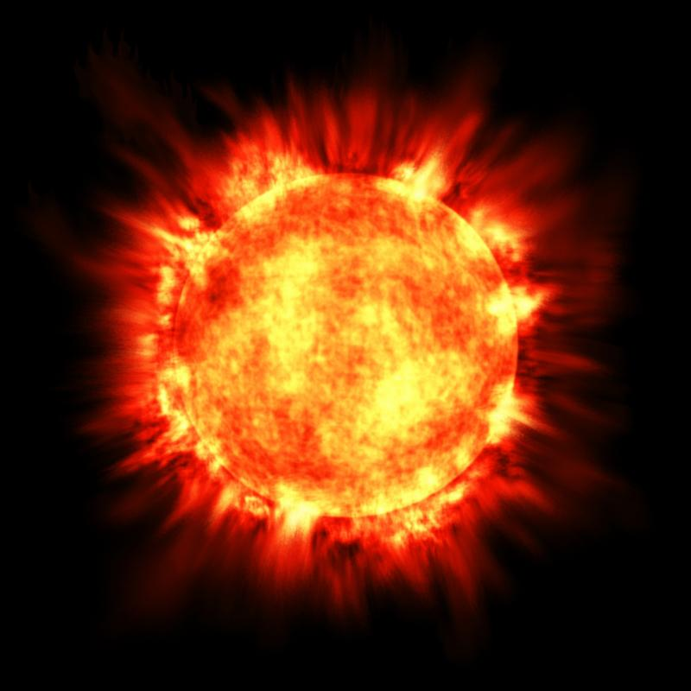
Ultraviolet (UV) Waves
Notes:
Ultraviolet (UV) waves are shorter than visible light but have higher frequencies and energy. The sun emits ultraviolet waves to the earth.

Slide 52
Ultraviolet (UV) Waves
Notes:
Earth’s atmosphere prevents most ultraviolet (UV) waves from entering. However, they can cause sunburns and cancer for the few that pass through. This is why we wear sunscreen!

Slide 53
Notes:
Now, we are going to look at x-rays.

Slide 54
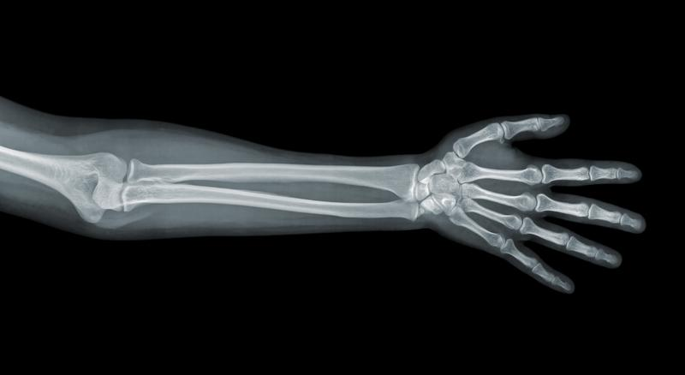
X-Rays
Notes:
X-rays have the second shortest wavelength and the second highest frequency and energy.

Slide 55
X-Rays
Notes:
X-rays are how doctors are able to get images of broken bones. They can pass through tissues and muscles, but get stopped by calcium in bones.

Slide 56
Notes:
Lastly, we are going to look at gamma rays.

Slide 57
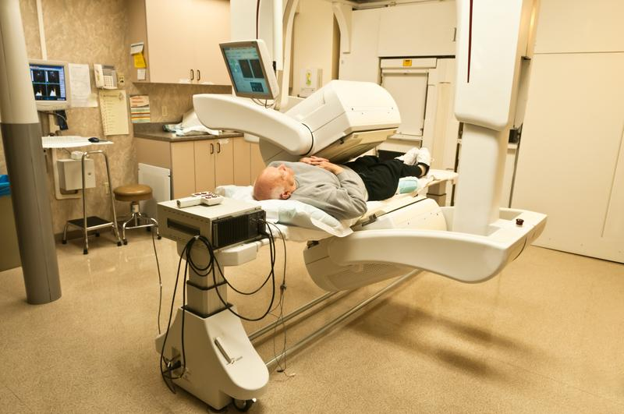
Gamma Rays
Notes:
Gamma rays have the shortest wavelength, and the highest frequencies and energy on the electromagnetic spectrum.

Slide 58
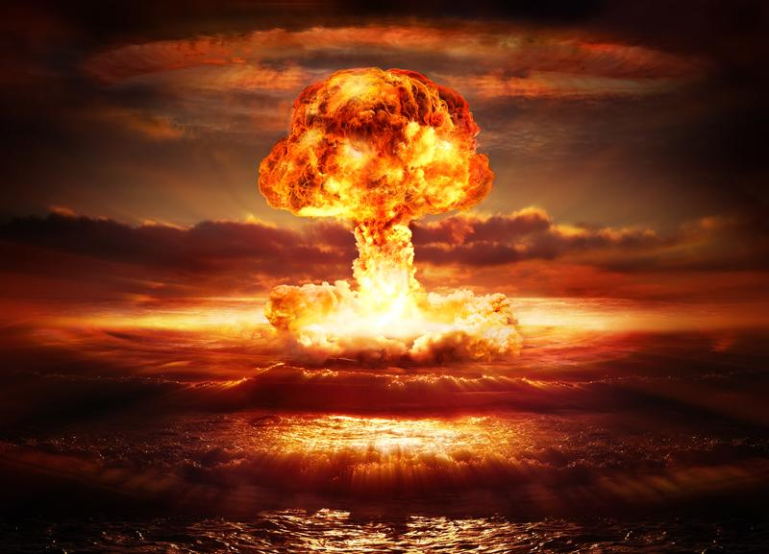
Gamma Rays
Notes:
Gamma rays are made from the radioactive decay of atomic nuclei. This is when the nucleus of an atom breaks. Gamma rays can be made in exploding stars or nuclear bombs. They are extremely toxic and deadly.

Slide 59
Notes:
Let’s check-in for understanding.

Slide 60
What are some characteristics of electromagnetic waves?
Notes:
What are some characteristics of electromagnetic waves?
[Frequency, intensity, amplitude, wavelength, etc.]
Feedback: Open ended questions can highlight students’ strength in understanding for these concepts as well as uncover misconceptions.

Slide 61
What are examples of electromagnetic waves?
Notes:
What are examples of electromagnetic waves?
[X-rays, visible light, microwaves, gamma rays, etc.]

Slide 62
Notes:
Next, let’s talk about some non-examples of electromagnetic waves.
Feedback: Non-examples often need some explanation to make it clear to students the difference.

Slide 63
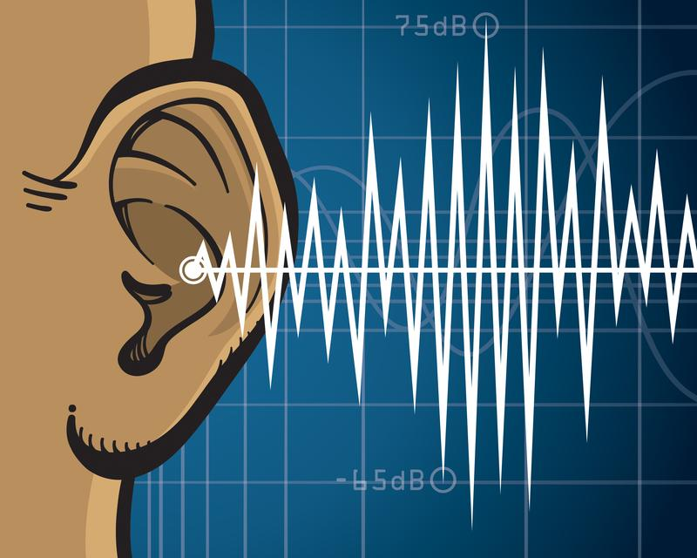
Sound Waves
Notes:
Sound waves are not an example of electromagnetic waves. Sound waves are mechanical energy and require a medium.

Slide 64
Notes:
Let’s check-in for understanding.
Feedback: It is important to take time throughout the close of the lesson to check for understanding one last time, this will help you know who may need more instruction or where further explanation is needed.

Slide 65
Why are sound waves not an example of electromagnetic waves?
NON
Notes:
Why are sound waves not an example of electromagnetic waves?
[Sound waves are mechanical energy and require a medium.]

Slide 66
What is the electromagnetic spectrum?
Notes:
What is the electromagnetic spectrum?
[The electromagnetic spectrum is the range of all types of electromagnetic waves. These are created as result of vibrations between an electric field and a magnetic field.]

Slide 67
What two parts make up an electromagnetic wave?
Magnetic field and electric field
Positive field and negative field
Electrons and protons
Notes:
What 2 parts make up an electromagnetic wave?

Slide 68
What two parts make up an electromagnetic wave?
Magnetic field and electric field
Positive field and negative field
Electrons and protons
Notes:
What 2 parts make up an electromagnetic wave?
[A. Magnetic field and electric field]

Slide 69
Which wave can humans see?
Radio waves
Microwaves
Infrared waves
Visible light
Ultraviolet Waves
X-rays
Gamma rays
Notes:
Which wave can humans see?

Slide 70
Which wave can humans see?
Radio waves
Microwaves
Infrared waves
Visible light
Ultraviolet Waves
X-rays
Gamma rays
Notes:
Which wave can humans see?
[D. Visible light]

Slide 71
Which three waves can cause harm to humans?
Radio waves
Microwaves
Infrared waves
Visible light
Ultraviolet Waves
X-rays
Gamma rays
Notes:
Which 3 waves can cause harm to humans?

Slide 72
Which three waves can cause harm to humans?
Radio waves
Microwaves
Infrared waves
Visible light
Ultraviolet Waves
X-rays
Gamma rays
Notes:
Which 3 waves can cause harm to humans?
[Ultraviolet waves, x-rays, and gamma rays]

Slide 73
Which wave has the shortest wavelength?
Radio waves
Microwaves
Infrared waves
Visible light
Ultraviolet Waves
X-rays
Gamma rays
Notes:
Which wave has the shortest wavelengths?

Slide 74
Which wave has the shortest wavelength?
Radio waves
Microwaves
Infrared waves
Visible light
Ultraviolet Waves
X-rays
Gamma rays
Notes:
Which wave has the shortest wavelengths?
[Gamma rays]

Slide 75
Remember!!!
Notes:
So remember!
Feedback: It is important to review the key term once more before the end of the lesson.

Slide 76
Electromagnetic Spectrum: range of all types of electromagnetic waves
Notes:
The electromagnetic spectrum is the range of all types of electromagnetic waves.

Slide 77
Radio Waves
Notes:
Radio waves have the lowest frequency, lowest energy, and largest wavelengths.

Slide 78
Microwaves
Notes:
Microwaves, like radio waves, also have low frequencies, low energy, and low wavelengths. Microwaves can typically be distinguished from radio waves by technologies used to access them.

Slide 79
Infrared Radiation
Notes:
Infrared radiation has slightly longer waves than visible light but shorter than microwaves. This means that the frequencies and energy of infrared radiation are little higher than microwaves.

Slide 80
Visible Light Waves
Notes:
Visible light waves are wavelengths that are visible to the human eye. They are the only wavelengths on the electromagnetic spectrum that are visible. The wavelengths are shorter, and have higher frequencies and energy than infrared radiation.

Slide 81
Ultraviolet (UV) Waves
Notes:
Ultraviolet (UV) waves are shorter than visible light but have higher frequencies and energy. The sun emits ultraviolet waves to the earth.

Slide 82
X-Rays
Notes:
X-rays have the second shortest wavelength, and the second highest frequency and energy.

Slide 83
Gamma Rays
Notes:
Gamma rays have the shortest wavelength, and the highest frequencies and energy on the electromagnetic spectrum.

Slide 84
Big Question: What is the electromagnetic spectrum? How do we experience it in everyday life?
Notes:
Explicit cue to revisit the big question at the end of the lesson: Okay everyone. Now that we’ve learned the term, let’s reflect once more on our big question. Was there anything that we predicted earlier that was correct or incorrect? Do you have any new hypotheses to share?

Slide 85
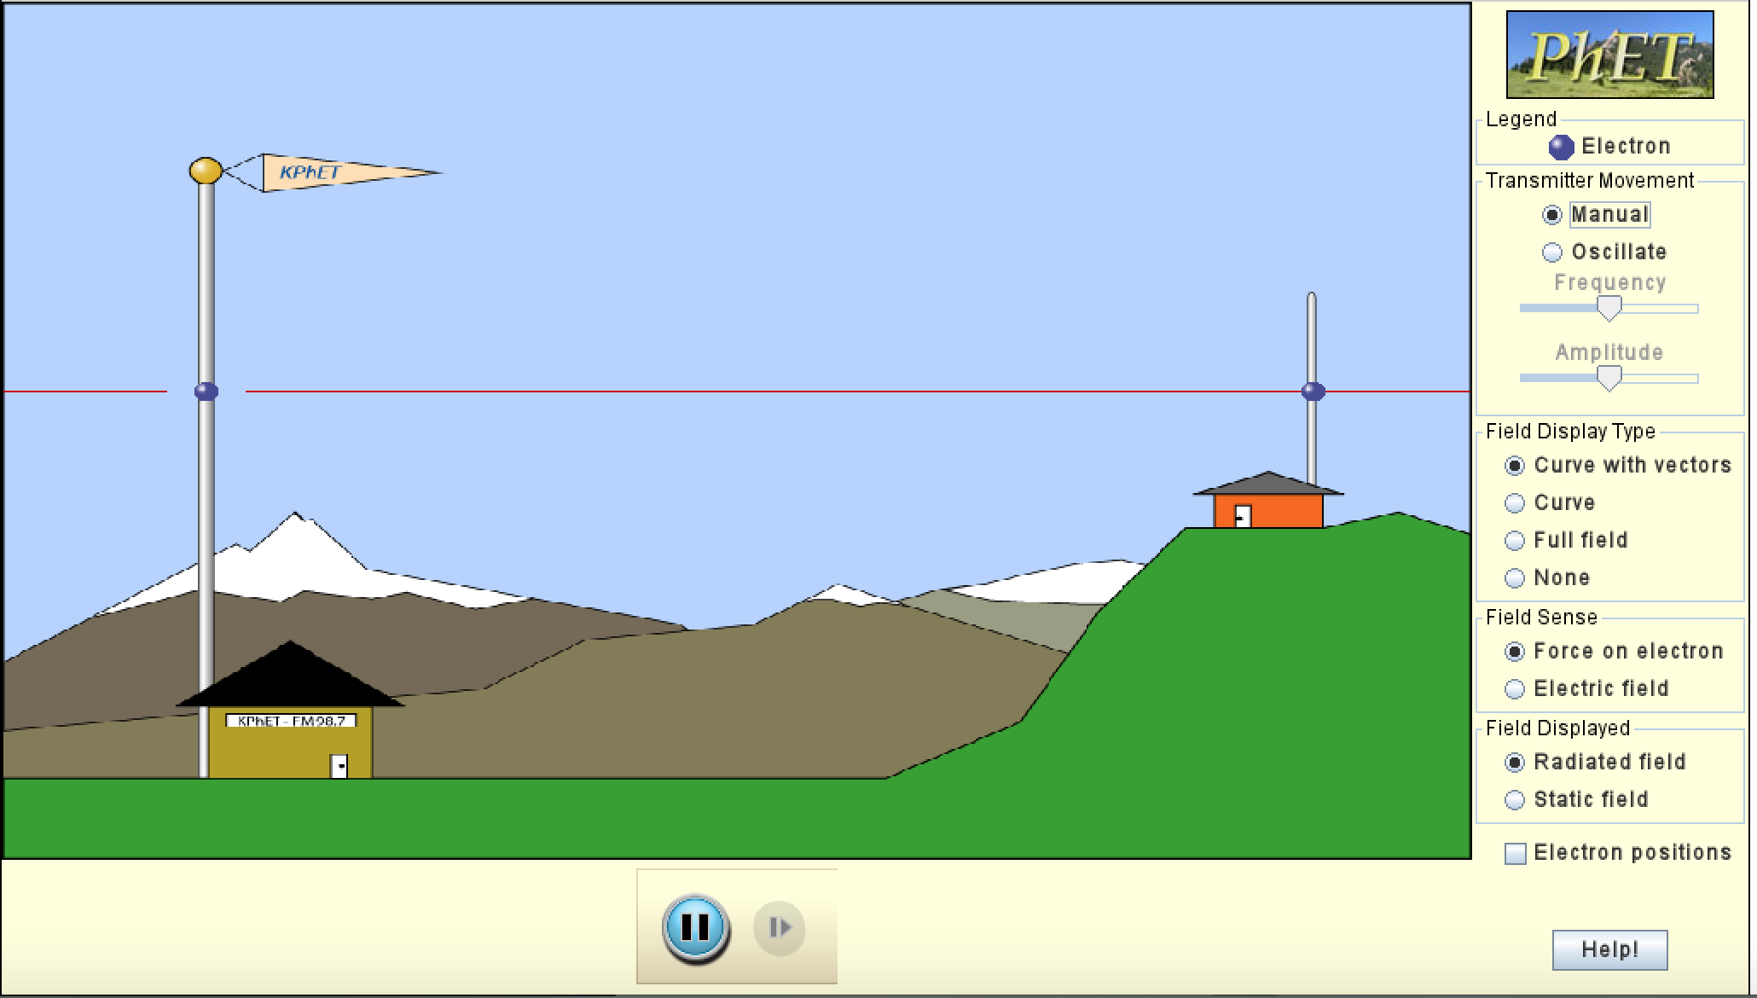
Simulation Activity
Radio Waves
(Phet)
Click the link above for a simulation to deepen your understanding of radio waves.
Remember, radio waves are only one type of wave on the electromagnetic spectrum.

Slide 86
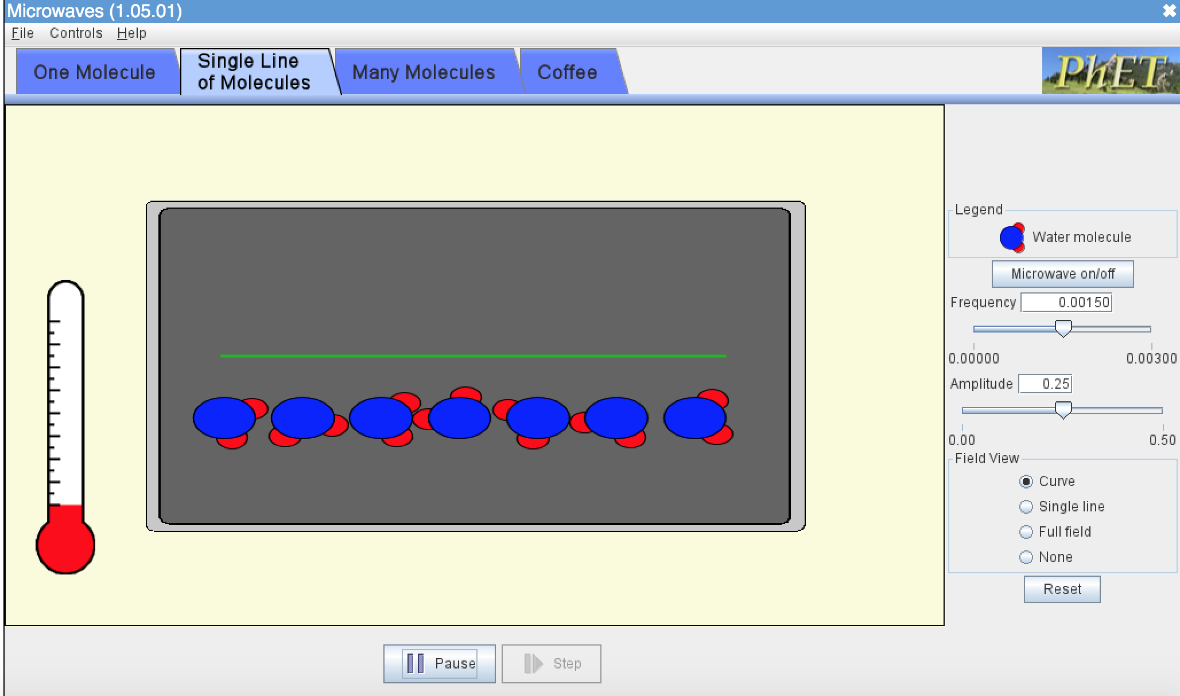
Simulation Activity
Microwaves
(Phet)
Click the link above for a simulation to deepen your understanding of microwaves.
Remember, microwaves are only one type of wave on the electromagnetic spectrum.

Slide 87
Notes:
Thanks for watching, and please continue watching CAPs available from this website.

Slide 88
This Video Was Created With Resources From:
Questions or Comments
Michael Kennedy, Ph.D. MKennedy@Virginia.edu
Rachel L Kunemund, Ph.D. rk8vm@virginia.edu

