Slide 1
Intro
“Big Idea” Question
Review Concepts
Check-In Questions
Teacher Demo
Vocabulary
Student-Friendly Definition
Examples & Non-Examples
Morphological Word Parts
Simulation/Activity
Notes:
OK everyone, get ready for our next lesson. Just as a reminder, these are the different components that our lesson may include, and you’ll see these icons in the top left corner of each slide so that you can follow along more easily!

Slide 2
Intro
Electromagnetic Spectrum
Notes:
Today we will learn about the electromagnetic spectrum.

Slide 3
Big Question: What is the electromagnetic spectrum? How do we experience it in everyday life?
Notes:
Our “big question” is: What is the electromagnetic spectrum? How do we experience it in everyday life?
[Pause and illicit predictions from students.]
I love all these thoughtful scientific hypotheses! Be sure to keep this question and your predictions in mind as we move through these next few lessons, and we’ll continue to revisit it.
Feedback: Providing students with the opportunity to make predictions about what will happen allows them to think critically about the content.

Slide 4
Notes:
Before we move on to our new vocabulary term, let’s review some other words & concepts that you already learned and make sure you are firm in your understanding.

Slide 5
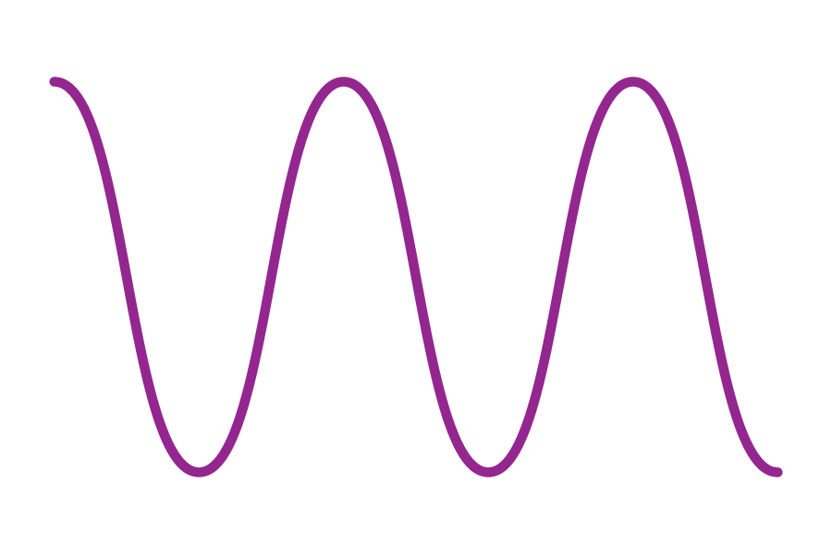
Waves: disturbances that travel through a medium, transporting energy from one location to another without transporting matter
Notes:
Waves are disturbances that travel through a medium, transporting energy from one location to another without transporting matter.

Slide 6
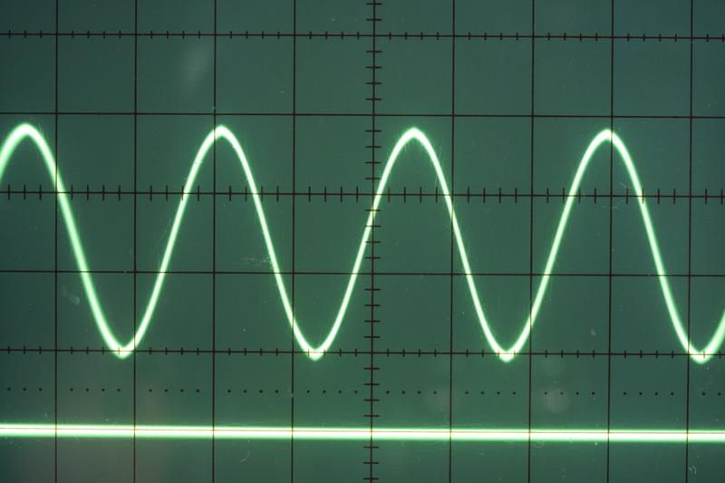
Transverse Waves: waves that travel perpendicularly to the direction they are moving
Notes:
Transverse waves are waves that travel perpendicularly to the direction they are moving.

Slide 7
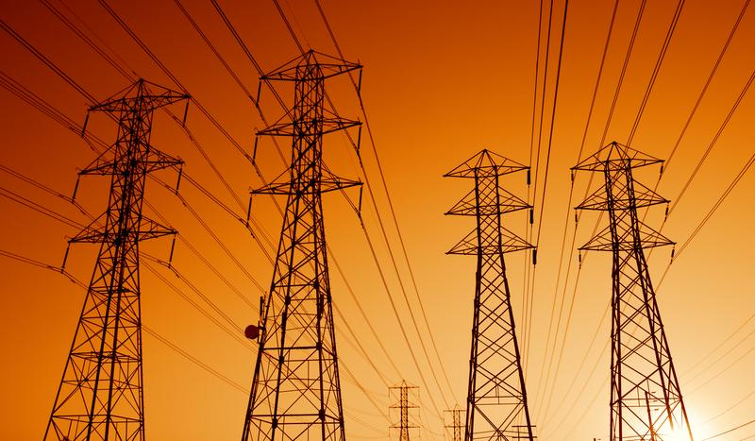
Electric Current: the movement of electrically charged particles
Notes:
Electric current is the movement of electrically charged particles.

Slide 8
Magnet: attracts metal objects
Notes:
A magnet attracts metal objects. It has two poles on opposite ends – one positive, one negative.

Slide 9
Notes:
Now let’s pause for a moment to check your understanding.
Feedback: Remember to make adjustments to your lesson and content if you see some students not demonstrating understanding, this can help them make connections and prevent frustration.

Slide 10
What is the difference between waves and transverse waves?
Notes:
What is the difference between waves and transverse waves?
[Transverse waves are simply a type of wave that moves perpendicularly to the direction they are moving. This is not the case for all waves.]

Slide 11
Electric current is the ________ of electrically charged particles.
Notes:
Electric current is the __________ of electrically charged particles.
[movement]

Slide 12
Electric current is the movement of electrically charged particles.
Notes:
Electric current is the movement of electrically charged particles.

Slide 13
What is a magnet?
Notes:
What is a magnet?
[A magnet attracts metal objects. It has two poles on opposite ends – one positive, one negative.]

Slide 14
Electromagnetic Spectrum
Notes:
Now that we’ve reviewed, let’s define our new term, electromagnetic spectrum.

Slide 15
Electromagnetic Spectrum: range of all types of electromagnetic waves
Notes:
The electromagnetic spectrum is the range of all types of magnetic waves.

Slide 16
Notes:
Let’s check-in for understanding.

Slide 17
What is the electromagnetic spectrum?
Notes:
What is the electromagnetic spectrum?
[The electromagnetic spectrum is the range of all types of electromagnetic waves. These are created as result of vibrations between an electric field and a magnetic field.]

Slide 18
Notes:
That is the basic definition, but there is a bit more you need to know.

Slide 19
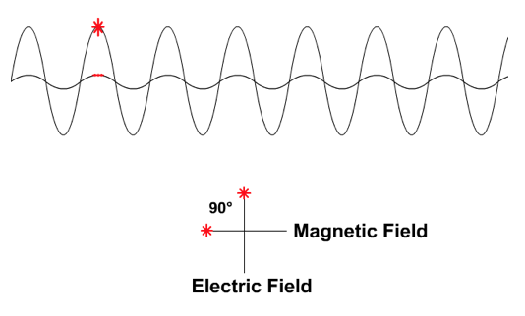
Electromagnetic Waves
Notes:
Electromagnetic waves are waves that are created as a result of vibrations between an electric field and a magnetic field.
Feedback: It can be helpful to break the definition down and explicitly explain each part to help students understand the whole definition. In this case, students need to understand what electromagnetic waves are to understand what the electromagnetic spectrum is.

Slide 20
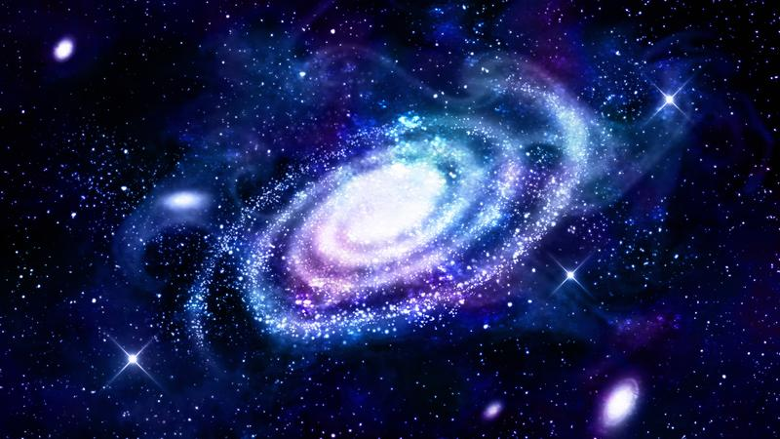
Notes:
Electromagnetic waves do not need a medium to be seen.

Slide 21
Notes:
Let’s check-in for understanding.

Slide 22
What is the relationship between a magnetic field and an electric field?
Notes:
What is the relationship between a magnetic field and an electric field?
[Electromagnetic waves are waves that are created as a result of vibrations between an electric field and a magnetic field.]

Slide 23
True/False: Electromagnetic waves do not need a medium to be seen.
Notes:
True/False: Electromagnetic waves do not need a medium to be seen.
[true]

Slide 24
True/False: Electromagnetic waves do not need a medium to be seen.
Notes:
True/False: Electromagnetic waves do not need a medium to be seen.
[true]

Slide 25
Notes:
Now, let’s talk about some examples of waves on the electromagnetic spectrum.

Slide 26
Notes:
We are going to begin with radio waves.
Feedback: It's great practice to introduce an example of the term WITH images to go along with it, this is a great way to help students make connections.

Slide 27
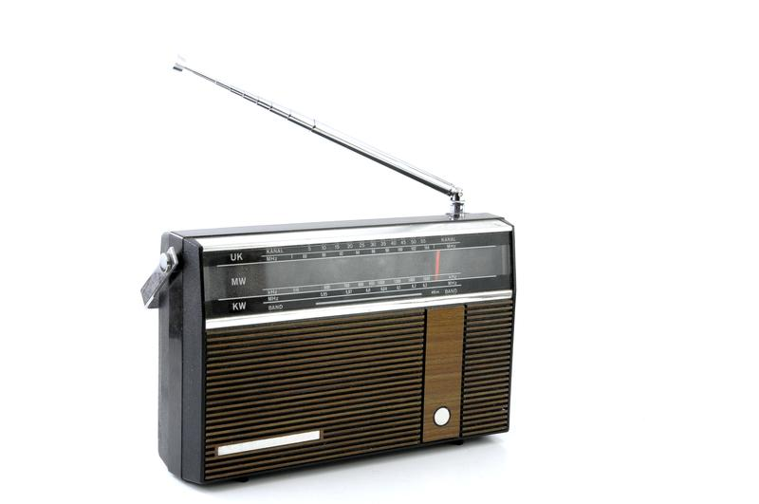
Radio Waves
Notes:
Radio waves have the lowest frequency, lowest energy, and largest wavelengths.

Slide 28
Radio Waves
Notes:
They are great for communication because they are not harmful since they have such a low frequency. There are radio waves passing through you right now.

Slide 29
Notes:
Next, we are going to look at microwaves.

Slide 30
Microwaves
Notes:
Microwaves, like radio waves, also have low frequencies, low energy, and low wavelengths. Microwaves can typically be distinguished from radio waves by technologies used to access them.

Slide 31
Microwaves
Notes:
Microwaves are good for cell phone communication, although most people easily recognize microwaves used to heat up our food. They are anywhere between 1 mm and 30 mic cm in length.

Slide 32
Notes:
Now, we are going to look at infrared radiation.

Slide 33
Infrared Radiation
Notes:
Infrared radiation has slightly longer waves than visible light but shorter than microwaves. This means that the frequencies and energy of infrared radiation are little higher than microwaves.

Slide 34
Infrared Radiation
Notes:
Infrared radiation is a type of radiant energy that we cannot see but we can feel as heat.

Slide 35
Notes:
Now, we are going to look at visible light.

Slide 36
Visible Light Waves
Notes:
Visible light waves are wavelengths that are visible to the human eye. They are the only wavelengths on the electromagnetic spectrum that are visible. The wavelengths are shorter, and have higher frequencies and energy than infrared radiation.

Slide 37
Visible Light Waves
Notes:
Each color we see is represented by a different wavelength. Red has the longest wavelength and violet has the shortest wavelength. We can only see a very small portion of the electromagnetic spectrum.

Slide 38
Notes:
Now, we are going to look at ultraviolet (UV) waves.
Feedback: This is a long section of examples. Keep in mind, it is important to continuously ask students questions and check for understanding. This will let you know if further instruction on certain content is needed.

Slide 39
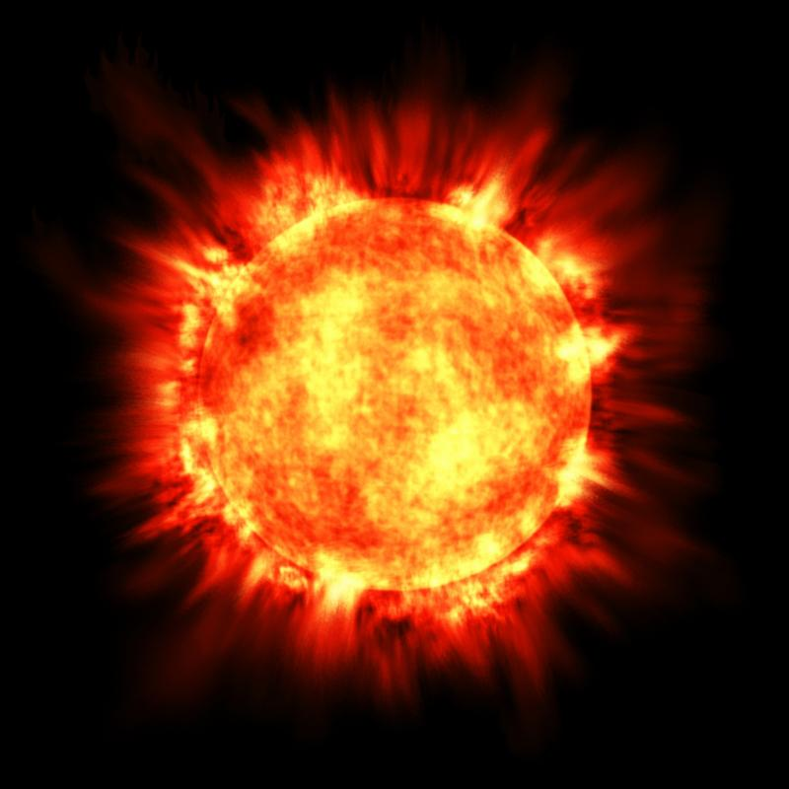
Ultraviolet (UV) Waves
Notes:
Ultraviolet (UV) waves are shorter than visible light but have higher frequencies and energy. The sun emits ultraviolet waves to the earth.

Slide 40
Ultraviolet (UV) Waves
Notes:
Earth’s atmosphere prevents most ultraviolet (UV) waves from entering. However, they can cause sunburns and cancer for the few that pass through. This is why we wear sunscreen!

Slide 41
Notes:
Now, we are going to look at x-rays.

Slide 42
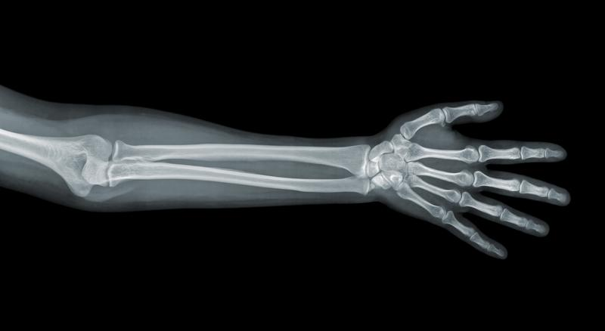
X-Rays
Notes:
X-rays have the second shortest wavelength and the second highest frequency and energy.

Slide 43
X-Rays
Notes:
X-rays are how doctors are able to get images of broken bones. They can pass through tissues and muscles, but get stopped by calcium in bones.

Slide 44
Notes:
Lastly, we are going to look at gamma rays.

Slide 45
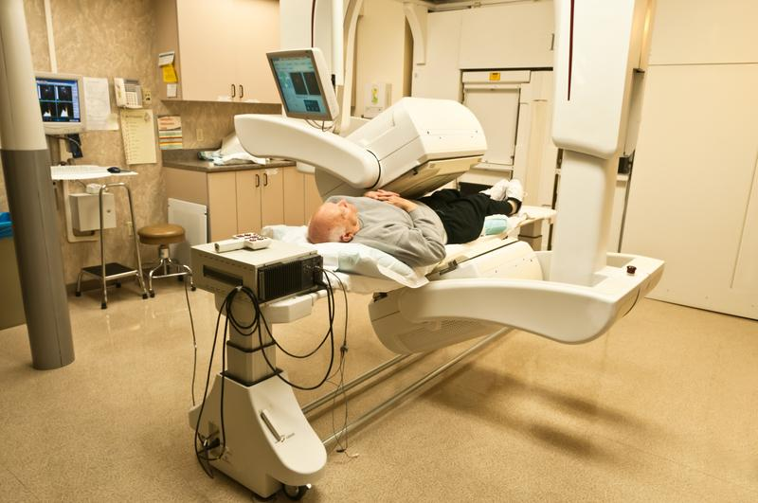
Gamma Rays
Notes:
Gamma rays have the shortest wavelength, and the highest frequencies and energy on the electromagnetic spectrum.

Slide 46
Gamma Rays
Notes:
Gamma rays are made from the radioactive decay of atomic nuclei. This is when the nucleus of an atom breaks. Gamma rays can be made in exploding stars or nuclear bombs. They are extremely toxic and deadly.

Slide 47
Notes:
Let’s check-in for understanding.

Slide 48
What are some characteristics of electromagnetic waves?
Notes:
What are some characteristics of electromagnetic waves?
[Frequency, intensity, amplitude, wavelength, etc.]

Slide 49
What are examples of electromagnetic waves?
Notes:
What are examples of electromagnetic waves?
[X-rays, visible light, microwaves, gamma rays, etc.]

Slide 50
Notes:
Next, let’s talk about some non-examples of electromagnetic waves.

Slide 51
Sound Waves
Notes:
Sound waves are not an example of electromagnetic waves. Sound waves are mechanical energy and require a medium.
Feedback: Non-examples often need some explanation to make it clear to students the difference. Using clear and simple language can help with this.

Slide 52
Notes:
Let’s check-in for understanding.

Slide 53
Why are sound waves not an example of electromagnetic waves?
NON
Notes:
Why are sound waves not an example of electromagnetic waves?
[Sound waves are mechanical energy and require a medium.]

Slide 54
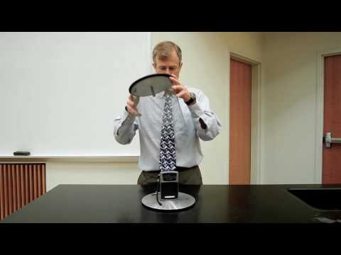
Demonstration - Faraday Cage
Notes:
The Faraday cage blocks the electromagnetic waves from reaching the radio antenna.
Feedback: It is important to give some background information or a related natural phenomena related to the topic of the activity/demonstration. This helps students make connections.

Slide 55
Notes:
Let’s check-in for understanding.

Slide 56
What is the electromagnetic spectrum?
Notes:
What is the electromagnetic spectrum?
[The electromagnetic spectrum is the range of all types of electromagnetic waves. These are created as result of vibrations between an electric field and a magnetic field.]

Slide 57
What two parts make up an electromagnetic wave?
Magnetic field and electric field
Positive field and negative field
Electrons and protons
Notes:
What 2 parts make up an electromagnetic wave?
[Magnetic field and electric field]
Feedback: It is important to take time throughout the close of the lesson to check for understanding one last time, this will help you know who may need more instruction or where further explanation is needed.

Slide 58
What two parts make up an electromagnetic wave?
Magnetic field and electric field
Positive field and negative field
Electrons and protons
Notes:
What 2 parts make up an electromagnetic wave?
[Magnetic field and electric field]

Slide 59
Which wave can humans see?
Visible Light
Radio Waves
Ultraviolet Waves
Microwaves
X-rays
Gamma Rays
Infrared Radiation
Notes:
Which wave can humans see?
[Visible light]

Slide 60
Which wave can humans see?
Visible Light
Radio Waves
Ultraviolet Waves
Microwaves
X-rays
Gamma Rays
Infrared Radiation
Notes:
Which wave can humans see?
[Visible light]

Slide 61
Which three waves can cause harm to humans?
Visible Light
Radio Waves
Ultraviolet Waves
Microwaves
X-rays
Gamma Rays
Infrared Radiation
Notes:
Which 3 waves can cause harm to humans?
[Ultraviolet waves, x-rays, and gamma rays]

Slide 62
Which three waves can cause harm to humans?
Visible Light
Radio Waves
Ultraviolet Waves
Microwaves
X-rays
Gamma Rays
Infrared Radiation
Notes:
Which 3 waves can cause harm to humans?
[Ultraviolet waves, x-rays, and gamma rays]

Slide 63
Which wave has the shortest wavelength?
Visible Light
Radio Waves
Ultraviolet Waves
Microwaves
X-rays
Gamma Rays
Infrared Radiation
Notes:
Which wave has the shortest wavelengths?
[Gamma rays]

Slide 64
Which wave has the shortest wavelength?
Visible Light
Radio Waves
Ultraviolet Waves
Microwaves
X-rays
Gamma Rays
Infrared Radiation
Notes:
Which wave has the shortest wavelengths?
[Gamma rays]

Slide 65
Remember!!!
Notes:
So remember!

Slide 66
Electromagnetic Spectrum: range of all types of electromagnetic waves
Notes:
The electromagnetic spectrum is the range of all types of magnetic waves.

Slide 67
Radio Waves
Notes:
Radio waves have the lowest frequency, lowest energy, and largest wavelengths.

Slide 68
Microwaves
Notes:
Microwaves, like radio waves, also have low frequencies, low energy, and low wavelengths. Microwaves can typically be distinguished from radio waves by technologies used to access them.

Slide 69
Infrared Radiation
Notes:
Infrared radiation has slightly longer waves than visible light but shorter than microwaves. This means that the frequencies and energy of infrared radiation are little higher than microwaves.

Slide 70
Visible Light Waves
Notes:
Visible light waves are wavelengths that are visible to the human eye. They are the only wavelengths on the electromagnetic spectrum that are visible. The wavelengths are shorter, and have higher frequencies and energy than infrared radiation.

Slide 71
Ultraviolet (UV) Waves
Notes:
Ultraviolet (UV) waves are shorter than visible light but have higher frequencies and energy. The sun emits ultraviolet waves to the earth.

Slide 72
X-Rays
Notes:
X-rays have the second shortest wavelength, and the second highest frequency and energy.

Slide 73
Gamma Rays
Notes:
Gamma rays have the shortest wavelength, and the highest frequencies and energy on the electromagnetic spectrum.

Slide 74
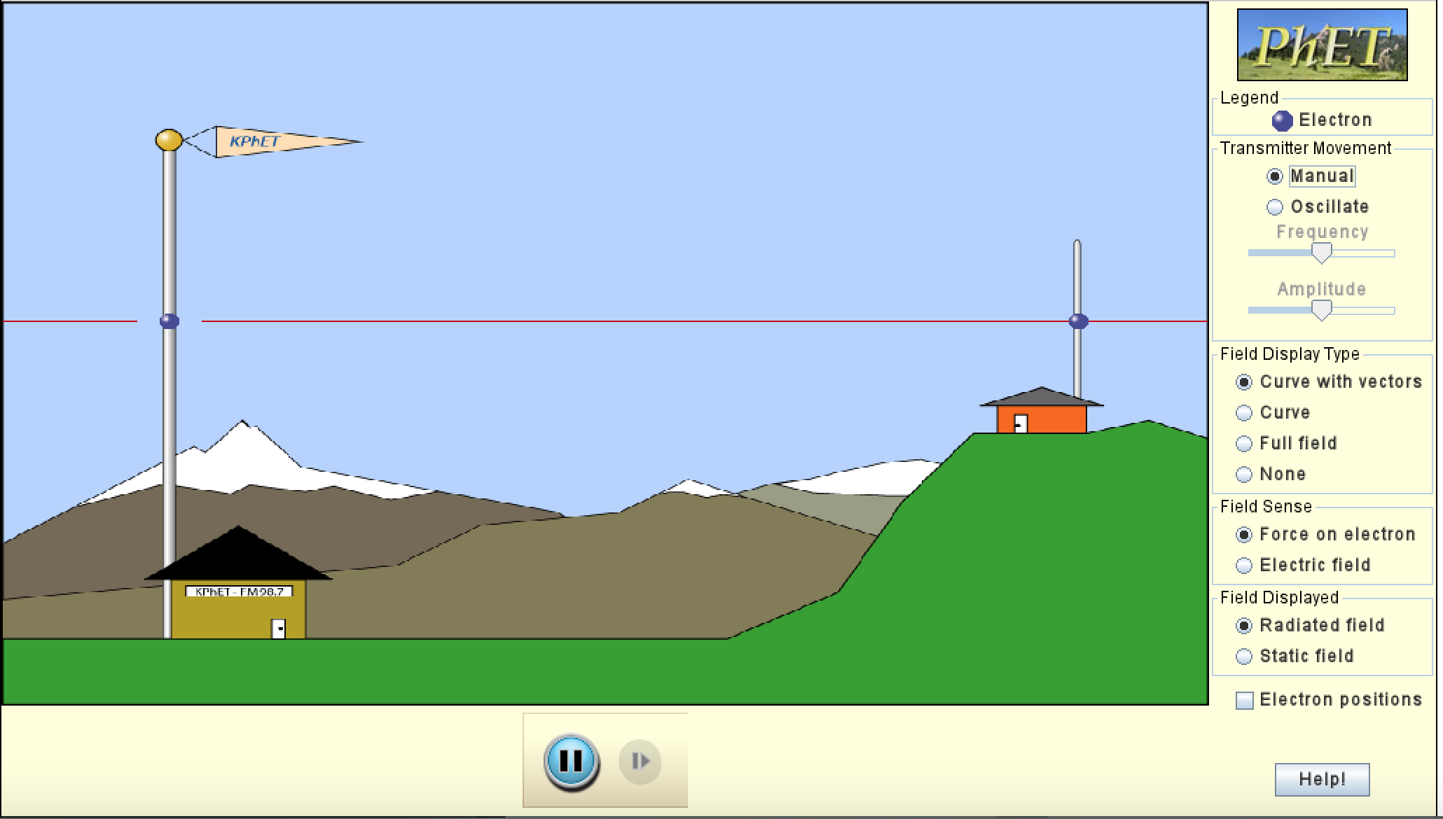
Simulation Activity
Radio Waves
(Phet)
Click the link above for a simulation to deepen your understanding of radio waves.
Remember, radio waves are only one type of wave on the electromagnetic spectrum.
Notes:
Feedback: Remember, we want students to gather information and then be able to not only evaluate but also effectively communicate what they have learned from this activity.

Slide 75
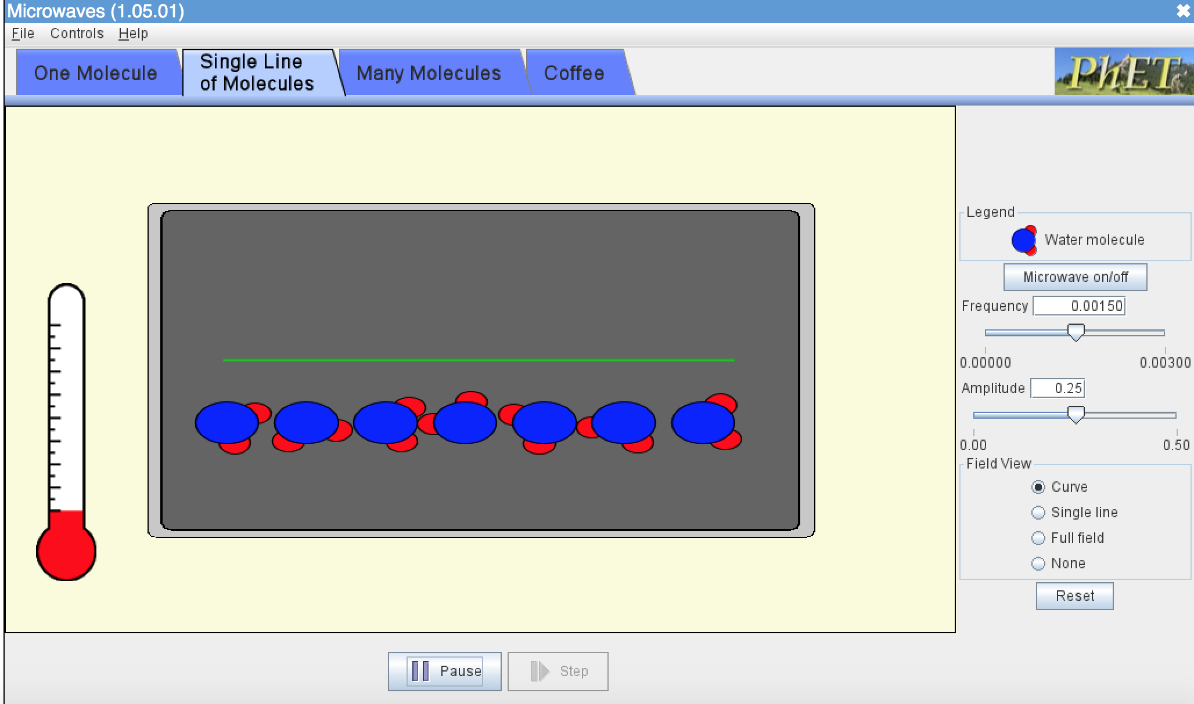
Simulation Activity
Microwaves
(Phet)
Click the link above for a simulation to deepen your understanding of microwaves.
Remember, microwaves are only one type of wave on the electromagnetic spectrum.

Slide 76
Big Question: What is the electromagnetic spectrum? How do we experience it in everyday life?
Notes:
Explicit cue to revisit the big question at the end of the lesson: Okay everyone. Now that we’ve learned the term, let’s reflect once more on our big question. Was there anything that we predicted earlier that was correct or incorrect? Do you have any new hypotheses to share?

Slide 77
Notes:
Thanks for watching, and please continue watching CAPs available from this website.

Slide 78
This Video Was Created With Resources From:
Questions or Comments
Michael Kennedy, Ph.D. MKennedy@Virginia.edu
Rachel L Kunemund, Ph.D. rk8vm@virginia.edu

Slide 79
Intro
“Big Idea” Question
Review Concepts
Check-In Questions
Teacher Demo
Vocabulary
Student-Friendly Definition
Examples & Non-Examples
Morphological Word Parts
Simulation/Activity
Notes:
OK everyone, get ready for our next lesson. Just as a reminder, these are the different components that our lesson may include, and you’ll see these icons in the top left corner of each slide so that you can follow along more easily!

Slide 80
Intro
Radiant Energy
Notes:
Today we’re going to learn about radiant energy.

Slide 81
Big Question: What is the electromagnetic spectrum? How do we experience it in everyday life?
Notes:
Before we start, let’s think about our “big question”: What is the electromagnetic spectrum? How do we experience it in everyday life?
[Pause and illicit predictions from students.]
I love all these thoughtful scientific hypotheses! Be sure to keep this question and your predictions in mind as we move through these next few lessons, and we’ll continue to revisit it.

Slide 82
Notes:
Before we move on to our new vocabulary term, let’s review some other words & concepts that you already learned and make sure you are firm in your understanding.

Slide 83
Waves: disturbances that travel through a medium, transporting energy from one location to another without transporting matter
Notes:
Waves are disturbances that travel through a medium, transporting energy from one location to another without transporting matter.

Slide 84
Transverse Waves: waves that travel perpendicularly to the direction they are moving
Notes:
Transverse waves are waves that travel perpendicularly to the direction they are moving.

Slide 85
Electromagnetic Waves: waves that are created as a result of vibrations between an electric field and a magnetic field
Notes:
Electromagnetic waves are waves that are created as a result of vibrations between an electric field and a magnetic field.

Slide 86
Notes:
Now let’s pause for a moment to check your understanding.
Feedback: It's really important to make sure that you're providing students with frequent opportunities to respond as you're activating prior knowledge – it will save so you so much time if you confirm understanding before asking them to try something independently.

Slide 87
What is the difference between waves and transverse waves?
Notes:
What is the difference between waves and transverse waves?
[Transverse waves are simply a type of wave that moves perpendicularly to the direction they are moving. This is not the case for all waves.]

Slide 88
What are electromagnetic waves?
Notes:
What are electromagnetic waves?
[Electromagnetic waves are waves that are created as a result of vibrations between an electric field and a magnetic field.]

Slide 89
Radiant Energy
Notes:
Now that we’ve reviewed, let’s define our new term, radiant energy.

Slide 90
Radiant Energy: energy that is radiating continuously from a source
Notes:
Radiant energy is energy that is radiating continuously from a source.
Feedback: When providing more student-friendly definitions, it is helpful to provide students with cues so that they can be prepared and know what to expect and be ready to copy down the information.

Slide 91
Notes:
Let’s check-in for understanding.

Slide 92
What is radiant energy?
Notes:
What is radiant energy?
[Radiant energy is energy that is radiating continuously from a source.]
Feedback: Provide clear and straightforward directions when asking students to explain the definitions. This helps to avoid confusion!

Slide 93
Notes:
That is the basic definition, but there is a bit more you need to know.

Slide 94
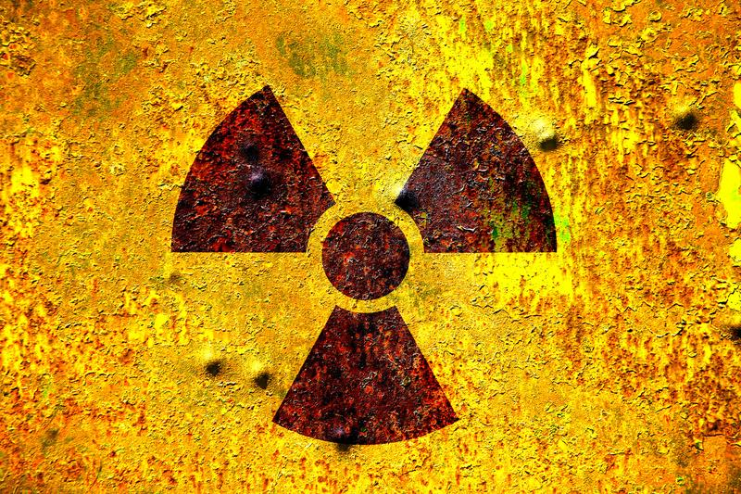
Electromagnetic Radiation
Notes:
Radiant energy can also be called electromagnetic radiation.

Slide 95
Travels in Straight Lines
Notes:
Radiant energy travels in straight lines until it strikes an object where it can be reflected absorbed, or transmitted. We will learn more about these terms later in the unit.

Slide 96
Notes:
Let’s check-in for understanding.

Slide 97
How does radiant energy travel?
Notes:
How does radiant energy travel?
[In straight lines]

Slide 98
Notes:
Now, let’s talk about some examples of radiant energy.
Feedback: It's good to pick a variety of examples to work through with your students. This prepares them for some types that might trip them up when they try it on their own.

Slide 99
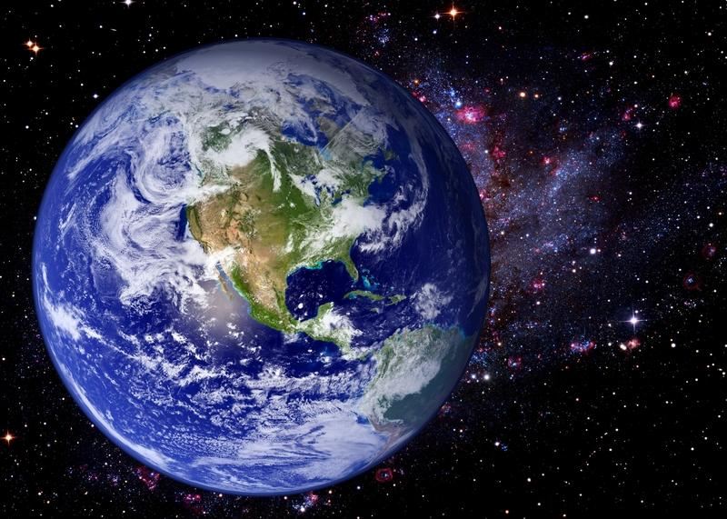
Notes:
The sun continuously radiates energy to the earth.

Slide 100
Notes:
Microwaves also use radiant energy to increase the temperature of your food.

Slide 101
Notes:
The heat emitted by a campfire is caused by radiant energy.

Slide 102
Notes:
Let’s check-in for understanding.

Slide 103
What are examples of radiant energy?
Notes:
What are examples of radiant energy?
[The Sun, a campfire, a microwave, etc.]

Slide 104
Demonstration
Notes:
Transfer of heat by radiant energy leads to many interesting effects.
Feedback: Providing a specific goal for use is crucial to letting students know what's expected and why this activity/demonstration is important.

Slide 105
Notes:
Let’s check-in for understanding.

Slide 106
Radiant energy is carried in ________.
Sound waves
Ocean waves
Electromagnetic waves
Notes:
Radiant energy is carried in __________.
[Electromagnetic waves]

Slide 107
Radiant energy is carried in ________.
Sound waves
Ocean waves
Electromagnetic waves
Notes:
Radiant energy is carried in __________.
[Electromagnetic waves]

Slide 108
What is radiant energy?
Notes:
What is radiant energy?
[Radiant energy is energy that is radiating continuously from a source.]

Slide 109
Explain how radiant energy travels.
Notes:
Explain how radiant energy travels.
[Radiant energy is travels in straight lines until it strikes an object where it can be reflected, absorbed, or transmitted.

Slide 110
Remember!!!
Notes:
So remember!
Feedback: A good general strategy for information retention is: 1) tell them what you're going to teach them, 2) teach them, and 3) tell them what you just taught them. Make sure to include the third and final step. While it is easy to think a quick review of what you just went over is unnecessary, it can be incredibly useful in helping the students remember the information over the long term.

Slide 111
Radiant Energy: energy that is radiating continuously from a source
Notes:
Radiant energy is energy that is radiating continuously from a source.

Slide 112
Travels in Straight Lines
Notes:
Radiant energy travels in straight lines until it strikes an object where it can be reflected absorbed, or transmitted. We will learn more about these terms later in the unit.

Slide 113
Big Question: What is the electromagnetic spectrum? How do we experience it in everyday life?
Notes:
Explicit cue to revisit the big question at the end of the lesson: Okay everyone. Now that we’ve learned the term, let’s reflect once more on our big question. Was there anything that we predicted earlier that was correct or incorrect? Do you have any new hypotheses to share?

Slide 114
Notes:
Thanks for watching, and please continue watching CAPs available from this website.

Slide 115
This Video Was Created With Resources From:
Questions or Comments
Michael Kennedy, Ph.D. MKennedy@Virginia.edu
Rachel L Kunemund, Ph.D. rk8vm@virginia.edu

