Slide 1
Intro
“Big Idea” Question
Review Concepts
Check-In Questions
Teacher Demo
Vocabulary
Student-Friendly Definition
Examples & Non-Examples
Morphological Word Parts
Reinforcement Activity
Notes:
OK everyone, get ready for our next lesson. Just as a reminder, these are the different components that our lesson may include, and you’ll see these icons in the top left corner of each slide so that you can follow along more easily!

Slide 2
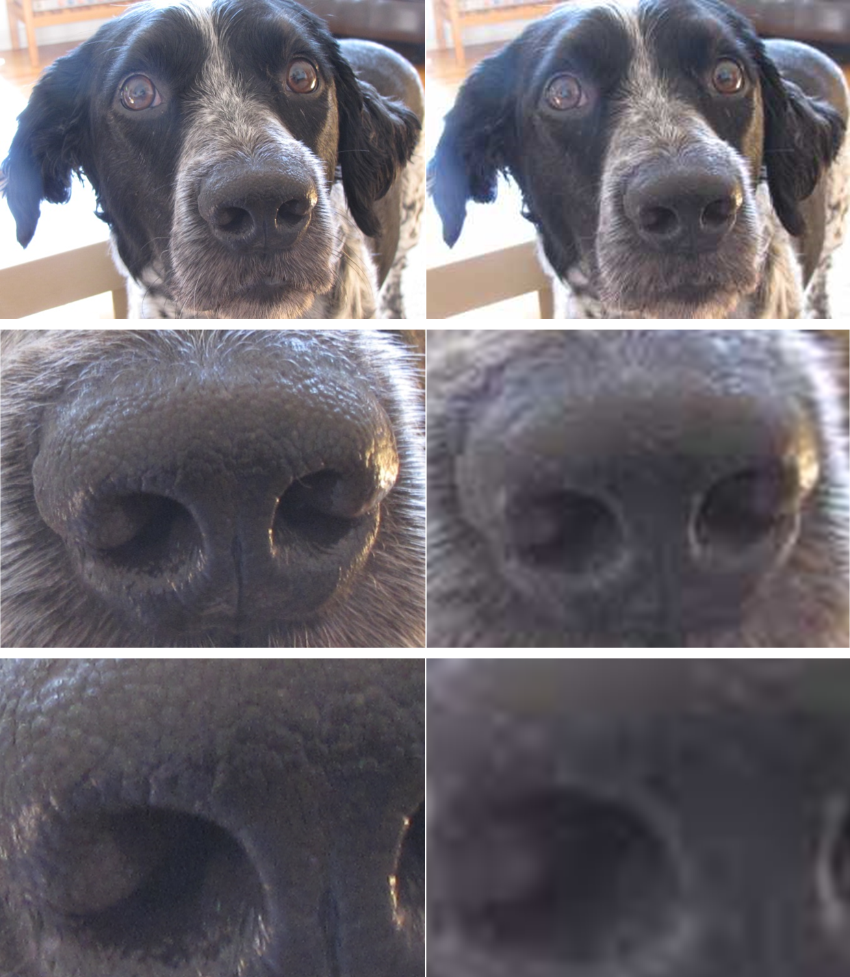
Intro
Magnification & Resolution
Notes:
Today we’re going to learn the terms, magnification and resolution.

Slide 3
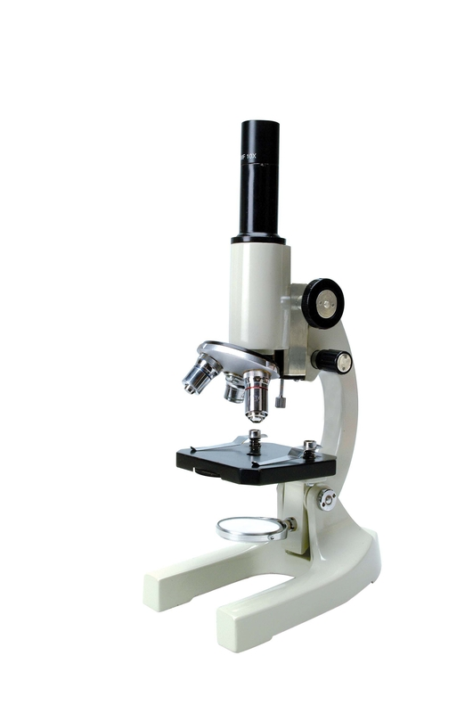
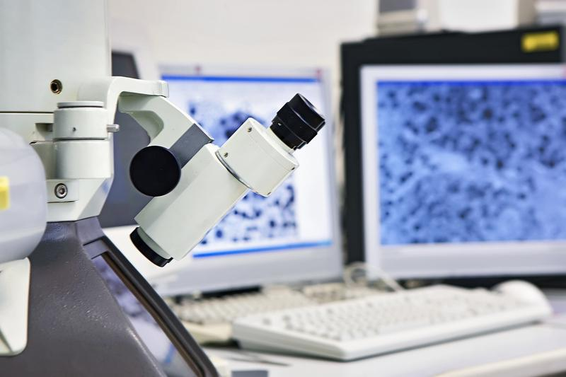
Big Question: How can advances in microscope technology improve your understanding of cells and their parts?
Notes:
Our “big question” is: How can advances in microscope technology improve your understanding of cells and their parts?
[Pause and illicit predictions from students.]
I love all these thoughtful scientific hypotheses! Be sure to keep this question and your predictions in mind as we move through these next few lessons, and we’ll continue to revisit it.

Slide 4
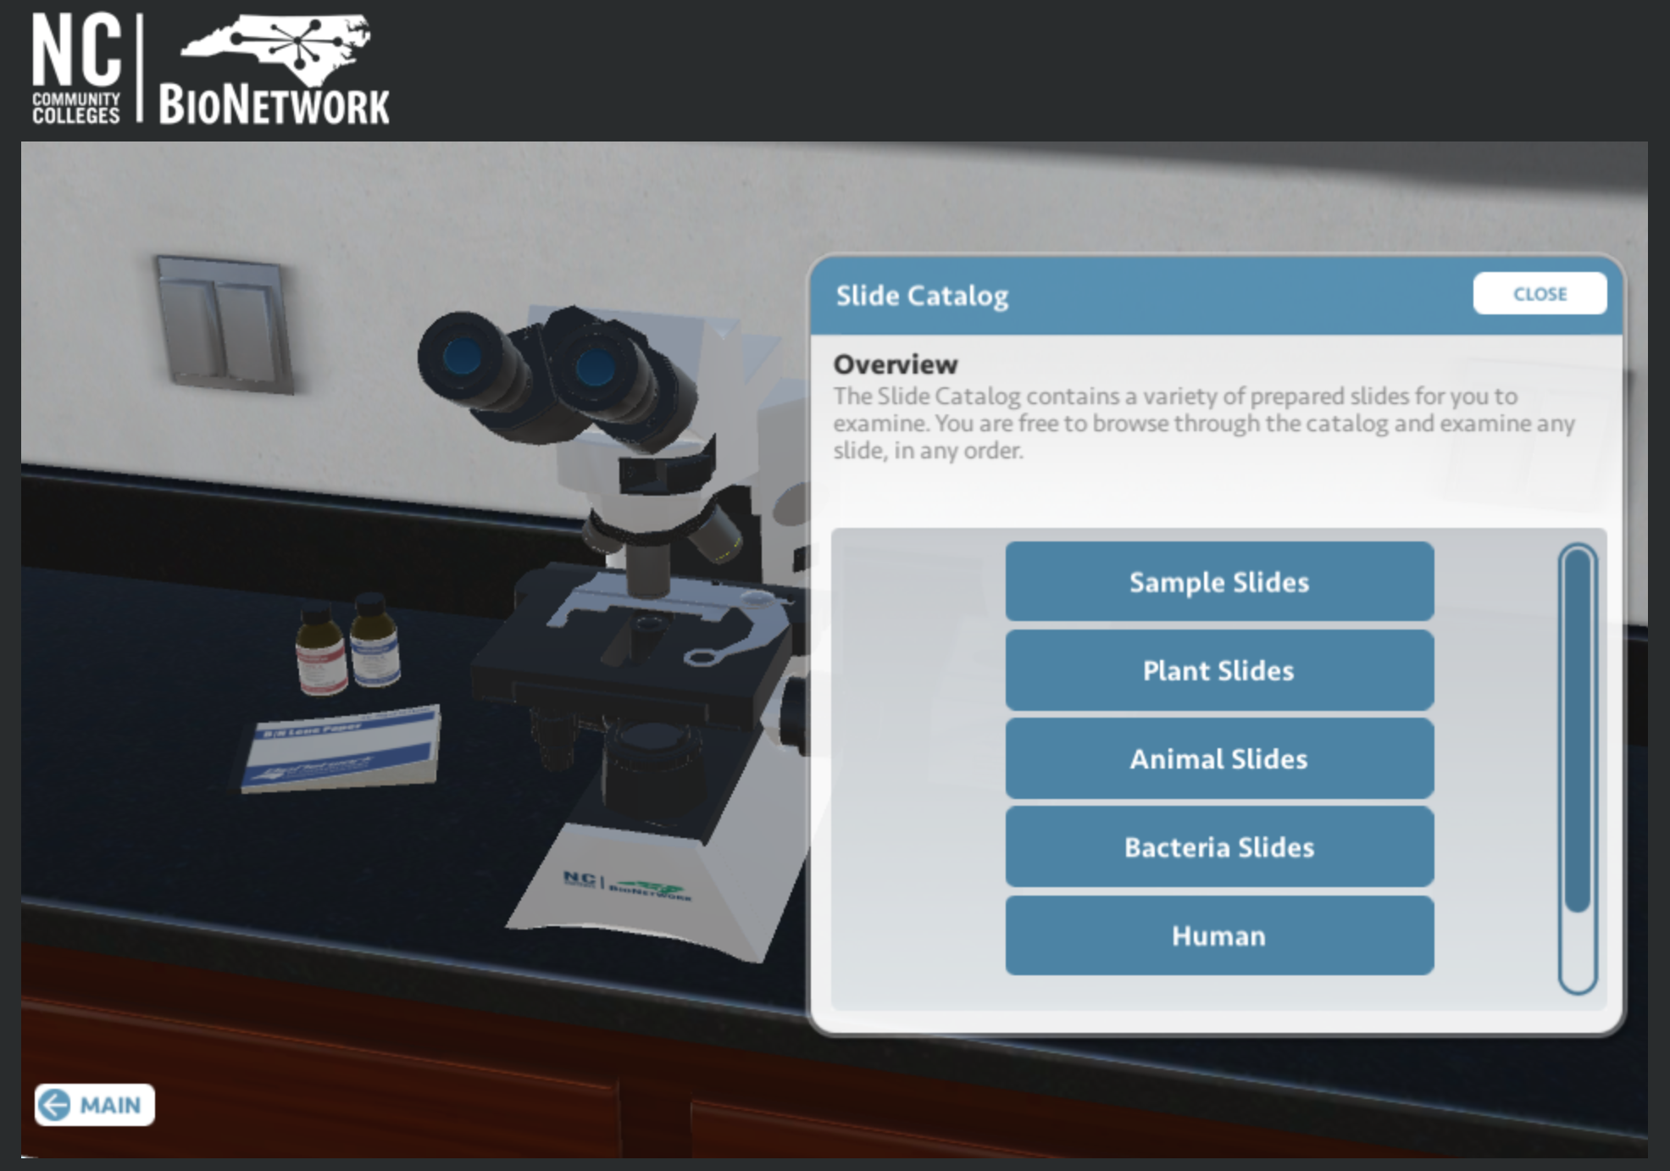
Demonstration
The Virtual Microscope
To demonstrate the functionality of microscopic imaging and familiarize students with the parts and processes involved with using a light microscope, access the website above and proceed to the “explore” tab. The simulation allows you to observe multiple types of slides while making adjustments for both magnification and resolution. Share your screen with students to engage them in inquiry surrounding the process.
Notes:
Feedback: An alternative to this demonstration would be to use a microscope that can be viewed with or attached to a computer-connected device so that students can observe as you magnify common objects.

Slide 5
Notes:
Before we define these terms, let’s review some other words that you already learned, and make sure you are firm in your understanding.

Slide 6
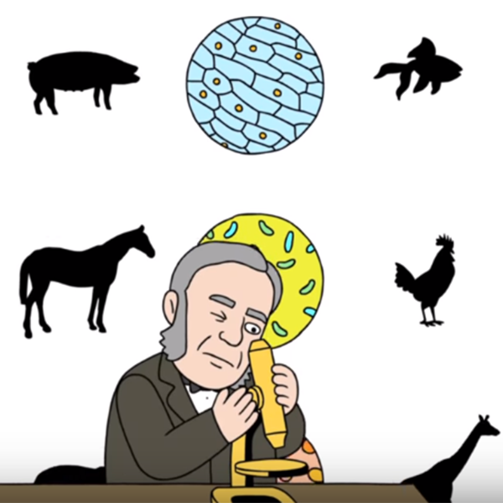
Cell Theory: the scientific theory that all living things are made of cells
Notes:
Cell theory is the scientific theory that all living things are made of cells. This theory was developed by a few different scientists as advancements were made in microscope technology.

Slide 7
Cell Theory
is made up of 3 basic rules
Notes:
The cell theory is made up of 3 basic principles, or rules. When something we observe in the natural world that meets all three of these rules, that means it is a living thing.

Slide 8
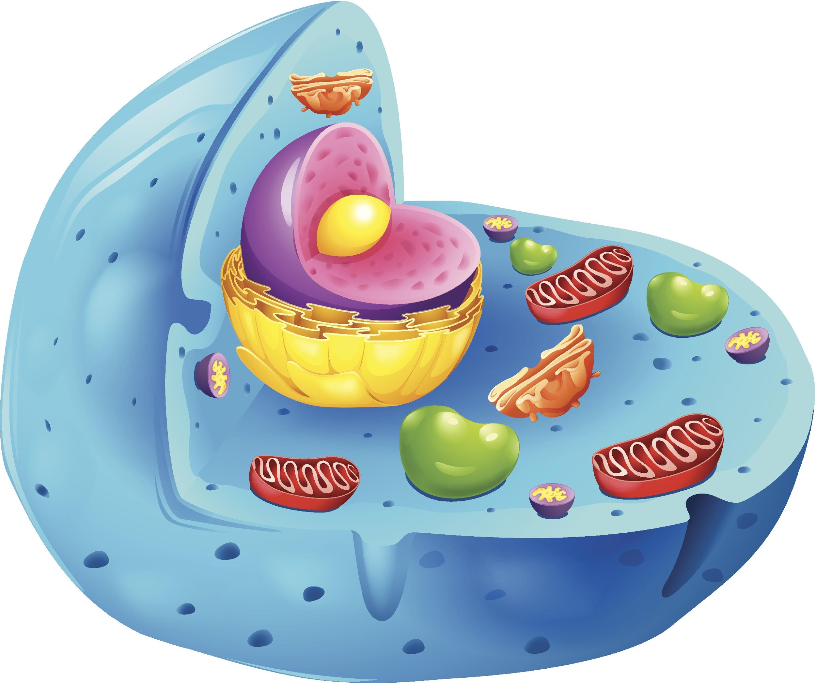
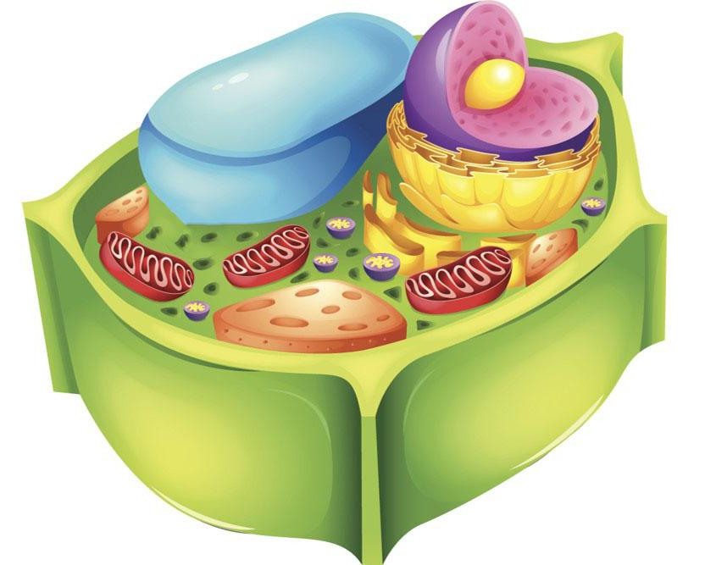
Rule #1: The cell is the basic unit of life.
Notes:
Rule Number One: The cell is the basic unit of life. This means that even though the cell is made up of many components, those components are not alive themselves.

Slide 9
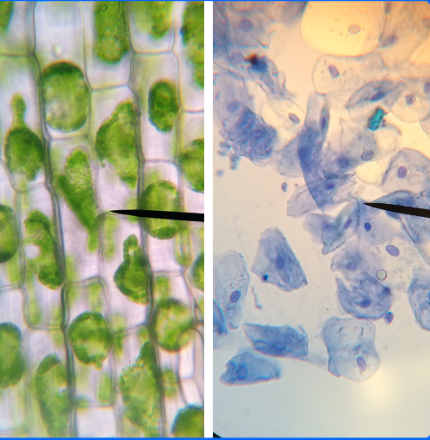
Rule #2: All living things are made of one or more cells.
Notes:
Rule Number Two: All living things are made up of one or more cells. Anything that is not made up of at least one cell is not alive.

Slide 10
Rule #3: All new cells are made from cells that already exist.
Notes:
Rule Number Three: All new cells are made from cells that already exist. Cells don’t just appear spontaneously. Rather, they multiply through replication and division.

Slide 11
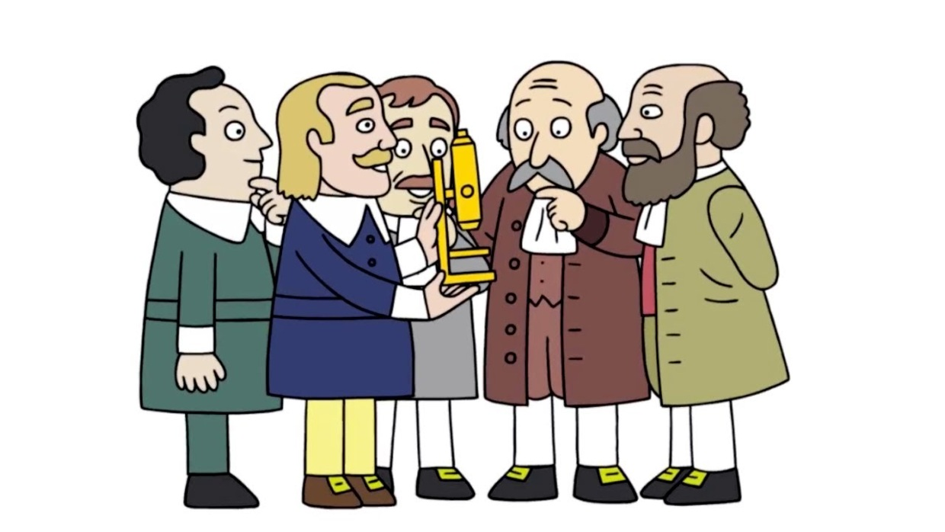
The development of cell theory is an example of how the nature of science concepts help guide scientists’ thinking.
Notes:
The development of cell theory is an example of how the nature of science concepts help to guide scientists’ thinking.

Slide 12
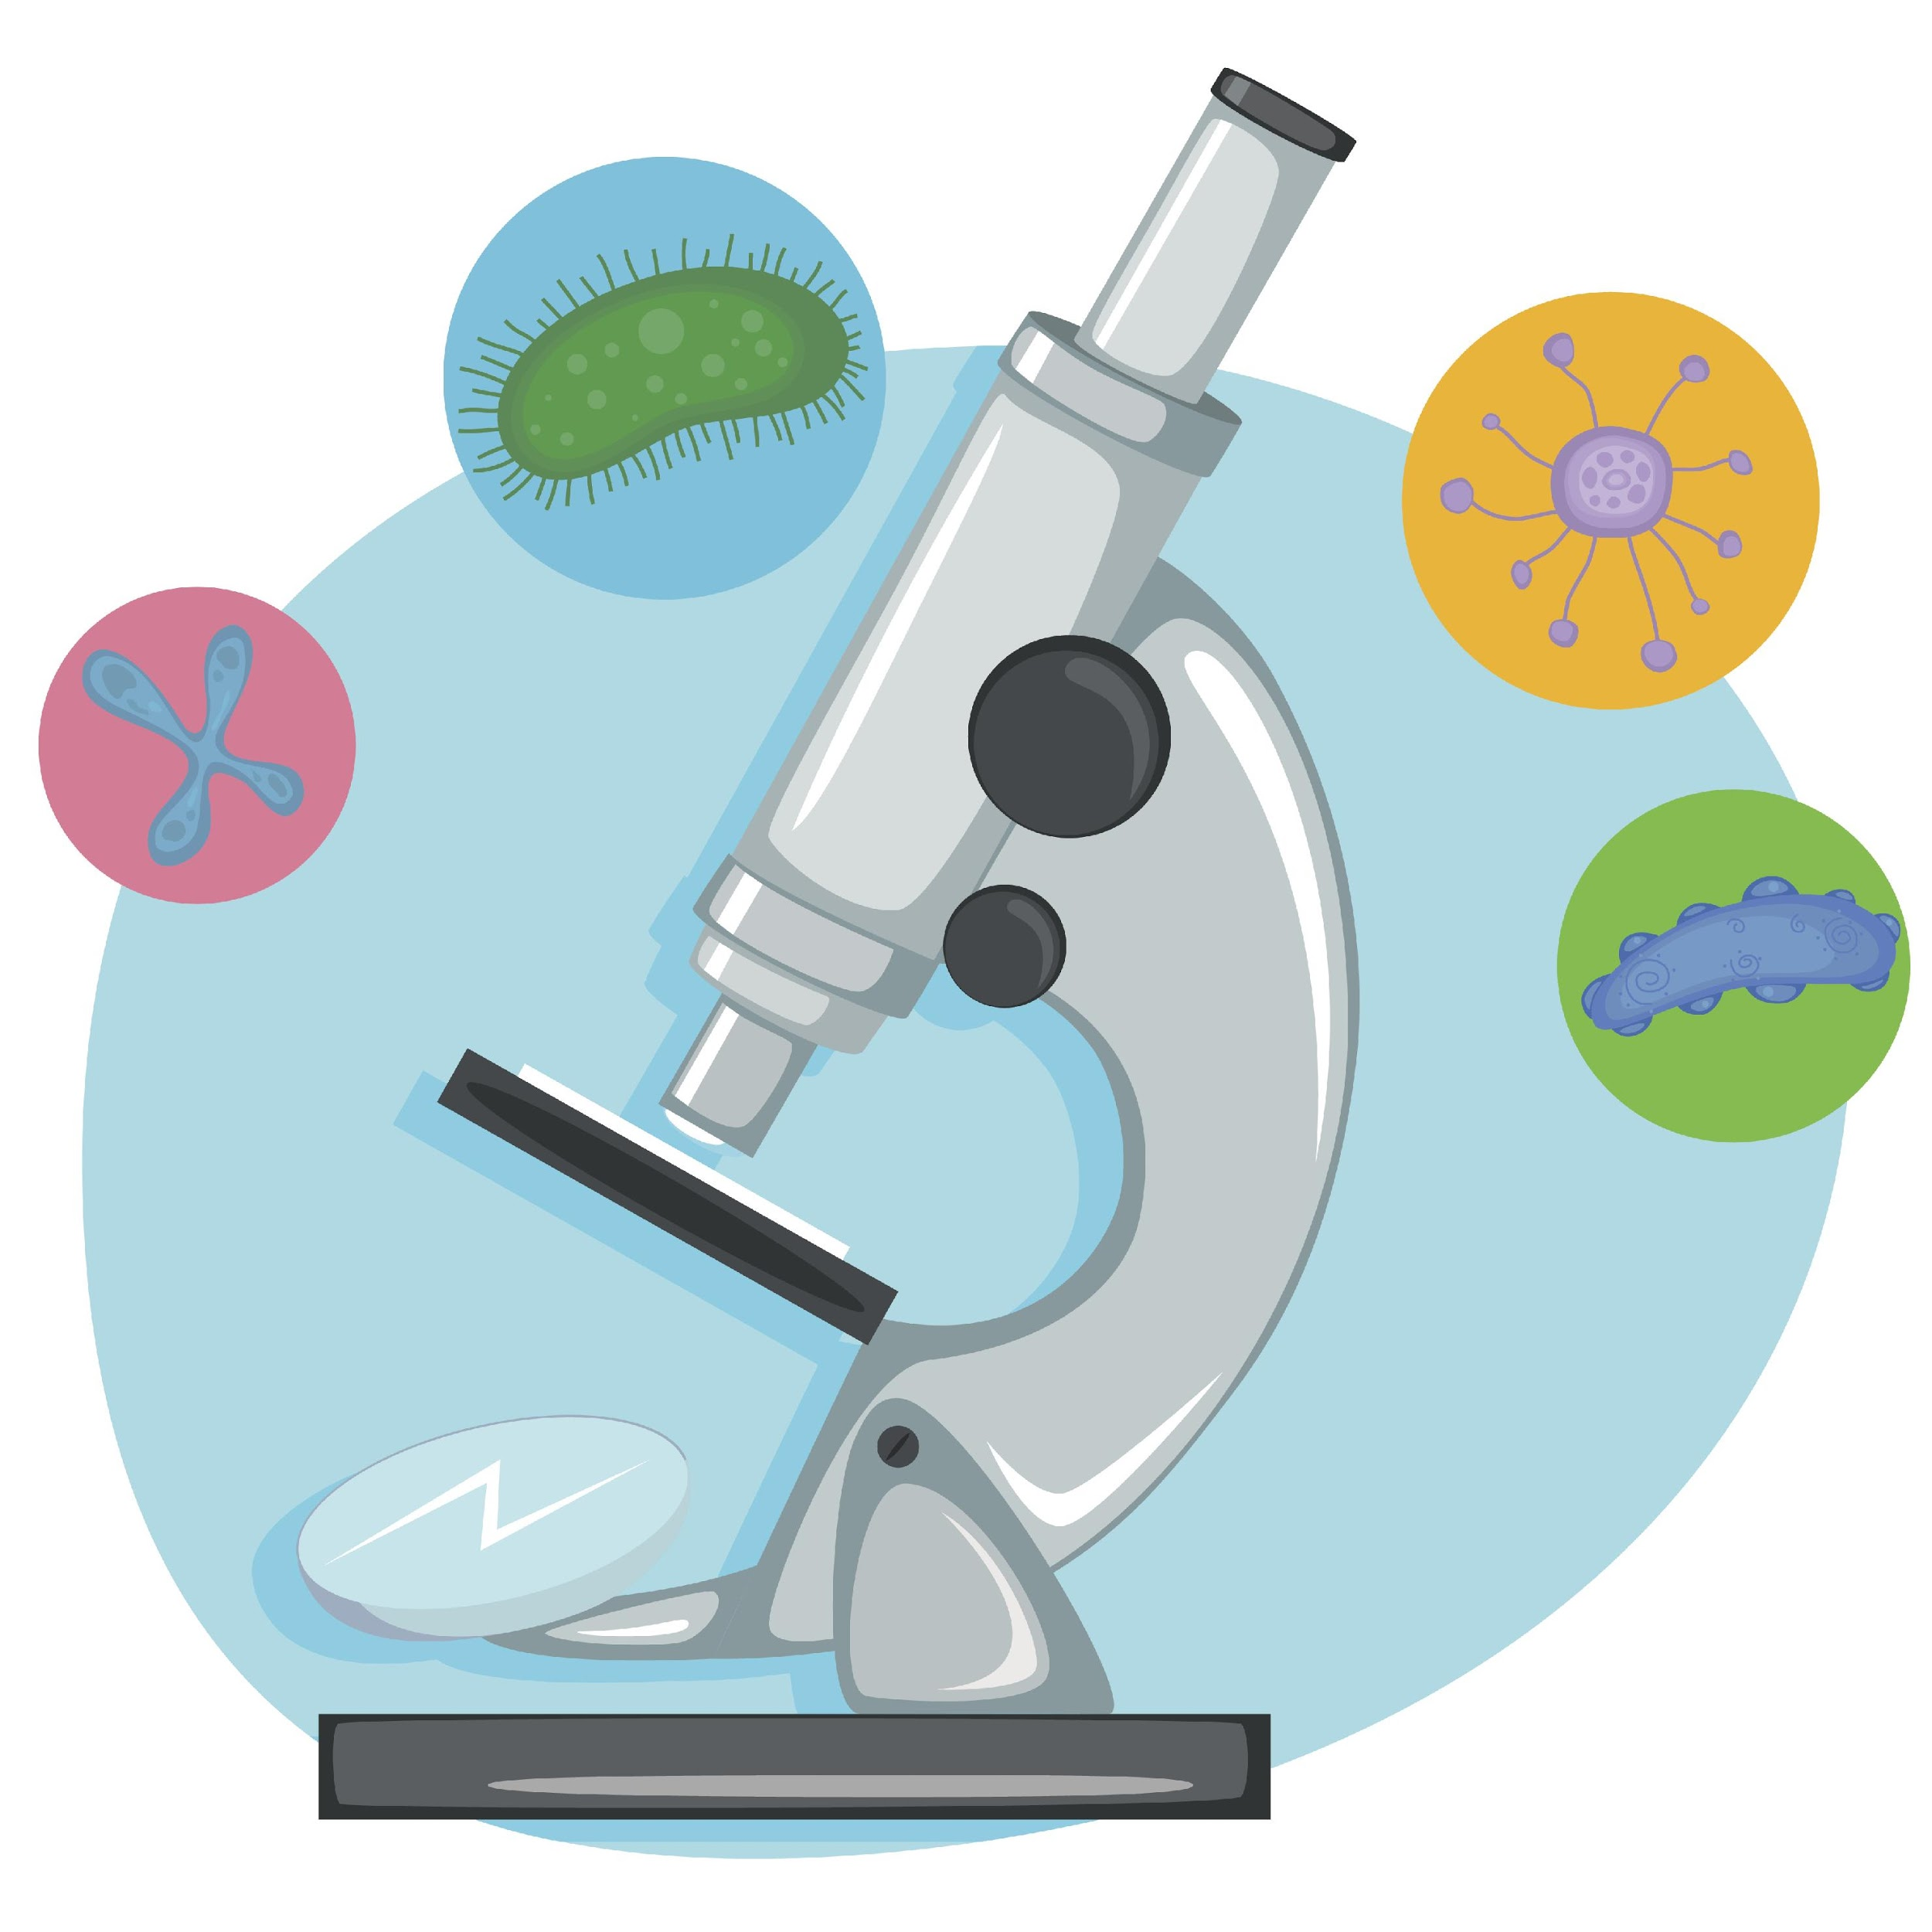
Science helps us understand the natural world.
Notes:
One of the nature of science concepts states that science helps us understand the natural world. The development of the microscope gave us a completely new view of the natural world that had never been seen before, as things like cells were too small to see with the naked eye. Thanks to the microscope, scientists developed the cell theory, and made many more discoveries about cells – many of which we’ll be learning about in this unit!

Slide 13
Notes:
Let’s pause for a moment & review what we’ve discussed so far.

Slide 14
What is the definition of cell theory?
Notes:
What is the definition of cell theory?
[The scientific theory that all living things are made of cells.]

Slide 15
Which is NOT one of the rules of cell theory?
All living things are made of one or more cells.
Non-living things have cells too.
The cell is the basic unit of life.
All new cells are made from cells that already exist.
Notes:
Which is NOT one of the rules of cell theory?

Slide 16
Which is NOT one of the rules of cell theory?
All living things are made of one or more cells.
Non-living things have cells too.
The cell is the basic unit of life.
All new cells are made from cells that already exist.
Notes:
Which is NOT one of the rules of cell theory?
[The answer choice that is NOT one of the rules of cell theory is that non-living things have cells too. Remember – the cell theory states that all LIVING things are made of cells, so cell theory cannot be applied to non-living things.]

Slide 17
What does the nature of science have to do with the development of cell theory?
Cell theory is an example of how the nature of science concepts help guide scientists’ thinking.
Absolutely nothing.
The same scientists who came up with the nature of science also created cell theory.
Notes:
What does the nature of science have to do with the development of cell theory?

Slide 18
What does the nature of science have to do with the development of cell theory?
Cell theory is an example of how the nature of science concepts help guide scientists’ thinking.
Absolutely nothing.
The same scientists who came up with the nature of science also created cell theory.
Notes:
What does the nature of science have to do with the development of cell theory?
[Cell theory is an example of how the nature of science concepts help guide scientists’ thinking.]

Slide 19
How does the invention of the microscope connect with the nature of science and what we know about cells?
Notes:
How does the invention of the microscope connect with the nature of science and what we know about cells?
[The invention of the microscope allowed scientists to see objects, like cells, that were too small to see with the naked eye. This connects to the nature of science because one of the NOS concepts states that we can use science to understand the natural world. The invention of the microscope also connects to the changing nature of scientific perceptions. Scientists had to adapt their understanding of nature in light of new information.]

Slide 20
Magnification
Notes:
First, let’s define the word magnification.

Slide 21
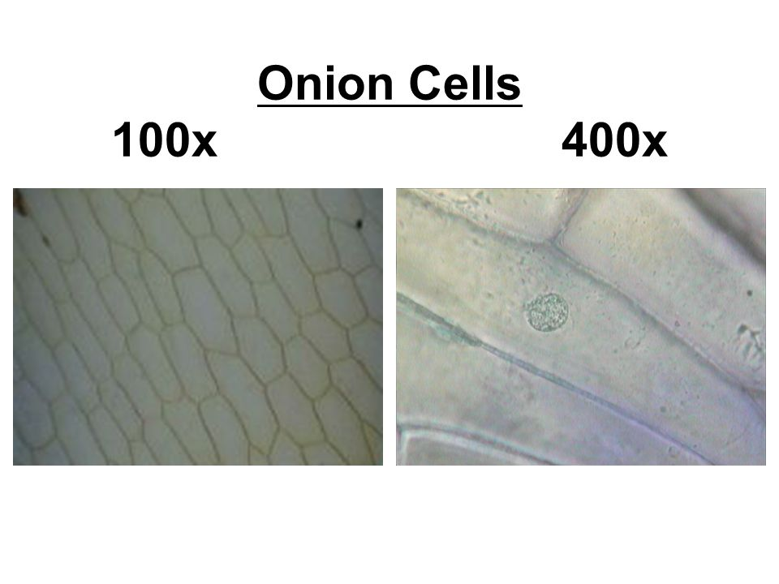
Magnification: how many times larger an image is than the actual object itself
Notes:
Magnification refers to how many times larger an image is than the actual object itself.

Slide 22
Notes:
Let’s pause for a moment & review what we’ve discussed so far.

Slide 23
What is magnification?
Notes:
What is magnification?
[Magnification is how many times larger an image is than the actual objects itself.]

Slide 24
Notes:
That is the basic definition, but there is a bit more that we need to go over here.

Slide 25
Notes:
Magnification can be adjusted in electron AND light microscopes. This image shows us how magnification in a light microscope works. The eyepiece has a magnifying lens that makes images appear 10 times larger, and the objective lens multiplies the eyepiece magnification by different amounts, depending on the objective lens that you choose. So, for example, if you choose the times 4 objective lens, the object you are viewing will appear 40 times larger than it actually is (10 x 4 = 40). If the objective lens is set to 10, the object will appear 100 times larger (10 x 10 = 100)... And so on.

Slide 26
Notes:
This image shows us what an onion looks like when the magnification of a microscope is adjusted to 100 times and 400 times larger than the actual onion you are viewing. You can see that when we adjust the magnification of a microscope, we are able to get an up-close view of the individual cells in this onion.

Slide 27
What do you notice about the magnified images in the first column versus the second column?
Notes:
What do you notice about the magnified images of this dog in the first column versus the second column?
As we look down each column of images, we can see that each one is magnified to the same size; but as the images on the right increase in size, they’re not as clear, or detailed, as the images on the left.

Slide 28
Magnification & Resolution
Notes:
This is where a microscope’s resolution comes in.

Slide 29
Notes:
Let’s pause for a moment & review what we’ve discussed so far.

Slide 30
True/False: Magnification can be adjusted in electron and light microscopes.
Notes:
True/False: Magnification can be adjusted in electron and light microscopes.

Slide 31
True/False: Magnification can be adjusted in electron and light microscopes.
Notes:
True/False: Magnification can be adjusted in electron and light microscopes.
[True]

Slide 32
Resolution
Notes:
Let’s define the term resolution.

Slide 33
Resolution: how clear, or detailed, an image is
Notes:
Resolution refers to how clear, or detailed, an image is.

Slide 34
Notes:
Let’s pause for a moment & review what we’ve discussed so far.

Slide 35
What is resolution?
Notes:
What is resolution?
[Resolution refers to how clear, or detailed, an image is.]

Slide 36
Notes:
That is the basic definition, but there is a bit more you need to know.

Slide 37
As you increase the magnification of a microscope, you also need to increase the resolution, so the image remains clear.
Increased both, detail is clear
Only increased magnification, detail is lost
Notes:
As you increase the magnification of a microscope, you also need to increase the resolution, so the image remains clear.
You can see that as the magnification of the images in the left column was increased, the resolution was also increased – this allows us to see all the detail of the dog’s nose when we’re zoomed in.
However, in the right column, only the magnification was increased, so the details of the dog’s nose became blurry as the image was enlarged.

Slide 38
The higher the resolution, the greater the detail!
Low Resolution
High Resolution
Notes:
So, the higher the resolution, the greater the detail!

Slide 39
Notes:
Now, let’s pause for a moment and review what we’ve discussed so far.

Slide 40
What is the definition of magnification?
Notes:
What is the definition of magnification?
[Magnification refers to how many times larger an image is than the actual object itself.]

Slide 41
What is the definition of resolution?
Notes:
What is the definition of resolution?
[Resolution refers to how clear, or detailed, an image is.]

Slide 42
True/False: As you increase the magnification of a microscope, you don’t need to change the resolution.
Notes:
True/False: As you increase the magnification of a microscope, you don’t need to change the resolution.

Slide 43
True/False: As you increase the magnification of a microscope, you don’t need to change the resolution.
Notes:
True/False: As you increase the magnification of a microscope, you don’t need to change the resolution.
[False – As you increase the magnification of a microscope, you also need to increase the resolution so you can make sure the image is clear and details can be seen.]

Slide 44
Remember!!!
Notes:
So remember!

Slide 45
Magnification: how many times larger an image is than the actual object itself
Notes:
Magnification refers to how many times larger an image is than the actual object itself.

Slide 46
Resolution: how clear, or detailed, an image is
Notes:
Resolution refers to how clear, or detailed, an image is.

Slide 47
Reinforcement Activity
The Virtual Microscope
Students can be given access to the virtual microscope lab and instructed to explore it’s features. It may be beneficial to develop a few guiding questions to provide students with a structure for their exploration.
Notes:
Feedback: It is important when planning questions for students to also consider non-normative, partially normative, and normative answers. What do you expect or hope students to answer? What are common misunderstandings that you can already plan responses to? This planning will help you to lighten your own cognitive load during discussions of reinforcement activities and be able to more effectively respond to atypical student ideas.

Slide 48
Big Question: How have advances in microscope technology improved our understanding of cells and their parts?
Notes:
Explicit cue to revisit the big question at the end of the lesson: Okay everyone. Let’s reflect once more on our big question. Does anyone have any additional ideas to share that haven’t been discussed yet? Is there any information that you’ve just learned that gives you some new ideas or changes some of your old ideas?

Slide 49
Notes:
Thanks for watching, and please continue watching CAPs available from this website.

Slide 50
This Video Was Created With Resources From:
Questions or Comments
Michael Kennedy, Ph.D. MKennedy@Virginia.edu
Rachel L Kunemund, Ph.D. rk8vm@virginia.edu

Slide 51
Intro
“Big Idea” Question
Review Concepts
Check-In Questions
Teacher Demo
Vocabulary
Student-Friendly Definition
Examples & Non-Examples
Morphological Word Parts
Simulation/Activity
Notes:
OK everyone, get ready for our next lesson. Just as a reminder, these are the different components that our lesson may include, and you’ll see these icons in the top left corner of each slide so that you can follow along more easily!

Slide 52
Electron Microscope & Light Microscope
Intro
Notes:
In this lesson we are going to learn about the electron microscope and the light microscope.

Slide 53
Big Question: How can advances in microscope technology improve your understanding of cells and their parts?
Notes:
Our “big question” is: How can advances in microscope technology improve your understanding of cells and their parts?
[Pause and illicit predictions from students.]
I love all these thoughtful scientific hypotheses! Be sure to keep this question and your predictions in mind as we move through these next few lessons, and we’ll continue to revisit it.

Slide 54
Notes:
Before we define these terms, let’s review some other words that you already learned, and make sure you are firm in your understanding.

Slide 55
Magnification: how many times larger an image is than the actual object itself
Notes:
Magnification refers to how many times larger an image is than the actual object itself.

Slide 56
Resolution: how clear, or detailed, an image is
Notes:
Resolution refers to how clear, or detailed, an image is.

Slide 57
Science helps us understand the natural world.
Notes:
One of the nature of science concepts states that science helps us understand the natural world. The development of the microscope gave us a completely new view of the natural world that had never been seen before, as things like cells were too small to see with the naked eye. Thanks to the microscope, scientists developed the cell theory, and made many more discoveries about cells – many of which we’ll be learning about in this unit!

Slide 58
Notes:
Now, let’s pause for a moment and review what we’ve discussed so far.

Slide 59
What is the definition of magnification?
Notes:
What is the definition of magnification?
[Magnification refers to how many times larger an image is than the actual object itself.]

Slide 60
What is the definition of resolution?
Notes:
What is the definition of resolution?
[Resolution refers to how clear, or detailed, an image is.]

Slide 61
True/False: As you increase the magnification of a microscope, you don’t need to change the resolution.
Notes:
True/False: As you increase the magnification of a microscope, you don’t need to change the resolution.

Slide 62
True/False: As you increase the magnification of a microscope, you don’t need to change the resolution.
Notes:
True/False: As you increase the magnification of a microscope, you don’t need to change the resolution.
[False – As you increase the magnification of a microscope, you also need to increase the resolution so you can make sure the image is clear and details can be seen.]

Slide 63
Electron Microscope
Notes:
Now that we’ve reviewed, let’s define our new term, electron microscope.

Slide 64
Electron Microscope: uses electron beams to magnify objects and has high resolution power
Notes:
An electron microscope uses electron beams to magnify objects and has high resolution power. Because of its high power, the electron microscope can give people a much closer and clearer look at objects.

Slide 65
Notes:
Now, let’s pause for a moment and review what we’ve discussed so far.

Slide 66
What is an electron microscope?
Notes:
What is an electron microscope?
[An electron microscope uses electron beams to magnify objects and has high resolution power.]

Slide 67
Light (Compound)
Microscope
Notes:
Now let’s define light, or compound, microscope.

Slide 68
Light Microscope: bends a light source through multiple lenses to magnify an object
Notes:
A light microscope bends a light source through multiple lenses to magnify an object.

Slide 69
Notes:
Now, let’s pause for a moment and review what we’ve discussed so far.

Slide 70
What is a light microscope?
Notes:
What is a light microscope?
[A light microscope bends a light source through multiple lenses to magnify an object.]

Slide 71
Notes:
Those are the basic definitions of electron & light microscopes, but there’s a bit more we need to know about these tools.

Slide 72
What do electron and light microscopes have to do with cells?
Notes:
What do you think electron and light microscopes have to do with cells?

Slide 73
The invention of these two microscopes helped scientists gain new knowledge about cells.
Notes:
Well, the invention of these two microscopes helped scientists gain new knowledge about cells.

Slide 74
We can look at cells with both microscopes – but each one helps us see and understand different things about cells.
Notes:
We can look cells with both microscopes, but each one helps us see and understand different things about cells.

Slide 75
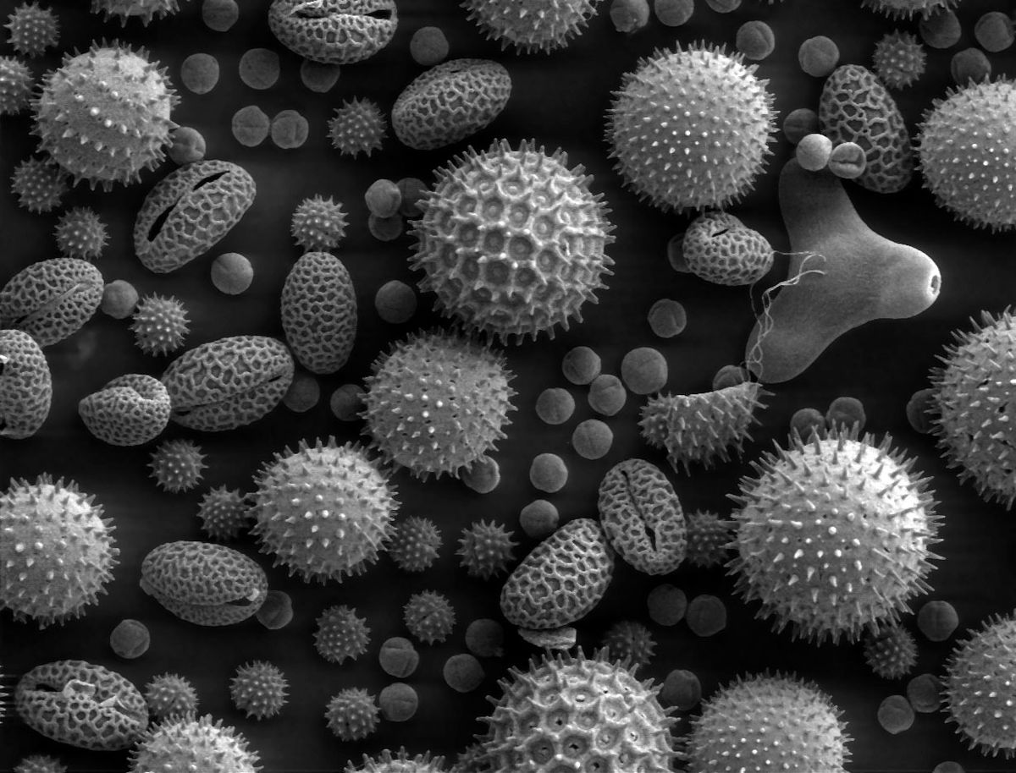
Electron microscopes provide extremely detailed images of objects.
Notes:
Electron microscopes provide extremely detailed images of objects. Some electron microscopes can even create 3-dimensional images, like the one shown here. This picture gives us an up-close view of different types of plant pollen.

Slide 76
Electron microscopes have much greater magnification and resolution capabilities than light microscopes.
Feature | Light Microscope | Electron Microscope
Maximum Magnification | x2000 | x2,000,000
Maximum Resolution | About 200nm | Less than 0.5nm *400 times better than the light microscope!
Notes:
The reason why we get more detailed images is because electron microscopes have much greater magnification and resolution capabilities than light microscopes.
Electron microscopes are able to magnify objects up to 2 million times larger than their actual size, while the very best light microscope can only magnify images up to 2000 times larger than the actual object. Electron microscopes also have much greater resolution power – 400 times better than the light microscope – providing a lot more detail to the images we view!

Slide 77
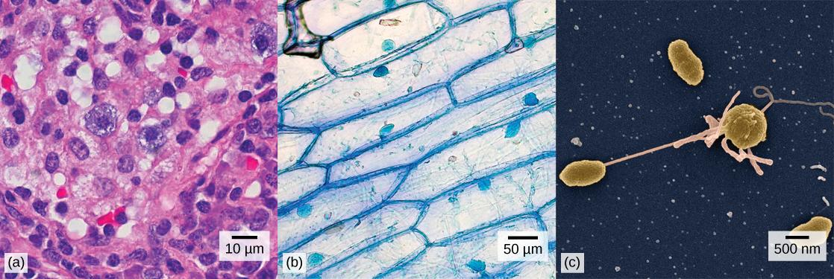
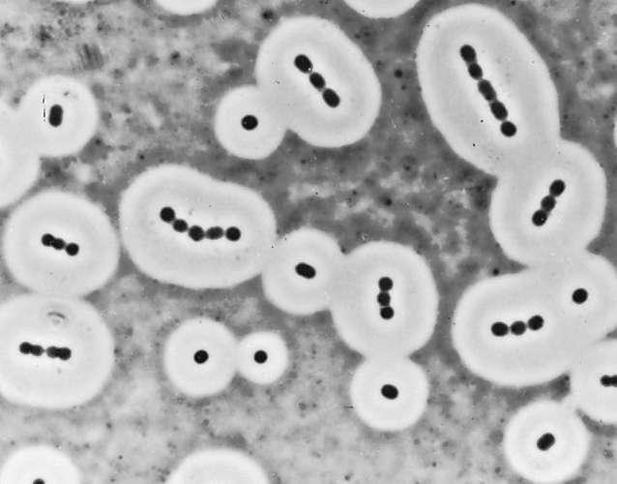
Light Microscope
Animal Cells
Plant Cells
Bacteria Cells
Notes:
This image shows us what animal, plant, and bacteria cells look like under a light microscope.

Slide 78
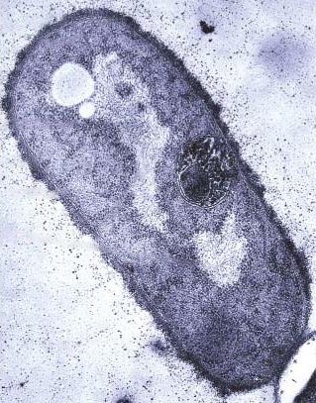
Electron Microscope
Animal Cell
Plant Cell
Bacteria Cell
Notes:
And this image shows us what an animal, plant, and bacteria cell look like under an electron microscope.

Slide 79
What differences do you notice?
Light Microscope
Electron Microscope
Notes:
So, what differences do you notice?

Slide 80
What differences do you notice?
Light Microscope
Animal Cells
Plant Cells
Bacteria Cells
Notes:
When looking at the images under a light microscope, we can see that the shapes of animal and plant cells are different. We can also see that plants and animals are made of many cells all stuck together, while bacteria cells work as individuals. This is where one of the rules of cell theory came from – the rule which states that all living things are made of one or more cells.

Slide 81
What differences do you notice?
Electron Microscope
Animal Cell
Plant Cell
Bacteria Cell
Notes:
See how these images show us up-close views of individual cells?
Because of the electron microscope’s powerful magnification and resolution capabilities, scientists were able to get an even closer look, giving them an even deeper understanding of the differences between these cells. For example, they found that bacteria cells have different parts than plant and animal cells which is why bacteria cells can function on their own. They also found that plant cells have some extra parts that animal cells do not have. We’ll be learning about these different parts in upcoming lessons.
Feedback: Explicit cues about what is coming up next in a lesson is an important way to prepare students.

Slide 82
(Electron Microscope Examples)
Notes:
Let’s look at some more examples of electron microscope images.

Slide 83
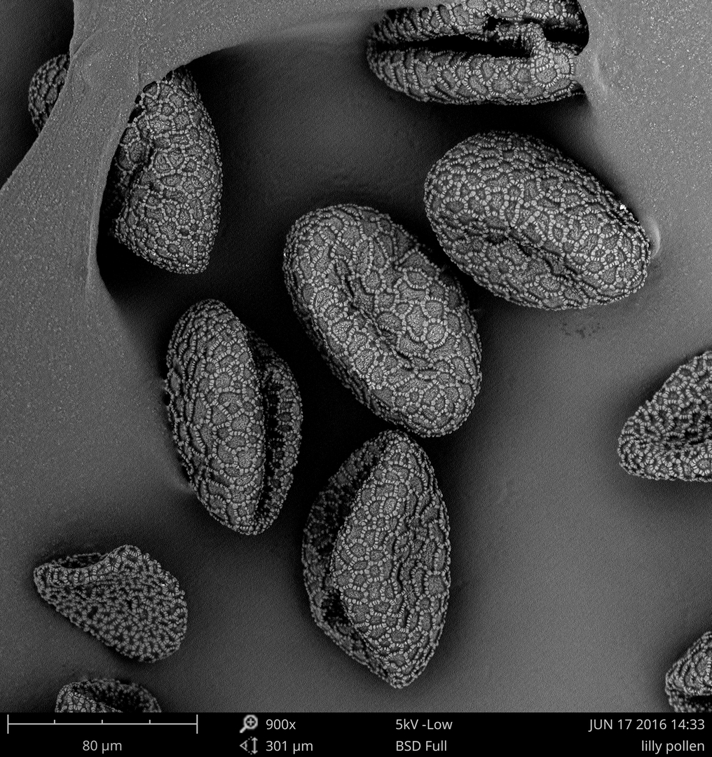

Slide 84
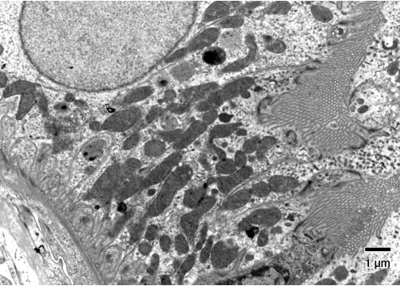

Slide 86
(Light Microscope Examples)
Notes:
Let’s look at some more examples of light microscope images.

Slide 87
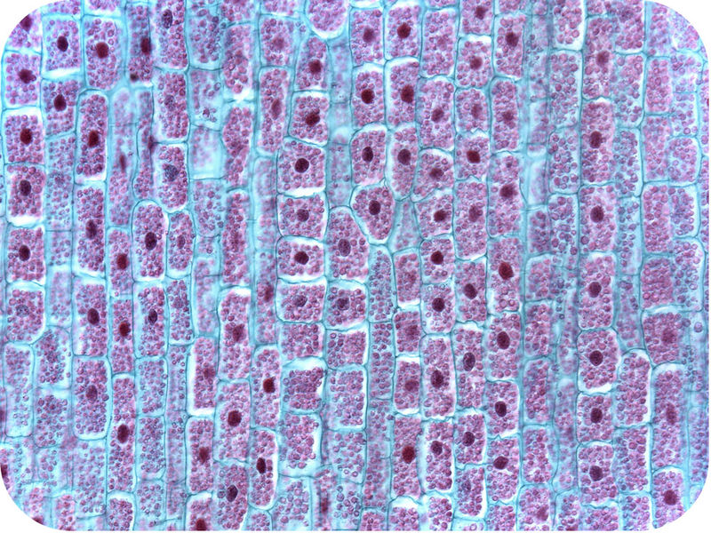

Slide 88
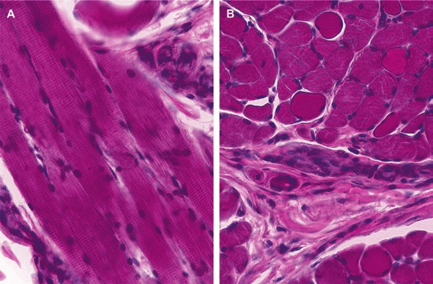

Slide 89
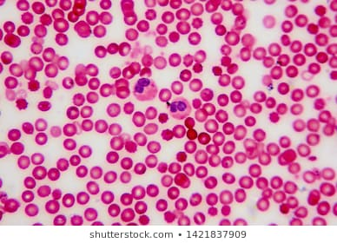

Slide 90
Notes:
Okay, now let’s review.

Slide 91
What does an electron microscope use to magnify objects?
Notes:
What does an electron microscope use to magnify objects?
[It uses an electron beam to magnify objects.]

Slide 92
What does a light microscope use to magnify objects?
Notes:
What does a light microscope use to magnify objects?
[It uses multiple lenses and a light source to magnify objects.]

Slide 93
Which type of microscope do you think captured this image?
Notes:
Which type of microscope provides extremely detailed images of objects?
[An electron microscope.]

Slide 94
True/False: You cannot see animal and plant cells with a light microscope.
Notes:
True/False: You cannot see animal and plant cells with a light microscope.

Slide 95
True/False: You cannot see animal and plant cells with a light microscope.
Notes:
True/False: You cannot see animal and plant cells with a light microscope.
[False – You CAN see animal and plant cells with a light microscope. It just won’t show you as much detail as an electron microscope.]

Slide 96
Remember!!!
Notes:
So remember...

Slide 97
Electron Microscope: uses electron beams to magnify objects and has high resolution power
Notes:
An electron microscope uses electron beams to magnify objects and has high resolution power. Because of its high power, the electron microscope can give people a much closer and clearer look at objects.

Slide 98
Light Microscope: bends a light source through multiple lenses to magnify an object
Notes:
A light microscope bends a light source through multiple lenses to magnify an object.

Slide 99
The invention of these two microscopes helped scientists gain new knowledge about cells.
Notes:
The invention of these two microscopes helped scientists gain new knowledge about cells.

Slide 100
We can look cells with both microscopes – but each one helps us see and understand different things.
Notes:
We can look cells with both microscopes, but each one helps us see and understand different things.

Slide 101
Light microscopes → cell shape and how they’re structured together
Electron microscopes → individual cells and differences in their parts
Notes:
With a light microscope, we can see the general shape of cells and how they’re structured together (or not). With an electron microscope, we can an up-close view of the different parts that are unique to each type of cell and help them function properly.

Slide 102
Electron microscopes have much greater magnification and resolution capabilities than light microscopes.
Feature | Light Microscope | Electron Microscope
Maximum Magnification | x2000 | x2,000,000
Maximum Resolution | About 200nm | Less than 0.5nm *400 times better than the light microscope!
Notes:
And, lastly, why are we able to get such a close-up view of cells with electron microscopes? Because electron microscopes have much greater magnification and resolution capabilities than light microscopes!

Slide 103
Big Question: How have advances in microscope technology improved our understanding of cells and their parts?
Notes:
Explicit cue to revisit the big question at the end of the lesson: Okay everyone. Let’s reflect once more on our big question. Does anyone have any additional ideas to share that haven’t been discussed yet? Is there any information that you’ve just learned that gives you some new ideas or changes some of your old ideas?

Slide 104
Reinforcement Activity
The Virtual Microscope
Students can be given access to the virtual microscope lab and instructed to explore it’s features. It may be beneficial to develop a few guiding questions to provide students with a structure for their exploration.
Notes:
Feedback: This simulation is a great way for students to use technology to model science phenomenon.

Slide 105
Notes:
Thanks for watching, and please continue watching CAPs available from this website.

Slide 106
This Video Was Created With Resources From:
Questions or Comments
Michael Kennedy, Ph.D. MKennedy@Virginia.edu
Rachel L Kunemund, Ph.D. rk8vm@virginia.edu

