Slide 1
Intro
“Big Idea” Question
Review Concepts
Check-In Questions
Teacher Demo
Vocabulary
Student-Friendly Definition
Examples & Non-Examples
Morphological Word Parts
Simulation/Activity
Notes:
OK everyone, get ready for our next lesson. Just as a reminder, these are the different components that our lesson may include, and you’ll see these icons in the top left corner of each slide so that you can follow along more easily!

Slide 2
Intro
Matter
Elements
Compounds
Mixtures
Notes:
In the next few lessons we’re going to focus on matter. Specifically, we’ll talk about three different classifications of matter, including elements, compounds and mixtures.

Slide 3
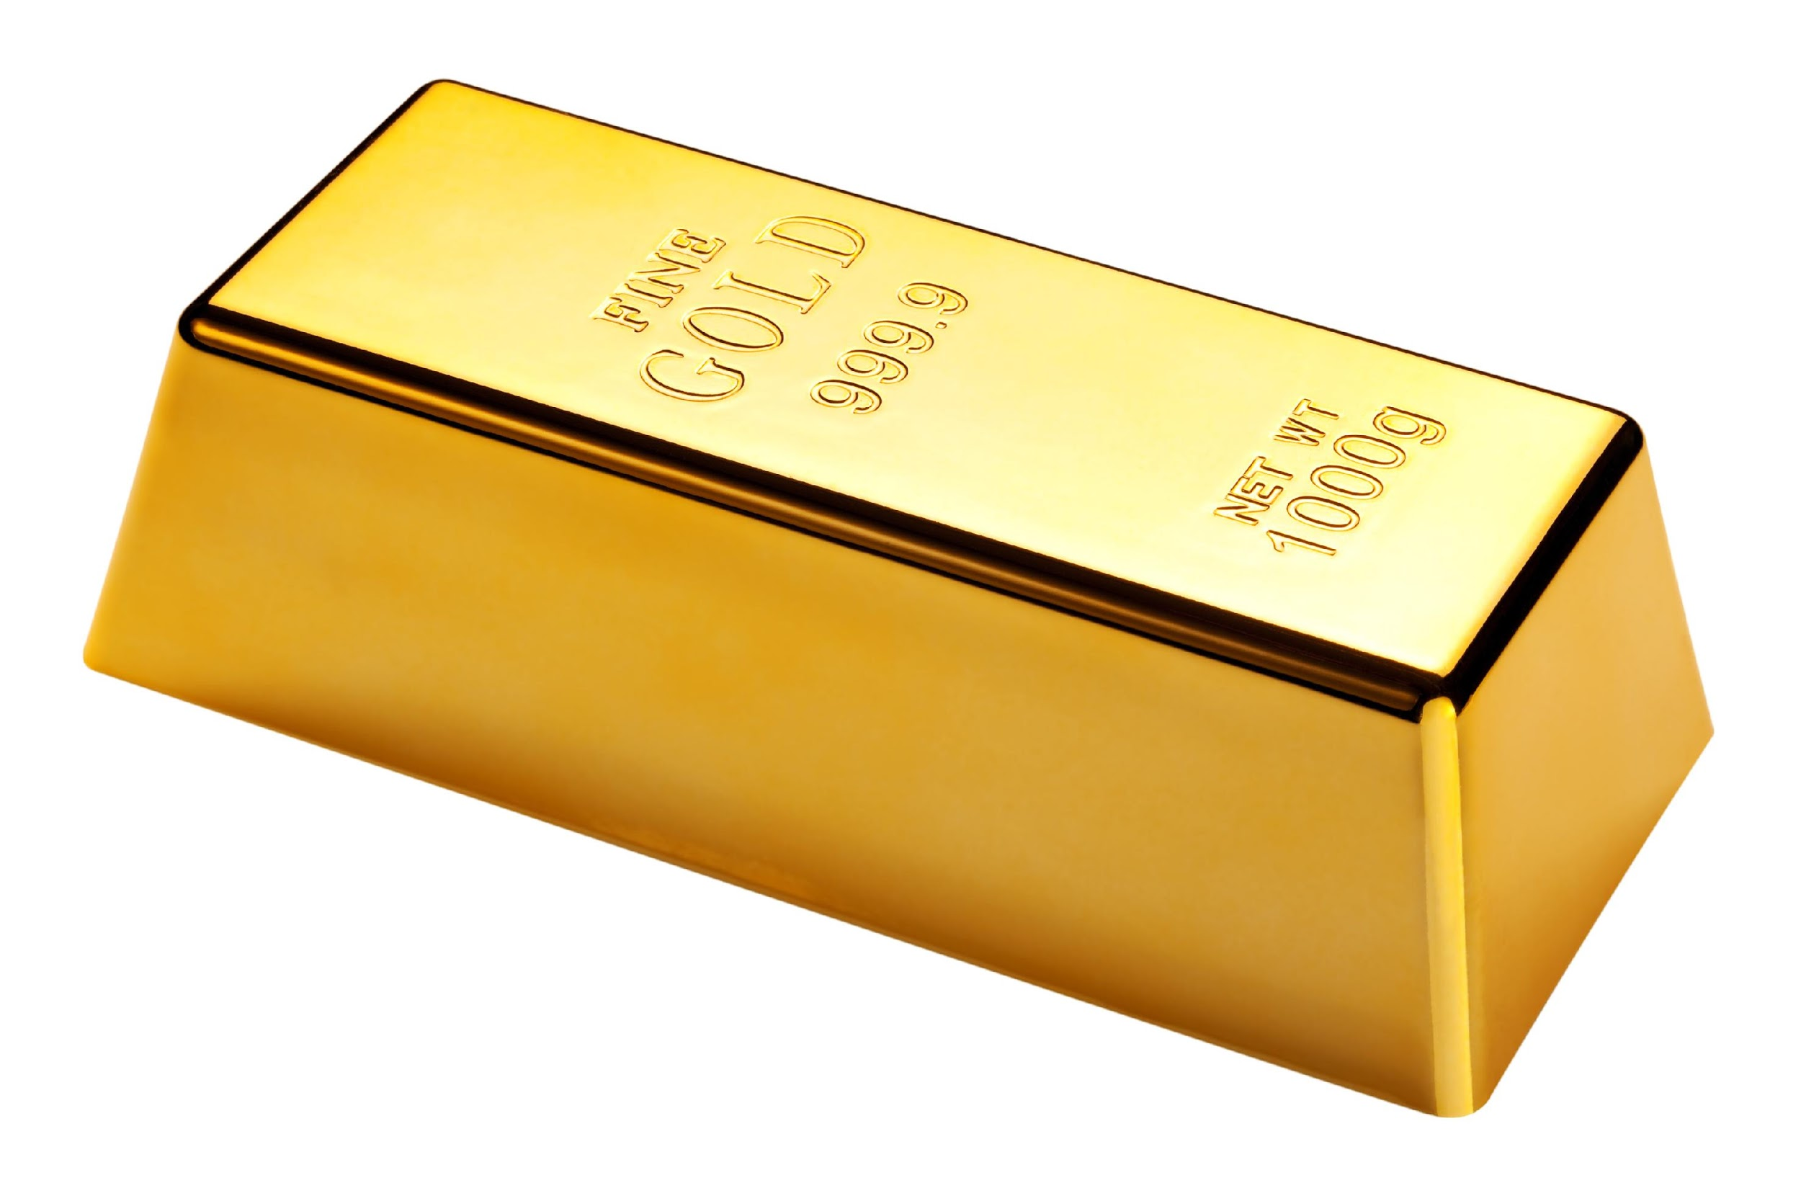
Intro
Elements
Notes:
Today, we will just focus on elements.

Slide 4
Big Question: How are elements, molecules, compounds, and mixtures related?
Notes:
Our “big question” is: How are elements, molecules, compounds, and mixtures related?
[Pause and illicit predictions from students.]
I love all these thoughtful scientific hypotheses! Be sure to keep this question and your predictions in mind as we move through these next few lessons, and we’ll continue to revisit them.

Slide 5
Demonstration
Elements, Mixtures, & Compounds
TEACHER DIRECTIONS:
Follow the link above to view a video and step-by-step directions for an activity that you can model for students. The materials required are household items (e.g., water, nuts/bolts, string, salt, etc.). Though this is meant to be a lab activity that students engage with in a traditional classroom setting, if teaching remotely you can demonstrate these steps for students and engage them in discussions around the following questions:
Describe and give examples of the three types of matter – elements, compounds, and mixtures.
Explain the different properties of each group of materials.
How do mechanical/material engineers use these terms regarding creating new composite materials?
How do chemical engineers use these terms when solving problems related to water purification and distillation of crude oil?
Notes:
Let’s do a quick demonstration that will help get our brains ready to think about elements, mixtures, and compounds, and how they relate to our big question.
Feedback: Remember to provide some background information that gives context to the demonstration and content being covered here. This helps students make sense of what they are exploring.

Slide 6
Notes:
Before we move on to our new vocabulary term, let’s review some other words & concepts that you already learned and make sure you are firm in your understanding.

Slide 7
Matter: anything that has mass and takes up space
Notes:
Matter is anything that has mass and takes up space.

Slide 8
Atom: the smallest whole unit of matter
Notes:
An atom is the smallest whole unit of matter. All matter is made up of atoms.

Slide 9
Notes:
Now let’s pause for a moment to check your understanding.
Feedback: Remember to make adjustments to your lesson and content if you see some students not demonstrating understanding, this can help them make connections and prevent frustration.

Slide 10
What is an atom?
Notes:
What is an atom?
[The smallest whole unit of matter.]

Slide 11
What is the relationship between atoms and matter?
Notes:
What is an atom?
[Atoms make up matter.]

Slide 12
Elements
Notes:
Now that we’ve reviewed, let’s define our new term, elements.

Slide 13
Element: pure substance made of only one type of atom
Notes:
An element is a pure substances made of only one type of atom.

Slide 14
Notes:
That is the basic definition, but there is a bit more you need to know.

Slide 15
Elements are in their simplest form, so they cannot be broken down into simpler substances.
Hydrogen
H
O
Oxygen
Notes:
Elements are already in their simplest form, so they cannot be broken down into simpler substances.

Slide 16
Notes:
All of the known elements are found on the periodic table of elements. There are currently 118 known elements.

Slide 17
Au
Gold
Carbon
C
Oxygen
O
Notes:
Elements are symbolized by a capital letter, sometimes with a lowercase letter, which is called its chemical symbol. Here we see three elements—gold, carbon, and oxygen—and their chemical symbols.

Slide 18
Notes:
Now let’s pause for a moment to check your understanding.
Feedback: Remember, students might look like they are understanding the definition but it is important that you check for understanding yourself by asking questions or providing them with other opportunities to respond.

Slide 19
What is an element?
Notes:
What is an element?
[An element is a pure substance made of only one type of atom.]

Slide 20
Why are elements unable to be broken down into simpler forms?
Hydrogen
H
O
Oxygen
Notes:
Why are elements unable to be broken down into simpler forms?
[They are already in their simplest form.]

Slide 21
Notes:
Now, let’s look at some examples of elements.
Feedback: Remember to try and use phrasing and language that is clear and easy for students to understand when going over examples of term meaning.

Slide 22
Au=Gold
Notes:
Gold is an element because it is made up of only gold atoms and cannot be broken down into a simpler substance.

Slide 23
Fe=Iron
Notes:
Iron is an element because it is made of only iron atoms and cannot be broken down into simpler forms.

Slide 24
Notes:
Now let’s pause for a moment to check your understanding.

Slide 25
Why is iron an example of an element?
Fe=Iron
Notes:
Why is iron an example of an element?
[Iron is an example of an element because iron is made up of only iron atoms and cannot be broken down into a simpler substance.]

Slide 26
Notes:
Next, let’s look at some non-examples of elements.
Feedback: Non-examples often need some explanation to make it clear to students the difference. Using clear and simple language can help with this.

Slide 27
Water
Hydrogen
H
H
ELEMENT
O
Oxygen
Notes:
Water is NOT an element because water is made up of different atoms, including hydrogen and oxygen atoms.

Slide 28
O
H
Glucose
H
Carbon
H
C
H
O
C
O
H
O
ELEMENT
C
C
H
C
C
H
O
O
H
H
H
H
Hydrogen
Oxygen
Notes:
Glucose, or sugar, is NOT an element because it is made up of different types of atoms, including carbon, hydrogen, and oxygen atoms.

Slide 29
Notes:
Now let’s pause for a moment to check your understanding.

Slide 30
What is water NOT an element?
Hydrogen
H
H
O
Oxygen
Notes:
Why is water NOT an element?
[Water is not an element because water is made up of different atoms, including hydrogen and oxygen atoms.]
Feedback: It is important that students know WHY something is an example or non-example. This will allow them to apply the content in future situations.

Slide 31
Remember!!!
Notes:
So remember!

Slide 32
Element: pure substance made of only one type of atom
Notes:
An element is a pure substance made of only one type of atom.

Slide 33
Elements are in their simplest form, so they cannot be broken down into simpler substances.
Hydrogen
H
O
Oxygen
Notes:
Elements are already in their simplest form, so they cannot be broken down into simpler substances.

Slide 34
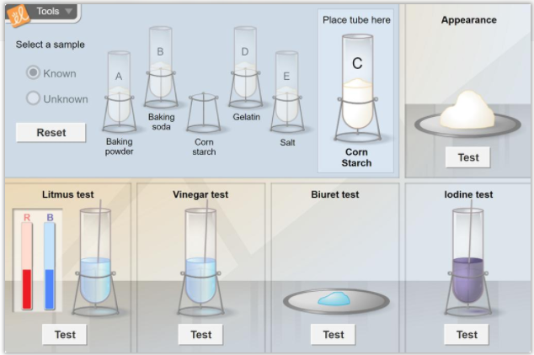
Simulation Activity
Mystery Powder Analysis
Click the link above to access the Mystery Powder Analysis Gizmo.
In this simulation activity, you will perform multiple experiments using several common powders such as corn starch, baking powder, baking soda, salt, and gelatin. We’ll see how pure substances can be identified based on their unique properties.
Notes:
Gizmo requires a subscription - a similar simulation could be done using the powders and techniques listed above.
Note: This is the same simulation as in the lesson on mixtures. Determine when it makes most sense for your particular class.
Feedback: Giving students a chance to analyze and interpret data is a great way to help them to continue to independently problem solve.

Slide 35
Big Question: How are elements, molecules, compounds, and mixtures related?
Notes:
Explicit cue to revisit the big question at the end of the lesson: Okay everyone. Now that we’ve learned the term, elements, let’s reflect once more on our big question. Was there anything that we predicted earlier that was correct or incorrect? Do you have any new hypotheses to share? [Illicit student responses]

Slide 36
Notes:
Thanks for watching, and please continue watching CAPs available from this website.

Slide 37
This Video Created With Resources From:
Questions or Comments
Michael Kennedy, Ph.D. MKennedy@Virginia.edu
Rachel L Kunemund, Ph.D. rk8vm@virginia.edu

Slide 38
Intro
“Big Idea” Question
Review Concepts
Check-In Questions
Teacher Demo
Vocabulary
Student-Friendly Definition
Examples & Non-Examples
Morphological Word Parts
Simulation/Activity
Notes:
OK everyone, get ready for our next lesson. Just as a reminder, these are the different components that our lesson may include, and you’ll see these icons in the top left corner of each slide so that you can follow along more easily!

Slide 39
Molecule
Intro
Notes:
Today we will learn about molecules.

Slide 40
Big Question: How are elements, molecules, compounds, and mixtures related?
Notes:
Our “big question” is: How are elements, molecules, compounds, and mixtures related?
[Pause and illicit predictions from students.]
I love all these thoughtful scientific hypotheses! Be sure to keep this question and your predictions in mind as we move through these next few lessons, and we’ll continue to revisit it.
We talked about this at the beginning and end of last class! Revisit and add to your predictions now - we’ll come back to these again at the end of class

Slide 41
Notes:
Before we move on to our new vocabulary term, let’s review some other words & concepts that you already learned and make sure you are firm in your understanding.

Slide 42
Matter: has mass and takes up space
Notes:
Matter is anything that has mass and takes up space.

Slide 43
Atom: smallest whole unit of matter
Atom
Atom
Atom
Atom
Atom
Notes:
An atom is the smallest whole unit of matter. Atoms have three particles: neutrons, protons, and electrons.

Slide 44
Element: a pure substance containing only one type of individual atoms
Notes:
An element is a pure substance containing only 1 type of individual atoms.

Slide 45
Notes:
All of the known elements are found on the periodic table of elements. There are currently 118 known elements.

Slide 46
Electron
Notes:
Electrons orbit the nucleus and have a negative charge.

Slide 47
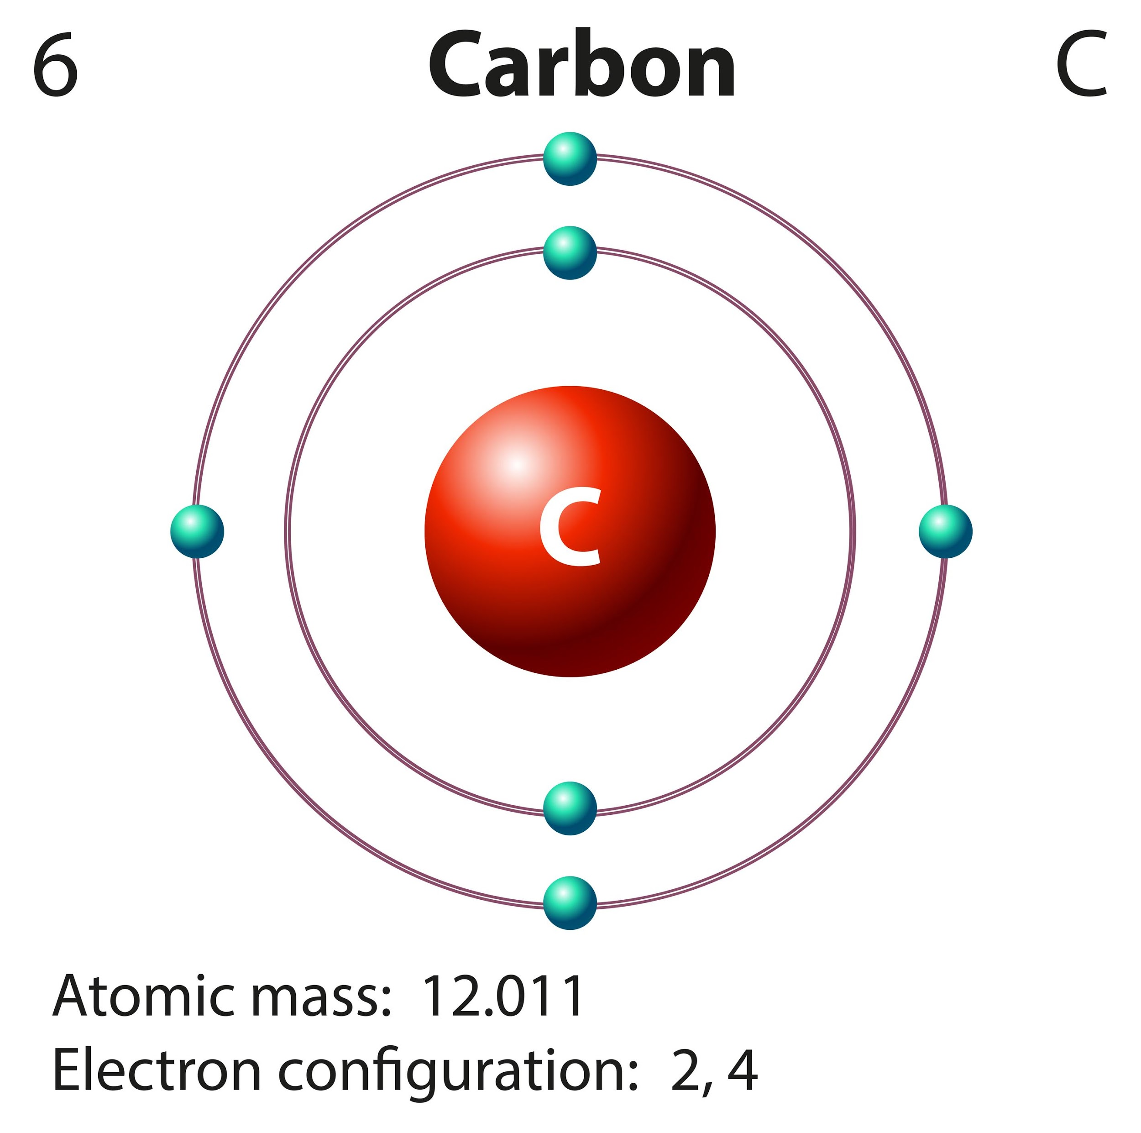
Valence Electrons: electrons in the outermost shell of an atom
Notes:
Valence electrons are the electrons in the outermost shell of an atom.

Slide 48
1 2 3 4 5 6 7 8
Notes:
The highest number of valence electrons an atom can have is eight, and atoms that have eight valence electrons are more stable than atoms with less than eight valence electrons.

Slide 49
Notes:
Now let’s pause for a moment to check your understanding.
Feedback: It's awesome to include many opportunities for students to demonstrate understanding, this can help you catch some confusion early and get students back on track.

Slide 50
What are the two characteristics of matter?
Notes:
What are the two characteristics of matter?
[Matter is anything that has mass and takes up space.]

Slide 51
True/False: An element is the smallest unit of matter.
Notes:
True/False: An element is the smallest unit of matter.
[False - An atom is the smallest unit of matter.]

Slide 52
True/False: An element is the smallest unit of matter.
Notes:
True/False: An element is the smallest unit of matter.
[False - An atom is the smallest unit of matter.]

Slide 53
What is an element?
Notes:
What is an element?
[An element is a pure substance containing only 1 type of individual atoms.]

Slide 54
What table is used to organize all known elements by characteristic?
Notes:
What table is used to organize all known elements by characteristic?
[All of the known elements are found on the periodic table of elements. There are currently 118 known elements.]
Feedback: Students should understand that the periodic table is just a way to organize all the known elements. Organizing and sorting the natural world by characteristic is a common theme in/goal of science.

Slide 55
What negatively charged particle orbits the nucleus?
Notes:
What negatively charged particle orbits the nucleus?
[Electrons orbit the nucleus and have a negative charge.]

Slide 56
What are valence electrons?
Notes:
What are valence electrons?
[Valence electrons are the electrons in the outermost shell of an atom.]

Slide 57
Molecules
Notes:
Now that we’ve reviewed, let’s define our new term, molecules.

Slide 58
Molecule: particle containing two or more atoms of the same OR different elements
OR
Notes:
A molecule is a particle containing 2 or more atoms of the same OR different elements.

Slide 59
Notes:
Now let’s pause for a moment to check your understanding.

Slide 60
What is a molecule?
OR
Notes:
What is a molecule?
[A molecule is a particle containing two or more atoms of the same OR different elements.]

Slide 61
Notes:
That is the basic definition, but there is a bit more you need to know.

Slide 62
Notes:
The atoms in a molecule are linked or held together through chemical bonds, which are visually represented by the red lines above.
Feedback: It's great to consistently use images in your lesson, this helps students make connections to the words in the definition.

Slide 63
Notes:
Now let’s pause for a moment to check your understanding.

Slide 64
How are molecules linked together?
Notes:
How are molecules linked together?
[The atoms in a molecule are linked or held together through chemical bonds, which are visually represented by the red lines above.]

Slide 65
Notes:
Now, let’s talk about some examples of molecules.

Slide 66
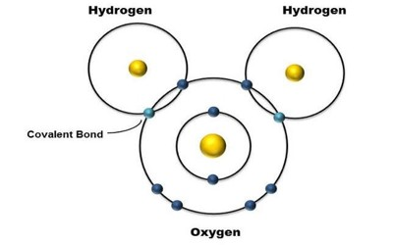
Notes:
Here we have an example of a molecule. There is a group of atoms held together by covalent bonds. We will learn more about covalent bonds throughout this unit.
Feedback: It's great practice to introduce an example of the term WITH images to go along with it, this is a great way to help students make connections.

Slide 67
Notes:
Glucose is a common example of a molecule that is held together by chemical bonds.

Slide 68
Notes:
Let’s check-in for understanding.

Slide 69
Name a common example of a molecule.
Notes:
Name a common example of a molecule.
[glucose, water, etc]

Slide 70
Explain why this is an example of a molecule.
Notes:
Explain why this is an example of a molecule.
[This shows a group of atoms held together by chemical bonds.]
Feedback: It’s important to have students practicing explaining WHY something is an example of a term.

Slide 71
Notes:
Next, let’s talk about some non-examples of molecules.

Slide 72
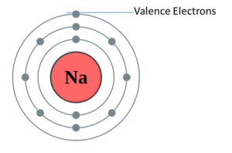
Notes:
We have seen this example before. This is a sodium atom. Remember, this atom by itself is not a molecule because a molecule is a group of atoms joined by bonds.

Slide 73
Notes:
We have seen this example before. This is a chlorine atom. Remember, this atom by itself is not a molecule because a molecule is a group of atoms joined by bonds.

Slide 74
Notes:
Now let’s pause for a moment to check your understanding.

Slide 75
Is the example below an example of a molecule? Explain your thinking.
Notes:
Is the example below an example of a molecule? Explain your thinking.
[No, this is a single atom.]

Slide 76
What is a molecule?
OR
Notes:
What is a molecule?
[A molecule is a particle containing two or more atoms of the same OR different elements.]
Feedback: It may seem repetitive that we are asking students to answer this question again. Repeated opportunities to demonstrate knowledge are a way to build content retention and consistently assess how well students are doing with the material.

Slide 77
Is this an example of a molecule? Explain your answer.
Notes:
Is this an example of a molecule? Explain your answer.
[Yes - this shows a group of atoms held together by chemical bonds.]

Slide 78
Is this an example of a molecule? Explain your answer.
Notes:
Is this an example of a molecule? Explain your answer.
[No - This is a chlorine atom. Remember, this atom by itself is not a molecule because a molecule is a group of atoms joined by chemical bonds.]

Slide 79
Remember!!!
Notes:
So remember!

Slide 80
Molecule: particle containing two or more atoms of the same OR different elements
OR
Notes:
A molecule is a particle containing 2 or more atoms of the same OR different elements.

Slide 81
Notes:
The atoms in a molecule are linked or held together through chemical bonds, which are visually represented by the red lines above.

Slide 82
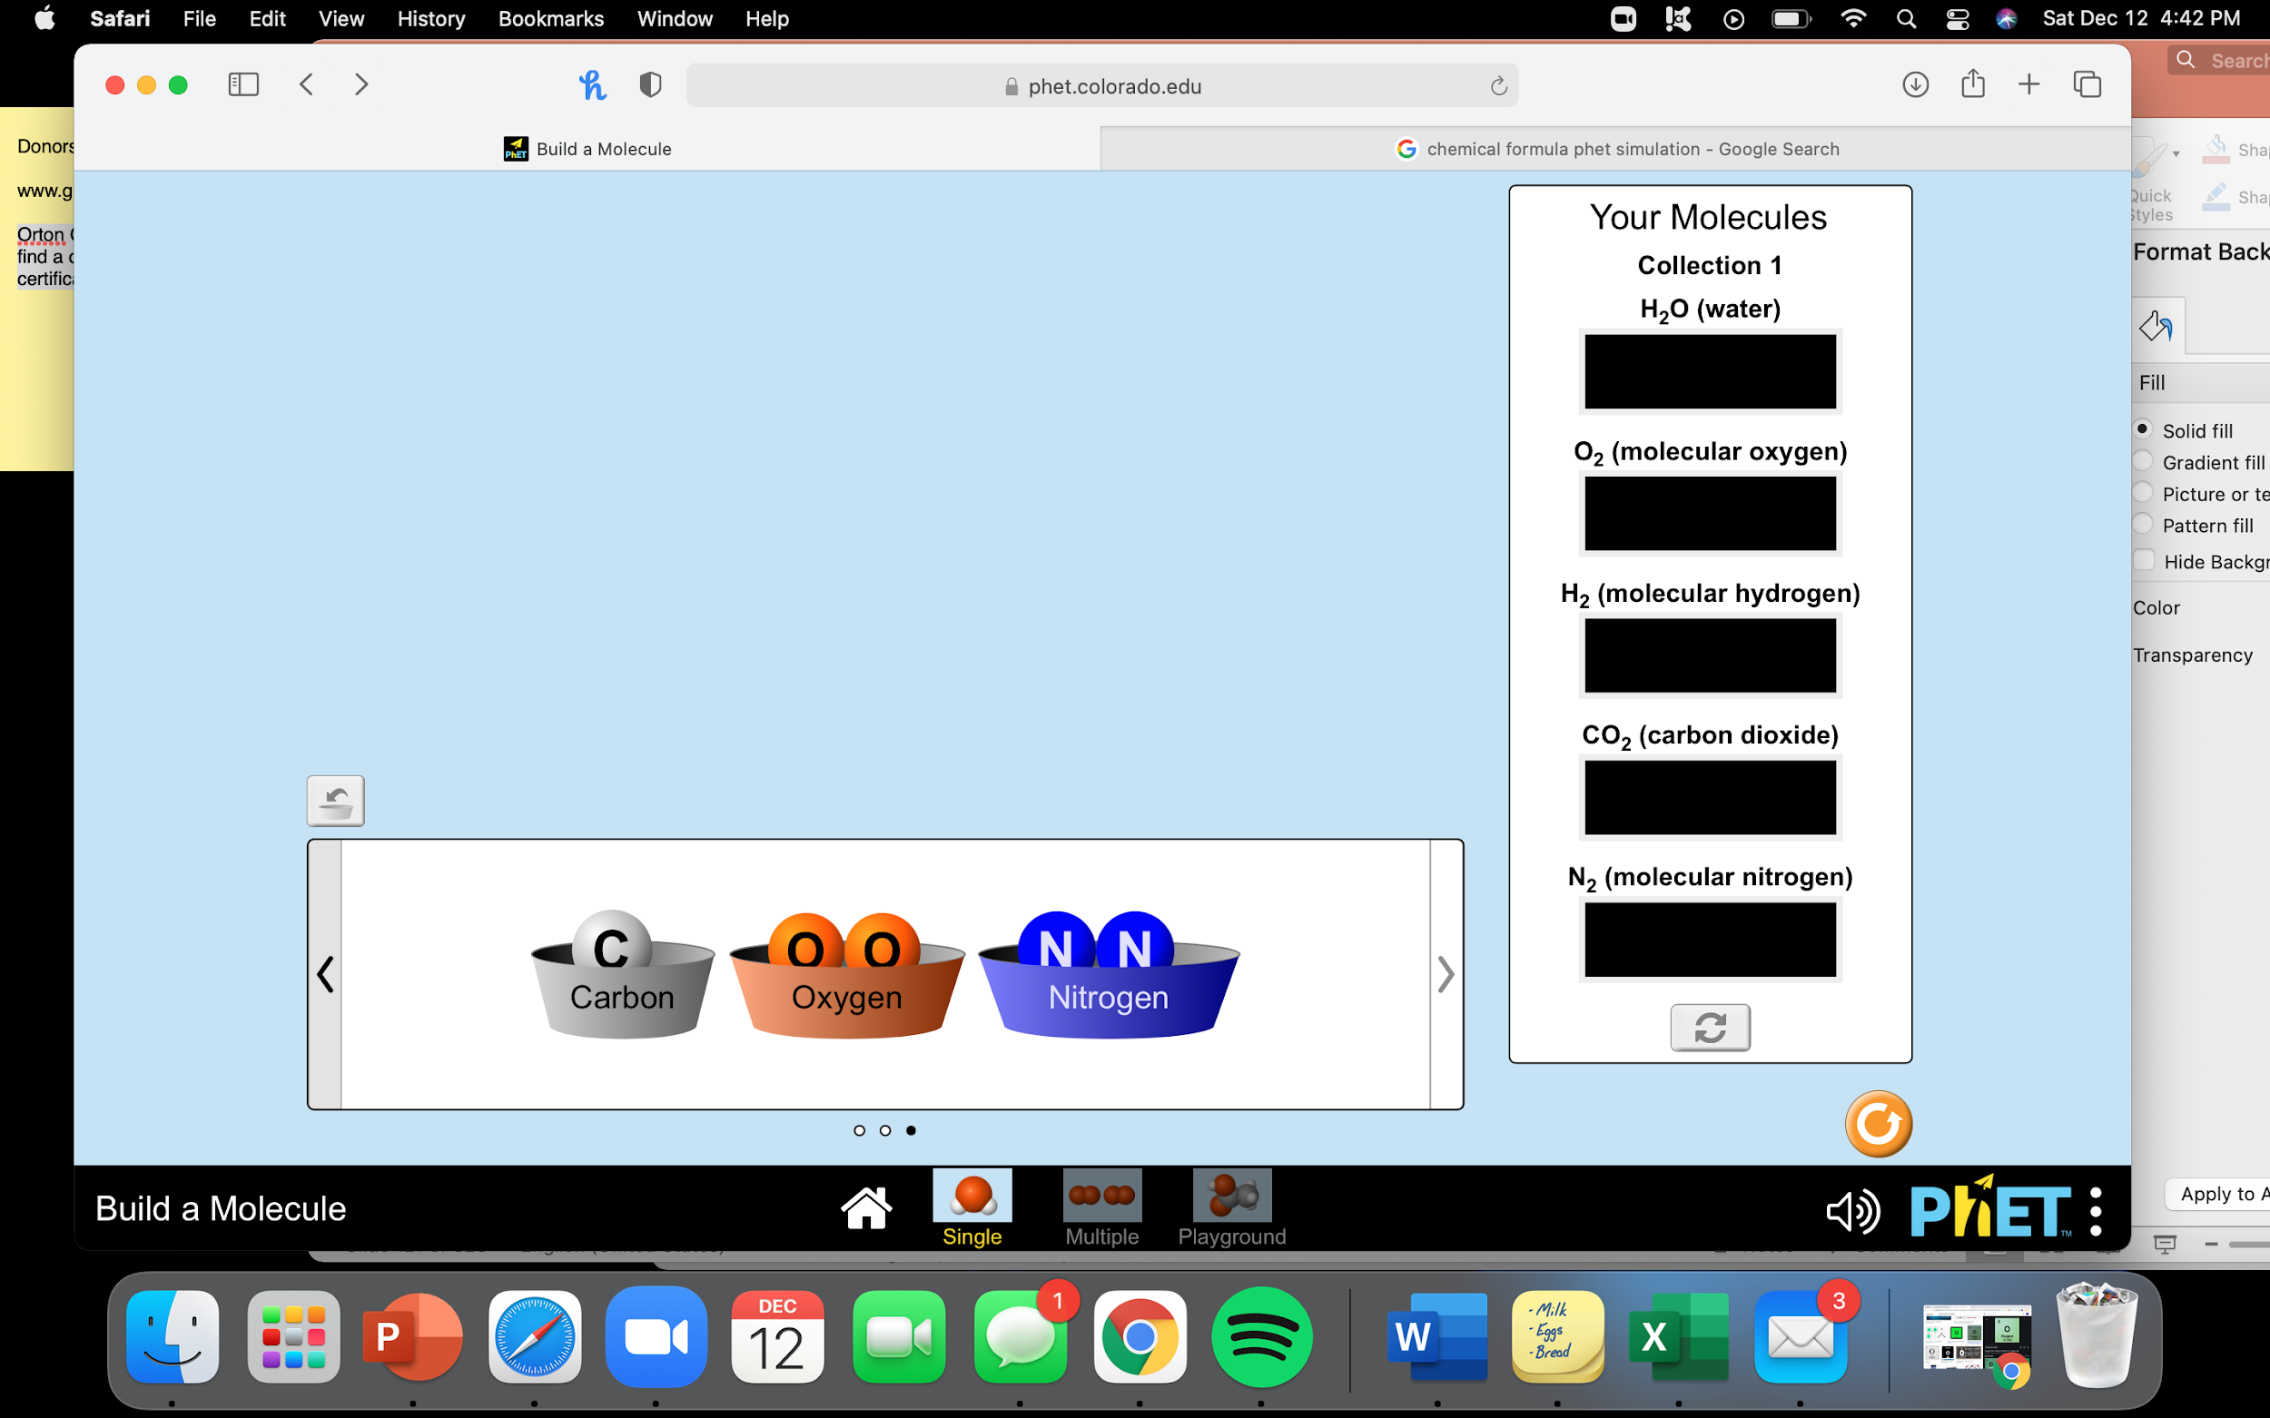
Simulation Activity
Build a Molecule
(Phet Colorado)
Click on the link above to practice building molecules.
In this simulation, practice building molecules that are given, then practice building your own molecules.
Notes:
Feedback: So that students are familiar with the controls and workings of the simulation, demonstrate how to open and work the simulation for the whole class. This allows students to focus on the content instead of the technical aspects of the activity.

Slide 83
Big Question: How are elements, molecules, compounds, and mixtures related?
Notes:
Explicit cue to revisit the big question at the end of the lesson: Okay everyone. Now that we’ve learned the term, molecule, let’s reflect once more on our big question. Was there anything that we predicted earlier that was correct or incorrect? Do you have any new hypotheses to share? [Illicit student responses]

Slide 84
Notes:
Thanks for watching, and please continue watching CAPs available from this website.

Slide 85
This Video Created With Resources From:
Questions or Comments
Michael Kennedy, Ph.D. MKennedy@Virginia.edu
Rachel L Kunemund, Ph.D. rk8vm@virginia.edu

Slide 86
Intro
“Big Idea” Question
Review Concepts
Check-In Questions
Teacher Demo
Vocabulary
Student-Friendly Definition
Examples & Non-Examples
Morphological Word Parts
Simulation/Activity
Notes:
OK everyone, get ready for our next lesson. Just as a reminder, these are the different components that our lesson may include, and you’ll see these icons in the top left corner of each slide so that you can follow along more easily!

Slide 87
Polar Molecule
Intro
Notes:
Today we will learn about polar molecules.

Slide 88
Big Question: How are elements, molecules, compounds, and mixtures related?
Notes:
Our “big question” is: How are elements, molecules, compounds, and mixtures related?
[Pause and illicit predictions from students.]
I love all these thoughtful scientific hypotheses! Be sure to keep this question and your predictions in mind as we move through these next few lessons, and we’ll continue to revisit it.
We talked about this at the beginning and end of last class! Revisit and add to your predictions now - we’ll come back to these again at the end of class

Slide 89
Notes:
Before we move on to our new vocabulary term, let’s review some other words & concepts that you already learned and make sure you are firm in your understanding.

Slide 90
Matter: has mass and takes up space
Notes:
Matter is anything that has mass and takes up space.

Slide 91
Atom: smallest whole unit of matter
Atom
Atom
Atom
Atom
Atom
Notes:
An atom is the smallest whole unit of matter. Atoms have three particles: neutrons, protons, and electrons.

Slide 92
Element: a pure substance containing only one type of individual atoms
Notes:
An element is a pure substance containing only 1 type of individual atoms.

Slide 93
Notes:
All of the known elements are found on the periodic table of elements. There are currently 118 known elements.

Slide 94
Electron
Notes:
Electrons orbit the nucleus and have a negative charge.

Slide 95
Valence Electrons: electrons in the outermost shell of an atom
Notes:
Valence electrons are the electrons in the outermost shell of an atom.

Slide 96
1 2 3 4 5 6 7 8
Notes:
The highest number of valence electrons an atom can have is eight, and atoms that have eight valence electrons are more stable than atoms with less than eight valence electrons.

Slide 97
Molecule: particle containing two or more atoms of the same OR different elements
OR
Notes:
A molecule is a particle containing 2 or more atoms of the same OR different elements.

Slide 98
Notes:
The atoms in a molecule are linked or held together through chemical bonds, which are visually represented by the red lines above.

Slide 99
Notes:
Now let’s pause for a moment to check your understanding.
Feedback: Providing your students with lots of opportunities to respond is critical to this part of your lesson as it helps you determine whether students understand the different steps before you ask them to apply it.

Slide 100
What are the two characteristics of matter?
Notes:
What are the two characteristics of matter?
[Matter is anything that has mass and takes up space.]

Slide 101
True/False: An element is the smallest unit of matter.
Notes:
True/False: An element is the smallest unit of matter.
[False - An atom is the smallest unit of matter.]

Slide 102
True/False: An element is the smallest unit of matter.
Notes:
True/False: An element is the smallest unit of matter.
[False - An atom is the smallest unit of matter.]

Slide 103
What is an element?
Notes:
What is an element?
[An element is a pure substance containing only 1 type of individual atoms.]

Slide 104
What orbits the nucleus and has a negative charge?
Notes:
What orbits the nucleus and has a negative charge?
[Electrons orbit the nucleus and have a negative charge.]

Slide 105
What are valence electrons?
Notes:
What are valence electrons?
[Valence electrons are the electrons in the outermost shell of an atom.]

Slide 106
What is a molecule?
OR
Notes:
What is a molecule?
[A molecule is a particle containing 2 or more atoms of the same OR different elements.]

Slide 107
How are molecules linked together?
Notes:
How are molecules linked together?
[The atoms in a molecule are linked or held together through chemical bonds, which are visually represented by the red lines above.]

Slide 108
Explain why this is an example of a molecule
Notes:
Explain why this is an example of a molecule.
[Here we have one hydrogen atom bonded with the oxygen atom and a separate hydrogen atom bonded with the oxygen atom.]

Slide 109
Polar Molecule
Notes:
Now that we’ve reviewed, let’s define our new term, polar molecule.

Slide 110
Polar Molecule: a molecule that has a partial positive and negative end because they do not share electrons equally
Notes:
A polar molecule is a molecule that has a partial positive and negative end because they do not share electrons equally.

Slide 111
Notes:
Now let’s pause for a moment to check your understanding.

Slide 112
What is a polar molecule?
Notes:
What is a polar molecule?
[A polar molecule is a molecule that has a partial positive and negative end because they do not share electrons equally.]

Slide 113
Notes:
That is the basic definition, but there is a bit more you need to know.

Slide 114
Partial = Part
Notes:
Partial means PART. Because they do not share electrons equally, polar molecules have a partial positive and negative end. One part is positive and one part is negative.
Feedback: Explaining the difficult vocabulary in the definition is helpful for students.

Slide 115
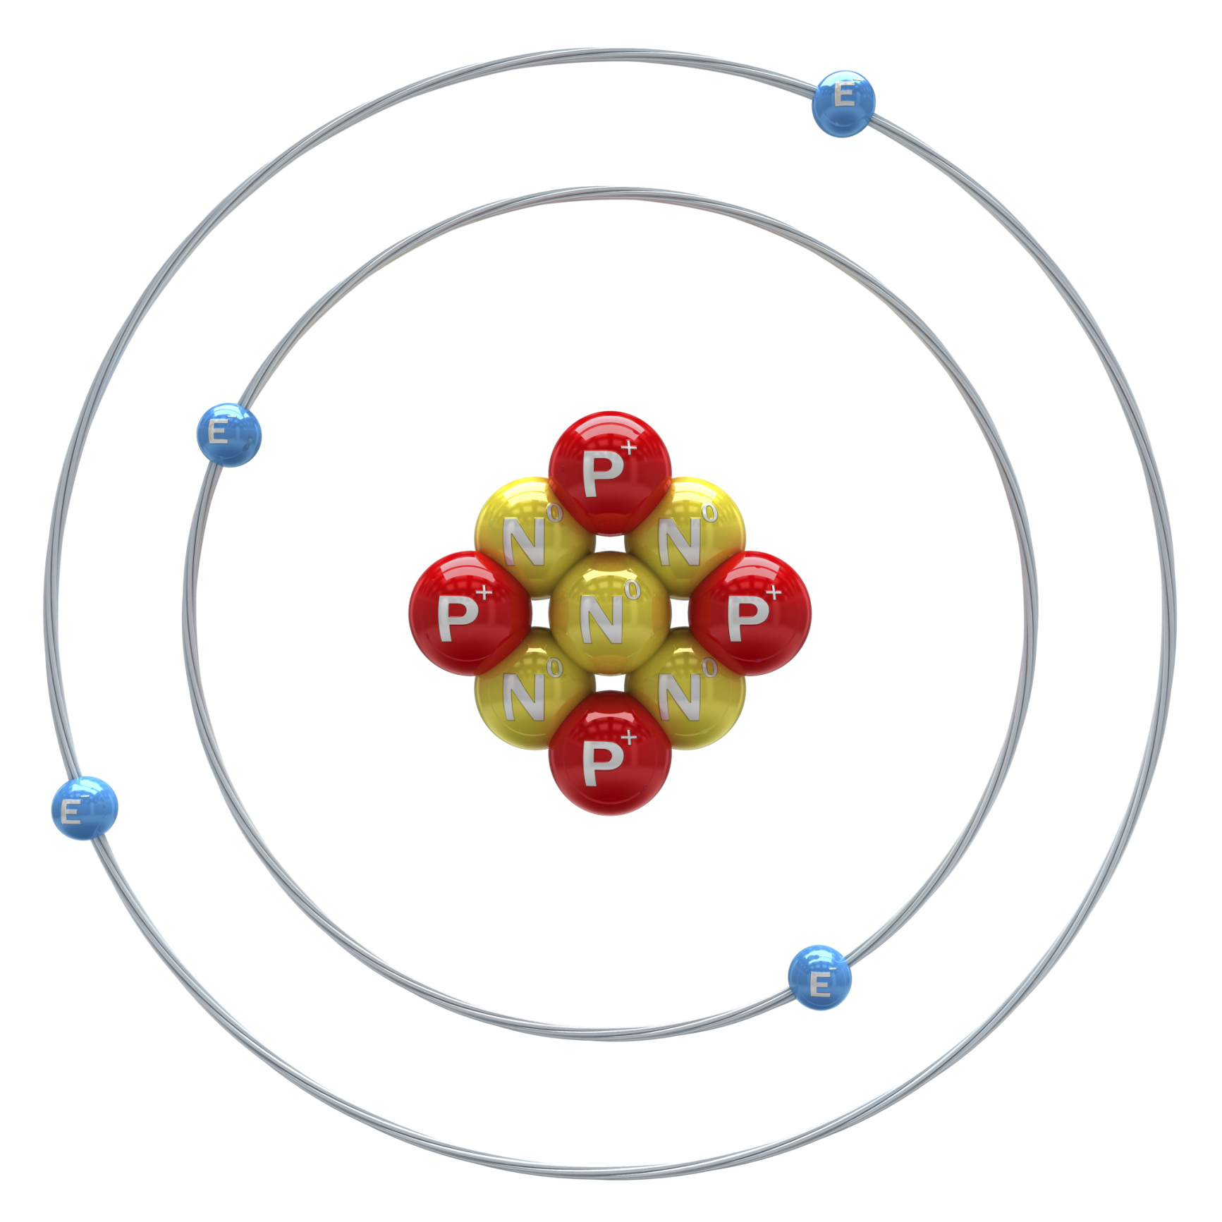
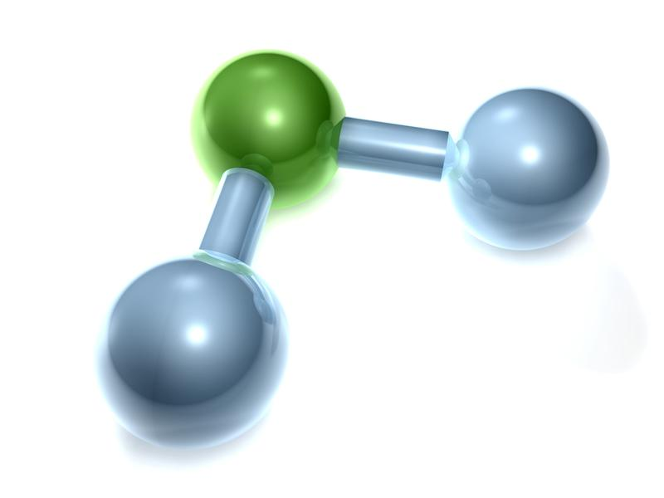
Negative Charge
Notes:
Remember that electrons have a negative charge. So, if they spend more time near more of the atoms, then it will gain a slightly negative charge.

Slide 116
Partial Positive Charge
Notes:
And the side where the electron does not spend majority of its time will have a positive charge.

Slide 117
Notes:
Now let’s pause for a moment to check your understanding.

Slide 118
What is a polar molecule?
Notes:
What is a polar molecule?
[A polar molecule is a molecule that has a partial positive and negative end because they do not share electrons equally.]

Slide 119
Describe the charge of a polar molecule.
Notes:
Describe the charge of a polar molecule.
[The charge of a polar molecule is unevenly distributed because the electrons concentrate on one side. That side is negatively charged and the other side is positively charged.]

Slide 120
Notes:
Now, let’s talk about some examples of polar molecules.

Slide 121
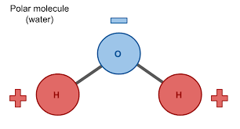
Notes:
The most common polar molecule is the water molecule. It is a polar molecule because it has a partial positive charge. The electrons aren’t shared equally which is why there is a partial positive charge and a partial negative charge

Slide 122
Notes:
Here we have another example of a polar molecule. We can see it has a partially positive charge, so it is a polar molecule.

Slide 123
Notes:
Now let’s pause for a moment to check your understanding.

Slide 124
What is a polar molecule?
Notes:
What is a polar molecule?
[A polar molecule is a molecule that has a partial positive and negative end because they do not share electrons equally.]
Feedback: Providing feedback is tricky but crucial. Remember to give students with feedback on their response because it helps students know what answers you are actually looking for.

Slide 125
Explain why this is an example of a polar molecule.
Notes:
Explain why this is an example of a polar molecule.
[It is partially positive. Electrons are not shared equally, so there is not a full positive or negative charge.]

Slide 126
Notes:
Next, let’s talk about some non-examples of polar molecules.

Slide 127
Notes:
This is not an example of a polar molecule. Here, electrons are equally shared, so there is no positive or negative charge. We will learn more about this in the next lesson.

Slide 128
Notes:
This is also not a polar molecule. Here, electrons are equally shared, so there is no positive or negative charge. We will learn more about this in the next lesson.
Feedback: It is useful to offer a small preview of the next lesson at the very end of the class. This not only offers the students a slight mental preparation for the next lesson but also helps the students see connections between the material.

Slide 129
Notes:
Now let’s pause for a moment to check your understanding.

Slide 130
Is this an example of a polar molecule? Explain your answer.
Notes:
Is this an example of a polar molecule? Explain your answer.
[No, the electrons are shared and the charge is evenly distributed.]

Slide 131
What is a polar molecule?
Notes:
What is a polar molecule?
[A polar molecule is a molecule that has a partial positive and negative end because they do not share electrons equally.]

Slide 132
Describe the charge of a polar molecule.
Notes:
Describe the charge of a polar molecule.
[The charge of a polar molecule is unevenly distributed because the electrons concentrate on one side. That side is negatively charged and the other side is positively charged.]

Slide 133
Is this a polar molecule? Explain your answer.
Notes:
Is this a polar molecule? Explain your answer.
[Yes - we can see it does not share electrons equally, which is why it had a partially positive charge and is a polar molecule.]

Slide 134
Is this a polar molecule? Explain your answer.
Notes:
Is this a polar molecule? Explain your answer.
[No - electrons are equally shared, so there is no positive or negative charge.]
Feedback: This may seem like a lot of similar, repetitive questions. Confirming students' understanding with lots of opportunities to respond when closing a lesson is super important before asking them to try it on their own.

Slide 135
Remember!!!
Notes:
So remember!

Slide 136
Polar Molecule: a molecule that has a partial positive and negative end because they do not share electrons equally
Notes:
A polar molecule is a molecule that has a partial positive and negative end because they do not share electrons equally.

Slide 137
Simulation Activity
Molecule Polarity
(Phet Colorado)
Click on the link above to practice building molecules.
In this simulation, explore polar and nonpolar molecules.
Notes:
Feedback: Definitely take time to preview the simulation before assigning it to students. That way, you’ll be able to help with the technical aspects and come up with guiding questions to increase the focus of the activity.

Slide 138
Big Question: How are elements, molecules, compounds, and mixtures related?
Notes:
Explicit cue to revisit the big question at the end of the lesson: Okay everyone. Now that we’ve learned the term, polar molecule, let’s reflect once more on our big question. Was there anything that we predicted earlier that was correct or incorrect? Do you have any new hypotheses to share? [Illicit student responses]

Slide 139
Notes:
Thanks for watching, and please continue watching CAPs available from this website.

Slide 140
This Video Created With Resources From:
Questions or Comments
Michael Kennedy, Ph.D. MKennedy@Virginia.edu
Rachel L Kunemund, Ph.D. rk8vm@virginia.edu

Slide 141
Intro
“Big Idea” Question
Review Concepts
Check-In Questions
Teacher Demo
Vocabulary
Student-Friendly Definition
Examples & Non-Examples
Morphological Word Parts
Simulation/Activity
Notes:
OK everyone, get ready for our next lesson. Just as a reminder, these are the different components that our lesson may include, and you’ll see these icons in the top left corner of each slide so that you can follow along more easily!

Slide 142
Nonpolar Molecule
Intro
O
C
O
Notes:
Today we will learn about nonpolar molecules.

Slide 143
Big Question: How are elements, molecules, compounds, and mixtures related?
Notes:
Our “big question” is: How are elements, molecules, compounds, and mixtures related?
[Pause and illicit predictions from students.]
I love all these thoughtful scientific hypotheses! Be sure to keep this question and your predictions in mind as we move through these next few lessons, and we’ll continue to revisit it.
We talked about this at the beginning and end of last class! Revisit and add to your predictions now - we’ll come back to these again at the end of class

Slide 144
Notes:
Before we move on to our new vocabulary term, let’s review some other words & concepts that you already learned and make sure you are firm in your understanding.

Slide 145
Matter: has mass and takes up space
Notes:
Matter is anything that has mass and takes up space.

Slide 146
Atom: smallest whole unit of matter
Atom
Atom
Atom
Atom
Atom
Notes:
An atom is the smallest whole unit of matter. Atoms have three particles: neutrons, protons, and electrons.

Slide 147
Element: a pure substance containing only 1 type of individual atoms
Notes:
An element is a pure substance containing only 1 type of individual atoms.

Slide 148
Notes:
All of the known elements are found on the periodic table of elements. There are currently 118 known elements.

Slide 149
Electron
Notes:
Electrons orbit the nucleus and have a negative charge.

Slide 150
Valence Electrons: electrons in the outermost shell of an atom
Notes:
Valence electrons are the electrons in the outermost shell of an atom.

Slide 151
1 2 3 4 5 6 7 8
Notes:
The highest number of valence electrons an atom can have is eight, and atoms that have eight valence electrons are more stable than atoms with less than eight valence electrons.

Slide 152
Molecule: particle containing 2 or more atoms of the same OR different elements
OR
Notes:
A molecule is a particle containing 2 or more atoms of the same OR different elements.

Slide 153
Notes:
The atoms in a molecule are linked or held together through chemical bonds, which are visually represented by the red lines above.

Slide 154
Polar Molecule: a molecule that has a partial positive and negative end because they do not share electrons equally
Notes:
A polar molecule is a molecule that has a partial positive and negative end because they do not share electrons equally.

Slide 155
Notes:
Now let’s pause for a moment to check your understanding.

Slide 156
What are the two characteristics of matter?
Notes:
What are the two characteristics of matter?
[Matter is anything that has mass and takes up space.]

Slide 157
True/False: An element is the smallest unit of matter.
Notes:
True/False: An element is the smallest unit of matter.
[False - An atom is the smallest unit of matter.]

Slide 158
True/False: An element is the smallest unit of matter.
Notes:
True/False: An element is the smallest unit of matter.
[False - An atom is the smallest unit of matter.]

Slide 159
What is an element?
Notes:
What is an element?
[An element is a pure substance containing only 1 type of individual atoms.]

Slide 160
Where are all known elements found?
Notes:
Where are all known elements found?
[All of the known elements are found on the periodic table of elements. There are currently 118 known elements.]

Slide 161
What orbits the nucleus and has a negative charge?
Notes:
What orbits the nucleus and has a negative charge?
[Electrons orbit the nucleus and have a negative charge.]

Slide 162
What are valence electrons?
Notes:
What are valence electrons?
[Valence electrons are the electrons in the outermost shell of an atom.]

Slide 163
What is a molecule?
OR
Notes:
What is a molecule?
[A molecule is a particle containing 2 or more atoms of the same OR different elements.]

Slide 164
How are molecules linked together?
Notes:
How are molecules linked together?
[The atoms in a molecule are linked or held together through chemical bonds, which are visually represented by the red lines above.]

Slide 165
Explain why this is an example of a molecule.
Notes:
Explain why this is an example of a molecule.
[Here we have an example of a molecule. We have one hydrogen atom bonded with the oxygen atom and a separate hydrogen atom bonded with the oxygen atom.]

Slide 166
What is a polar molecule?
Notes:
What is a polar molecule?
[A polar molecule is a molecule that has a partial positive and negative end because they do not share electrons equally.]

Slide 167
Why is this an example of a polar molecule?
Notes:
Why is this an example of a polar molecule?
[Here we have another example of a polar molecule. We can see it does not share electrons equally, which is why it had a partially positive charge and is a polar molecule.]

Slide 168
Nonpolar Molecule
Notes:
Now that we’ve reviewed, let’s define our new term, nonpolar molecule.

Slide 169
Nonpolar Molecule: a molecule that equally shares electrons
O
C
O
Notes:
A nonpolar molecule is a molecule that equally shares electrons.
Feedback: When providing more student-friendly definitions, it is helpful to provide students with cues so that they can be prepared and know what to expect and be ready to copy down the information.

Slide 170
Notes:
Now let’s pause for a moment to check your understanding.

Slide 171
What is a nonpolar molecule?
O
C
O
Notes:
What is a nonpolar molecule?
[A nonpolar molecule is a molecule that equally shares electrons.]
Feedback: Provide clear and straightforward directions when asking students to explain the definitions. This helps to avoid confusion!

Slide 172
Notes:
That’s the basic definition, but there is more you need to know.

Slide 173
No Partial charges
O
C
O
Notes:
Nonpolar molecules equally share electrons. So there is no partial sharing.

Slide 174
Notes:
Now let’s pause for a moment to check your understanding.

Slide 175
What is a nonpolar molecule?
O
C
O
Notes:
What is a nonpolar molecule?
[A nonpolar molecule is a molecule that equally shares electrons.]

Slide 176
Describe the charge of a nonpolar molecule.
O
C
O
Notes:
Describe the charge of a nonpolar molecule.
[Nonpolar molecules equally share electrons. So there is no partial sharing.]

Slide 177
Notes:
Now, let’s talk about some examples of nonpolar molecules.

Slide 178
Notes:
This is a nonpolar molecule. It is nonpolar because electrons are equally shared and there are no partial charges.
Feedback: When providing an example, it can be helpful to explain WHY the example fits the definition. This allows students to apply the same content in the future.

Slide 179
Notes:
Here is another example of a nonpolar molecule. It is nonpolar because electrons are equally shared and there are no partial charges.

Slide 180
Notes:
Now let’s pause for a moment to check your understanding.

Slide 181
What is a nonpolar molecule?
O
C
O
Notes:
What is a nonpolar molecule?
[A nonpolar molecule is a molecule that equally shares electrons.]

Slide 182
Why is this an example of a nonpolar molecule?
Notes:
Why is this an example of a nonpolar molecule?
[This is a nonpolar molecule. It is nonpolar because electrons are equally shared and there are no partial charges.]

Slide 183
Notes:
Next, let’s talk about some non-examples of nonpolar molecules.

Slide 184
Notes:
This water molecule is not nonpolar. It is polar because it has a partial positive/negative charge.
Feedback: Using clear language as you introduce a non-example helps students to make sense of the difference.

Slide 185
Notes:
This is also NOT a nonpolar molecule. It is polar because this molecule also has a partial positive/negative charge.

Slide 186
Notes:
Now let’s pause for a moment to check your understanding.

Slide 187
Is this an example of a nonpolar molecule? Explain.
Notes:
Is this an example of a nonpolar molecule? Explain.
[No - This water molecule is not nonpolar. It is polar because it has a partial positive/negative charge.]

Slide 188
Notes:
Let’s break down the word parts of nonpolar.

Slide 189
non polar
Notes:
The term nonpolar has two parts: non and polar.

Slide 190
non polar
Not + Polar
Notes:
Non means not. So if you put the word parts together, nonpolar molecules are molecules that are not to either a positive or a negative side.
Feedback: Reuniting the word parts is a crucial step in helping students understand the whole picture when reviewing morphological word parts.

Slide 191
Notes:
Let’s check-in for understanding.

Slide 192
non polar
How does breaking down the word “nonpolar” help us remember its meaning?
Notes:
How does breaking down the word “nonpolar” help us remember its meaning?
[The term nonpolar has two parts: non and polar.
Non means not. So if you put the word parts together, nonpolar molecules are molecules that are not to either a positive or a negative side.]

Slide 193
What is a nonpolar molecule?
O
C
O
Notes:
What is a nonpolar molecule?
[A nonpolar molecule is a molecule that equally shares electrons.]

Slide 194
Describe the charge of a nonpolar molecule.
O
C
O
Notes:
Describe the charge of a nonpolar molecule.
[Nonpolar molecules equally share electrons. So there is no partial sharing.]

Slide 195
Why is this an example of a nonpolar molecule?
Notes:
Why is this an example of a nonpolar molecule?
[This is a nonpolar molecule. It is nonpolar because electrons are equally shared and there are no partial charges.]

Slide 196
Is this an example of a nonpolar molecule? Explain.
Notes:
Is this an example a nonpolar molecule? Explain.
[No - This water molecule is not nonpolar. It is polar because it has a partial positive/negative charge.]

Slide 197
Remember!!!
Notes:
So remember!

Slide 198
Nonpolar Molecule: a molecule that equally shares electrons
O
C
O
Notes:
Nonpolar molecules equally share electrons.

Slide 199
Big Question: How are elements, molecules, compounds, and mixtures related?
Notes:
Explicit cue to revisit the big question at the end of the lesson: Okay everyone. Now that we’ve learned the term, nonpolar molecule, let’s reflect once more on our big question. Was there anything that we predicted earlier that was correct or incorrect? Do you have any new hypotheses to share? [Illicit student responses]

Slide 200
Notes:
Thanks for watching, and please continue watching CAPs available from this website.

Slide 201
This Video Created With Resources From:
Questions or Comments
Michael Kennedy, Ph.D. MKennedy@Virginia.edu
Rachel L Kunemund, Ph.D. rk8vm@virginia.edu

Slide 202
Intro
“Big Idea” Question
Review Concepts
Check-In Questions
Teacher Demo
Vocabulary
Student-Friendly Definition
Examples & Non-Examples
Morphological Word Parts
Simulation/Activity
Notes:
OK everyone, get ready for our next lesson. Just as a reminder, these are the different components that our lesson may include, and you’ll see these icons in the top left corner of each slide so that you can follow along more easily!
Feedback: Previewing the format of the lesson for students is helpful in preparing them for what’s to come. Additionally, using the same components in each lesson creates structure and provides additional support.

Slide 203
Intro
Matter
Elements
Compounds
Mixtures
Notes:
Today we’re going to continue with our focus on the three different classifications of matter, including elements, compounds and mixtures.

Slide 204
Compounds
Intro
Notes:
In this lesson we’ll specifically focus on compounds.

Slide 205
Big Question: How are elements, molecules, compounds, and mixtures related?
Notes:
Our “big question” is: How are elements, molecules, compounds, and mixtures related?
[Pause and illicit predictions from students.]
I love all these thoughtful scientific hypotheses! Be sure to keep this question and your predictions in mind as we move through these next few lessons, and we’ll continue to revisit it.
We talked about this at the beginning and end of last class! Revisit and add to your predictions now - we’ll come back to these again at the end of class

Slide 206
Notes:
Before we move on to our new vocabulary term, let’s review some other words & concepts that you already learned and make sure you are firm in your understanding.

Slide 207
Matter: anything that has mass and takes up space
Notes:
Matter is anything that has mass and takes up space.

Slide 208
Atom: the smallest whole unit of matter
Notes:
An atom is the smallest whole unit of matter. All matter is made up of atoms.

Slide 209
Element: pure substance made of only one type of atom
Notes:
An element is a pure substance made of only one type of atom.

Slide 210
Elements are in their simplest form, so they cannot be broken down into simpler substances.
Hydrogen
H
O
Oxygen
Notes:
Elements are already in their simplest form, so they cannot be broken down into simpler substances.

Slide 211
Molecule: particle containing 2 or more atoms of the same OR different elements
OR
Notes:
A molecule is a particle containing 2 or more atoms of the same OR different elements.

Slide 212
Polar Molecule: a molecule that has a partial positive and negative end because they do not share electrons equally
Notes:
A polar molecule is a molecule that has a partial positive and negative end because they do not share electrons equally.

Slide 213
Nonpolar Molecule: a molecule that equally shares electrons
O
C
O
Notes:
Nonpolar molecules equally share electrons.

Slide 214
Notes:
Now let’s pause for a moment to check your understanding.
Feedback: Intentionally repeating key information when engaging in this part of the lesson highlights what is important for the students.

Slide 215
What is an atom?
Notes:
What is an atom?
[The smallest whole unit of matter.]

Slide 216
What is the relationship between atoms and matter?
Notes:
What is the relationship between atoms and matter?
[Atoms make up matter.]

Slide 217
What is an element?
Notes:
What is an element?
[An element is a pure substance made of only one type of atom.]

Slide 218
Why are elements unable to be broken down into simpler forms?
Hydrogen
H
O
Oxygen
Notes:
Why are elements unable to be broken down into simpler forms?
[They are already in their simplest form.]

Slide 219
What is a molecule?
OR
Notes:
What is a molecule?
[A molecule is a particle containing 2 or more atoms of the same OR different elements.]

Slide 220
What is the difference between a polar and nonpolar molecule?
O
C
O
Notes:
What is the difference between a polar and nonpolar molecule?
[A polar molecule is a molecule that has a partial positive and negative end because they do not share electrons equally.
Nonpolar molecules equally share electrons.]

Slide 221
Compounds
Notes:
Now that we’ve reviewed, let’s define our new term, compounds.

Slide 222
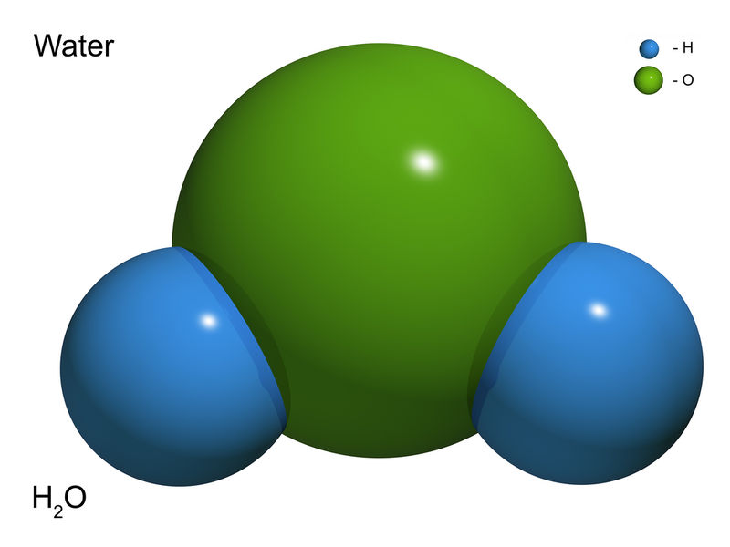
Compounds: pure substances made of two or more different elements that are chemically bonded (joined)
Notes:
Compounds are pure substances made of two or more different elements that are chemically bonded, or joined.
Feedback: Using italics or bolded font can emphasize key parts of the definition.

Slide 223
Notes:
Now let’s pause for a moment to check your understanding.

Slide 224
What is a compound?
Notes:
What is a compound?
[Compounds are pure substances that are made of two or more different elements that are chemically bonded together.]

Slide 225
Notes:
That is the basic definition, but there is a bit more you need to know.

Slide 226
Compounds are made up of a specific ratio of elements that is always the same.
O
H
H
Notes:
Compounds are made up of a specific ratio of elements that is always the same. For example, water is represented as H2O – it will always have two hydrogen atoms and one oxygen atom joined together.

Slide 227
The chemical and physical properties of a compound are different from the properties of their separate elements.
O
O
H
H
H
Gases
Liquid
Notes:
The chemical and physical properties of a compound are different from the properties of their separate elements. For example, when separate, the elements of hydrogen and oxygen are both gases. But when joined together to create the H2O, the water compound is a liquid.

Slide 228
A compound is a type of molecule.
O
H
H
Notes:
A compound is a type of molecule. For example, this is an H2O, or water, molecule.

Slide 229
This is because two or more bonded atoms create molecules.
C
O
C
H
H
C₂
H₂O
Both are molecules!
Notes:
This is because two or more bonded atoms create molecules. So, for instance, both the C2 and H2O seen here are molecules.

Slide 230
But two or more different elements must be bonded to be considered a compound.
C
O
C
H
H
Compound
Molecule
Compound
Molecule
Notes:
But two or more different elements must be bonded for a molecule to be considered a compound. So, C2 is considered a molecule, but NOT compound; whereas H2O is considered a compound AND a molecule.
Feedback: Remember to take the time to link this part of the lesson to other content that is related to the current topic. This is great as it helps students make connections!

Slide 231
Notes:
Now let’s pause for a moment to check your understanding.

Slide 232
What is a compound?
Notes:
What is the definition of a compound?
[A compound is a pure substance that is made of two or more different elements that are chemically bonded together.]

Slide 233
How are compounds different from elements?
O
O
H
H
H
Element
Compound
Element
Notes:
How are compounds different from elements?
[Compounds are made of two or more types of elements; elements are the purest form and cannot be separated into simpler substances; etc.]

Slide 234
Why is the molecule shown below NOT considered a compound?
C
C
C₂
Notes:
Why is the molecule shown below NOT considered a compound?
[Because a compound must be made of two or more different elements.]

Slide 235
Notes:
Now, let’s look at some examples of compounds.

Slide 236
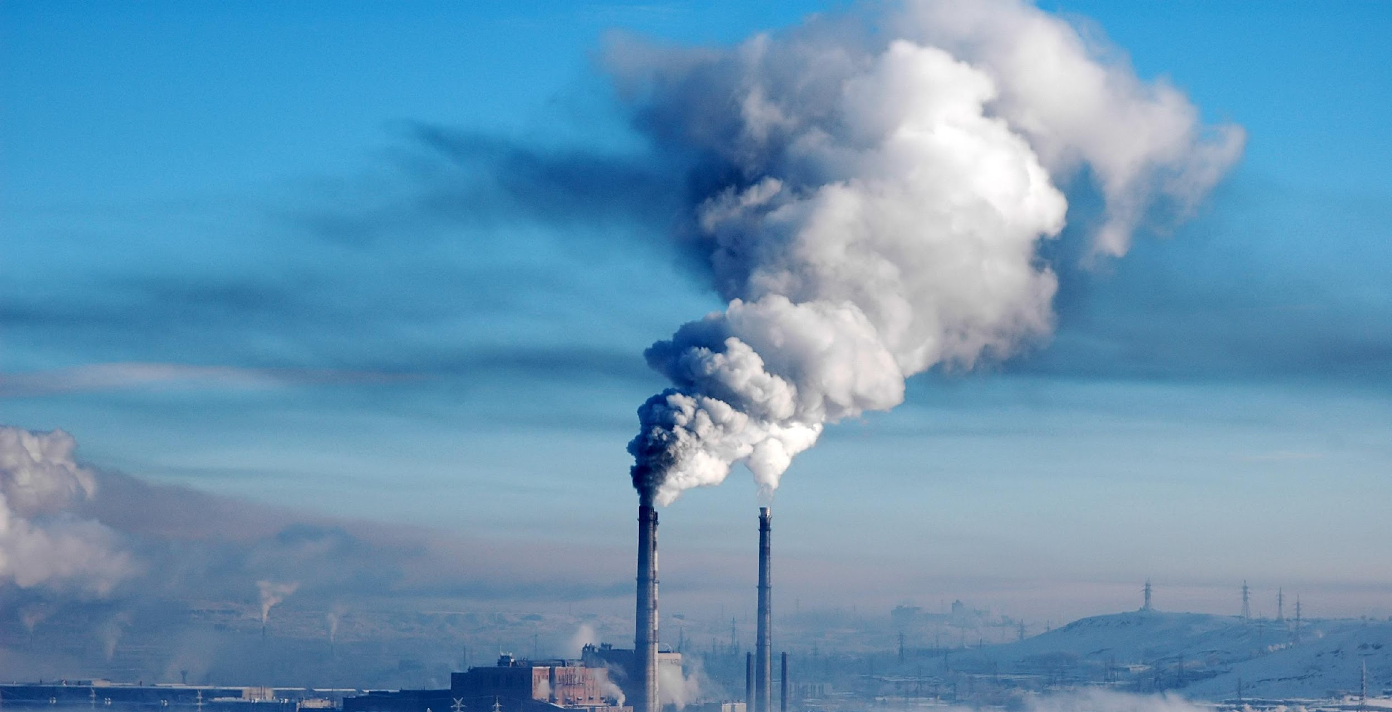
C
O
O
Notes:
A carbon dioxide is a compound that has one carbon atom and two oxygen atoms. It is also considered a molecule because it has two or more atoms bonded together.

Slide 237
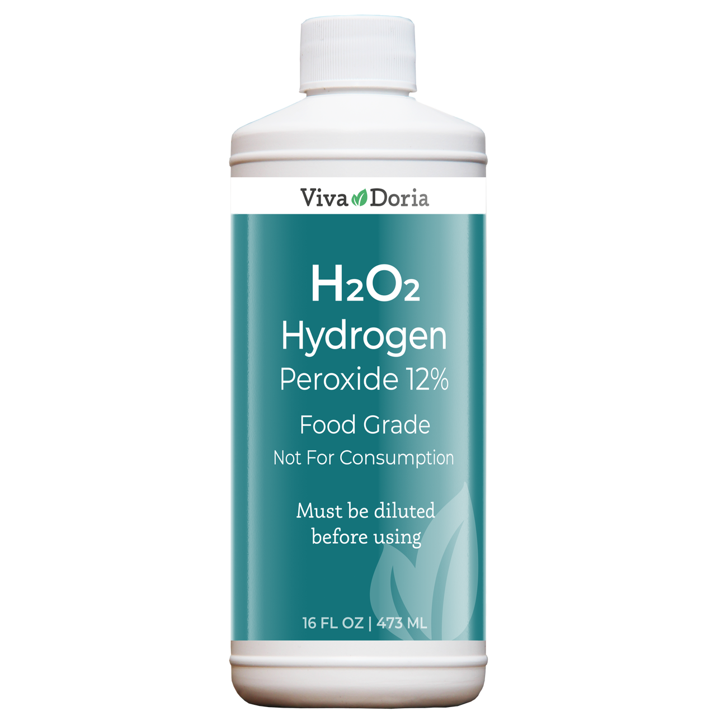
H
O
O
H
Notes:
Hydrogen peroxide is another example of a compound because it is made up of two hydrogen atoms and two oxygen atoms. Since it is made up of two or more atoms bonded together, it is also considered a molecule.

Slide 238
Notes:
Now let’s pause for a moment to check your understanding.

Slide 239
Why is carbon dioxide (CO₂) an example of a compound?
C
O
O
Notes:
Why is carbon dioxide an example of a compound?
[Because carbon dioxide is made of two different elements.]

Slide 240
Notes:
Next, let’s look at some non-examples of compounds.

Slide 241
Fe=Iron
Notes:
Iron is NOT a compound because it is only made of one element.

Slide 242
Ag=Gold
Notes:
Gold is also NOT a compound, because it is only made of one element.

Slide 243
Notes:
Now let’s pause for a moment to check your understanding.

Slide 244
Why is iron considered a NON-example of a compound?
Fe=Iron
Notes:
Why is iron considered a NON-example of a compound?
[It is not considered a compound because iron is a pure element – it is not made of two different elements.]

Slide 245
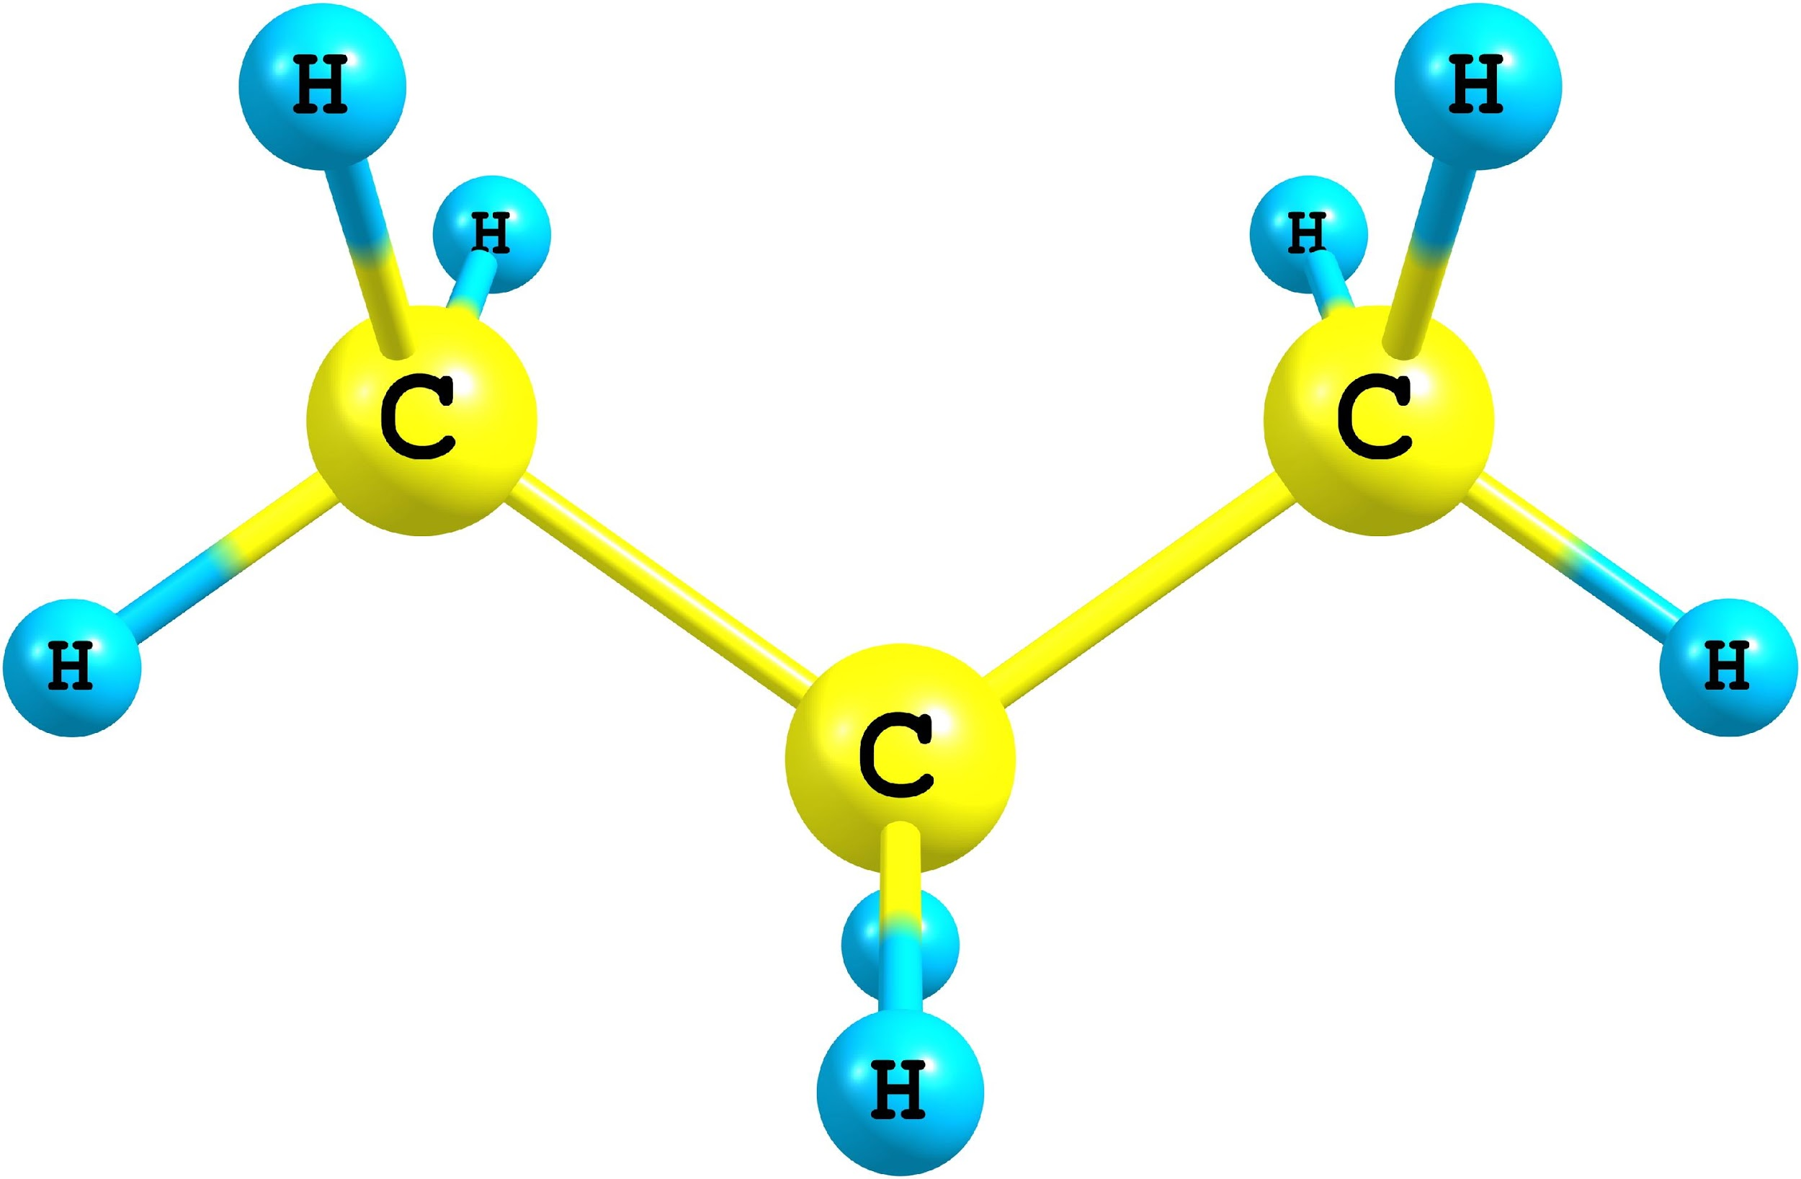
Is this both a compound and molecule, or just a molecule? Why?
Notes:
Is this both a compound and molecule, or just a molecule? Why?
[This is both a compound and molecule, because it is made of two different elements that are bonded together.]

Slide 246
Is this both a compound and molecule, or just a molecule? Why?
C
C
C₂
Notes:
Is this both a compound and molecule, or just a molecule? Why?
[This is just a molecule, because it is only made of 1 type of element.]

Slide 247
Demonstration
Elements, Mixtures, & Compounds
TEACHER DIRECTIONS:
Follow the link above to view a video and step-by-step directions for an activity that you can model for students. The materials required are household items (e.g., water, nuts/bolts, string, salt, etc.). Though this is meant to be a lab activity that students engage with in a traditional classroom setting, if teaching remotely you can demonstrate these steps for students and engage them in discussions around the following questions:
Describe and give examples of the three types of matter – elements, compounds, and mixtures.
Explain the different properties of each group of materials.
How do mechanical/material engineers use these terms regarding creating new composite materials?
How do chemical engineers use these terms when solving problems related to water purification and distillation of crude oil?
Notes:
Let’s do a quick demonstration.
Note: this is the same demonstration as in the previous and next day’s slides. Determine when it makes most sense for your particular class.
Feedback: Remember to plan out the demonstration so that you are able to follow a logical order. This will help students make sense of the activity and not become lost.

Slide 248
Remember!!!
Notes:
So remember!

Slide 249
Compounds: pure substances made of two or more different elements that are chemically bonded (joined).
Notes:
Compounds are pure substances made of two or more different elements that are chemically bonded, or joined.

Slide 250
A compound is a type of molecule.
O
H
H
Notes:
A compound is a type of molecule. For example, this is an H2O, or water, molecule.

Slide 251
But two or more different elements must be bonded to be considered a compound.
C
O
C
H
H
Compound
Molecule
Compound
Molecule
Notes:
But two or more different elements must be bonded for a molecule to be considered a compound. So, C2 is considered a molecule, but NOT compound; whereas H2O is considered a compound AND a molecule.

Slide 252
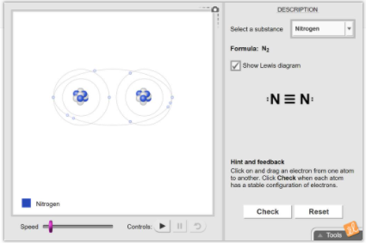
Simulation Activity
Covalent Bonds
Click the link above to access the Covalent Bonds Gizmo.
In this simulation activity, you will choose a substance and move electrons between atoms to form covalent bonds and build molecules. Observe the orbits of shared electrons in single, double, and triple covalent bonds. Compare the completed molecules to the corresponding Lewis diagrams.
Notes:
Feedback: Remember, it is important to provide students with opportunities to ask questions themselves and work to define the problem. You can scaffold supports to help them along the way.

Slide 253
Big Question: How are elements, molecules, compounds, and mixtures related?
Notes:
Explicit cue to revisit the big question at the end of the lesson: Okay everyone. Now that we’ve learned the term, compounds, let’s reflect once more on our big question. Was there anything that we predicted earlier that was correct or incorrect? Do you have any new hypotheses to share?

Slide 254
Notes:
Thanks for watching, and please continue watching CAPs available from this website.

Slide 255
This Video Created With Resources From:
Questions or Comments
Michael Kennedy, Ph.D. MKennedy@Virginia.edu
Rachel L Kunemund, Ph.D. rk8vm@virginia.edu

Slide 256
Intro
“Big Idea” Question
Review Concepts
Check-In Questions
Teacher Demo
Vocabulary
Student-Friendly Definition
Examples & Non-Examples
Morphological Word Parts
Simulation/Activity
Notes:
OK everyone, get ready for our next lesson. Just as a reminder, these are the different components that our lesson may include, and you’ll see these icons in the top left corner of each slide so that you can follow along more easily!

Slide 257
Intro
Matter
Elements
Compounds
Mixtures
Notes:
Today we’re going to continue with our focus on the three different classifications of matter, including elements, compounds and mixtures.

Slide 258
Intro
Mixtures
Notes:
In this lesson, we’re going to specifically focus on mixtures.

Slide 259
Big Question: How are elements, molecules, compounds, and mixtures related?
Notes:
Our “big question” is: How are elements, molecules, compounds, and mixtures related?
[Pause and illicit predictions from students.]
I love all these thoughtful scientific hypotheses! Be sure to keep this question and your predictions in mind as we move through these next few lessons, and we’ll continue to revisit it.
We talked about this at the beginning and end of last class! Revisit and add to your predictions now - we’ll come back to these again at the end of class

Slide 260
Notes:
Before we move on to our new vocabulary term, let’s review some other words & concepts that you already learned and make sure you are firm in your understanding.
Feedback: Referring to prior topics that are relevant and on topic helps students make connections to the new content they will be learning and tie it to prior knowledge.

Slide 261
Matter: anything that has mass and takes up space
Notes:
Matter is anything that has mass and takes up space.

Slide 262
Atom: the smallest whole unit of matter
Notes:
An atom is the smallest whole unit of matter. All matter is made up of atoms.

Slide 263
Molecule: particle containing 2 or more atoms of the same OR different elements
OR
Notes:
A molecule is a particle containing 2 or more atoms of the same OR different elements.

Slide 264
Polar Molecule: a molecule that has a partial positive and negative end because they do not share electrons equally
Notes:
A polar molecule is a molecule that has a partial positive and negative end because they do not share electrons equally.

Slide 265
Nonpolar Molecule: a molecule that equally shares electrons
O
C
O
Notes:
Nonpolar molecules equally share electrons.

Slide 266
Compounds: pure substances made of two or more different elements that are chemically bonded (joined).
Notes:
Compounds are pure substances made of two or more different elements that are chemically bonded, or joined.

Slide 267
A compound is a type of molecule.
O
H
H
Notes:
A compound is a type of molecule. For example, this is an H2O, or water, molecule.

Slide 268
But two or more different elements must be bonded to be considered a compound.
C
O
C
H
H
Compound
Molecule
Compound
Molecule
Notes:
But two or more different elements must be bonded for a molecule to be considered a compound. So, C2 is considered a molecule, but NOT compound; whereas H2O is considered a compound AND a molecule.

Slide 269
Notes:
Now let’s pause for a moment to check your understanding.
Feedback: There are a lot of opportunities to respond throughout this portion of the lesson, which is so important for ensuring that your students are grasping this new skill.

Slide 270
What is an atom?
Notes:
What is an atom?
[The smallest whole unit of matter.]

Slide 271
What is the relationship between atoms and matter?
Notes:
What is an atom?
[Atoms make up matter.]

Slide 272
What is a molecule?
OR
Notes:
What is a molecule?
[A molecule is a particle containing 2 or more atoms of the same OR different elements.]

Slide 273
What is the difference between a polar and nonpolar molecule?
O
C
O
Notes:
What is the difference between a polar and nonpolar molecule?
[A polar molecule is a molecule that has a partial positive and negative end because they do not share electrons equally.
Nonpolar molecules equally share electrons.]

Slide 274
What is the definition of a compound?
Notes:
What is the definition of a compound?
[Compounds are pure substances that are made of two or more different elements that are chemically bonded together.]

Slide 275
How are compounds different from elements?
O
O
H
H
H
Element
Compound
Element
Notes:
How are compounds different from elements?
[Compounds are made of two or more types of elements; elements are the purest form and cannot be separated into simpler substances; etc.]

Slide 276
Why is the molecule shown below NOT considered a compound?
C
C
C₂
Notes:
Why is the molecule shown below NOT considered a compound?
[It is not a compound because a compound must be made of two or more different elements.]

Slide 277
Is this both a compound and molecule, or just a molecule? Why?
Notes:
Is this both a compound and molecule, or just a molecule? Why?
[This is both a compound and molecule, because it is made of two different elements that are bonded together.]

Slide 278
Mixtures
Notes:
Now that we’ve reviewed, let’s define our new term, mixtures.

Slide 279
Mixture: a combination of two or more pure substances that are physically combined, not chemically combined
Notes:
A mixture is when two or more substances are combined physically, not chemically
Feedback: Using clear language can take make formal more complicated definitions a little easier for students to understand.

Slide 280
Notes:
Now let’s pause for a moment to check your understanding.

Slide 281
What is a mixture?
Notes:
What is a mixture?
[A mixture is a combination of two or more pure substances that are physically combined, not chemically combined.]

Slide 282
Notes:
That is the basic definition, but there is a bit more you need to know.

Slide 283
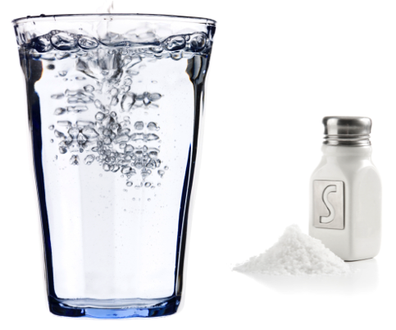
Mixtures are held together by physical forces – no chemical change takes place.
Notes:
Mixtures are held together by physical forces – no chemical change takes place. For example, when you combine salt and water, they both retain their unique properties, with water as a liquid and salt as a solid.

Slide 284
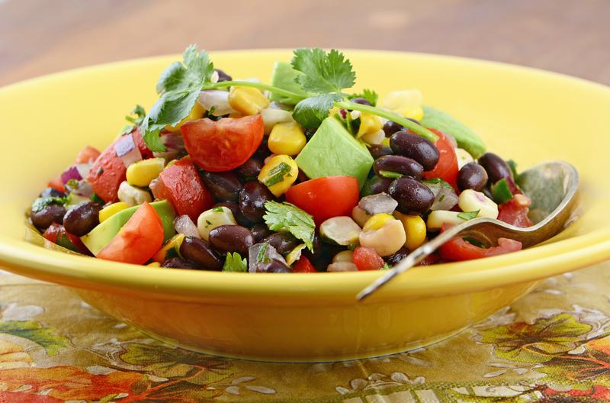
Mixtures can consist of a lot of different elements.
Notes:
The composition, or make up, of mixtures varies. For instance, all of the images shown here are examples of mixtures, but they all are composed of different materials.

Slide 285
But all mixtures can be physically separated.
Notes:
But all mixtures can be physically separated. Some mixtures are more easily separated (like the salad) while others need to settle out over time (like salt in water).
Feedback: Sometimes it can be helpful to use examples during the definition portion of the lesson.

Slide 286
Notes:
Now let’s pause for a moment to check your understanding.

Slide 287
What is the definition of a mixture?
Notes:
What is the definition of a mixture?
[Mixtures are a combination of two or more pure substances that are physically combined, not chemically combined.]

Slide 288
How are compounds and mixtures different from each other?
O
H
H
Notes:
How are compounds and mixtures different from each other?
[Compounds are chemically combined, while mixtures are only combined physically.]

Slide 289
Notes:
Now, let’s look at some examples of mixtures.
Feedback: Remember to provide students with instructional cues that give them a chance to prepare for what is coming up next in the lesson, this will help orient them and be better able to engage with the content.

Slide 290
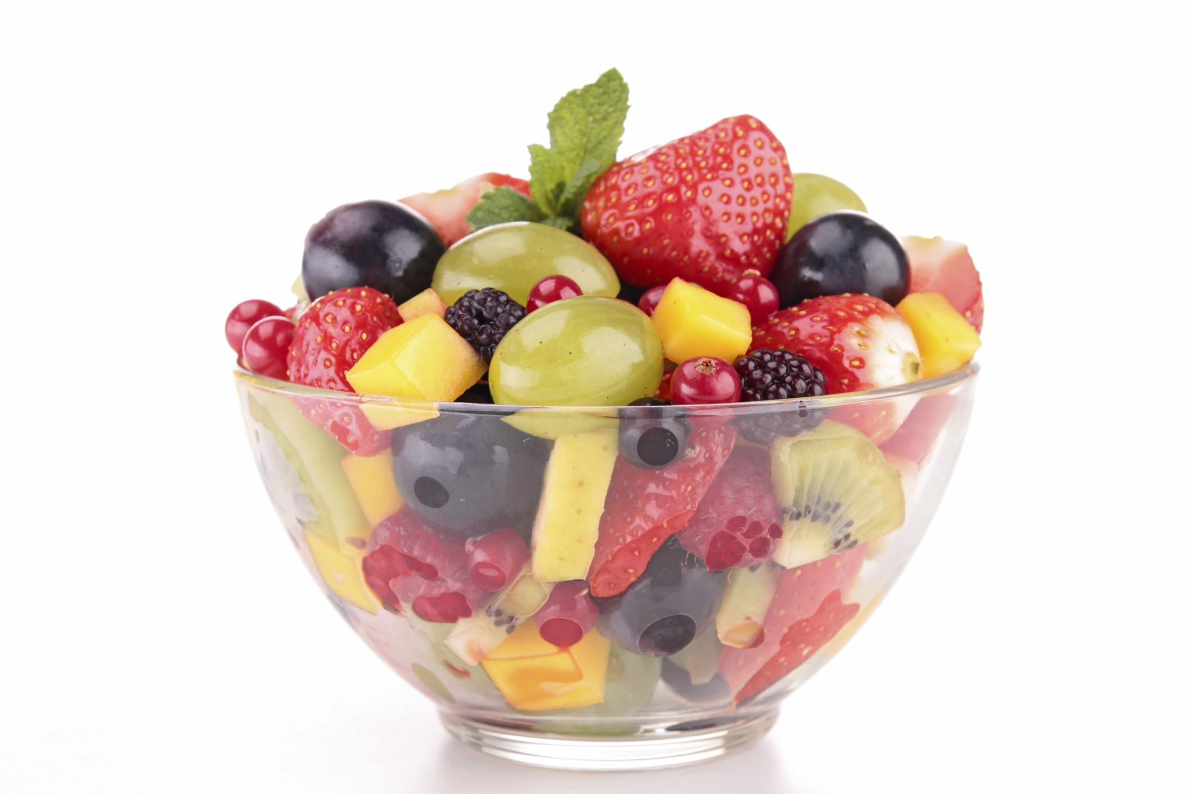
Notes:
Fruit salad is one example of a mixture because it combines multiple fruits together physically, but they are not chemically combined and each fruit keeps its unique properties. The fruit can also be physically separated.

Slide 291
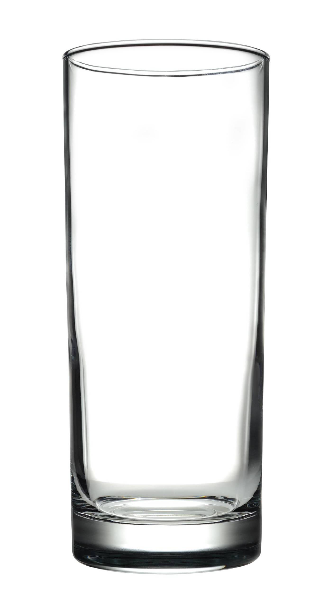
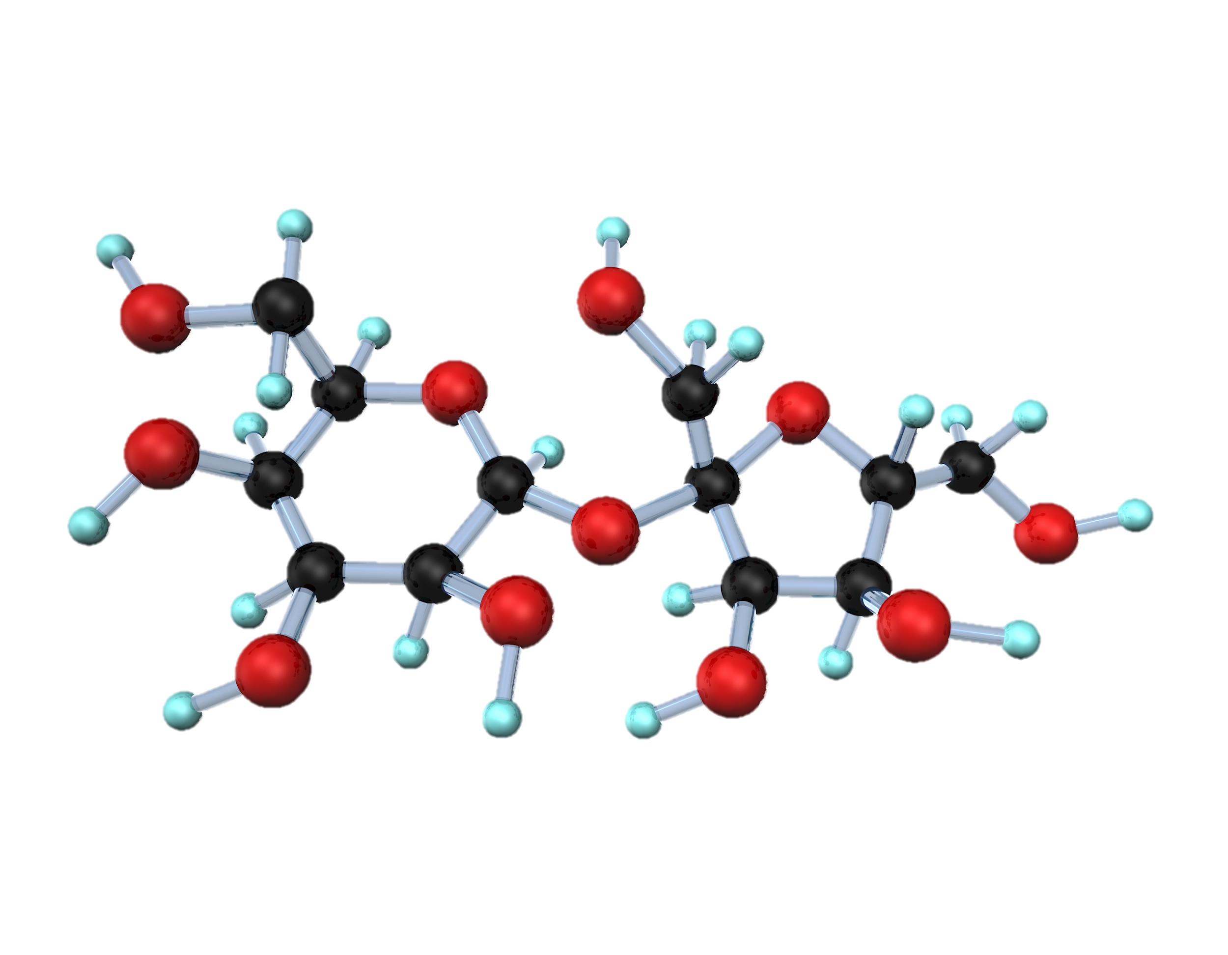
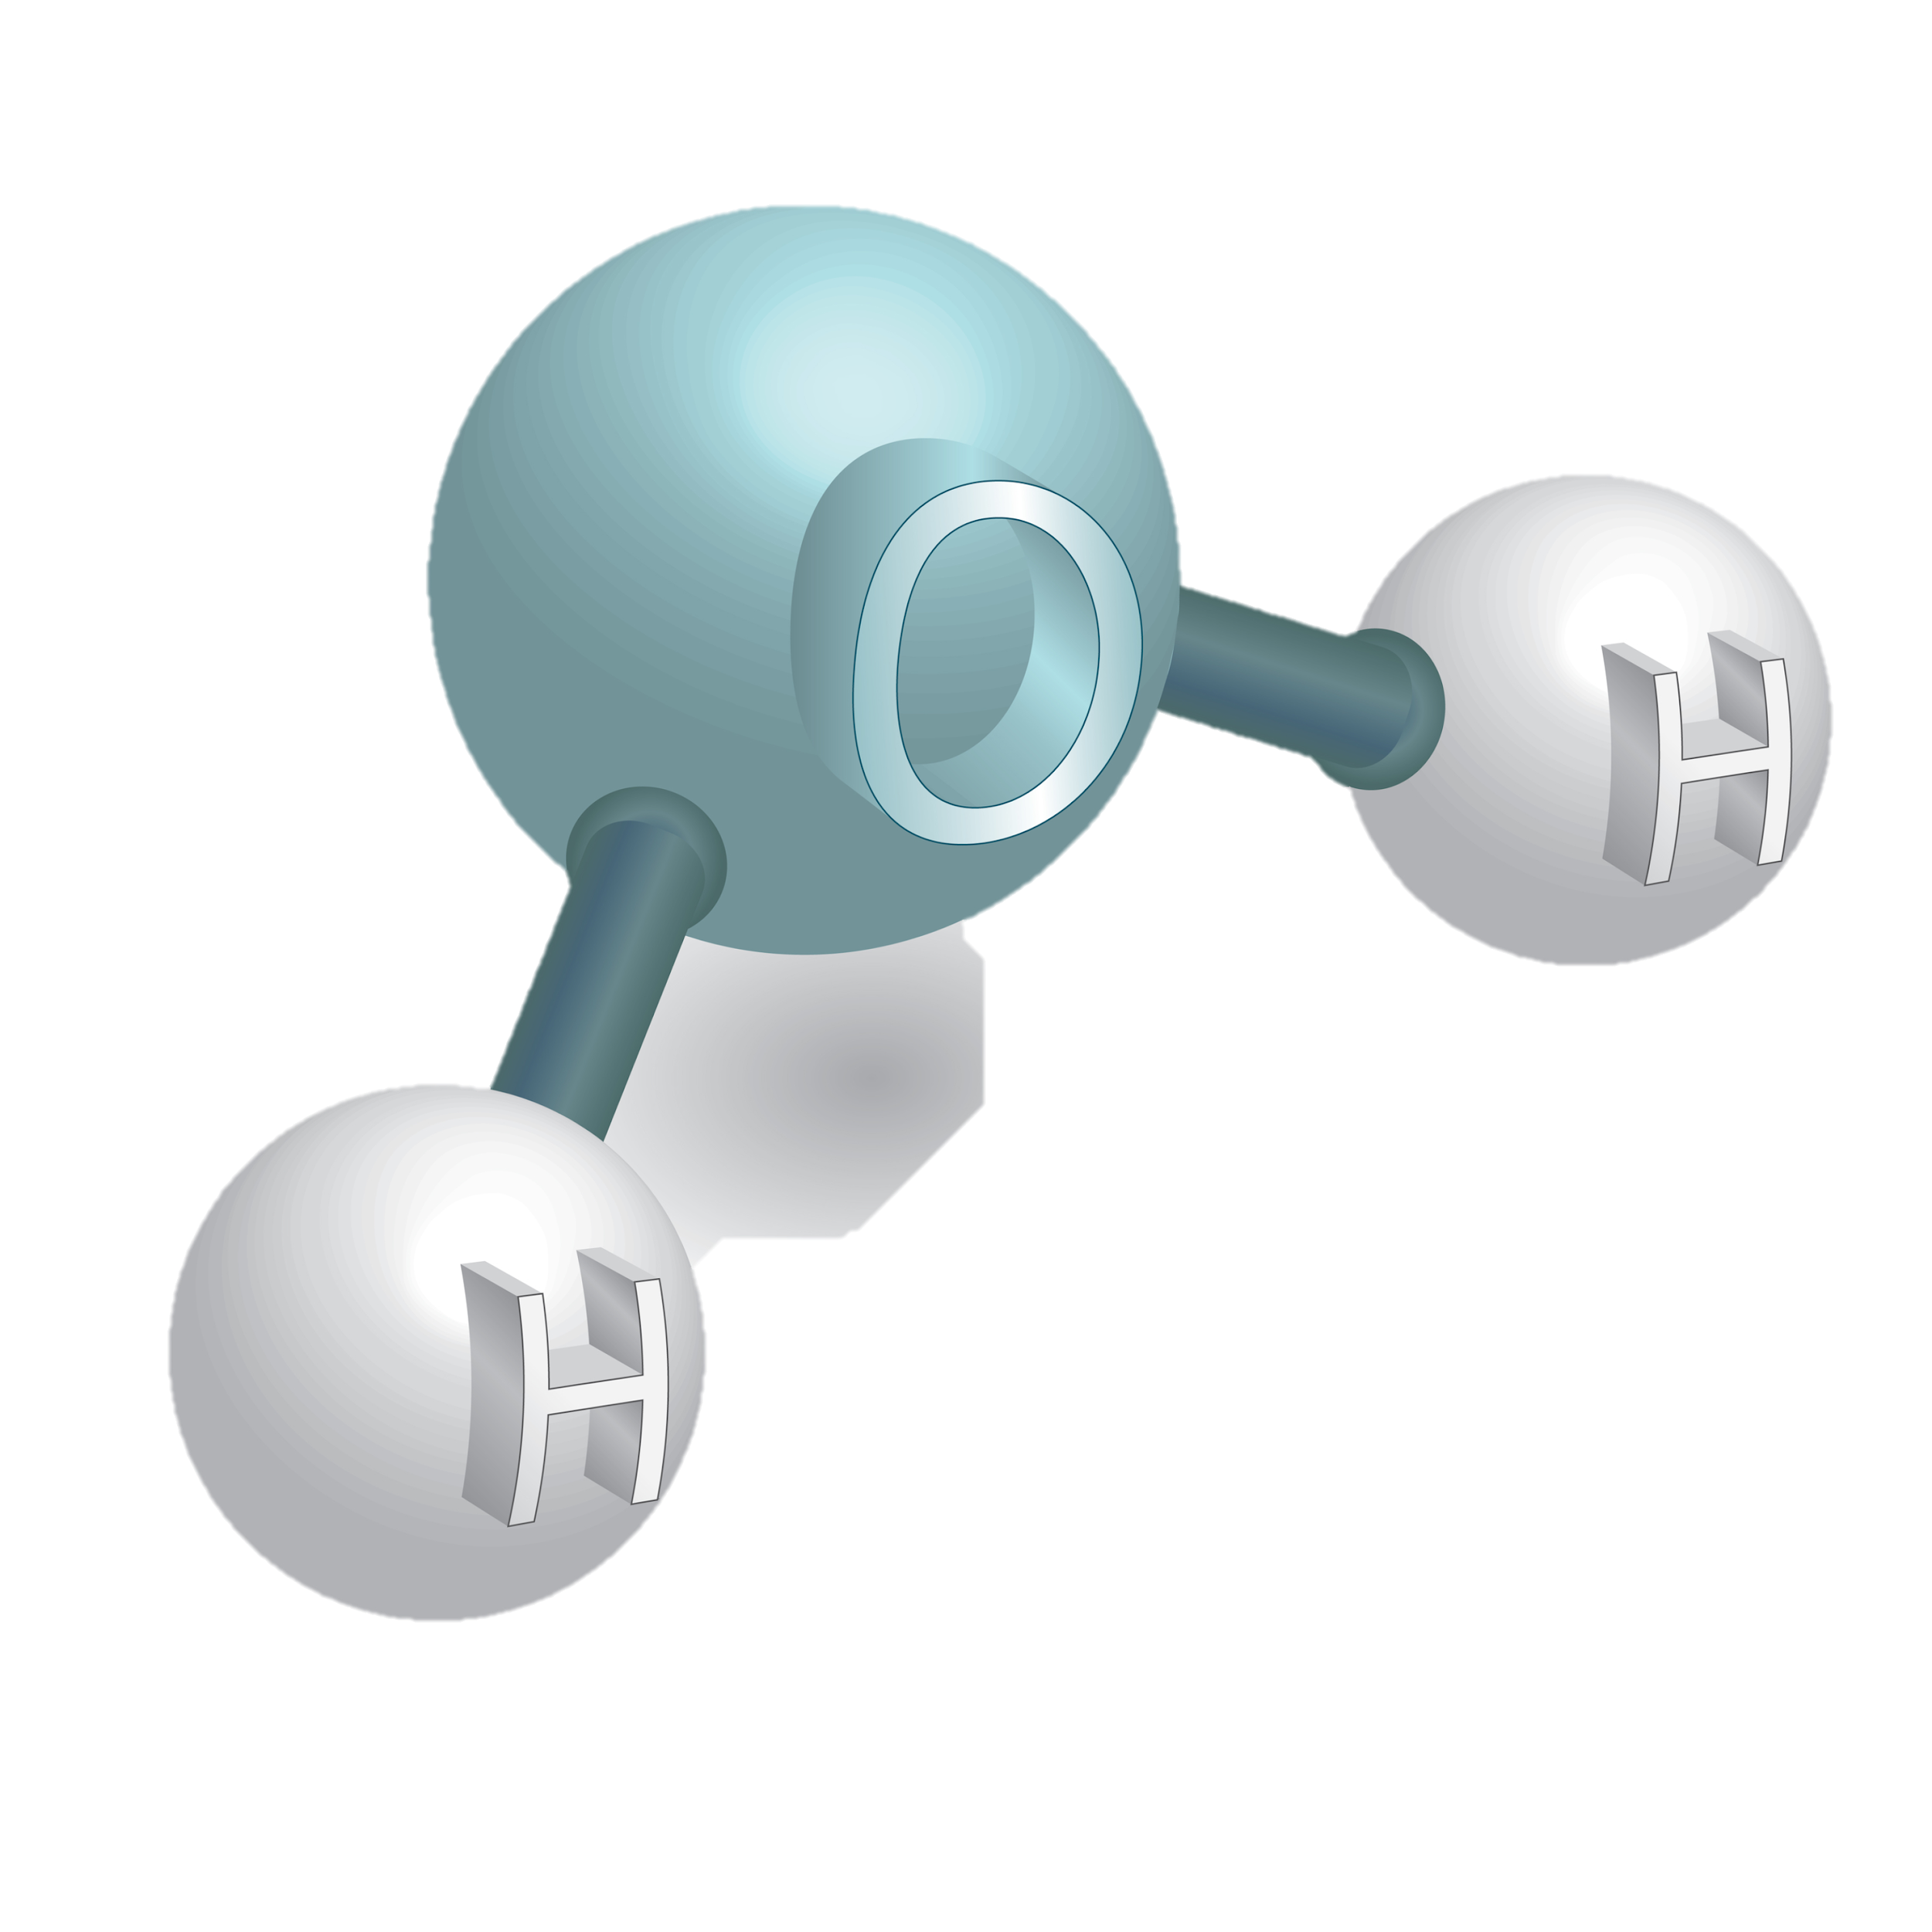
Sugar Molecule
Water Molecule
Notes:
Combining sugar and water is another example of a mixture. The sugar and water molecules are physically combined, they keep their unique properties, and they can be physically separated.

Slide 292
Notes:
Now let’s pause for a moment to check your understanding.

Slide 293
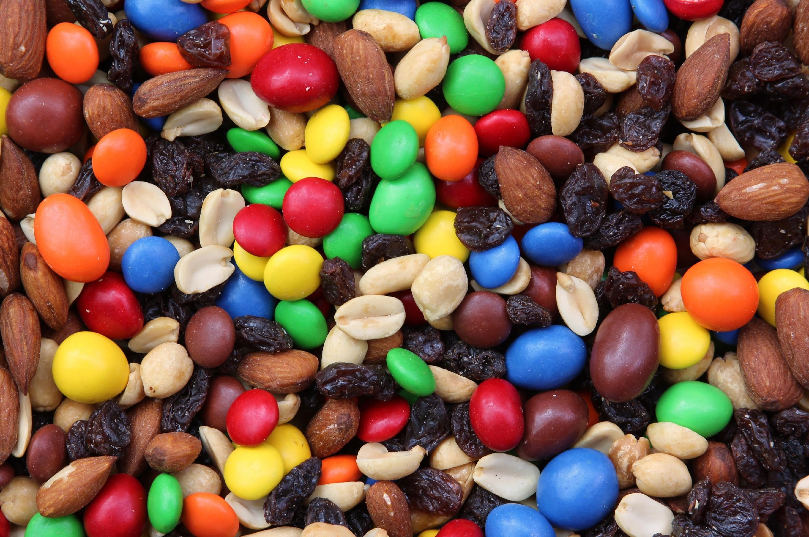
Is this trail mix an example of a mixture?
Why or why not?
Notes:
Is trail mix an example of a mixture? Why or why not?
[Yes! The nuts and raisins and M&Ms are physically combined, they keep their properties, and they can be physically separated.]

Slide 294
Why is sugar water considered a mixture if you can’t see the sugar mixed in it?
Notes:
Why is sugar water considered a mixture if you can’t see the sugar mixed in it?
[Because the sugar and water are not chemically bonded/combined, and the sugar can be separated out through physical means.]

Slide 295
Notes:
Next, let’s look at some non-examples of mixtures.

Slide 296
H
O
O
C
C
H
H
H
Notes:
A sugar molecule is not a mixture. Even though sugar has different types of atoms, these atoms are CHEMICALLY bonded together, not just physically combined.

Slide 297
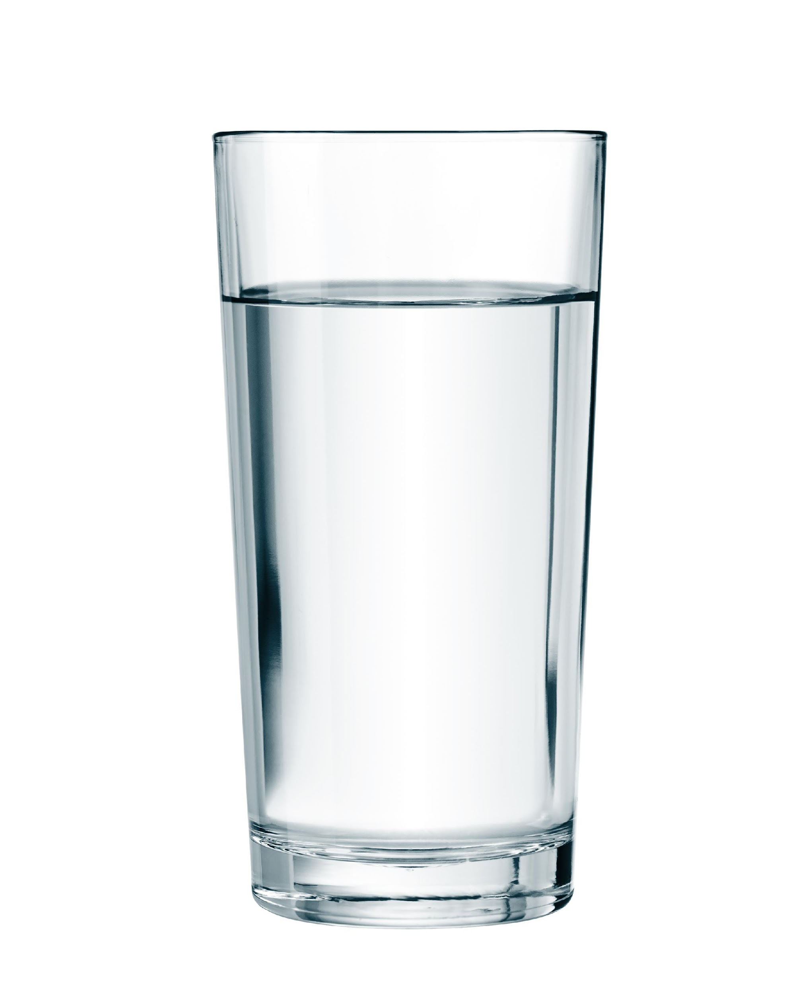
Notes:
This cup of water is also NOT a mixture. Unless you mix something in it, water on its own is just a compound of hydrogen and oxygen atoms.

Slide 298
Notes:
Now let’s pause for a moment to check your understanding.

Slide 299
Why is this NOT an example of a mixture?
H
O
O
C
C
H
H
H
Notes:
Why is this NOT an example of a mixture?
[Even though sugar has different types of atoms, these atoms are CHEMICALLY bonded together, not just physically combined.]
Feedback: Remember to take a moment to explicitly distinguish between the similarities of the non-examples and the vocabulary term you were covering today. This helps students resolve any misconceptions they may have.

Slide 300
Which of the following is an example of a mixture?
Salt
Lemonade
Water
Sugar
Notes:
Which of the following is an example of a mixture?
[Lemonade]

Slide 301
Which of the following is an example of a mixture?
Salt
Lemonade
Water
Sugar
Notes:
Which of the following is an example of a mixture?
[Lemonade]

Slide 302
Demonstration
Elements, Mixtures, & Compounds
TEACHER DIRECTIONS:
Follow the link above to view a video and step-by-step directions for an activity that you can model for students. The materials required are household items (e.g., water, nuts/bolts, string, salt, etc.). Though this is meant to be a lab activity that students engage with in a traditional classroom setting, if teaching remotely you can demonstrate these steps for students and engage them in discussions around the following questions:
Describe and give examples of the three types of matter – elements, compounds, and mixtures.
Explain the different properties of each group of materials.
How do mechanical/material engineers use these terms regarding creating new composite materials?
How do chemical engineers use these terms when solving problems related to water purification and distillation of crude oil?
Notes:
Let’s do a quick demonstration that will help get our brains ready to think about producers, and how they relate to our big question.
Note: this is the same demonstration as in the previous days’ slides. Determine when it makes most sense for your particular class.
Feedback: Remember to continuously check for understanding throughout the demonstration to make sure that students are following along and understand the content.

Slide 303
Remember!!!
Notes:
So remember!

Slide 304
Mixtures: a combination of two or more pure substances that are physically combined, not chemically combined
Notes:
A mixture is when two or more substances are combined physically, not chemically.

Slide 305
Mixtures are held together by physical forces – no chemical change takes place.
Notes:
Mixtures are held together by physical forces – no chemical change takes place. For example, when you combine salt and water, they both retain their unique properties, with water as a liquid and salt as a solid.

Slide 306
Simulation Activity
Mystery Powder Analysis
Click the link above to access the Mystery Powder Analysis Gizmo.
In this simulation activity, you will perform multiple experiments using several common powders such as corn starch, baking powder, baking soda, salt, and gelatin. We’ll see how pure substances can be identified based on their unique properties.
Notes:
Note: This is the same simulation as in the lesson on elements. Determine when it makes most sense for your particular class.

Slide 307
Big Question: How are elements, compounds, and mixtures related?
Notes:
Explicit cue to revisit the big question at the end of the lesson: Okay everyone. Now that we’ve learned about mixtures, let’s reflect once more on our big question. Was there anything that we predicted earlier that was correct or incorrect? Do you have any new hypotheses to share?

Slide 308
Notes:
Thanks for watching, and please continue watching CAPs available from this website.

Slide 309
This Video Created With Resources From:
Questions or Comments
Michael Kennedy, Ph.D. MKennedy@Virginia.edu
Rachel L Kunemund, Ph.D. rk8vm@virginia.edu

