Slide 1
Intro
“Big Idea” Question
Review Concepts
Check-In Questions
Teacher Engagement
Vocabulary
Student-Friendly Definition
Examples & Non-Examples
Frayer Model
Simulation/Activity
Notes:
OK everyone, get ready for our next lesson. Just as a reminder, these are the different components that our lesson may include, and you’ll see these icons in the top left corner of each slide so that you can follow along more easily!

Slide 2
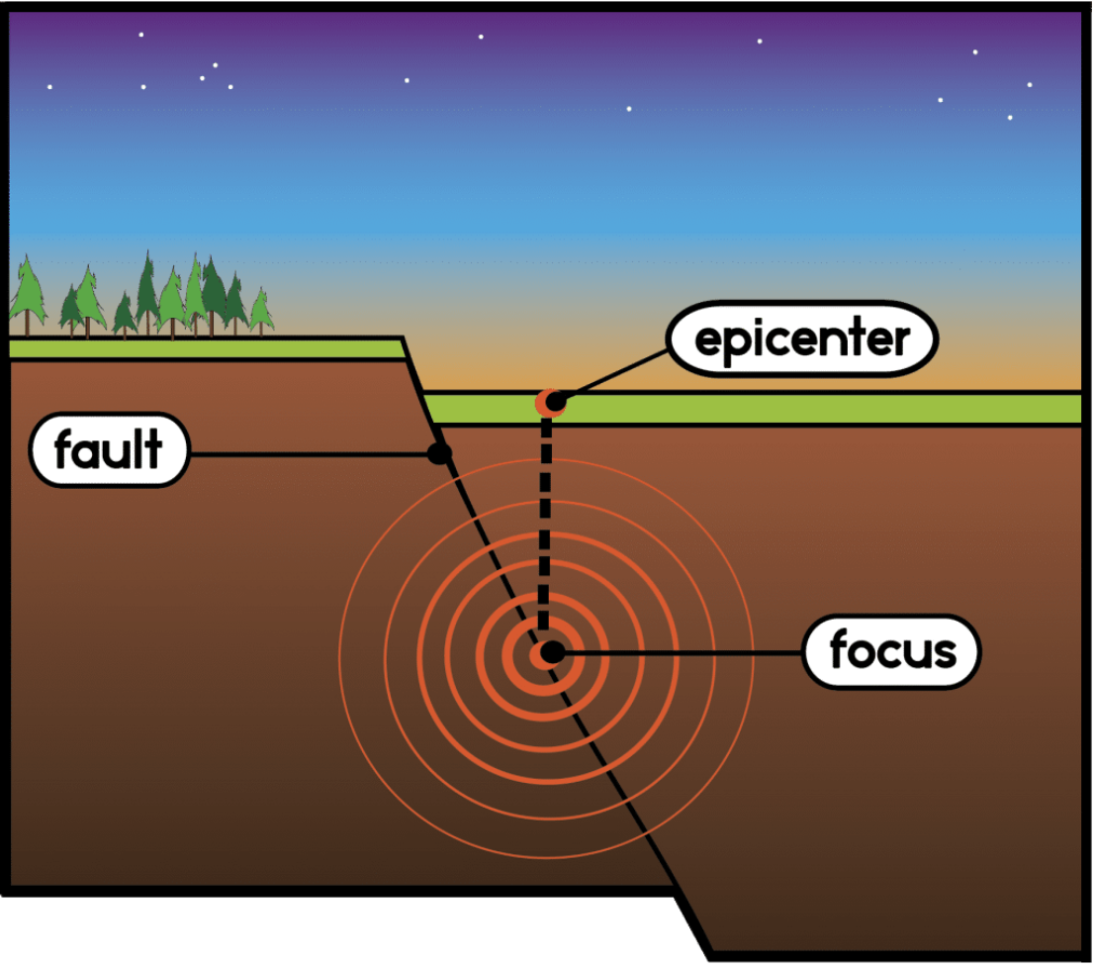
Intro
Epicenter
Notes:
Today, we’ll be learning about the term: Epicenter

Slide 3
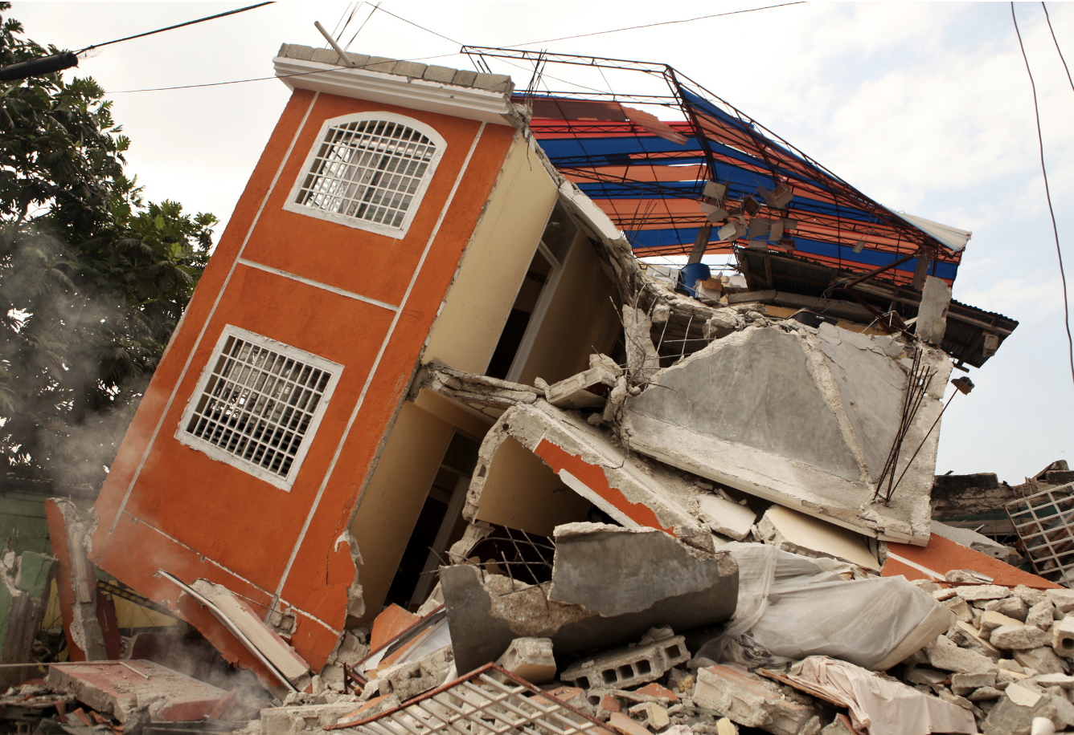
Big Question: How do you think the location of an earthquake's epicenter affects the way people live and build their communities in different parts of the world?
Notes:
Our “big question” is: How do you think the location of an earthquake's epicenter affects the way people live and build their communities in different parts of the world?
[Pause and illicit predictions from students.]
I love all these thoughtful scientific hypotheses! Be sure to keep this question and your predictions in mind as we move through these next few lessons, and we’ll continue to revisit it.

Slide 4
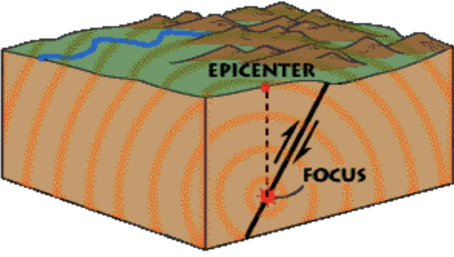
Demonstration
TEACHER DIRECTIONS:
Before viewing: Ask students what they already know about epicenters. Tell students today they will be learning about the term epicenter.
During: Encourage students to think about what might happen in areas close to the epicenter versus areas further away. Discuss preparedness and safety measures for earthquakes.
After: Tell students that today they will be learning more about the term epicenter.
Notes:
A feasible and effective classroom demonstration to teach 5th graders about epicenters involves a simple and interactive activity using common materials:
Materials Needed:
A large sheet of paper or a tabletop map.
A small ball or a marker to represent the earthquake's focus.
A ruler or a piece of string.
Steps:
Prepare the Base: Lay the large sheet of paper or map flat on a table or the floor. This represents the Earth's surface.
Identify the Focus: Place the ball or marker at a point on the paper or map. Explain that this point represents where an earthquake starts underground, known as the focus.
Find the Epicenter: Directly above where you placed the ball or marker, mark a point on the surface of the paper or map. Explain that this point is the epicenter, the spot on the Earth's surface right above where the earthquake begins.
Measure Distance: Use the ruler or string to measure the distance from the epicenter to various points on the map. Discuss how the effects of an earthquake might be stronger closer to the epicenter and weaker as you move farther away.
Interactive Discussion: Encourage students to think about what might happen in areas close to the epicenter versus areas further away. Discuss preparedness and safety measures for earthquakes.
This demonstration helps students visually and physically understand the concept of an epicenter and its relation to the focus of an earthquake. It's a simple yet effective way to make the learning experience engaging and memorable.

Slide 5
Notes:
Before we move on to our new topic, let’s review some other words & concepts that you already learned and make sure you are firm in your understanding.

Slide 6
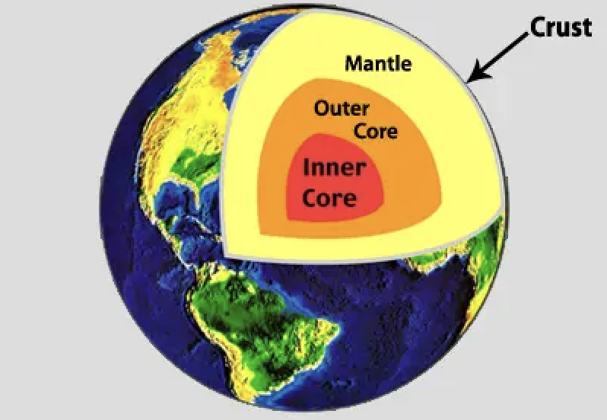
Crust: The outermost shell of the Earth
Notes:
Crust is the outermost shell of the Earth

Slide 7
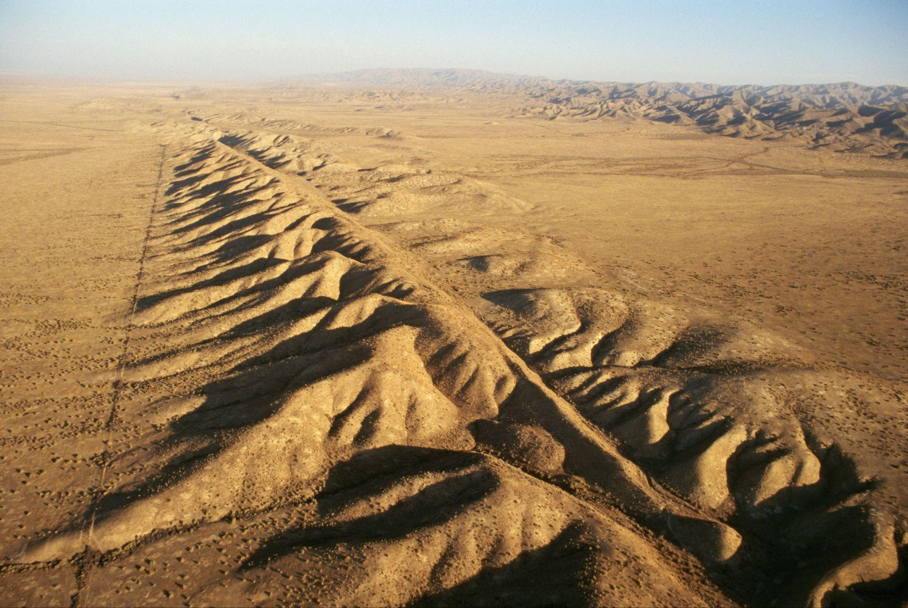
Fault: Long crack in the surface of the Earth
Notes:
A fault is a long crack in the surface of the Earth.

Slide 8
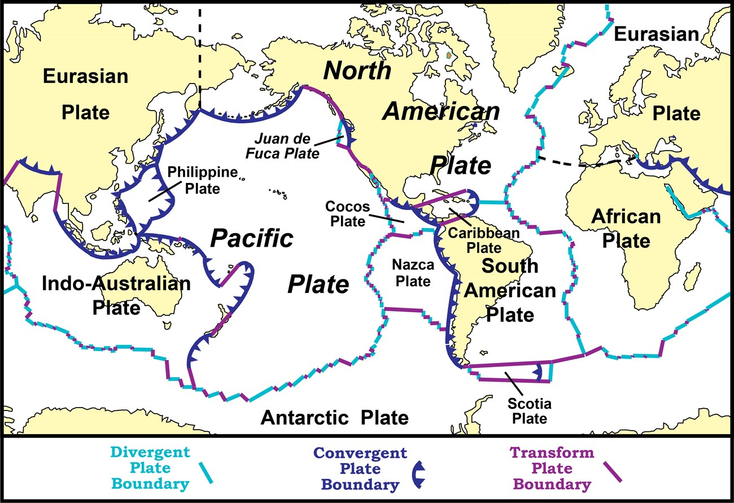
Tectonic Plates: Huge pieces of the Earth's surface that fit together like a puzzle and move very slowly over time
Notes:
Tectonic plates are huge pieces of the Earth’s surface that fit together like a puzzle and move very slowly over time.

Slide 9
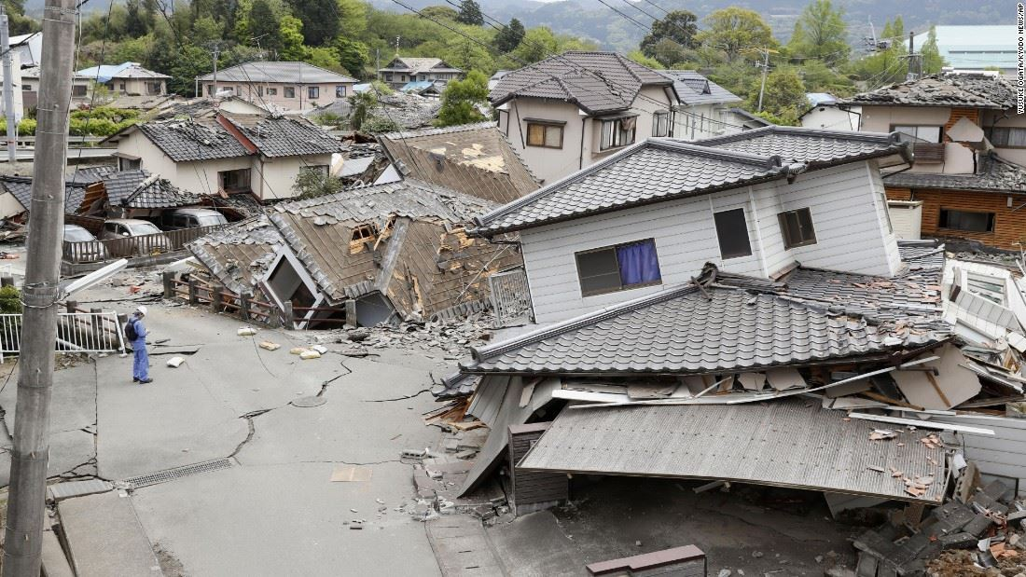
Earthquake: Sudden shaking of the ground caused by the movement of Earth's tectonic plates
Notes:
An earthquake is the sudden shaking of the ground cause by the movement of Earth’s tectonic plates.

Slide 10
Notes:
Now let’s pause for a moment to review the information we have covered already.

Slide 11
The outermost shell of the Earth is called the…
Crust
Core
Notes:
The outermost shell of the Earth is called the…
[Crust]

Slide 12
The outermost shell of the Earth is called the…
Crust
Core
Notes:
The outermost shell of the Earth is called the…
[Crust]

Slide 13
A _____ is a long _____ in the surface of the Earth.
fault, crack
crack, fault
Notes:
A _____ is a long _____ in the surface of the Earth.
[fault, crack]

Slide 14
A _____ is a long _____ in the surface of the Earth.
fault, crack
crack, fault
Notes:
A _____ is a long _____ in the surface of the Earth.
[fault, crack]

Slide 15
True or False: An earthquakes is the sudden shaking of the ground caused by the movement of Earth's tectonic plates
Notes:
True or False: An earthquake is sudden shaking of the ground caused by the movement of Earth’s tectonic plates.
[True}

Slide 16
True or False: Earthquakes are the sudden shaking of the ground caused by the movement of Earth's tectonic plates
Notes:
An earthquake is sudden shaking of the ground caused by the movement of Earth’s tectonic plates.]

Slide 17
Tectonic Plates can be compared to:
Blankets
Puzzle Pieces
Pieces of Paper
Notes:
Tectonic Plates can be compared to:
[B. Puzzle Pieces]

Slide 18
Tectonic Plates can be compared to:
Blankets
Puzzle Pieces
Pieces of Paper
Notes:
Tectonic Plates can be compared to: Puzzle Pieces

Slide 19
Epicenter
Notes:
Now that we’ve reviewed, let’s define the phrase epicenter.

Slide 20
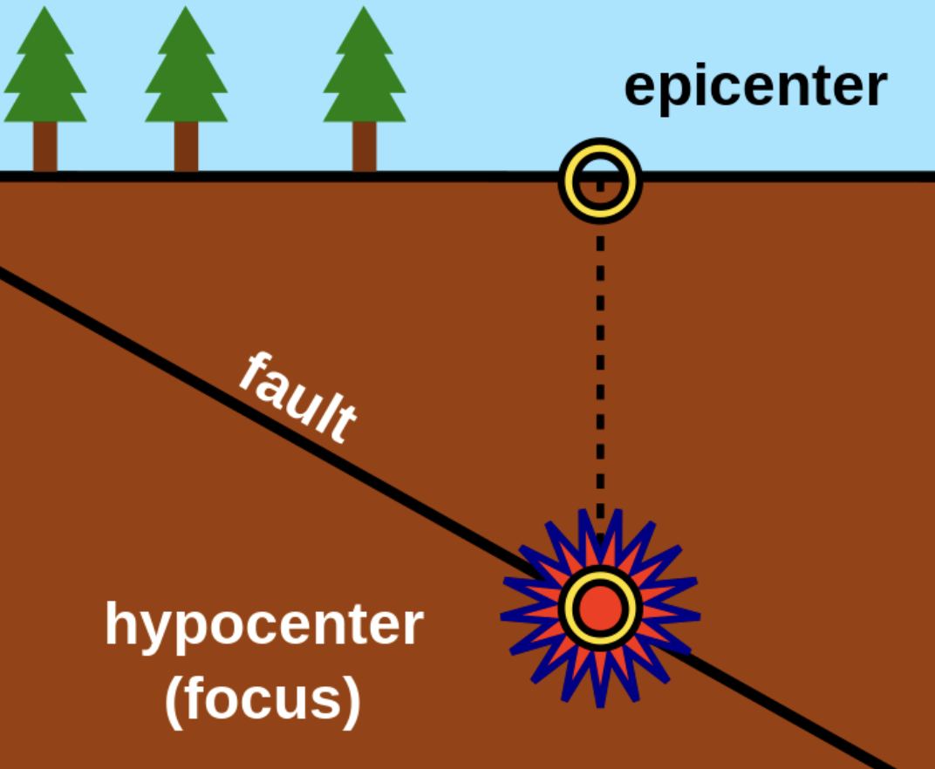
Epicenter: the point on the Earth's surface directly above where an earthquake begins
Notes:
Epicenter: the point on the Earth's surface directly above where an earthquake begins

Slide 21
Notes:
Let’s check-in for understanding.

Slide 22
What is an epicenter?
Notes:
Epicenter: the point on the Earth's surface directly above where an earthquake begins

Slide 23
Notes:
That is the basic definition, but there is a bit more you need to know.

Slide 24
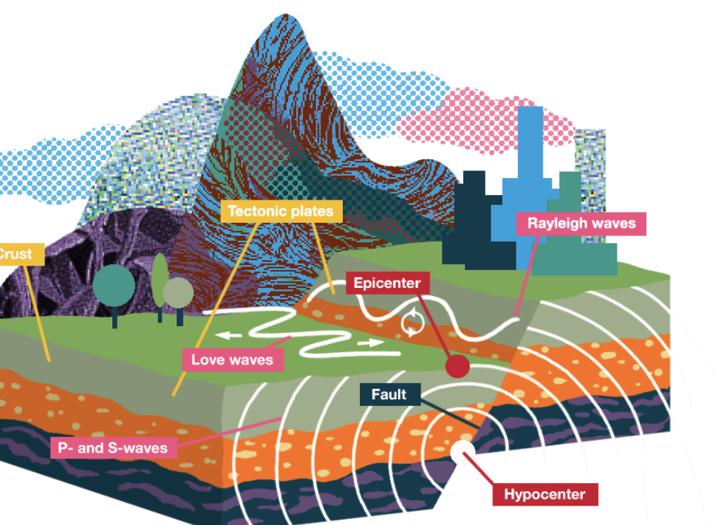
Earthquakes start deep within the Earth's crust, where rocks break and shift. The epicenter is right above this point on the Earth's surface.
Notes:
Earthquakes start deep within the Earth's crust, where rocks break and shift. The epicenter is right above this point on the Earth's surface.

Slide 25
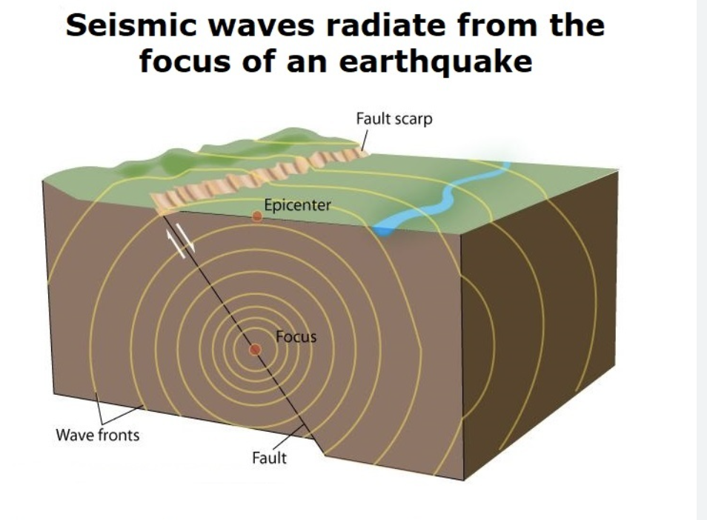
Seismic waves are the energy waves that travel outward from the earthquake's origin. The epicenter is where these waves reach the surface.
Notes:
Seismic waves are the energy waves that travel outward from the earthquake's origin. The epicenter is where these waves reach the surface.

Slide 26
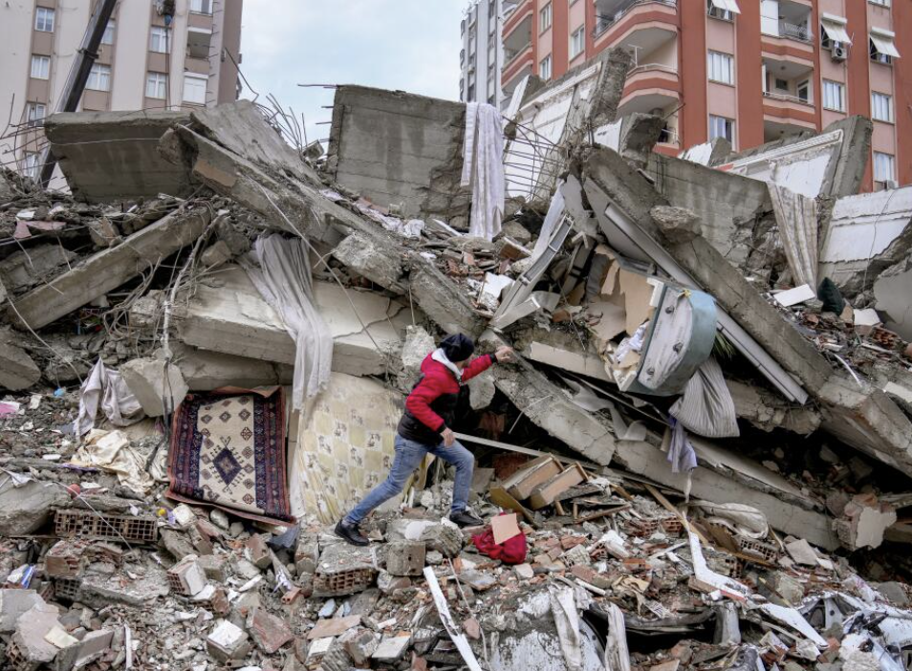
The epicenter is often where the shaking and damage from the earthquake are most severe. Buildings and structures experience the strongest impact at or near the epicenter.
Notes:
The epicenter is often where the shaking and damage from the earthquake are most severe. Buildings and structures experience the strongest impact at or near the epicenter.

Slide 27
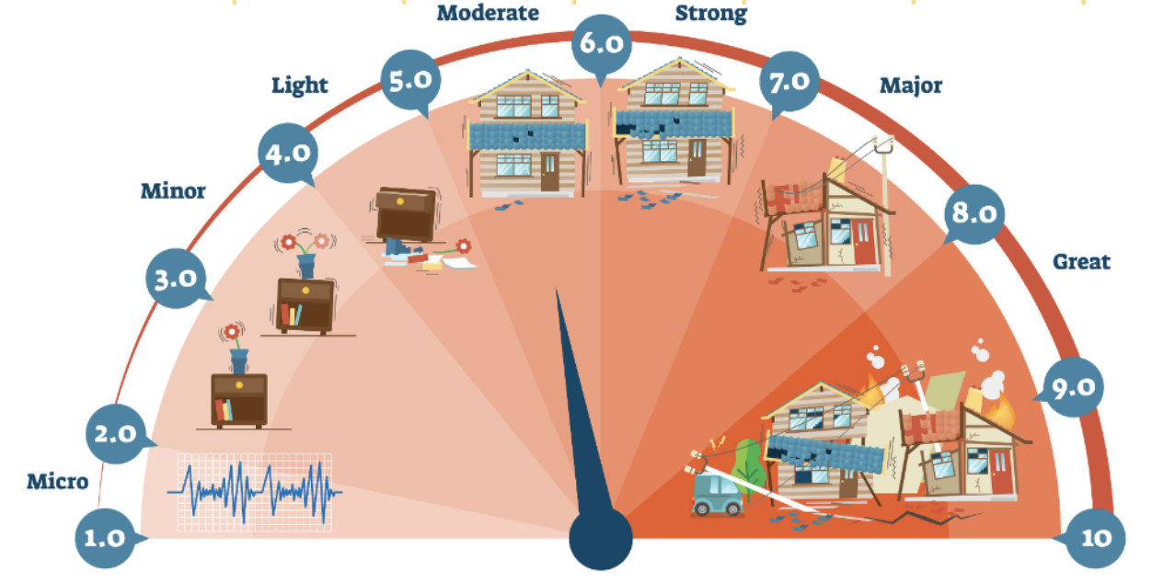
Scientists use the Richter scale to measure the strength of earthquakes. The epicenter's location helps determine the earthquake's magnitude.
Notes:
Scientists use the Richter scale to measure the strength of earthquakes. The epicenter's location helps determine the earthquake's magnitude.

Slide 28
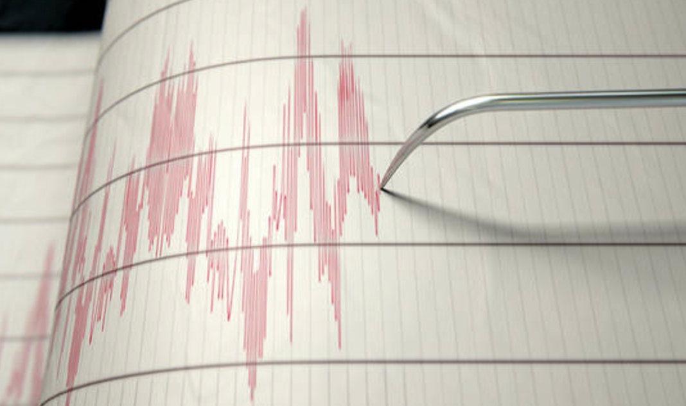
Seismographs are instruments that record seismic waves. They are crucial in locating the epicenter. Scientists analyze data from multiple seismographs to pinpoint the exact location.
Notes:
Seismographs are instruments that record seismic waves. They are crucial in locating the epicenter. Scientists analyze data from multiple seismographs to pinpoint the exact location.

Slide 29
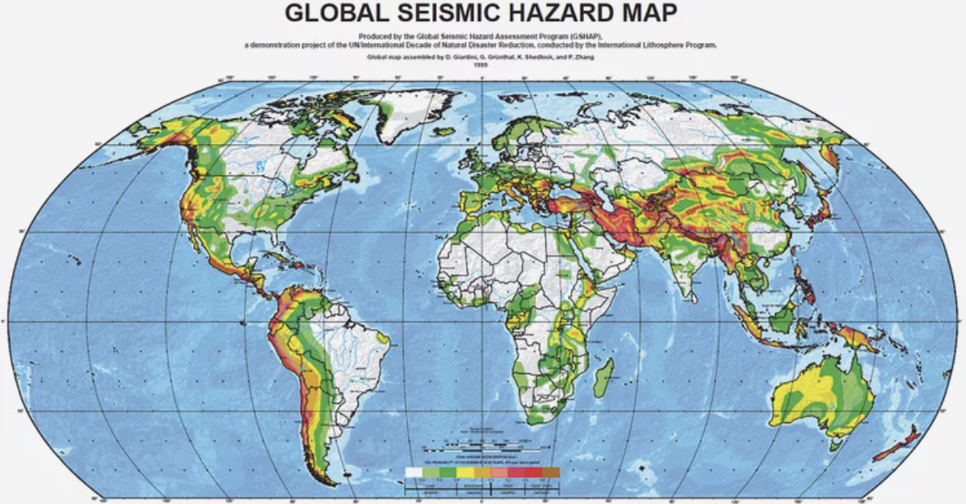
Earthquakes can happen anywhere on Earth, and epicenters are scattered worldwide. Some regions, known as seismic hotspots, experience more earthquakes than others.
Notes:
Earthquakes can happen anywhere on Earth, and epicenters are scattered worldwide. Some regions, known as seismic hotspots, experience more earthquakes than others.

Slide 30
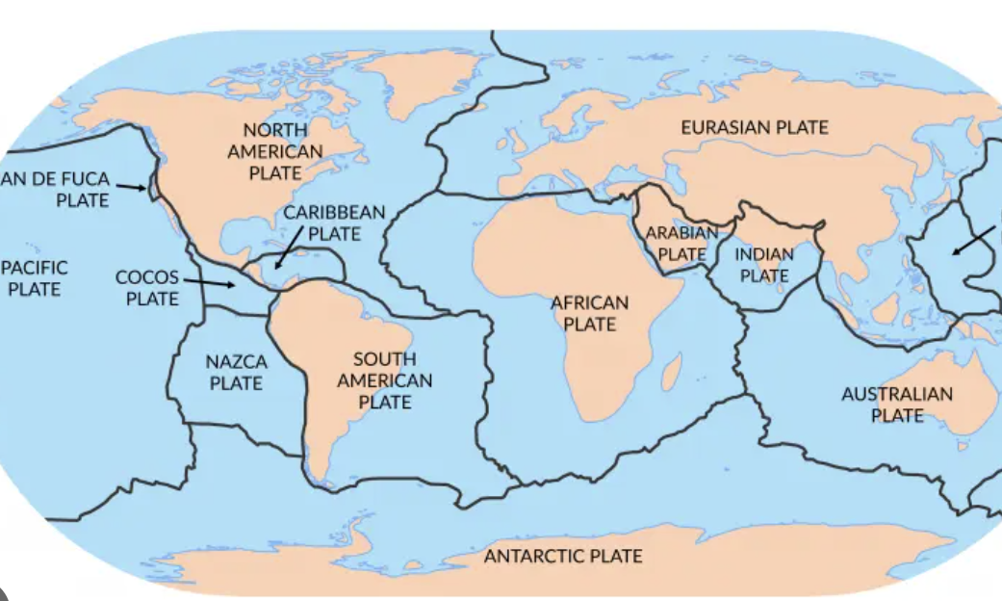
The movement of tectonic plates beneath the Earth’s surface impact the occurrence of earthquakes and the location of epicenters.
Notes:
The movement of tectonic plates beneath the Earth’s surface impact the occurrence of earthquakes and the location of epicenters.

Slide 31
Notes:
Let’s check-in for understanding.

Slide 32
Earthquakes start within the Earth's crust, where rocks break and shift. The epicenter is right above this point on the Earth’s .
Notes:
Earthquakes start within the Earth's crust, where rocks break and shift. The epicenter is right above this point on the Earth’s .
[deep, surface]

Slide 33
Earthquakes start deep within the Earth's crust, where rocks break and shift. The epicenter is right above this point on the Earth’s surface.
Notes:
Earthquakes start deep within the Earth's crust, where rocks break and shift. The epicenter is right above this point on the Earth’s surface.

Slide 34
True or False: The epicenter is often where the least amount of damage occurs.
Notes:
True or False: The epicenter is often where the least amount of damage occurs.
[False]

Slide 35
True or False: The epicenter is often where the least amount of damage occurs.
Notes:
True or False: The epicenter is often where the most amount of damage occurs.

Slide 36
Notes:
Now, let’s talk about some examples of earthquakes.

Slide 37
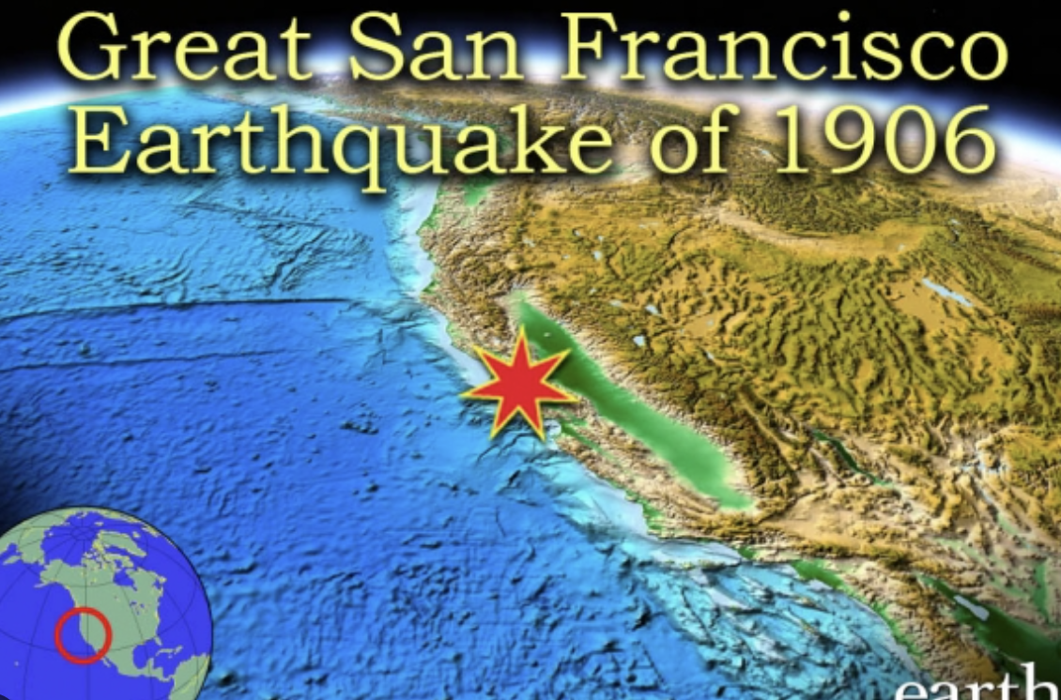
One example is the epicenter where the great San Francisco earthquake began in 1906. The star here represents the epicenter.
Notes:
One example is the epicenter where the great San Francisco earthquake began in 1906. The star here represents the epicenter.

Slide 38
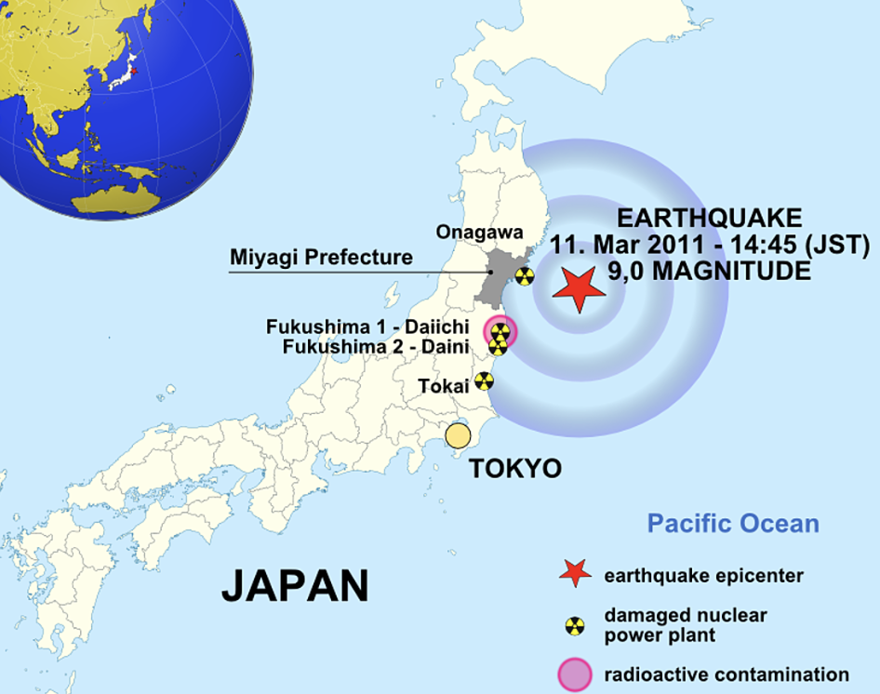
Another example is the epicenter where an earthquake began off the coast of Japan in 2011. The star here represents the epicenter.
Notes:
Another example is the epicenter where an earthquake began off the coast of Japan in 2011. The star here represents the epicenter.

Slide 39
Notes:
Now, let’s talk about some non-examples of earthquakes.

Slide 40
The focus, or hypocenter, is NOT an example of an epicenter. The focus is the actual point inside the Earth where an earthquake begins.
Notes:
The focus, or hypocenter, is NOT an example of an epicenter. The focus is the actual point inside the Earth where an earthquake begins.

Slide 41
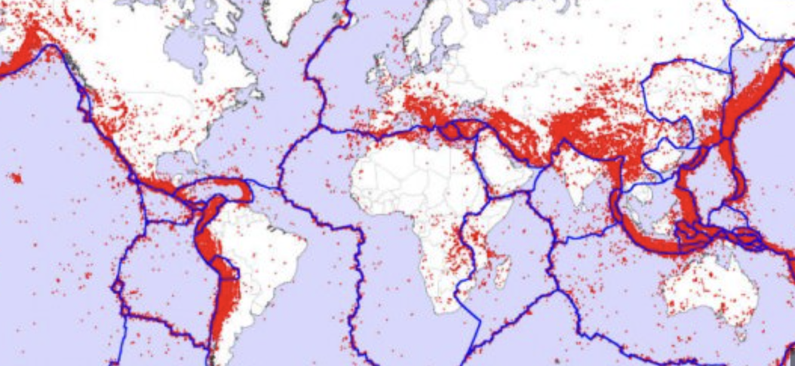
Fault lines are NOT an example of tectonic plates. While they are related (fault lines often occur at plate boundaries), they are NOT plates themselves but fractures in the Earth's crust where plates have slipped past each other.
Notes:
Fault lines, such as the San Andreas Fault in California, are often confused with tectonic plate boundaries. While they are related (fault lines often occur at plate boundaries), they are not plates themselves but fractures in the Earth's crust where plates have slipped past each other.

Slide 42
Notes:
Now let’s pause for a moment to check your understanding.

Slide 43
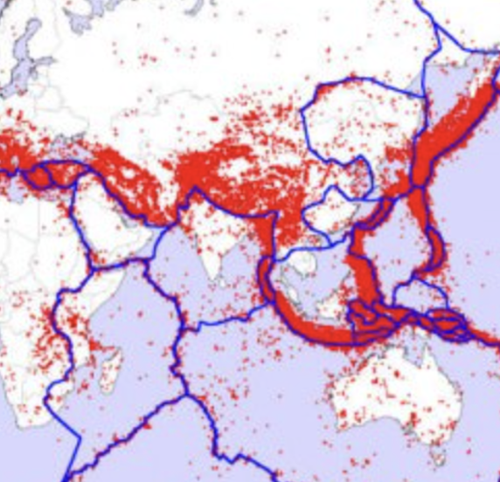
Why are the focus and fault lines not examples of epicenter?
Notes:
Why are the focus and fault lines not examples of epicenter?
[The focus is not the same as the epicenter. The focus is the actual point inside the Earth where an earthquake begins, while the epicenter is the the point on the Earth's surface directly above where an earthquake begins. A fault line is not an examples of an epicenter. Fault lines are fractures in the Earth's crust where plates have slipped past each other]

Slide 44
Remember!!!
Notes:
So remember!

Slide 45
Epicenter: the point on the Earth's surface directly above where an earthquake begins
Notes:
Epicenter: the point on the Earth's surface directly above where an earthquake begins

Slide 46
Notes:
We will now complete this concept map, called a Frayer model, to summarize and further clarify what you have learned about the term earthquake.

Slide 47
Definition
Picture
Epicenter
Example
How do epicenters impact my life?
Notes:
To complete the Frayer model, we will choose from four choices the correct picture, definition, example, and response to the question, “How do epicenters impact my life?” Select the best response for each question using the information you just learned. As we select responses, we will see how this model looks filled in for the term epicenter.

Slide 48
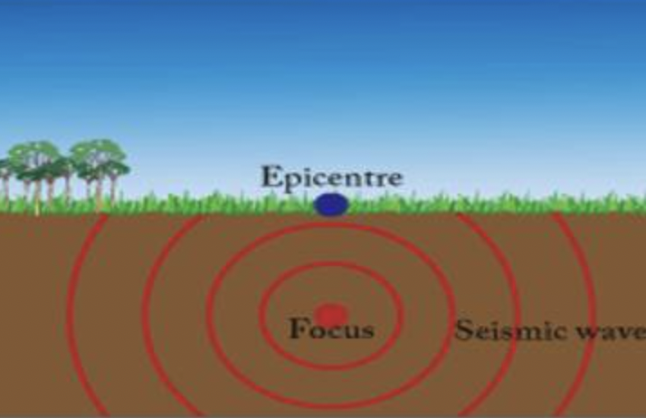
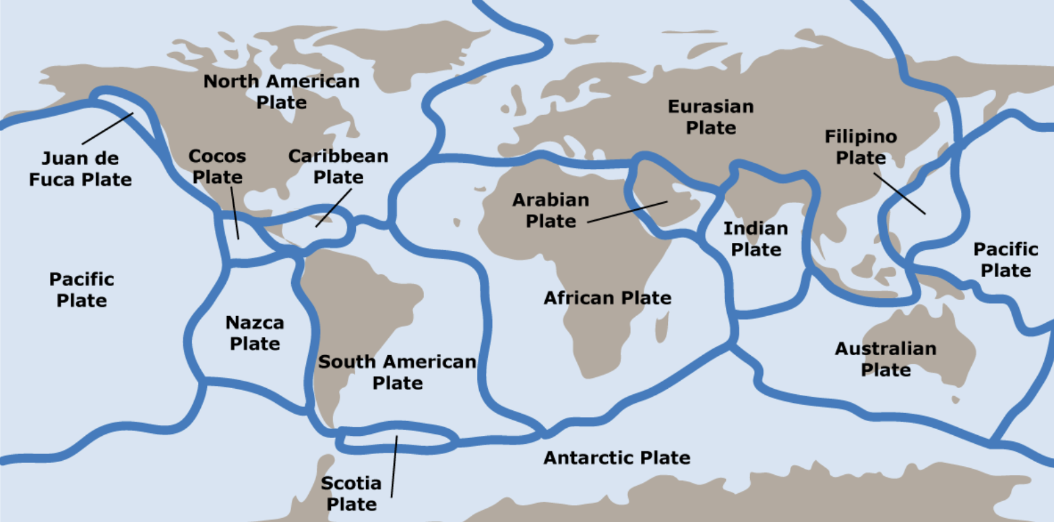
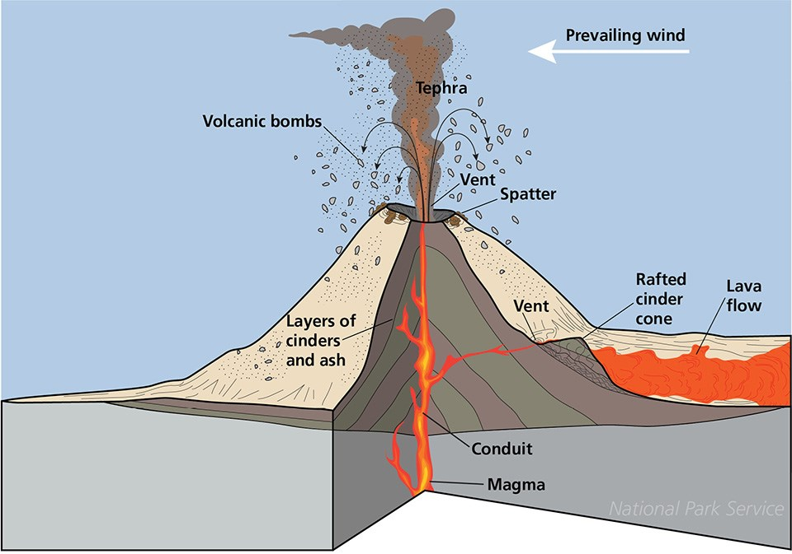
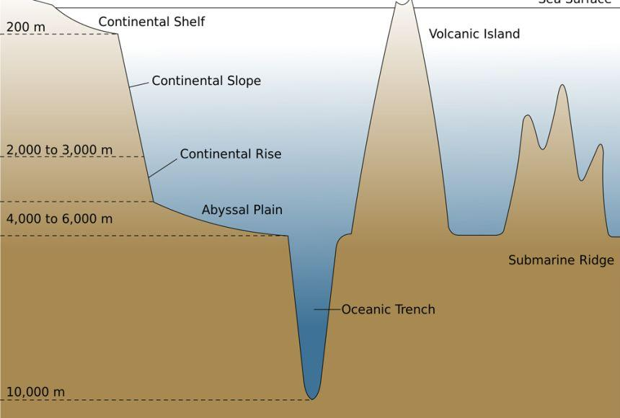
Directions: Choose the correct picture of an epicenter from the choices below.
A
B
C
D
Notes:
Choose the one correct picture of epicenter from these four choices.

Slide 49
Directions: Choose the correct picture of an epicenter from the choices below.
A
B
C
D
Notes:
This is the picture that shows the epicenter.

Slide 50
Definition
Picture
Epicenter
Example
How do epicenters impact my life?
Notes:
Here is the Frayer model filled in with a picture of an epicenter.

Slide 51
Directions: Choose the correct definition of epicenter from the choices below.
A
Huge pieces of the Earth's surface that fit together like a puzzle and move very slowly over time
B
The point on the Earth's surface directly above where an earthquake begins
C
The process of breaking down a rock over a long period of time
D
Sudden shaking of the ground caused by the movement of the Earth’s tectonic plates
Notes:
Choose the one correct definition of epicenter from these four choices.

Slide 52
Directions: Choose the correct definition of epicenter from the choices below.
A
Huge pieces of the Earth's surface that fit together like a puzzle and move very slowly over time
B
The point on the Earth's surface directly above where an earthquake begins
C
The process of breaking down a rock over a long period of time
D
Sudden shaking of the ground caused by the movement of the Earth’s tectonic plates
Notes:
“The point on the Earth's surface directly above where an earthquake begins” is correct! This is the definition of epicenter.

Slide 53
Definition
Picture
The point on the Earth's surface directly above where an earthquake begins
Epicenter
Example
How do epicenters impact my life?
Notes:
Here is the Frayer Model with a picture and the definition filled in for epicenter: The point on the Earth's surface directly above where an earthquake begins

Slide 54
Directions: Choose the correct example of an epicenter from the choices below.
A
The point on the surface of the Earth directly above where the Indian Ocean earthquake of 2004 began.
B
Shaking of the ground that tumbles buildings
C
North American Plate
D
Dirt and other land mass falling into the ocean off a cliff
Notes:
Choose the one correct example of an epicenter from these four choices.

Slide 55
Directions: Choose the correct example of an epicenter from the choices below.
A
The point on the surface of the Earth directly above where the Indian Ocean earthquake of 2004 began.
B
Shaking of the ground that tumbles buildings
C
North American Plate
D
Dirt and other land mass falling into the ocean off a cliff
Notes:
“The point on the surface of the Earth directly above where the Indian Ocean earthquake of 2004 began” is correct! This is an example of an epicenter.

Slide 56
Definition
Picture
The point on the Earth's surface directly above where an earthquake begins
Epicenter
The point on the surface of the Earth directly above where the Indian Ocean earthquake of 2004 began.
Example
How do epicenters impact my life?
Notes:
Here is the Frayer Model with a picture, definition, and an example filled in for epicenter: The point on the surface of the Earth directly above where the Indian Ocean earthquake of 2004 began.

Slide 57
Directions: Choose the correct response for “how do epicenters impact my life?” from the choices below.
Epicenters show us exactly where an earthquake is strongest on the Earth's surface. Knowing about epicenters can help us build safer buildings and be better prepared for earthquakes.
A
B
Epicenters can shake buildings, break roads, and sometimes cause power outages, making it important for us to be prepared and know how to stay safe during these shakes.
C
Epicenters account for the amount of land we have on our planet versus ocean and tells us where to build habitats.
Epicenters form mountains and cause earthquakes, which can affect where and how we live. Their movements also create natural wonders like volcanoes and ocean trenches that we can explore and learn about.
D
Notes:
Choose the one correct response for “how do epicenters impact my life?” from these four choices.

Slide 58
Directions: Choose the correct response for “how do epicenters impact my life?” from the choices below.
Epicenters show us exactly where an earthquake is strongest on the Earth's surface. Knowing about epicenters can help us build safer buildings and be better prepared for earthquakes.
A
B
Epicenters can shake buildings, break roads, and sometimes cause power outages, making it important for us to be prepared and know how to stay safe during these shakes.
C
Epicenters account for the amount of land we have on our planet versus ocean and tells us where to build habitats.
Epicenters form mountains and cause earthquakes, which can affect where and how we live. Their movements also create natural wonders like volcanoes and ocean trenches that we can explore and learn about.
D
Notes:
“Epicenters show us exactly where an earthquake is strongest on the Earth's surface. Knowing about epicenters can help us build safer buildings and be better prepared for earthquakes.” That is correct! This is an example of how epicenters impact your life.

Slide 59
Definition
Picture
The point on the Earth's surface directly above where an earthquake begins
Epicenter
The point on the surface of the Earth directly above where the Indian Ocean earthquake of 2004 began.
Epicenters show us exactly where an earthquake is strongest on the Earth's surface. Knowing about epicenters can help us build safer buildings and be better prepared for earthquakes.
Example
How do epicenters impact my life?
Notes:
Here is the Frayer Model with a picture, definition, example, and a correct response to “how do epicenters impact my life?”: Epicenters show us exactly where an earthquake is strongest on the Earth's surface. Knowing about epicenters can help us build safer buildings and be better prepared for earthquakes.

Slide 60
Remember!!!
Notes:
So remember!

Slide 61
Epicenter: the point on the Earth's surface directly above where an earthquake begins
Notes:
Epicenter: the point on the Earth's surface directly above where an earthquake begins

Slide 62
Big Question: How do you think the location of an earthquake's epicenter affects the way people live and build their communities in different parts of the world?
Notes:
Let’s reflect once more on our big question. Our “big question” is: How do you think the location of an earthquake's epicenter affects the way people live and build their communities in different parts of the world?
Does anyone have any additional examples to share that haven’t been discussed yet?

Slide 63
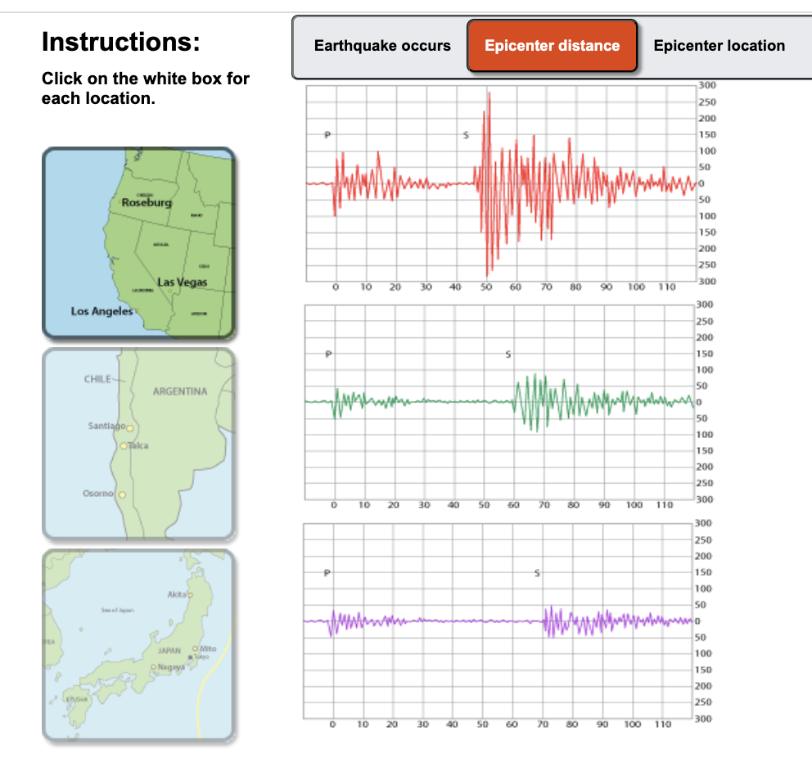
Simulation Activity
Earthquake and Epicenter Simulator
Click the link above for a simulation to deepen your knowledge of earthquakes and their epicenters.
Notes:
Click the link above for a simulation to deepen your understanding of earthquakes and their epicenters. In this simulation, you will determine the epicenter of each earthquake.

Slide 64
Notes:
Thanks for watching, and please continue watching CAPs available from this website.

Slide 65
This Was Created With Resources From:
Questions or Comments
Michael Kennedy, Ph.D. MKennedy@Virginia.edu
Rachel L Kunemund, Ph.D. rk8vm@virginia.edu

